Slide 1
ISO 20400 SUSTAINABLE PROCUREMENT

Slide 2

Strategy on sustainable procurement
Once a decision is taken on the sourcing strategy, the sustainability criteria should be defined and documented. There are different documents addressing the requirements. Integrating sustainability aspects into these documents is the most effective means of ensuring that sustainability risks (including opportunities) are incorporated into the procurement decision-making. This should be done in coordination with key internal stakeholders, in order to reflect practical and technical considerations. Some of these requirements apply directly to the goods or services being purchased. Some might apply to the production and process methods used to deliver goods or services and others to the supplier organization in itself. Policies and procedures we request from our suppliers:
Social responsibility policy
Sustainable procurement policy
Procurement procedure
Contract procedure
Development procedure
Machine processing procedure
Assembly procedure
SUSTAINABLE PROCUREMENT
Delivery procedure
Waste management procedure

Slide 3
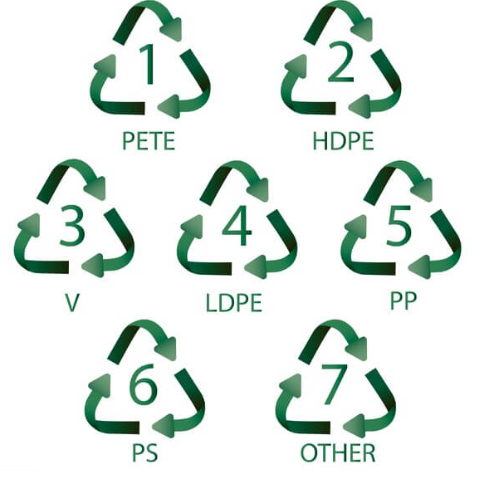



Standards required for different raw materials - example
Acrylic
ISO 7823-1 for acrylic cast sheets
ISO 7823-2 for acrylic extruded sheets
Aluminum tin
EN 485-4 aluminum and aluminum alloy sheets
PET G
DIN EN ISO 11963
Steel tin
EN 10025-1:2005 Hot rolled products of structural steels
Wood
FSC
EN 622-5 (6 - 45 mm) ‐ MDF
EN 14322 (8 - 28 mm) - melamine faced MDF

Slide 4
Supplier analysis
Sustainability criteria checklist - example

Slide 5

Supplier analysis
List of top 20 raw material suppliers - example

Slide 6


Supplier analysis
Proving the requests
Code of conduct

Slide 7
Calculating CO2 emission

Slide 8
Definition
The carbon footprint is expressed in terms of CO2e, where the CO2e is a sum of fossil-based emissions calculated with help of IPPC* weighting factors (for 100 years). The CO2e figures exclude the biogenic carbon dioxide emissions, and sequestered carbon.
CO2e Emission Factor for electricity-related emissions is calculated in accordance with USA Energy and the Environment Equivalencies Calculator for the electricity-related emissions**.
Another useful document for calculating CO2 emission from
various materials could be sourced from European ECO2
research project.
* IPPC - The Intergovernmental Panel on Climate Change is the United Nations body for assessing the science related to climate change
** https://www.epa.gov/energy/greenhouse-gases-equivalencies-calculator-calculations-and-references

Slide 9
Example on Philips - Carbon footprint CO2e (kg) by materials
Total carbon footprint expressed in terms of CO2e is 56.59 metric tons

Slide 10
Carbon footprint CO2e (kg) by market
Total carbon footprint expressed in terms of CO2e is 56.59 metric tons

Slide 11

CO2 Emission Factor for electricity-related emissions
According to USA Energy and the Environment which provides a national marginal emission factor for the Equivalencies Calculator electricity-related emissions, CO2 Emission Factor for is caluculated as following:
1,558.8 lbs CO₂/MWh × (4.536 × 10-4 metric tons/lb) × 0.001 MWh/kWh = 7.07 × 10⁻⁴ metric tons CO₂/kWhls
Total carbon footprint expressed in terms of CO2e for electricity used to produce all products made for Philips is (7.07 x 0,0001) CO2/kWhls x 88.951,39 kWh = 62,89 metric tons CO2

