Slide 2

ENVIRONMENTAL SUSTAINABILITY
HOW WE CARE?
MATERIALS EFFICENCY EXAMPLE
TECHNOLOGY EFFICENCY EXAMPLE

Slide 3

ENVIRONMENTAL SUSTAINABILITY
BETTER TOMORROW THROUGH SUSTAINABILITY COMMITMENT
OUR SUSTAINABILITY COMMITMENT
1
REDUCING C02 FOOTPRINT
2
USING RECYCABLE AND RECYCLED MATERIALS
3
DECREASE ENERGY CONSUMPTION
4
REDUCE SCRAP
Please check our sustainability video:
https://vimeo.com/474723155/579f192891

Slide 4



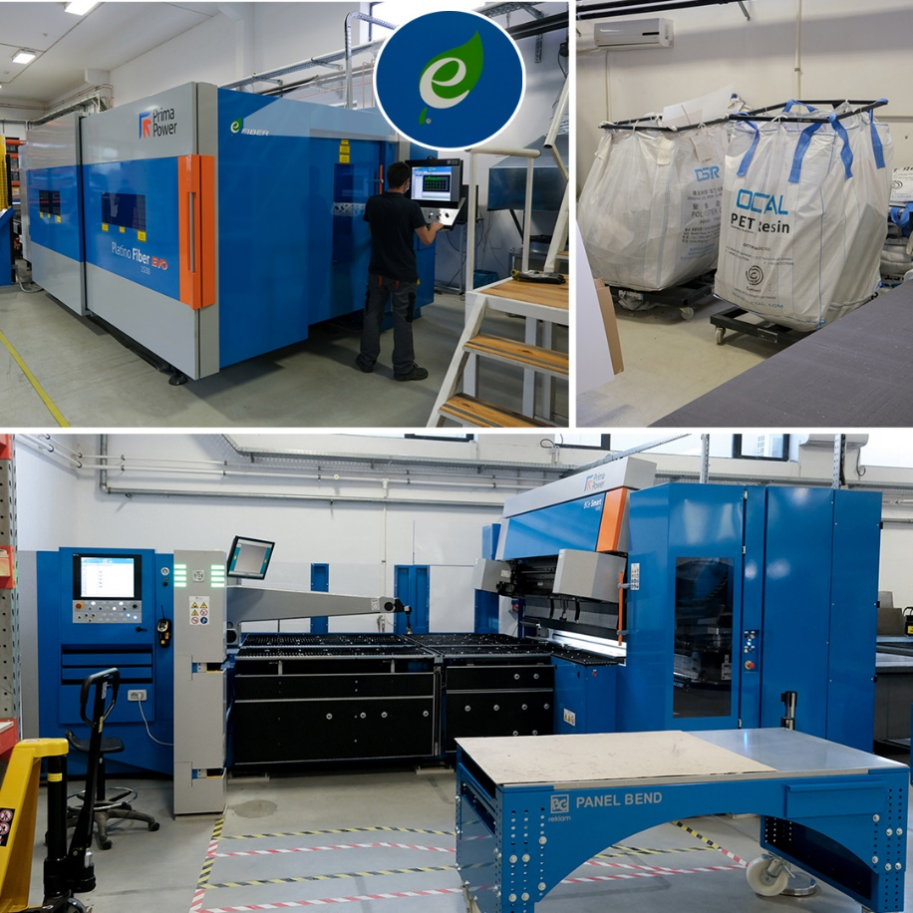
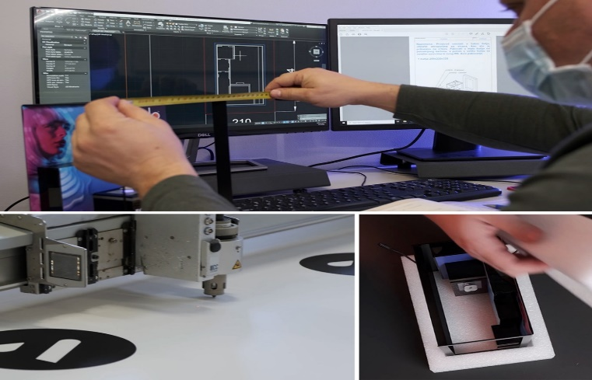
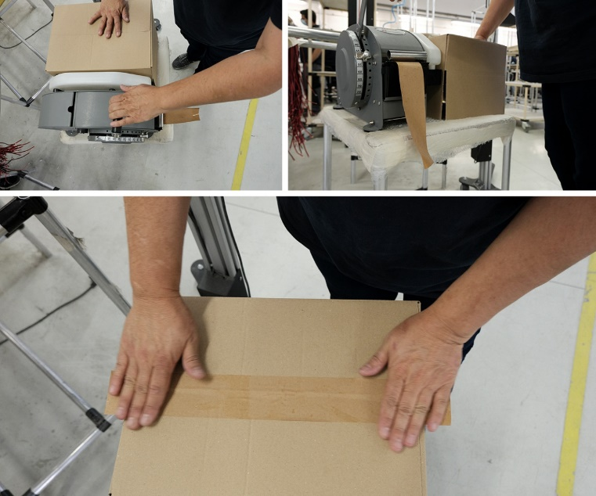
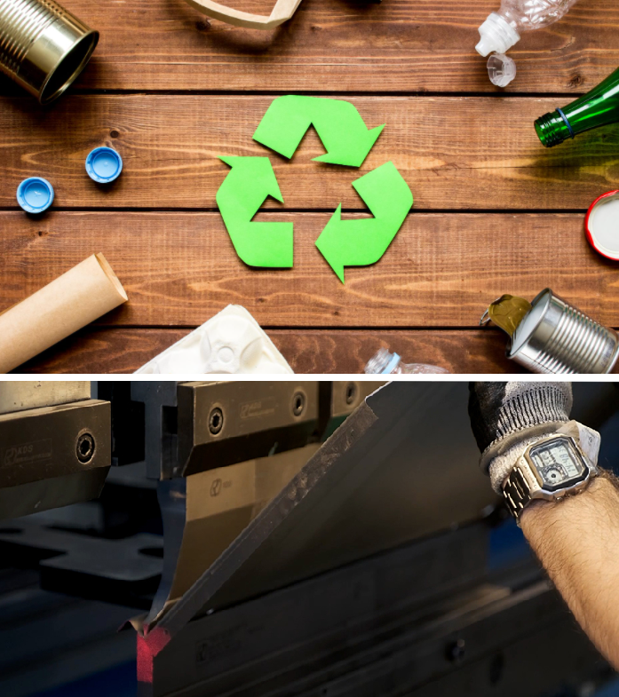
HOW WE CARE?
SCRAP – engineering and technology
ENERGY CONSUMPTION – technology
PERMANENT SOLUTIONS (3-5Ys) – last longer
REBRENDABLE POSM – use more times
USE OF FULLY RECYCLABLE MATERIALS
EASY TO SORT MATERIALS AT THE END-OF-PRODUCT’ S LIFE CYCLE

Slide 5
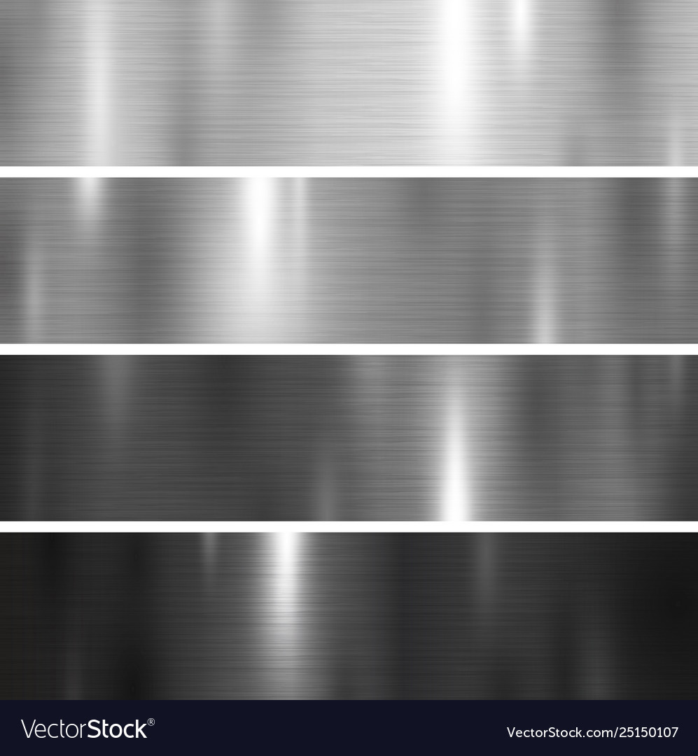


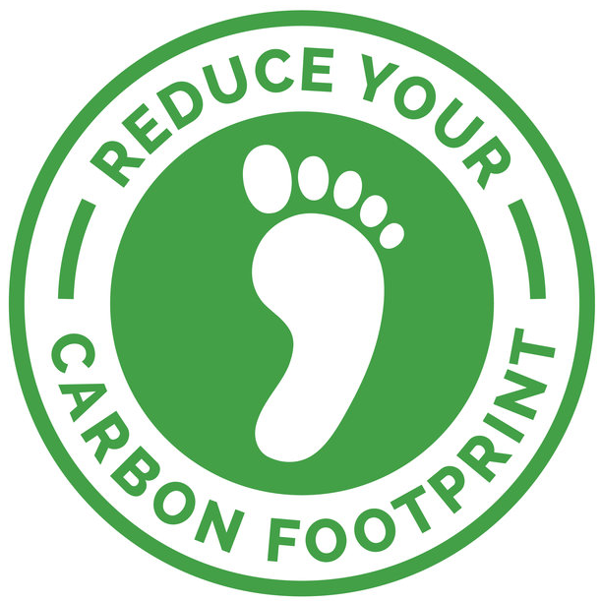
MATERIALS EFFICIENCY EXAMPLE
WE ARE MANAGING TO REDUCE CARBON FOOTPRINT BY CAREFUL SELECTION OF MATERIALS
METAL
WOOD
SUSTAINABLE MATERIALS IN FOCUS
METAL AND WOOD USAGE DECREASING C02 EMISSION UP TO 25%
Improved strength
More durable (up to 10x than other materials)
Recyclable
Renewable, recyclable, natural
Low energy production
FSC Certificate
Zero added formaldehyde MDF

Slide 6
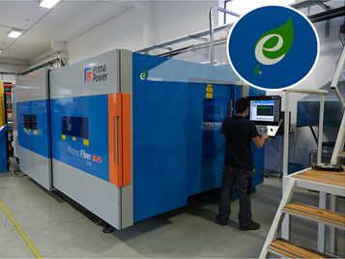
TECHNOLOGY EFFICIENCY EXAMPLE
ACHIEVING SIGNIFICANT ENERGY SAVINGS BY INVESTING IN GREEN TECHNOLOGY
WE ARE ALWAYS LOOKING FOR MORE SUSTAINABLE TECHNOLOGY
OUR FIBBER LASER
IN 2020 WE SAVED
7544 TONES OF C02 THROUGH NEW TECHNOLOGY
CO2 EMISSION IS ZERO!

Slide 7

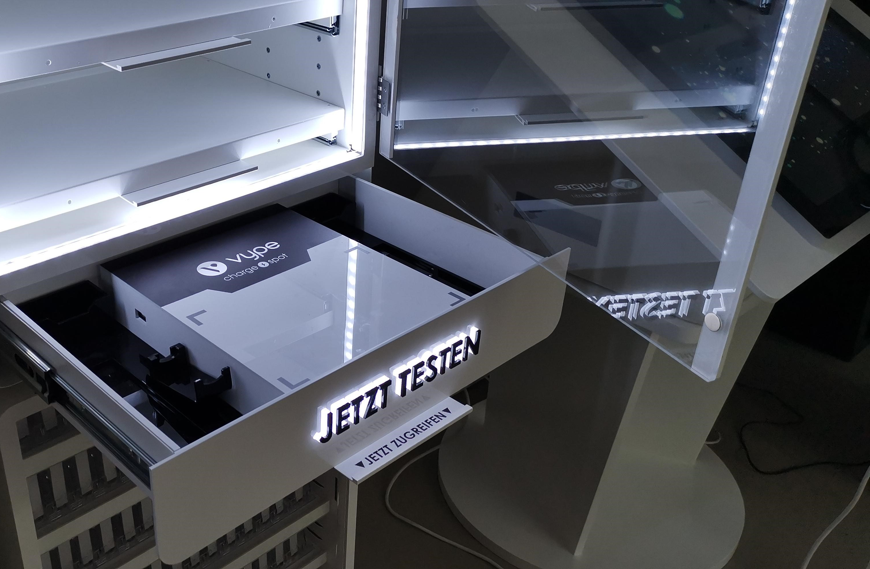
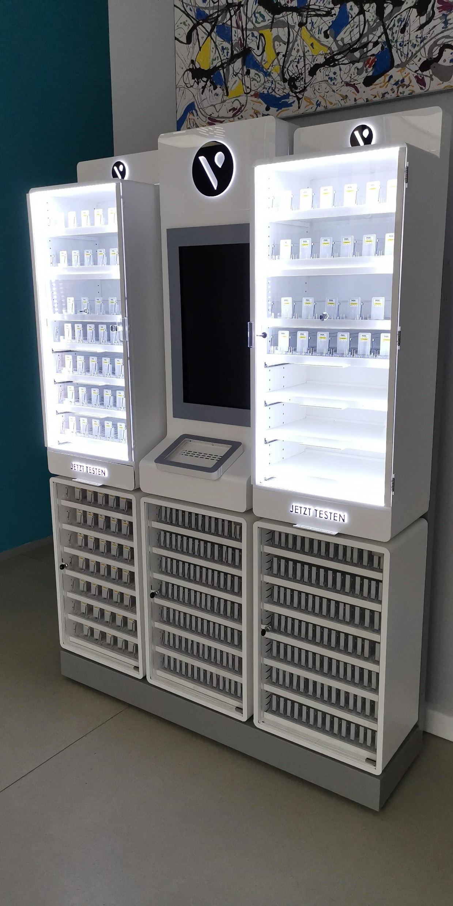
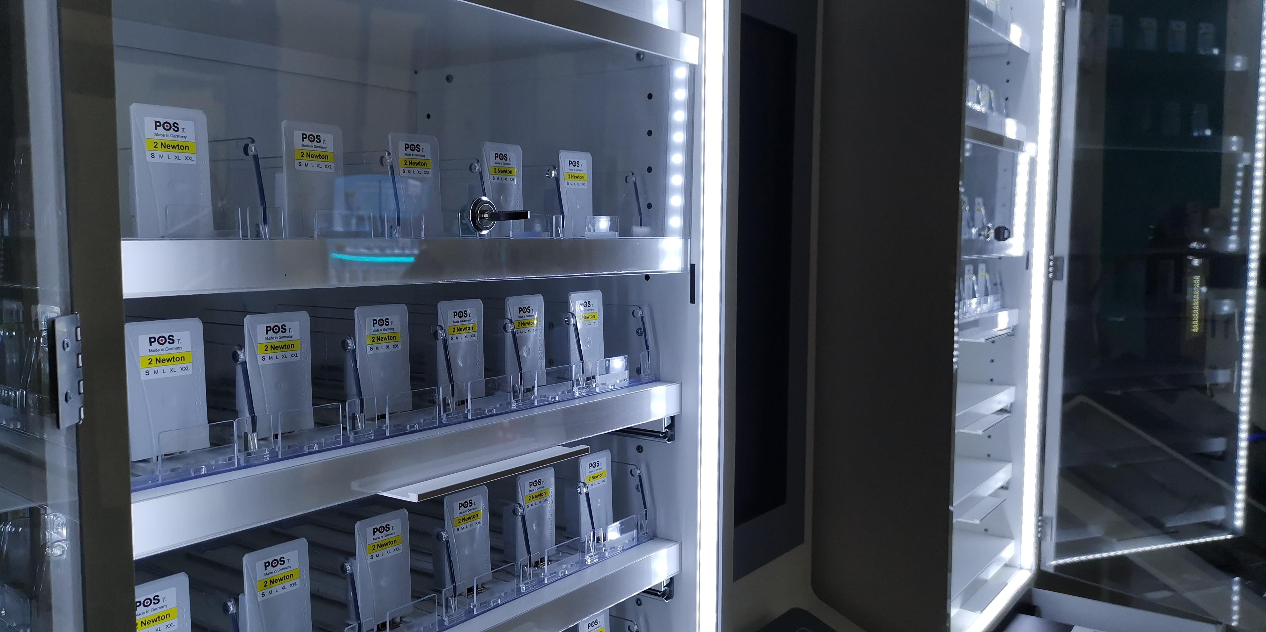
MATERIALS EFFICIENCY EXAMPLE – BAT
PROJECT “CLOONEY”
By selecting optimal materials and making ‘ecology re-engineering’ during the early stage of this project, we managed to achieve 12% decrease in CO2 emission. Main substitutes were made in transferring acrylic components with metal ones where possible, without impacting the visual or structural requirements.
Through partnering with suppliers that are fully certified and compliant with eco-standards, we are managing to decrease CO2 emission by 9% as an average of all materials. This has been ratified through ISO 20400 standard that BG Reklam obtained during 2020, which proofs our selection of suppliers and their material sourcing.
In total, we have managed to achieve 21% of CO2 savings or total of 32 tones CO2!

Slide 8
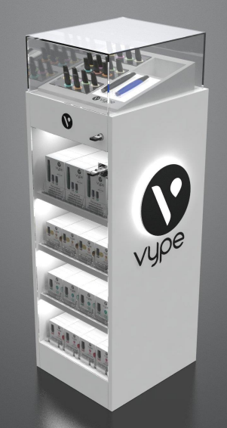
Example on BAT Project
Unit Part | Weight (kg) | Material | Does the material include recycled content % | Weight of recycled content (kg) | Is the unit able to be recycled at end of life? | Weight able to be recycled (kg)
Carcass | 45.72 | Steel (100%) | 20% | 9.14 | 98% | 44.8
Shelves | 11.28 | Steel (100%) | 20% | 2.26 | 100% | 11.28
Door | 3.656 | Glass | 100% | 3.656 | Yes 100% | 3.656
Topper lid | 4.6 | Glass | 100% | 4.6 | Yes 100% | 4.6
Electric components | 2.136 | Steel, Aluminium, other | 20% | 0.43 | 90% | 1.92
Packaging | 2.37 | Cardboard | 90% | 2.133 | Yes 100% | 2.37

Slide 9
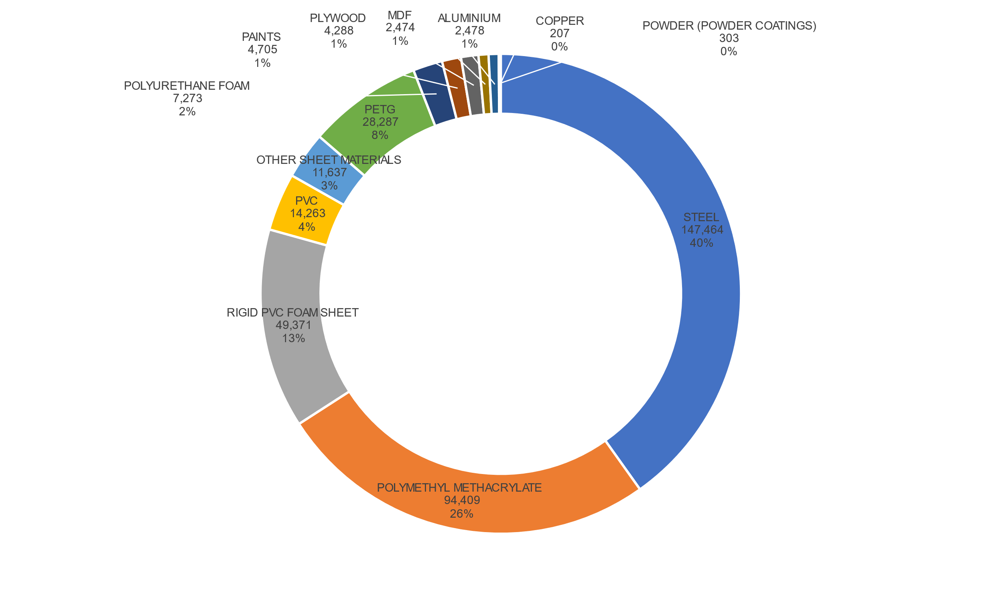
CO2e BY MATERIAL – BAT OVERALL H1 2022
Total carbon footprint (expressed in terms of CO2e) would be 367.16 metric tons if we hadn’t used RECYCABLE MATERIALS and/or alternatives to acrylic, PVC and PETG
Total carbon footprint expressed in terms of CO2e is 298,51 metric tons
68.65 metric tones of CO2e saved;
19% saving – on track with our 5 YEAR plan!

Slide 10







ACCREDITATIONS
OUR CERTIFICATIONS PROVE OUR COMMITMENT TO SUSTAINABILITY.
WE ALREADY HAVE:
QUALITY
MANAGEMENT
ENVIRONMENTAL
MANEGEMENT
HEALTH AND SAFETY
MANAGEMENT
SUSTAINABLE PROCUREMENT
SOCIAL
RESPONSIBILITY

