Slide 1

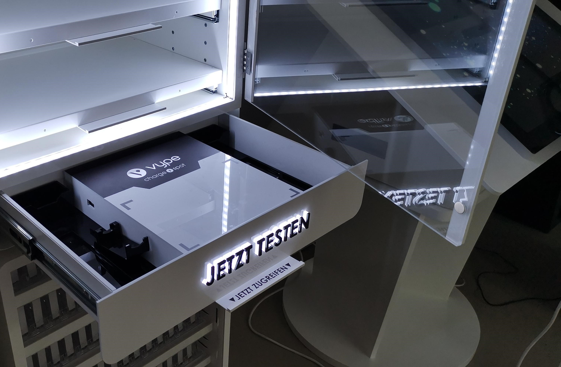
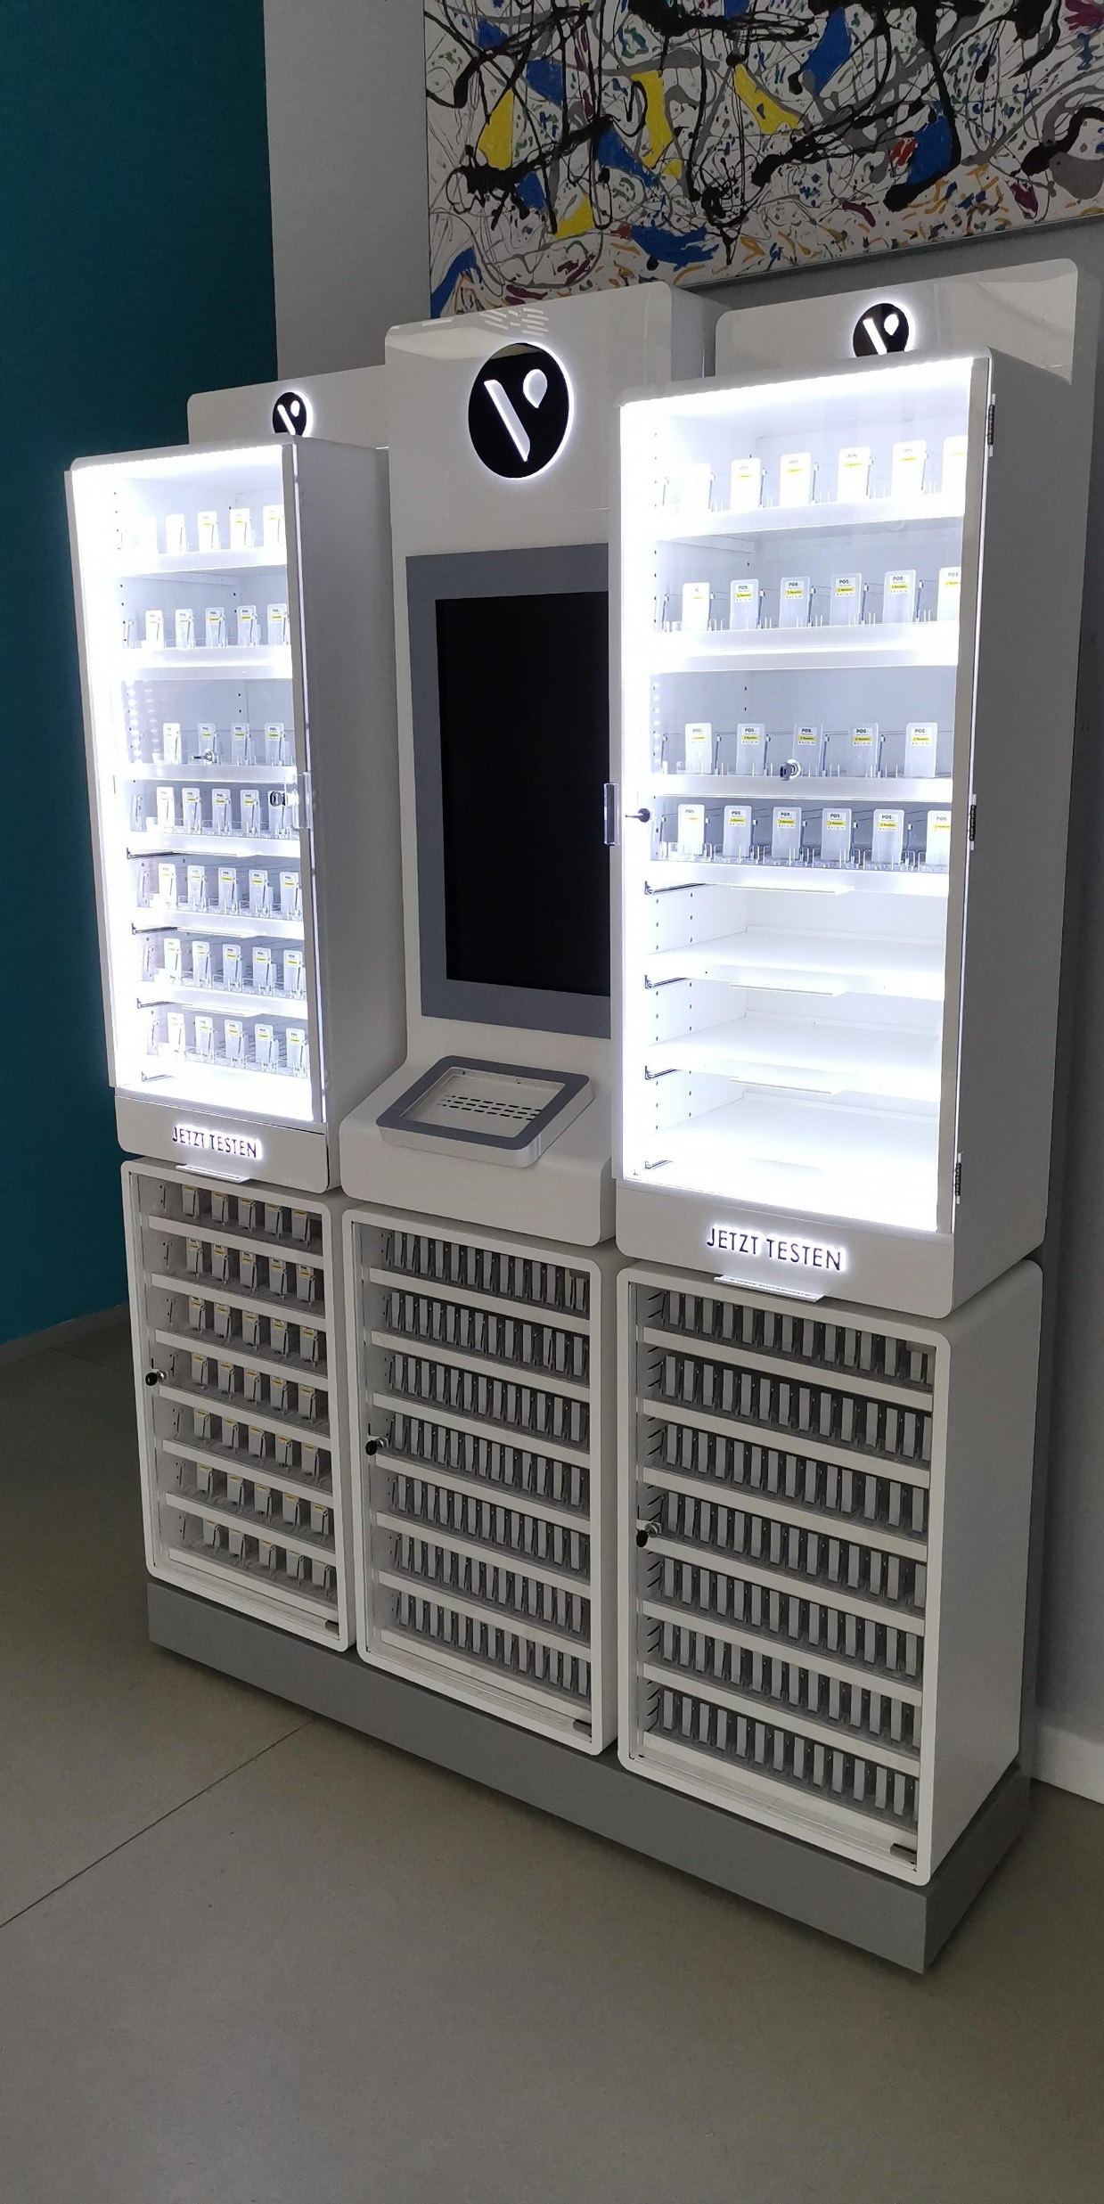
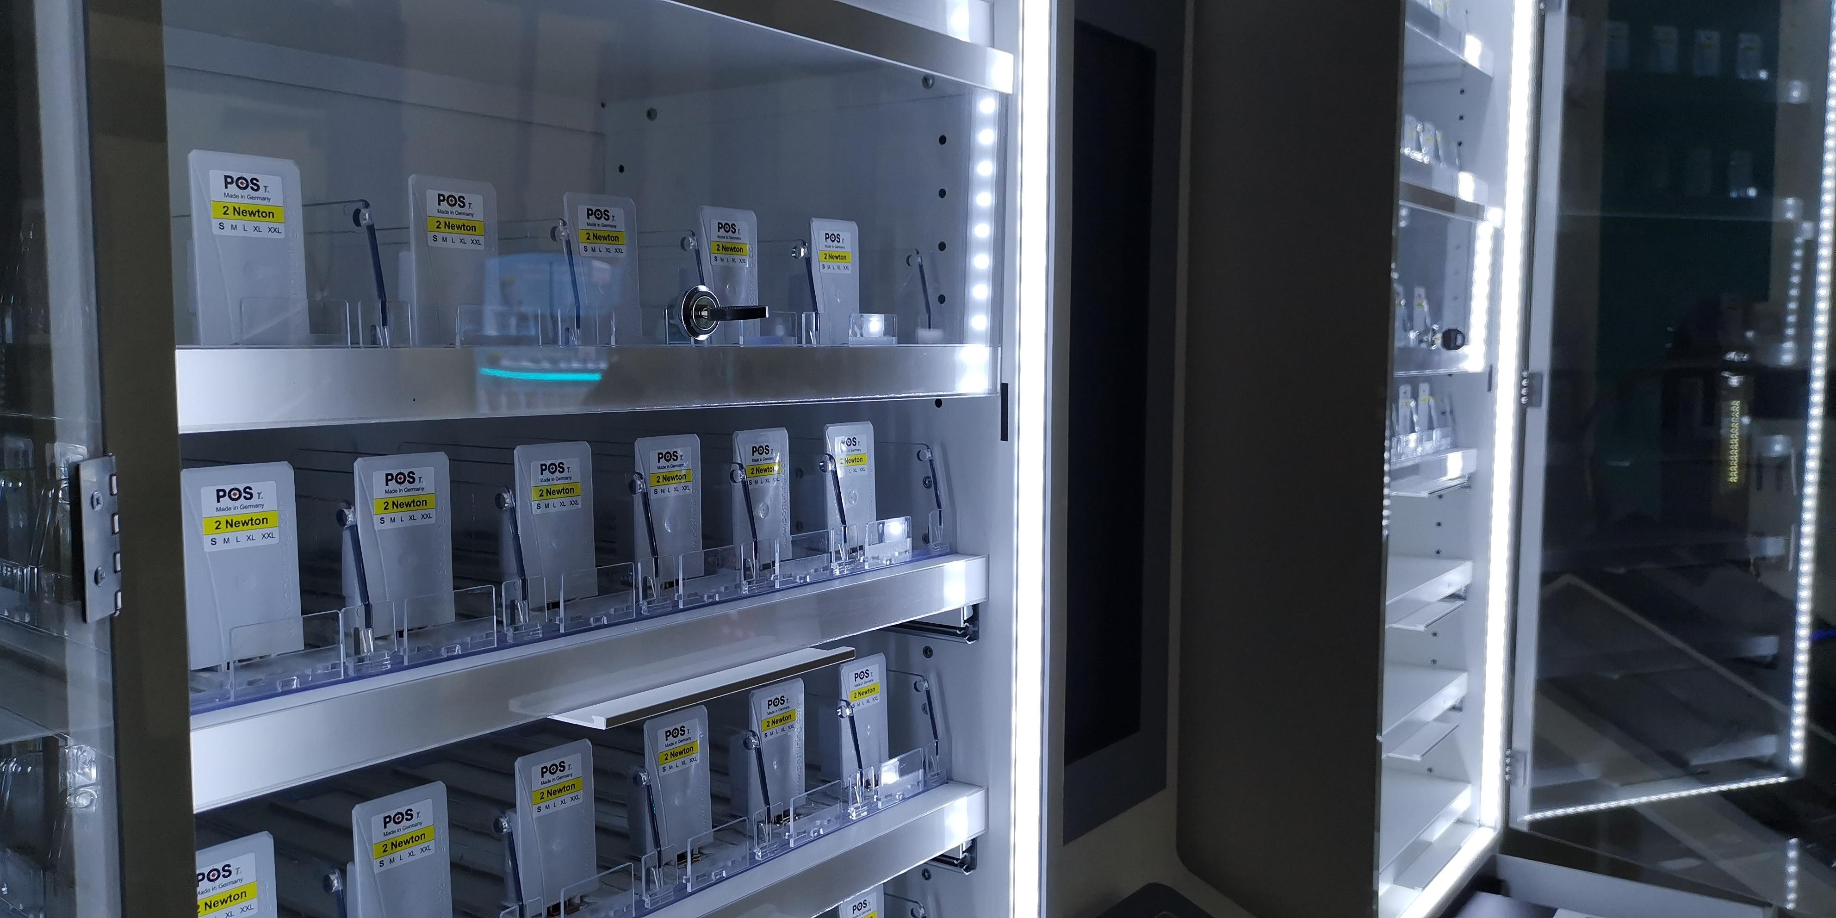
MATERIALS EFFICIENCY EXAMPLE – BAT
PROJECT “CLOONEY”
By selecting optimal materials and making ‘ecology re-engineering’ during the early stage of this project, we managed to achieve 12% decrease in CO2 emission. Main substitutes were made in transferring acrylic components with metal ones where possible, without impacting the visual or structural requirements.
Through partnering with suppliers that are fully certified and compliant with eco-standards, we are managing to decrease CO2 emission by 9% as an average of all materials. This has been ratified through ISO 20400 standard that BG Reklam obtained during 2020, which proofs our selection of suppliers and their material sourcing.
In total, we have managed to achieve 21% of CO2 savings or total of 32 tones CO2!

Slide 2
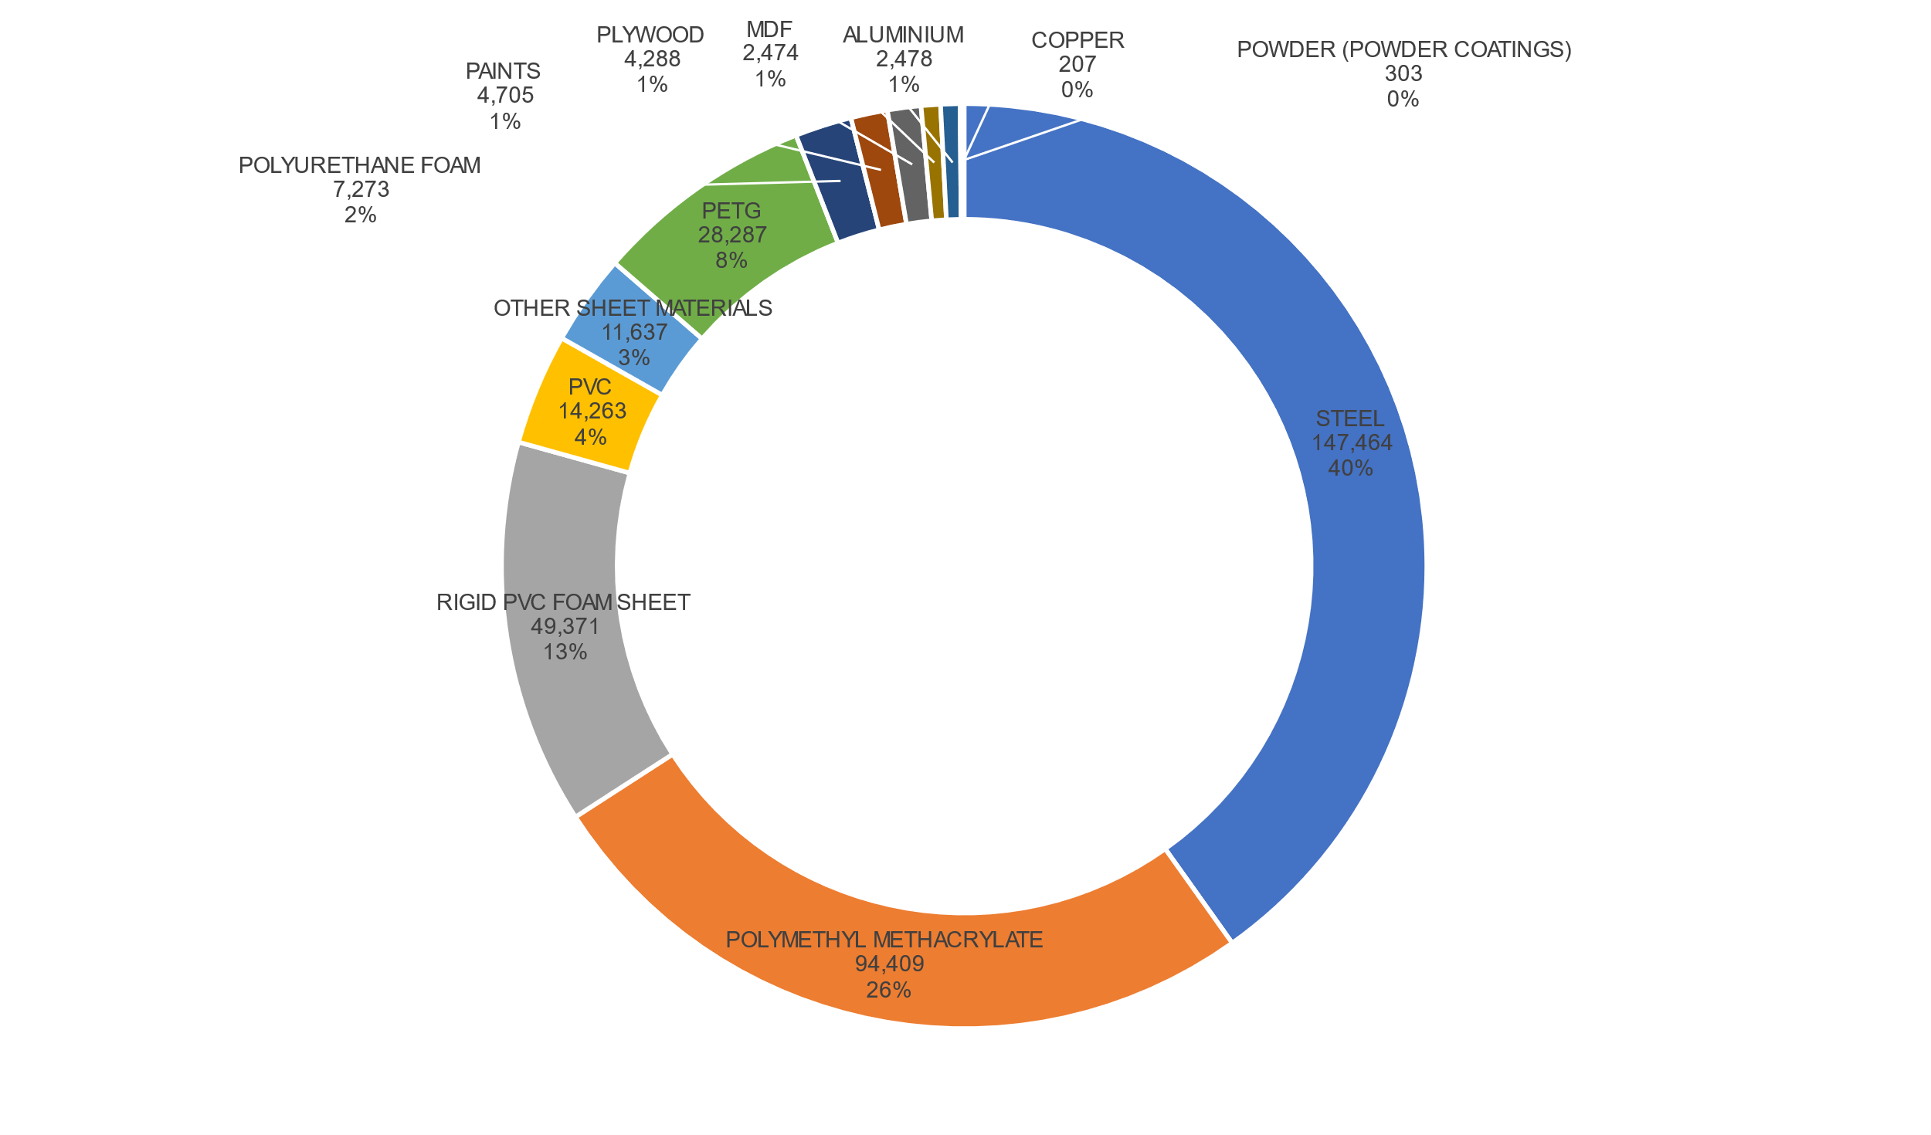
CO2e BY MATERIAL – BAT OVERALL H1 2022
Total carbon footprint (expressed in terms of CO2e) would be 367.16 metric tons if we hadn’t used RECYCABLE MATERIALS and/or alternatives to acrylic, PVC and PETG
Total carbon footprint expressed in terms of CO2e is 298,51 metric tons
68.65 metric tones of CO2e saved;
19% saving – on track with our 5 YEAR plan!

