Slide 1



Slide 2
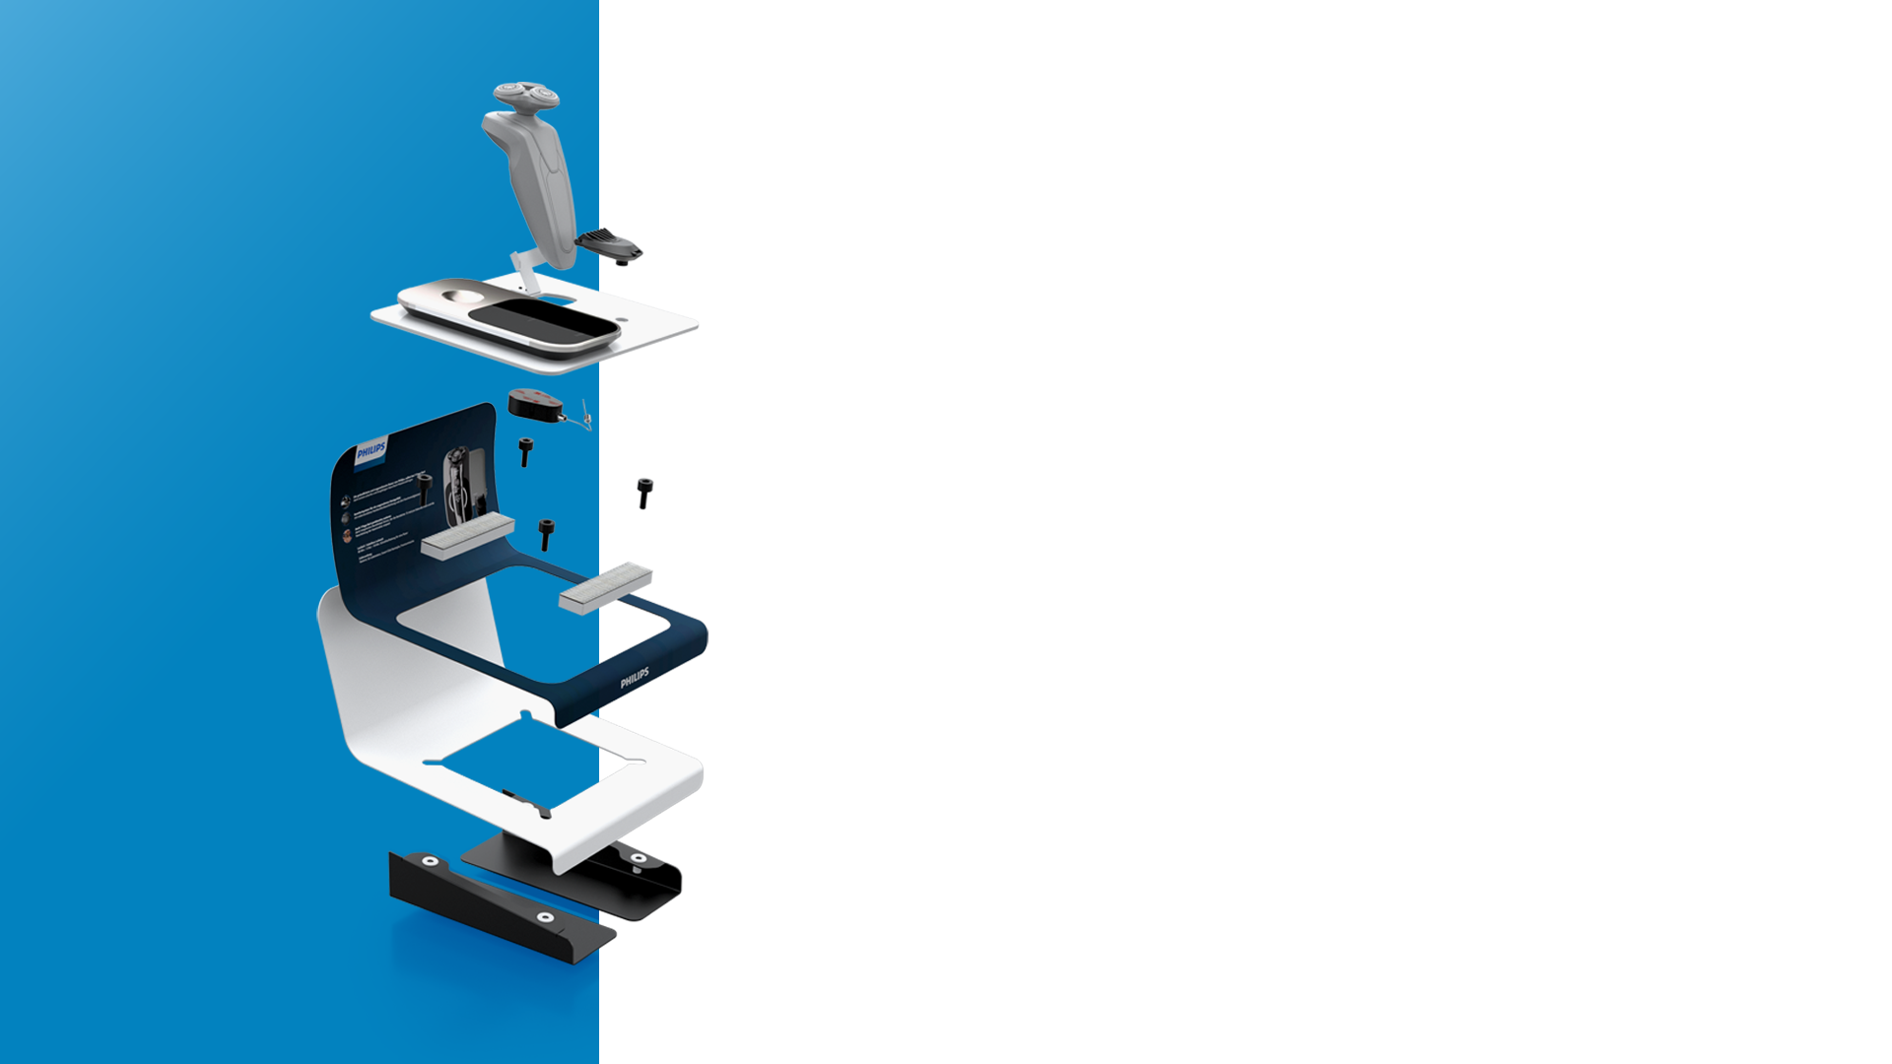
Contents.
Technology
More planet less waste
Materials
Example
Certificates

Slide 3
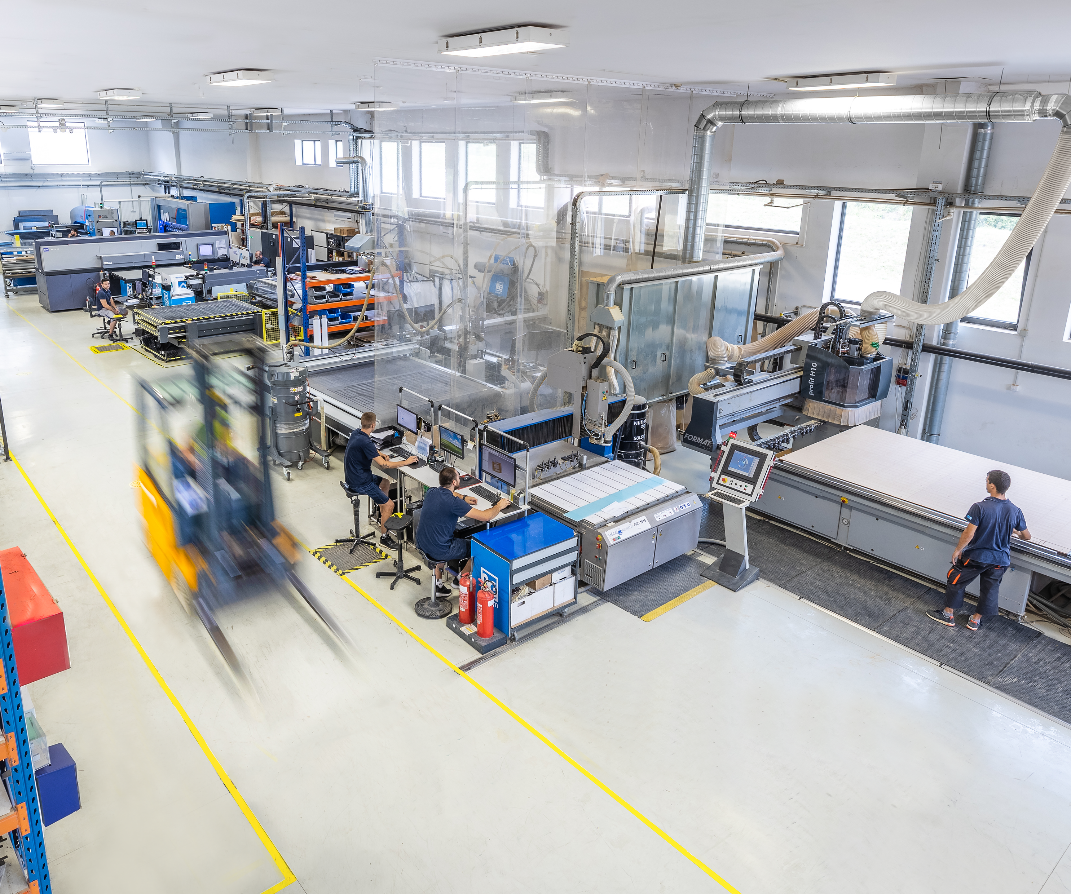
06.
Technology
& Efficiency
Technology is the key to achieving our sustainability objectives: reducing waste, improving efficiency in processes, shortening delivery times and developing eco-friendly products. Our top priorities are providing a safe working environment for our employees and offering our customers the best balance of price and performance while also prioritizing reduction of our impact on the environment.

Slide 4

06.
More planet
Less waste.
Re-Use:
Designing versatile and easily adaptable displays with longer life and use with any future products.
Re-Duce:
By always investing in cutting edge technology, we significantly reduce scrap and improve efficiency.
Re-Cycle:
Engineering displays that can be easily disassembled and recycled. Always ensuring to use sustainable materials.
Re-Peat:
Plant new trees and create eco projects for our community and give back to the environment.

Slide 5
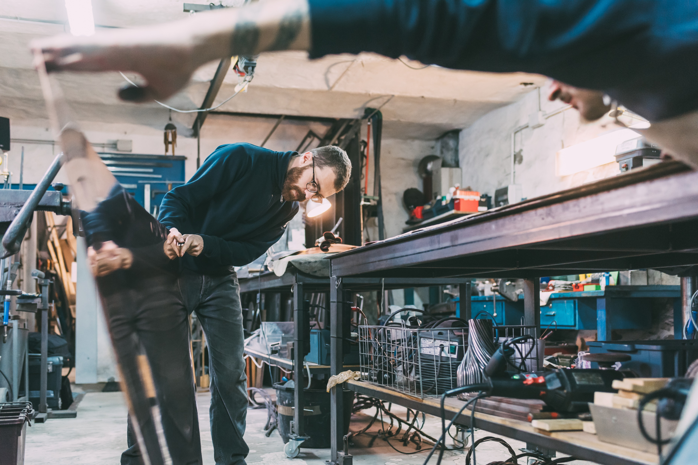
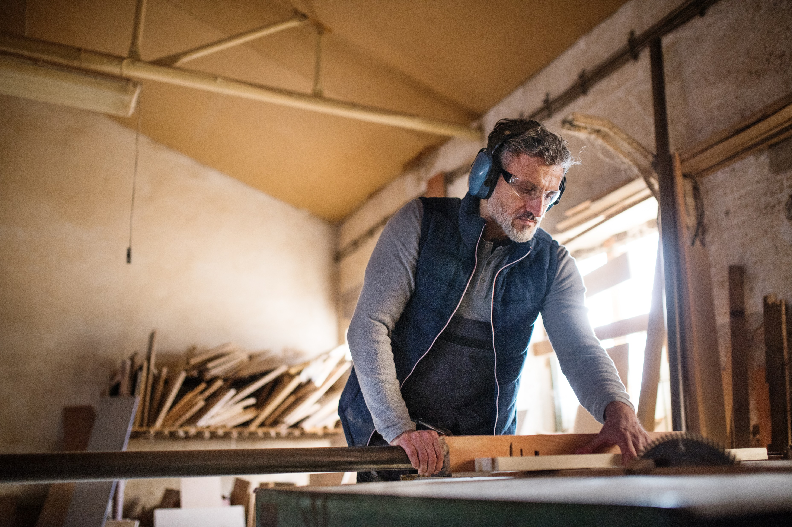
06.
Materials Efficiency
Example
METAL
Metal is a durable and strong material that offers up to 10 times more longevity than other materials. It has improved strength and is easily recyclable, making it a sustainable choice for various applications.
We are committed to reducing our carbon footprint. Our aim is to source materials that have minimal impact on the environment, such as those made from recycled materials or that can be easily recycled after use. By incorporating sustainable materials into our products, we are taking an important step towards reducing waste and being more environmentally responsible.
Wood is a renewable, natural and recyclable material that is both environmentally friendly and aesthetically pleasing. Its production requires low energy, and FSC certification ensures that it is sourced from responsibly managed forests. With the option of zero added formaldehyde, wood provides a sustainable solution for various applications.
WOOD

Slide 6

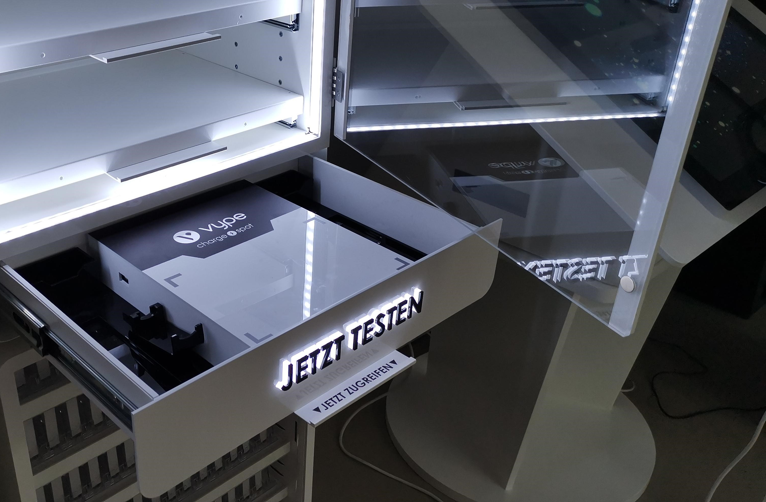
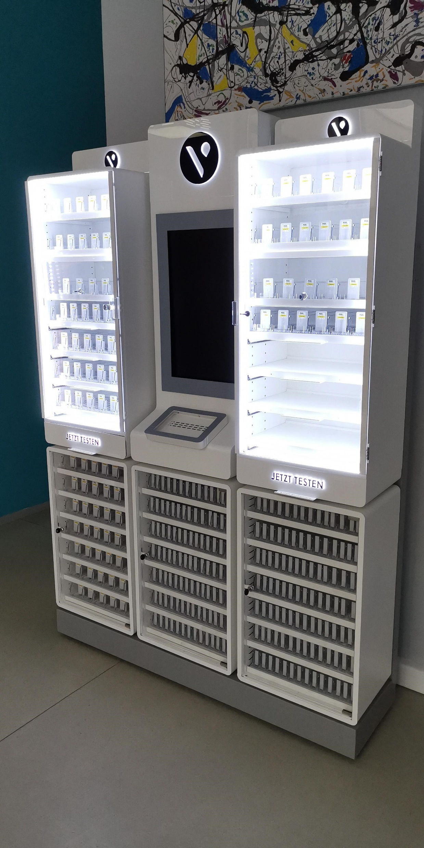
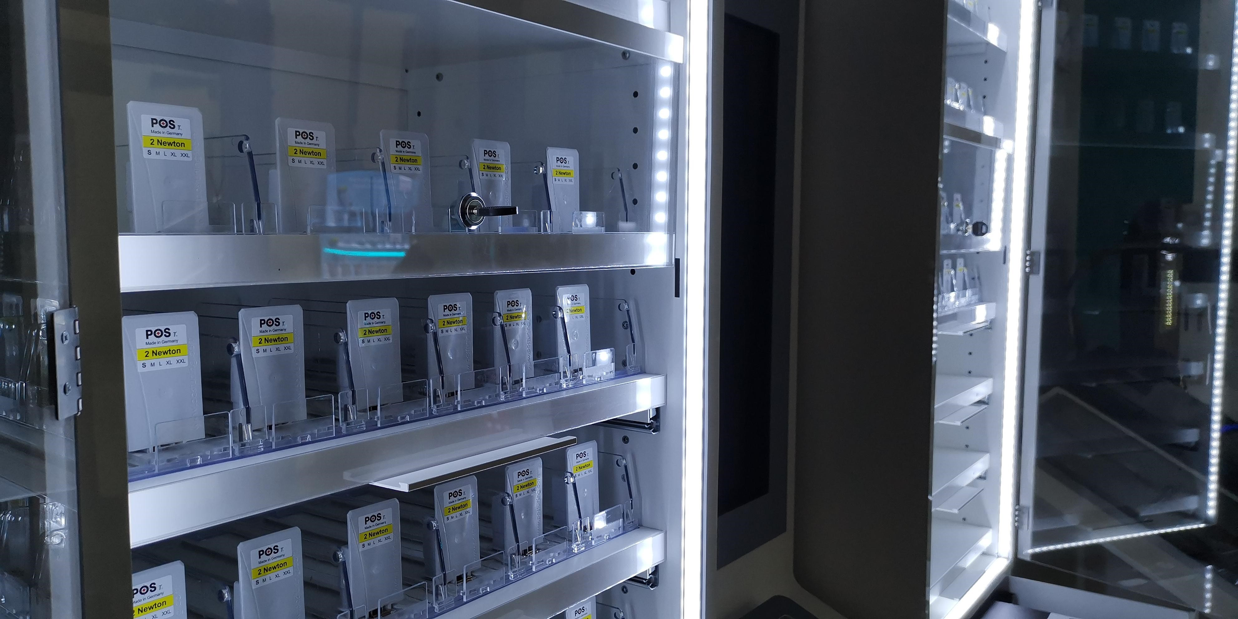
Materials Efficiency Example – BAT
Project “CLOONEY”
By selecting optimal materials and making ‘ecology re-engineering’ during the early stage of this project, we managed to achieve 12% decrease in CO2 emission. Main substitutes were made in transferring acrylic components with metal ones where possible, without impacting the visual or structural requirements.
Through partnering with suppliers that are fully certified and compliant with eco-standards, we are managing to decrease CO2 emission by 9% as an average of all materials. This has been ratified through ISO 20400 standard that BG Reklam obtained during 2020, which proofs our selection of suppliers and their material sourcing.
In total, we have managed to achieve 21% of CO2 savings or total of 32 tones CO2!

Slide 7
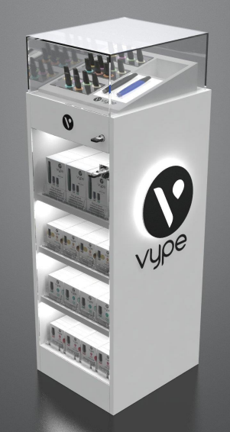
Example on BAT Project
Unit Part | Weight (kg) | Material | Does the material include recycled content % | Weight of recycled content (kg) | Is the unit able to be recycled at end of life? | Weight able to be recycled (kg)
Carcass | 45.72 | Steel (100%) | 20% | 9.14 | 98% | 44.8
Shelves | 11.28 | Steel (100%) | 20% | 2.26 | 100% | 11.28
Door | 3.656 | Glass | 100% | 3.656 | Yes 100% | 3.656
Topper lid | 4.6 | Glass | 100% | 4.6 | Yes 100% | 4.6
Electric components | 2.136 | Steel, Aluminium, other | 20% | 0.43 | 90% | 1.92
Packaging | 2.37 | Cardboard | 90% | 2.133 | Yes 100% | 2.37

Slide 8
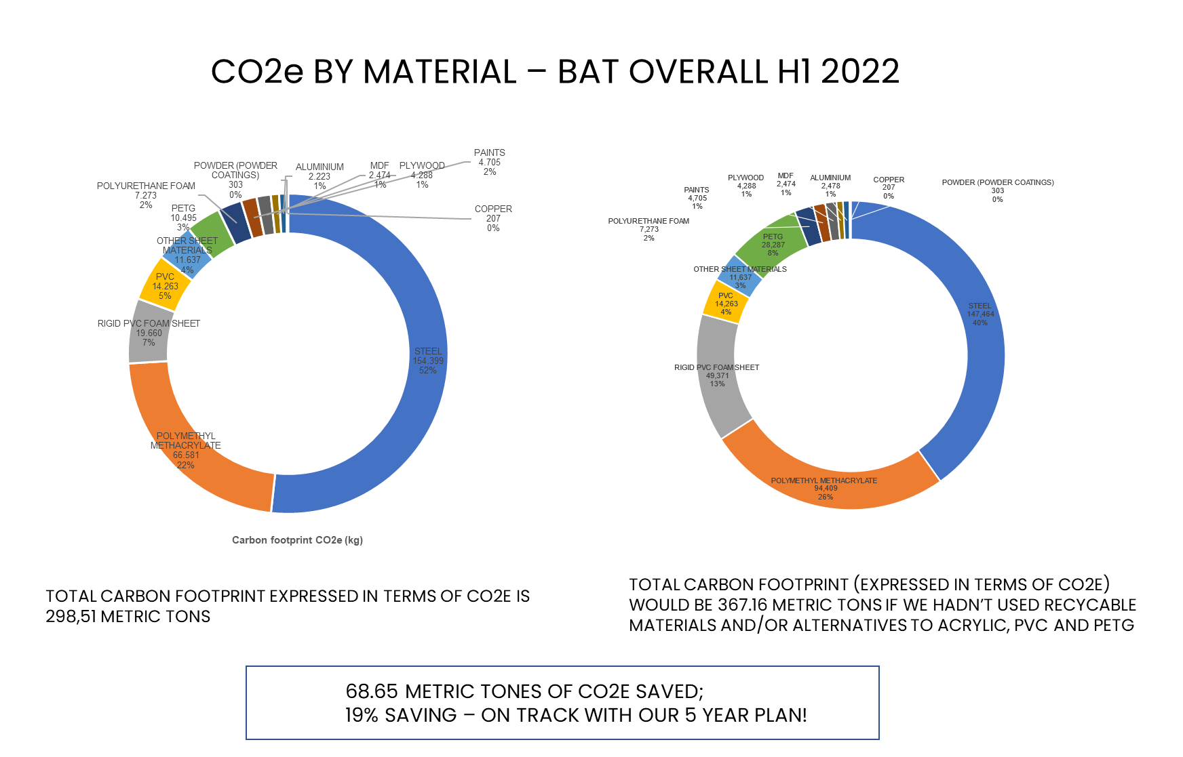

Slide 9

06.
Certifications
ISO the International Organization for Standardization.
ISO 9001 Sets out the criteria for a quality management system
ISO 14001 Sets out the criteria for an environmental management system
ISO 45001:2018 Occupational health and safety (OH&S) management system
ISO 20400 Integrating sustainability within procurement.
ISO 26000 Organization’s commitment to sustainability and its overall performance.

Slide 10
BG REKLAM
HEADQUATERS
29. Novembra 1M
11460 Belgrade, Serbia
info@bgreklam.com
+381 11 785 64 64
+381 60 68 69 110
Thank You.
BG REKLAM GMBH
Leverkusenstraße 3
22761 Hamburg, Deutschland
hamburg@bgreklam.com
+49 40 85413003
www.bgreklam.com
BG REKLAM
UK LTD
2588 Davenport House,
207 Regent St
London, W1B 3HH, UK
+44 75 4288 2312

