Slide 1
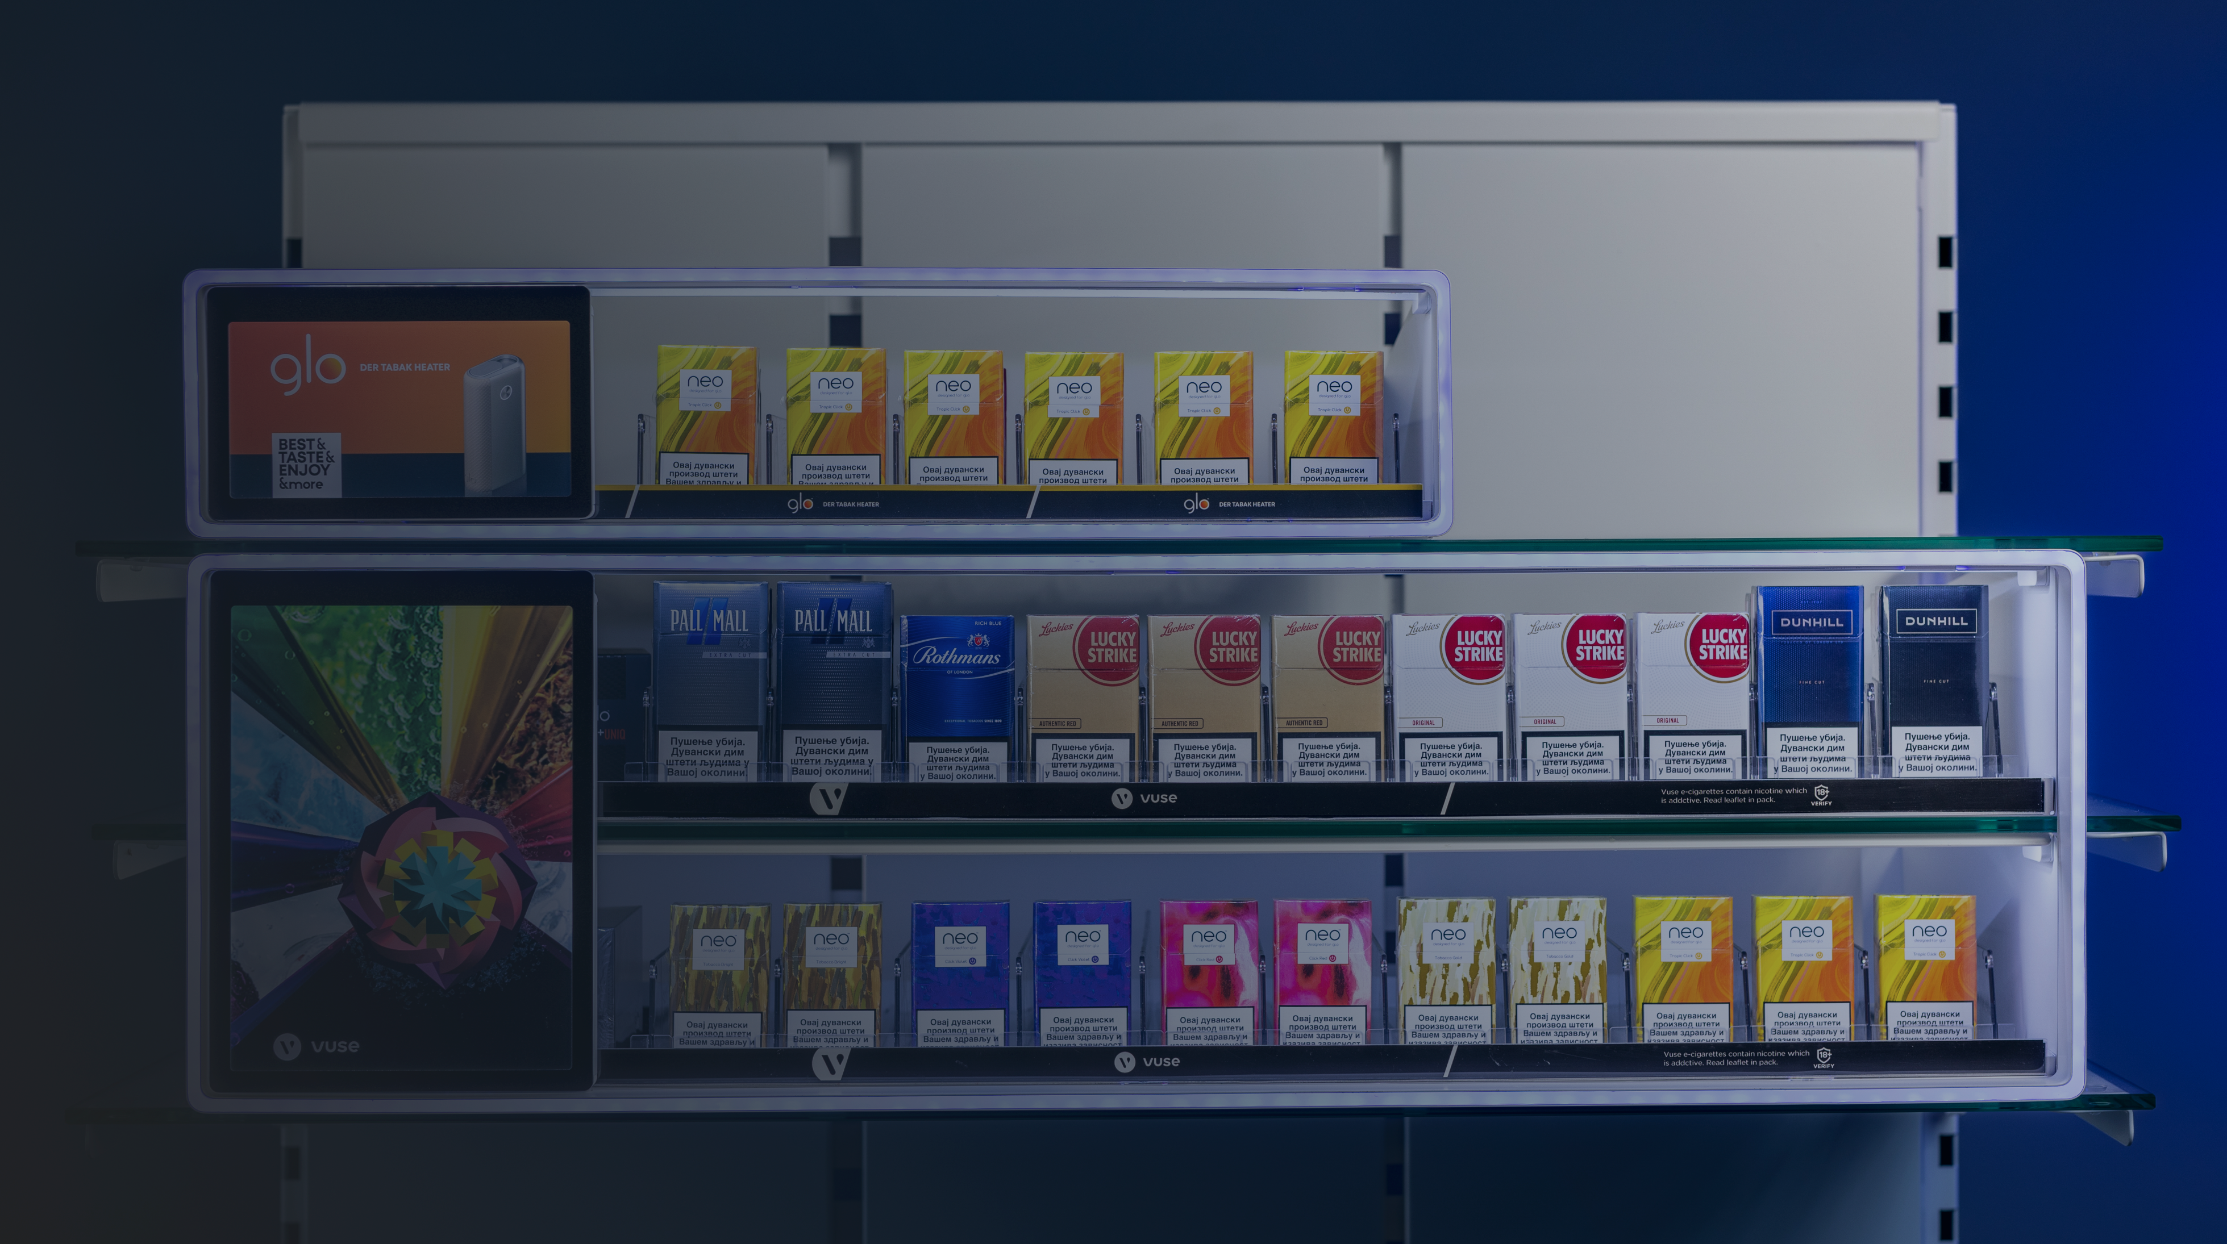

Premium
POS Industry
People are always going to go shopping.
A lot of our effort is just how we make the retail experience a great one!

Slide 2
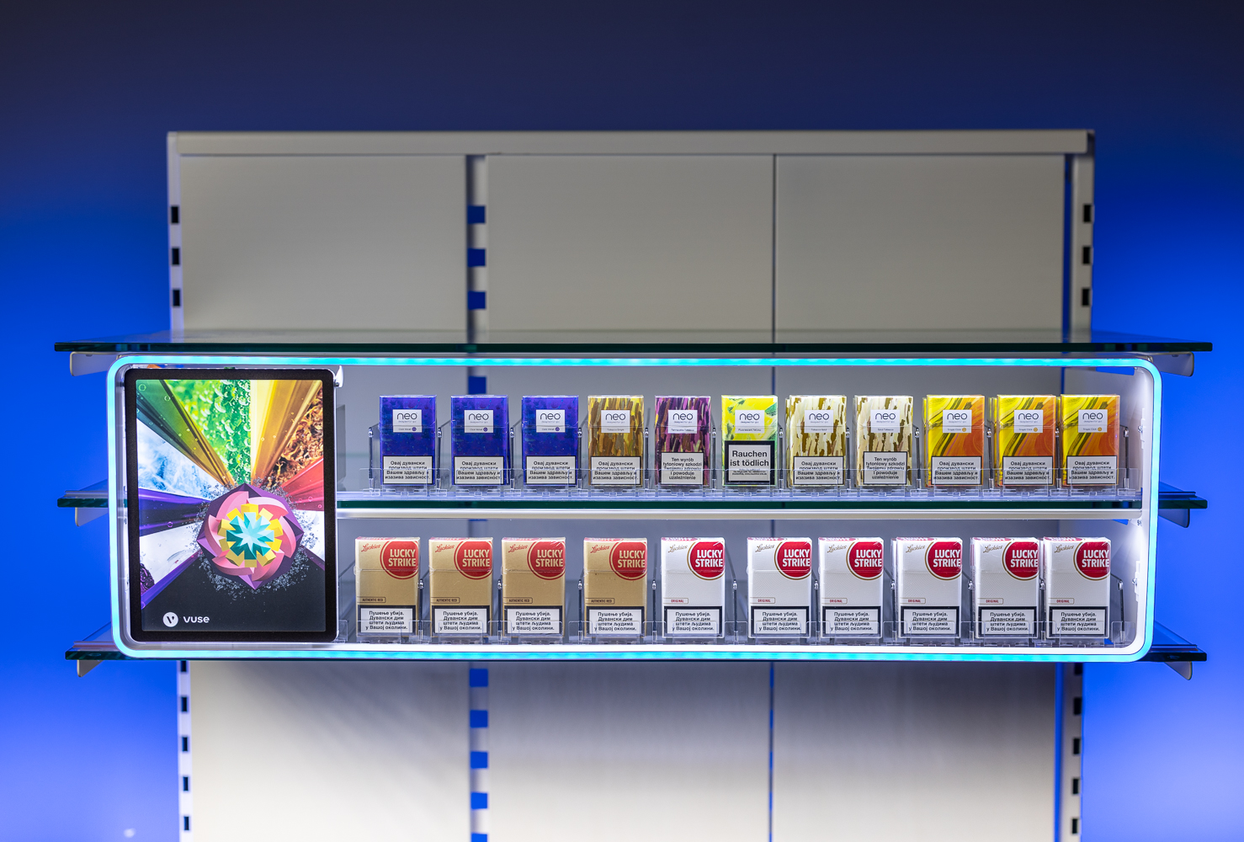
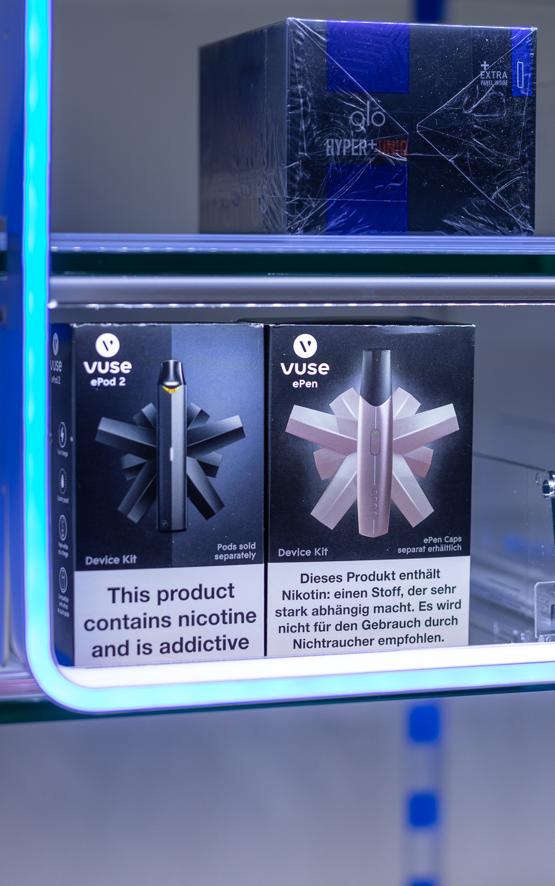

02. “L Shape” removed GLO/Vuse device products are now easier to handle and maximum available height used.
03. As agreed
additional holes made for better air flow and cooling
1. Stripes removed

Slide 3
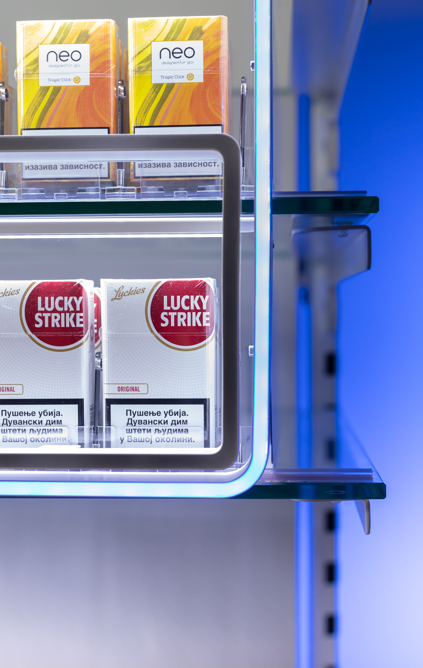
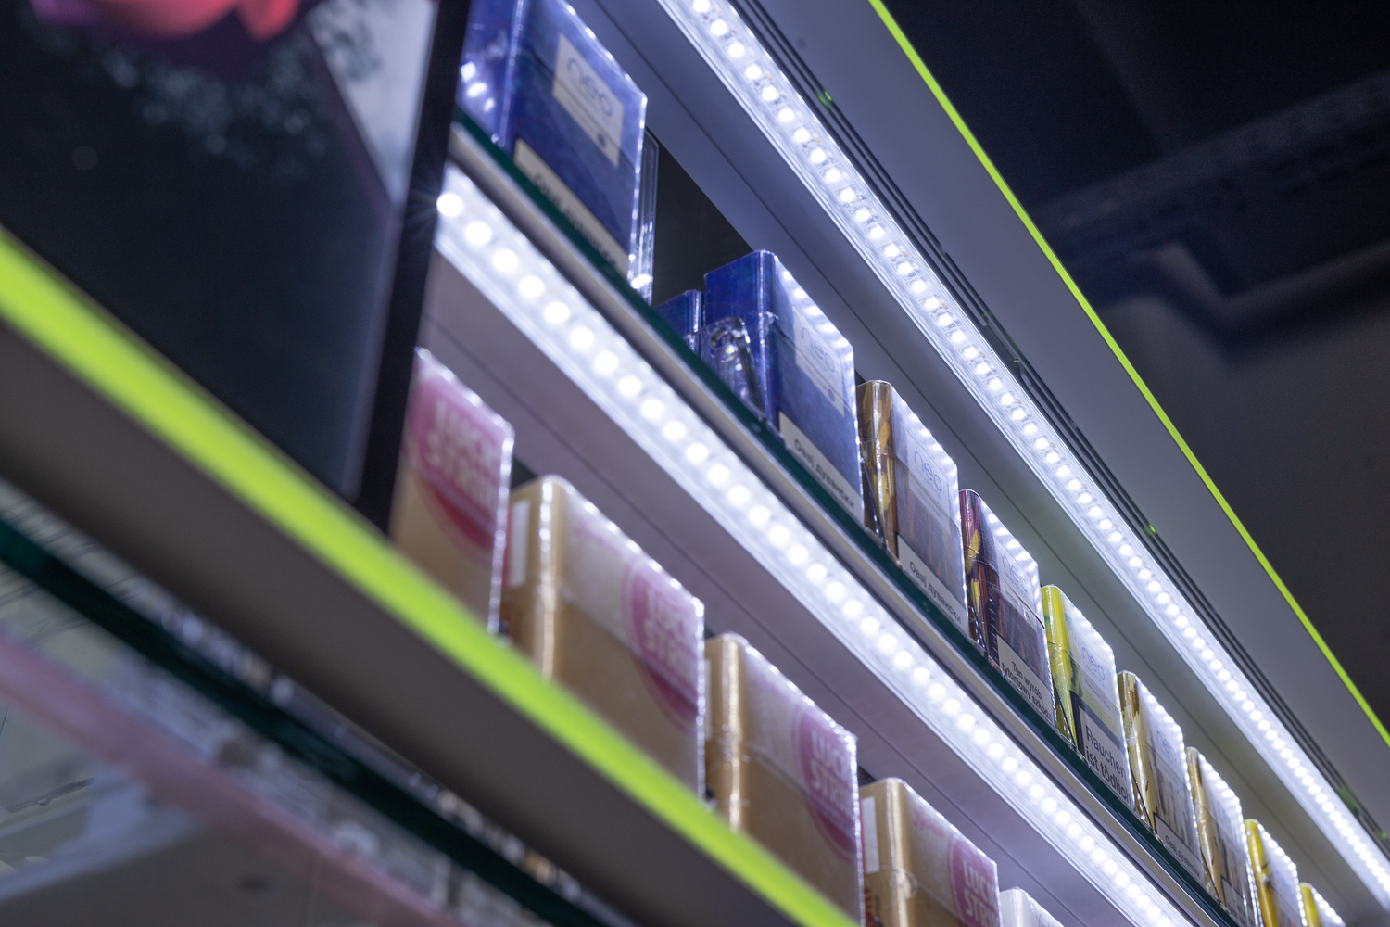
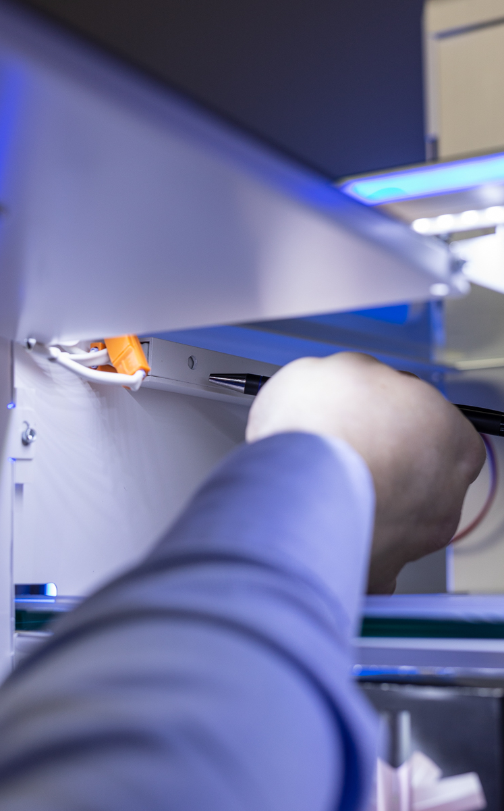
4. Edges curved as
per request
05. LED lamps
covered for safety
06. No visible black and
red cables
Old frame
New frame

Slide 4
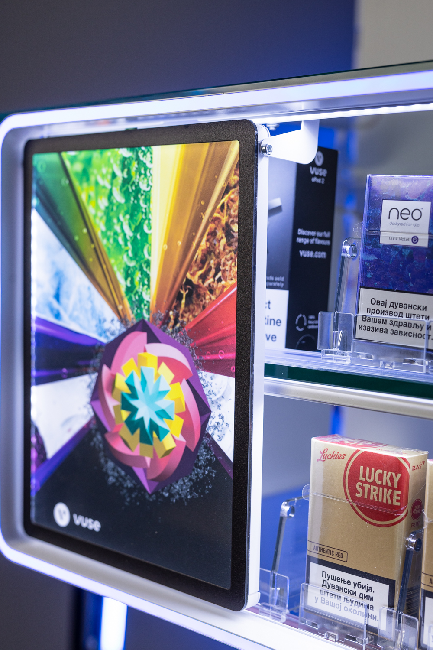
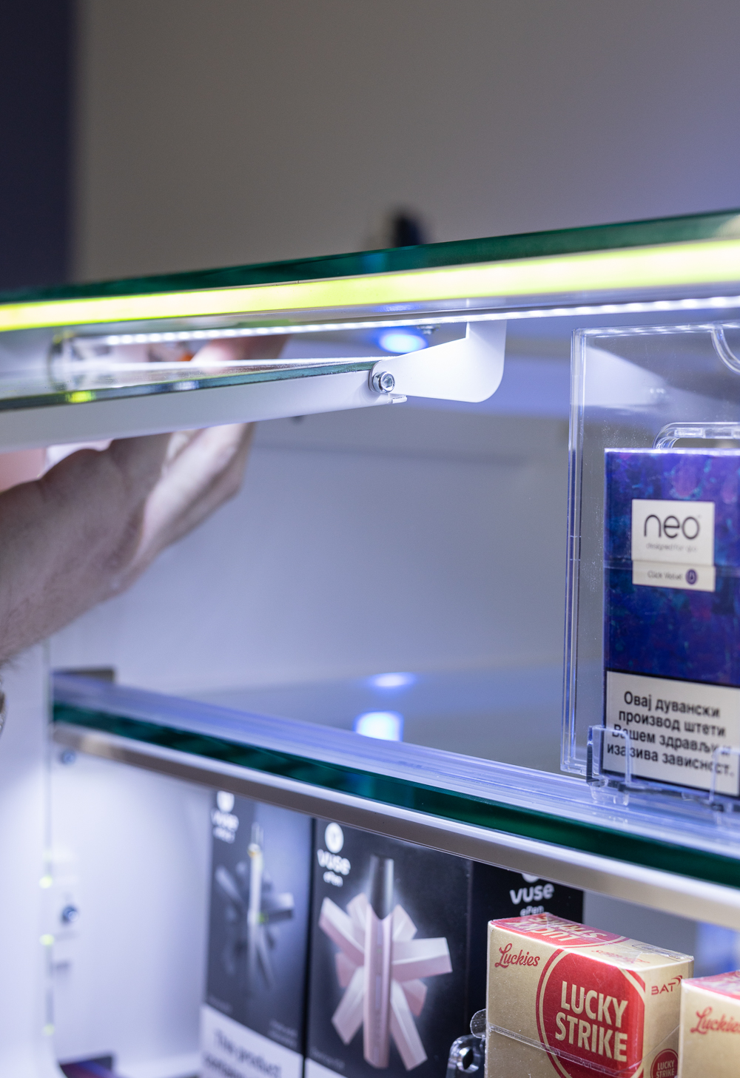
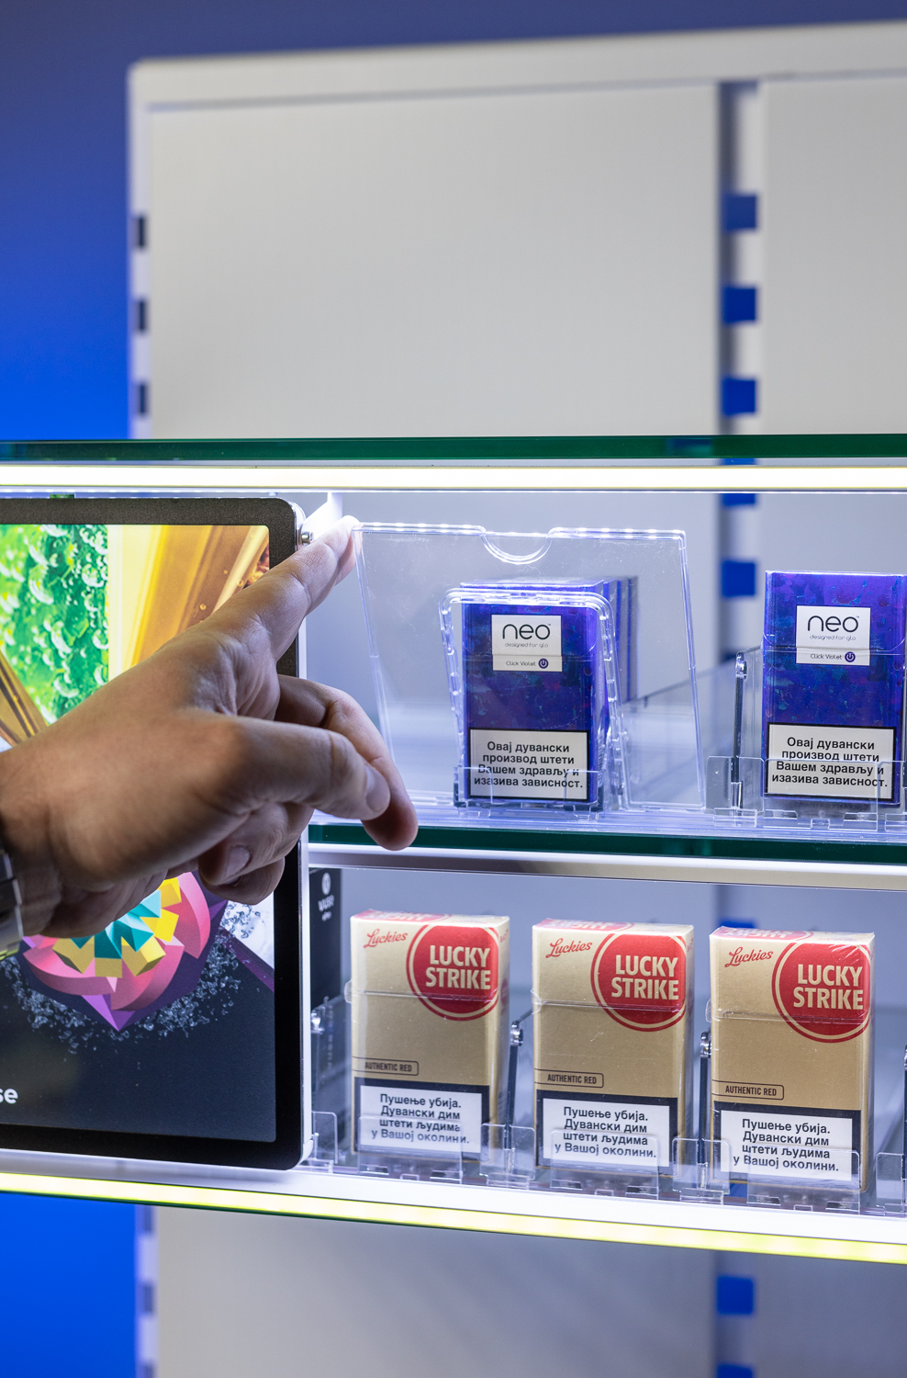
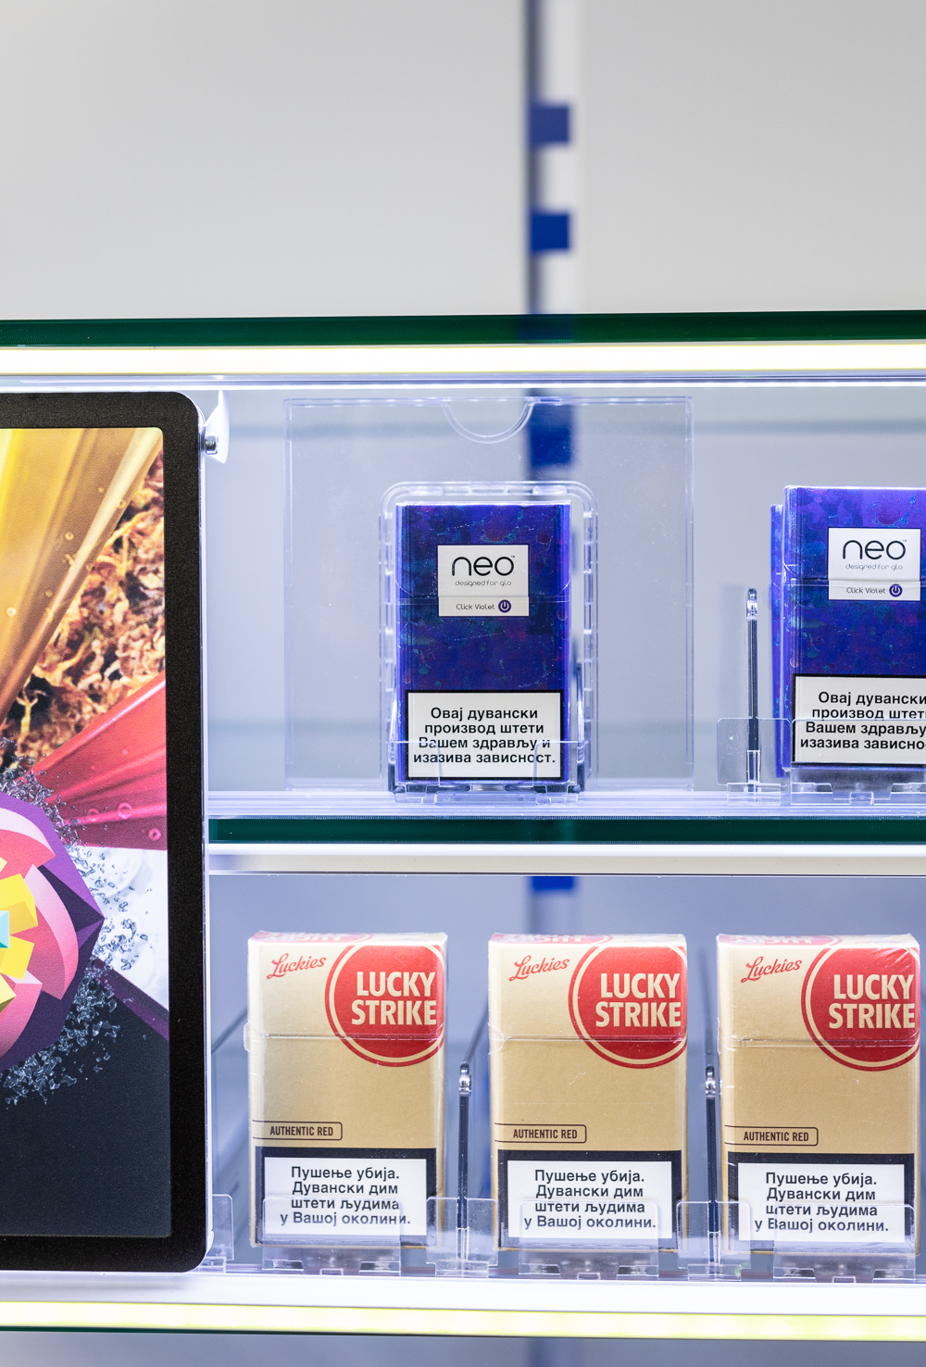
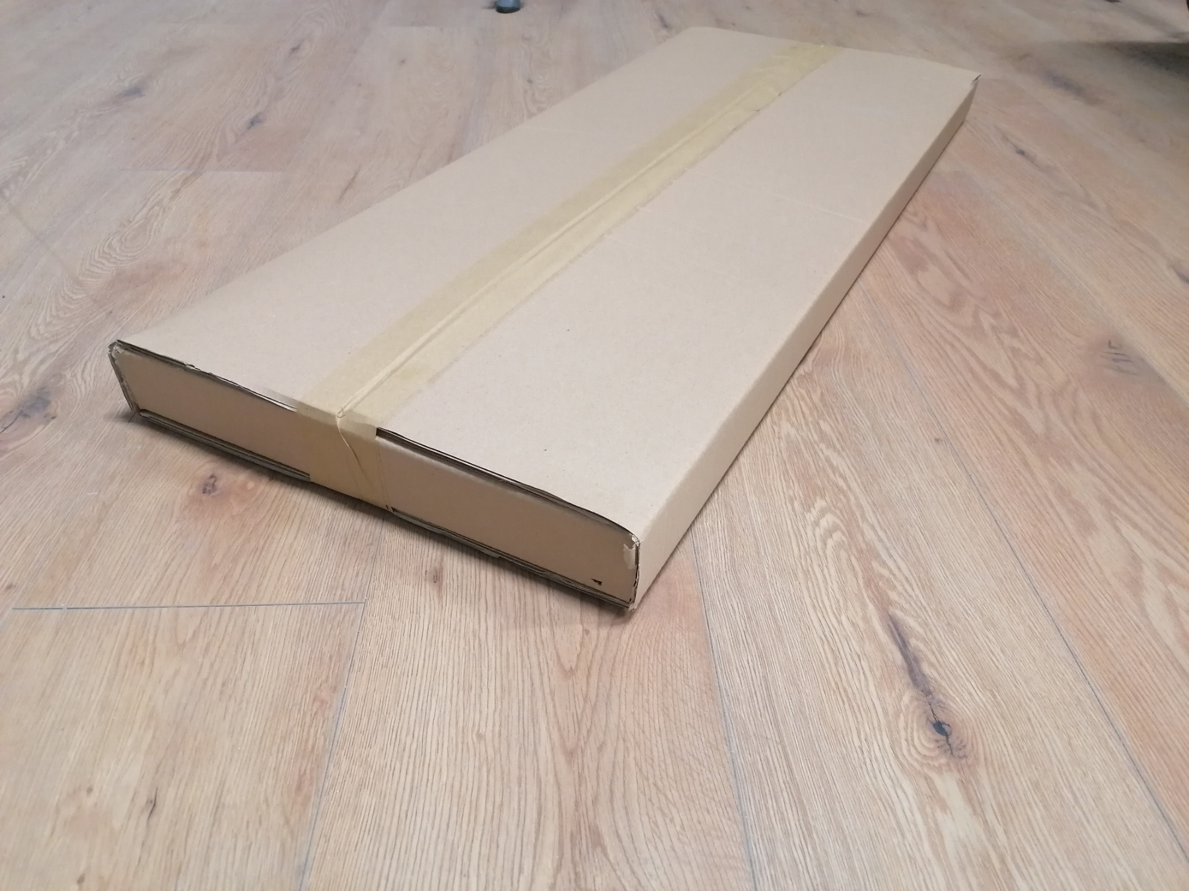
7. Fixed flap and implemented
with agreed gap.
Small flap one row can replace one big flap.
08. GLO tray +
Commsmodule
09. Packaging
size reduced by 70%

Slide 5
RGB LED Stripes
10 or more colors available (TBA)
No dimmers and ON/OFF switch removed
Remote controller removed
As agreed, hidden button implemented (photo)
As already communicated “code” for switching ON/OFF will be implemented in mass production. (Please see video bellow)

Slide 6
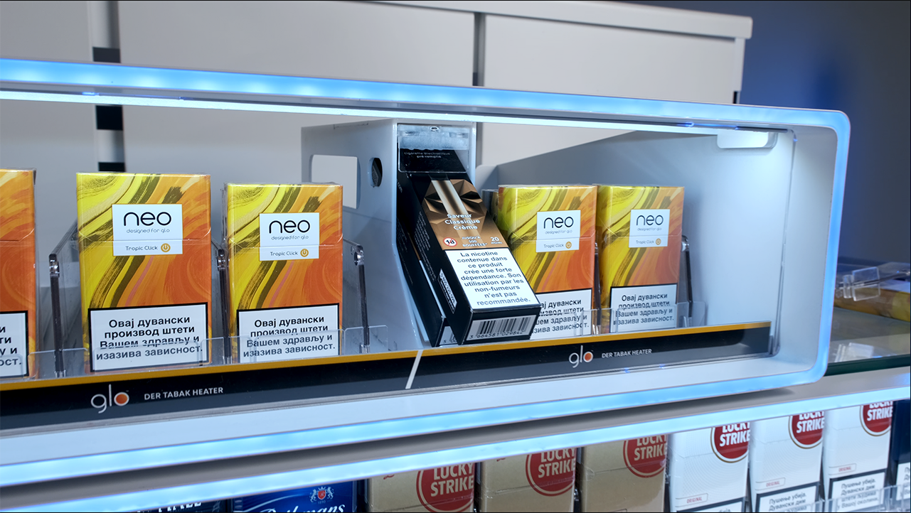
ePod Caps Pack
Current ePod caps pack is 112mm, standard pusher height at front reduces total space by 11mm, which leaves only 4mm for handling the packs.
Due to very limited space, handling packs becomes difficult.
We recommend that we should maybe consider using similar solution that you had developed with angled pushers for VusoGo packs (photo).

Slide 7
BG REKLAM
HEADQUATERS
29. Novembra 1M
11460 Belgrade, Serbia
info@bgreklam.com
+381 11 785 64 64
+381 60 68 69 110
Thank You.
BG REKLAM GMBH
Leverkusenstraße 3
22761 Hamburg, Deutschland
hamburg@bgreklam.com
+49 40 85413003
www.bgreklam.com
BG REKLAM
UK LTD
2588 Davenport House,
207 Regent St
London, W1B 3HH, UK
+44 75 4288 2312

