Slide 1
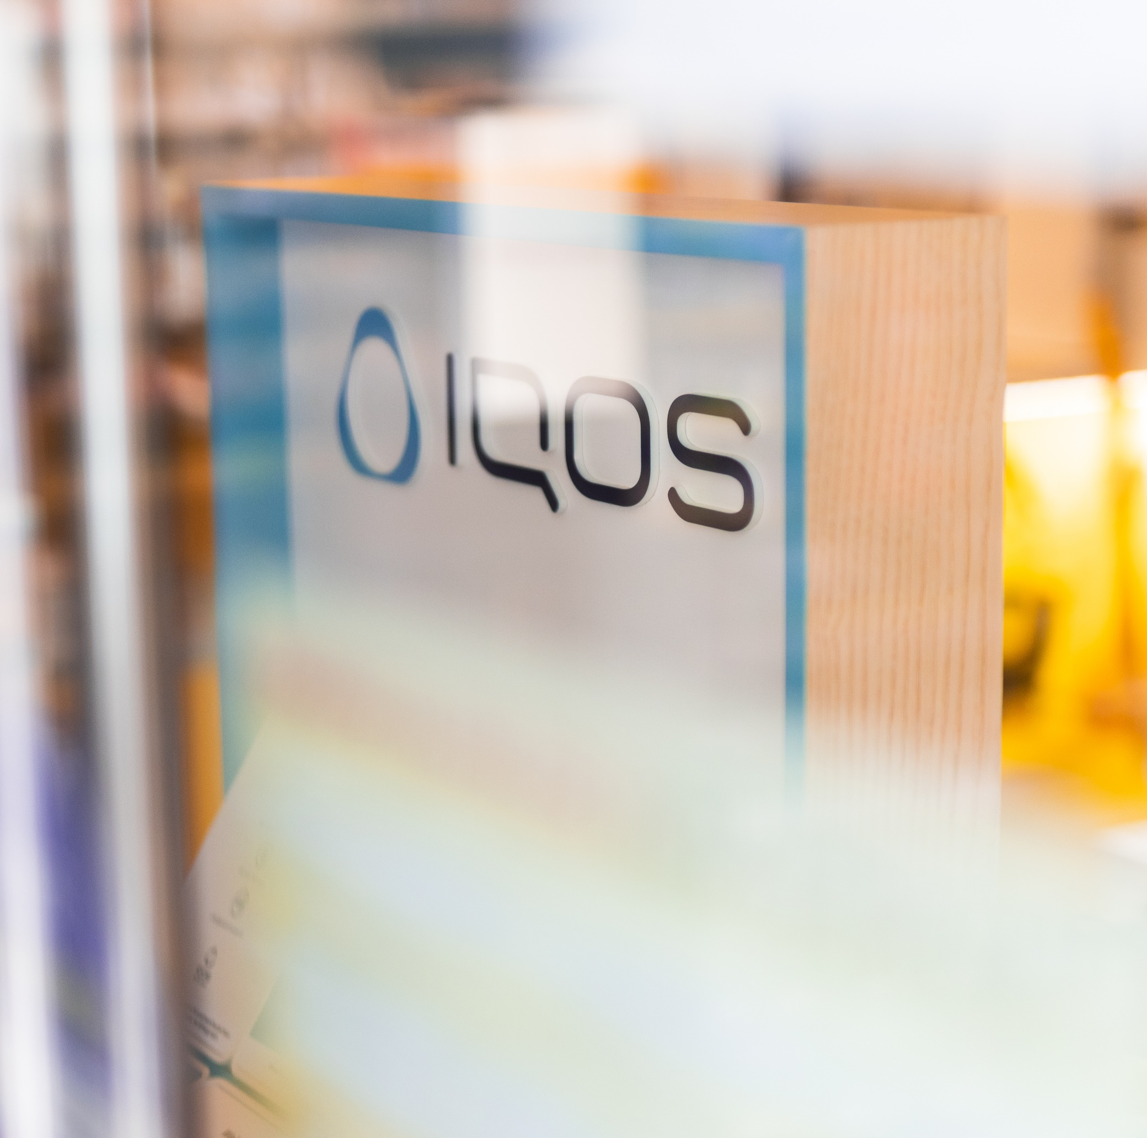

Premium
POS Industry
People are always going to go shopping.
A lot of our effort is how to make the retail experience a great one!

Slide 2
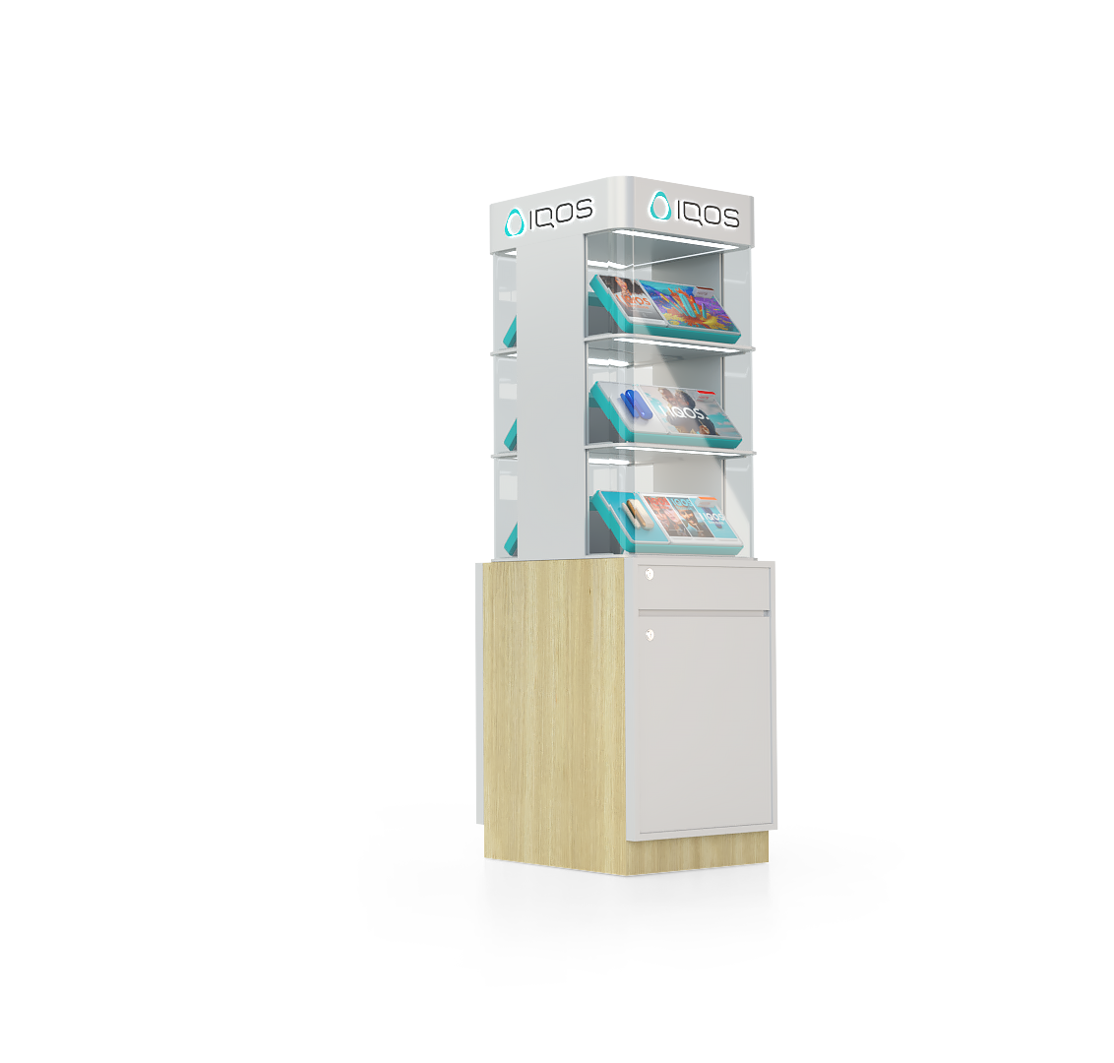

Contents.
Company Profile
PMI Markets
Working with PMI
Projects

Slide 3
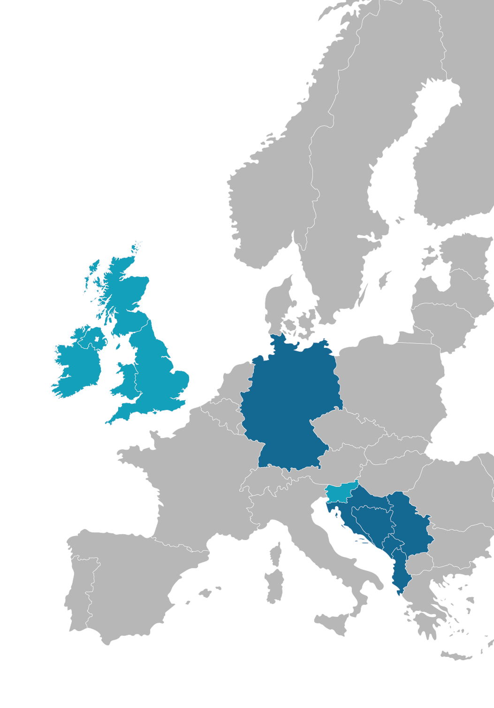

02.
PMI Markets
We cover
Offices:
Belgrade Hamburg London
Production/Manufacturing:
Belgrade, Serbia
Projects regularly
Projects occasionally

Slide 4

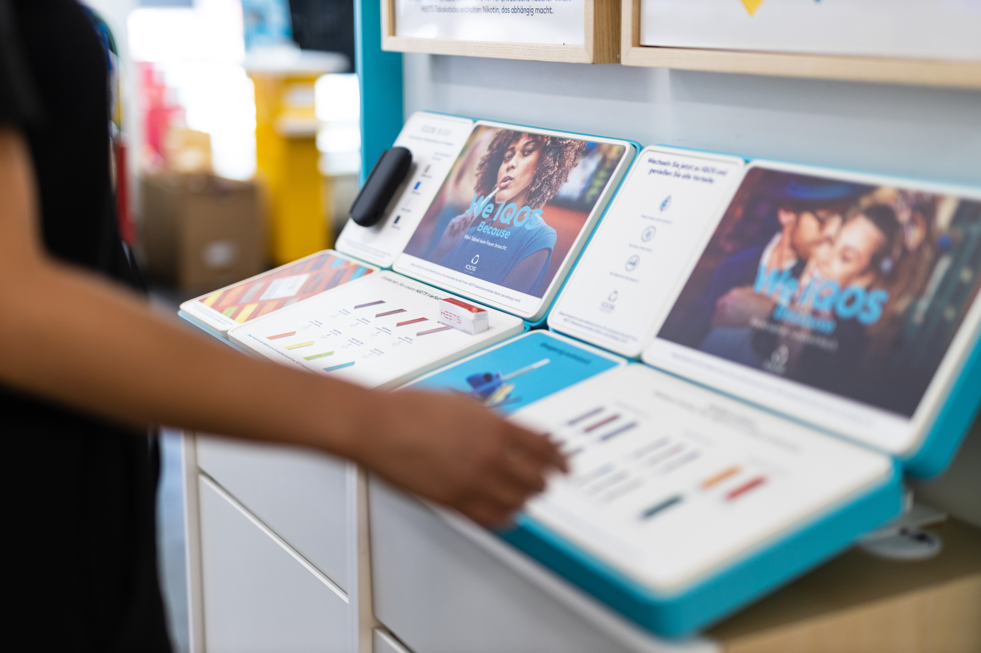
03.
Working with PMI
With 15+ years of experience in all categories across different channels but also having an insight into other industries and up-to-date technologies we continue to support PMI markets in execution excellence across European retail.

Slide 5
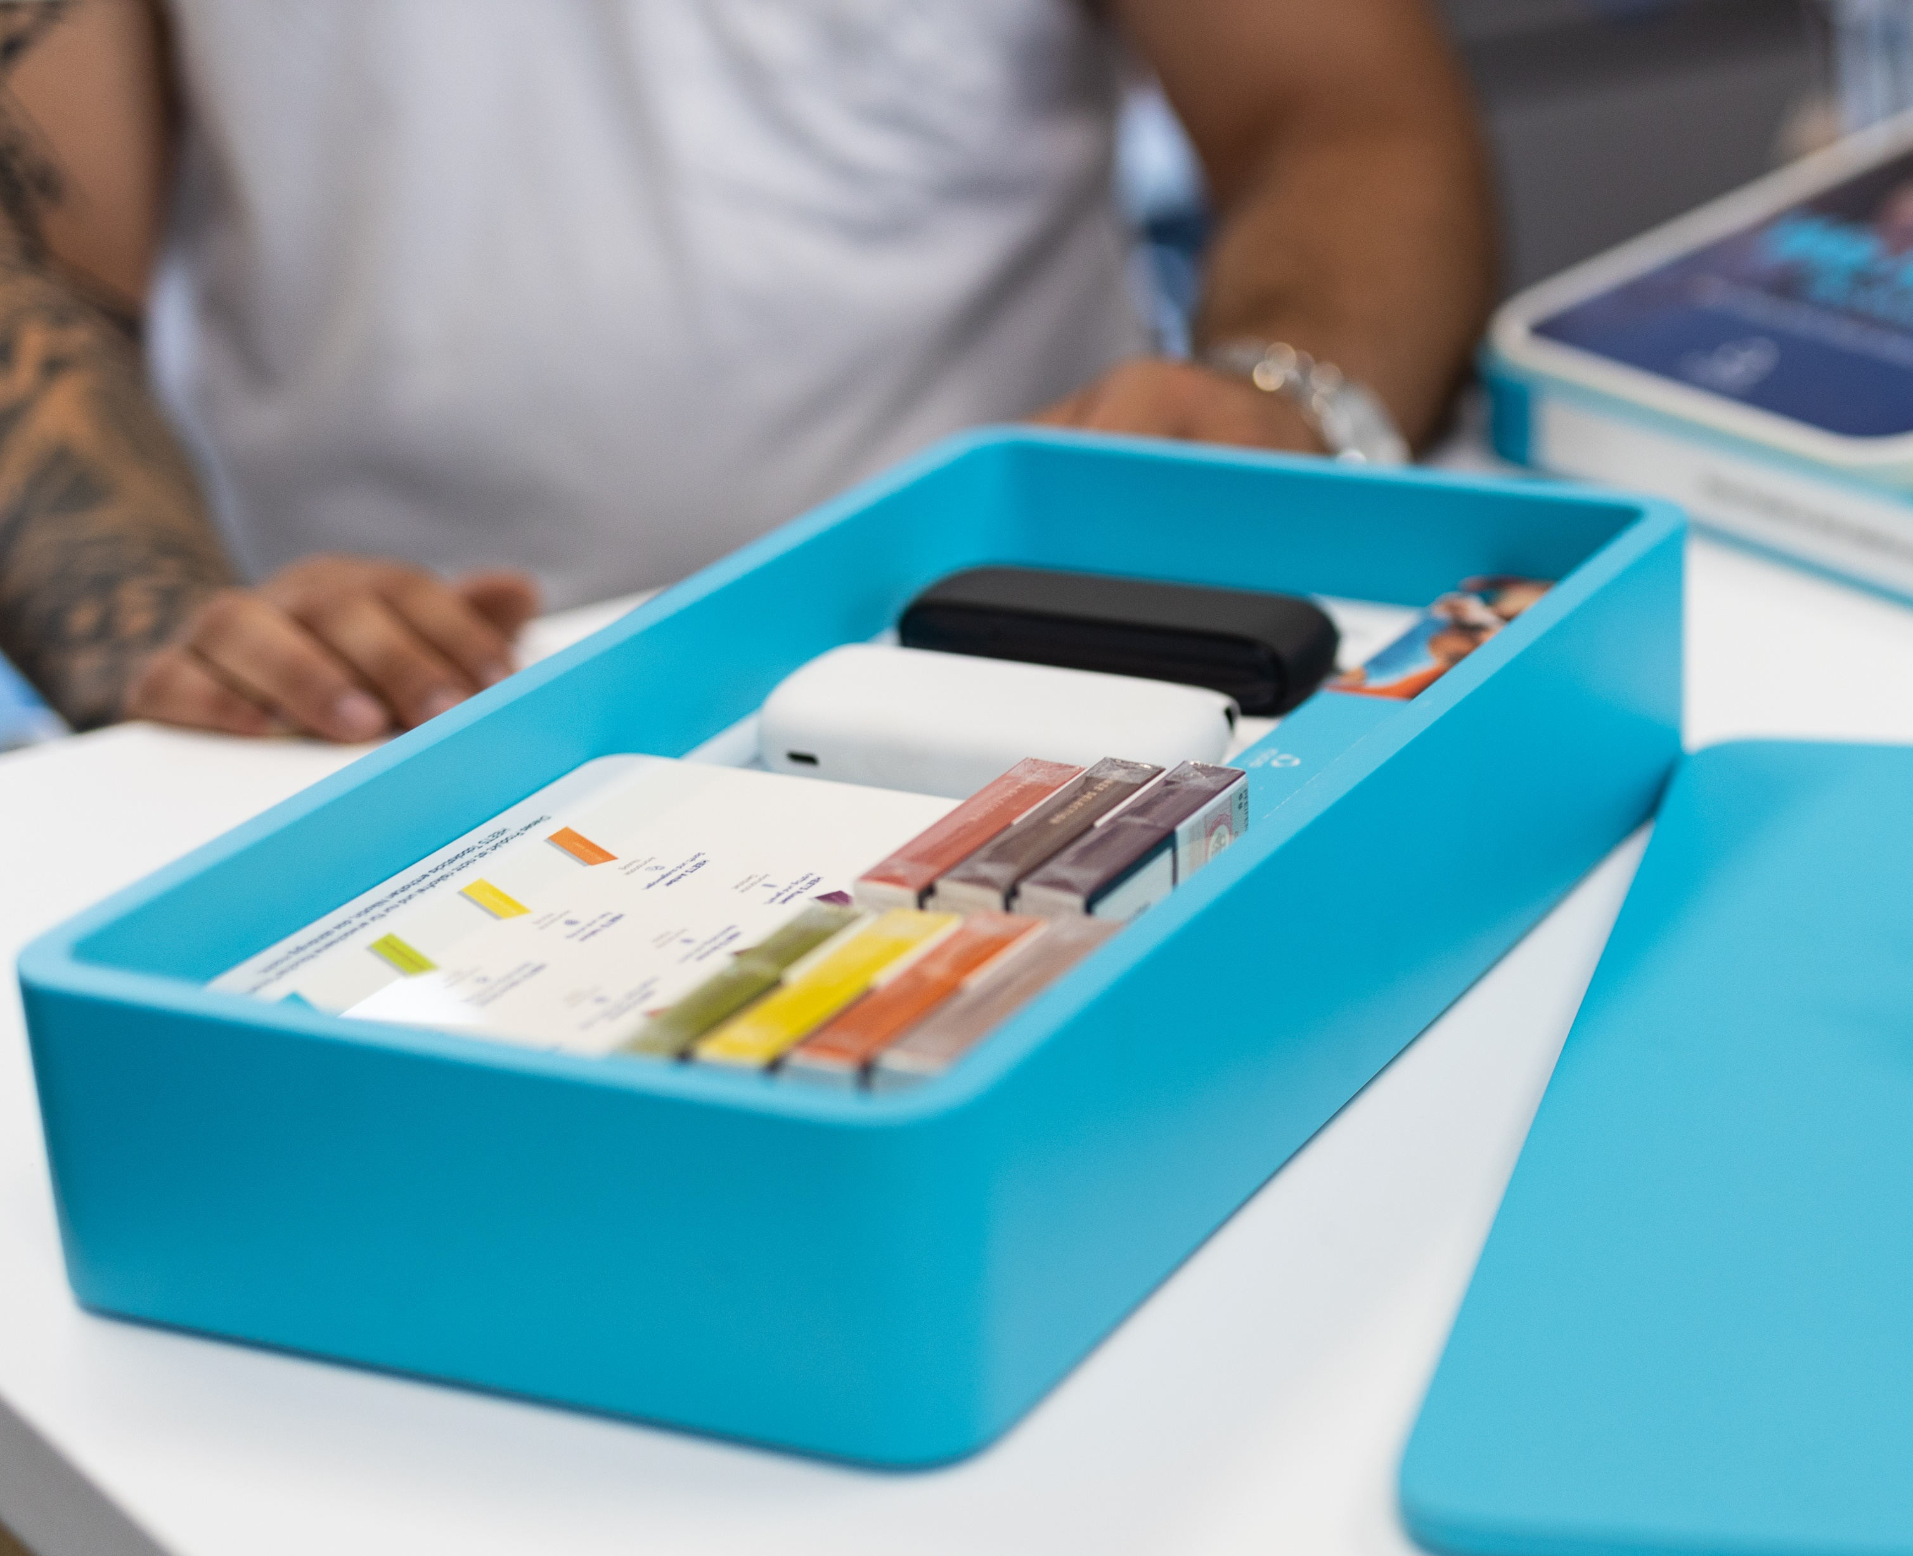
04.
Projects
Everything is designed and produced under one roof.
Giving our design, engineering, production, and sales teams a unique perspective and rare opportunity to be part of the entire production process.

Slide 6

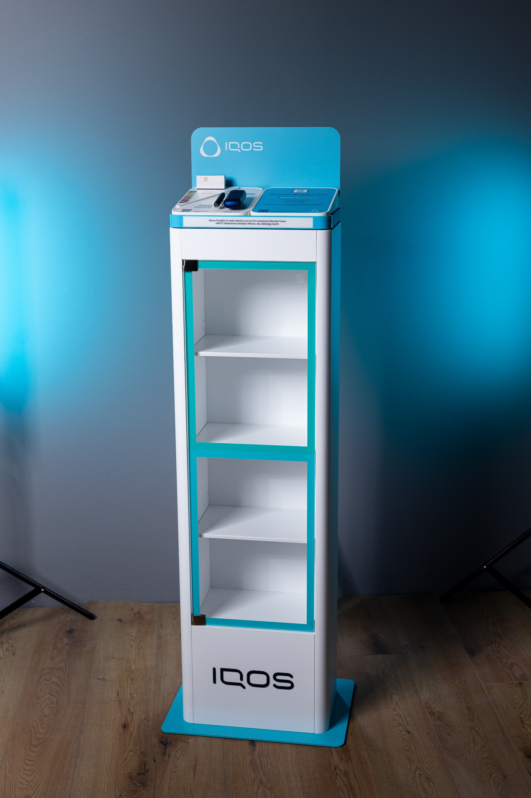
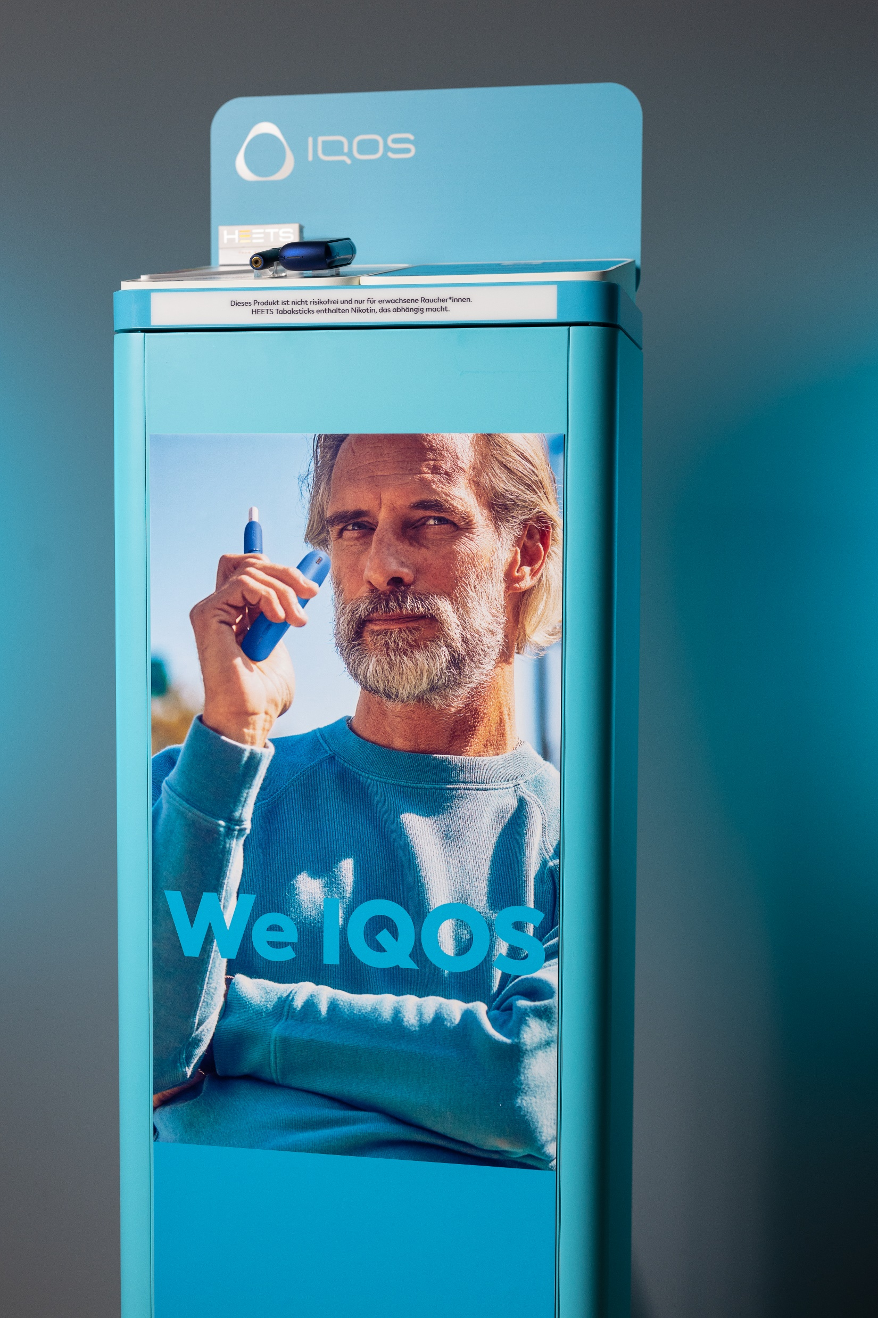
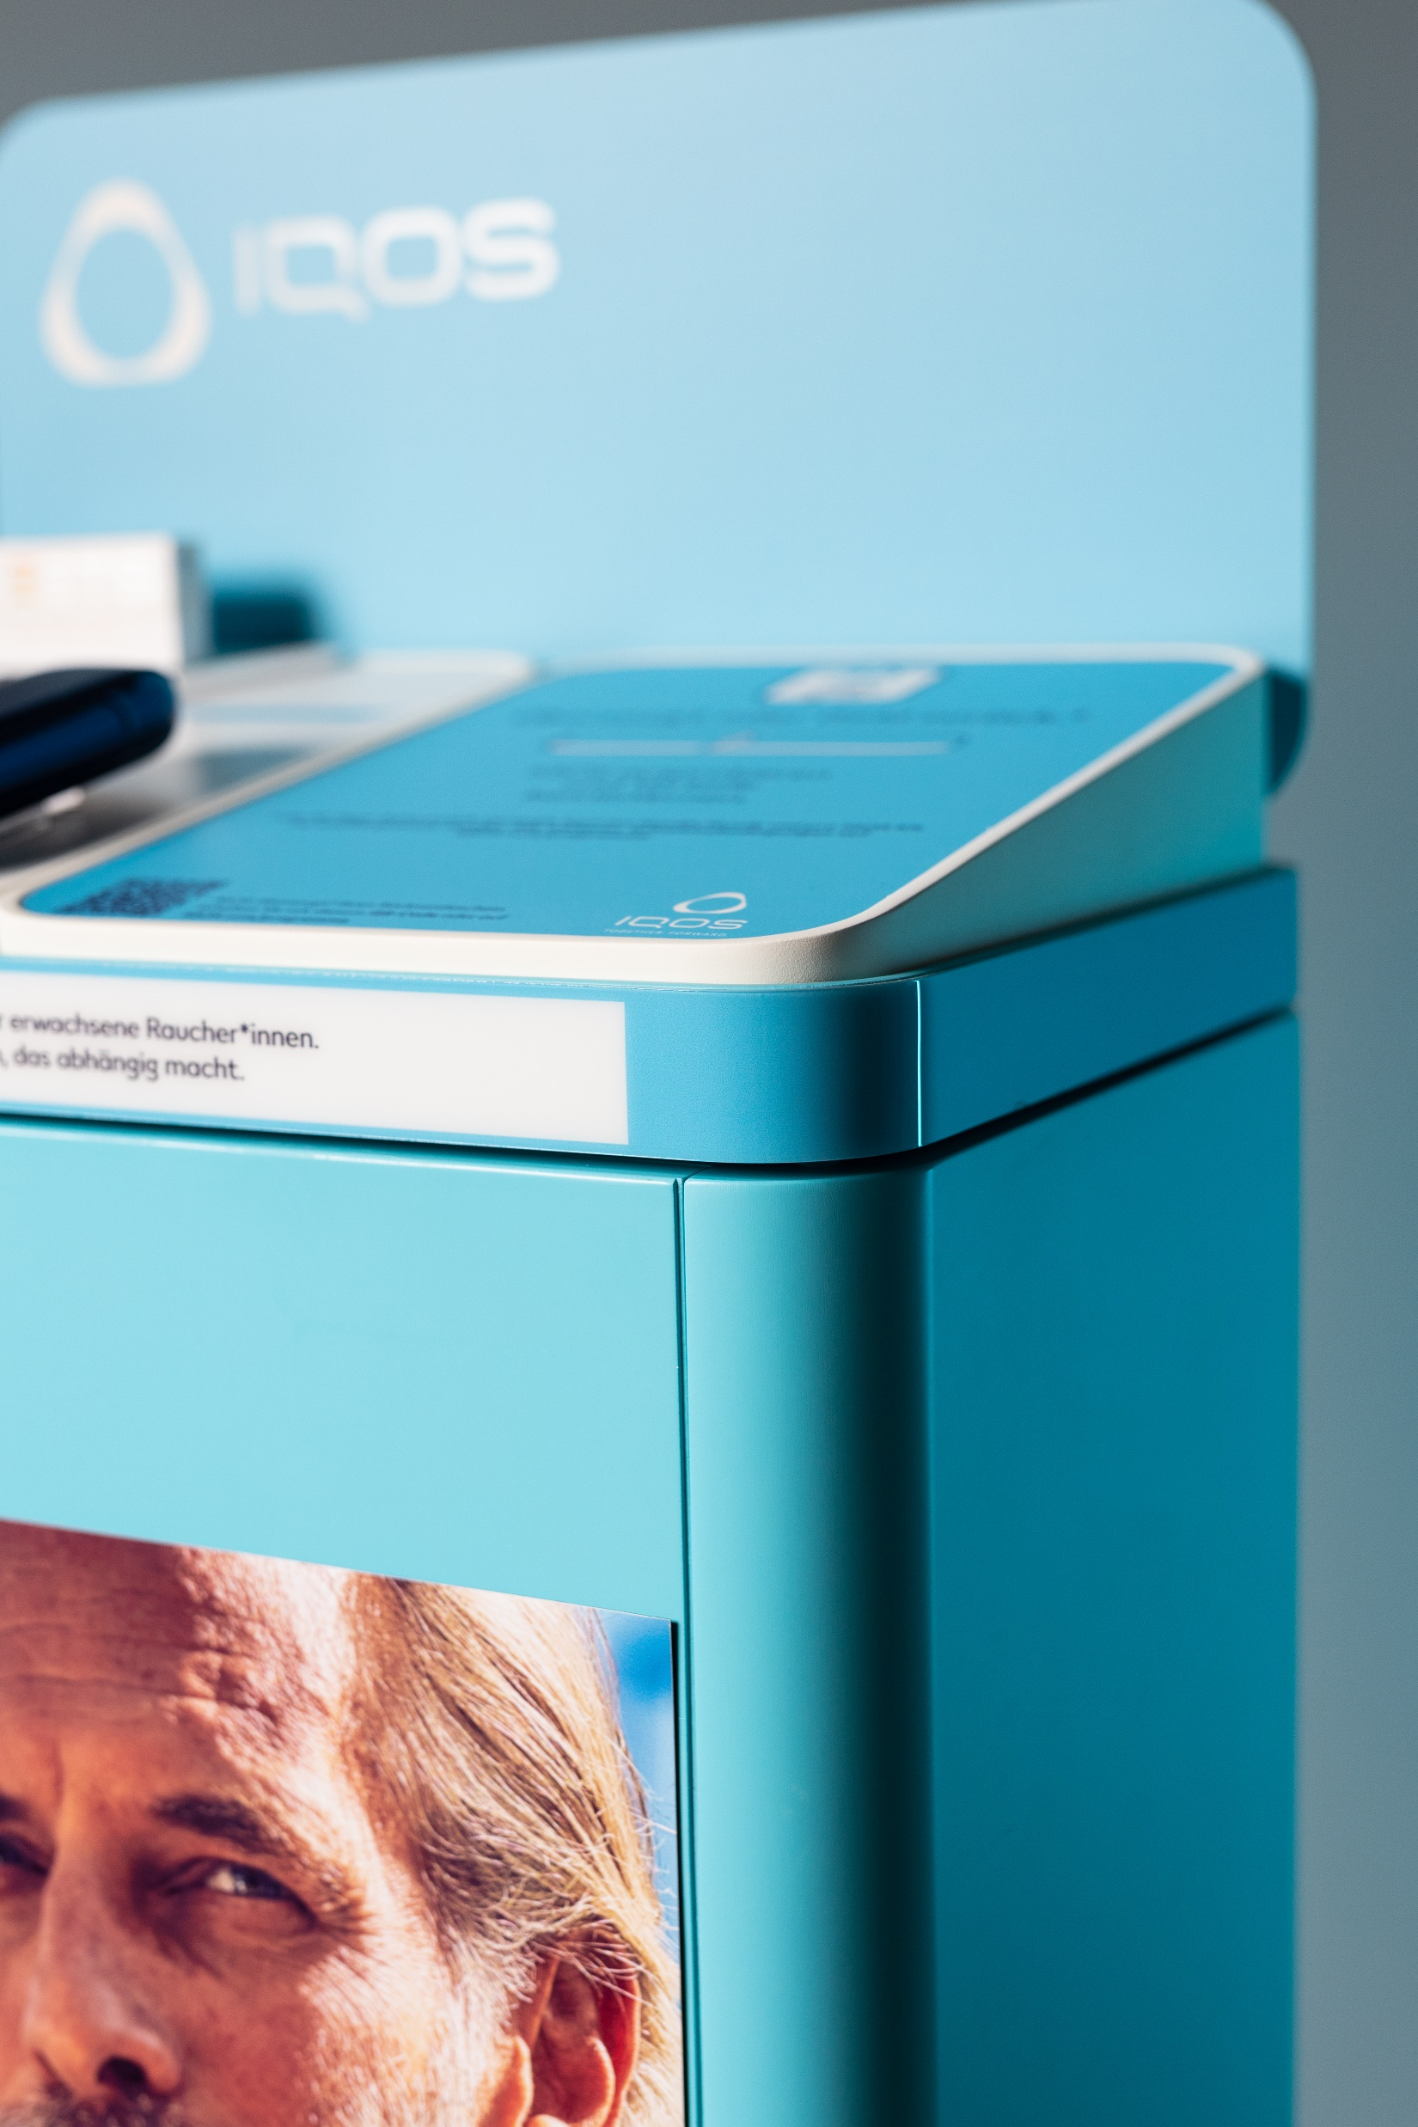

Slide 7
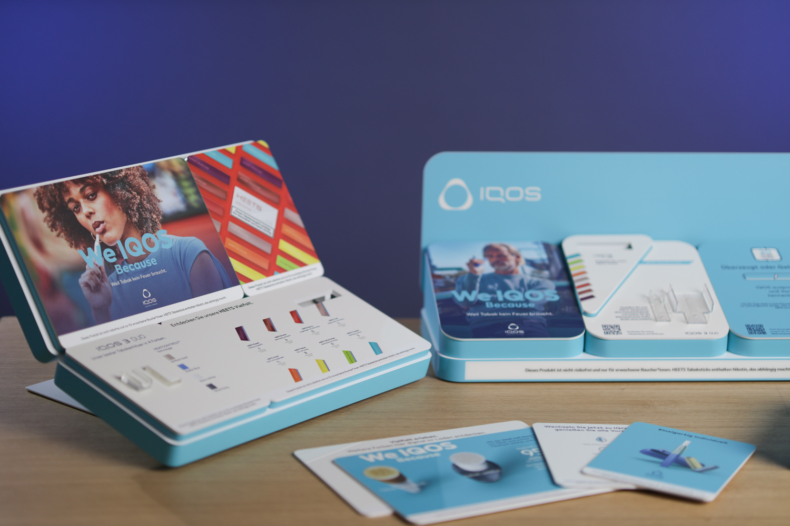

Slide 8
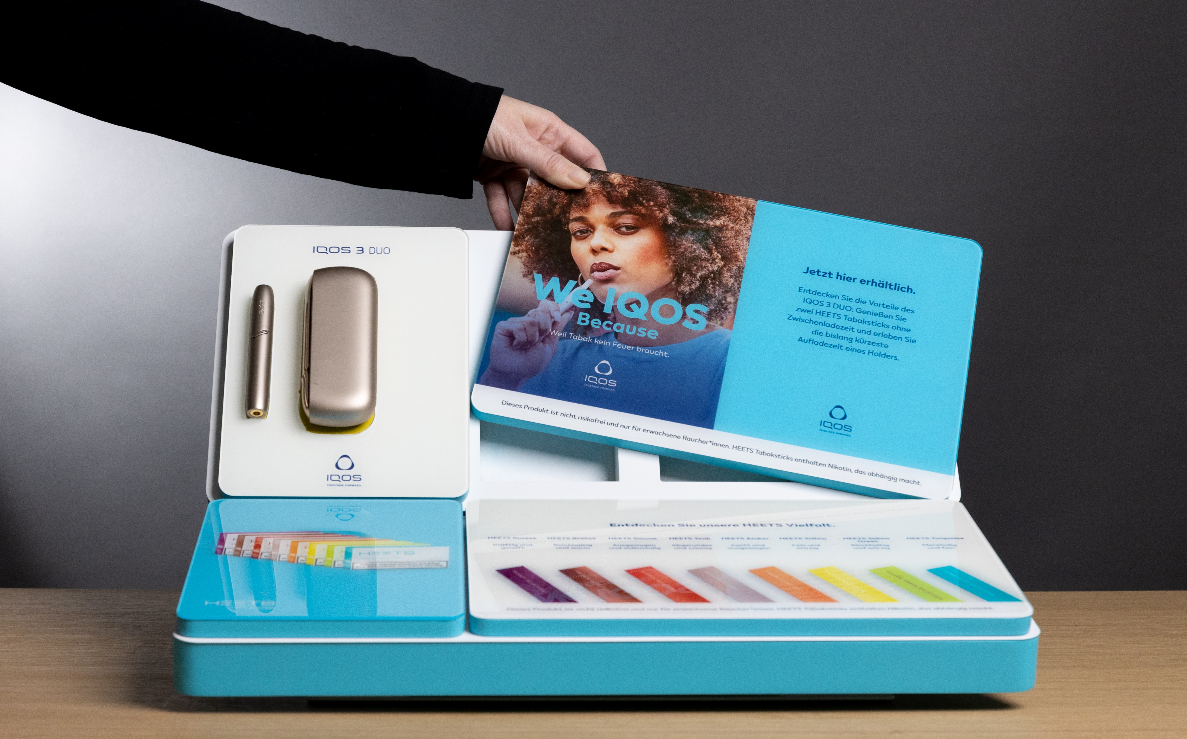

Slide 9
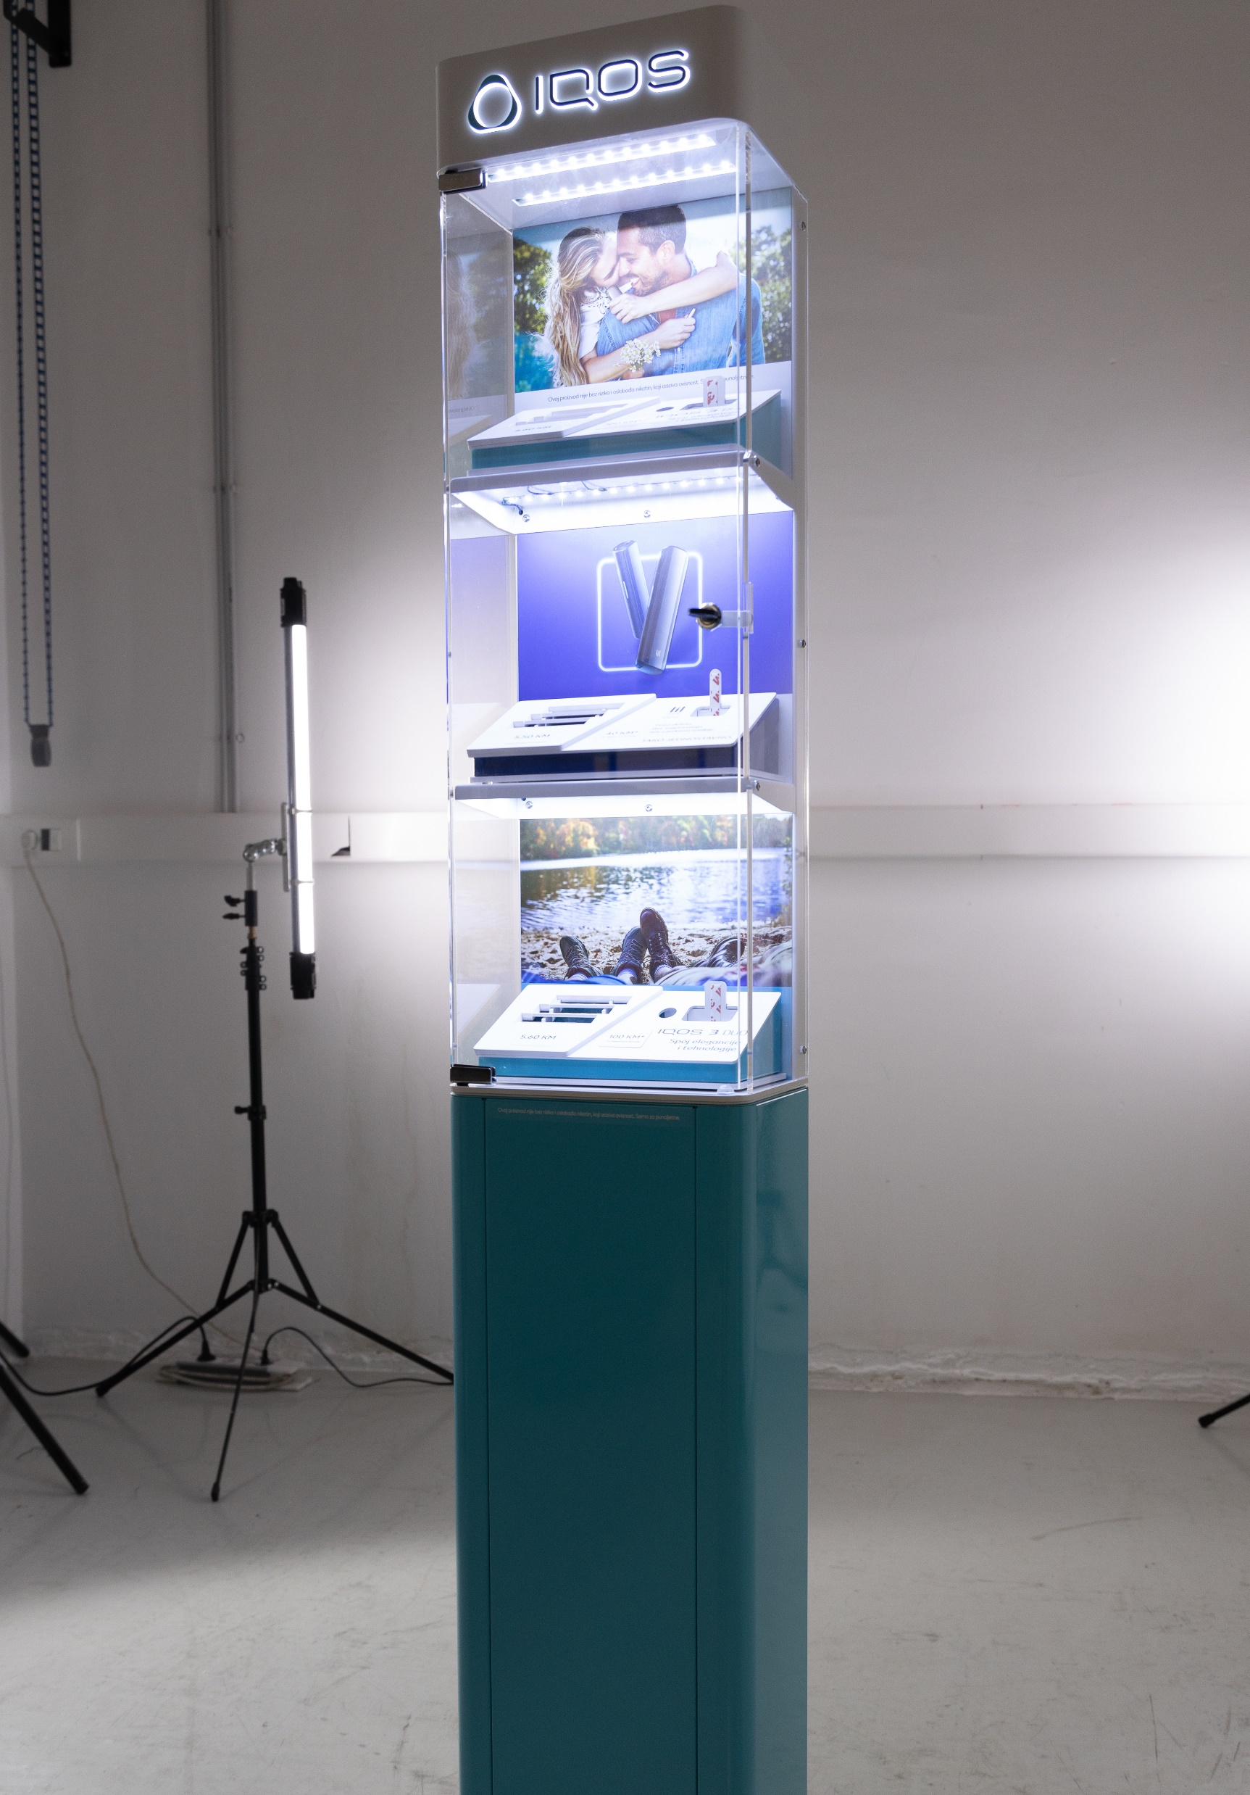
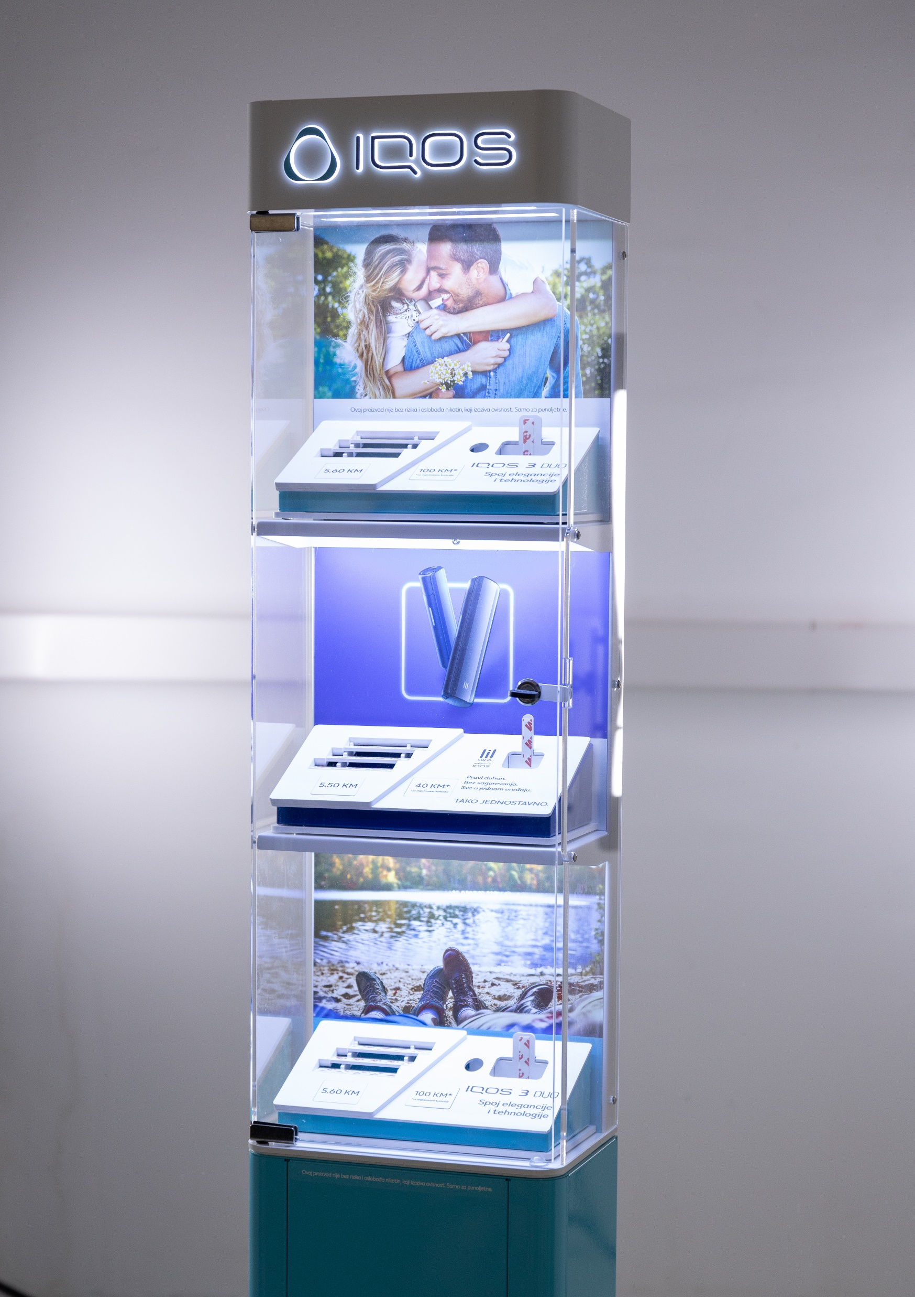
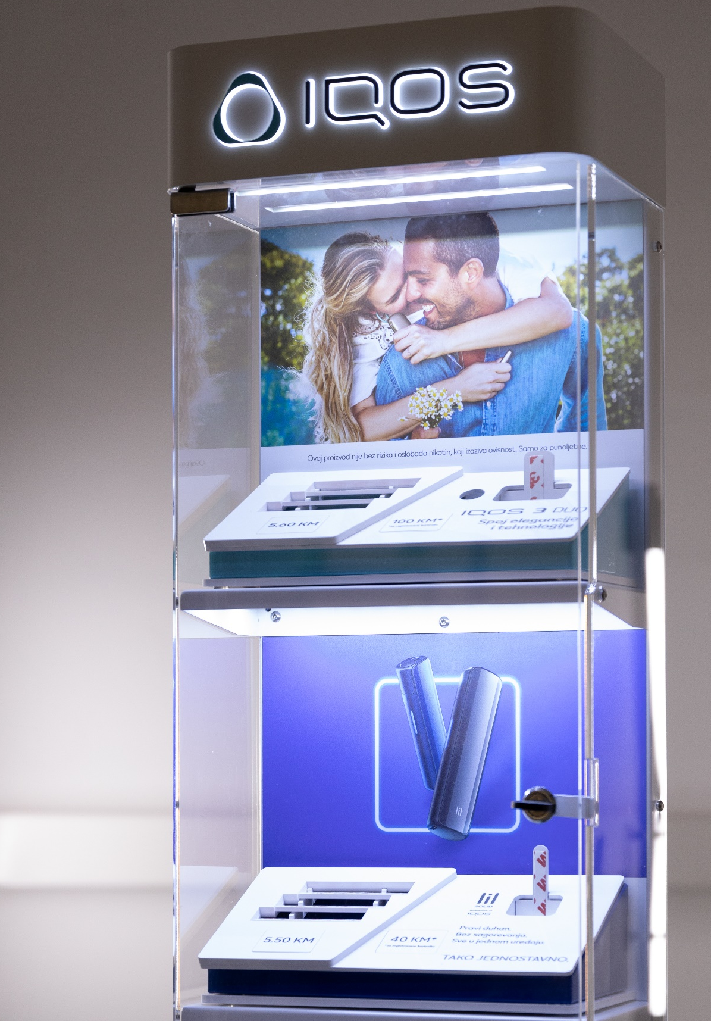

Slide 10
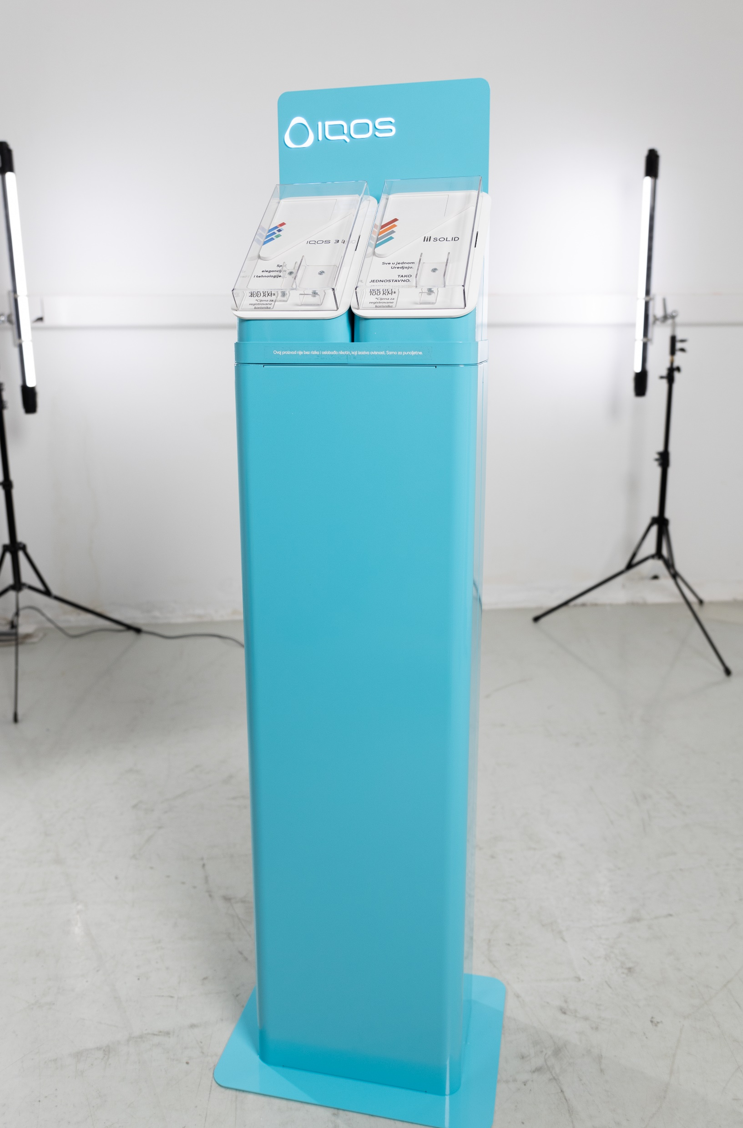
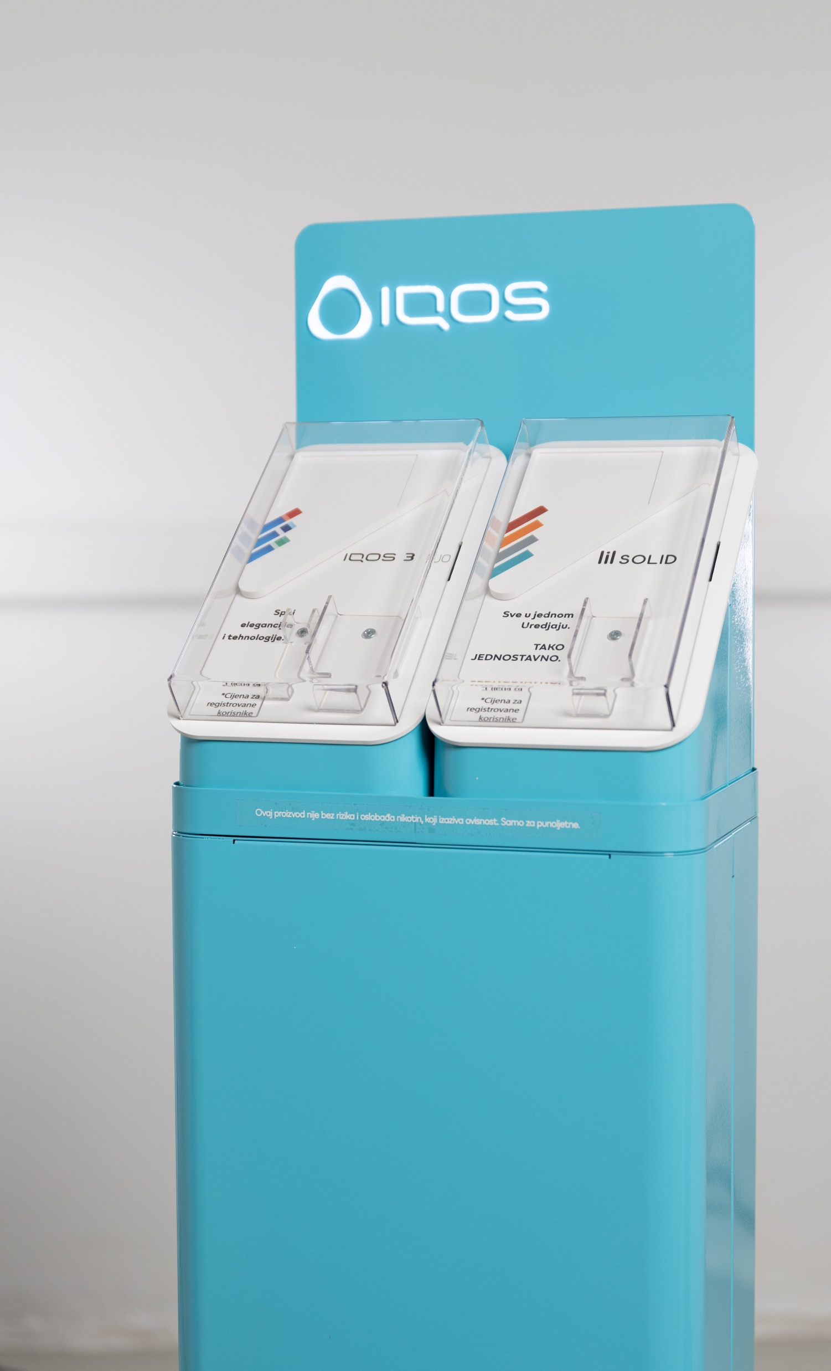
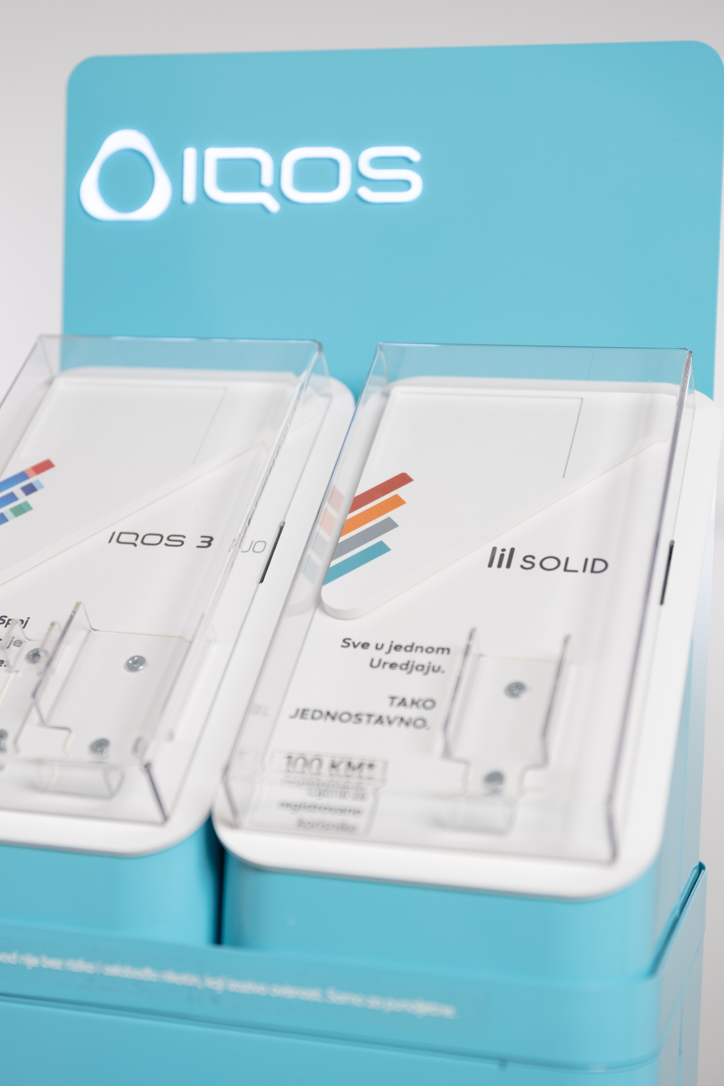

Slide 11
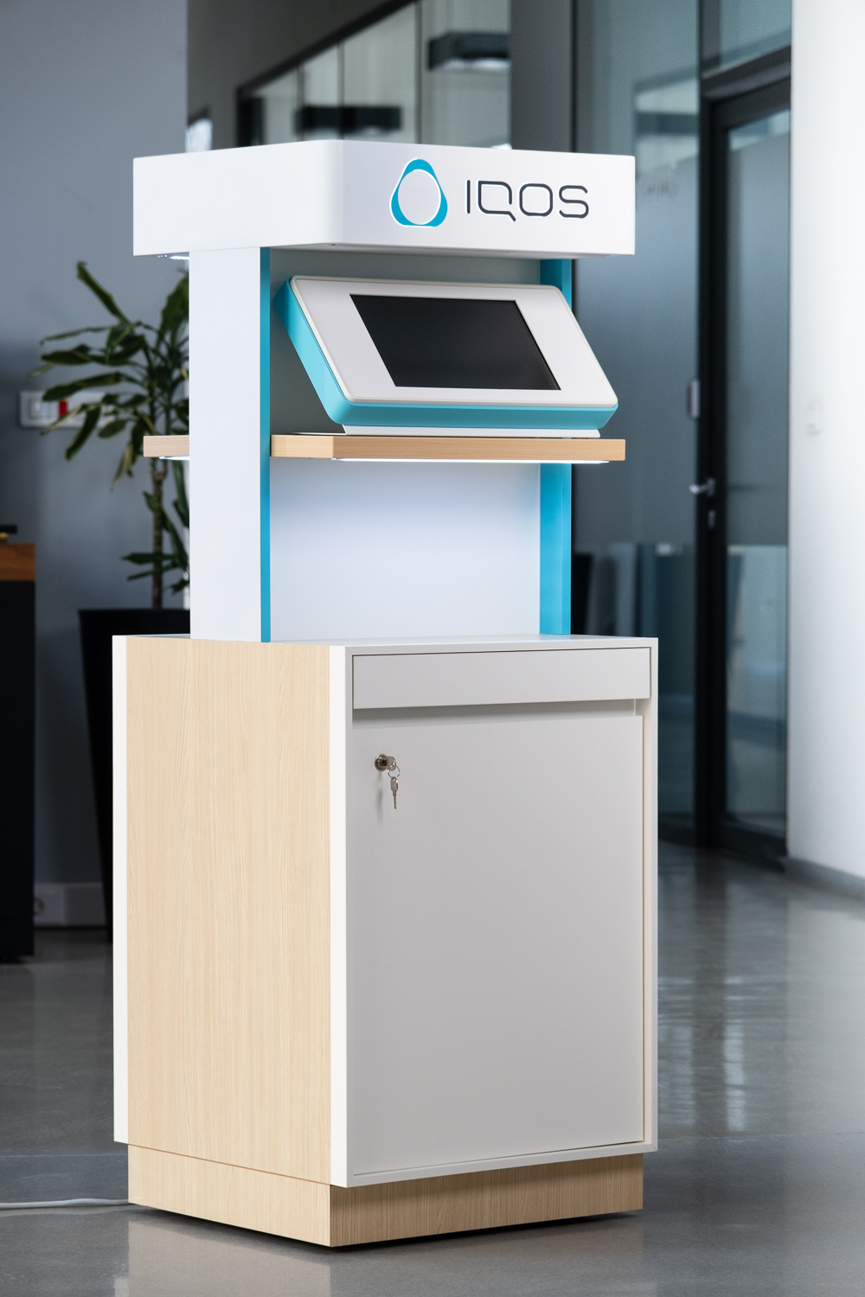
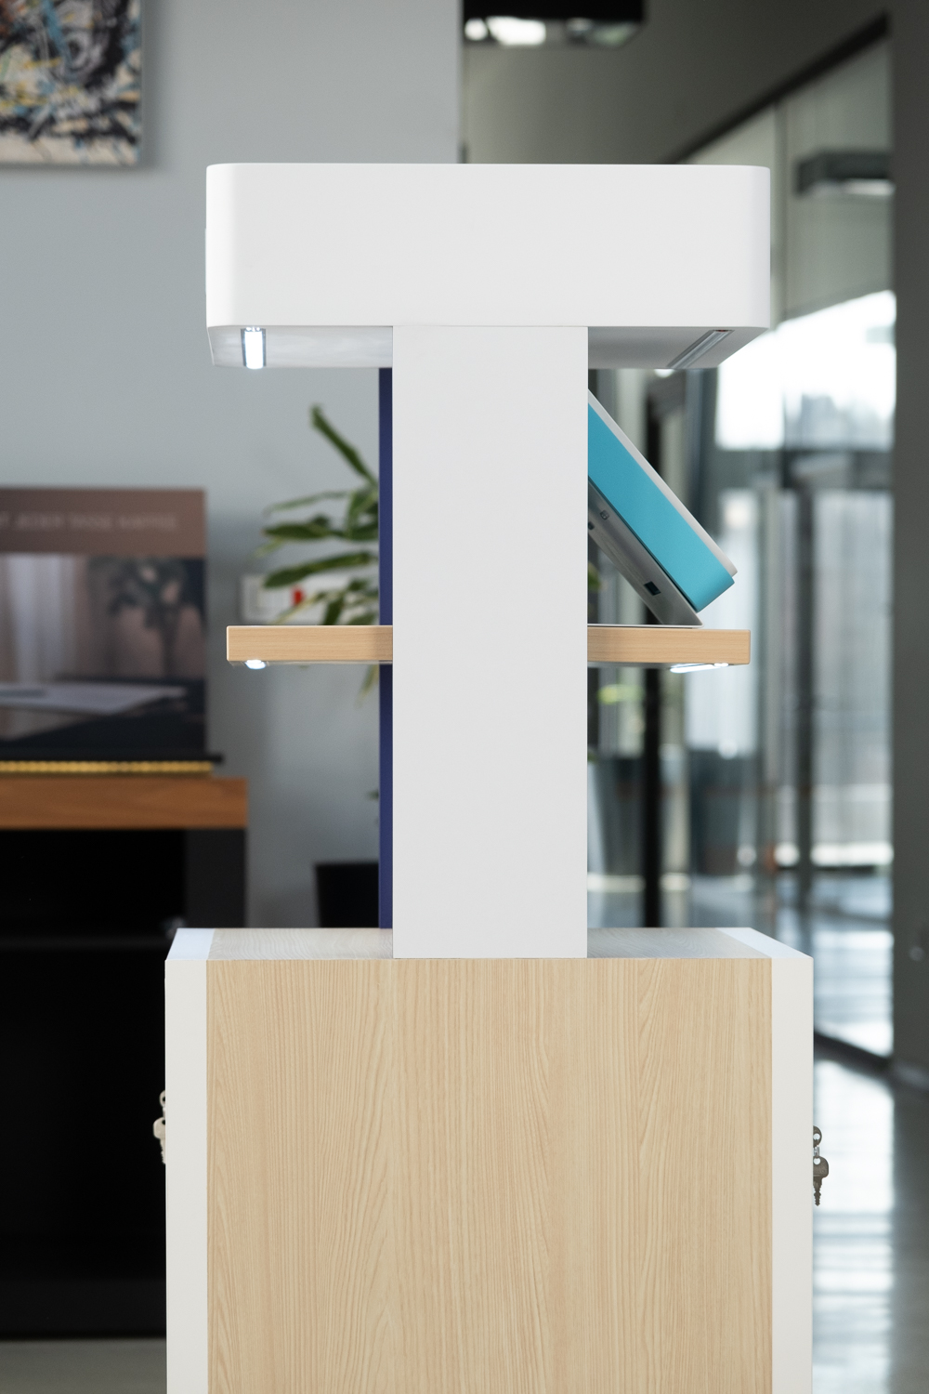

Slide 12
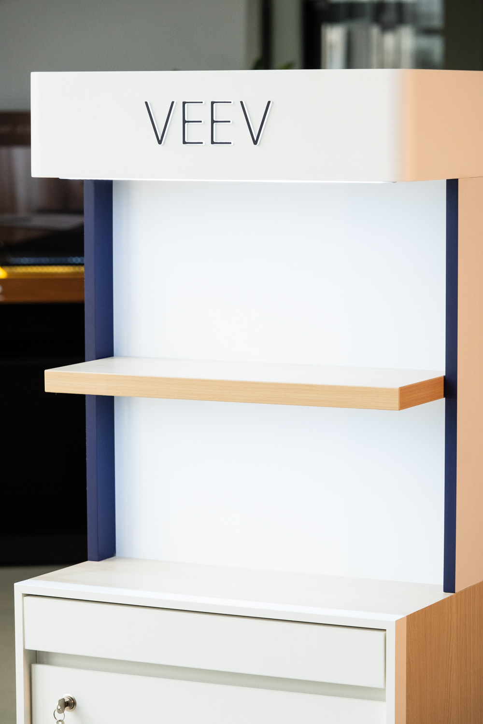
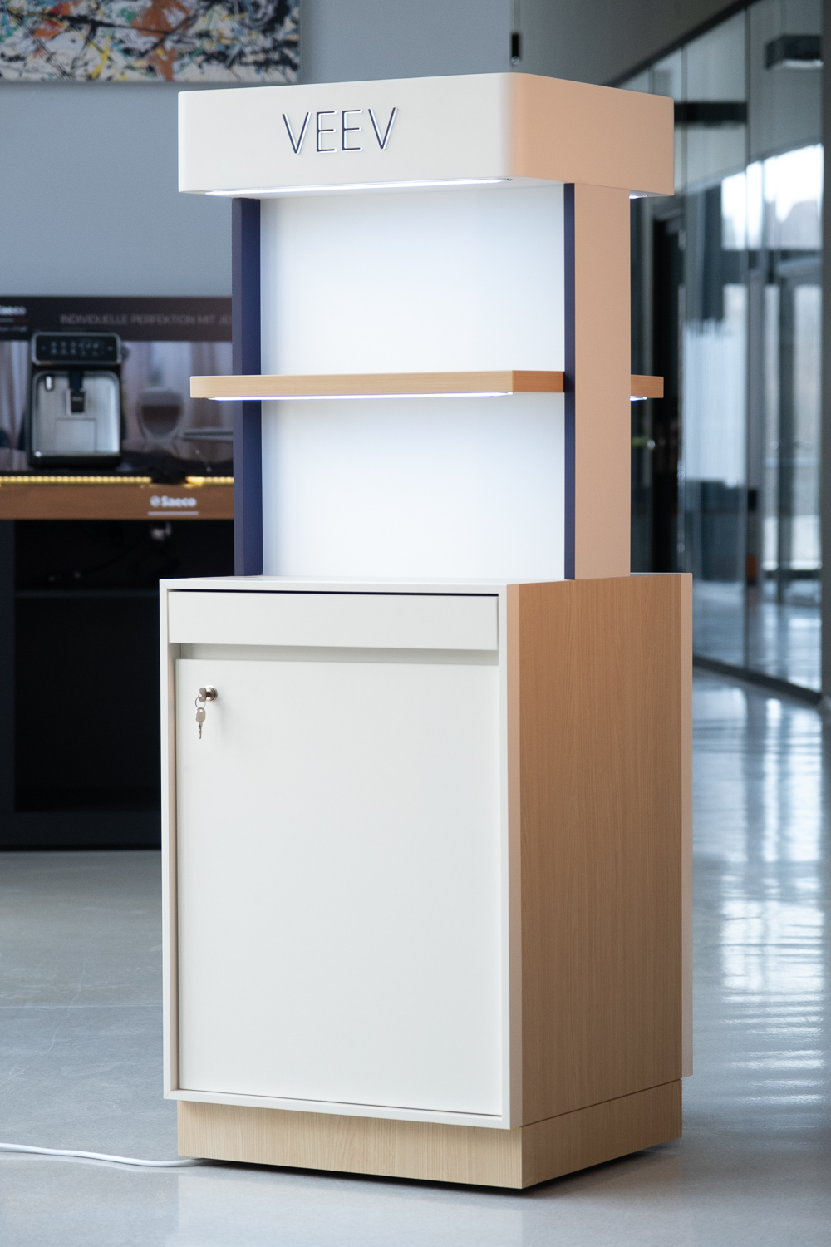

Slide 13


Slide 14
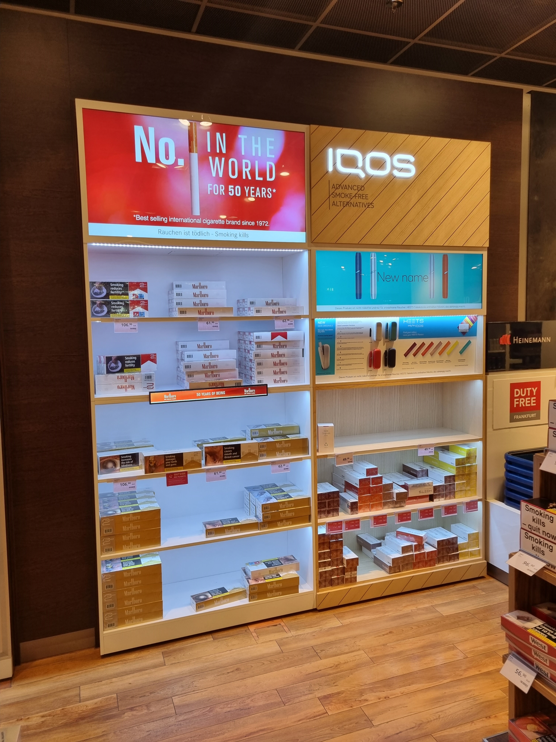
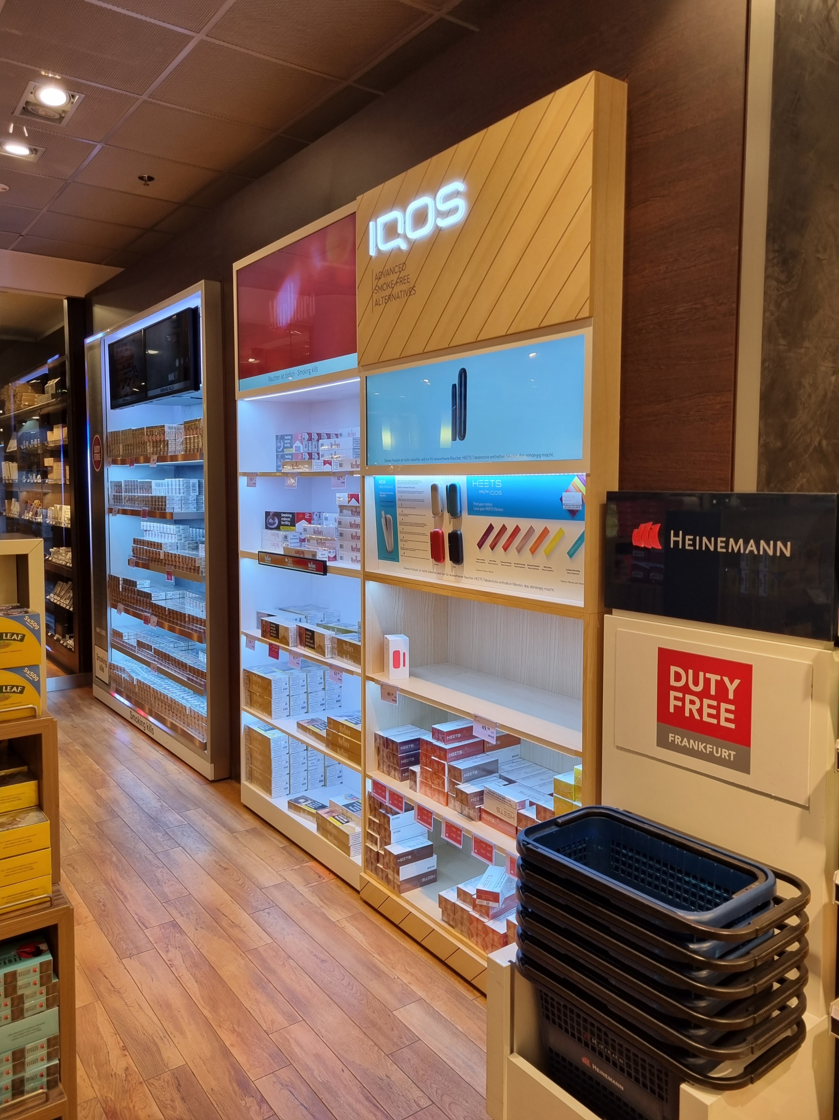

Slide 15
BG REKLAM
PRODUCTION
29. Novembra 1M
11460 Belgrade, Serbia
info@bgreklam.com
+381 11 785 64 64
+381 60 68 69 110
Thank You.
BG REKLAM GMBH
Leverkusenstraße 3
22761 Hamburg, Deutschland
hamburg@bgreklam.com
+49 40 85413003
www.bgreklam.com
BG REKLAM
UK LTD
2588 Davenport House,
207 Regent St
London, W1B 3HH, UK
+44 75 4288 2312

