Slide 1
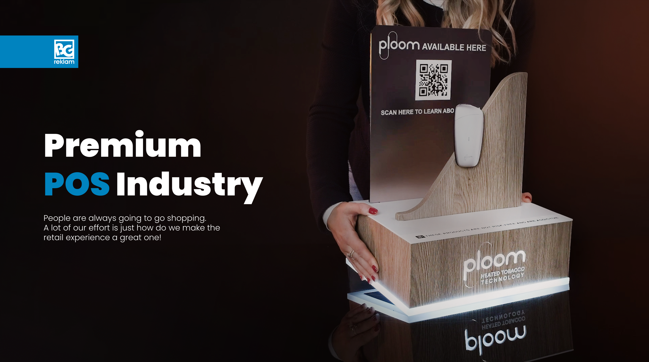

Premium
POS Industry
People are always going to go shopping.
A lot of our effort is how to make the retail experience a great one!

Slide 2
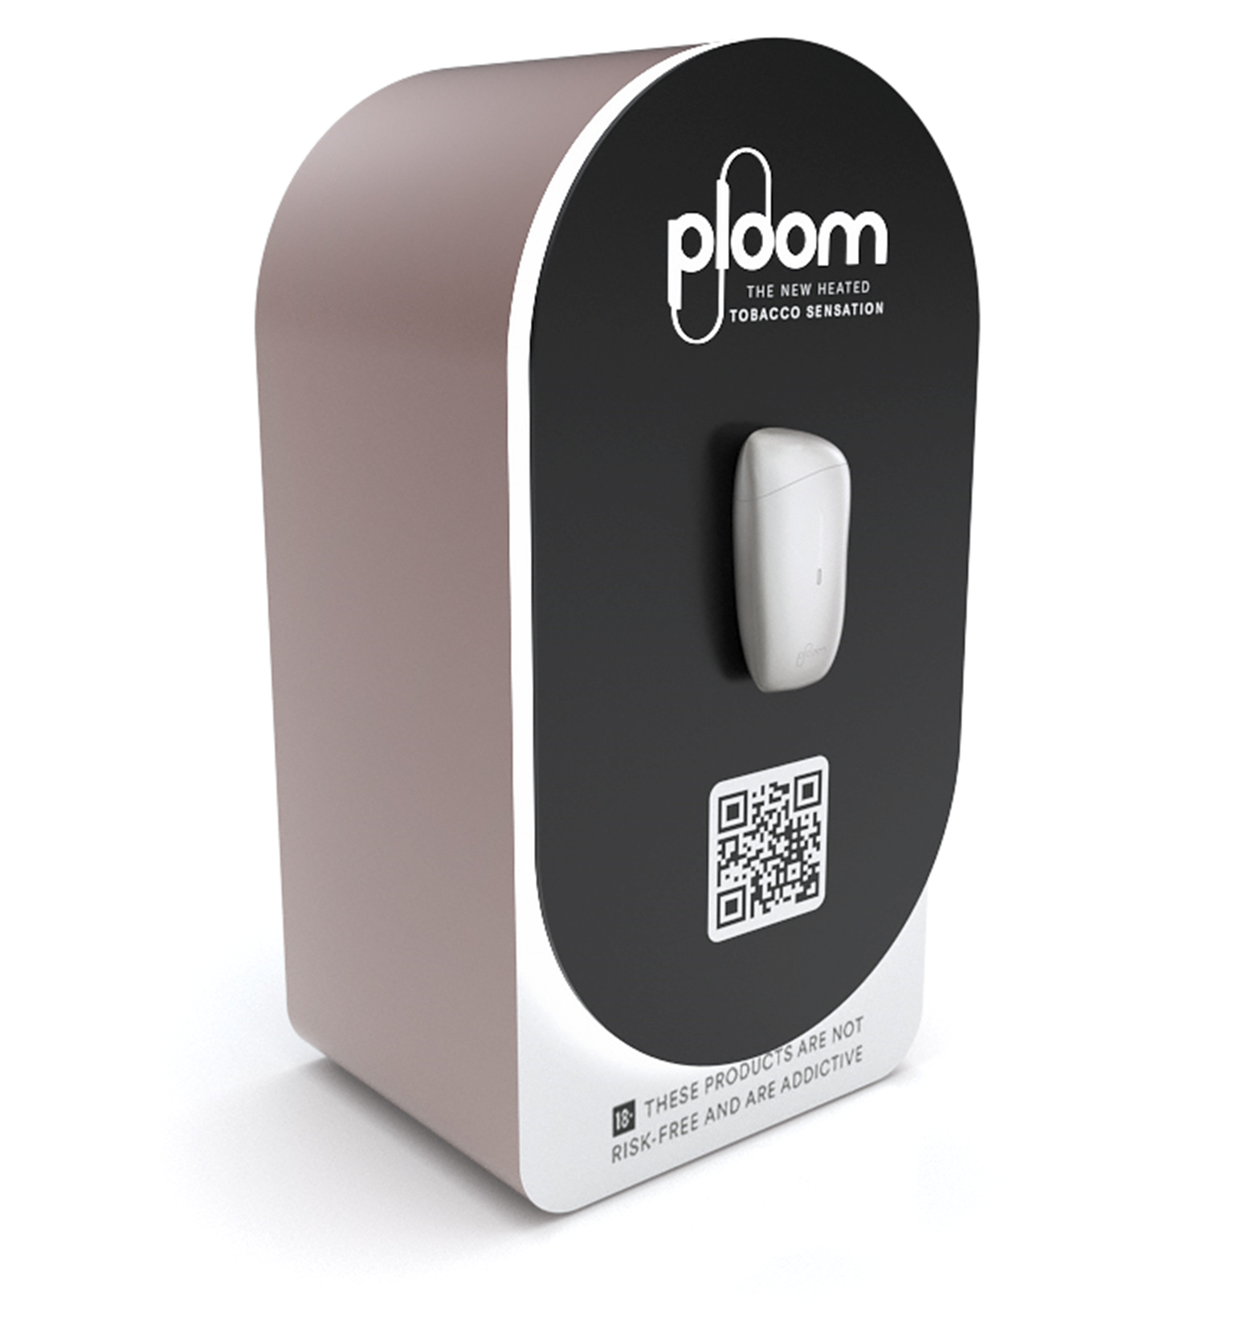
Contents.
Company Profile
JTI Markets
Working with JTI
Projects

Slide 3
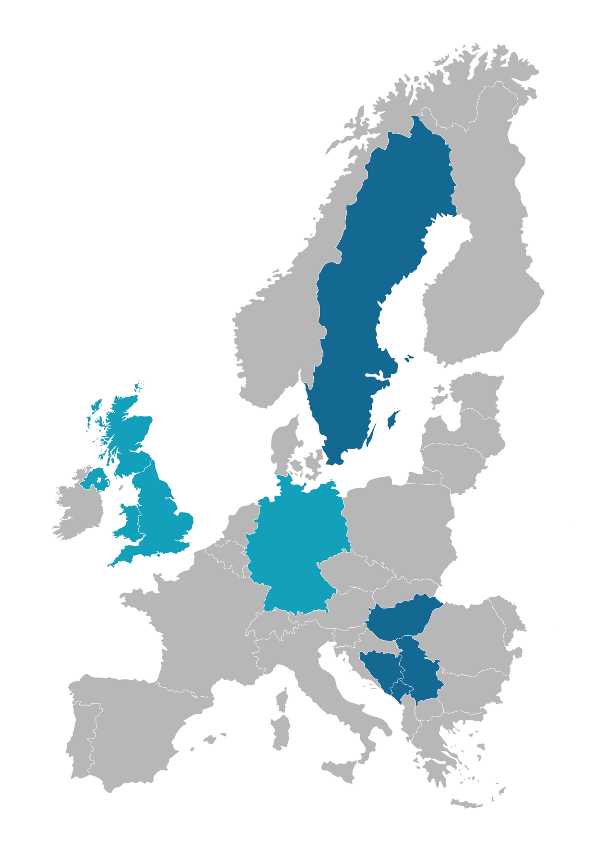

02.
Markets
We cover
Offices:
Belgrade Hamburg London
Production/Manufacturing:
Belgrade, Serbia
Projects regularly
Projects occasionally

Slide 4


03.
Working with JTI
With 15+ years of experience in all categories across different channels but also having an insight into other industries and up-to-date technologies we continue to support JTI markets in execution excellence across European retail.

Slide 5
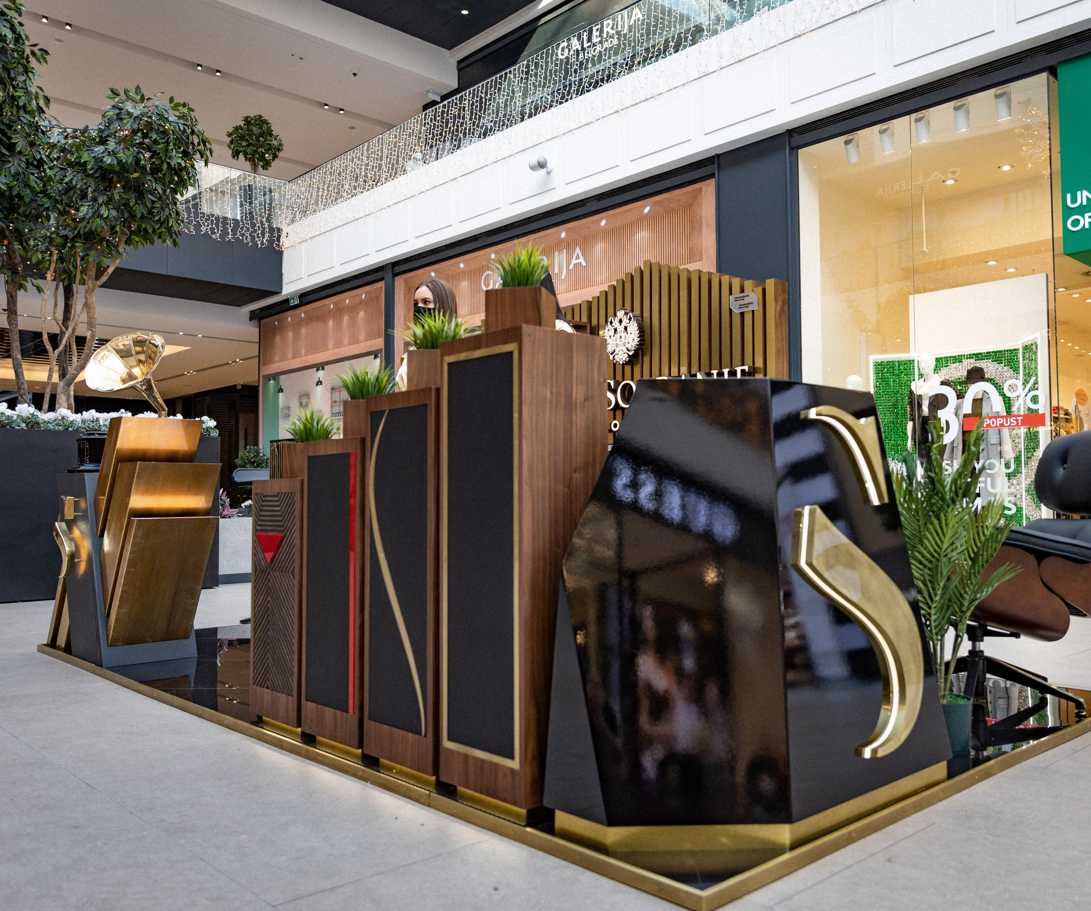
04.
Projects
Everything is designed and produced under one roof.
Giving our design, engineering, production, and sales teams a unique perspective and rare opportunity to be part of the entire production process.

Slide 6

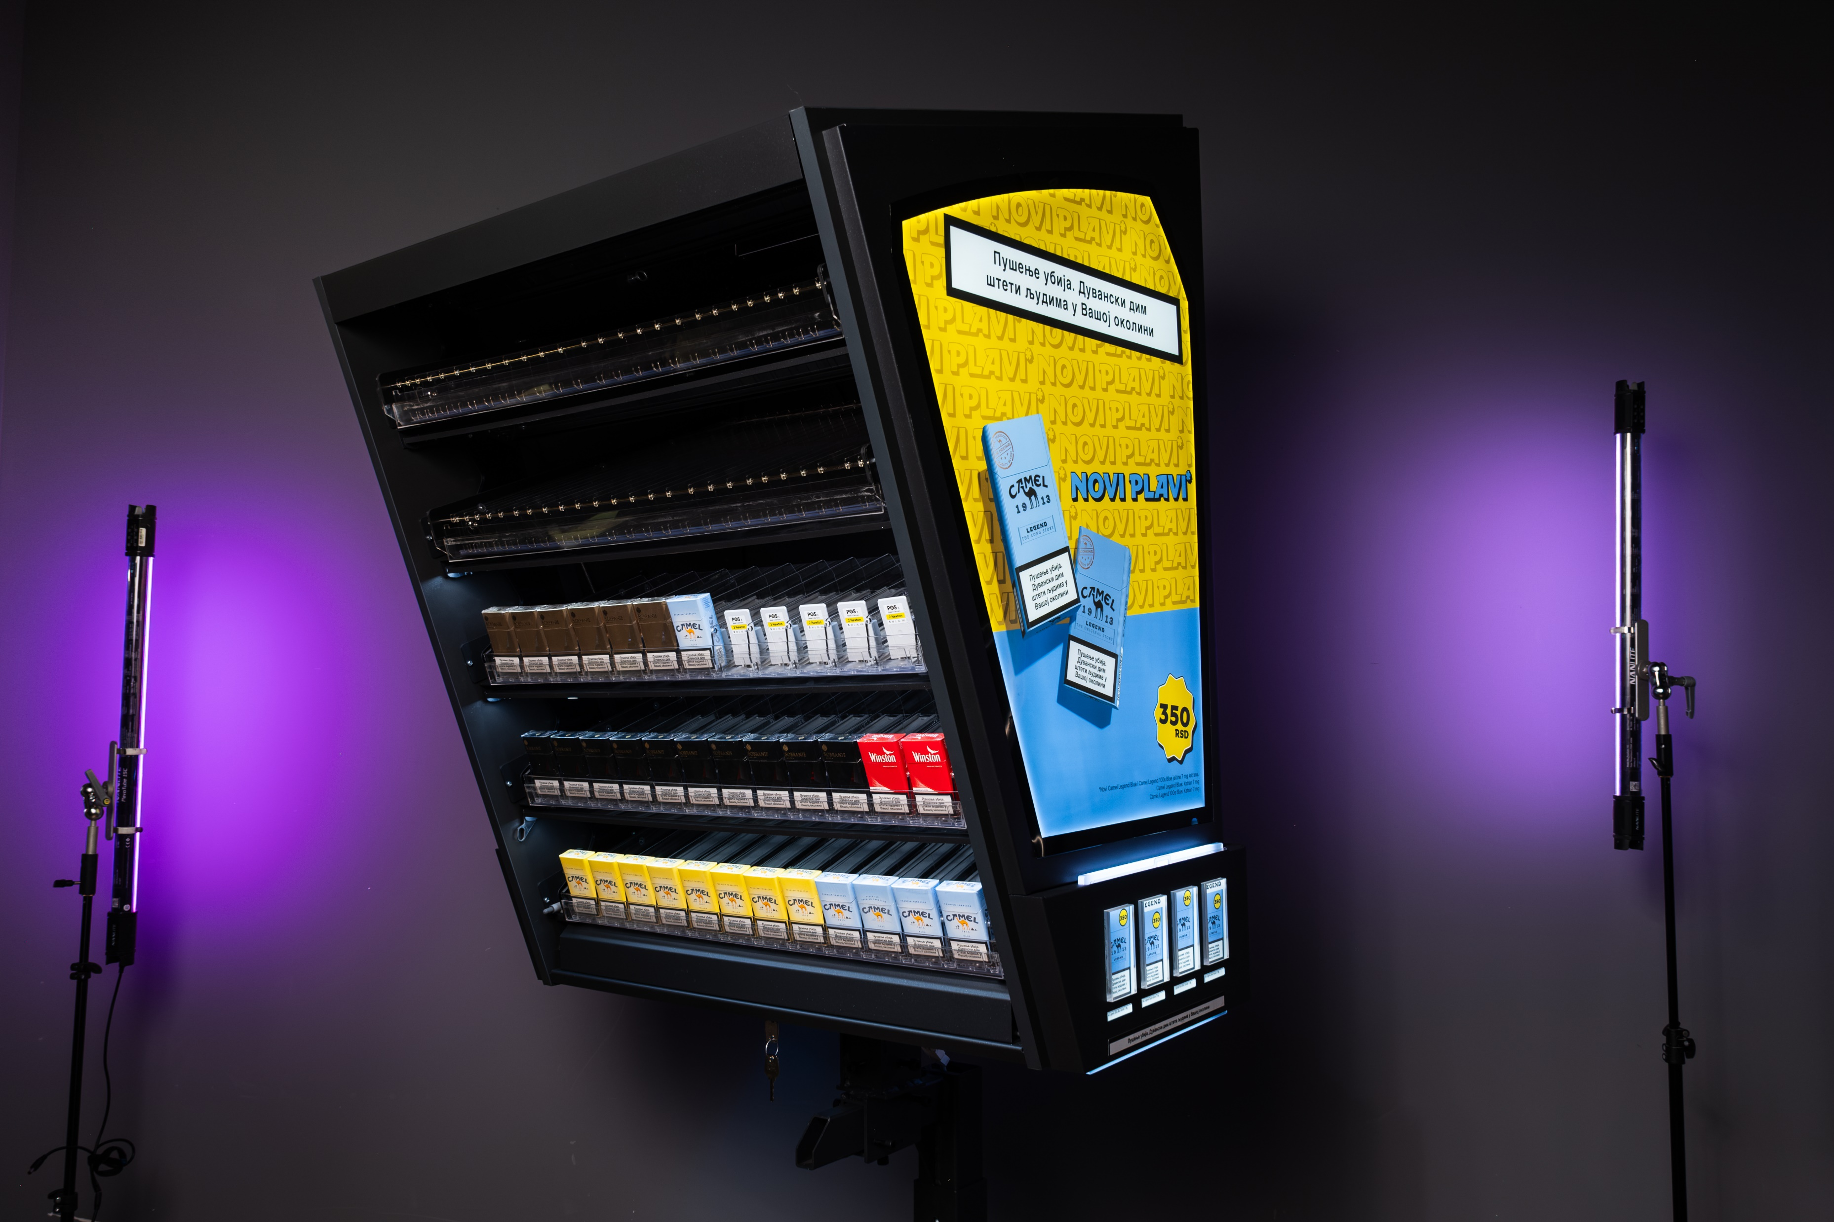

Slide 7
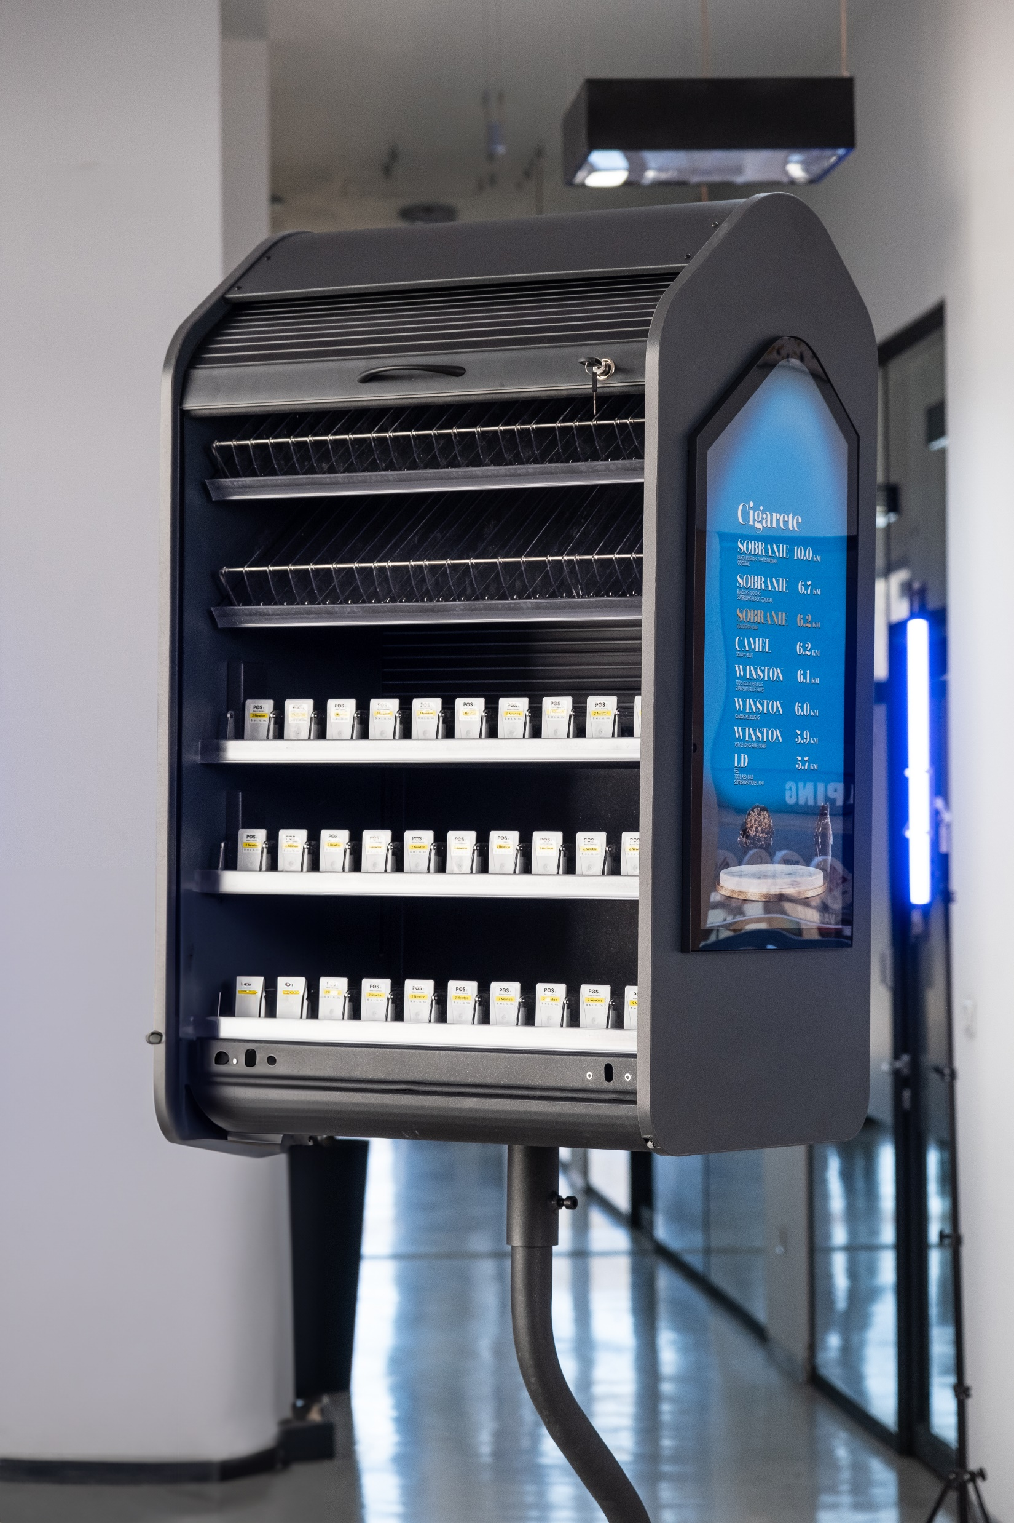
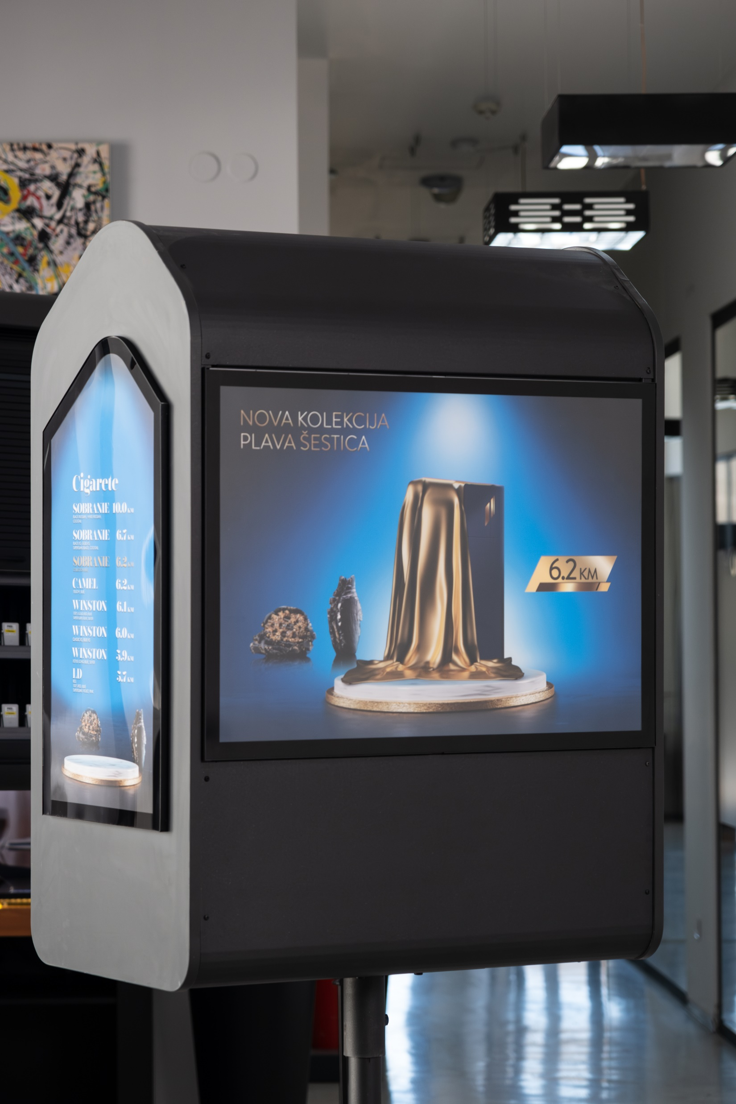

Slide 8
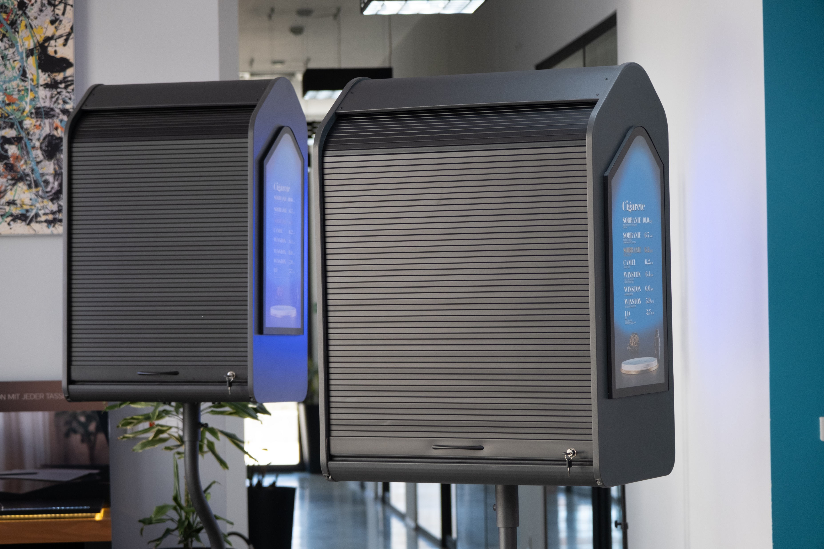

Slide 9
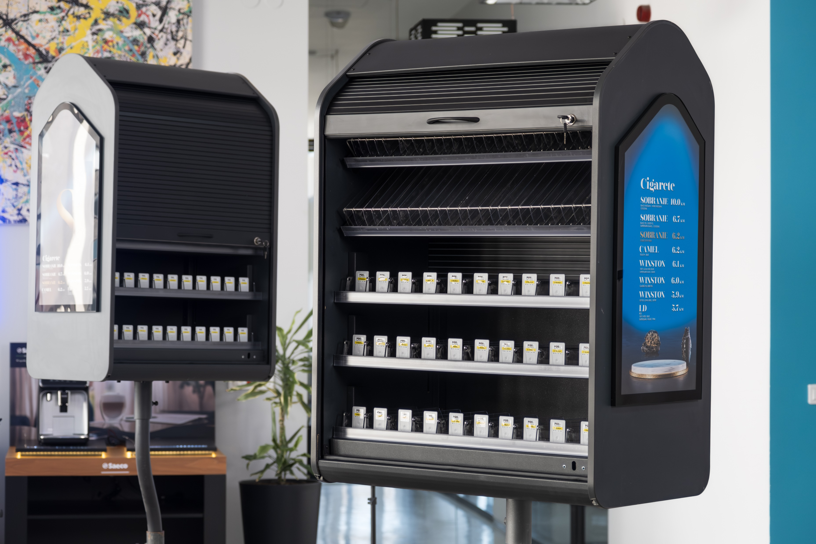

Slide 10
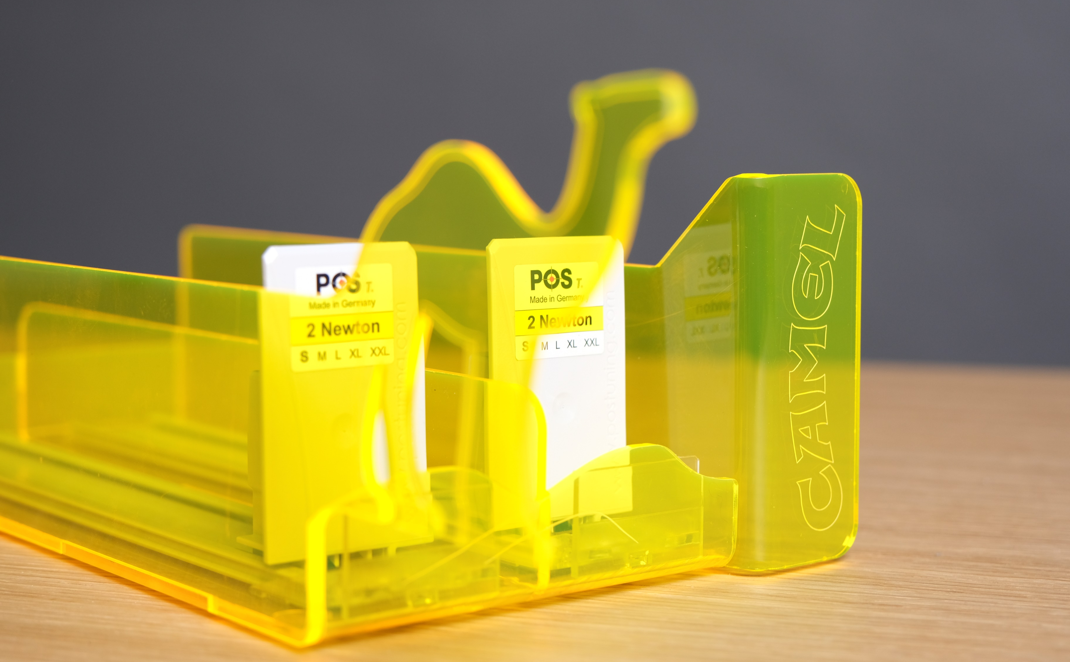

Slide 11
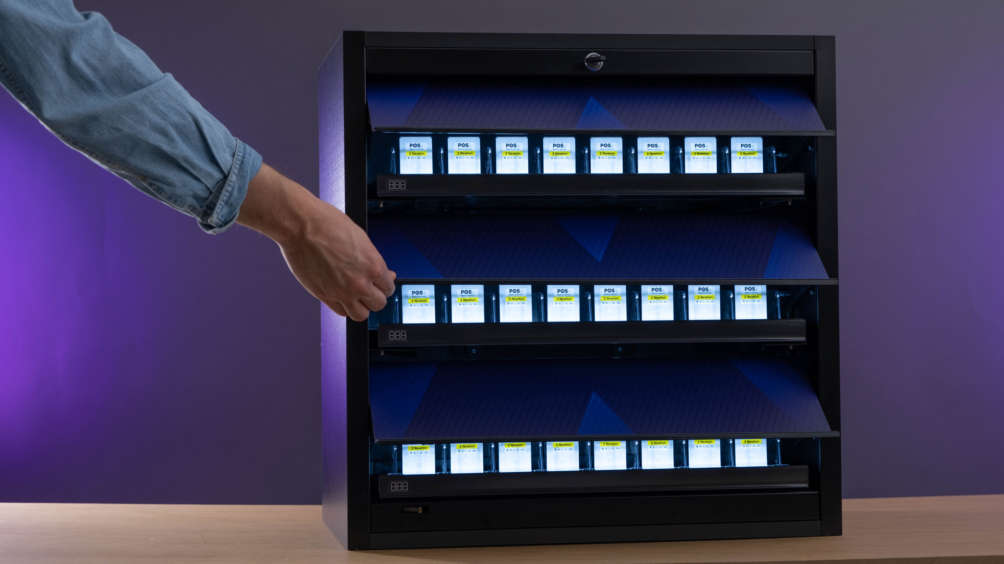

Slide 12
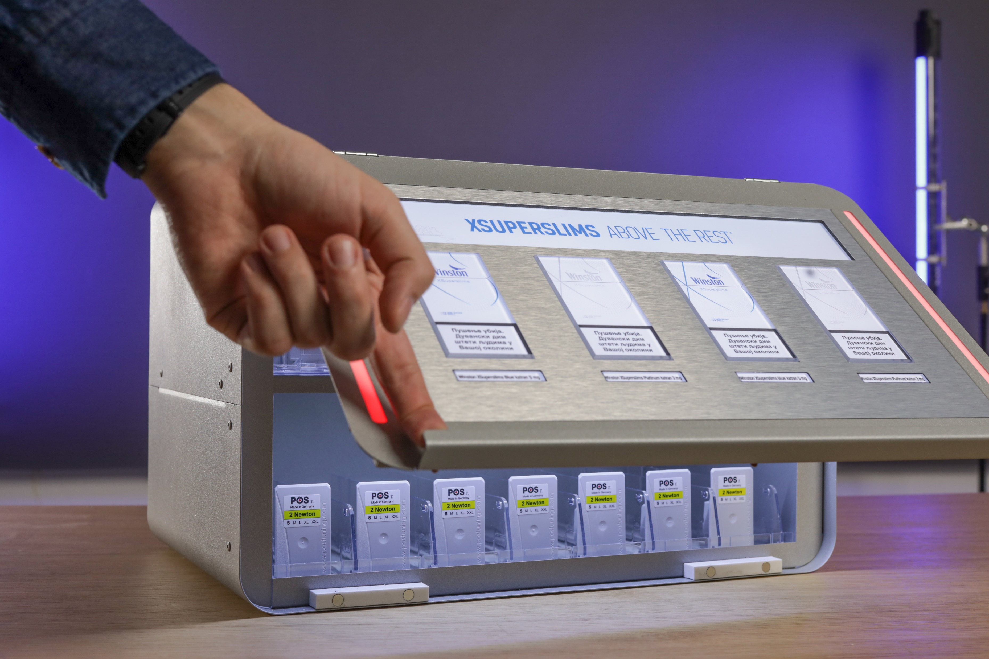

Slide 13
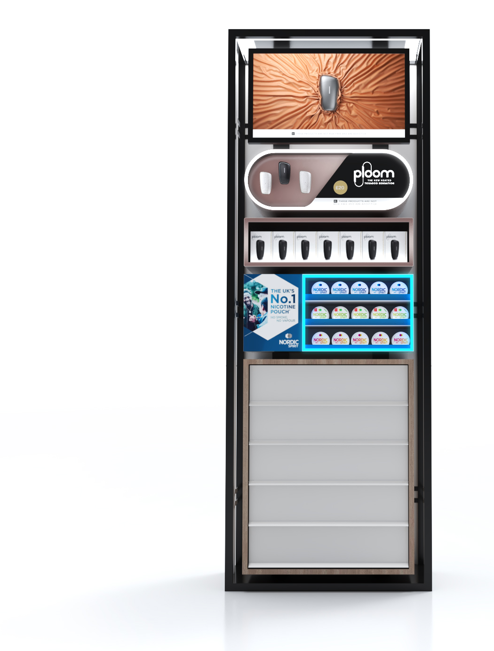
RRP
Displays
Our main goal is to create a visually striking displays that stand out among crowded stores and become instantly recognizable. Our displays must be versatile, easily adaptable and sustainable.

Slide 14


DISPLAYS
PRODUCED
Innovative Solutions in Action: Highlighting Designs that Made the Production for Impactful ploom Displays

Slide 15

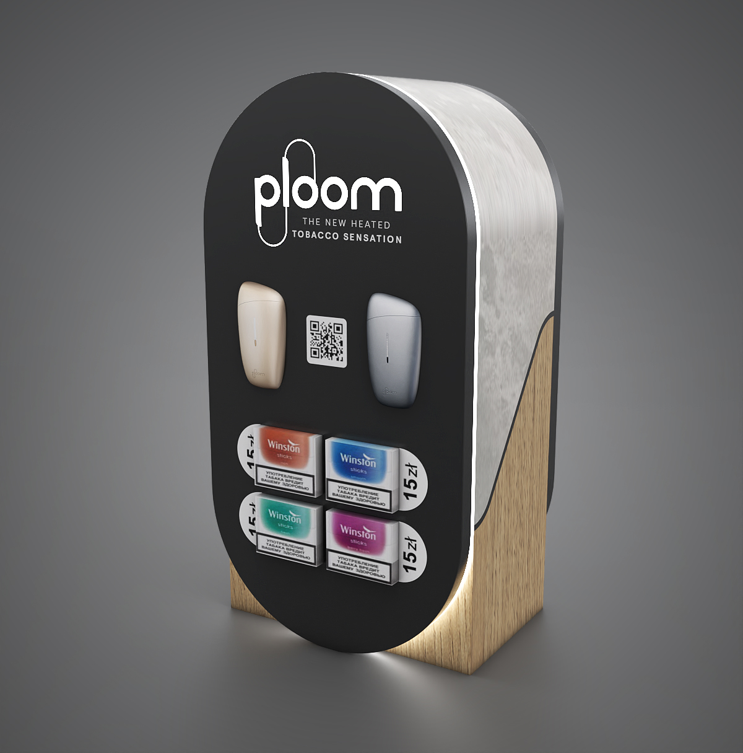
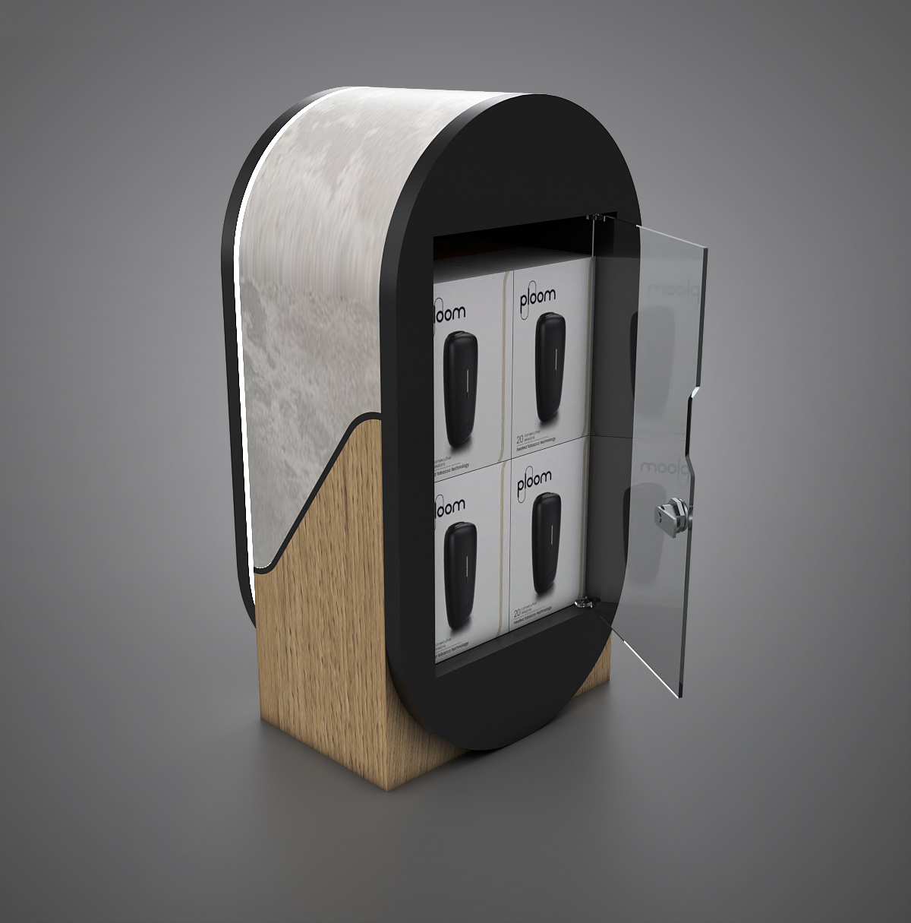


Slide 16
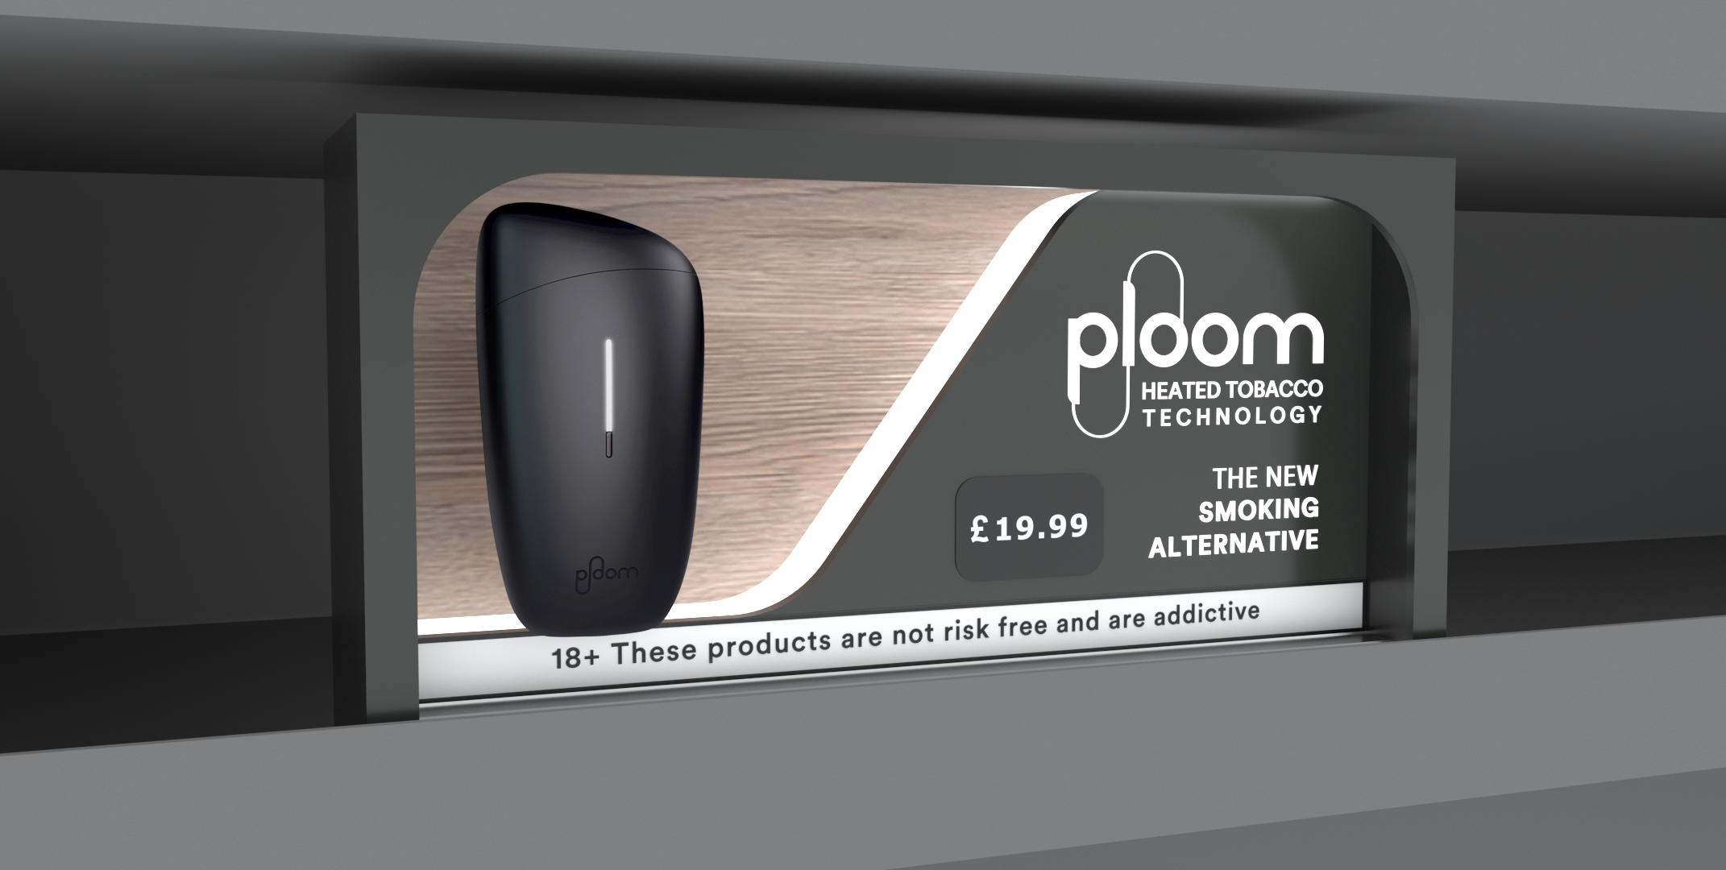

Slide 17
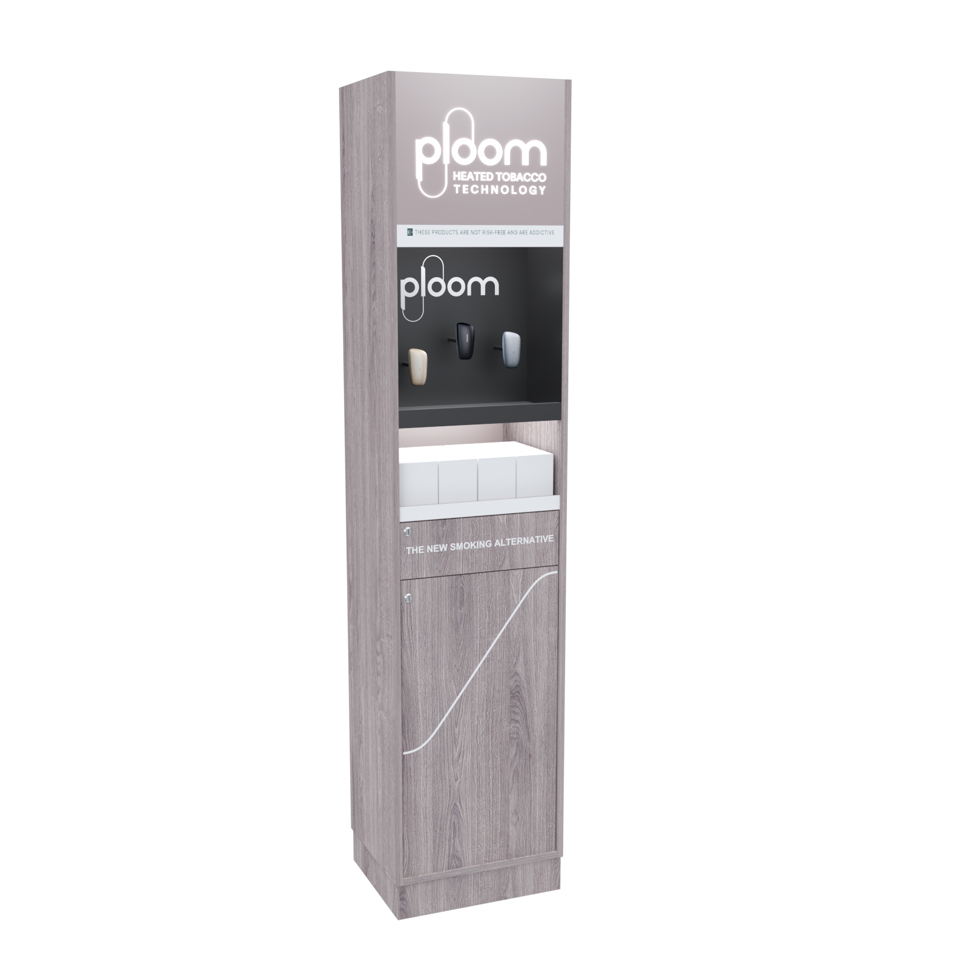
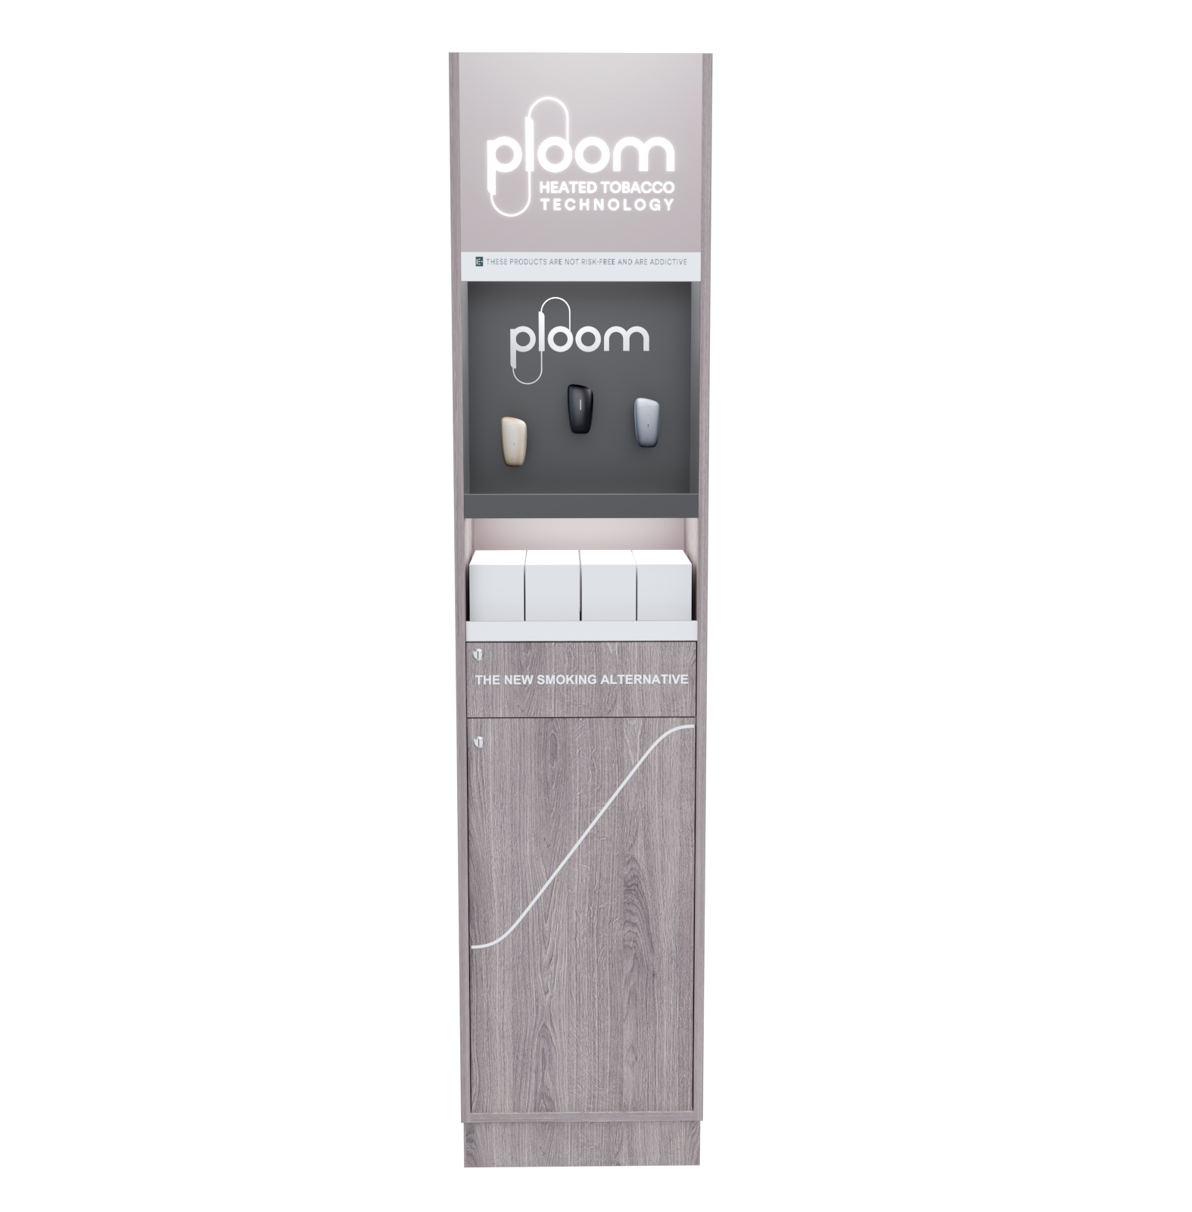

Slide 18
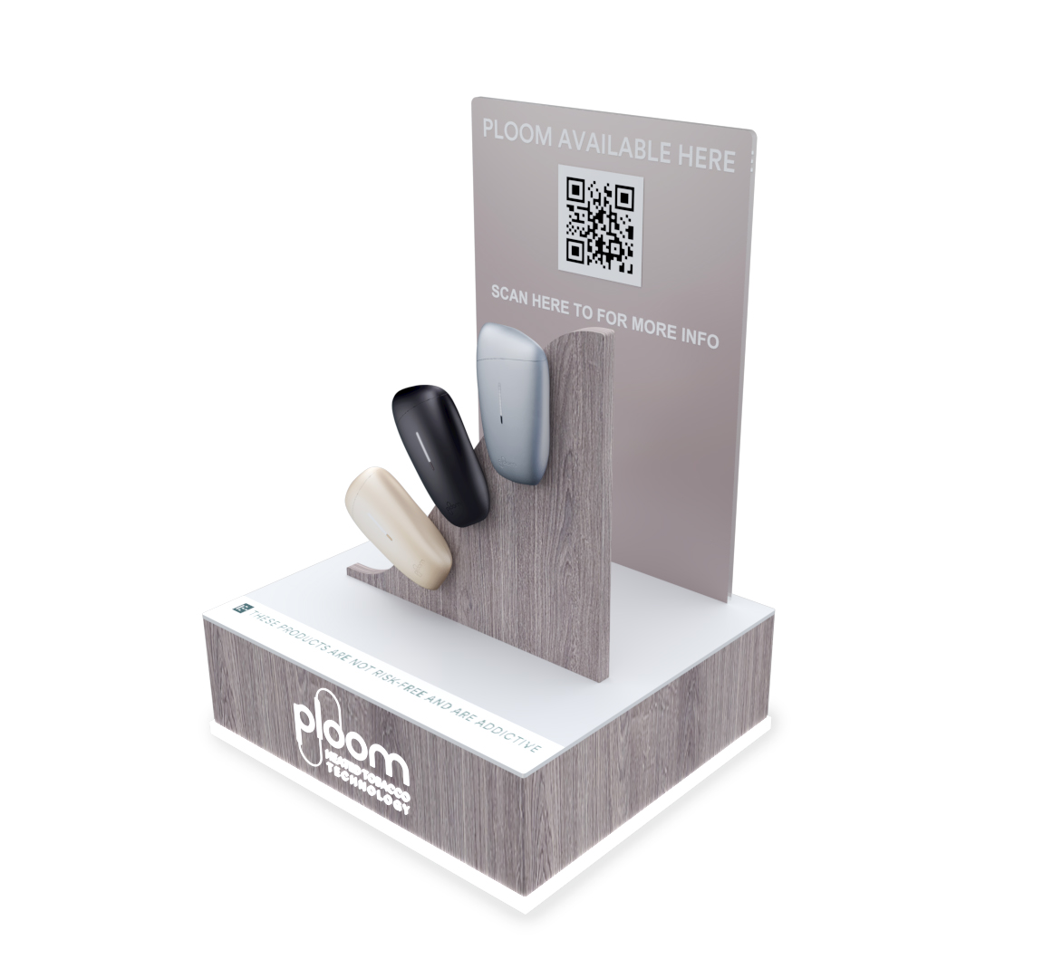
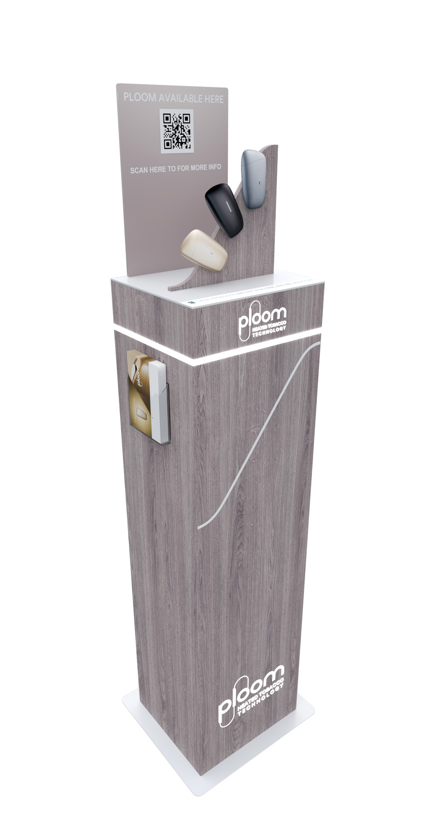

Slide 19
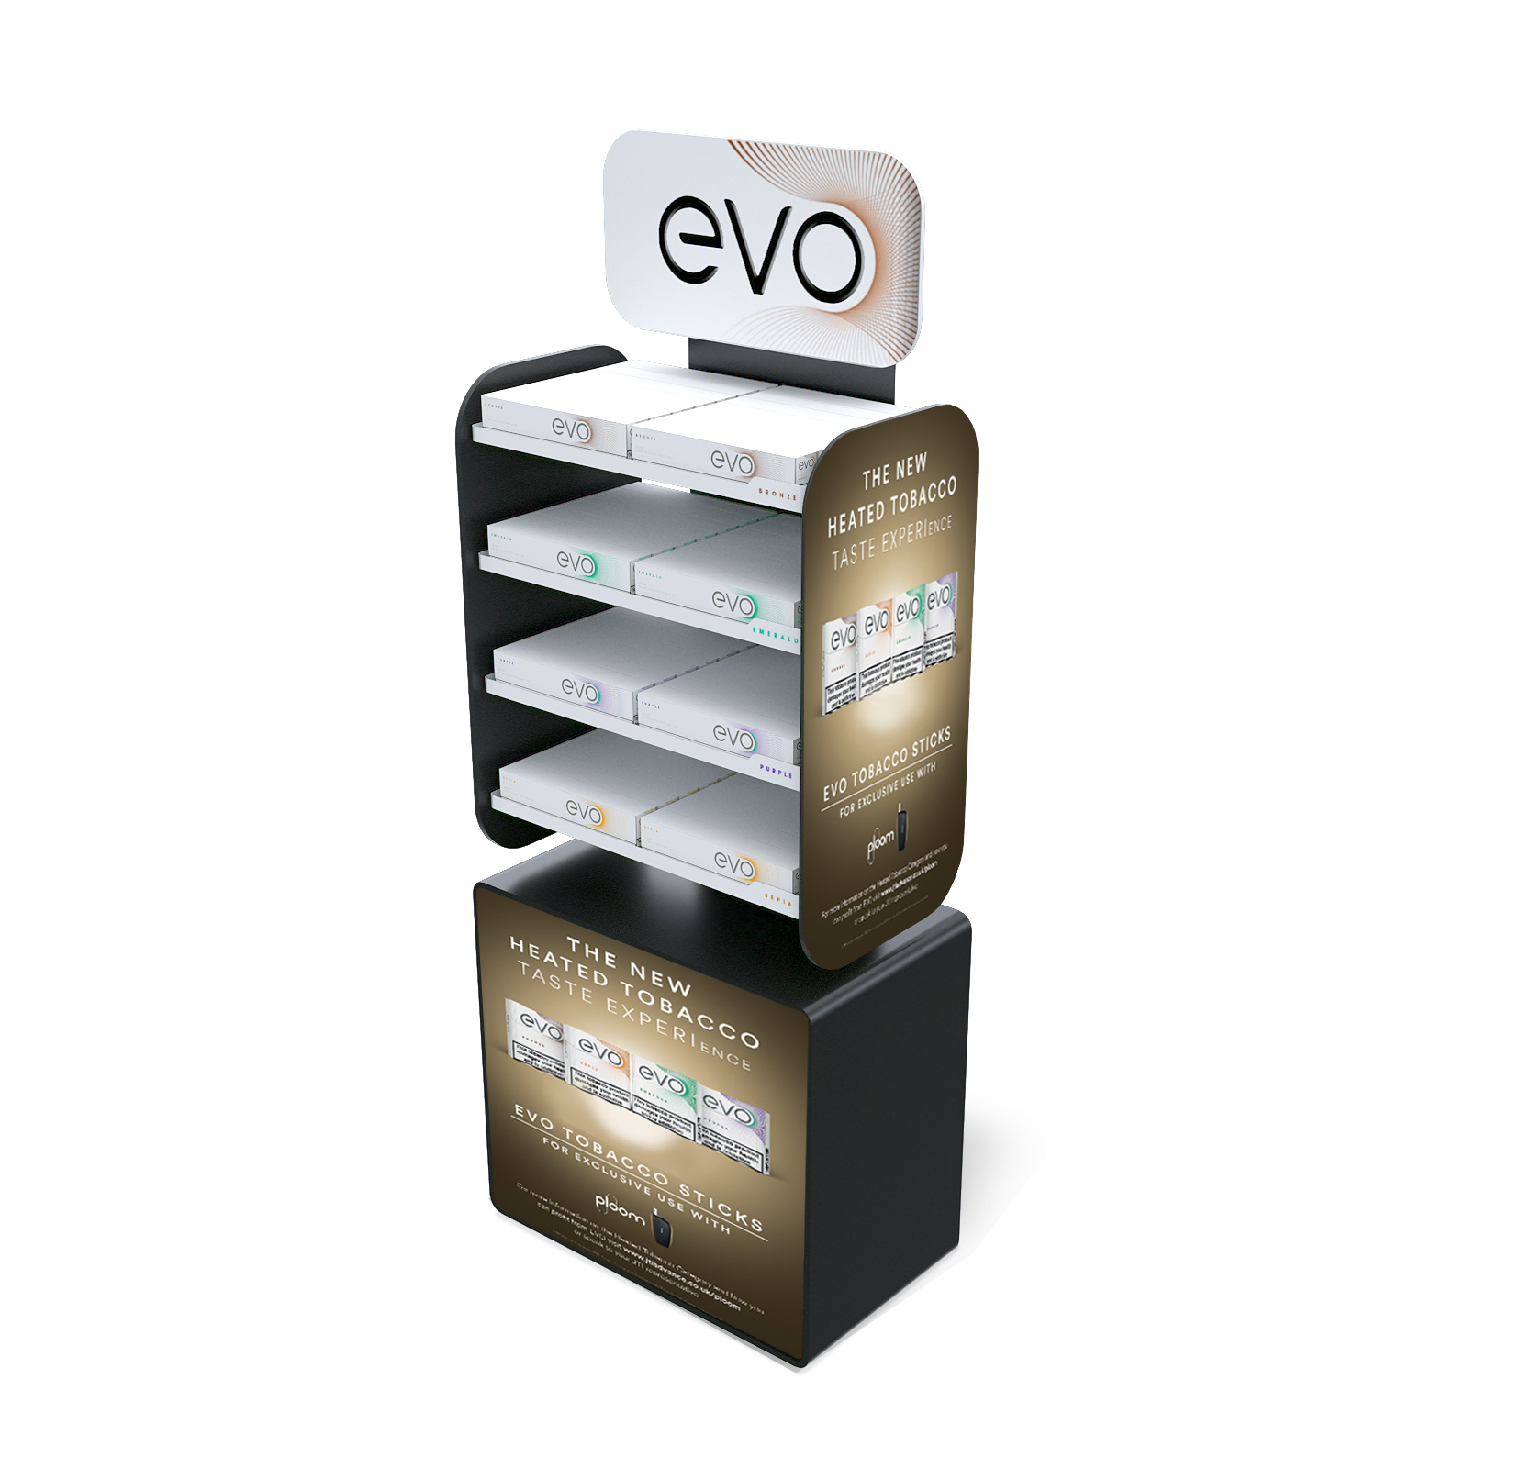

Slide 20
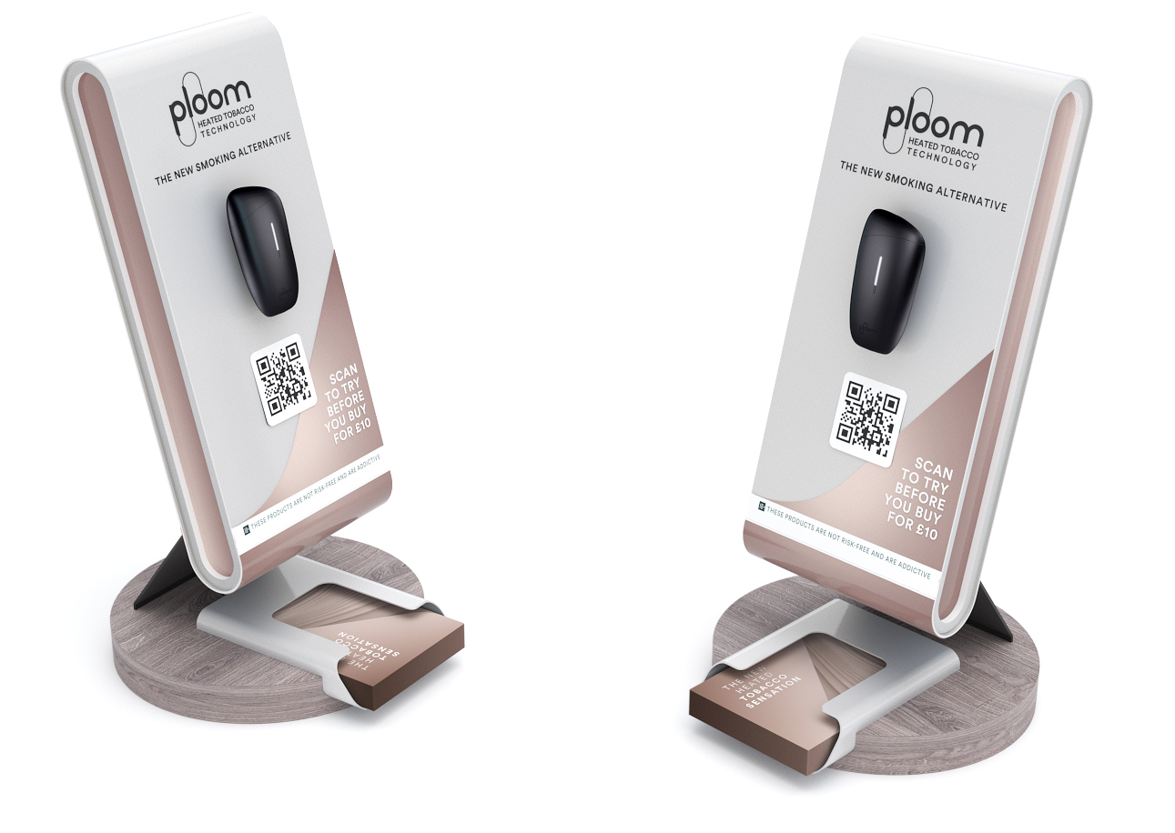

Slide 21
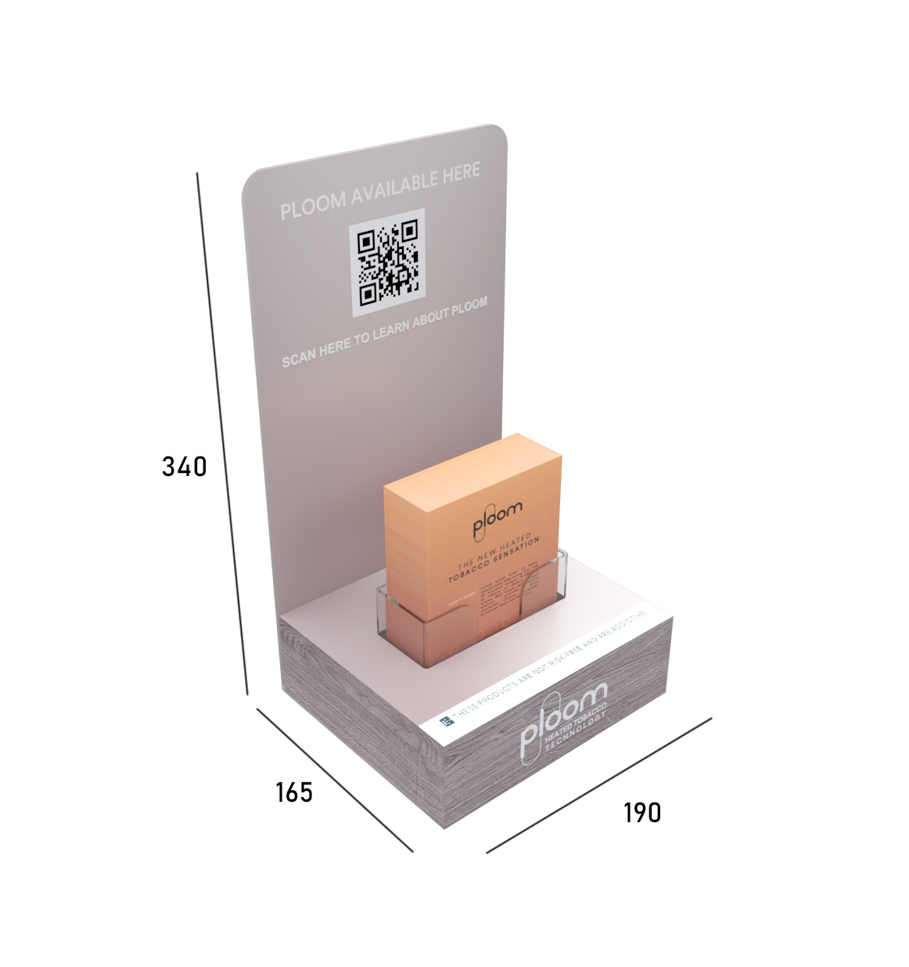
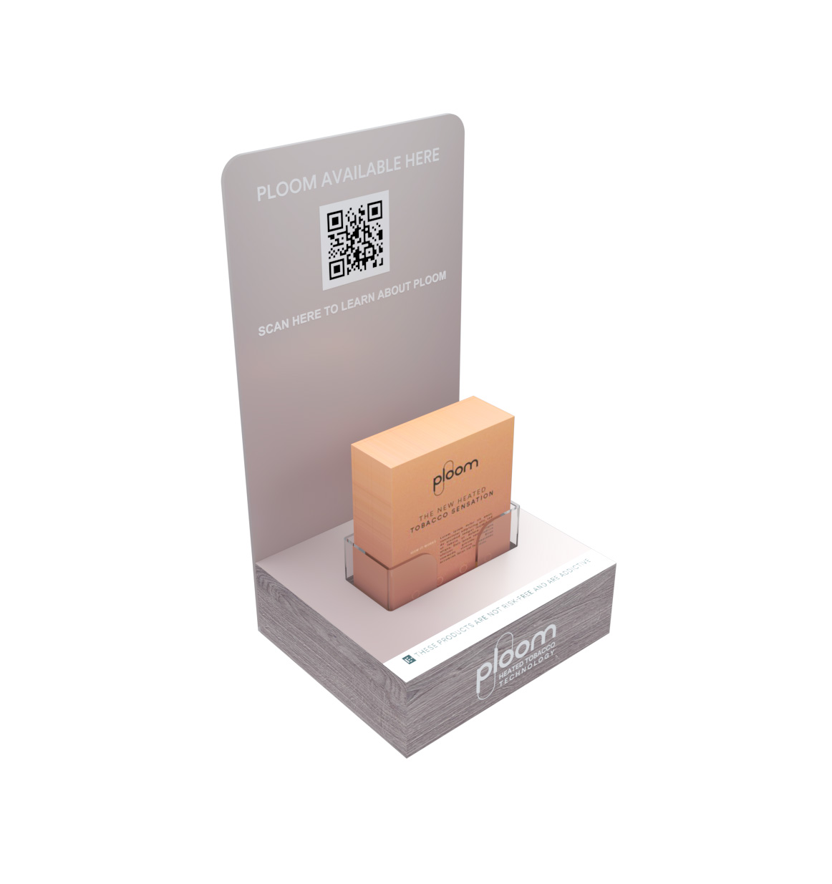

Slide 22

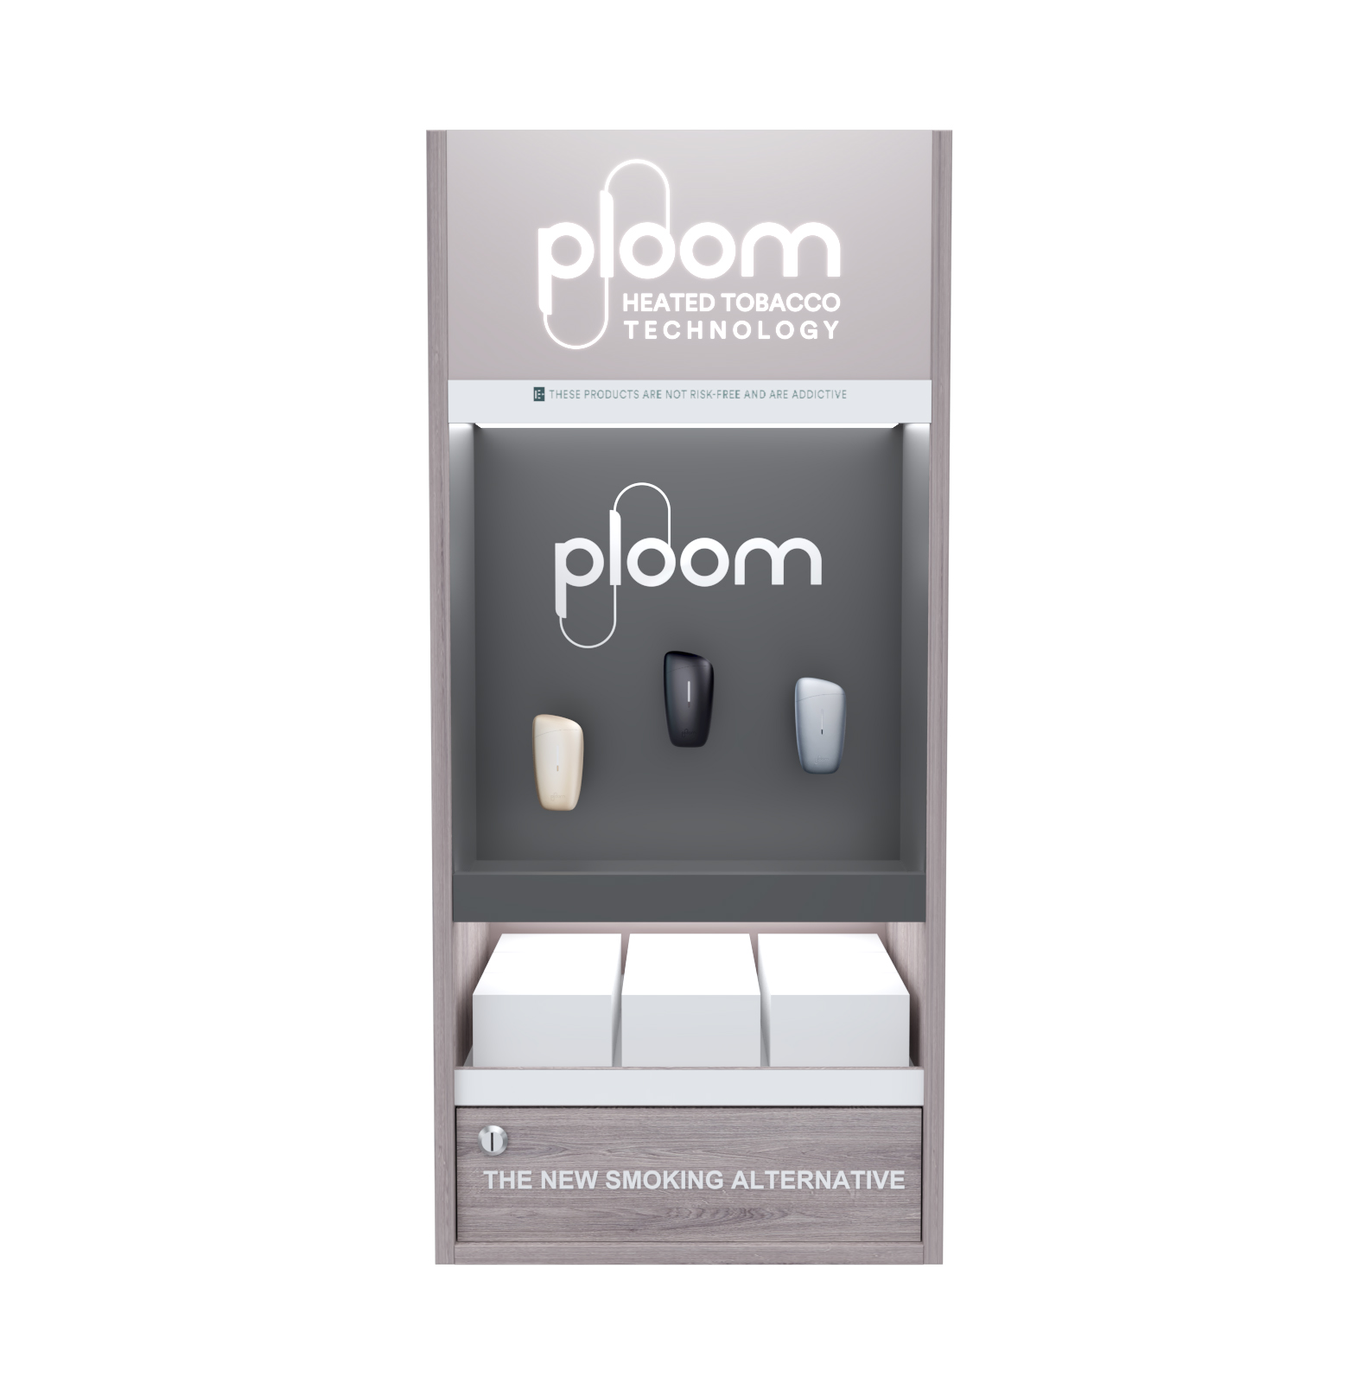

Slide 23
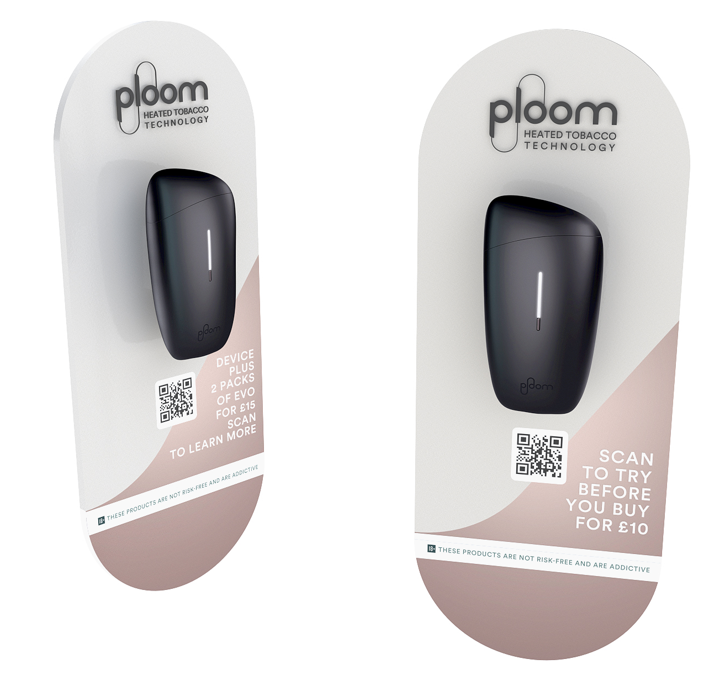
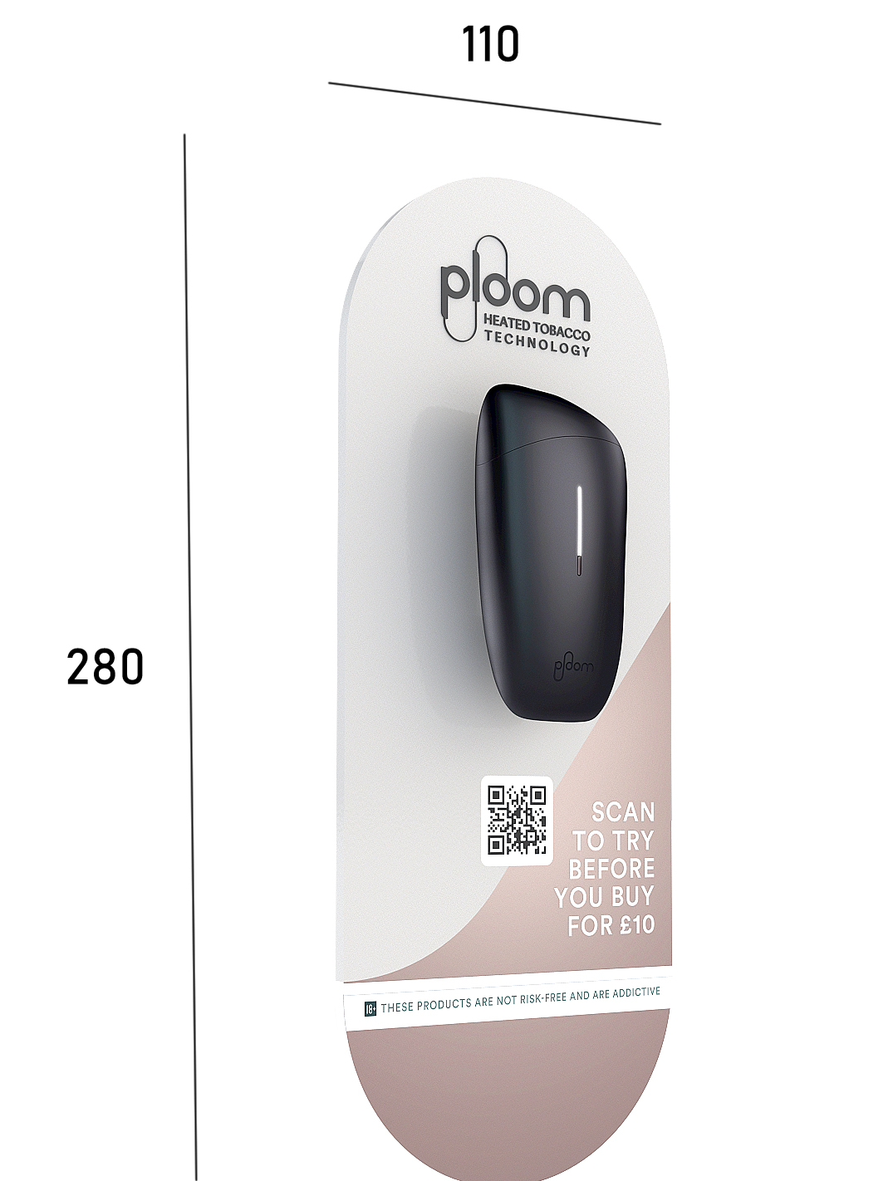

Slide 24
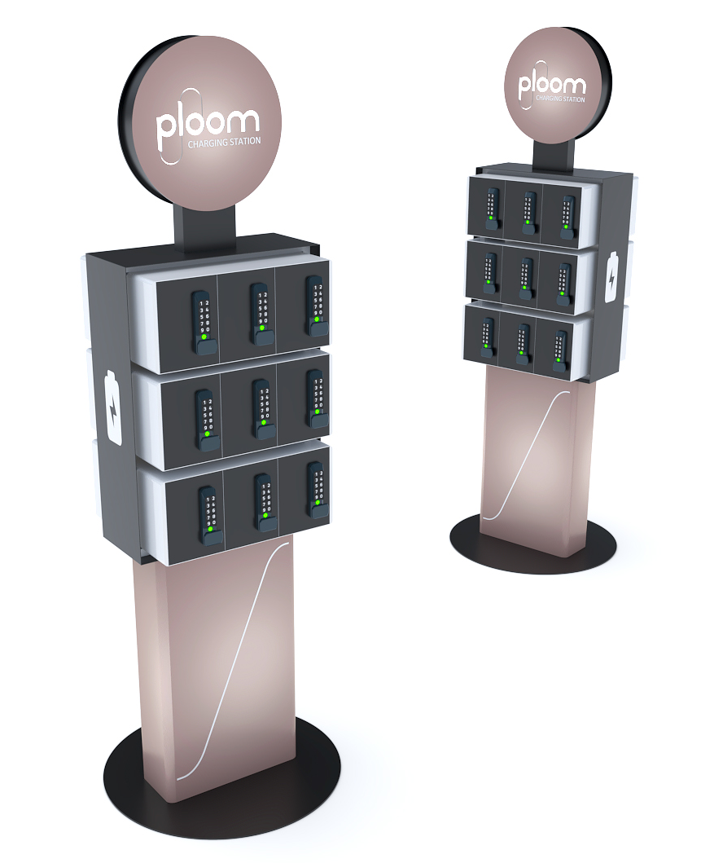
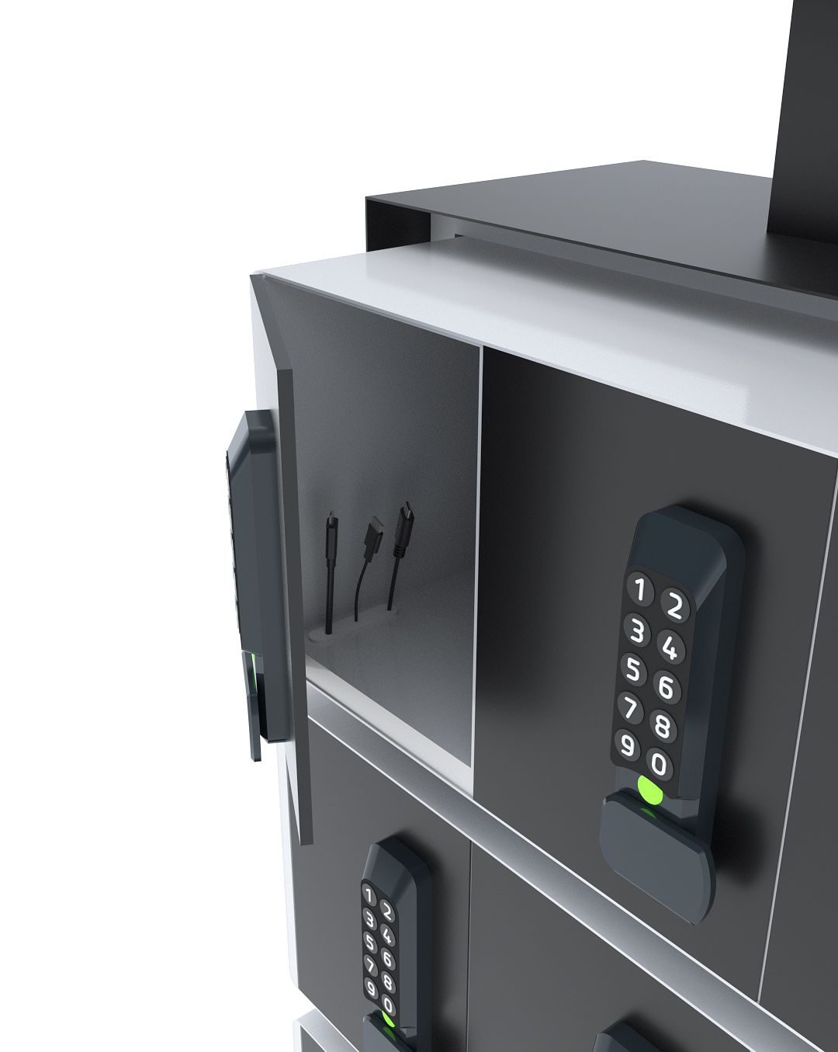

Slide 25

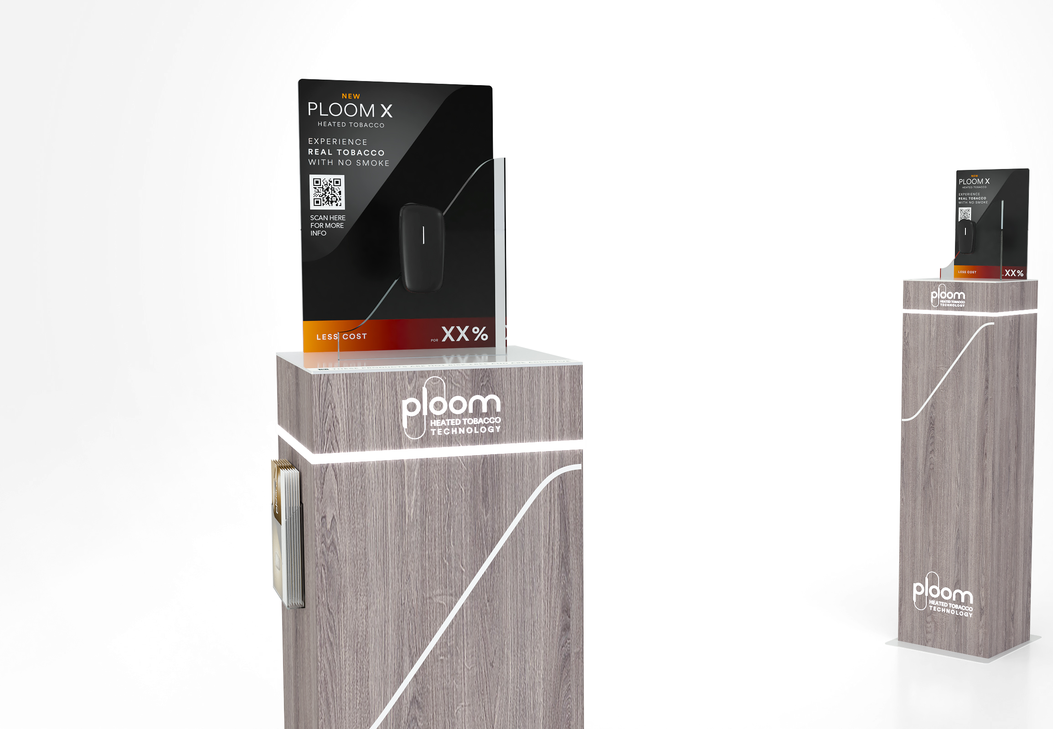
DESIGN
CONCEPTS
Unlocking Creativity: Exploring Innovative Design Concepts for Captivating POSM Displays

Slide 26
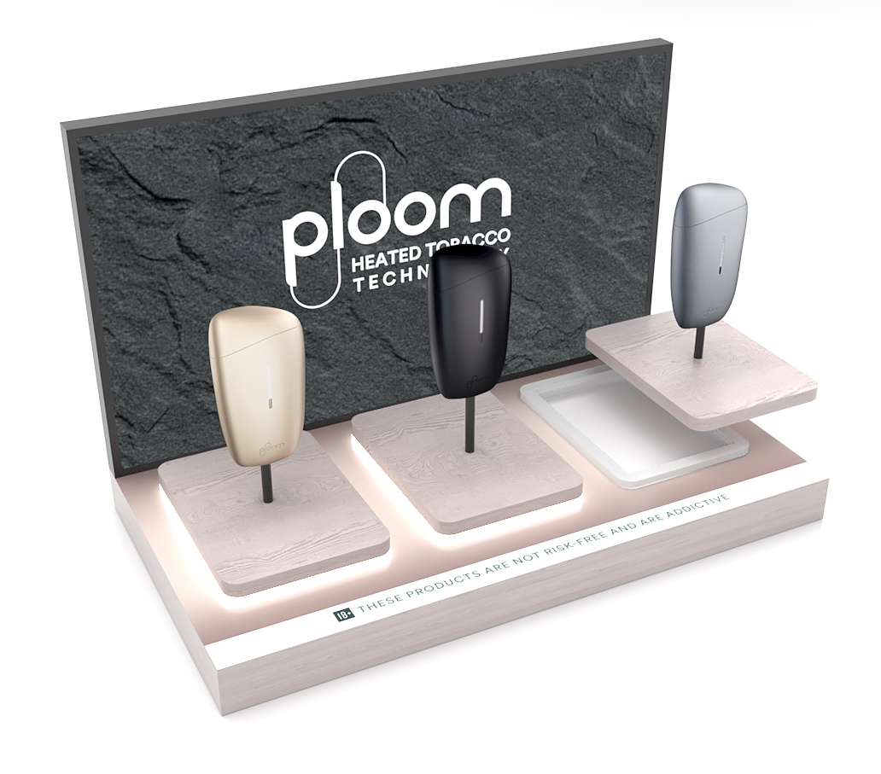

Slide 27
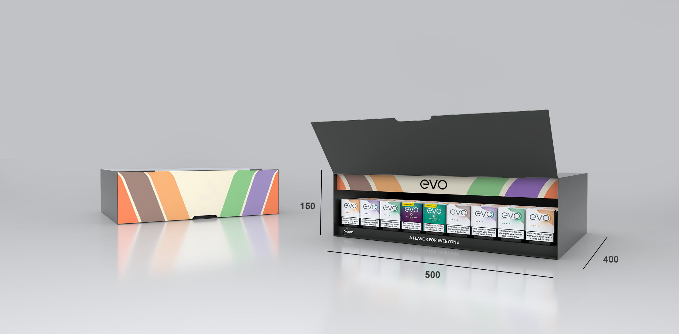


Slide 28

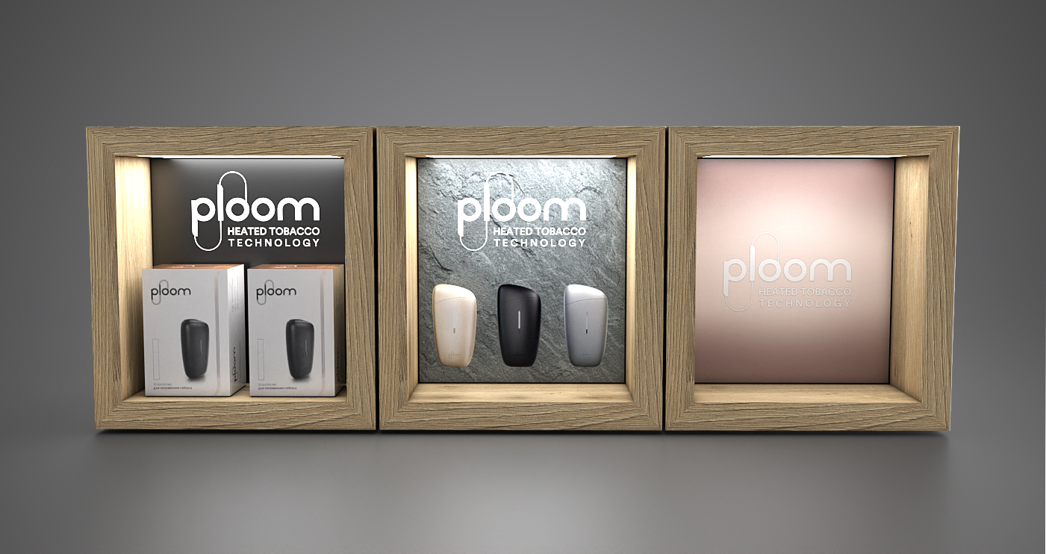

Slide 29
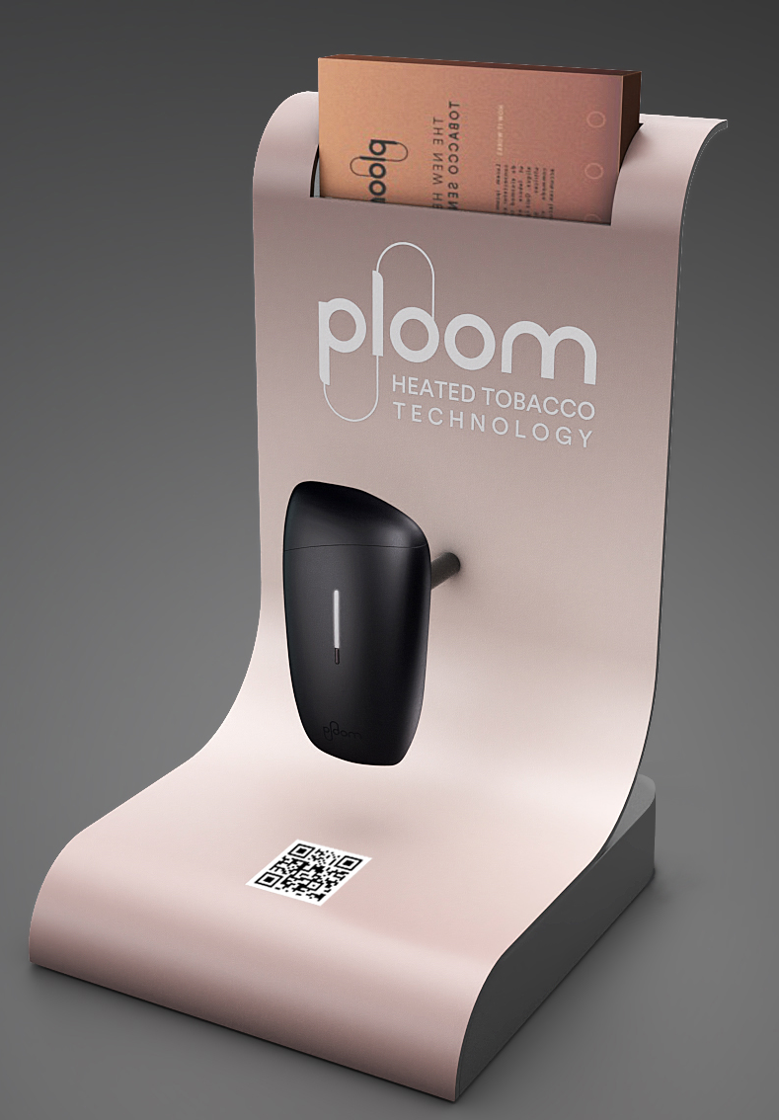

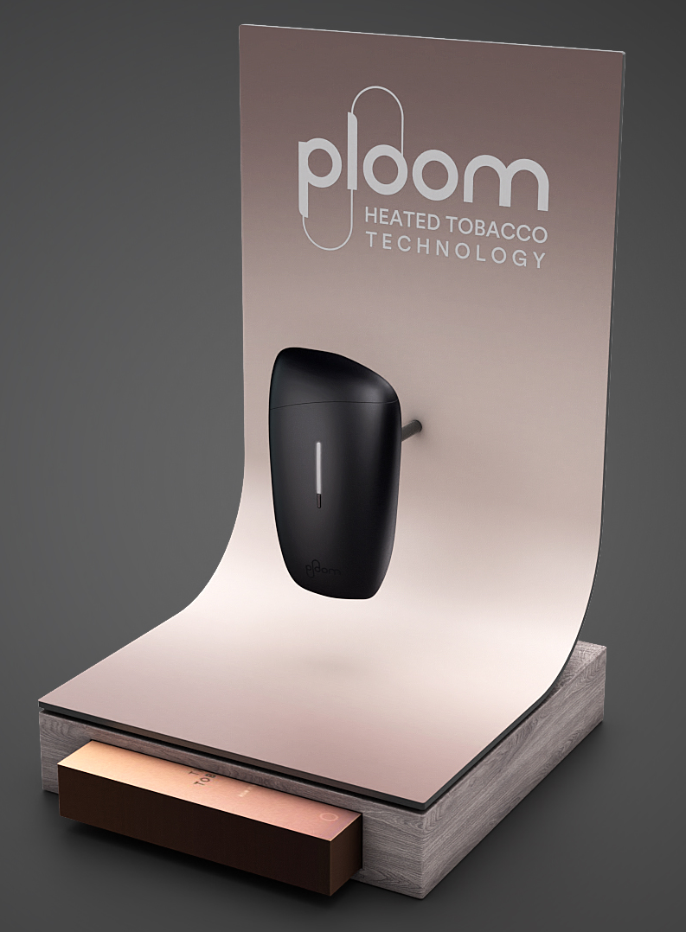

Slide 30
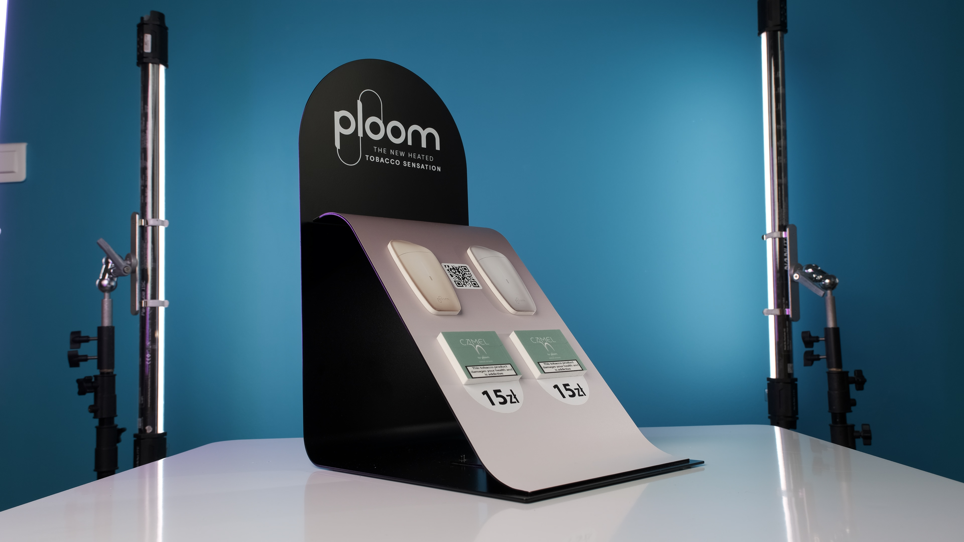

Slide 31
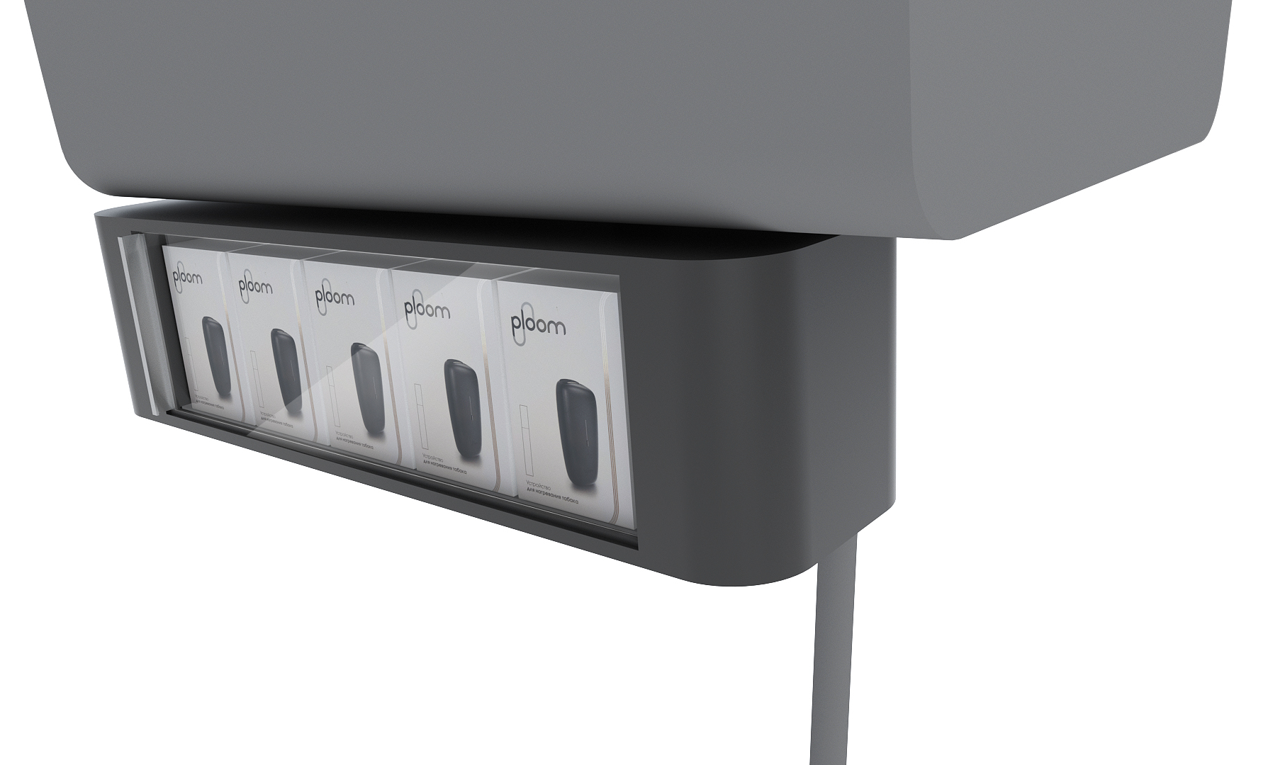
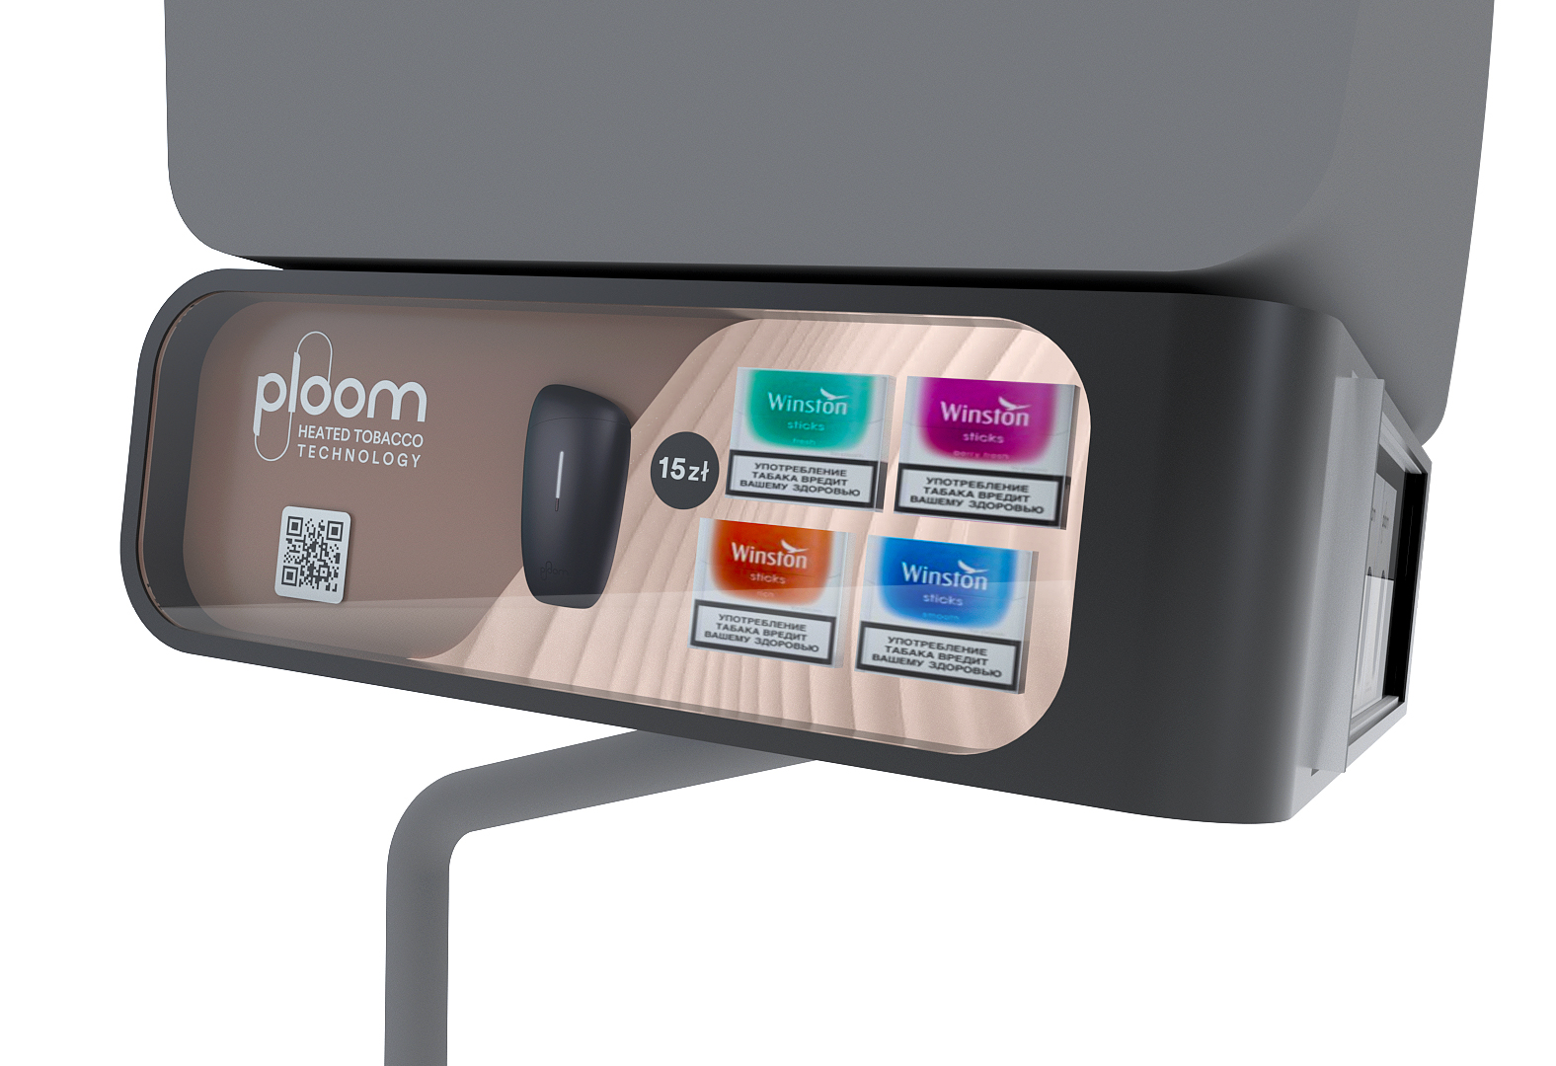
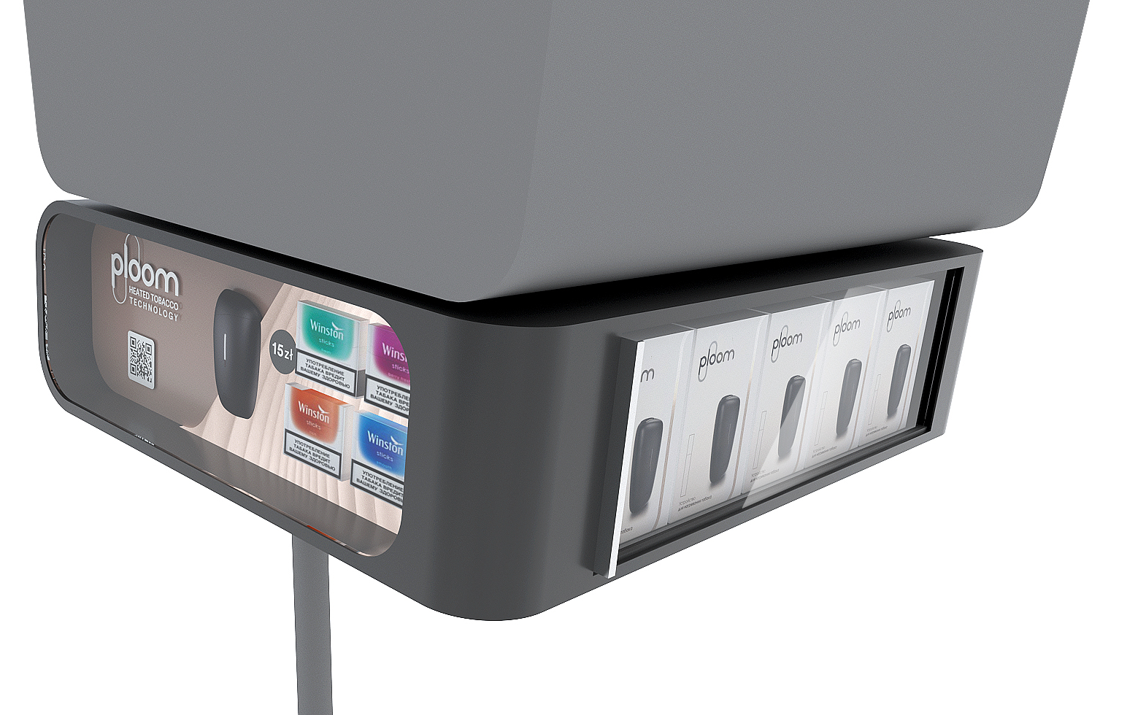
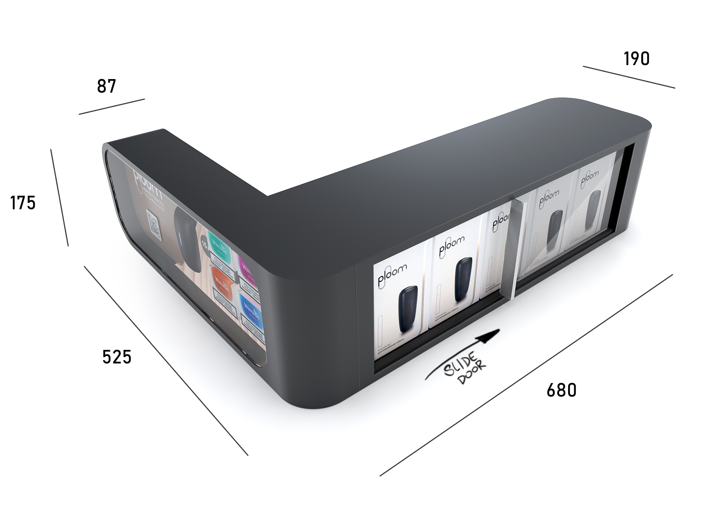

Slide 32
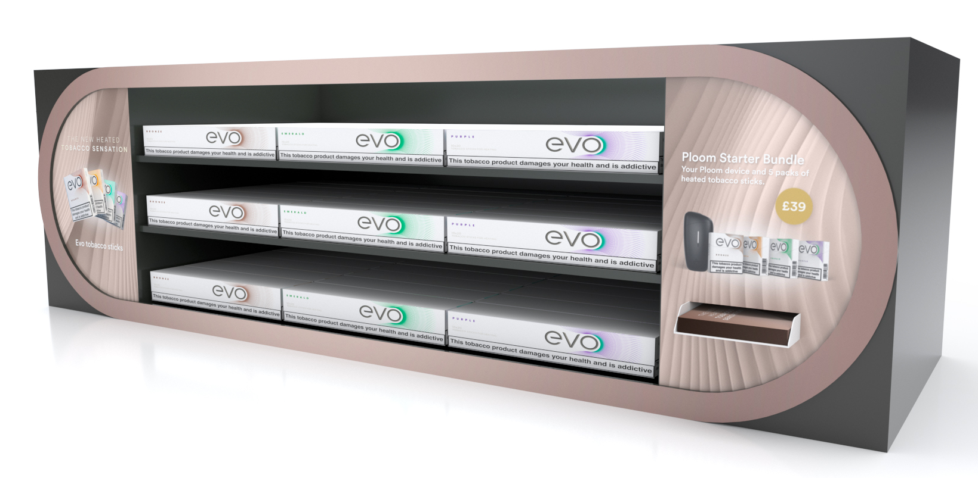

Slide 33
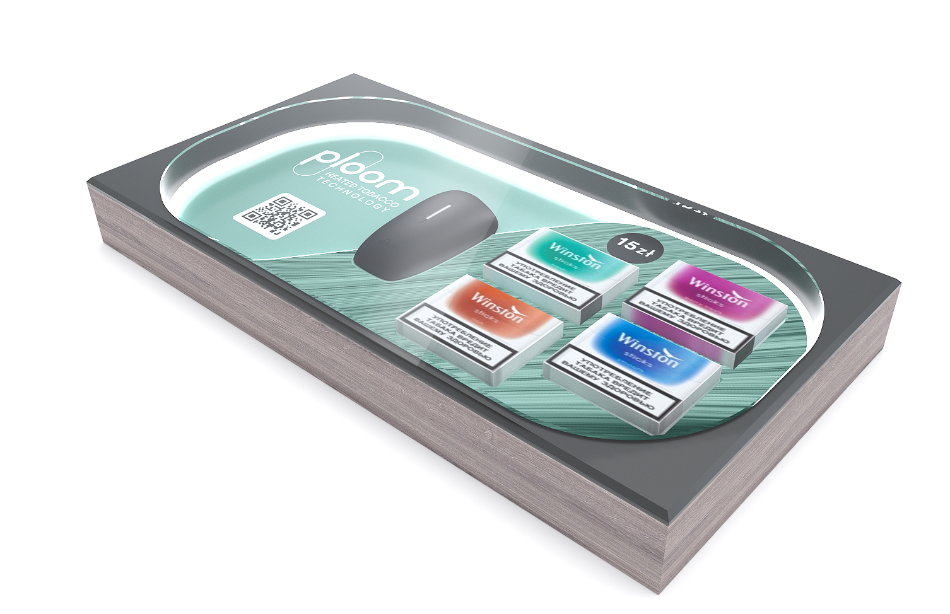
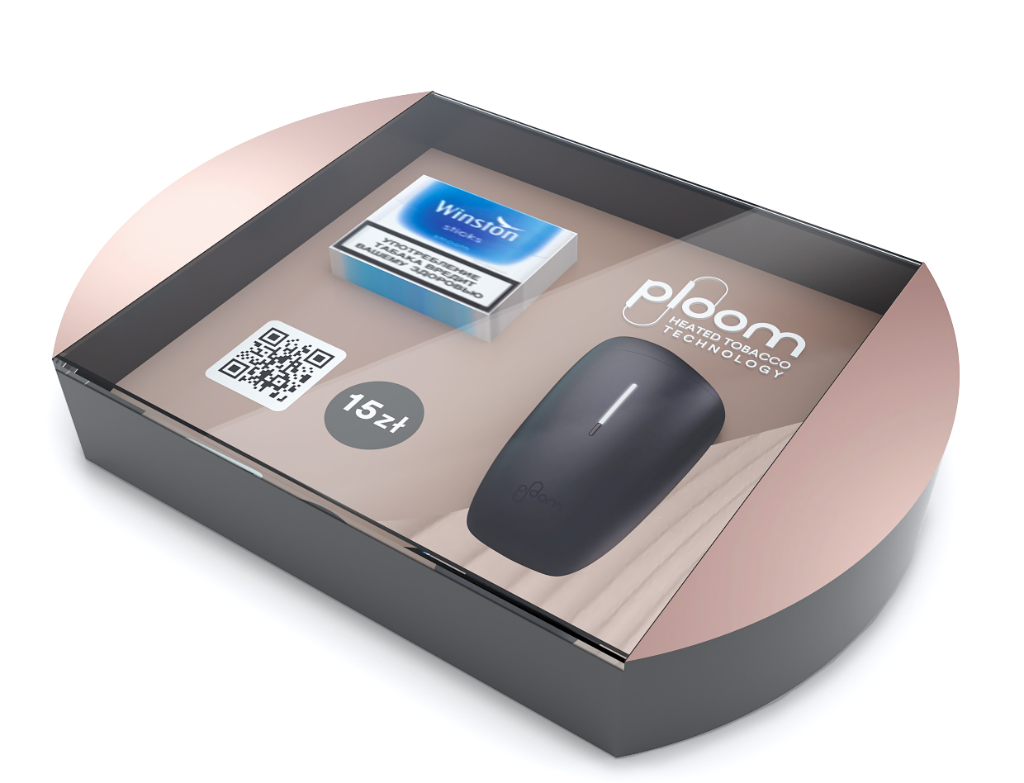
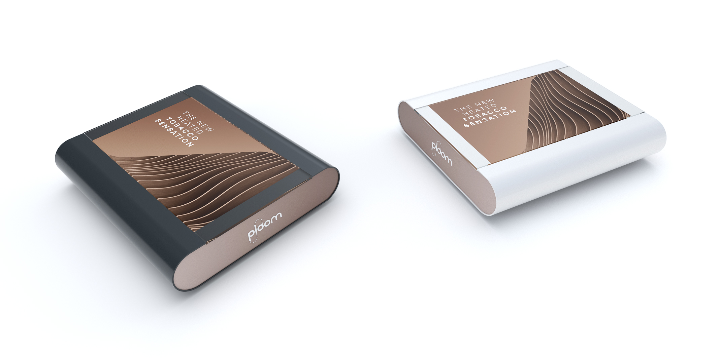

Slide 34
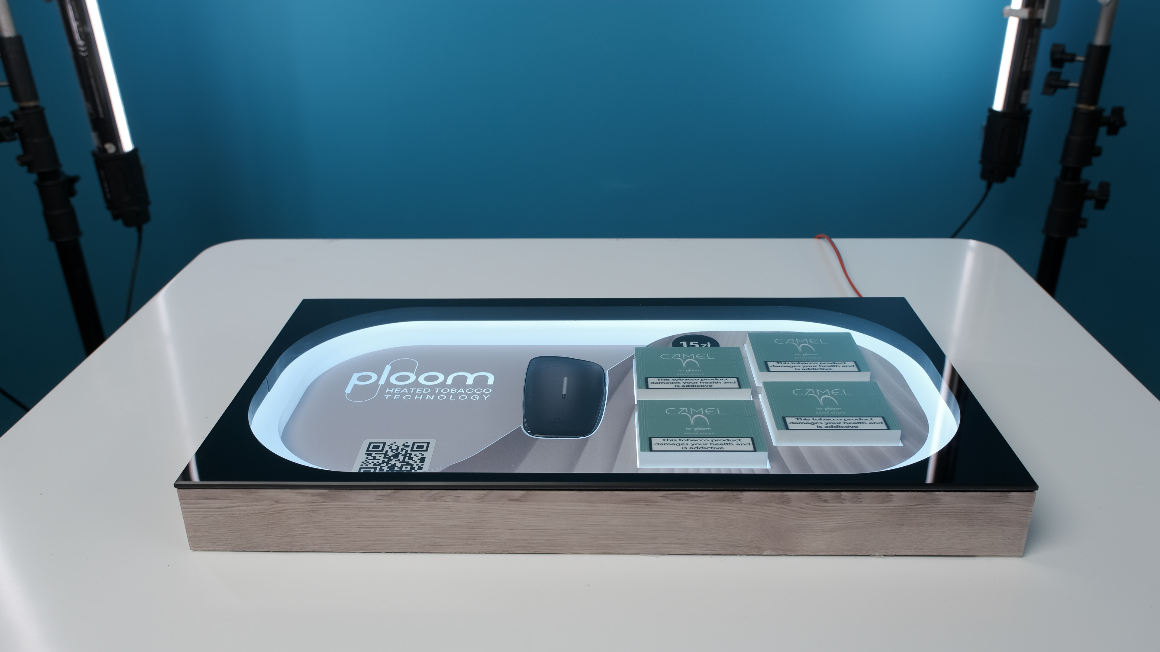

Slide 35
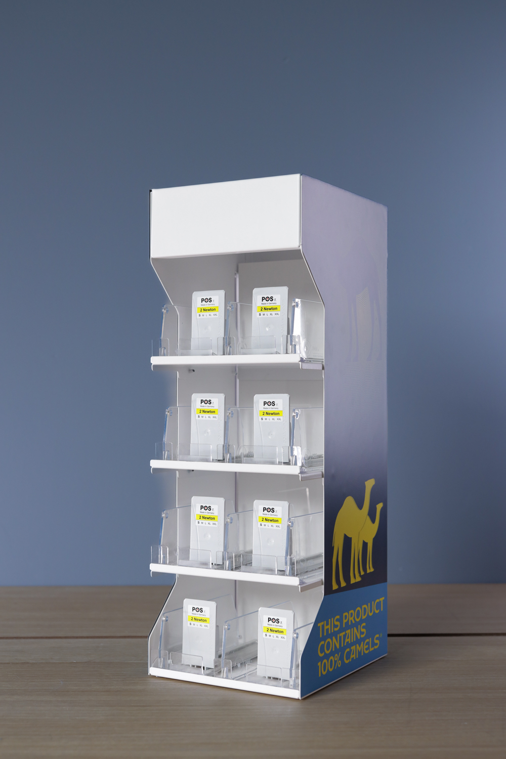
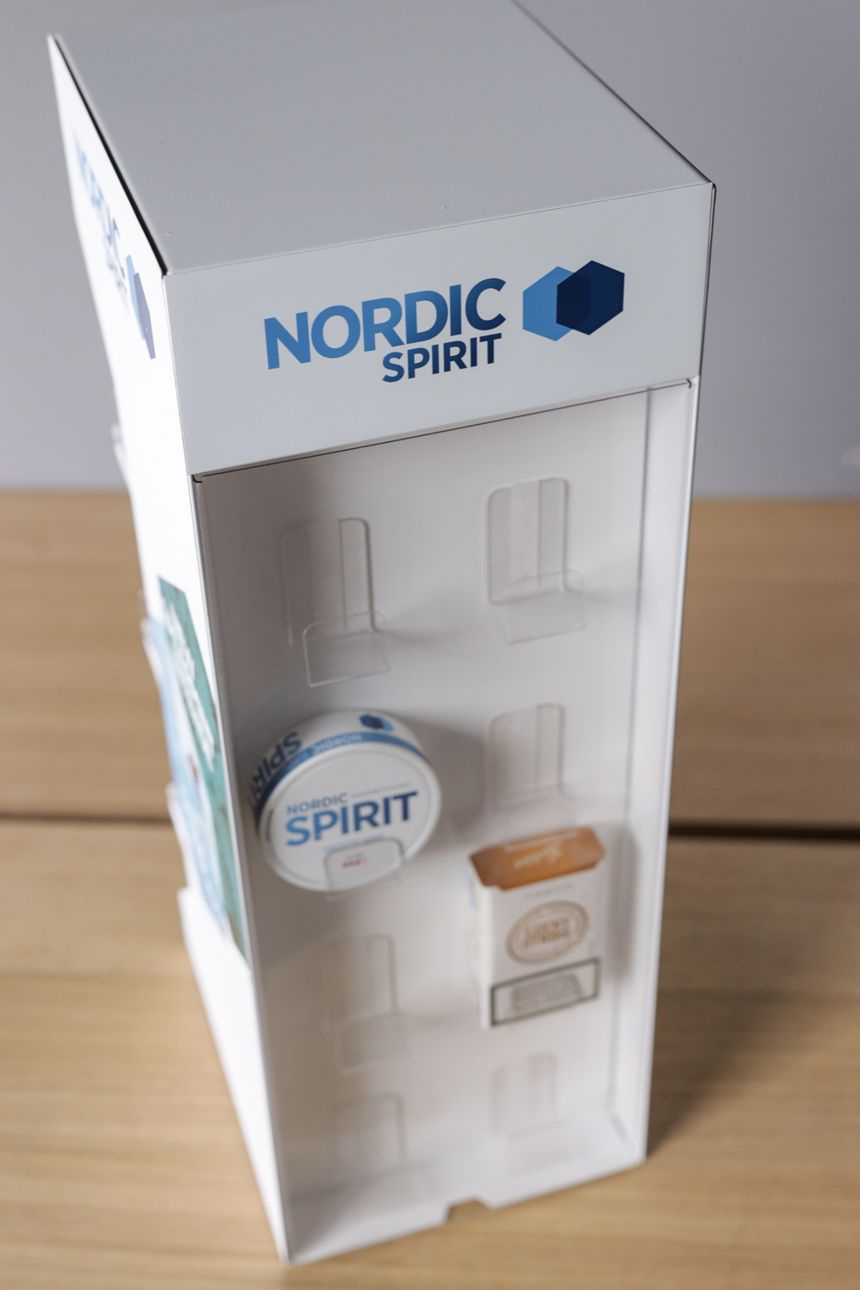
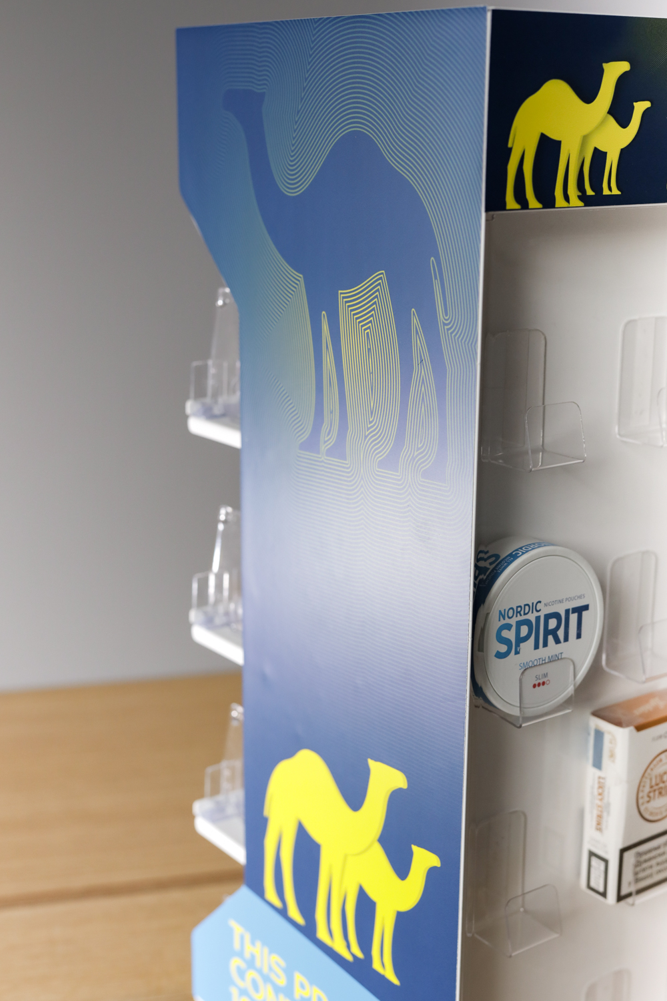

Slide 36


Slide 37
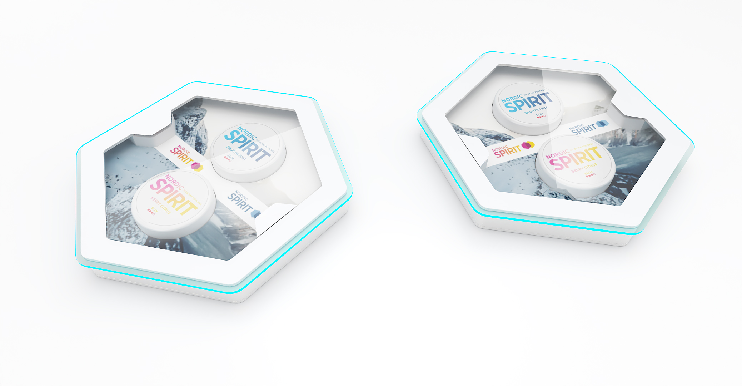

Slide 38
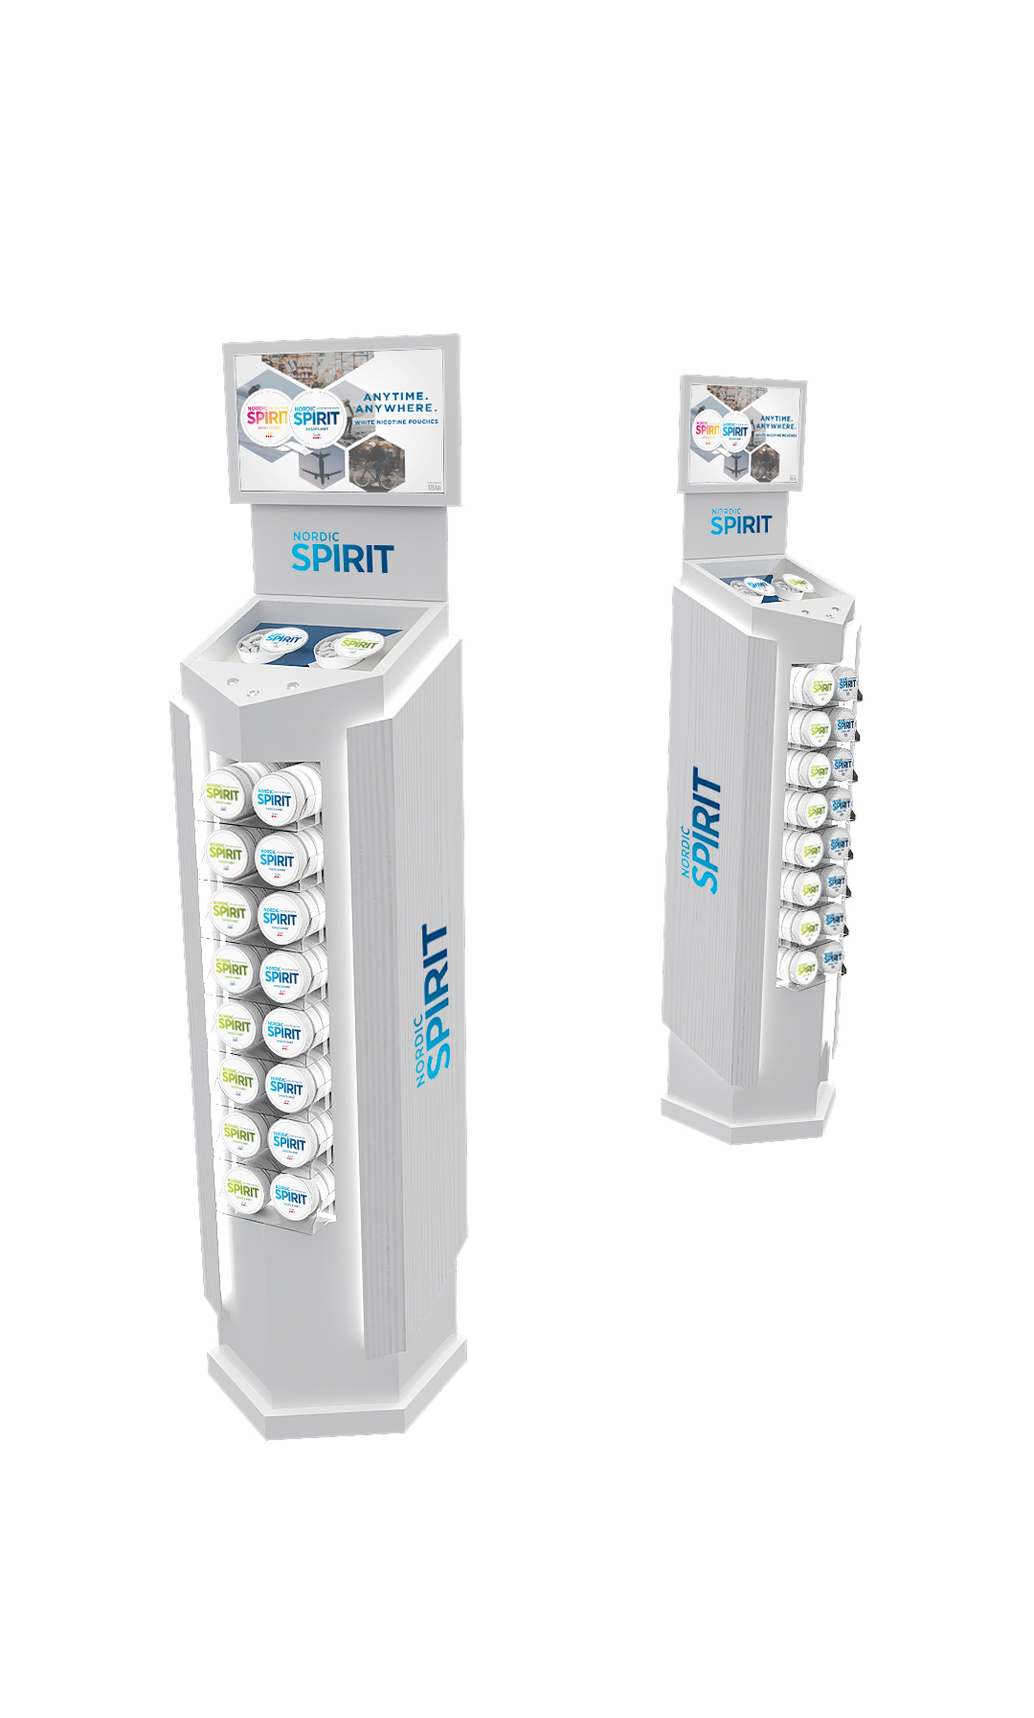


Slide 39


Slide 40
BG REKLAM
PRODUCTION
29. Novembra 1M
11460 Belgrade, Serbia
info@bgreklam.com
+381 11 785 64 64
+381 60 68 69 110
Thank You.
BG REKLAM GMBH
Leverkusenstraße 3
22761 Hamburg, Deutschland
hamburg@bgreklam.com
+49 40 85413003
www.bgreklam.com
BG REKLAM
UK LTD
2588 Davenport House,
207 Regent St
London, W1B 3HH, UK
+44 75 4288 2312

