Slide 1
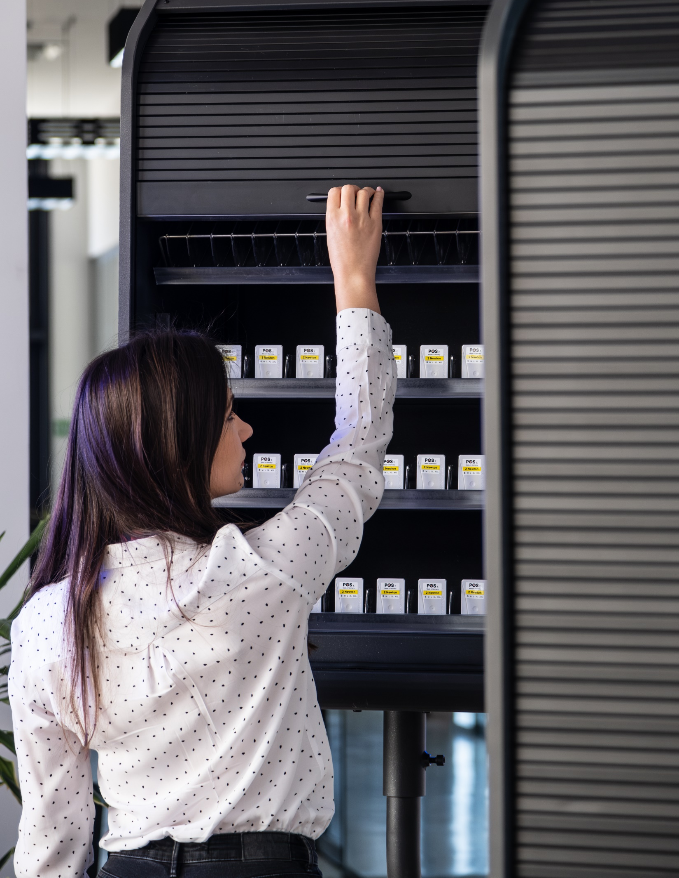

Premium
POS Industry
People are always going to go shopping.
A lot of our effort is how to make the retail experience a great one!

Slide 2

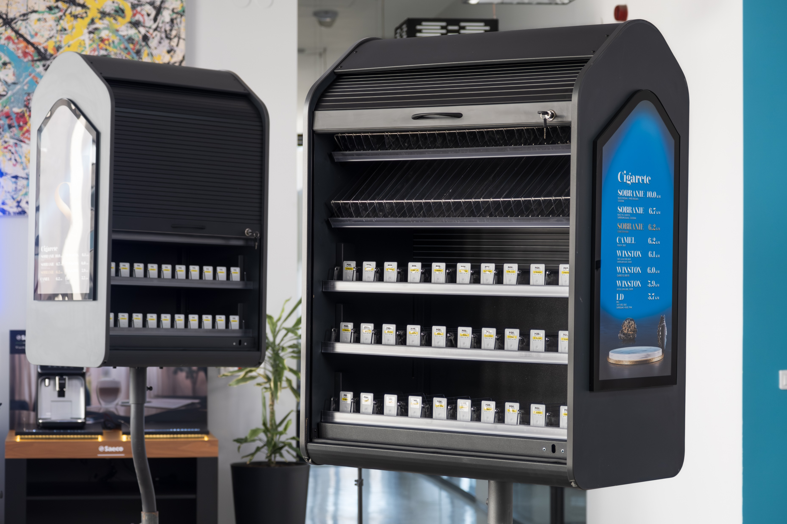

Slide 3
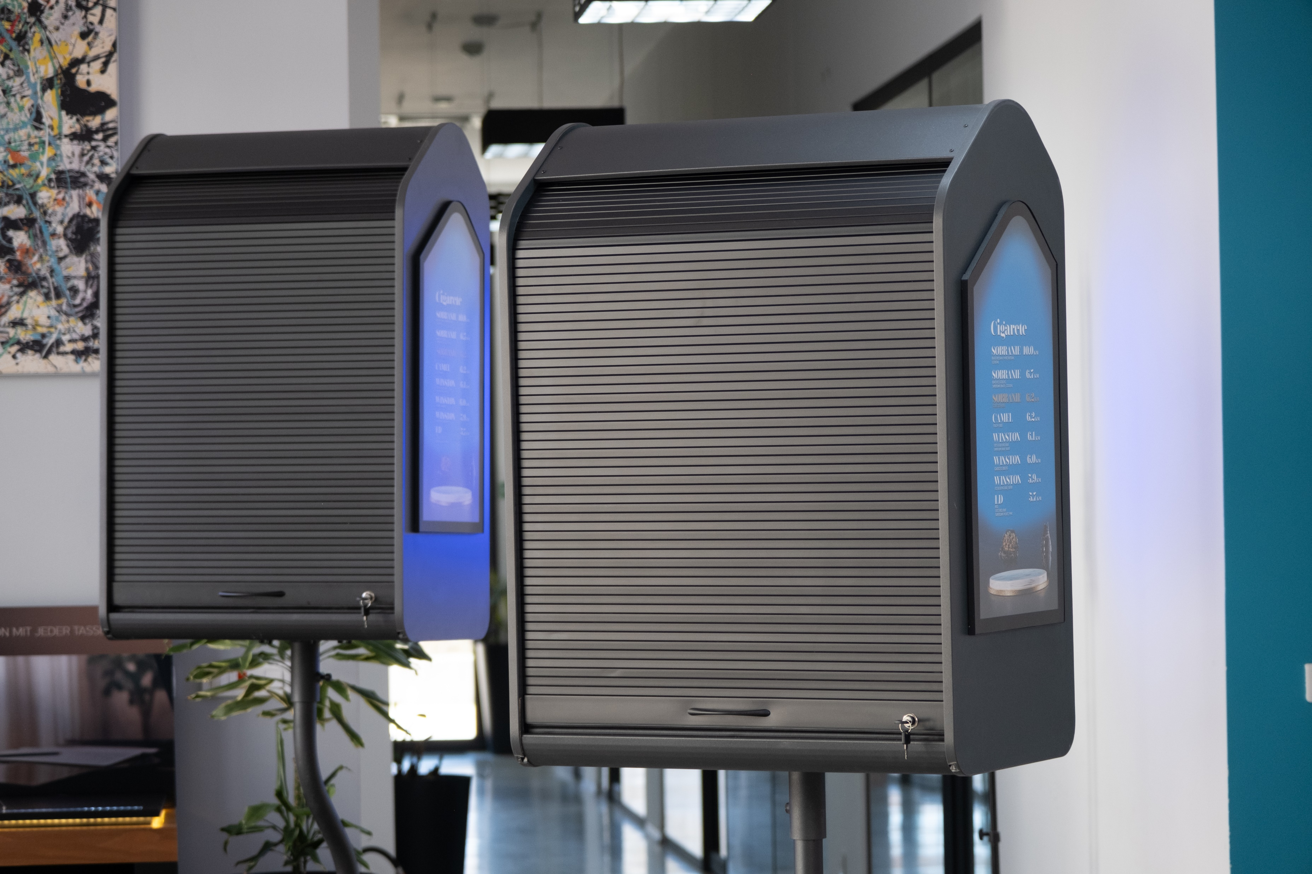

Slide 4
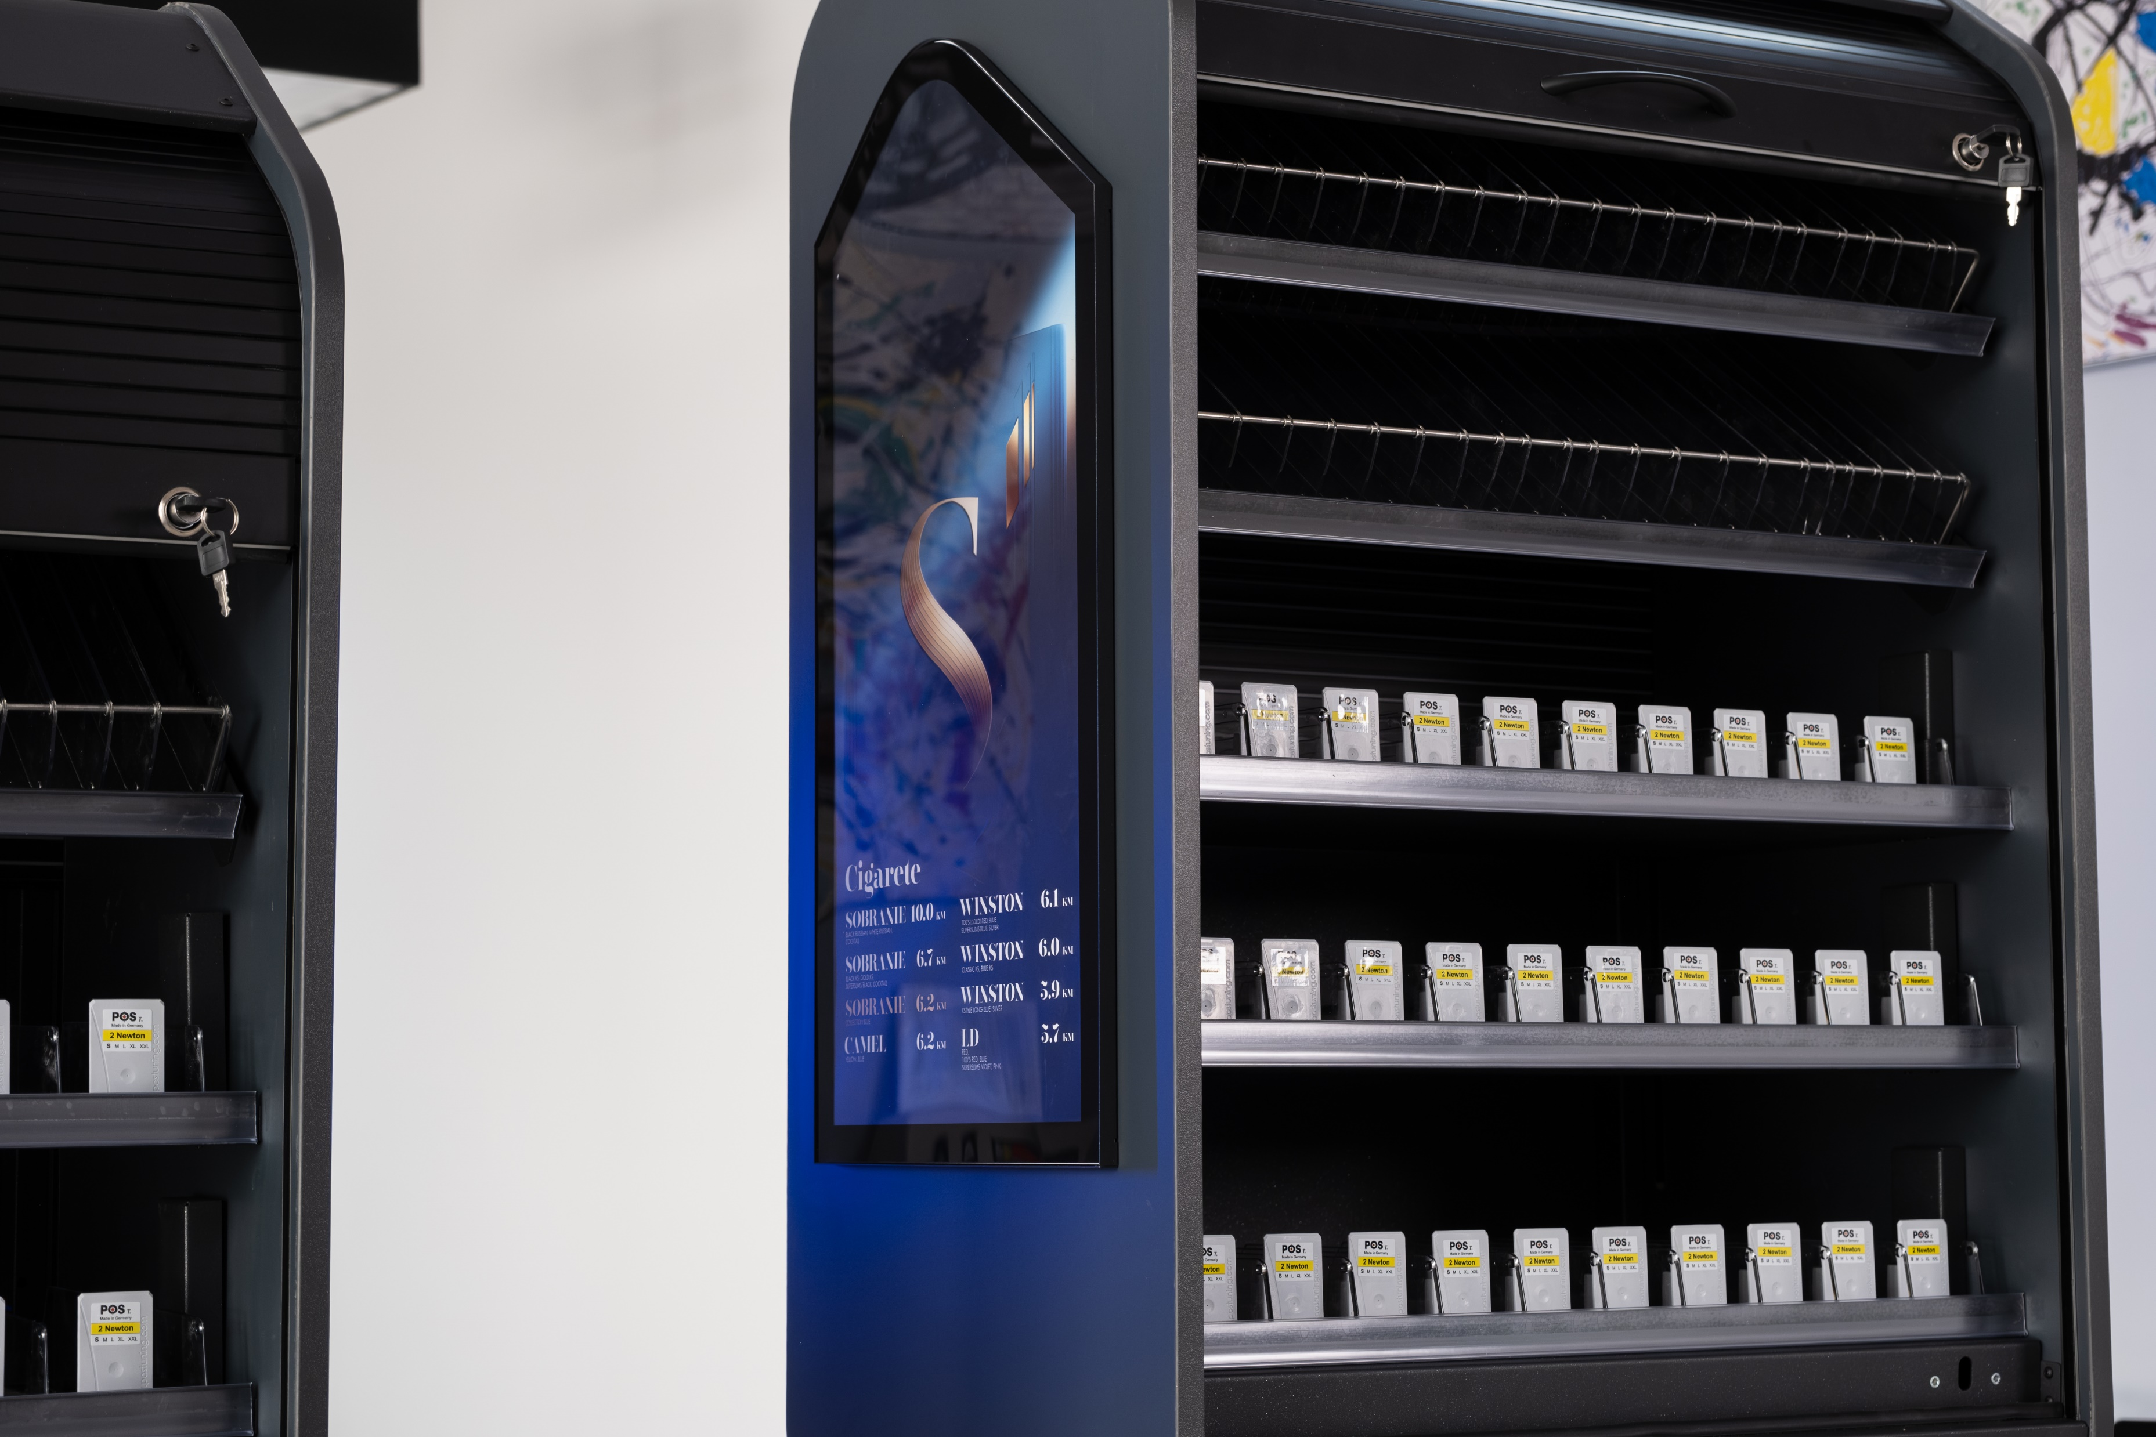

Slide 5
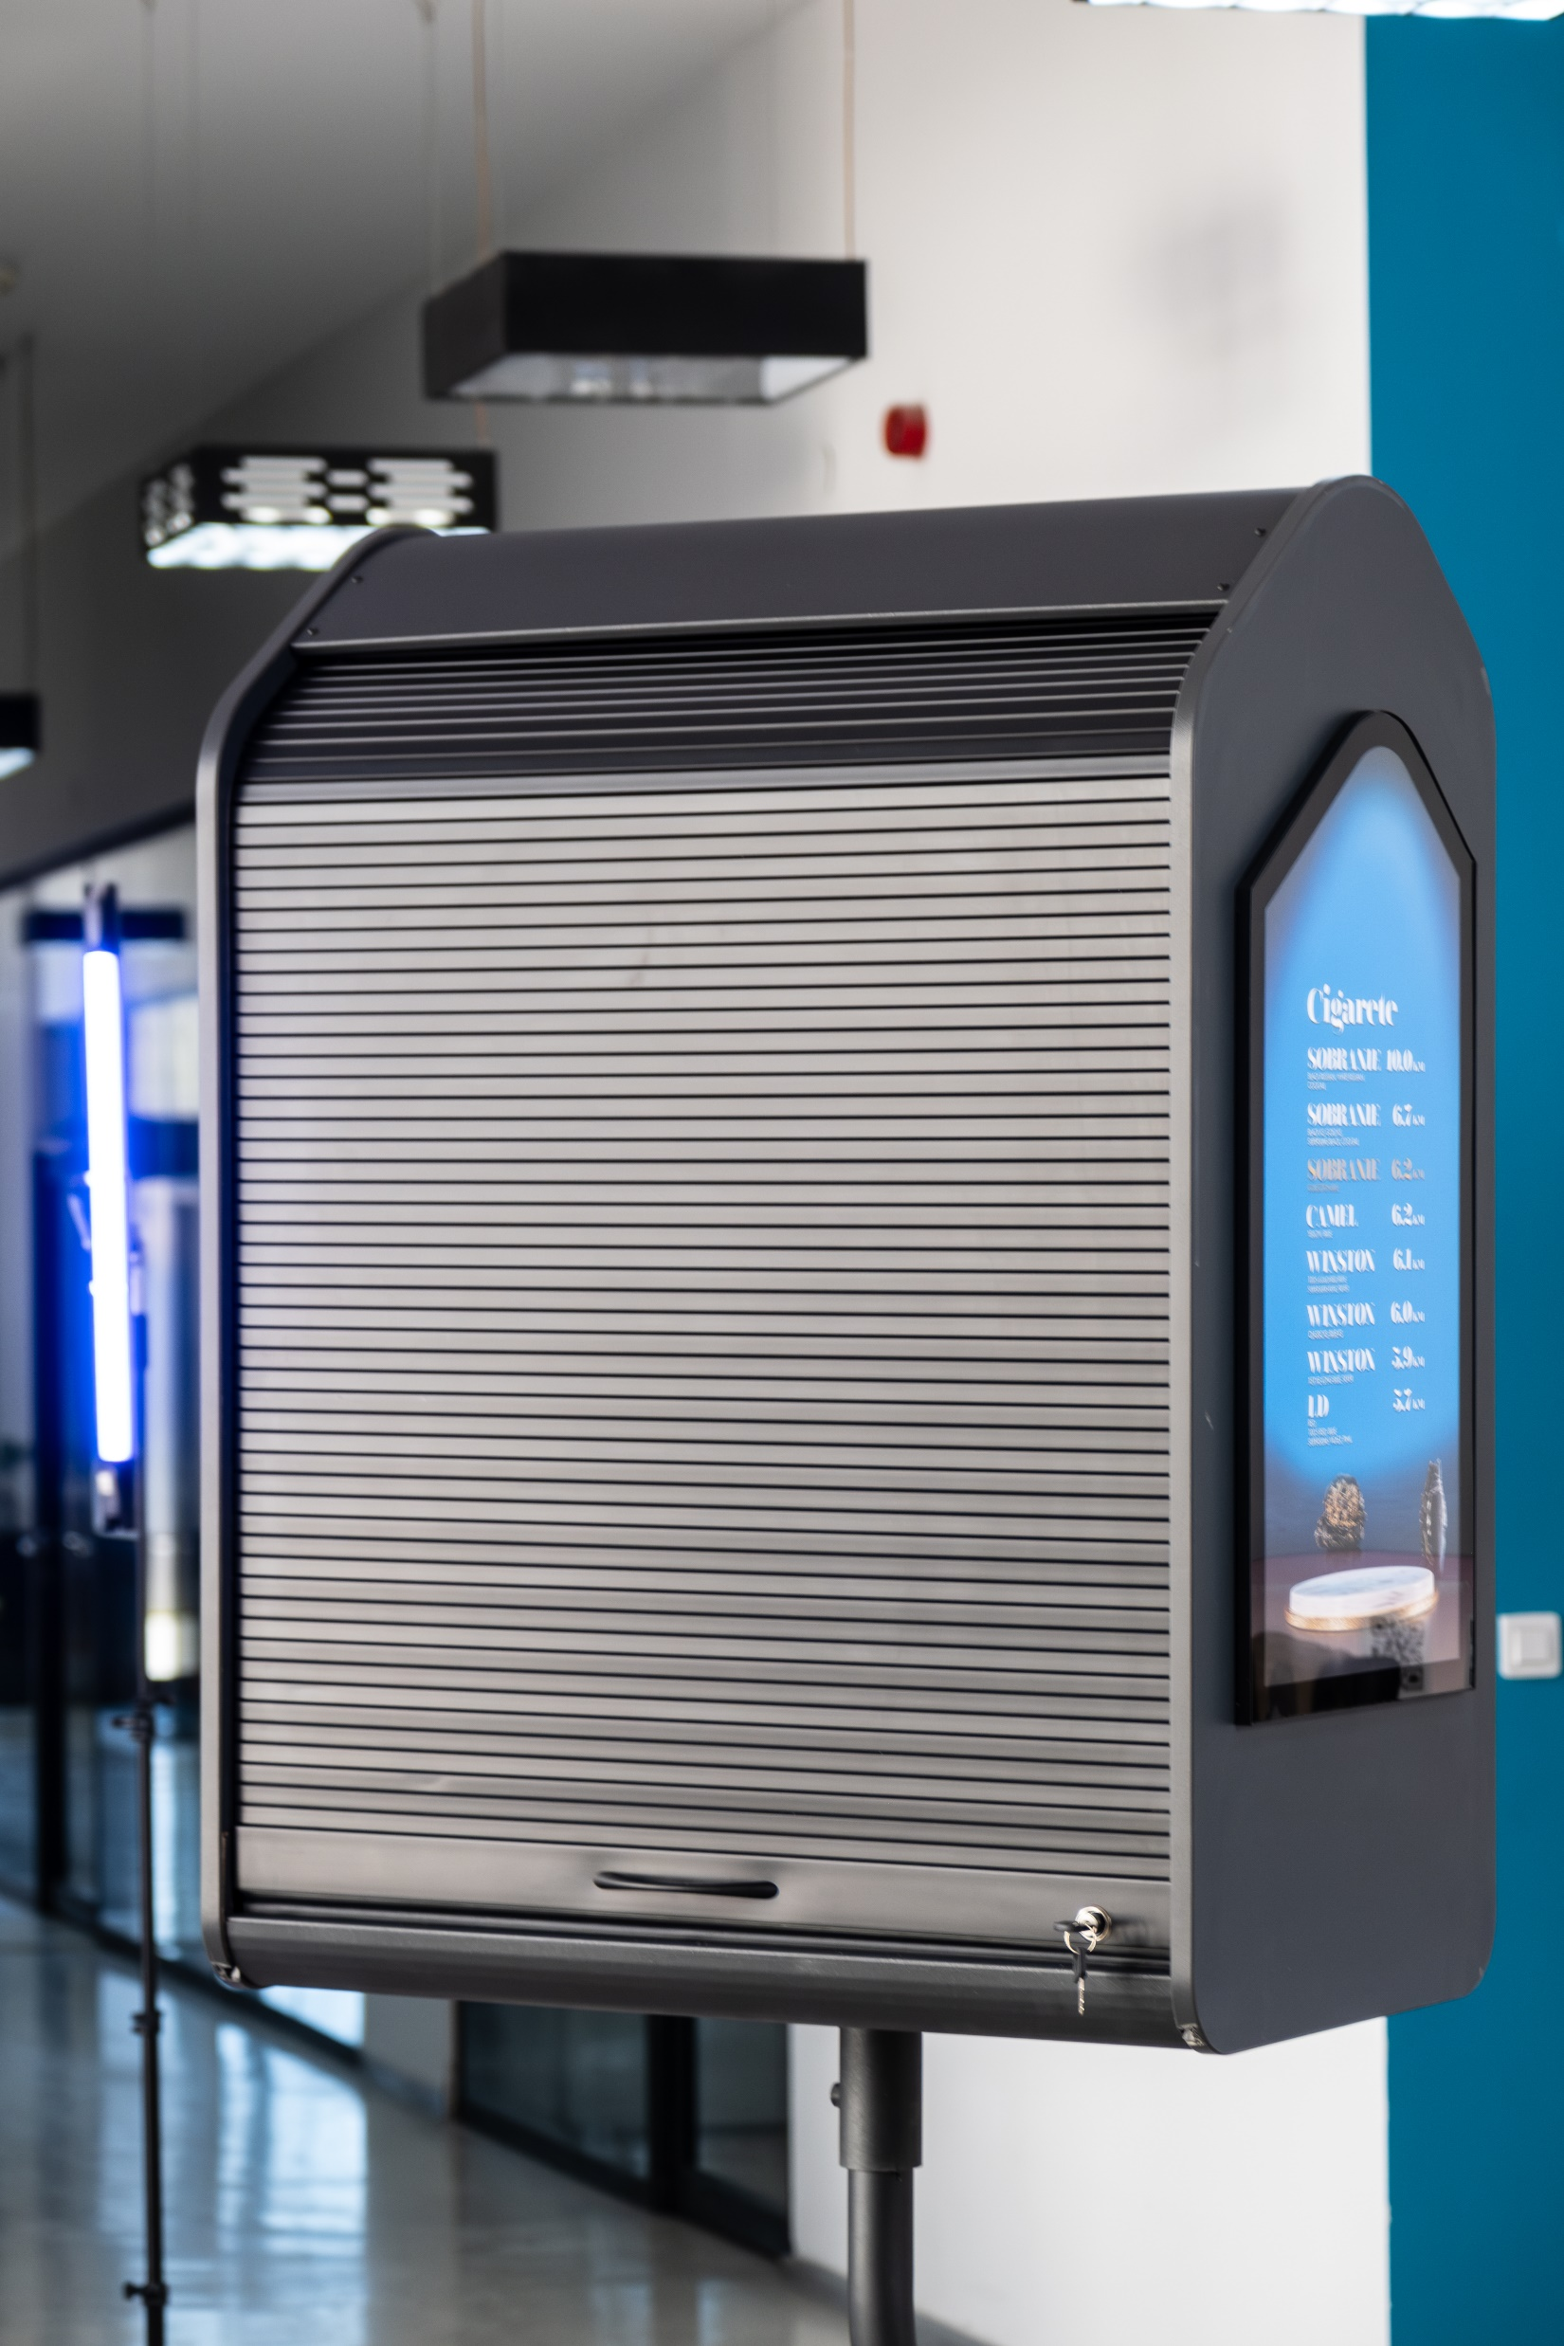
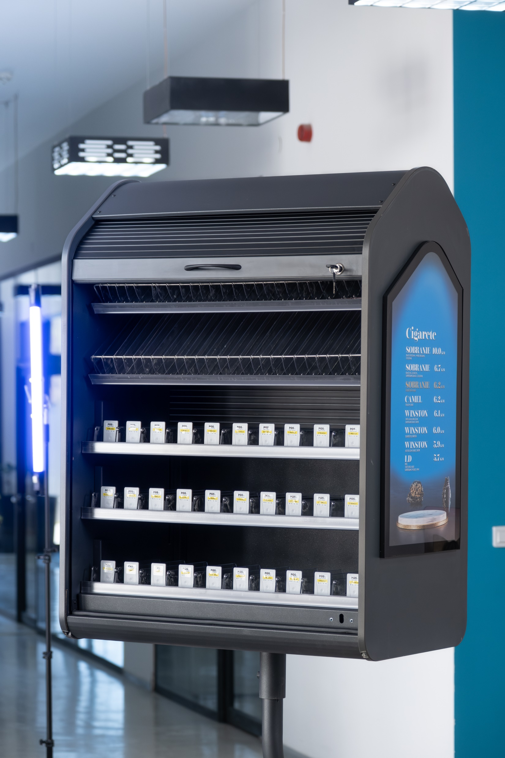

Slide 6
BG REKLAM
PRODUCTION
29. Novembra 1M
11460 Belgrade, Serbia
info@bgreklam.com
+381 11 785 64 64
+381 60 68 69 110
Thank You.
BG REKLAM GMBH
Leverkusenstraße 3
22761 Hamburg, Deutschland
hamburg@bgreklam.com
+49 40 85413003
www.bgreklam.com
BG REKLAM
UK LTD
2588 Davenport House,
207 Regent St
London, W1B 3HH, UK
+44 75 4288 2312

