Slide 1


Sales
Driven
By Design
“The only important thing about design is how it relates to people.”
— Victor Papanek

Slide 2
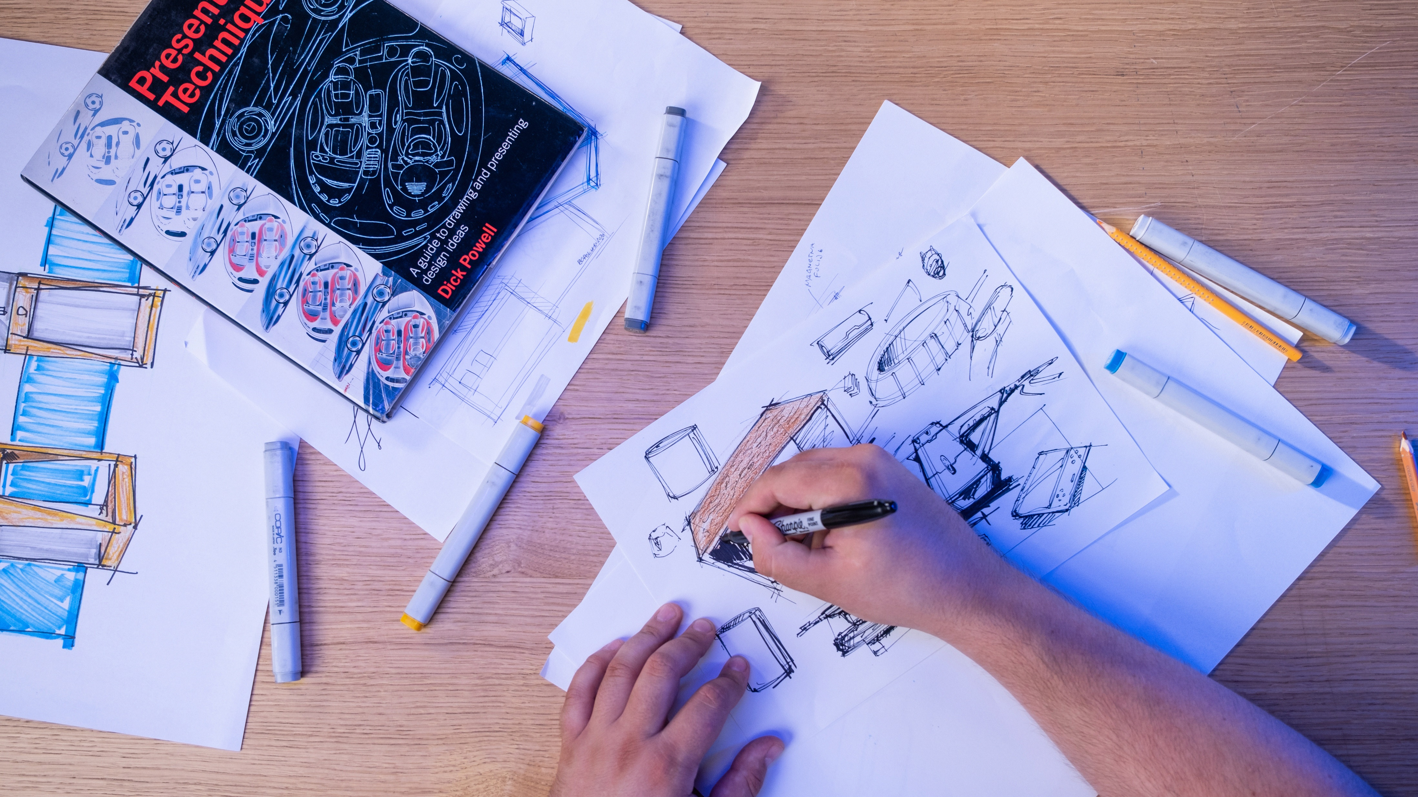
Meet
The team
Design Process is often described as a problem-solving process, the first step is always “define our clients needs.”
Full in-house design team with diverse skillsets. Whether it’s a 3D modeling, photo editing, or a digital design.
25+
Combined Years of
Industrial design
Experience.

Slide 3
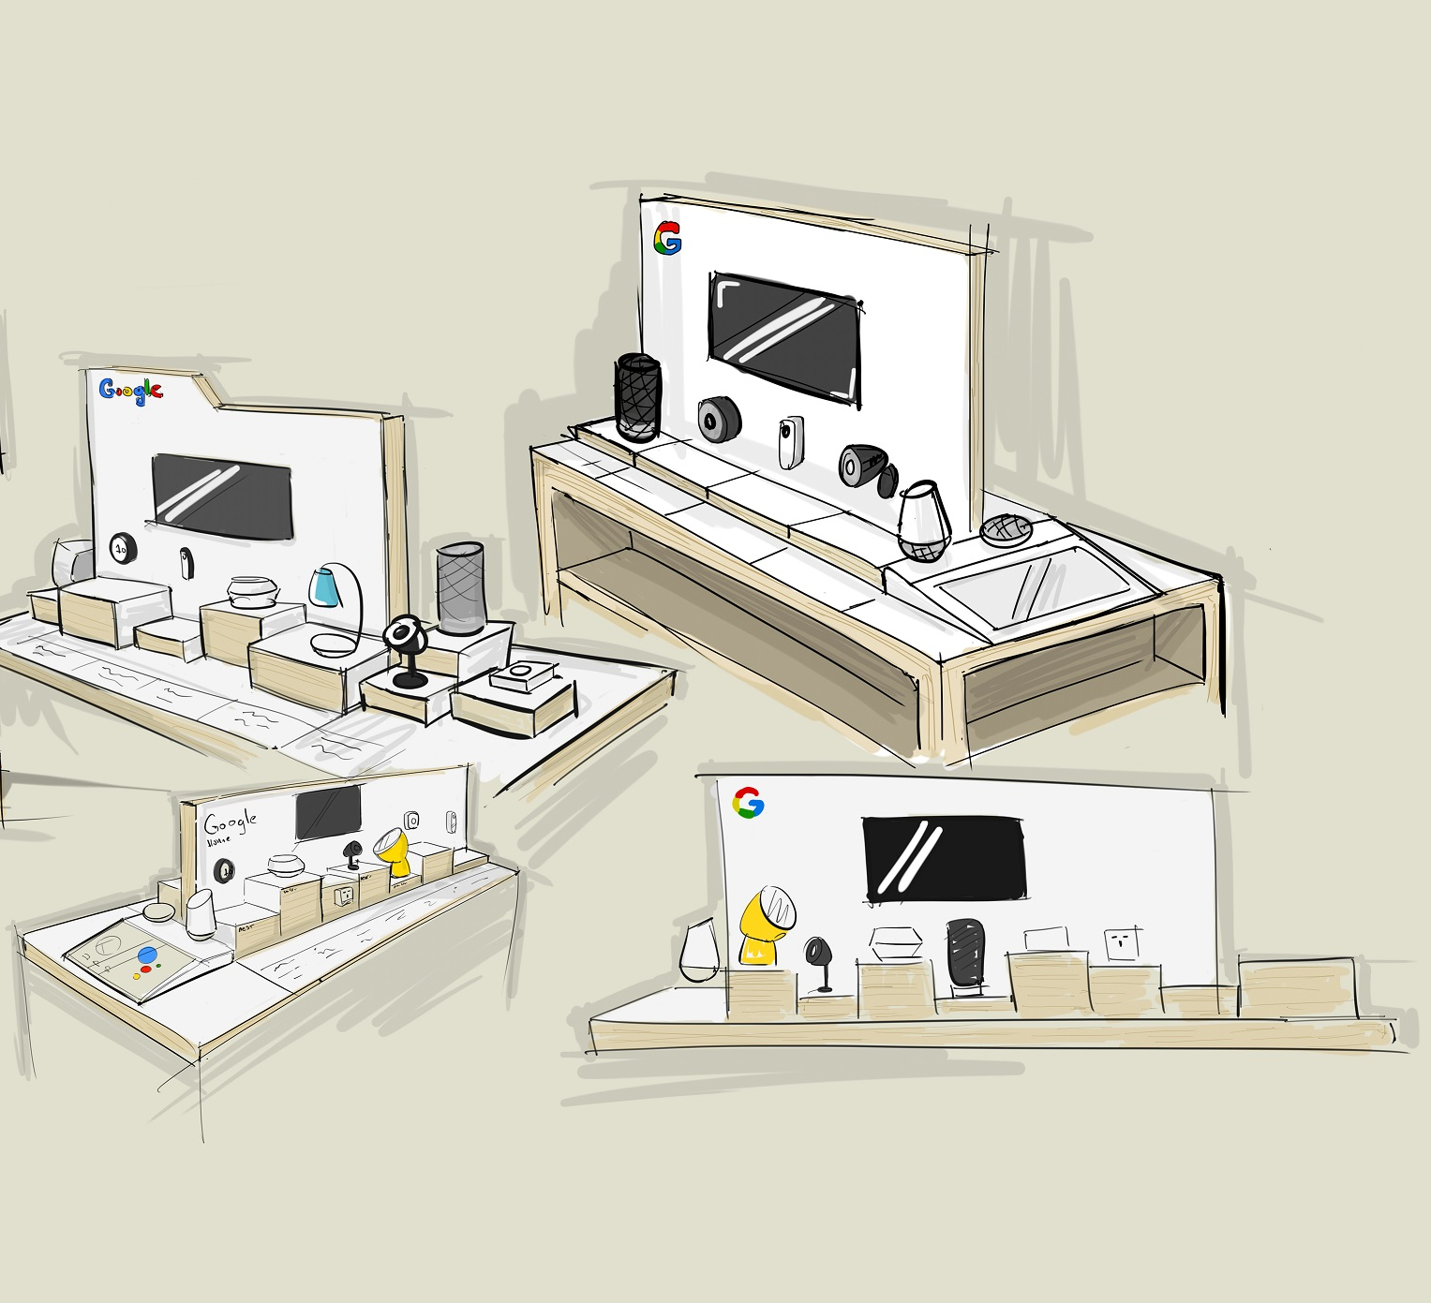
Design
Portfolio

Slide 4
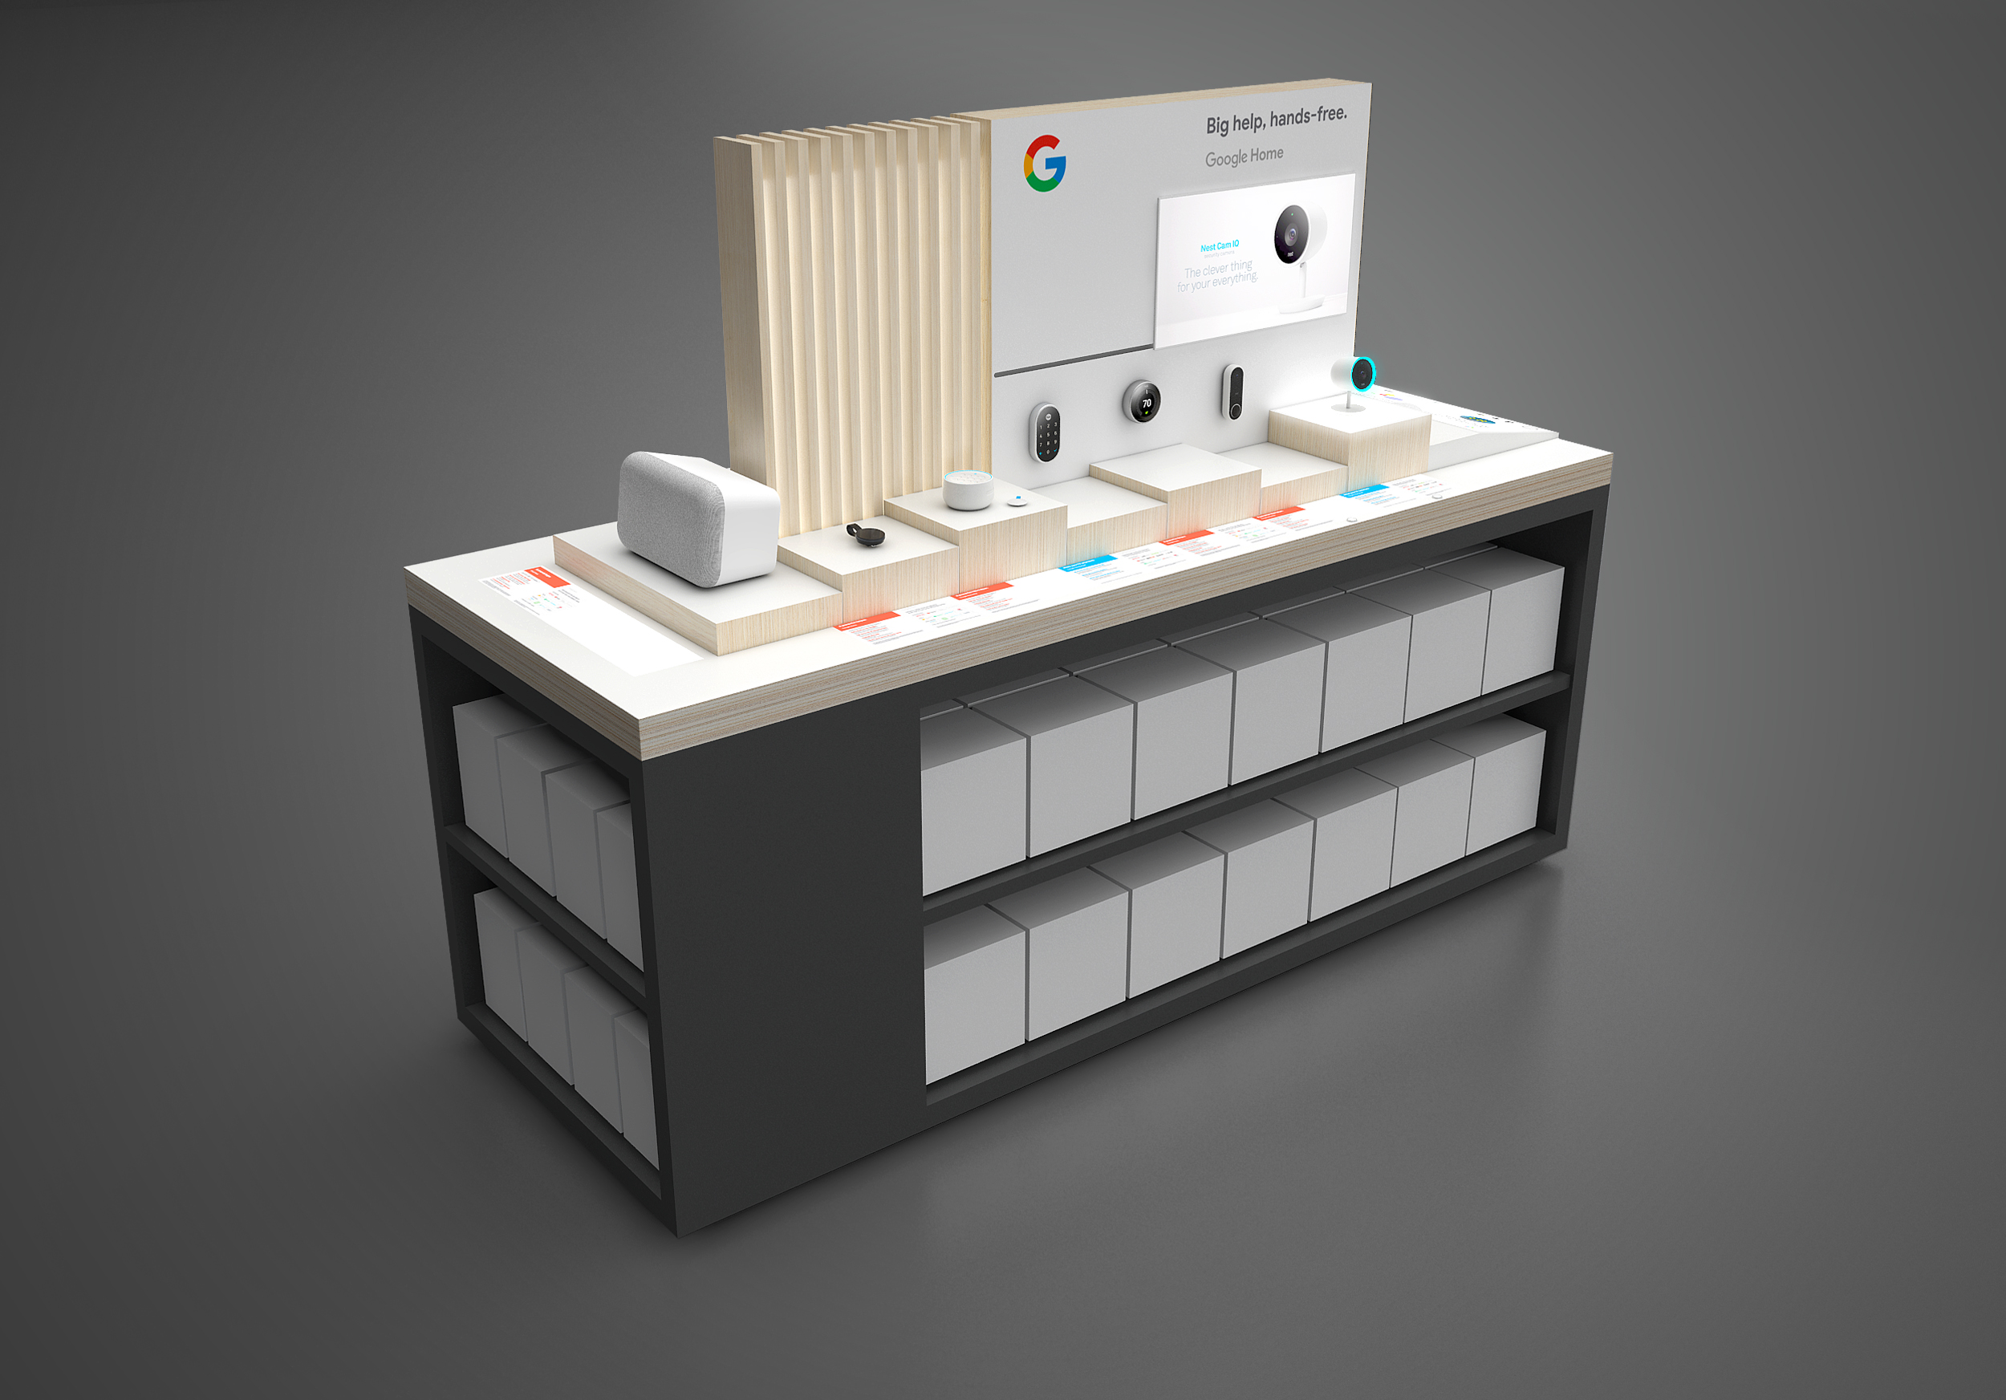
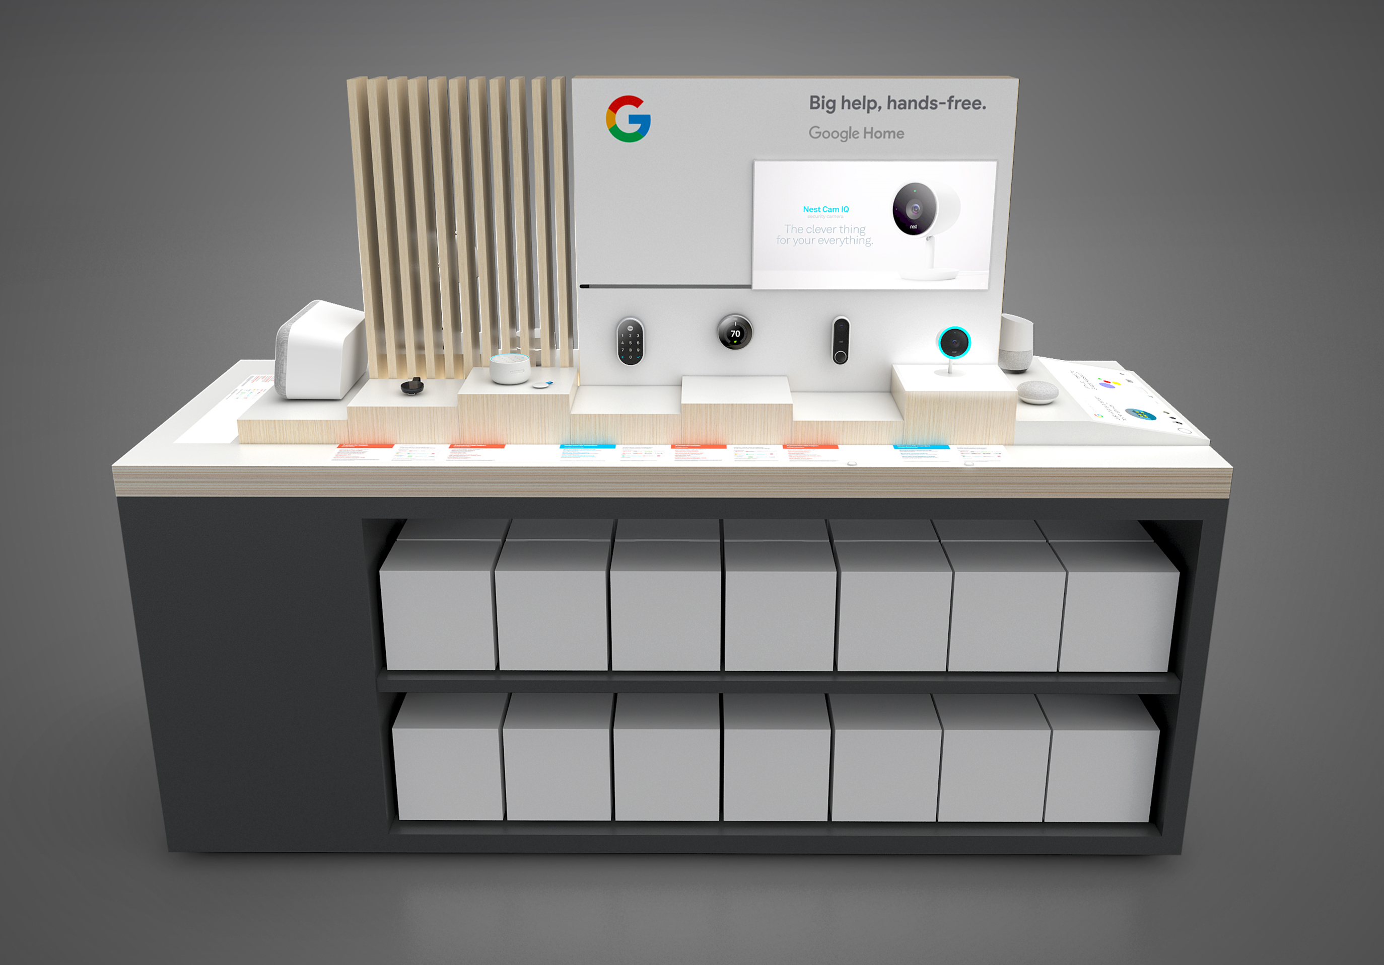

Slide 5


Slide 6
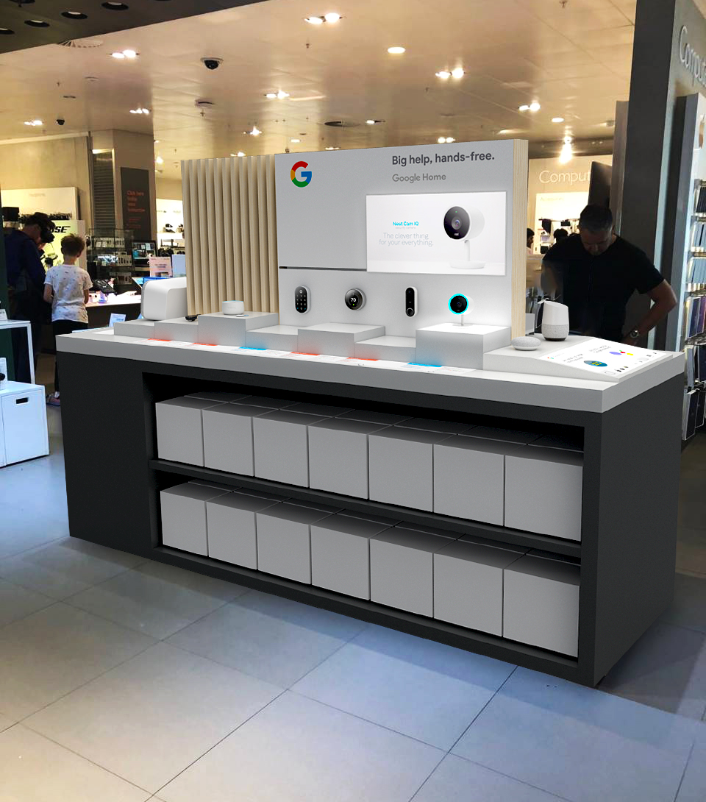
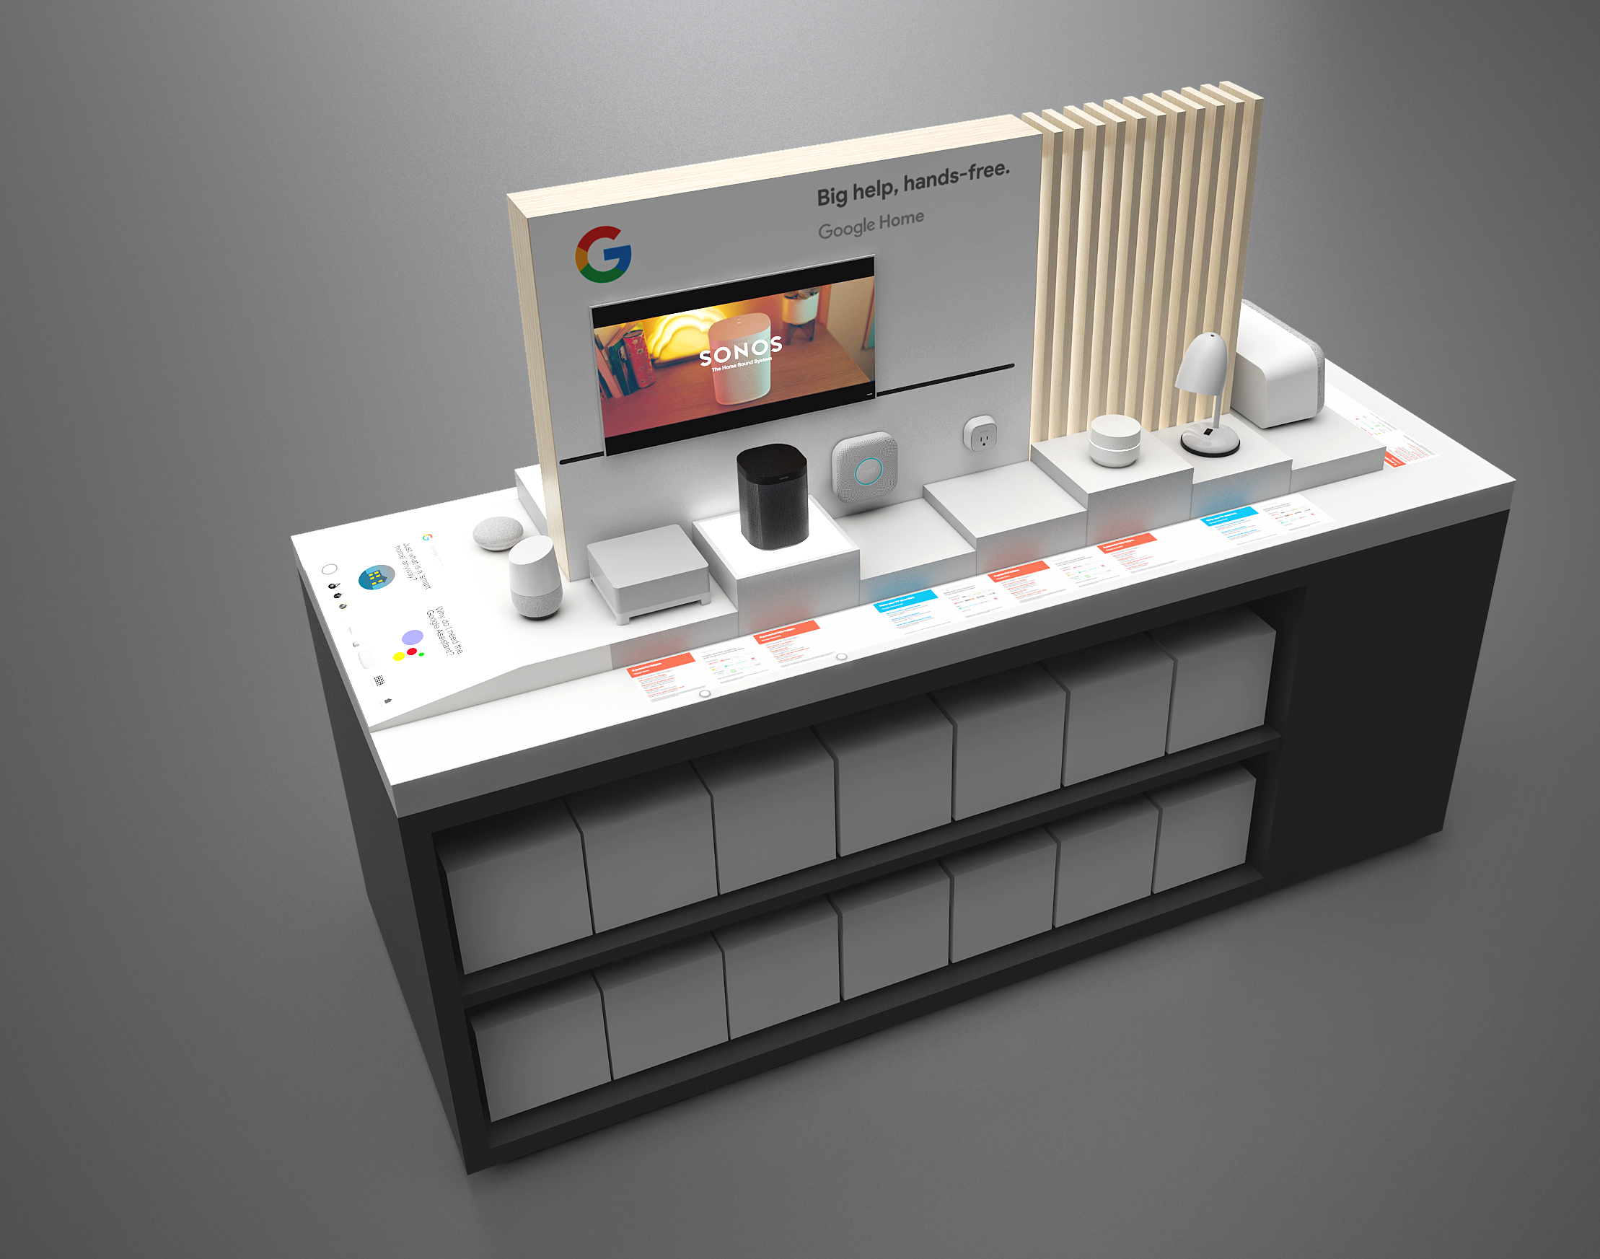

Slide 7
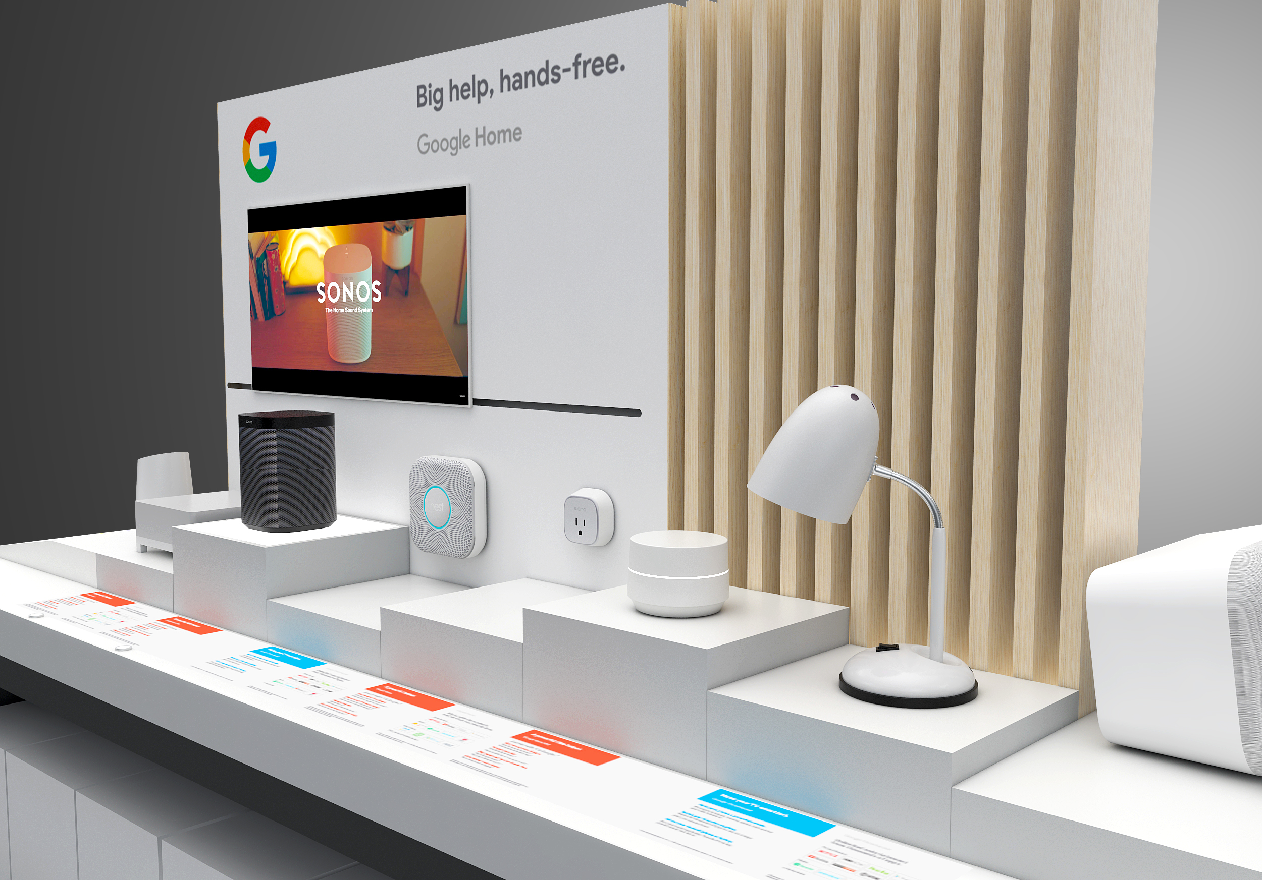

Slide 8
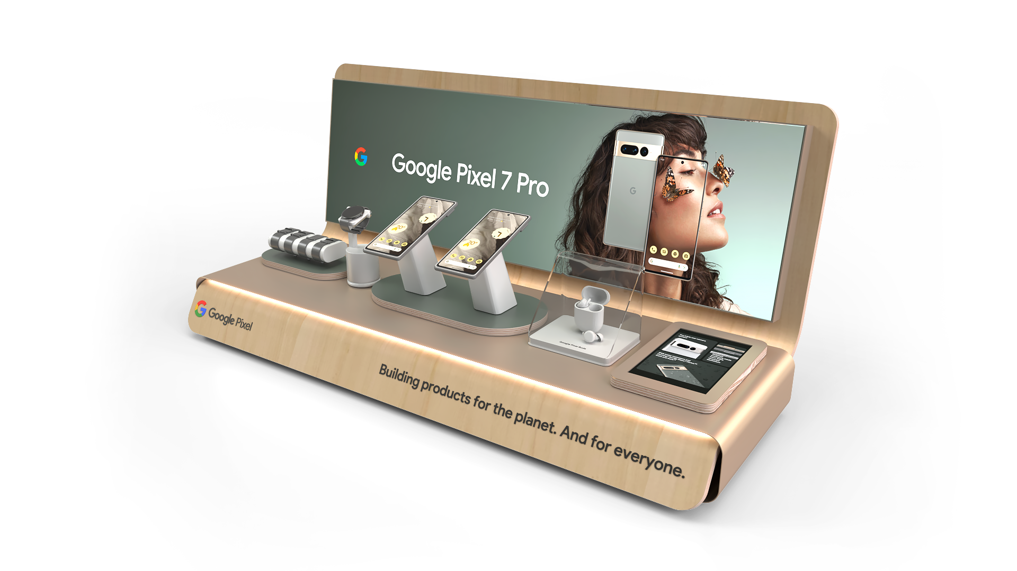

Slide 9

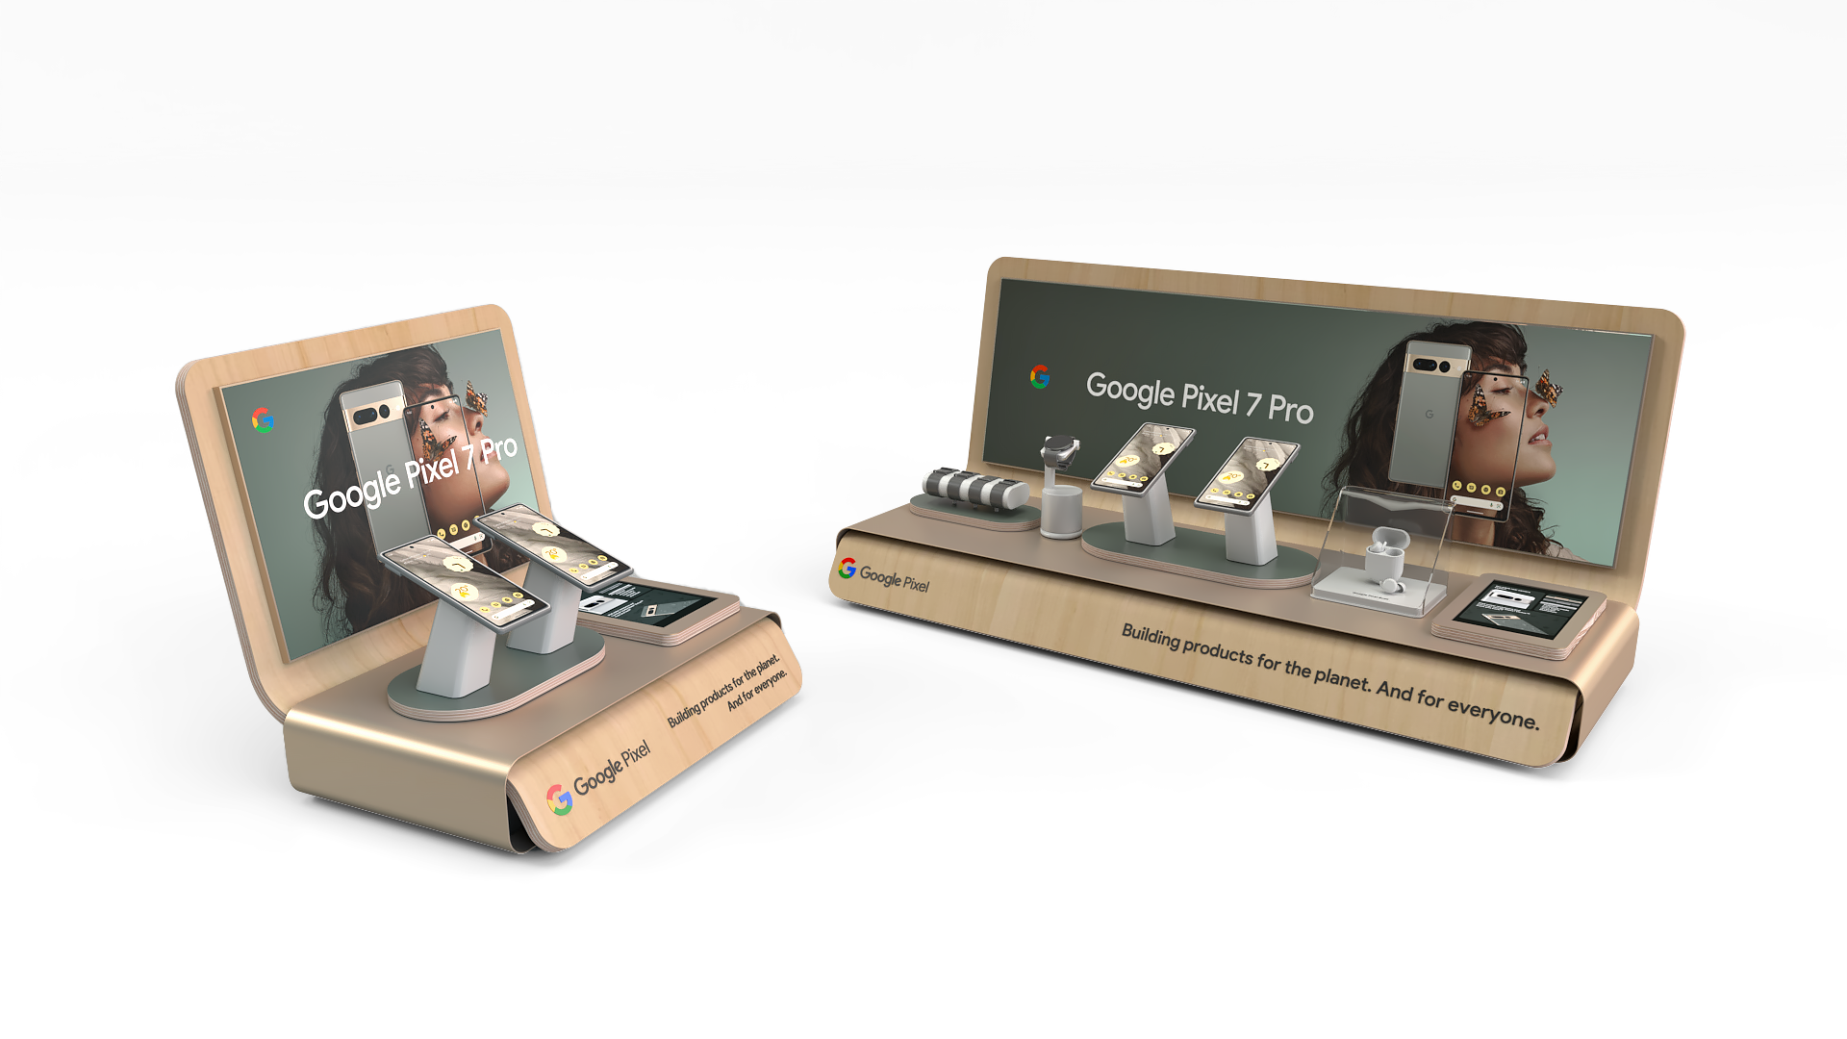

Slide 10
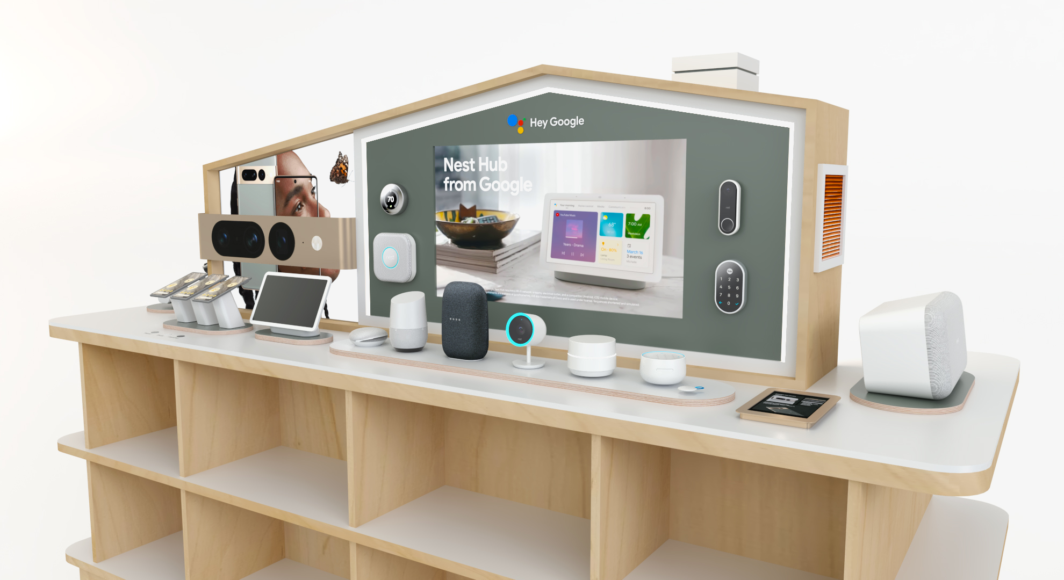
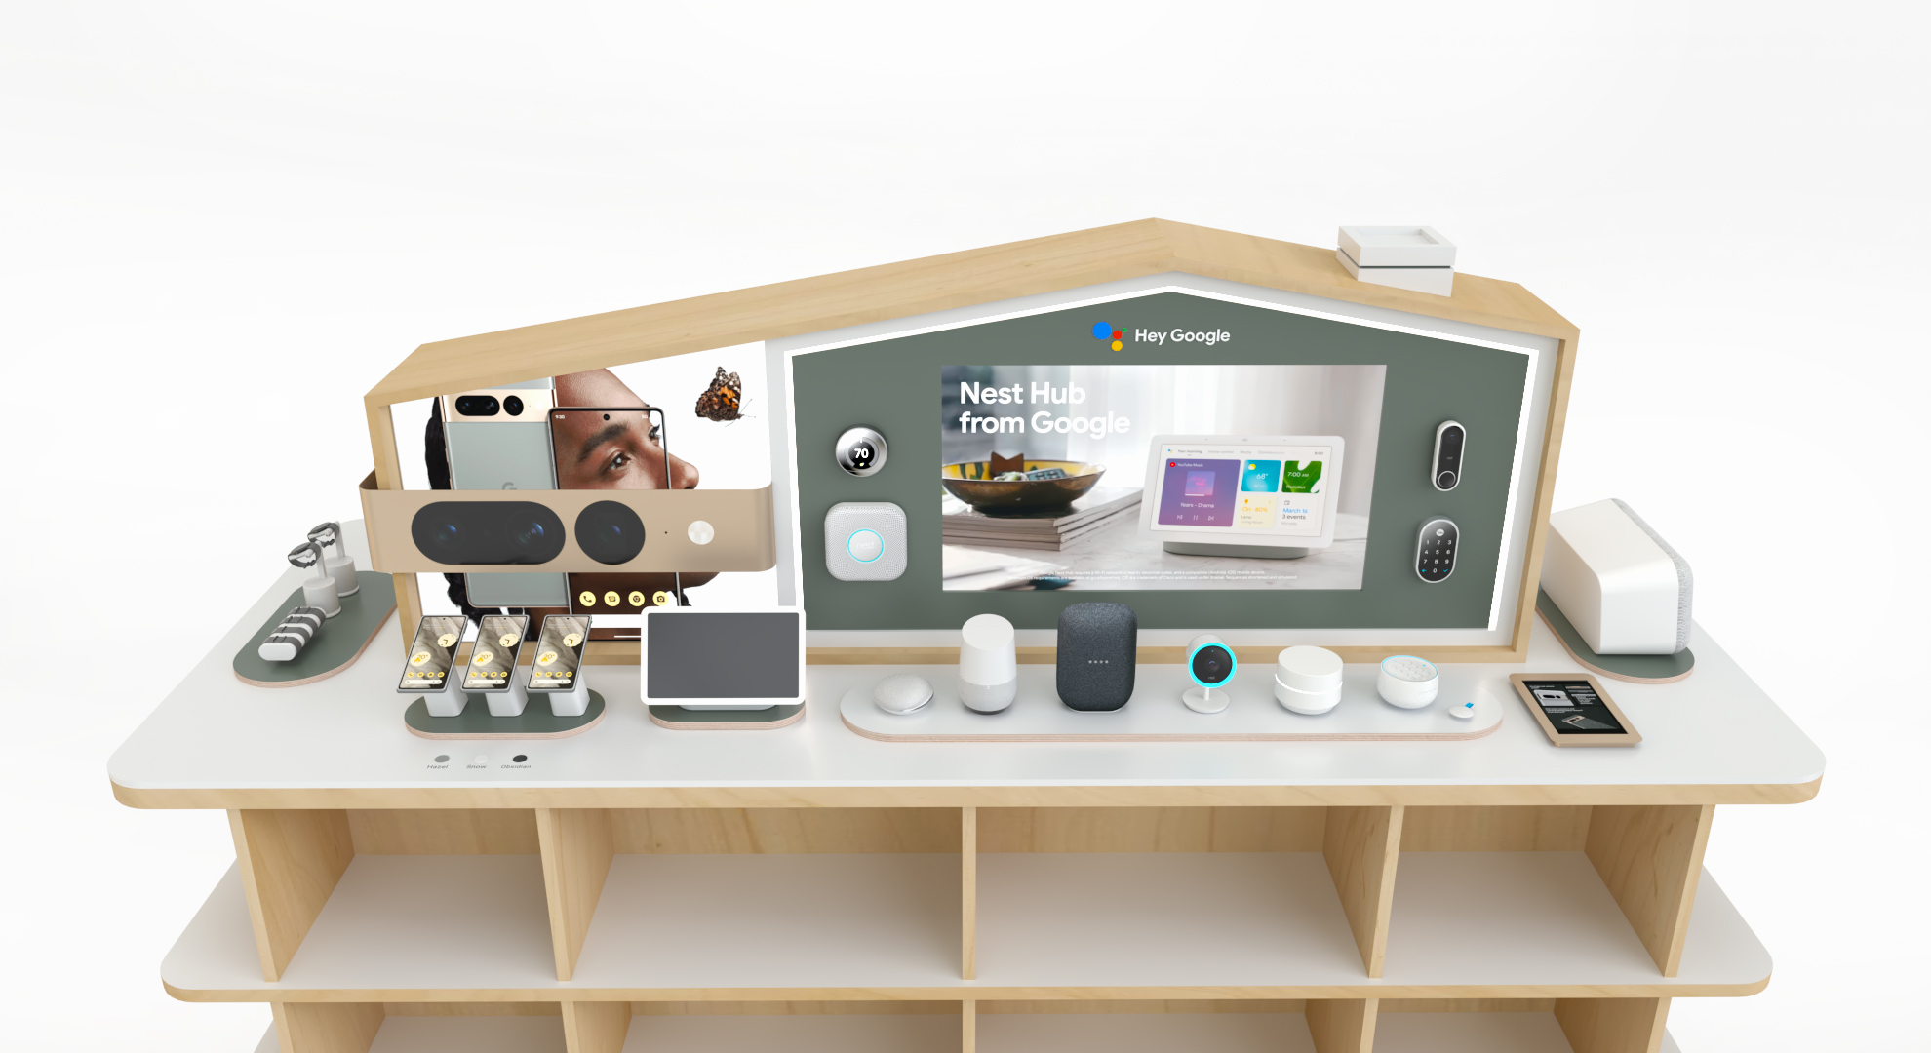
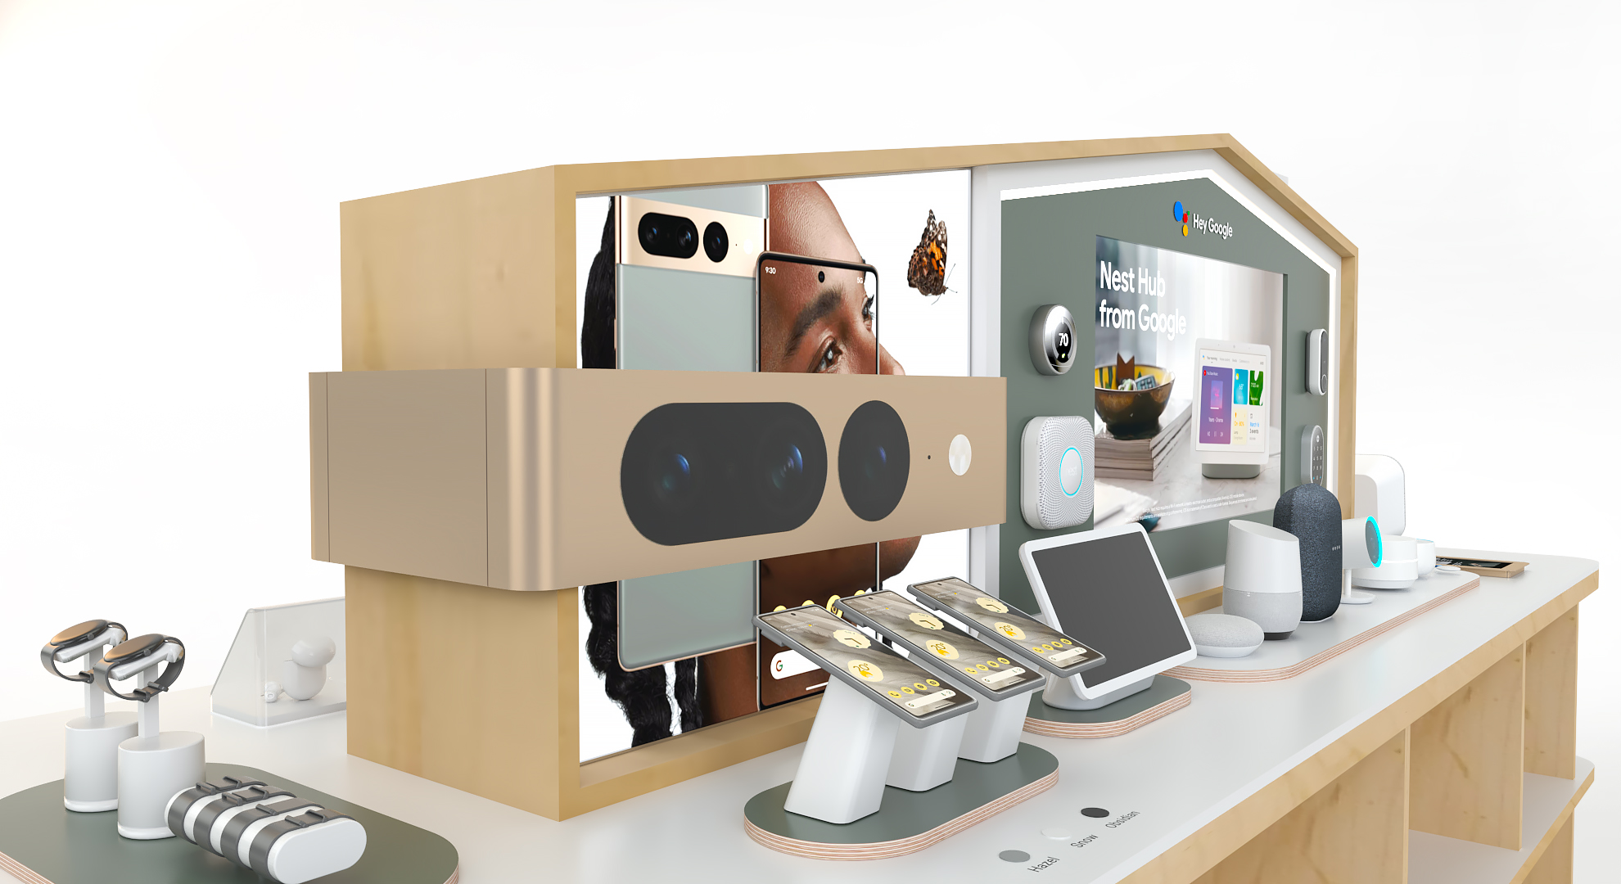
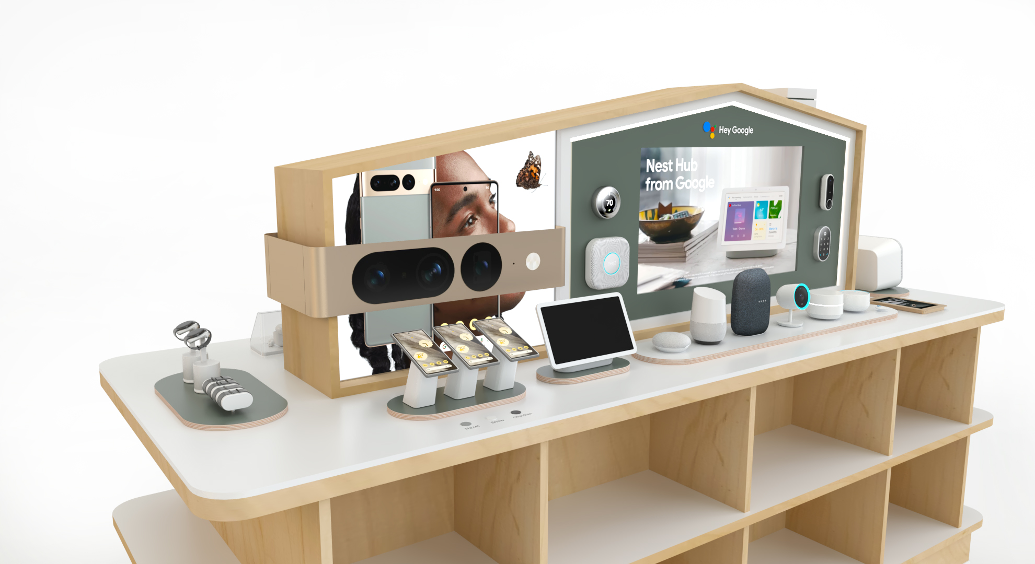

Slide 12
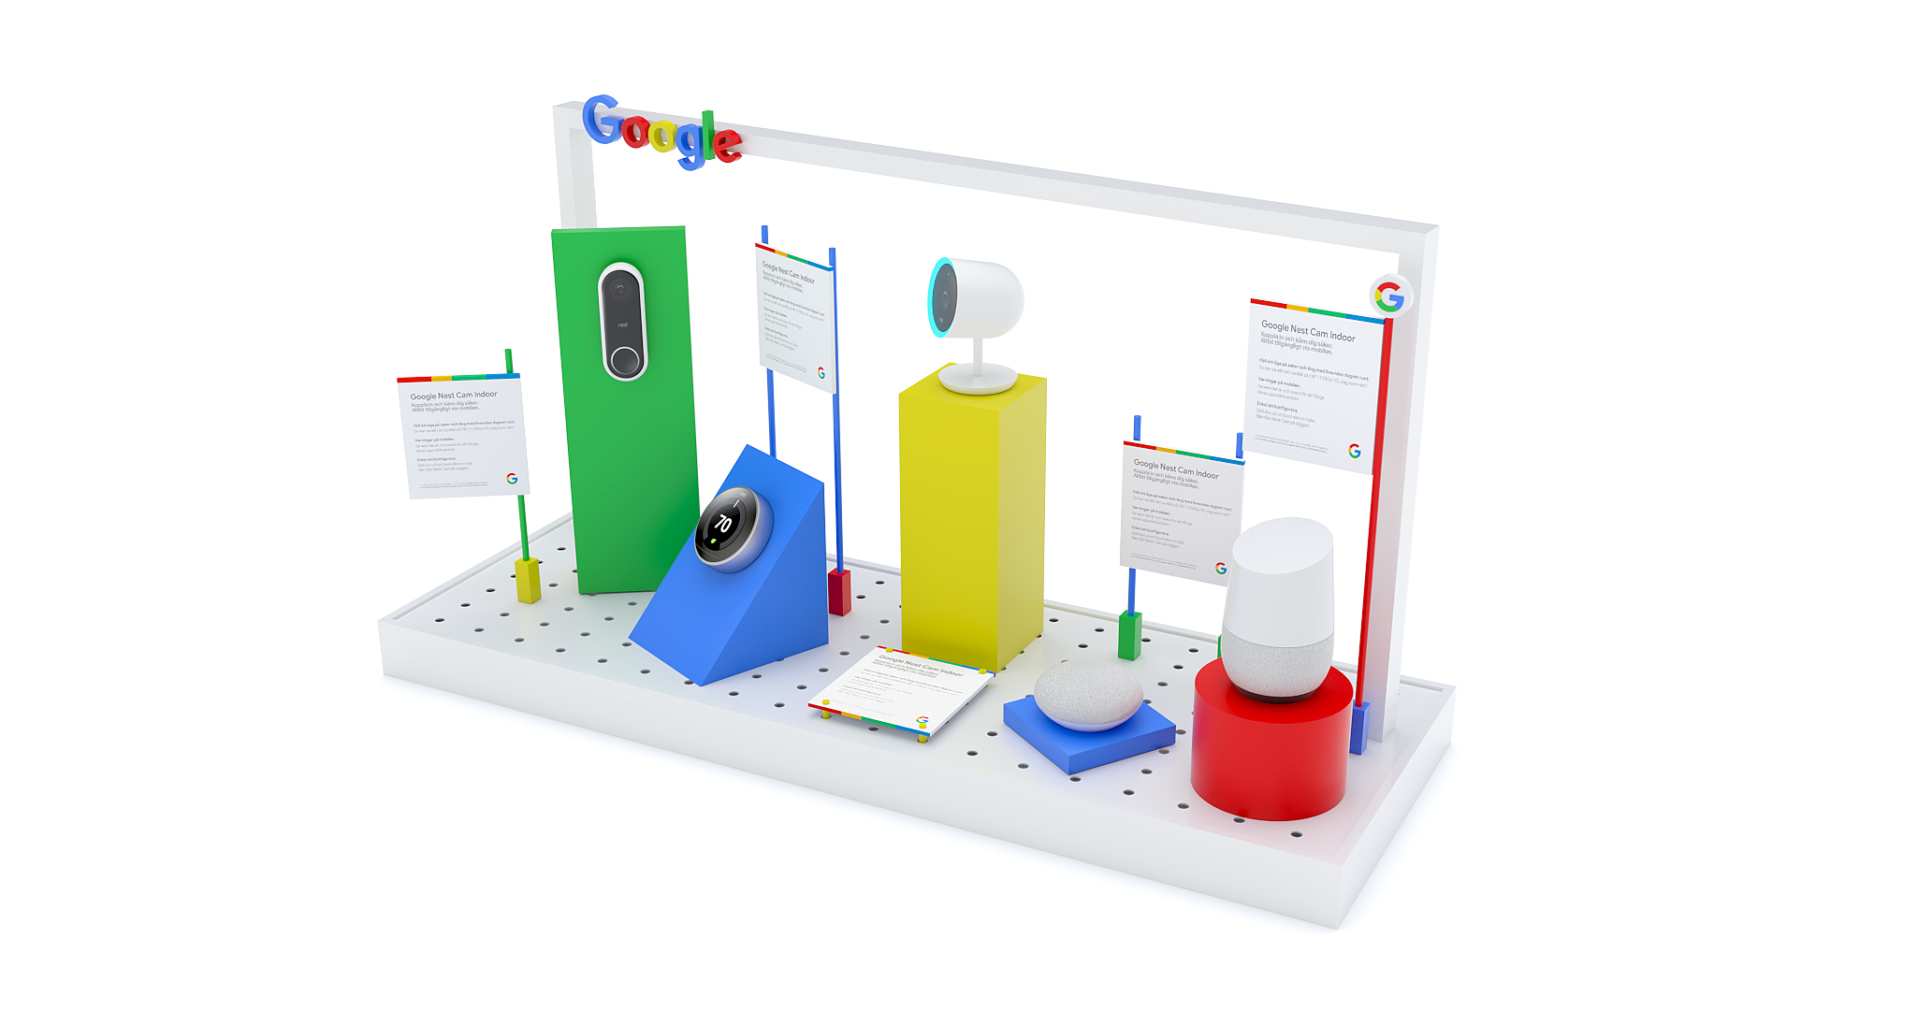

Slide 13
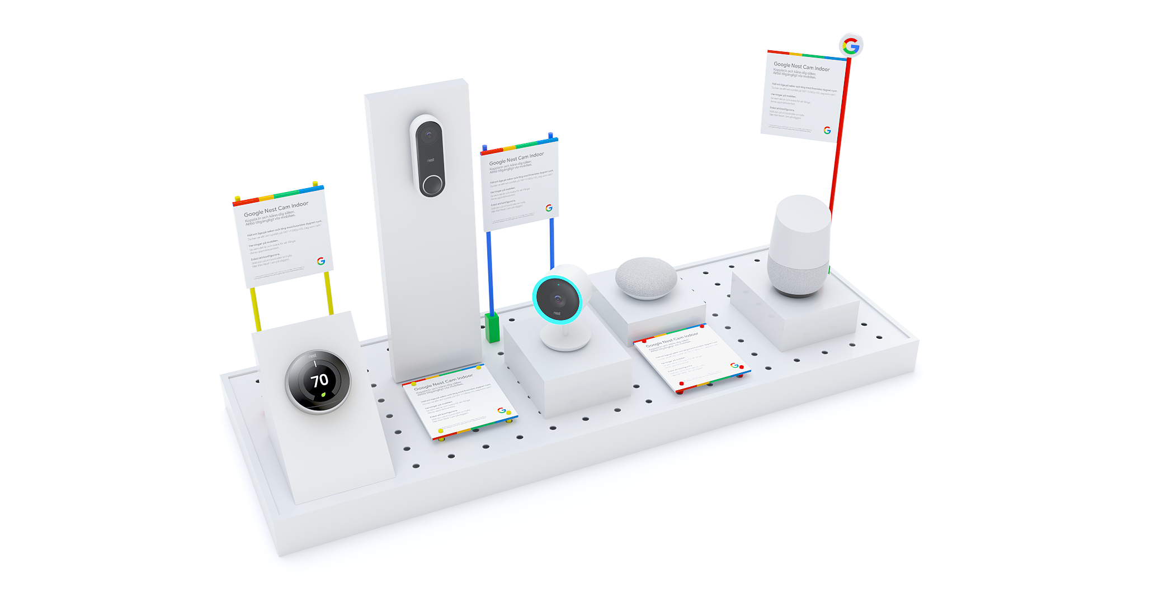

Slide 14

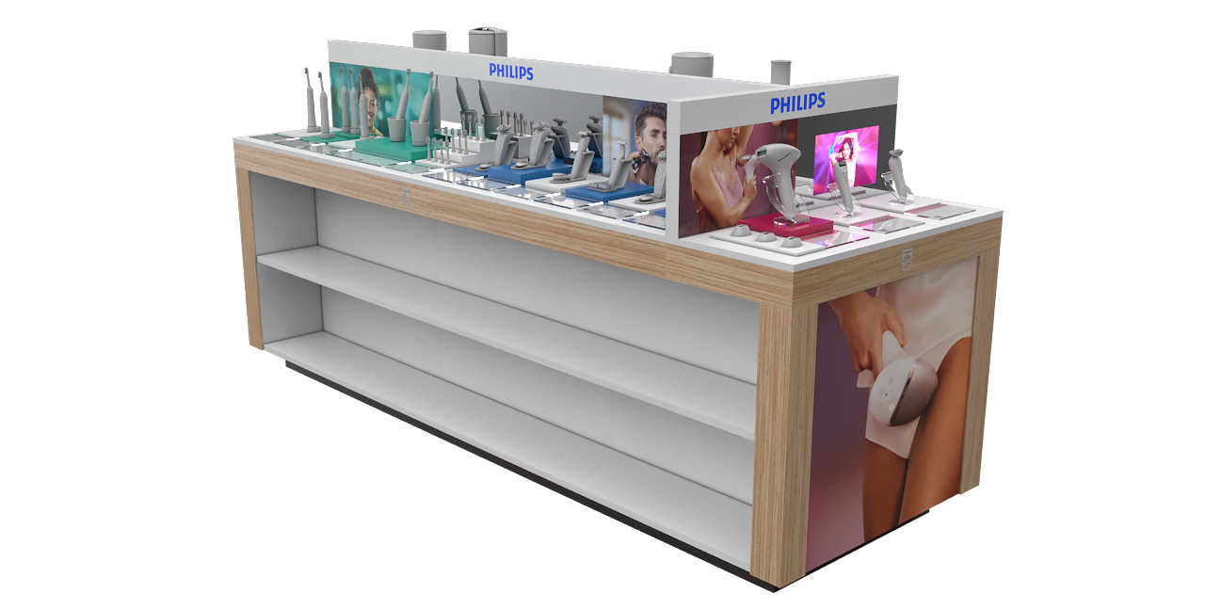

Slide 15
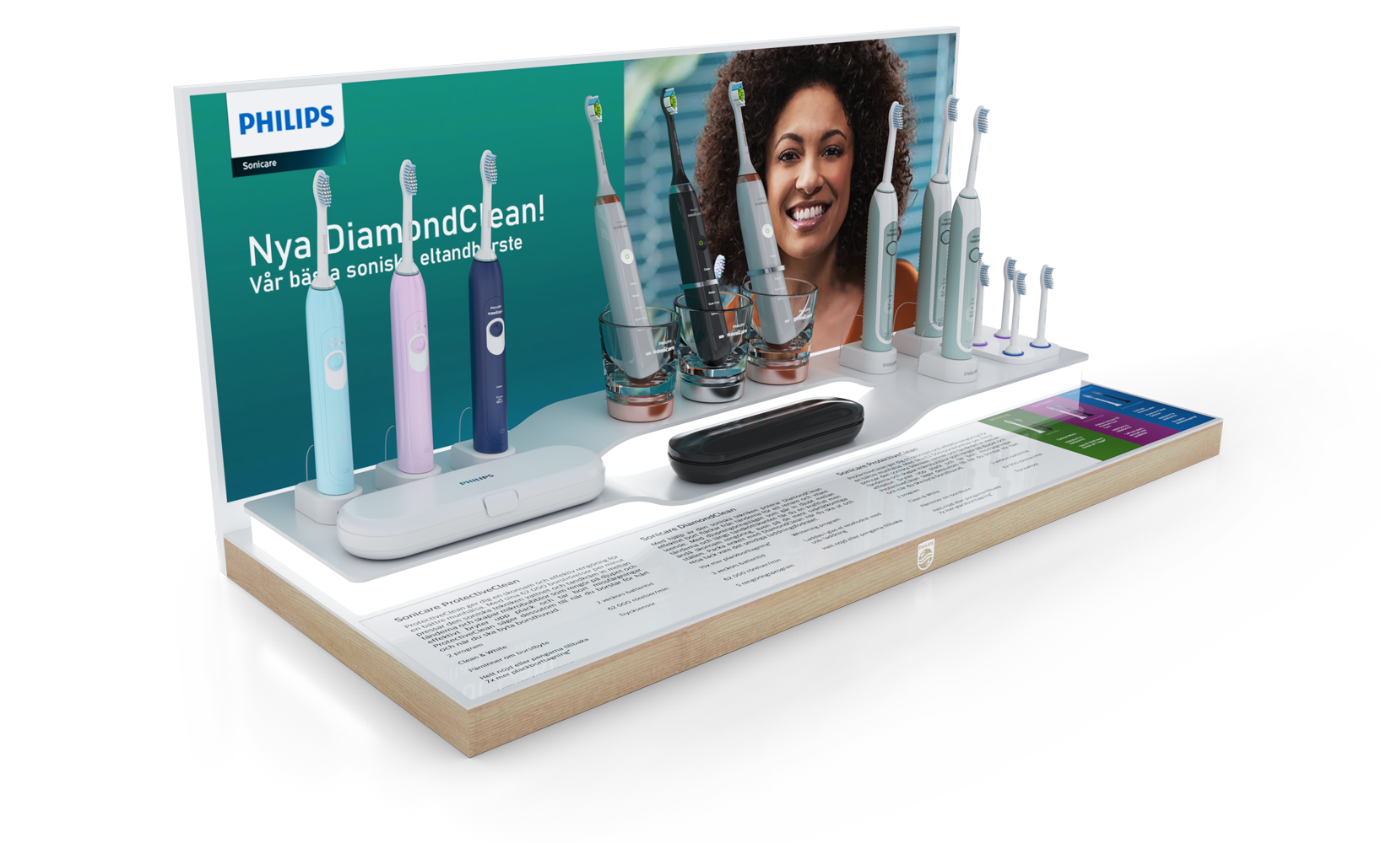

Slide 16
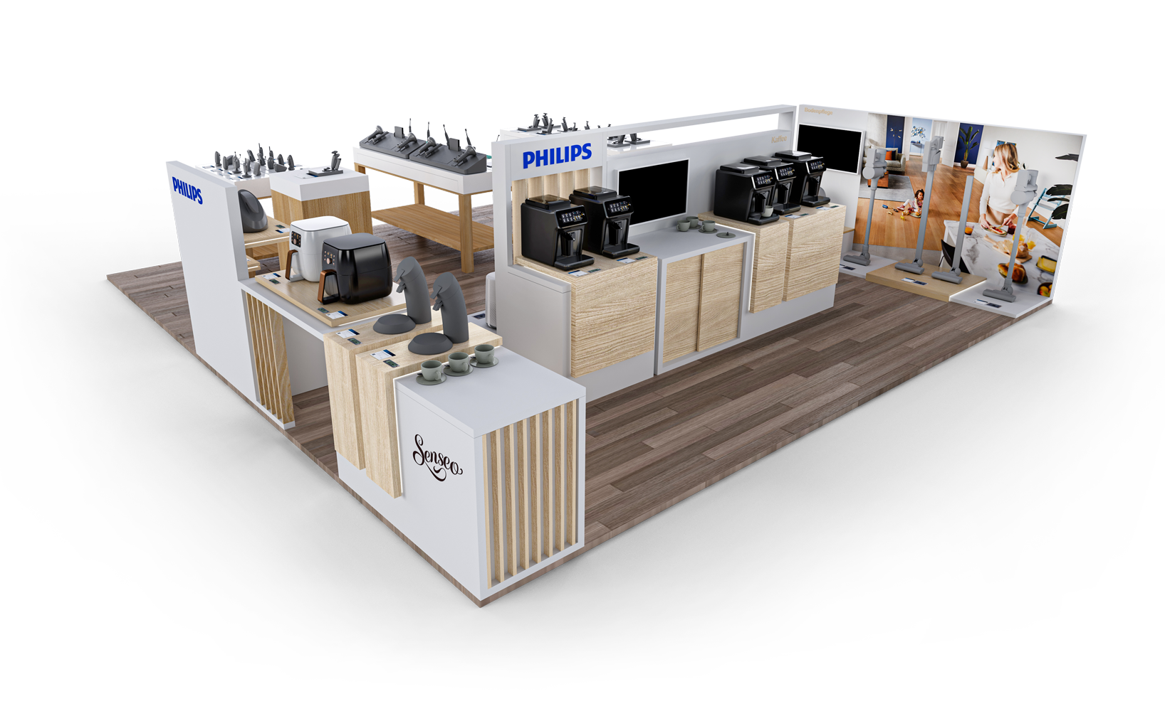

Slide 17
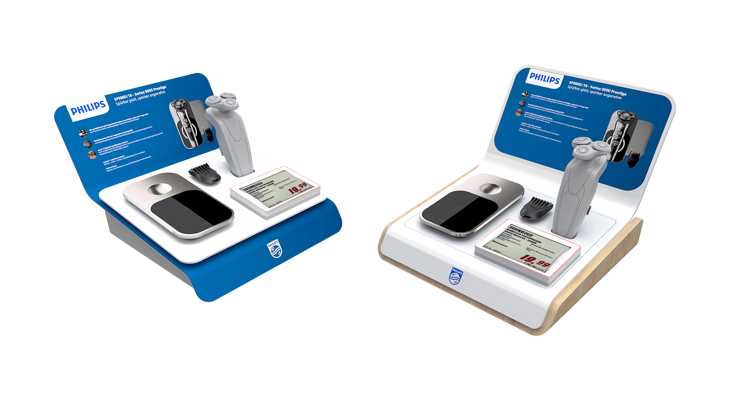

Slide 18
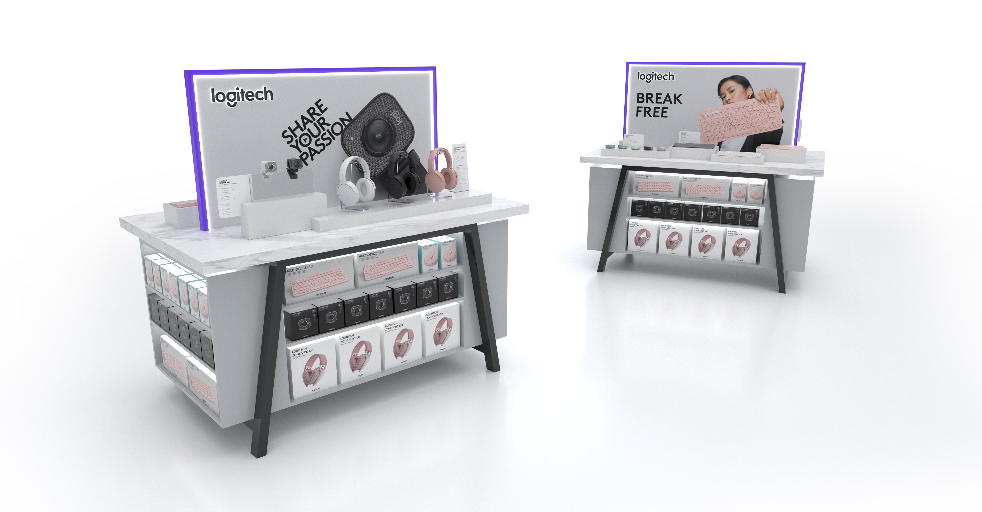

Slide 19
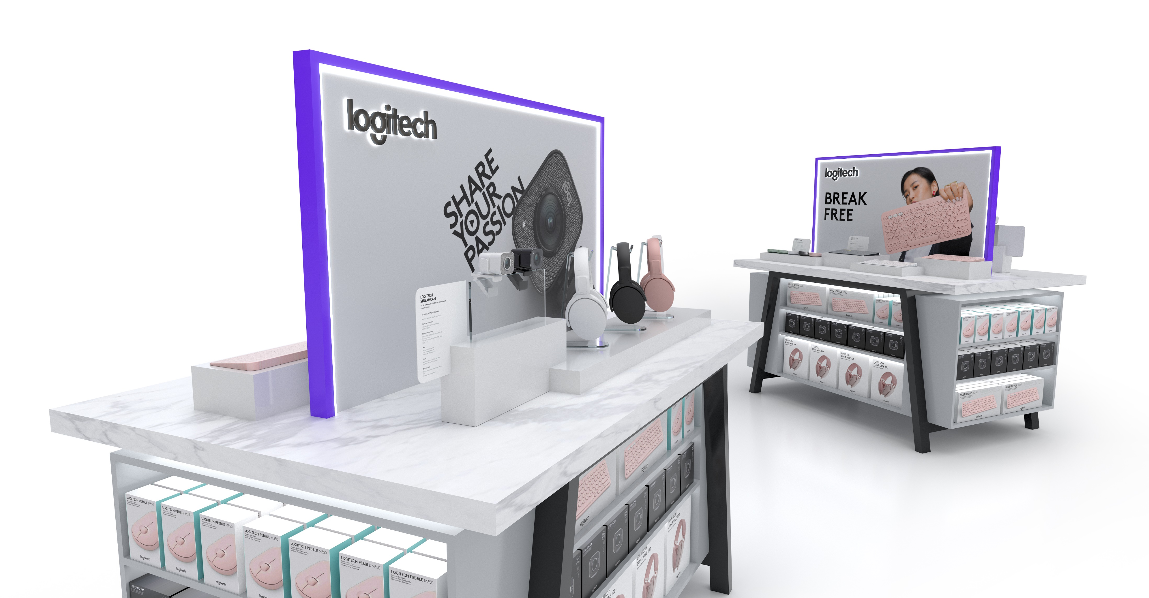

Slide 20
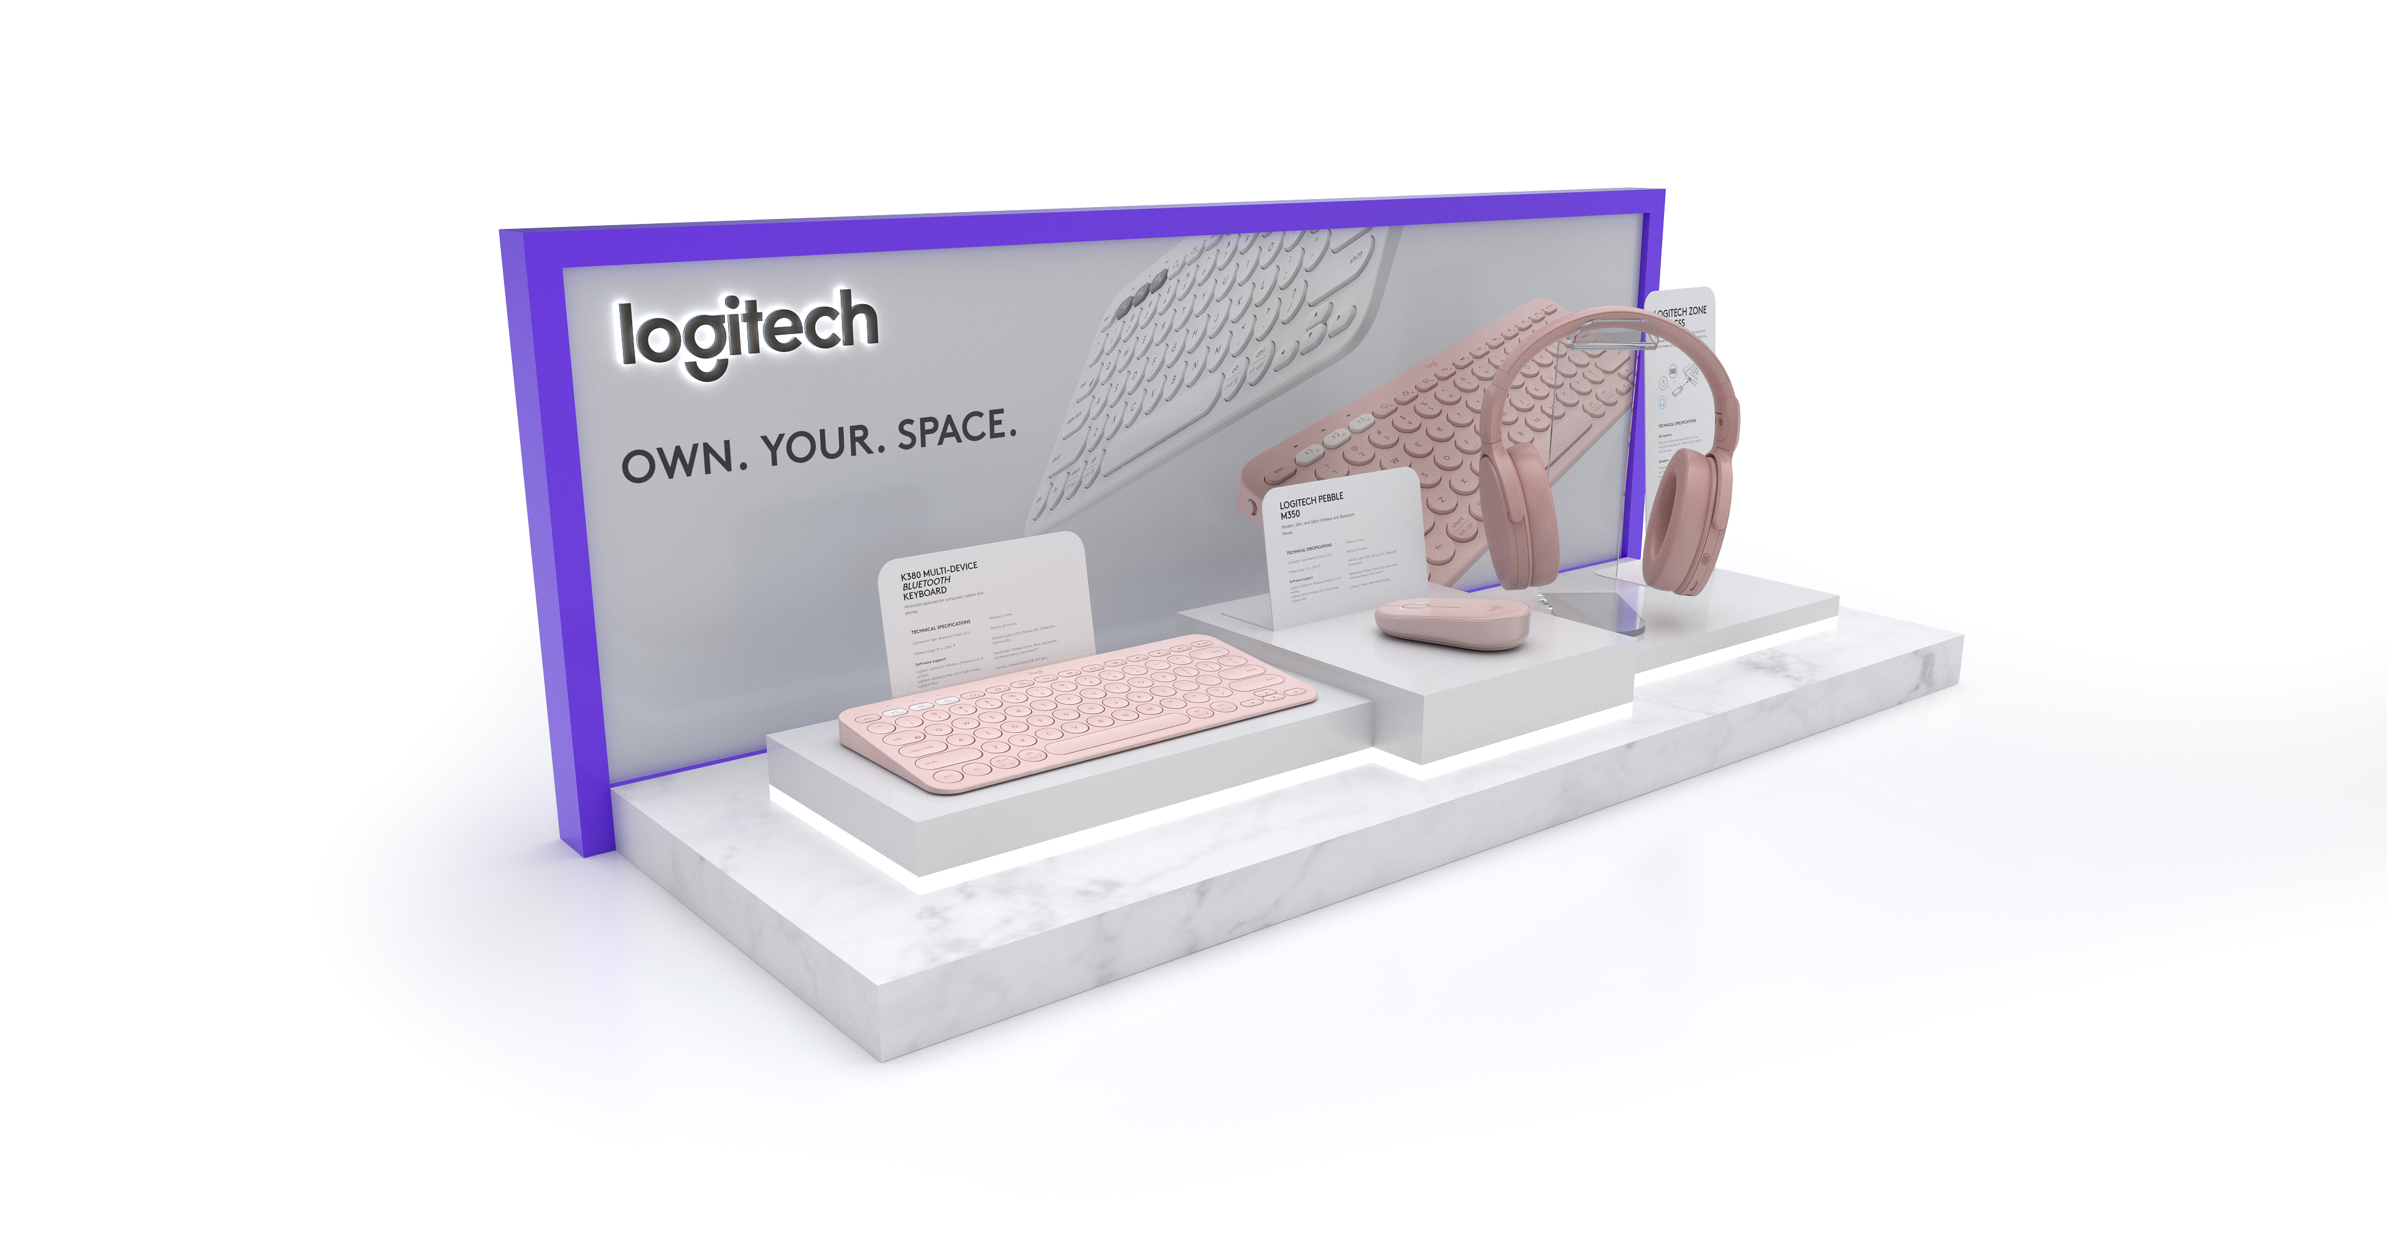

Slide 21
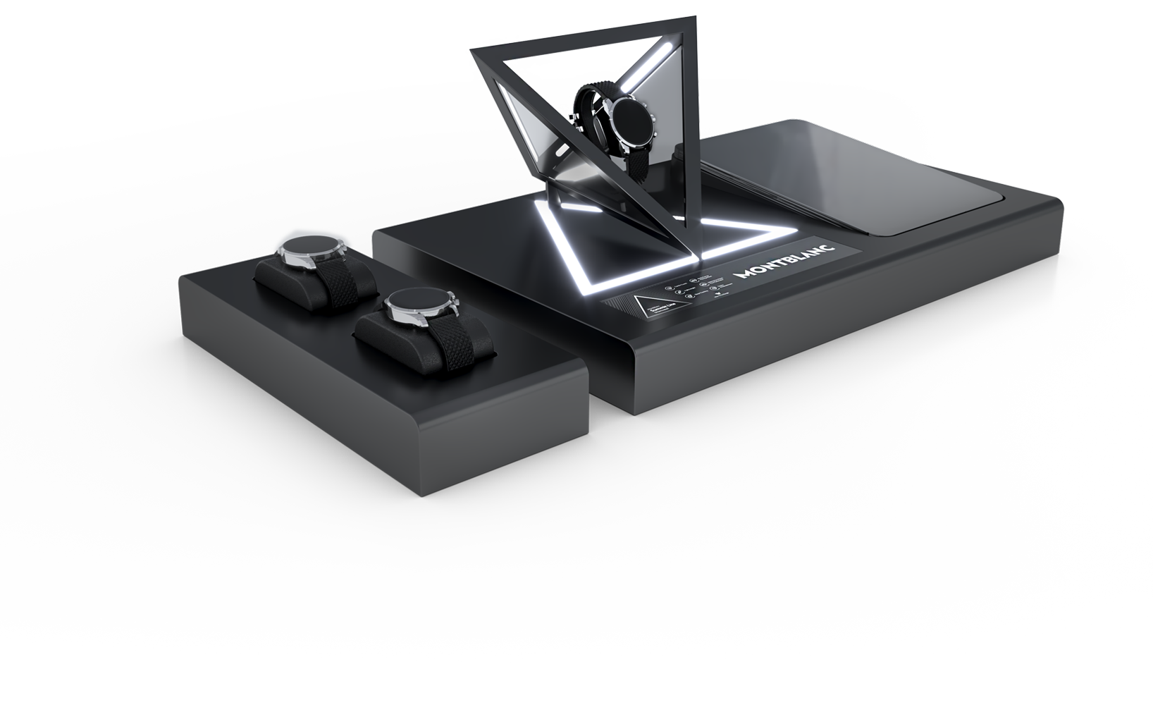

Slide 22
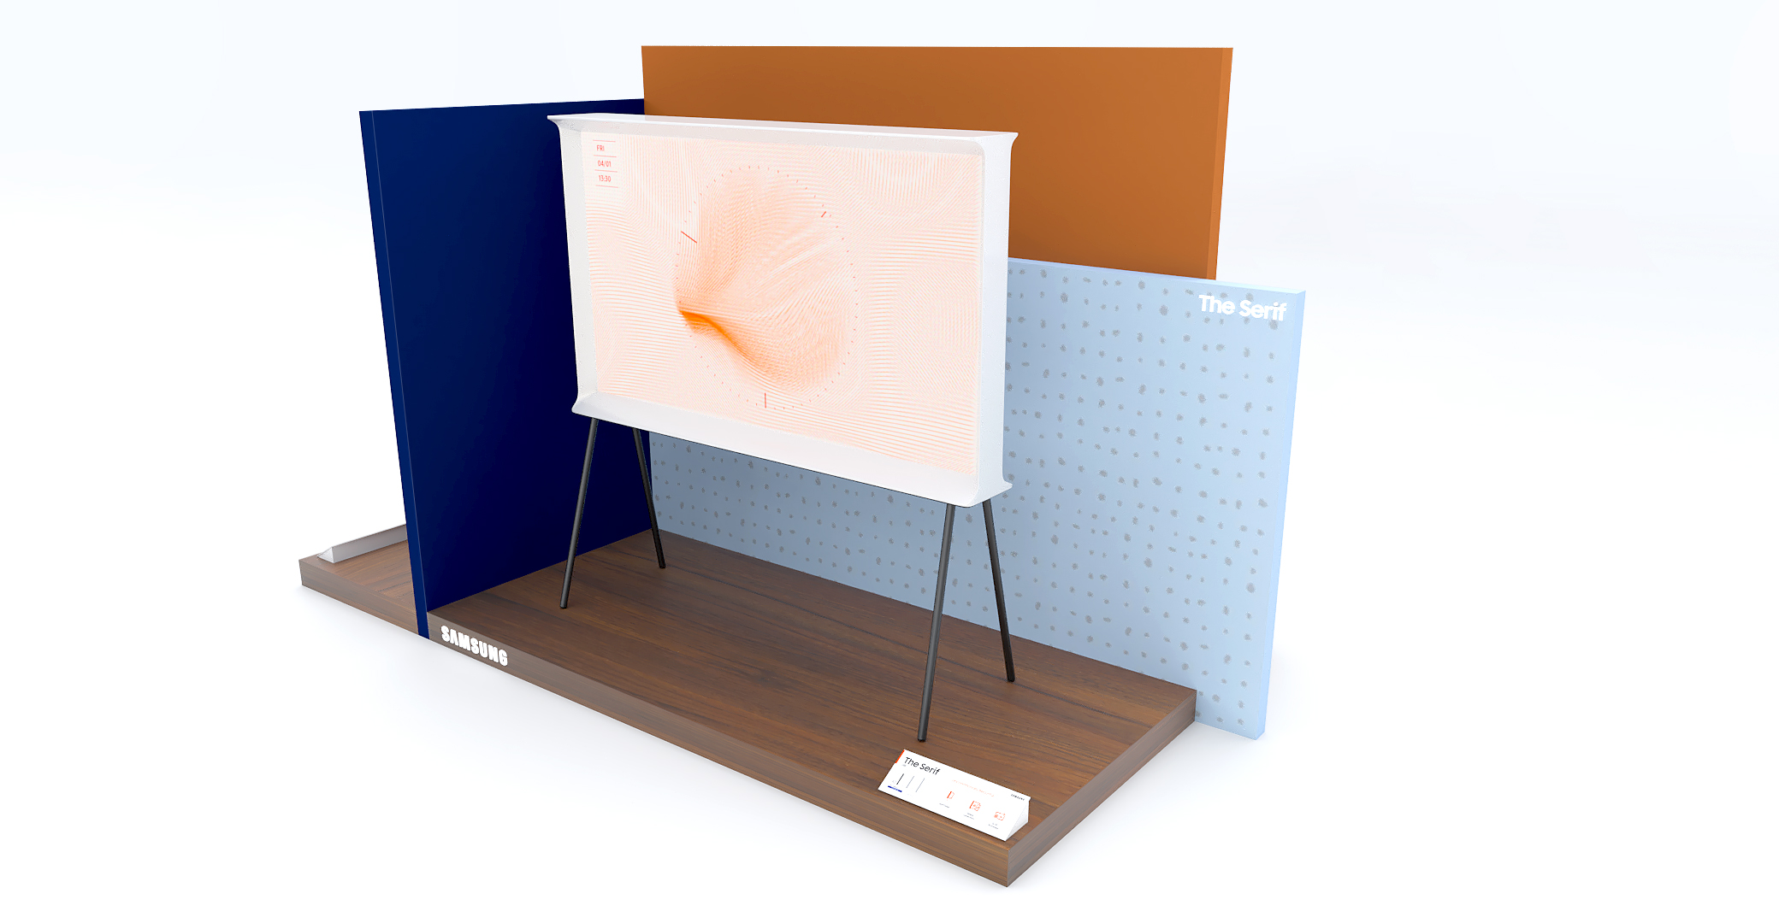

Slide 23
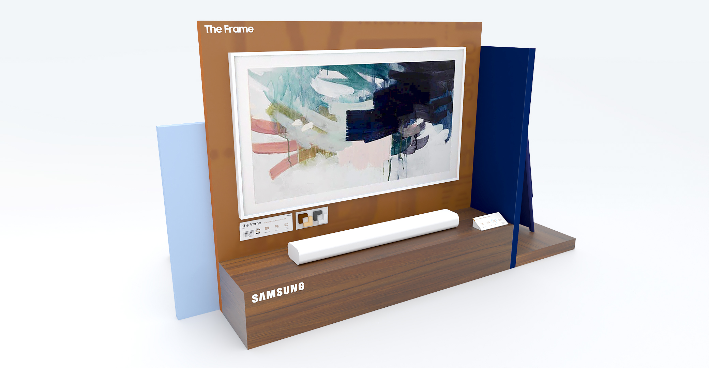

Slide 24
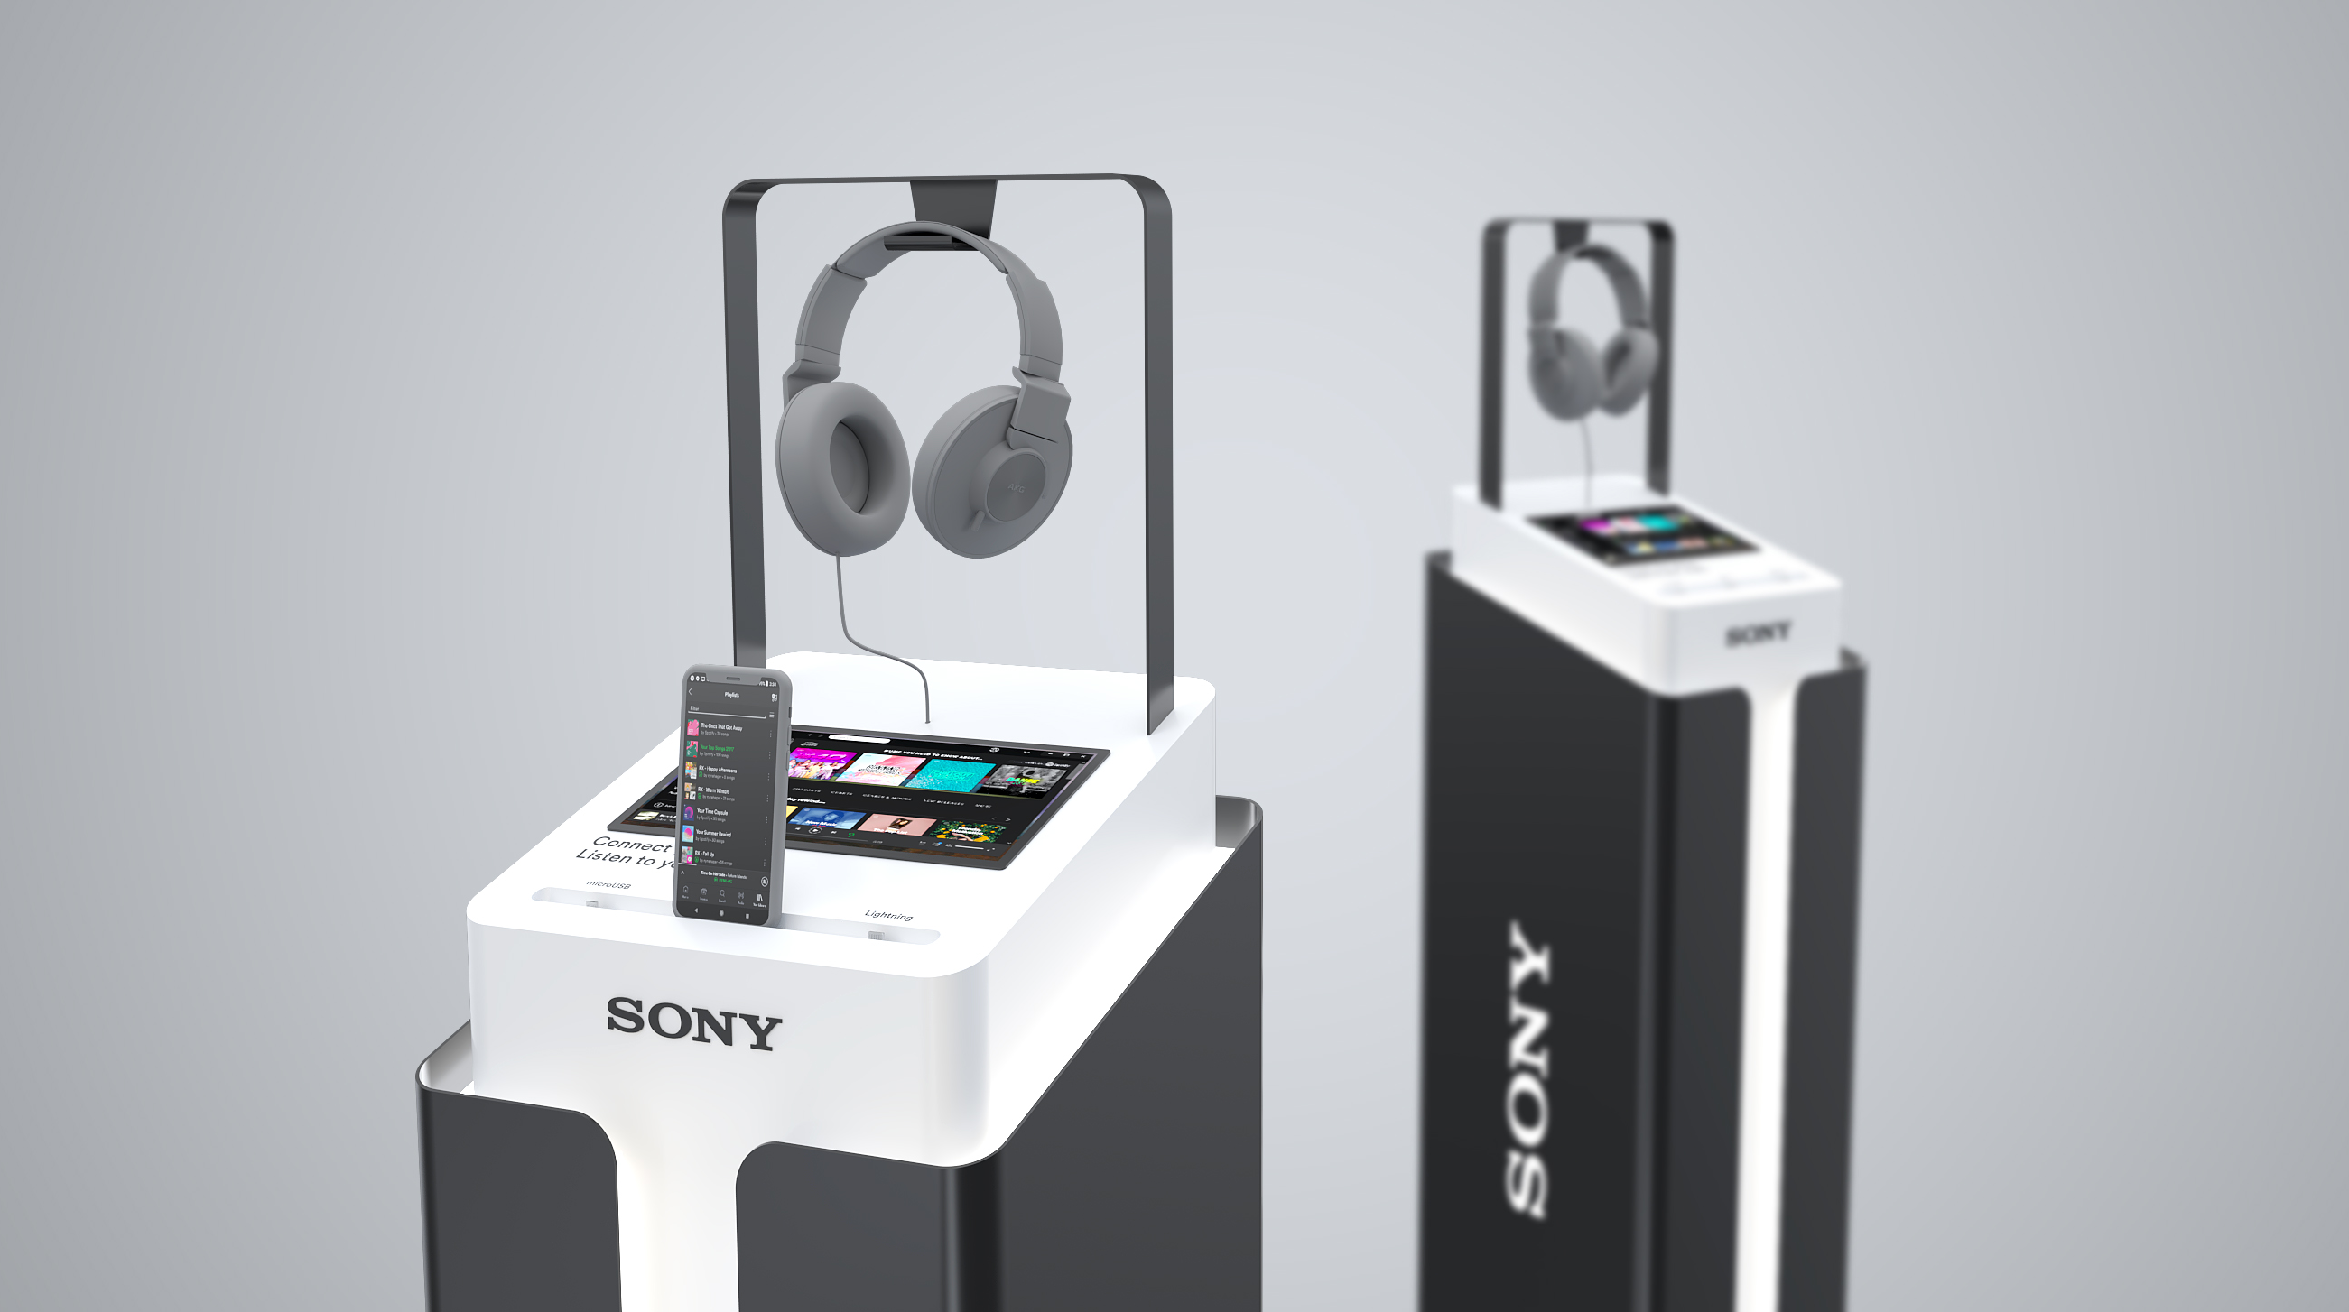

Slide 25
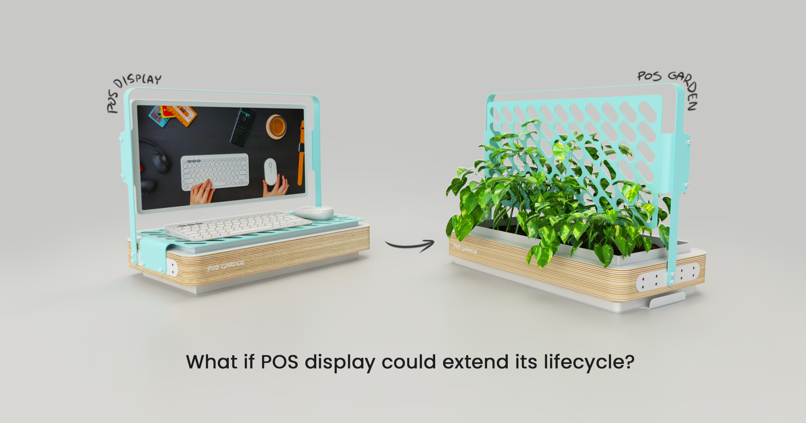

Slide 26
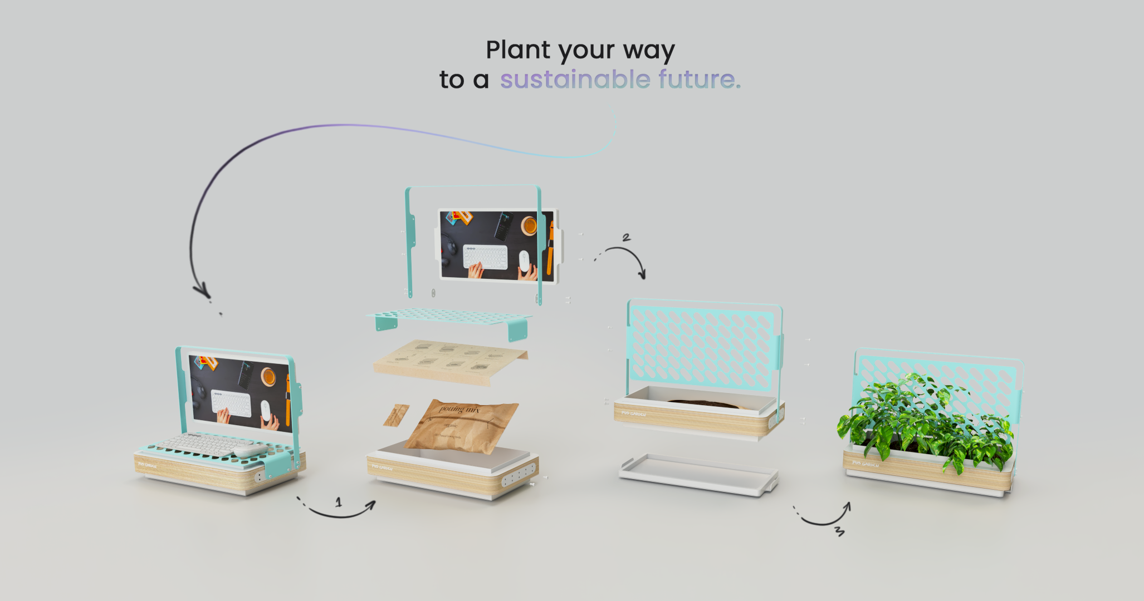

Slide 27
BG REKLAM
HEADQUATERS
29. Novembra 1M
11460 Belgrade, Serbia
info@bgreklam.com
+381 11 785 64 64
+381 60 68 69 110
Thank You.
BG REKLAM GMBH
Leverkusenstraße 3
22761 Hamburg, Deutschland
hamburg@bgreklam.com
+49 40 85413003
www.bgreklam.com
BG REKLAM
UK LTD
2588 Davenport House,
207 Regent St
London, W1B 3HH, UK
+44 75 4288 2312

