Slide 1
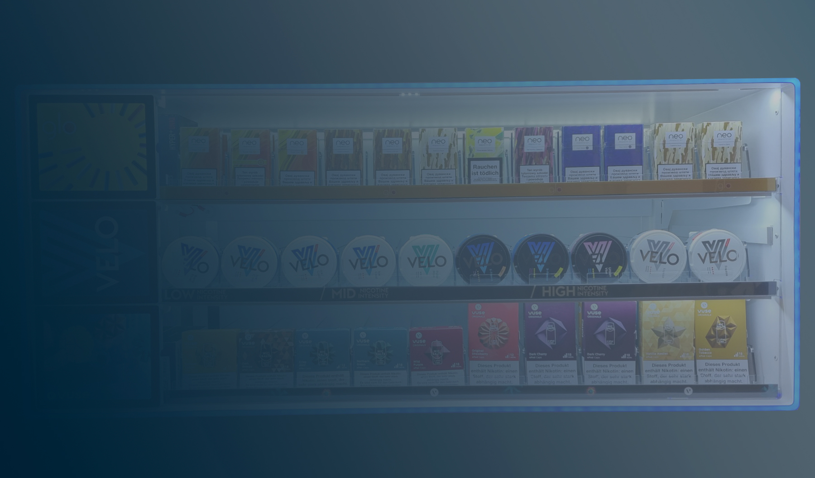

Premium
POS Industry
People are always going to go shopping.
A lot of our effort is just how we make the retail experience a great one!

Slide 2
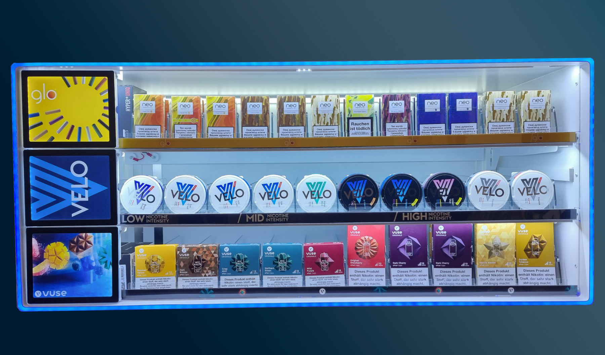
Product weight reduced by 10kg
Dimensions adjusted as requested
Background RGB replaced with regular LED Stripe
Front frame RGB controlled via remote controller
Dimmer removed
Timer remembers last settings even if unplugged

Slide 3
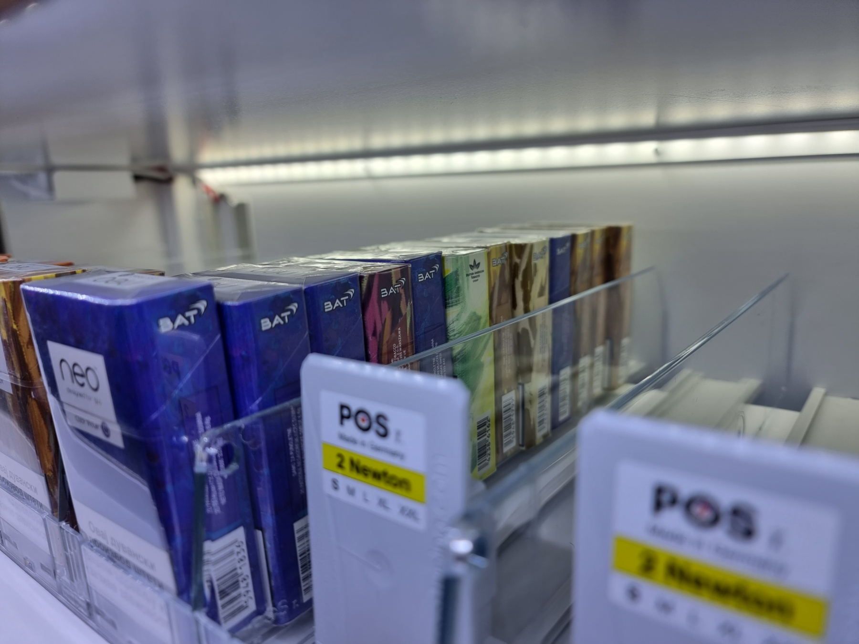
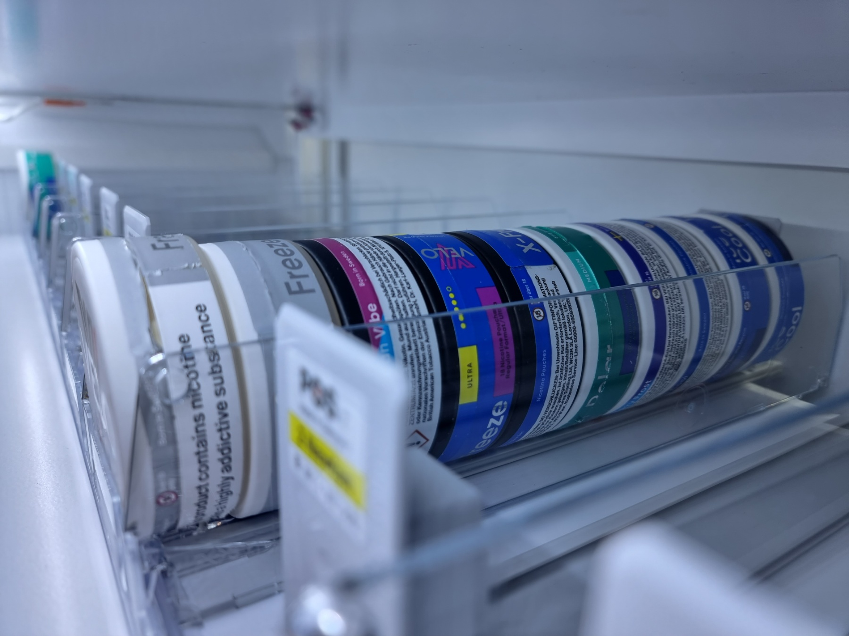
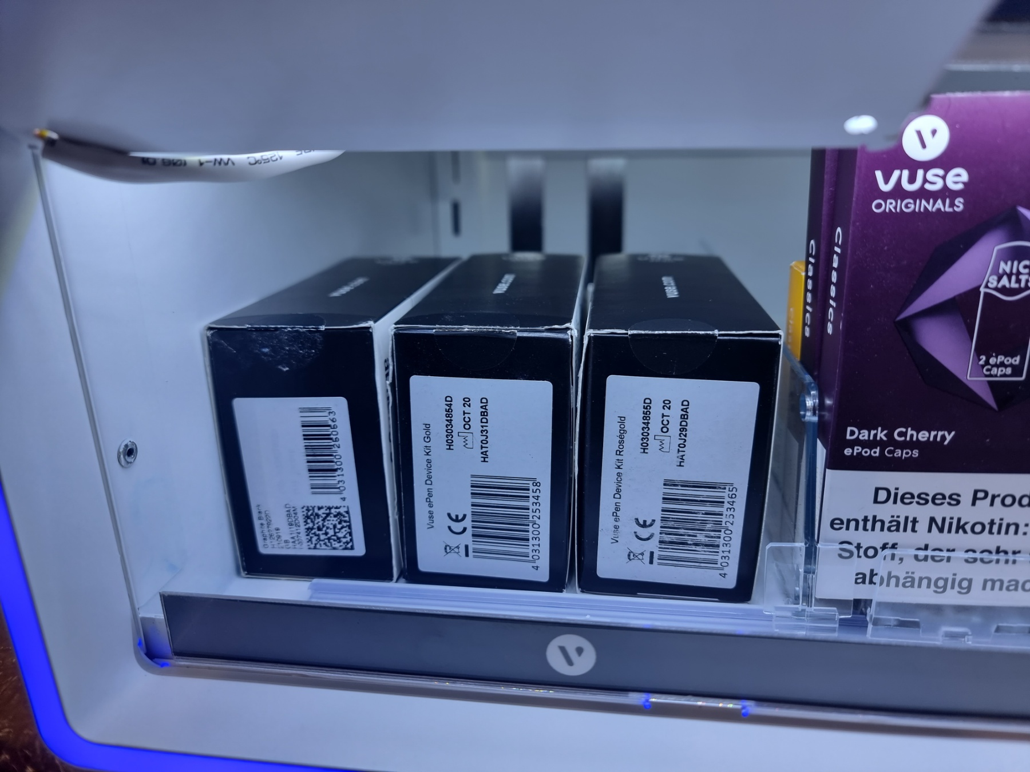
13x Neo packs
10x Velo packs
3x packs of Vuse ePen

Slide 4
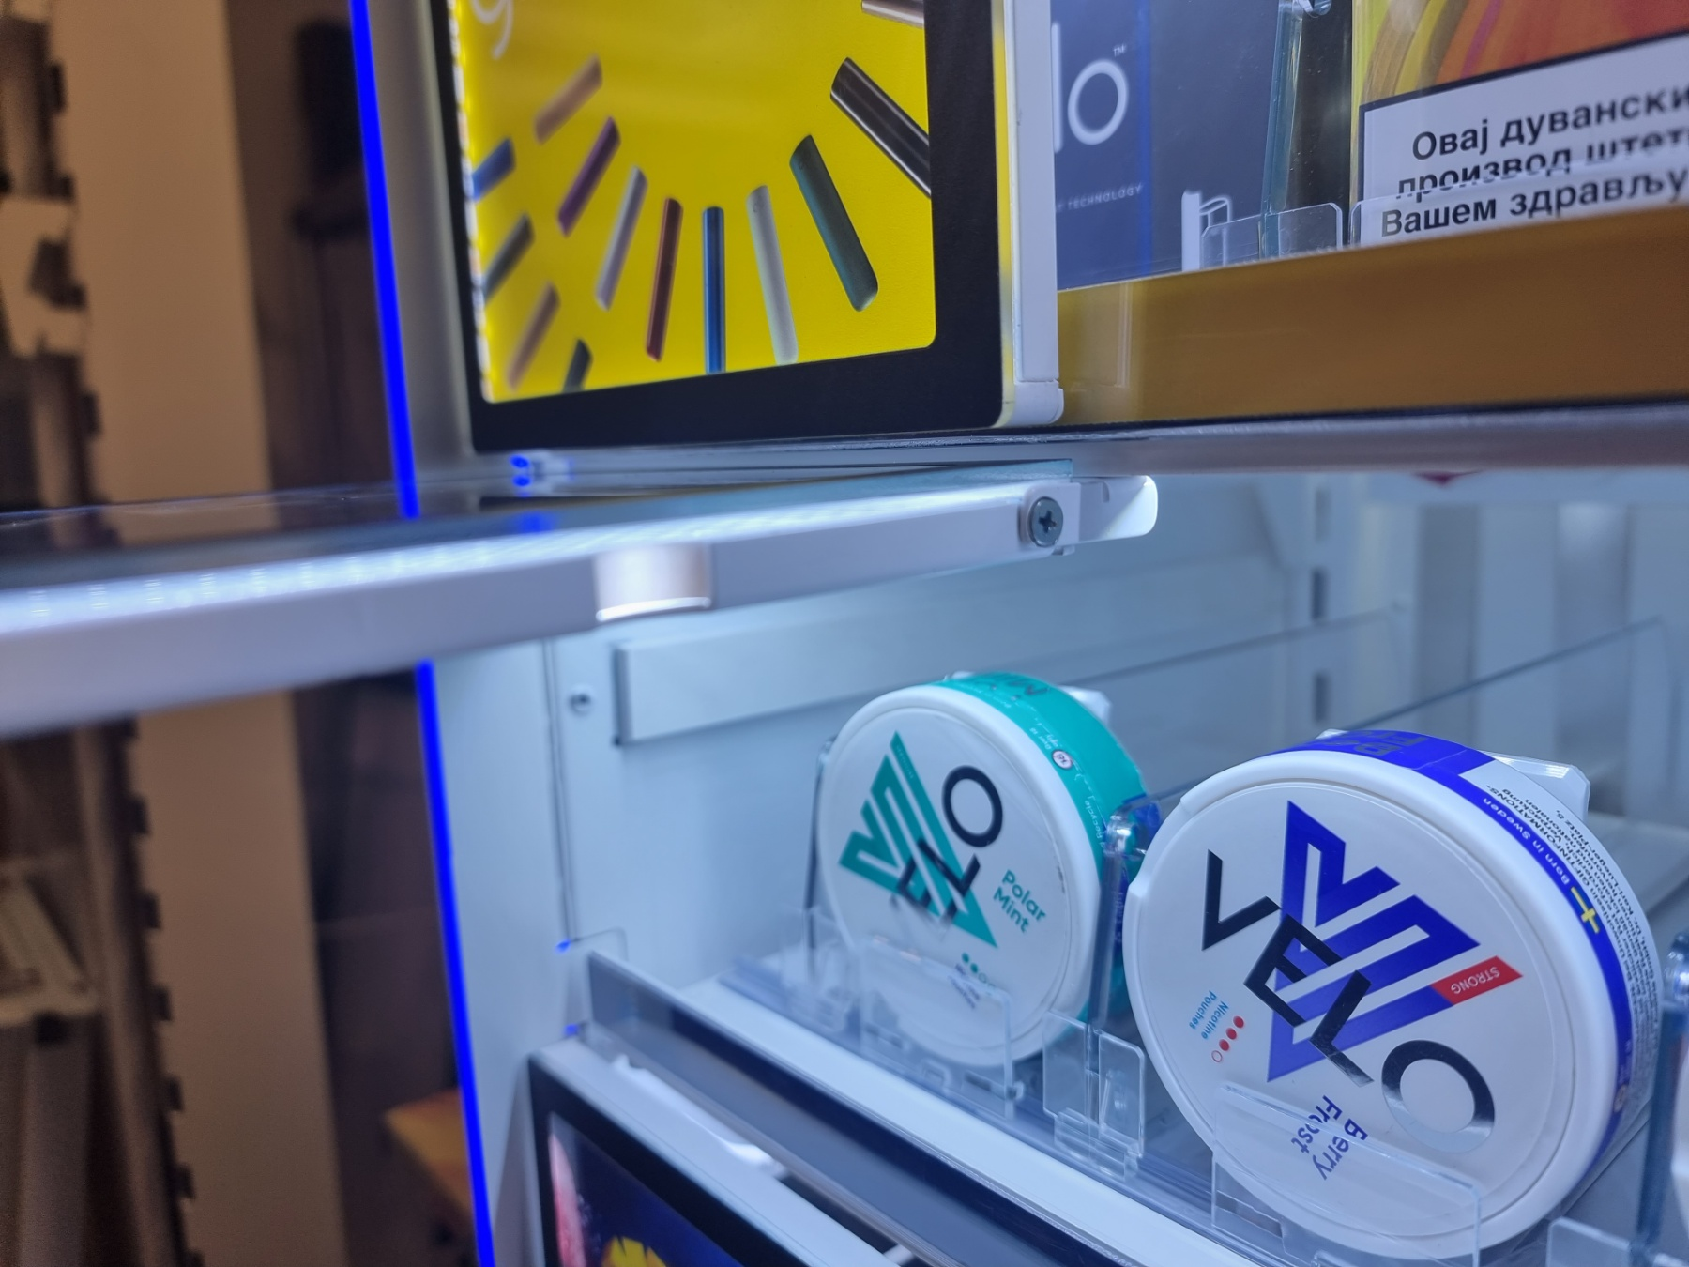
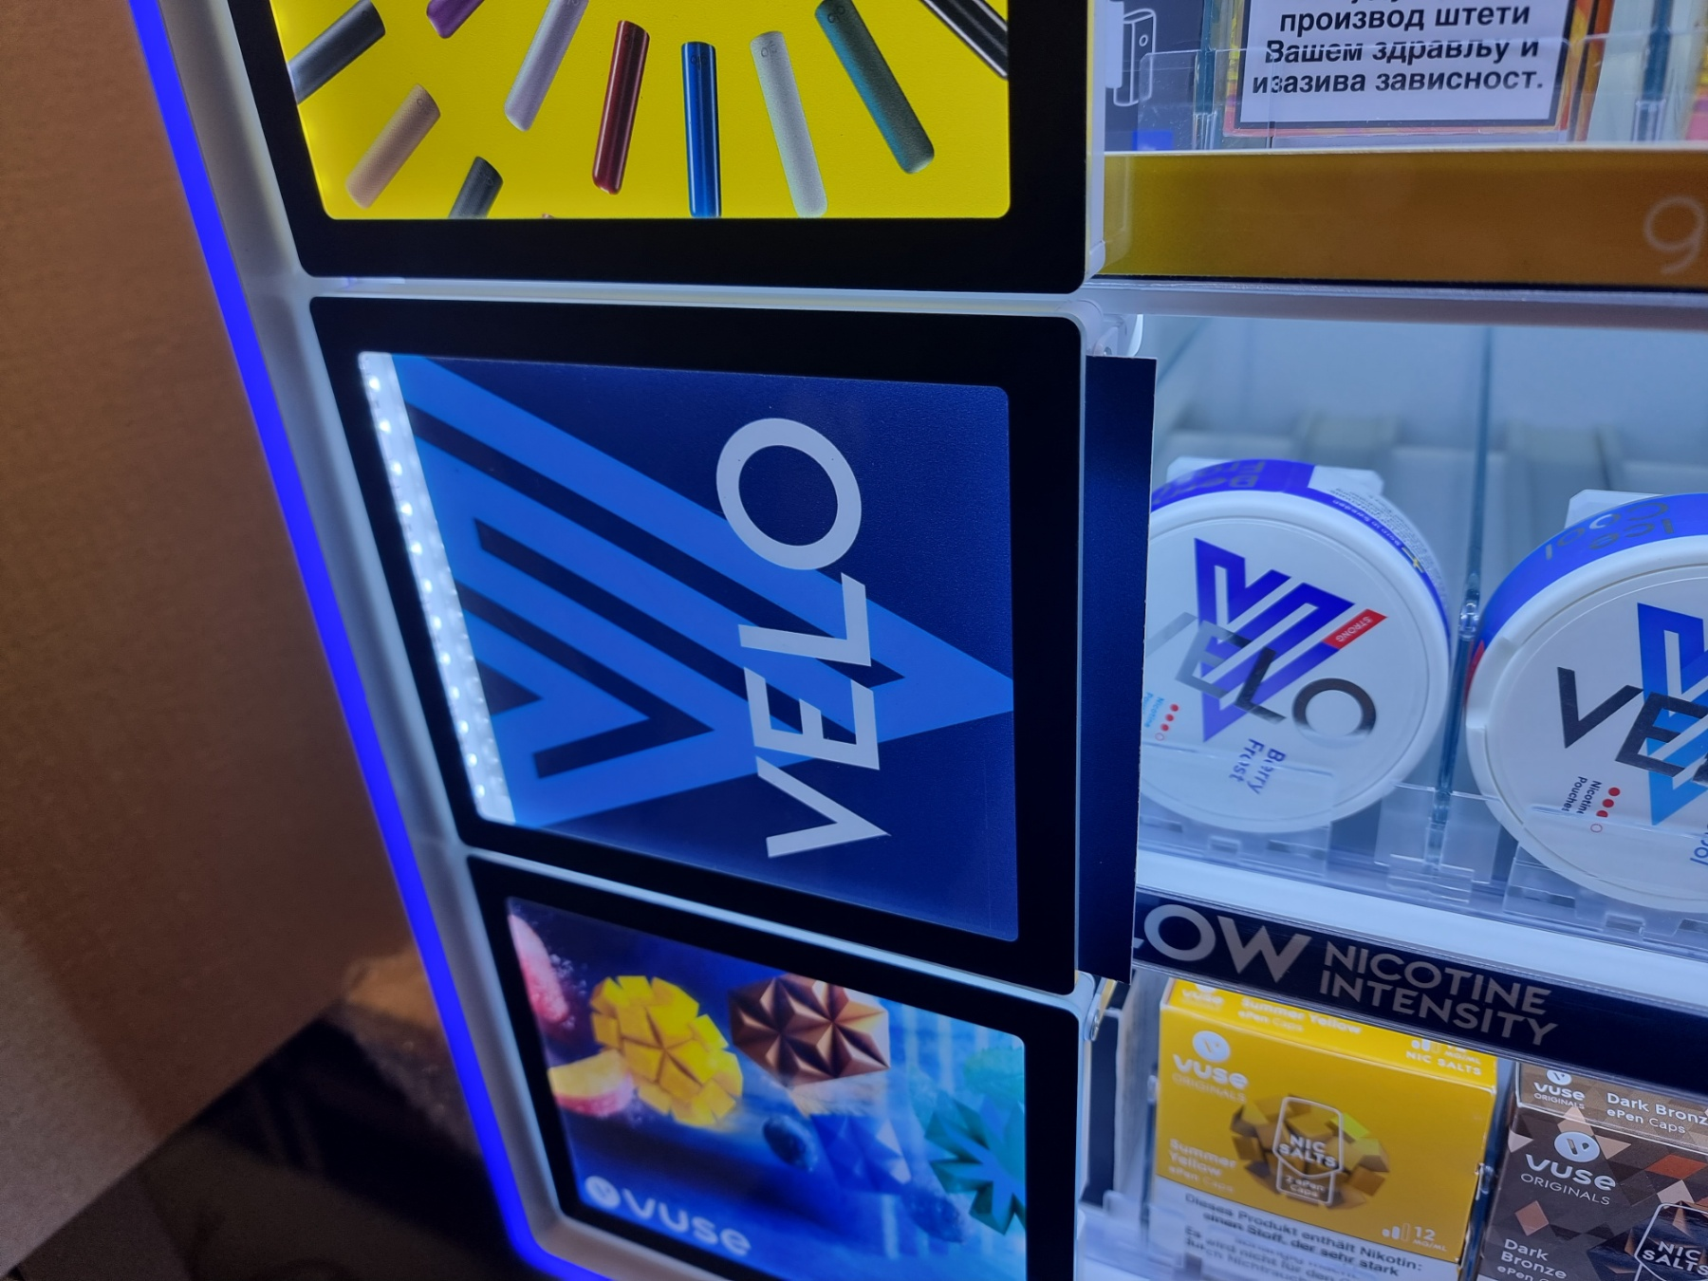
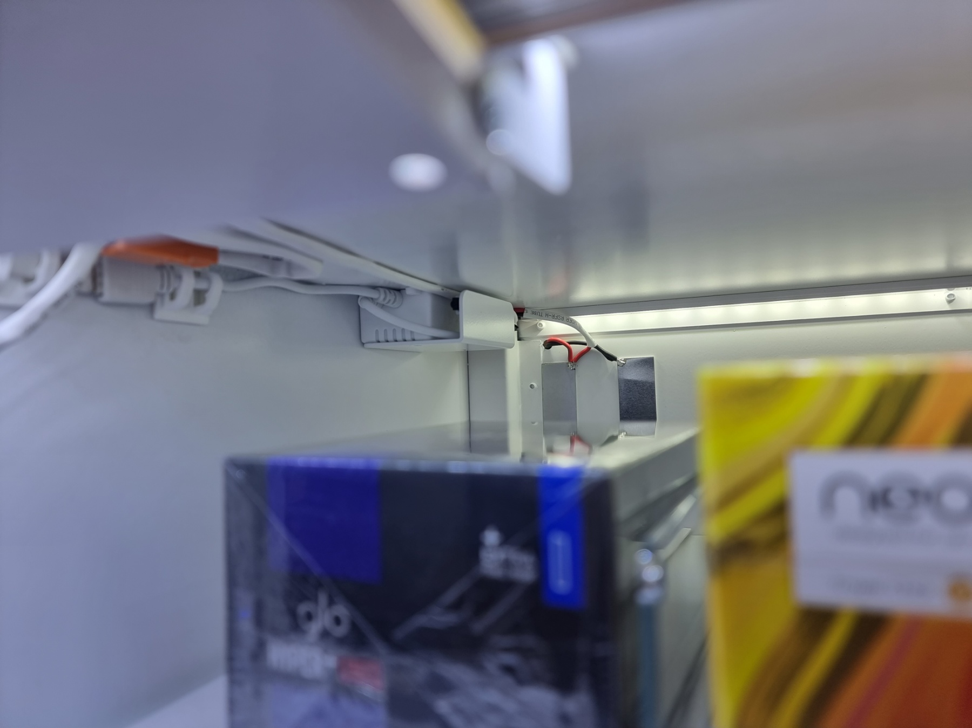
Fixed flaps
and
Print easily to change from the side
RGB Adapter moved
inside the box

Slide 5
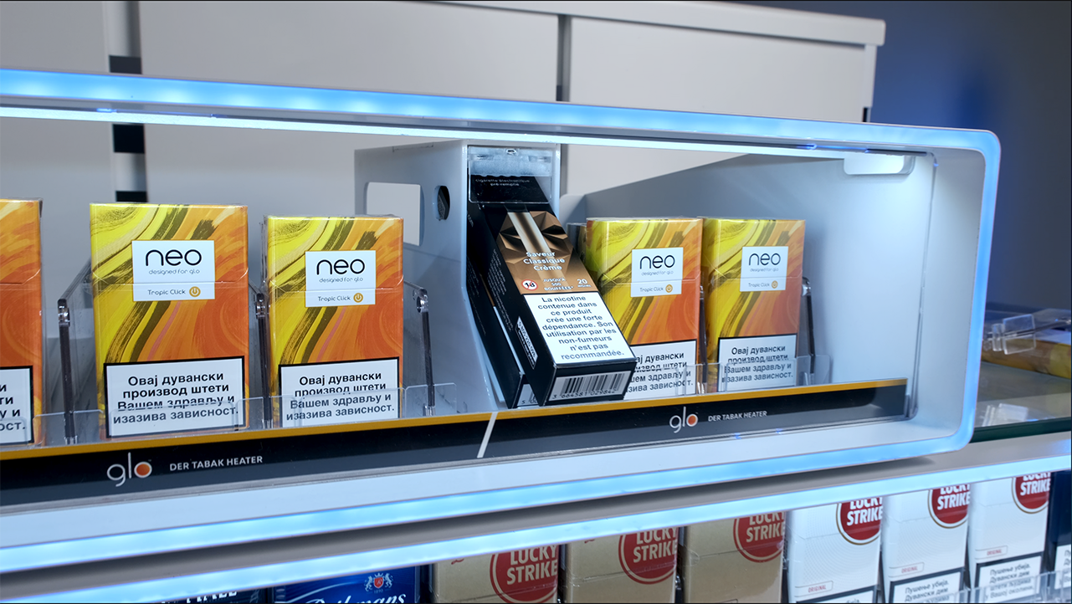
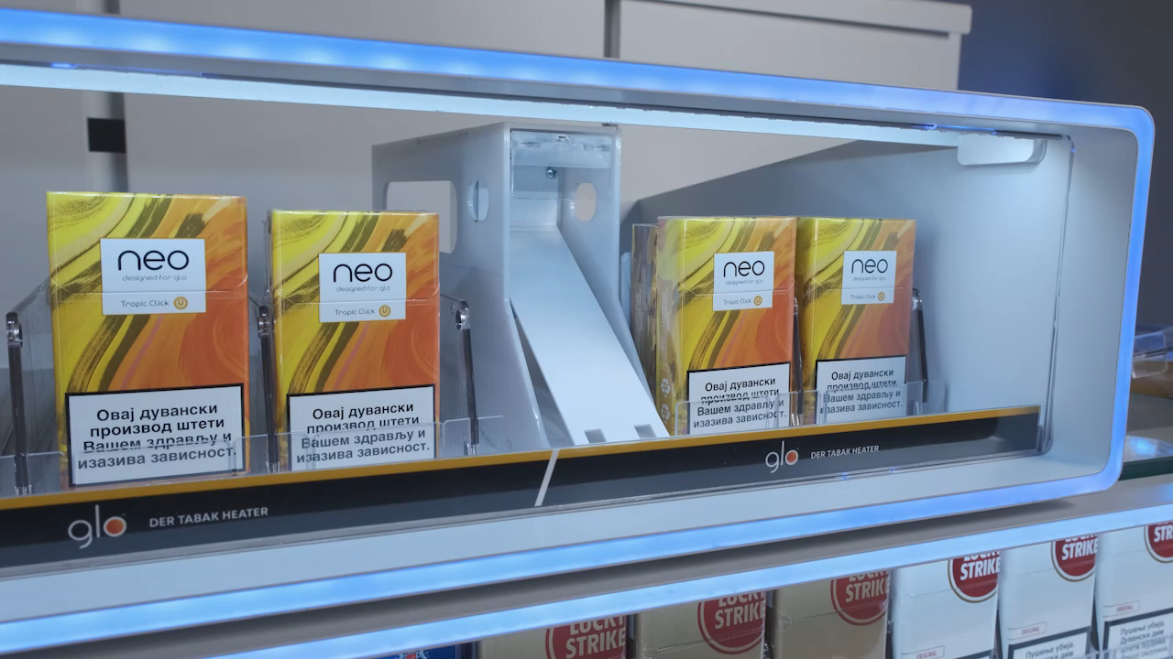

Solution for VuseGo that can be implemented for Austrian MultiBox solution

Slide 6
BG REKLAM
HEADQUATERS
29. Novembra 1M
11460 Belgrade, Serbia
info@bgreklam.com
+381 11 785 64 64
+381 60 68 69 110
Thank You.
BG REKLAM GMBH
Leverkusenstraße 3
22761 Hamburg, Deutschland
hamburg@bgreklam.com
+49 40 85413003
www.bgreklam.com
BG REKLAM
UK LTD
2588 Davenport House,
207 Regent St
London, W1B 3HH, UK
+44 75 4288 2312

