Slide 1
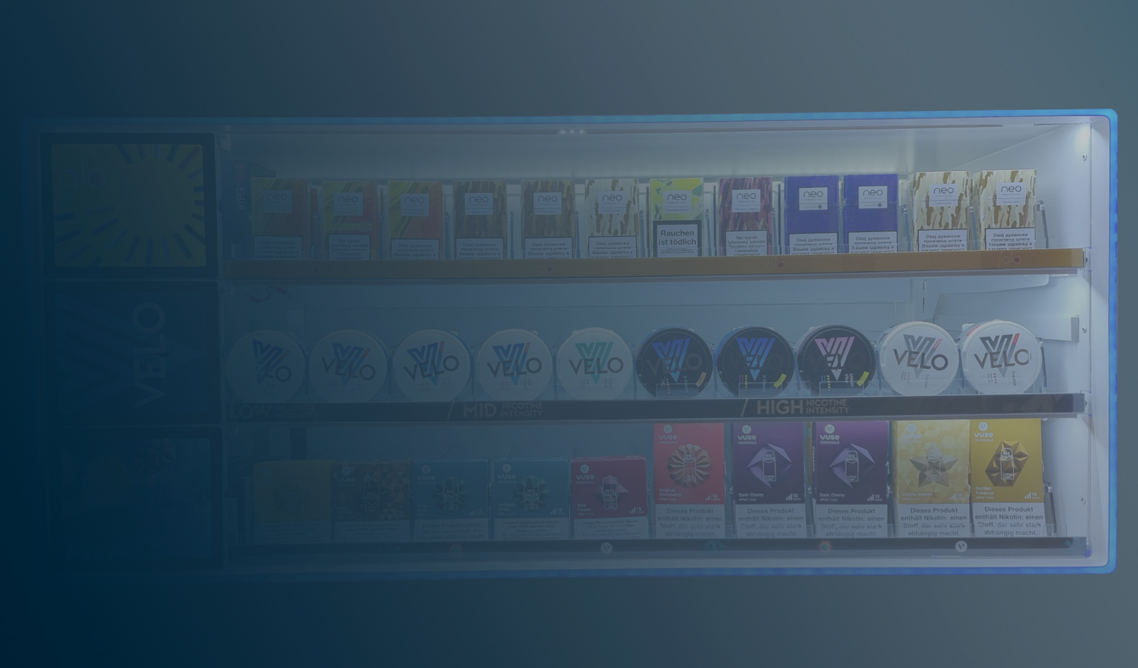

Premium
POS Industry
People are always going to go shopping.
A lot of our effort is just how we make the retail experience a great one!

Slide 2
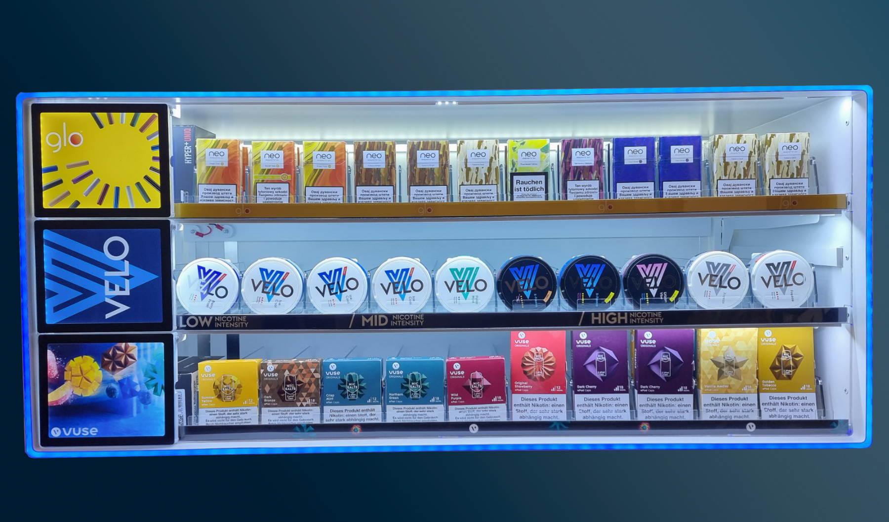
Product weight reduced by 10kg
Dimensions adjusted as requested
Background RGB replaced with regular LED Stripe
Front frame RGB flashing removed
Dimmer removed
Timer remembers last settings even if unplugged for several days

Slide 3
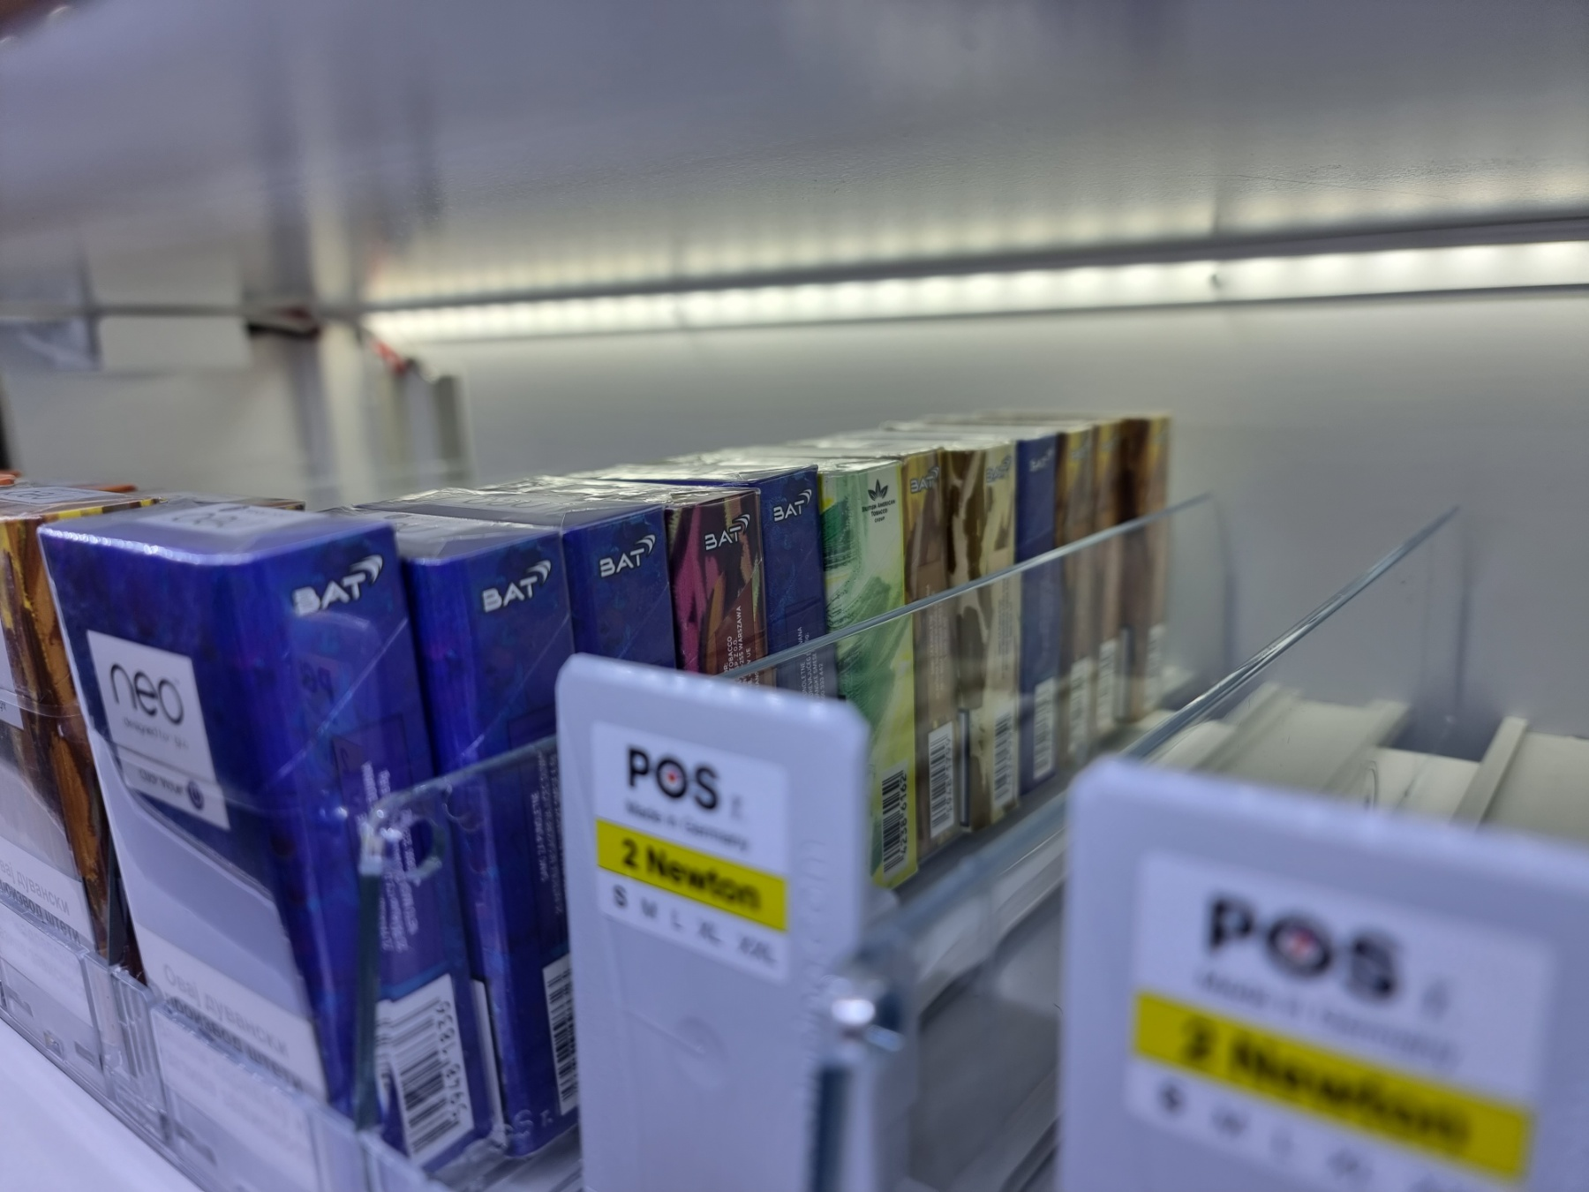
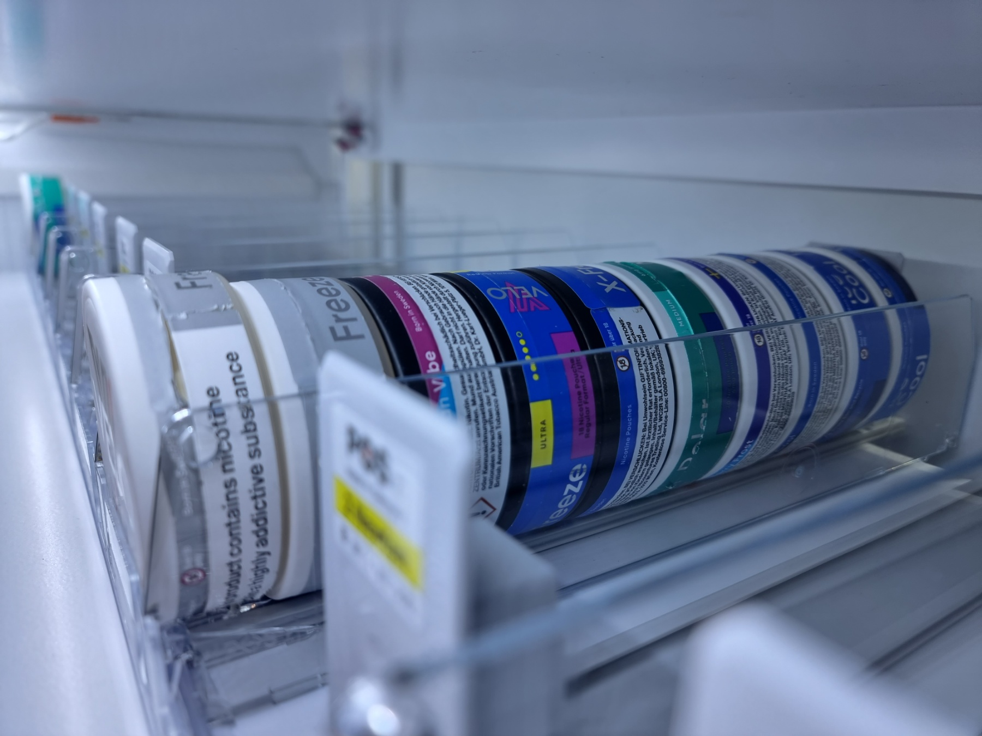
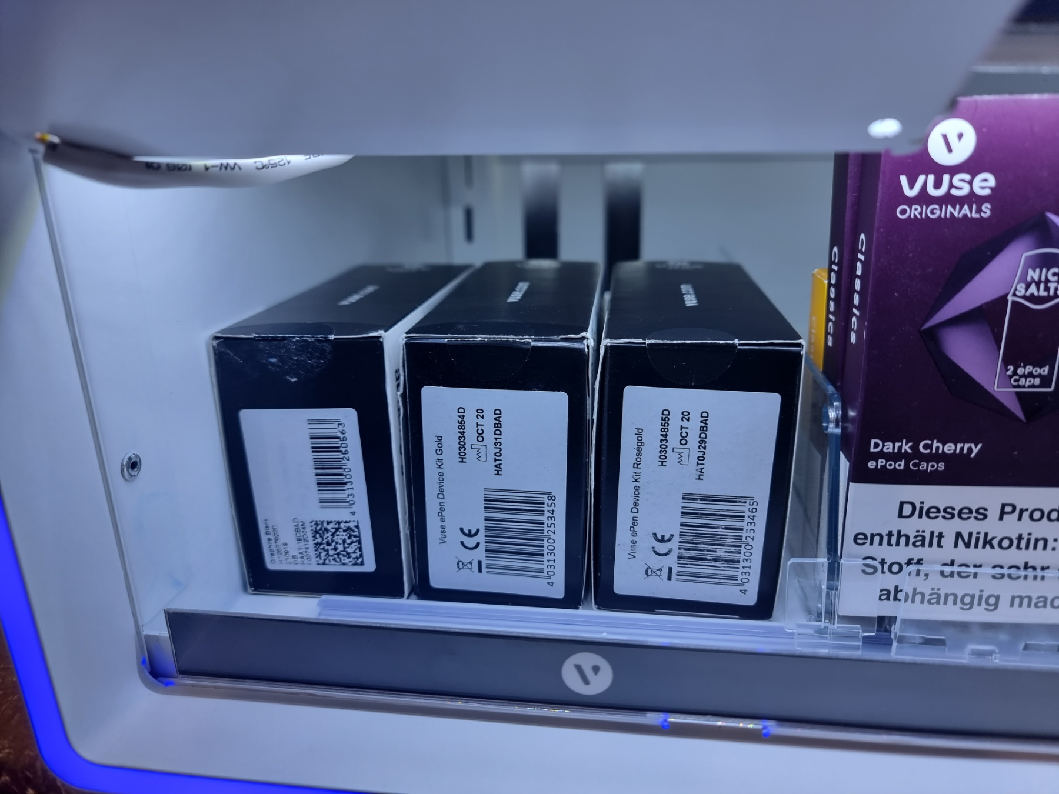
As requested fit Eleven Neo packs
As requested fit ten velo packs
Flap now fits three vuse ePen boxes

Slide 4
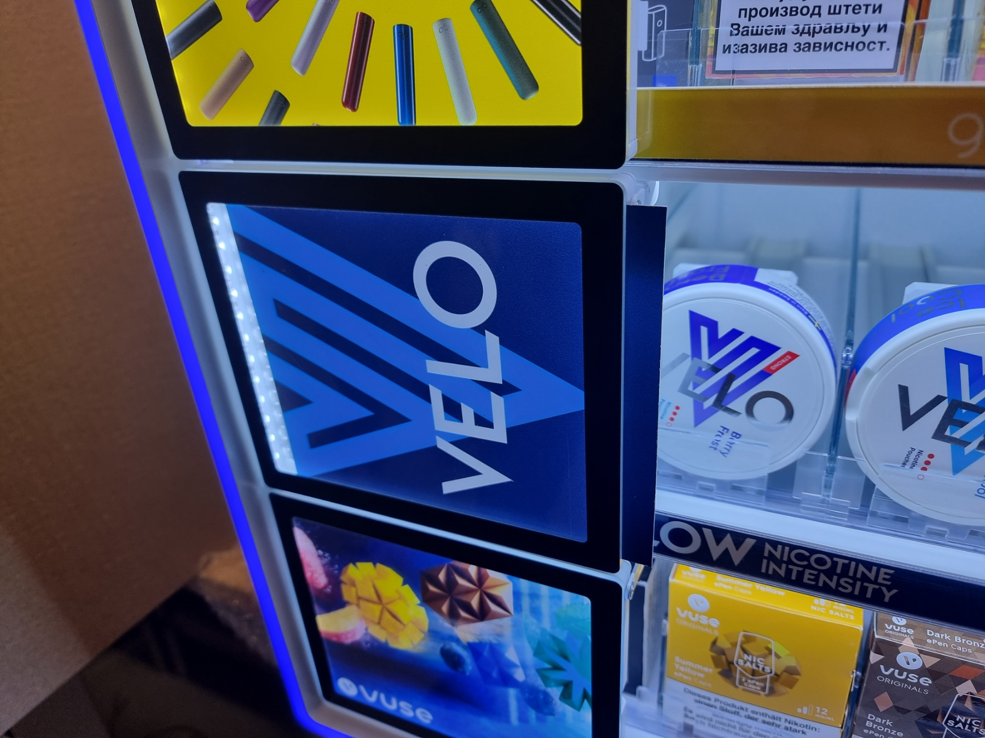
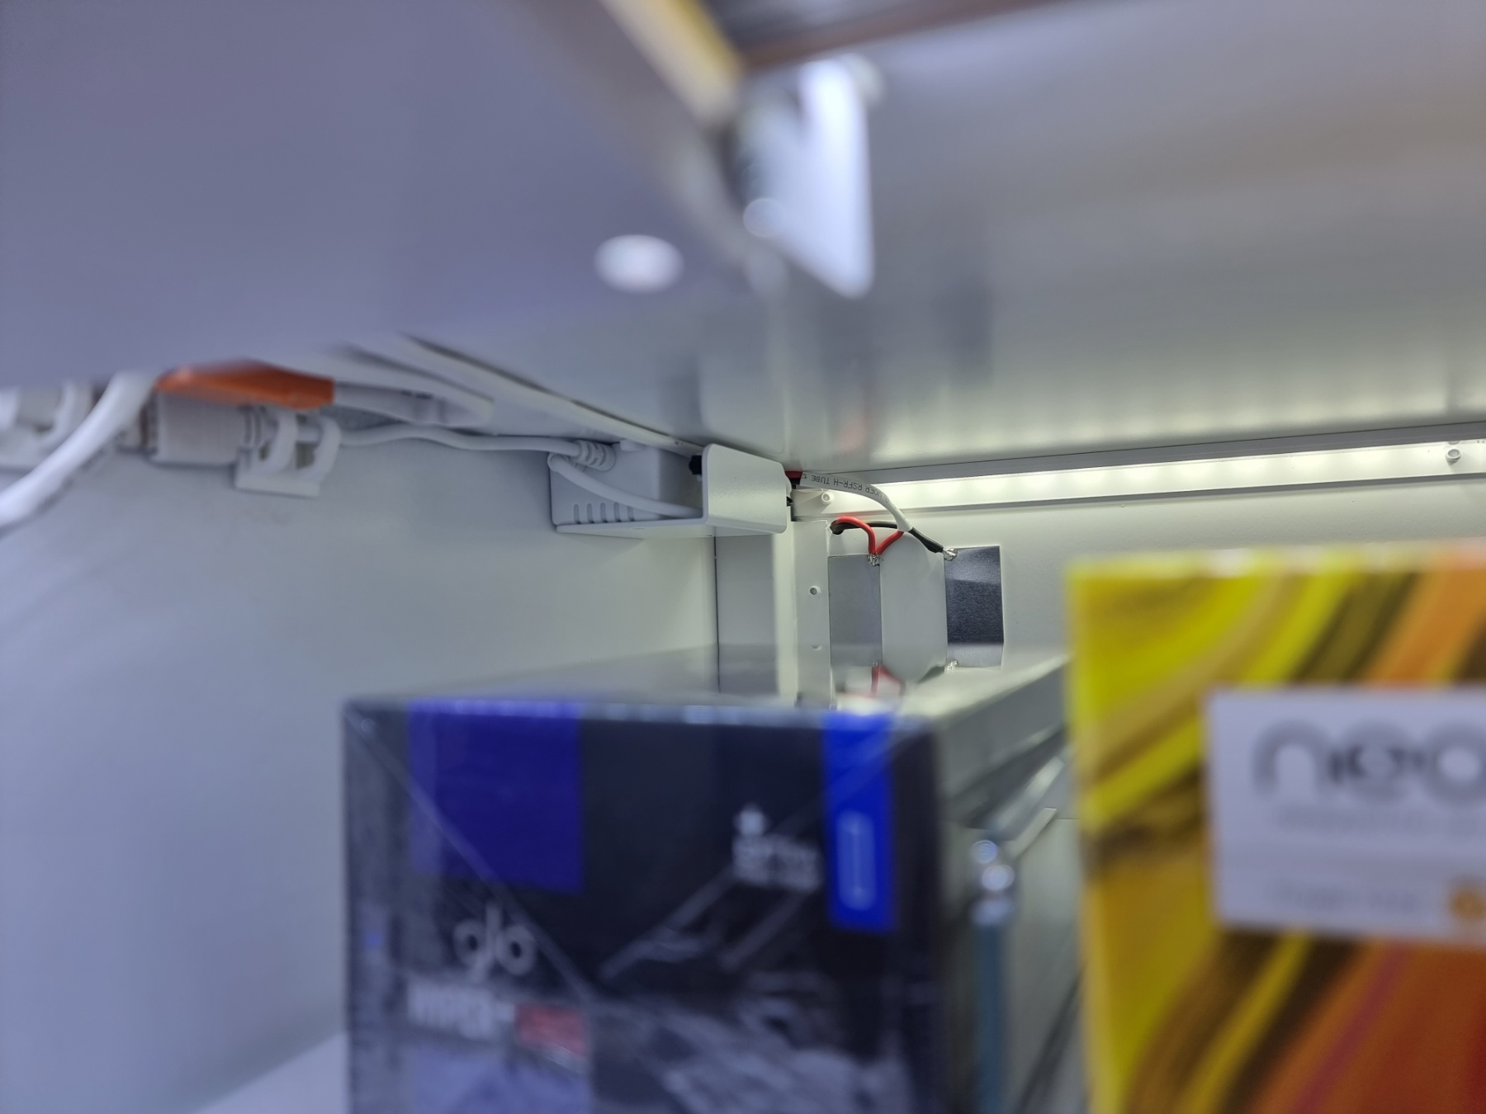
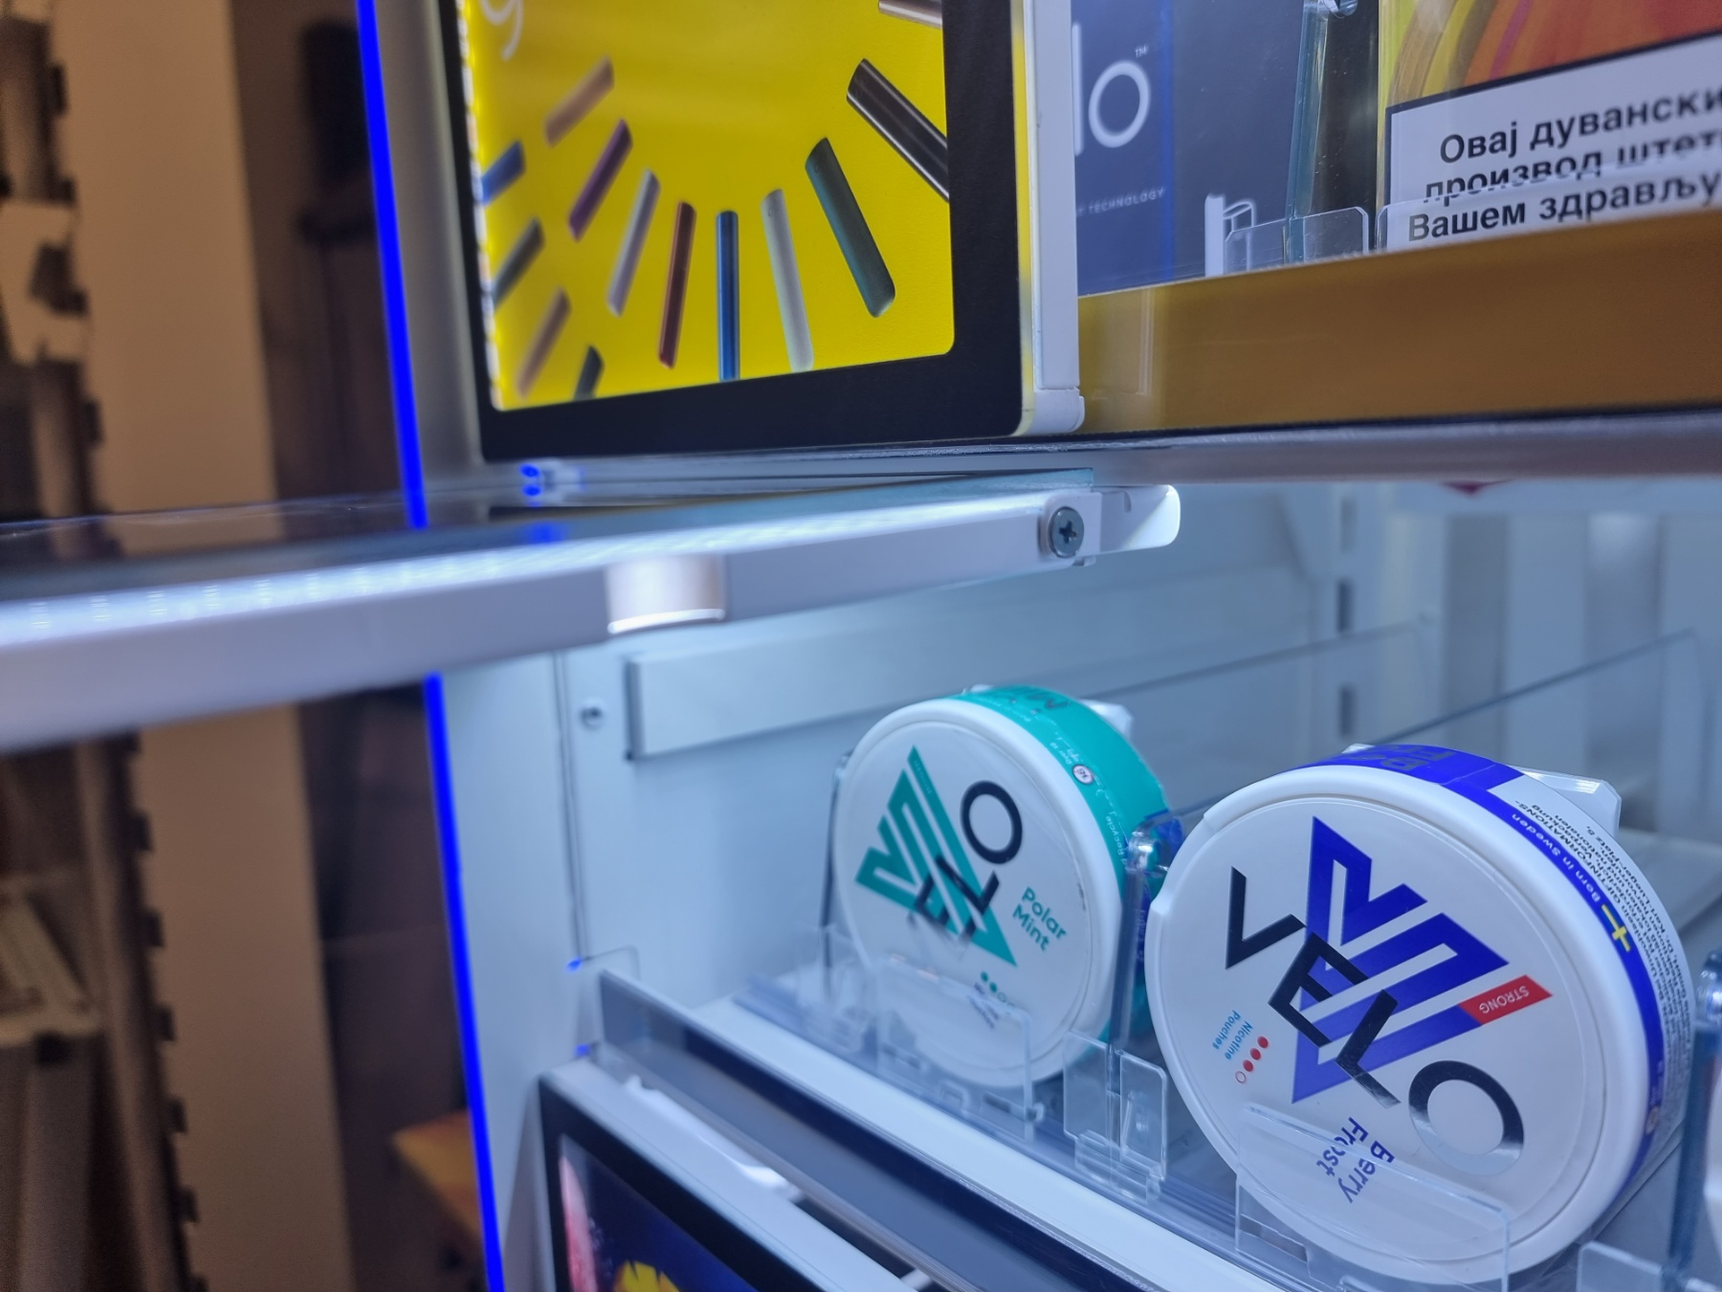
RGB Cables moved
inside of the box
Print easily to change
Fixed flaps

Slide 5
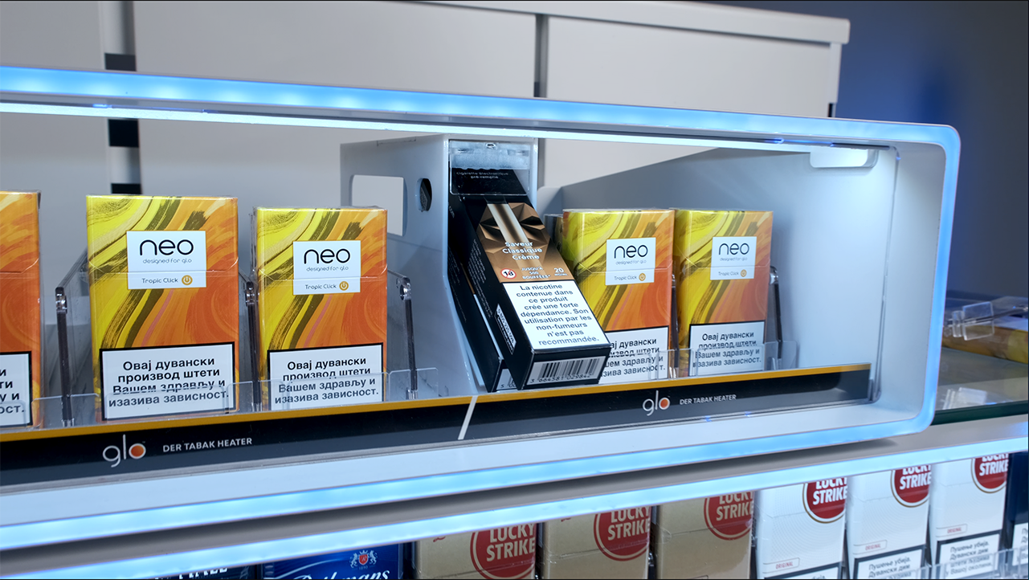
ePod Caps Pack
Current ePod caps pack is 112mm, standard pusher height at front reduces total space by 11mm, which leaves only 4mm for handling the packs.
Due to very limited space, handling packs becomes difficult.
We recommend that we should maybe consider using similar solution that you had developed with angled pushers for VusoGo packs (video).

Slide 6
BG REKLAM
HEADQUATERS
29. Novembra 1M
11460 Belgrade, Serbia
info@bgreklam.com
+381 11 785 64 64
+381 60 68 69 110
Thank You.
BG REKLAM GMBH
Leverkusenstraße 3
22761 Hamburg, Deutschland
hamburg@bgreklam.com
+49 40 85413003
www.bgreklam.com
BG REKLAM
UK LTD
2588 Davenport House,
207 Regent St
London, W1B 3HH, UK
+44 75 4288 2312

