Slide 1
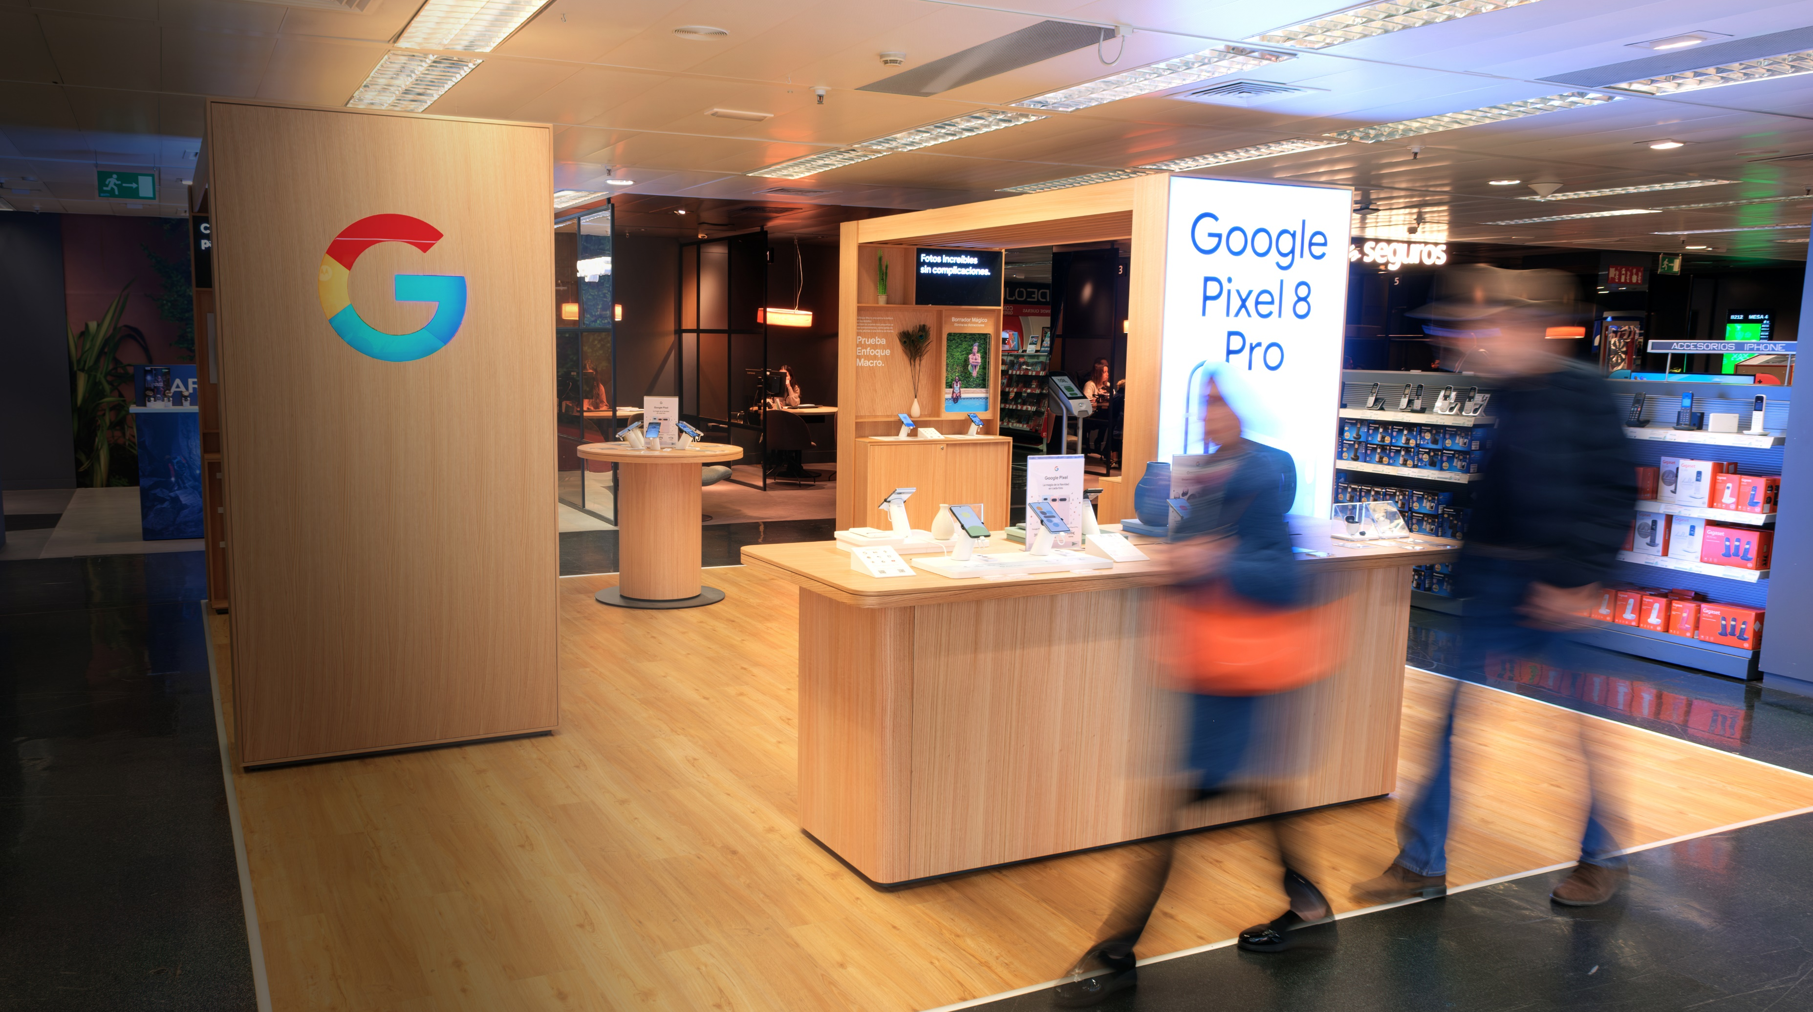

Premium
POS Industry
People are always going to go shopping.
A lot of our effort is just how do we make the retail experience a great one!

Slide 2
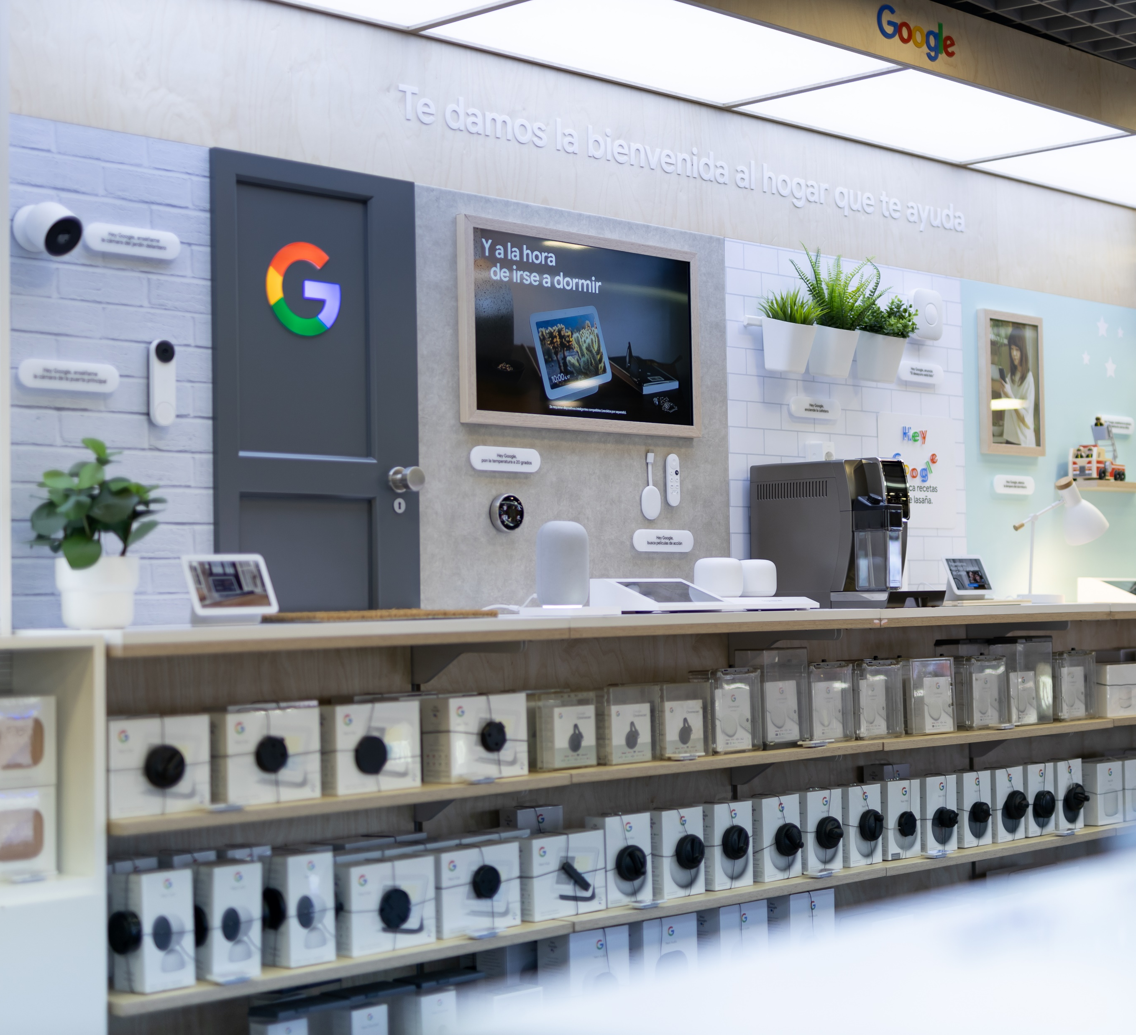
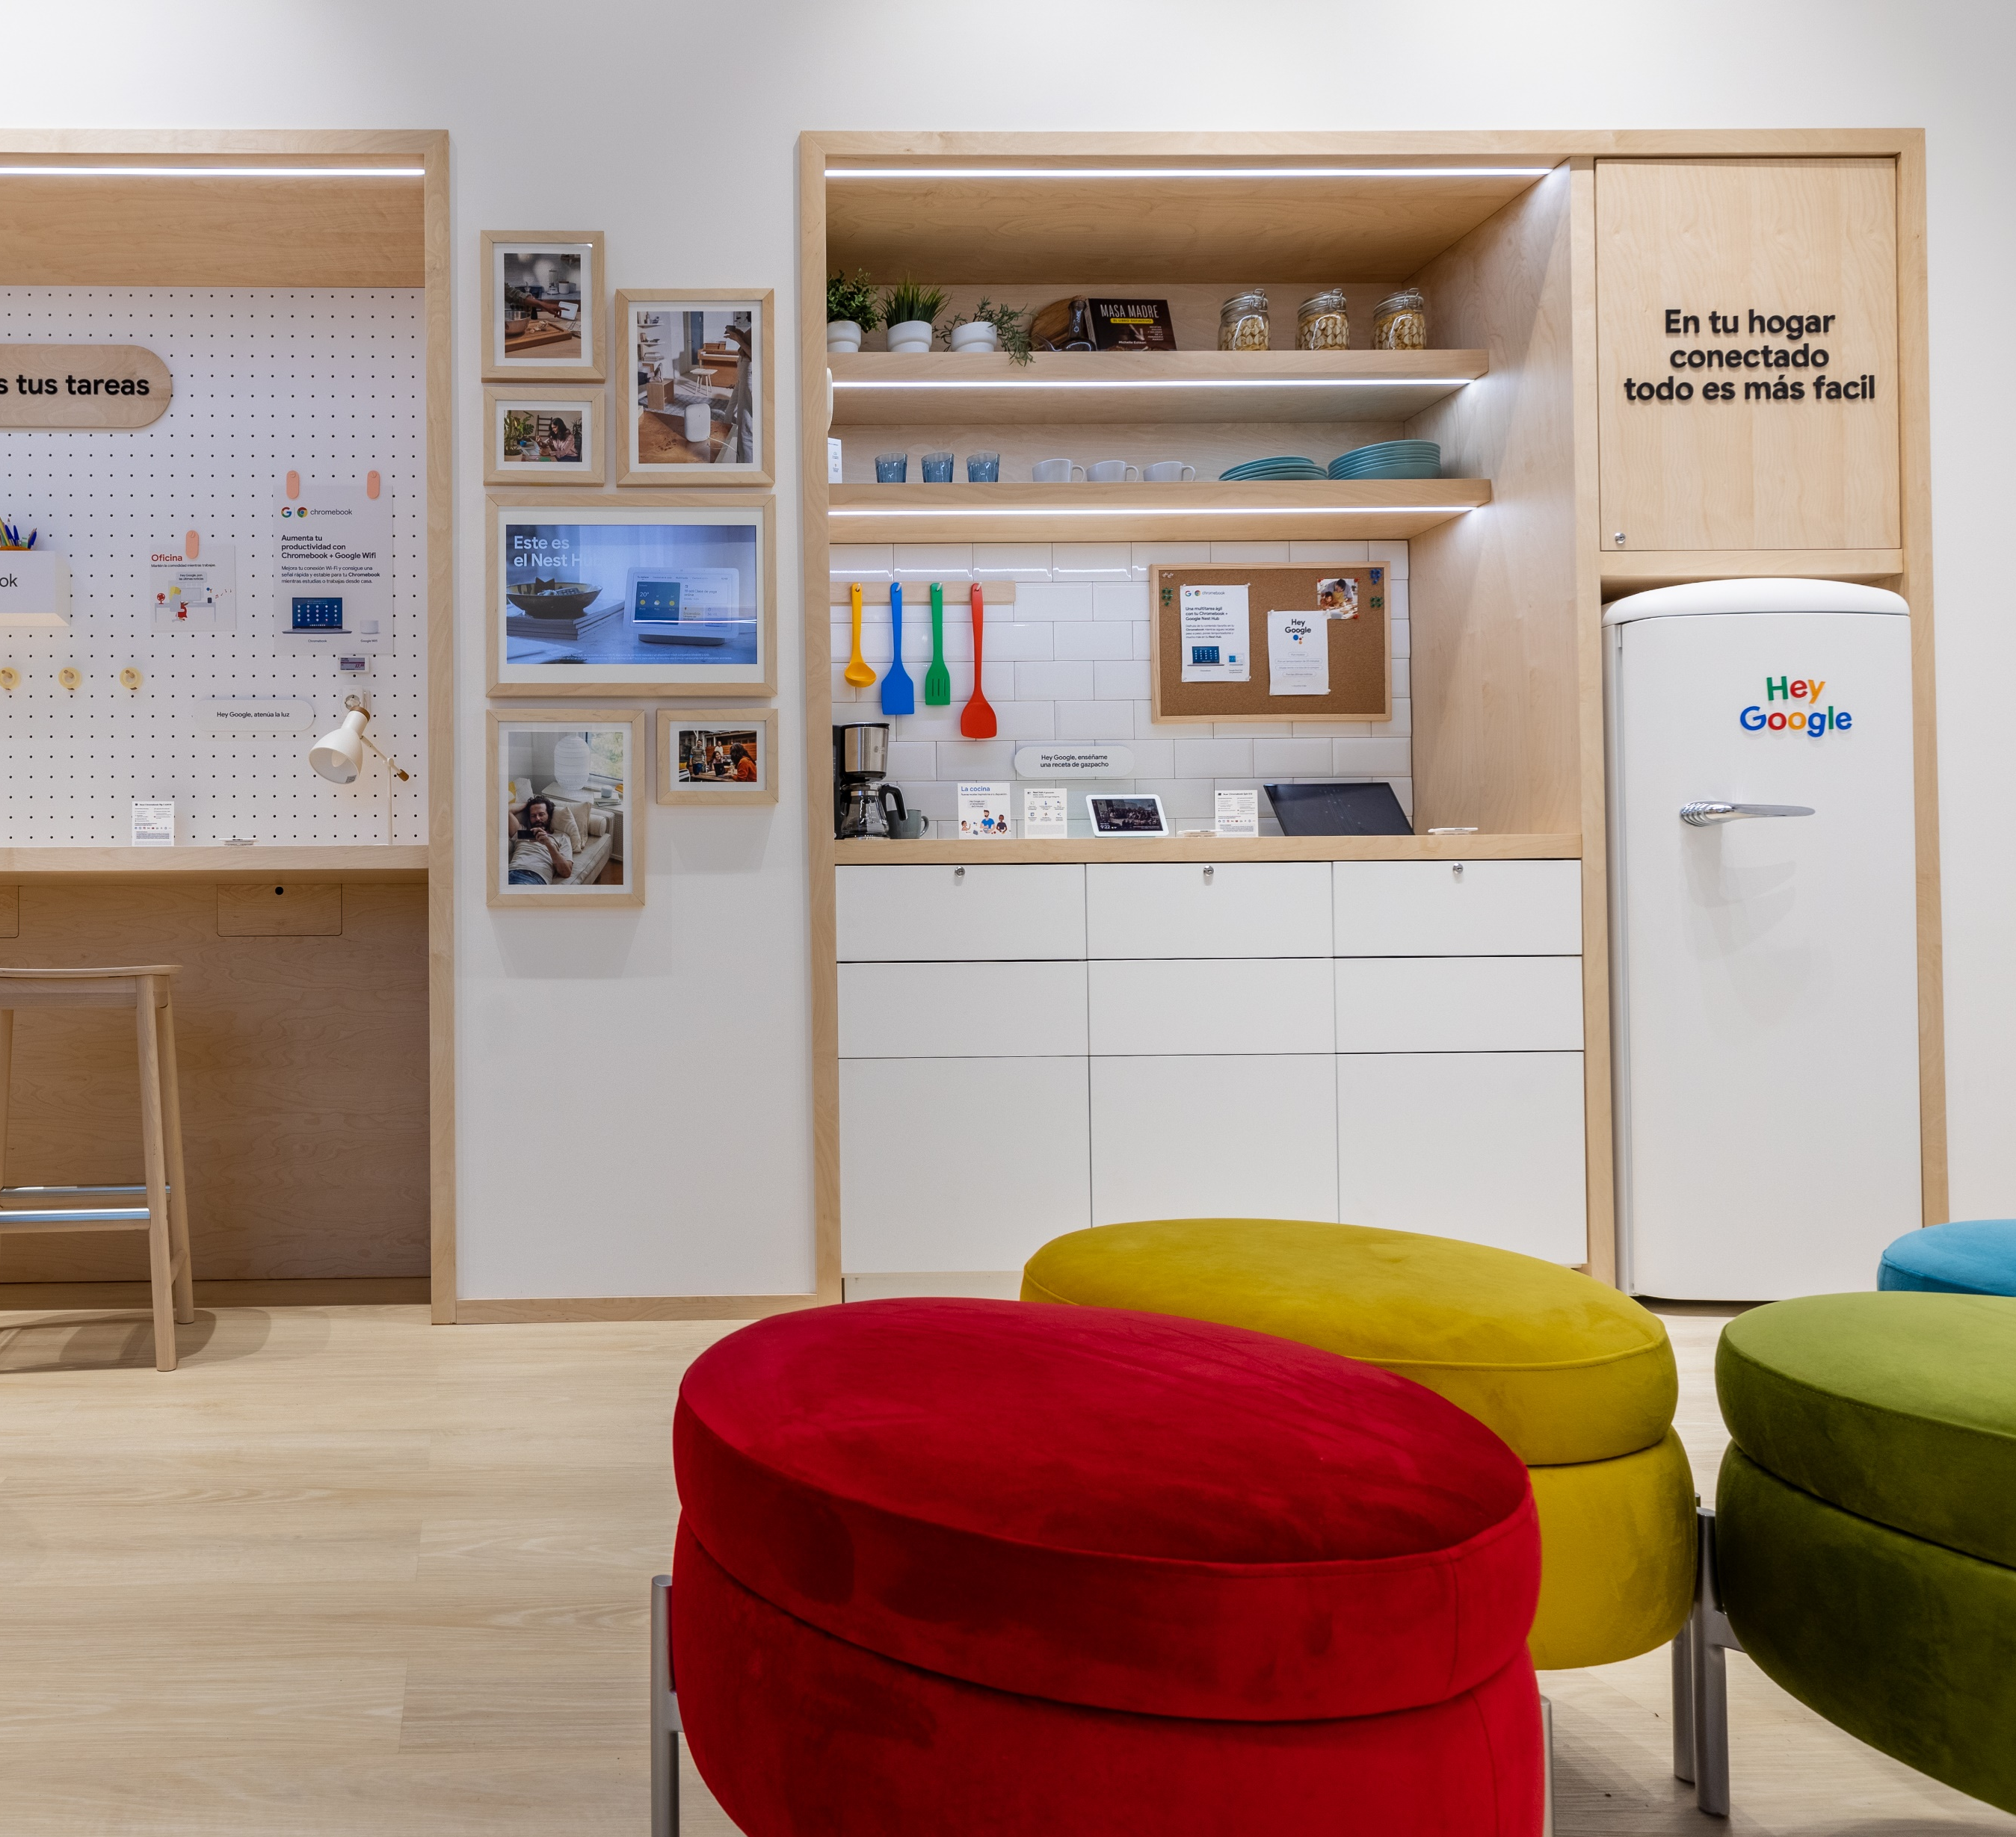
From idea
To stores
Our company offers a complete solution, taking your project from the initial concept and design all the way through development, engineering, production, and final installation. What sets us apart is our ability to handle everything in-house, unlike creative or marketing agencies that often outsource parts—or all—of the process. This makes us uniquely equipped to ensure quality and consistency at every step of the journey.
25+
Combined Years of
Industrial design
Experience.

Slide 3
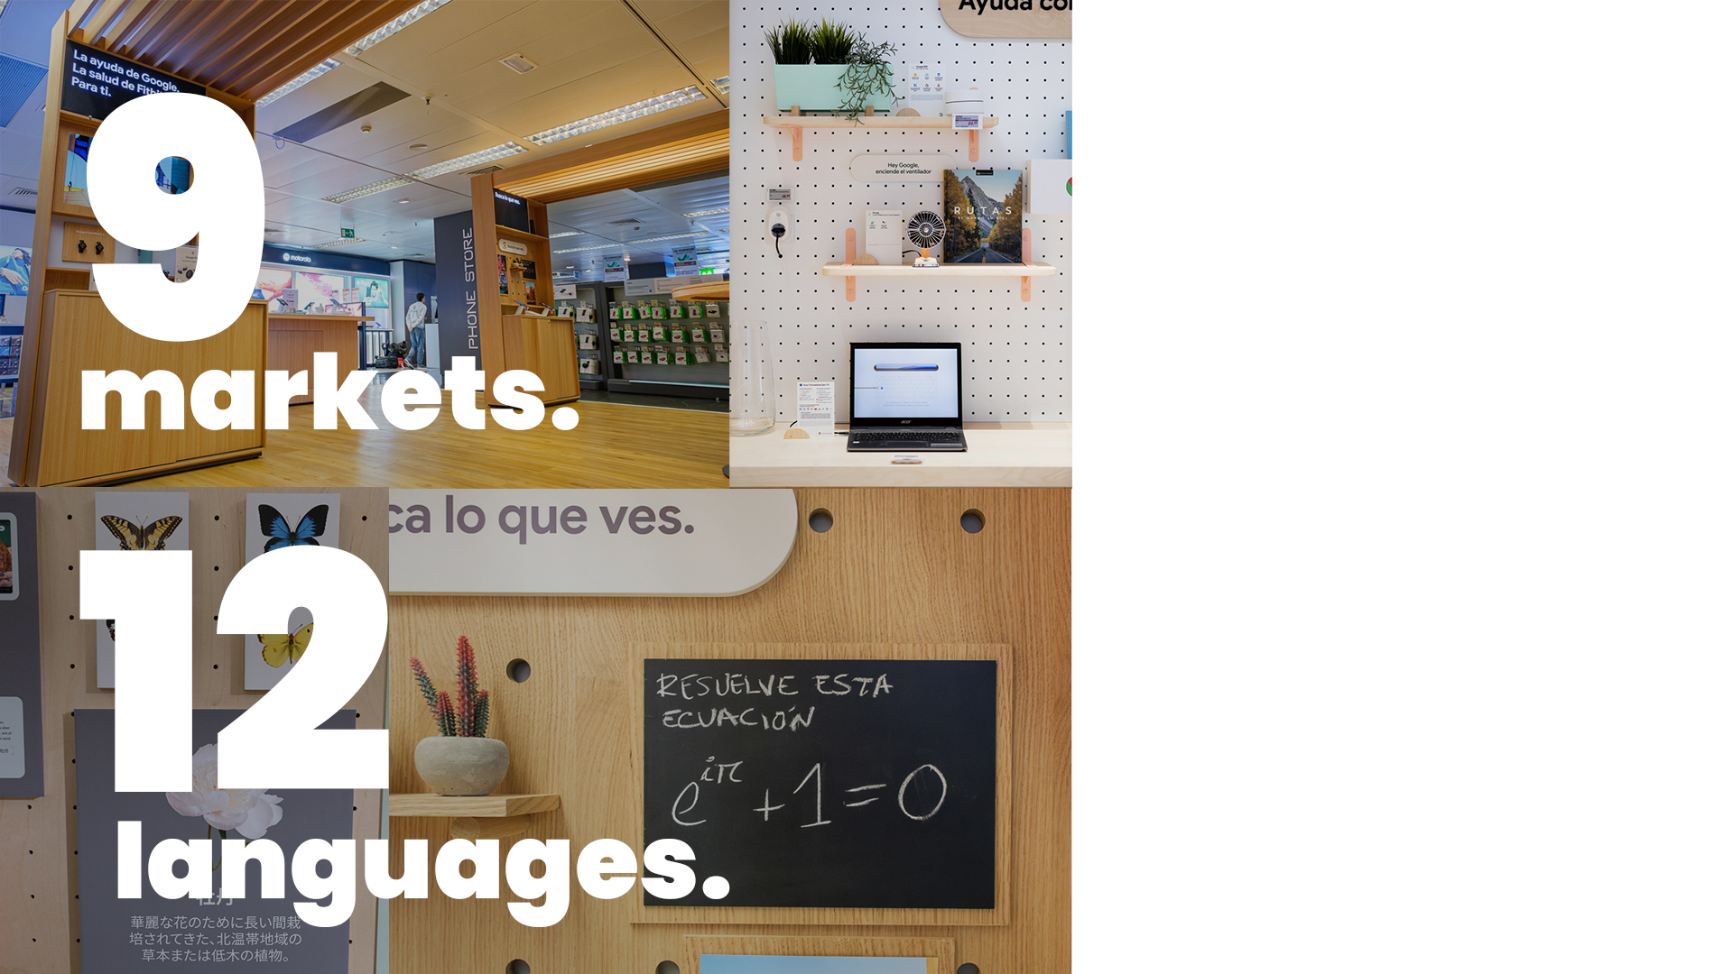
Deployment
management
We expertly manage deployment across 9 markets and in 12 languages, ensuring seamless execution and coordination at every stage. Our experience allows us to adapt to diverse markets and deliver consistent results, no matter the location or language requirements.

Slide 4
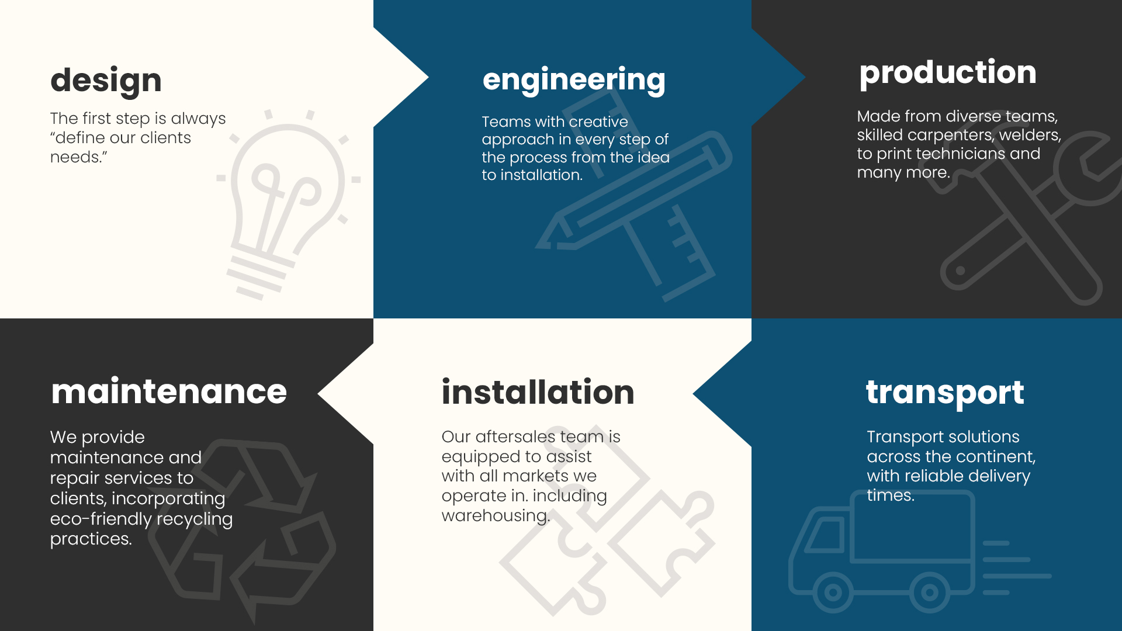
1
2
3
6
5
4

Slide 5

Irene Vaquè
Operations Manager at Google Spain
“Working with BG Reklam has always been a pleasure.
Their professionalism and attention to detail made even the most complex projects smooth and successful. The people on their team are what really set them apart, and I would definitely recommend them.”

Slide 6
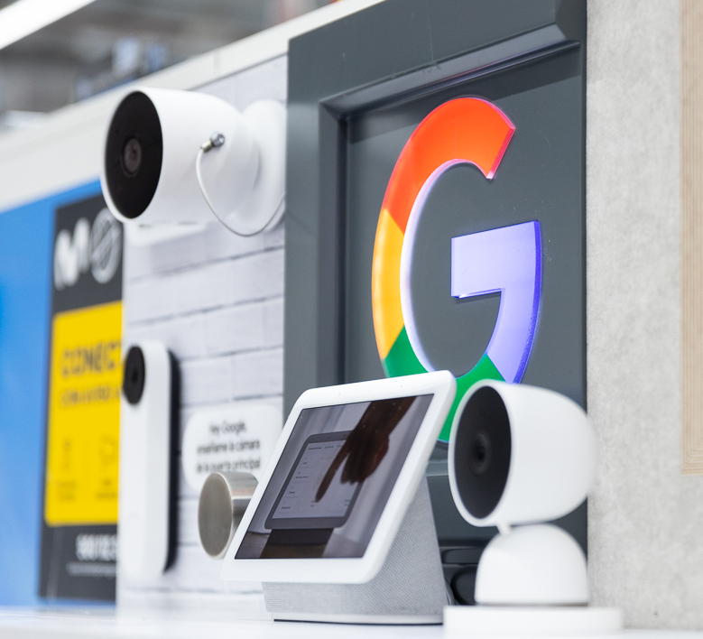
Projects
Portfolio
A showcase of our successful projects across major European cities, demonstrating our expertise in delivering high-quality solutions in diverse locations. From concept to completion, each project highlights our commitment to excellence and innovation.

Slide 7
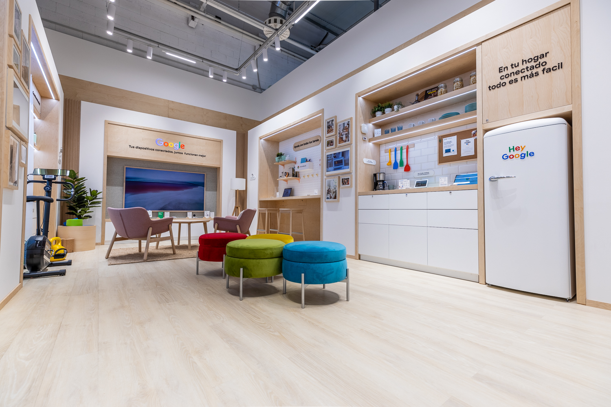
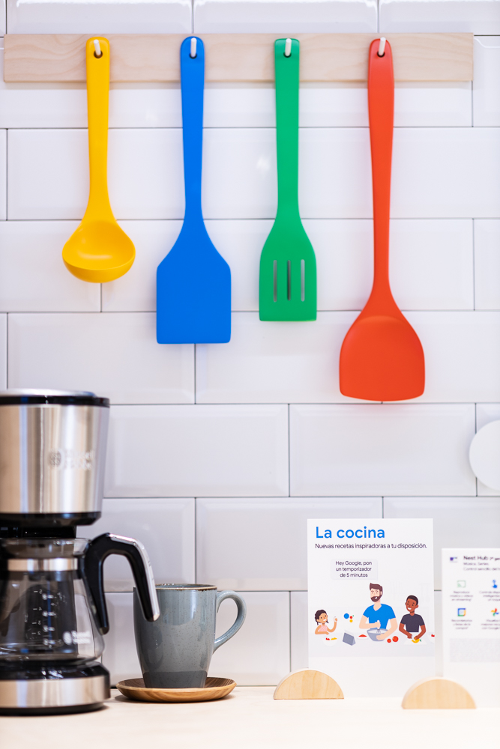

MADRID
2022

Slide 8
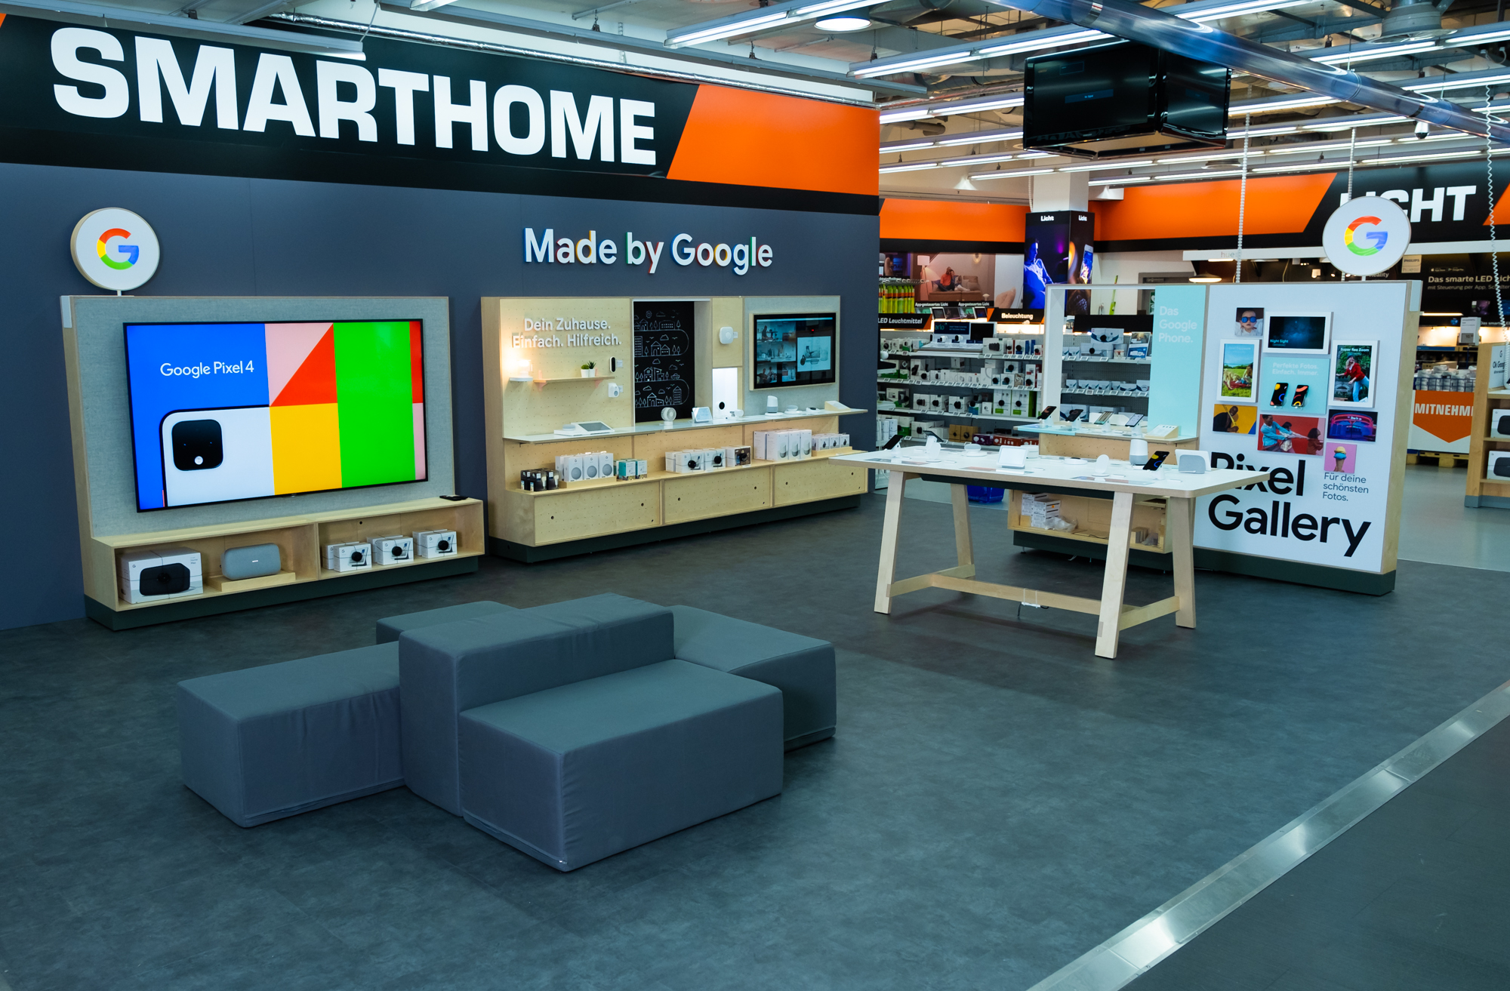
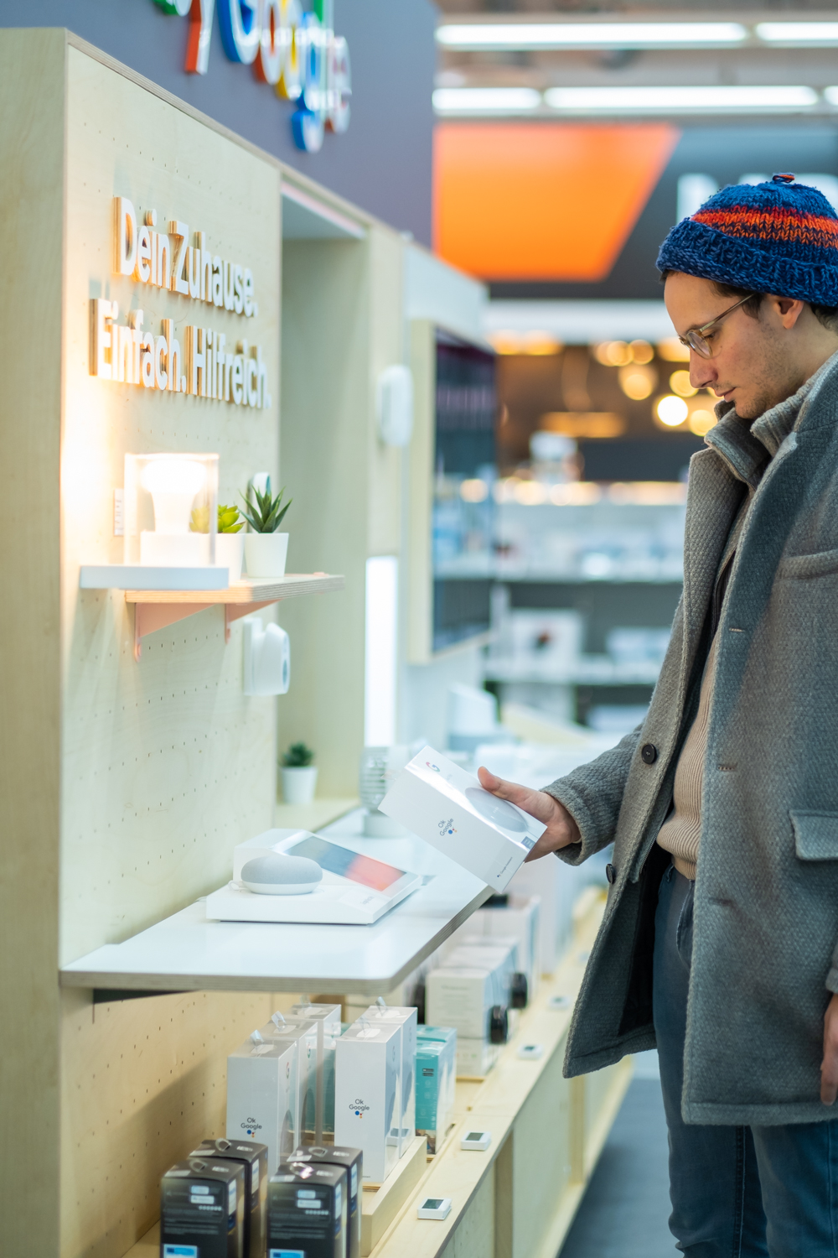
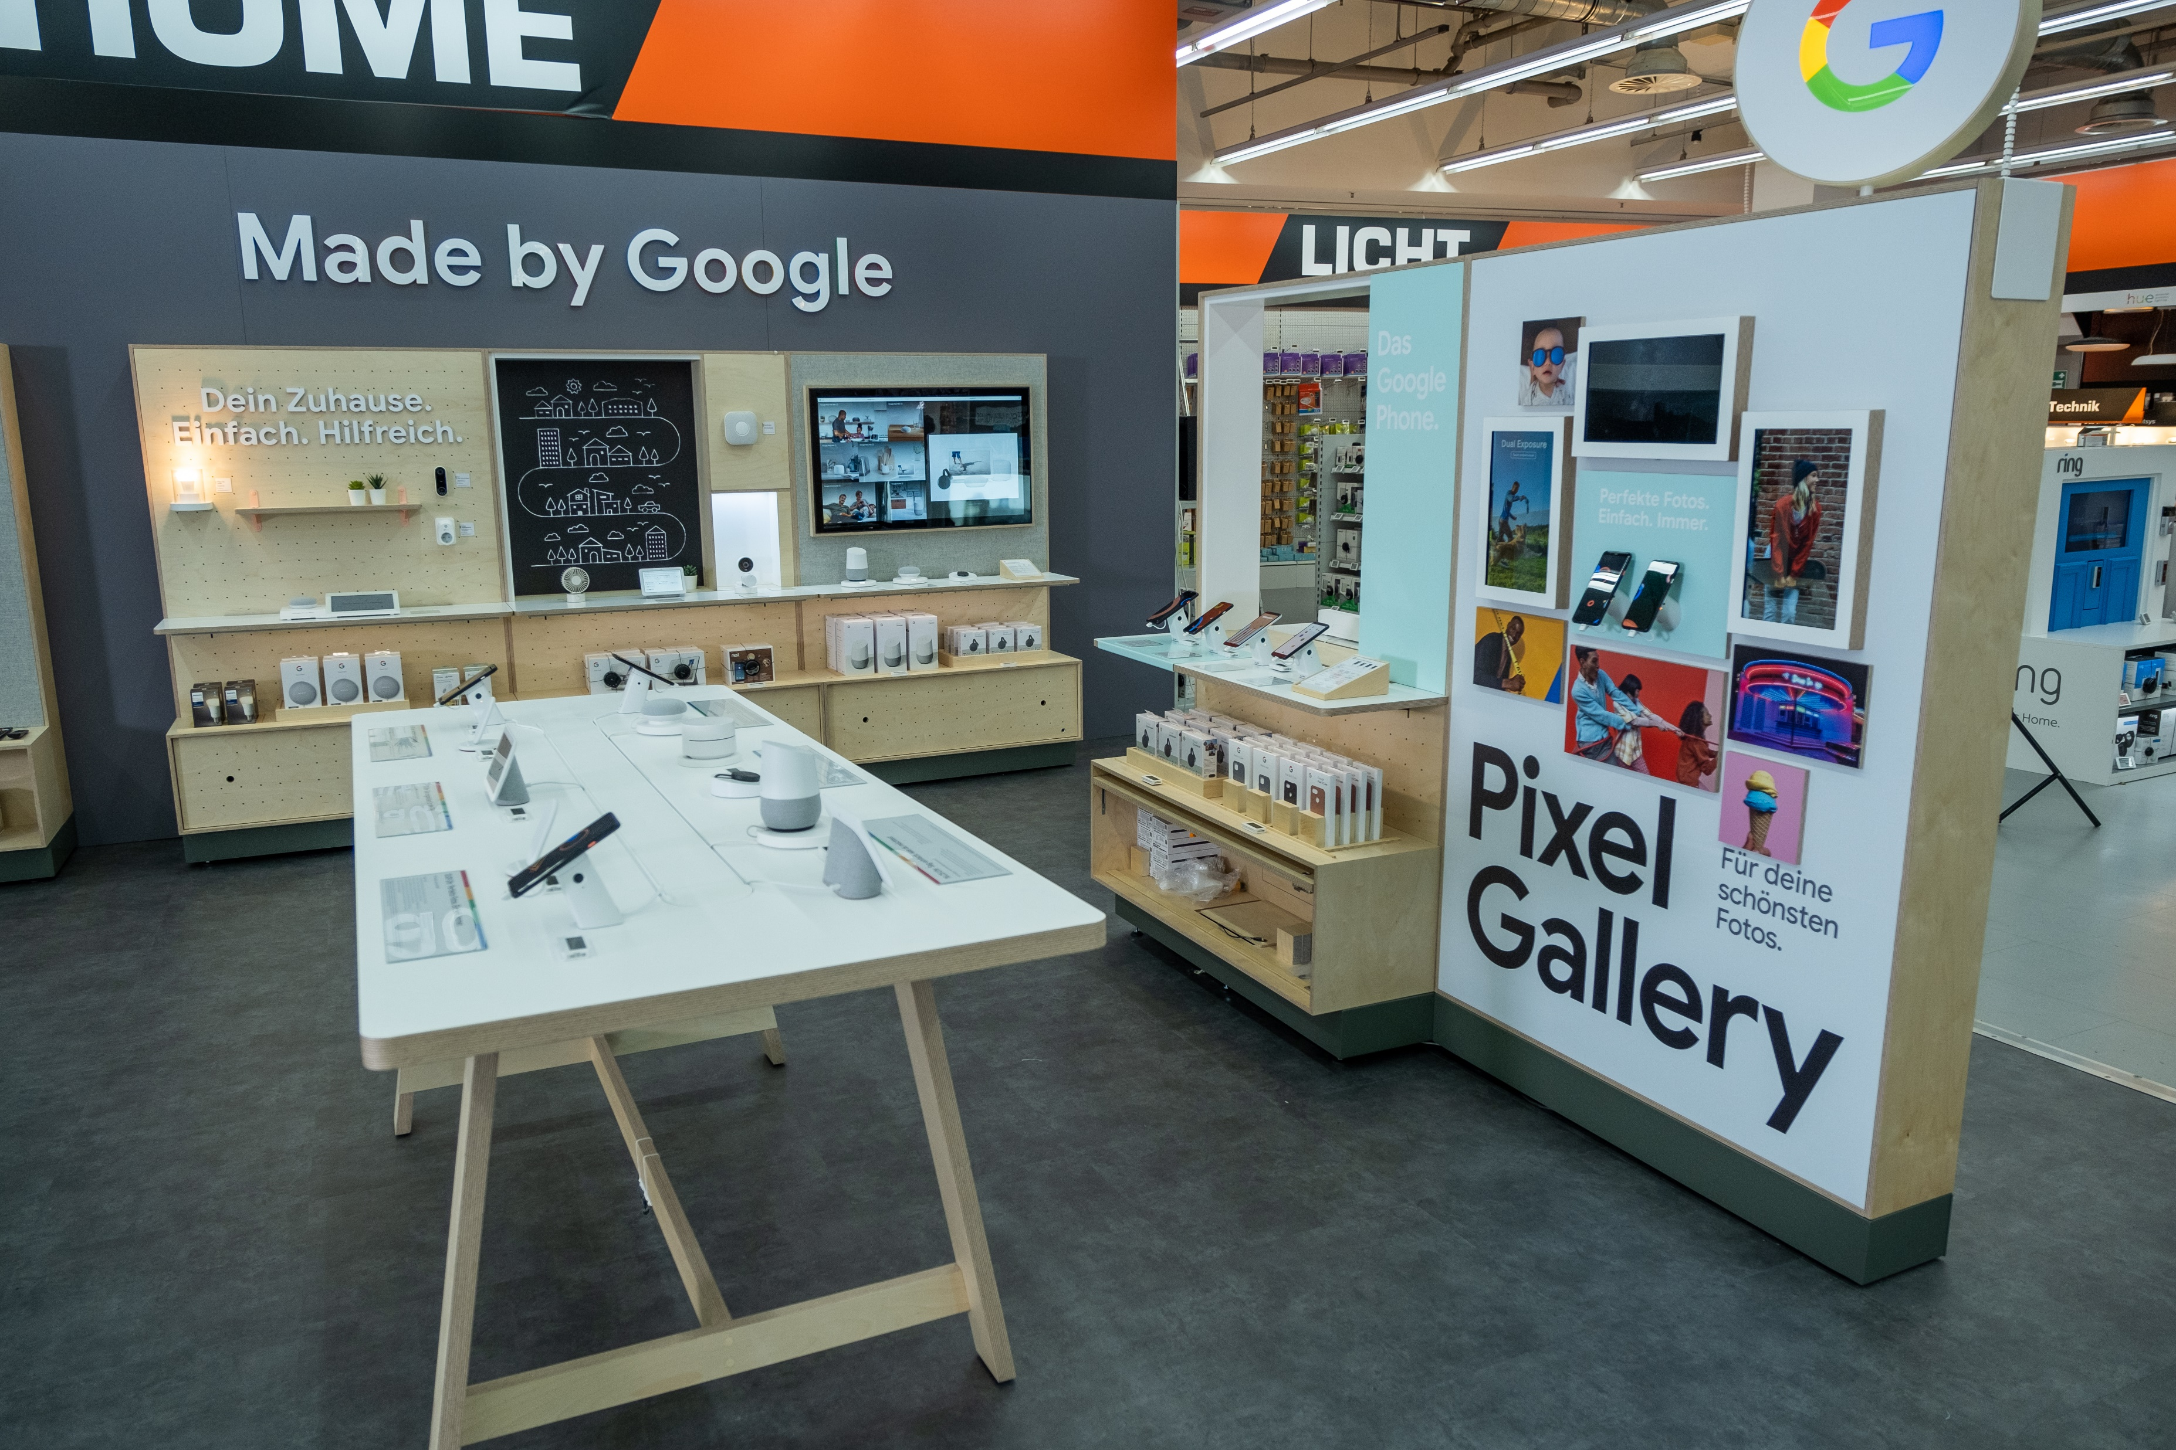
HAMBURG
2019

Slide 9
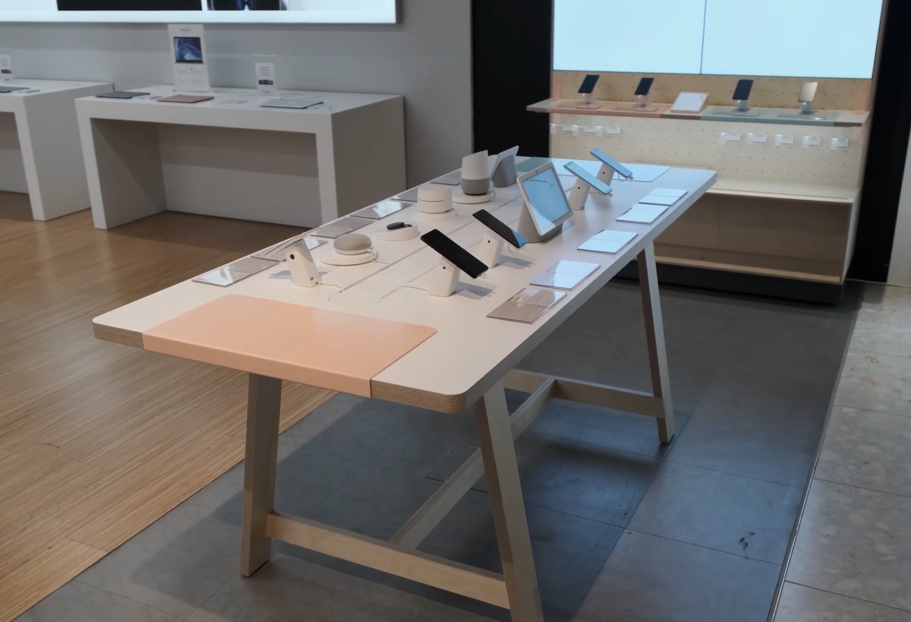
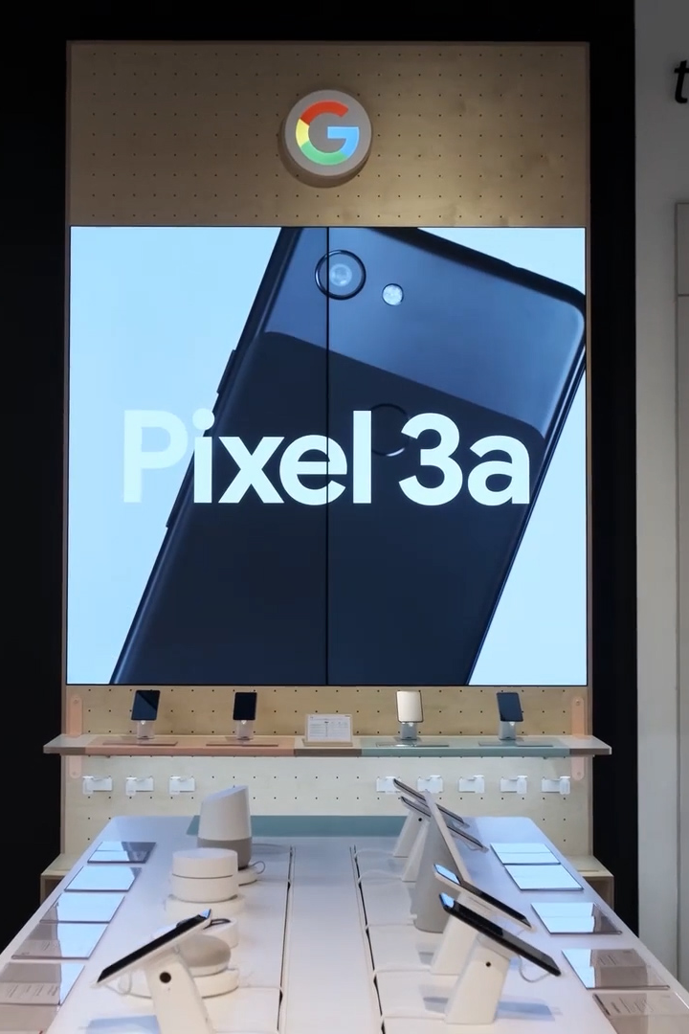
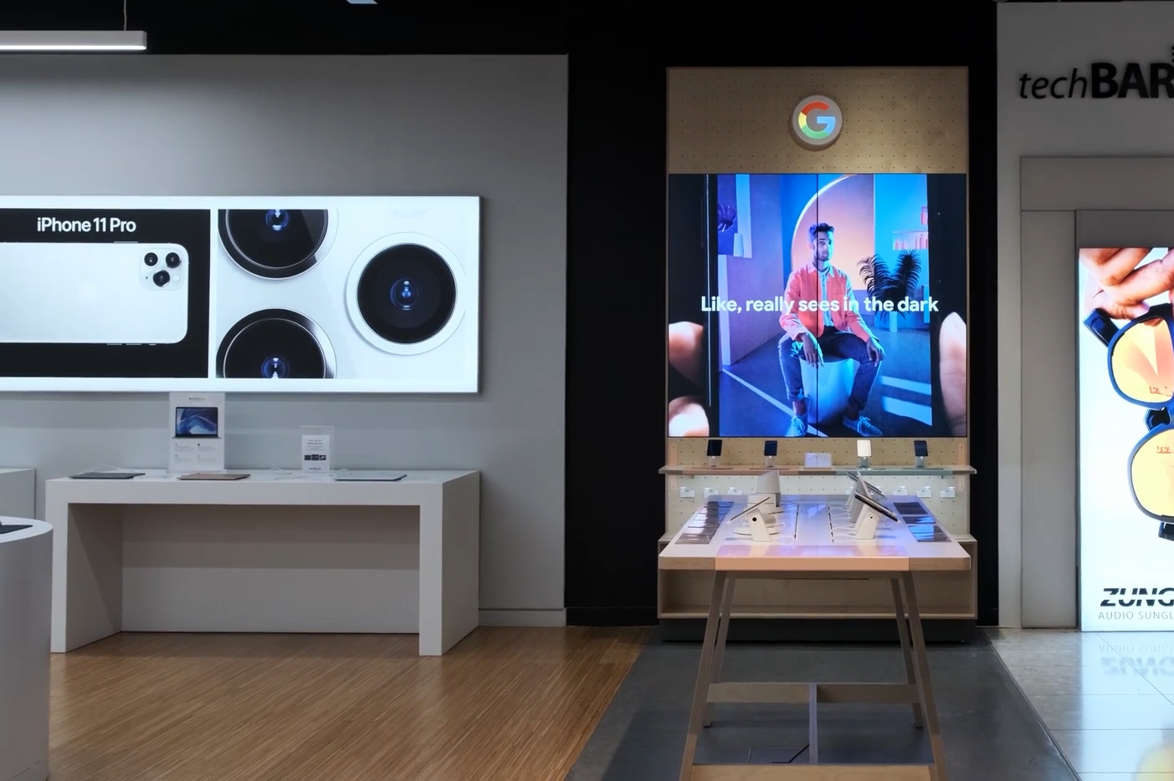
LONDON
2020

Slide 10
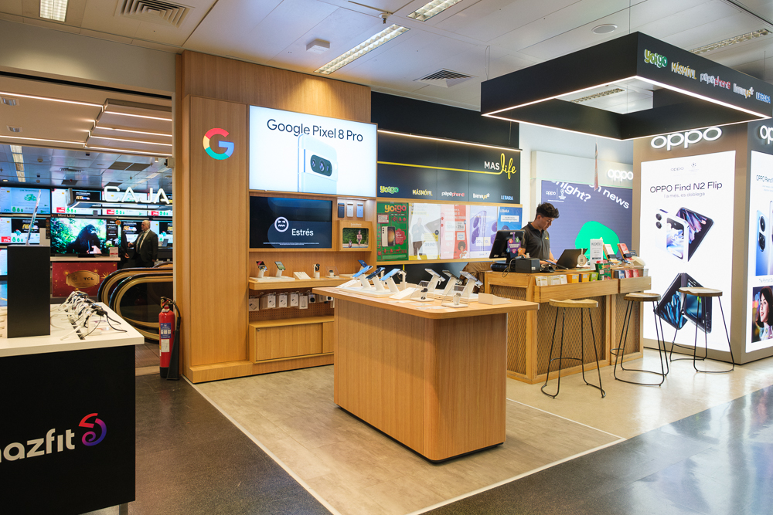
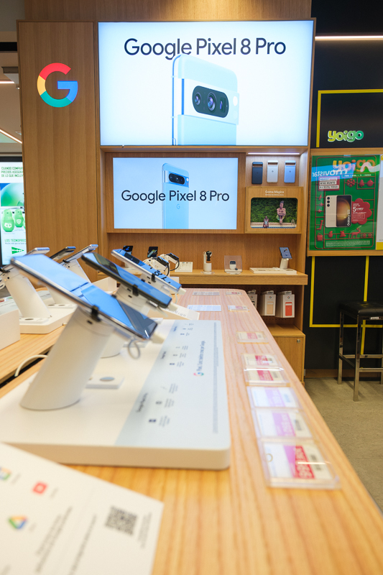
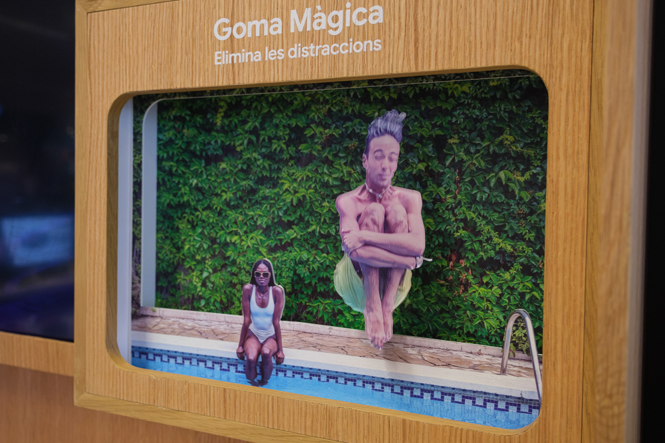
BARCELONA
2023

Slide 11
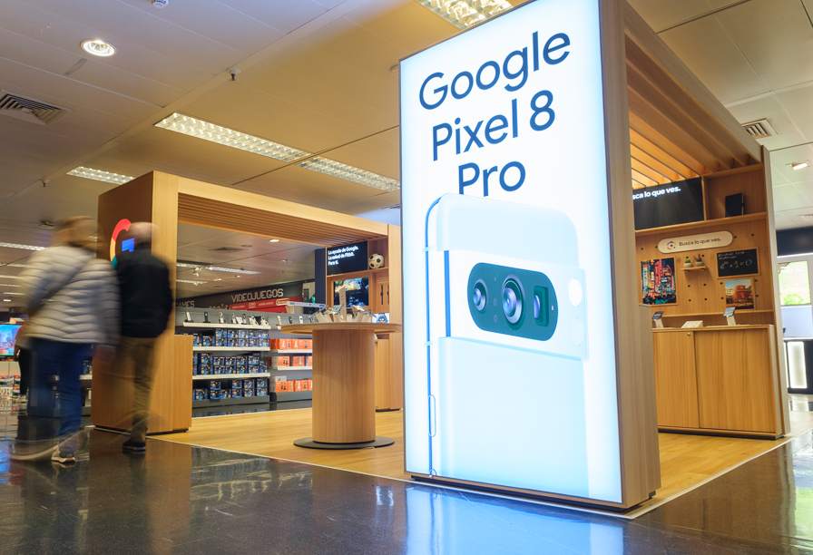
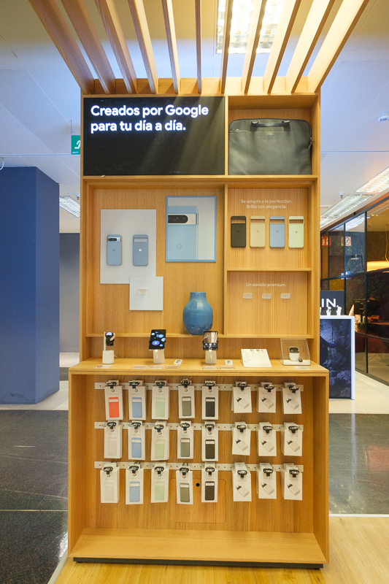
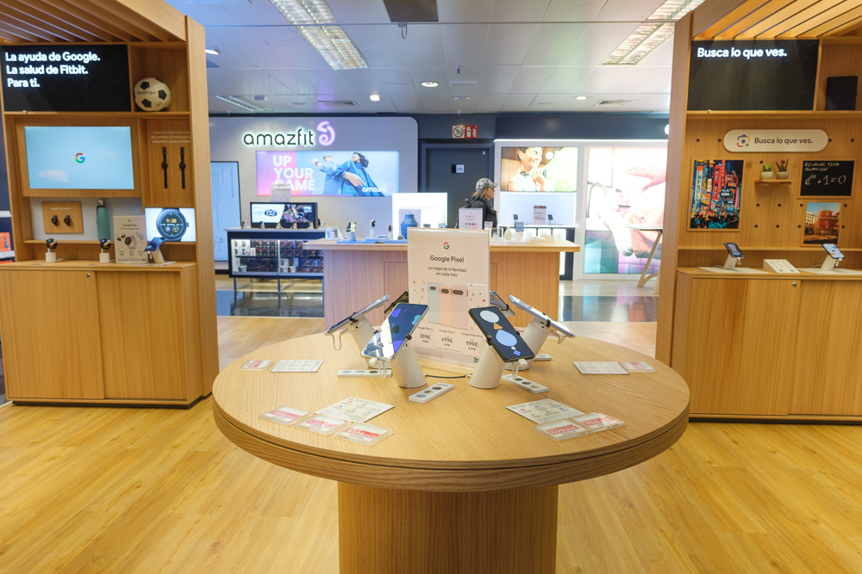
MADRID
2023

Slide 12
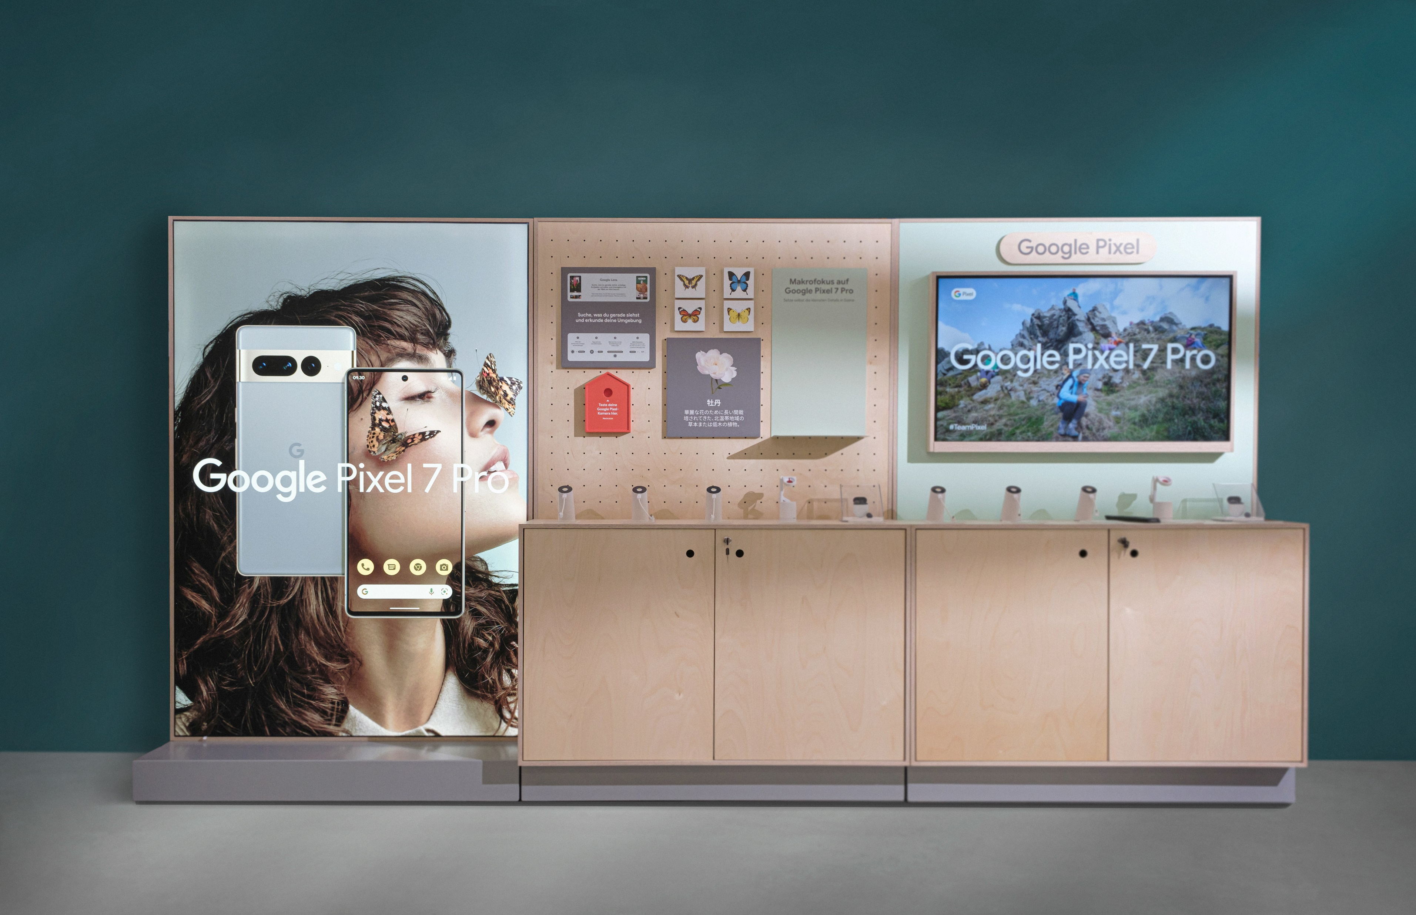
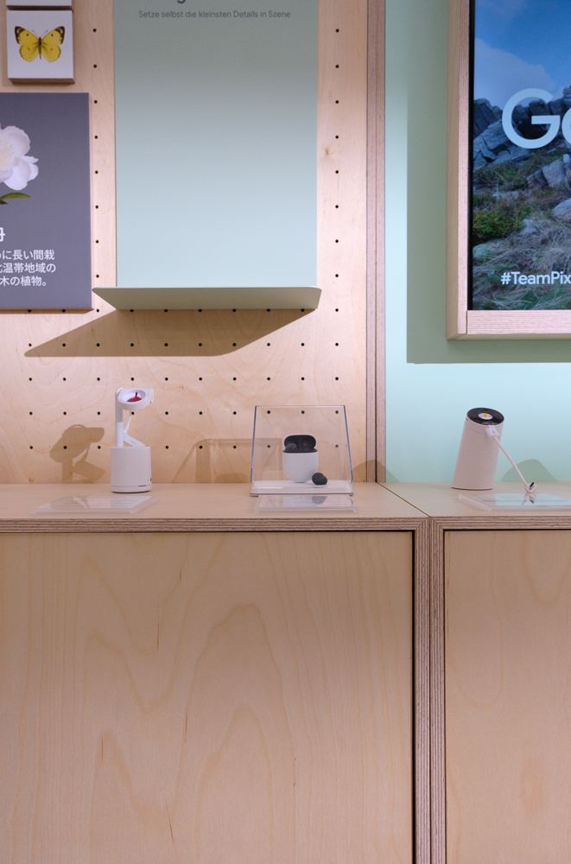
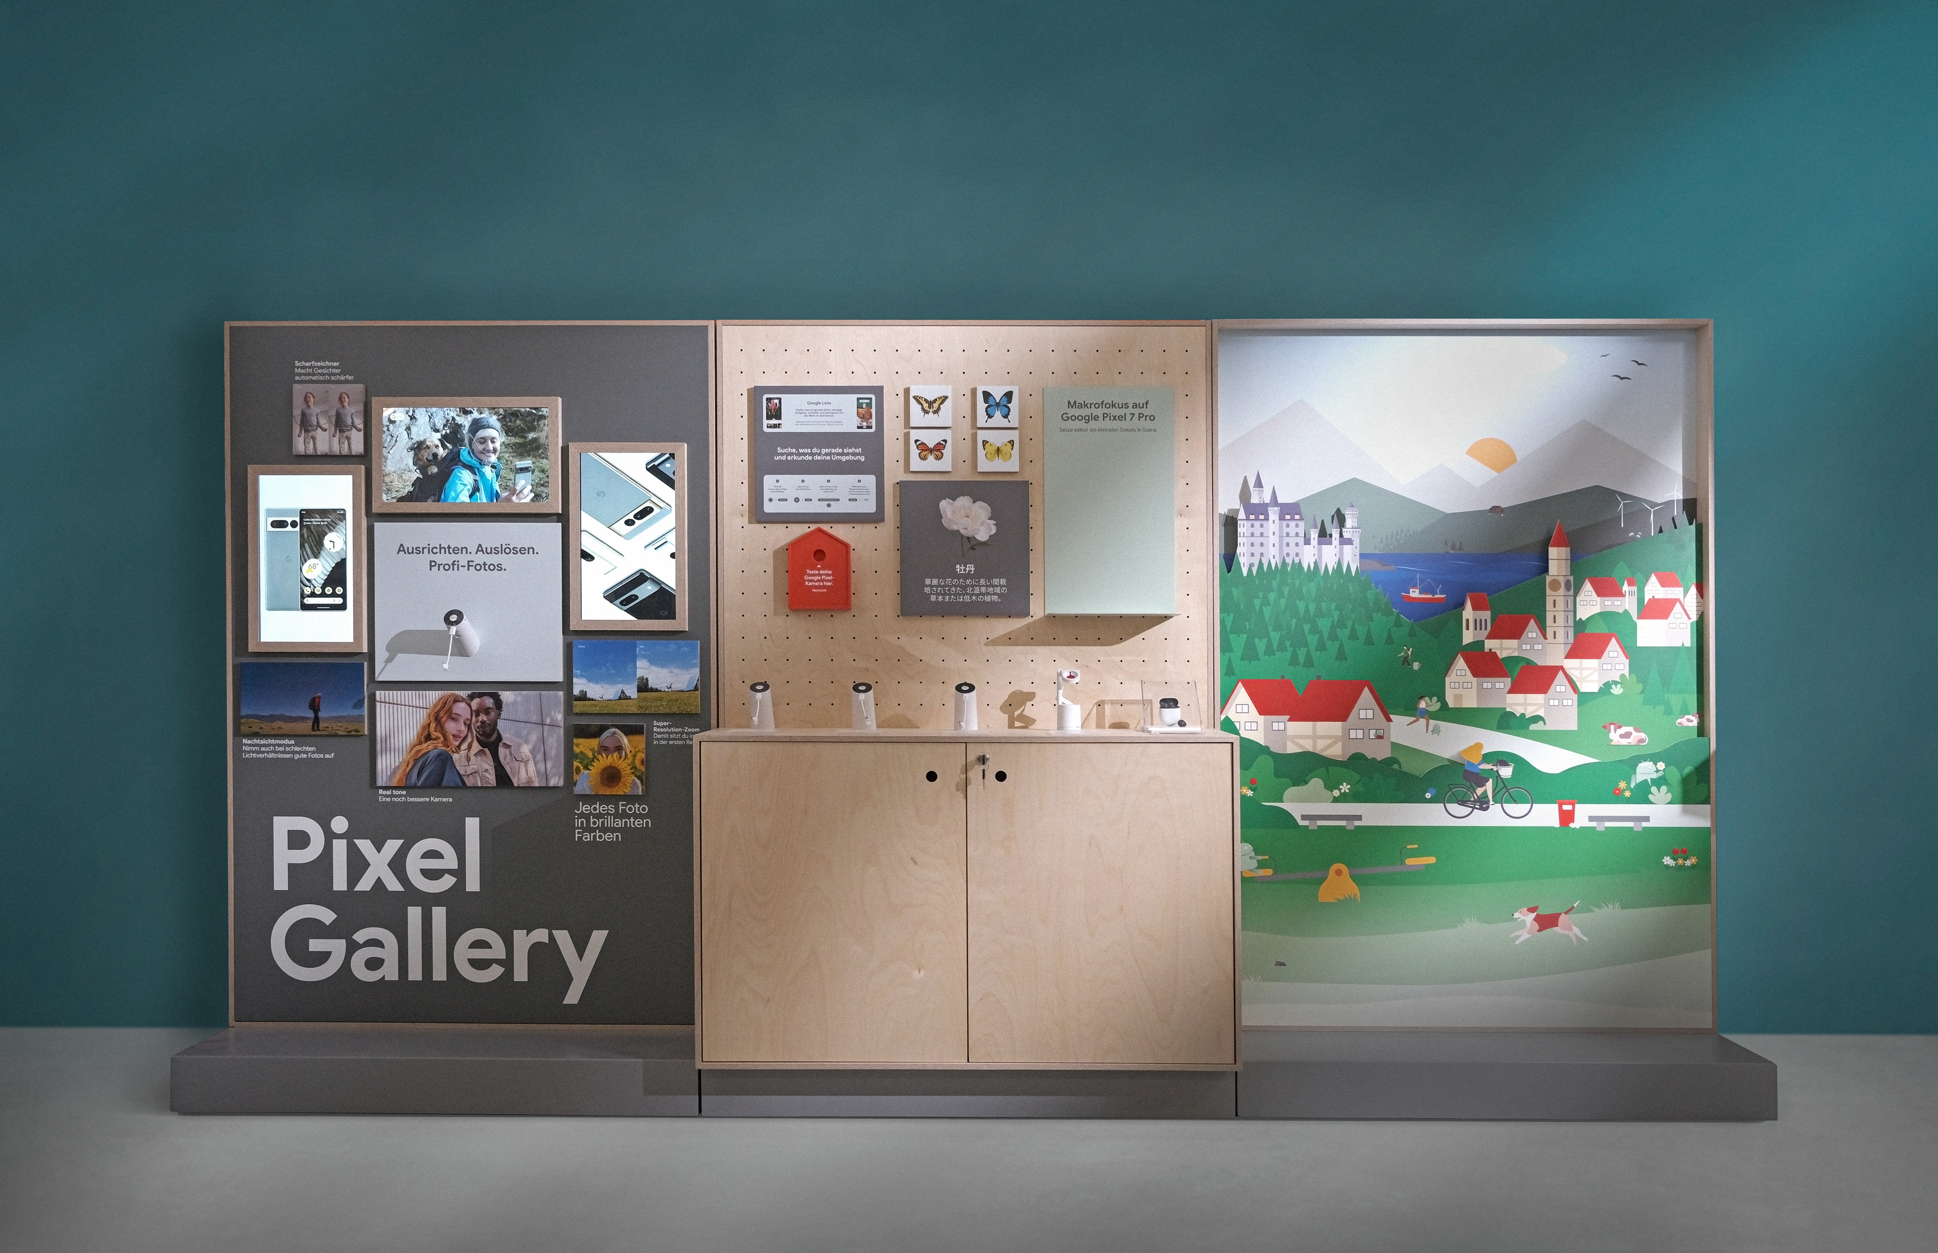
ZURICH
2023

Slide 13
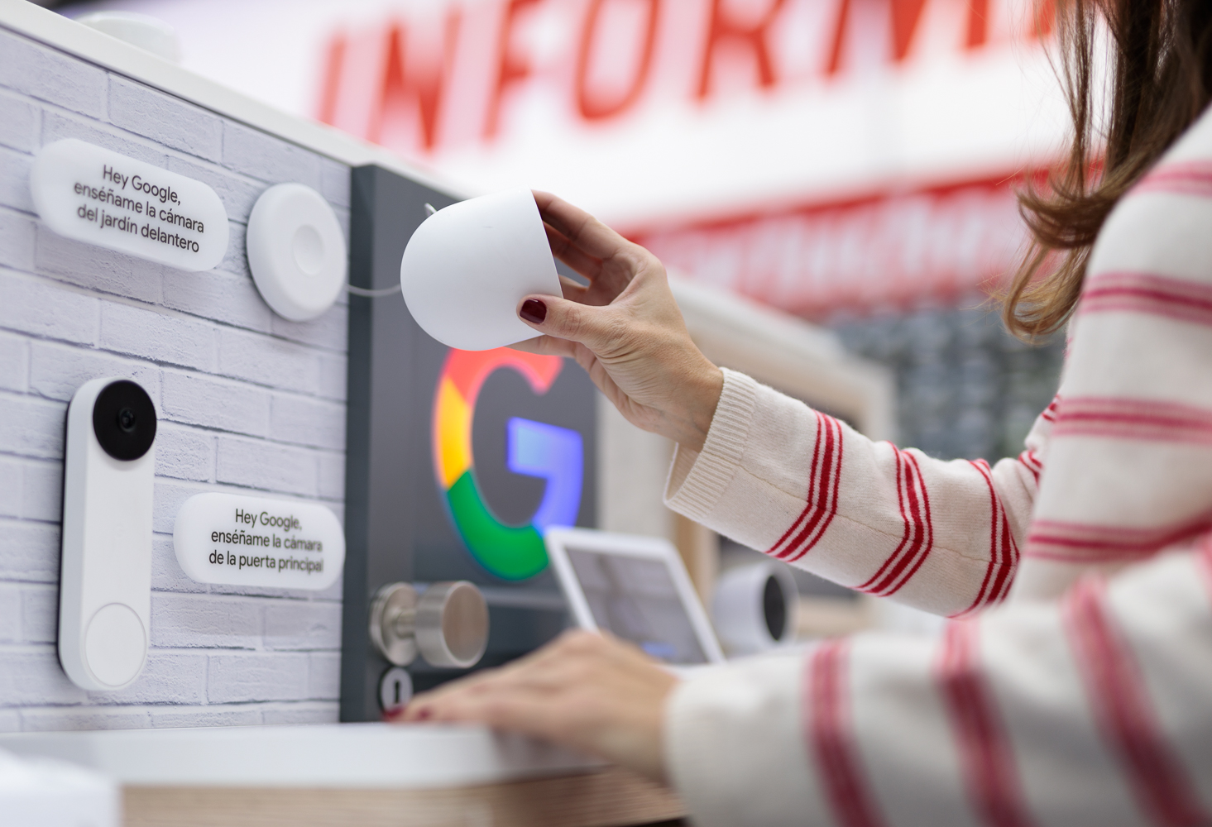
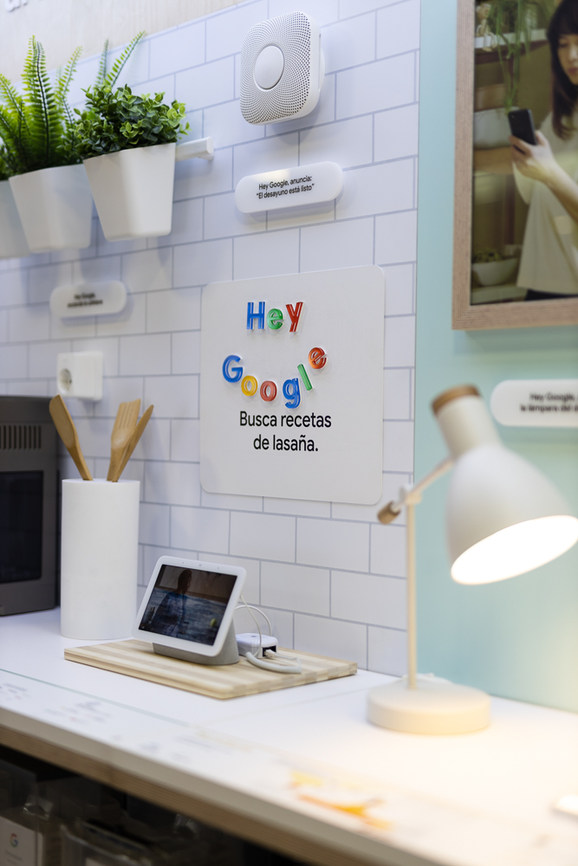
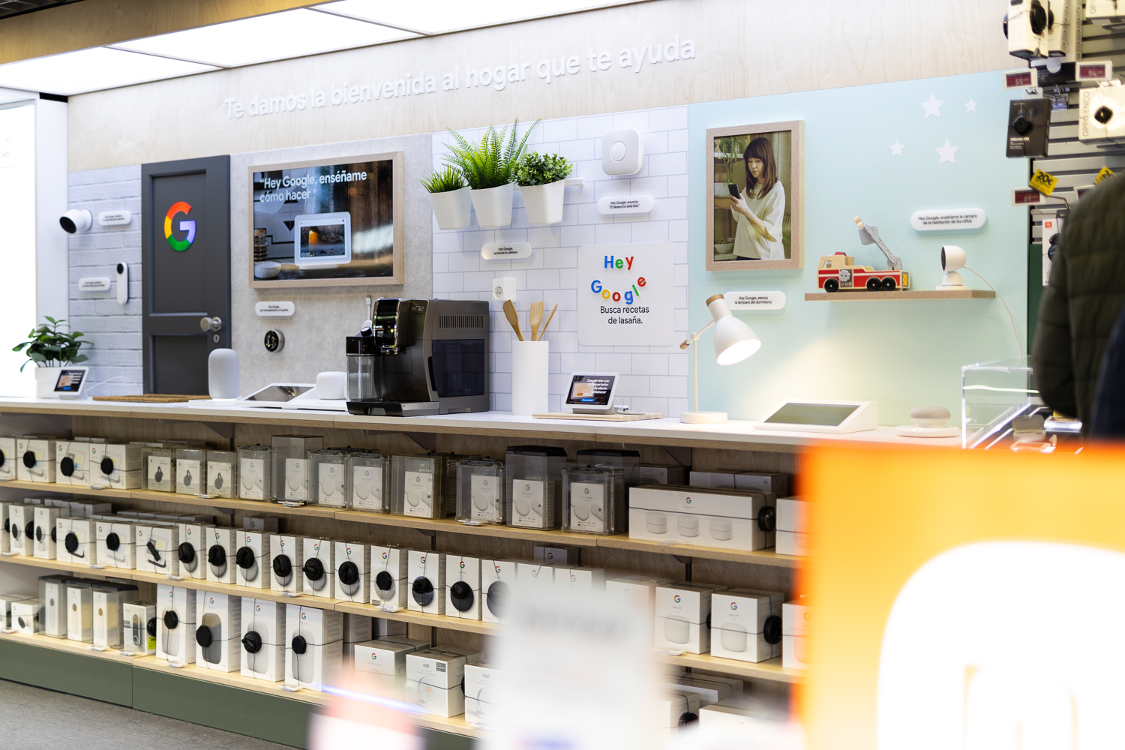
MADRID
2022

Slide 14
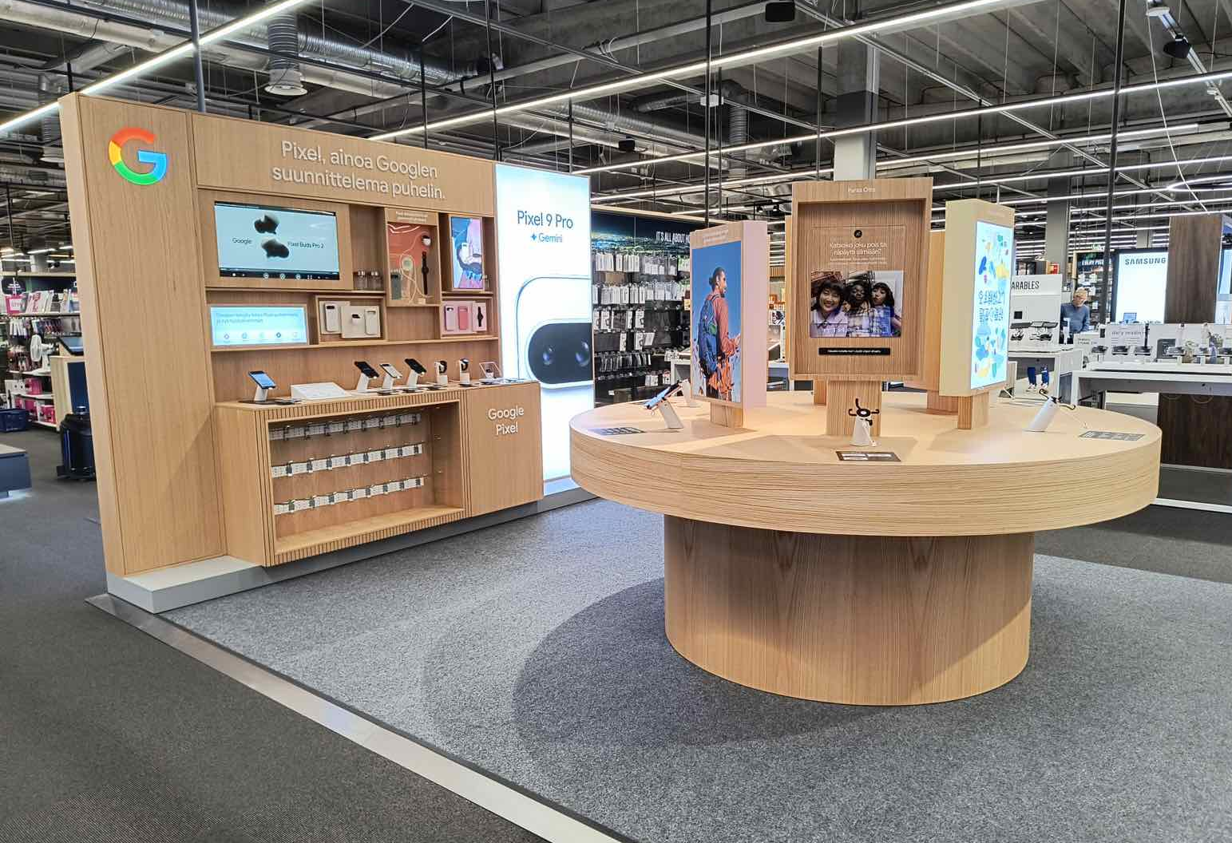
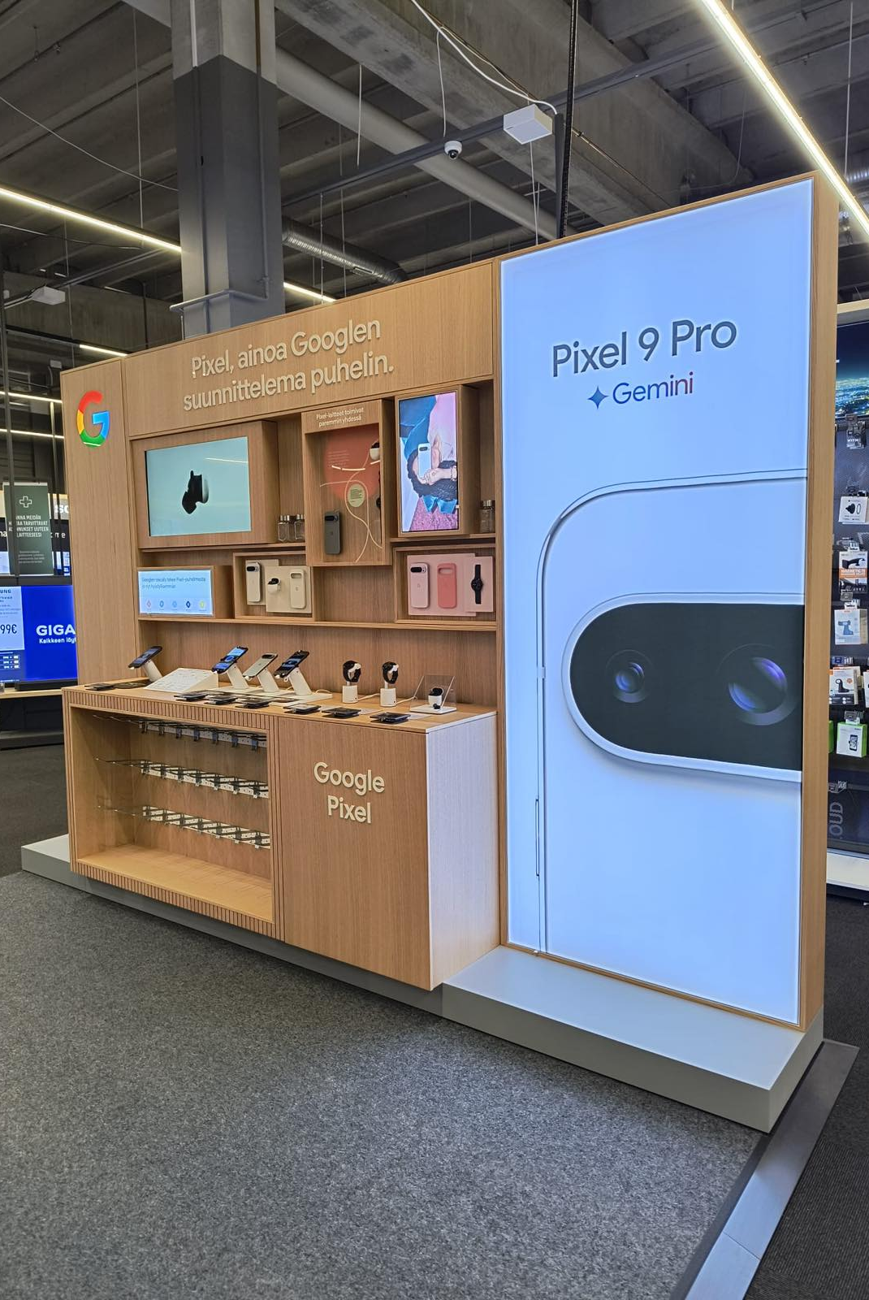
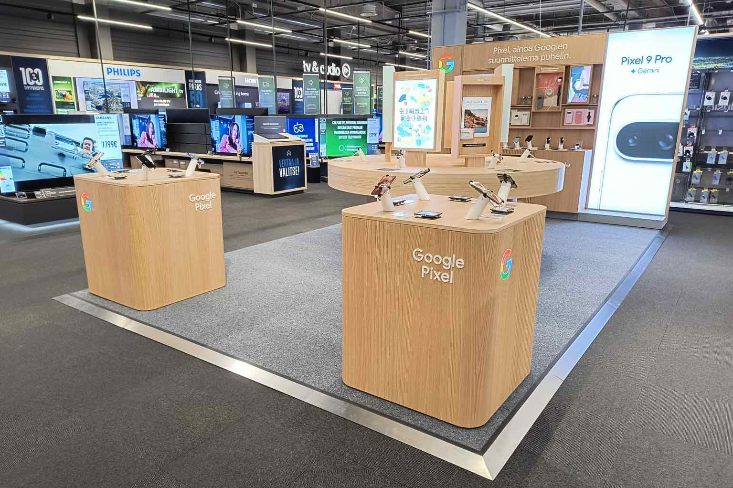
HELSINKI
2024

Slide 15
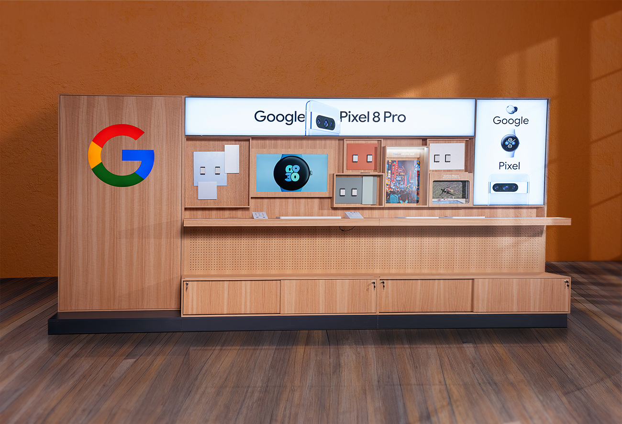
BOLOGNA
2024

Slide 16
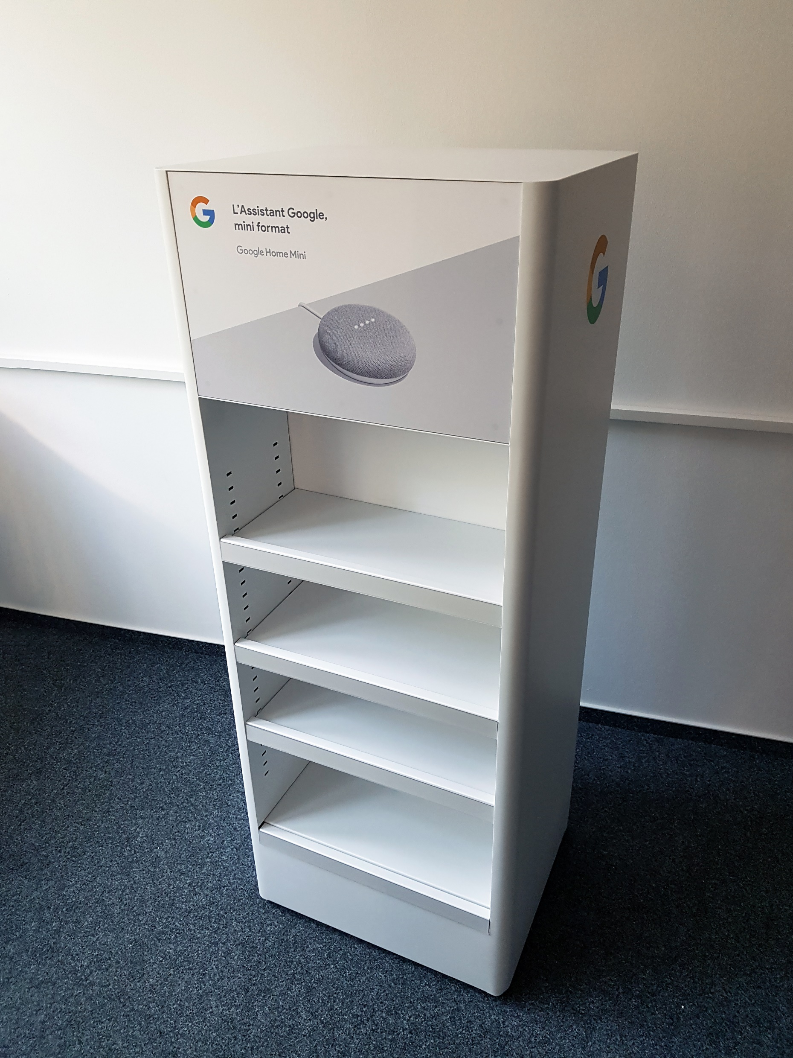
Free standing
Unit “Google Home mini”
2018
One of our first project for Google began in 2018 with a modest Google display for their popular speaker product. Fast forward to today, and we now deliver full retail shops across the continent, showcasing the evolution of our partnership and our growing capabilities.

Slide 17
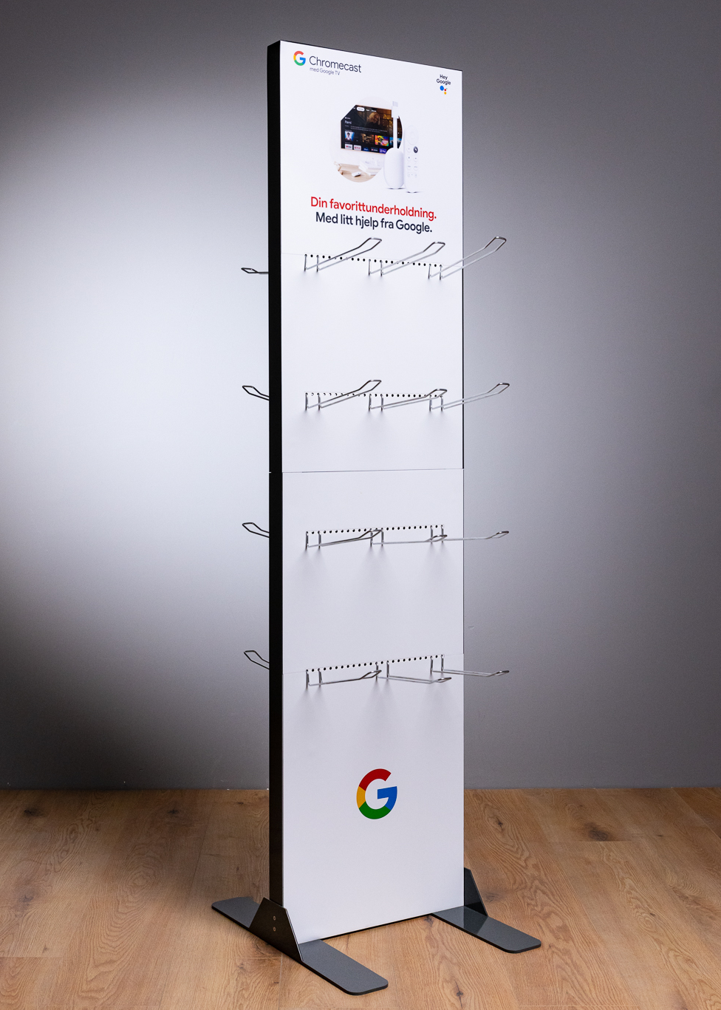
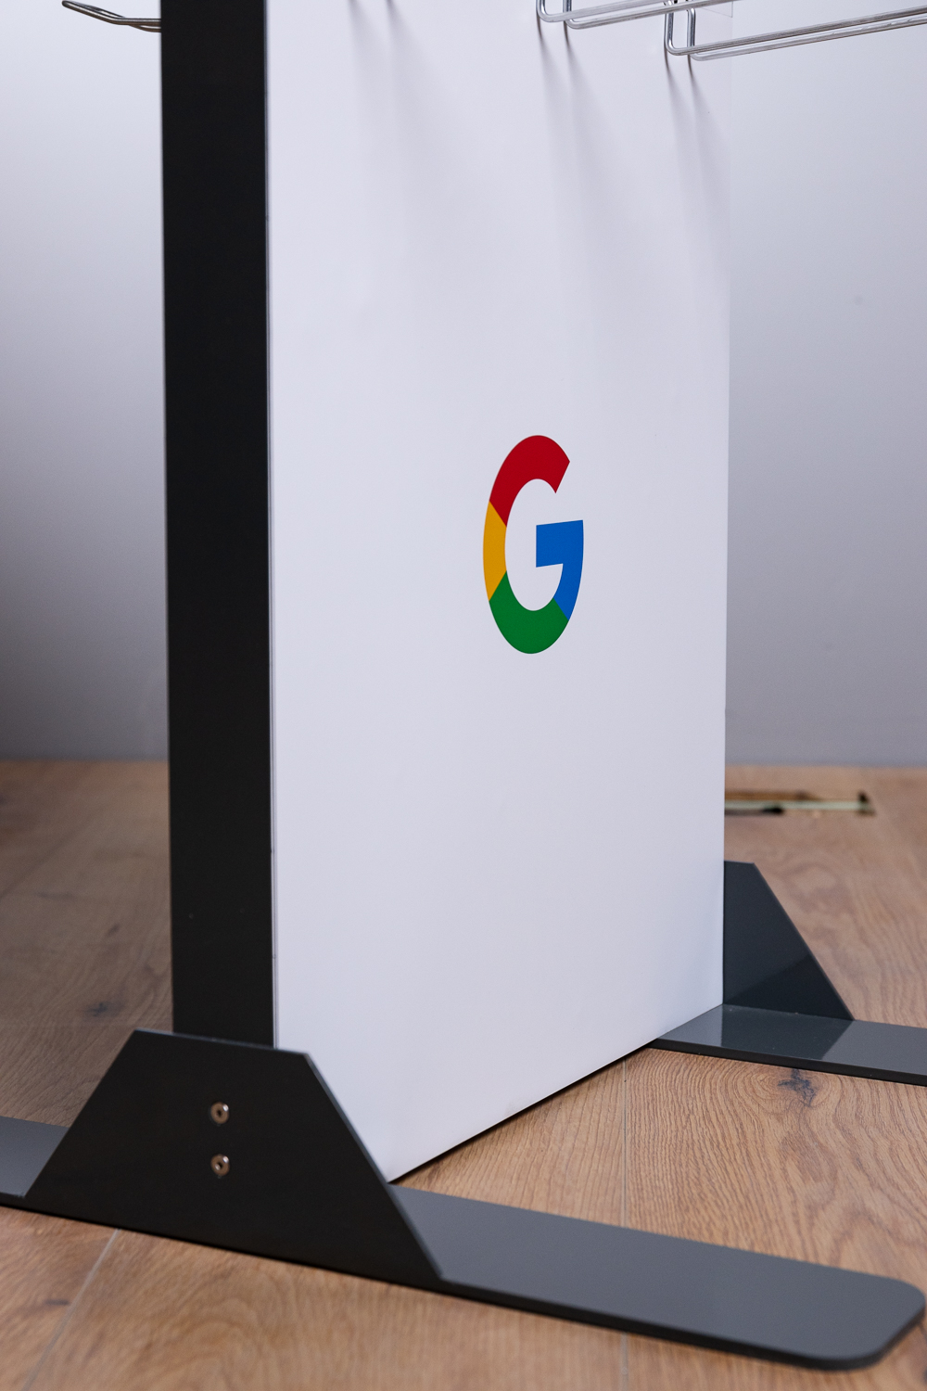
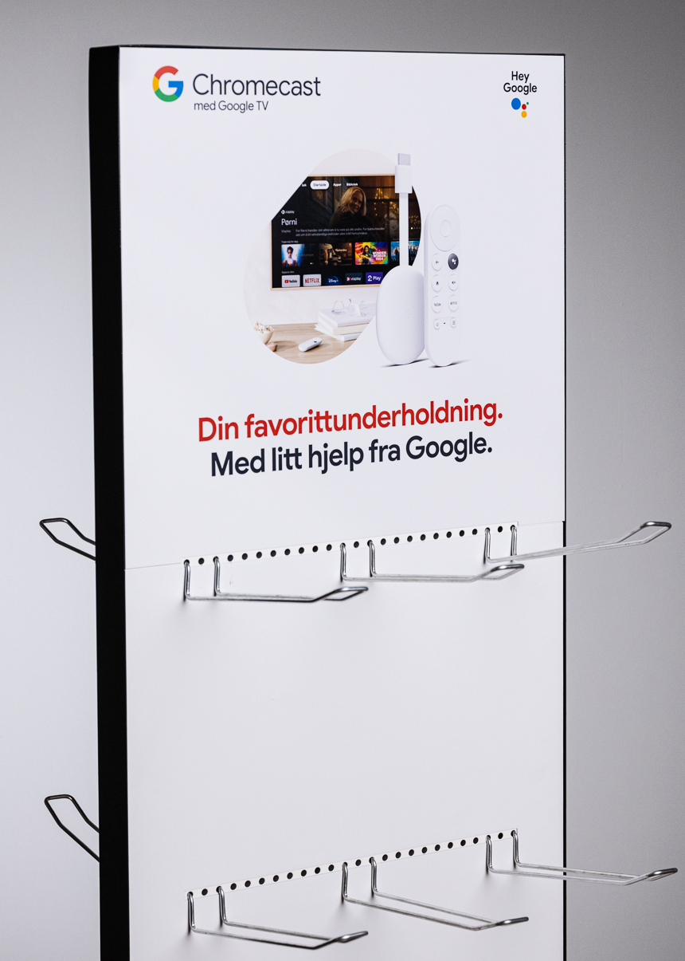
GOOGLE
Free standing unit
2022

Slide 18
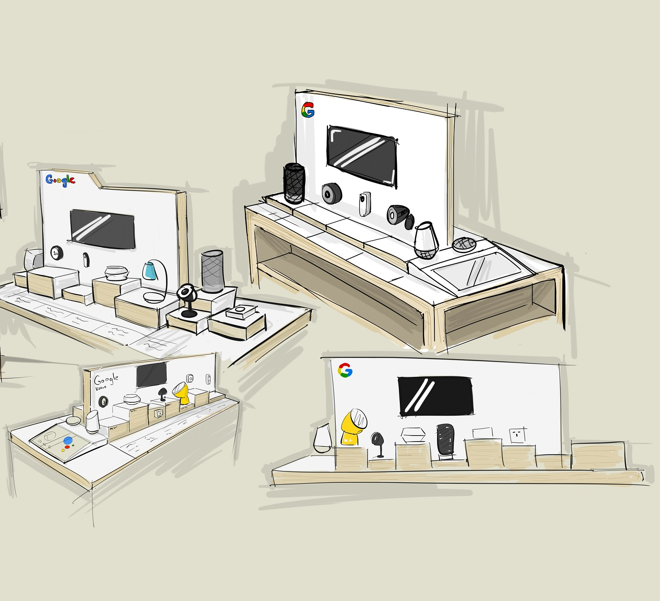
Design
Portfolio
Our design process is often seen as a problem-solving journey, with the first step always being to define our clients' needs. With a full in-house design team boasting a wide range of skillsets—from 3D modelling to photo editing and digital design—we’re equipped to tackle any challenge, ensuring creative solutions tailored to every project..

Slide 19
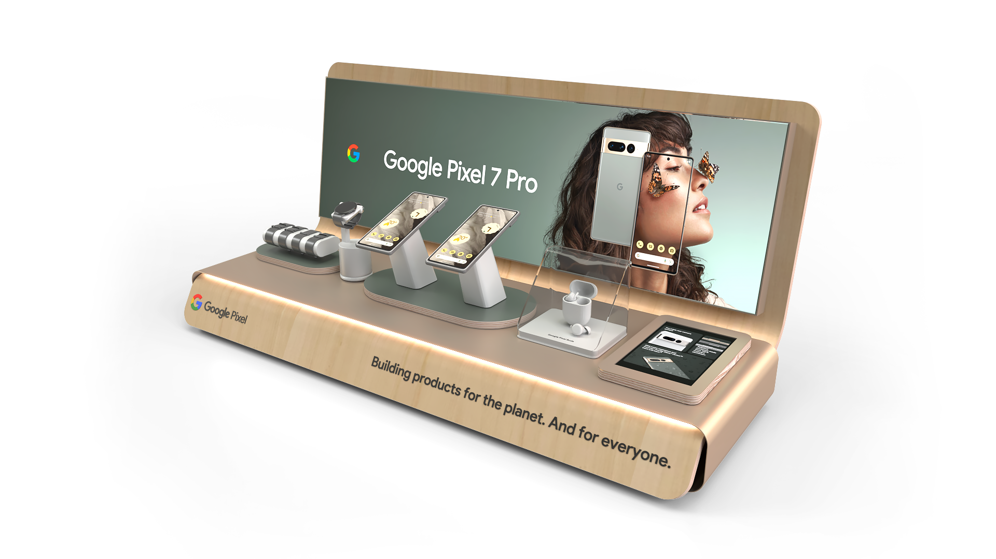
GOOGLE INLINE
CONCEPT
2022

Slide 20

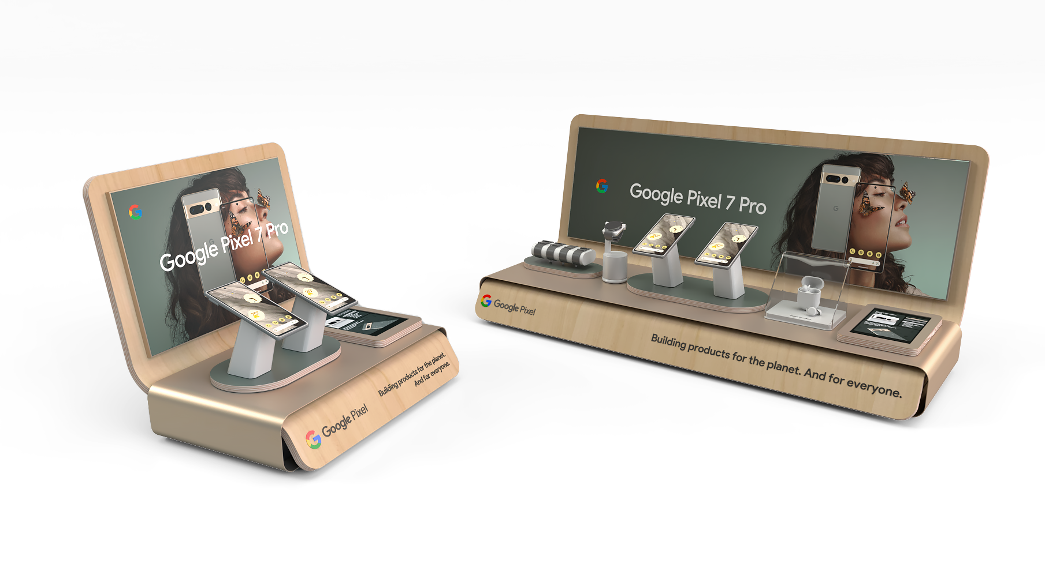

Slide 21
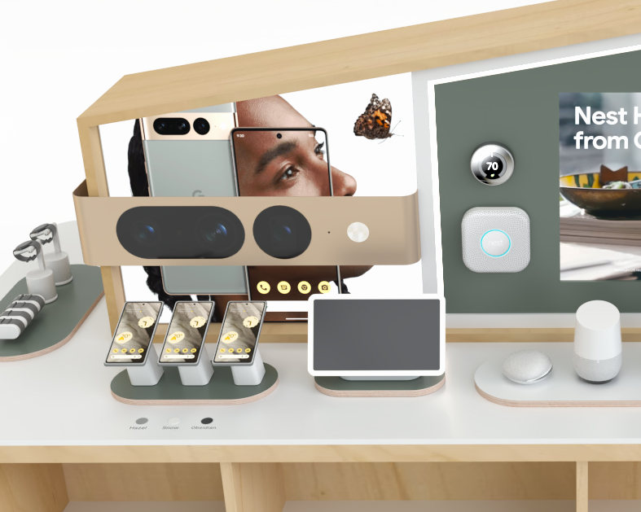
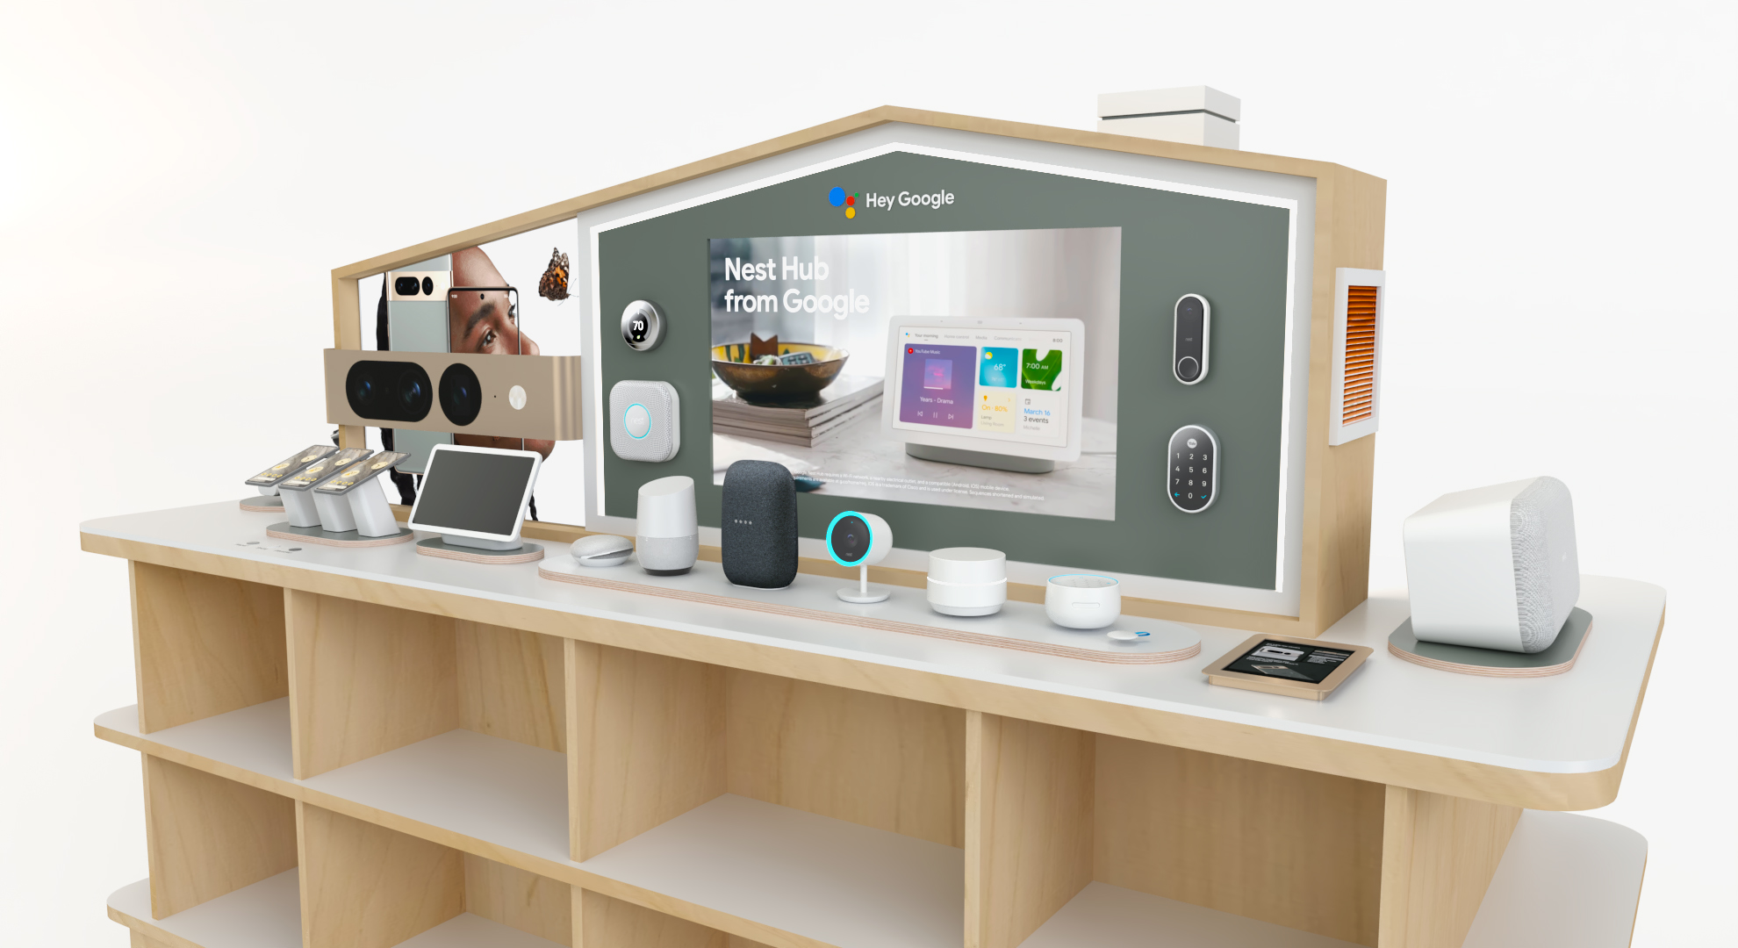
GOOGLE HOME
GONDOLA CONCEPT
2022

Slide 22
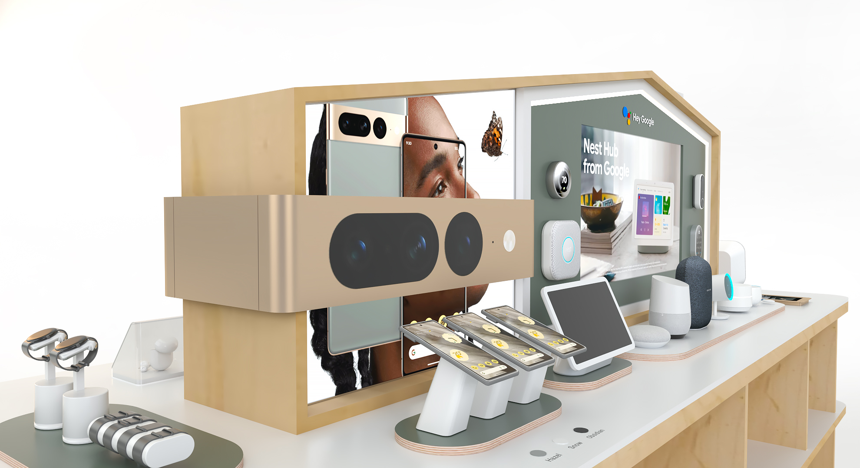

Slide 23
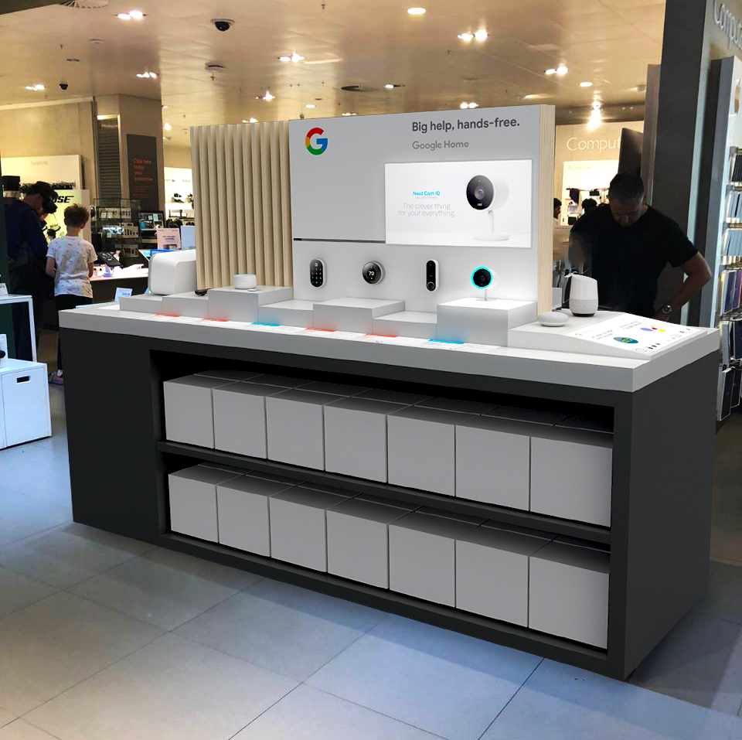
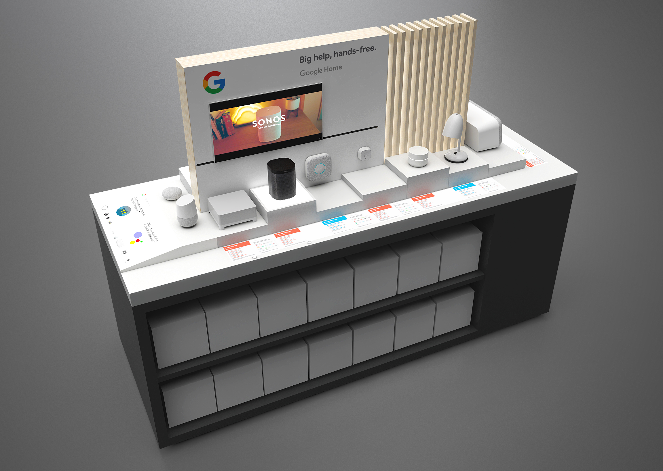
GOOGLE CONCEPT for JLP
2018

Slide 24
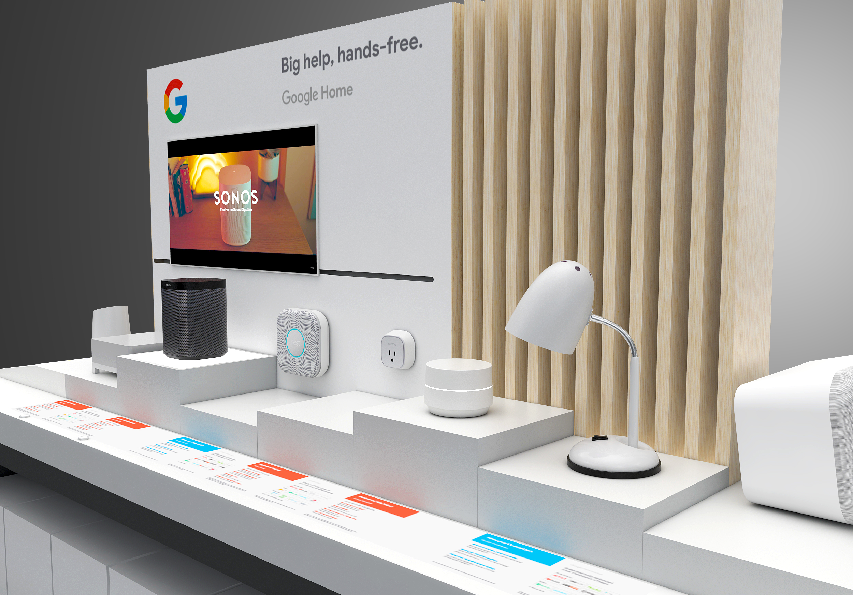

Slide 25
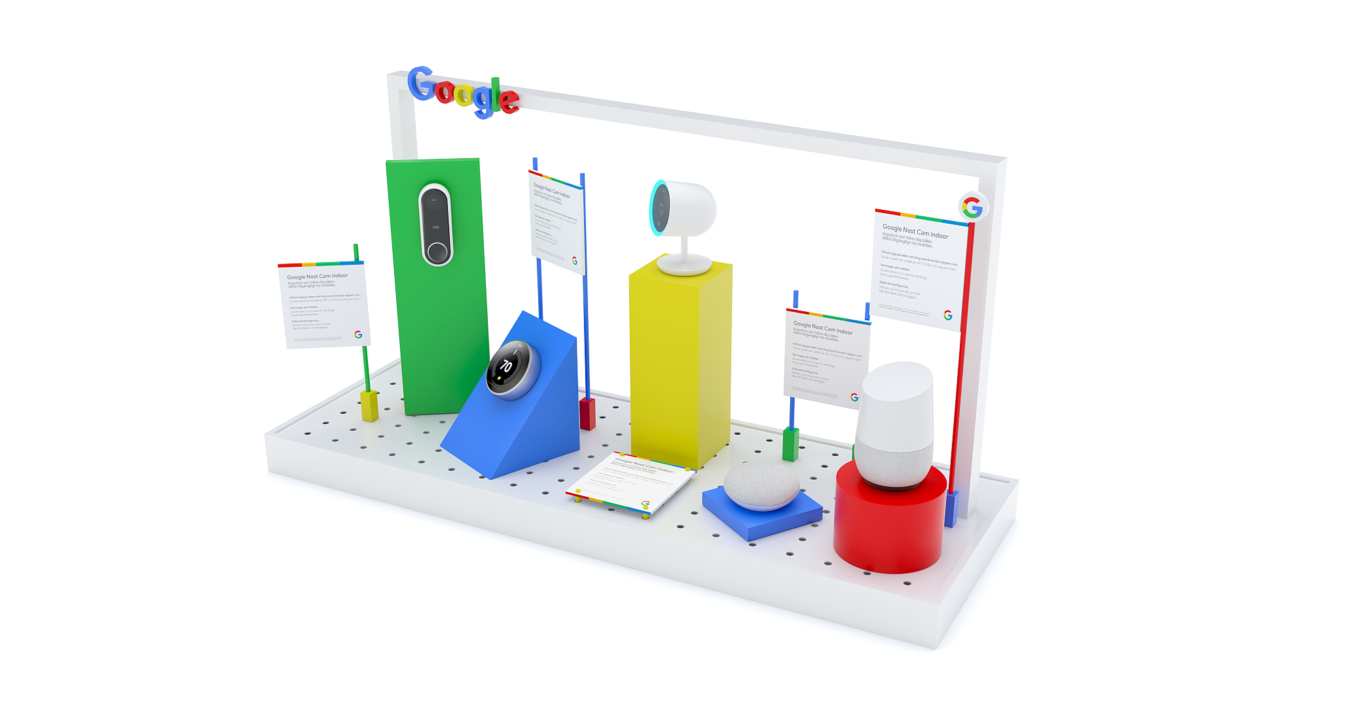
GOOGLE INLINE
CONCEPT
2020

Slide 26
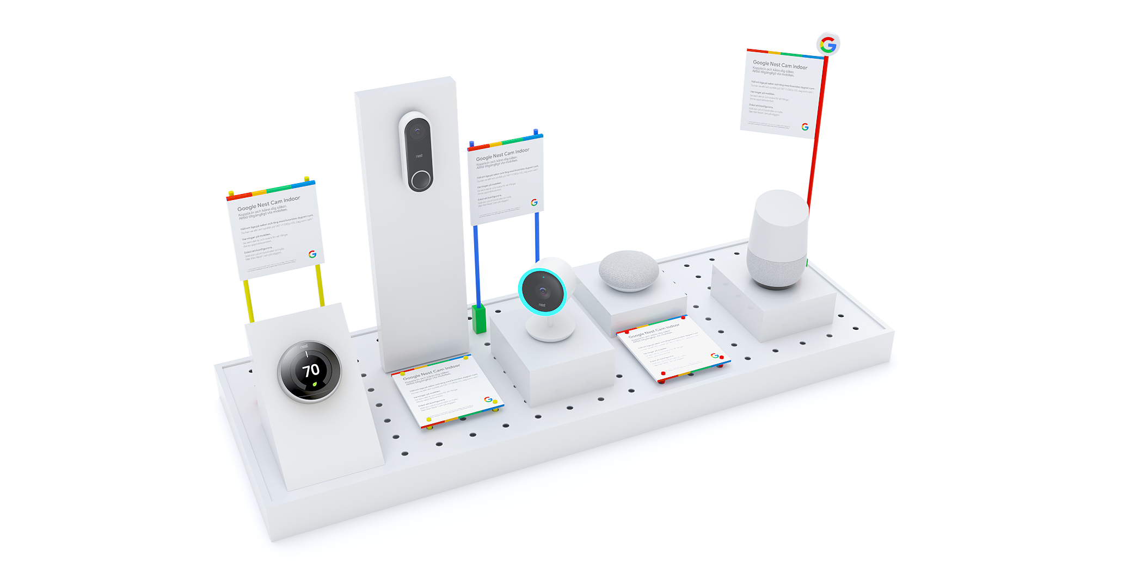

Slide 27
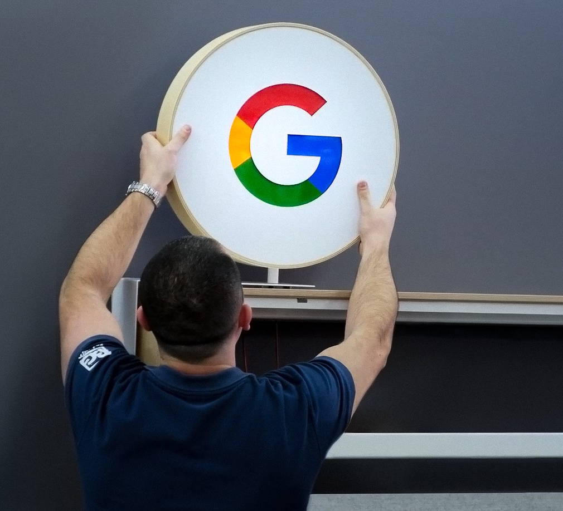
Our Commitment to Partnership
We’ve strengthened our partnership with Google by setting up a dedicated office and forming an in-house team focused entirely on their projects. This allows us to deliver solutions efficiently and stay aligned with their needs across Europe.

Slide 28
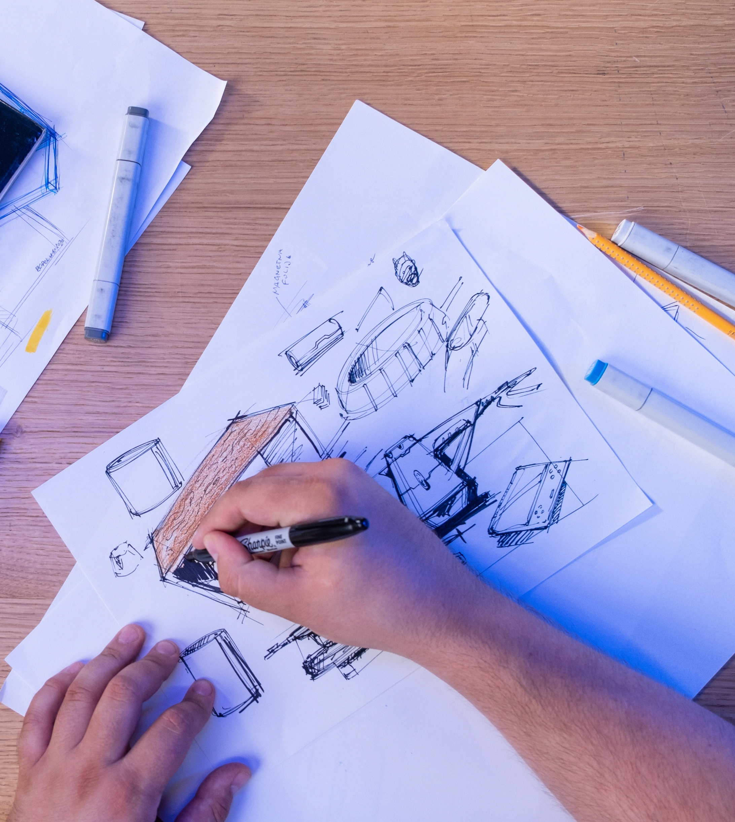
Google Dedicated Team
Dedicated Design Team A talented team of designers focused on bringing creative concepts to life, ensuring that every project aligns with both the client's vision and brand identity.
Engineers Our experienced engineers provide technical expertise, transforming designs into functional and durable solutions, ready for production and installation.
Prototyping specialist Specialists who develop and refine prototypes, allowing us to test and perfect designs before full-scale production, ensuring quality and precision.
Google dedicated office A dedicated office space that serves as the hub for all Google-related projects, providing focus and seamless coordination between teams.

Slide 29
BG REKLAM
HEADQUATERS
29. Novembra 1M
11460 Belgrade, Serbia
info@bgreklam.com
+381 11 785 64 64
+381 60 68 69 110
Thank You.
BG REKLAM GMBH
Leverkusenstraße 3
22761 Hamburg, Deutschland
hamburg@bgreklam.com
+49 40 85413003
www.bgreklam.com
BG REKLAM
UK LTD
2588 Davenport House,
207 Regent St
London, W1B 3HH, UK
+44 75 4288 2312

