Slide 1
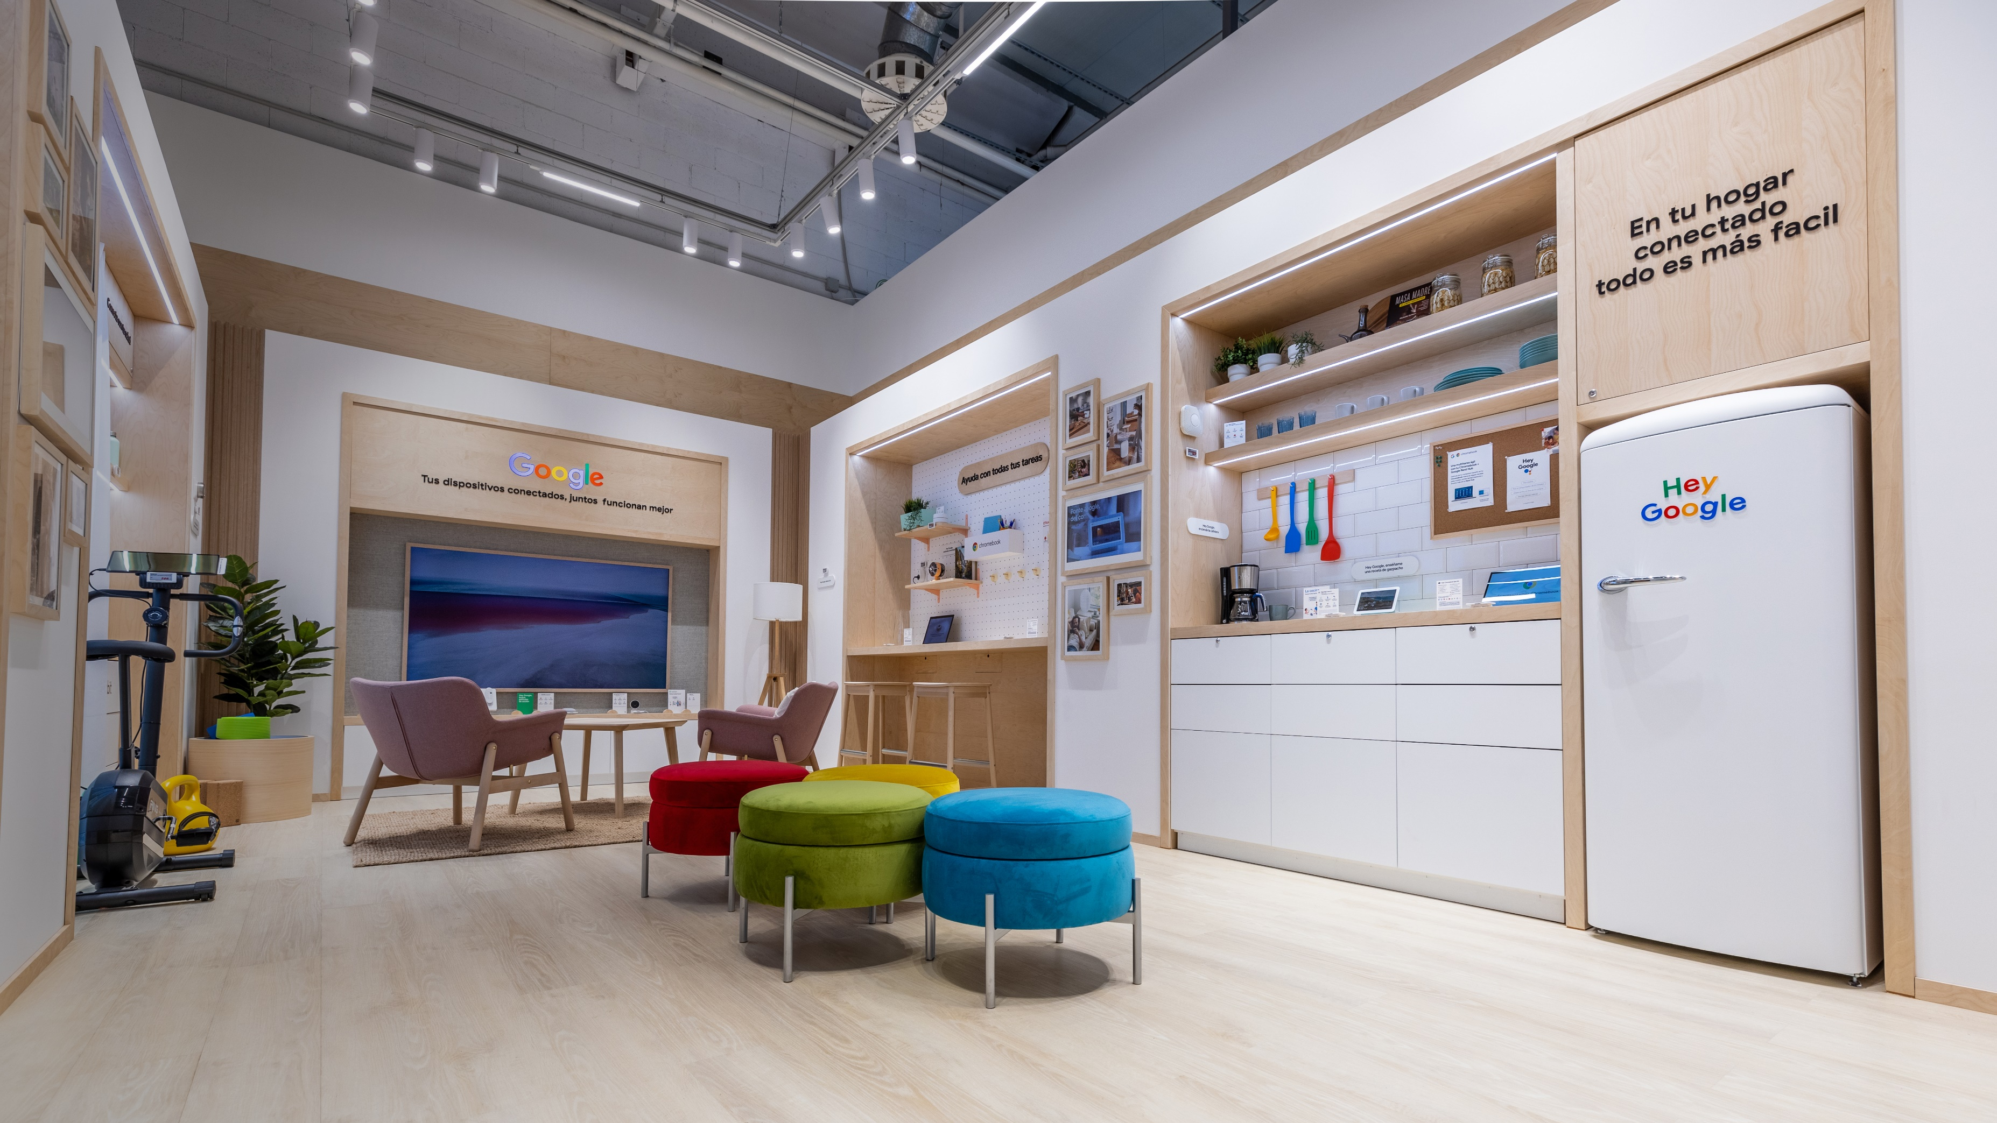

Google –
BG Reklam
meeting

Slide 2
Where we are and how we move forward
Project management improvement (tool)…
Communication with markets, their installation partners, real delivery dates
(explaining some of the issues through positive examples)

Slide 3
Project management team and tool
Drew and Aleksandra to create a project management tool that we will all track
This needs to be done by year end so we can start tracking projects real time
Clearly shows timelines and check points so we avoid situations we had with Italy and France this year that affected Poland and Baltic countries.
Also, when artworks are delivered late there is no time for testing.
Good practice example: Nordics
Only one deck per project is active, when anything changes BGR must get a notification immediately;
If it is not in the tool it doesn’t exist

Slide 4
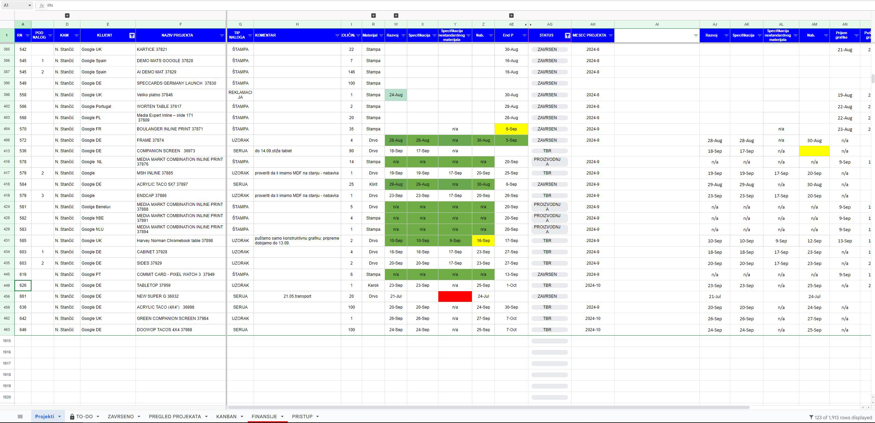
We are already using a Googlesheet internally

Slide 5
Communication with markets and their partners
Nemanja communicates directly with markets establishing clear communication and trustful relationship.
Nemanja communicates with their installation partners providing manuals, live demonstration with BGR people when needed and solving potential small issues when they arise.
Makes sure there is no misunderstanding in terms of dates, quantities, etc.
Makes sure we do use all the buffers that exist for CSA in the best possible way

Slide 6
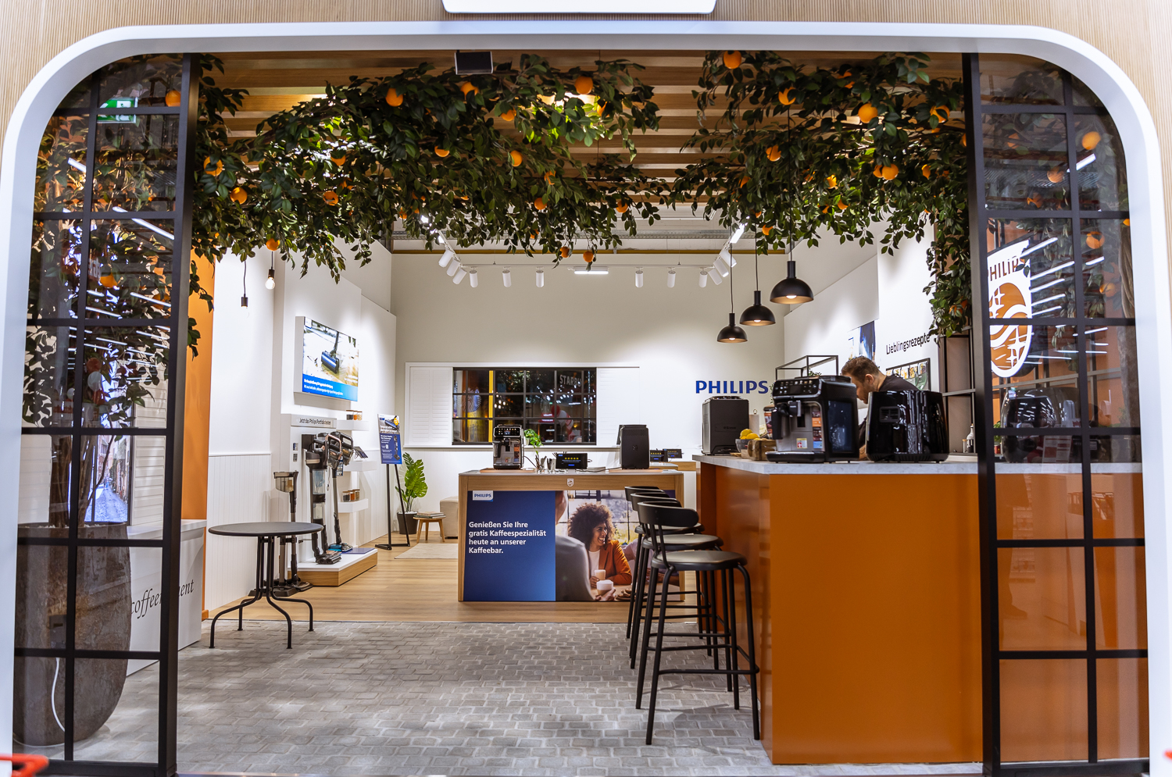
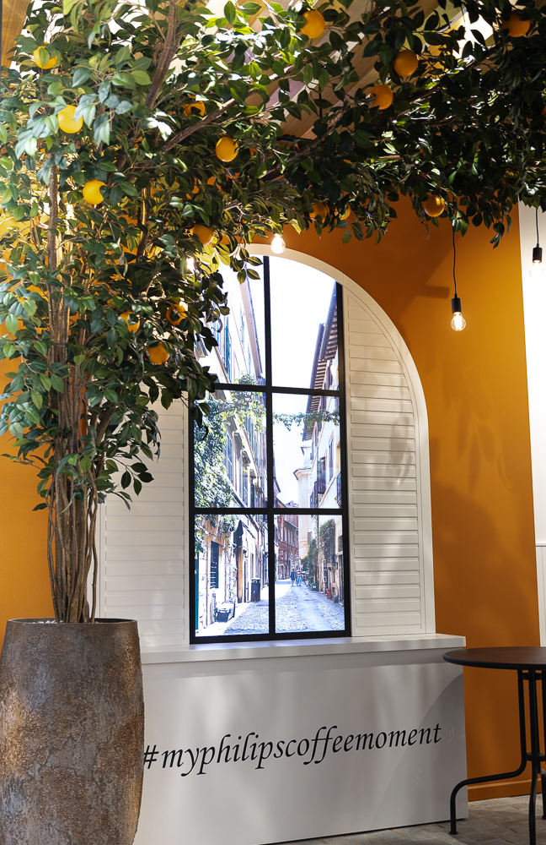
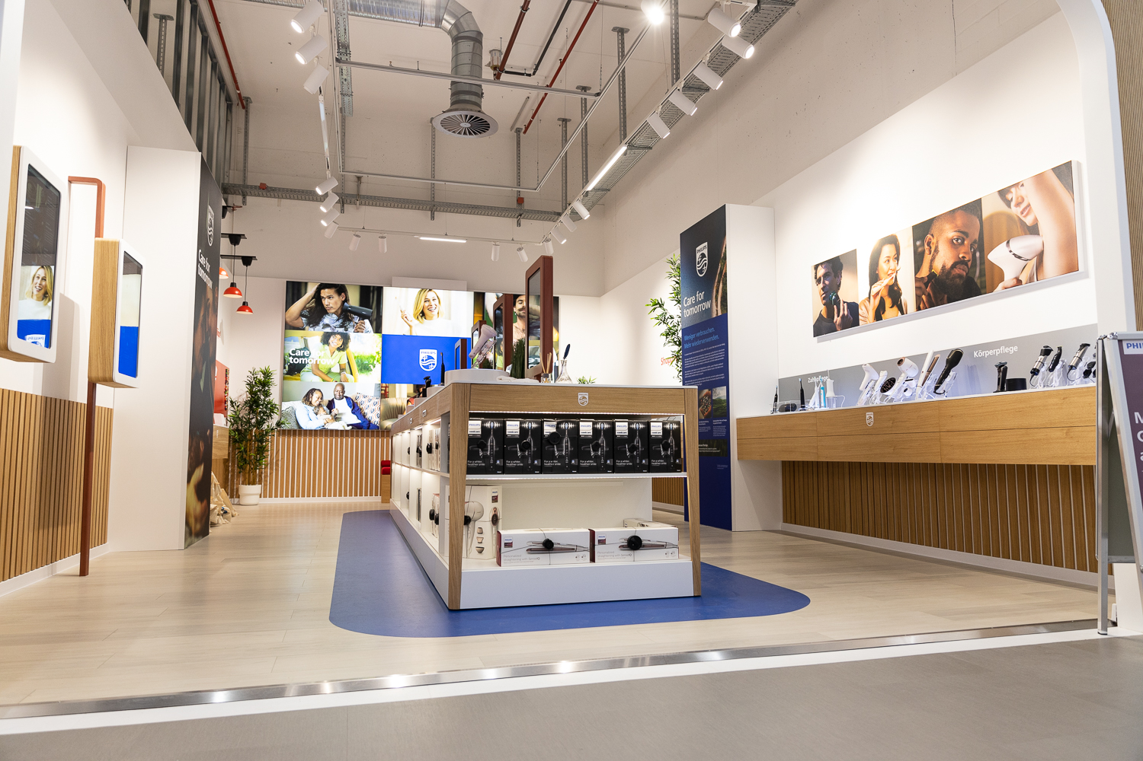
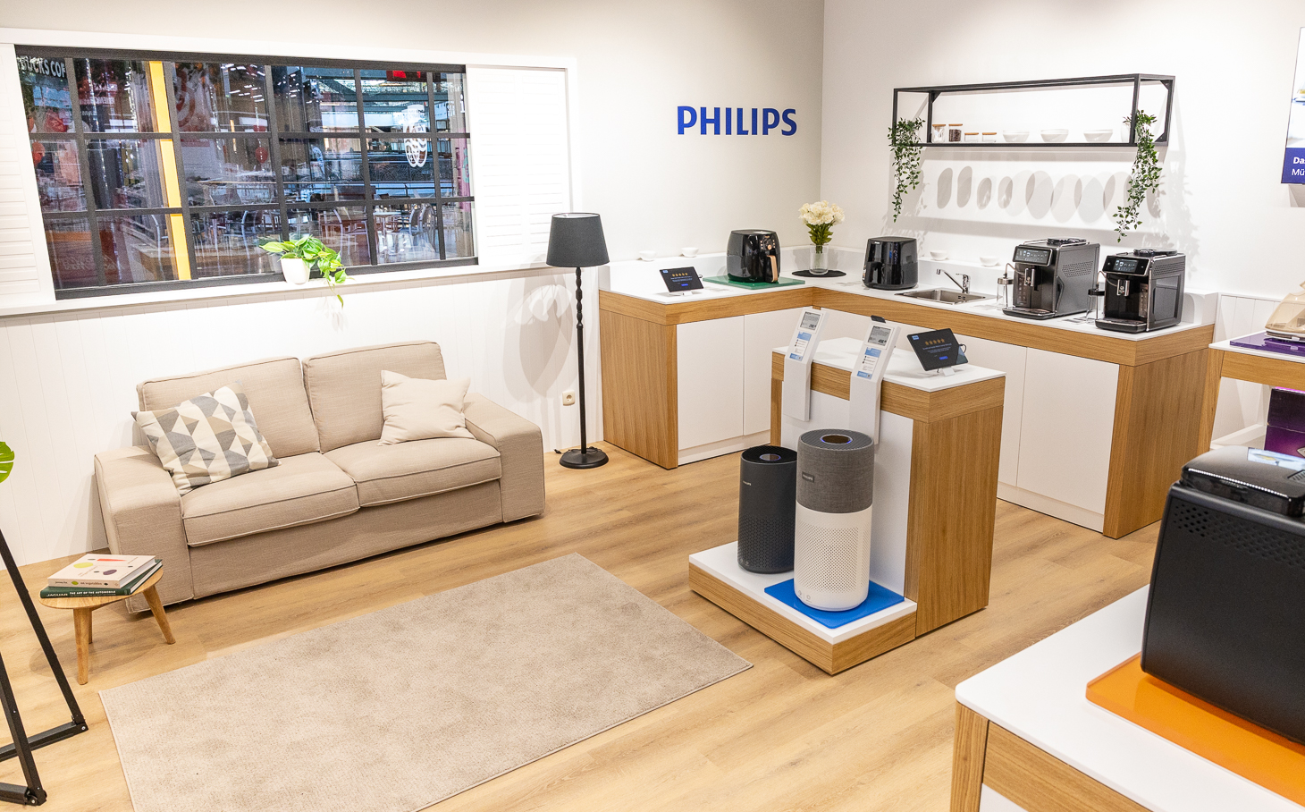
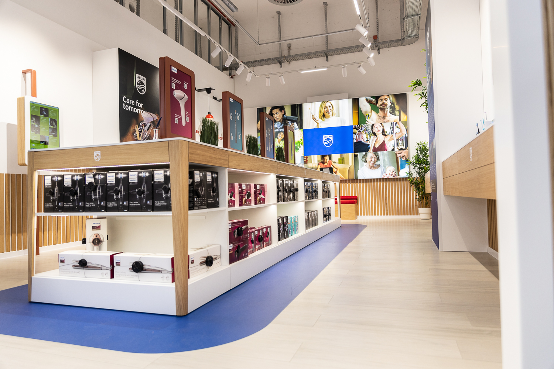
How it can work in practice

Slide 7
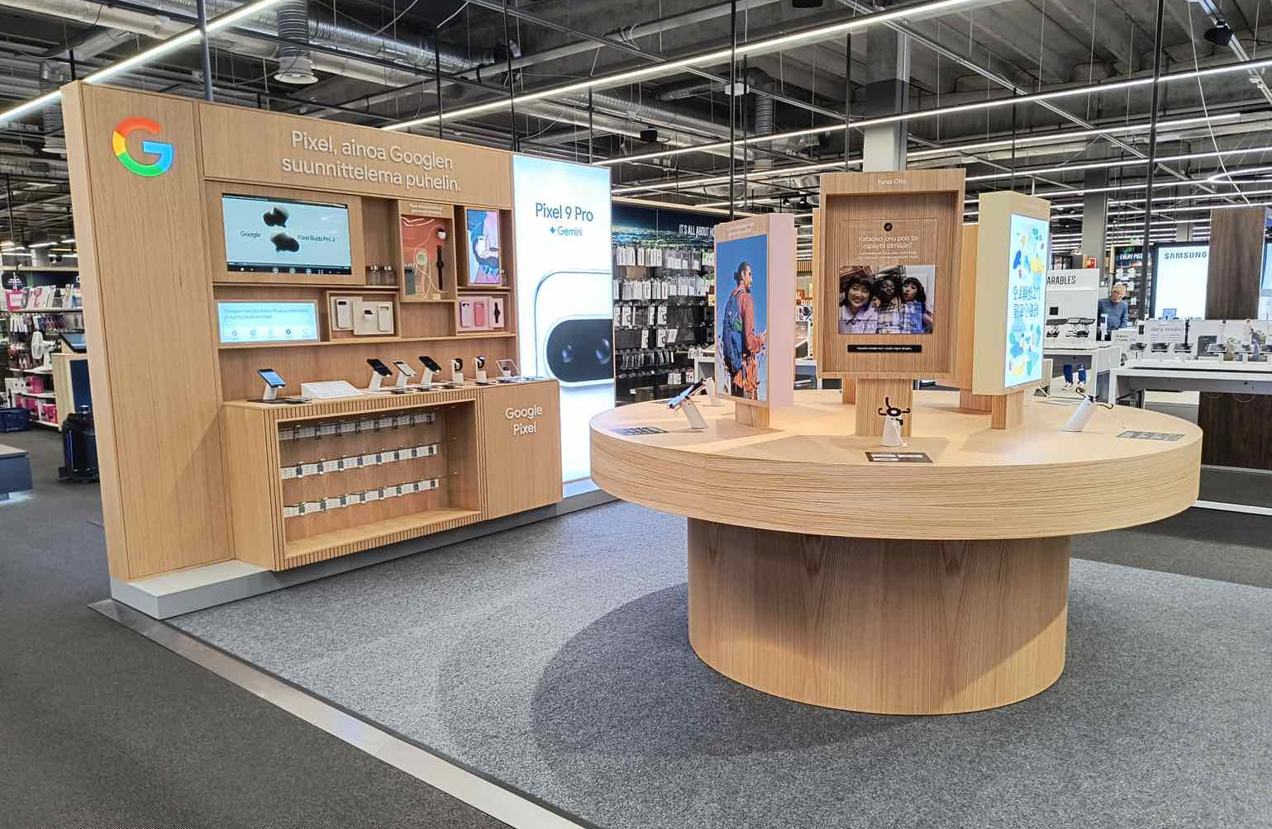
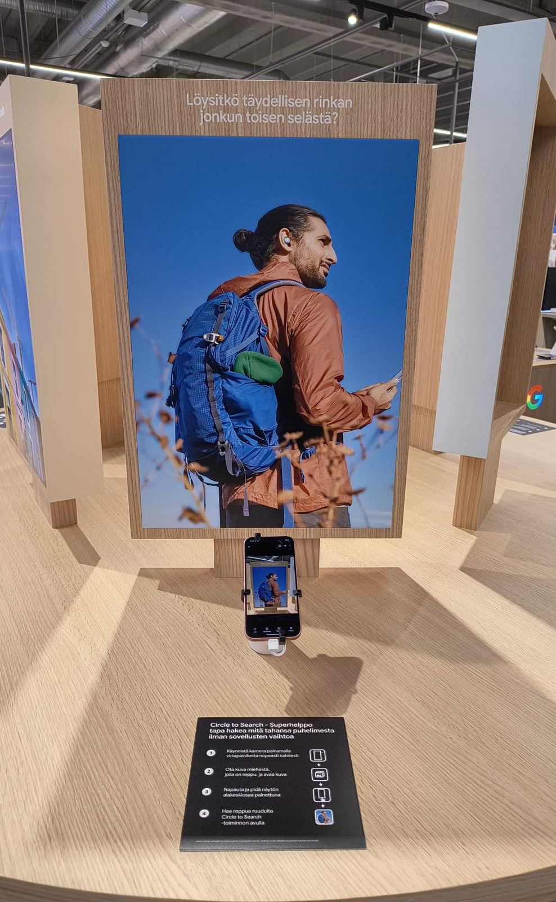
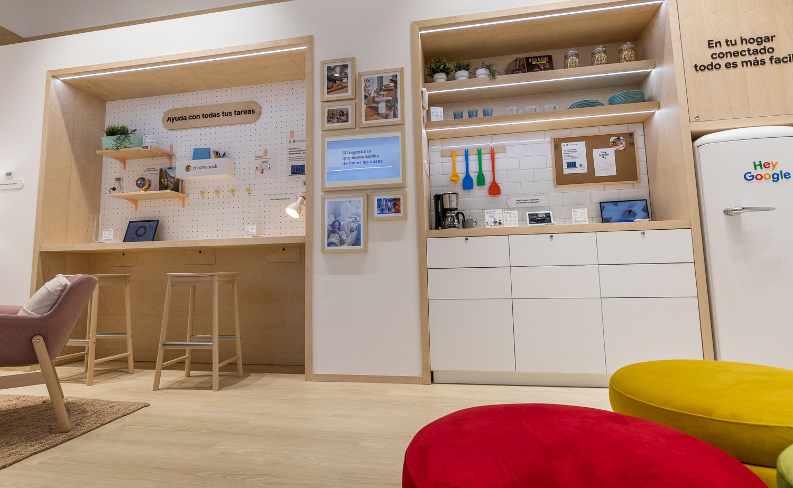
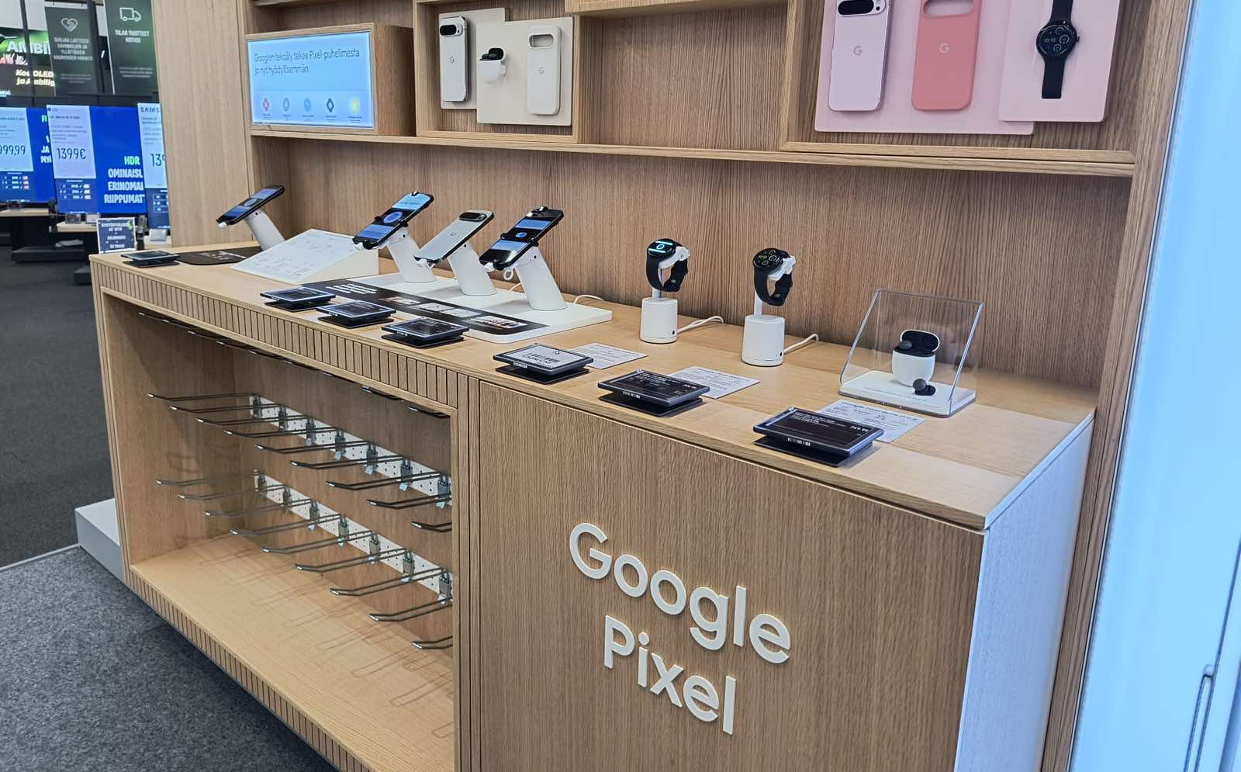
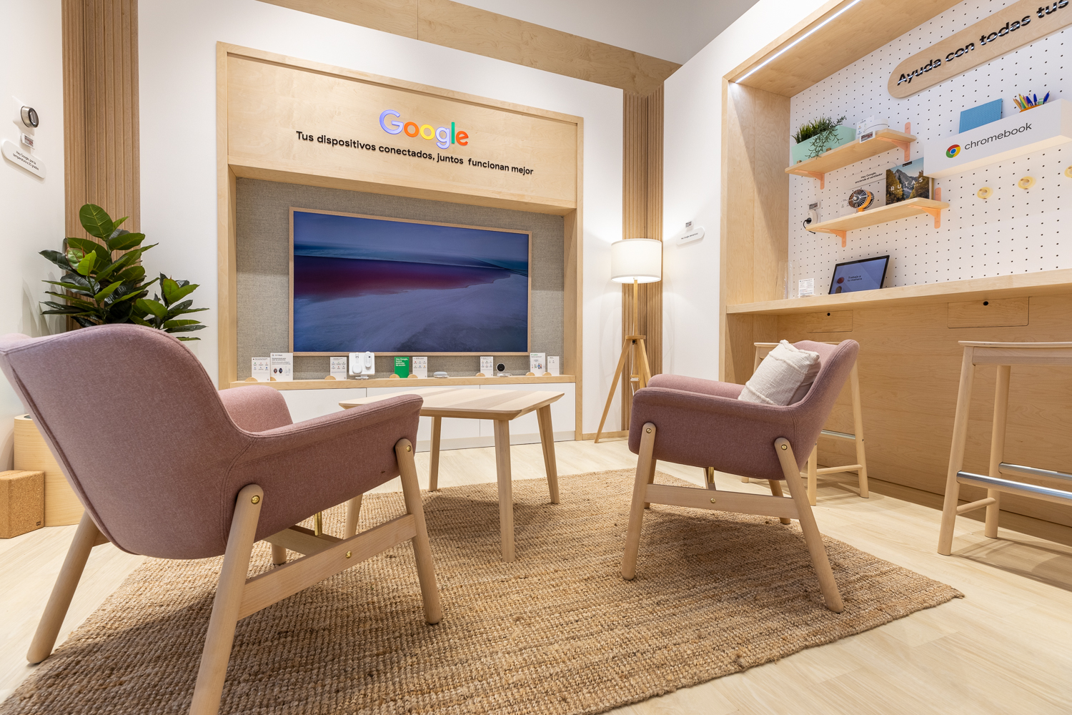
How it already works really well with Google!

Slide 8
How it looks in numbers
Client
Number of
markets
Number of
projects
Out of
which SiS
Development
hours
Production
hours
Number of
claims
PHILIPS
EMEA
17
67
8
1445
11260
1
GOOGLE
12
38
2
2730
13080
9

Slide 9
Good practices we would like to reapply
SiS’ in Spain, Italy, Denmark, Sweden, Germany and TCR – 0 issues with the most complex projects. On the other side, ‘simple’ projects with a lot of communication, nervousness and sometimes frustration on all sides (Poland during the last launch)
Italy installation of 7 wall-bays last winter – 2 installed without a single issue; other 5 with a lot of noise and problems due to installation challenges
Nordics, Spain, France, Benelux, Austria, Portugal… which stand for 74% of total Google production with close to 0 issues in the last 3 years – everything sent on time, or if not we align together on the best approach on how to avoid any issues. Italy, with a constant opportunity for better communication. Issue with the deadline in 2023, issue in July 24…
Constant communication with Spanish team for all different projects and great direct communication on their requirements, changes, updates… total of 17 decks, with 324 slides and approximately 1,200 pictures that are subject to a change on a daily basis, usually without any notification

Slide 10
BG REKLAM
PRODUCTION
29. Novembra 1M
11460 Belgrade, Serbia
info@bgreklam.com
+381 11 785 64 64
+381 60 68 69 110
Thank You.
BG REKLAM GMBH
Leverkusenstraße 3
22761 Hamburg, Deutschland
hamburg@bgreklam.com
+49 40 85413003
www.bgreklam.com
BG REKLAM
UK LTD
2588 Davenport House,
207 Regent St
London, W1B 3HH, UK
+44 75 4288 2312

