Slide 2
TABLE OF CONTENTS
OVERVIEW
BG REKLAM – ABOUT US
BENEFITS OF WORKING WITH US
4. CSR
PROJECTS
SUPPORT TEAM – CONTACT US

Slide 3
1. OVERVIEW

Slide 4
OVERVIEW
Welcome to our PRODUCT CATALOGUE !
This interactive product collection will provide you product information at the touch of the click.
It will provide you benefit insights, which you as our partner have from cooperation with us.
We are delivering exceptional experience for shoppers at physical retail (point – of – sale); products – per your request or special needs.
For more detailed product information, please contact our support team (your dedicated account manager) or contact us at Premium POS solutions for retail from concept to store (bgreklam.com).

Slide 5
2. ABOUT US

Slide 6
BG REKLAM – ABOUT US
We are professionals in production of premium POSM solutions.
BG Reklam creates outstanding various POSM that support in – store activation and drive sales at the point – of – sale of our clients for more than 20 years.
We are specialised in all areas, from Design & Concept Solutions, Innovations, through Engineering, to Development & Production of tailored POSM solutions. We are completing the entire process under one roof.
Our partner companies on local markets provide excellent Installation and Maintenance services.

Slide 7




Slide 8



Slide 9


OUR OFFICES
2001
2013
2017
2018
BG REKLAM (Headquarters)
29. Novembra 1M 11460 Belgrade, Serbia
+38111 785 64 64
+381 60 68 69 110
BG REKLAM GmbH
LeverkusenstraBe 3
22761 Hamburg, Germany
+ 49 40 8541 3003
BG REKLAM UK Ltd
1st Floor, Artist House 35 Little Russell Street London, WClA 2НН, UK
+44 20 3290 6345
BG REKLAM
SERBIA (HQ)
BG REKLAM
SERBIA (FACTORY)
BG REKLAM
UNITED KINGDOM
BG REKLAM
GERMANY
Hamburg
London
Belgrade

Slide 10
3. BENEFITS OF WORKING WITH US

Slide 11
BENEFITS OF WORKING WITH US
Today more than ever, especially during COVID-19 pandemic, in order to achieve goals and proceed with all projects on time and efficiently, every company needs to have a reliable business partner.
We are dedicated, creative and have experience in developing premium POSM solutions on your request, based on your needs. We are agile and we have experience working in tobacco category.
We are a reliable partner for the outstanding tailored sustainable POSM solutions.
We are supporting you to get through extremely busy time at work.
We care for your growth.

Slide 12
PARTNERING STRATEGY
PREMIUM PRODUCTS
Increasing brands’ image and sales through premium POSM solutions.
BENEFITS
ACCOUNT MANAGEMENT
Highly experienced and multilingual sales team, with presence on all the markets where we operate.
PROJECT MANAGEMENT
One Stop Shop – full project management support with one single point of contact. From design and concept solutions to installations and maintenance.
CREATE VALUE FOR OUR CLIENTS
MONETARY
High product quality and service at competitive prices.
SAVINGS
TIME
Lead time is 5 weeks* – from briefing to product delivery.
ENERGY
One Stop Shop, plus efficient communication and fast responsiveness.
*5 weeks lead time on average (from briefing to final product delivery) depending on the project complexity.

Slide 13

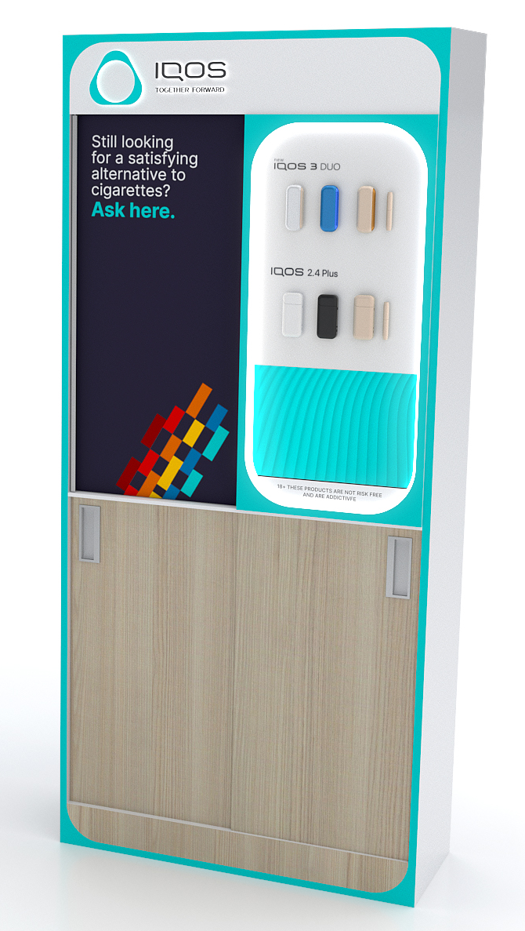
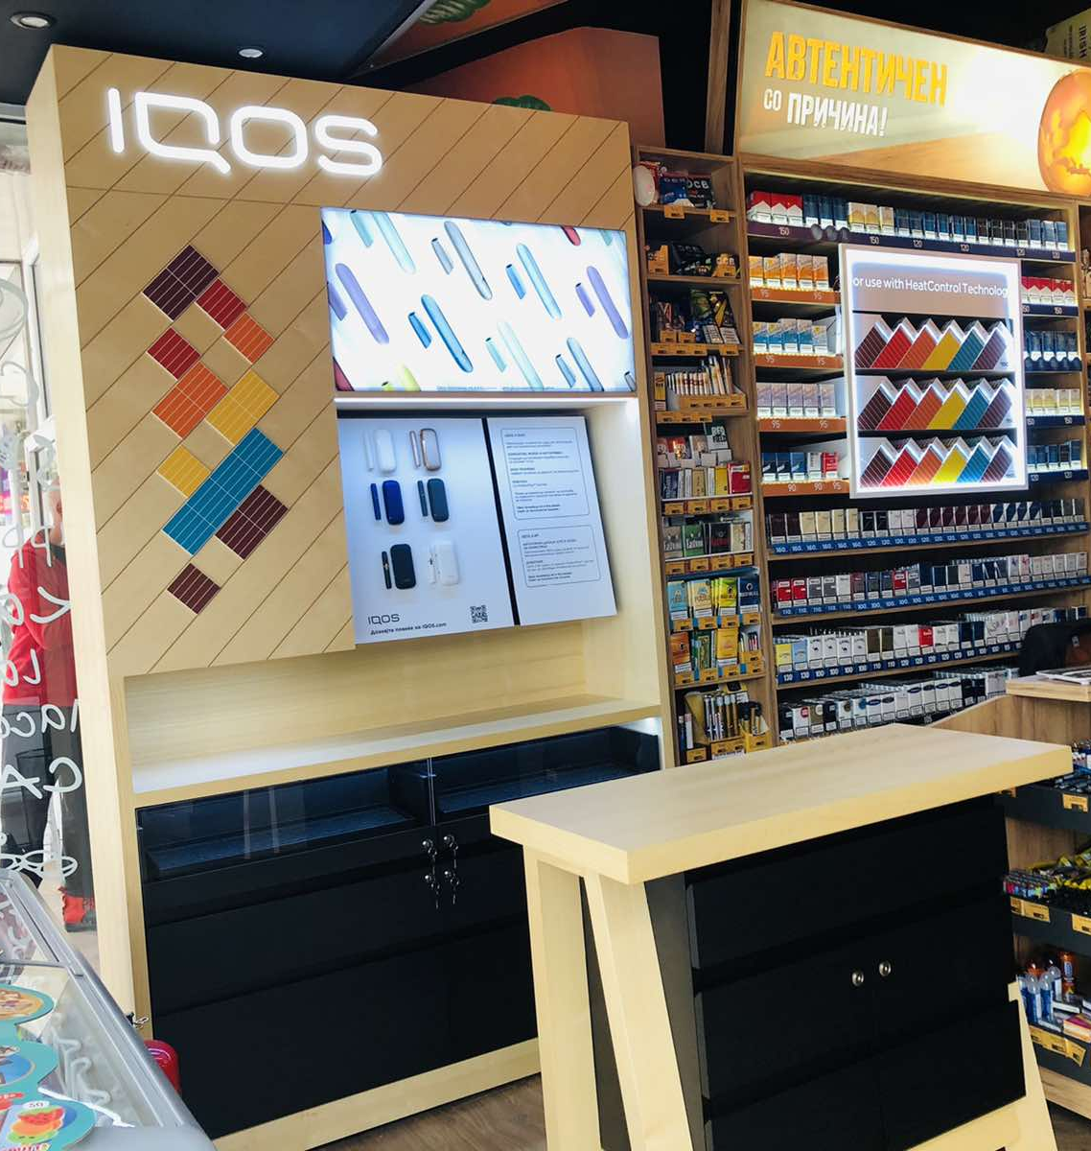


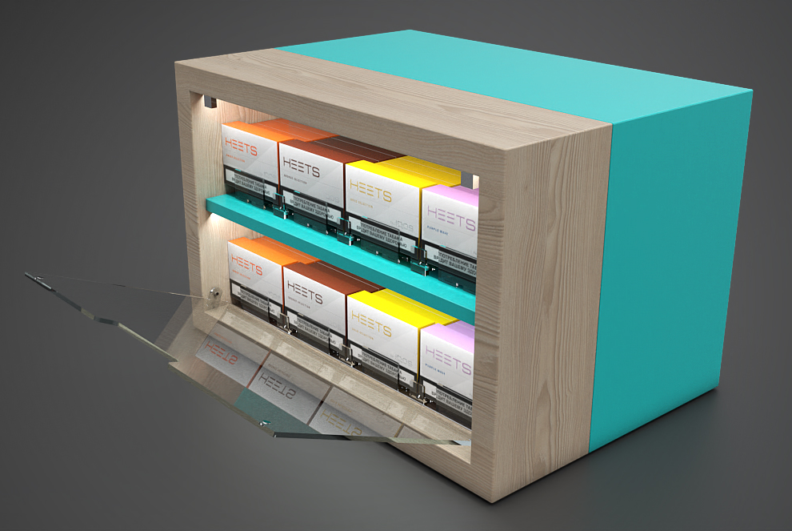
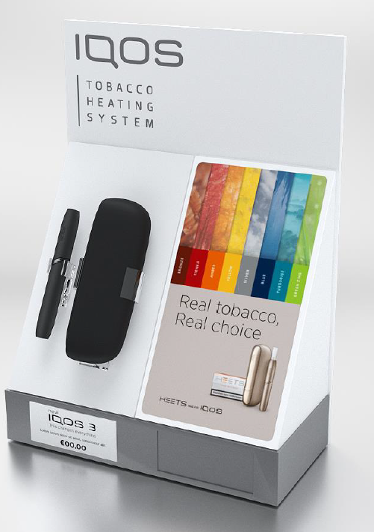
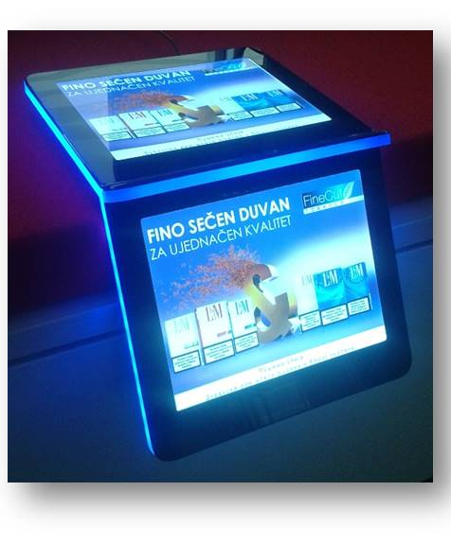
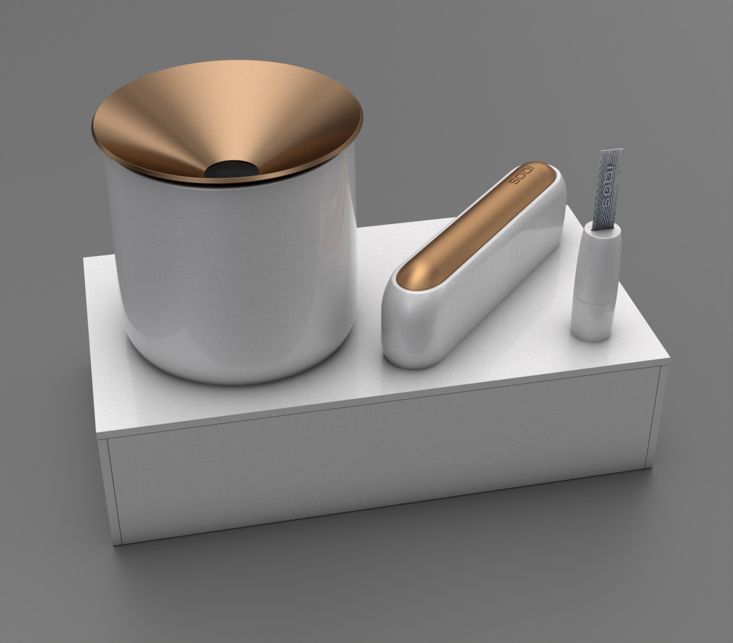
BG REKLAM & PMI
COOPERATION between PMI and BG REKLAM
We are pleased to cooperate 20 years.
We are happy to cover 11 markets where PMI has operations.
We are proud that together we developed more than 200K pcs POSM solutions.
Our exclusive & unique designs and specific materials are used to emphasize and tell a PMI brand story at POS.
Our intentions are driven by a customer centric approach in order to improve customer experience at POS.

Slide 14
4. CORPORATE SOCIAL RESPONSIBILITY

Slide 15
OUR PROMISES
As a socially responsible company, we committed to our four stakeholders the following:
EMPLOYEES – We are committed to providing a safe and secure working environment for all employees. We believe that: innovation, honesty and doing the right thing approach is a basis of everything we do.
CLIENTS – Our clients deserve outstanding products and services. Every single day, we strive with passion to meet our clients' demands.
ENVIRONMENT – We are committed to run a sustainable business. Our aim is to: 1. use eco-friendly materials (such as wood, metal, PET sheets, corrugated cardboard), 2. use recycled products; 3. create social initiatives.
COMMUNITY – We are continuously trying to be part of various socially responsible projects, to involve local marginalised groups in our supplier chain, as well to encourage our employees to volunteer in their local community.

Slide 16
BETTER TOMORROW THROUGH SUSTAINABILITY COMMITMENT
Our sustainability initiatives:
Reducing environmental impact
Using energy more efficiently
Reducing packaging waste
Using recyclable and reusable materials
Reducing carbon footprint by optimising our production process and technology
Please check our sustainability video: https://vimeo.com/474723155/579f192891

Slide 17
ENVIRONMENATLLY RESPONSIBLE BEHAVIOUR
Every day we are actively and continuously work to:
REDUCE – scrap and energy consumption. Our business is focused and completely aligned with certifications ISO 20400 and 26000.
REUSE – our aim is to produce re-brandable and multi usage products (allows easily changeable communication)
RECYCLE – use of fully recyclable materials. Our special attention in production is in line with lifecycle thinking approach (all used materials can be easily splited at the end of the production lifecycle).

Slide 18
WE ARE USING LATEST TECHNOLOGY IN PRODUCTION PROCESS
By careful selection of materials and machines in our production process we are managing to reduce carbon footprint.
Based on your request we can deliver eco-friendly materials and outstanding sustainable POSM solutions.

Slide 19



Slide 20







CERTIFICATIONS
Our accreditations prove our commitment to sustainability. We have:
QUALITY
MANAGEMENT
ENVIRONMENTAL
MANEGEMENT
HEALTH AND SAFETY
MANAGEMENT
SUSTAINABLE PROCUREMENT
SOCIAL
RESPONSIBILITY

Slide 21
5. PROJECTS

Slide 22
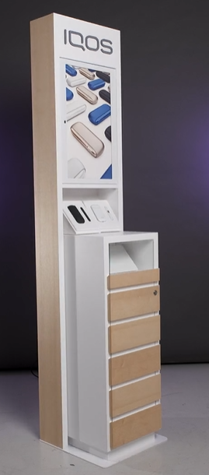
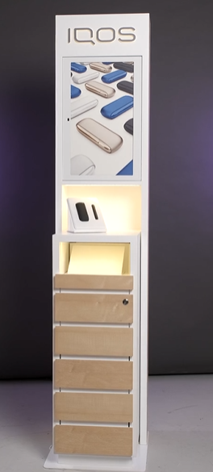
PROJECT
IQOS DIGITAL FREESTANDING UNITS – SERBIA
Retailer
Across premium convenience stores in Serbia
Year
2021
Description
It is a digital IQOS Expert solution where touch screens were installed into the unit for consumer education/registration on POS.
Briefing and sample production and then delivery of full quantities (with material procurement) took 5 weeks, as previously agreed.
Materials
Wood, Metal, Acrylic, Glass, LED
Dimensions
H2000xW600xD400
*Product demo video on request

Slide 23
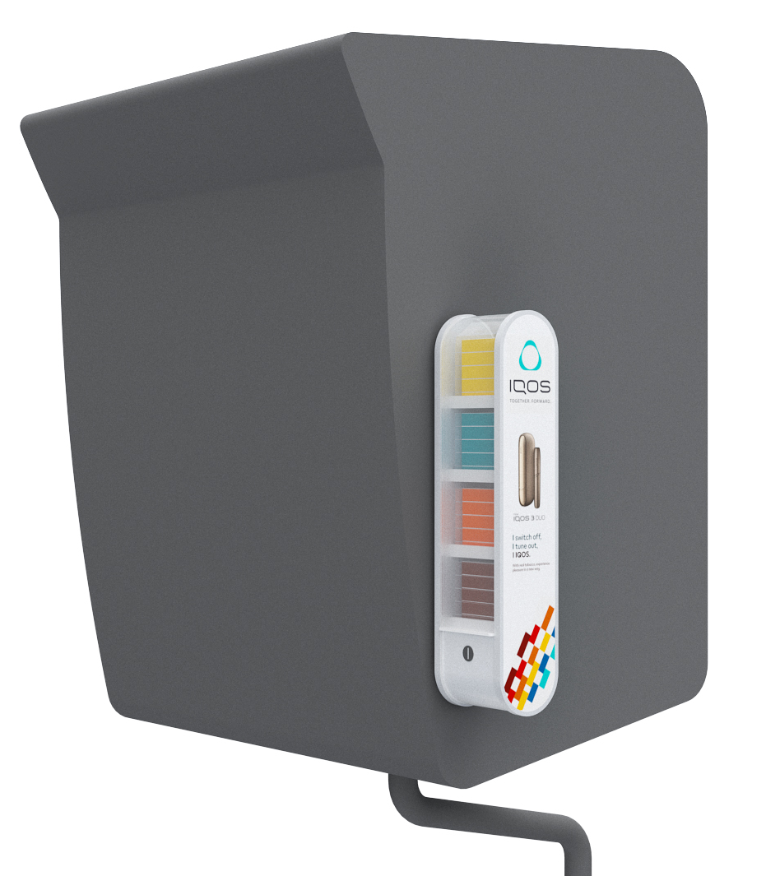
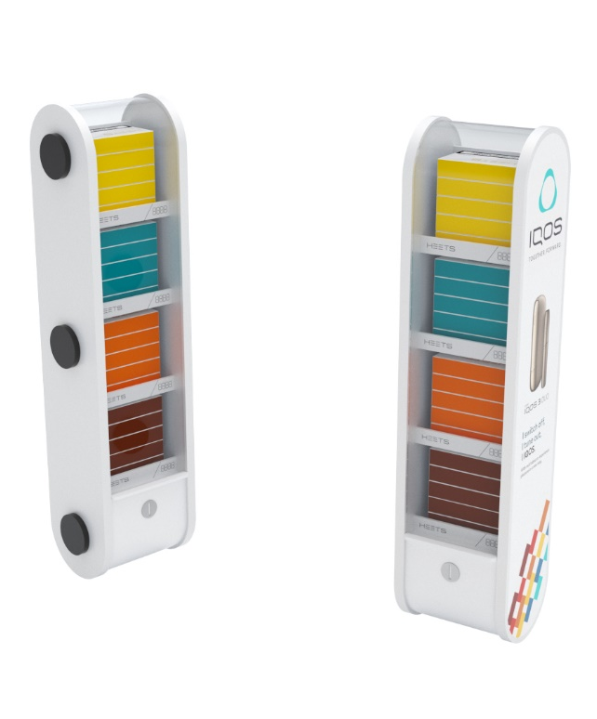
PROJECT
HEETS SELECTION – SERBIA
Retailer
Independent stores across Serbia.
Year
2021
Description
Changeable communication.
4 SKU, could be multiplied.
Lockable non (transparent) shutter.
Materials
Forex, Magnets
Dimensions
H485xW120xD100

Slide 24
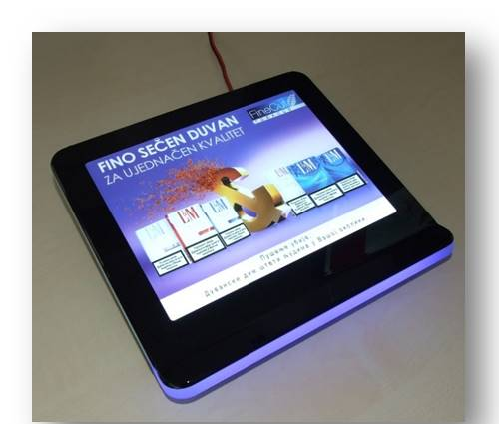
PROJECT
IQOS CASH TRAY – SERBIA, BOSNIA, N.MACEDONIA, ALBANIA, MONTENEGRO
Retailer
Kiosk network across Adria
Year
2019 – 2021
Description
Premium and waterfall cash trays for kiosk POS.
Changeable visual communication with RGB illumination.
Materials
Acrylic, Metal, LED diodes.
Dimensions
H50xW270xD200

Slide 25
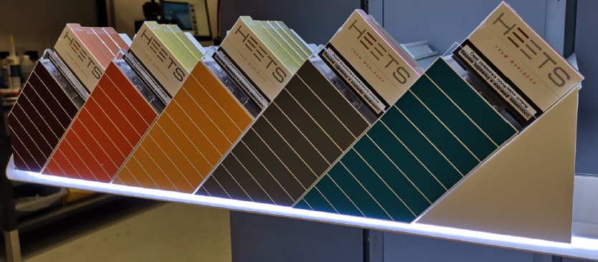
PROJECT
HEETS STAGING UNIT – SERBIA, BOSNIA, N.MACEDONIA, ALBANIA, MONTENEGRO
Retailer
Independent stores across ADRIA
Year
2019-2021
Description
Staging unit for different types of shelves.
Materials
Acrylic, Magnetic foil
Dimensions
Various dimensions

Slide 26
PROJECT
IQOS BACKWALL UNIT AND TABLE – NORTH MACEDONIA
Retailer
Premium convenience stores in Skopje
Year
2021
Description
Producing IQOS back wall units and tables for premium retail.
Briefing and sample production and then delivery of full quantities (with material procurement) took 5 weeks, as previously agreed.
Materials
Wood, Glass, Magnetic foil, Tension fabric
Dimensions
H2000xW1600xD300

Slide 27
PROJECT
HORECA DISPLAY – ALBANIA
Retailer
HoReCa across Albania.
Year
2021
Description
Illuminated storage area for HEETS.
Materials
MDF, Acrylic
Dimensions
H225xW350xD245

Slide 28
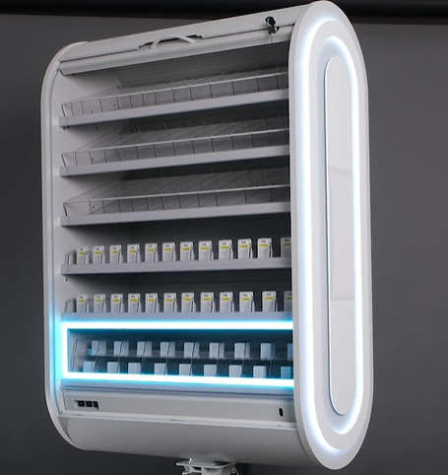
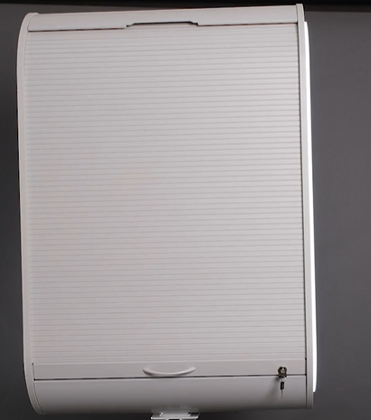
PROJECT
SLIM CHECKOUT UNIT – CROATIA
Retailer
Independent stores and KA
Year
2021
Description
Checkout unit used as a side storage area with lockable shutter, could be used as a counter unit.
Materials
Powder coated metal, Acrylic, LED diodes.
Dimensions
Various dimensions

Slide 29
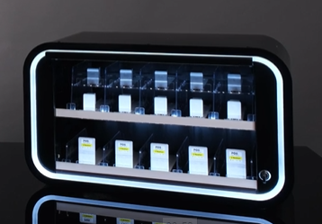
PROJECT
HoReCa UNIT – CROATIA
Retailer
HoReCa
Year
2020
Description
HoReCa unit produced for dark market with lockable shutter and illuminated shelves.
This unit has shutter which blinds the interior of the unit due to market legislation.
Materials
Powder coated metal, Acrylic
Dimensions
H300xW800xD270

Slide 30
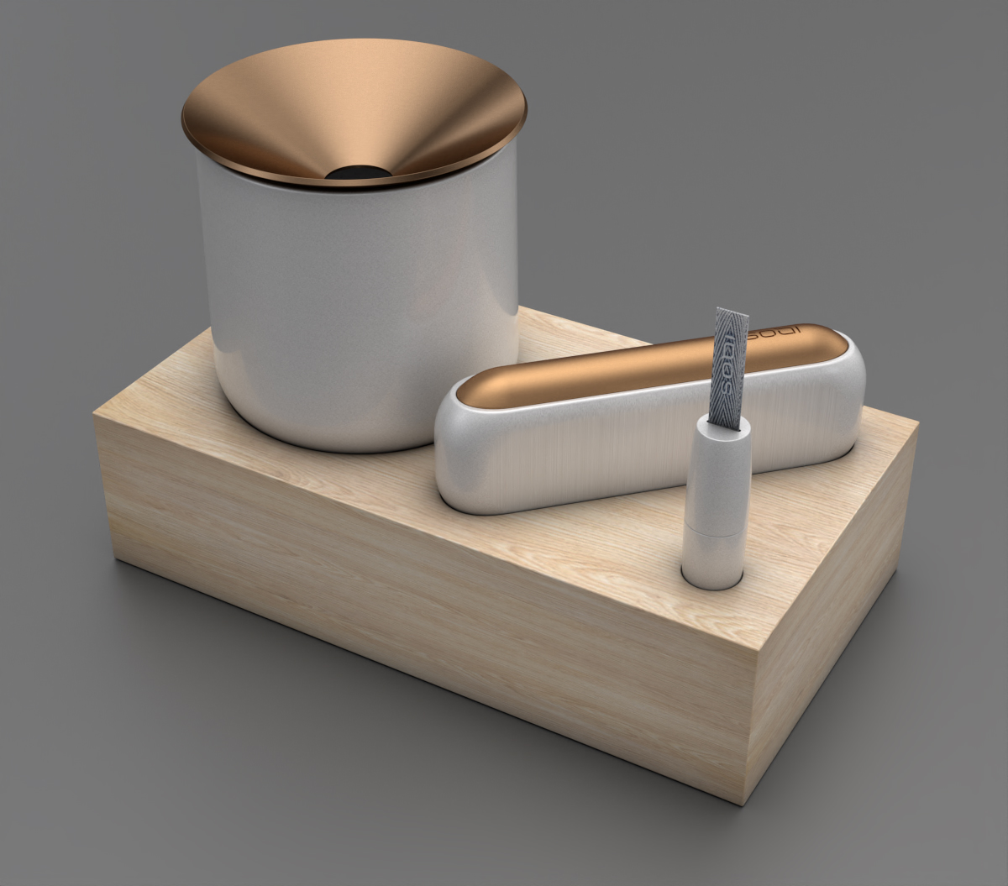
PROJECT
IQOS DOCKING STATION – CROATIA AND SLOVENIA
Retailer
Cafes across Croatia and Slovenia
Year
2021
Description
Wooden docking station for DUO IQOS device. Chargeable power bank inserted into the unit.
Ashtray and cleaning stick attached by magnets.
Materials
MDF, Powder coated metal.
Dimensions
H60xW110xD195

Slide 31
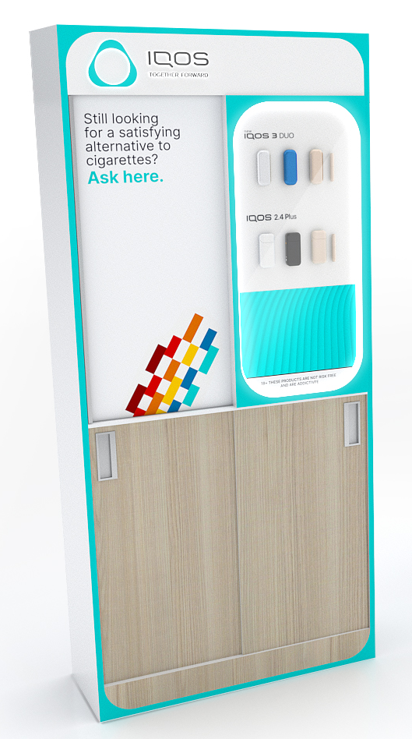
PROJECT
BACKWALL UNIT – UNITED KINGDOM
Retailer
General Trade
Year
2021
Description
Free standing Back wall unit with changeable display area. All 4 doors are covering storage room and they can have changeable visual communication.
Displayed products:
IQOS devices, HEETS, cigarettes, snus products.
Materials
MDF, Powder coated metal
Dimensions
H2200W1000xD400 – can be also 500 and 650mm

Slide 32
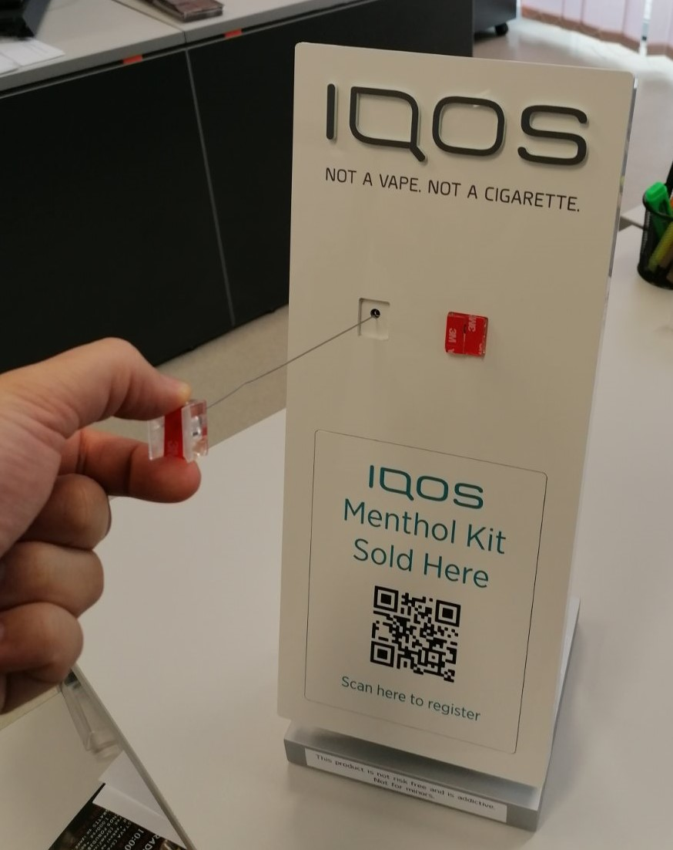
PROJECT
IQOS COUNTER – UNITED KINGDOM
Retailer
Wide retail network across UK
Year
2020
Description
IQOS counter with anti – theft system.
Changeable communication.
QR code for registration.
Materials
Powder coated sheet metal, Acrylic, Wood
Dimensions
H350xW150xD165

Slide 33
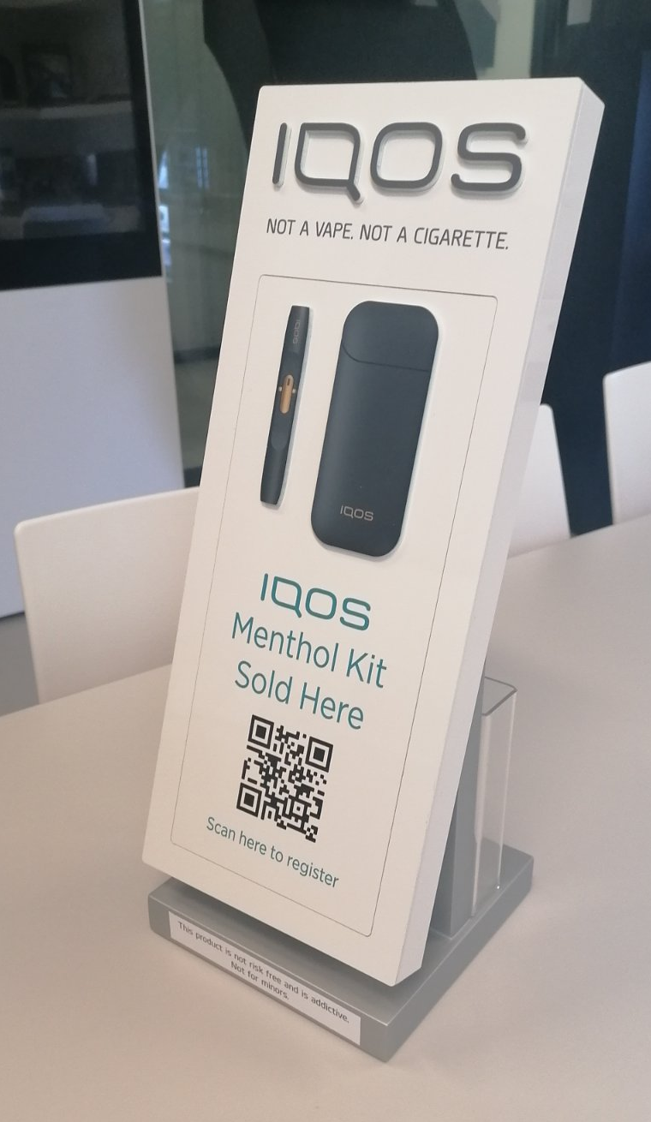
PROJECT
IQOS 3D COUNTER – UNITED KINGDOM
Retailer
Wide retail network across UK
Year
2020
Description
IQOS 3D print counter.
Changeable communication.
QR code for registration.
Materials
Powder coated sheet metal, Acrylic, Wood, Forex
Dimensions
H350xW150xD165

Slide 34
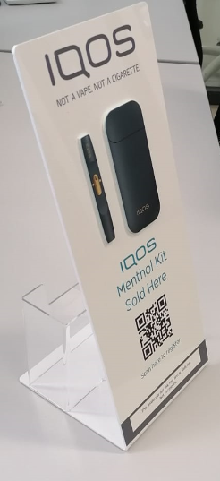
PROJECT
IQOS 3D COUNTER – UNITED KINGDOM
Retailer
Wide retail network across UK
Year
2020
Description
IQOS 3D print counter.
QR code for registration at the front and back.
Space for flyers at the back.
Materials
Acrylic, Forex
Dimensions
H320xW150xD165

Slide 35
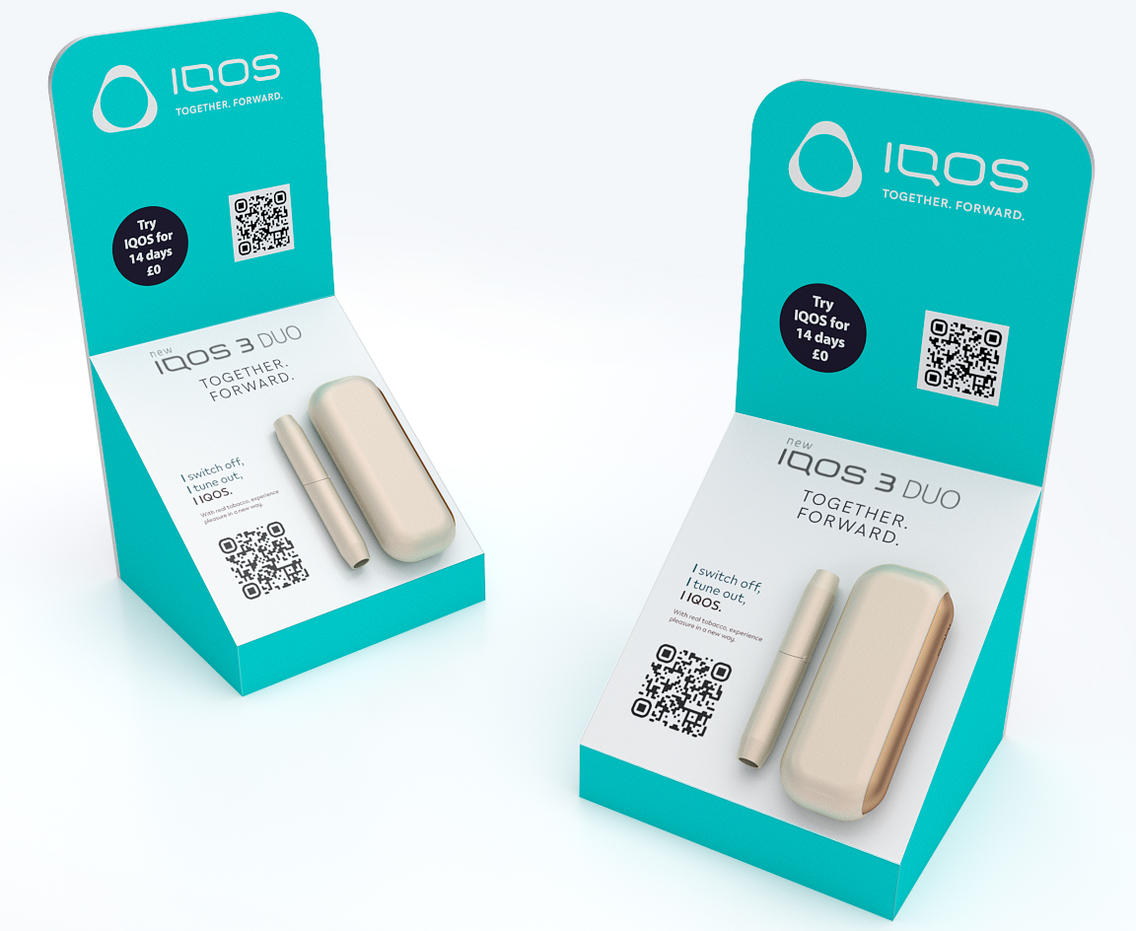
PROJECT
IQOS ON COUNTER – UNITED KINGDOM
Retailer
Independent stores across UK
Year
2021
Description
Changeable visual communication on lower panel.
Dummy device attached to the base – changeable plate.
Materials
Acrylic, Cling foil
Dimensions
H157xW270xD360

Slide 36
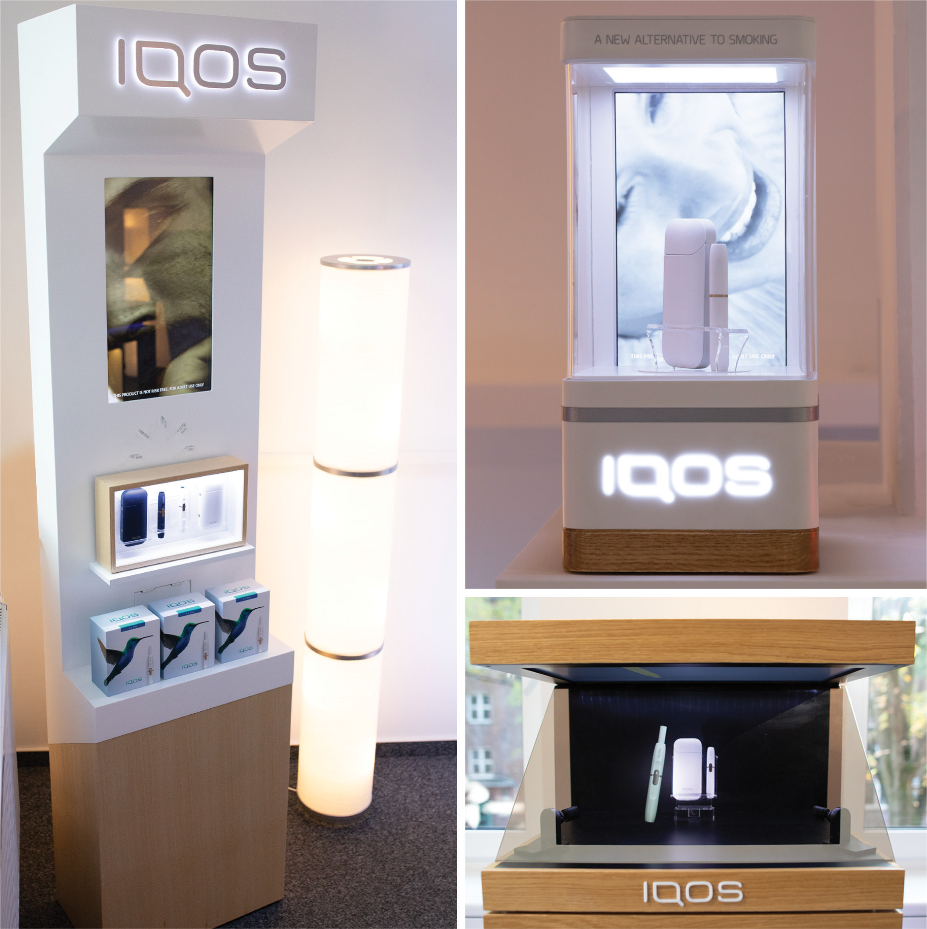
PROJECT
IQOS RETAIL AND HORECA DISPLAYS – UNITED KINGDOM
Retailer
Vaping stores and Bars
Year
2018
Description
A range of different sized solutions designed to display the features of IQOS, from countertop units to FSDUs, with integrated video screens and illumination.
Materials
Thermo-formed solid surface, LED, Metal construction, Backlight print
Dimensions
Various dimensions

Slide 37
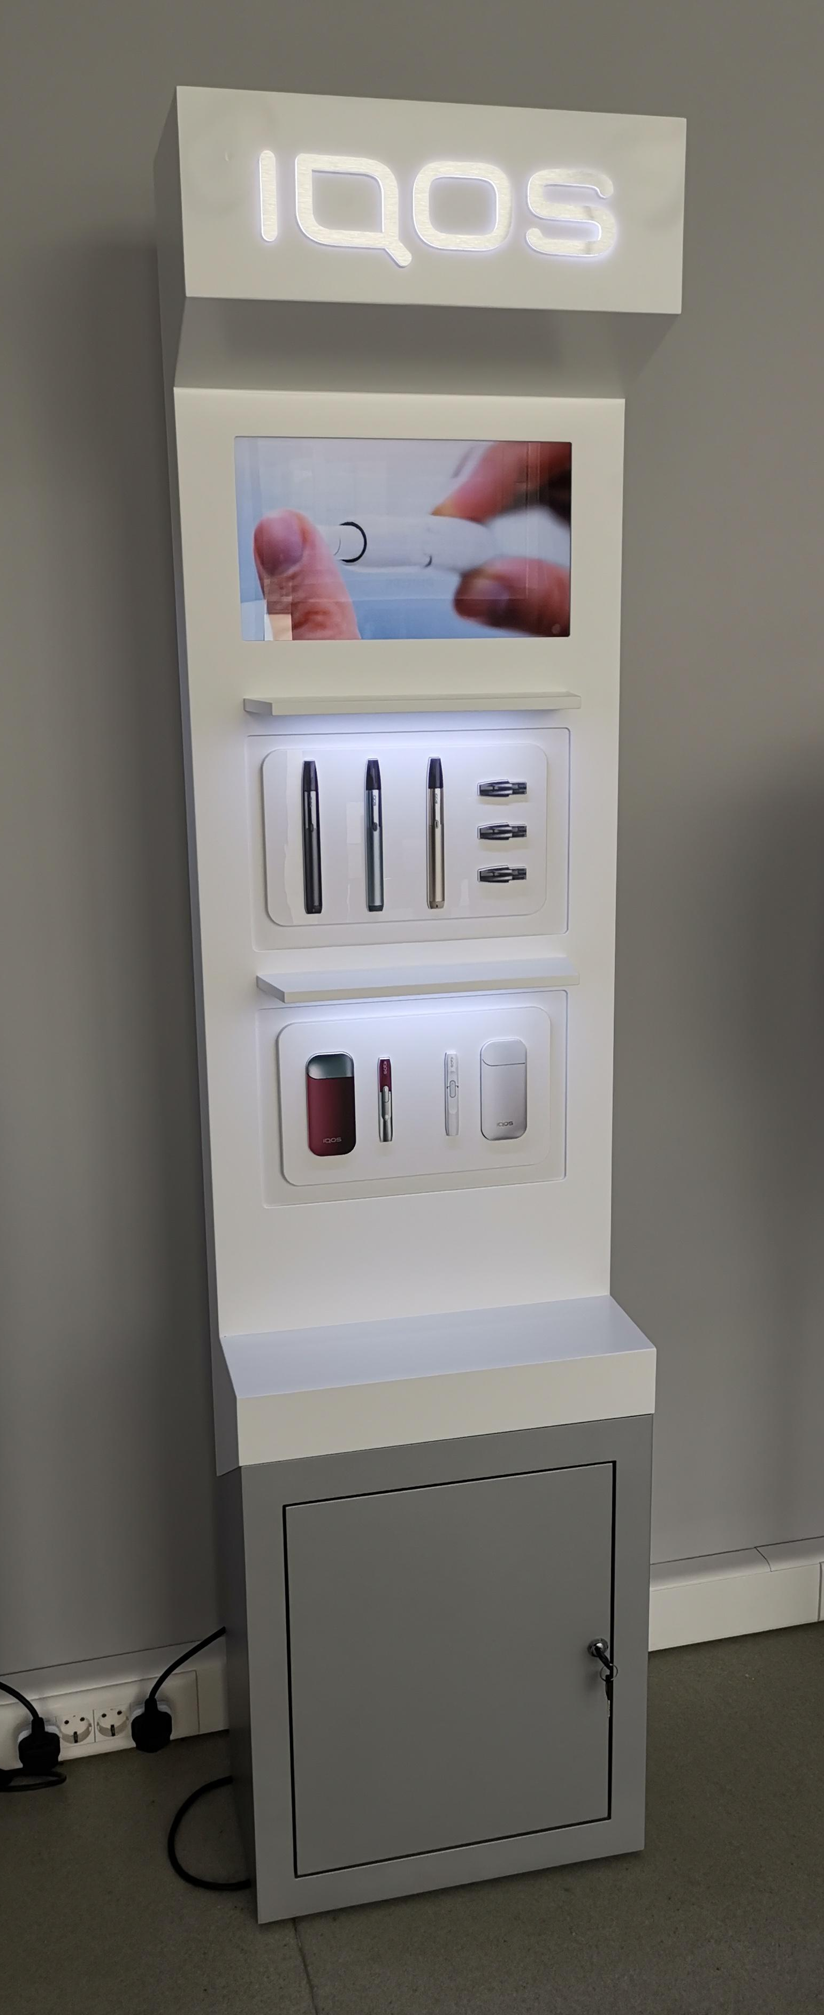

PROJECT
IQOS TOTEM WITH SCREEN – UNITED KINGDOM
Retailer
Convenience stores across UK
Year
2018
Description
IQOS totem with illuminated logo.
Product storage space.
Horizontal or vertical 17’’ screen
Modular device staging options bellow the screen.
Materials
Powder coated metal, Acrylic, MDF
Dimensions
H1800xW600xD300

Slide 38
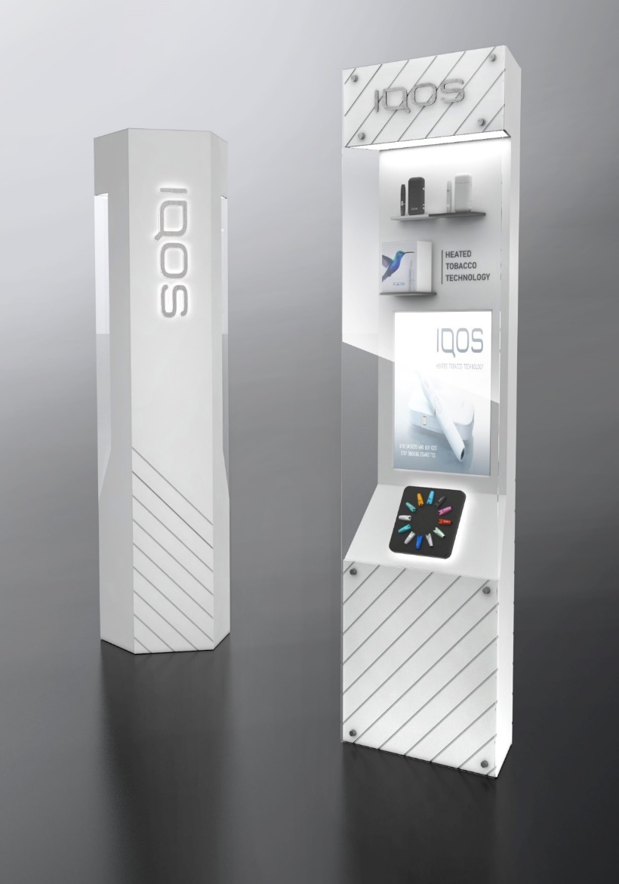
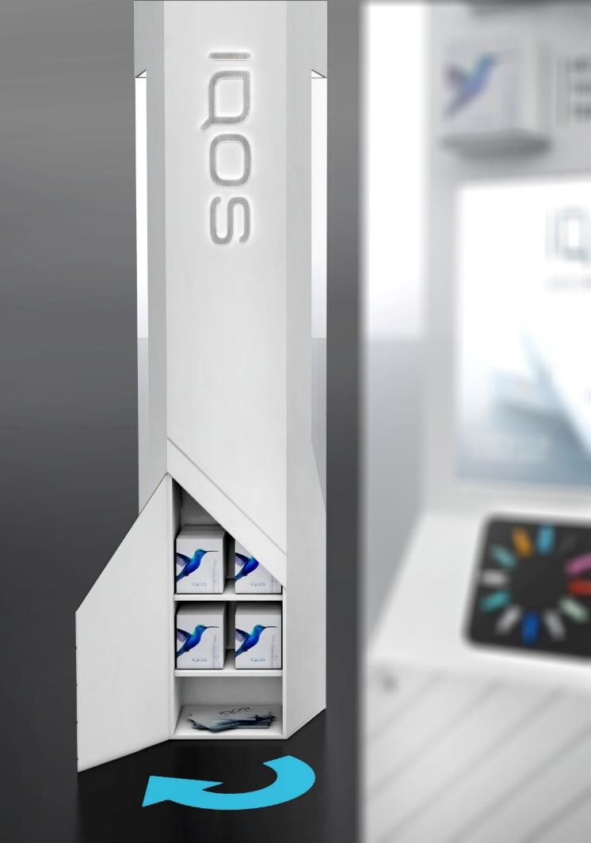
PROJECT
IQOS TOTEM – UNITED KINGDOM
Retailer
Convenience stores across UK.
Year
2018
Description
IQOS totem with storage.
Materials
MDF, Acrylic, LED diodes, Screen (optional)
Dimensions
H1900xW450xD300

Slide 39
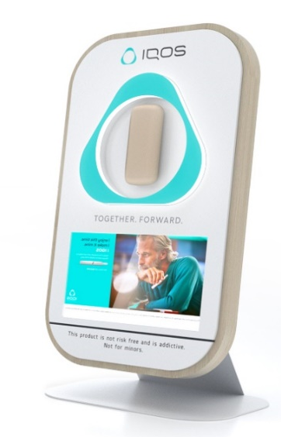
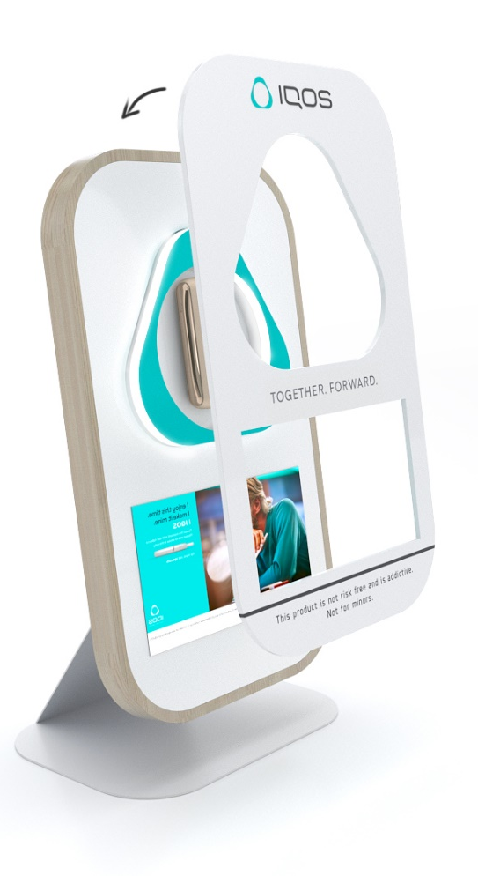
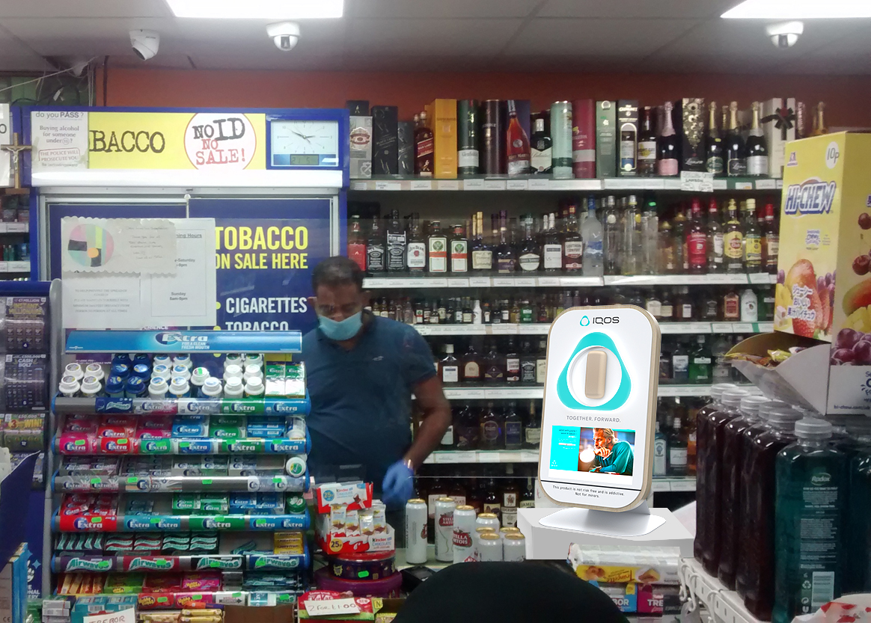
PROJECT
IQOS DIGITAL COUNTER – UNITED KINGDOM
Possibility to change the print
Retailer
Independent stores across UK.
Year
2021
Description
Premium counter display.
Characteristics:
10.1-inch Digital screen
CMS system (if required)
Illuminated logo edging
Materials
MDF, powder coated metal, screen.
Dimensions
H520xW290xD208

Slide 40
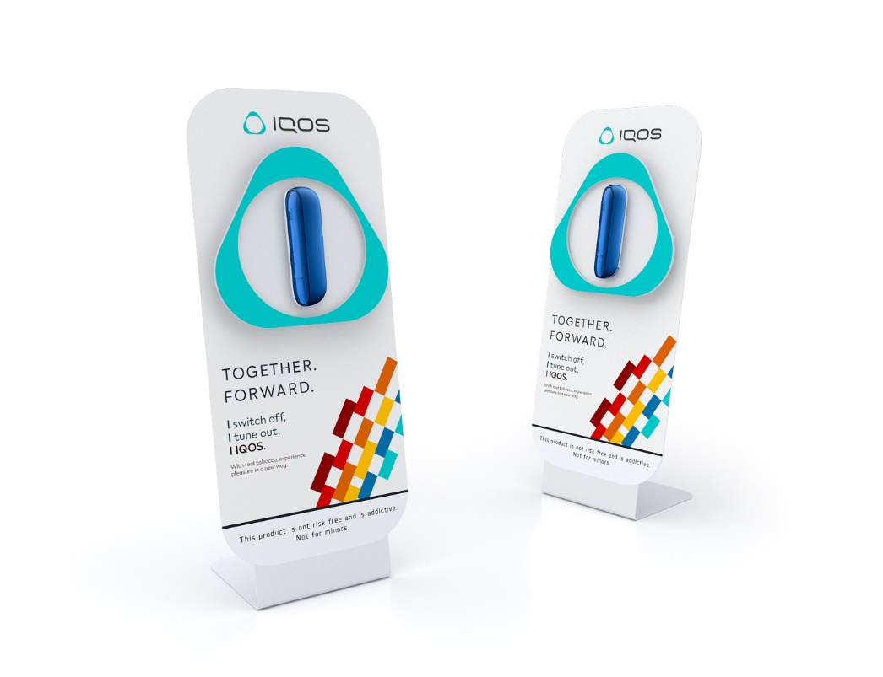
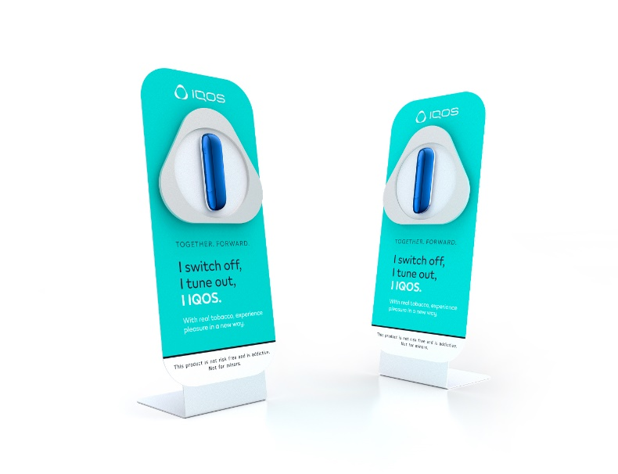
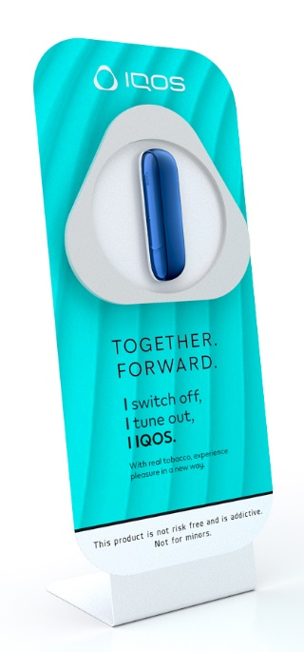
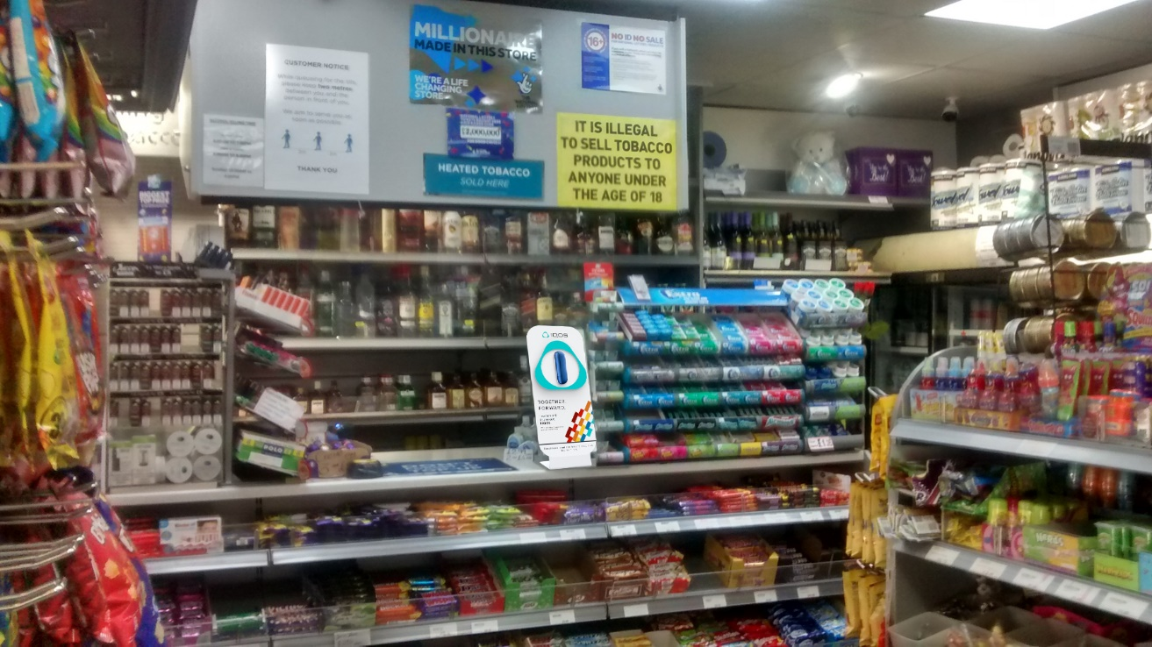
PROJECT
IQOS COUNTER DISPLAY – UNITED KINGDOM
Retailer
Independent stores across UK
Year
2021
Description
Counter display with changeable communication.
Various design options – per request.
Materials
Powder coated metal, Magnetic foil.
Dimensions
H480xW135xD200

Slide 41
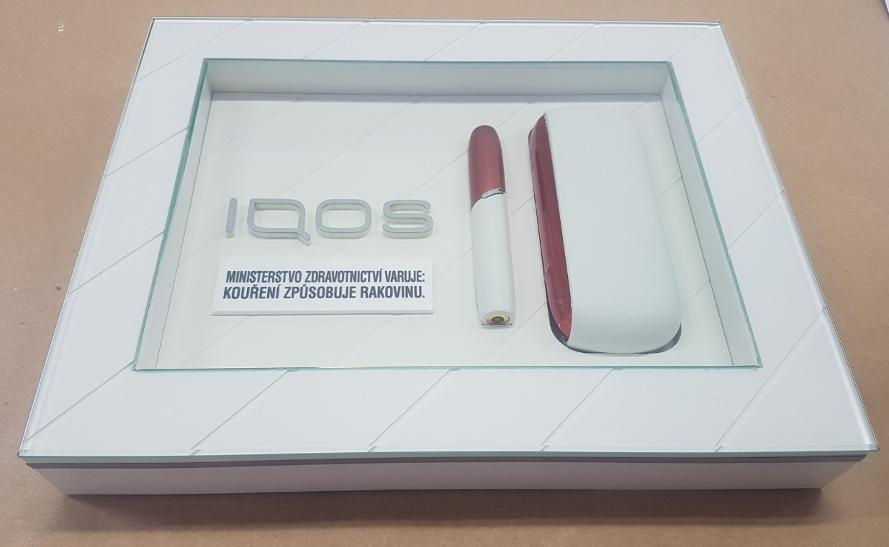
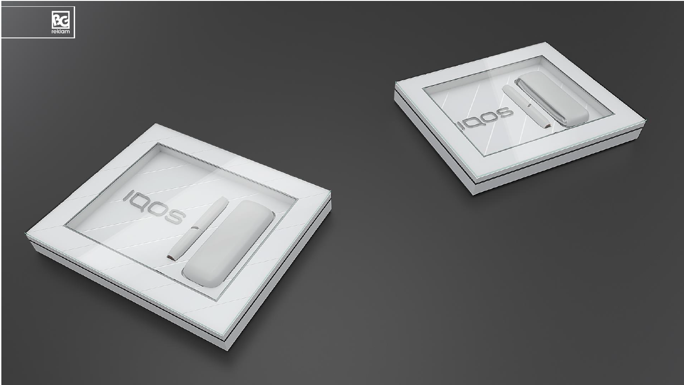
PROJECT
IQOS CASH TRAY – CZECH REPUBLIC
Retailer
Independent stores across Prague
Year
2019
Description
Cash tray with dummy device.
Materials
MDF, Glass, Acrylic
Dimensions
H50xW300xD200

Slide 42
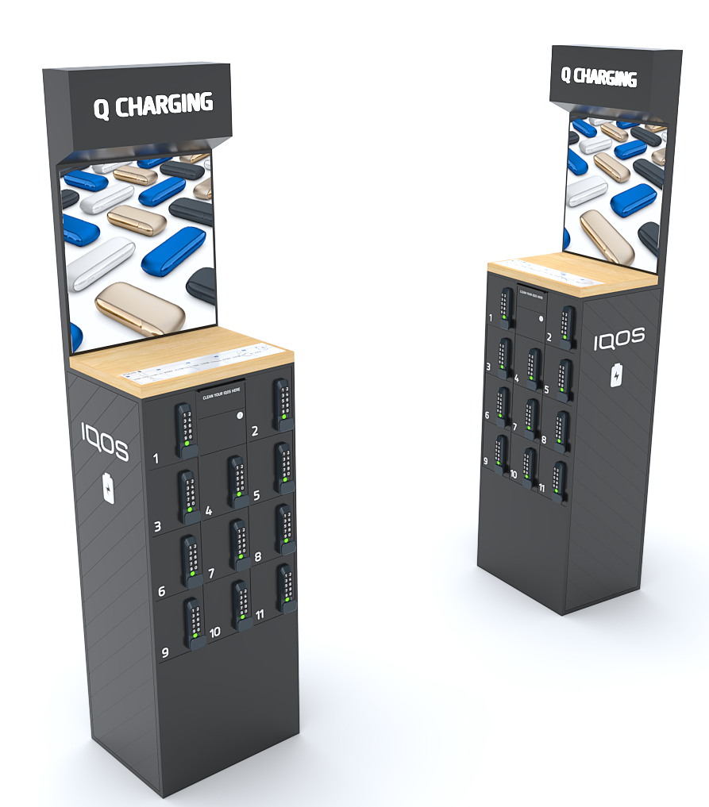
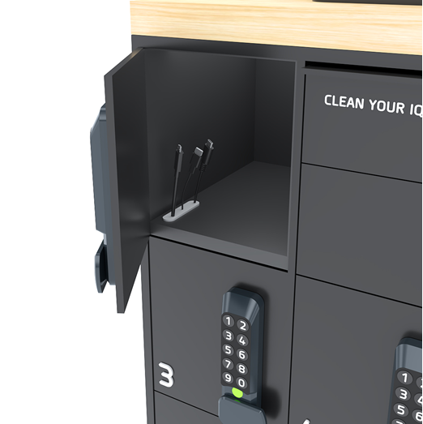
PROJECT
IQOS DOCKING STATION – CZECH REPUBLIC
Retailer
HoReCa
Year
2020
Description
IQOS docking station.
Free standing modular unit with personalised compartments for device/phone charging.
Materials
Powder coated sheet metal, Acrylic
Dimensions
H2000xW500x400D
USB-C,
Micro USB,
Apple lightening cable

Slide 43
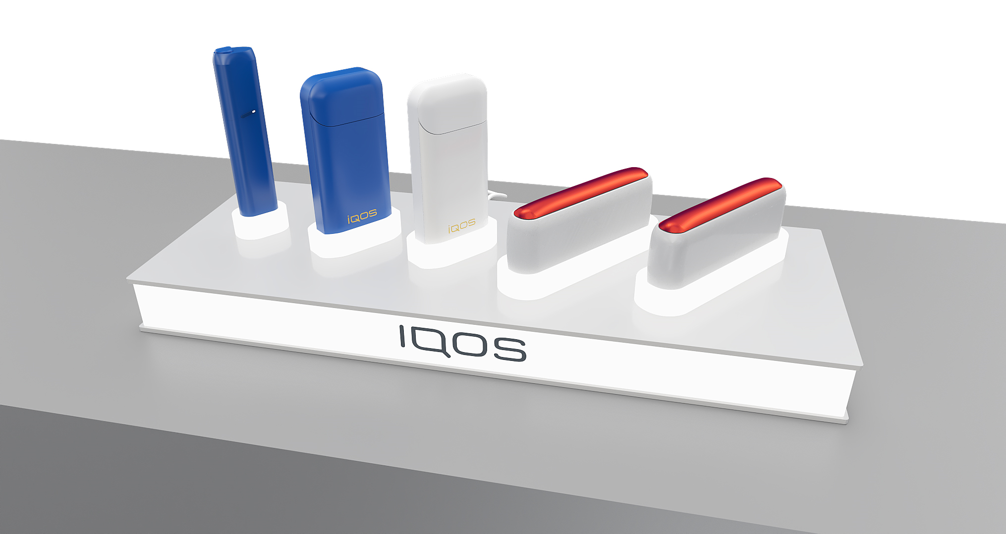
PROJECT
IQOS DOCKING STATION – CZECH REPUBLIC, SLOVAKIA
Retailer
HoReCa and convenience stores across Czech Republic and Slovakia
Year
2020
Description
Developed and produced by BG Reklam.
Illumination controlled by dimmer.
Materials
Acrylic, LED diodes
Dimensions
H50xW450xD230

Slide 44
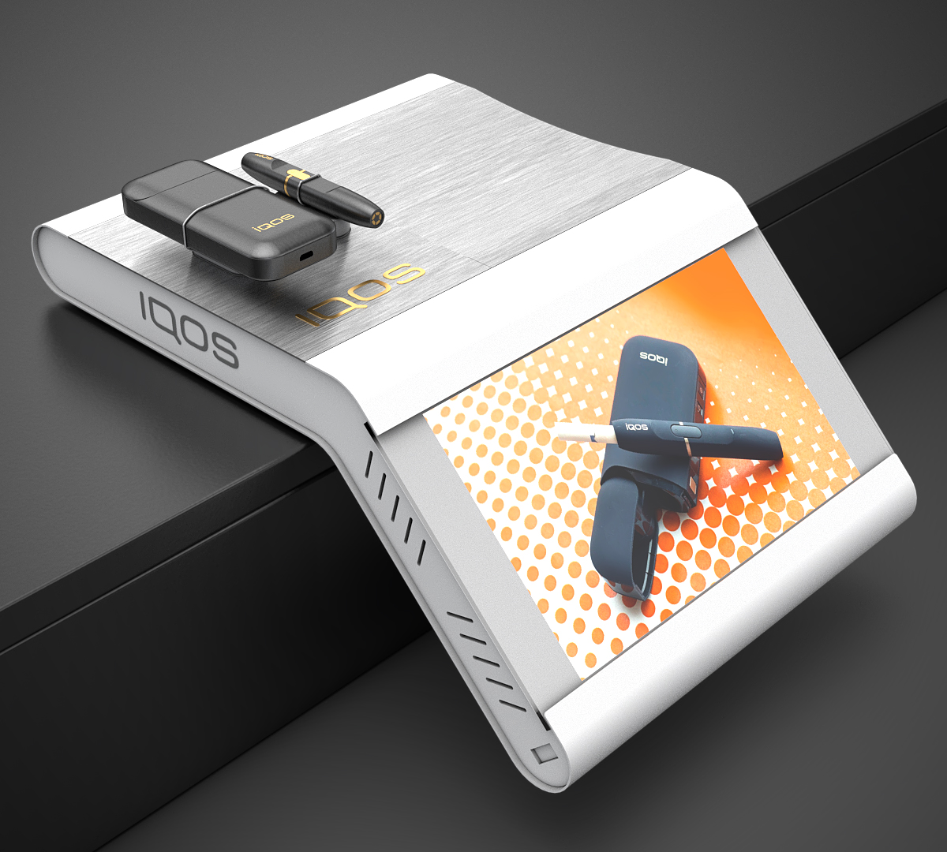
PROJECT
IQOS CASH TRAY – BULGARIA
Retailer
Kiosk network across Bulgarian market
Year
2021
Description
Waterfall cash tray with optional screen (in lower area) with device and stick with antitheft cords.
Materials
Powder coated metal and acrylic.
Dimensions
H157xW270xD360

Slide 45
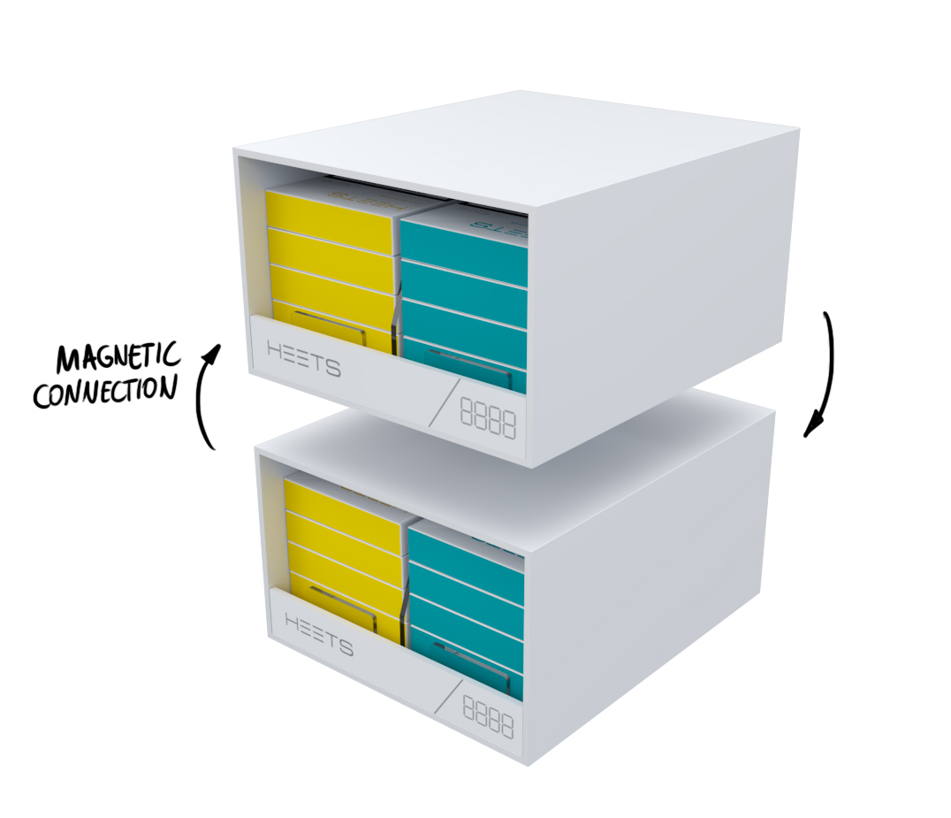

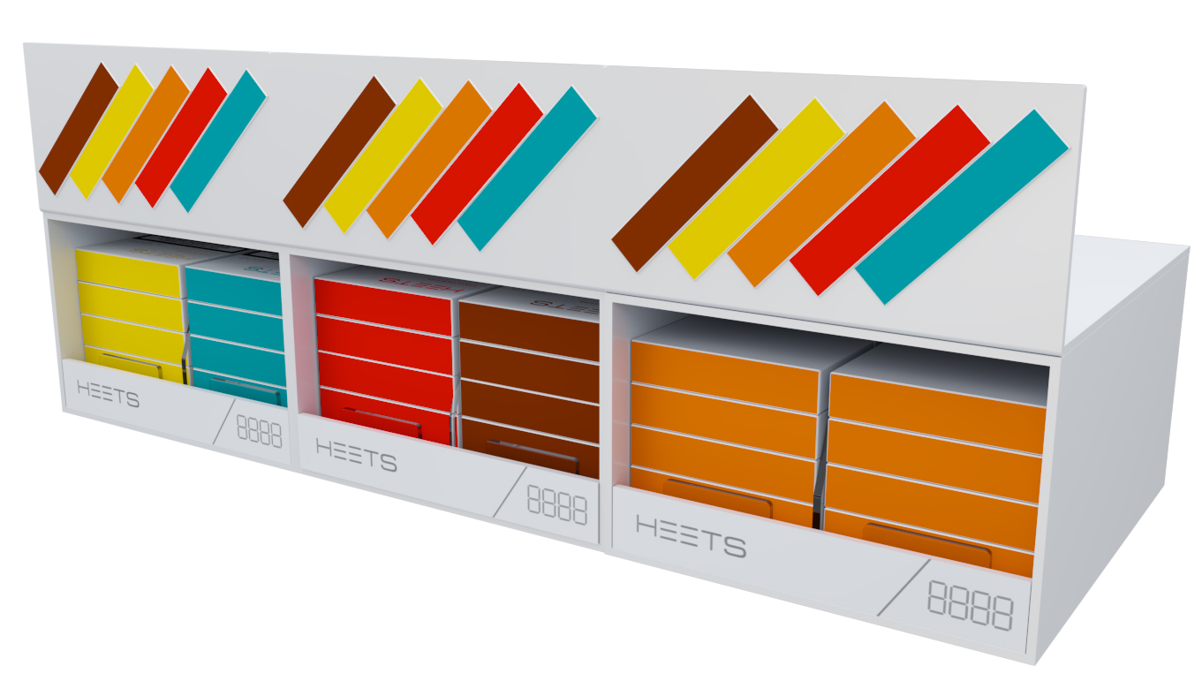
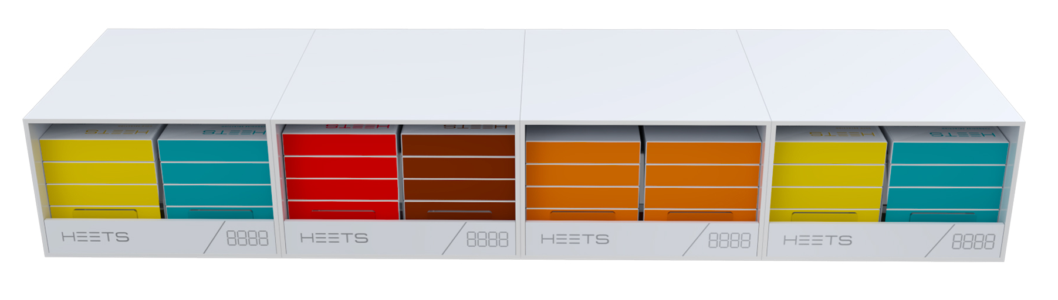
PROJECT
LEGO CUBES FOR HEETS – BULGARIA
Retailer
Independent stores
Year
2020
Description
LEGO cubes with magnets on all four sides so different orientation is possible depending on available POS space.
Materials
Acrylic, Magnets, Magnetic Foil
Dimensions
H100xW160xD190 (one cube)

Slide 46
PROJECT
IQOS CASH TRAY – GERMANY
Retailer
Independent stores across Germany
Year
2020
Description
Premium cash tray with screen or any other visual communication.
Materials
Metal, Video screen
Dimensions
H55xW280xD200

Slide 47
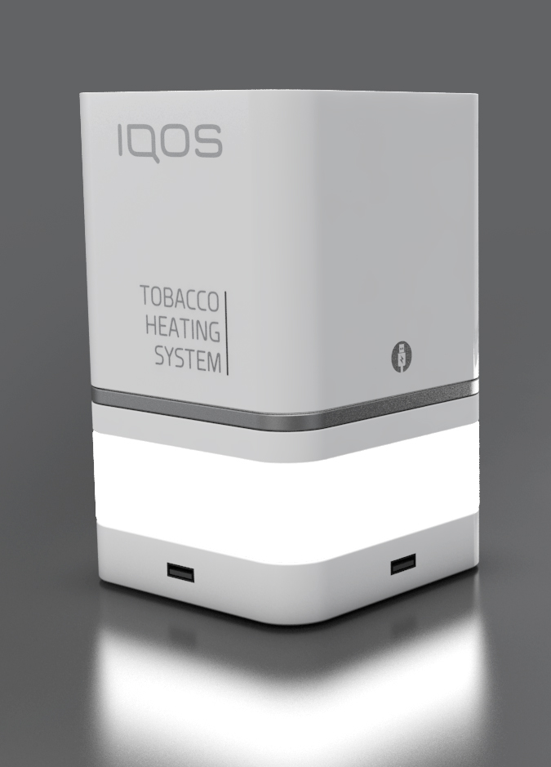
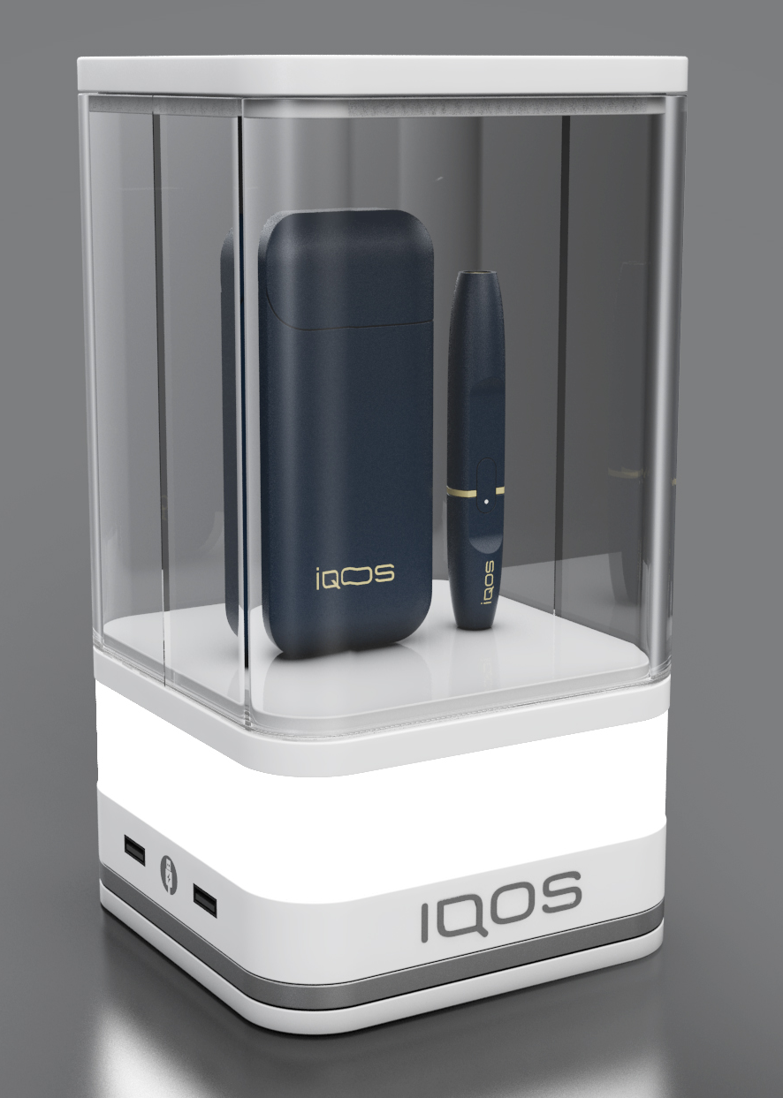
PROJECT
IQOS LAMPS – KAZAKHSTAN
Retailer
HoReCa
Year
2019
Description
IQOS lamps for tables and counters.
Materials
MDF, Solid wood, Acrylic, LED diodes.
Dimensions
H220xW150xD150

Slide 48
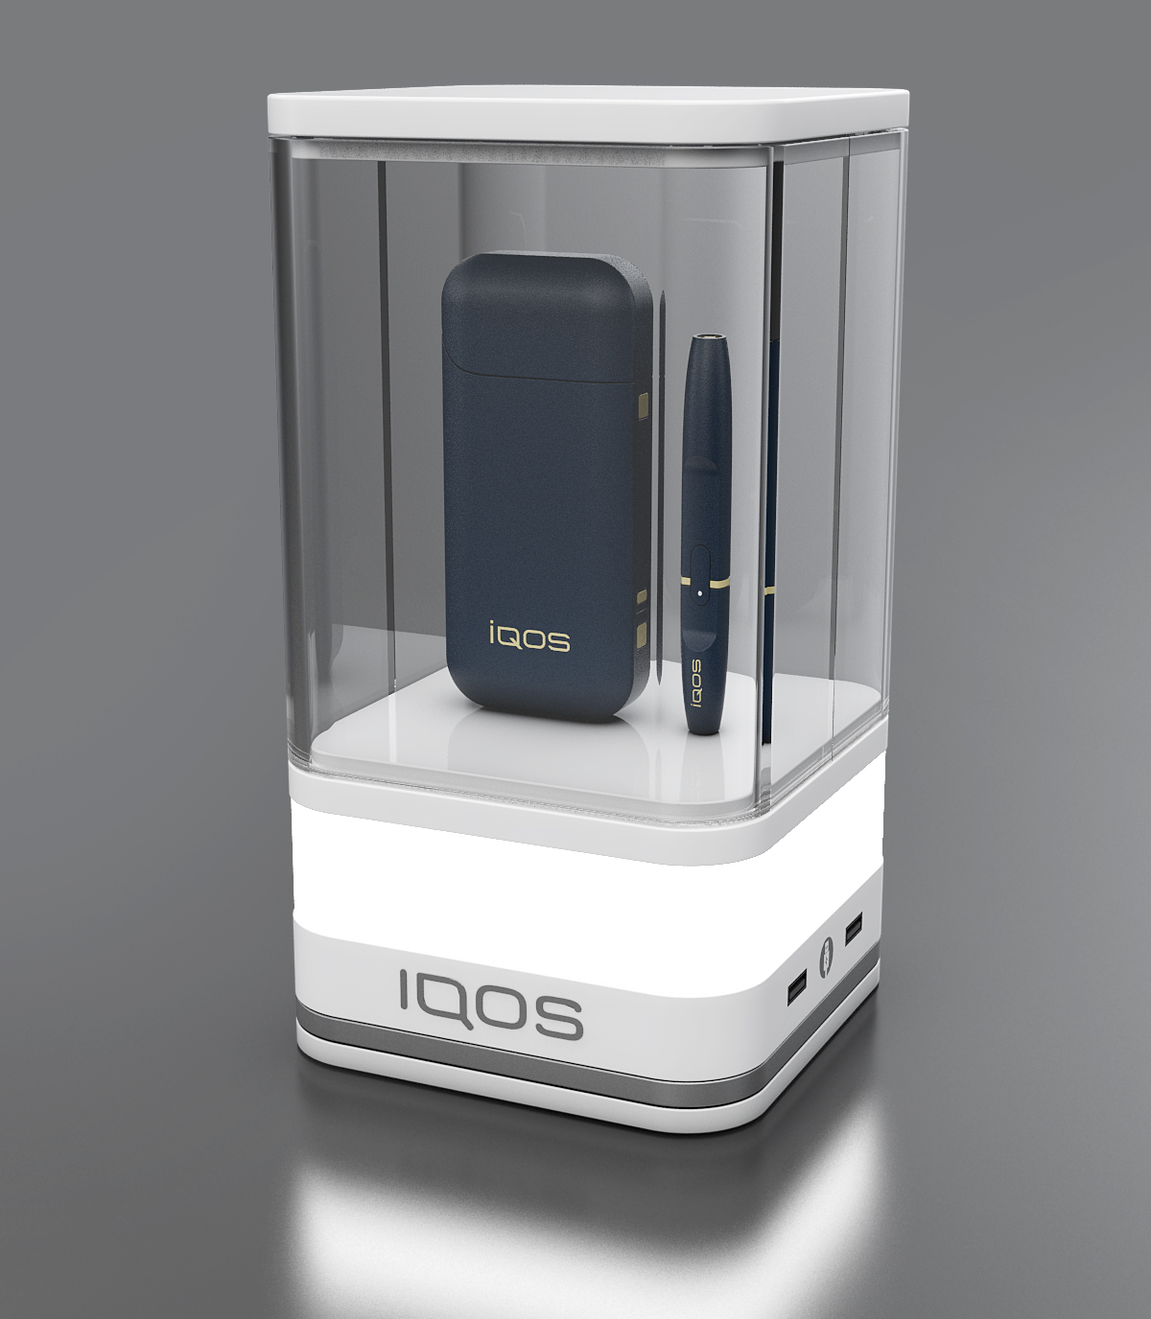
PROJECT
IQOS LAMPS – KAZAKHSTAN
Retailer
HoReCa
Year
2019
Description
IQOS lamps for tables and counters.
Materials
MDF, Solid wood, Acrylic, LED diodes.
Dimensions
H200xW150xD150

Slide 49
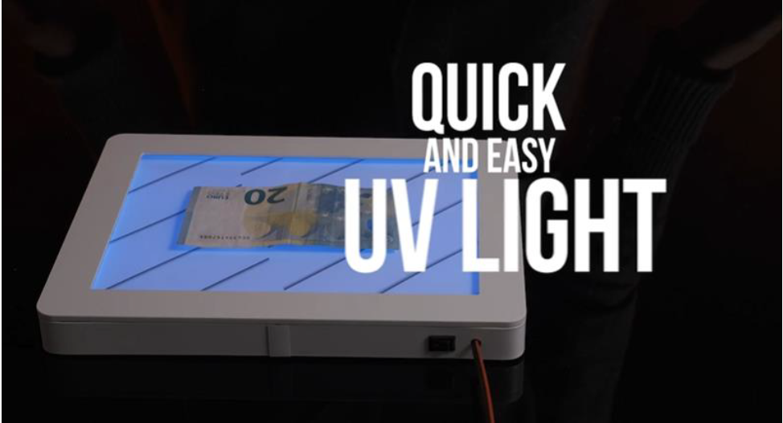
PROJECT
IQOS CASH TRAY – SWITZERLAND
Retailer
Independent stores
Year
2020
Description
Metal frame.
Branded print on foil.
Less scratching.
Materials
Metal and acrylic
Dimensions
H55xW270xD190

Slide 50
IQOS
ACCESORIES

Slide 51
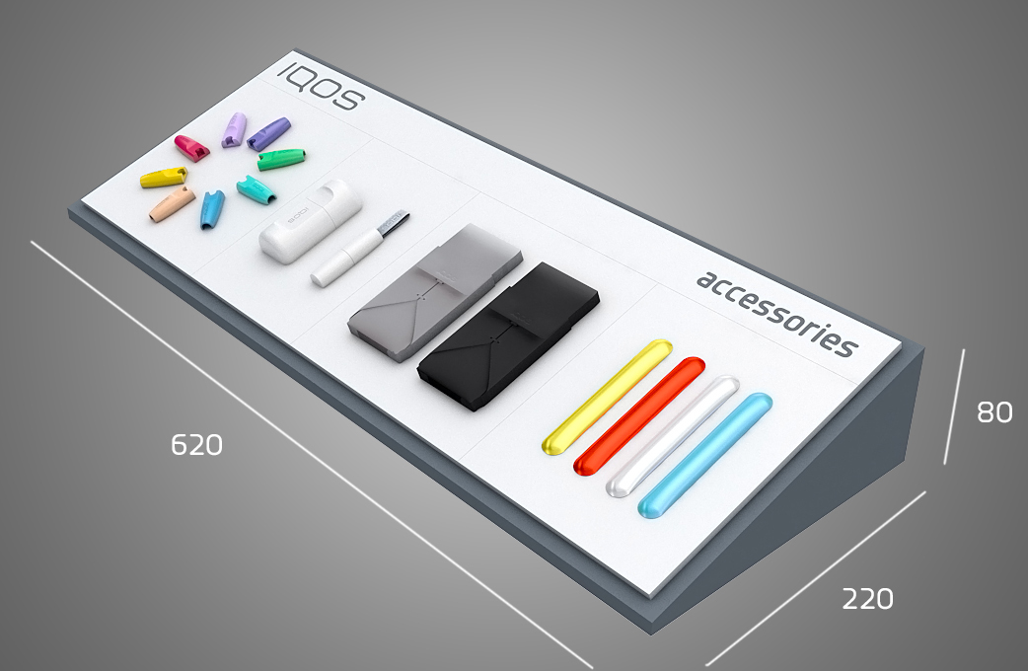
PROJECT
IQOS ACCESSORY DISPLAY – SERBIA
Retailer
IQOS zones
Year
2020
Description
Developed and produced by BG Reklam for undercounter space with transparent covers. Changeable content and print.
Materials
MDF, Acrylic
Dimensions
H80xW620xD220

Slide 52
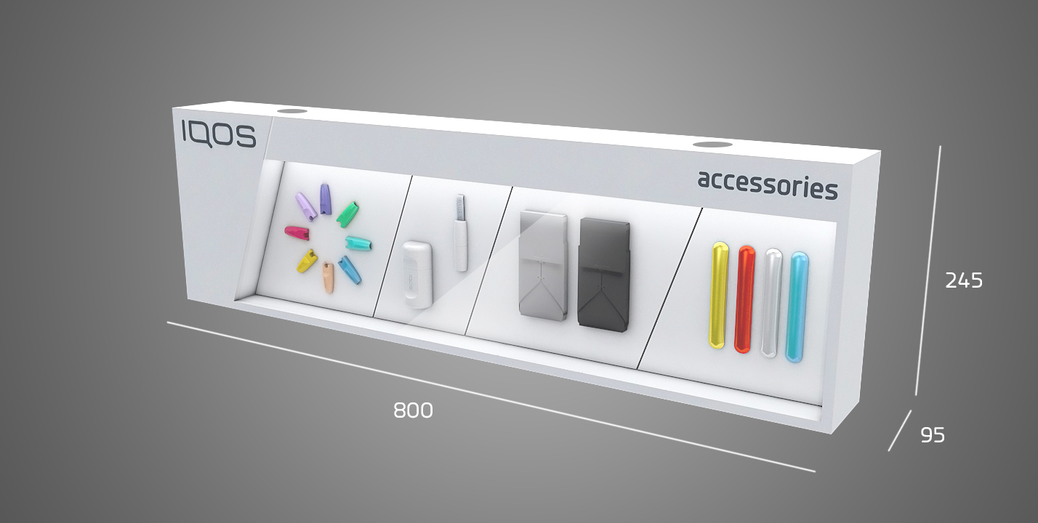
PROJECT
IQOS ACCESSORY CHECKOUT UNIT – SERBIA
Retailer
Premium key account POS across Serbia
Year
2020
Description
Developed and produced by BG Reklam.
Width can be modified.
It can be inserted in the backwall units or used below checkout units.
Materials
Acrylic, Metal
Dimensions
Various dimensions per request.

Slide 53
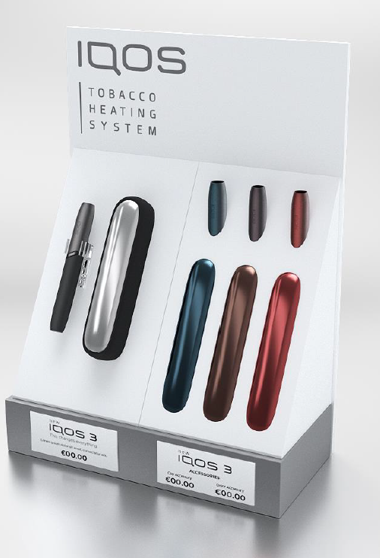
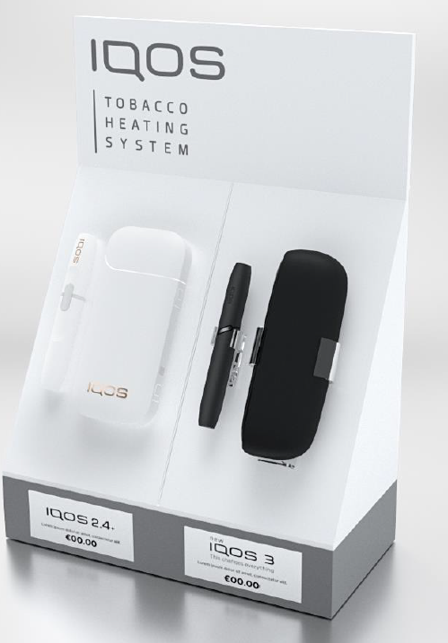
PROJECT
IQOS COUNTER – UNITED KINGDOM
Retailer
Retail network across UK
Year
2019
Description
Counter units with changeable plates / holders for products.
Materials
Acrylic
Dimensions
420Hx300WxD180

Slide 54
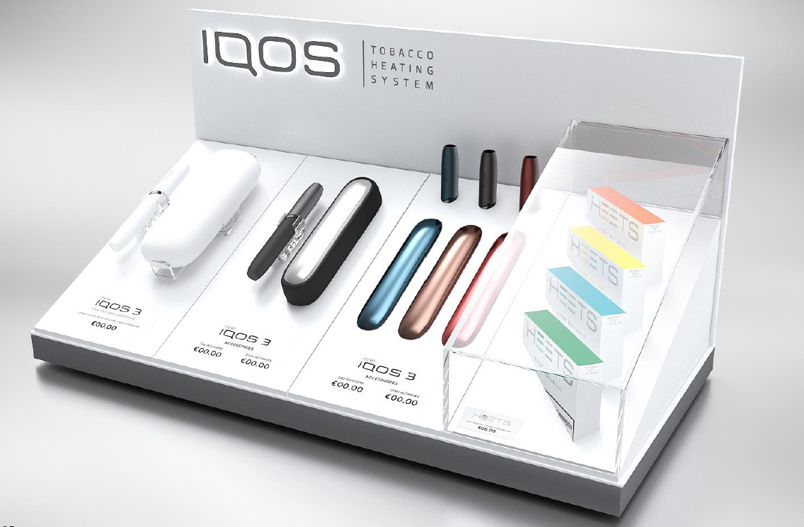
PROJECT
IQOS COUNTER – UNITED KINGDOM
Retailer
Retail network across UK
Year
2019
Description
Counter units with changeable plates / holders for products.
Materials
Acrylic, MDF
Dimensions
Various dimensions

Slide 55
6. SUPPORT
TEAM

Slide 56




CONTACT US – TELL US ABOUT YOUR PROJECT
Nikola Elezović
nikola.elezovic@bgreklam.com
+381 64 221 0 633
Director of Commercial Operations
English speaking
Dino Ramić
dino.ramic@bgreklam.com
+49 160 919 3878
Business Development Manager
DACH Region
German & English speaking
Nenad Klarić
nenad.klaric@bgreklam.com
+381 60 68 69 144
+49 151 52 559 046
Key Account Manager
DACH Region
German & English speaking
Jacqueline Eli
jacqueline.eli@bgreklam.com
+49 177 58 953 58
Key Account Manager
DACH Region
German & English & French speaking

Slide 57




CONTACT US – TELL US ABOUT YOUR PROJECT
Milan Bajić
milan.bajic@bgreklam.com
+381 60 68 69 127
Senior Key Account Manager
Nordics, BeNeLux & France region
English & French speaking
Nemanja Stančić
nemanja.stancic@bgreklam.com
+381 60 68 69 136
Key Account Manager
UK, Ireland & Central Europe
English & Russian speaking
Sandra Ratković
sandra.ratkovic@bgreklam.com
+381 60 68 69 143
+49 151 53 31 2634
Key Account Manager
Adria & DACH Region
German & English speaking
Dimitrije Božić
dimitrije.bozic@bgreklam.com
+381 60 68 69 137
Junior Key Account Manager
Adria Region
English & German speaking

