Slide 2
TABLE OF CONTENTS
OVERVIEW
BG REKLAM – ABOUT US
BENEFITS OF WORKING WITH US
4. CSR
PROJECTS
SUPPORT TEAM – CONTACT US

Slide 3
1. OVERVIEW

Slide 4
OVERVIEW
Welcome to our PRODUCT CATALOGUE !
This interactive product collection will provide you product information at the touch of the click.
It will provide you benefit insights, which you as our partner have from cooperation with us.
We are delivering exceptional experience for shoppers at physical retail (point – of – sale); products – per your request or special needs.
For more detailed product information, please contact our support team (your dedicated account manager) or contact us at Premium POS solutions for retail from concept to store (bgreklam.com).

Slide 5
2. ABOUT US

Slide 6
BG REKLAM – ABOUT US
We are professionals in production of premium POSM solutions.
BG Reklam creates outstanding various POSM that support in – store activation and drive sales at the point – of – sale of our clients for more than 20 years.
We are specialised in all areas, from Design & Concept Solutions, Innovations, through Engineering, to Development & Production of tailored POSM solutions. We are completing the entire process under one roof.
Our partner companies on local markets provide excellent Installation and Maintenance services.

Slide 7




Slide 8



Slide 9


OUR OFFICES
2001
2013
2017
2018
BG REKLAM (Headquarters)
29. Novembra 1M 11460 Belgrade, Serbia
+38111 785 64 64
+381 60 68 69 110
BG REKLAM GmbH
LeverkusenstraBe 3
22761 Hamburg, Germany
+ 49 40 8541 3003
BG REKLAM UK Ltd
1st Floor, Artist House 35 Little Russell Street London, WClA 2НН, UK
+44 20 3290 6345
BG REKLAM
SERBIA (HQ)
BG REKLAM
SERBIA (FACTORY)
BG REKLAM
UNITED KINGDOM
BG REKLAM
GERMANY
Hamburg
London
Belgrade

Slide 10
3. BENEFITS OF WORKING WITH US

Slide 11
BENEFITS OF WORKING WITH US
Today more than ever, especially during COVID-19 pandemic, in order to achieve goals and proceed with all projects on time and efficiently, every company needs to have a reliable business partner.
We are dedicated, creative and have experience in developing premium POSM solutions on your request, based on your needs. We are agile and we have experience working in tobacco category.
We are a reliable partner for the outstanding tailored sustainable POSM solutions.
We are supporting you to get through extremely busy time at work.
We care for your growth.

Slide 12
PARTNERING STRATEGY
PREMIUM PRODUCTS
Increasing brands’ image and sales through premium POSM solutions.
BENEFITS
ACCOUNT MANAGEMENT
Highly experienced and multilingual sales team, with presence on all the markets where we operate.
PROJECT MANAGEMENT
One Stop Shop – full project management support with one single point of contact. From design and concept solutions to installations and maintenance.
CREATE VALUE FOR OUR CLIENTS
MONETARY
High product quality and service at competitive prices.
SAVINGS
TIME
Lead time is 5 weeks* – from briefing to product delivery.
ENERGY
One Stop Shop, plus efficient communication and fast responsiveness.
*5 weeks lead time on average (from briefing to final product delivery) depending on the project complexity.

Slide 13


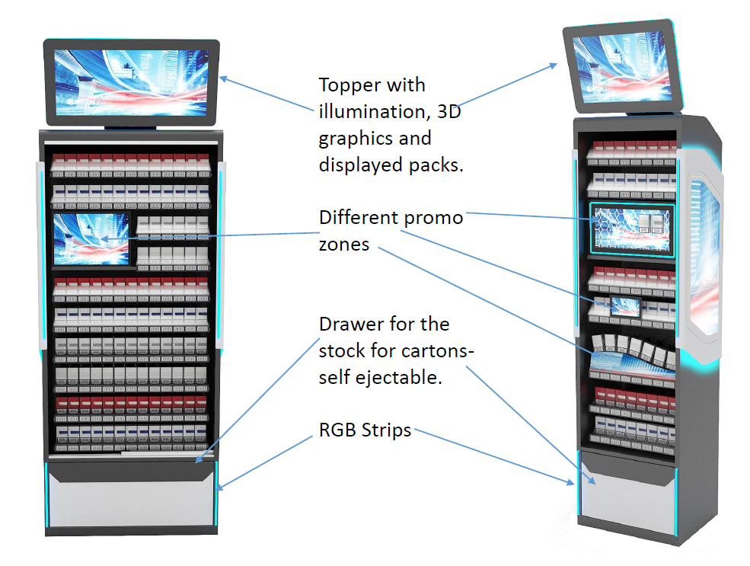
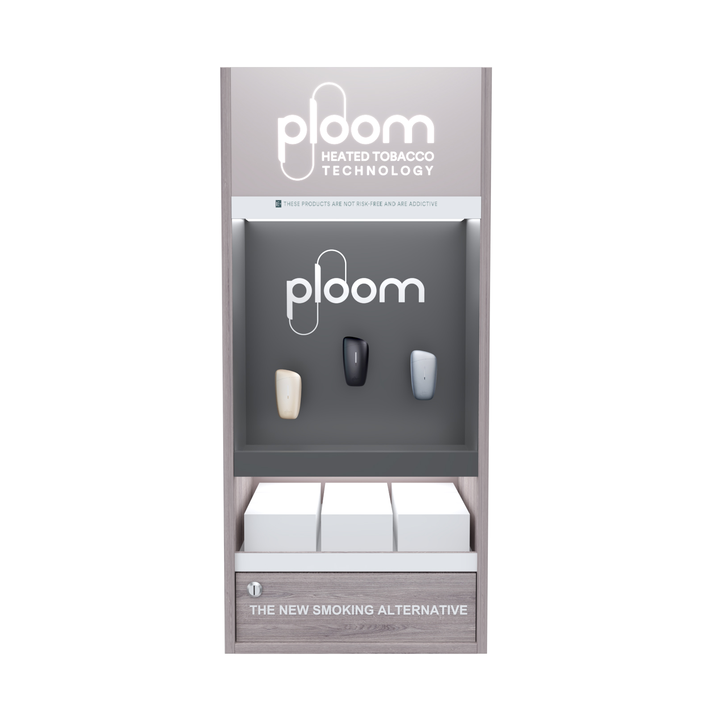
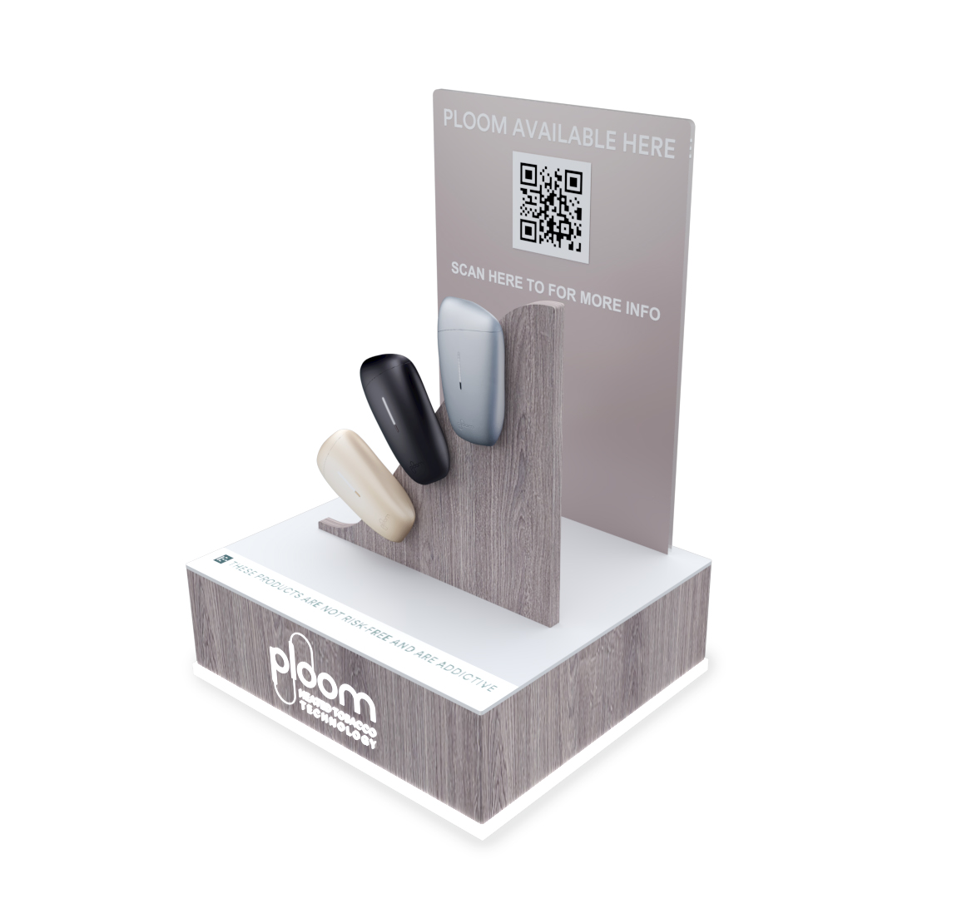
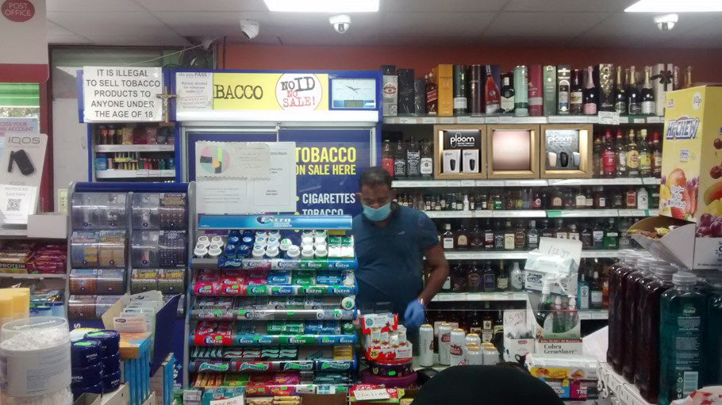

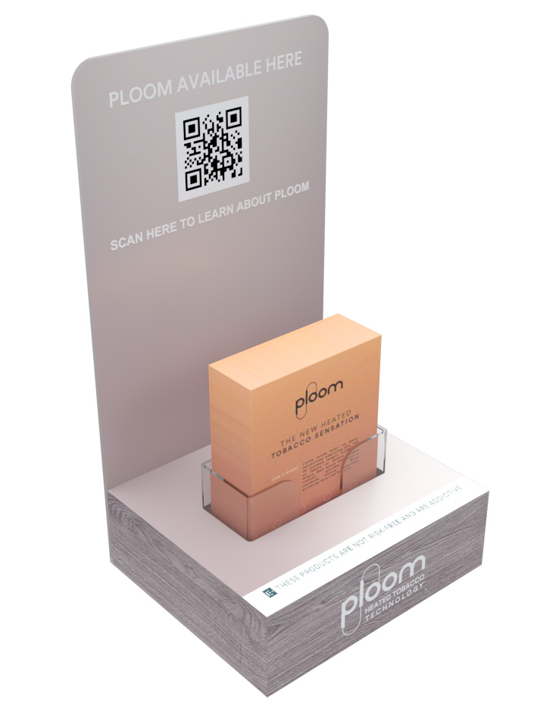
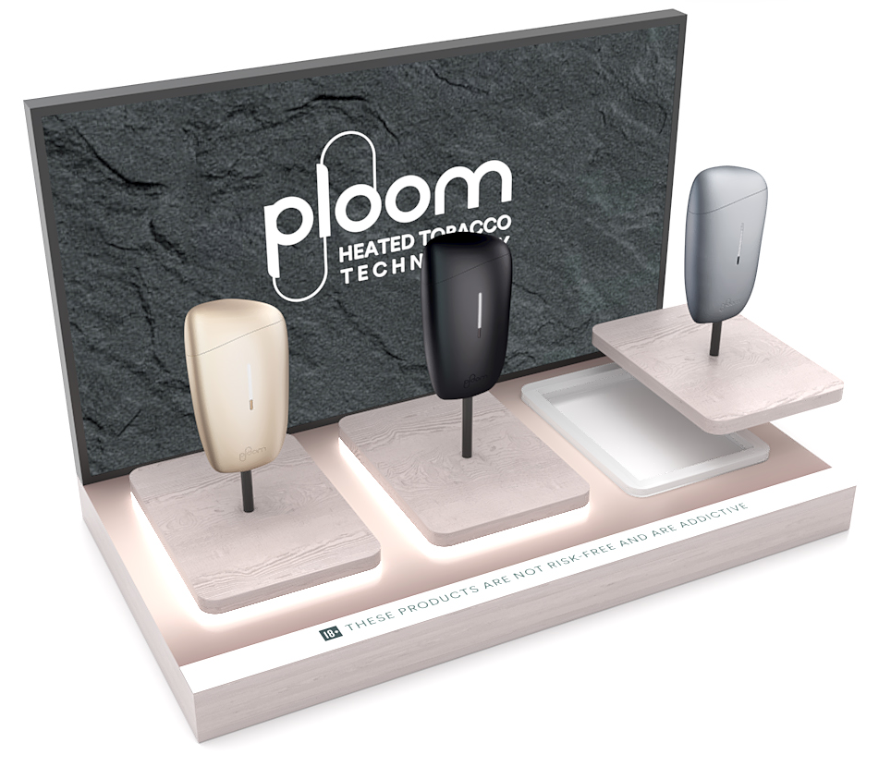
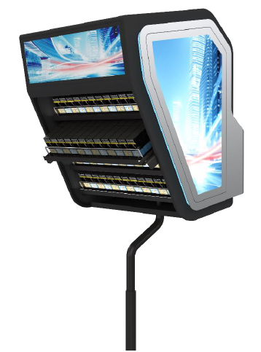
BG REKLAM & JTI
COOPERATION between JTI and BG REKLAM
We are pleased to cooperate more than 15 years.
We are happy to cover 10 markets where JTI has operations.
We are proud that we together developed more than 140K pcs POSM solutions.
Our exclusive & unique designs and specific materials are used to emphasize and tell a JTI brand story at POS.
Our intentions are driven by a customer centric approach in order to improve customer experience at POS.

Slide 14
4. CORPORATE SOCIAL RESPONSIBILITY

Slide 15
OUR PROMISES
As a socially responsible company, we committed to our four stakeholders the following:
EMPLOYEES – We are committed to providing a safe and secure working environment for all employees. We believe that: innovation, honesty and doing the right thing approach is a basis of everything we do.
CLIENTS – Our clients deserve outstanding products and services. Every single day, we strive with passion to meet our clients' demands.
ENVIRONMENT – We are committed to run a sustainable business. Our aim is to: 1. use eco-friendly materials (such as wood, metal, PET sheets, corrugated cardboard), 2. use recycled products; 3. create social initiatives.
COMMUNITY – We are continuously trying to be part of various socially responsible projects, to involve local marginalised groups in our supplier chain, as well to encourage our employees to volunteer in their local community.

Slide 16
BETTER TOMORROW THROUGH SUSTAINABILITY COMMITMENT
Our sustainability initiatives:
Reducing environmental impact
Using energy more efficiently
Reducing packaging waste
Using recyclable and reusable materials
Reducing carbon footprint by optimising our production process and technology
Please check our sustainability video: https://vimeo.com/474723155/579f192891

Slide 17
ENVIRONMENATLLY RESPONSIBLE BEHAVIOUR
Every day we are actively and continuously work to:
REDUCE – scrap and energy consumption. Our business is focused and completely aligned with certifications ISO 20400 and 26000.
REUSE – our aim is to produce re-brandable and multi usage products (allows easily changeable communication)
RECYCLE – use of fully recyclable materials. Our special attention in production is in line with lifecycle thinking approach (all used materials can be easily splited at the end of the production lifecycle).

Slide 18
WE ARE USING LATEST TECHNOLOGY IN PRODUCTION PROCESS
By careful selection of materials and machines in our production process we are managing to reduce carbon footprint.
Based on your request we can deliver eco-friendly materials and outstanding sustainable POSM solutions.

Slide 19



Slide 20







CERTIFICATIONS
Our accreditations prove our commitment to sustainability. We have:
QUALITY
MANAGEMENT
ENVIRONMENTAL
MANEGEMENT
HEALTH AND SAFETY
MANAGEMENT
SUSTAINABLE PROCUREMENT
SOCIAL
RESPONSIBILITY

Slide 21
5. PROJECTS

Slide 22
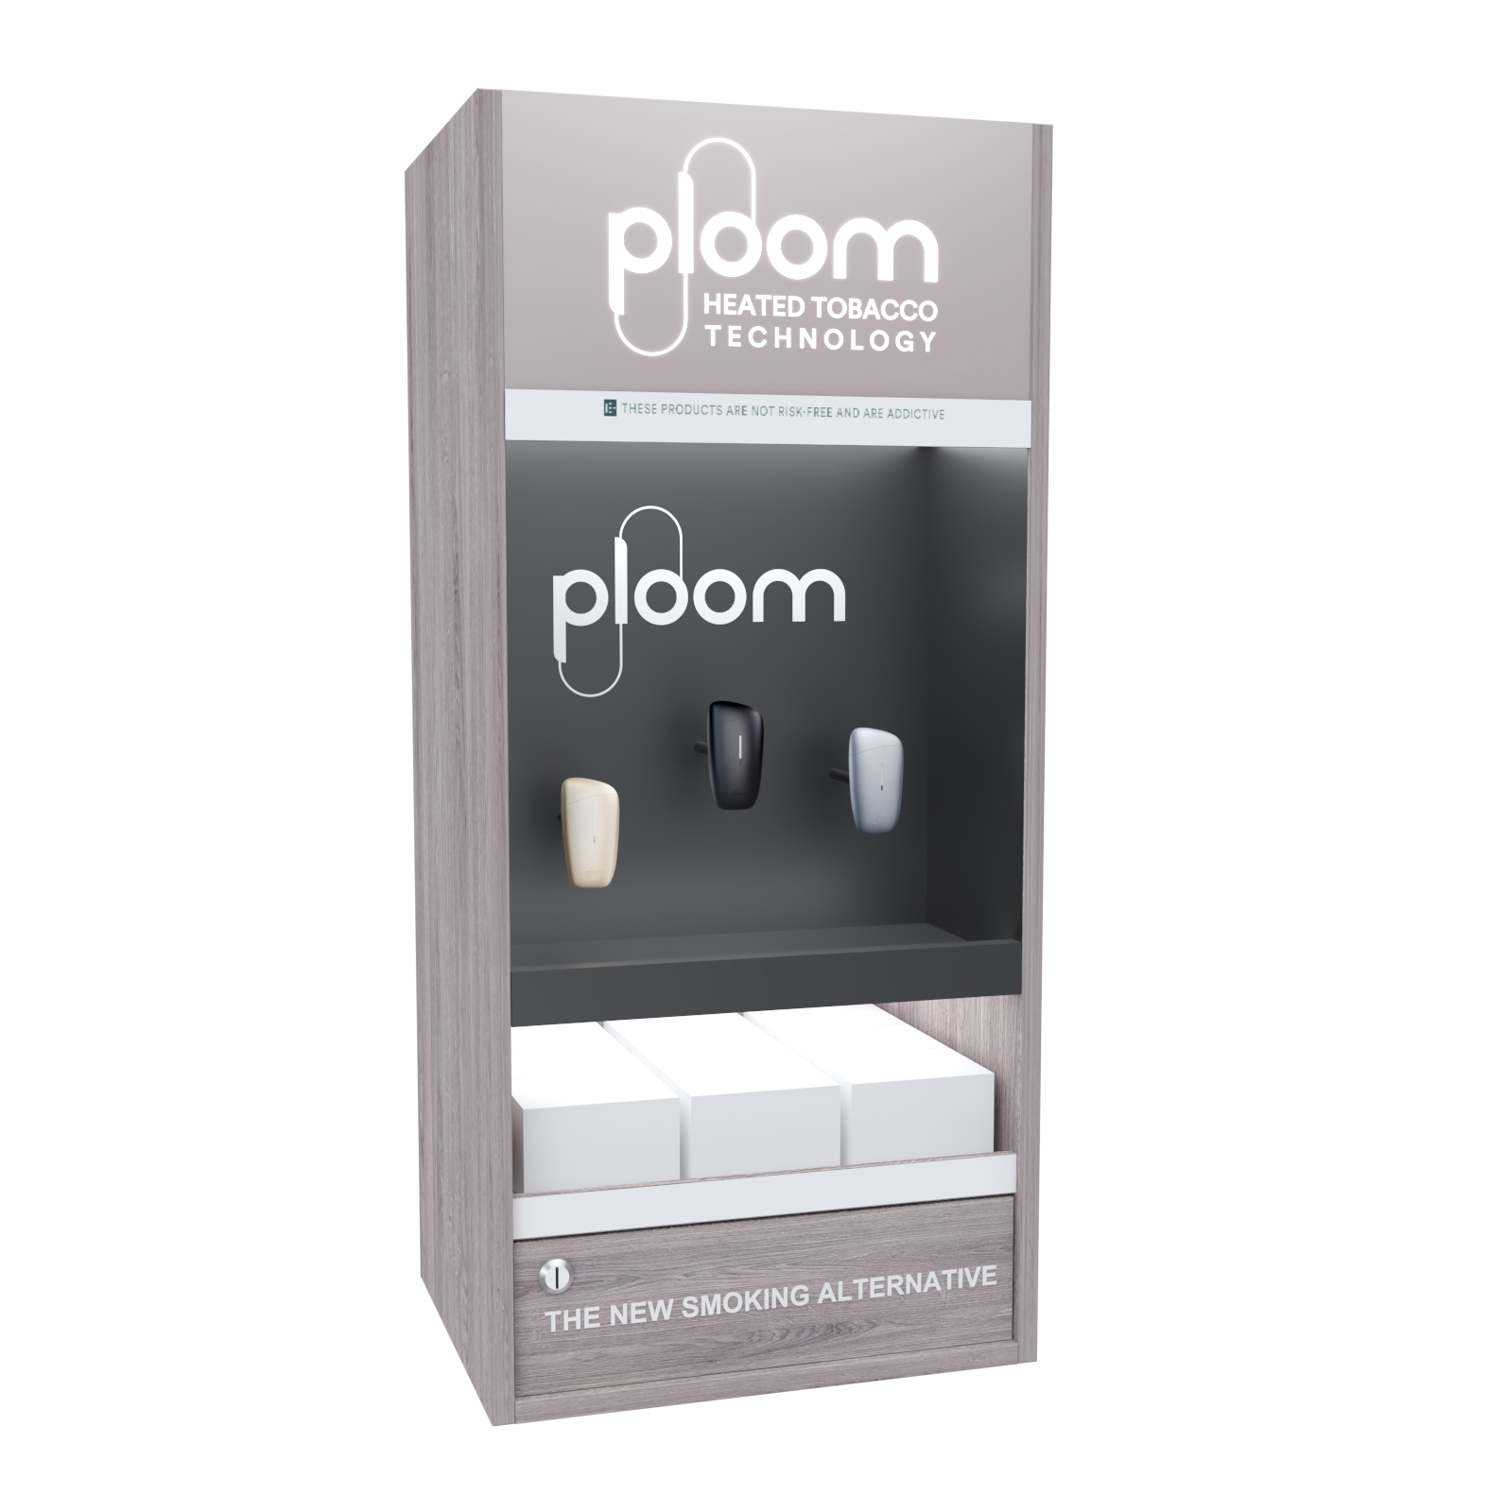
PROJECT
PLOOM LAUNCH – UNITED KINGDOM
Retailer
Retail network across London
Year
2020 – 2021
Description
Back wall units intended to stand on the existing shelf or hung on Theggo shelf.
Materials
MDF, Acrylic, Powder coated sheet metal, LED lights
Dimensions
H1100xW500xD400

Slide 23
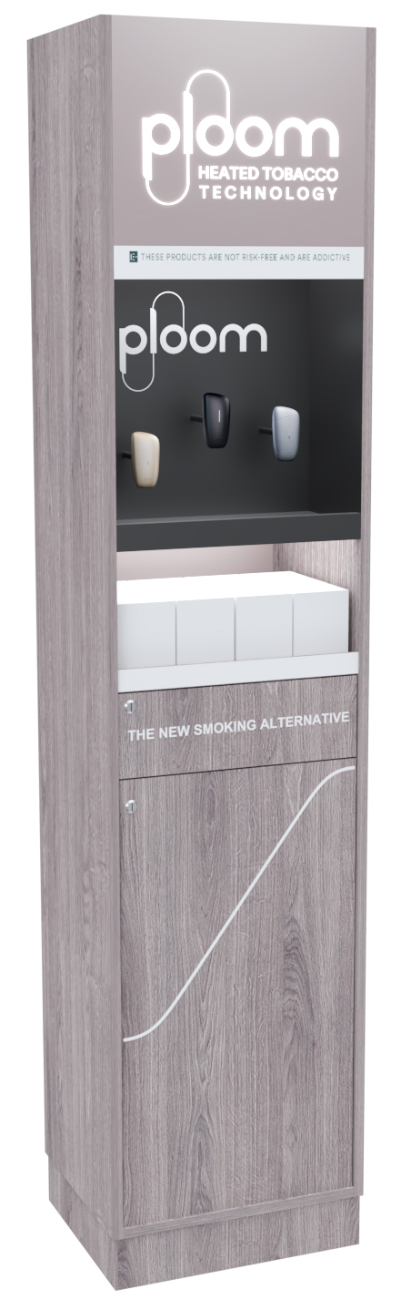
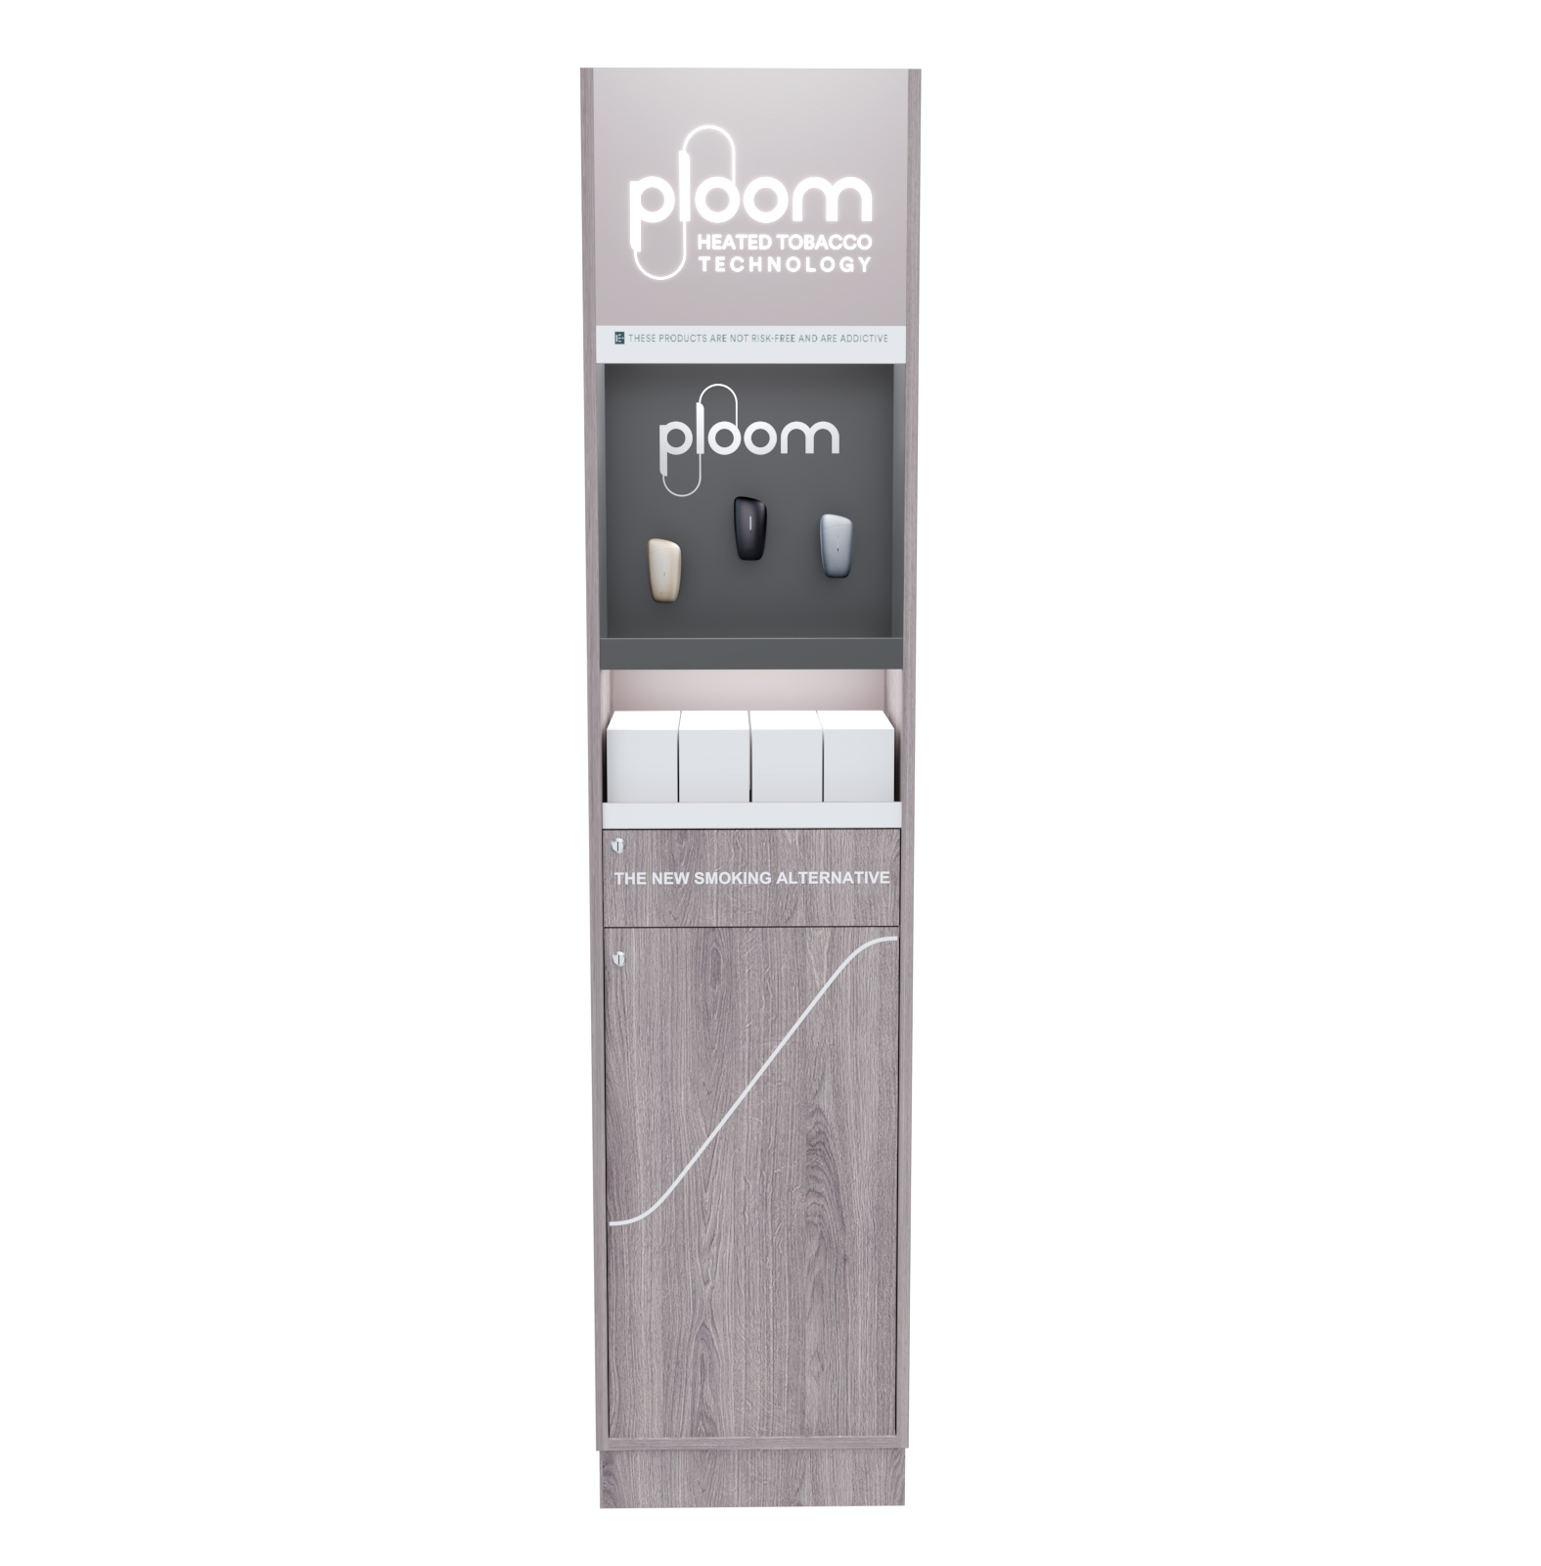
PROJECT
PLOOM LAUNCH – UNITED KINGDOM
Retailer
Retail network across London
Year
2020 – 2021
Description
Back wall units intended to stand on the existing shelf or hung on Theggo shelf.
Changeable communication area.
Materials
MDF, Acrylic, Powder coated sheet metal, LED lights
Dimensions
H2200xW500xD400

Slide 24
PROJECT
PLOOM LAUNCH – UNITED KINGDOM
Retailer
Retail network across London
Year
2020 – 2021
Description
Counter units for wide retail network.
Materials
MDF, Acrylic, Powder coated sheet metal, LED lights
Dimensions
H190xW340xD165

Slide 25
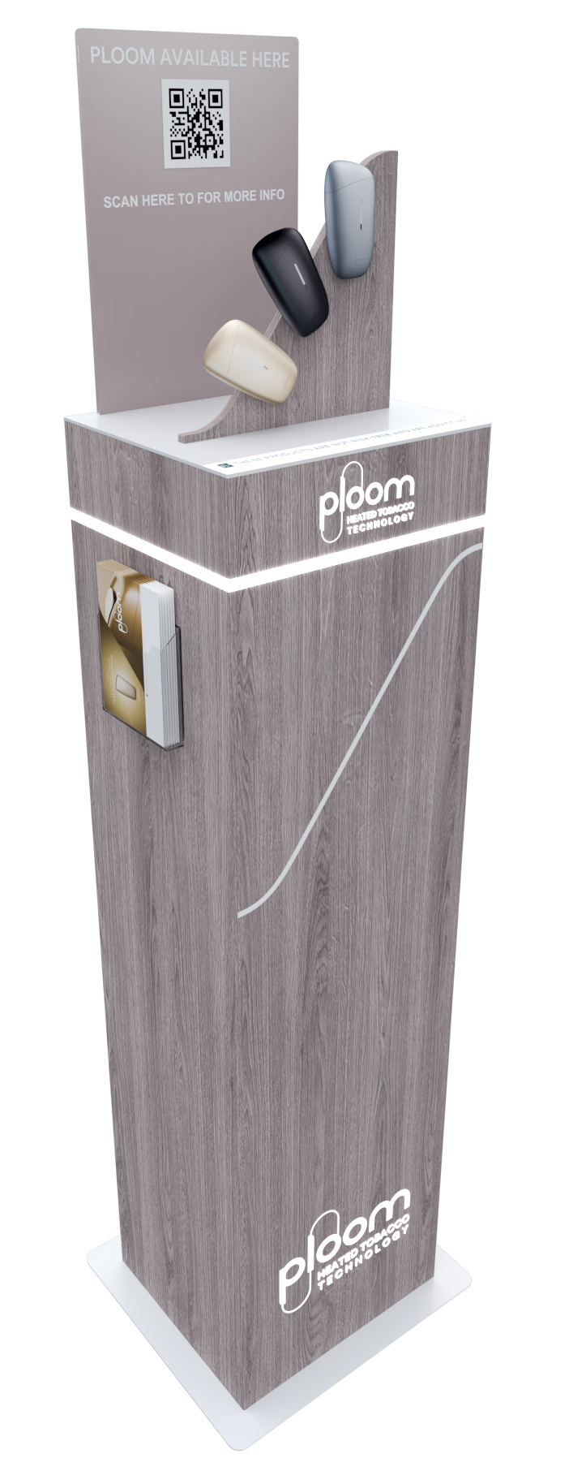
PROJECT
PLOOM LAUNCH – UNITED KINGDOM
Retailer
Retail network across London
Year
2020 – 2021
Description
Modular free-standing unit with detachable topper that can be an independent counter unit.
Changeable communication on the topper.
Materials
MDF, Acrylic, Powder coated sheet metal, LED lights
Dimensions
H1300xW400xD350
Detachable topper

Slide 26

PROJECT
PLOOM LAUNCH – UNITED KINGDOM
Retailer
Retail network across London
Year
2020 – 2021
Description
Shop sign tested and certified for outside weather conditions.
Materials
Powder coated sheet metal, Acrylic, LED lights
Dimensions
R 500

Slide 27
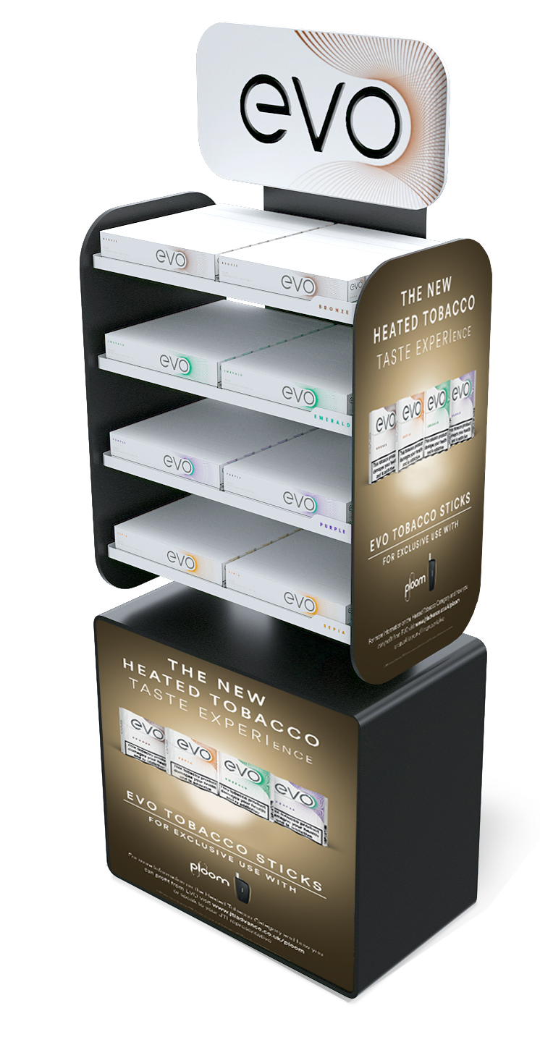
PROJECT
PLOOM LAUNCH – UNITED KINGDOM
Retailer
Cash and Carry POS across London
Year
2020 – 2021
Description
EVO storage unit with changeable communication.
Materials
Powder coated sheet metal, Forex
Dimensions
H1600xW625xD350

Slide 28
PROJECT
PLOOM LAUNCH – UNITED KINGDOM
Retailer
Retail for consumer electronics
Year
2020 – 2021
Description
Shelf unit with changeable brick system
Materials
MDF, Acrylic, Powder coated sheet metal
Dimensions
H600xW250xD350

Slide 29

PROJECT
PLOOM LAUNCH – UNITED KINGDOM
Retailer
Wide retail network
Year
2020 – 2021
Description
Modular shelf units.
Changeable communication and holders.
Intended for horizontal placement on shelves.
Materials
MDF, Powder coated sheet metal, Magnetic foil
Dimensions
H300x320xD250

Slide 30
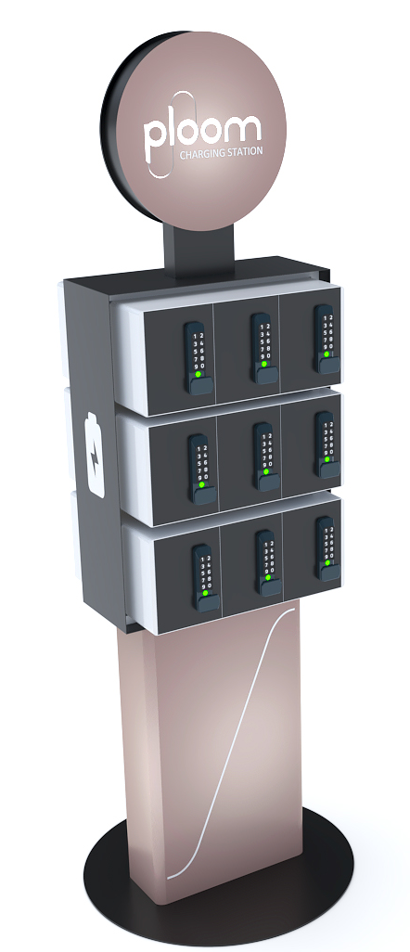
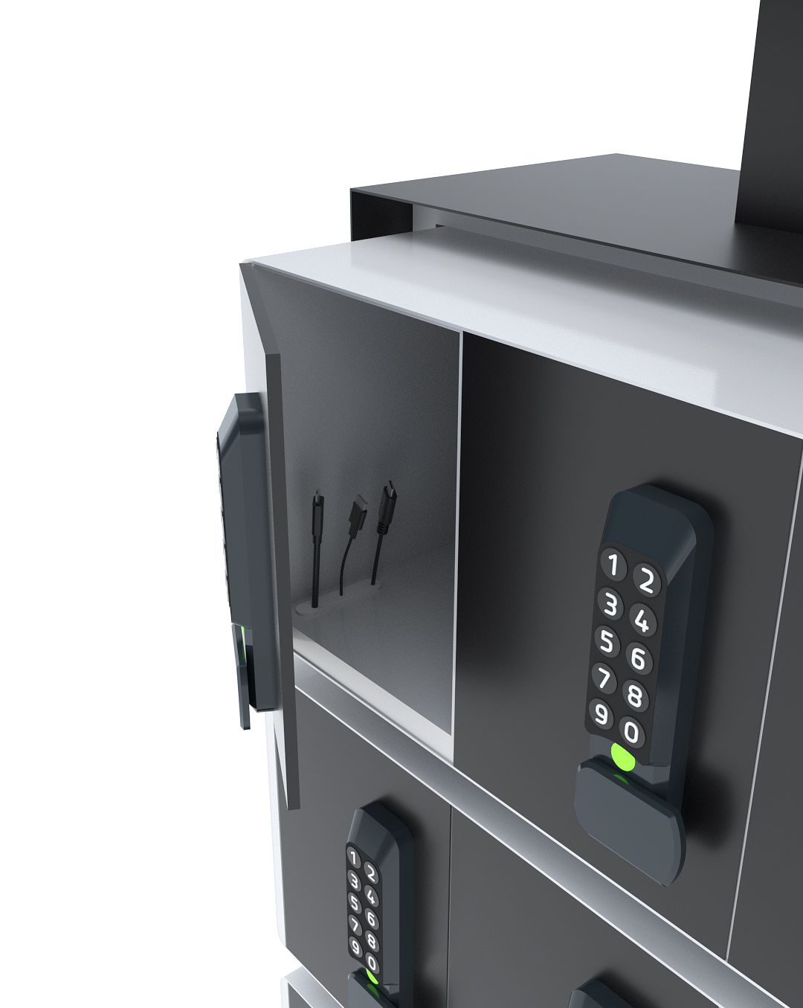
PROJECT
PLOOM LAUNCH – UNITED KINGDOM
Retailer
Wide retail network
Year
2020 – 2021
Description
Ploom device docking station.
Free – standing modular unit with
personalised compartments.
Materials
Powder coated sheet metal, Acrylic
Dimensions
H2000xW700
USB - C
Apple lightening cable
Micro USB

Slide 31
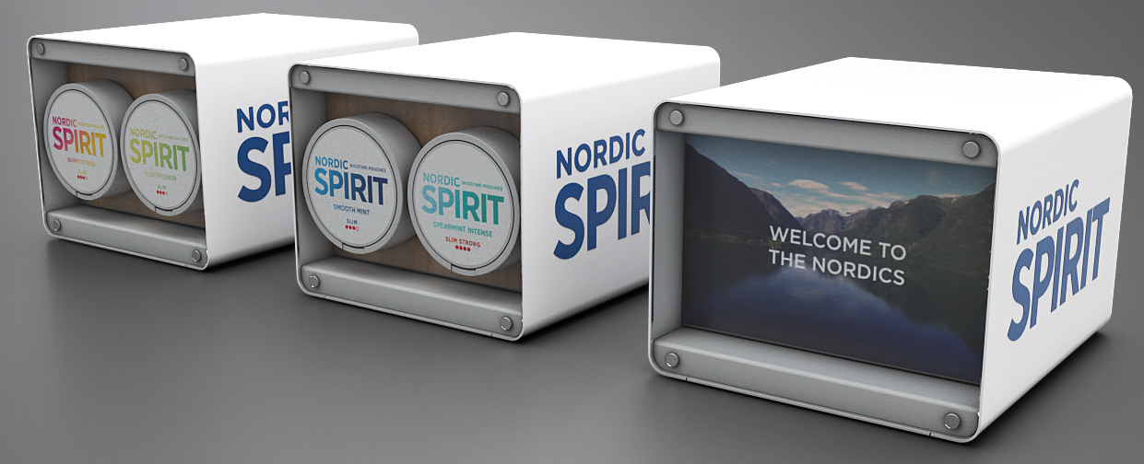
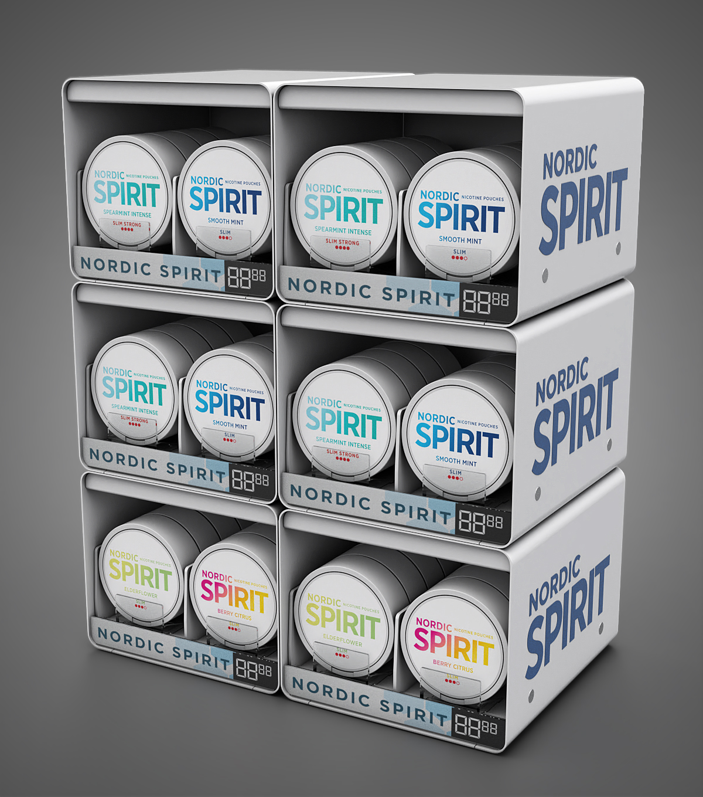
PROJECT
NORDIC SPIRIT CAMPAIGN – UNITED KINGDOM
Retailer
Retail network in selected cities
Year
2021
Description
LEGO cubes that can be illuminated.
Easy to build storage and communication space on each POS thanks to magnets on each cube.
Changeable height of shelves.
Materials
Powder coated sheet metal, Acrylic
Dimensions
H1300xW550D470

Slide 32
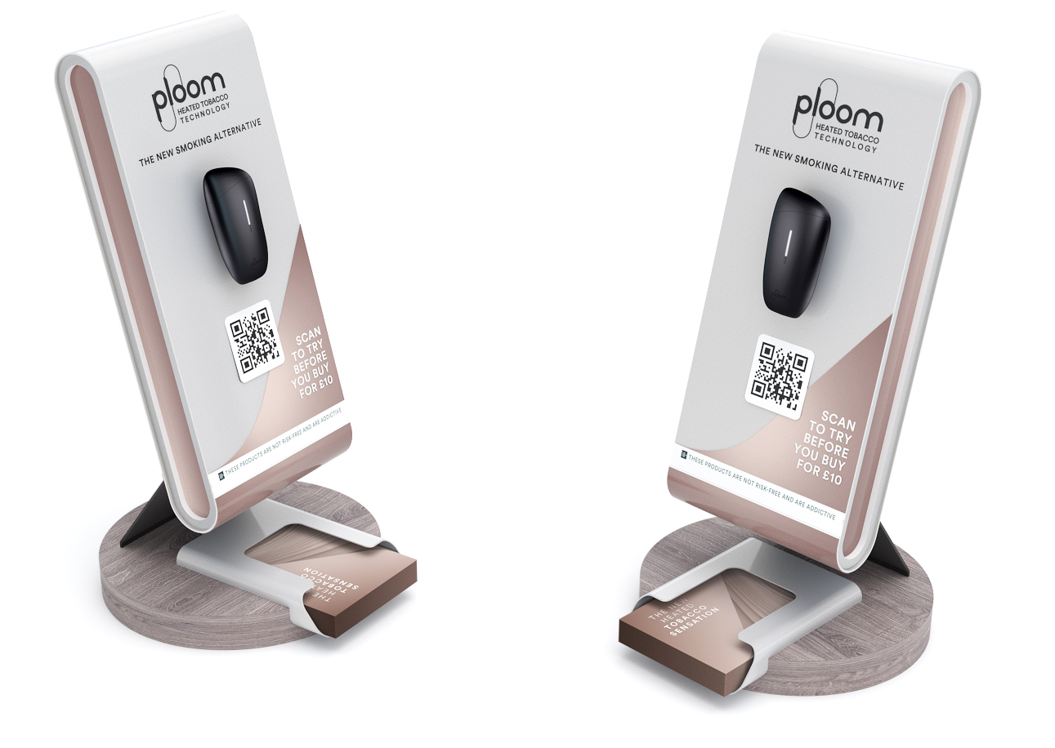
PROJECT
PLOOM, MORRISON’S UNITS AND COUNTERS – UNITED KINGDOM
Retailer
Morrison
Year
2021
Description
Counter unit with antitheft system for device.
Changeable visual communication and premium look.
Materials
MDF, Metal, Magnetic foil
Dimensions
H440xW226D180

Slide 33
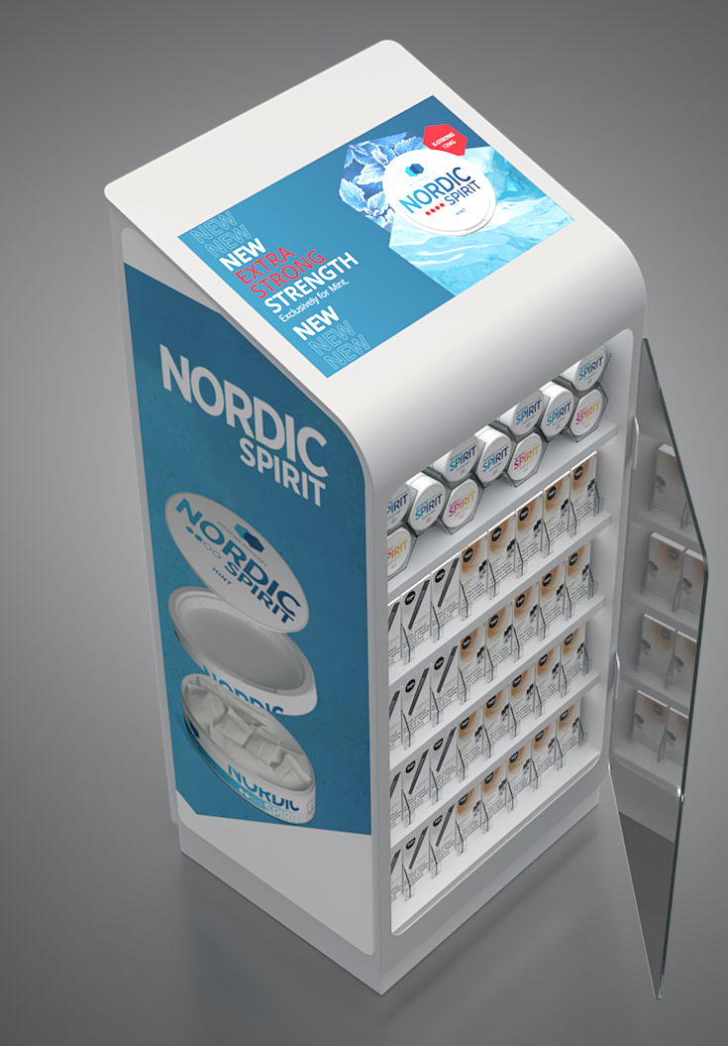
PROJECT
NORDIC SPIRIT PROJECT – UNITED KINGDOM
Retailer
Premium retail network
Year
2021
Description
Free standing vape tower with changeable communication.
Screen installed on top.
Changeable height of shelves.
Materials
Powder coated sheet metal, Glass
Dimensions
H1300xW550D470

Slide 34

PROJECT
NORDIC SPIRIT WALL UNIT – UNITED KINGDOM
Retailer
Independent stores across UK
Year
2020
Description
Wall unit with storage for Nordic spirit tins. The storage is refilled from the top by opening the lid.
Materials
Acrylic
Dimensions
H350xW270xD150

Slide 35

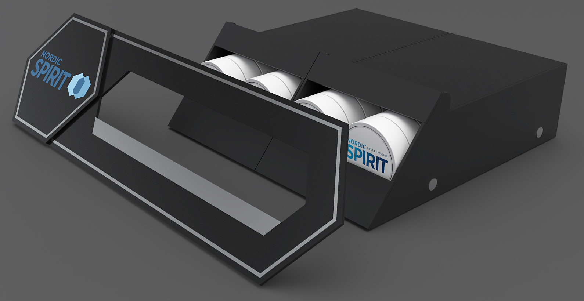
PROJECT
NORDIC SPIRIT SHELF TALKER – UNITED KINGDOM
Retailer
Independent stores across UK
Year
2020
Description
Shelf highlighter with changeable front panel.
Materials
Acrylic
Dimensions
H180xW550xD420

Slide 36
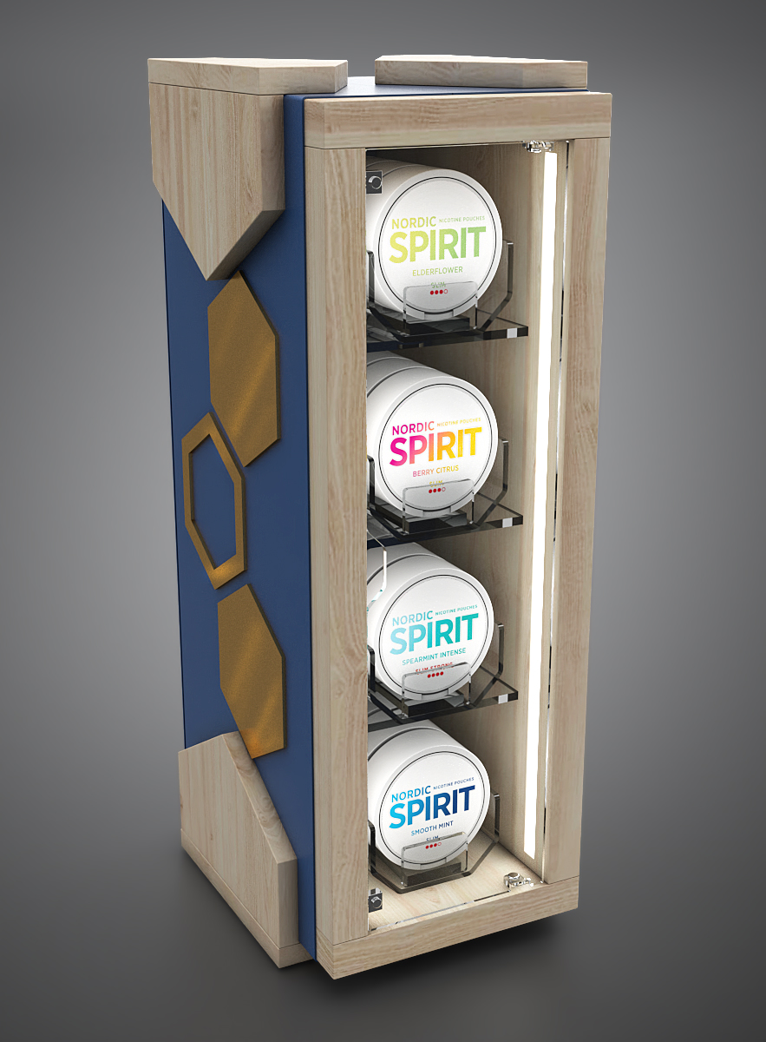
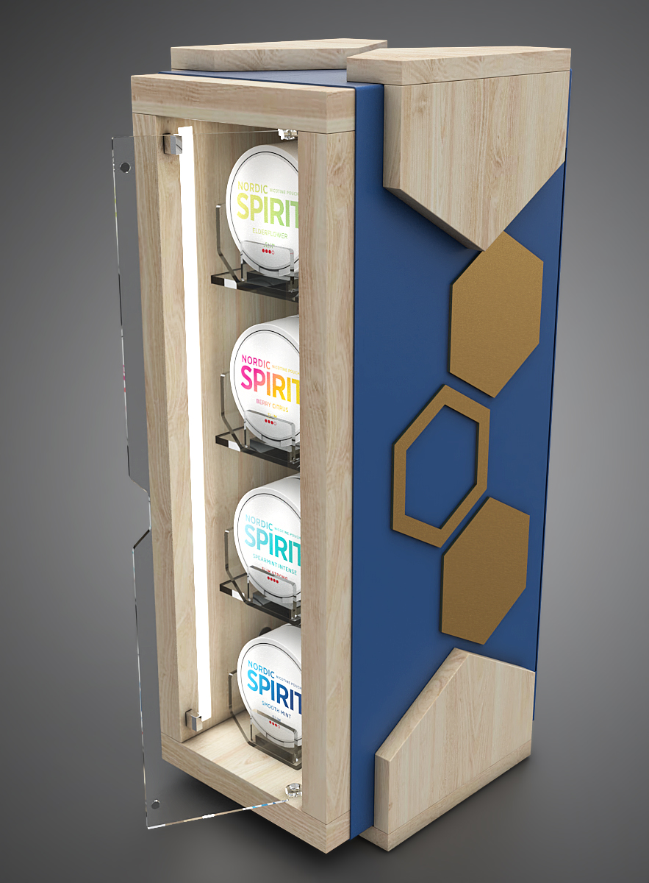
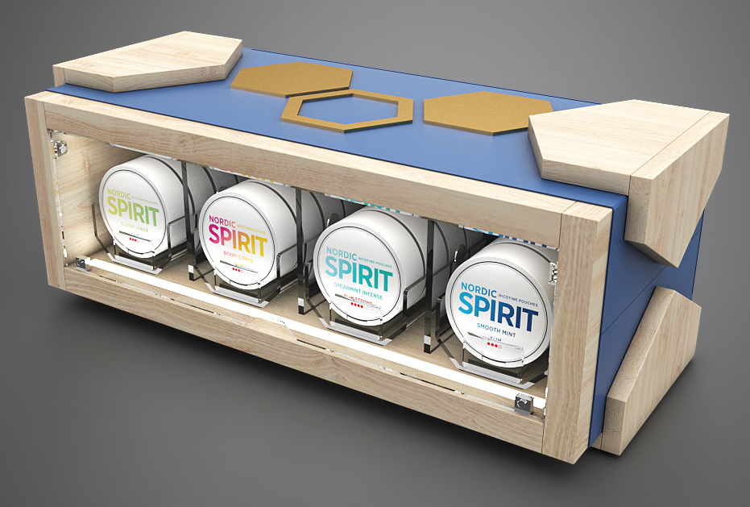
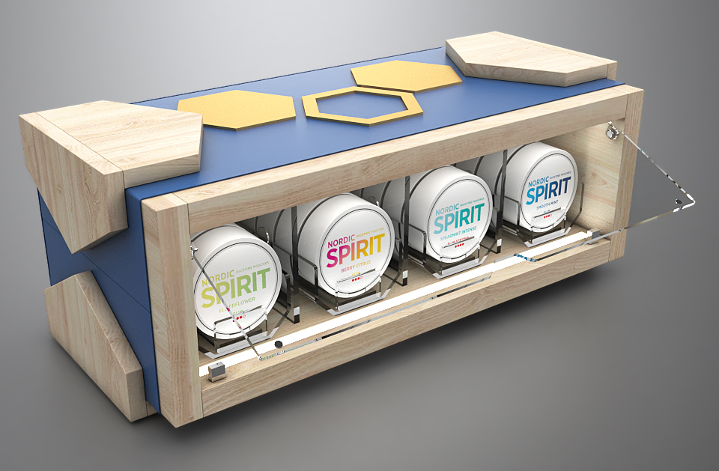
PROJECT
HoReCa NORDIC SPIRIT – UNITED KINGDOM
Retailer
HoReCa
Year
2020
Description
Modular counter unit for HoReCa channel.
Rotating pushers enable different orientation of the unit.
Materials
MDF, Metal
Dimensions
H457xW174xD206

Slide 37
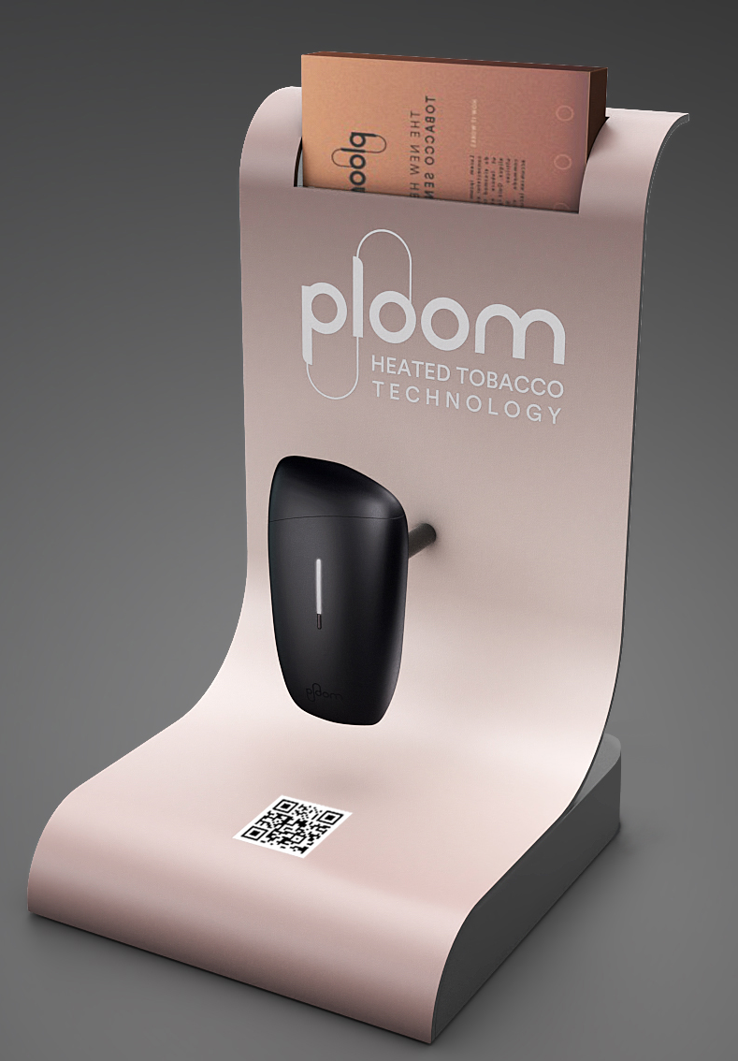
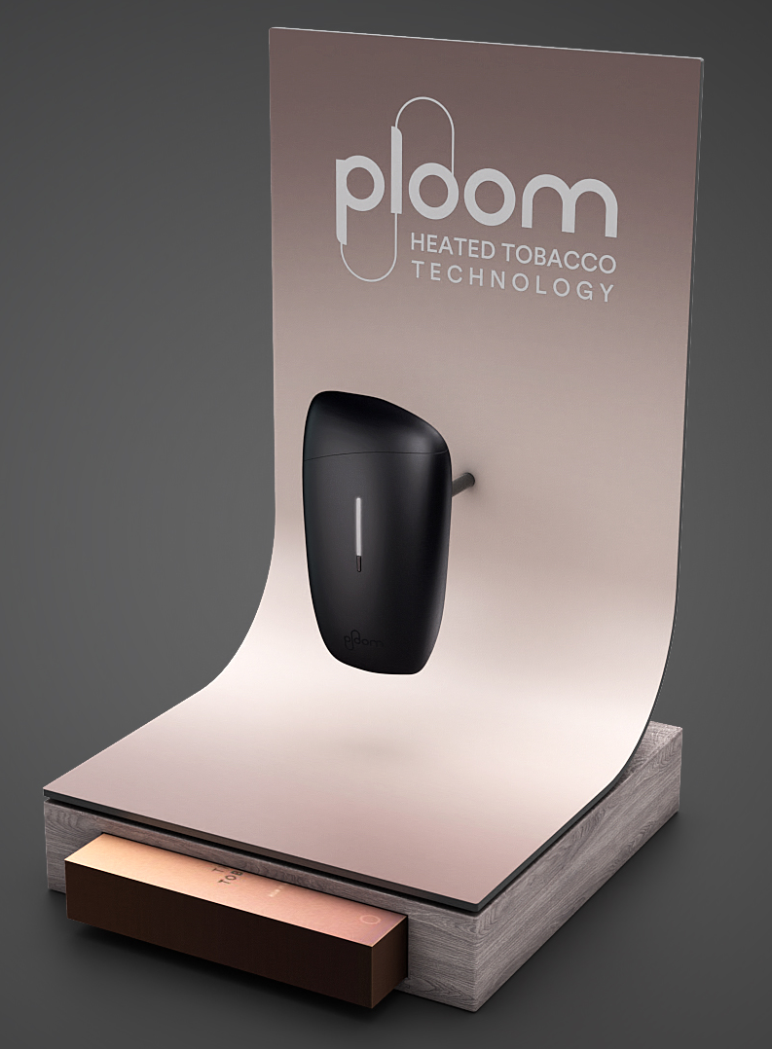

PROJECT
PLOOM LAUNCH – EUROPE
Retailer
Wide retail in selected cities
Year
2021
Description
Counter units with optional antitheft system for device.
Materials
Powder coated sheet metal, Acrylic
Dimensions
H300xW180xD200

Slide 38
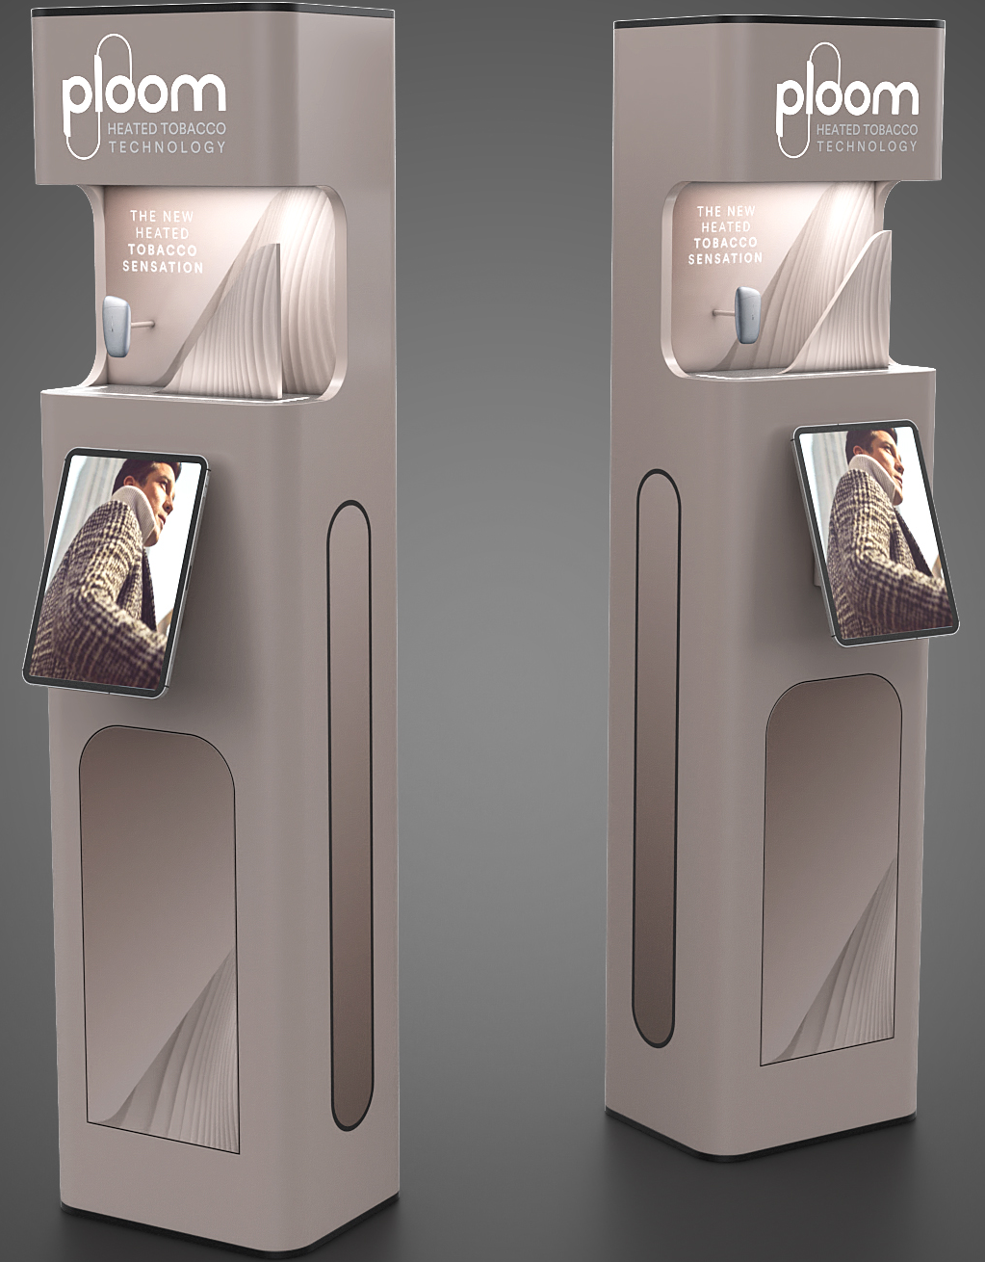
PROJECT
PLOOM LAUNCH – EUROPE
Retailer
Retail network in selected cities
Year
2021
Description
Totem units with screens.
Materials
Powder coated sheet metal, Acrylic, MDF
Dimensions
H1800xW400D350

Slide 39
PROJECT
OVERHEAD – ADRIATICA
Retailer
Wide retail network
Year
– 2021
Description
Overhead units
Materials
Powder coated sheet metal, Acrylic
Dimensions
Different dimensions

Slide 40
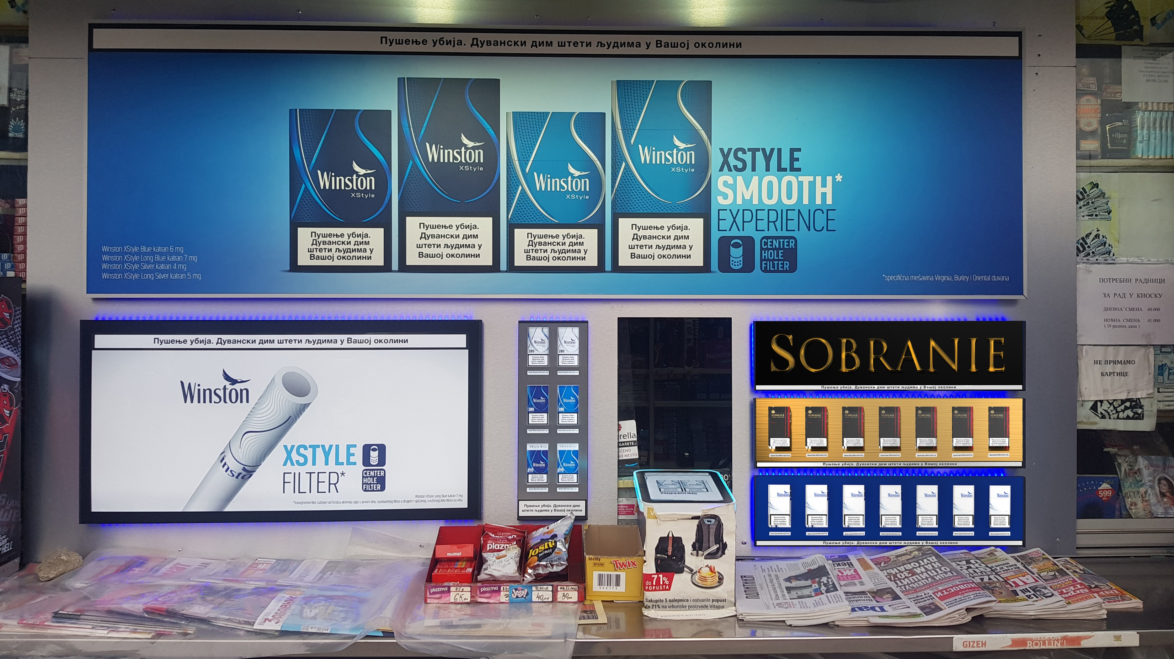
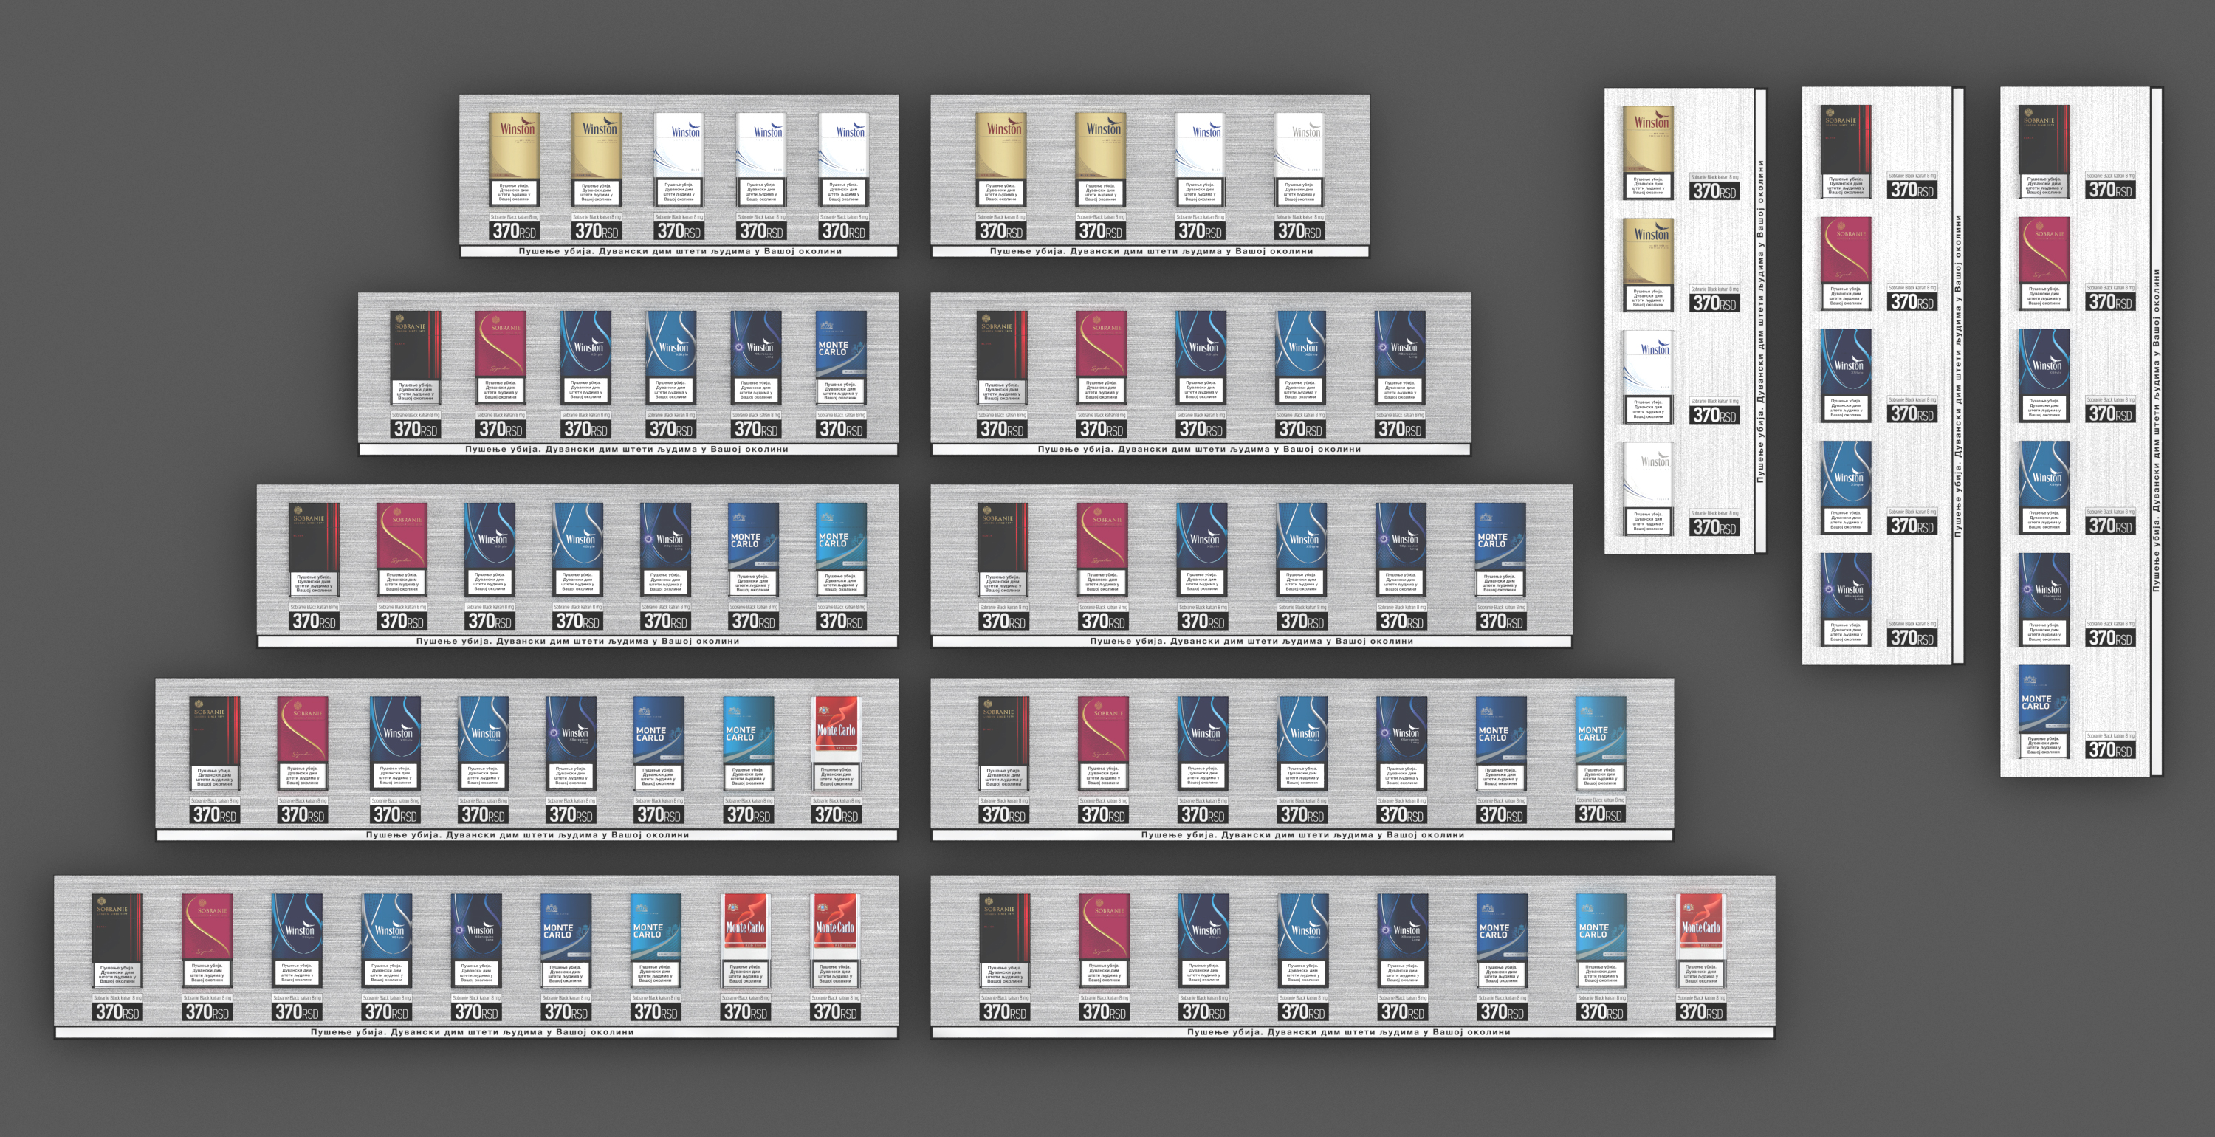
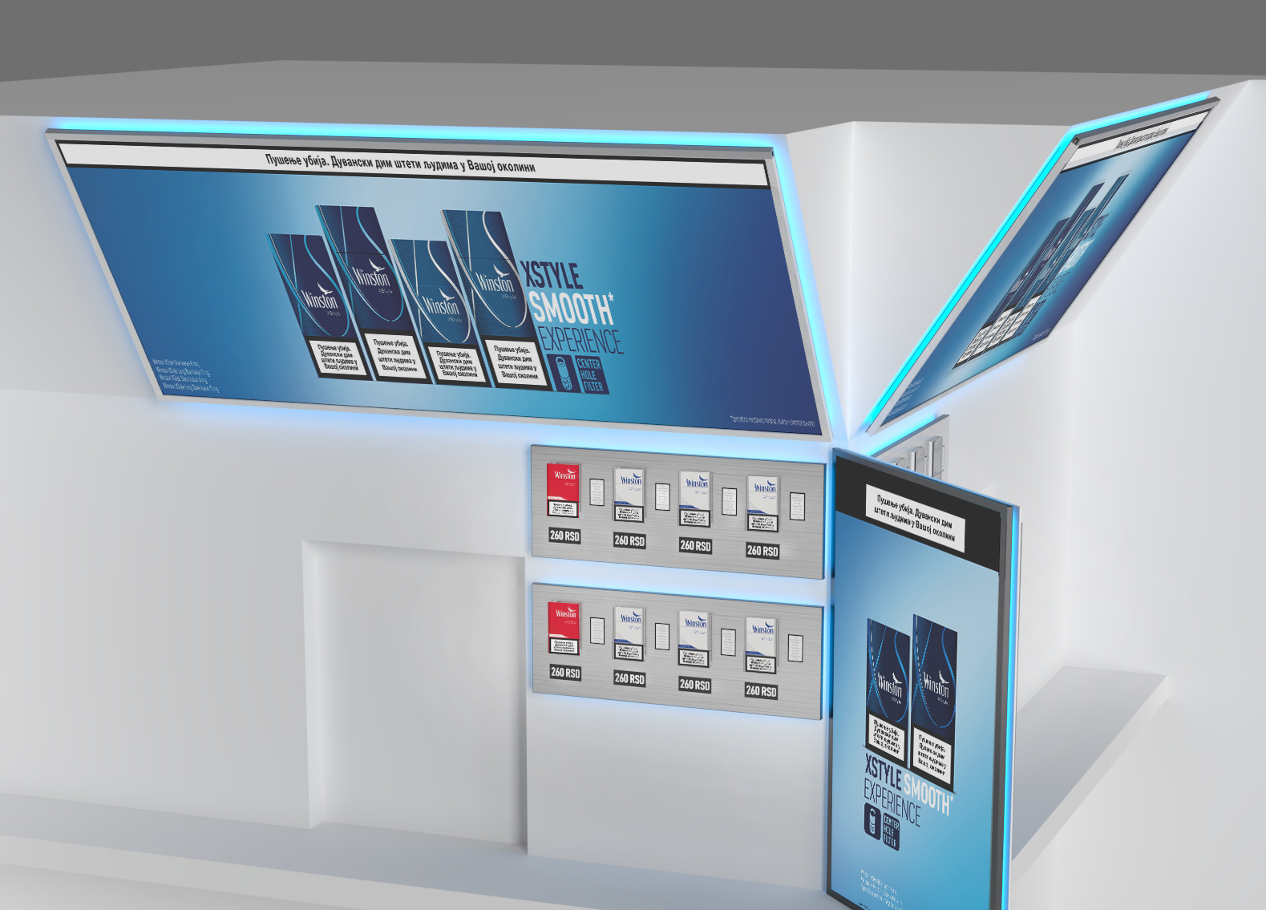
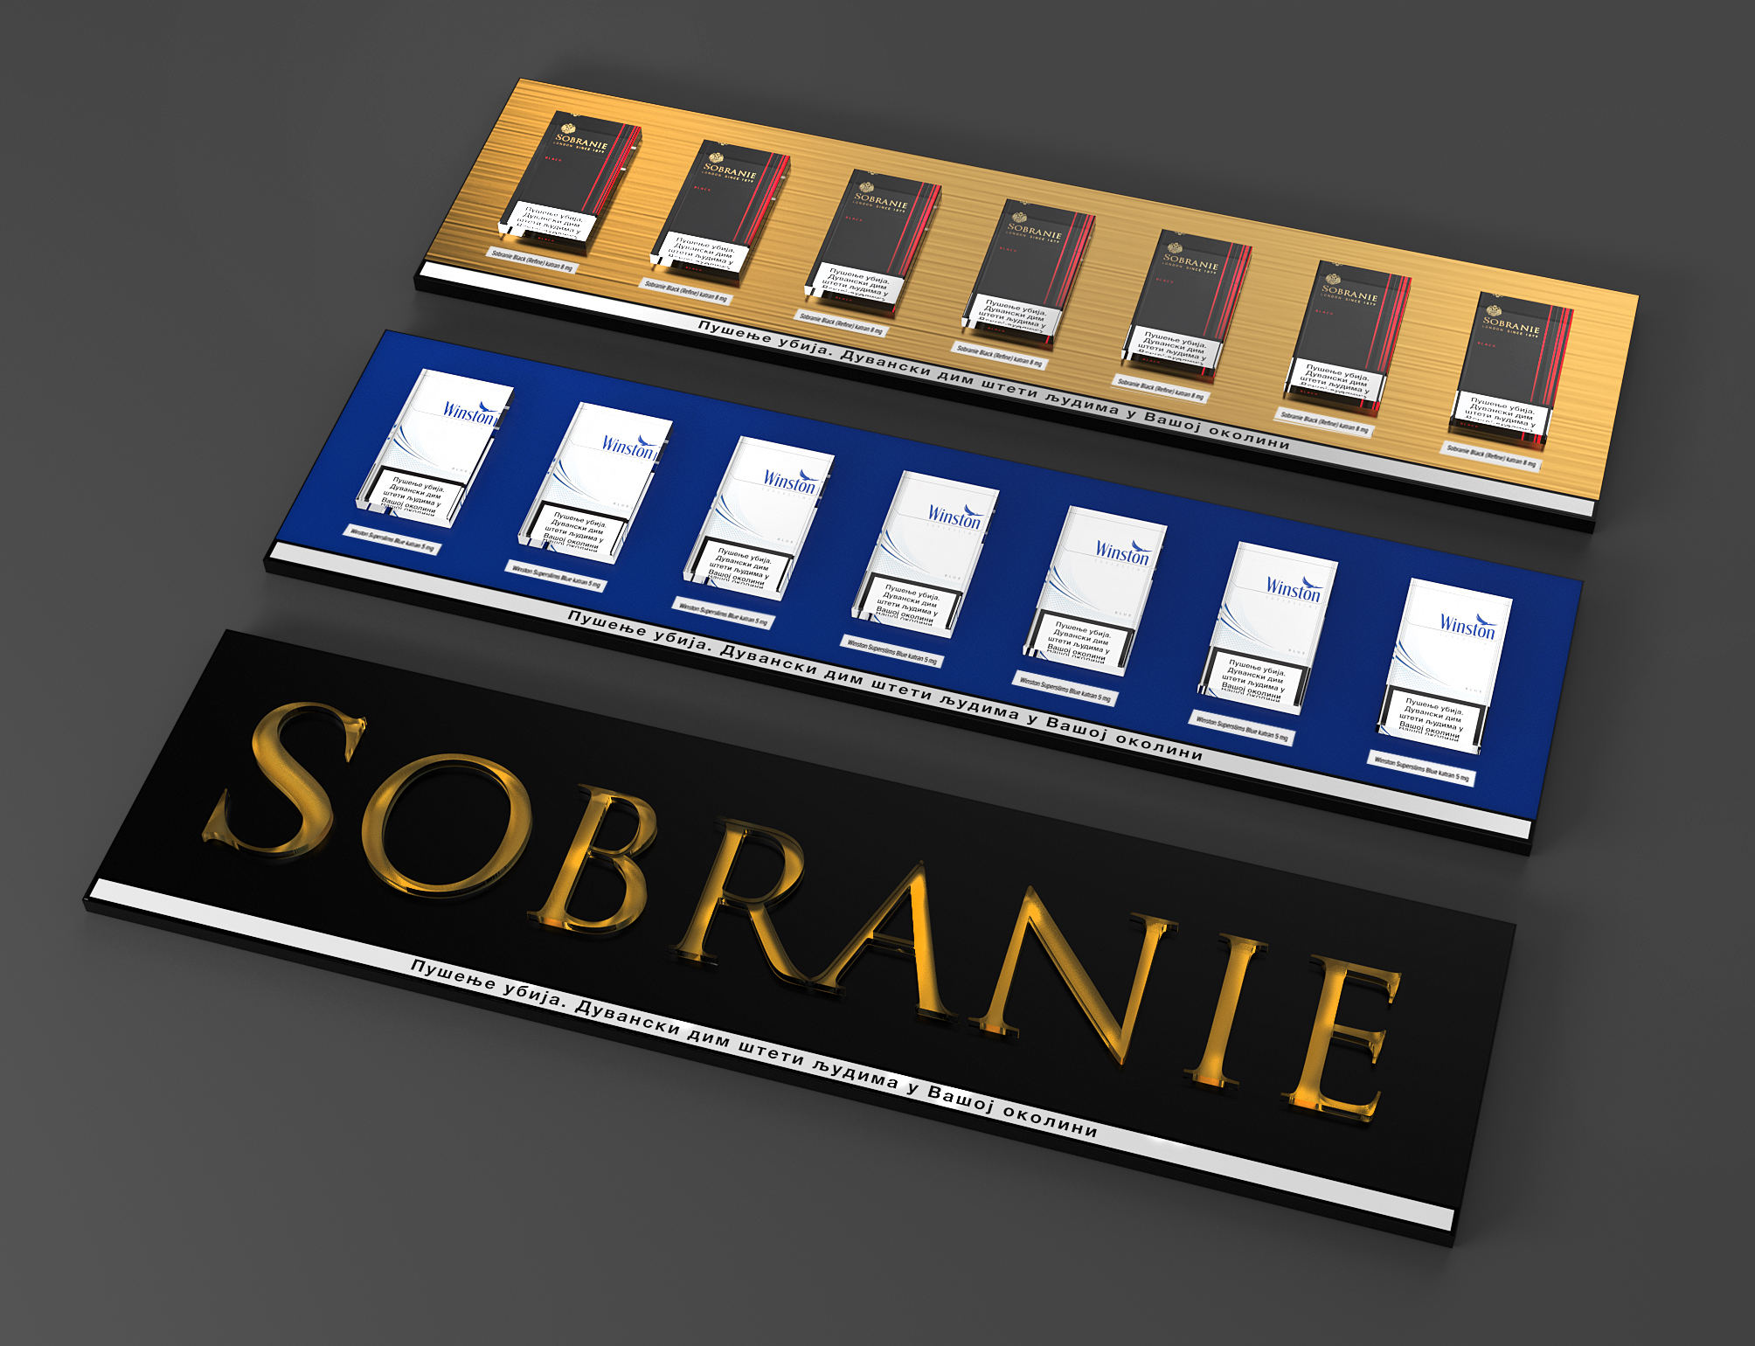
PROJECT
KIOSK PACK & MODULE SYSTEM – ADRIATICA
Retailer
Wide Retail Network
Year
2020
Description
Kiosk system
Materials
Alu bond, Acrylic, Metal
Dimensions
Different dimensions

Slide 41
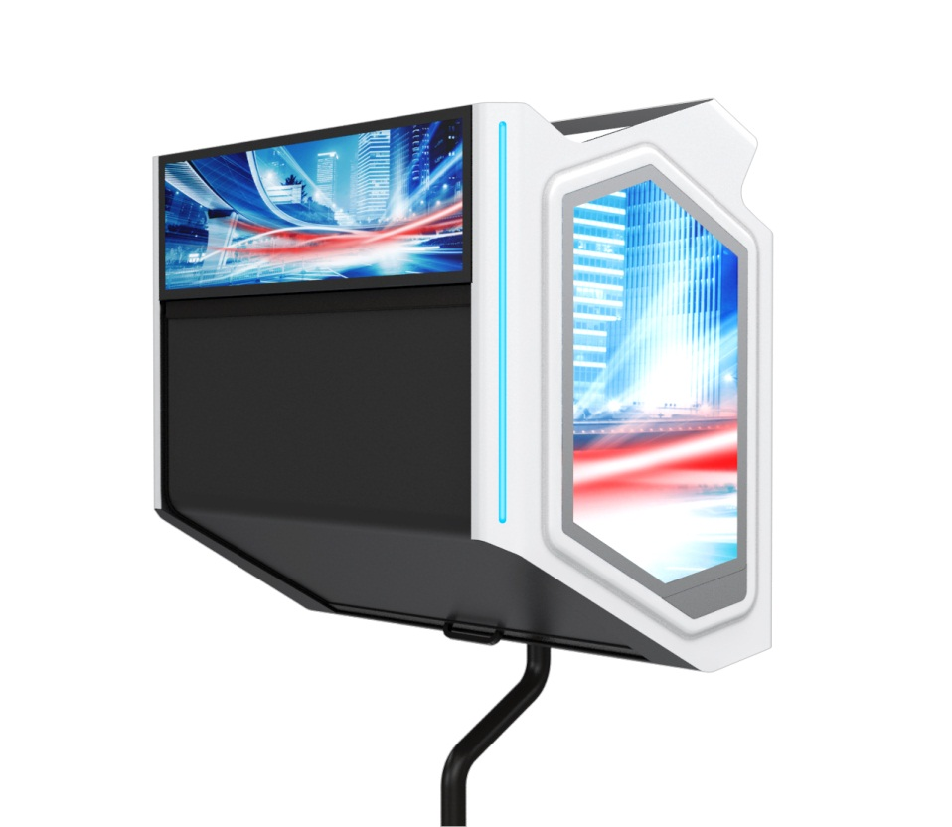
PROJECT
OVERHEAD – ADRIATICA
Retailer
Wide retail network
Year
2018 – 2021
Description
Overhead units
Materials
Powder coated sheet metal, Acrylic
Dimensions
Different dimensions

Slide 42
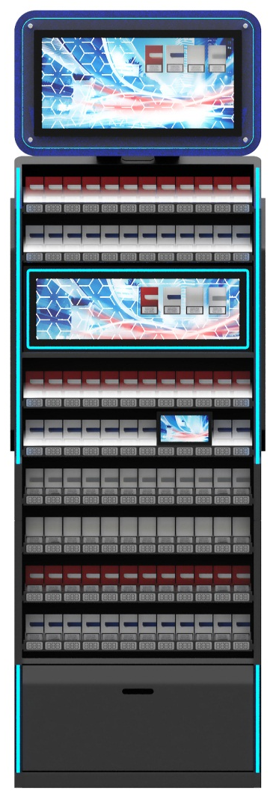
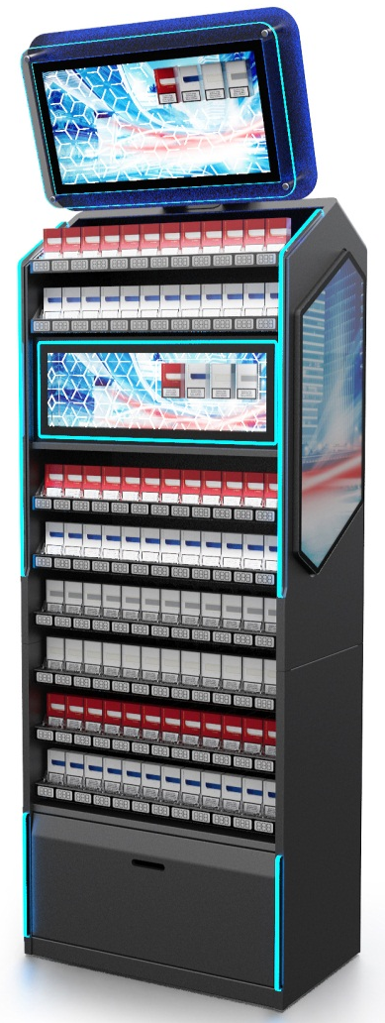
PROJECT
BACKWALL UNIT – ADRIATICA
Topper with illumination
3D graphics and displayed packs
Promo zone 1
Retailer
Wide retail network
Year
2018 – 2021
Description
Back Wall Units
Materials
Powder coated sheet metal, Acrylic
Dimensions
Different dimensions
Promo zone 2
Promo zone 3
Drawer for the stock, cartons – self ejactable
RGB Strips

Slide 43
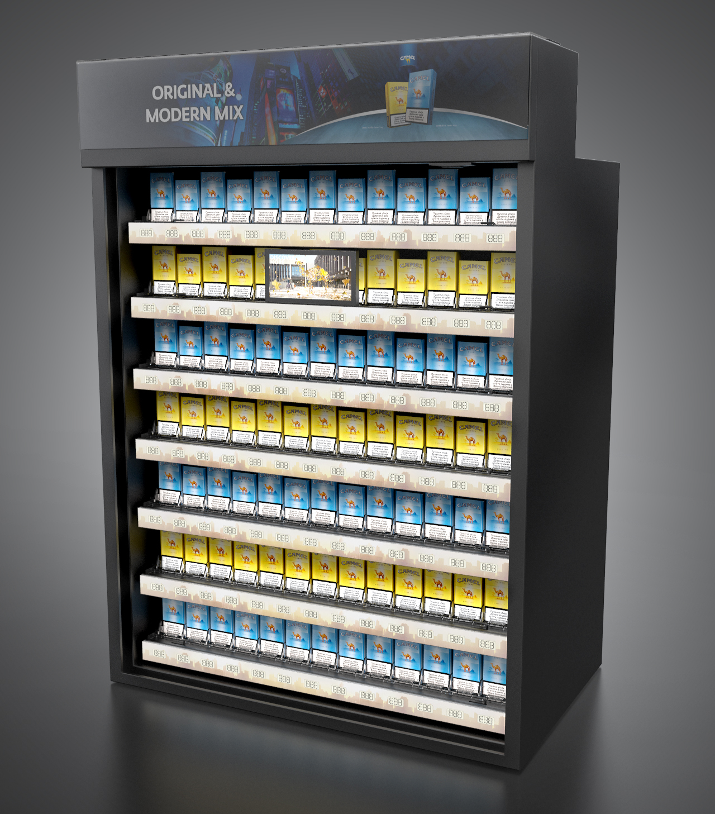
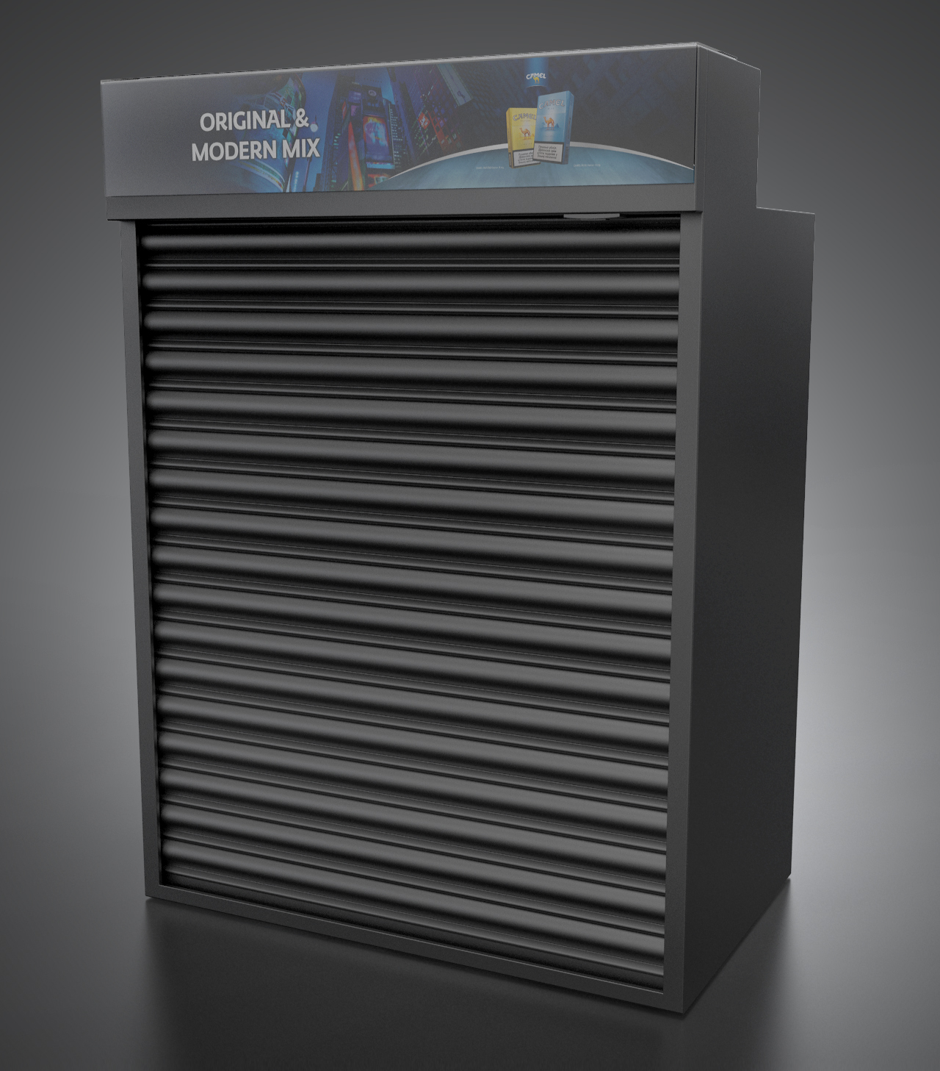
PROJECT
BWU SECURITY EQUIPMENT – SWEDEN
Retailer
Wide retail network
Year
2018 – 2021
Description
Backwall units certified
on POS
with security issues.
ECB S Certification:
Materials
Powder coated sheet metal, Acrylic
Dimensions
H1245xW900xD606

Slide 44
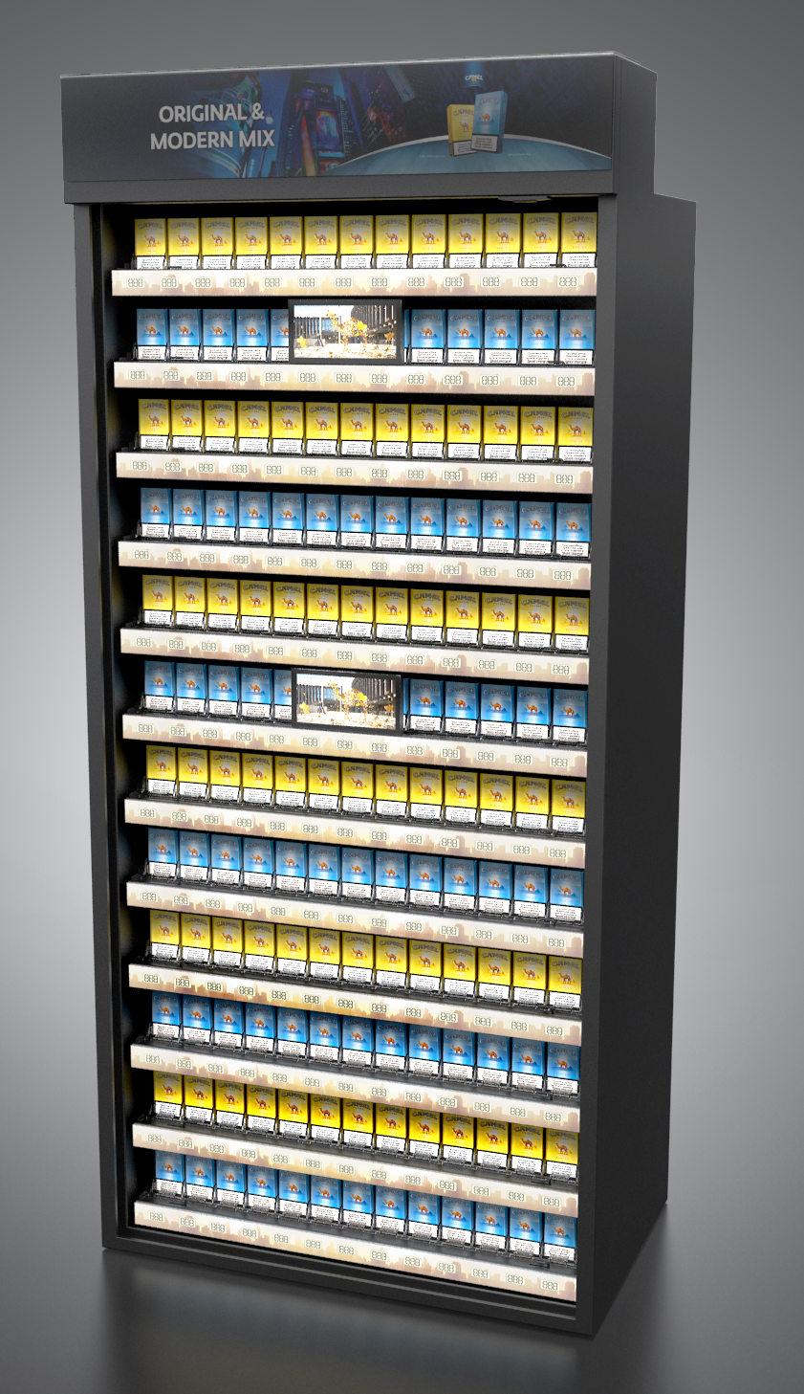
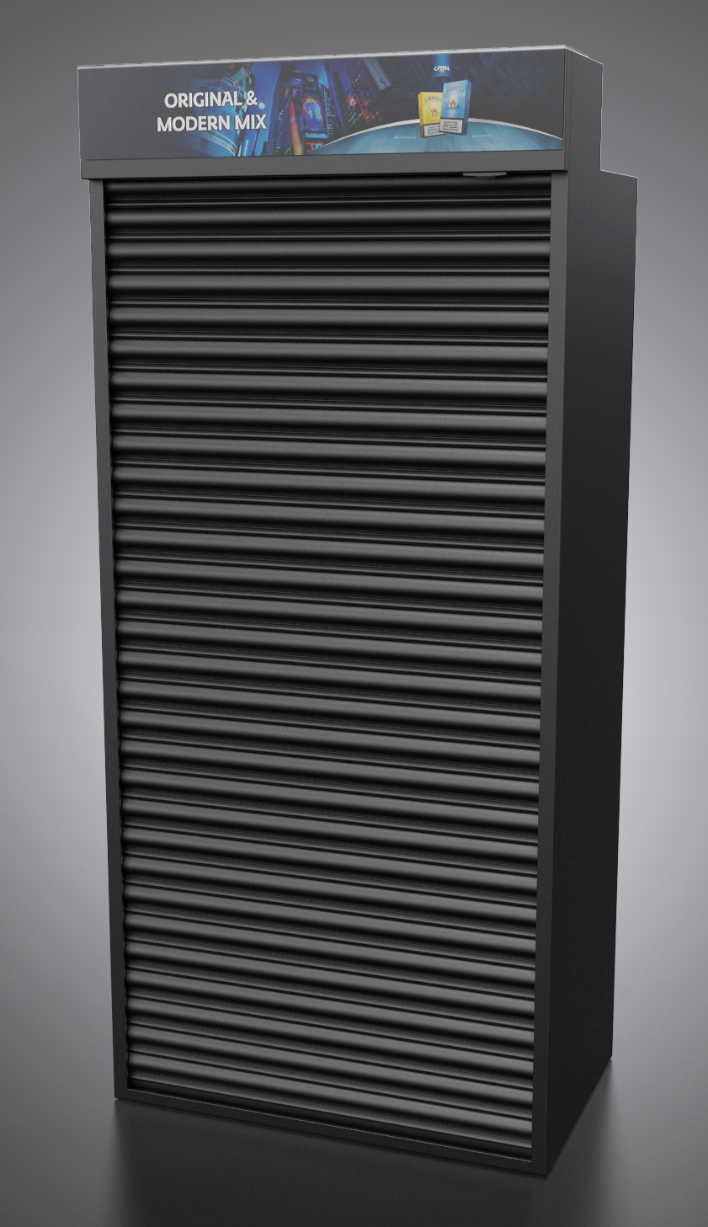
PROJECT
BWU SECURITY EQUIPMENT – SWEDEN
Retailer
Wide retail network
Year
2018 – 2021
Description
Backwall units certified
on POS
with security issues.
ECB S Certification:
Materials
Powder coated sheet metal, Acrylic
Dimensions
H2060xW900xD606

Slide 45
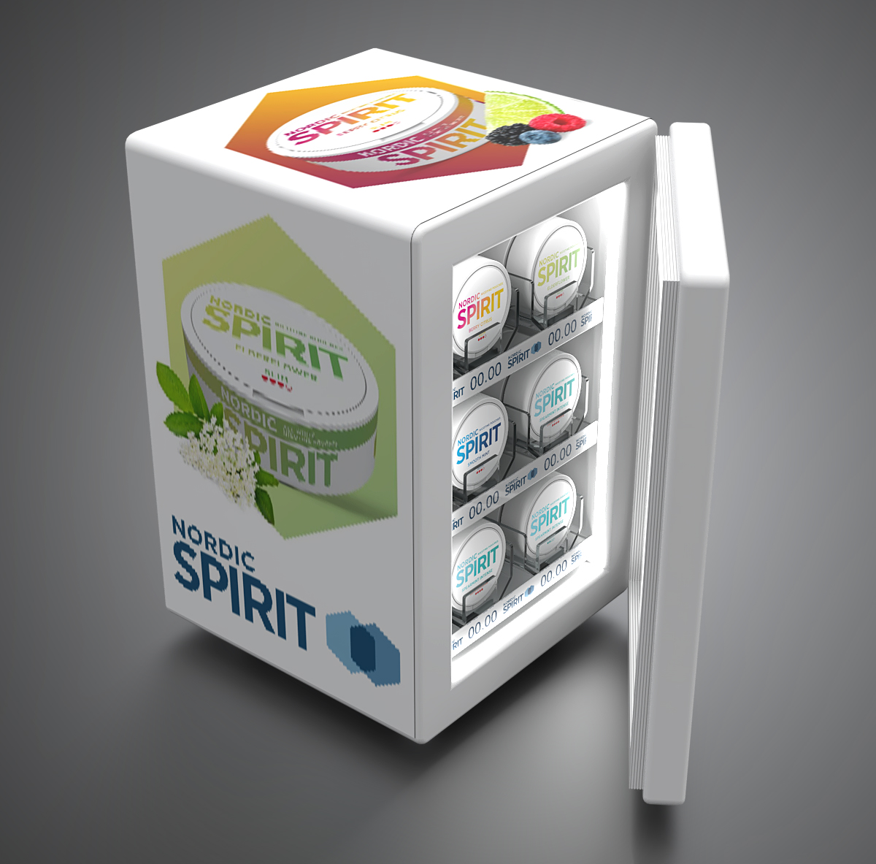
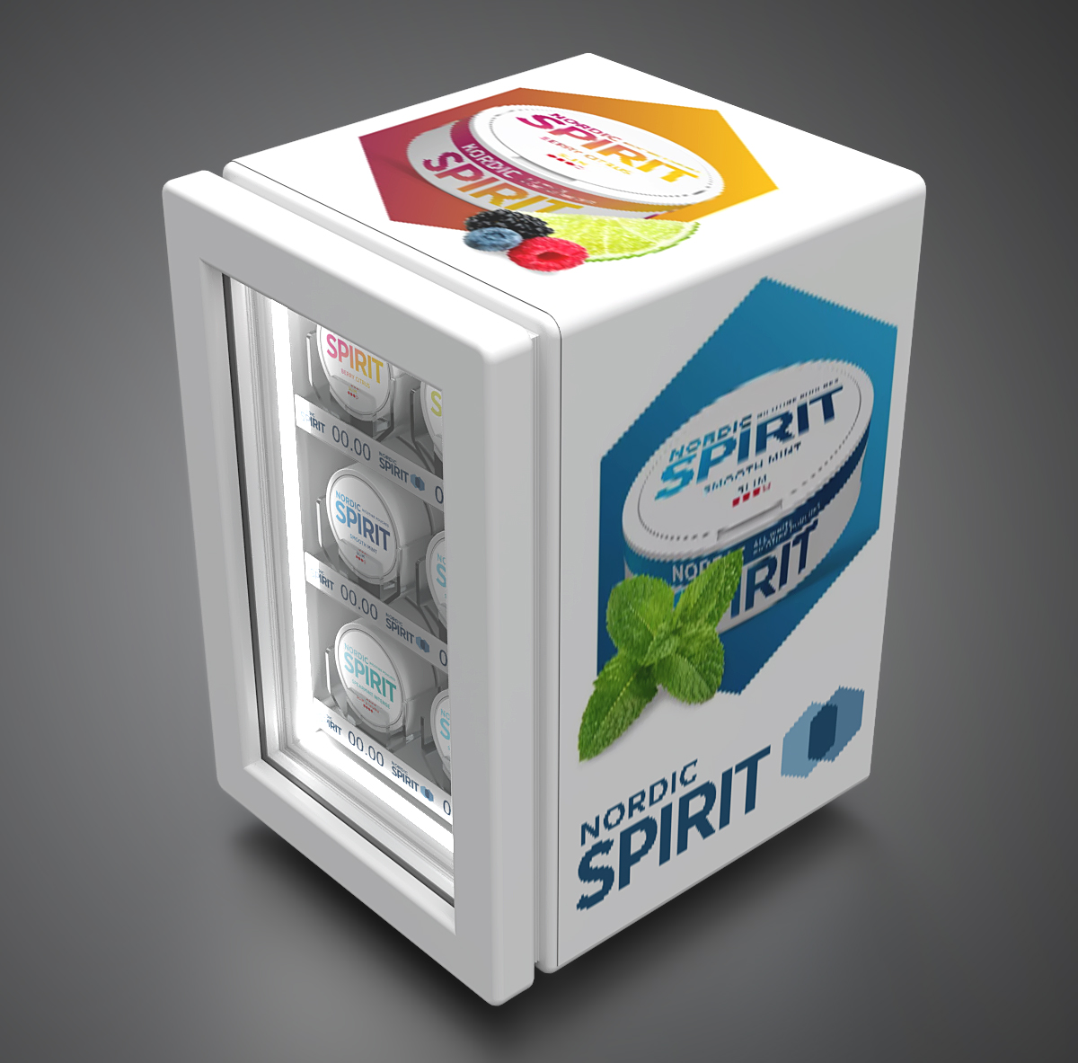
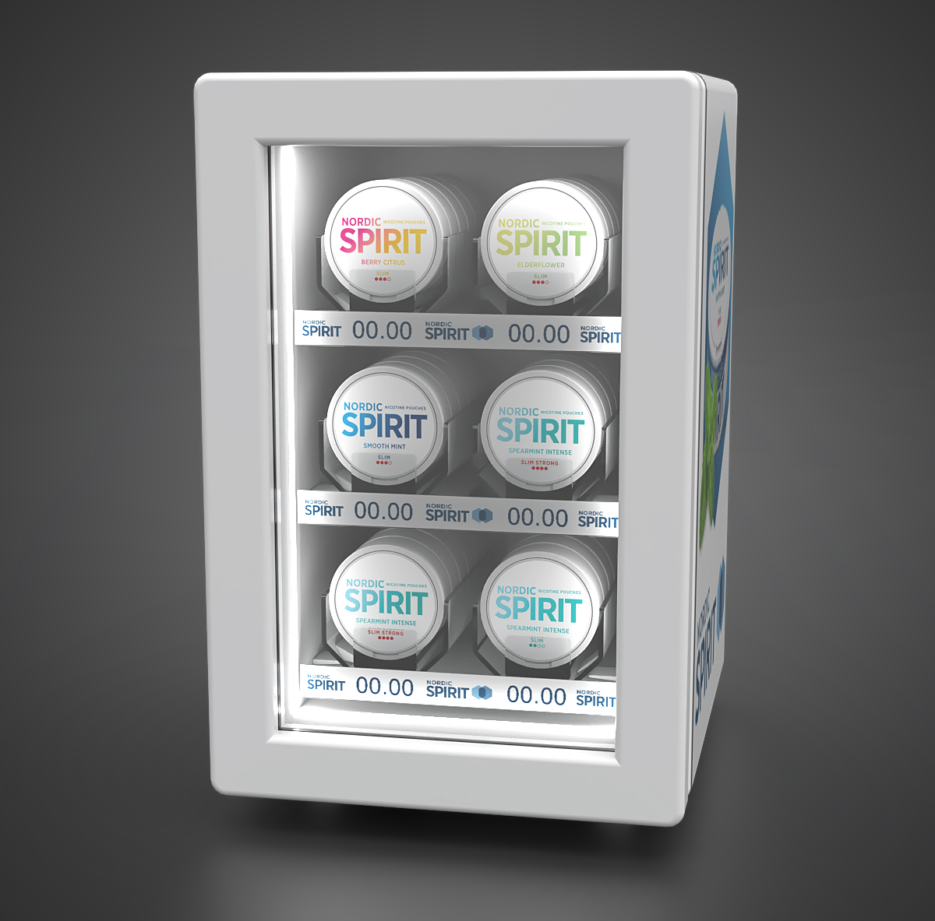
PROJECT
COOLER NORDIC SPIRIT – SWITZERLAND
Retailer
Convenience stores in Switzerland
Year
2020
Description
Freezing unit for Nordic spirit tins, placed on counters across retail network of a local chain.
Materials
Metal, Magnetic foil, Refrigerator, LED diodes
Dimensions
H340xW250xD290

Slide 46


PROJECT
HoReCa display – SWITZERLAND
Retailer
HoReCa
Year
2020
Description
Illuminated counter displays with different branding communication.
Materials
Acrylic, Metal, LED diodes
Dimensions
Different dimensions.

Slide 47
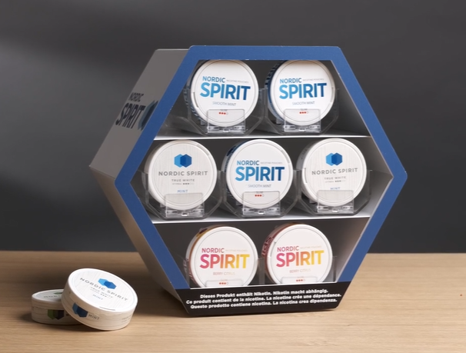
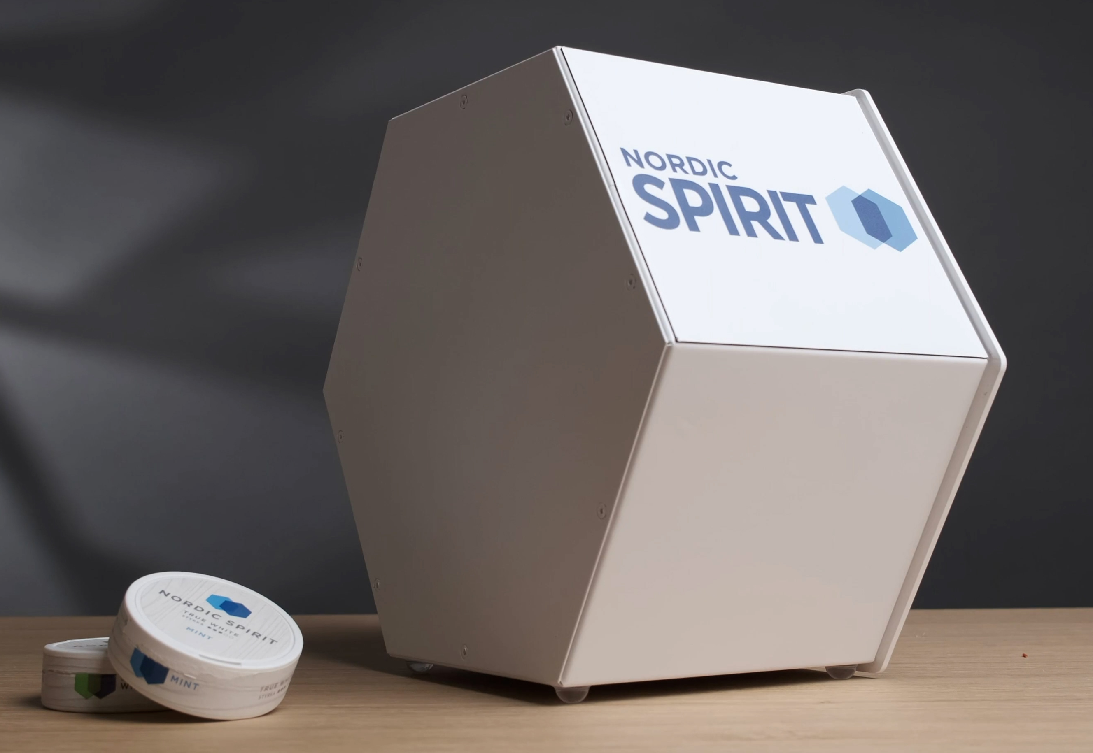
PROJECT
NORDIC COUNTER – SWITZERLAND
Retailer
Gas stations across Switzerland
Year
2021
Description
Dispenser for Nordic Spirit with changeable side communication.
Materials
Metal, Acrylic, Magnetic foil, Pusher System
Dimensions
H210xW200xD150

Slide 48
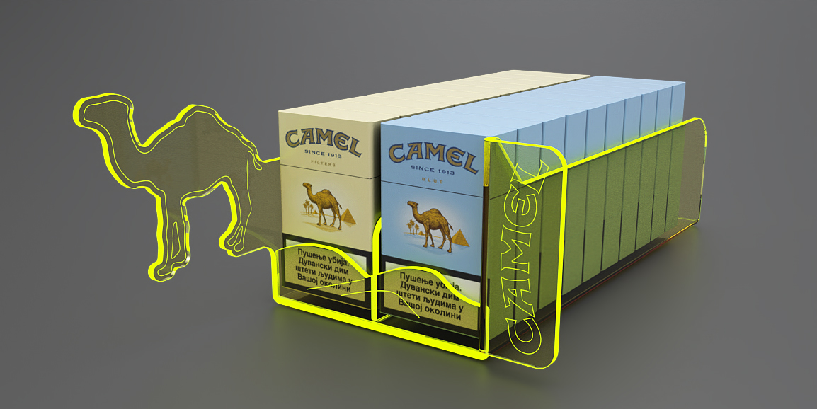
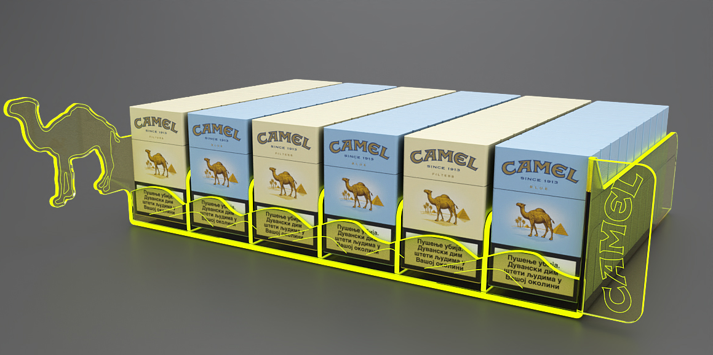
PROJECT
CAMEL SHELF FLUO HIGHLIGHTER – BULGARIA
Retailer
Wide Retail Network
Year
2021
Description
Emphasizing Camel creative icon (by engraved wording) in order to communicate different pack variations.
Materials
Fluo Acrylic
Dimensions
H90xW120xD265

Slide 49
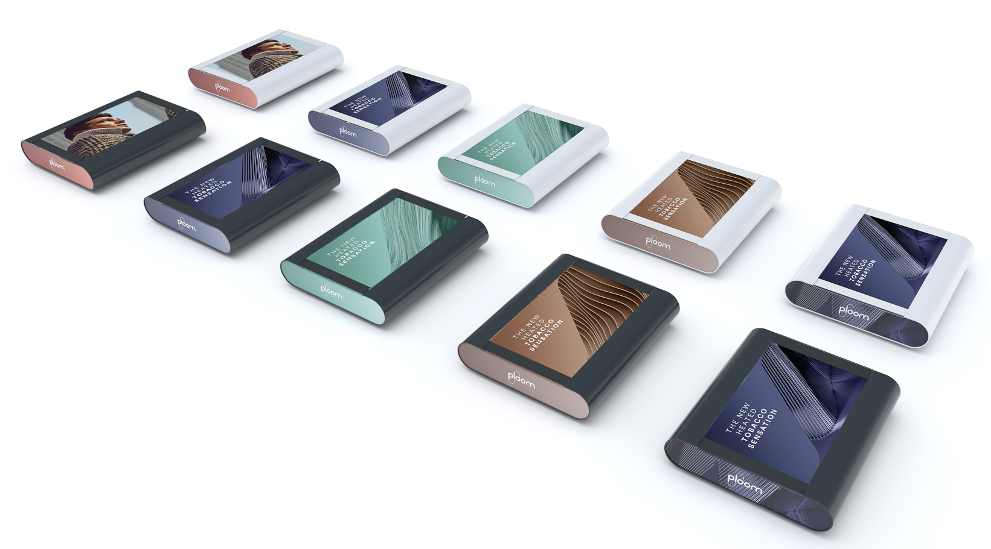
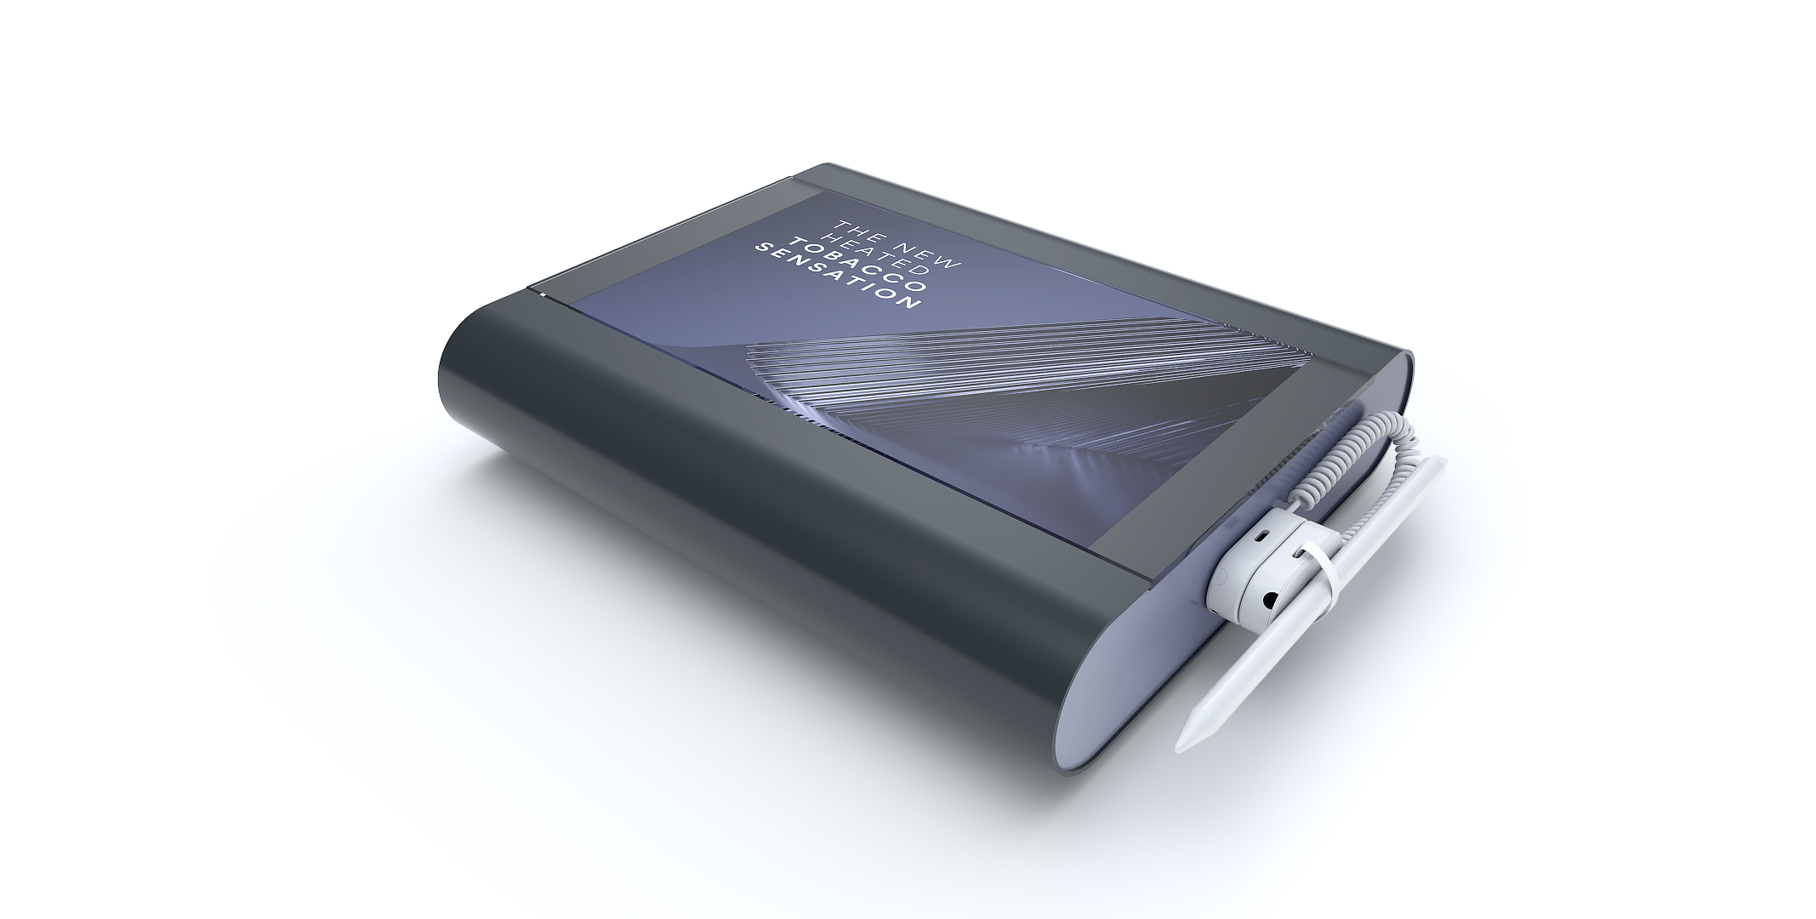
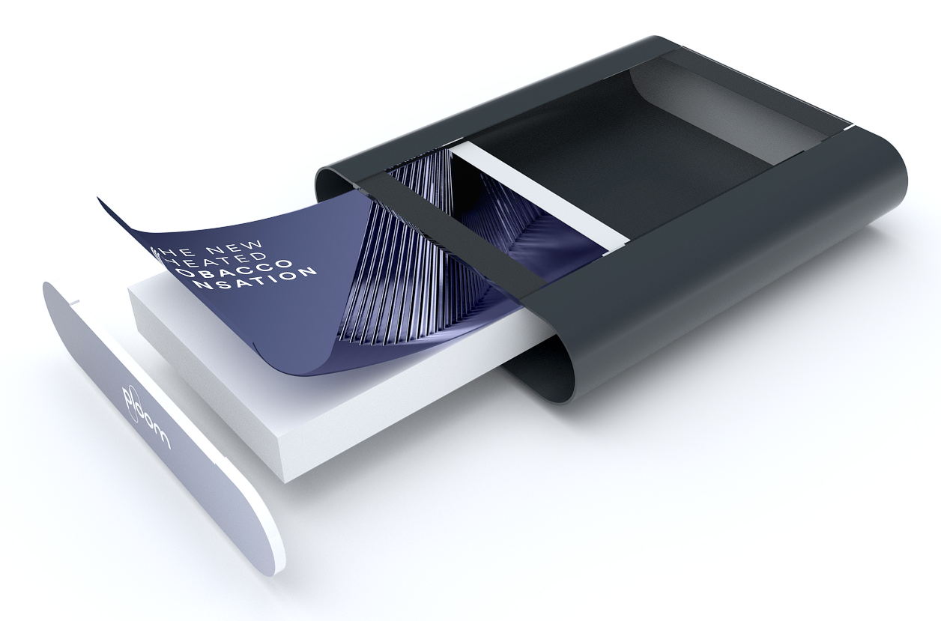
PROJECT
PLOOM CASH TRAY – EUROPE
Retailer
Convenience stores across Germany
Year
2021
Description
Cash trays with changeable prints.
There is an option to insert a digital screen instead of print.
Materials
Metal, Forex, Acrylic
Dimensions
H60xW270xD240

Slide 50
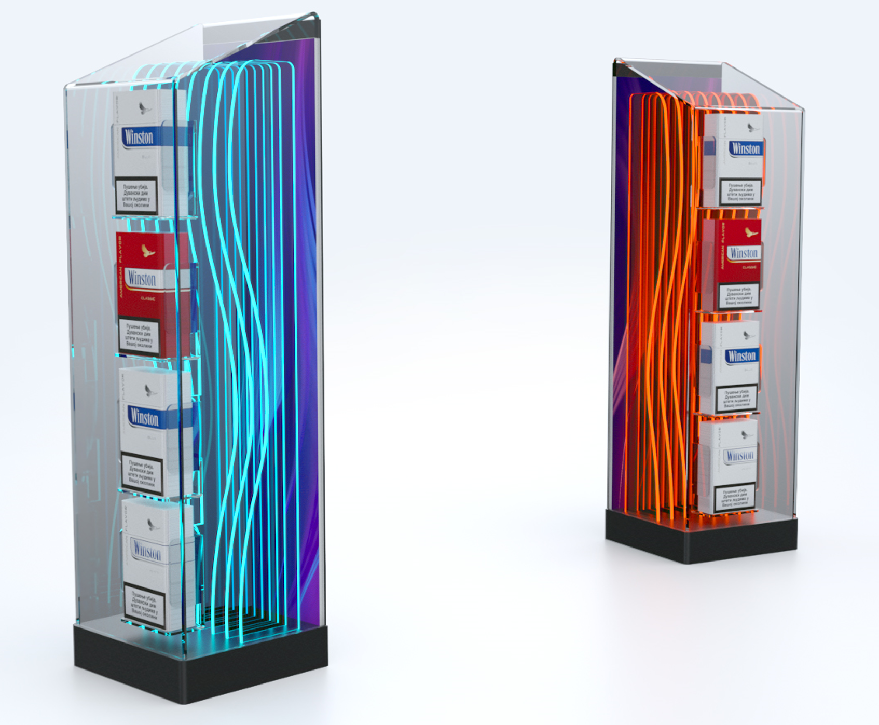
PROJECT
COUNTER UNIT – HUNGARY
Retailer
Wide Retail Network
Year
2020
Description
Changeable visual communication.
RGB lights.
Materials
Powder Coated Sheet Metal, Acrylic, Forex
Dimensions
H470xW135xD130

Slide 51
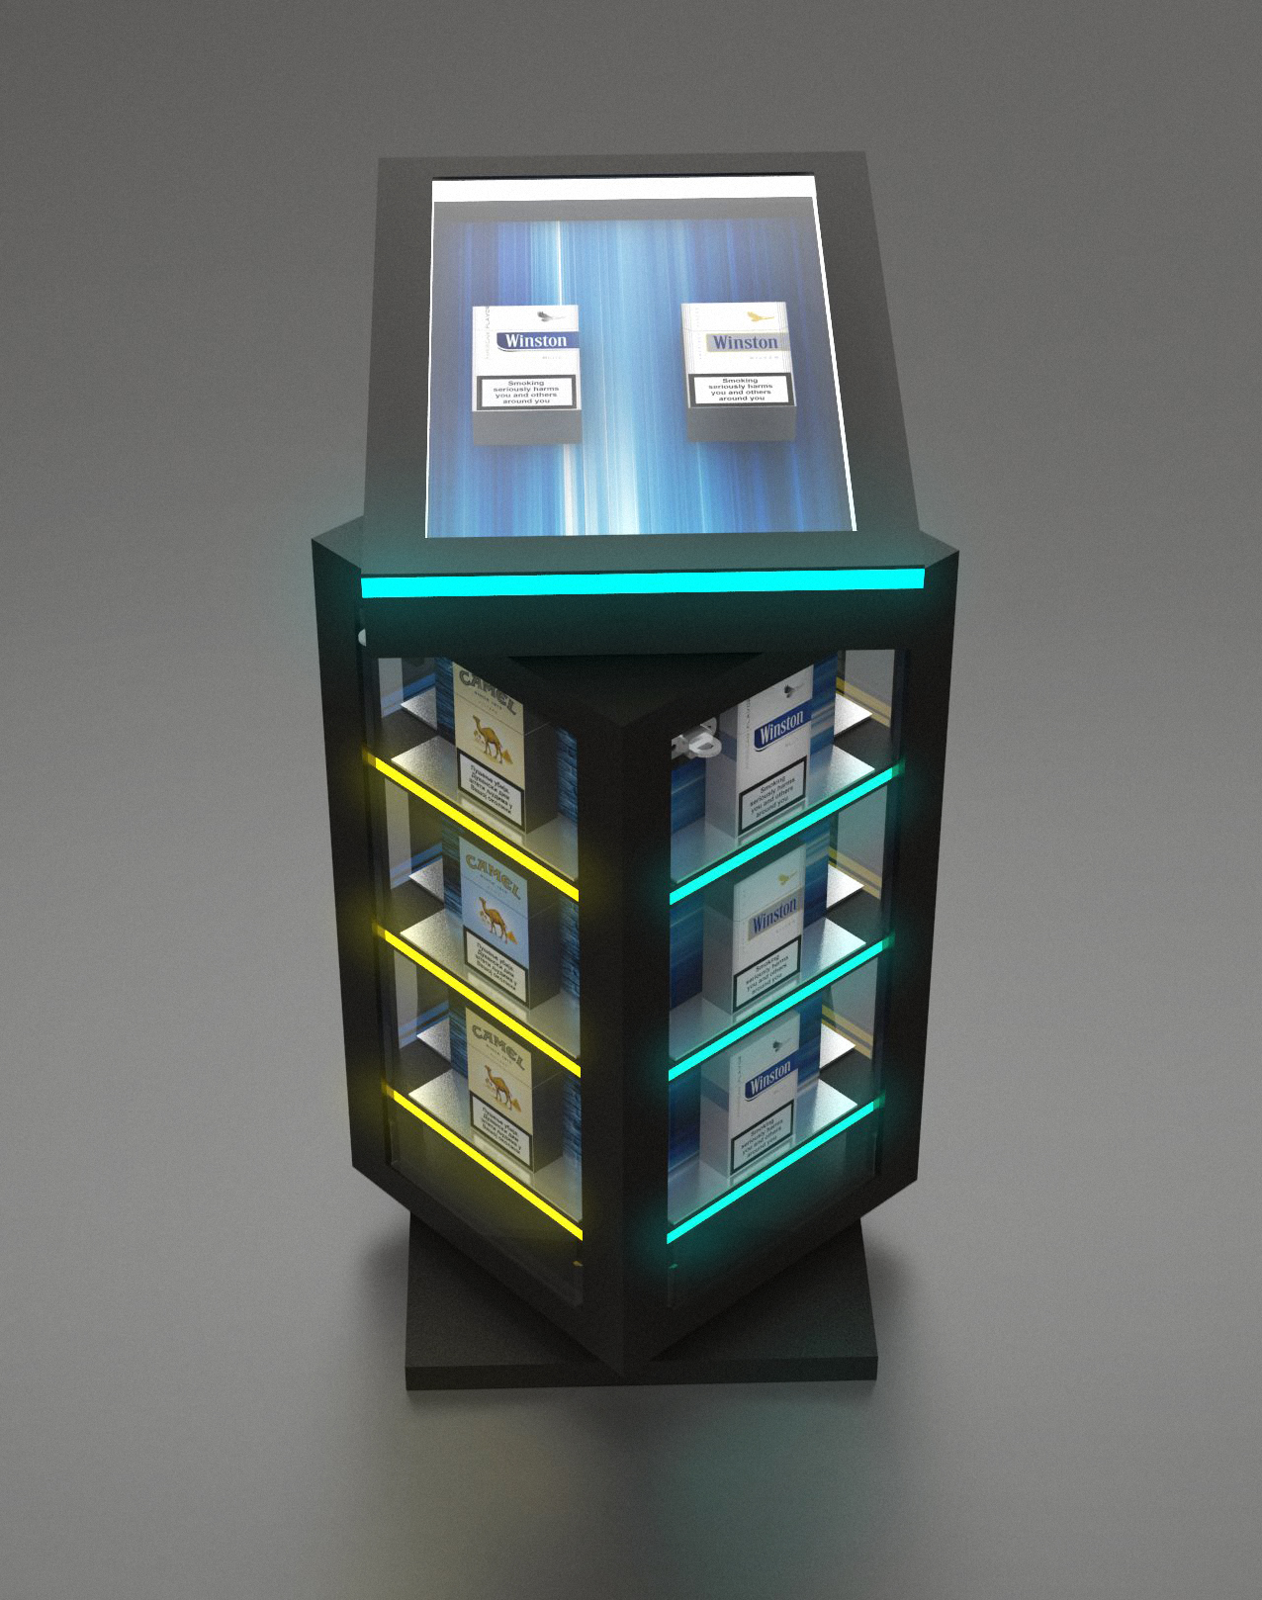
PROJECT
ROTATING COUNTER UNIT – HUNGARY
Retailer
Wide Retail Network
Year
2018
Description
Counter unit with rotating display.
Materials
Metal, Acrylic, RGB lights
Dimensions
W230xH570xD235

Slide 52
6. SUPPORT
TEAM

Slide 53




CONTACT US – TELL US ABOUT YOUR PROJECT
Nikola Elezović
nikola.elezovic@bgreklam.com
+381 64 221 0 633
Director of Commercial Operations
English speaking
Dino Ramić
dino.ramic@bgreklam.com
+49 160 919 3878
Business Development Manager
DACH Region
German & English speaking
Nenad Klarić
nenad.klaric@bgreklam.com
+381 60 68 69 144
+49 151 52 559 046
Key Account Manager
DACH Region
German & English speaking
Jacqueline Eli
jacqueline.eli@bgreklam.com
+49 177 58 953 58
Key Account Manager
DACH Region
German & English & French speaking

Slide 54




CONTACT US – TELL US ABOUT YOUR PROJECT
Milan Bajić
milan.bajic@bgreklam.com
+381 60 68 69 127
Senior Key Account Manager
Nordics, BeNeLux & France region
English & French speaking
Nemanja Stančić
nemanja.stancic@bgreklam.com
+381 60 68 69 136
Key Account Manager
UK, Ireland & Central Europe
English & Russian speaking
Sandra Ratković
sandra.ratkovic@bgreklam.com
+381 60 68 69 143
+49 151 53 31 2634
Key Account Manager
Adria & DACH Region
German & English speaking
Dimitrije Božić
dimitrije.bozic@bgreklam.com
+381 60 68 69 137
Junior Key Account Manager
Adria Region
English & German speaking

