Slide 2
TABLE OF CONTENTS
OVERVIEW
BG REKLAM – ABOUT US
BENEFITS OF WORKING WITH US
4. CSR
PROJECTS
SUPPORT TEAM – CONTACT US

Slide 3
OVERVIEW

Slide 4
OVERVIEW
Welcome to our PRODUCT CATALOGUE !
This interactive product collection will provide you product information at the touch of the click.
It will provide you benefit insights, which you as our partner have from cooperation with us.
We are delivering exceptional experience for shoppers at physical retail (point – of – sale); products – per your request or special needs.
For more detailed product information, please contact our support team (your dedicated account manager) or contact us at Premium POS solutions for retail from concept to store (bgreklam.com).

Slide 5
ABOUT US

Slide 6
BG REKLAM – ABOUT US
We are professionals in production of premium POSM solutions.
BG Reklam creates outstanding various POSM that support in – store activation and drive sales at the point – of – sale of our clients for more than 20 years.
We are specialised in all areas, from Design & Concept Solutions, Innovations, through Engineering, to Development & Production of tailored POSM solutions. We are completing the entire process under one roof.
Our partner companies on local markets provide excellent Installation and Maintenance services.

Slide 7




Slide 8



Slide 9


OUR OFFICES
2001
2017
2018
BG REKLAM (Headquarters)
29. Novembra 1M 11460 Belgrade, Serbia
+38111 785 64 64
+381 60 68 69 110
BG REKLAM GmbH
LeverkusenstraBe 3
22761 Hamburg, Germany
+ 49 40 8541 3003
BG REKLAM UK Ltd
1st Floor, Artist House 35 Little Russell Street London, WClA 2НН, UK
+44 20 3290 6345
BG REKLAM
SERBIA (HQ)
BG REKLAM
UNITED KINGDOM
BG REKLAM
GERMANY
Hamburg
London
Belgrade

Slide 10
BENEFITS OF WORKING WITH US

Slide 11
BENEFITS OF WORKING WITH US
Today more than ever, especially during COVID-19 pandemic, in order to achieve goals and proceed all projects on time and efficiently, every company need to have a reliable business partner.
We are dedicated, creative and have experience in developing premium POSM solutions on your request, based on your needs. We are agile and we have experience working in tobacco category.
We are reliable partner for the outstanding tailored sustainable POSM solutions.
We are supporting you to get through extremely busy time at work.
We care for your growth.

Slide 12
WE ARE PARTNERS
PREMIUM PRODUCTS
Increasing brands’ image and sales through premium POSM solutions.
ACCOUNT MANAGEMENT
Highly experienced and multilingual sales team, with presence on all the markets where we operate.
BENEFITS
PROJECT MANAGEMENT
One Stop Shop – full project management support with one single point of contact. From design and concept solutions to installations and maintenance.
KNOW HOW
20 years of expertise in industry. 100k+ POSM units produced in cooperation with more than 50 international clients.
CREATE VALUE FOR OUR CLIENTS
MONETARY
High product quality and service at competitive prices.
SAVINGS
TIME
Lead time is 5 weeks* – from briefing to product delivery.
ENERGY
One Stop Shop, plus efficient communication and fast responsiveness.

Slide 13

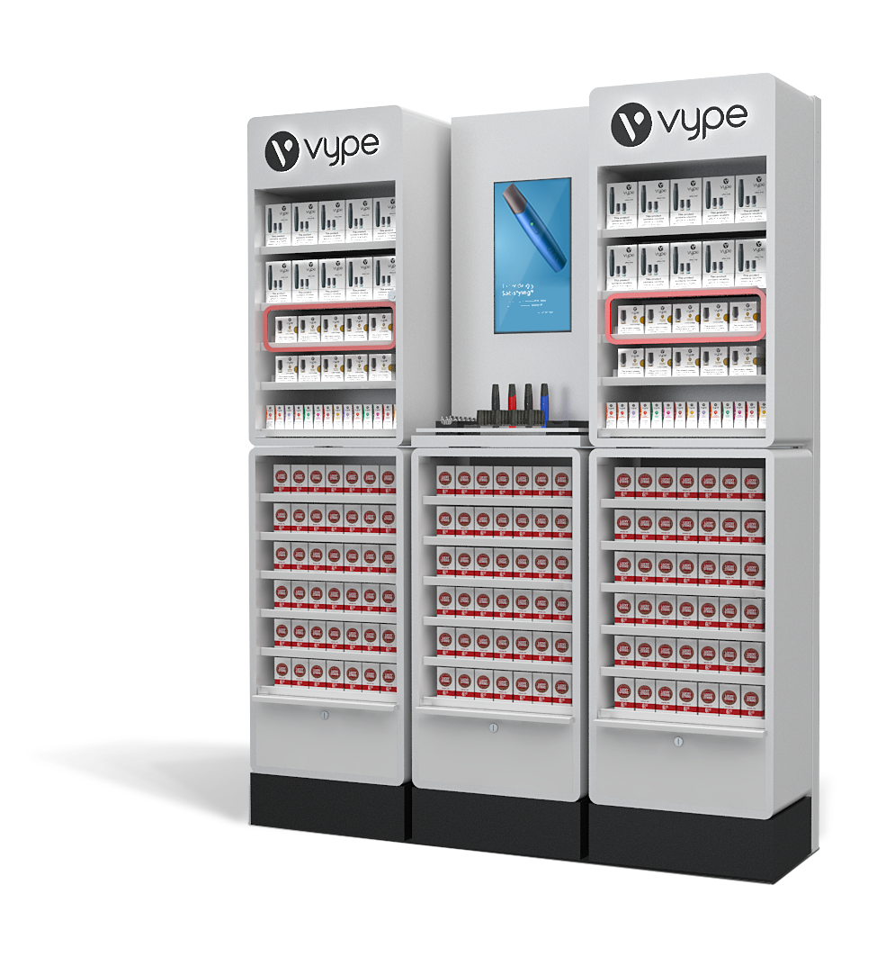


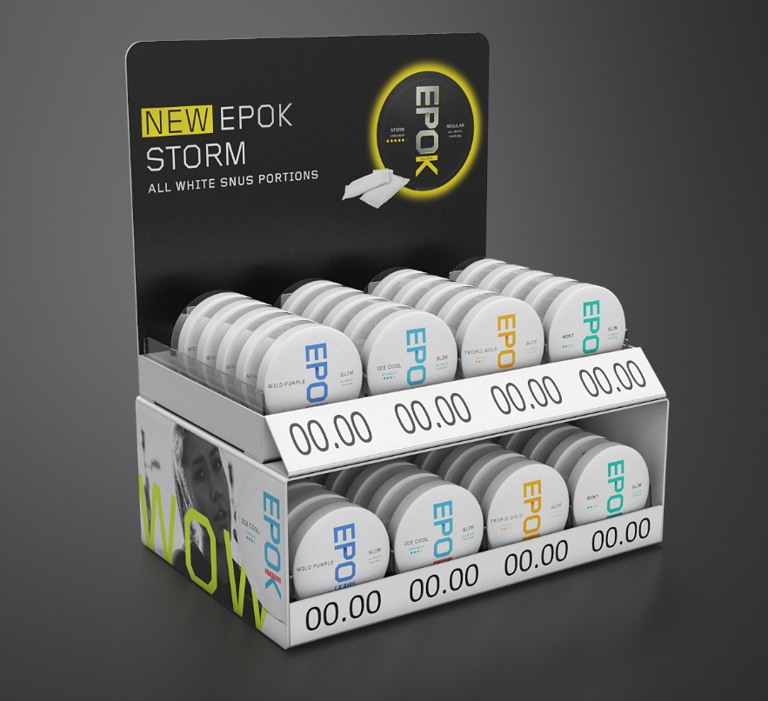
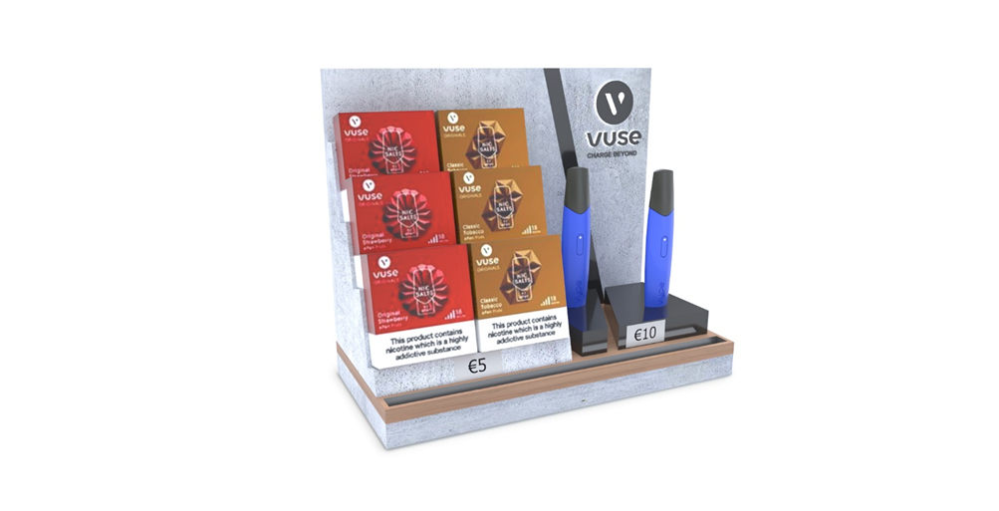
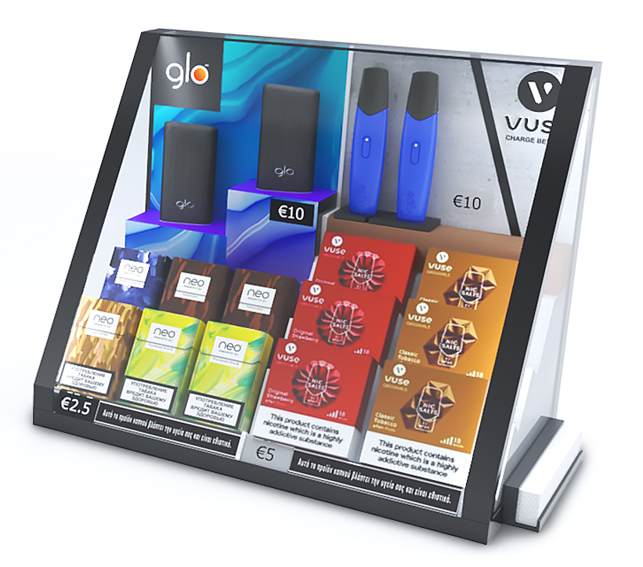
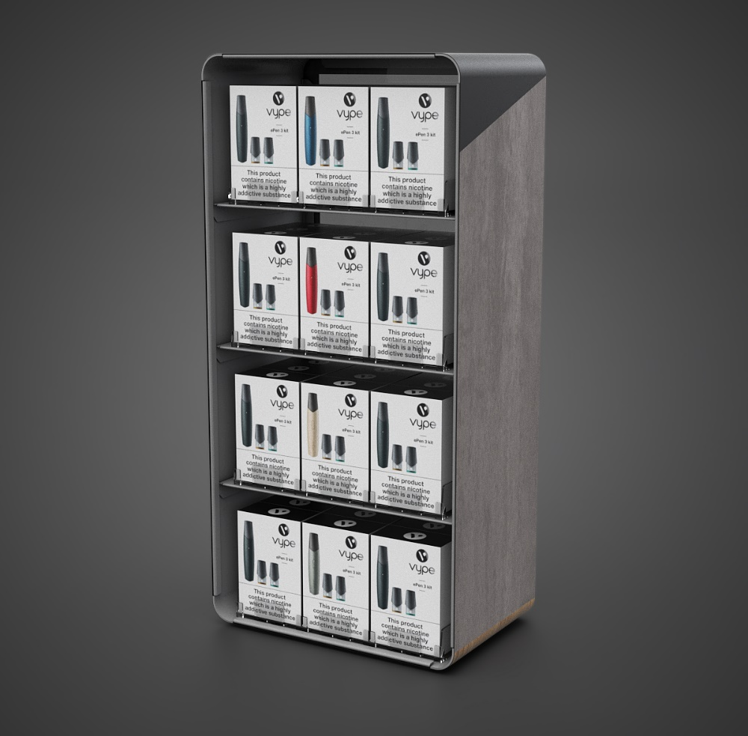
BAT & BG REKLAM
We are pleased to cooperate more than 17 years.
We are happy to cover 24 markets where BAT has operations.
Our exclusive & unique designs and specific materials are used to emphasize and tell a BAT story of product quality at POS.
All our intentions are driven by a customer centric approach in order to improve customer experience at POS.
We are proud that we together developed more than 35.000 pcs POSM solutions.

Slide 14
CORPORATE SOCIAL RESPONSIBILITY

Slide 15
OUR PROMISES
As a socially responsible company, we committed to our four stakeholders the following:
EMPLOYEES – We are committed to providing a safe and secure working environment for all employees. We believe that: innovation, honesty and doing the right thing approach is a basis of everything we do.
CLIENTS – Our clients deserve outstanding products and services. Every single day, we strive with passion to meet our clients' demands.
ENVIRONMENT – We are committed to run a sustainable business. Our aim is to: 1. use eco-friendly materials (such as wood, metal, PET sheets, corrugated cardboard), 2. use recycled products; 3. create social initiatives.
COMMUNITY – We are continuously trying to be part of various socially responsible projects, to involve local marginalised groups in our supplier chain, as well to encourage our employees to volunteering in their local community.

Slide 16
BETTER TOMORROW THROUGH SUSTAINABILITY COMMITMENT
Our sustainability initiatives:
Reducing environmental impact
Using energy more efficiently
Reducing packaging waste
Using recyclable and reusable materials
Reducing carbon footprint by optimising our production process and technology
Please check our sustainability video: https://vimeo.com/474723155/579f192891

Slide 17
ENVIRONMENATLLY RESPONSIBLE BEHAVIOUR
Every day we are actively and continuously work to:
REDUCE – scrap and energy consumption. Our business is focused and completely aligned with certifications ISO 20400 and 26000.
REUSE – our aim is to produce re-brandable and multi usage products (allows easily changeable communication)
RECYCLE – use of fully recyclable materials. Our special attention in production is in line with lifecycle thinking approach (all used materials can be easily splited at the end of the production lifecycle).

Slide 18
WE ARE USING LATEST TECHNOLOGY IN PRODUCTION PROCESS
By careful selection of materials and machines in our production process we are managing to reduce carbon footprint.
Based on your request we can deliver eco-friendly materials and outstanding sustainable POSM solutions.

Slide 19



Slide 20







CERTIFICATIONS
Our accreditations prove our commitment to sustainability. We have:
QUALITY
MANAGEMENT
ENVIRONMENTAL
MANEGEMENT
HEALTH AND SAFETY
MANAGEMENT
SUSTAINABLE PROCUREMENT
SOCIAL
RESPONSIBILITY

Slide 21
PROJECTS

Slide 22
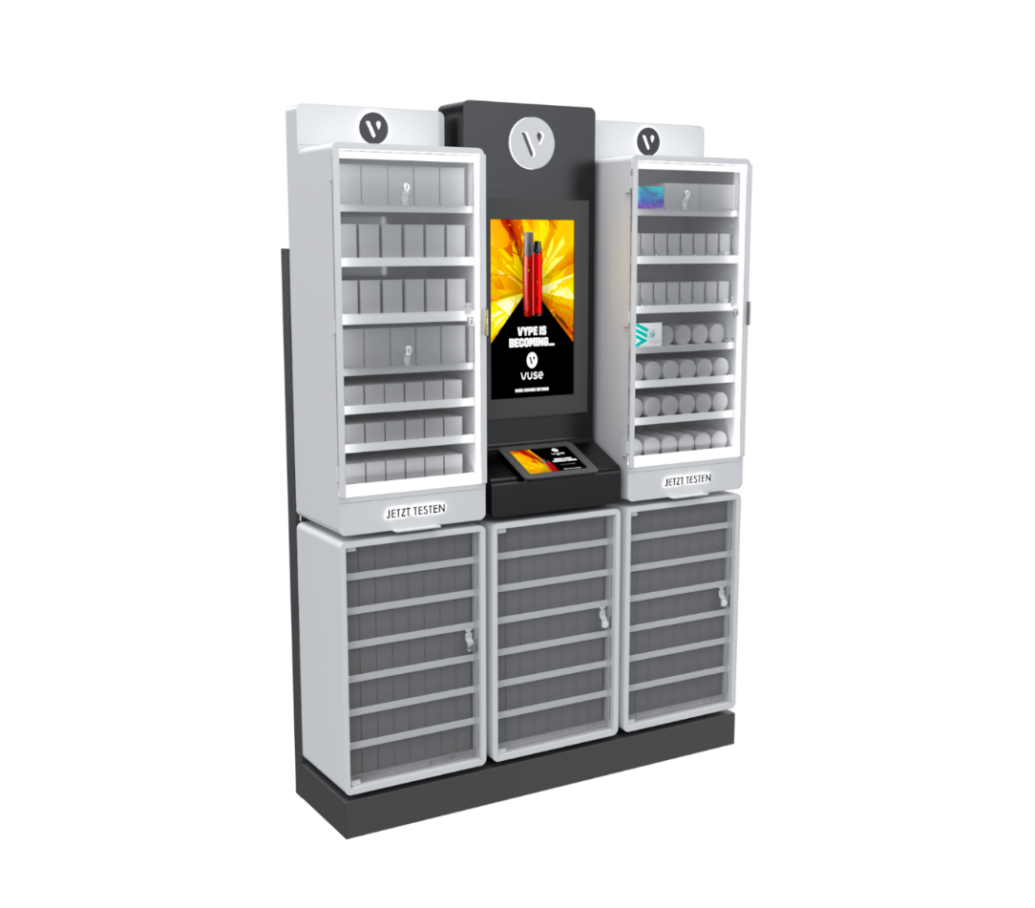
PROJECTS – POSM SOLUTIONS
Project
Clooney (Vype Backwall unit)
Markets
Germany & France
Retailer
HES, Vape Stores
Year
2019 – 2020
Description
Having six individual modules, this Backwall unit is highly adaptable to any space available. Each module plays a different part from storing different types of alternative nicotine products, to a testing module with a large central screen for client education.
This project is one of the largest electronic cigarette POS projects in Europe in 2019 and 2020.
Materials
Metal, Aluminium frames, LED, Tension Fabric, Video screens
Vype (bat) (vimeo.com)
* 5 weeks lead time on average (from briefing to final product delivery) depending on the project complexity.

Slide 23
VYPE BACKWALL TASTING UNIT (vertical screen)
Illuminated logo
Illuminated shelves adjustable by height
Optional shelf highlighter
19” video screen
Lockable glass doors
Exchangeable tasting zone
Additional storage locked drawers

Slide 24
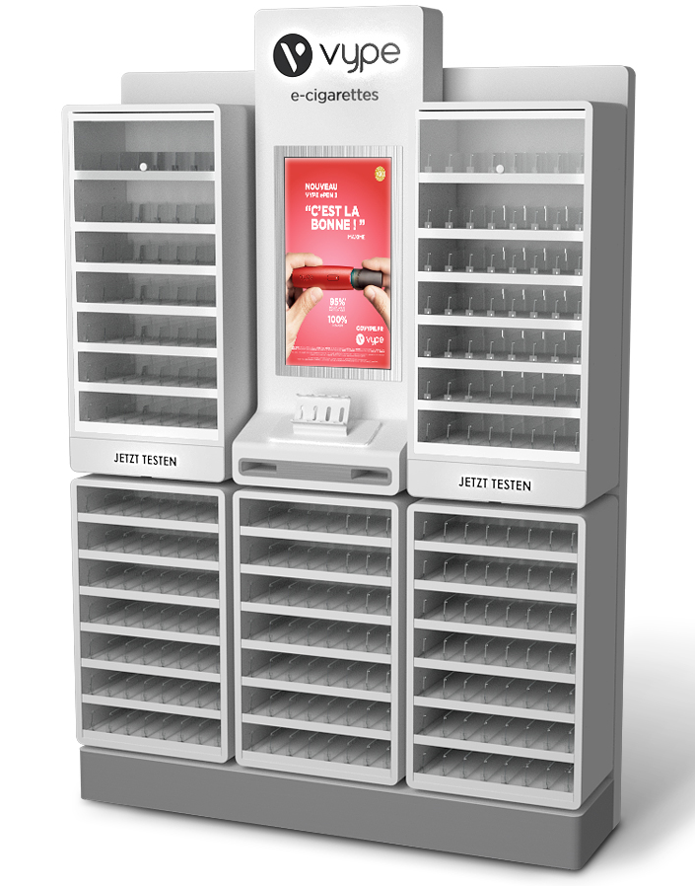
VYPE BACKWALL TASTING UNIT (horizontal screen)
Illuminated logo on central module
Illuminated shelves adjustable by height
Optional shelf highlighter
23” video screen
Lockable glass doors
2 drawers containing tasting units & liquids
Leaflet holders
Illuminated lower modules

Slide 25
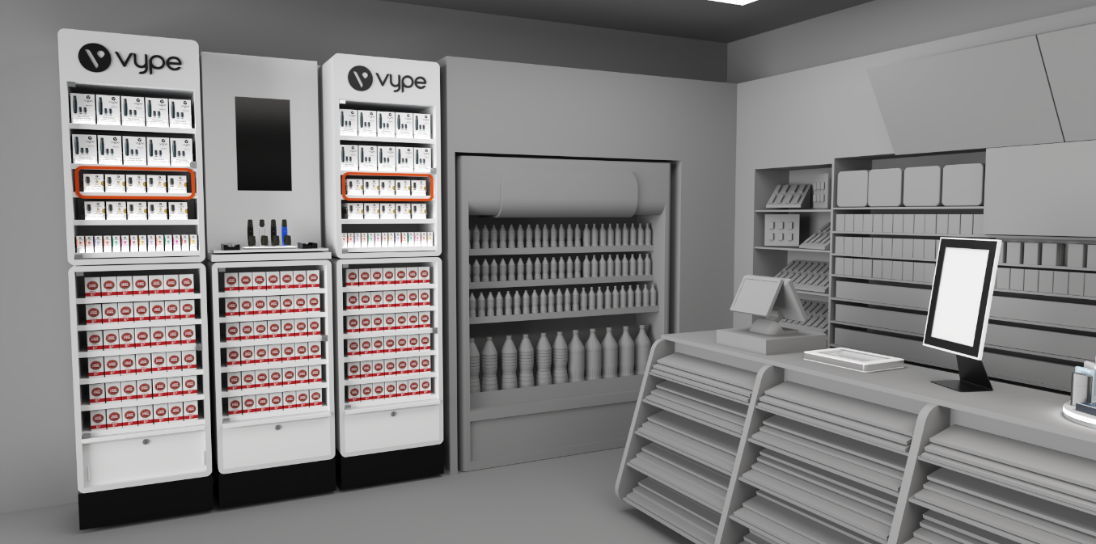
VR STORE

Slide 26
PROJECTS – POSM SOLUTIONS
Project
Compass OT Dispenser
Market
Germany
Retailer
Valora
Year
2021
Description
Multifunctional, easy changeable modular OTC dispenser with possibility to combine SKUs.
The upper and lower parts can be separated quickly and easily at the point – of – sale.
Materials
Acrylic (transparent and white), Sheet metal, Magnetic Foil
* 5 weeks lead time on average (from briefing to final product delivery) depending on the project complexity.

Slide 27
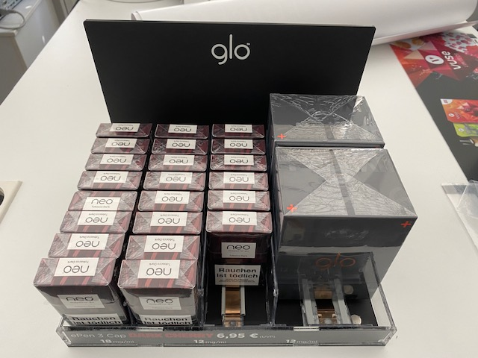
PROJECTS – POSM SOLUTIONS
Project
Glo Balcony
Market
Germany
Retailer
Local tender
Year
2020
Description
Modular and multifunctional display with possibility to combine SKUs.
Small topper, very adaptable even for very small point – of – sales.
Materials
Acrylic (black matt and transparent), Magnets, Push Feed System
* 5 weeks lead time on average (from briefing to final product delivery) depending on the project complexity.

Slide 28
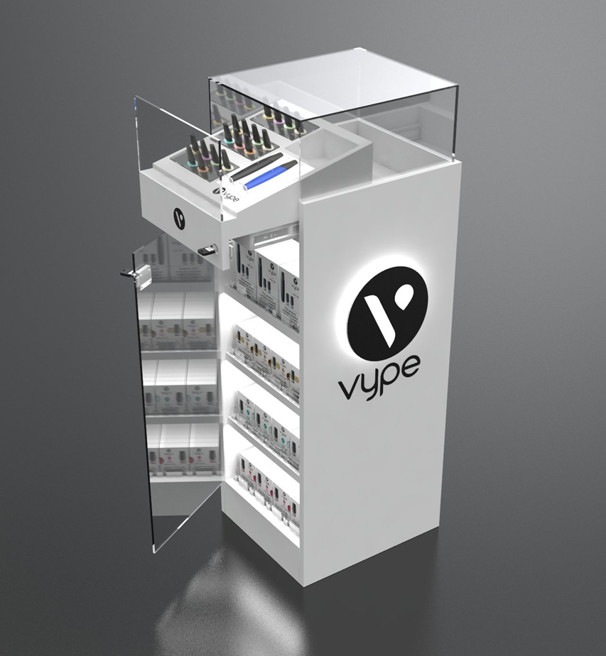
PROJECTS – POSM SOLUTIONS
Project
Vype Vitrine (sample)
Market
France
Retailer
-
Year
2019
Description
Vitrine is illuminated. Construction is made of the whited painted MDF, with lockable drawers for product presentation and lockable storage for Epens and capsules.
There are:
1) 4 facings for capsules – each facing has a depth for 18 – 20 packs; 2) 3 facings for Epens devices – each facing has a depth for 5 – 6 packs.
Materials
Wood, Glass, Acrylic
* 5 weeks lead time on average (from briefing to final product delivery) depending on the project complexity.

Slide 29
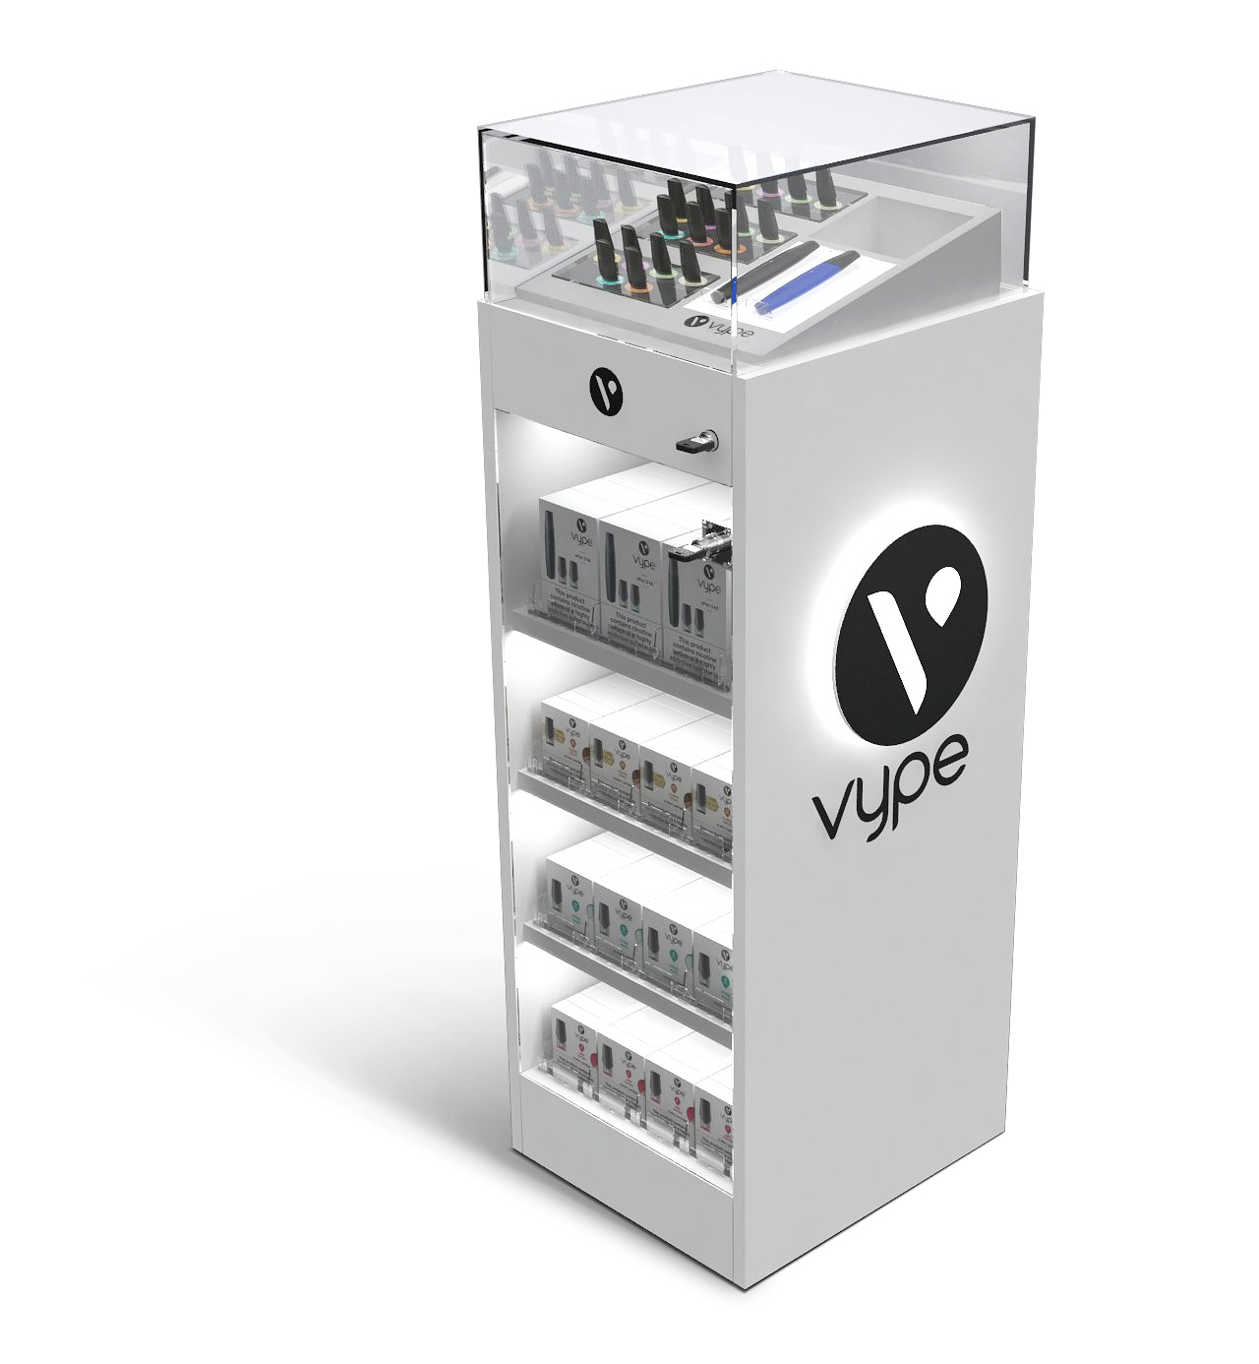
VYPE VITRINE
Tempered glass top
Tasting area, illuminated
Extendible drawer with guide rails
Tempered glass doors (lockable)
Illuminated logo
Illuminated shelves

Slide 30
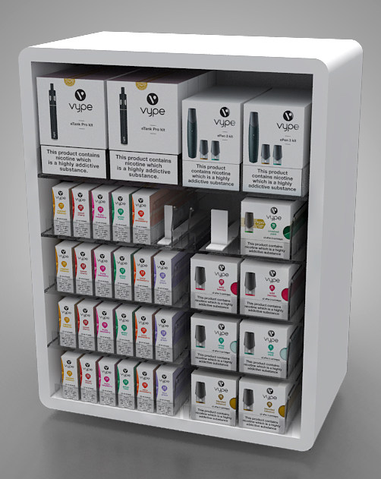
PROJECTS – POSM SOLUTIONS
Project
Box on Counter
Market
Belgium
Retailer
HoReCa
Year
2020
Description
On counter display with 16 SKU’s placement and stock for products. Illuminated products from the front side with lock on the retailer end for securing the products from theft.
Materials
Wood, Acrylic, Glass, LEDs
* 5 weeks lead time on average (from briefing to final product delivery) depending on the project complexity.

Slide 31
PROJECTS – POSM SOLUTIONS
Project
Drawer Display
Market
Belgium
Retailer
Tobacconist
Year
2020
Description
On counter display with 16 SKU’s placement and stock for products. Easily replaceable print on the display for new launches.
Flexible product presentation inside the display, with open access for selling on retailer’s side.
Materials
Sheet metal, Acrylic, Magnetic Foil
https://vimeo.com/500386089/02931e99aa
* 5 weeks lead time on average (from briefing to final product delivery) depending on the project complexity.

Slide 32
PROJECTS – POSM SOLUTIONS
Project
Psilika Display (GLO Hyper Launch)
Market
Greece
Retailer
Wide Grocery Network
Year
2021
Description
Multibrand display for wide network of grocery stores and HoReCa across Greece.
It is intended for Vuse and Glo devices and their sticks.
Visual communication (print) is completely changeable.
Materials
Acrylic, Metal, Illuminated
https://vimeo.com/518558092/9840e57eab
* 5 weeks lead time on average (from briefing to final product delivery) depending on the project complexity.

Slide 33
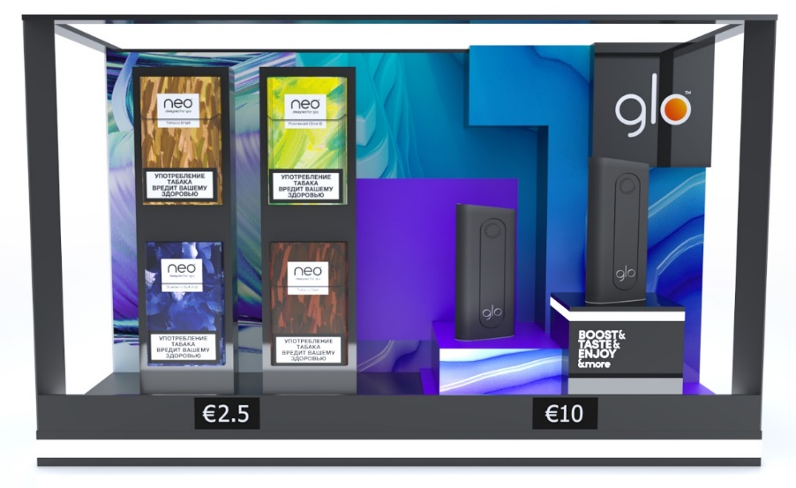
PROJECTS – POSM SOLUTIONS
Project
Nobacco Display (GLO Hyper Launch)
Market
Greece
Retailer
Tobacco Store Chain
Year
2021
Description
Nobacco displays are comprised of two independent units – one for Vuse, another for GLO.
They can be used together or separately depending on the space in Nobacco POS.
Materials
Acrylic, Metal, Illuminated
* 5 weeks lead time on average (from briefing to final product delivery) depending on the project complexity.

Slide 34
SUPPORT
TEAM

Slide 35




CONTACT US – TELL US ABOUT YOUR PROJECT
Nikola Elezović
nikola.elezovic@bgreklam.com
+381 64 221 0 633
Director of Commercial Operations
English speaking
Dino Ramić
dino.ramic@bgreklam.com
+49 160 919 3878
Business Development Manager
DACH Region
German & English speaking
Nenad Klarić
nenad.klaric@bgreklam.com
+381 60 68 69 144
+49 151 52 559 046
Key Account Manager
DACH Region
German & English speaking
Jacqueline Eli
jacqueline.eli@bgreklam.com
+49 177 58 953 58
Key Account Manager
DACH Region
German & English & French speaking

Slide 36




CONTACT US – TELL US ABOUT YOUR PROJECT
Milan Bajić
milan.bajic@bgreklam.com
+381 60 68 69 127
Senior Key Account Manager
Nordics, BeNeLux & France region
English & French speaking
Nemanja Stančić
nemanja.stancic@bgreklam.com
+381 60 68 69 136
Key Account Manager
UK, Ireland & Central Europe
English & Russian speaking
Sandra Ratković
sandra.ratkovic@bgreklam.com
+381 60 68 69 143
+49 151 53 31 2634
Key Account Manager
Adria & DACH Region
German & English speaking
Dimitrije Božić
dimitrije.bozic@bgreklam.com
+381 60 68 69 137
Junior Key Account Manager
Adria Region
English & German speaking

