Slide 2
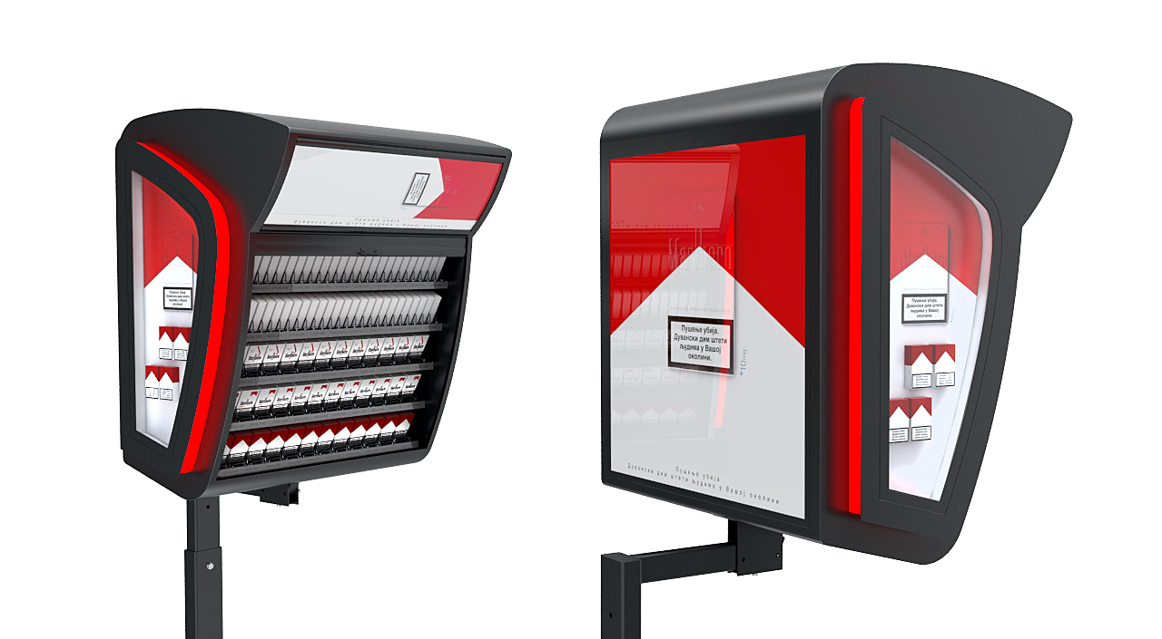
PMI COU rebrending

Slide 3
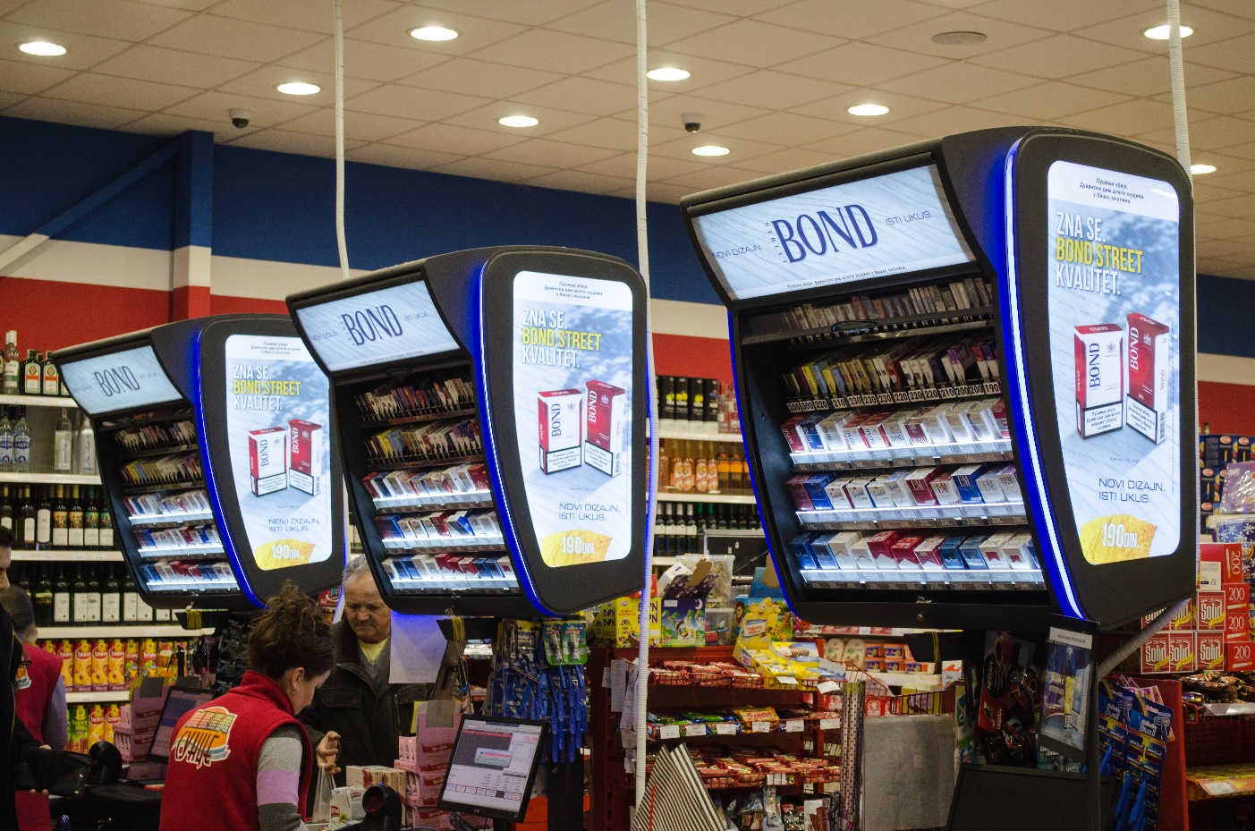
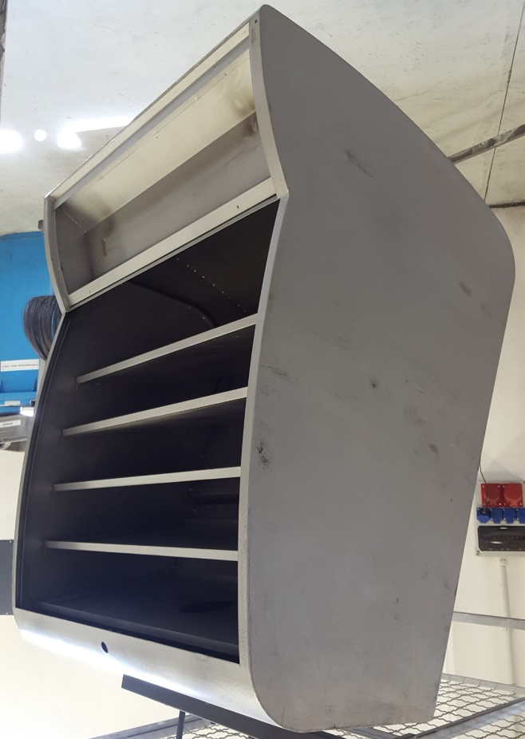
PMI COU rebrending

Slide 4
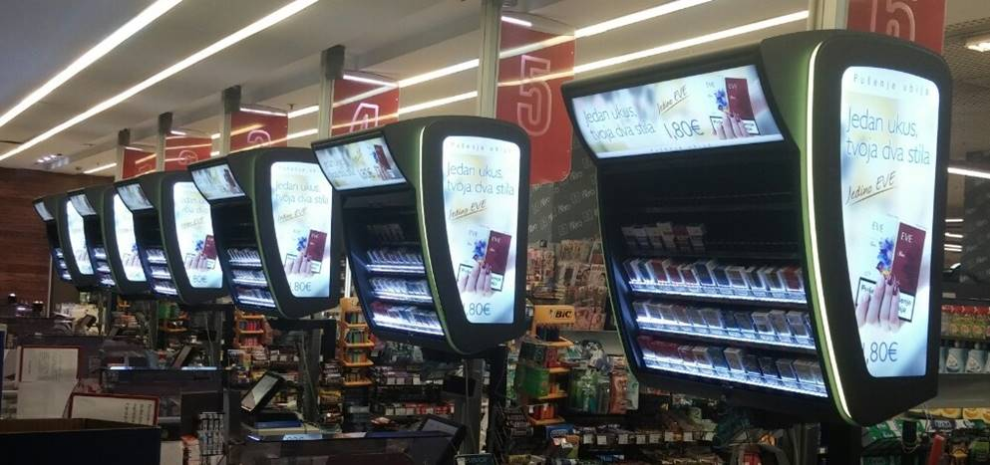
PMI COU rebrending

Slide 5
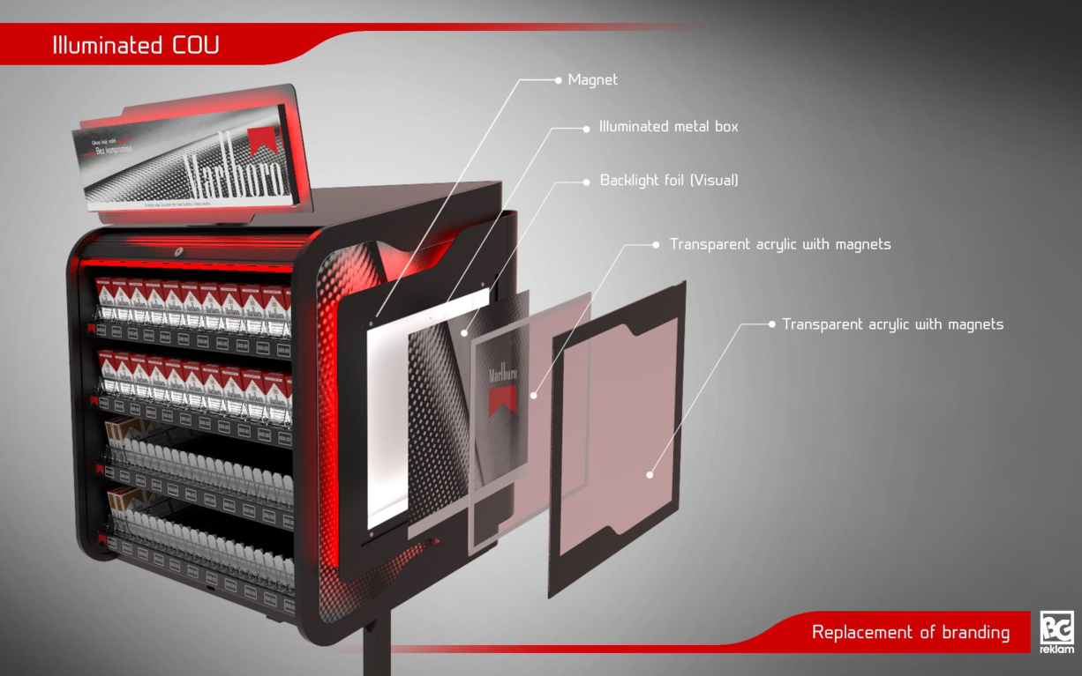
PMTKP Macedonia COU

Slide 6
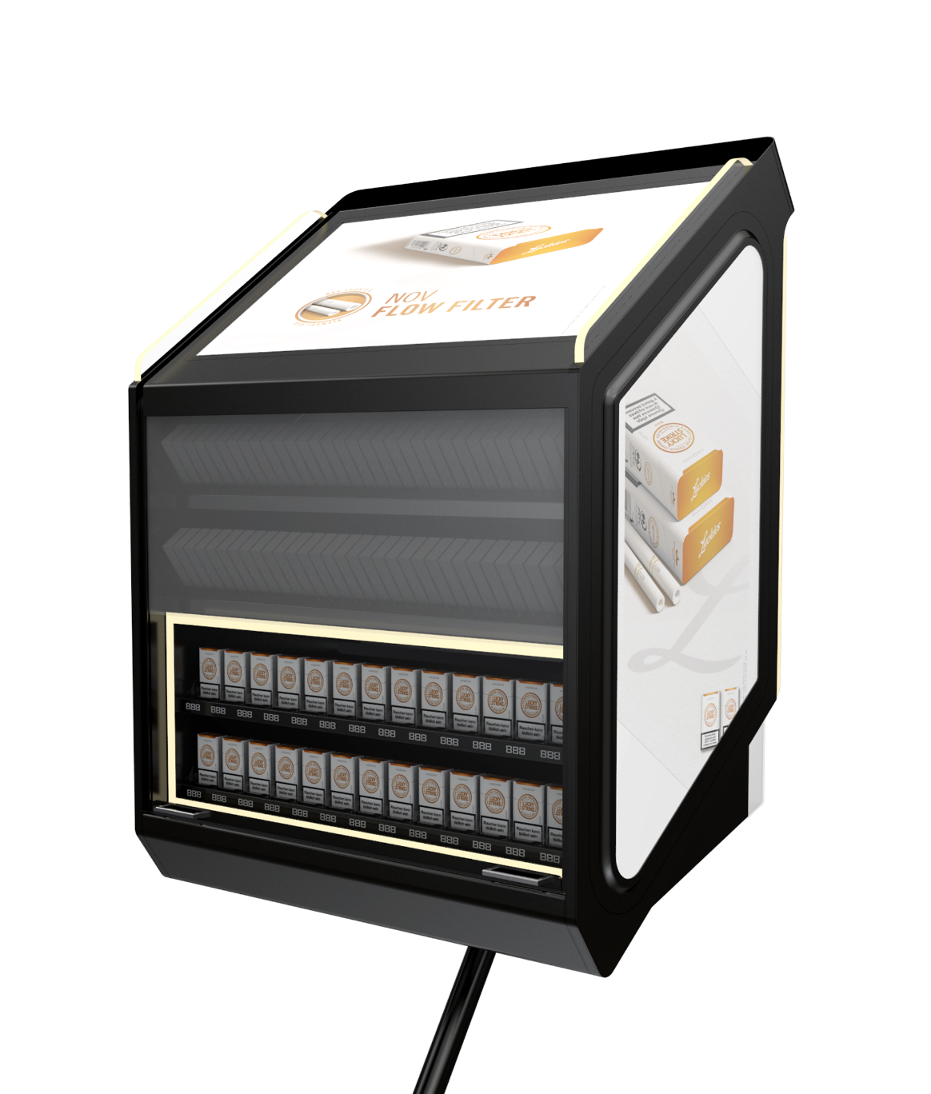
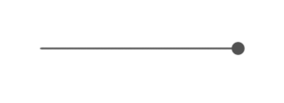
Overhead units
Powder coated heavy duty sheet metal casing
Illuminated crystal box
Lead time: | 4 weeks for 200 pcs
Quantity: | 200 + 600 pcs
Countries: | Serbia, Bulgaria, Czech Republic
Description: | Premium OHD unit and Resized Unit
Back-light foil (visual)
Transparent acrylic with magnets
Aluminium sides

Slide 7
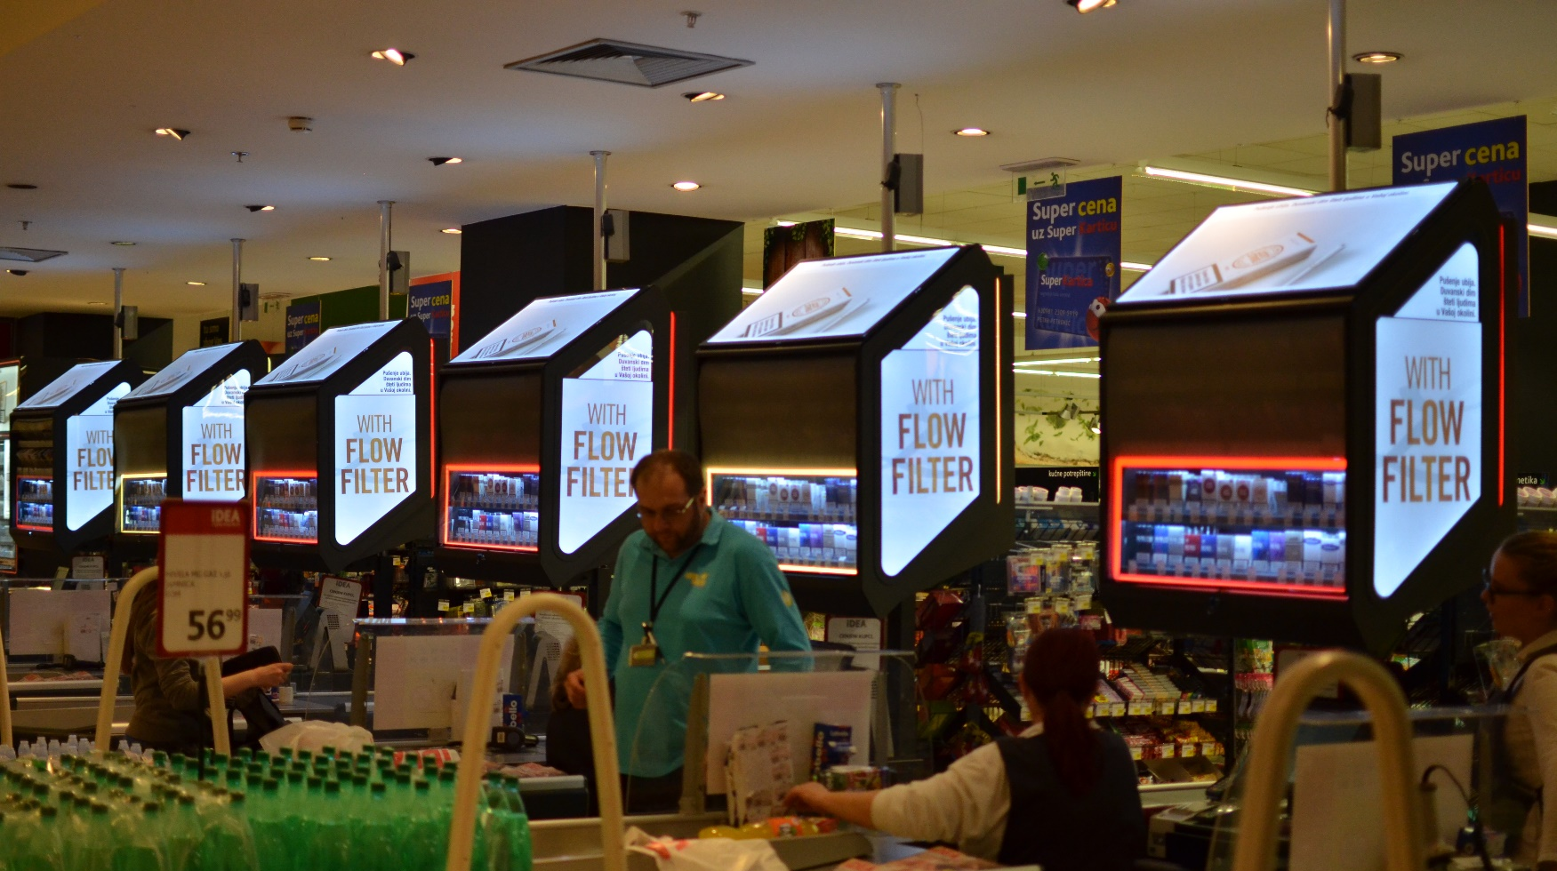
Product in store

Slide 8
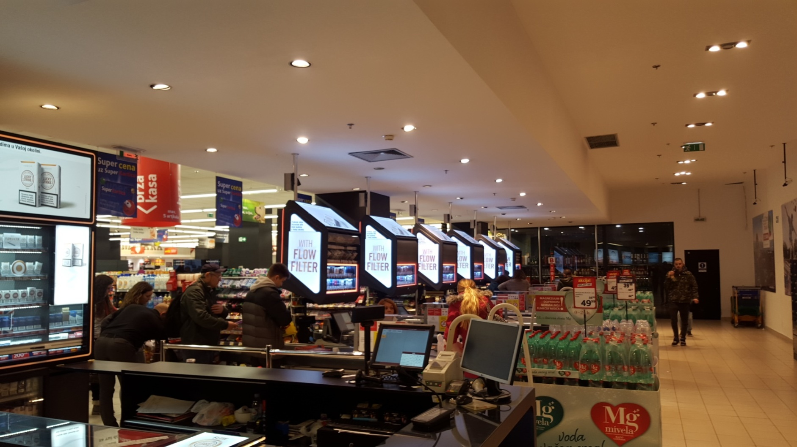
Product in store

Slide 9
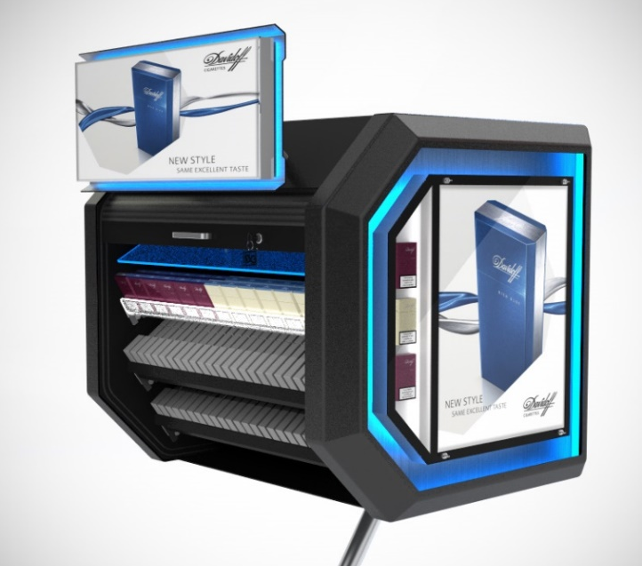
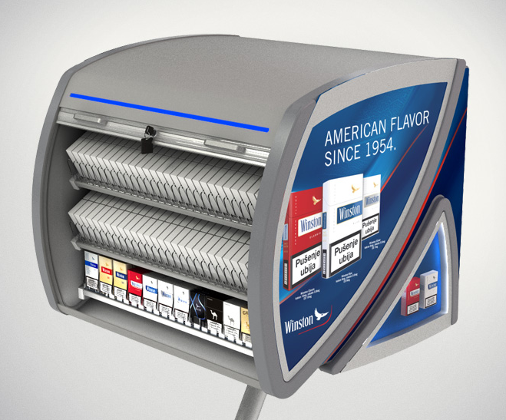
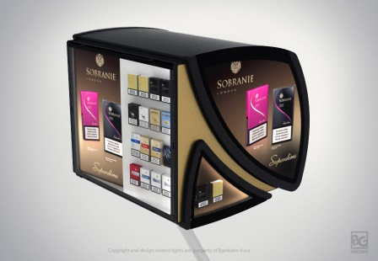
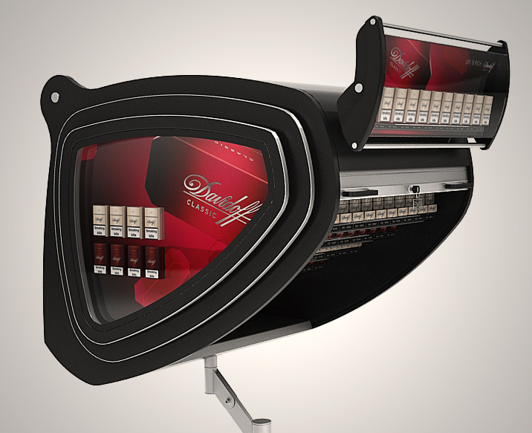
Overhead units

Slide 10
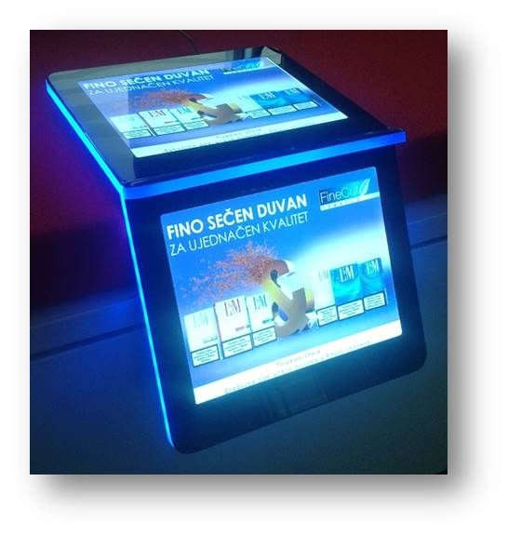
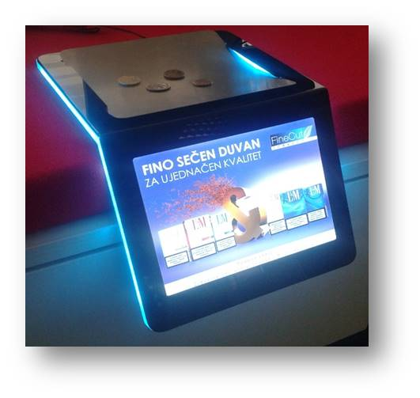
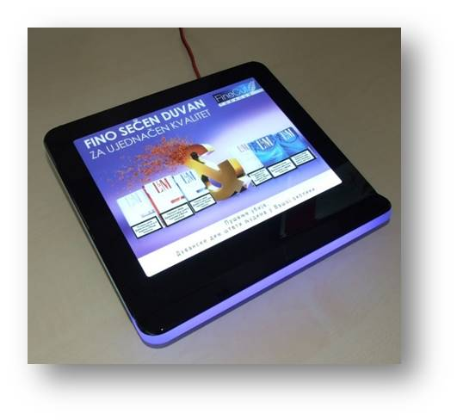
Cash trays

Slide 11
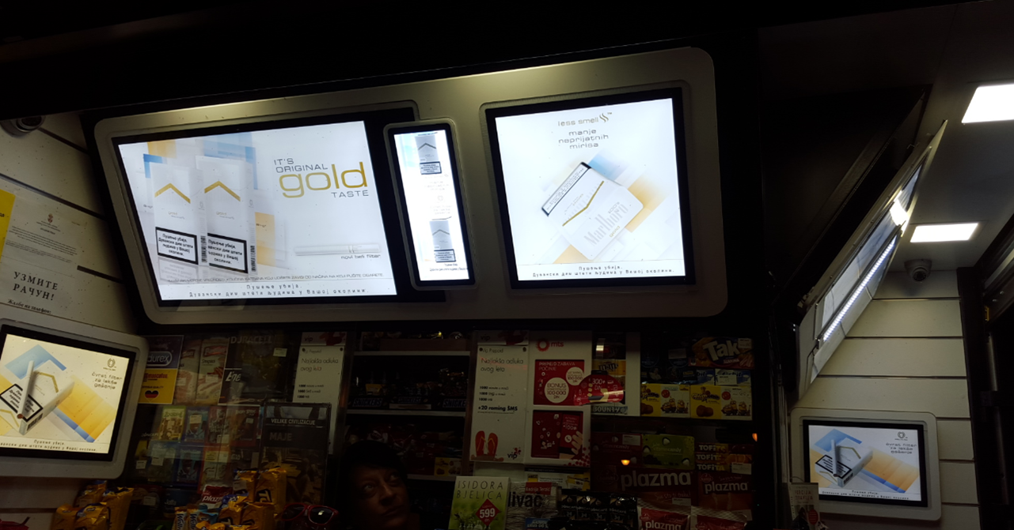
Modulex Unit for kiosk

Slide 12
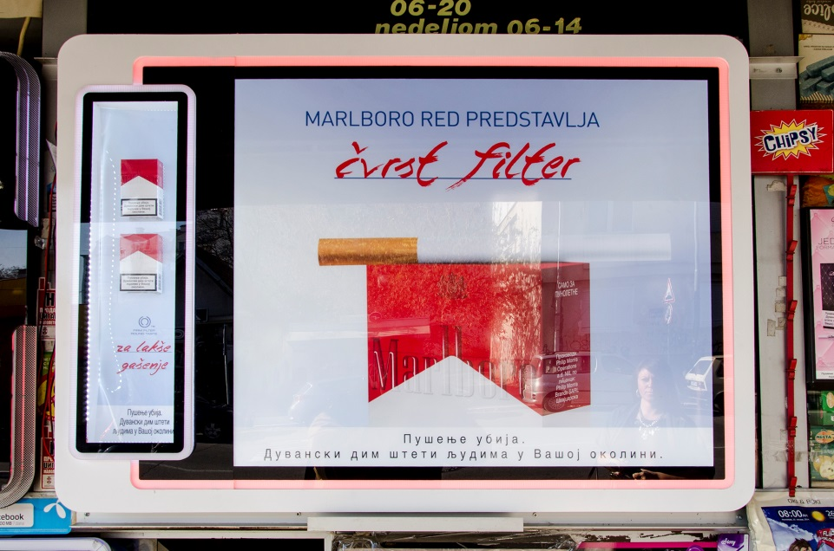
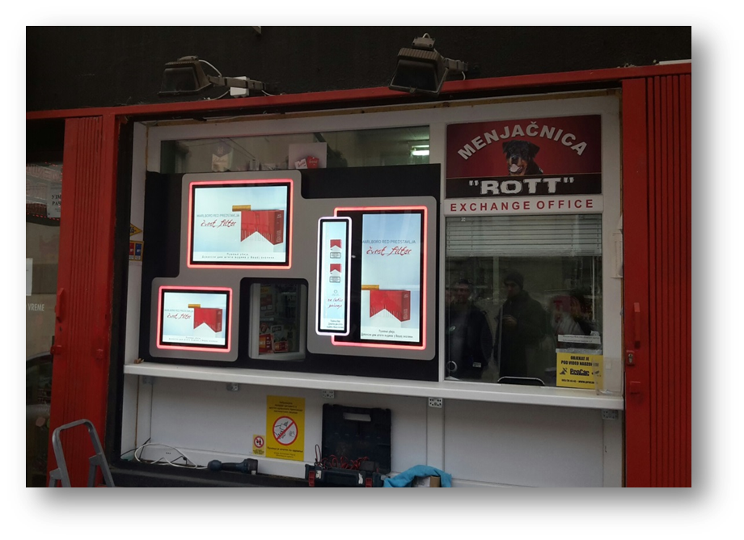
Modulex Unit for kiosk

Slide 13
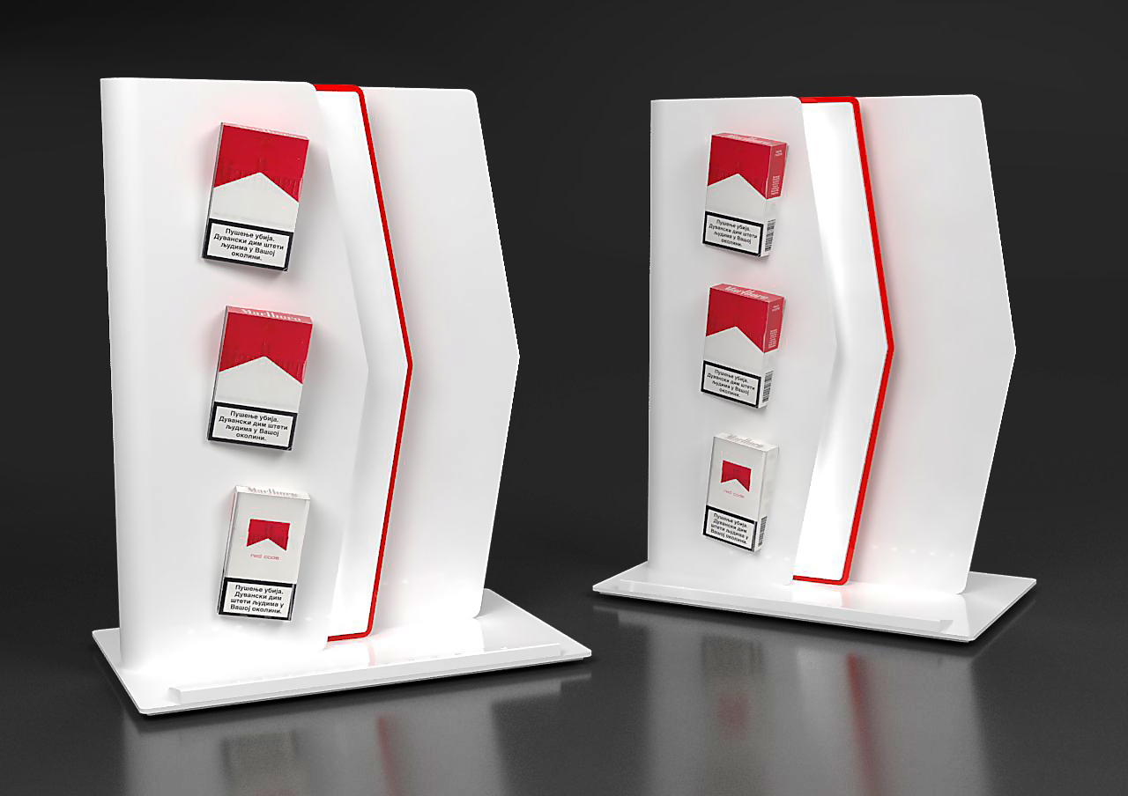
BG reklam for PMI

Slide 14
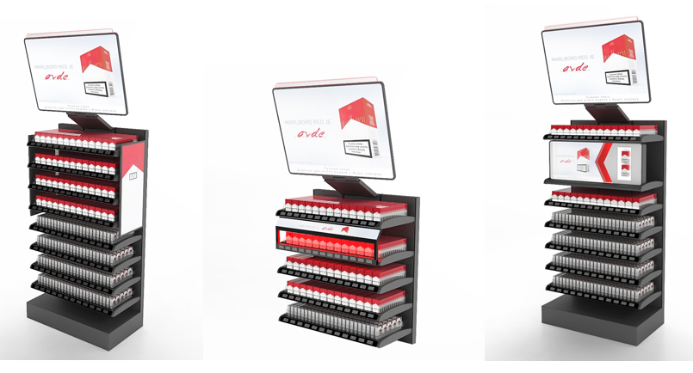
BG reklam for PMI

Slide 15
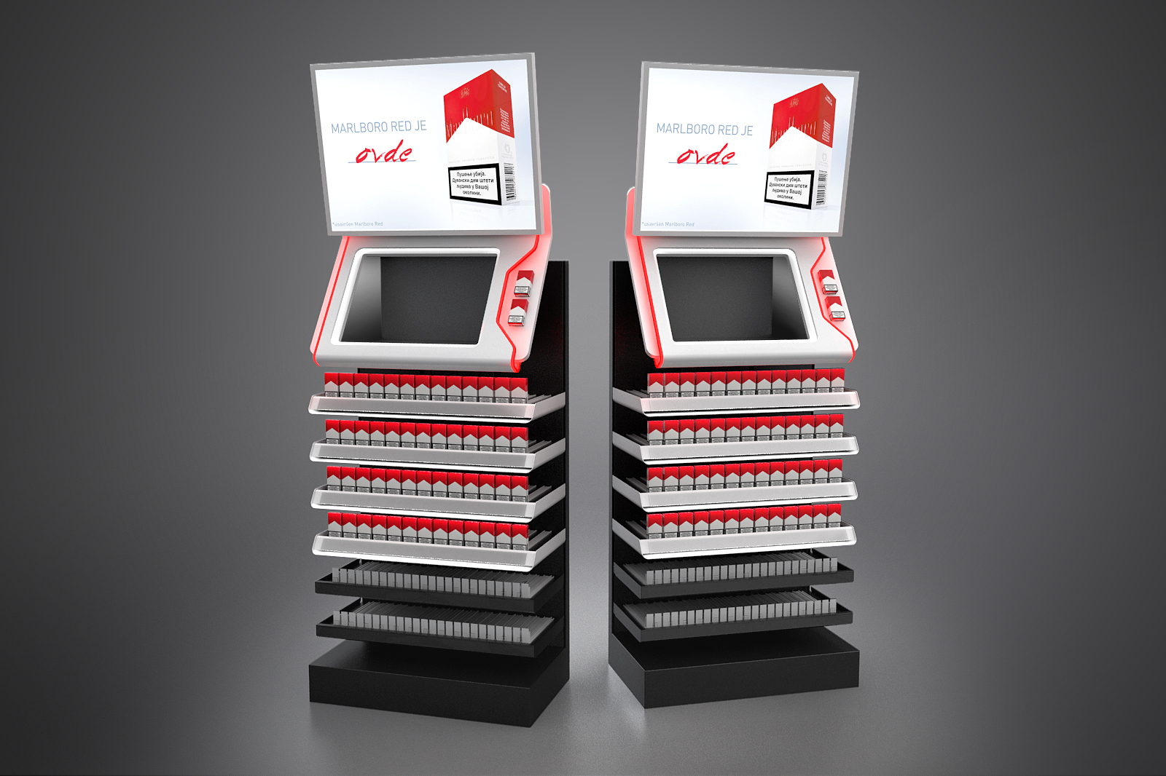
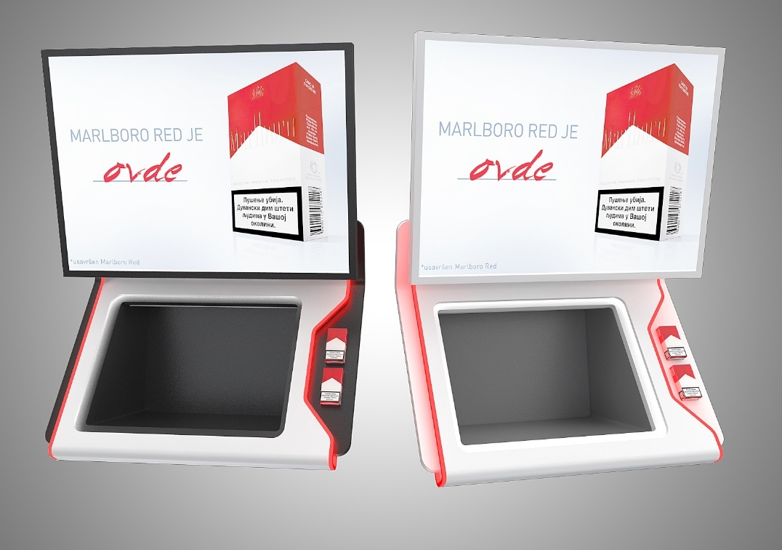
BG reklam for PMI

Slide 16
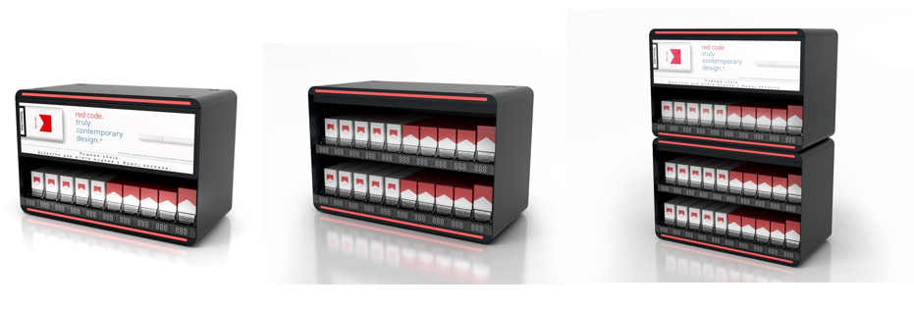
Basic Modular Unit

Slide 17
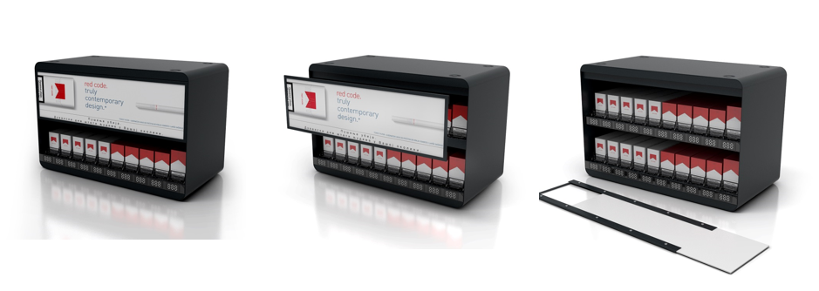
Basic Modular Unit
74 €/per module without light with pushers and dividers

Slide 18
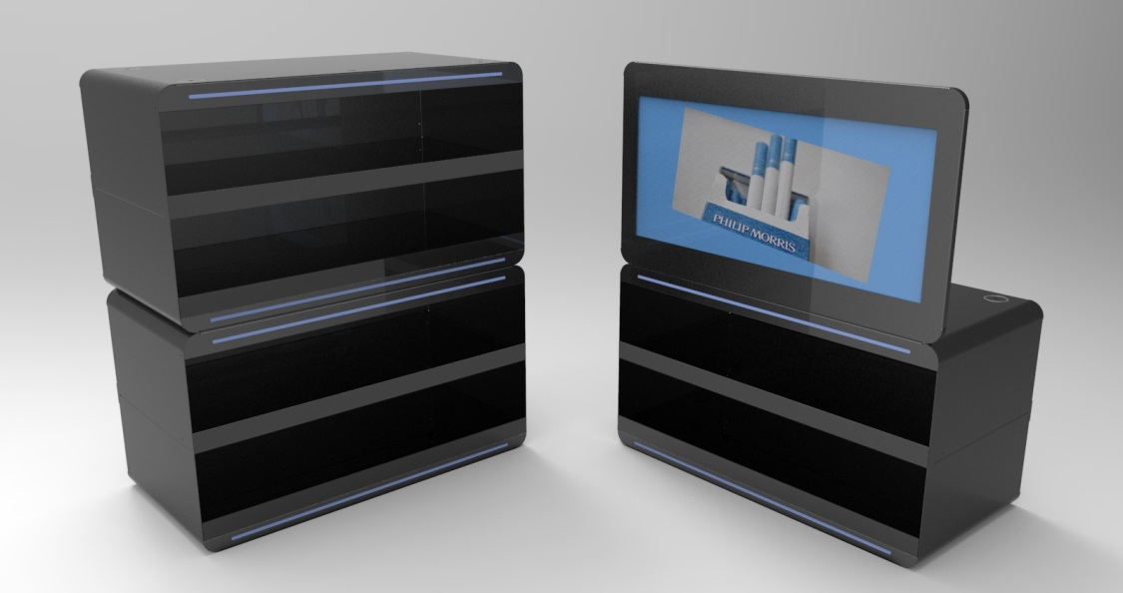
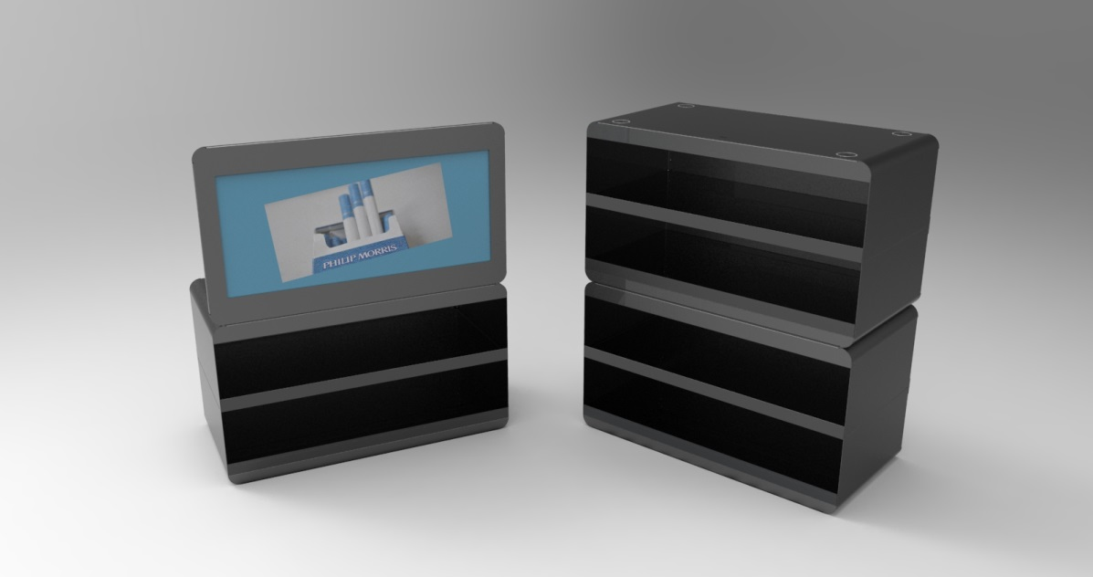
Basic Modular Unit
With pushers and dividers with LED light
123,96 €/per module with topper
74 €/per module without light with pushers and dividers

Slide 19
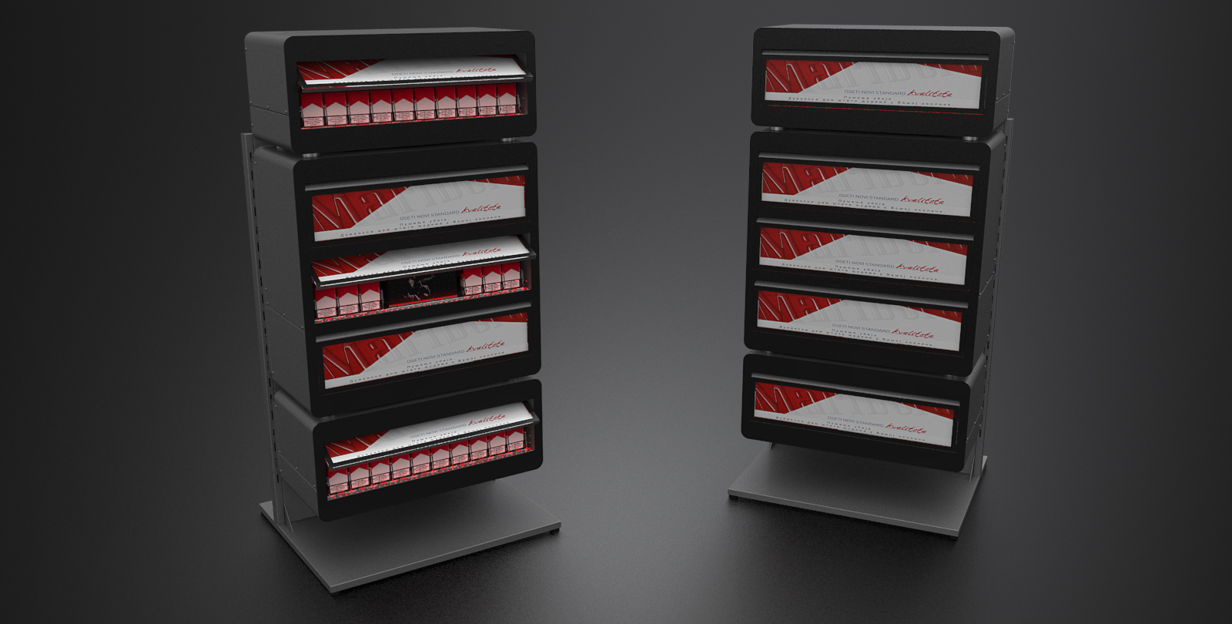
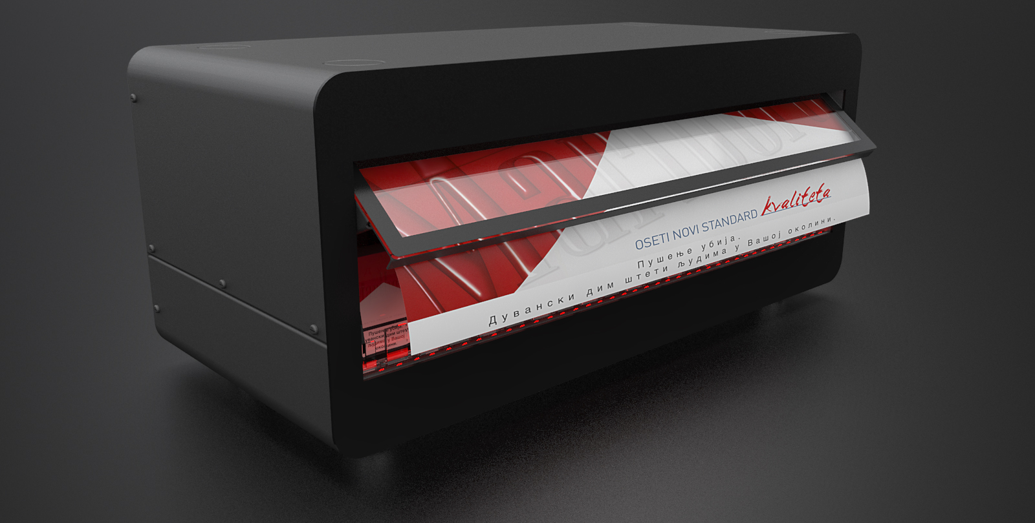
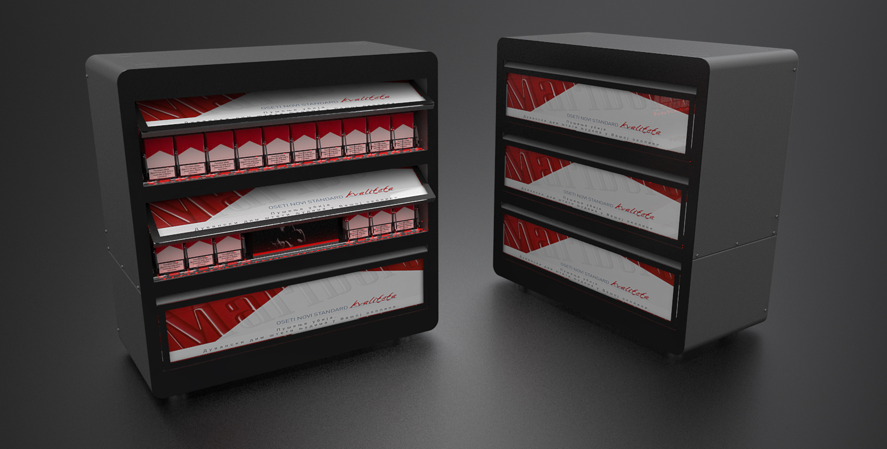

Slide 20
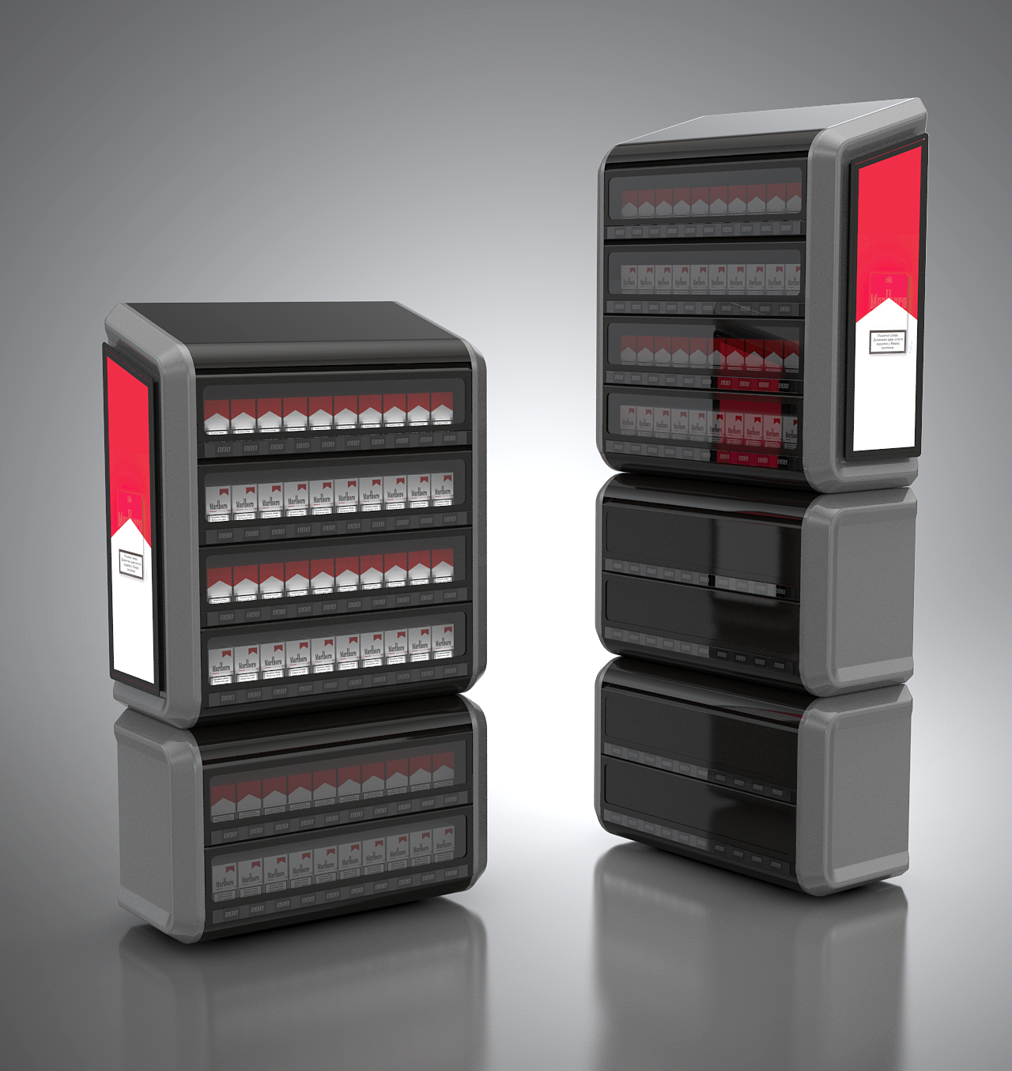
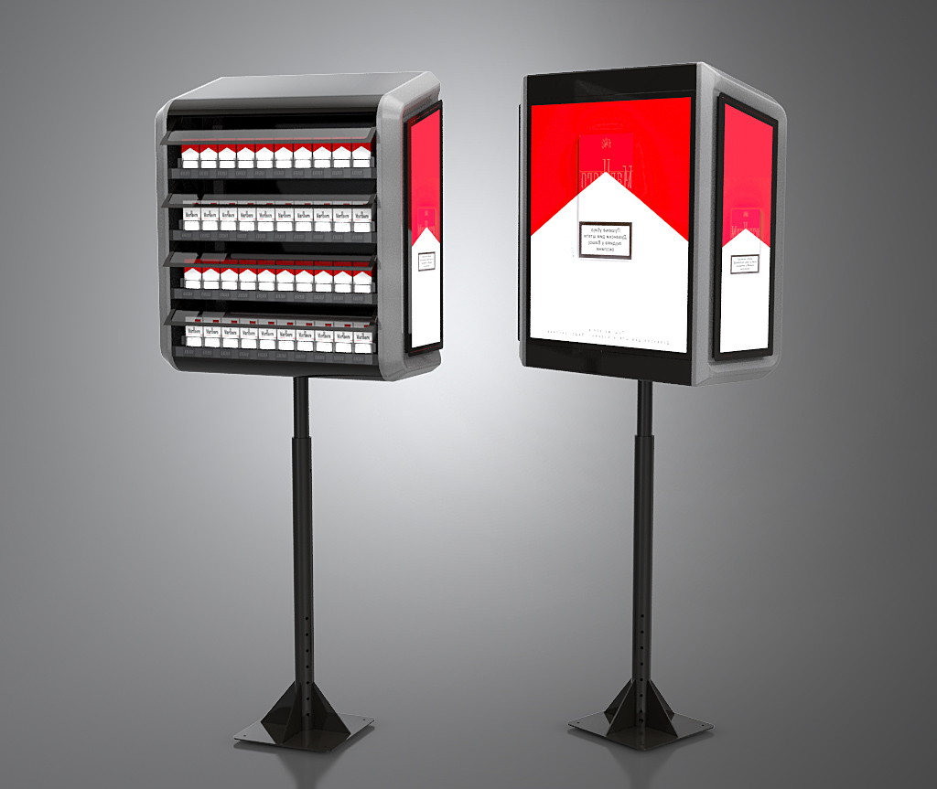

Slide 21
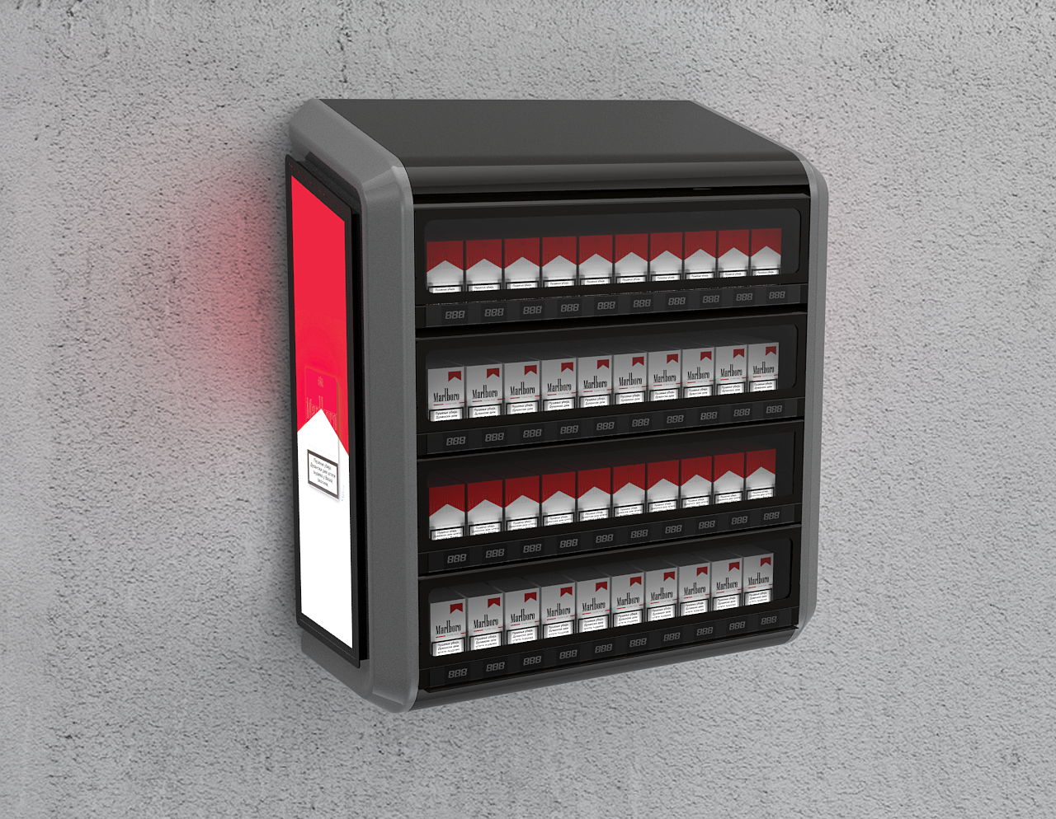
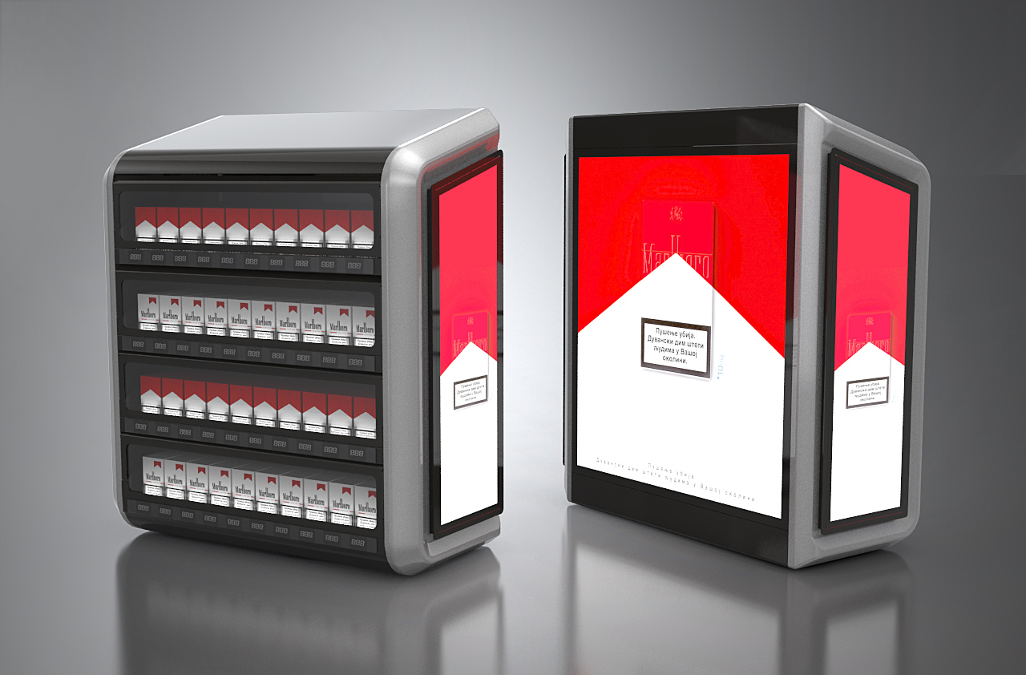

Slide 22
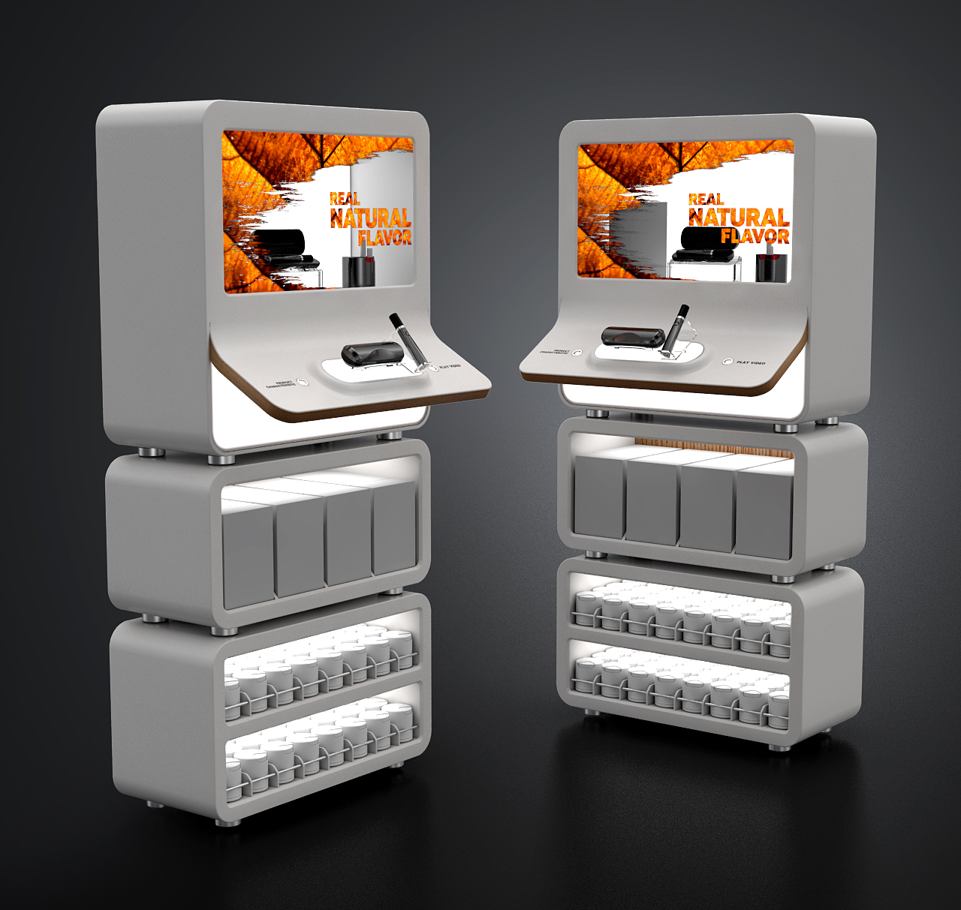
E-cigarettes display

Slide 23
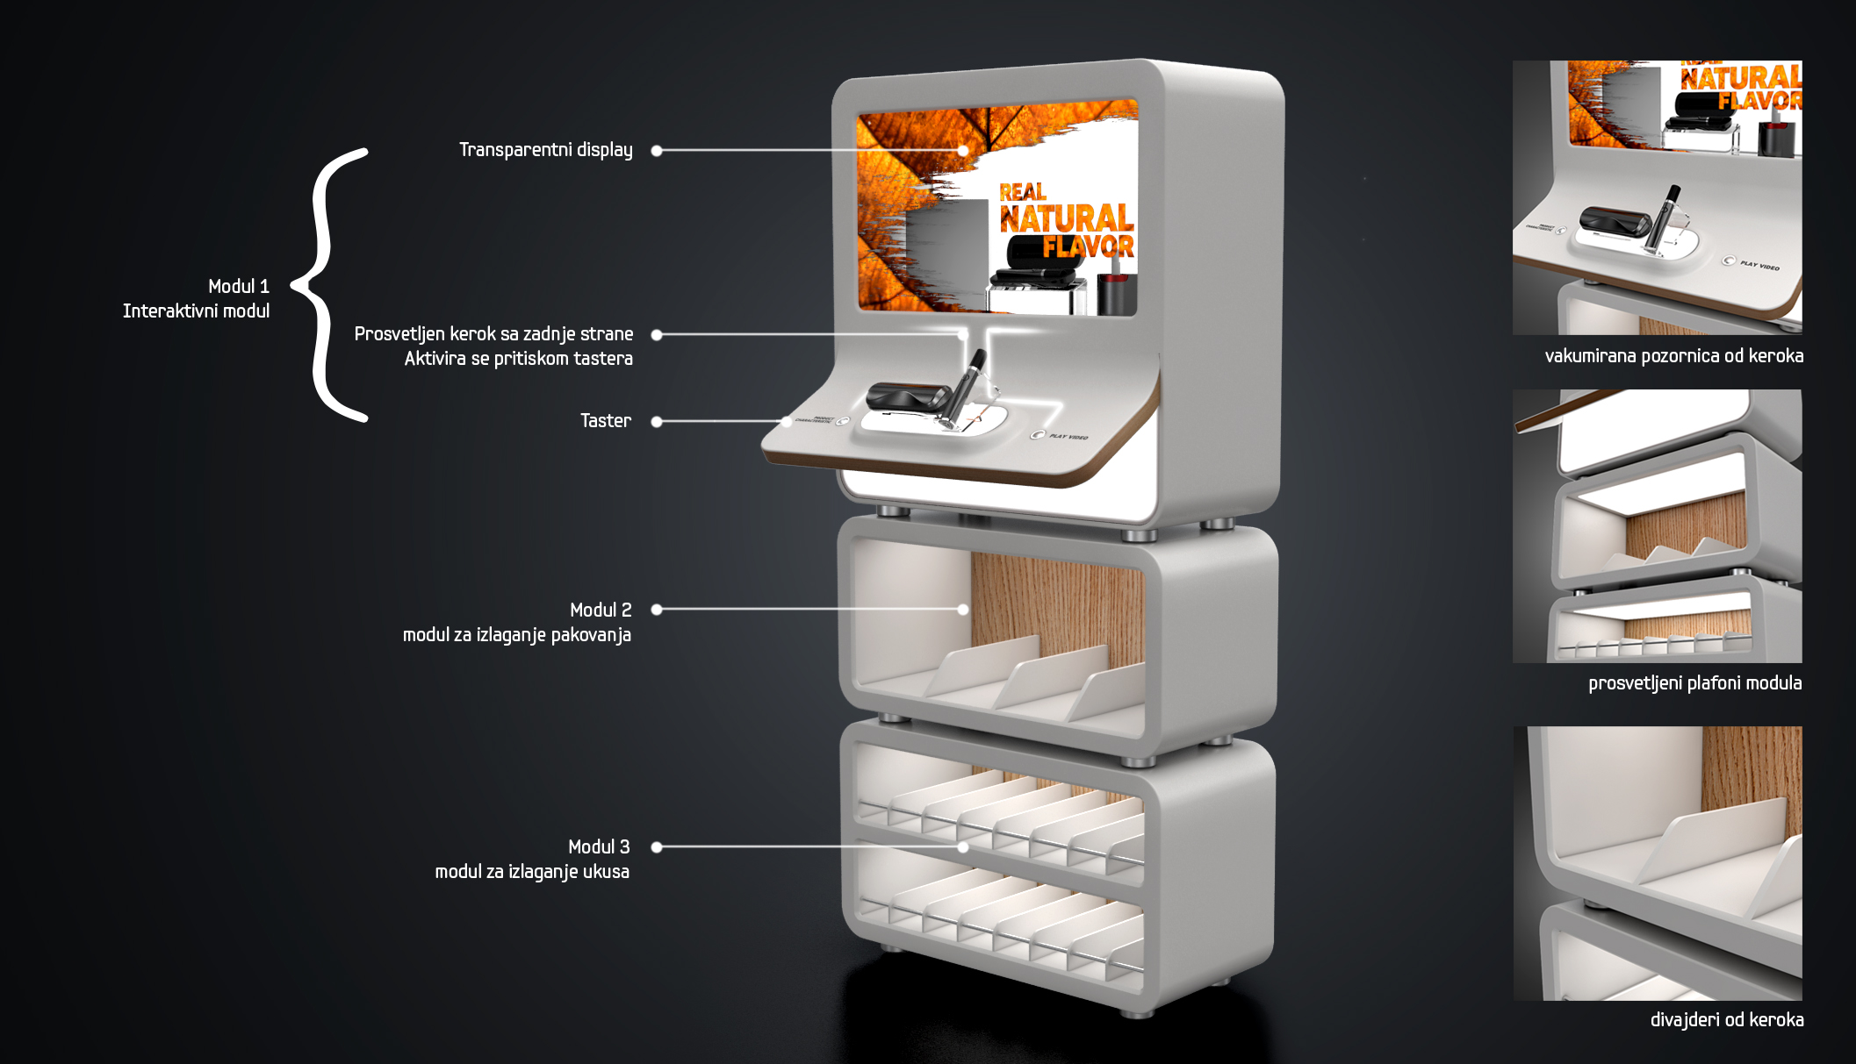
E-cigarettes display

Slide 24
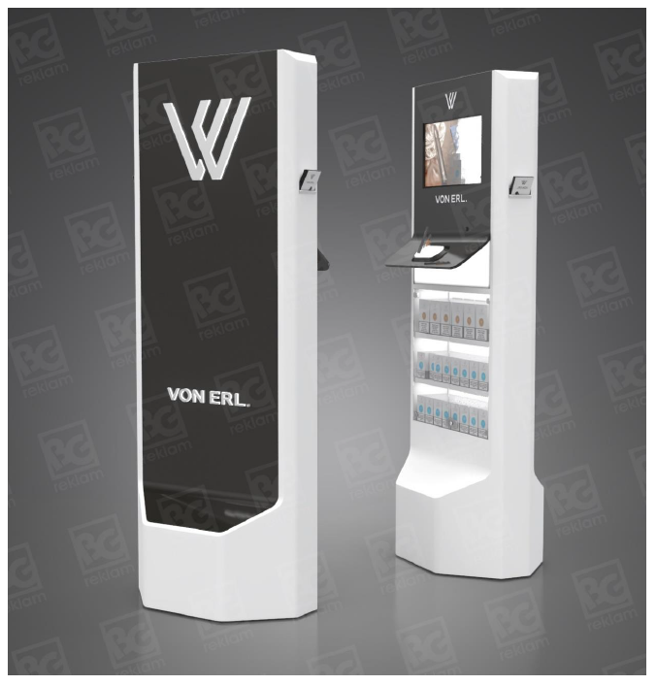
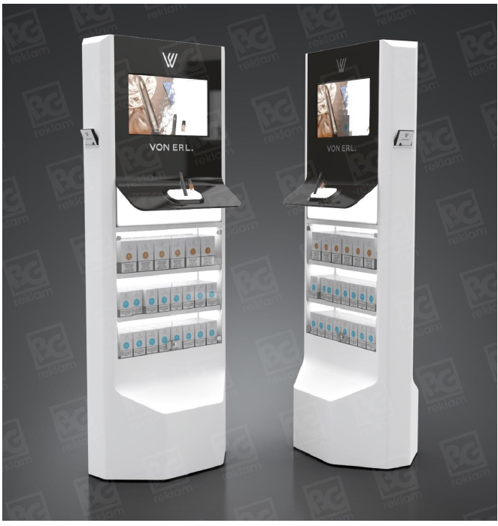
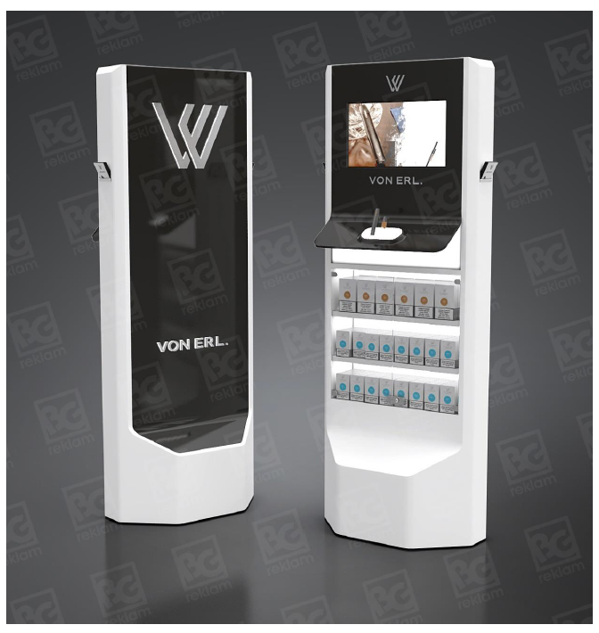
E-cigarettes display VON ERL.

Slide 25
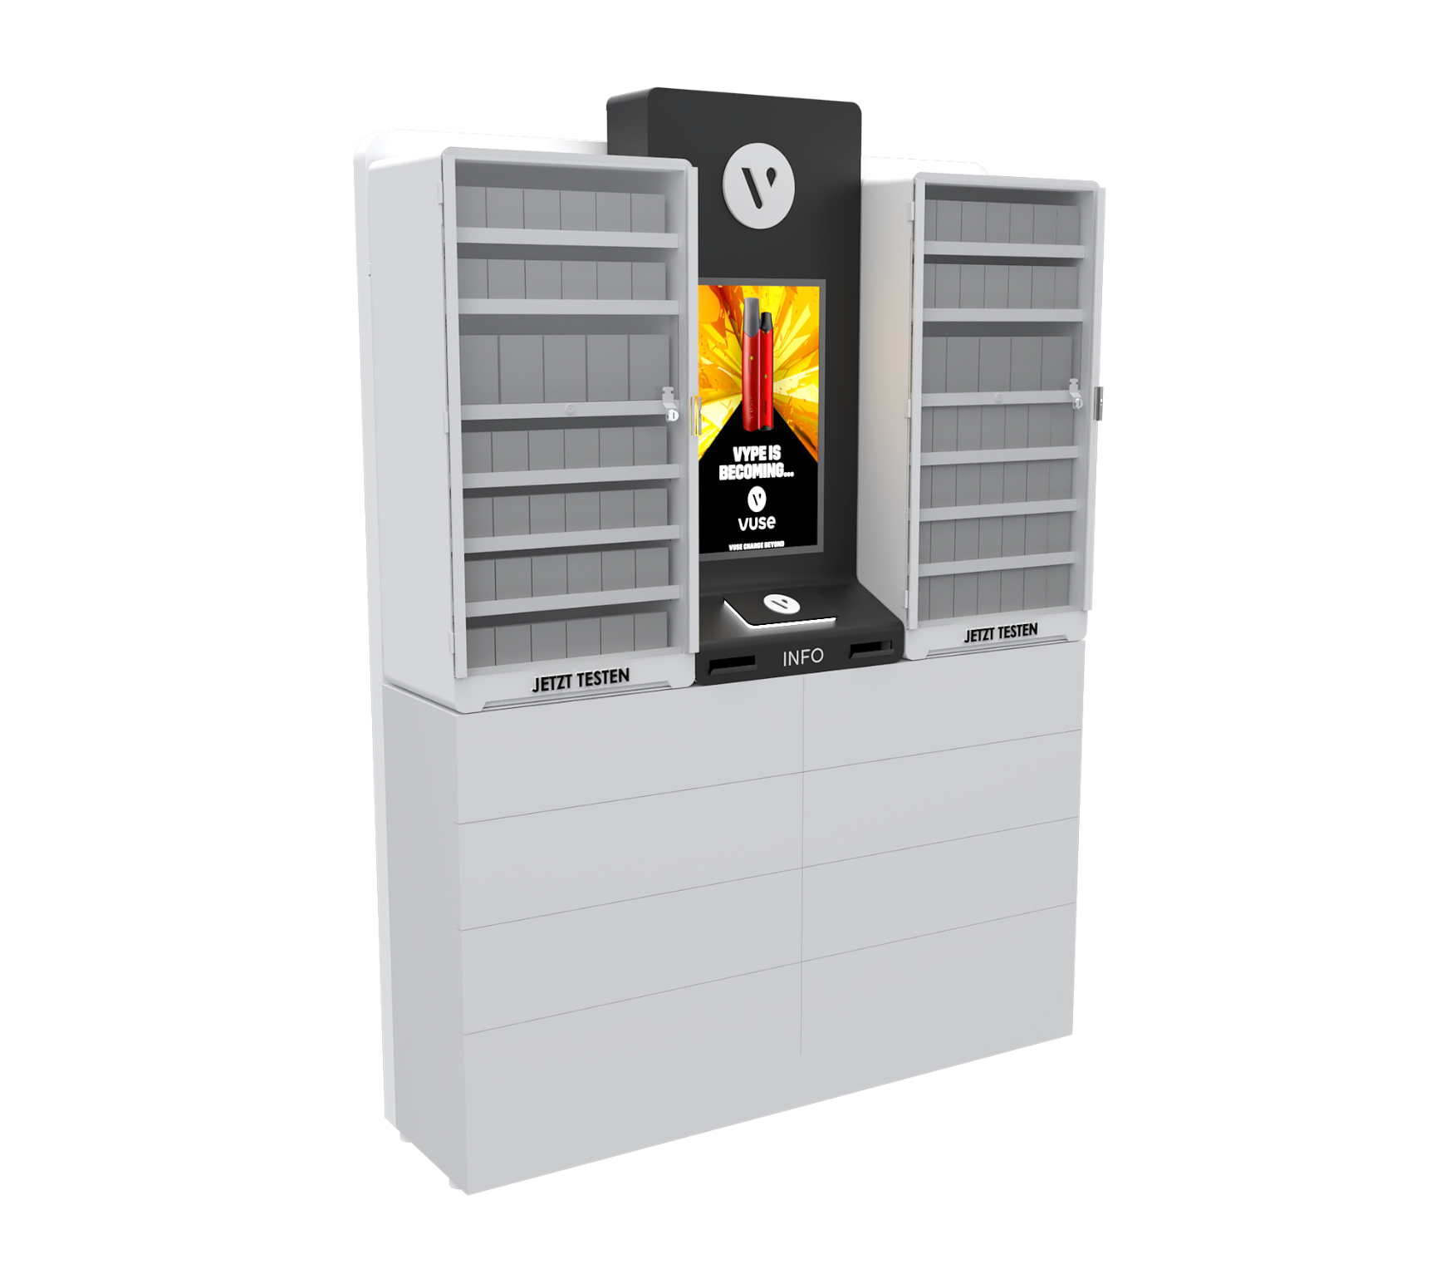
Clooney 1 HES

Slide 26
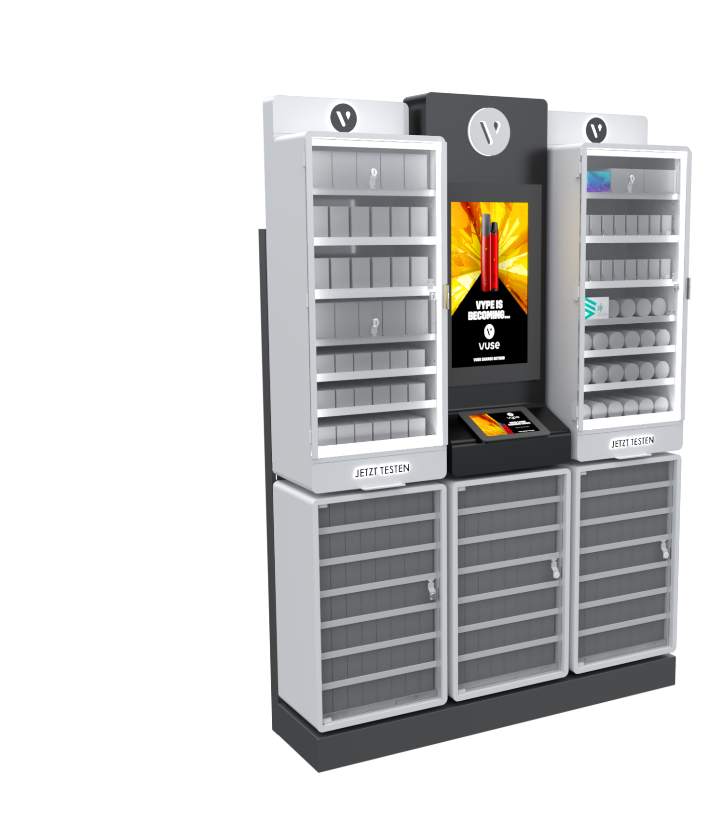
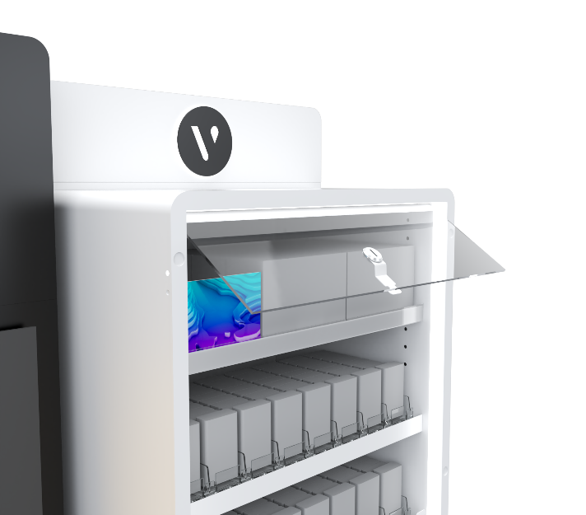
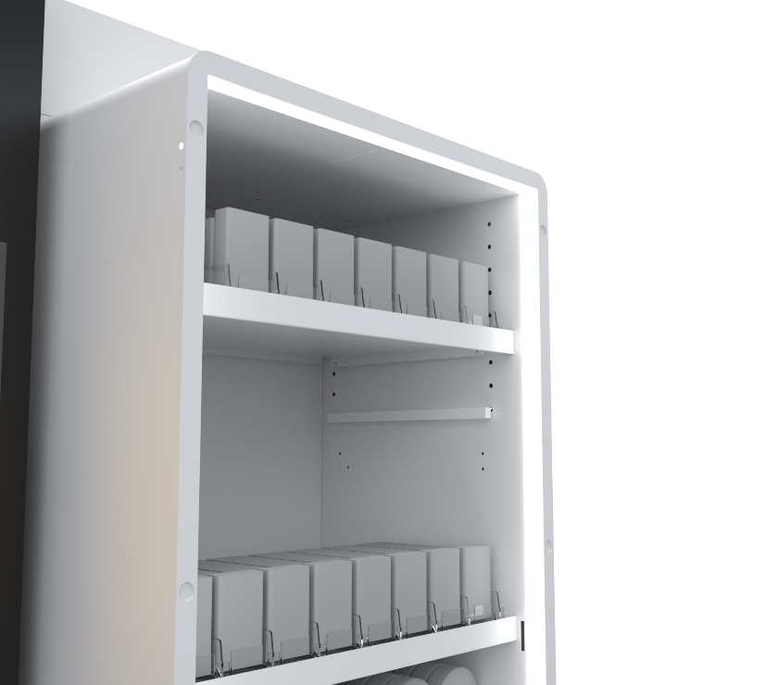
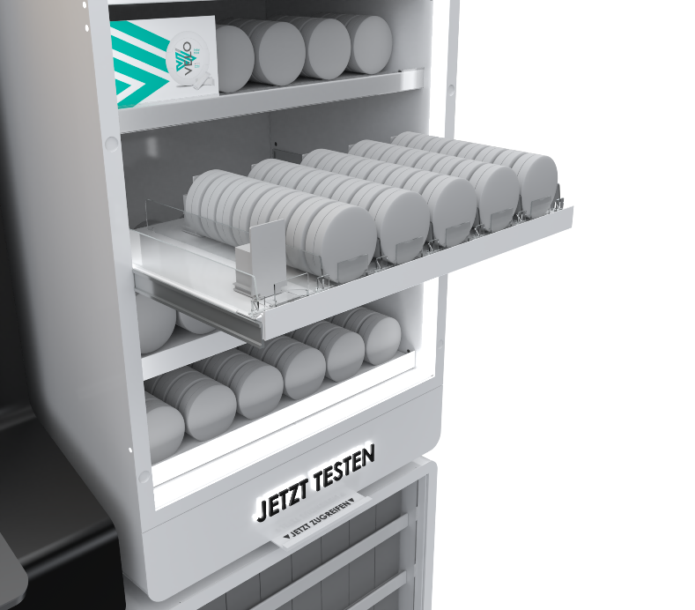
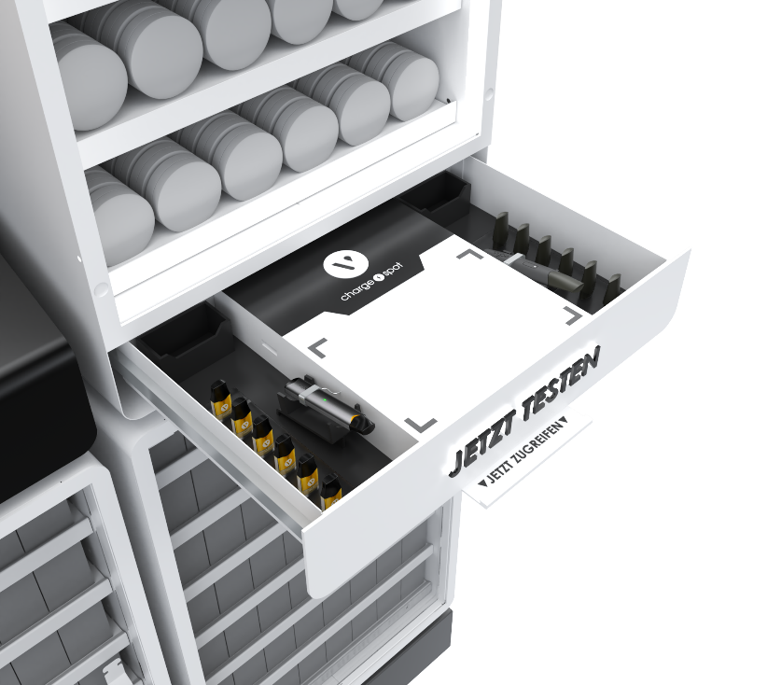
Clooney 2

Slide 27
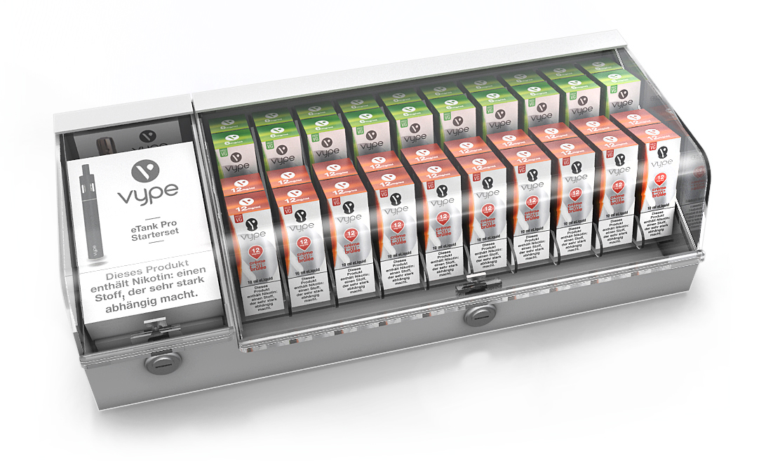
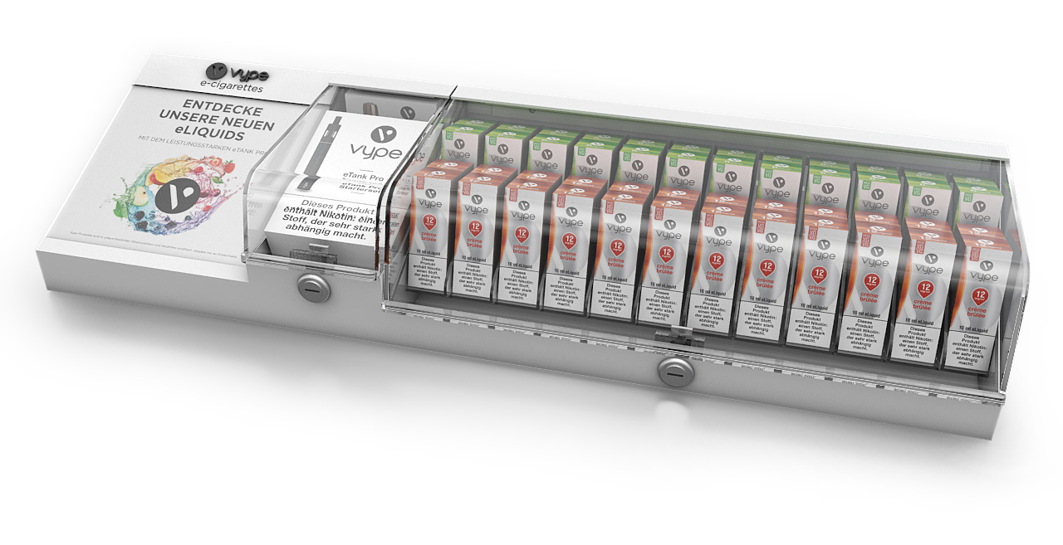
JET Lockable On Counter Display with Storage

Slide 28
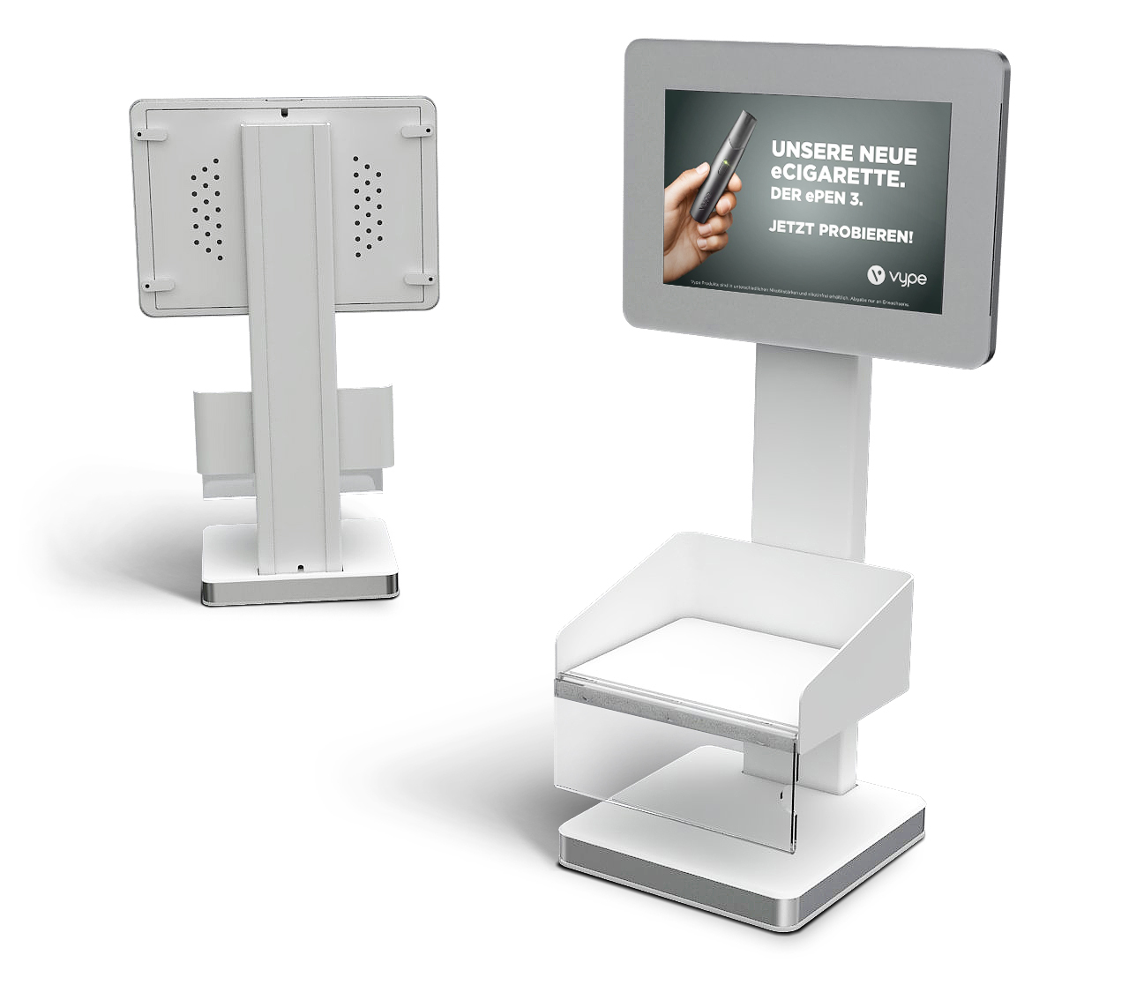
Tang Screen Module

Slide 29
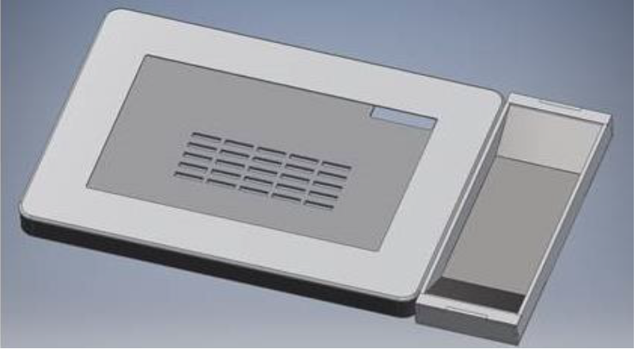
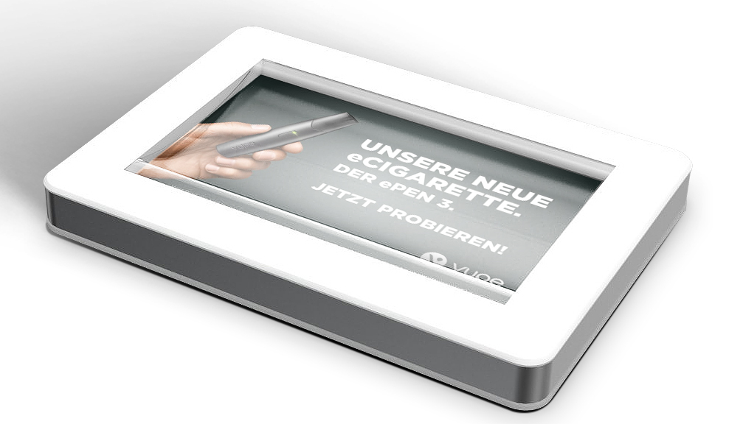
Cash Tray mit Mulde + Cash Tray

Slide 30


Shelf Highlighter

Slide 31

GLO Quattro

Slide 32


Presenterbox

Slide 33


Rocky & Rocky NEO

Slide 34


FSU Adonis - NEW

Slide 35






Glo ARAL Highlighter
Basiselement – Neo „Treppe“
110mm
Possibility to use various printed front communication for navigating between tastes
Basiselement – Device Slot
158mm
02

Slide 36


Docking in Shelf
600mm Layout with device
02

Slide 37

Small On Counter Tasting Unit
Illuminated Header
Insert visual
Tempered glass doors (lockable)
Tempered glass doors (lockable)

Slide 38

Modular variations

Slide 39

Modular variations

Slide 40



Glo-Round Counter Unit
Premium BGR Industry
Premium BGR Industry
Premium BGR Industry

Slide 41

Vype Vitrine FREE STANDING UNIT
Tempered glass top
Tasting area, illuminated
Extendible drawer with guide rails
Tempered glass doors (lockable)
Illuminated logo
Illuminated shelves

Slide 42
Vype Vitrine FREE STANDING UNIT
Tempered glass top
Tasting area, illuminated
Extendible drawer with guide rails
Tempered glass doors (lockable)
Illuminated logo
Illuminated shelves

Slide 43

Modular variations

Slide 44

Modular variations

Slide 45

Modular variations

Slide 46


Modular variations

Slide 47

Modular variations

Slide 48

IN-STORE VIEW
Modular variations

Slide 49

IN-STORE VIEW
Modular variations

Slide 50

GLO COUNTER DISPLAYPLAY
Modular variations

Slide 51

GLO COUNTER DISPLAYPLAY
Modular variations

