Slide 2
TABLE OF CONTENTS
OVERVIEW
BG REKLAM – ABOUT US
BENEFITS OF WORKING WITH US
4. CSR
PROJECTS
SUPPORT TEAM – CONTACT US

Slide 3
1. OVERVIEW

Slide 4
OVERVIEW
Welcome to our PRODUCT CATALOGUE !
This interactive product collection will provide you product information at the touch of the click.
It will provide you benefit insights, which you as our partner have from cooperation with us.
We are delivering exceptional experience for shoppers at physical retail (point – of – sale); products – per your request or special needs.
For more detailed product information, please contact our support team (your dedicated account manager) or contact us at Premium POS solutions for retail from concept to store (bgreklam.com).

Slide 5
2. ABOUT US

Slide 6
BG REKLAM – ABOUT US
We are professionals in production of premium POSM solutions.
BG Reklam creates outstanding various POSM that support in – store activation and drive sales at the point – of – sale of our clients for more than 20 years.
We are specialised in all areas, from Design & Concept Solutions, Innovations, through Engineering, to Development & Production of tailored POSM solutions. We are completing the entire process under one roof.
Our partner companies on local markets provide excellent Installation and Maintenance services.

Slide 7




Slide 8



Slide 9


OUR OFFICES
2001
2013
2017
2018
BG REKLAM (Headquarters)
29. Novembra 1M 11460 Belgrade, Serbia
+38111 785 64 64
+381 60 68 69 110
BG REKLAM GmbH
LeverkusenstraBe 3
22761 Hamburg, Germany
+ 49 40 8541 3003
BG REKLAM UK Ltd
1st Floor, Artist House 35 Little Russell Street London, WClA 2НН, UK
+44 20 3290 6345
BG REKLAM
SERBIA (HQ)
BG REKLAM
SERBIA (FACTORY)
BG REKLAM
UNITED KINGDOM
BG REKLAM
GERMANY
Hamburg
London
Belgrade

Slide 10
3. BENEFITS OF WORKING WITH US

Slide 11
BENEFITS OF WORKING WITH US
Today more than ever, especially during COVID-19 pandemic, in order to achieve goals and proceed with all projects on time and efficiently, every company needs to have a reliable business partner.
We are dedicated, creative and have experience in developing premium POSM solutions on your request, based on your needs. We are agile and we have experience working in tobacco category.
We are a reliable partner for the outstanding tailored sustainable POSM solutions.
We are supporting you to get through extremely busy time at work.
We care for your growth.

Slide 12
PARTNERING STRATEGY
PREMIUM PRODUCTS
Increasing brands’ image and sales through premium POSM solutions.
BENEFITS
ACCOUNT MANAGEMENT
Highly experienced and multilingual sales team, with presence on all the markets where we operate.
PROJECT MANAGEMENT
One Stop Shop – full project management support with one single point of contact. From design and concept solutions to installations and maintenance.
CREATE VALUE FOR OUR CLIENTS
MONETARY
High product quality and service at competitive prices.
SAVINGS
TIME
Lead time is 5 weeks* – from briefing to product delivery.
ENERGY
One Stop Shop, plus efficient communication and fast responsiveness.
*5 weeks lead time on average (from briefing to final product delivery) depending on the project complexity.

Slide 13

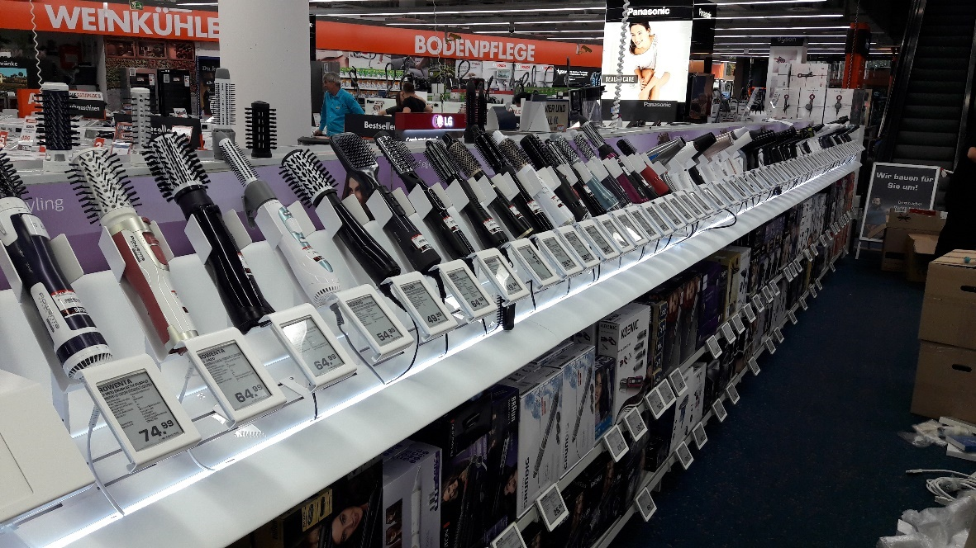


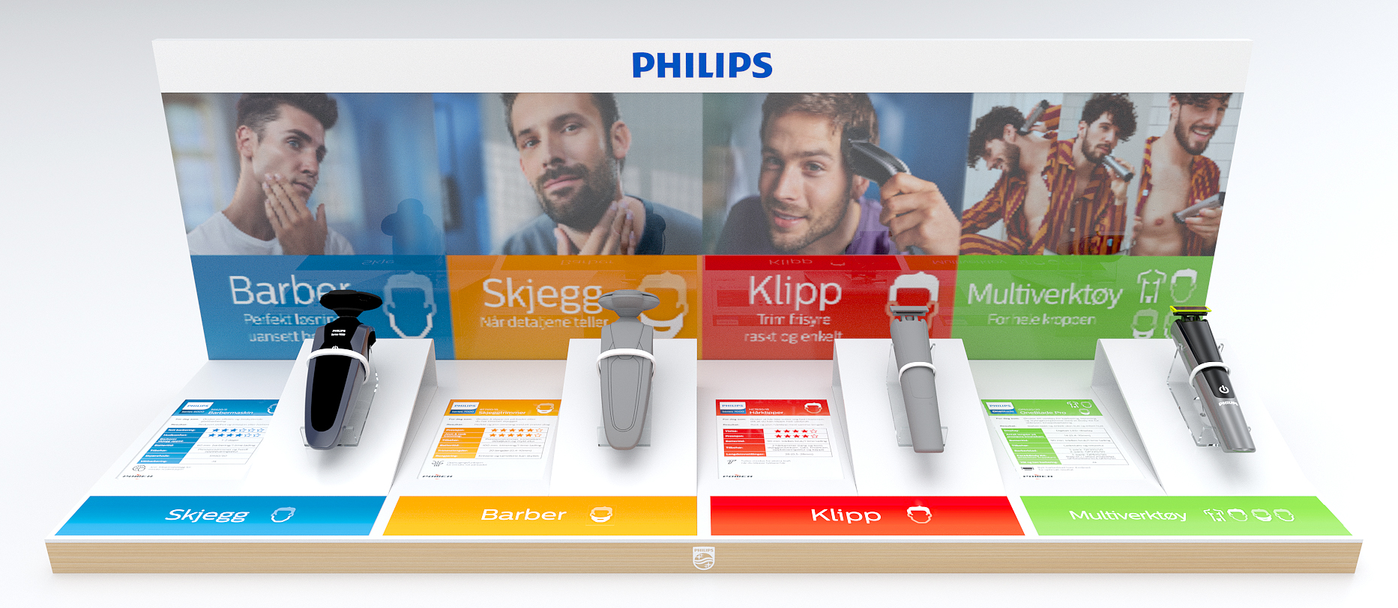
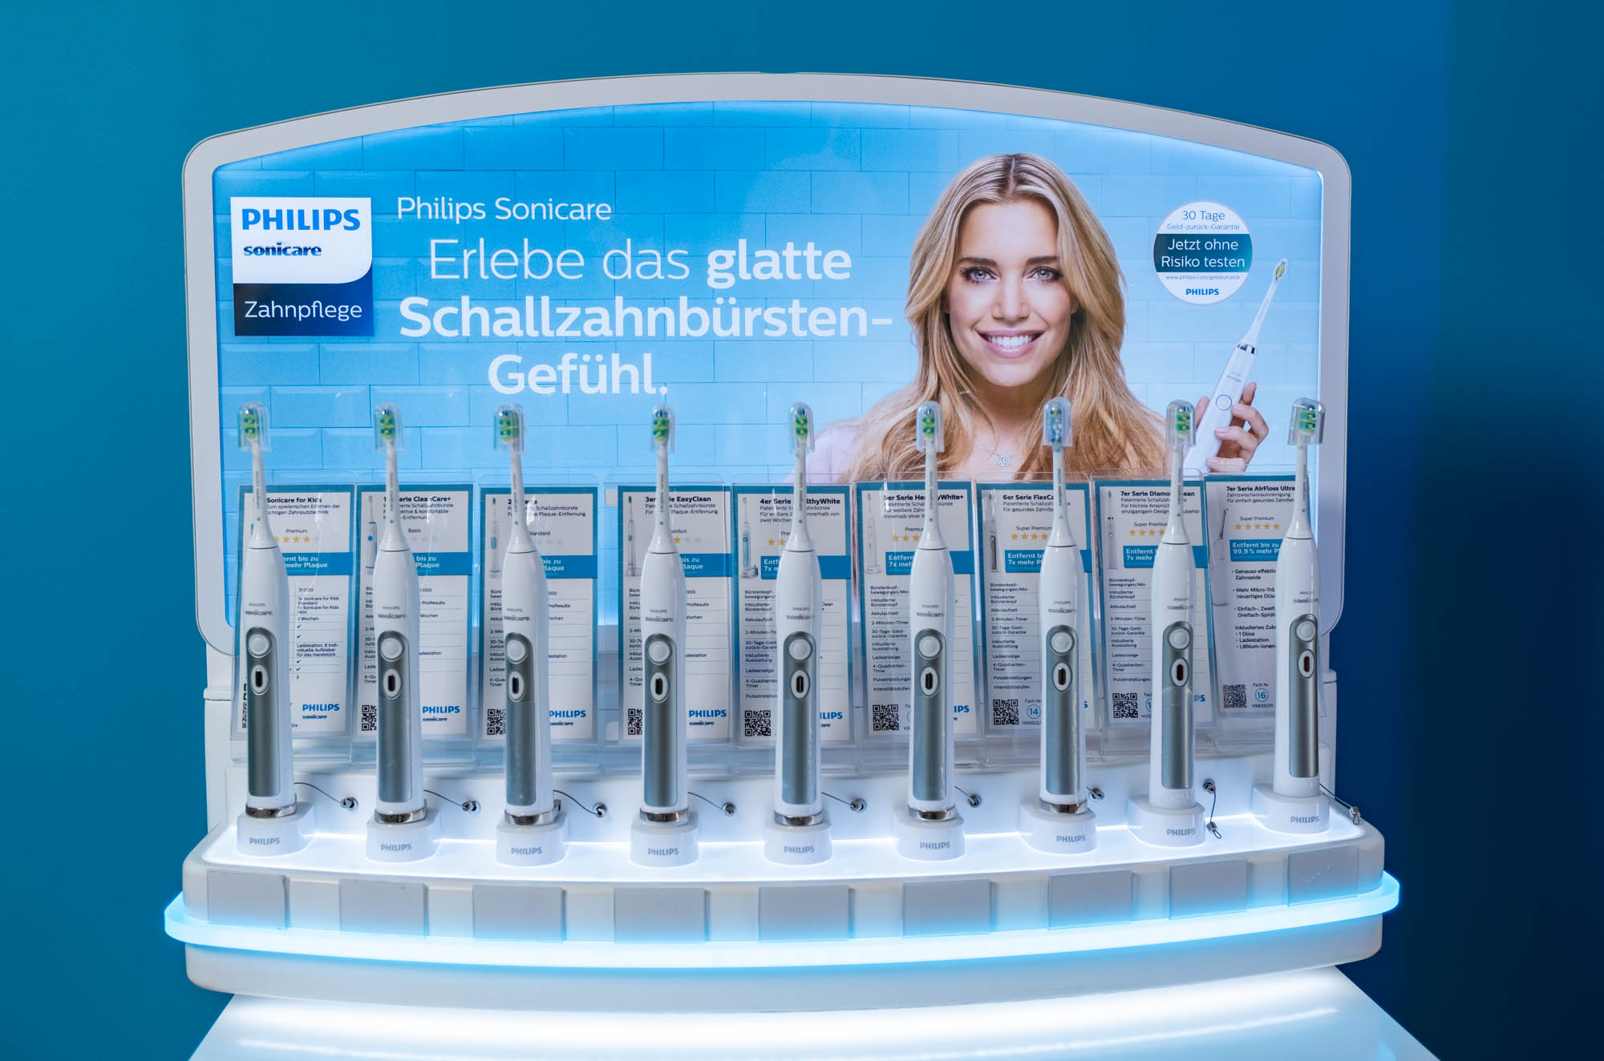

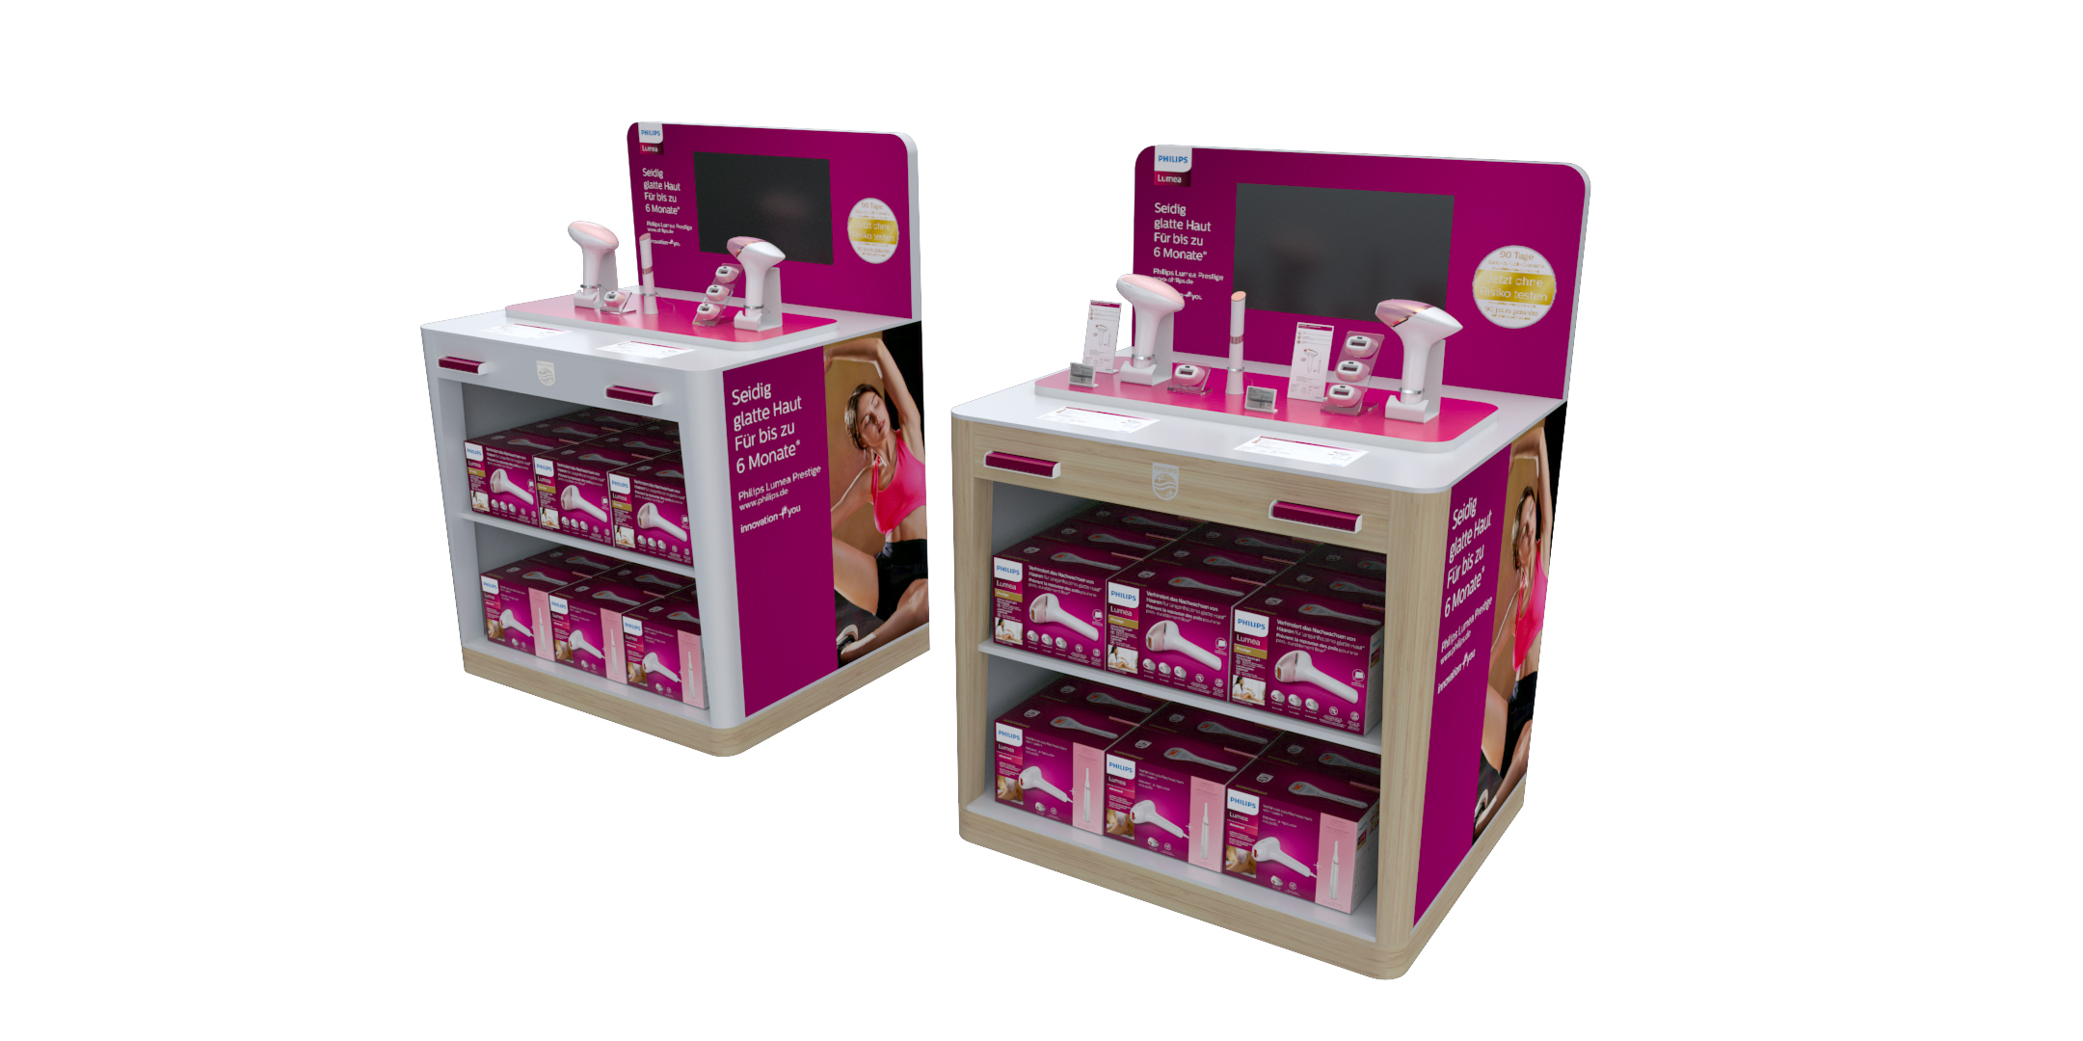
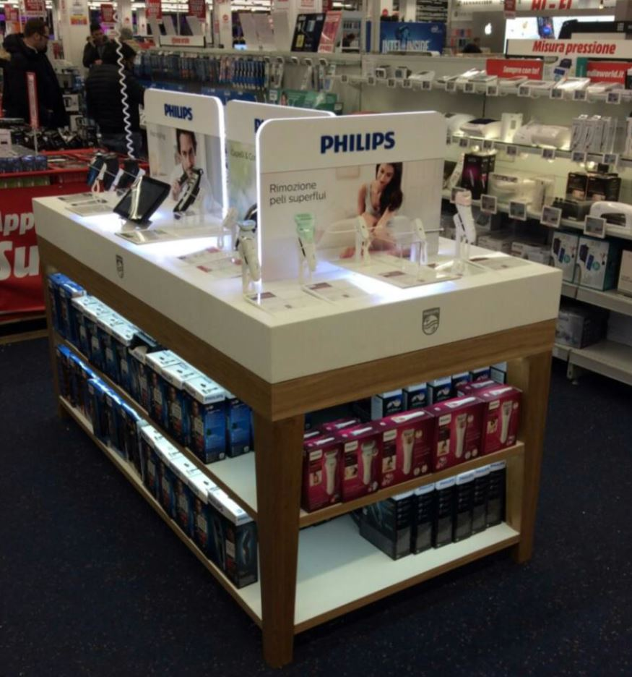
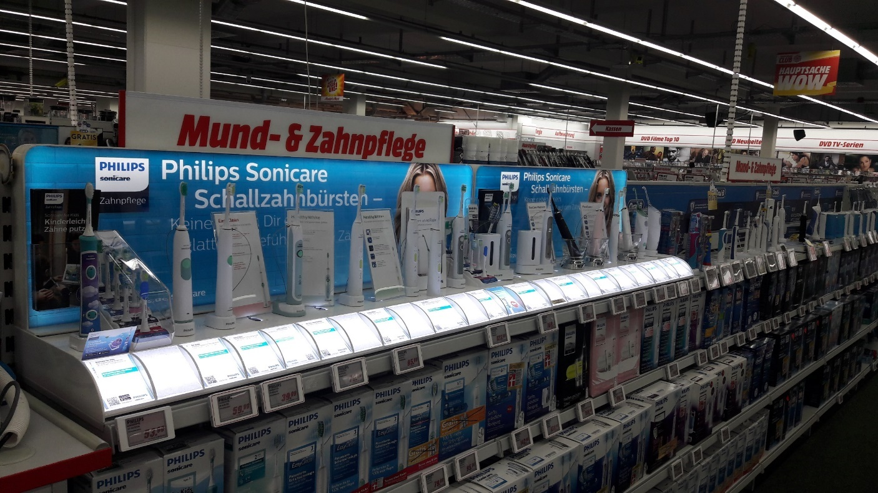
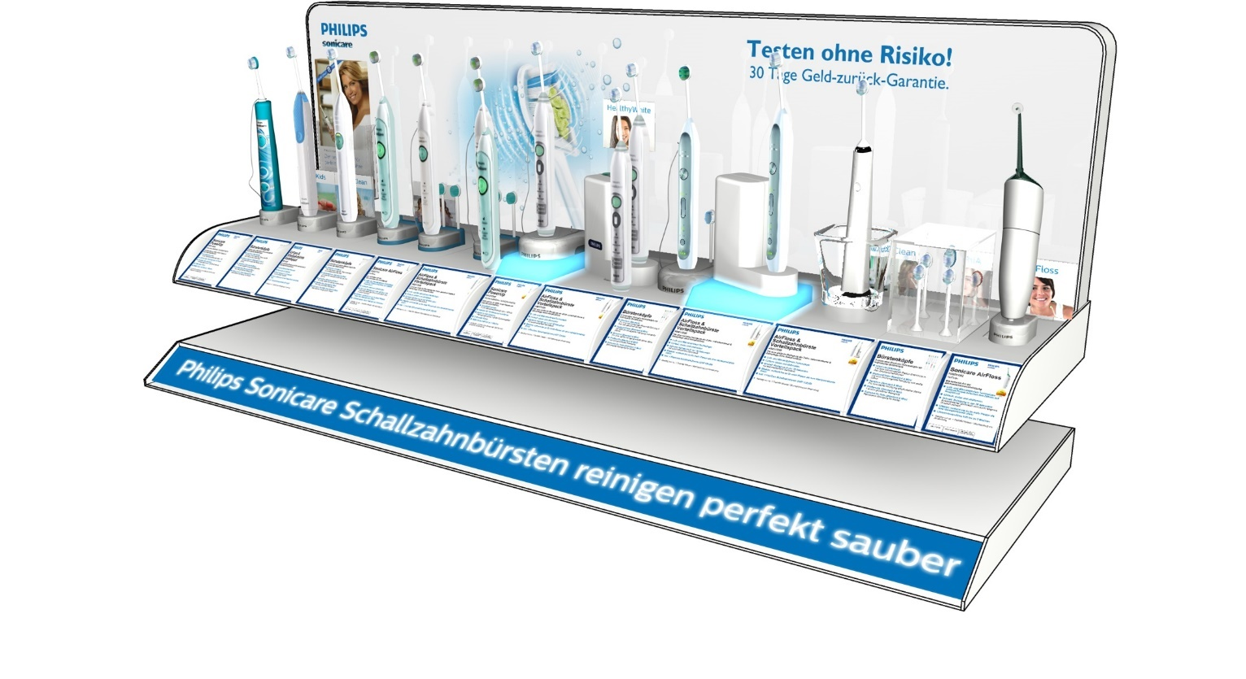
BG REKLAM & PHILIPS
COOPERATION between PHILIPS and BG REKLAM
We are pleased to cooperate 7 years.
We are happy to cover 7 markets where PHILIPS has operations.
We are proud that together we developed more than 100K pcs POSM solutions.
Our exclusive & unique designs and specific materials are used to emphasize and tell a PHILIPS brand story at POS.
Our intentions are driven by a customer centric approach in order to improve customer experience at POS.

Slide 14
4. CORPORATE SOCIAL RESPONSIBILITY

Slide 15
OUR PROMISES
As a socially responsible company, we committed to our four stakeholders the following:
EMPLOYEES – We are committed to providing a safe and secure working environment for all employees. We believe that: innovation, honesty and doing the right thing approach is a basis of everything we do.
CLIENTS – Our clients deserve outstanding products and services. Every single day, we strive with passion to meet our clients' demands.
ENVIRONMENT – We are committed to run a sustainable business. Our aim is to: 1. use eco-friendly materials (such as wood, metal, PET sheets, corrugated cardboard), 2. use recycled products; 3. create social initiatives.
COMMUNITY – We are continuously trying to be part of various socially responsible projects, to involve local marginalised groups in our supplier chain, as well to encourage our employees to volunteer in their local community.

Slide 16
BETTER TOMORROW THROUGH SUSTAINABILITY COMMITMENT
Our sustainability initiatives:
Reducing environmental impact
Using energy more efficiently
Reducing packaging waste
Using recyclable and reusable materials
Reducing carbon footprint by optimising our production process and technology
Please check our sustainability video: https://vimeo.com/474723155/579f192891

Slide 17
ENVIRONMENATLLY RESPONSIBLE BEHAVIOUR
Every day we are actively and continuously work to:
REDUCE – scrap and energy consumption. Our business is focused and completely aligned with certifications ISO 20400 and 26000.
REUSE – our aim is to produce re-brandable and multi usage products (allows easily changeable communication)
RECYCLE – use of fully recyclable materials. Our special attention in production is in line with lifecycle thinking approach (all used materials can be easily splited at the end of the production lifecycle).

Slide 18
WE ARE USING LATEST TECHNOLOGY IN PRODUCTION PROCESS
By careful selection of materials and machines in our production process we are managing to reduce carbon footprint.
Based on your request we can deliver eco-friendly materials and outstanding sustainable POSM solutions.

Slide 19



Slide 20







CERTIFICATIONS
Our accreditations prove our commitment to sustainability. We have:
QUALITY
MANAGEMENT
ENVIRONMENTAL
MANEGEMENT
HEALTH AND SAFETY
MANAGEMENT
SUSTAINABLE PROCUREMENT
SOCIAL
RESPONSIBILITY

Slide 21
5. PROJECTS

Slide 22
PERSONAL CARE

Slide 23
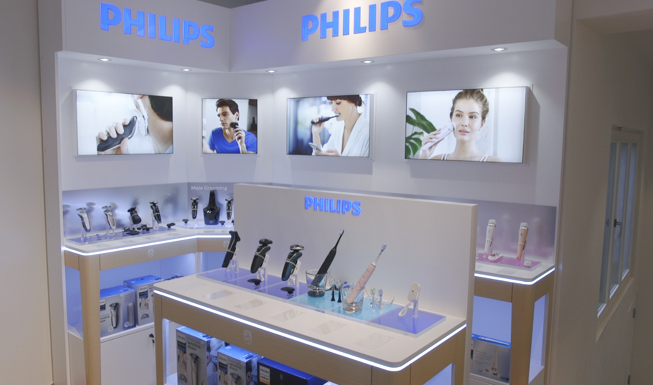
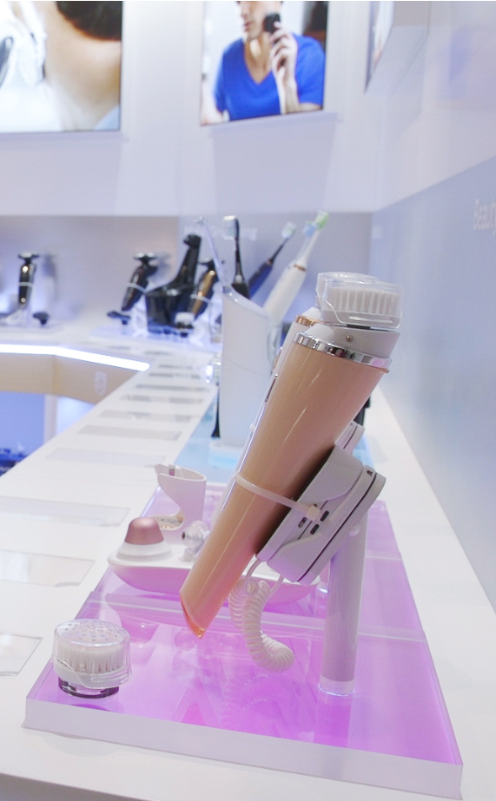
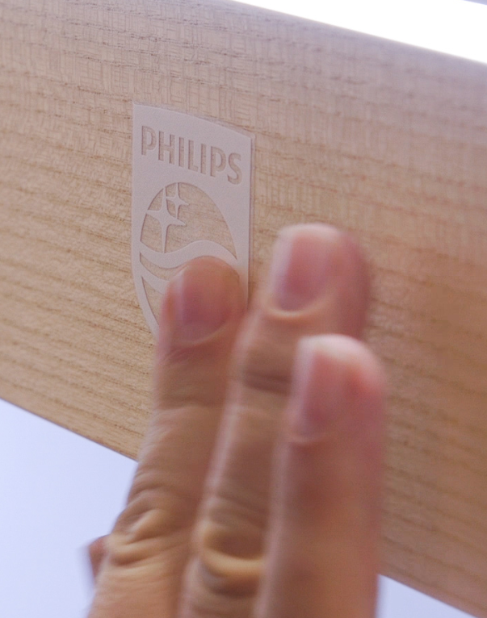
PROJECT
LUXURY STORE – BELGIUM, NETHERLANDS, LUXEMBOURG
Retailer
DM Stores
Year
2018
Description
Shop in Shop elements creating а unique Brand Experience, in а luxury travel retail environment. LED lights.
With а leadtime of just under 4 weeks, we can proudly say – our client's expectations were exceeded.
Materials
Mdf, Acrylic sheet, Backlight print, Tension fabric, Solid surface
Dimensions
H1400xW1000xD400

Slide 24
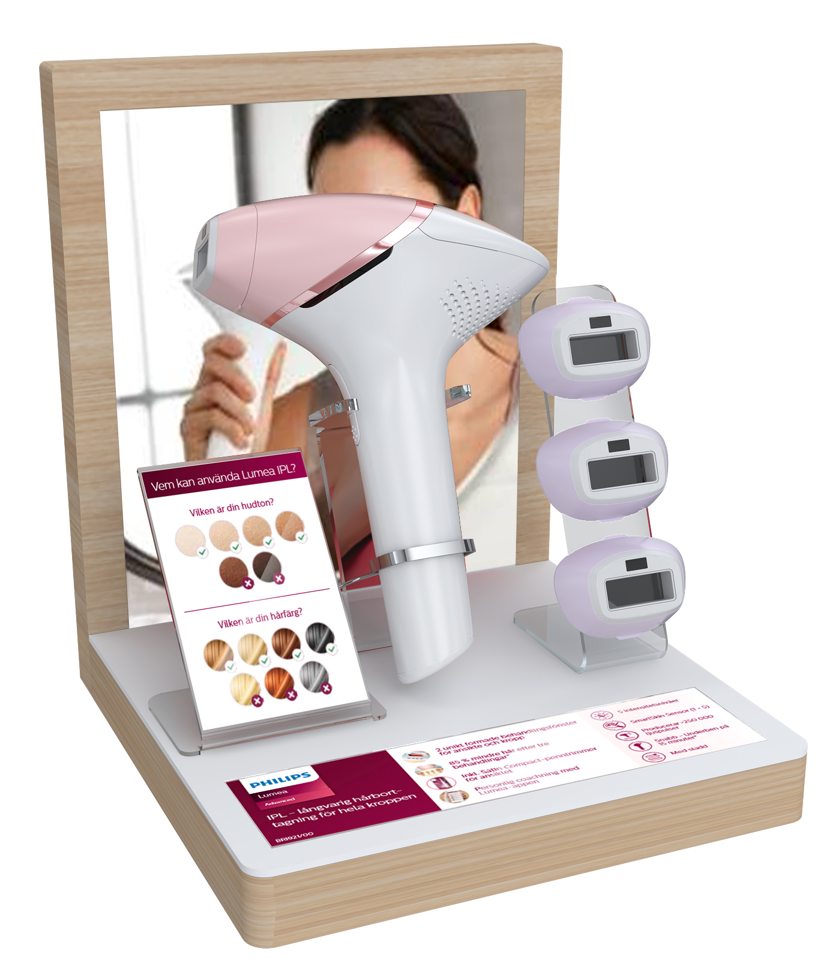
PROJECT
HAIR REMOVAL DISPLAY – SWEDEN
Retailer
Media markt, Elkjop, Clas Ohlson
Year
2020
Description
On counter display produced to emphasize hair removal experience.
Materials
Wood, Acrylic sheet
Dimensions
H350xW250xD250

Slide 25
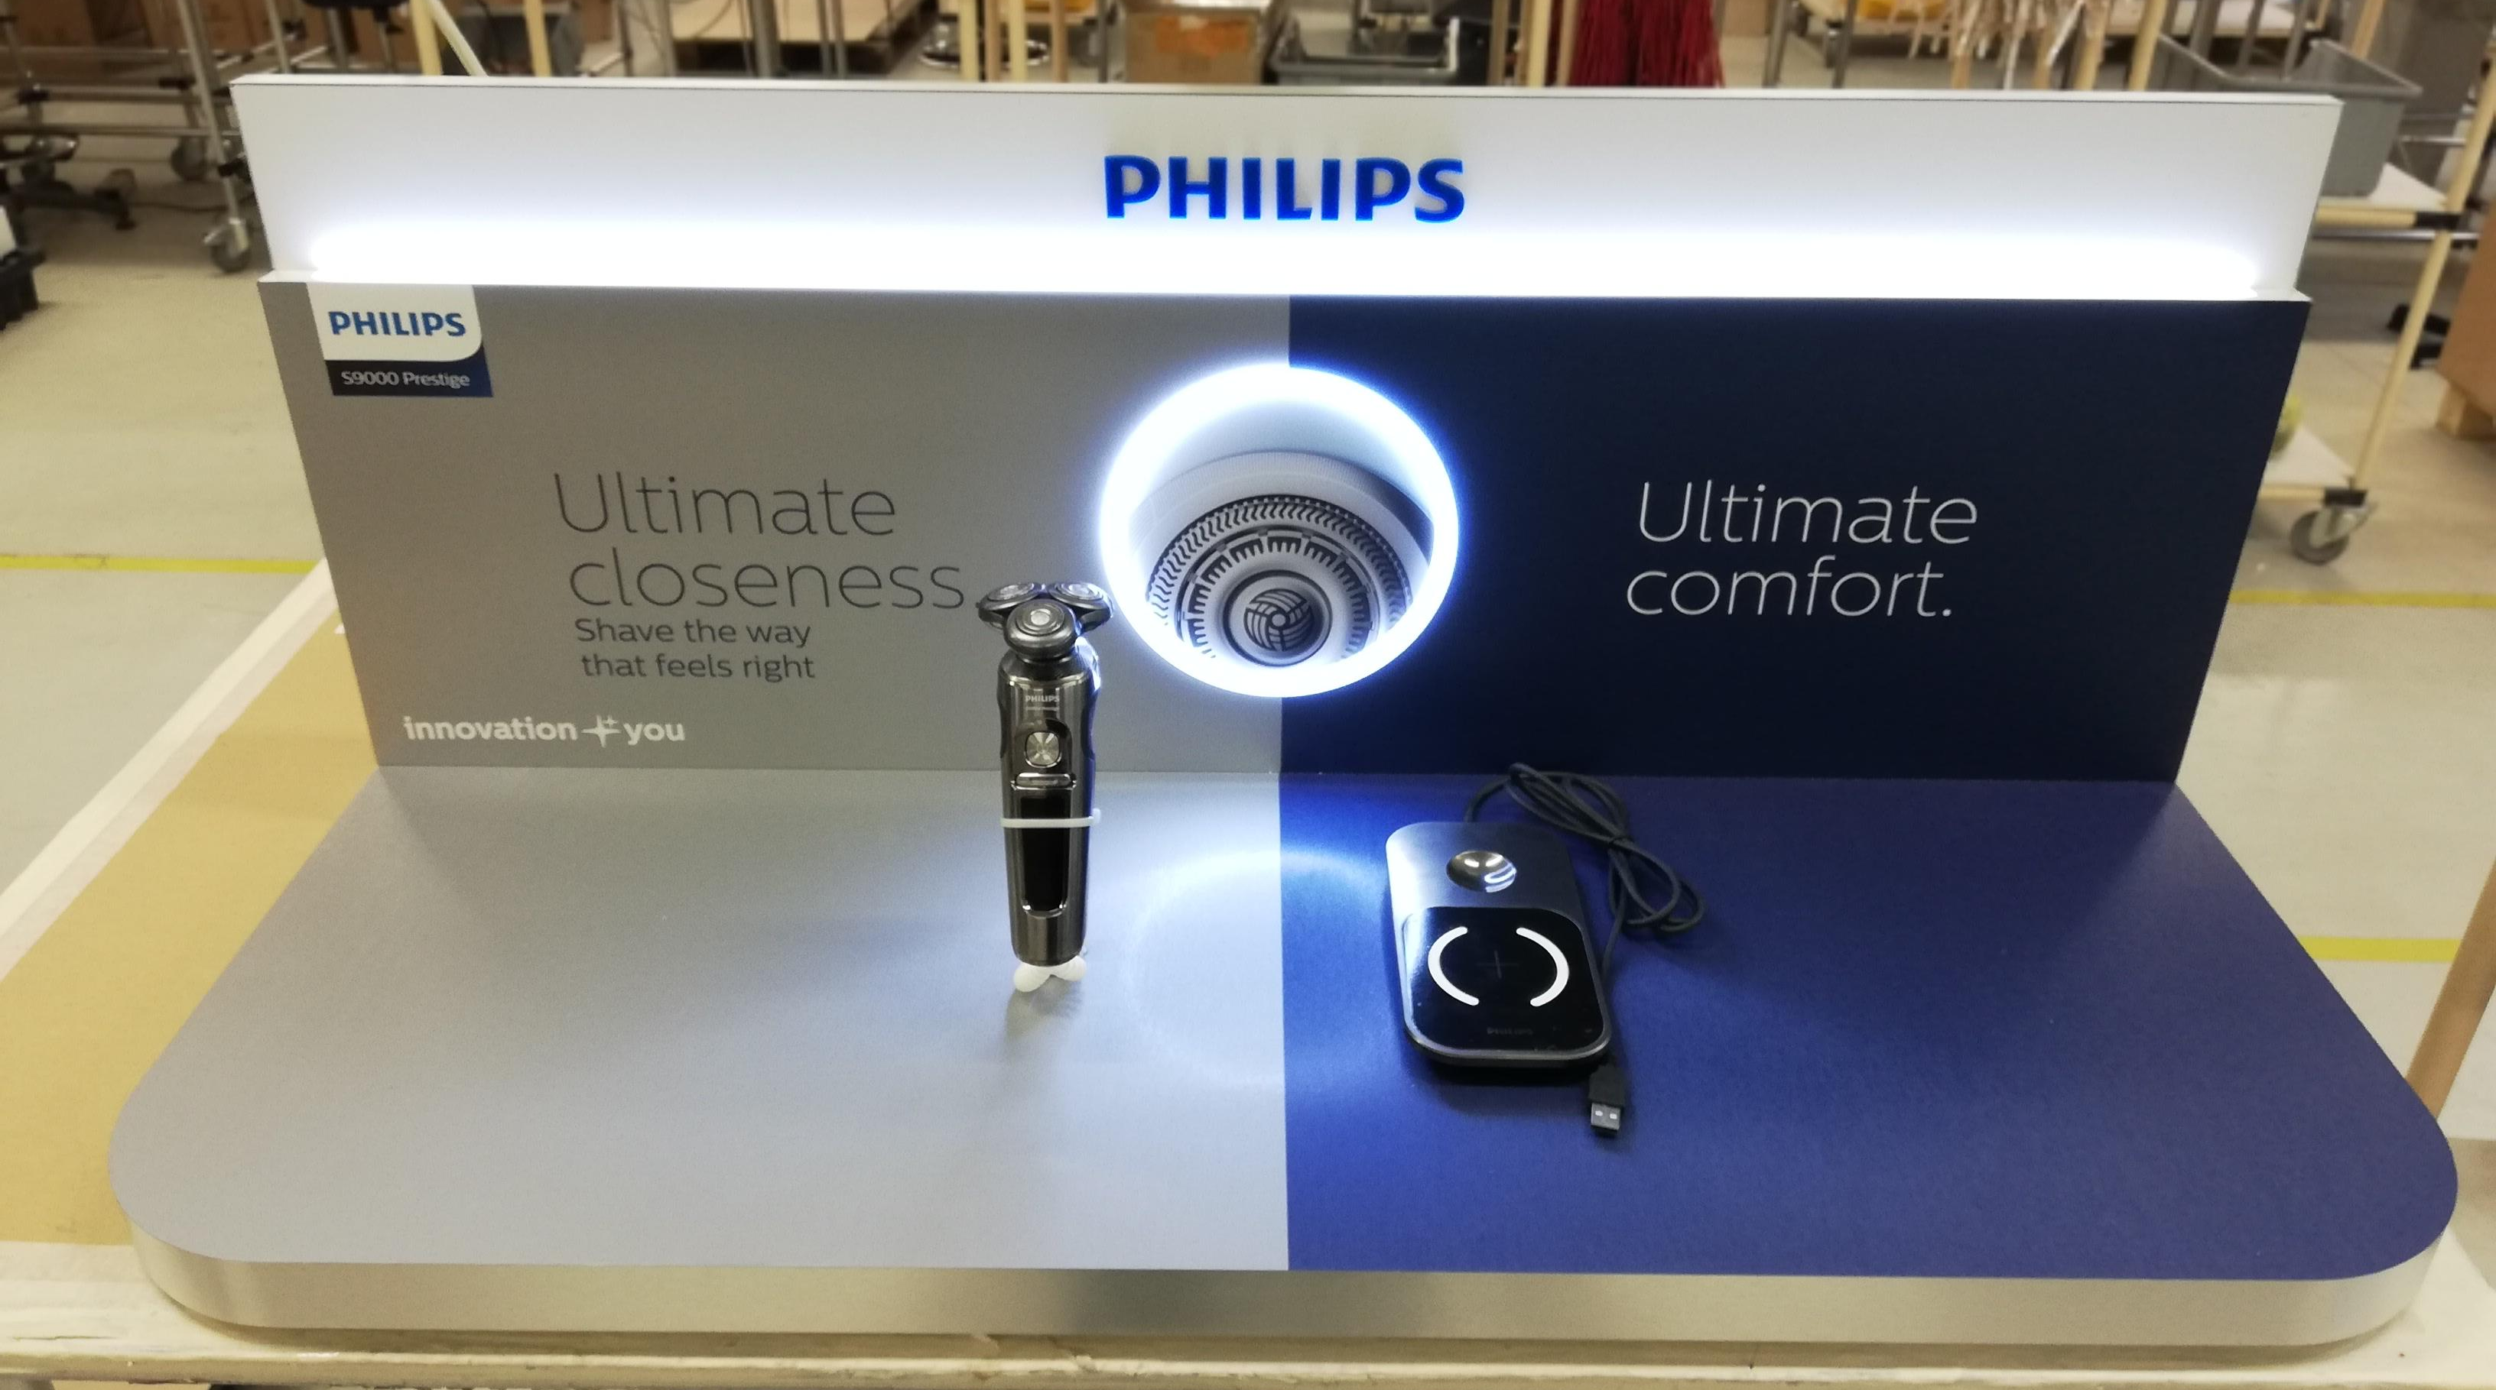
PROJECT
S9000 FACE SHAVERS DISPLAY – NETHERLANDS
Retailer
MediaM
Year
2018
Description
Eye catchy Illuminated on counter large display emphasize S9000 Prestige at POP.
Materials
Wood, Acrylic sheet
Dimensions
H350xW1000xD300

Slide 26
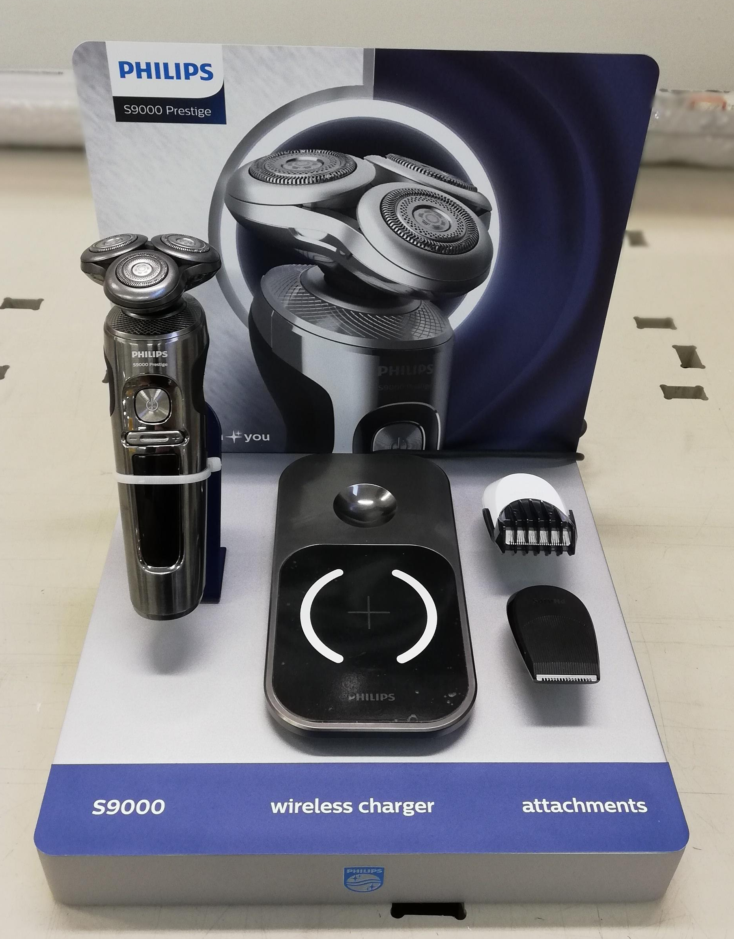
PROJECT
S9000 FACE SHAVERS SMALL DISPLAY – FRANCE
Retailer
Media Markt
Year
2018
Description
On counter small display for a line of S9000 shavers.
Materials
Wood, Metal sheet
Dimensions
H200xW150xD150

Slide 27
PROJECT
FACE SHAVERS DISPLAY – NORDIC REGION
Retailer
Power
Year
2020
Description
On counter display for MG products.
Materials
Wood, Acrylic sheet, Carbon steel sheet
Dimensions
H350xW1000xD300

Slide 28
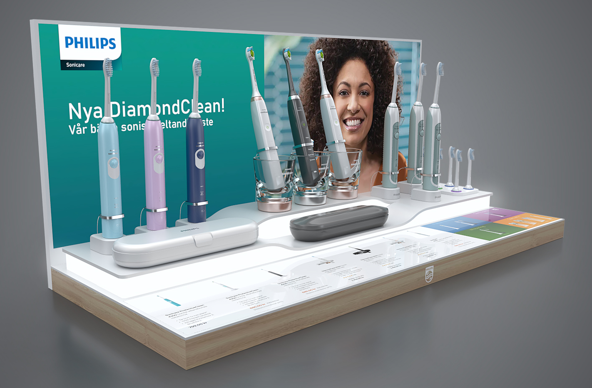
PROJECT
ORAL HEALTHCARE – SWEDEN
Year
2020
Description
On counter display designed to customize brushing experience.
Design per request provided by BG Reklam.
Materials
Corian, Wood, Acrylic sheet, Carbon steel sheet, Printed canvas
Dimensions
H400xW900xD380

Slide 29
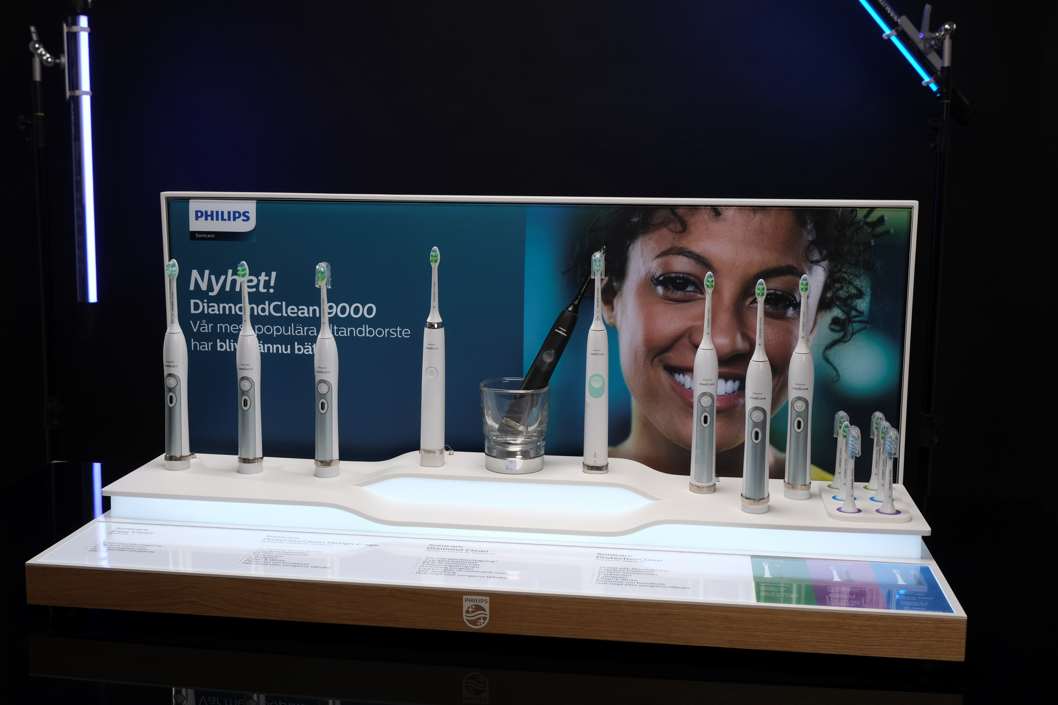
PROJECT
ORAL HEALTHCARE CATEGORY – SWEDEN
Year
2020
Description
On counter display designed to customize brushing experience.
Design per request provided by BG Reklam.
Materials
Corian, Wood, Acrylic sheet, Carbon steel sheet, Printed canvas
Dimensions
H400xW900xD380

Slide 30
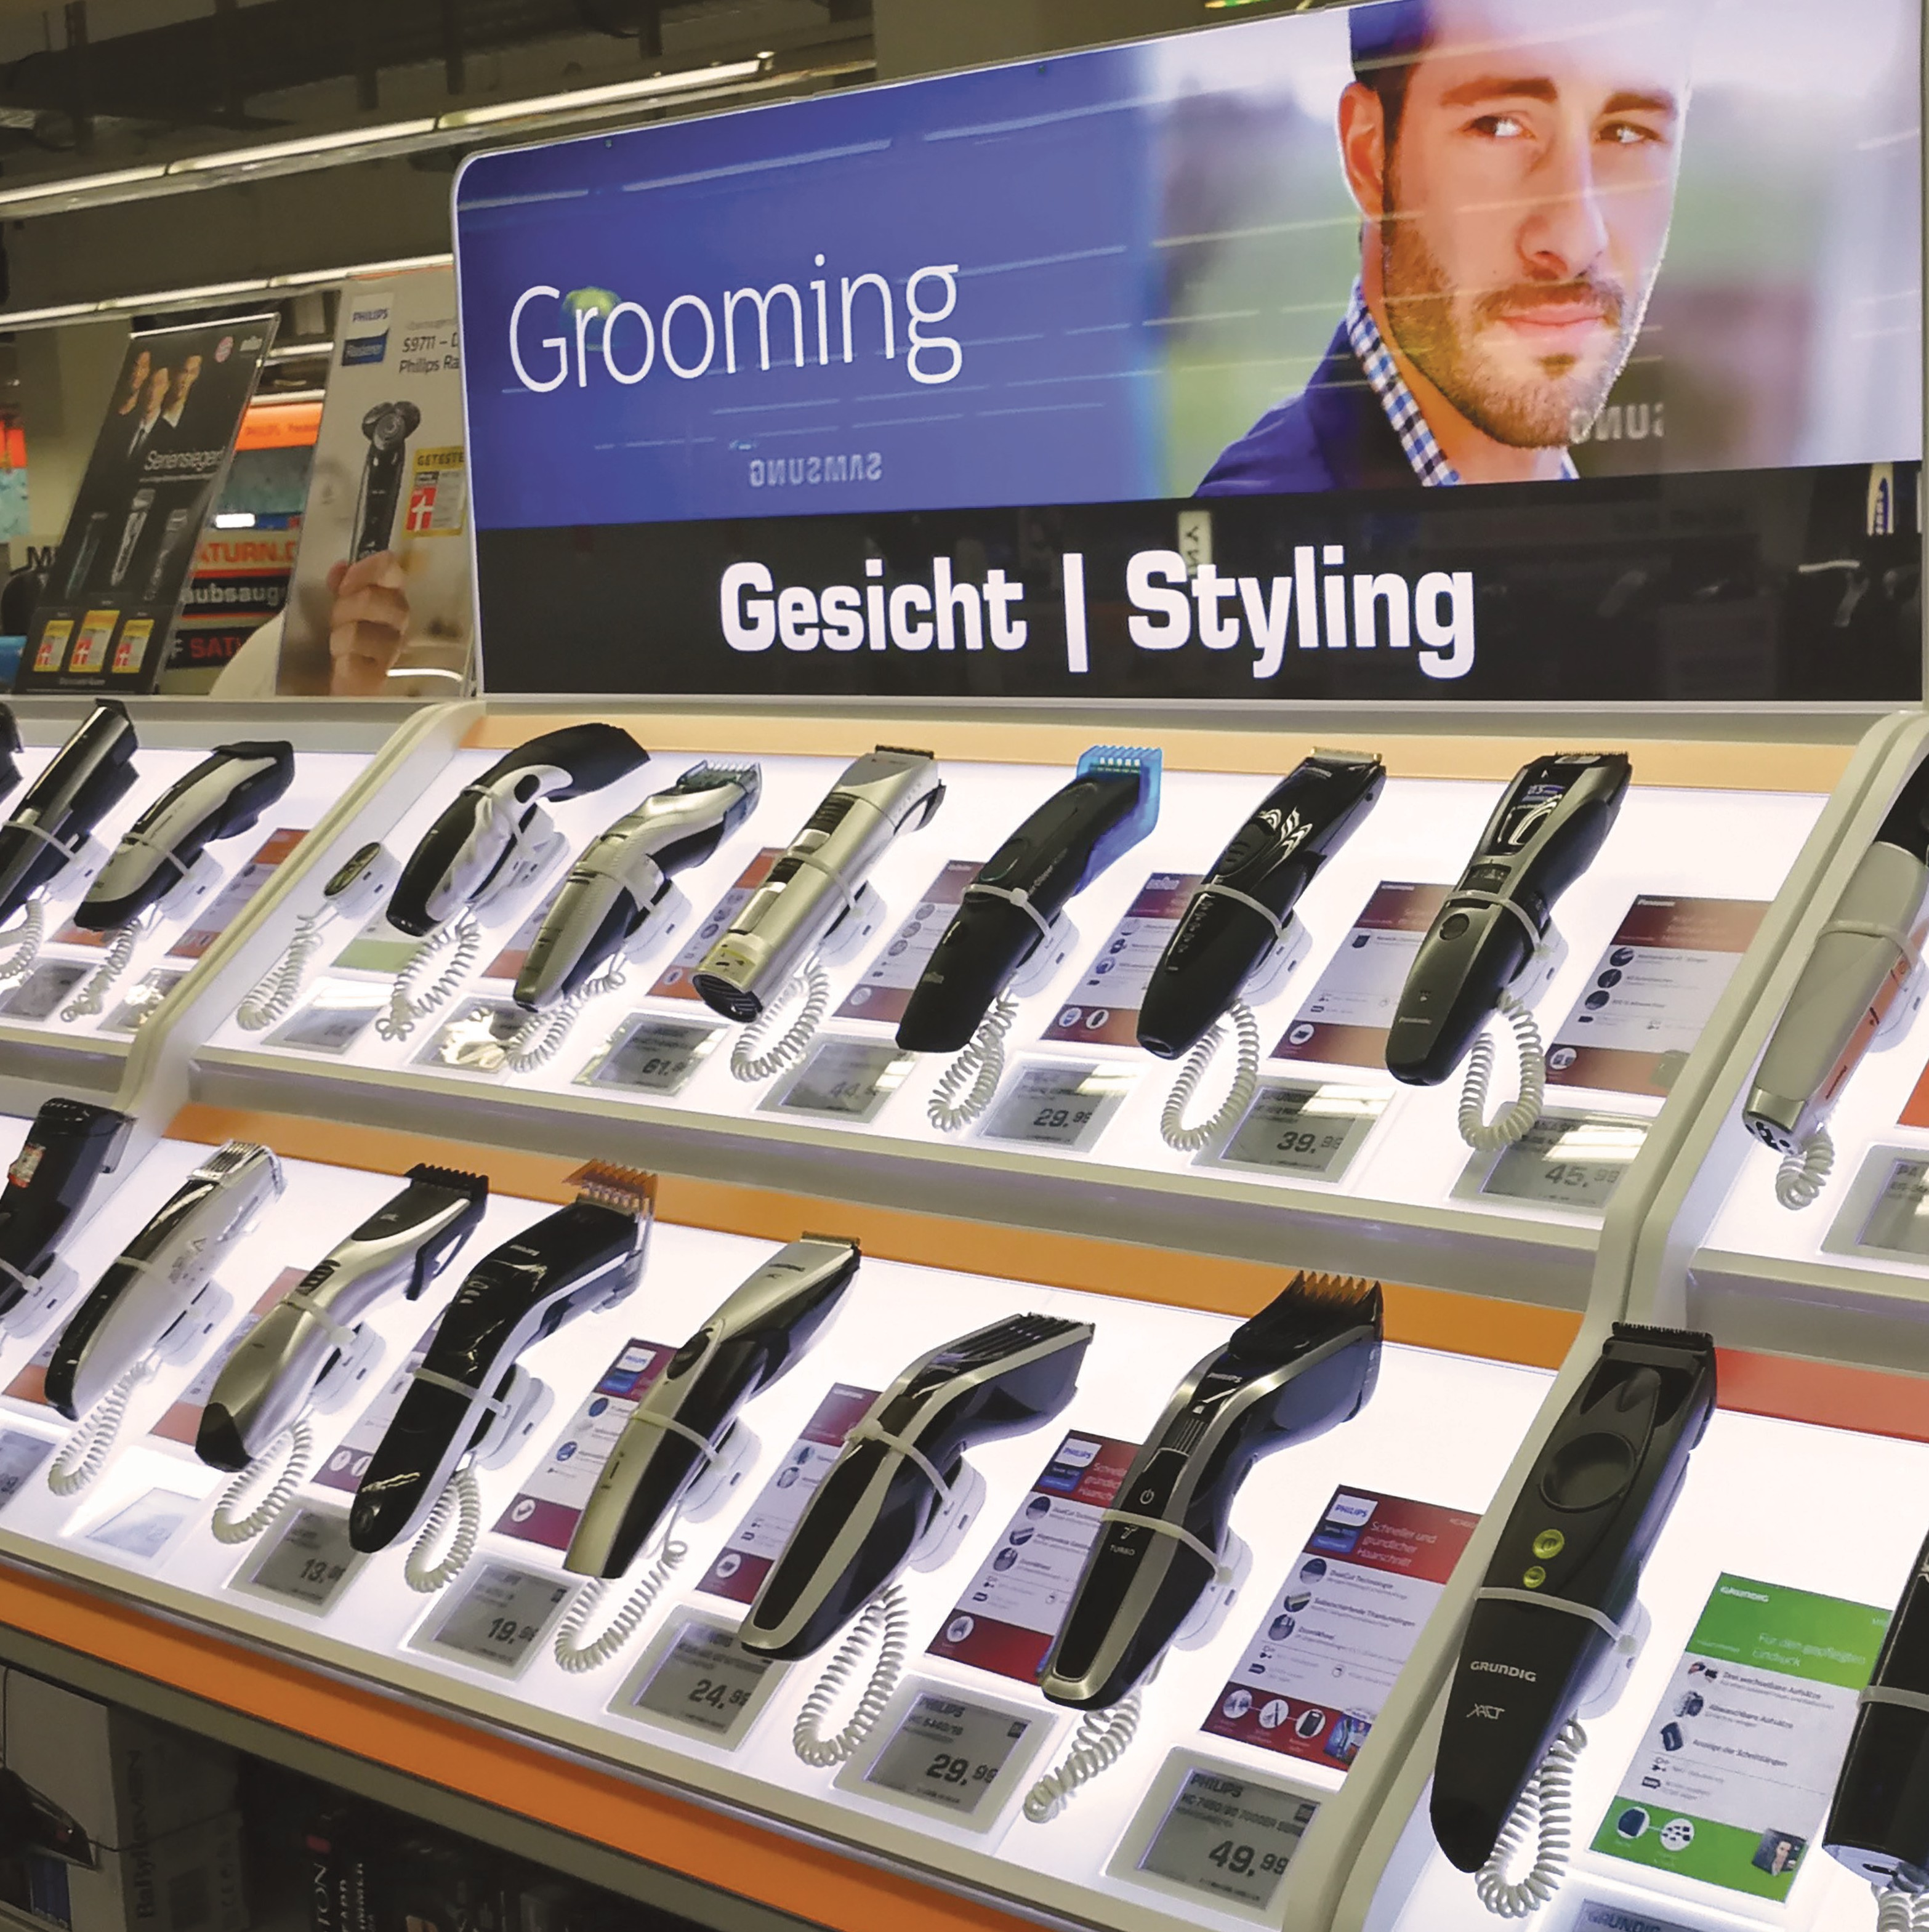
PROJECT
FACE GROOMING SOLUTION – GERMANY, SWITZERLAND, AUSTRIA
Retailer
Media Markt, Saturn
Year
2018
Description
Universal illuminated module with fully flexibe facing and colour highlights. LED lights.
Optional illuminated headers on all modules.
Materials
Mdf, Acrylic sheet, Backlight print, Powder coated sheet metal
Dimensions
H1250xW1000xD500

Slide 31
PROJECT
FSD DISPLAY – GERMANY, SWITZERLAND, AUSTRIA
Retailer
MSD
Year
2020 – 2021
Description
Wooden gondola end with video screen for brand presentation and storage
space.
LED lights.
Materials
Wood, Acrylic sheet
Dimensions
H1400xW1000xD1000

Slide 32
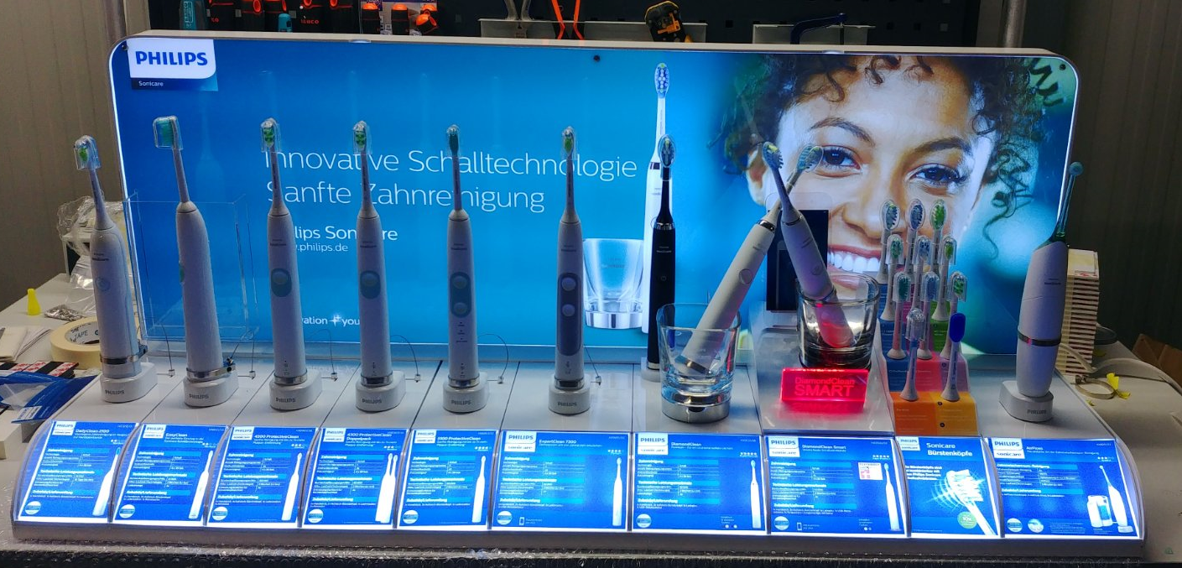
PROJECT
OHC SONICARE DISPLAY – GERMANY, SWITZERLAND, AUSTRIA
Retailer
Media Markt, Saturn
Year
2017 – 2021
Description
Eye catchy on counter display produced to emphasize Sonicare toothbrushes at the POS.
Exchangeable communication, LED lights, anti – theft system.
Materials
Acrylic sheet, Metal sheet, Backlights foil
Dimensions
H300xW1000xD350

Slide 33
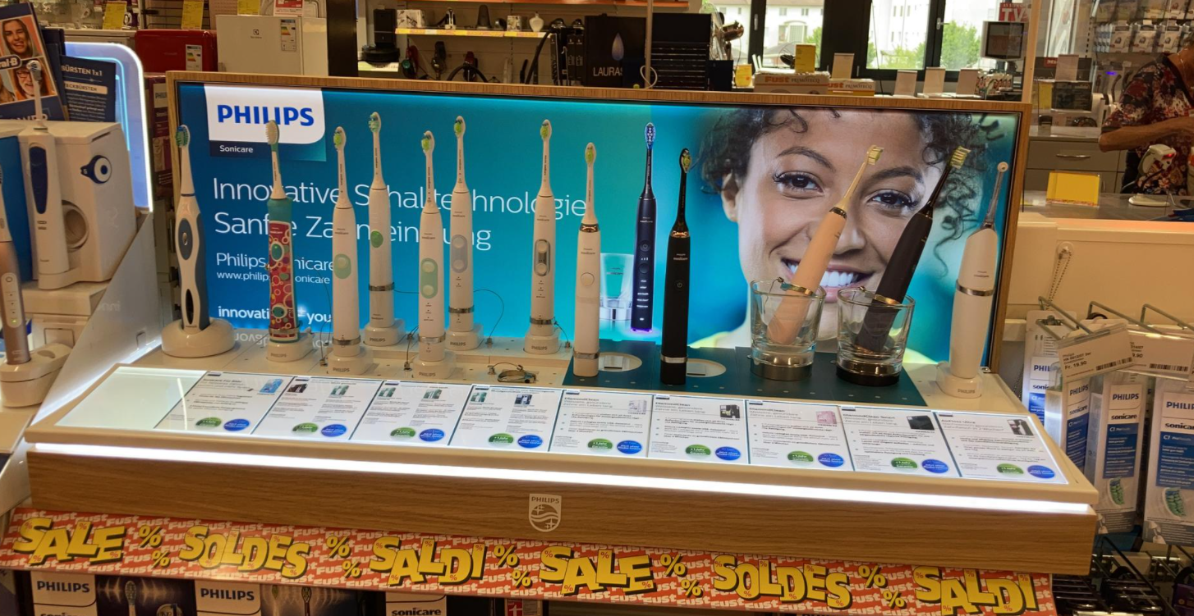
PROJECT
OHC SONICARE 2 DISPLAY – GERMANY, SWITZERLAND, AUSTRIA
Retailer
Media Markt, Saturn, Fust
Year
2017 – 2021
Description
On counter display produced to emphasize Sonicare toothbrushes at the POS.
Eye catchy, Exchangeable communication, LED lights, anti – theft system.
Materials
Wood, Acrylic sheet, Metal sheet, Printed canvas
Dimensions
H300xW1000xD350

Slide 34
PROJECT
ORAL HEALTHCARE COUNTER – GERMANY, SWITZERLAND
Retailer
Muller
Year
2018 – 2021
Description
Eye catchy on counter display at the POS.
Exchangeable communication, LED lights, anti – theft system.
Materials
Acrylic sheet, Backlight foil
Dimensions
H500xW1000xD200

Slide 35
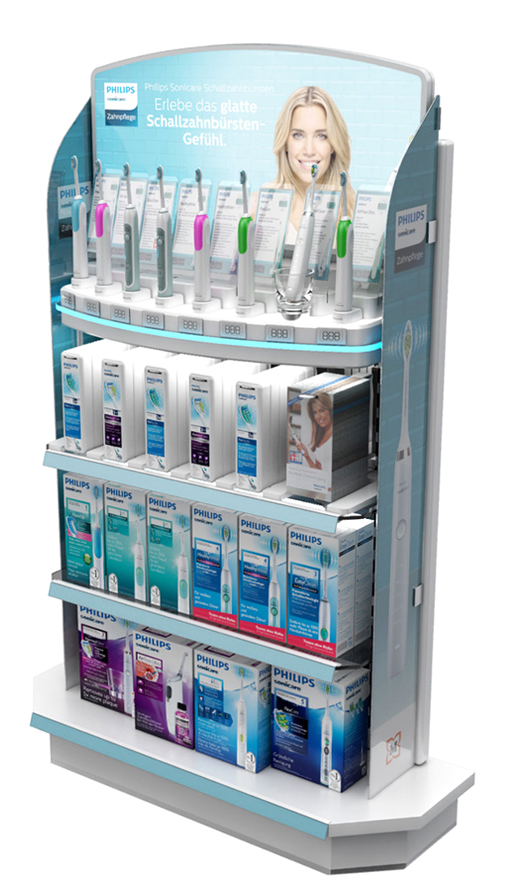
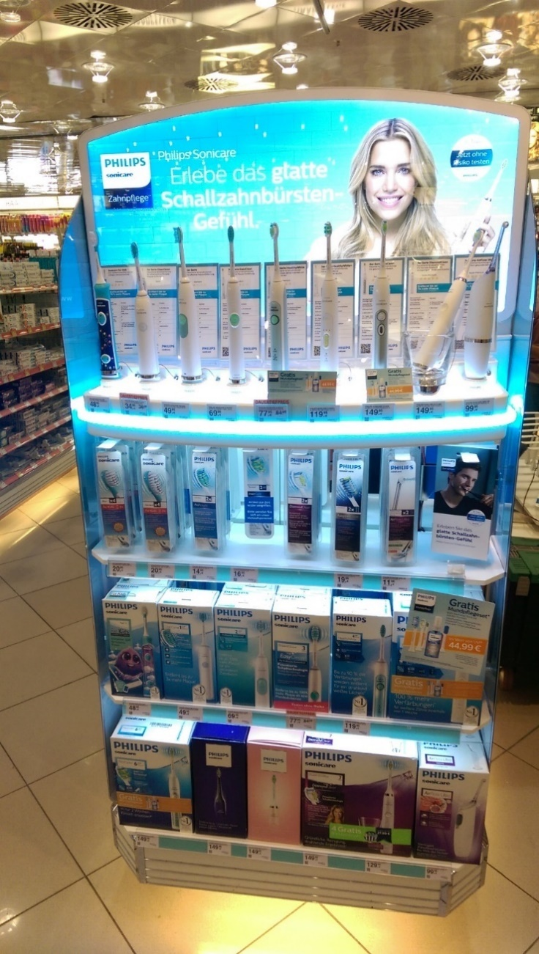
PROJECT
ORAL HEALTHCARE GONDOLA END – GERMANY, SWITZERLAND
Retailer
Muller
Year
2018 – 2021
Description
Eye catchy gondola at the POS.
Exchangeable communication, LED lights, products storage space, anti – theft system.
Materials
Acrylic sheet, Backlight foil
Dimensions
H1400xW1000xD400

Slide 36
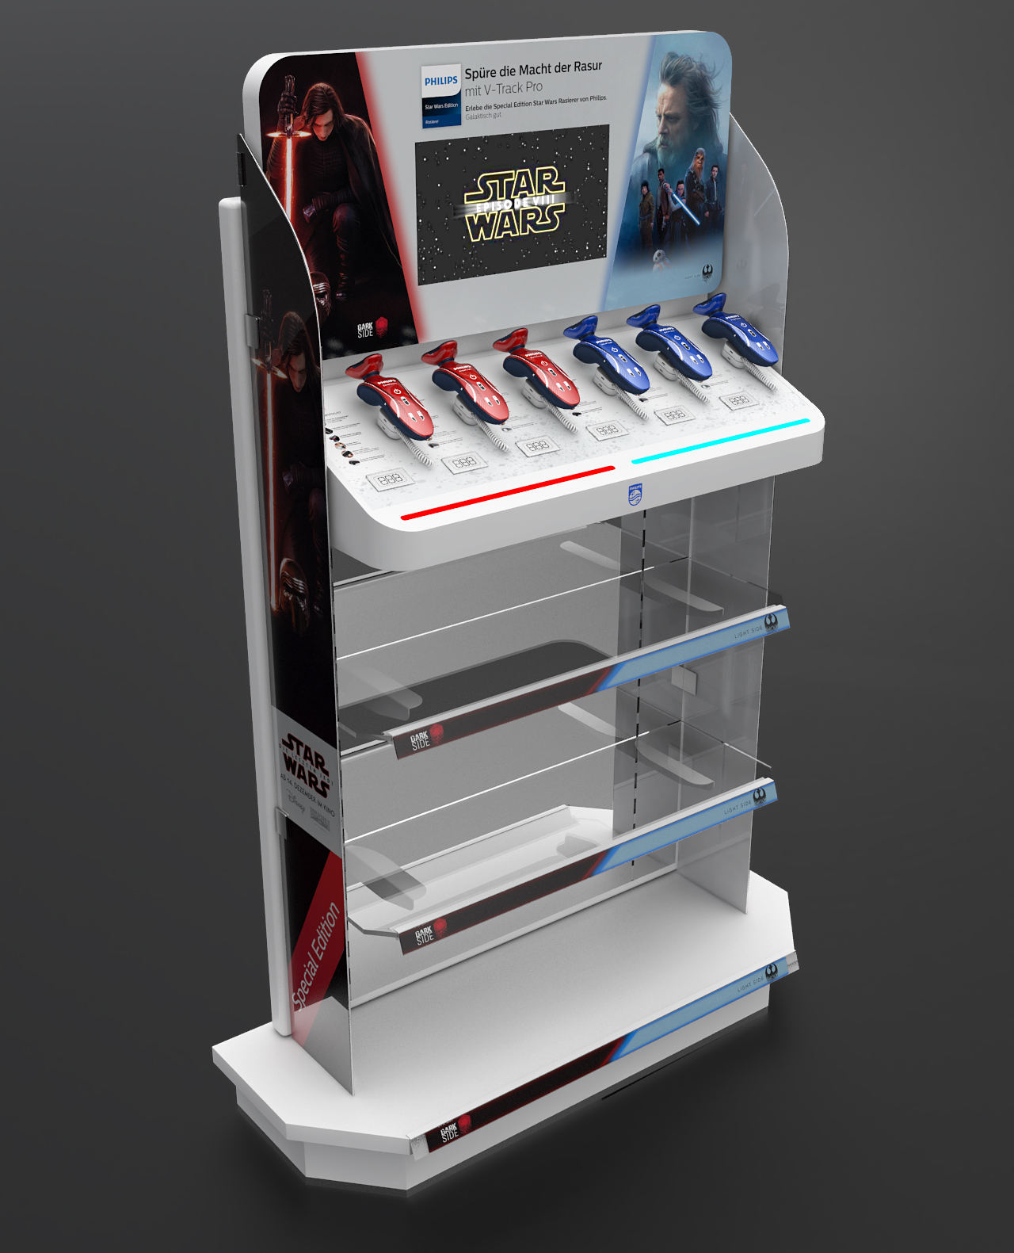
PROJECT
STAR WARS GONDOLA – GERMANY
Retailer
Muller
Year
2017 – 2021
Description
Eye catchy gondola produced to emphasize Star Wars special edition shavers at the POS.
Exchangeable communication, LED lights, anti – theft system.
Video screen with brand communication.
Materials
Acrylic sheet, Metal sheet, Magnetic foil
Dimensions
H1400xW1000xD400

Slide 37
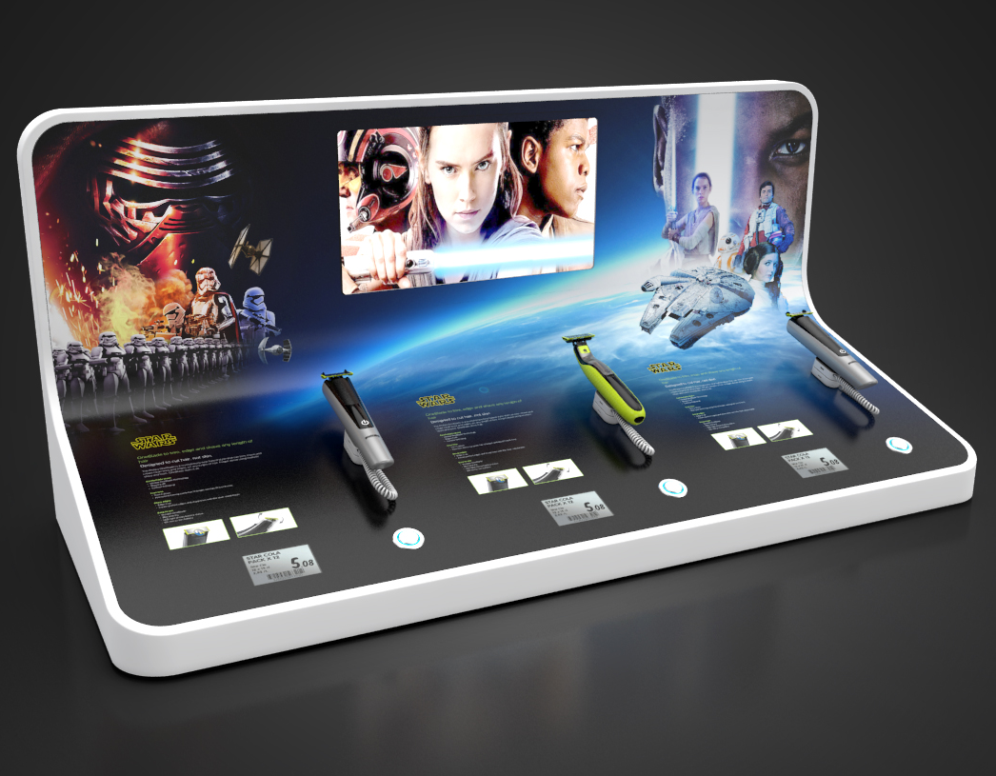
PROJECT
STAR WARS COUNTER DISPLAY – GERMANY
Retailer
Muller
Year
2017 – 2021
Description
On counter display produced to emphasize Star Wars special edition shavers at the POS.
Eye catchy, exchangeable communication, LED lights, anti – theft system.
Video screen with brand communication.
Materials
Acrylic sheet, Metal sheet, Magnetic foil
Dimensions
H500xW1000xD400

Slide 38
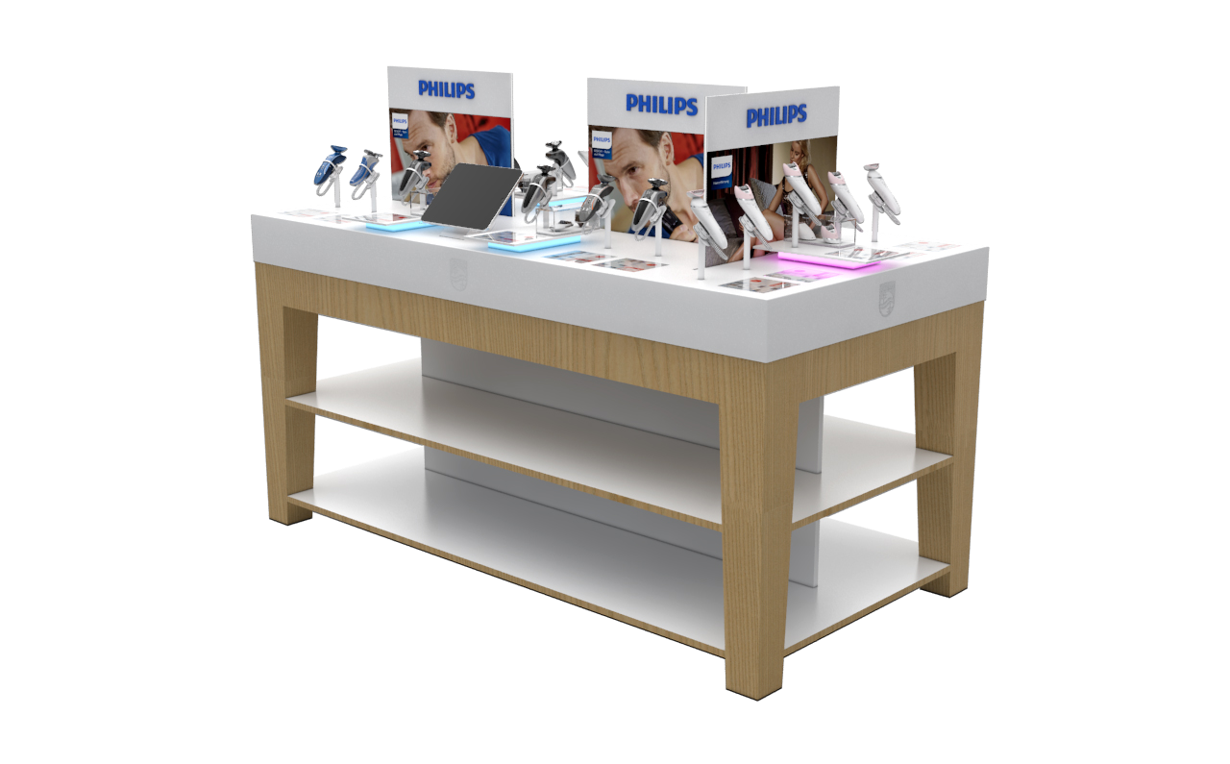
PROJECT
MSD ISLAND – GERMANY
Retailer
Muller
Year
2018
Description
Wooden island for product presentation and testing.
Materials
Wood, Acrylic sheet, Backlight foil
Dimensions
H110xW2000xD100

Slide 39
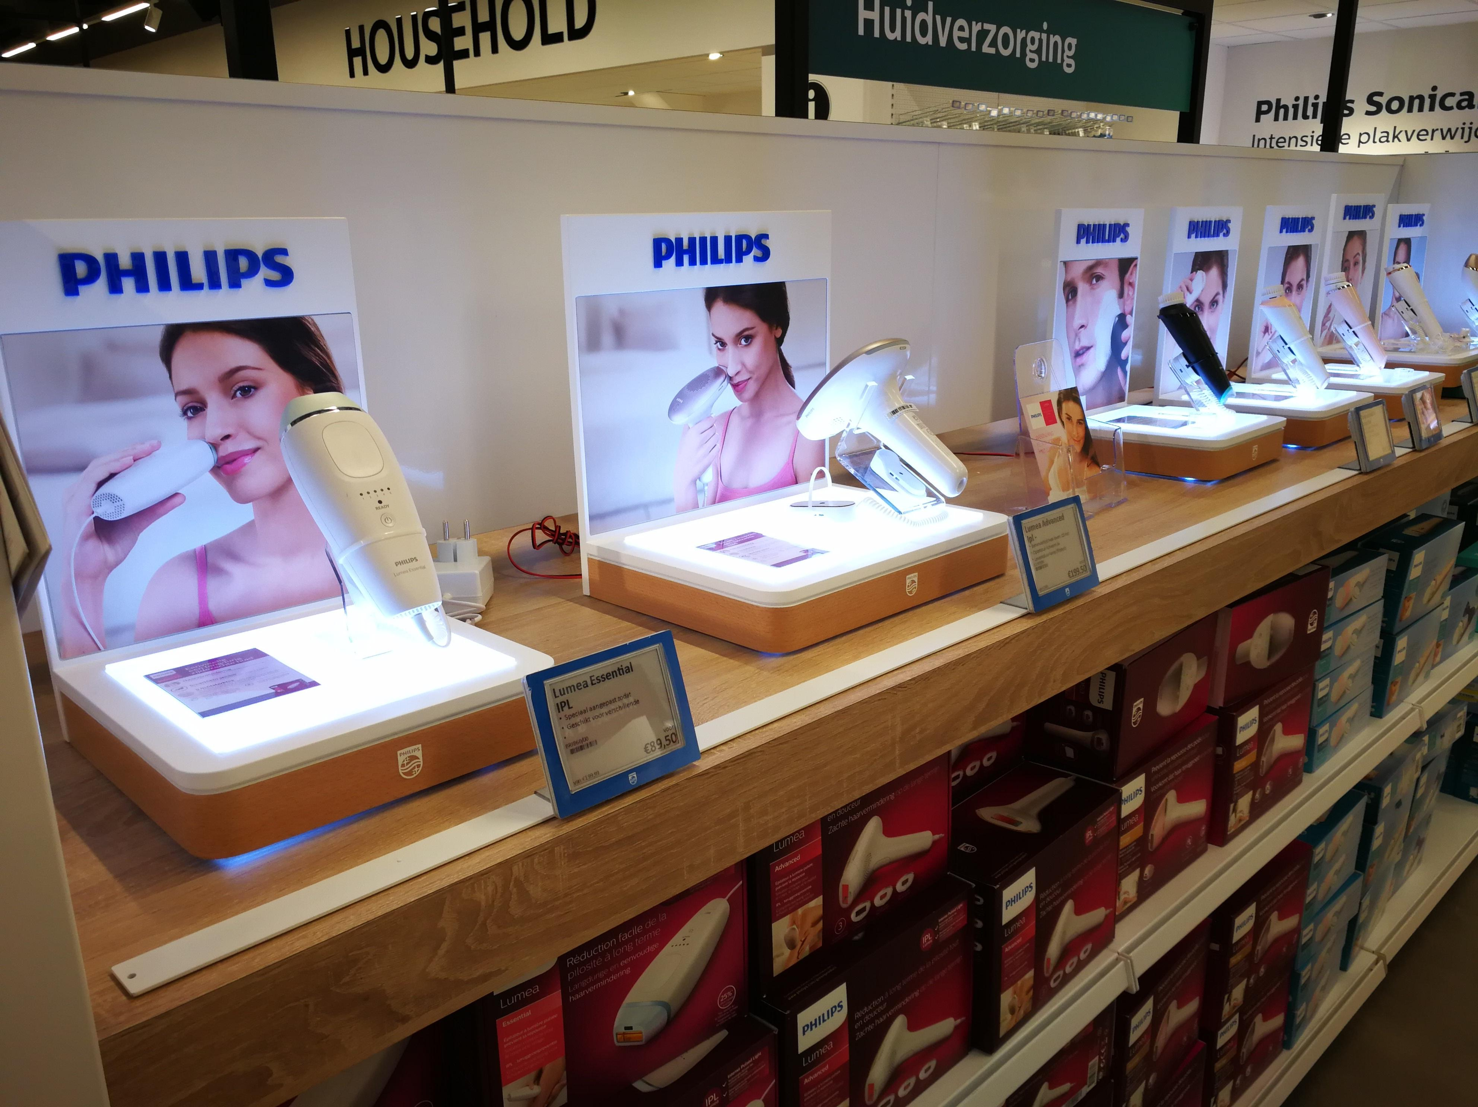
PROJECT
BEAUTY COUNTER – GERMANY
Retailer
MSD
Year
2020
Description
On counter display produced to emphasize hair removal experience.
Highlight display.
Materials
Wood, Acrylic sheet, LED lights
Dimensions
H500xW500xD500

Slide 40
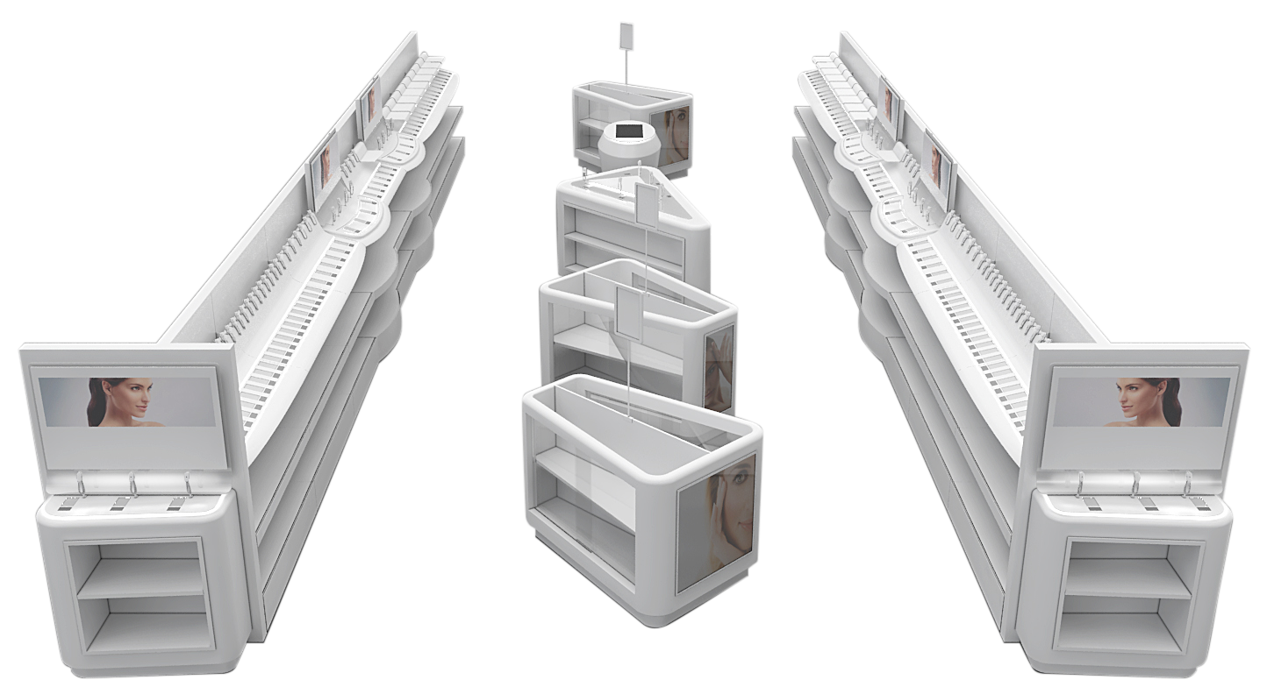
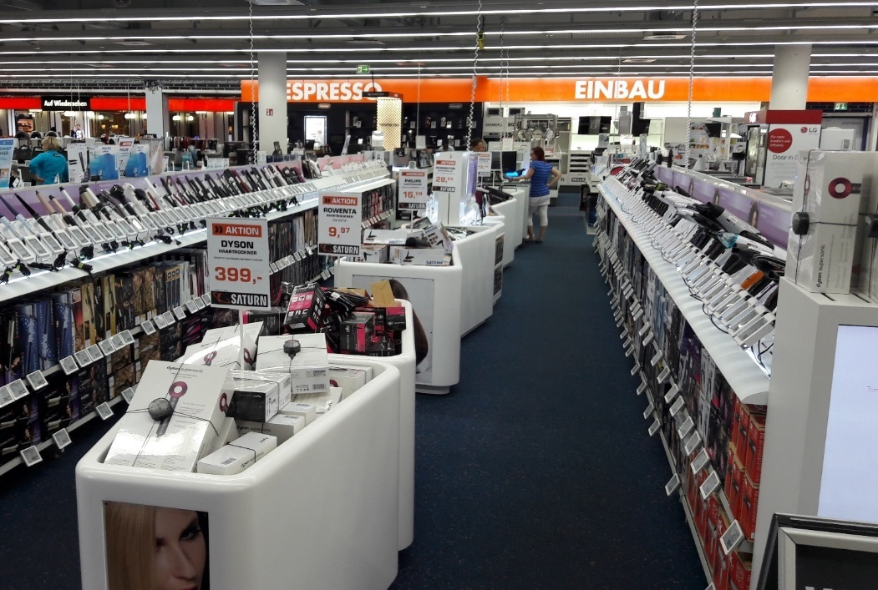
PROJECT
BEAUTY SOLUTION – GERMANY
Retailer
Saturn
Year
2017
Description
Complete in store beauty category solution.
LED lights.
Materials
Metal sheet, Acrylic sheet
Dimensions
H1400xW7000xD800

Slide 41
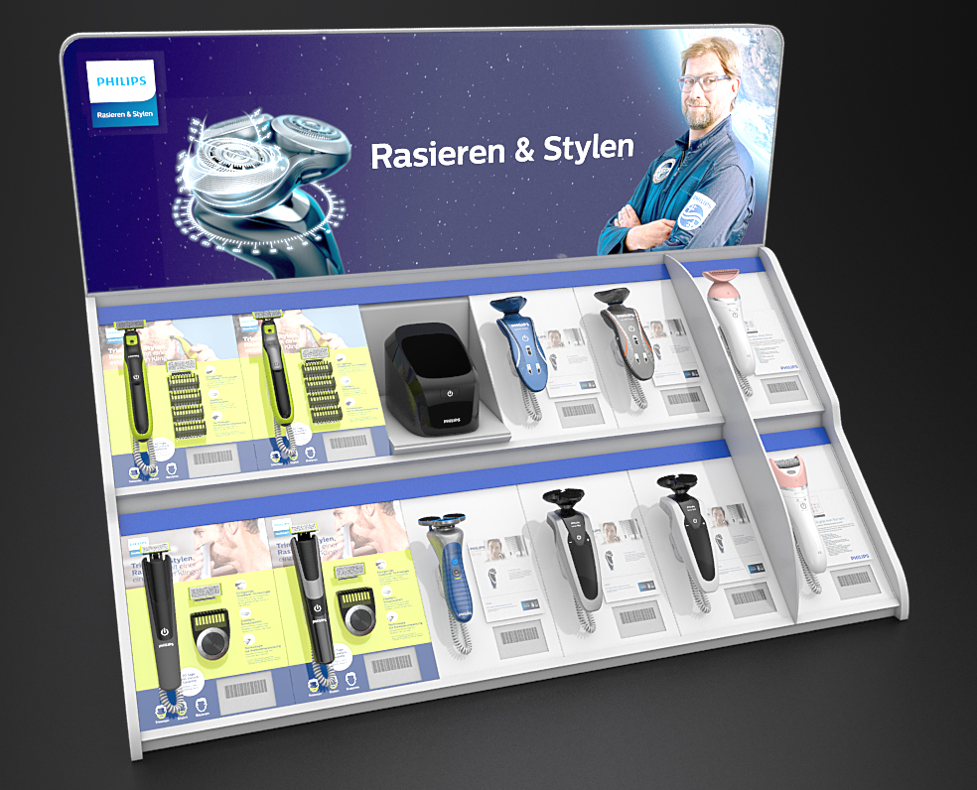
PROJECT
FACE SHAVERS DISPLAY – GERMANY
Retailer
MSD
Year
2018
Description
On counter display to highlight shavers at the POS.
Materials
Wood, Metal sheet, Acrylic sheet, Magnetic foil
Dimensions
H100xW1000xD600

Slide 42
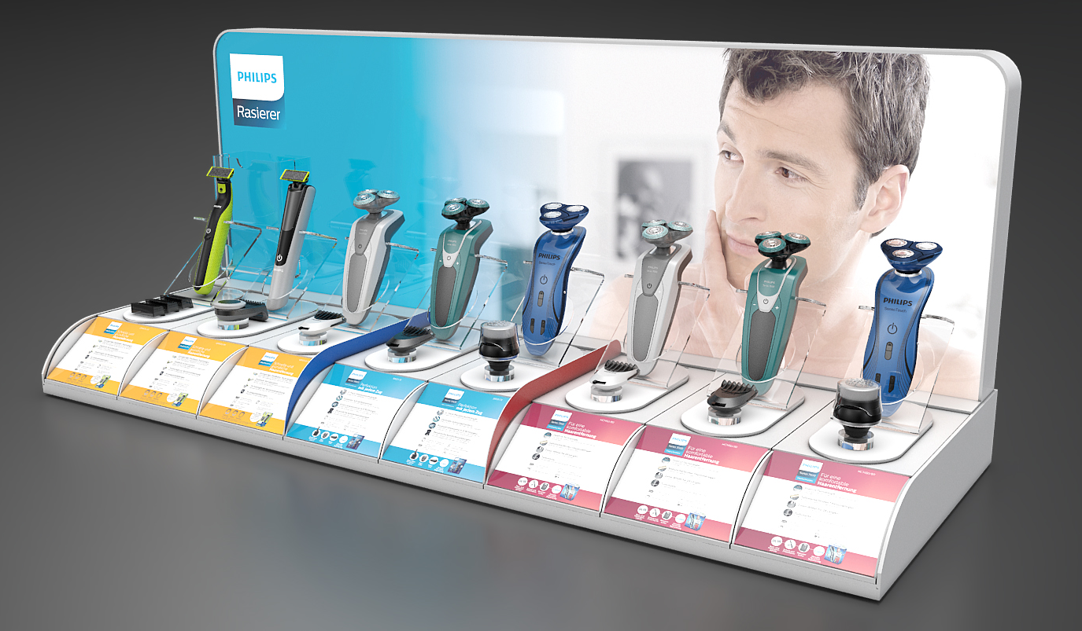
PROJECT
FACE SHAVERS DISPLAY – GERMANY
Retailer
Media Markt, Saturn, Fust
Year
2017 – 2021
Description
On counter display to highlight shavers at the POS.
LED lights.
Materials
Wood, Acrylic sheet, Metal sheet, Printed canvas
Dimensions
H300xW1000xD350

Slide 43
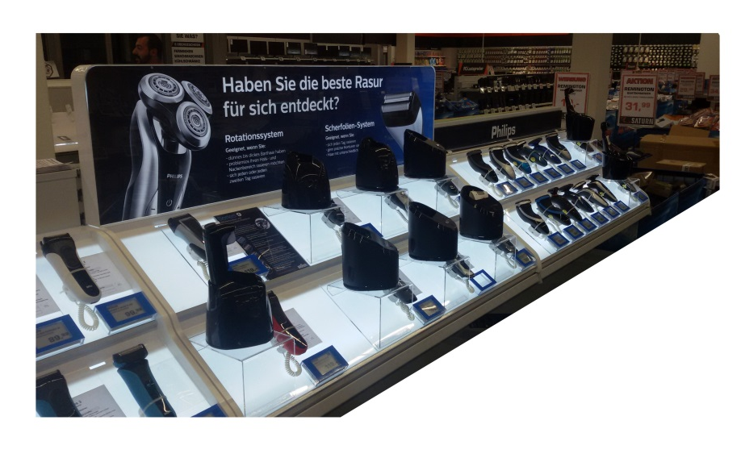
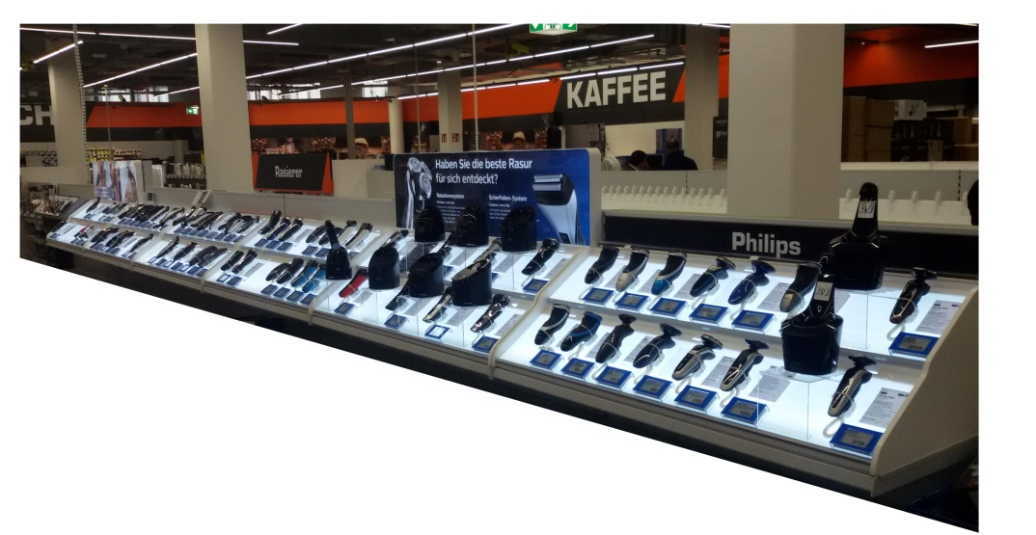
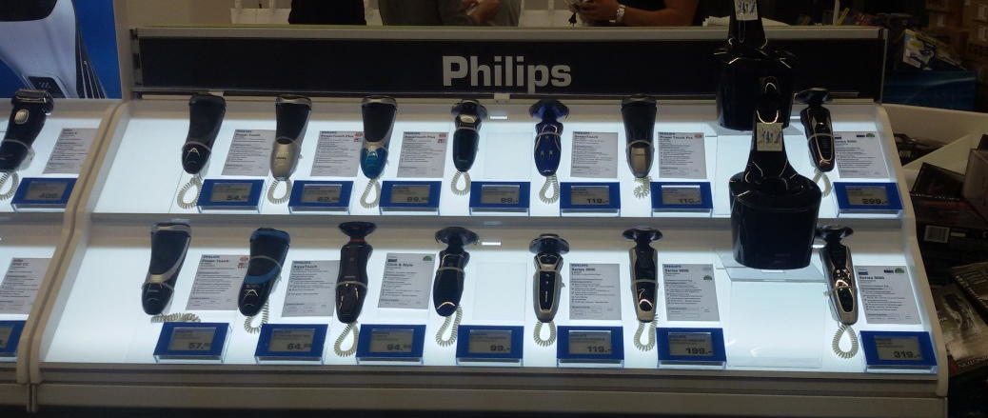
PROJECT
FACE SHAVERS MODULE – GERMANY
Retailer
Saturn
Year
2017 – 2021
Description
Universal illuminated shaving solution with fully flexibe facing and color highlights. LED lights.
Optional illuminated headers on all modules.
Materials
Mdf, Acrylic sheet, Backlight print, Powder coated sheet metal
Dimensions
H1250xW1000xD500

Slide 44
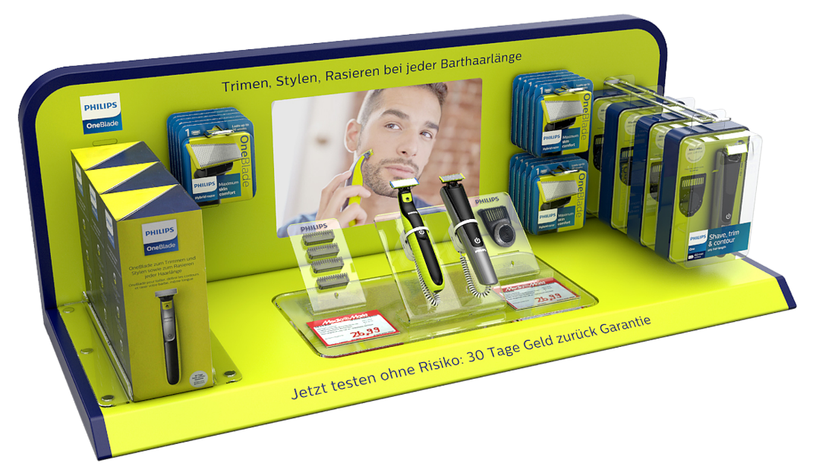
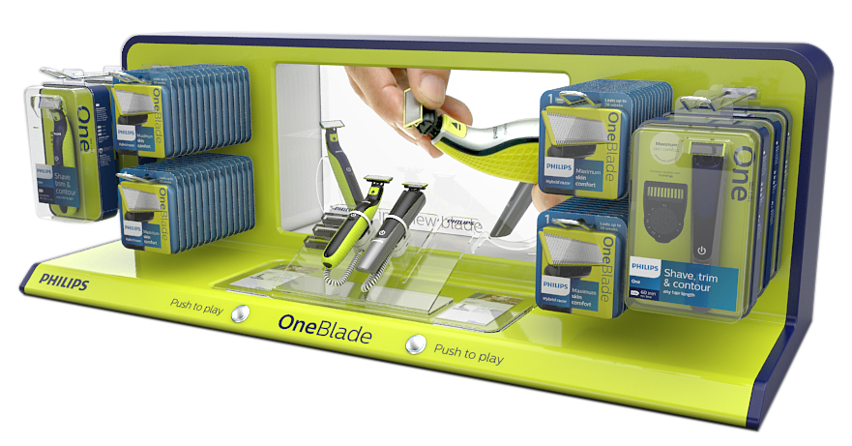
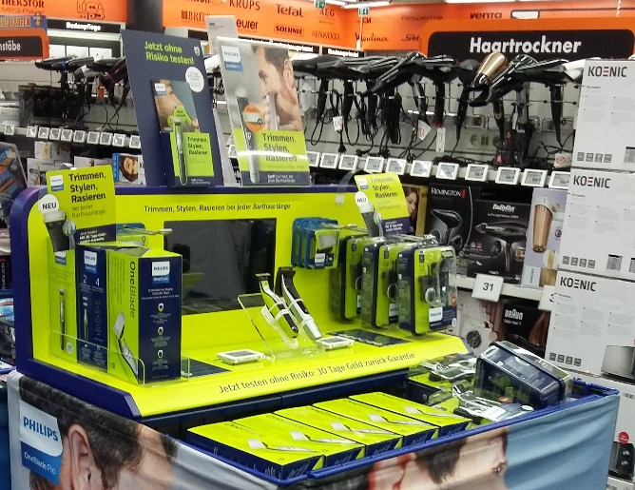
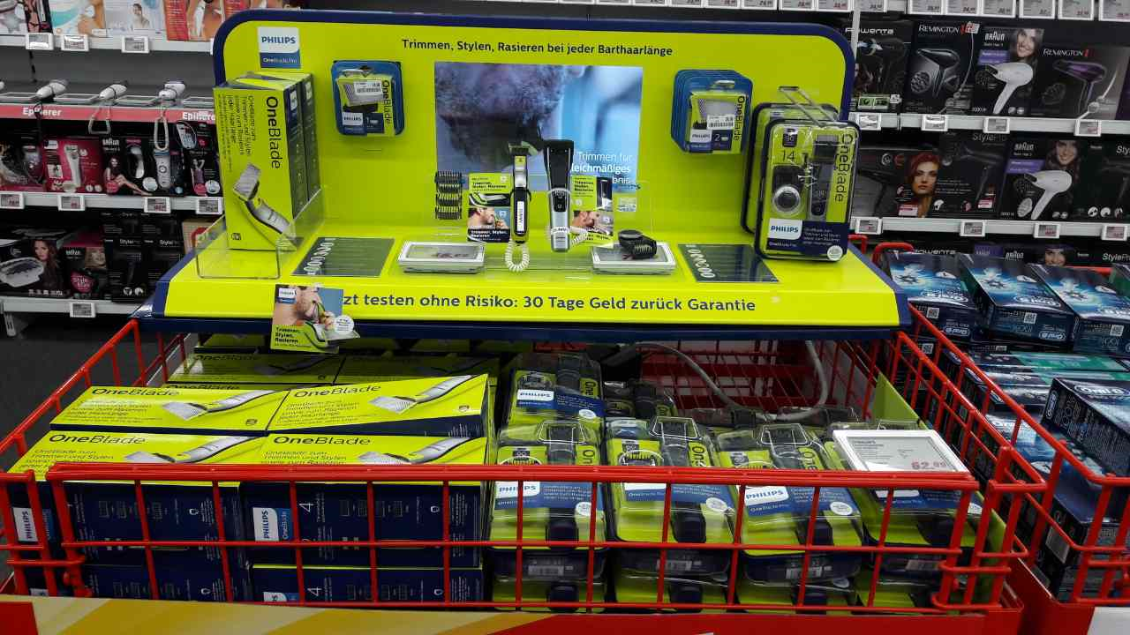
PROJECT
OneBlade SOLUTION – GERMANY
Retailer
Media Markt, Saturn
Year
2017 – 2021
Description
On counter display with video screen to highlight OneBlade at the POS.
Eye catchy, exchangeable communication, LED lights, anti – theft system.
Materials
Metal sheet, Magnetic foil
Dimensions
H300xW1000xD350

Slide 45
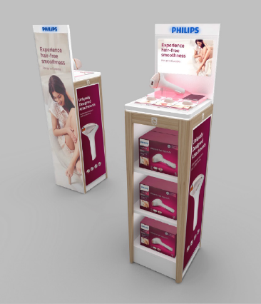
PROJECT
HAIR REMOVAL FREESTANDING UNIT – GERMANY, NETHERLANDS, UNITED KINGDOM
Retailer
Media markt
Year
2020
Description
Illuminated beauty freestanding unit with video screen produced to emphasize hair removal experience at the POP.
Materials
Wood, Acrylic sheet
Dimensions
H1500xW500xD500

Slide 46
MOTHER & CHILD CARE

Slide 47

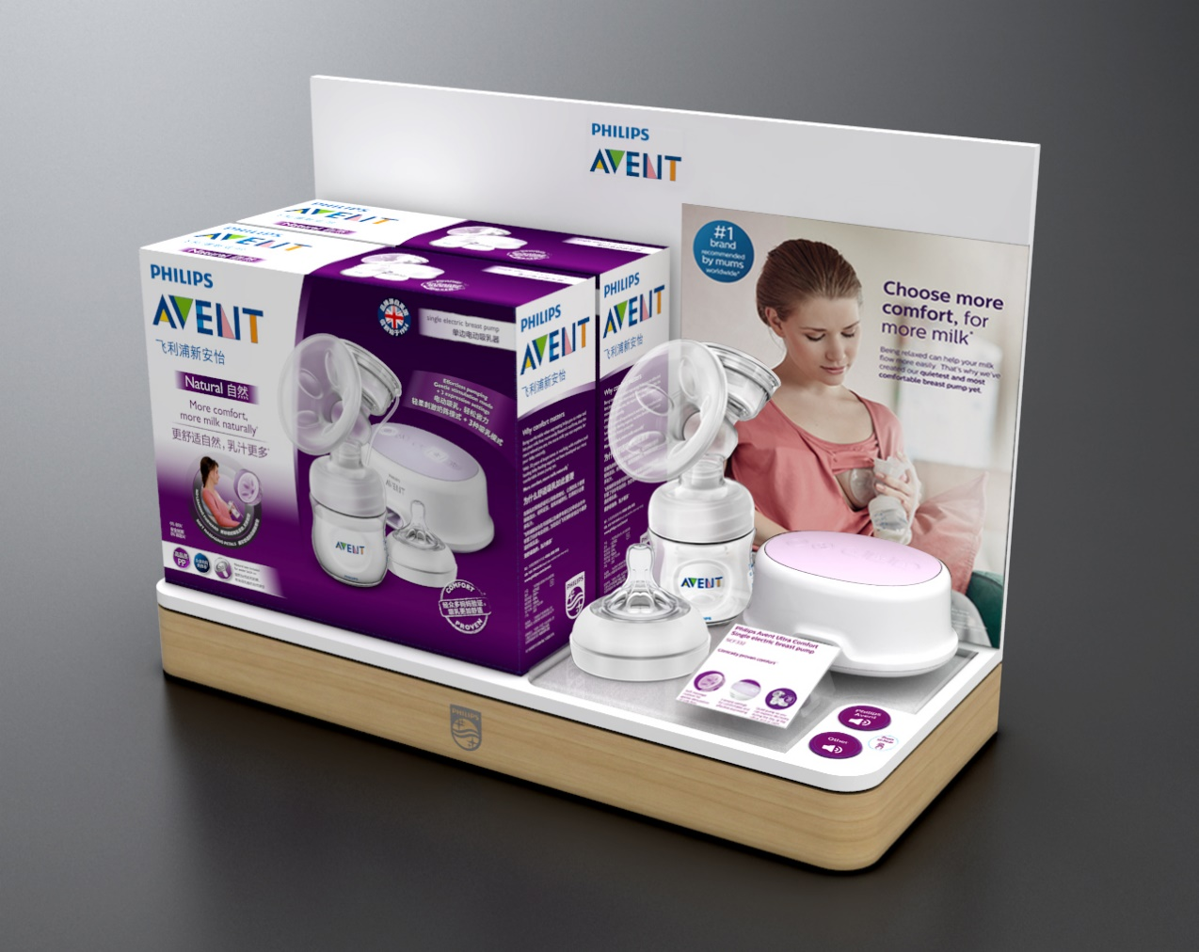
PROJECT
BREAST PUMPS & CARE DISPLAY – NETHERLANDS, SWEDEN
Retailer
MSD
Year
2019
Description
On counter display to highlight Mother & Child care category at the POS.
Materials
Wood, Acrylic sheet, Metal sheet
Dimensions
H600xW800xD500

Slide 48
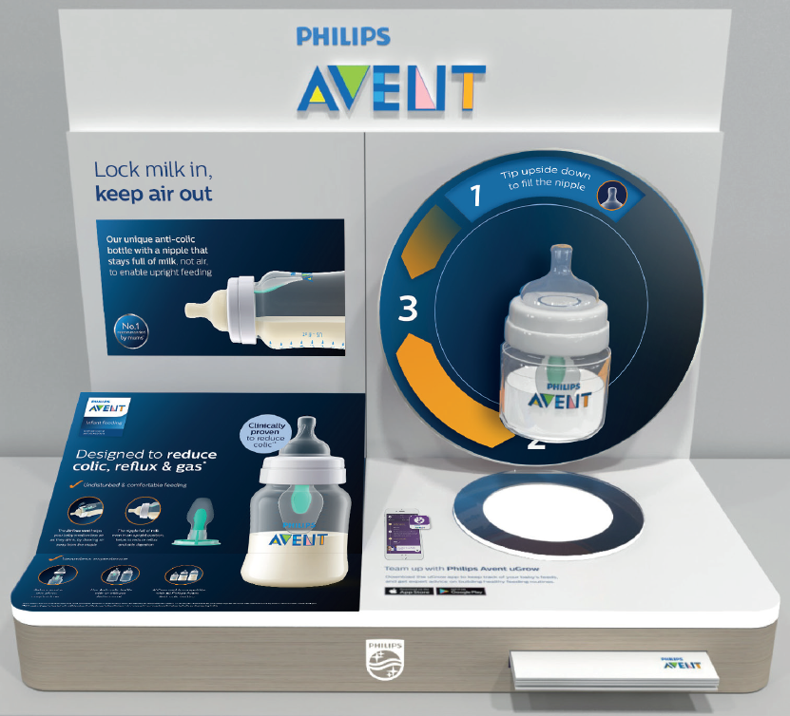
PROJECT
KEPLER BABY BOTTLE DISPLAY – NETHERLANDS
Retailer
MSD
Year
2019
Description
On counter display emphasize Mother & Child care category at the POP.
Materials
Wood, Acrylic sheet, Metal sheet
Dimensions
H600xW800xD500

Slide 49
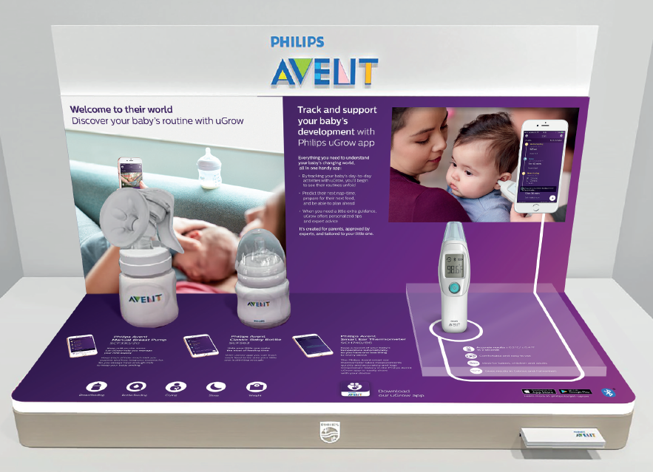
PROJECT
uGrow DISPLAY – NETHERLANDS
Retailer
MSD
Year
2019
Description
On counter display to highlight Mother & Child care category at the POP.
Materials
Metal sheet, Wood, Acrylic sheet
Dimensions
H600xW800xD500

Slide 50
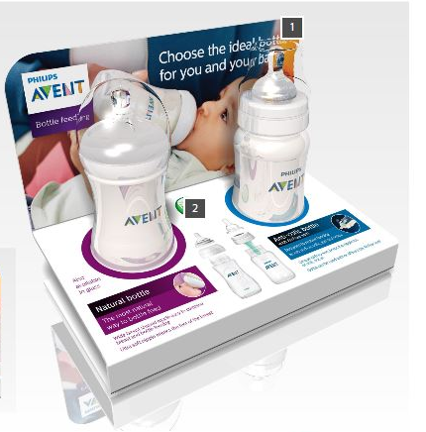
PROJECT
MULAN DISPLAY – NETHERLANDS
Retailer
MSD
Year
2019
Description
On counter display emphasize Mother & Child care category at the POP.
Materials
Metal sheet, Wood, Acrylic sheet
Dimensions
H600xW700xD350

Slide 51
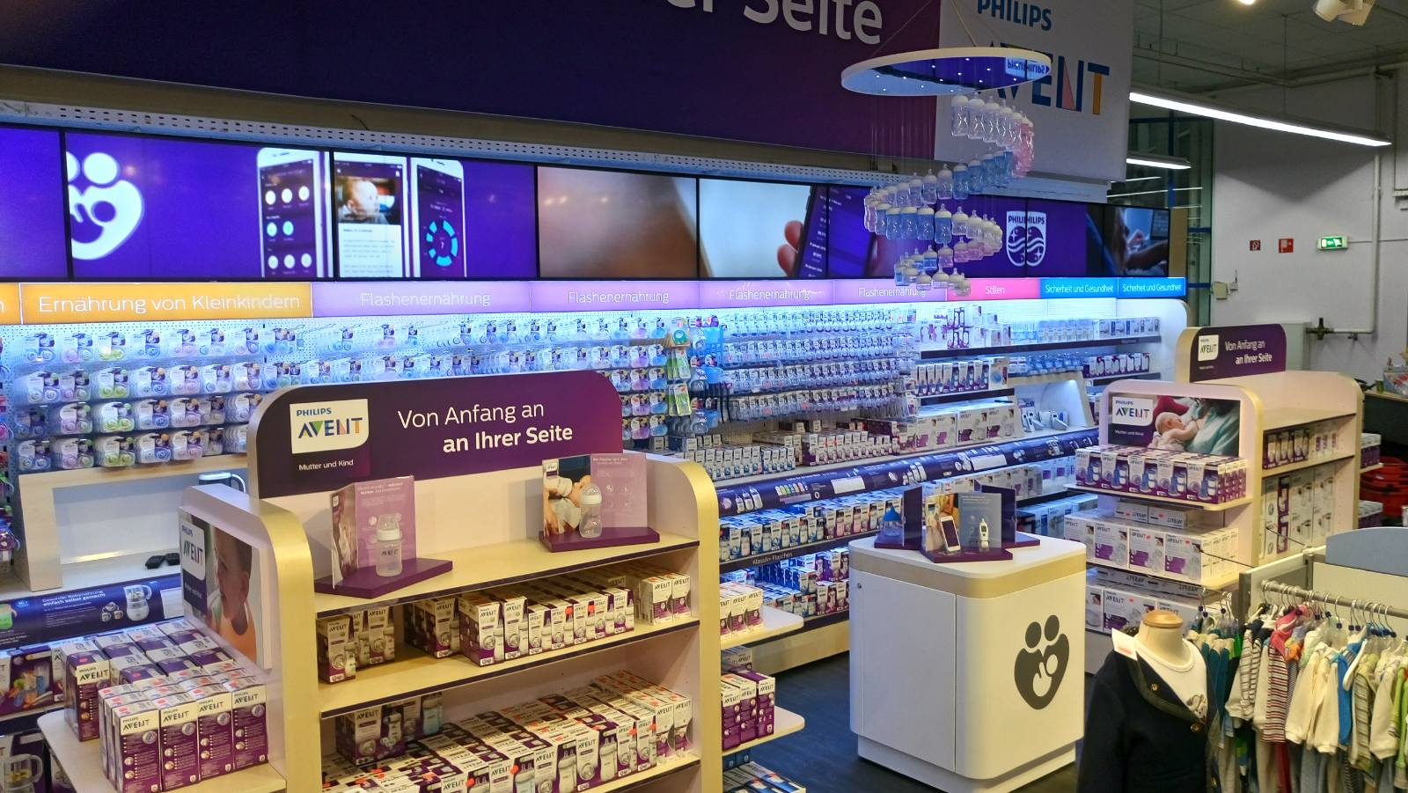
PROJECT
MOTHER & CARE SOLUTION – GERMANY
Retailer
Independent retailer
Year
2016
Description
Complete in store beauty category solution.
LED lights. Digital signage.
Materials
Metal sheet, Wood, Acrylic sheet, Printed magnetic foil
Dimensions
On request

Slide 52
6. SUPPORT
TEAM

Slide 53




CONTACT US – TELL US ABOUT YOUR PROJECT
Nikola Elezović
nikola.elezovic@bgreklam.com
+381 64 221 0 633
Director of Commercial Operations
English speaking
Dino Ramić
dino.ramic@bgreklam.com
+49 160 919 3878
Business Development Manager
DACH Region
German & English speaking
Nenad Klarić
nenad.klaric@bgreklam.com
+381 60 68 69 144
+49 151 52 559 046
Key Account Manager
DACH Region
German & English speaking
Jacqueline Eli
jacqueline.eli@bgreklam.com
+49 177 58 953 58
Key Account Manager
DACH Region
German & English & French speaking

Slide 54




CONTACT US – TELL US ABOUT YOUR PROJECT
Milan Bajić
milan.bajic@bgreklam.com
+381 60 68 69 127
Senior Key Account Manager
Nordics, BeNeLux & France region
English & French speaking
Nemanja Stančić
nemanja.stancic@bgreklam.com
+381 60 68 69 136
Key Account Manager
UK, Ireland & Central Europe
English & Russian speaking
Sandra Ratković
sandra.ratkovic@bgreklam.com
+381 60 68 69 143
+49 151 53 31 2634
Key Account Manager
Adria & DACH Region
German & English speaking
Dimitrije Božić
dimitrije.bozic@bgreklam.com
+381 60 68 69 137
Junior Key Account Manager
Adria Region
English & German speaking

