Slide 1
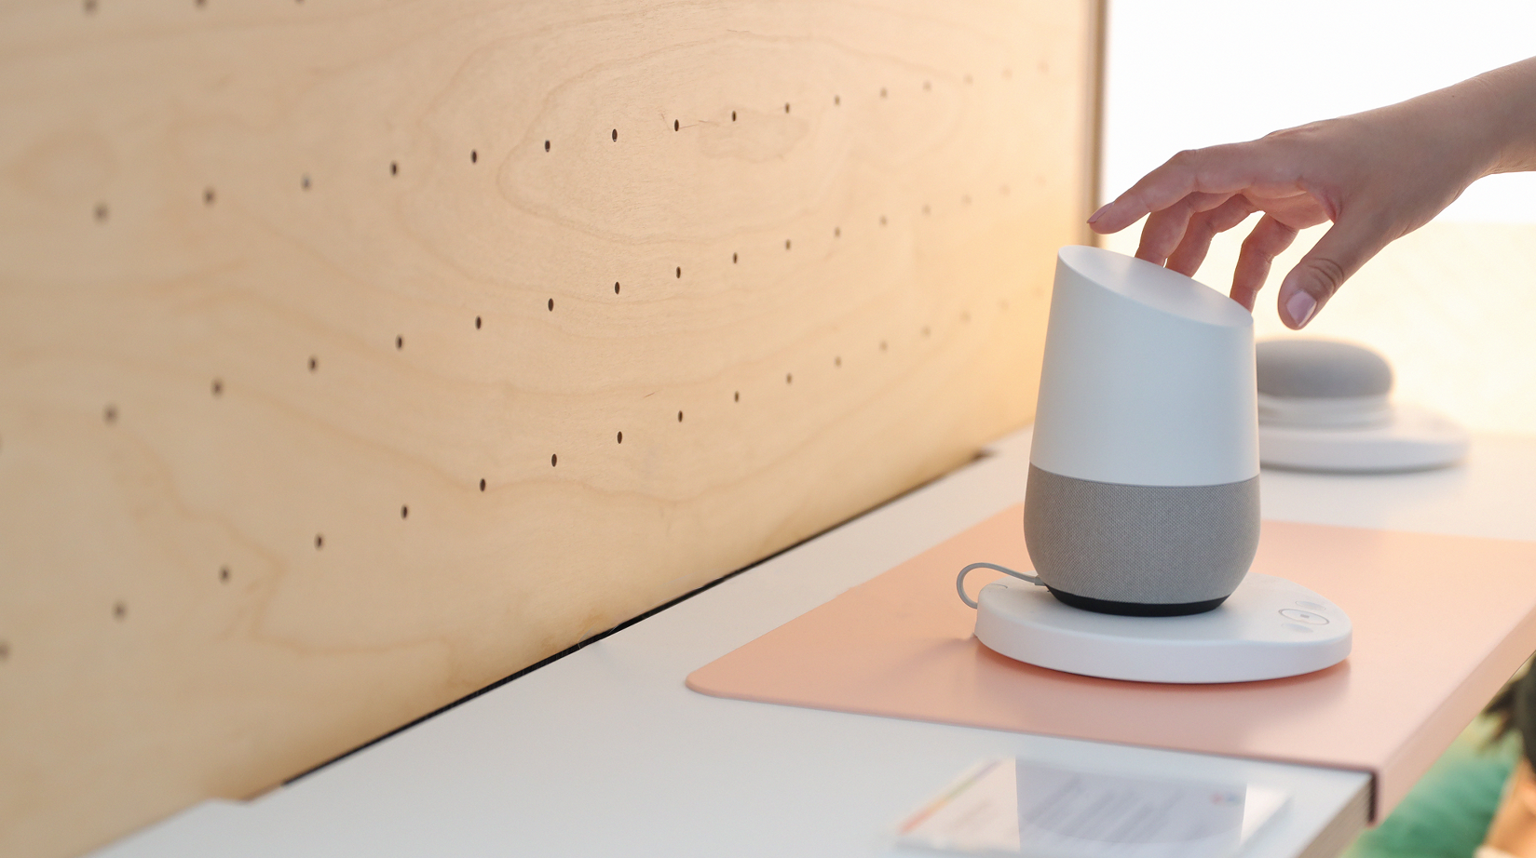

Premium
POS Industry
People are always going to go shopping.
A lot of our effort is just ‘how do we make the retail experience a great one!

Slide 2
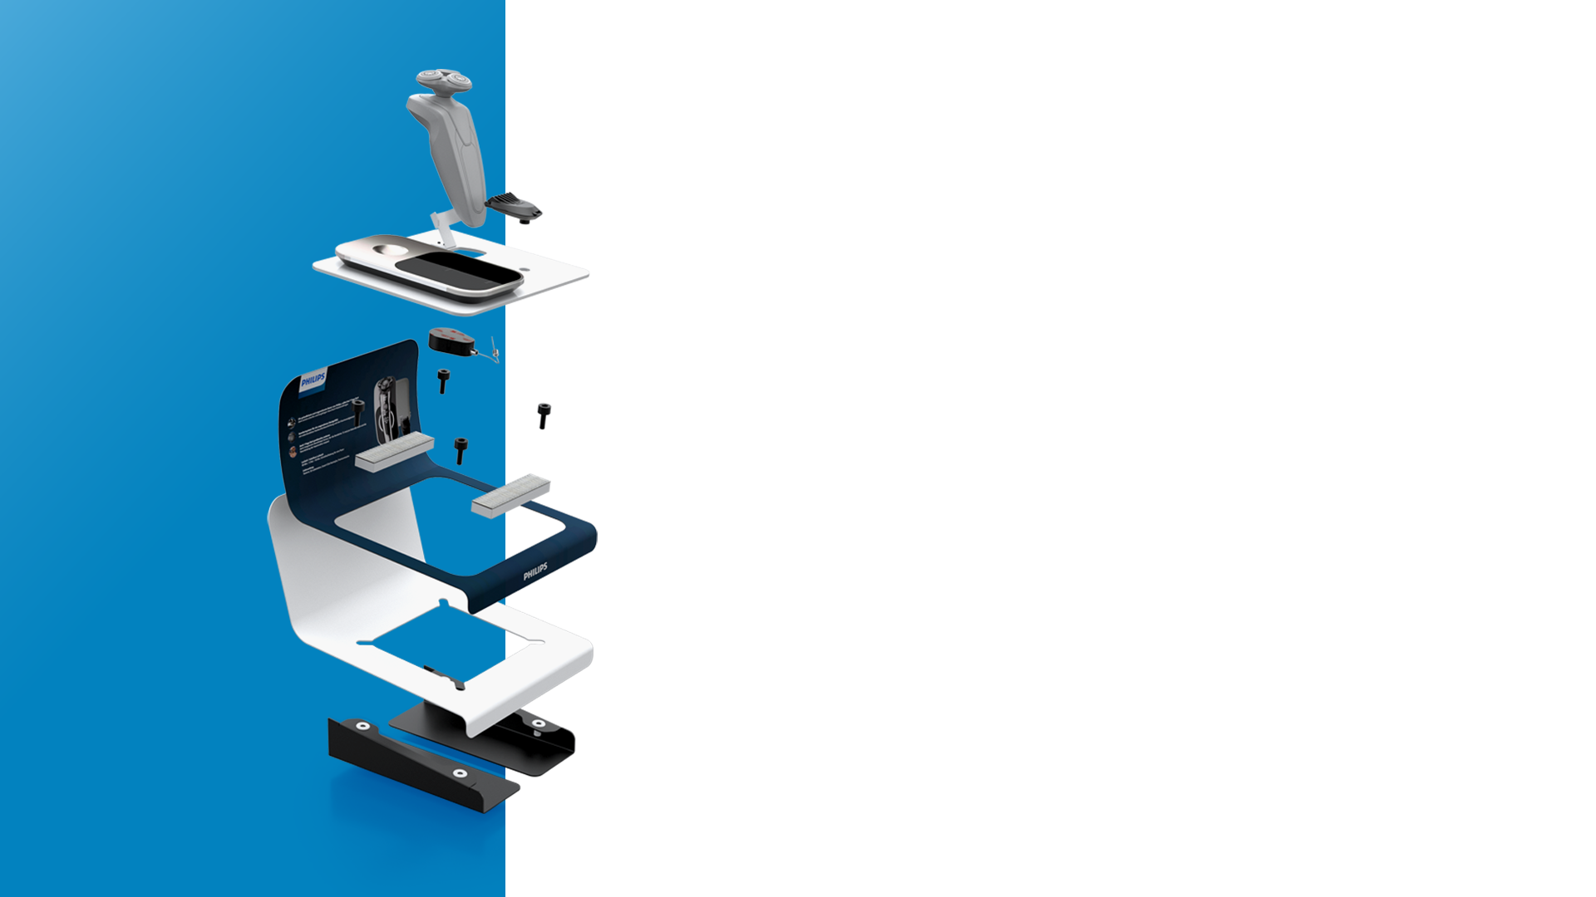
Contents.
Company Profile
Markets
Working with BG Reklam
Partners
More planet less waste
Accreditations
Projects

Slide 3

01.
Company
Profile
Private company, established in 2001, with factory and HQ in Belgrade, Serbia.
Entire value chain from design and production, installation
and maintenance at the point of sale.
Sustainable materials the core of our production process.
200+ skilled employees and 5.000 square meters of office and production space.
20+
Years of experience
and development of
Premium POS solutions.

Slide 4
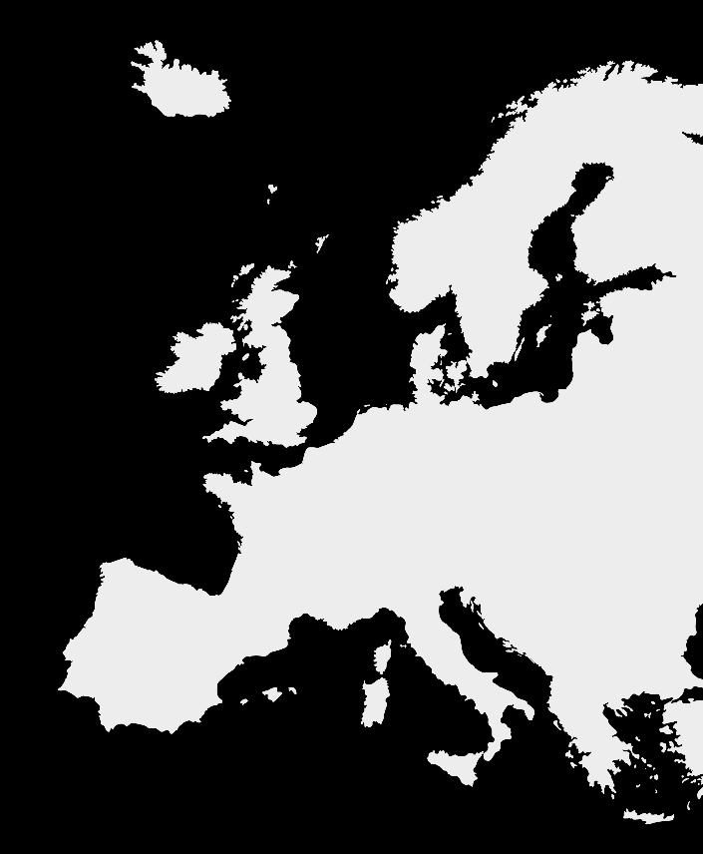

02.
Markets
We cover
Region in focus:
Western and Central Europe
Presence:
25+ Markets across the globe
Offices:
Belgrade Hamburg London
Delivery times:
We deliver our products to any European destination within three working days.

Slide 5
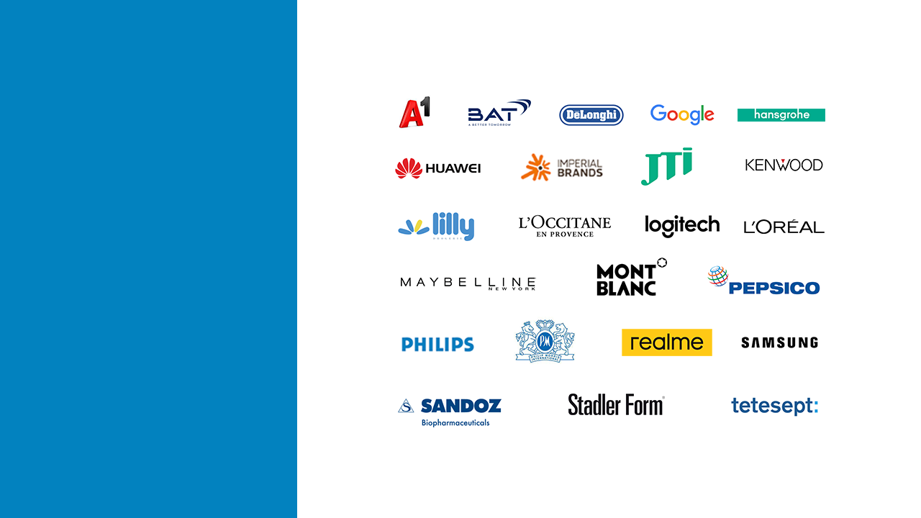
04.
Partners

Slide 6

05.

Slide 7
What we do?
Our Projects

Slide 8
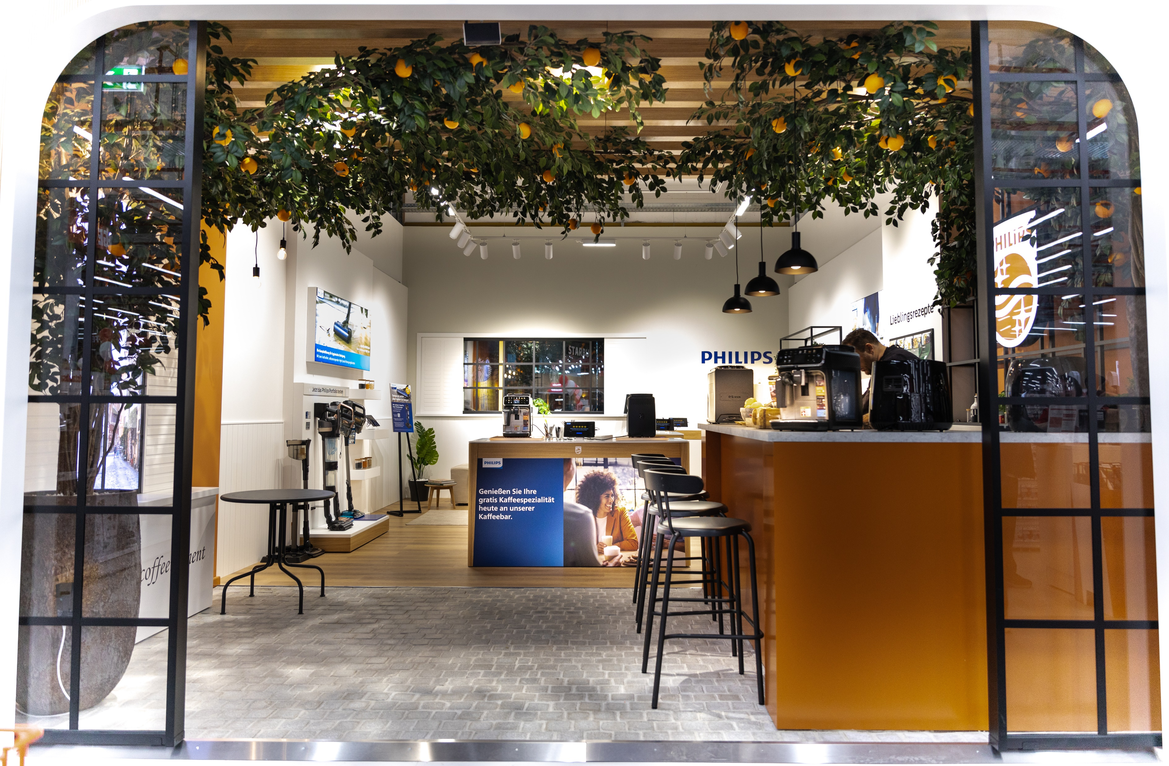
07.
Shop in
Shop
solutions
Description
Premium Shop in Shop concept for Philips domestic apliances. Designed, produced and installed by BGReklam in Berlin Germany.

Slide 9
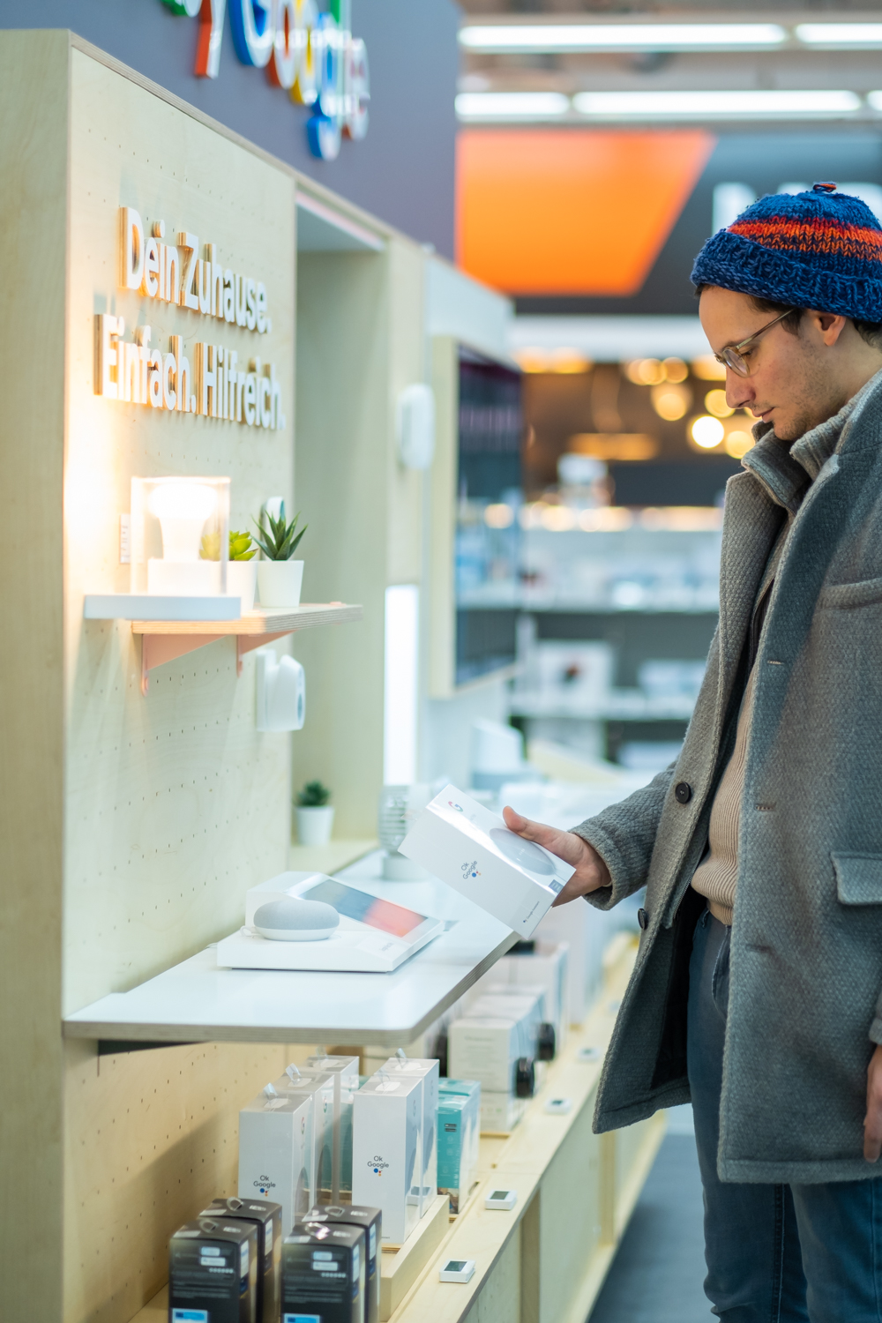
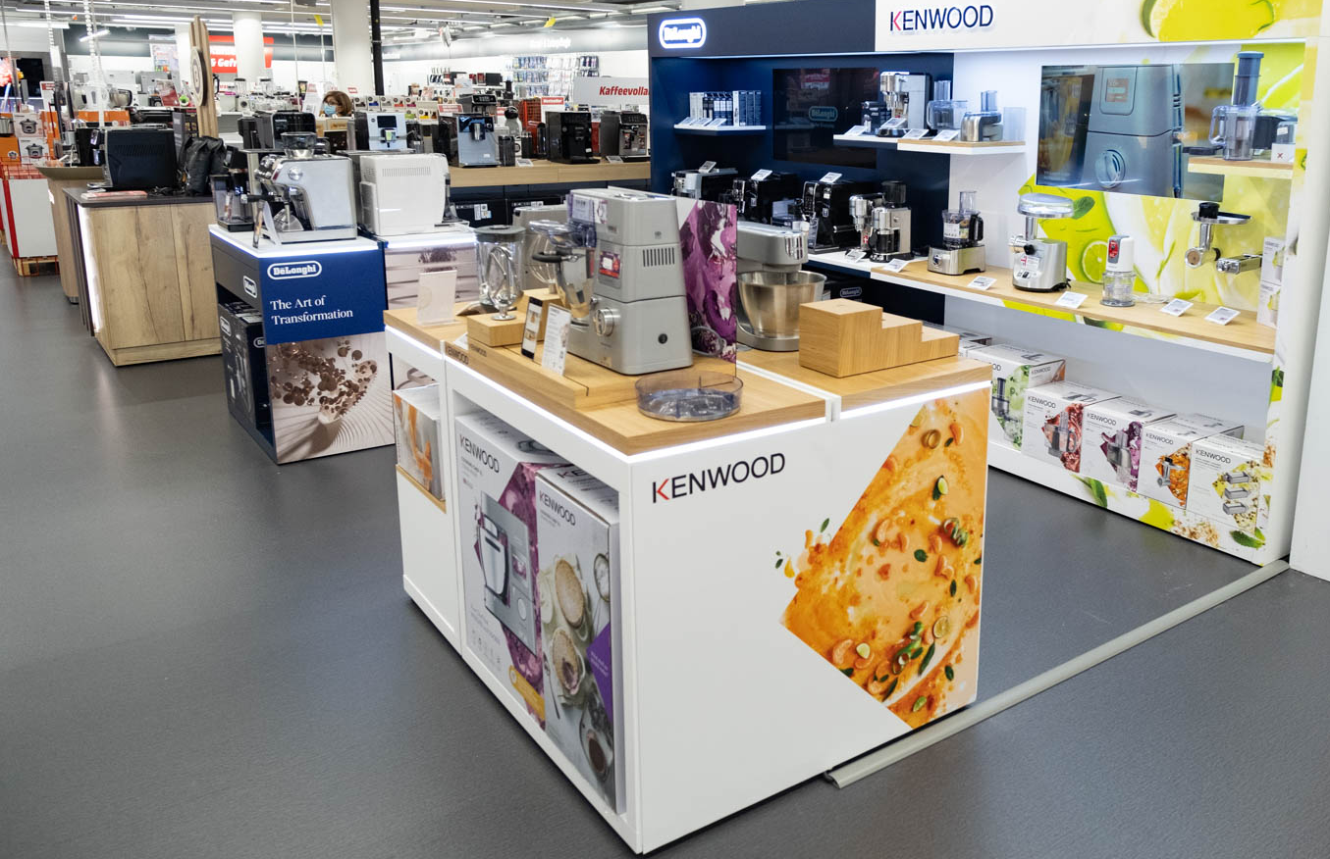
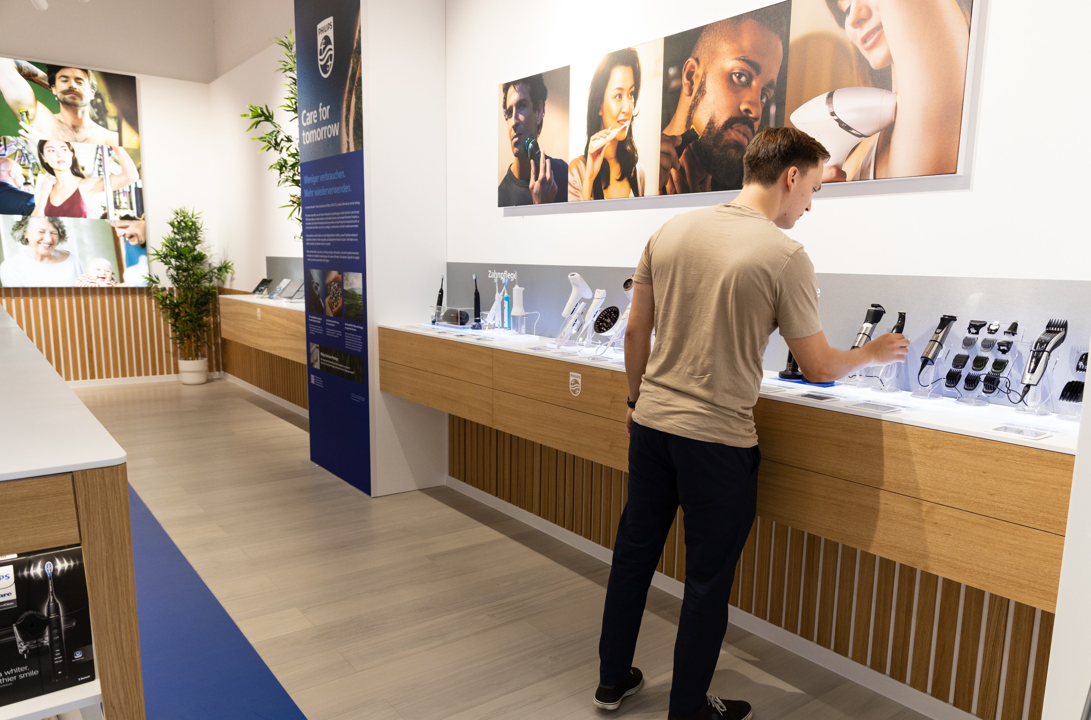
MediaMarkt
Aleksandarplatz, Berlin
Philips Domestic appliances
Philips Personal care

Slide 10
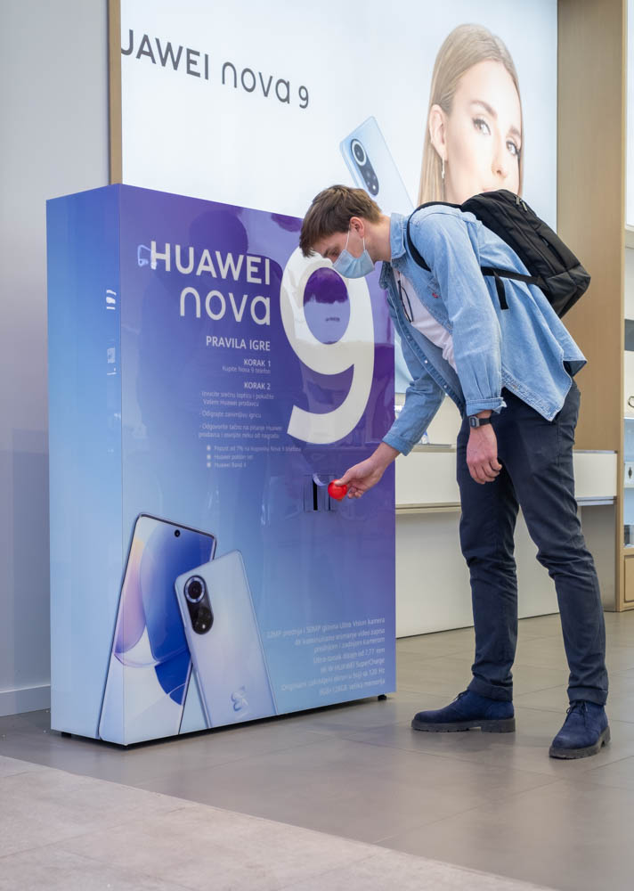
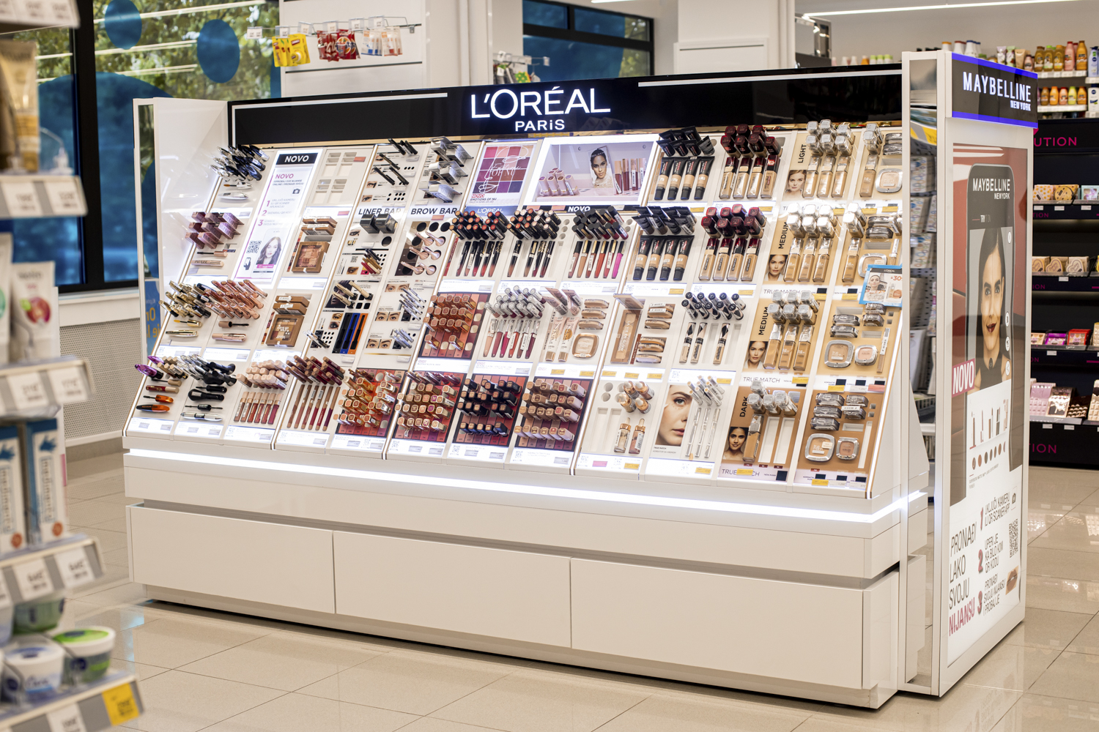
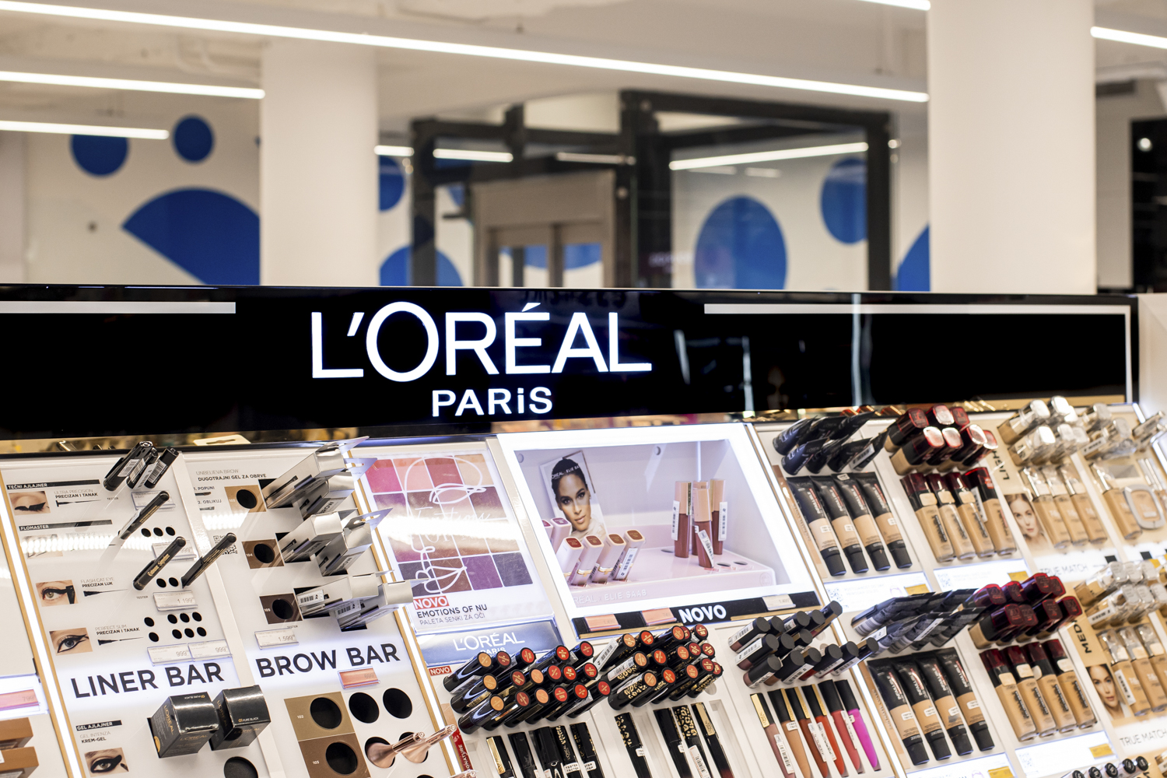
Belgrade Serbia
Clients:
Huawei Adria
L'Oréal Paris Serbia

Slide 11
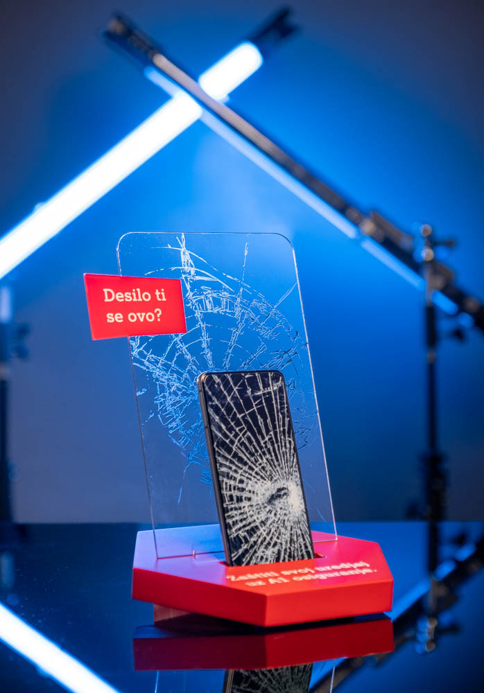
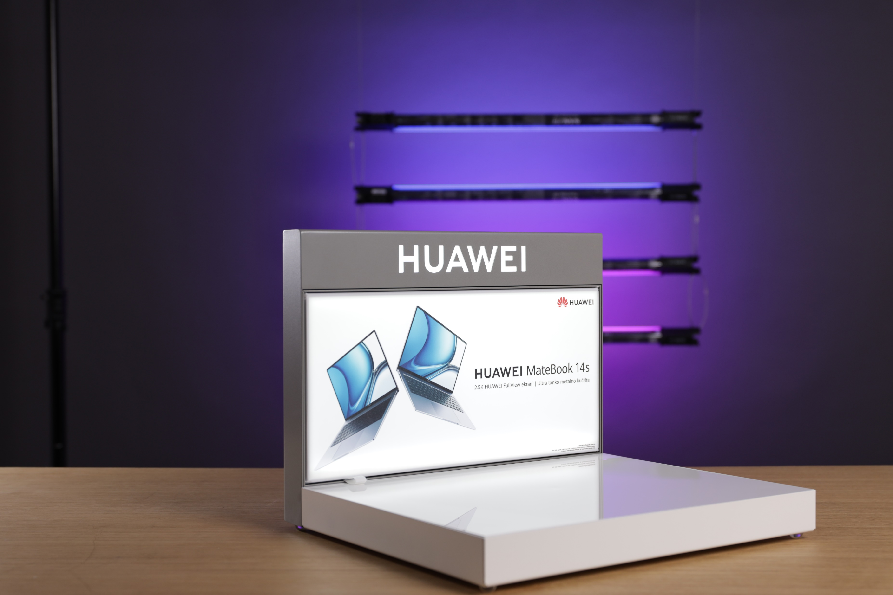
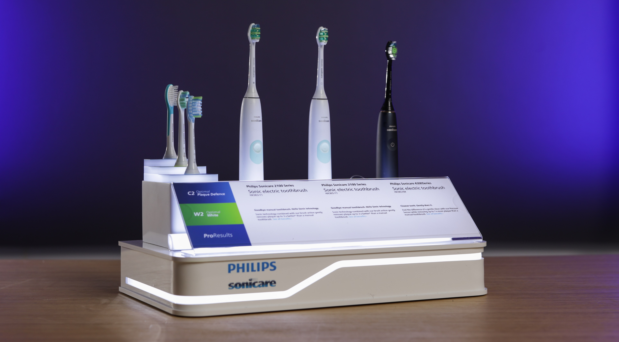
Clients:
A1 Serbia
Philips OHC
Huawei

Slide 12
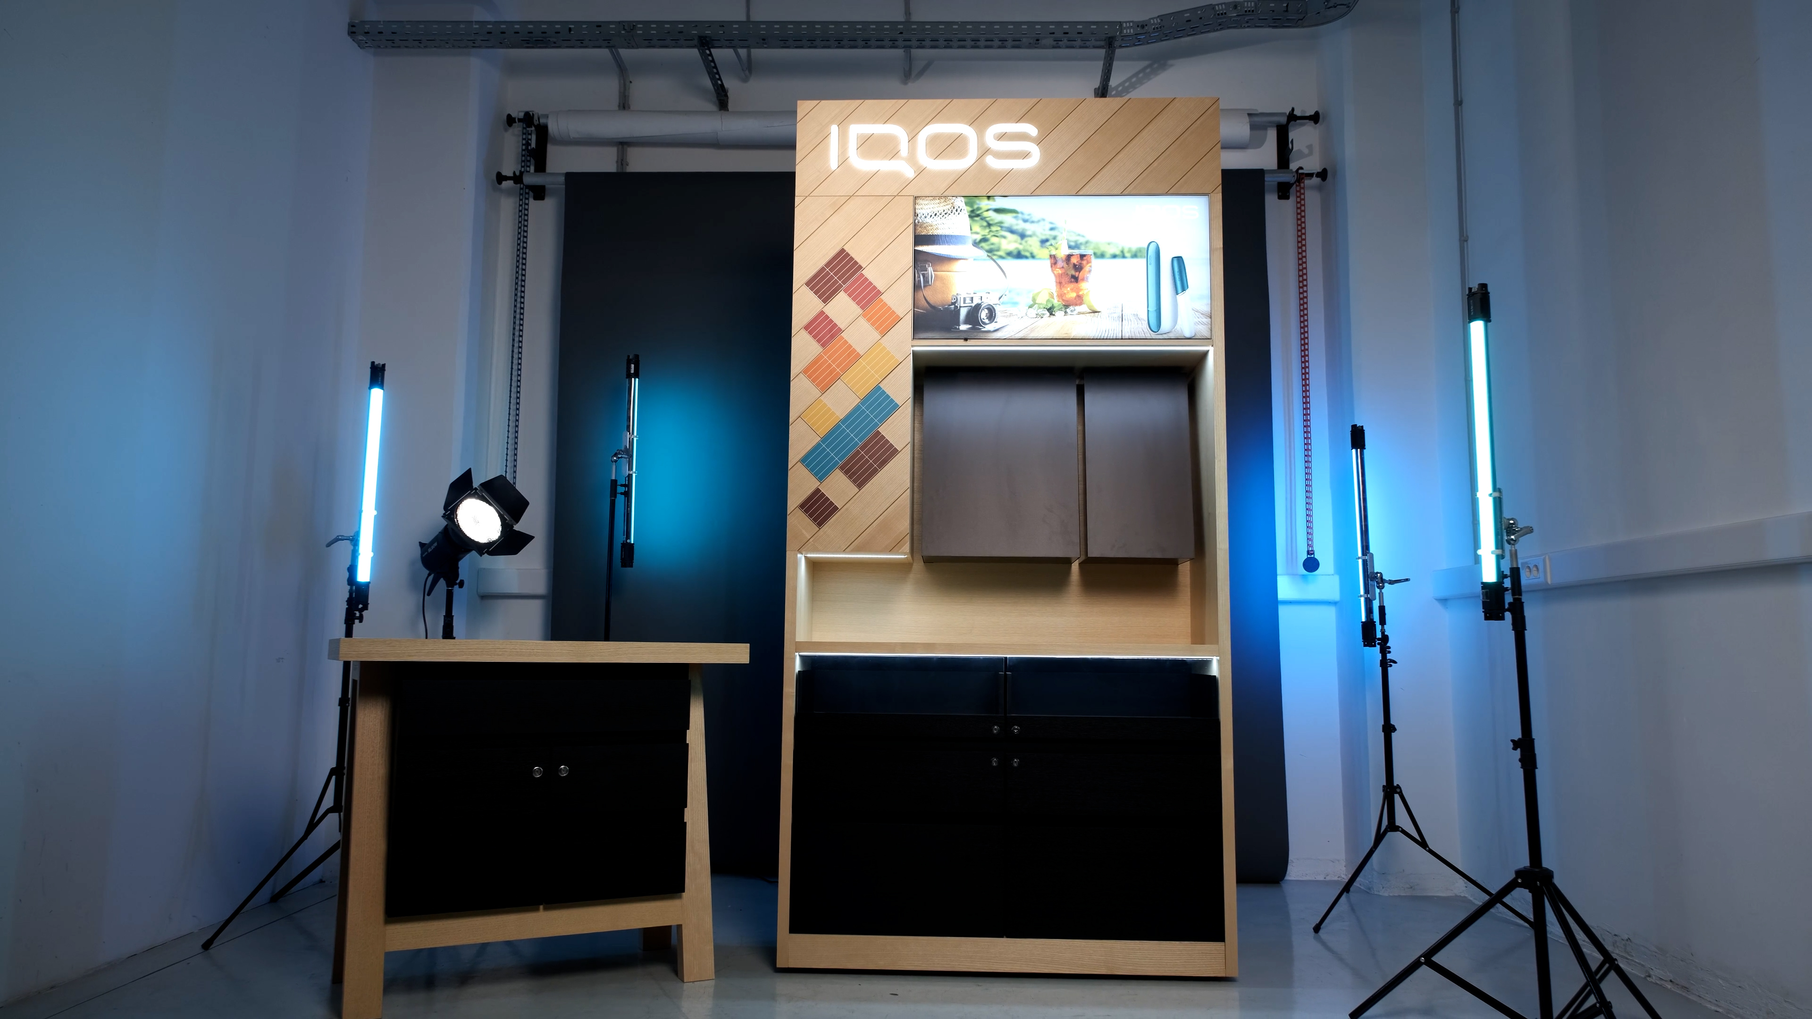
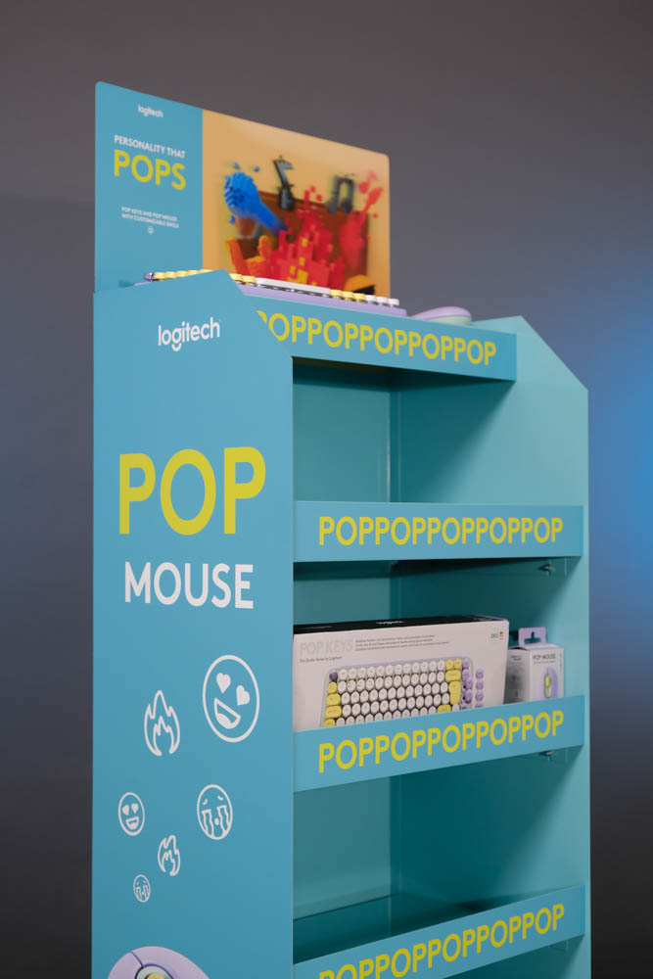
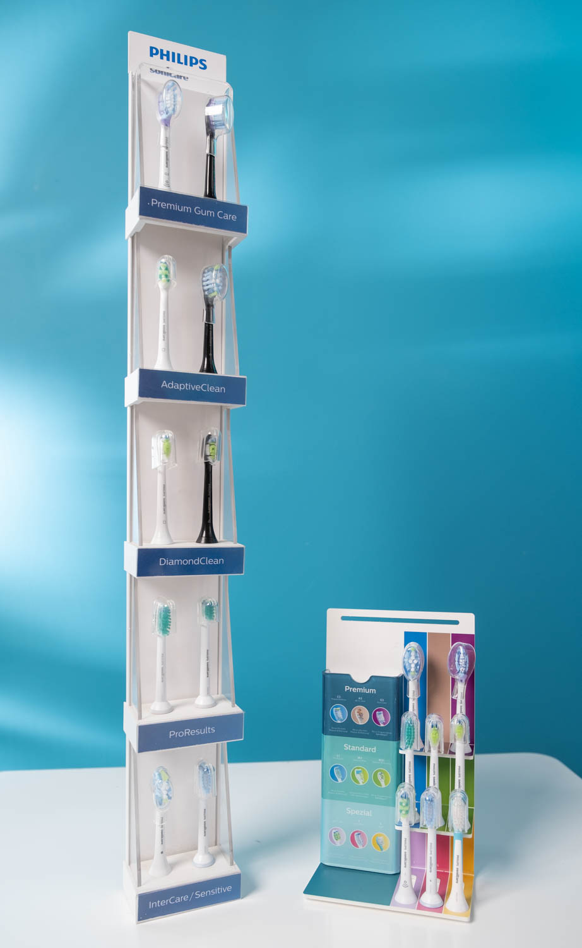
Wood
Acrylic
Metal

Slide 13
“Od malog biznisa do lidera na evropsom trzistu”

Slide 14
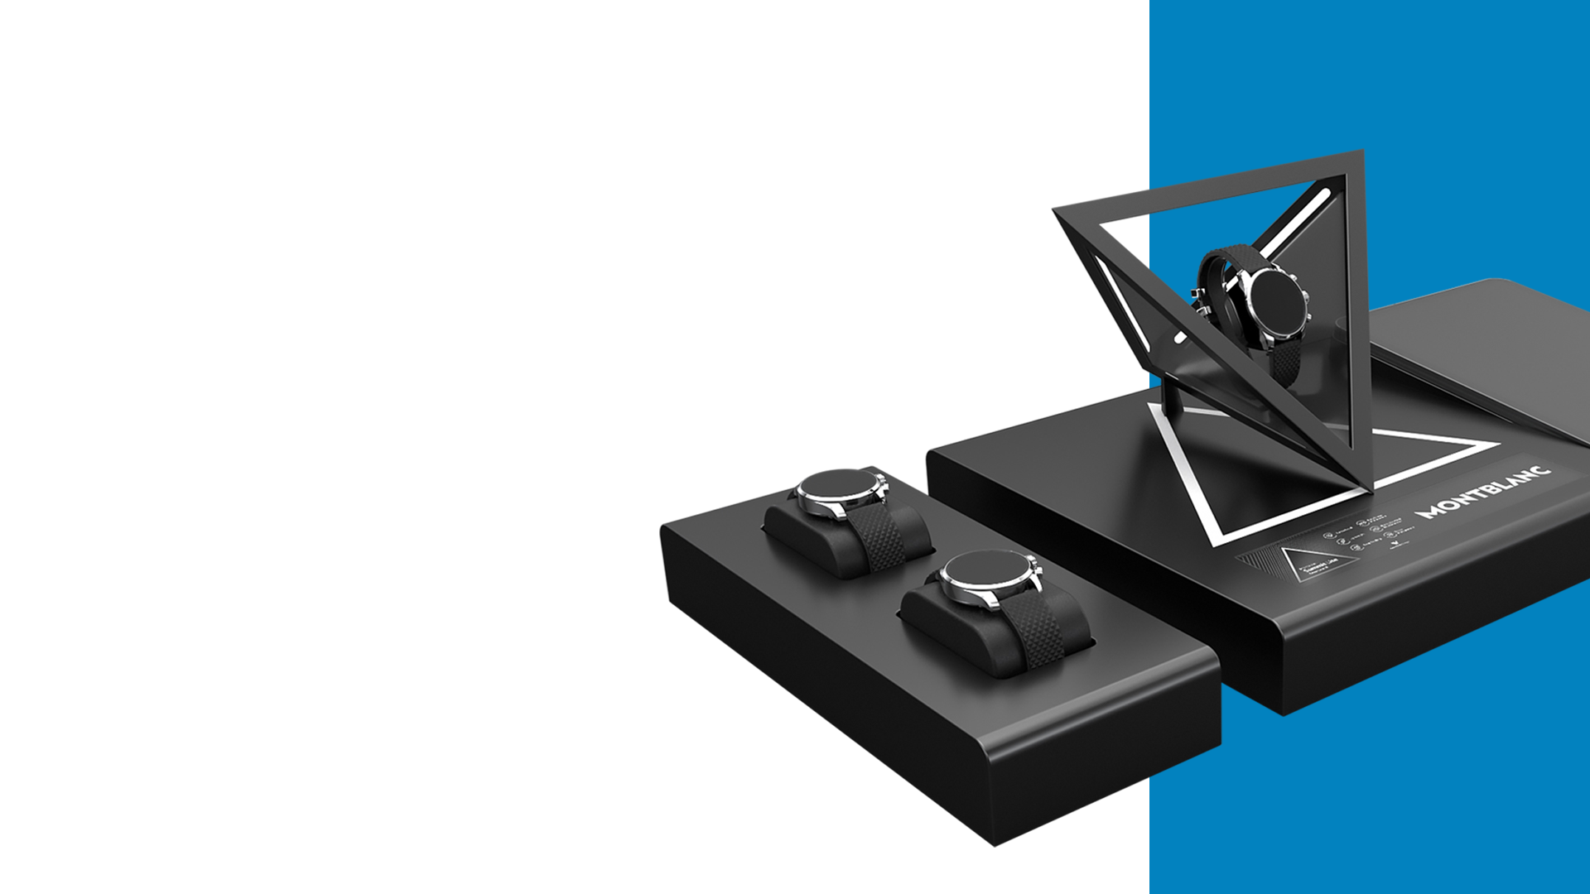
03.
03.
From idea
To stores
At BGReklam everything is designed and produced under one roof.
Giving our design, engineering, production, and sales teams a unique perspective and rare opportunity to be part of the entire production process.

Slide 15
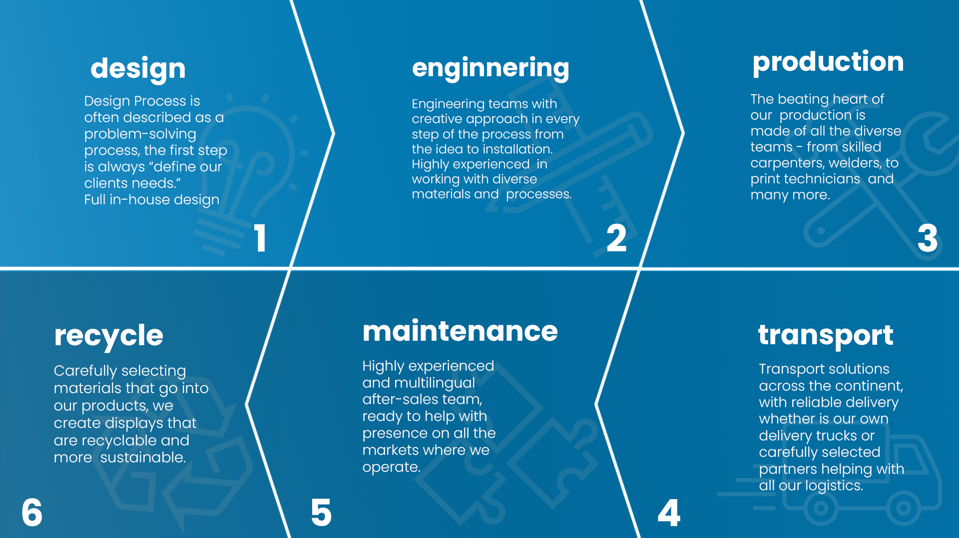
1
2
3
6
5
4

Slide 16
200
180
80
Google Display
Lighthouse
40
Philips Big Display
2023
25
2020
Overhead
3
2015
Mali kliritni display
2010
Lav reklame
2005
2001

Slide 18
Liderstvo
Leading a change in POS industry
Leading innovation agenda
Lead a team and group of people
Leda yourself

Slide 19
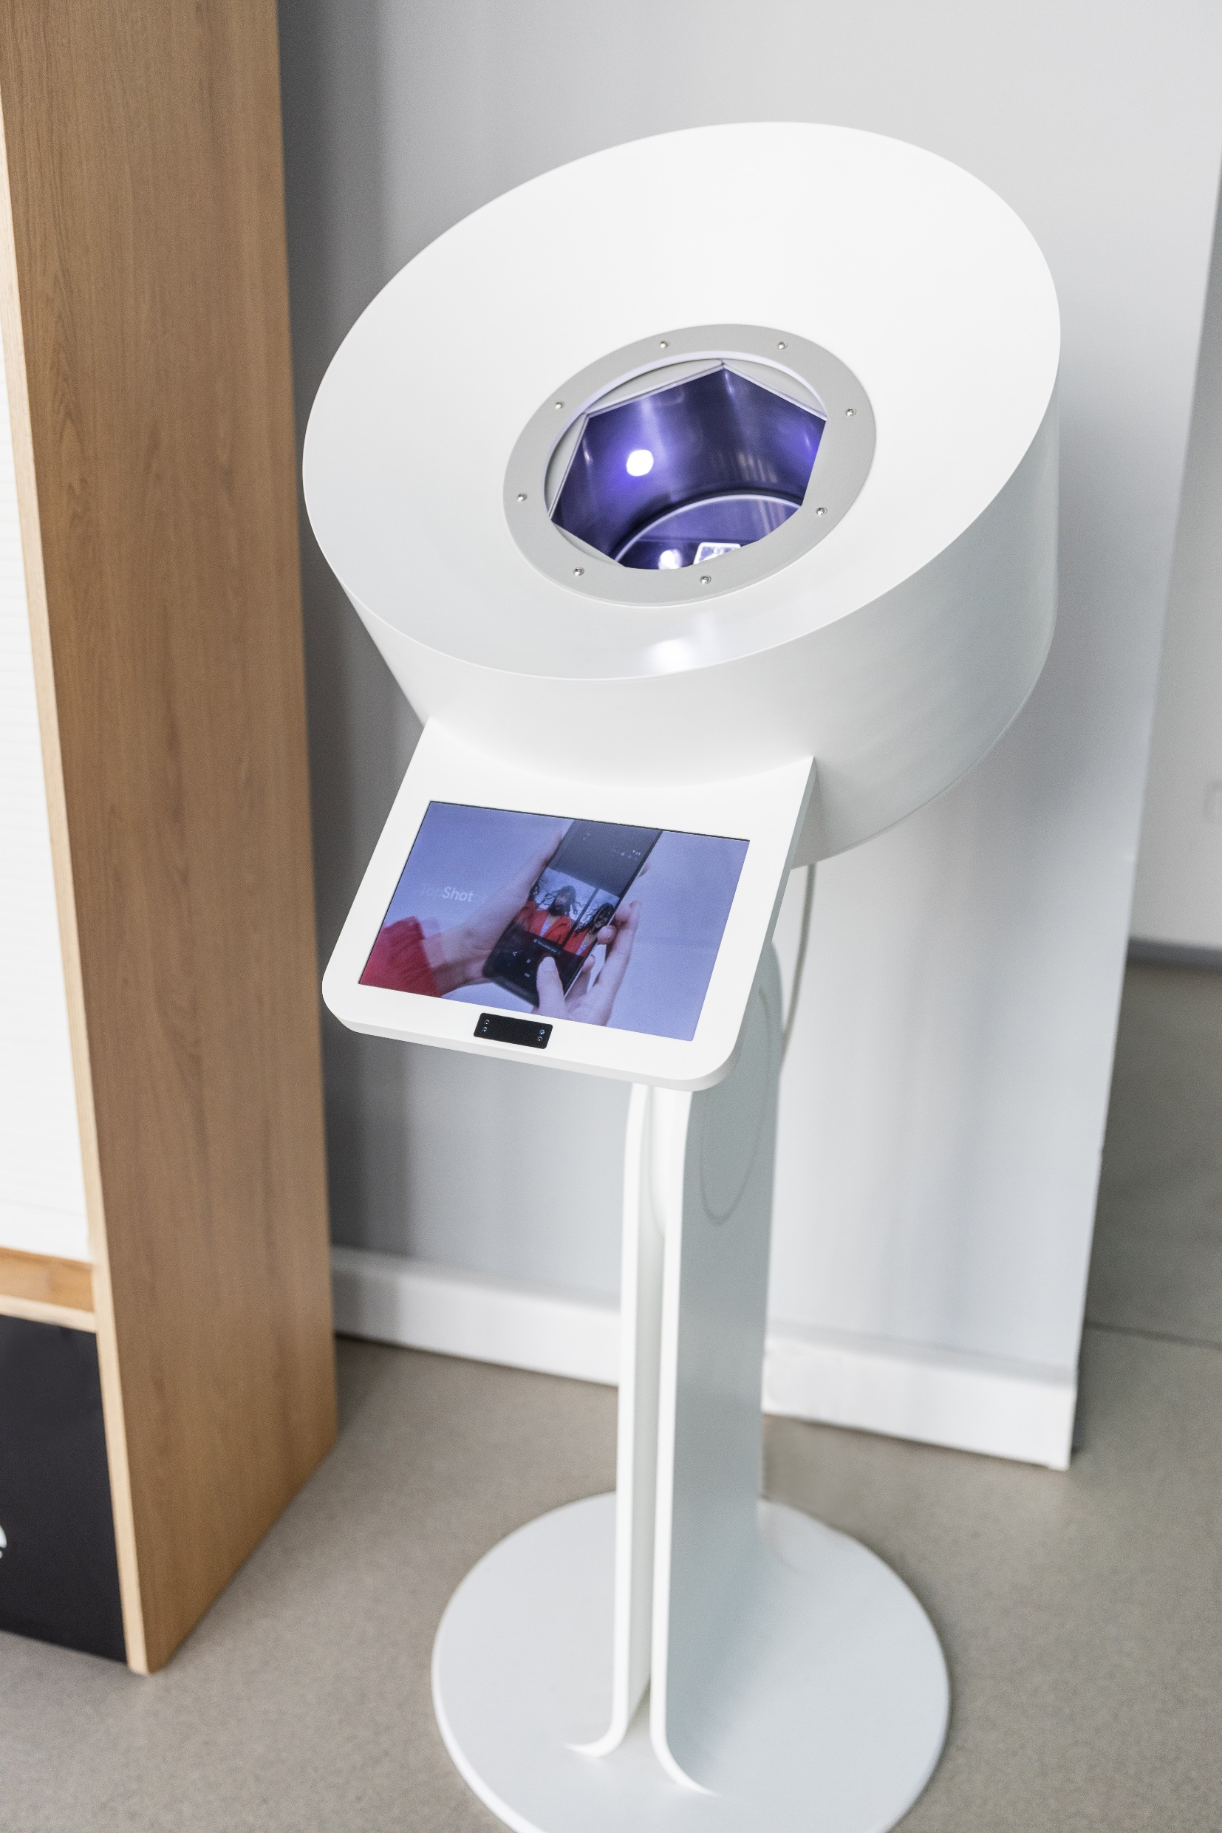
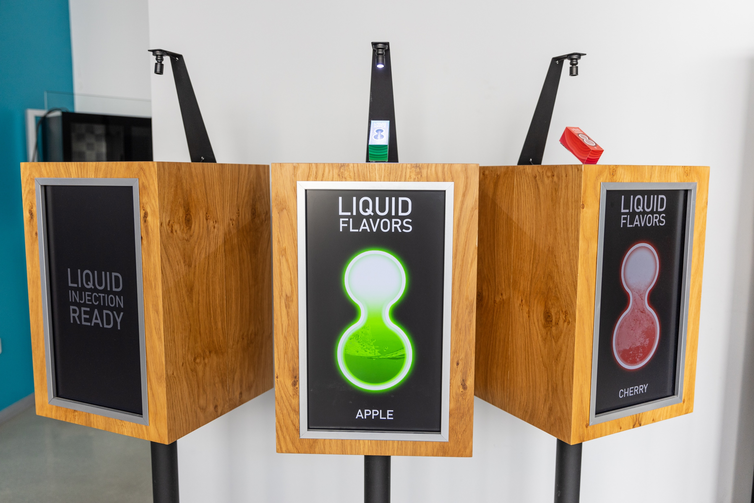
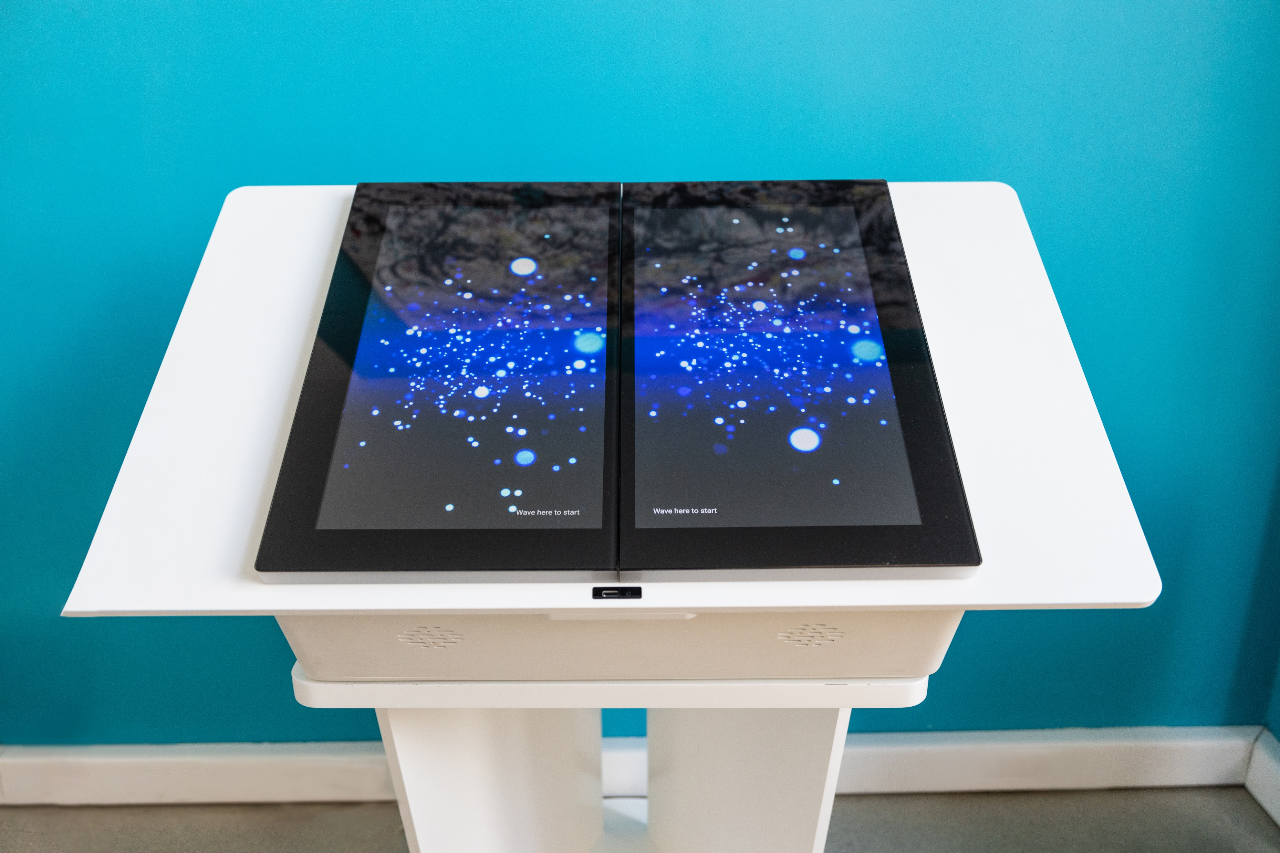
TITAN Video
Belgrade Serbia
Clients:
Google
BAT Global

Slide 20
BG REKLAM
HEADQUATERS
29. Novembra 1M
11460 Belgrade, Serbia
info@bgreklam.com
+381 11 785 64 64
+381 60 68 69 110
Thank You.
BG REKLAM GMBH
Leverkusenstraße 3
22761 Hamburg, Deutschland
hamburg@bgreklam.com
+49 40 85413003
www.bgreklam.com
BG REKLAM
UK LTD
2588 Davenport House,
207 Regent St
London, W1B 3HH, UK
+44 75 4288 2312

