Slide 1


Sales
Driven
By Design
“The only important thing about design is how it relates to people.”
— Victor Papanek

Slide 2
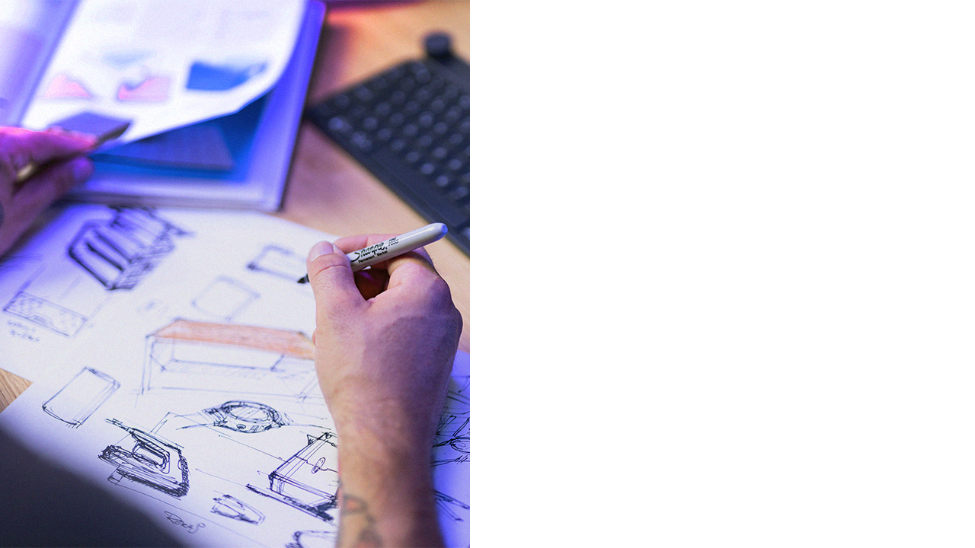
Contents.
History
Meet the team
Philips portfolio

Slide 3

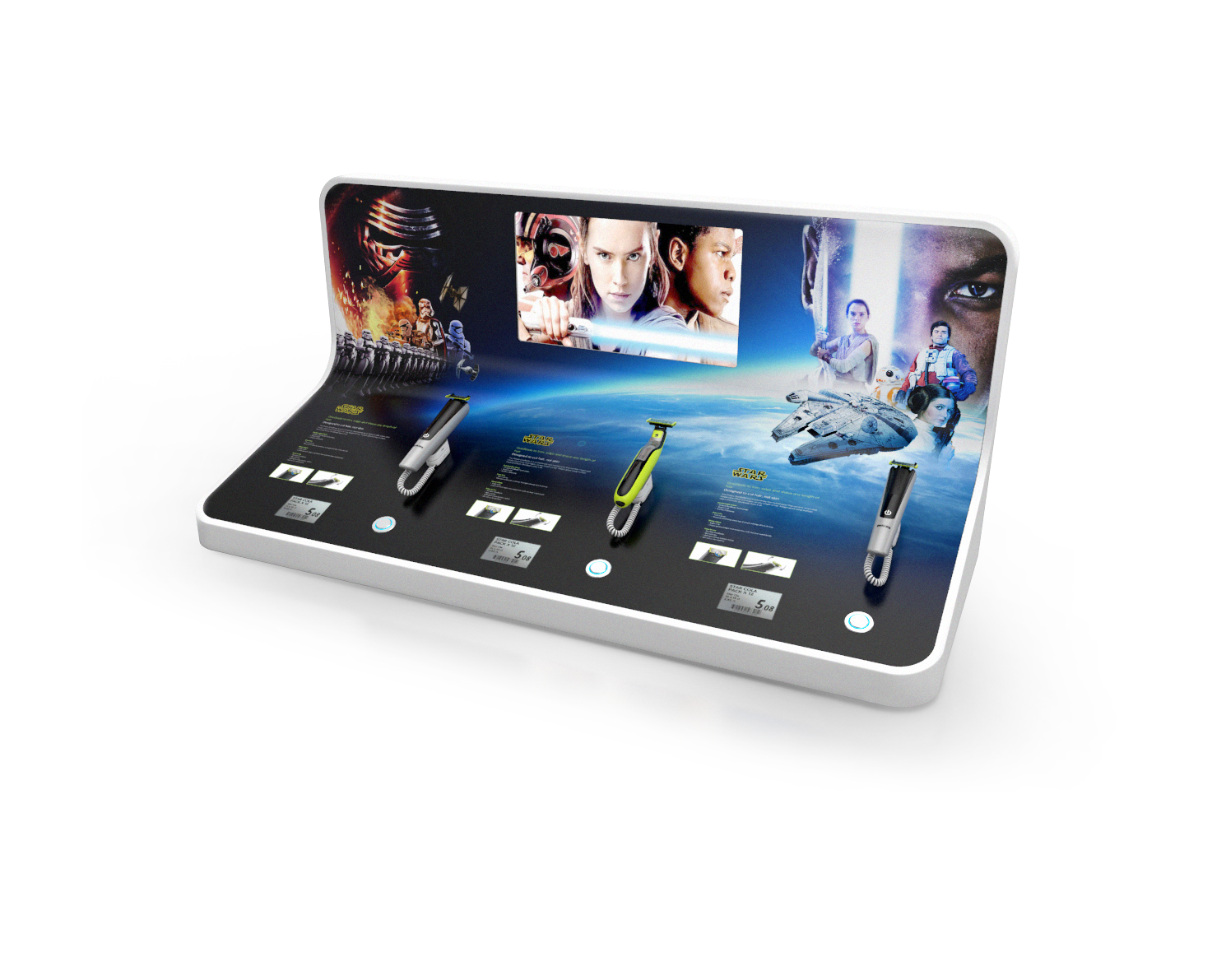
01.
History
With
PHILIPS
Back in 2014 was our first contact with
Philips, since then we successfully delivered over 100+ unique and striking
display designs.

Slide 4
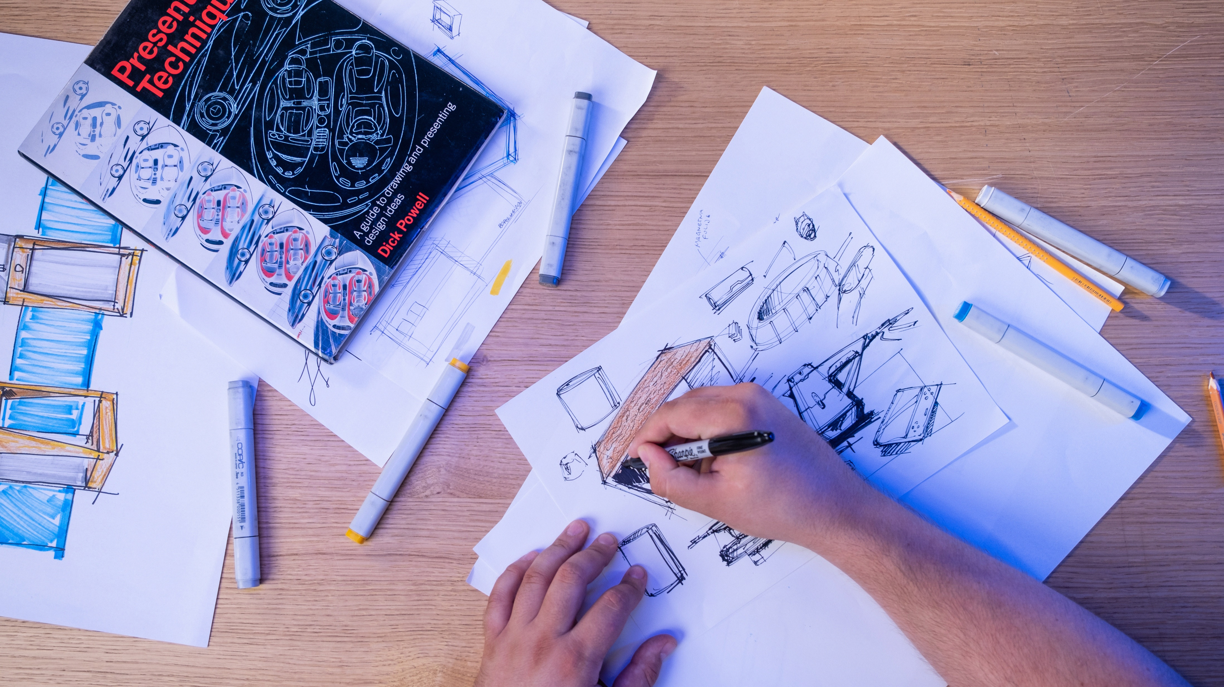
02.
Meet
The team
Design Process is often described as a problem-solving process, the first step is always “define our clients needs.”
Full in-house design team with diverse skillsets. Whether it’s a 3D modeling, photo editing, or a digital design.
25+
Combined Years of
Industrial design
Experience.

Slide 5

03.
From ideas
to stores.
At BG Reklam everything is designed and produced under one roof.
Giving our design team a unique perspective and rare opportunity to be part of the entire production process. Ultimately resulting in designs that are not only esthetically pleasing but also, more sustainable, efficient to make and affordable.

Slide 6
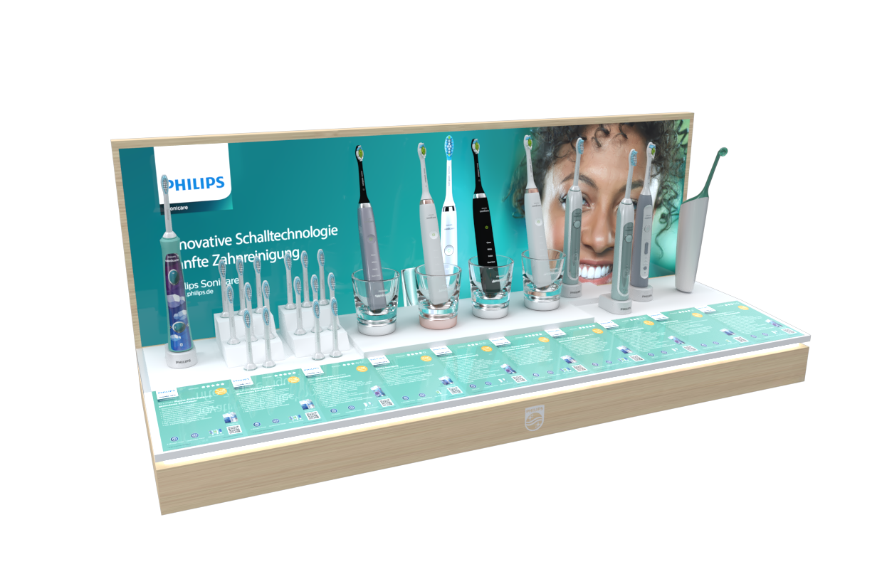
OHC
Display
The name of the game is versatility.
This display is a real mainstay of OHC displays.
With 10 interchangeable individual bricks that can be configurated in many different and unique ways.
Additionally, the back luminated visuals are interchangeable extending the use of this display for many different ranges of products.

Slide 7
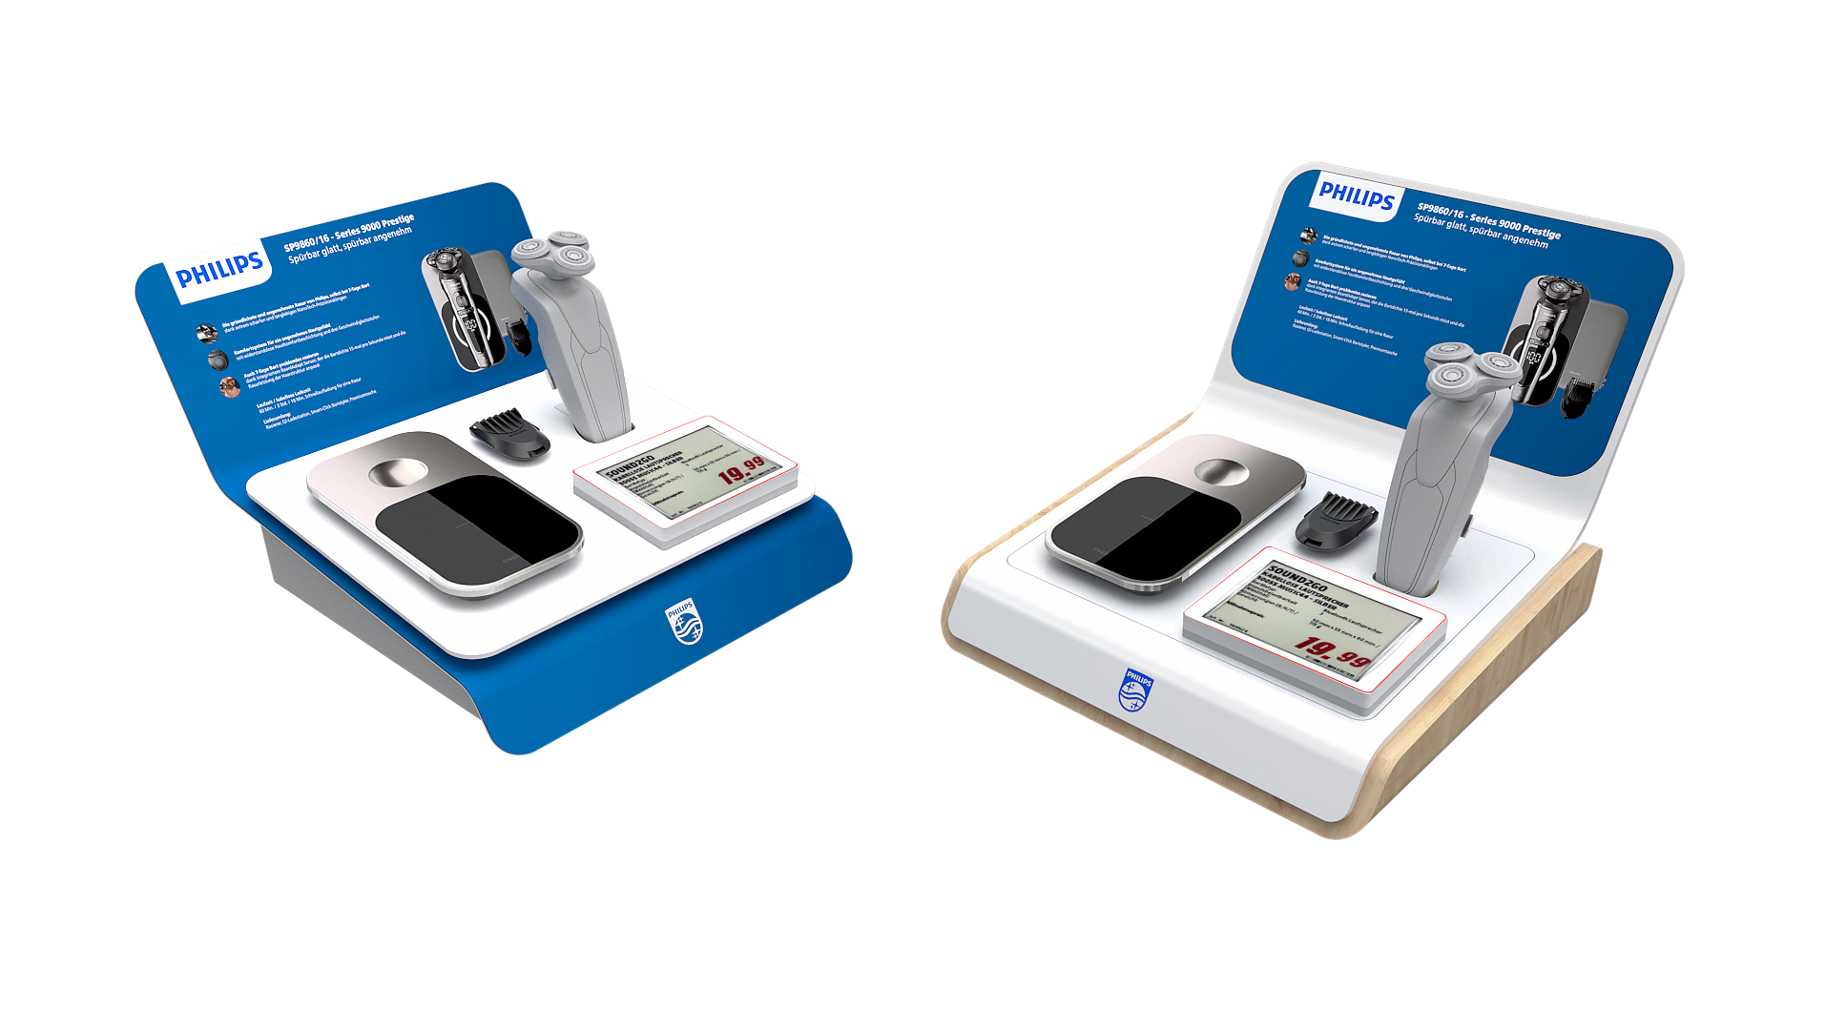
Small Shelf
Displays
Striking and premium design meets modularity
and future proofing .
The design of these unique displays was not only challenged by the limitation of already busy and tight shelf space but feature fully sustainable production process in its core design.
These displays must stand out among the see of other similar products and brands, and at the same time include all the basics like stores bulky price tag.
Choose your design: “premium” or “super premium” with added luxury materials like, Corian and wood.

Slide 8
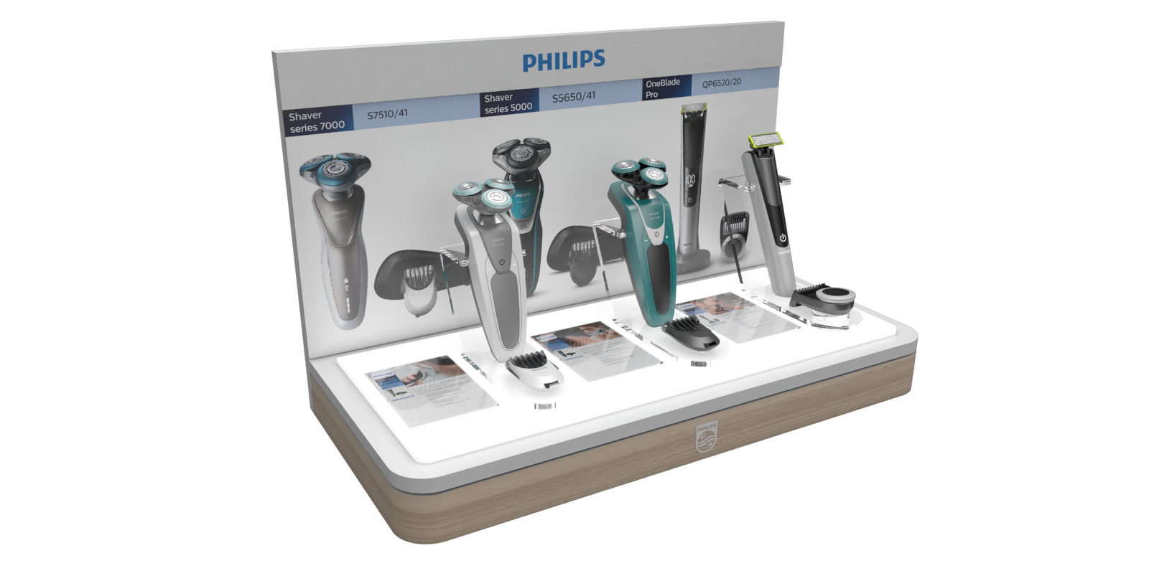
Male Grooming
Display
To make the products stand out, the design features all round diffused light, illuminating the entire lower part of the display.
Diffused soft light surrounds the three products on top and makes them more visible to the consumer. The light also serves a secondary purpose and that is to highlight the info cards and visuals.

Slide 9
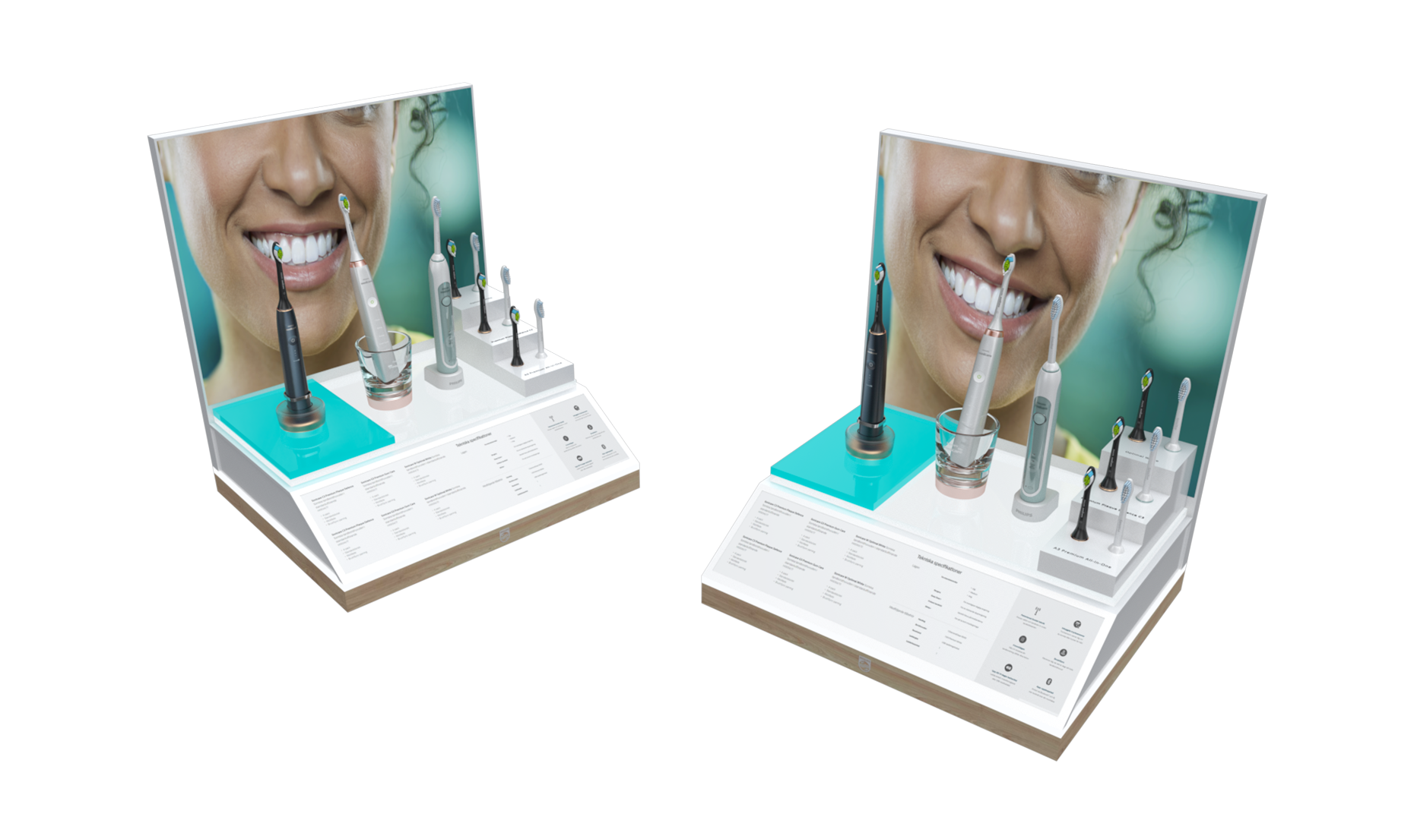
Small OHC
Display
Same as its bigger brother this display features
interchangeable individual bricks that can be configurated in many unique ways. Only in a smaller more compact size.

Slide 10
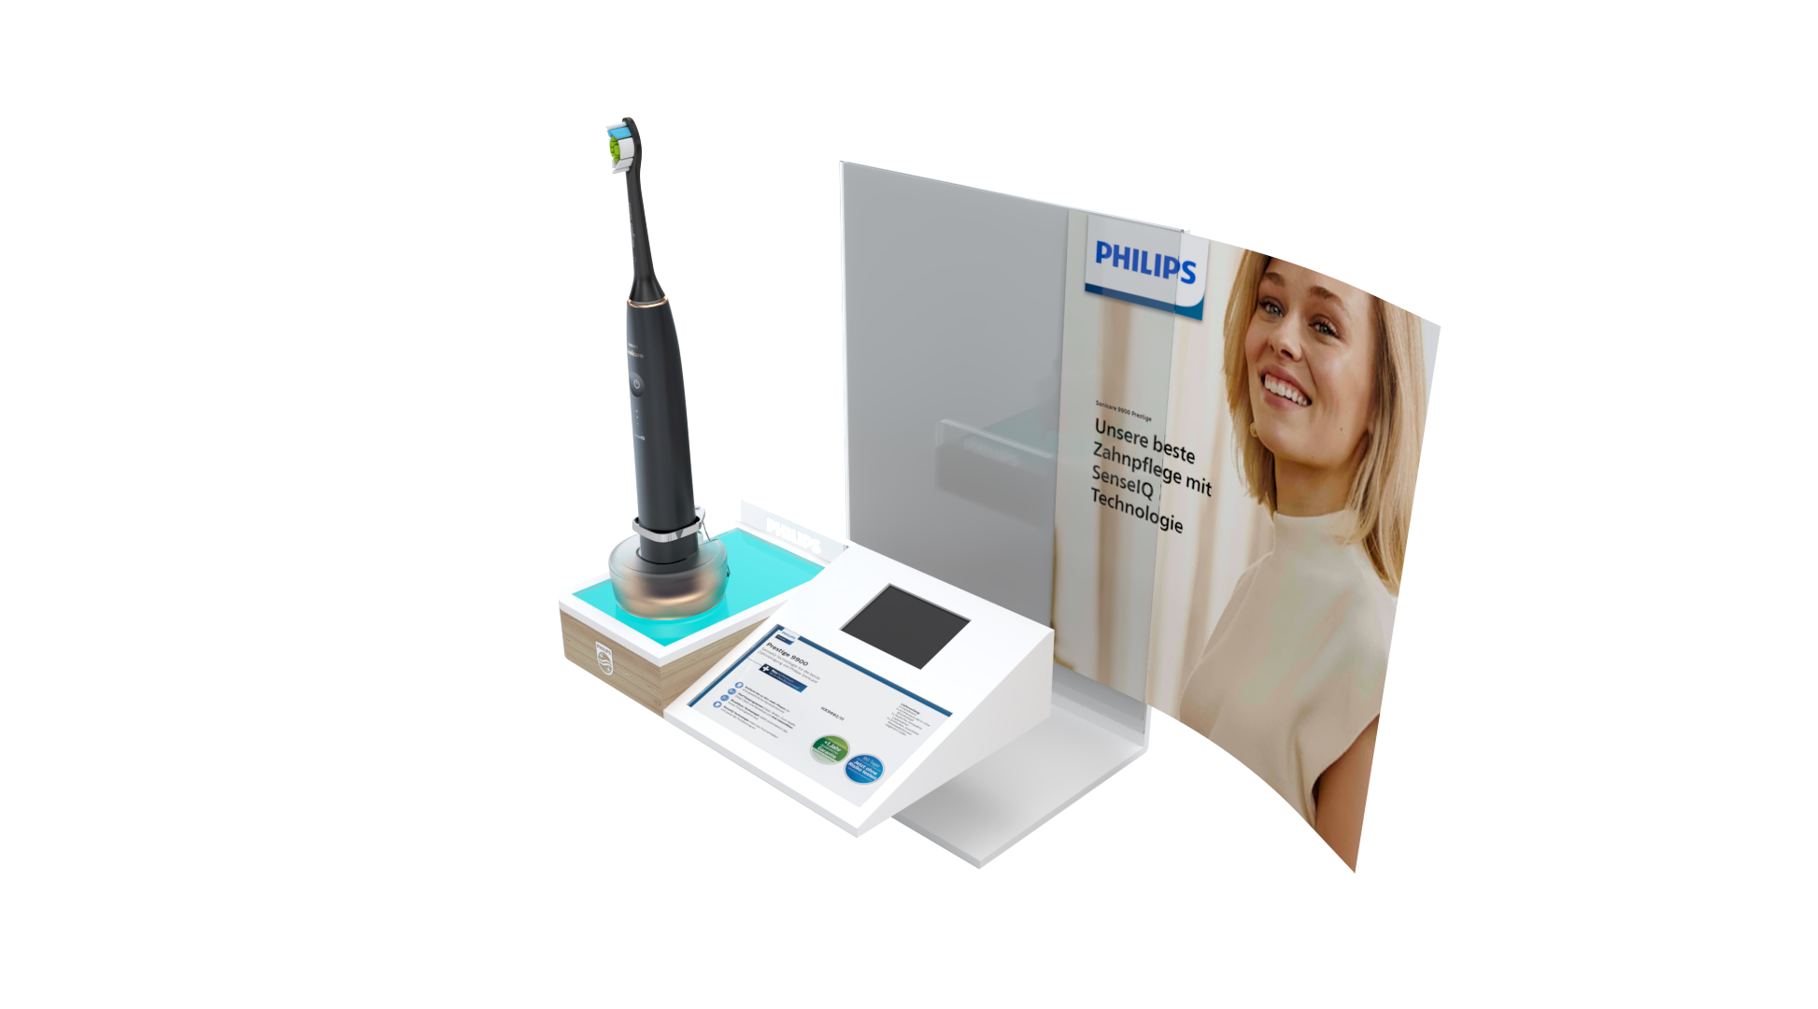
OHC Xian mini
Display
Materials
MDF, Acrylic, Metal, Printed PVC stickers, LED Canvas.
Interchangeable visuals and digital price tag.

Slide 11
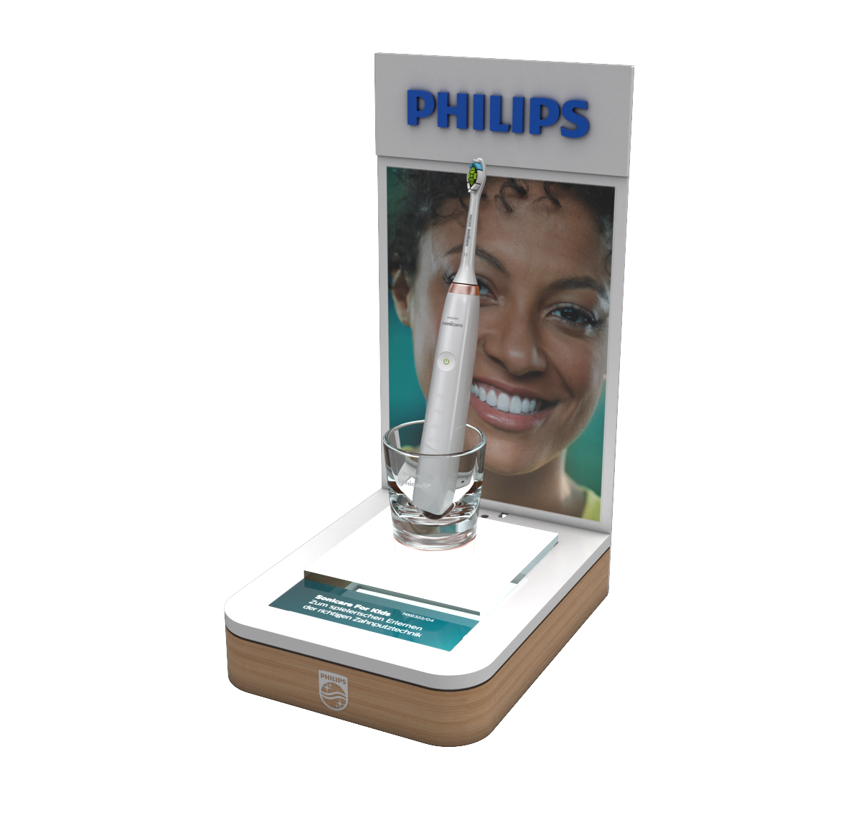
OHC Xian
Tabletop Display
Small in size, but not in features.
This OHC display is built with magnetic feat that attached the display firmly to any metal shelf surface.
LED Illuminated bottom half highlighting the products and completely interchangeable magnetic visuals.

Slide 12
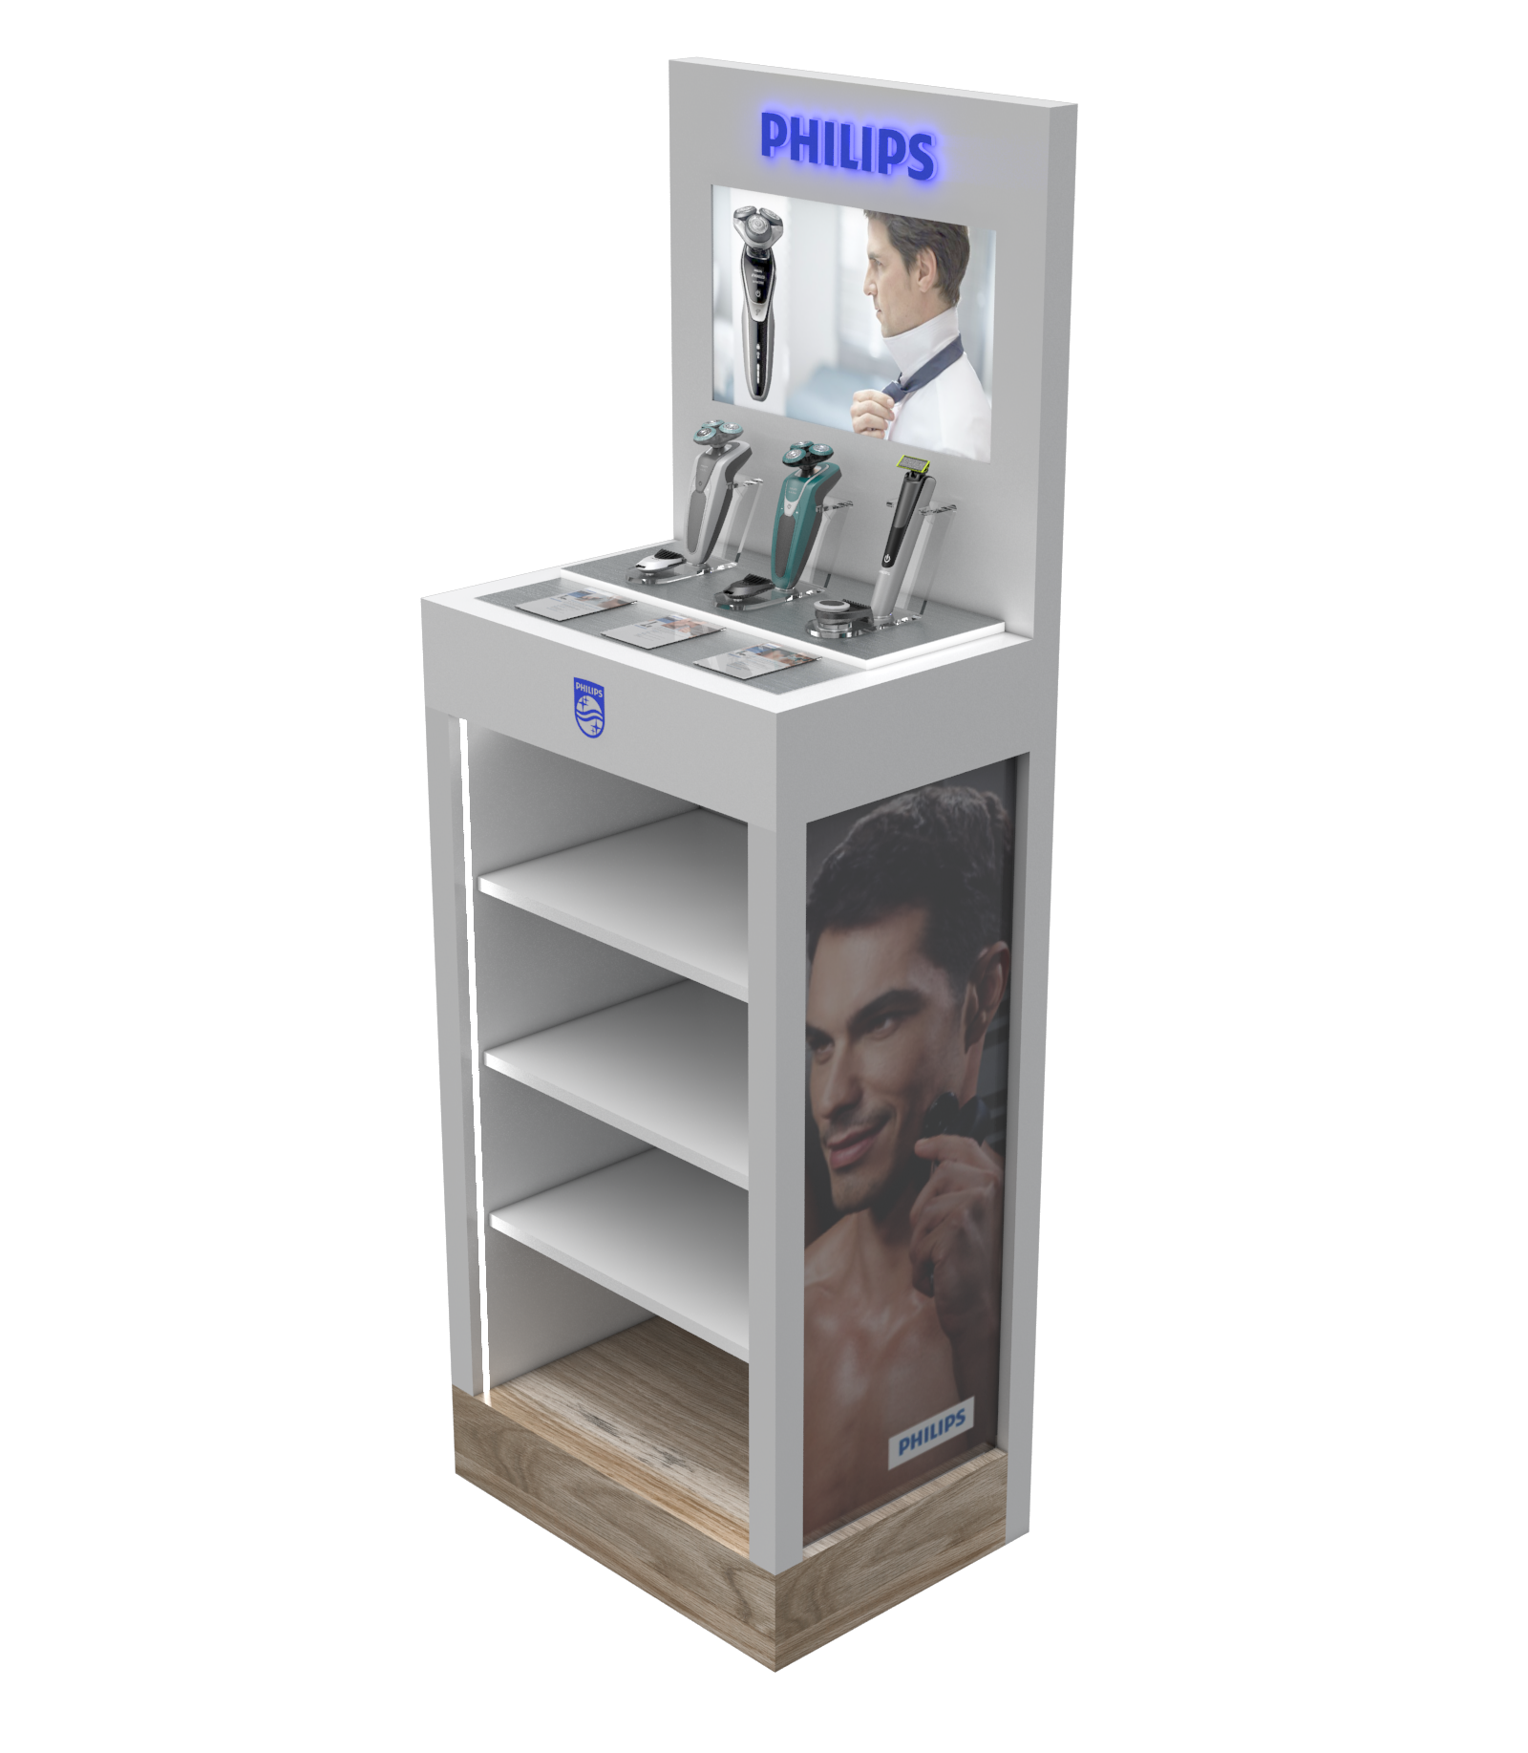
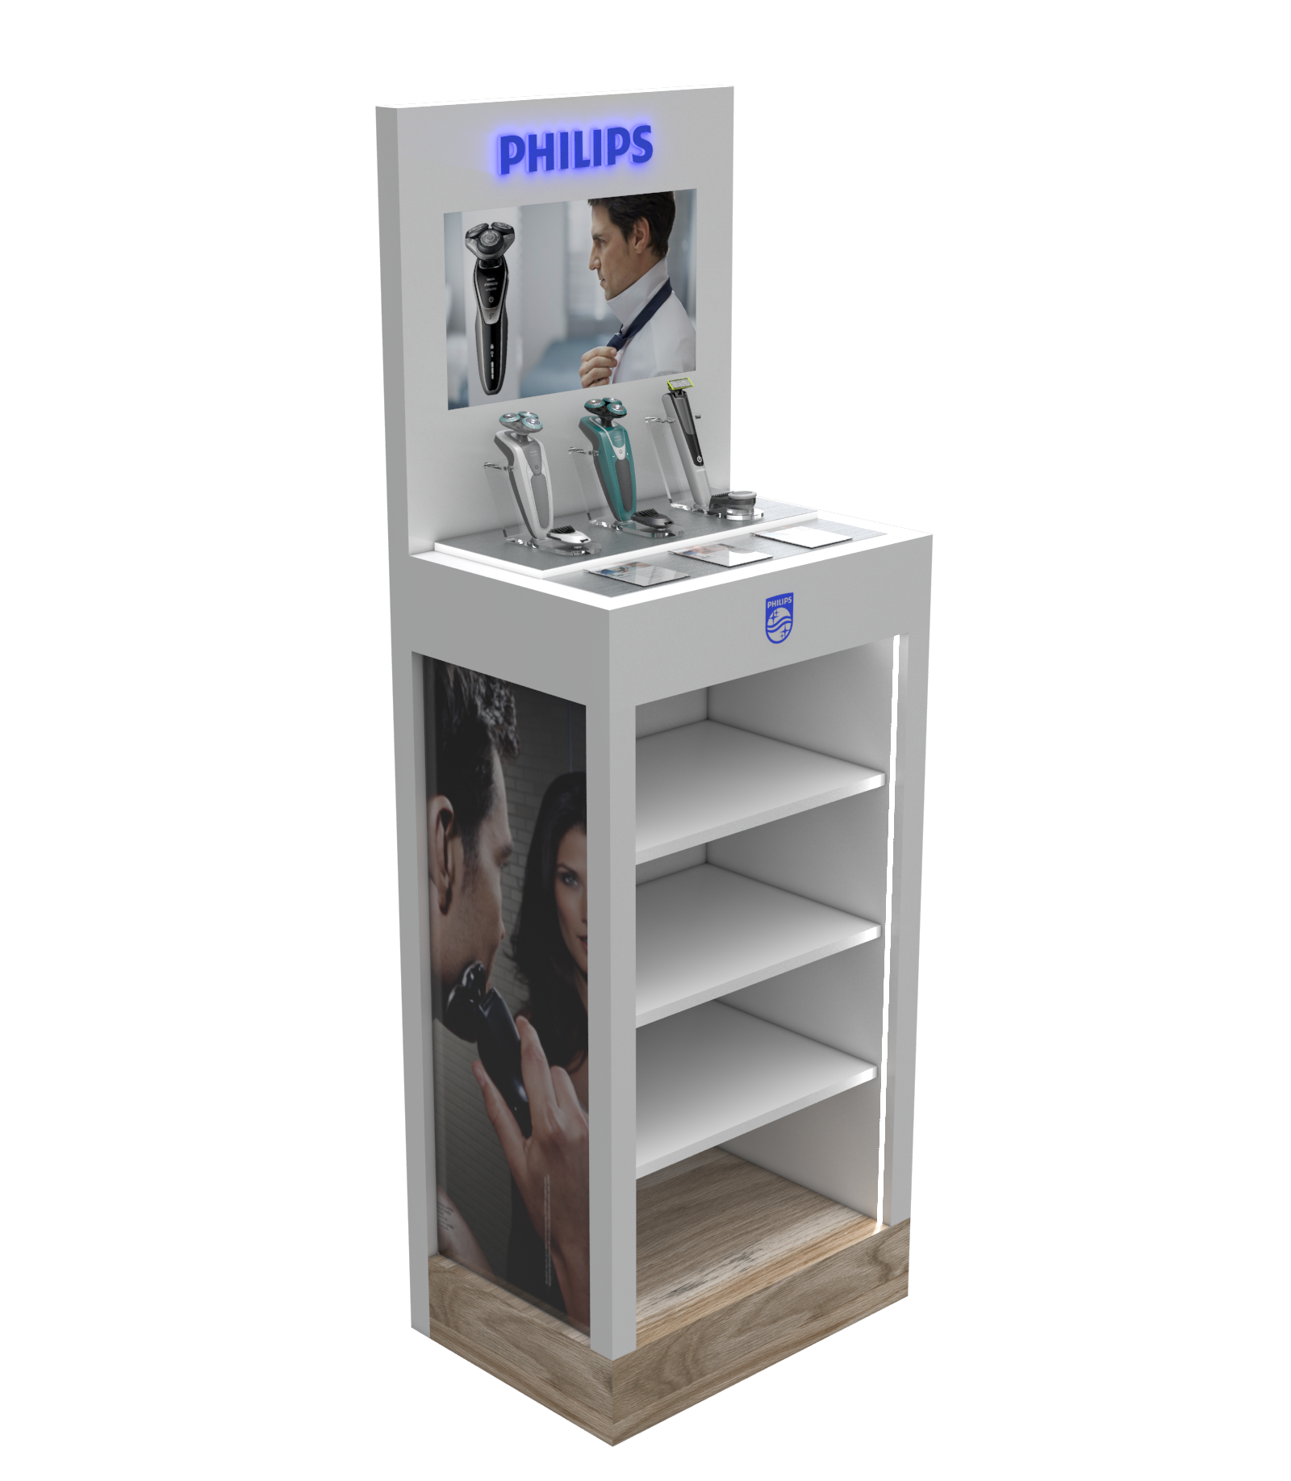
Male Grooming
Totem
Premium display featuring LED lighting and a TFT screen for attention grabbing video visuals.
Lighting illuminates the entire bottom part of the shelf making the products stand out.

Slide 13
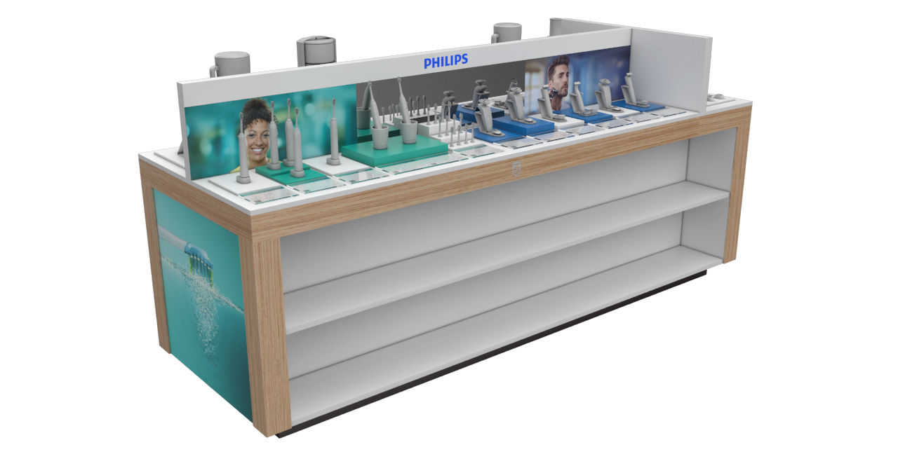
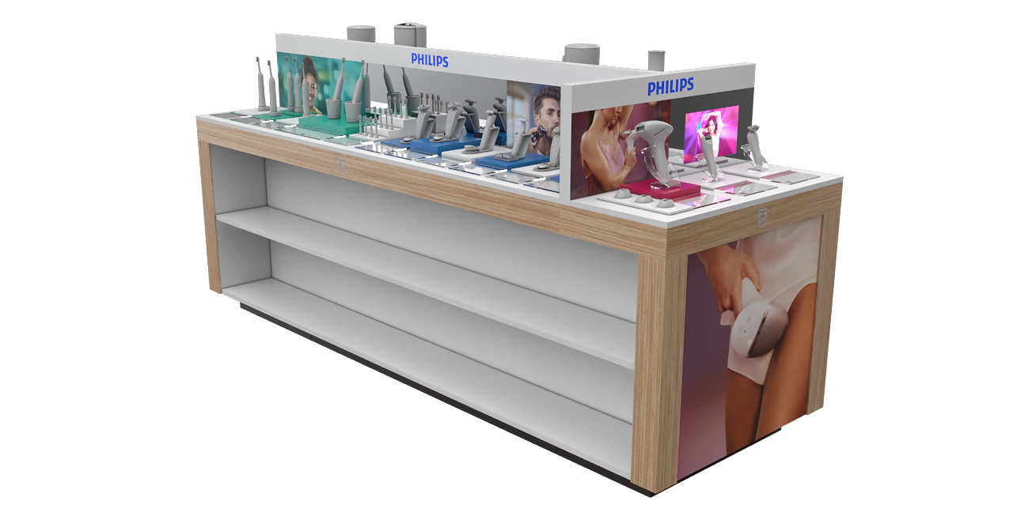
Multi cat.
Table Display
This is a big one! Display that lives up to is multicategory name.
Design idea was to incorporate several different product lines – Philips personal health, Lumea, Men's grooming and Philips domestic appliances.
With many diverse product on one table the challenge was to make them fit together seamlessly and compliment each other.

Slide 14
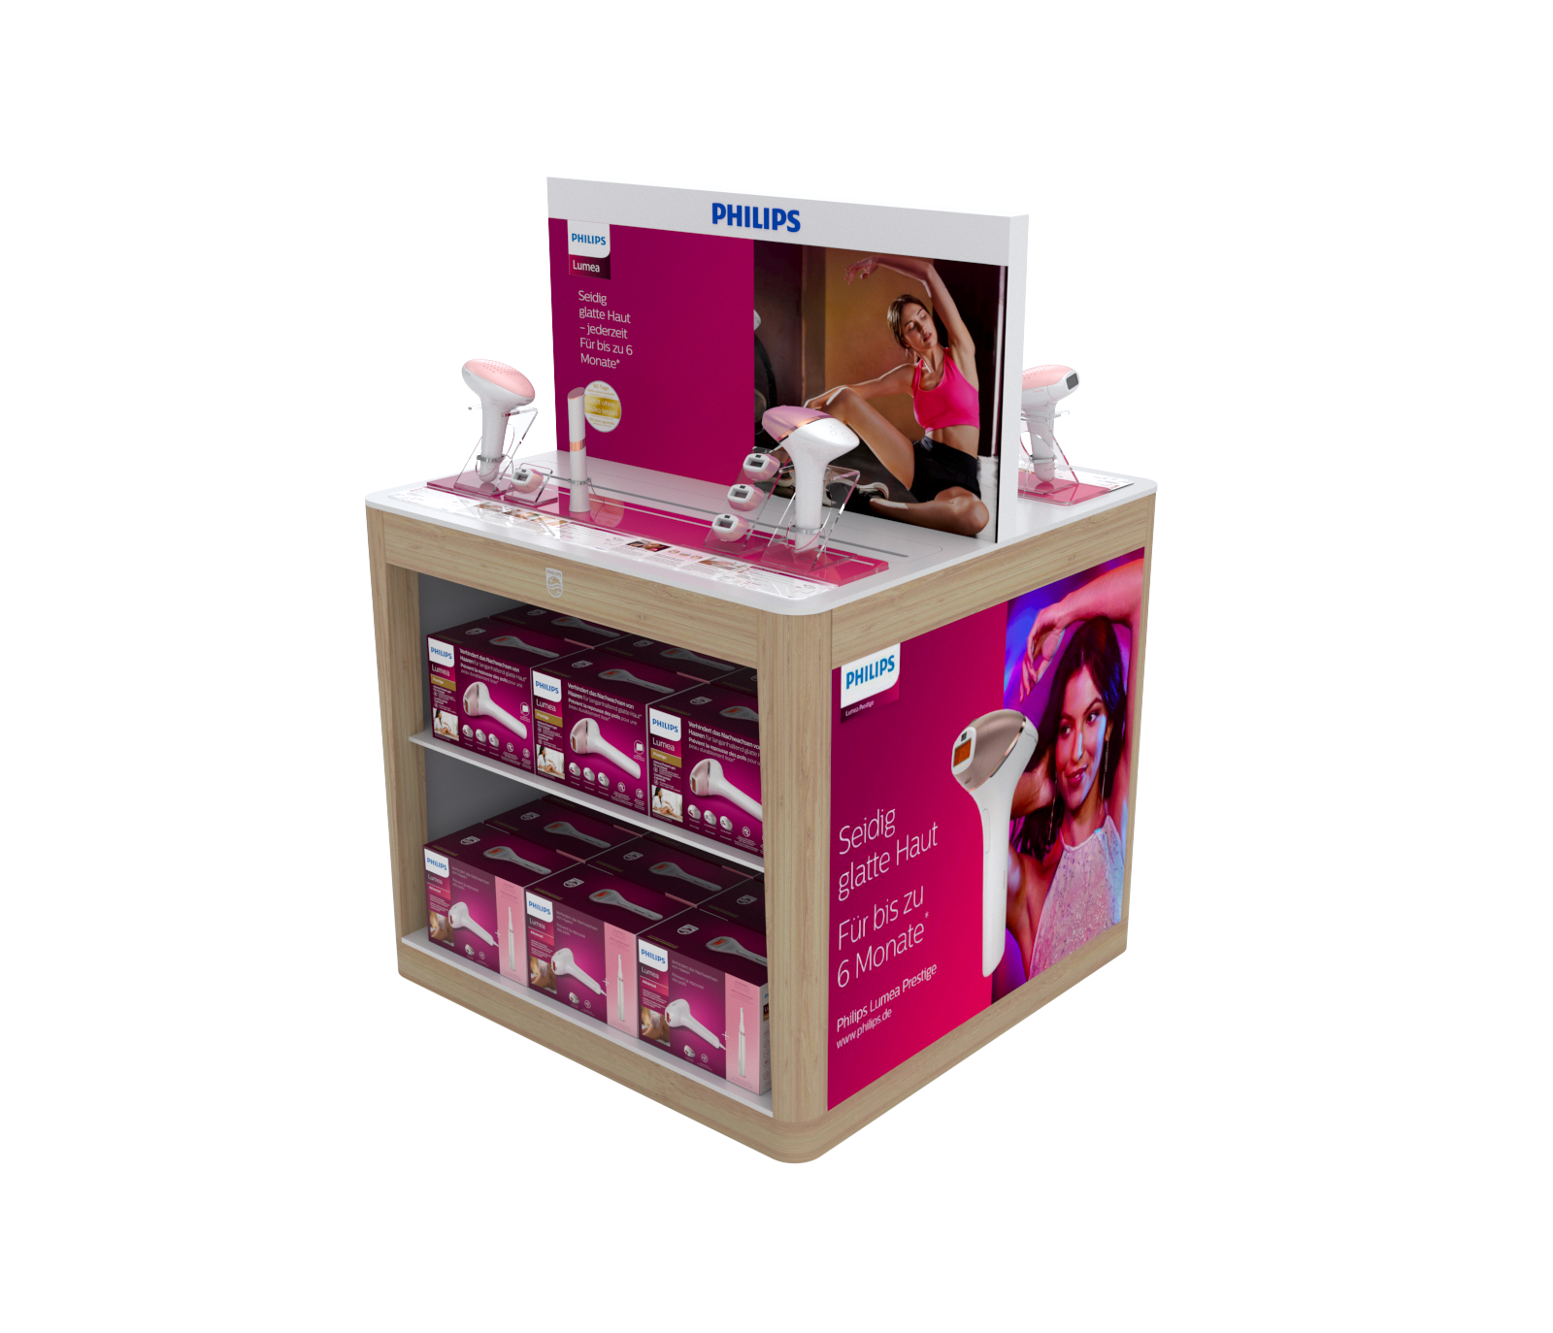
Lumea
Table Display
Design was intended to maximize space and create all-round Branded experience.
Visuals are printed on magnetic foil and easily re-brandable and applicable to new products.
Design of this display features premium materials like wood and Corian.

Slide 15
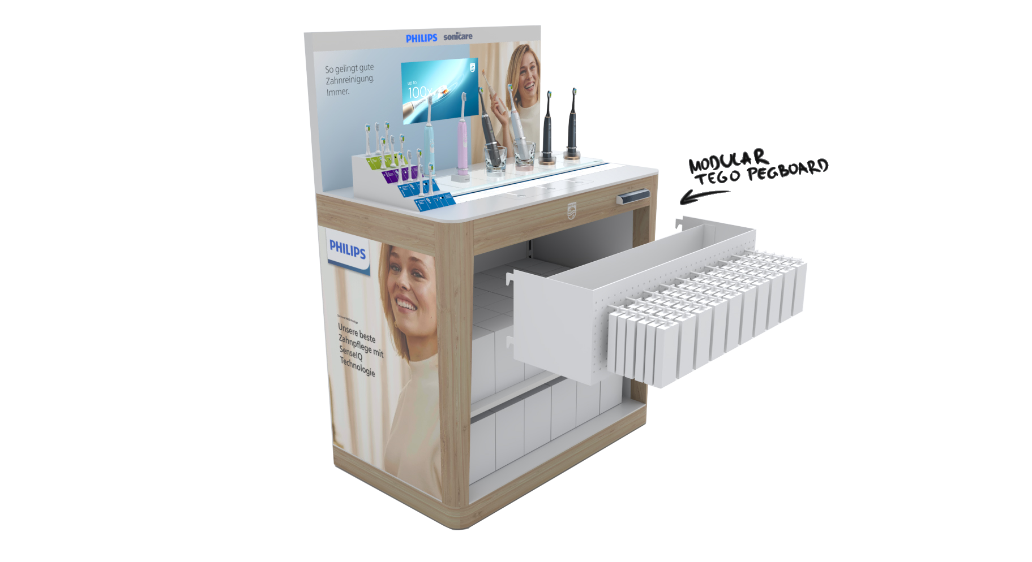
Re-brandable
End cap
This display truly solves the problem of using one design across different brands and products.
With just a few simple changes to the shelfs, visuals and top plates the displays completely transforms form OHC to Lumea line of products.
The added premium looking materials like furnished wood or TFT screens, make this a unique and striking design.

Slide 16
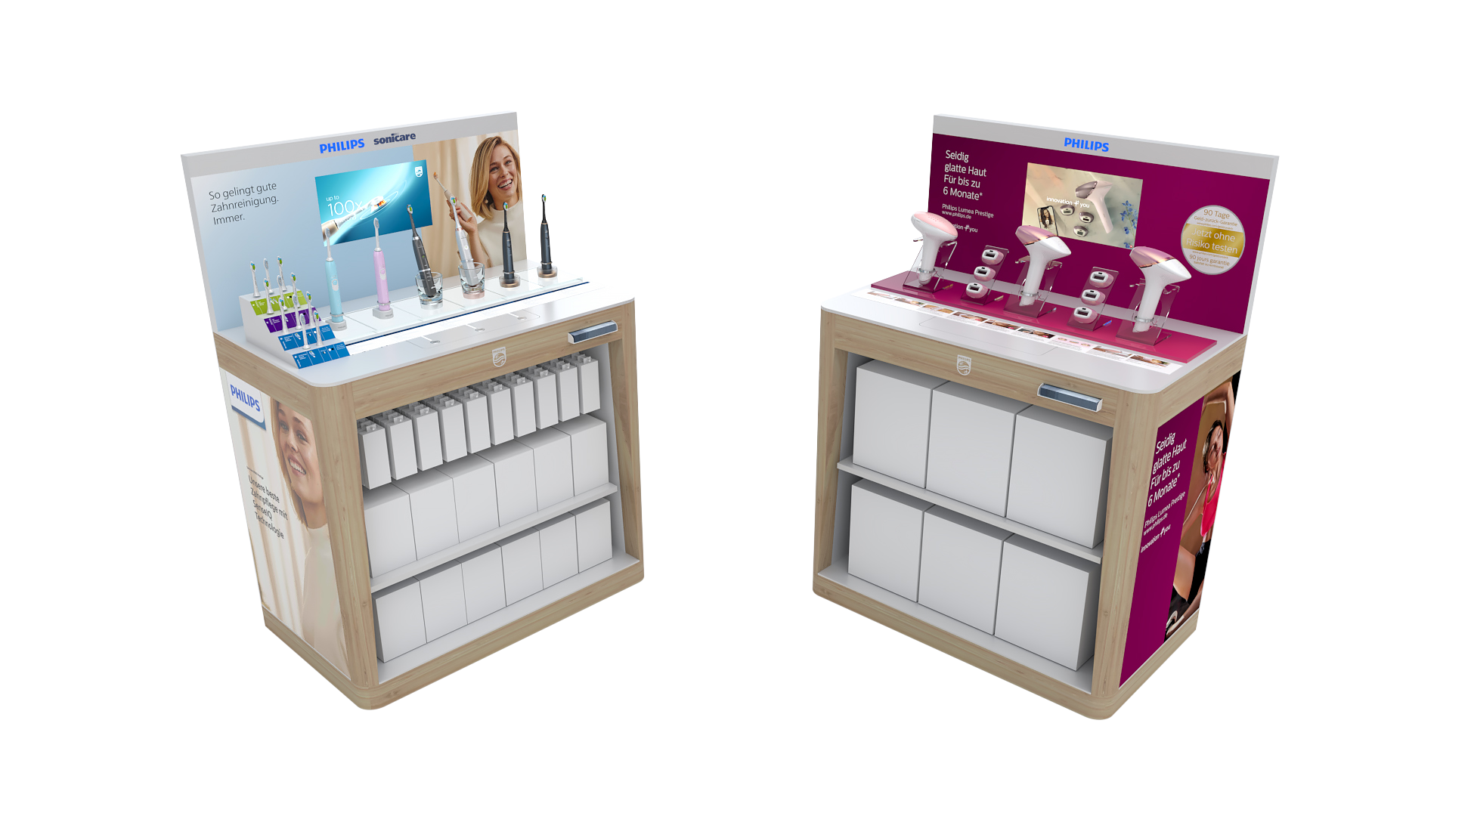
Ver.01
Ver.02

Slide 17
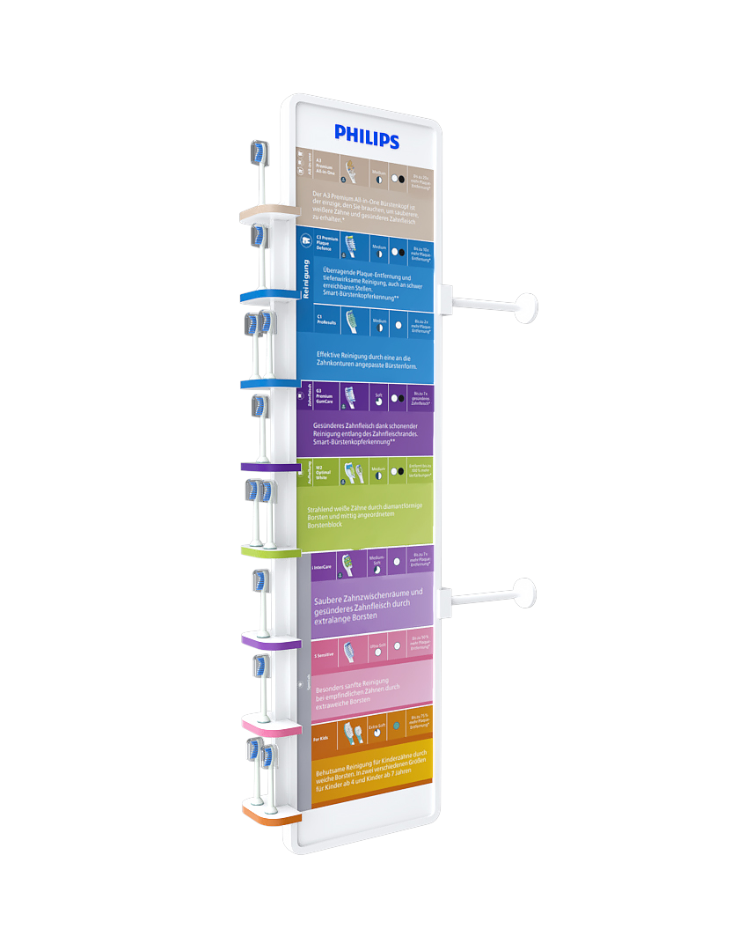
OHC
Shopper Stopper
Design challenge was to create a unique display that is easily attached to industry standard shelfs, to feature bright colors and make the products “pop”.
Once we grab consumers attention all the information about the products is clearly displayed in easy to find categories.

Slide 18
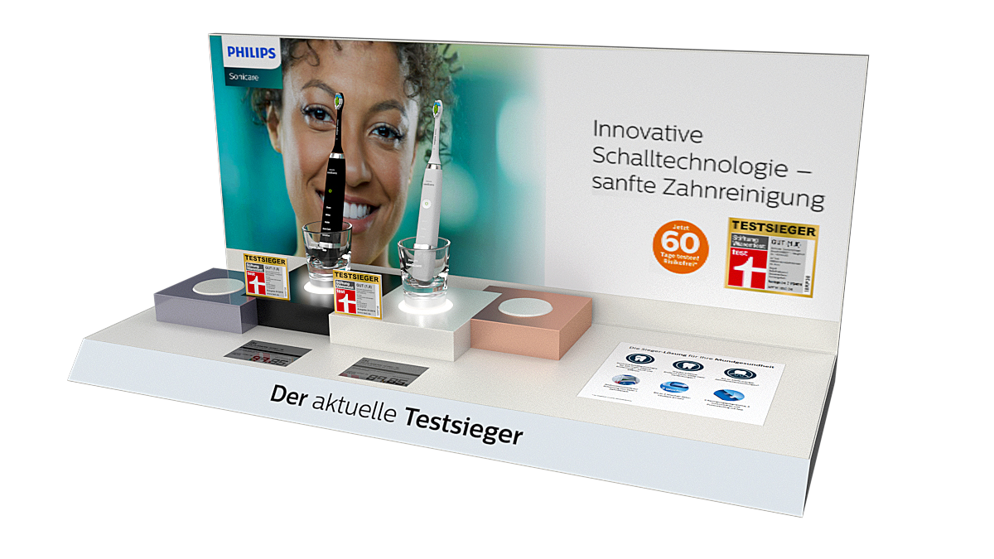
OHC Testsieger
Display
Materials
MDF, Acrylic, Metal, Printed PVC stickers, LED lights

Slide 19
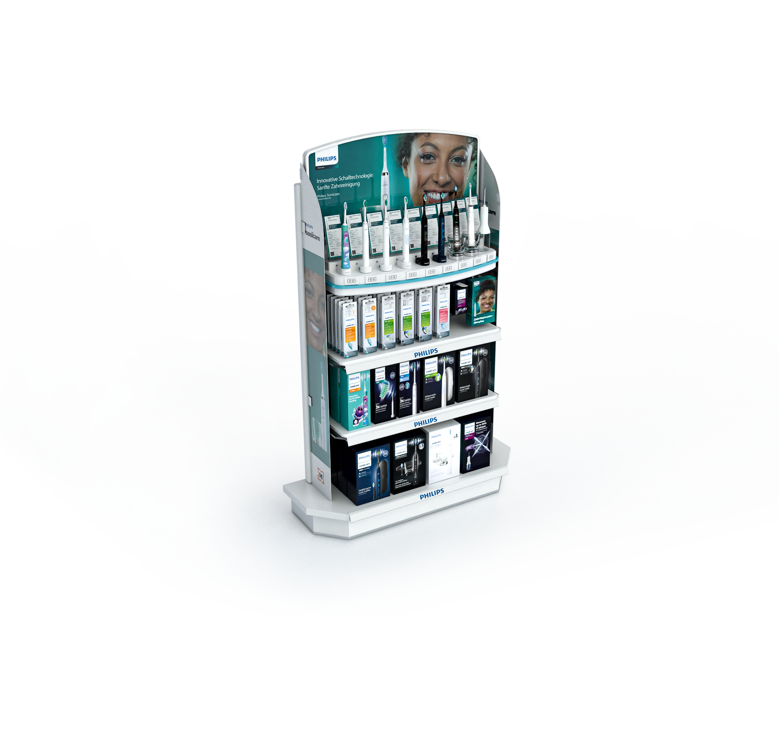
OHC
Modular Endcap
Display is featured in Muller stores across Germany, the purpose here was to create a visually striking display that stands out among crowded stores and is instantly recognizable. The visual impact of the shelf was only half of the design brief as the shelf must be versatile, easily adaptable to future products and visuals. All the shelves are modular and visuals on the sides are easily replaceable with new promotional print material.

Slide 20
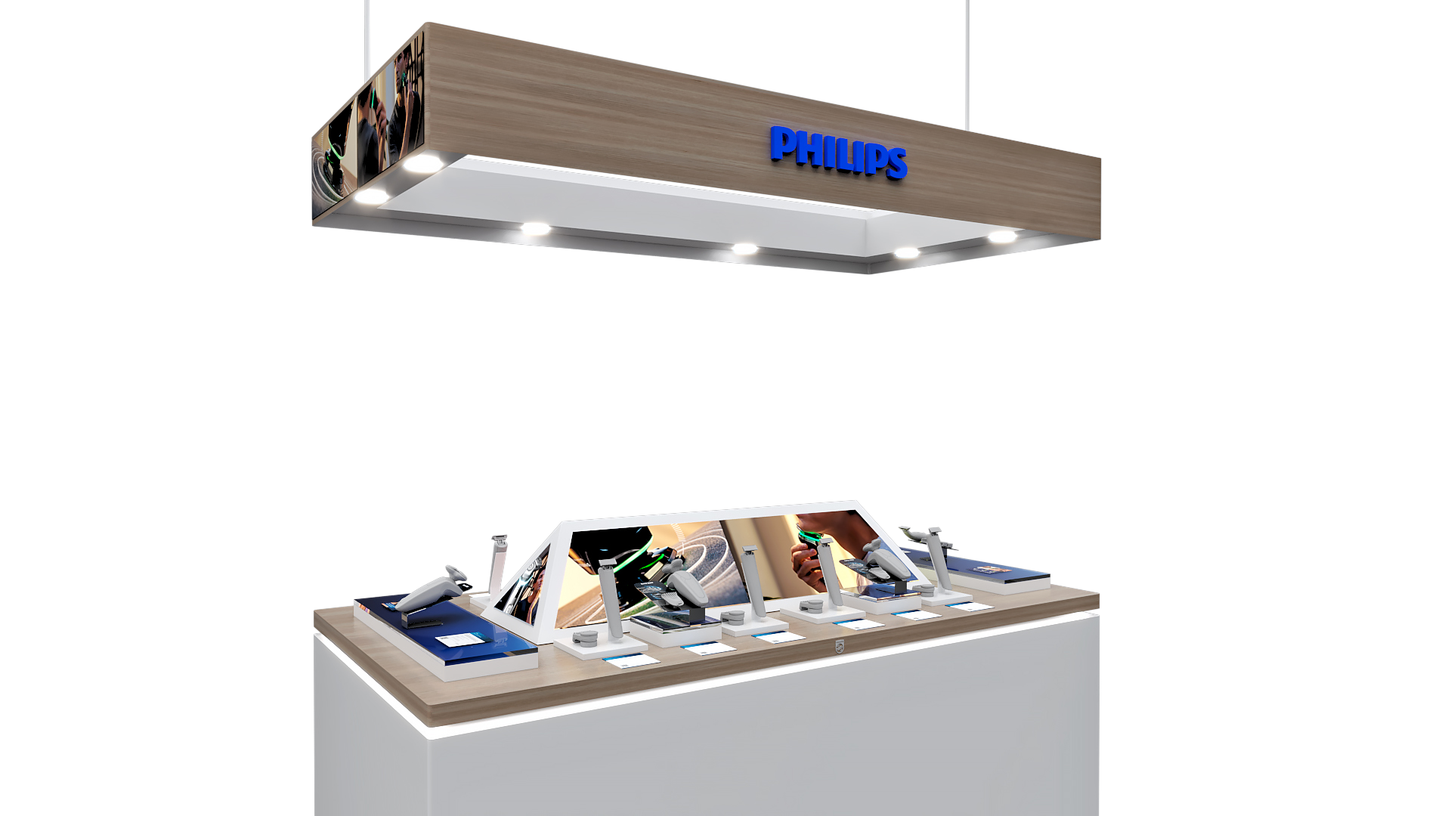
Elkjop Table
Male Grooming
The task here was to create a striking central pyramidal piece that is illuminated and features attention grabbing visuals from all sides. For the added premium look and feel we added branded overhead lights with two additional illuminated promo visuals.
Even though all these elements are not typical for Philips POSM we feel that design successfully managed to incorporate them and feature recognizable Philips look.

Slide 21
BG REKLAM
HEADQUATERS
29. Novembra 1M
11460 Belgrade, Serbia
info@bgreklam.com
+381 11 785 64 64
+381 60 68 69 110
Thank You.
BG REKLAM GMBH
Leverkusenstraße 3
22761 Hamburg, Deutschland
hamburg@bgreklam.com
+49 40 85413003
www.bgreklam.com
BG REKLAM
UK LTD
2588 Davenport House,
207 Regent St
London, W1B 3HH, UK
+44 75 4288 2312

