Slide 1
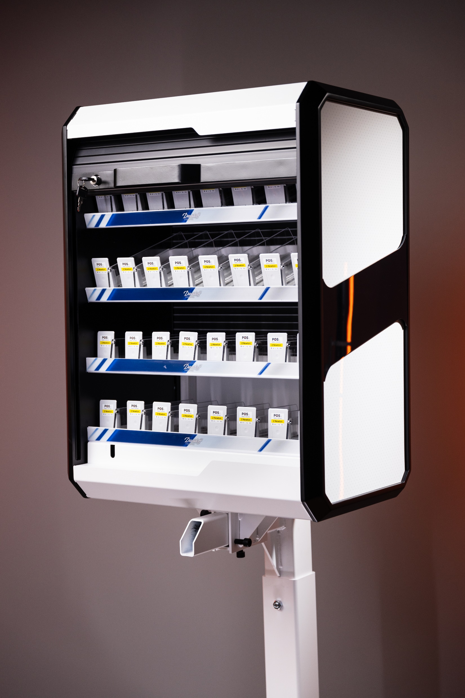

Premium
POS
Industry
People are always going to go shopping.
A lot of our effort is just ‘how do we make the retail experience a great one!

Slide 2

01.
Company
Profile
Private company, established in 2001, with factory and HQ in Belgrade, Serbia.
Entire value chain from design and production, installation
and maintenance at the point of sale.
Sustainable materials the core of our production process.
200+ skilled employees and 5.000 square meters of office and production space.
20+
Years of experience
and development of
Premium POS solutions.

Slide 3
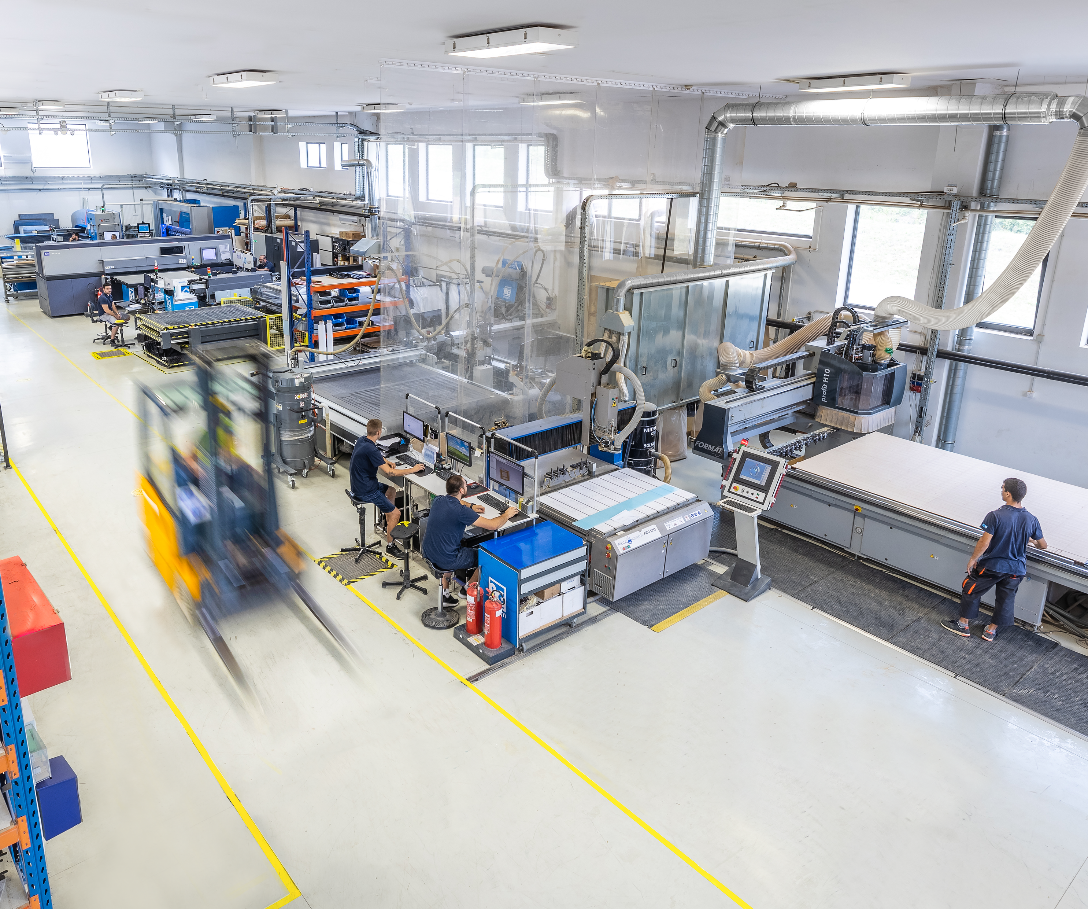
Technology
& Efficiency
Technology is just a way to reach our objectives: to grow, to improve efficiency, and to implement processes, products, and enable our clients to increase profits.
Our objective is to find the most efficient and easiest way to use technology to improve the efficiency, quality, and reduce cost for our clients.

Slide 4


02.
Markets
We cover
Region in focus:
Western and Central Europe
Presence:
25+ Markets across the globe
Offices:
Belgrade Hamburg London
Delivery times:
We deliver our products to any European destination within three working days.

Slide 5
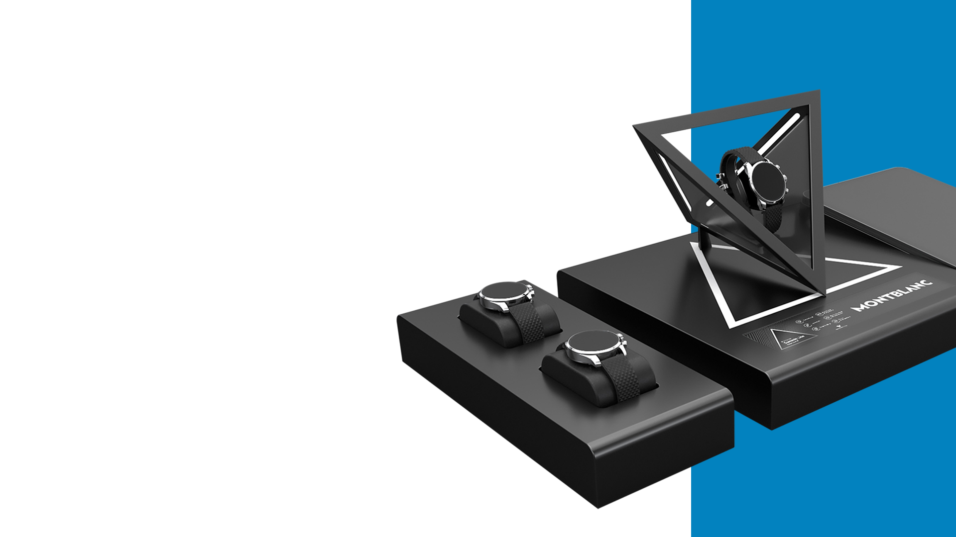
03.
03.
From idea
To stores
At BGReklam everything is designed and produced under one roof.
Giving our design, engineering, production, andsales teams a unique perspective and rare opportunity to be part of the entire production process.

Slide 6
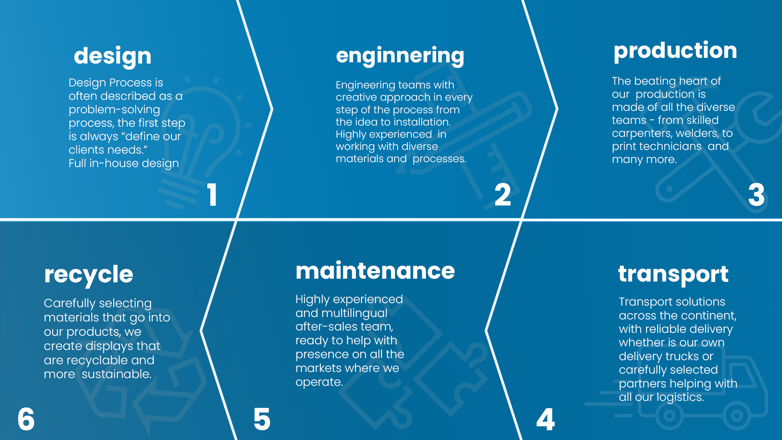
1
2
3
6
5
4

Slide 7
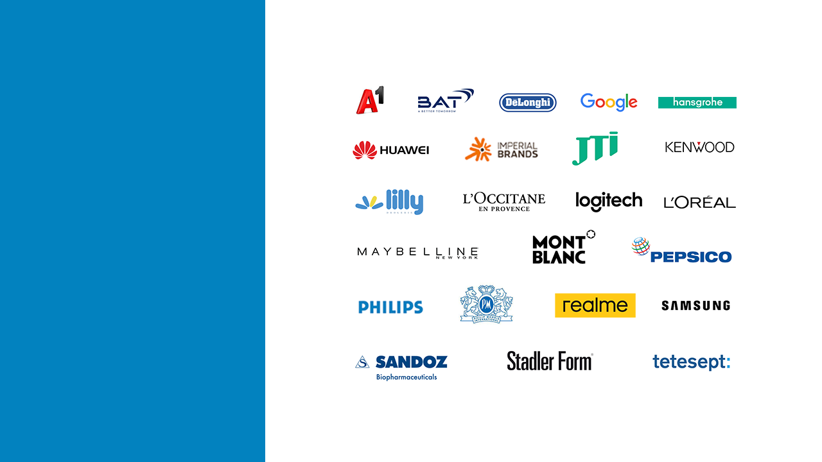
04.
Partners

Slide 8

05.

Slide 9

More planet
Less waste.
Re-Use:
Designing versatile and easily adaptable displays with longer life and use with any future products.
Re-Duce:
By always investing in cutting edge technology, we significantly reduce scrap and improve efficiency.
Re-Cycle:
Engineering displays that can be easily disassembled and recycled. Always ensuring to use sustainable materials.
Re-Peat:
Plant new trees and create eco projects for our community and give back to the environment.

Slide 10

06.
Certifications
ISO the International Organization for Standardization.
ISO 9001 Sets out the criteria for a quality management system
ISO 14001 Sets out the criteria for an environmental management system
ISO 45001:2018 Occupational health and safety (OH&S) management system
ISO 20400 Integrating sustainability within procurement.
ISO 26000 Organization’s commitment to sustainability and its overall performance.

Slide 11
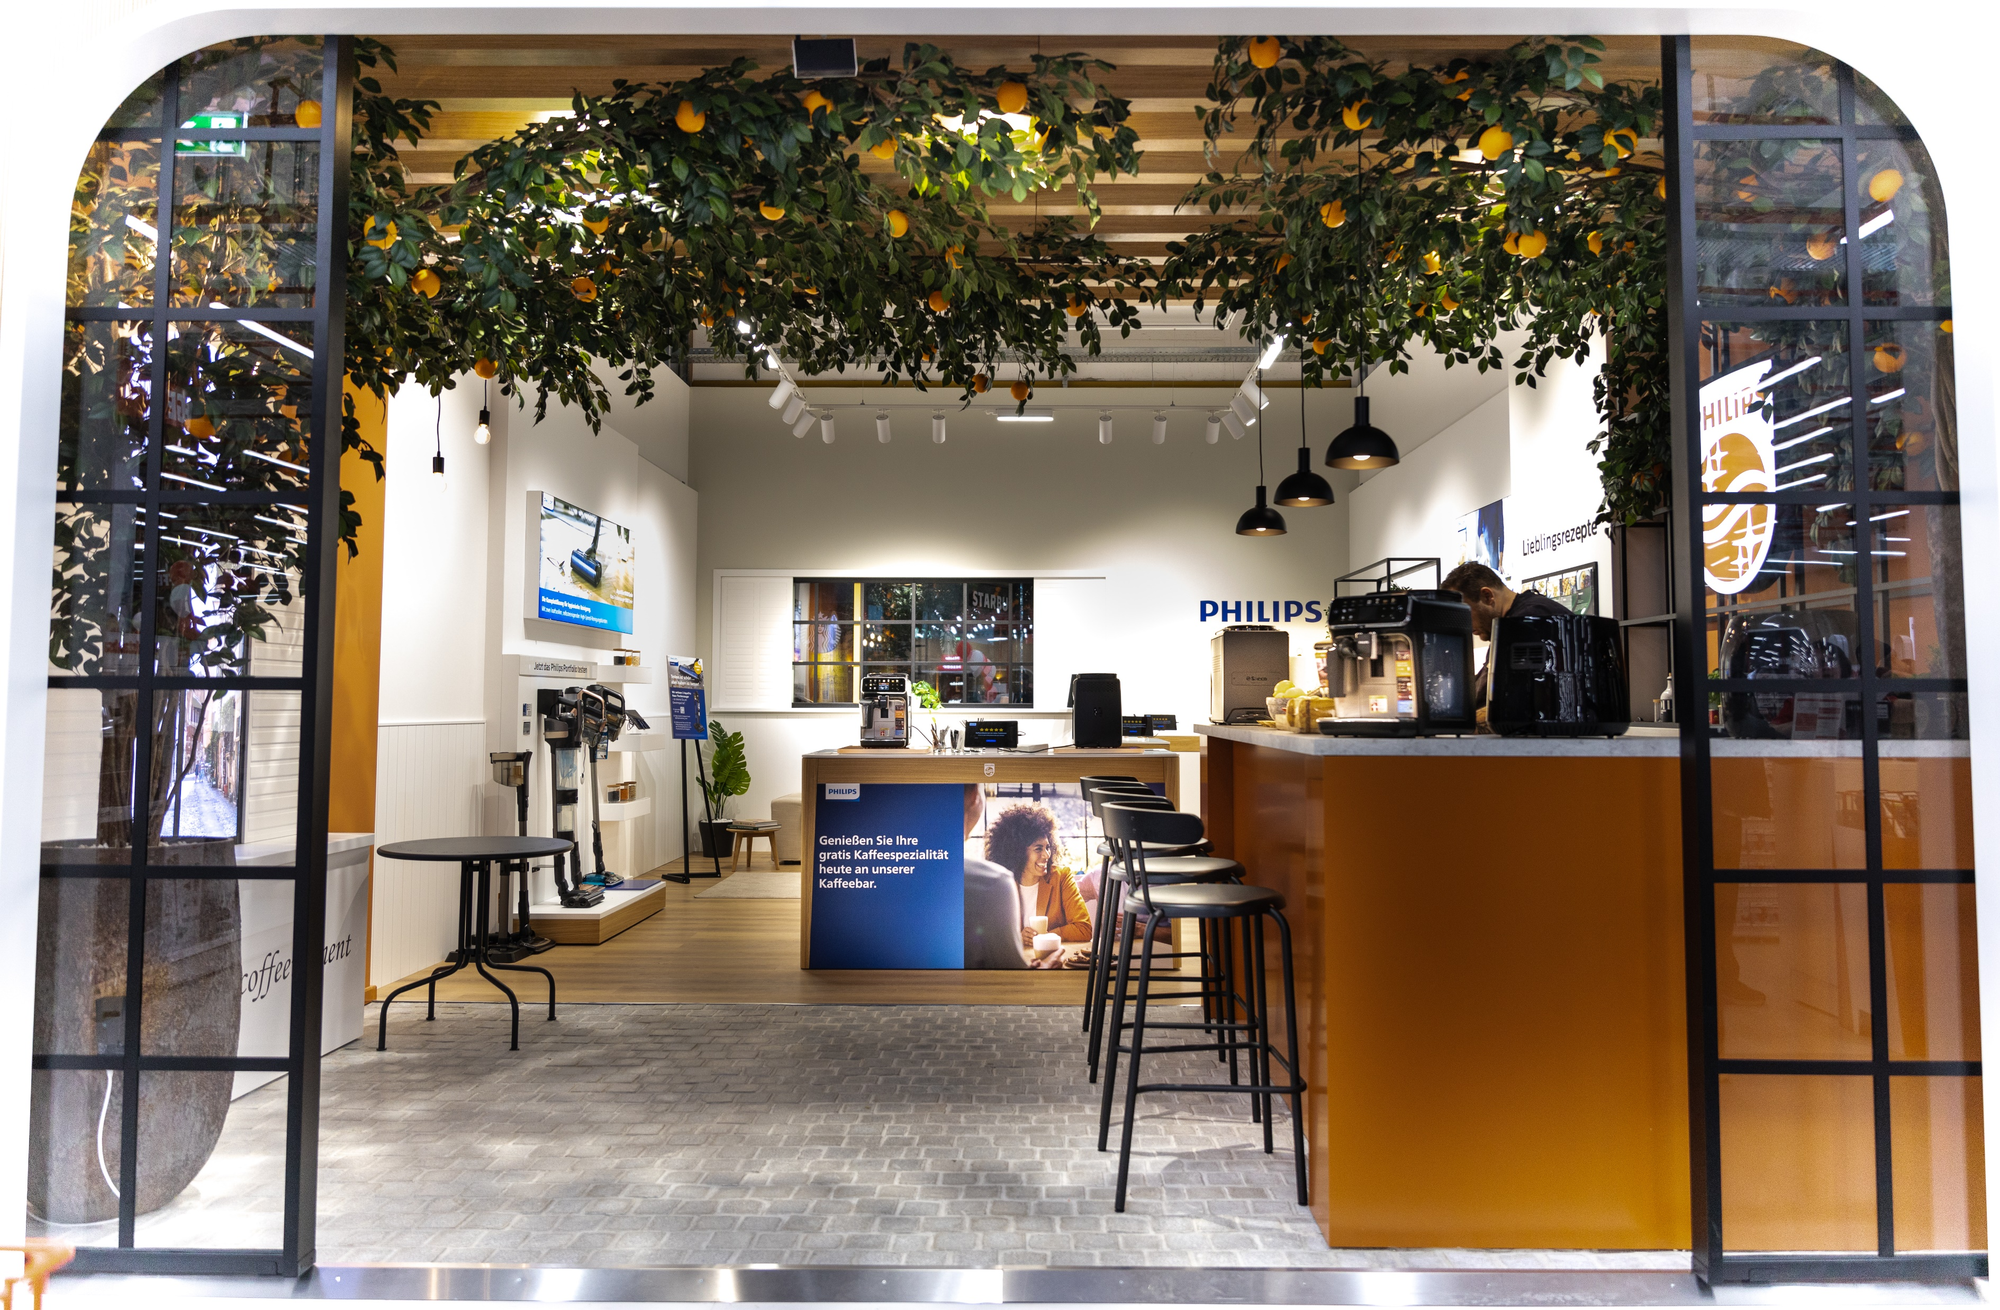
07.
Shop in
Shop
solutions

Slide 12
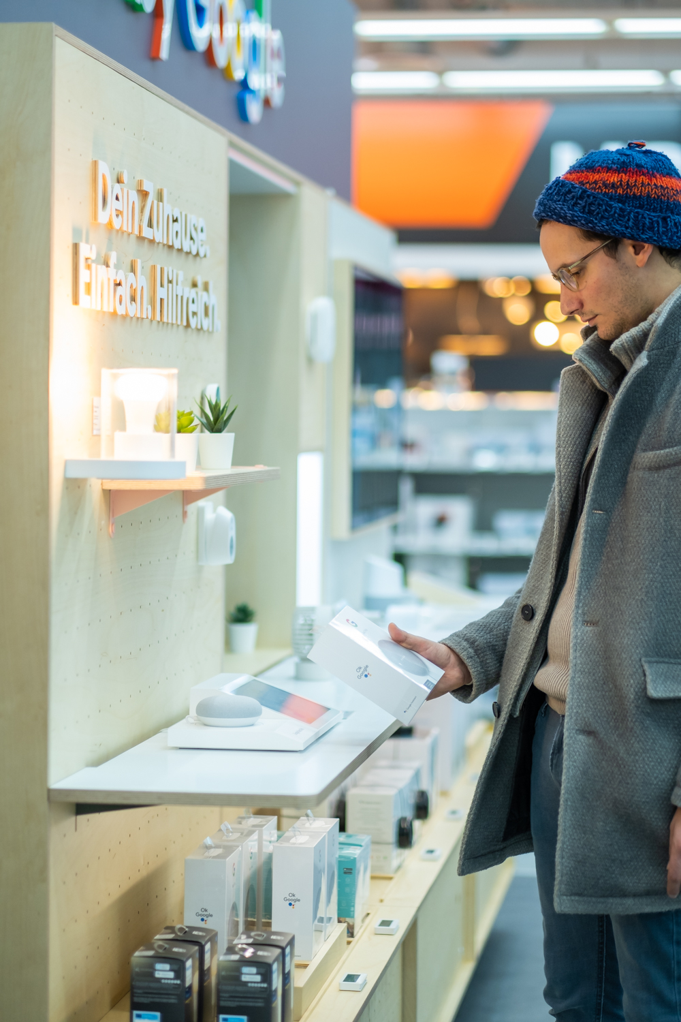
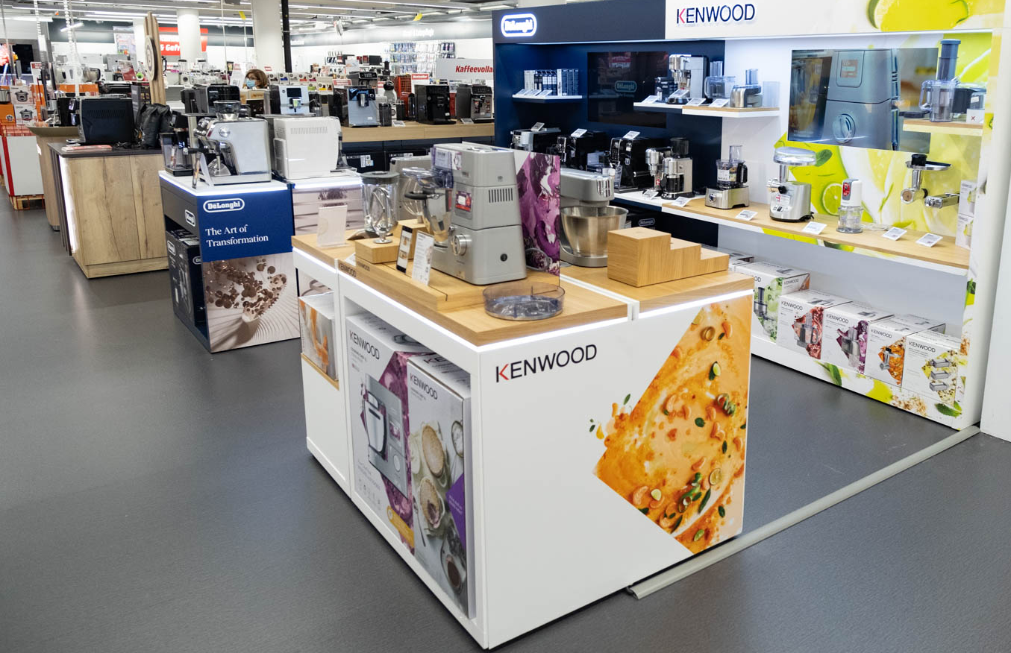
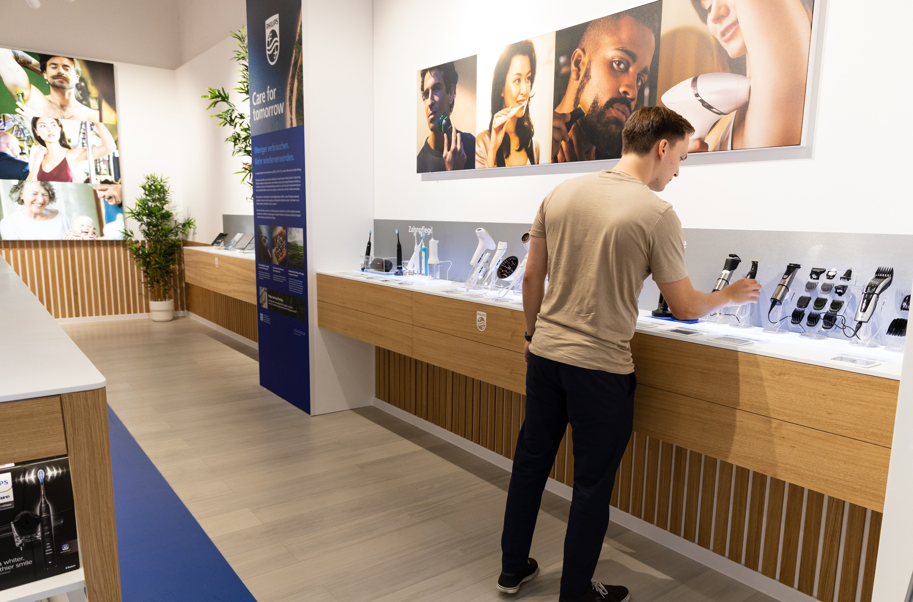
MediaMarkt
Aleksandarplatz, Berlin
Philips Domestic appliances
Philips Personal care

Slide 13
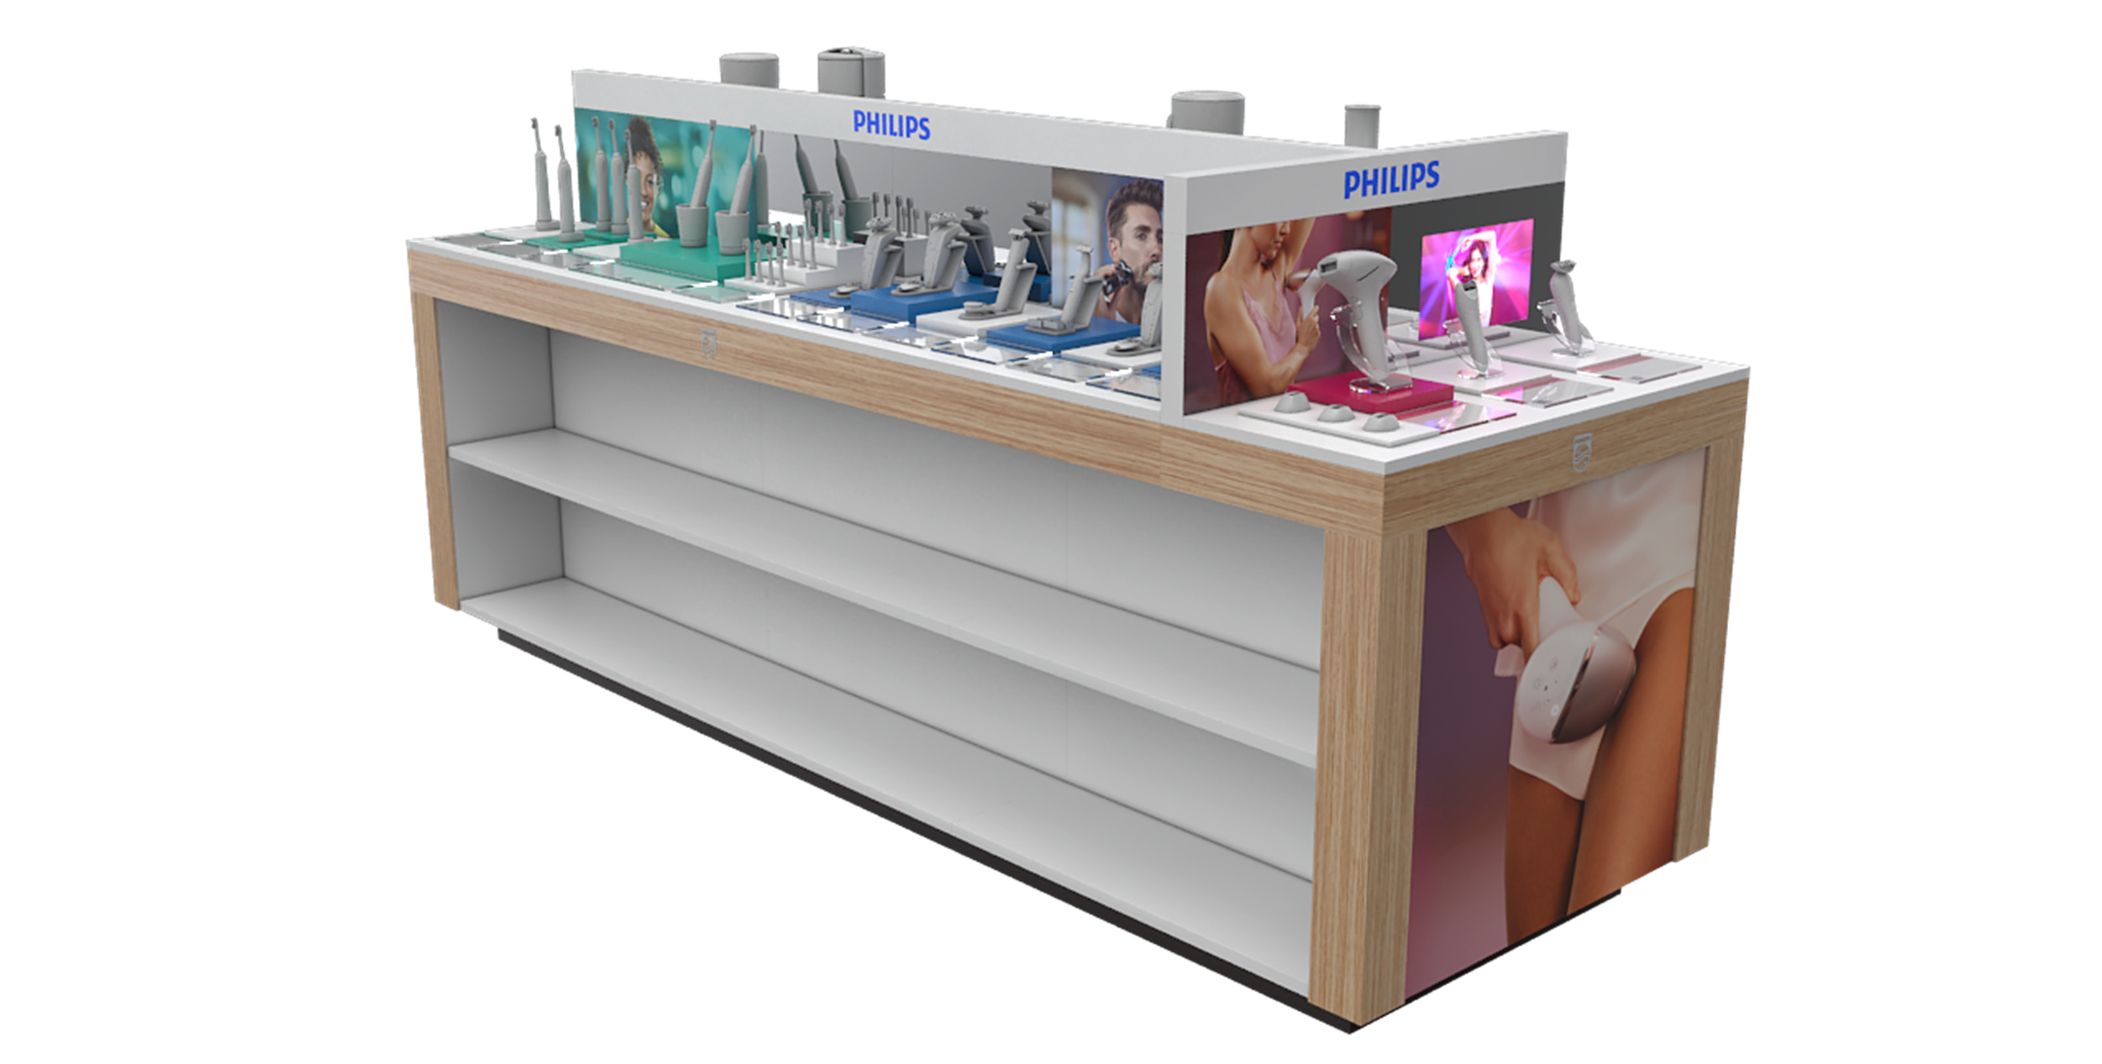
Large
Displays

Slide 14
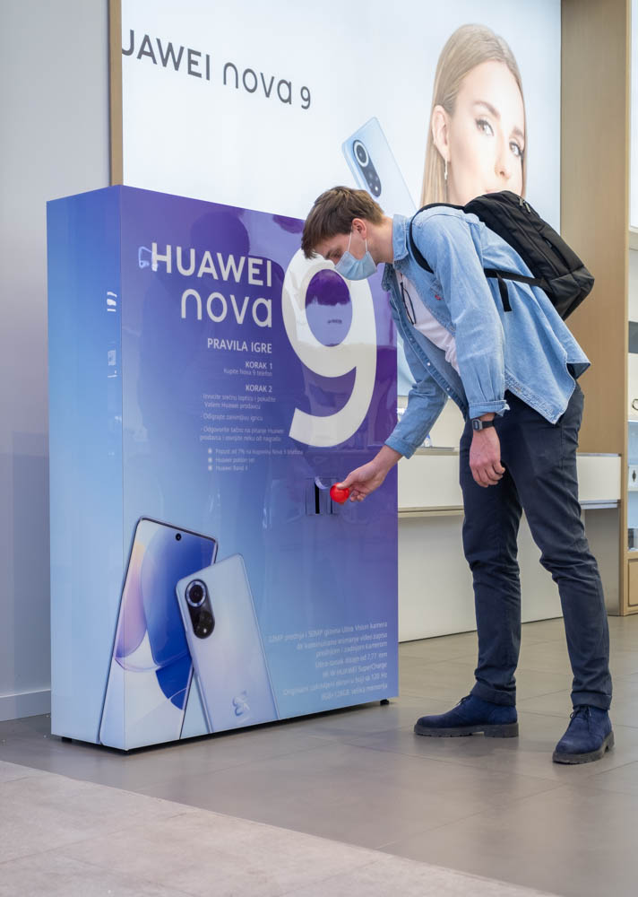
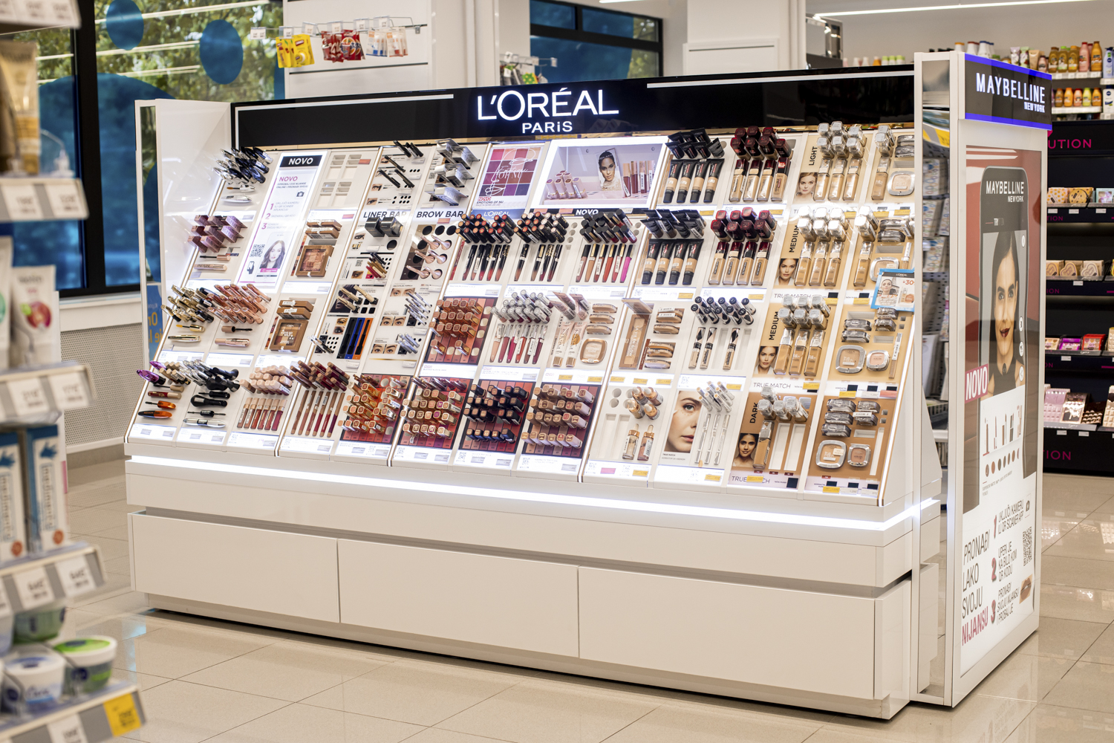
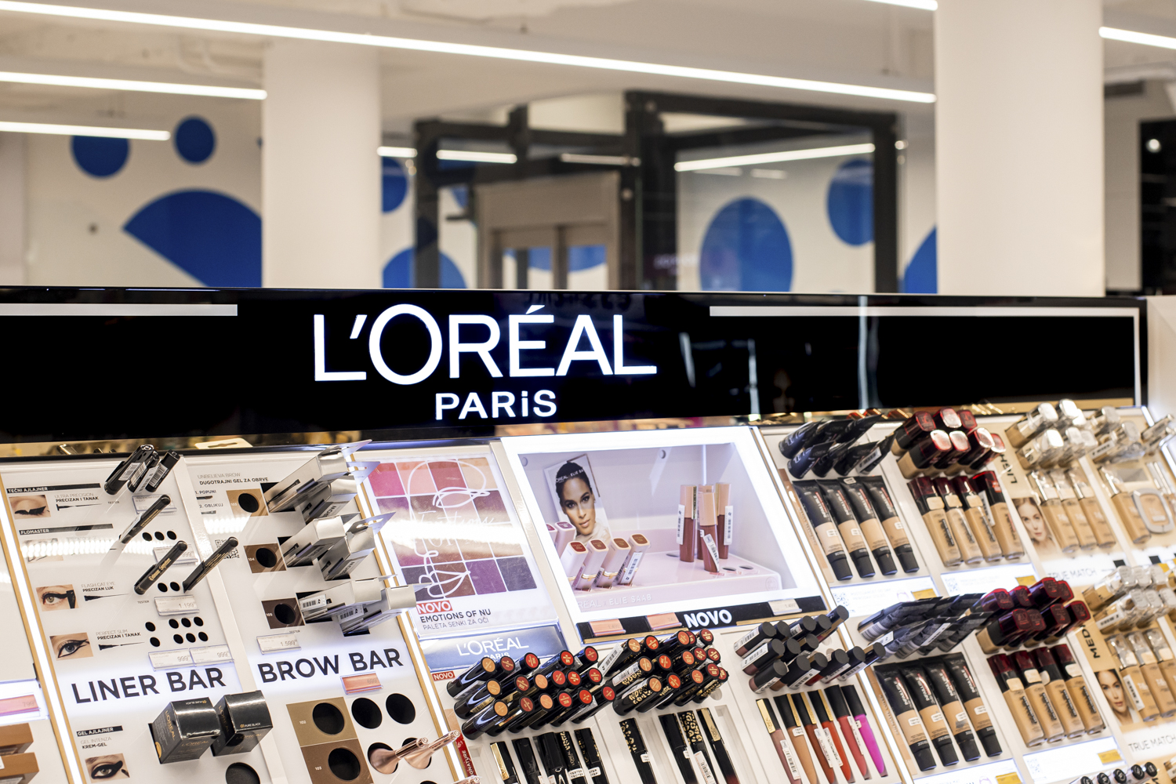
MediaMarkt
Aleksandarplatz, Berlin
Philips Domestic appliances
Philips Personal care

Slide 15
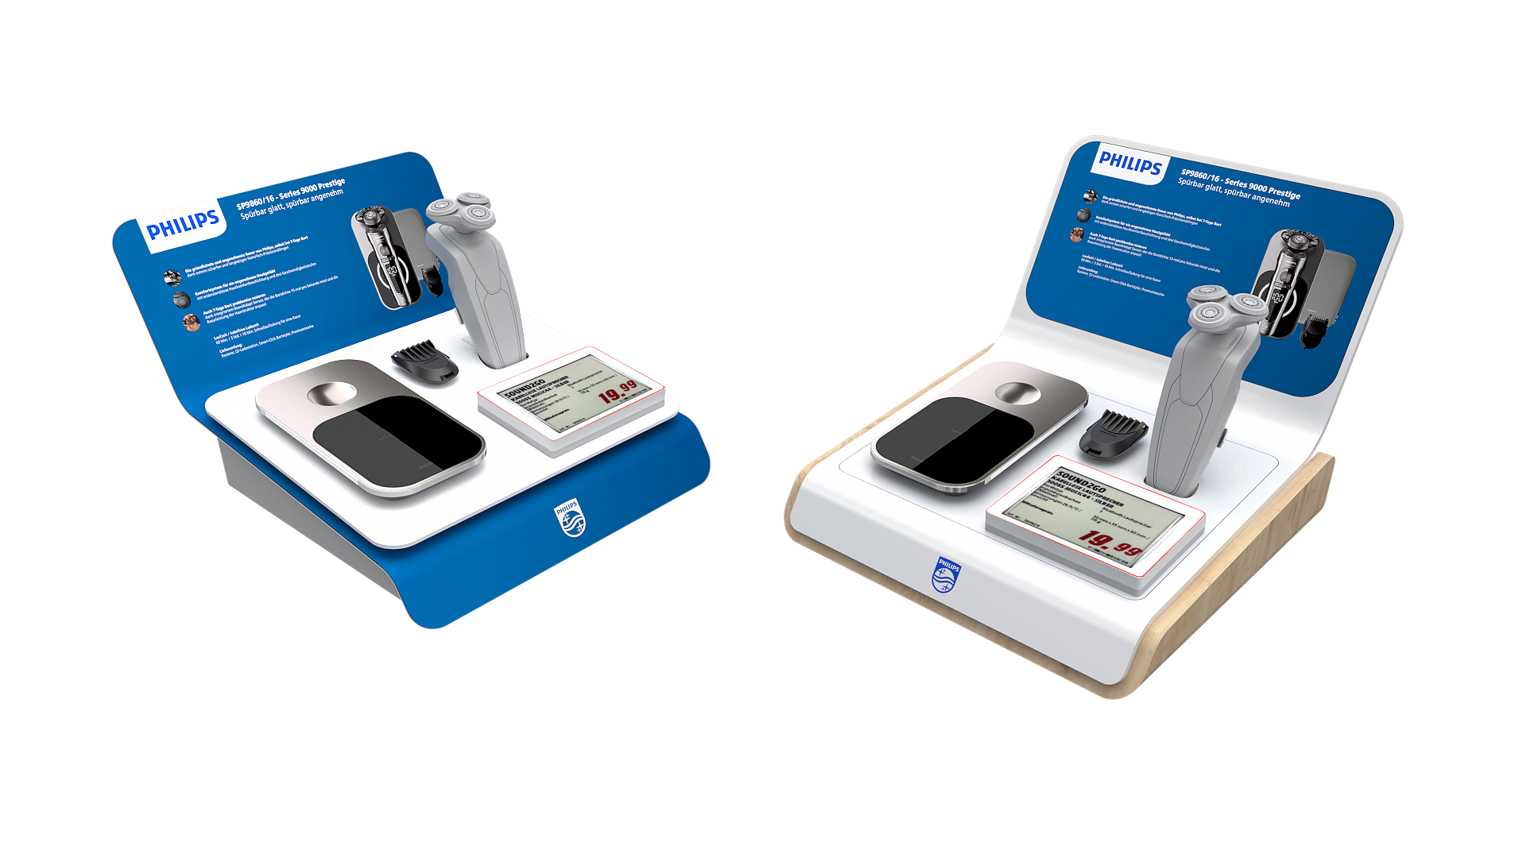
Small
Displays

Slide 16
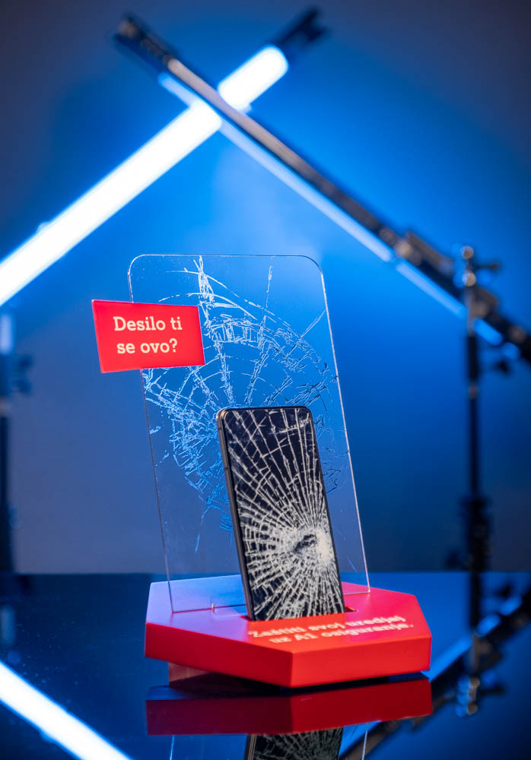
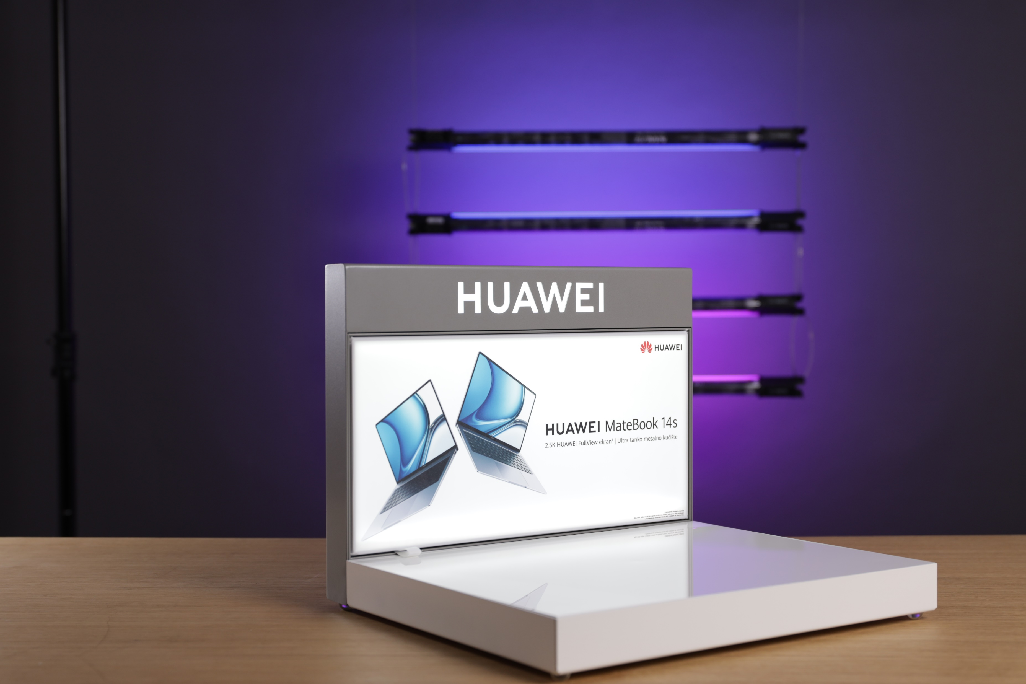
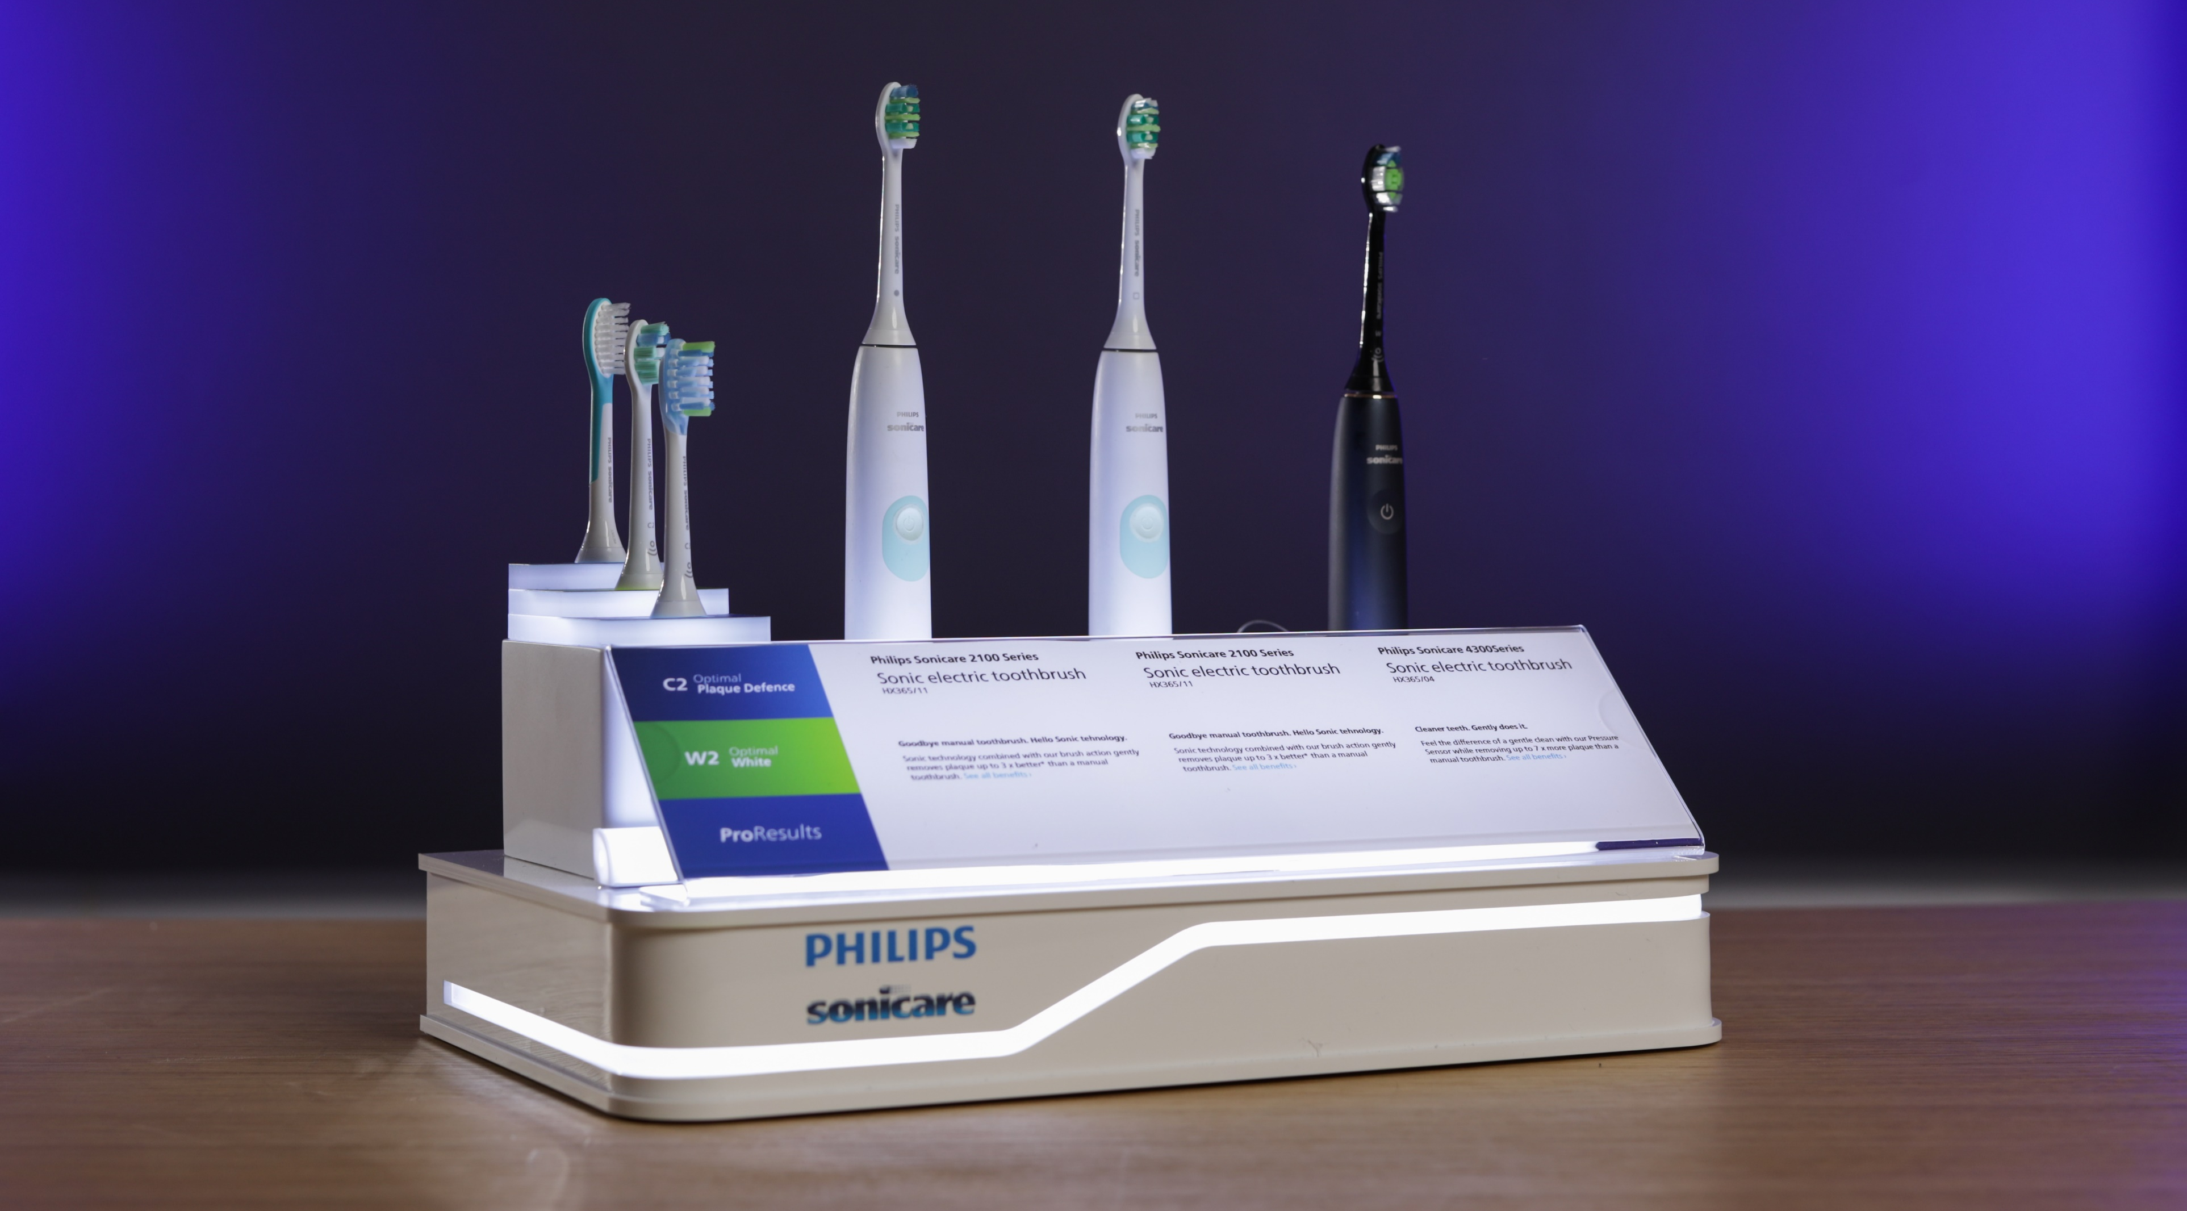
MediaMarkt
Aleksandarplatz, Berlin
Philips Domestic appliances
Philips Personal care

Slide 17
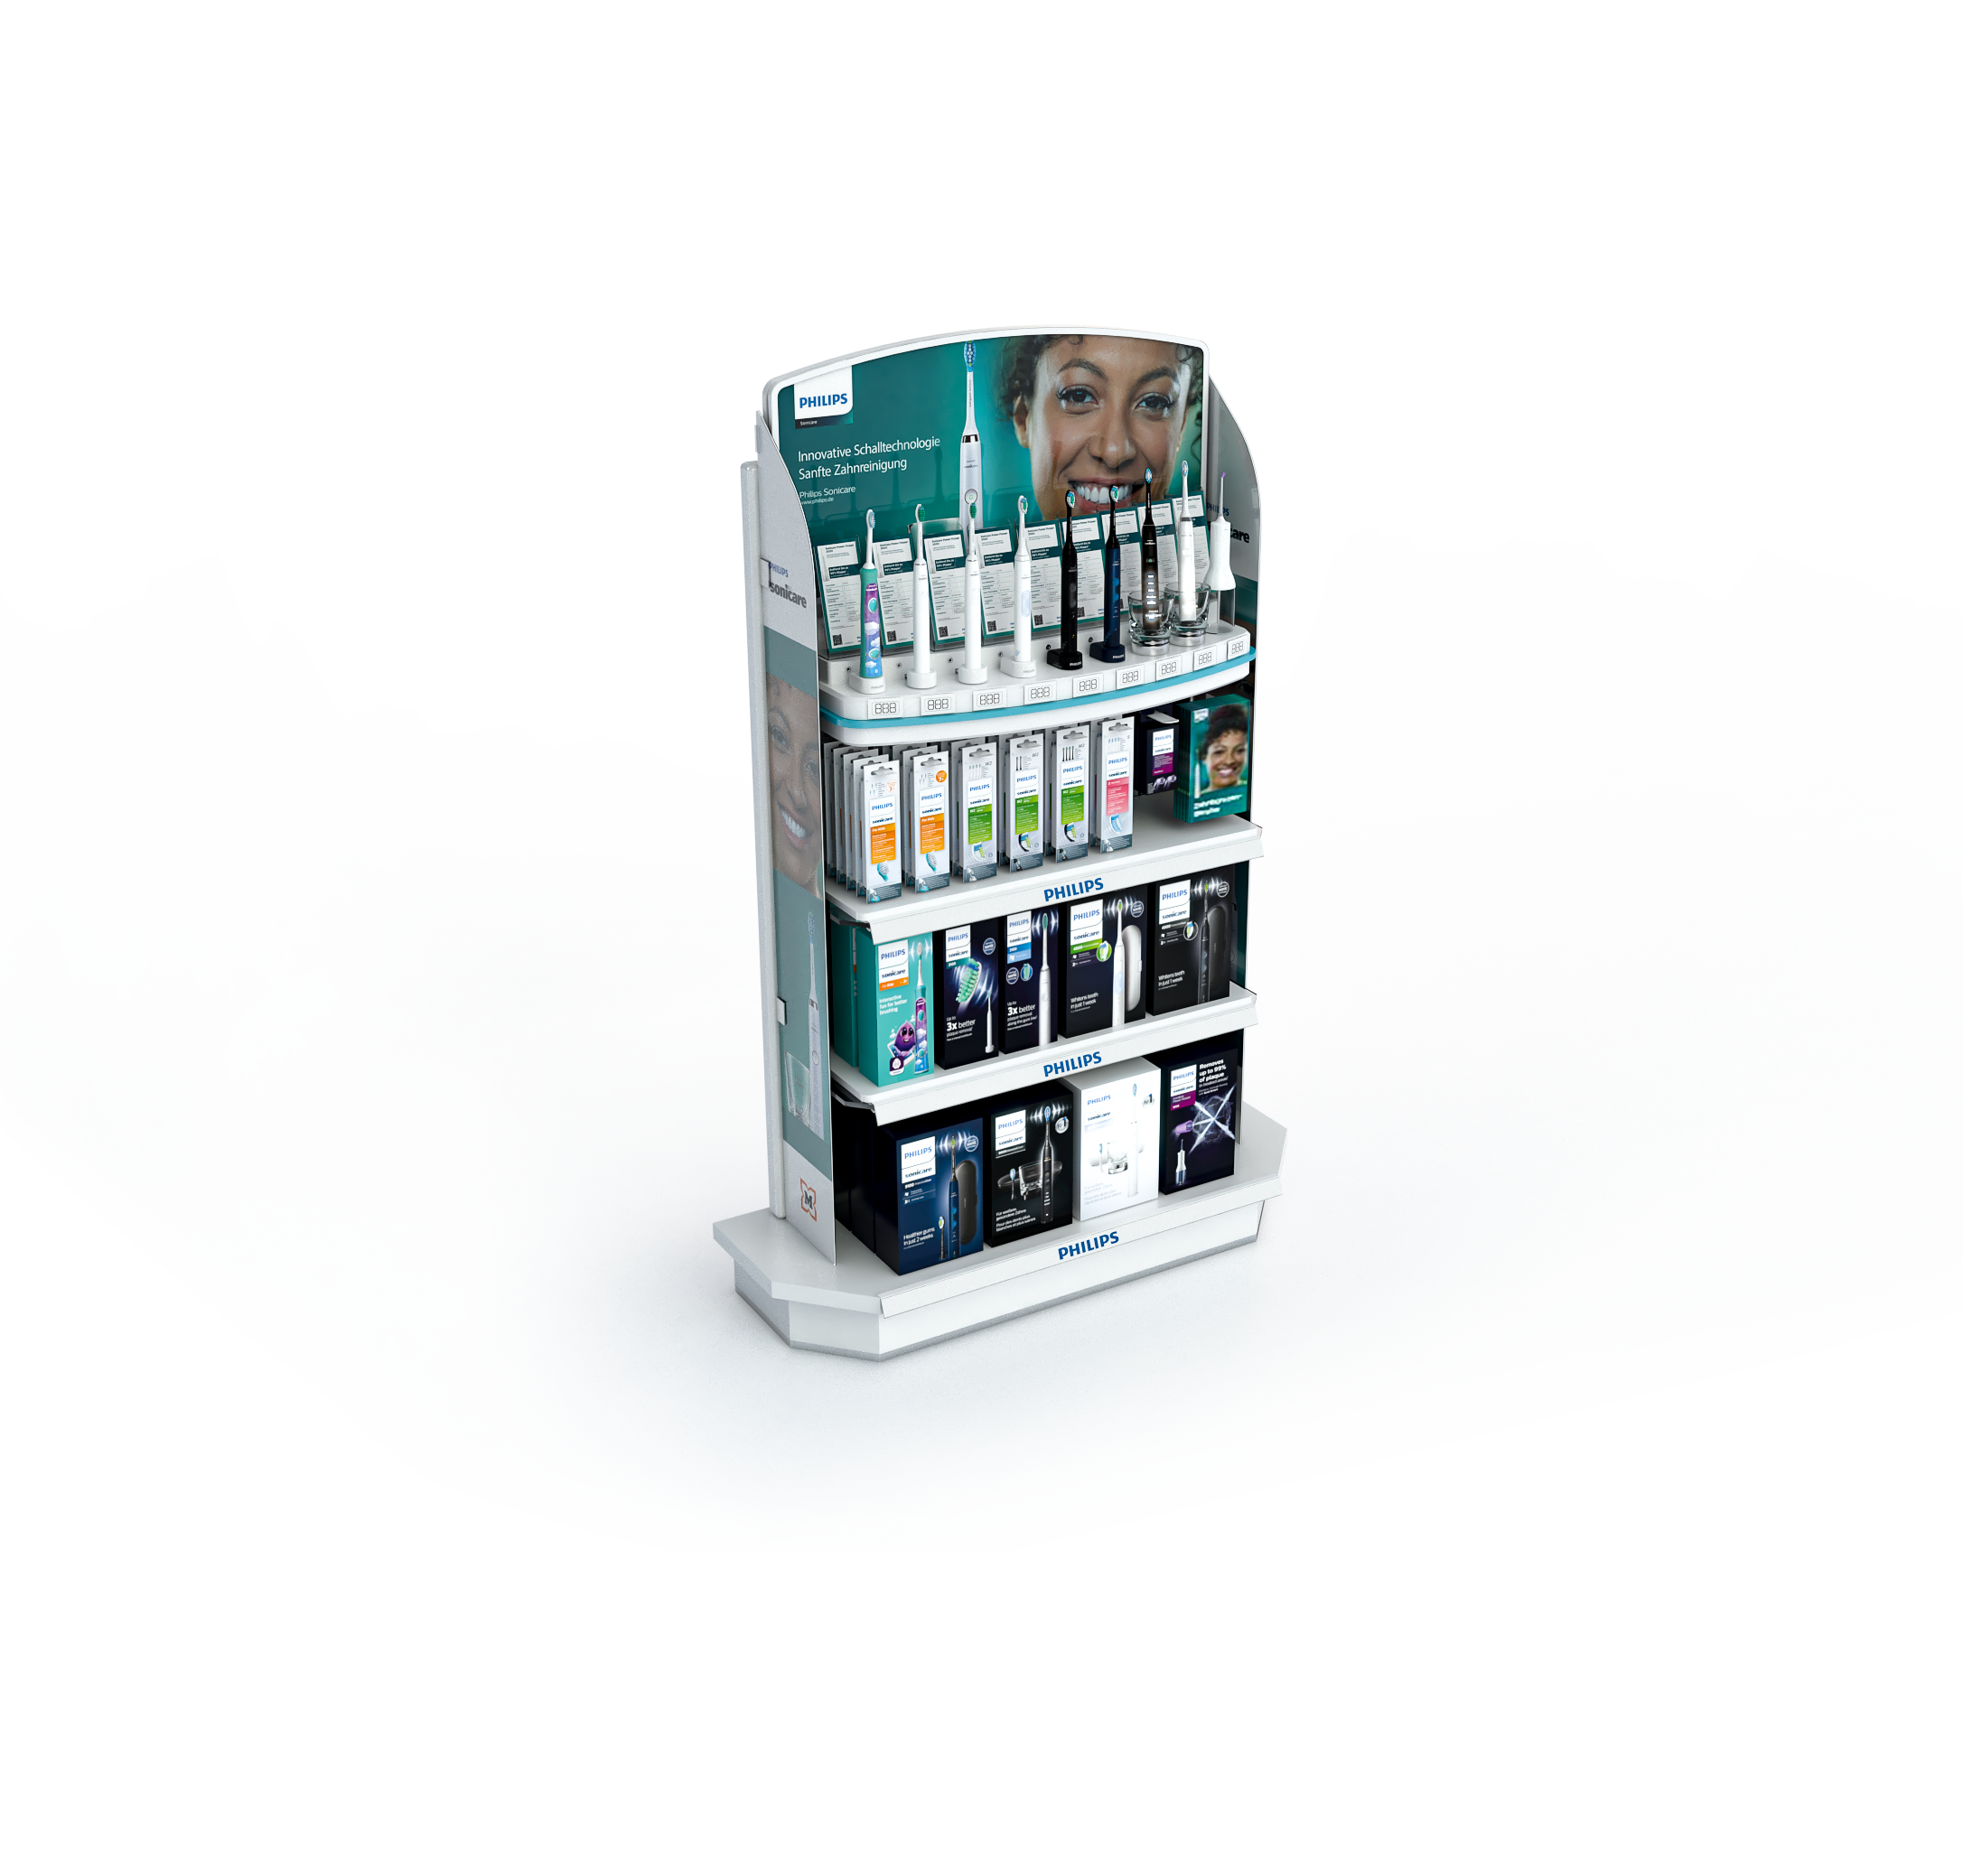
Different
Materials we
Use

Slide 18
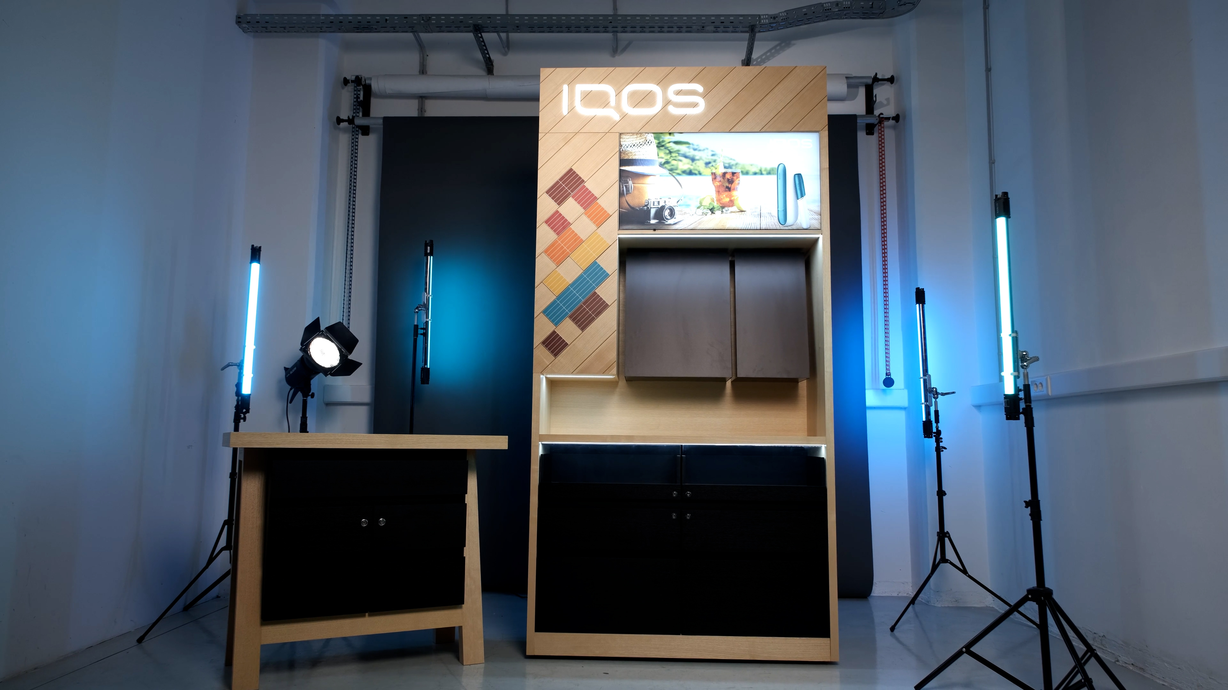
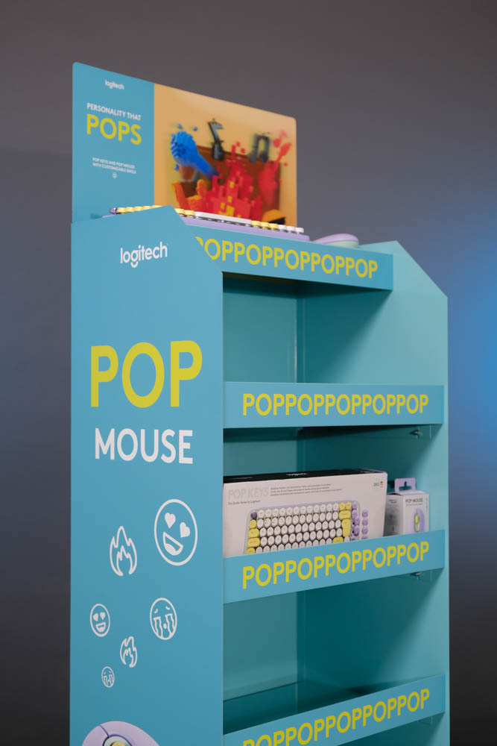
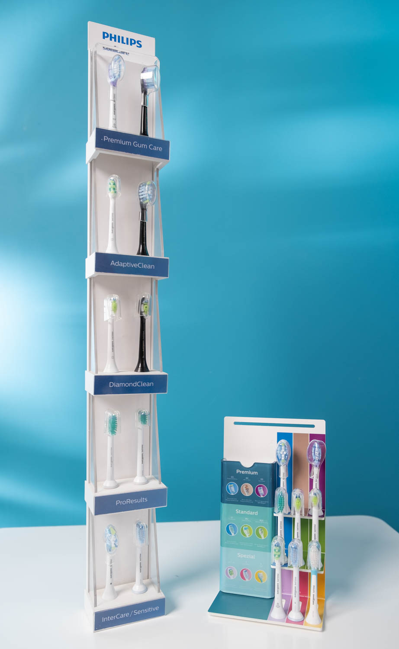
Wood
Acrylic
Metal

Slide 19
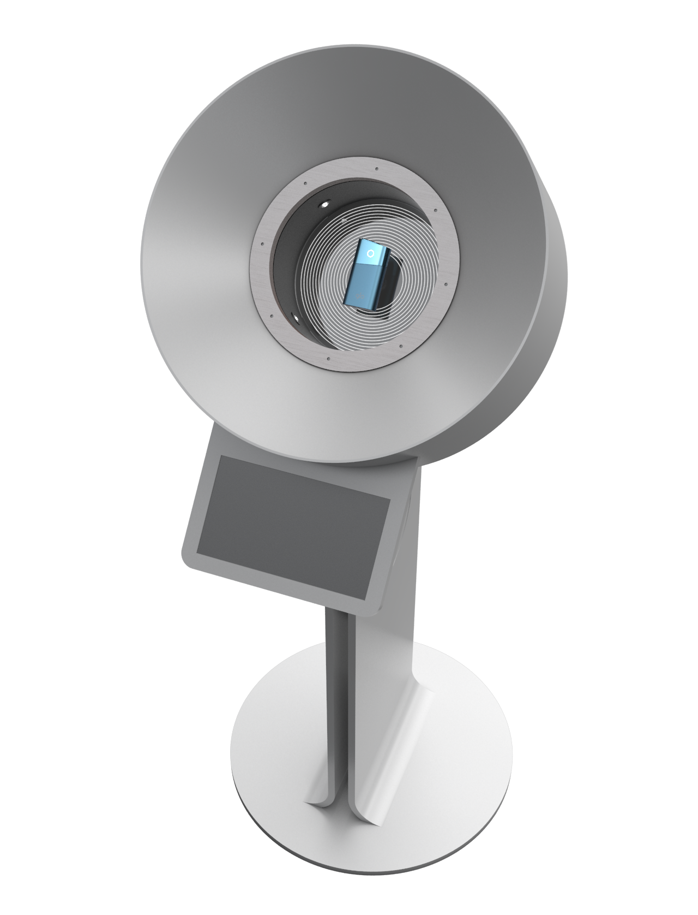
Innovating
displays

Slide 20
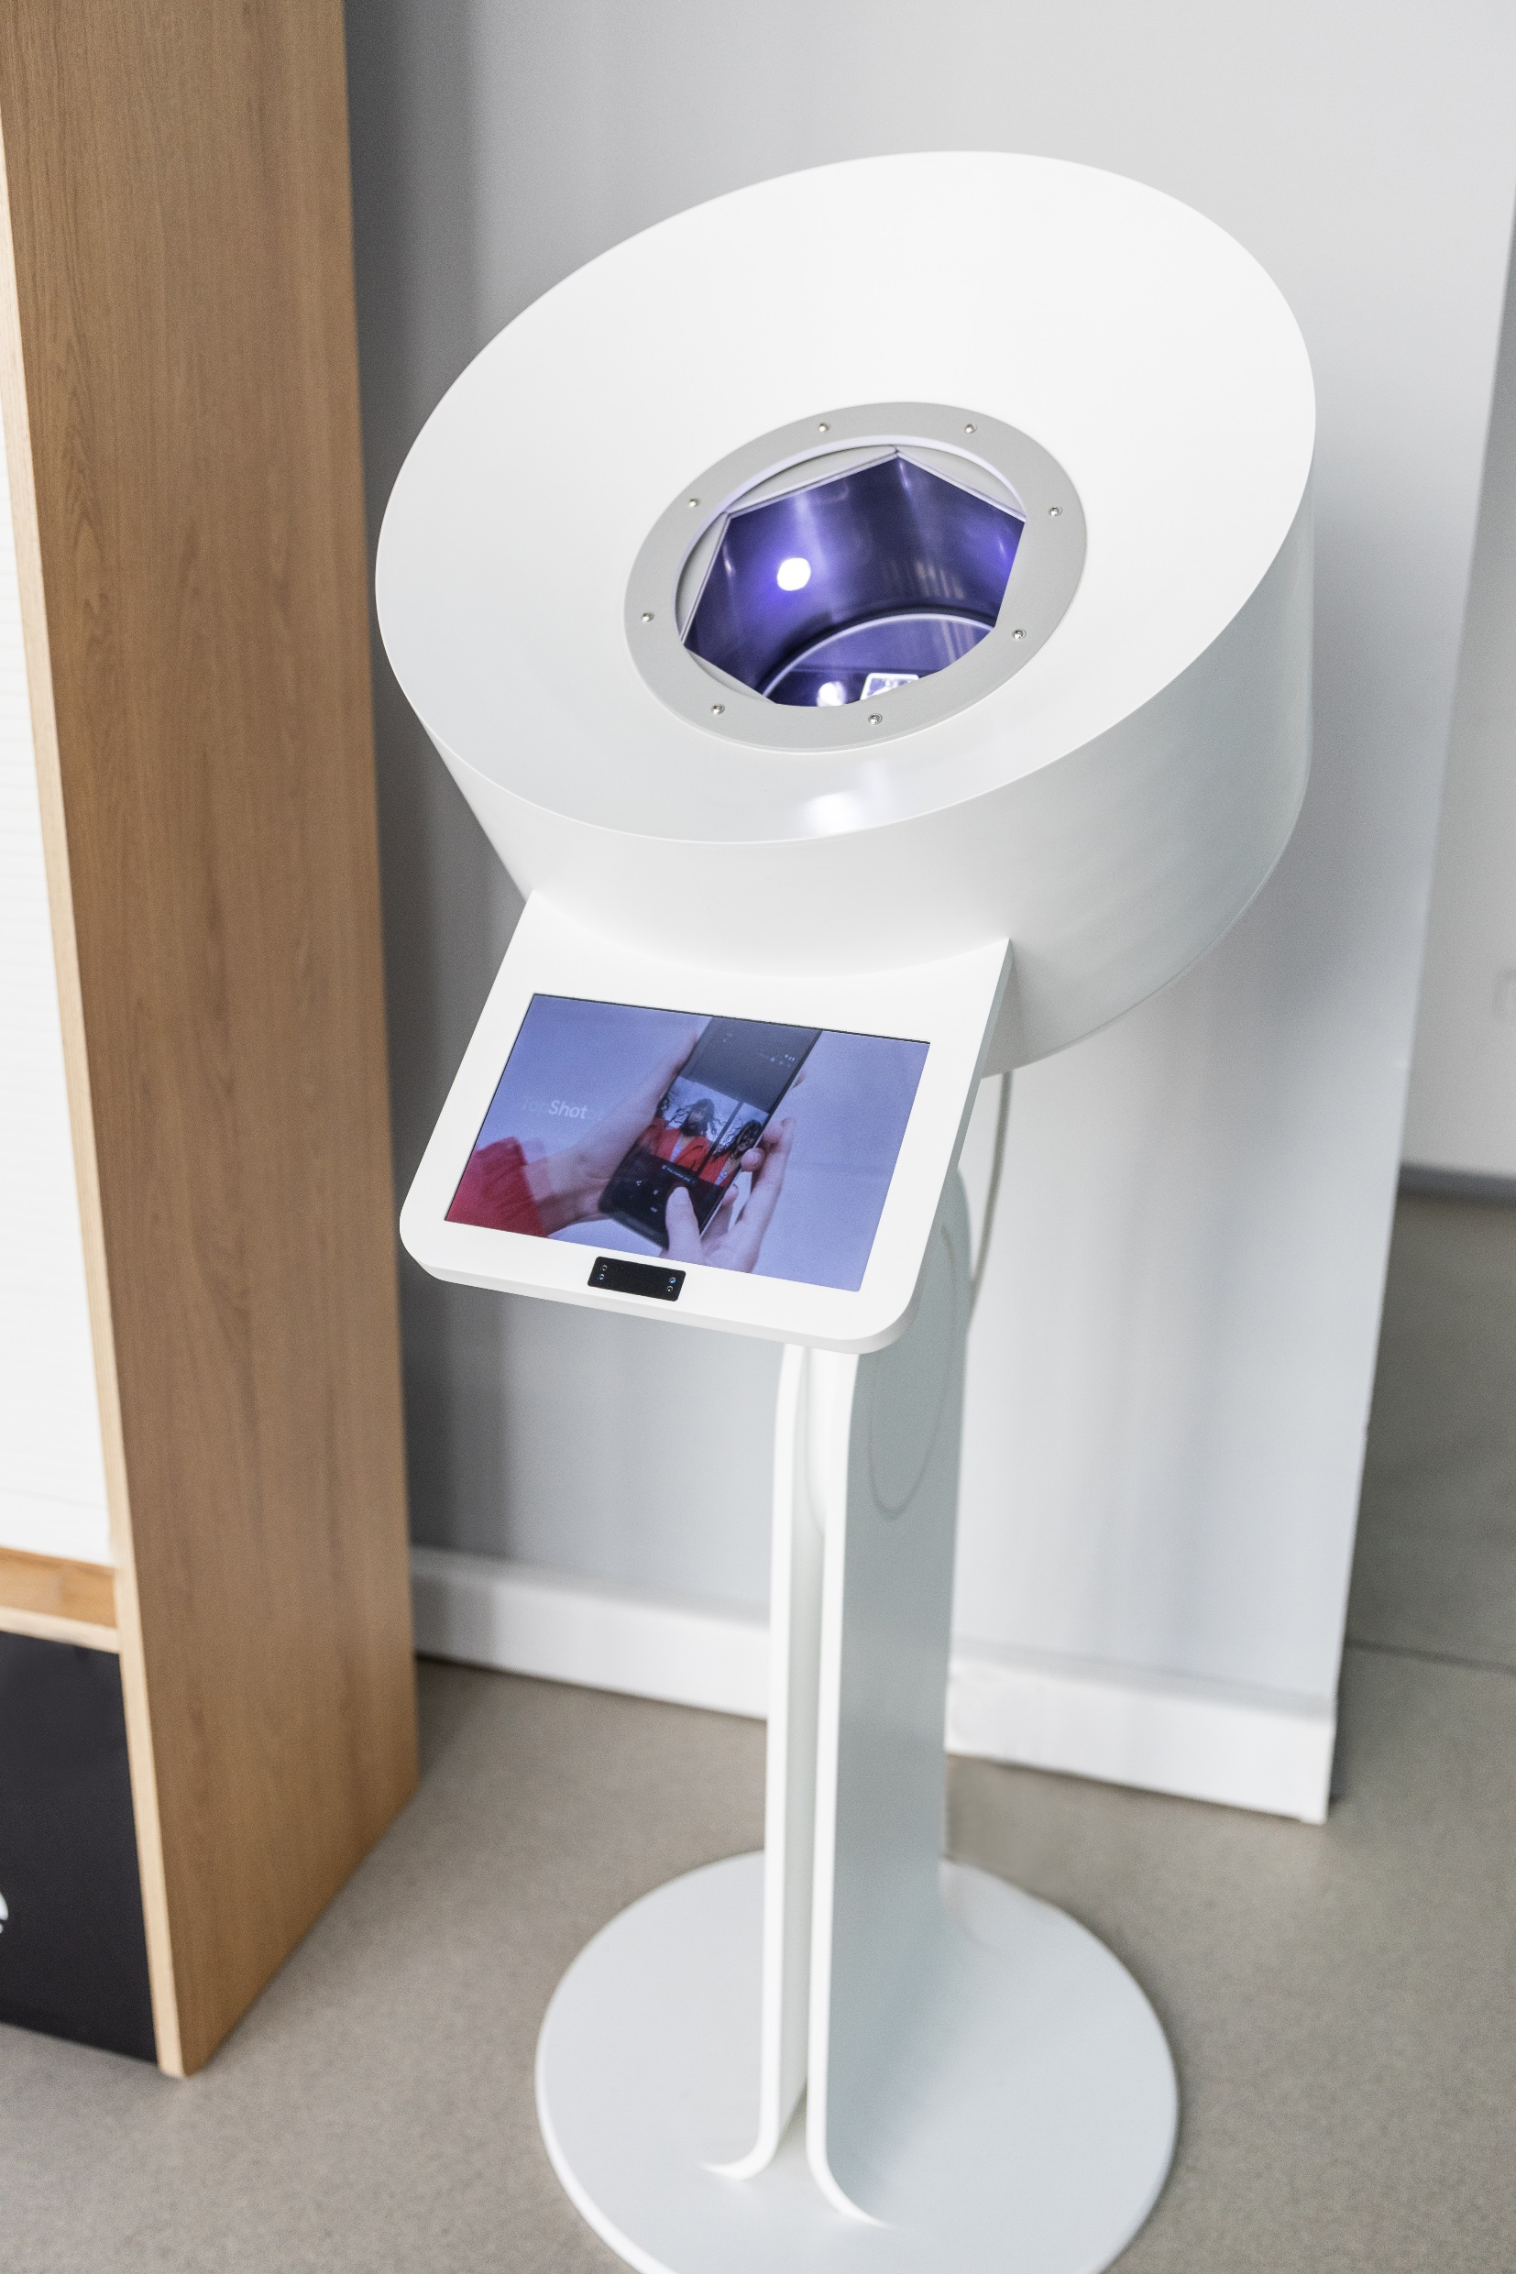
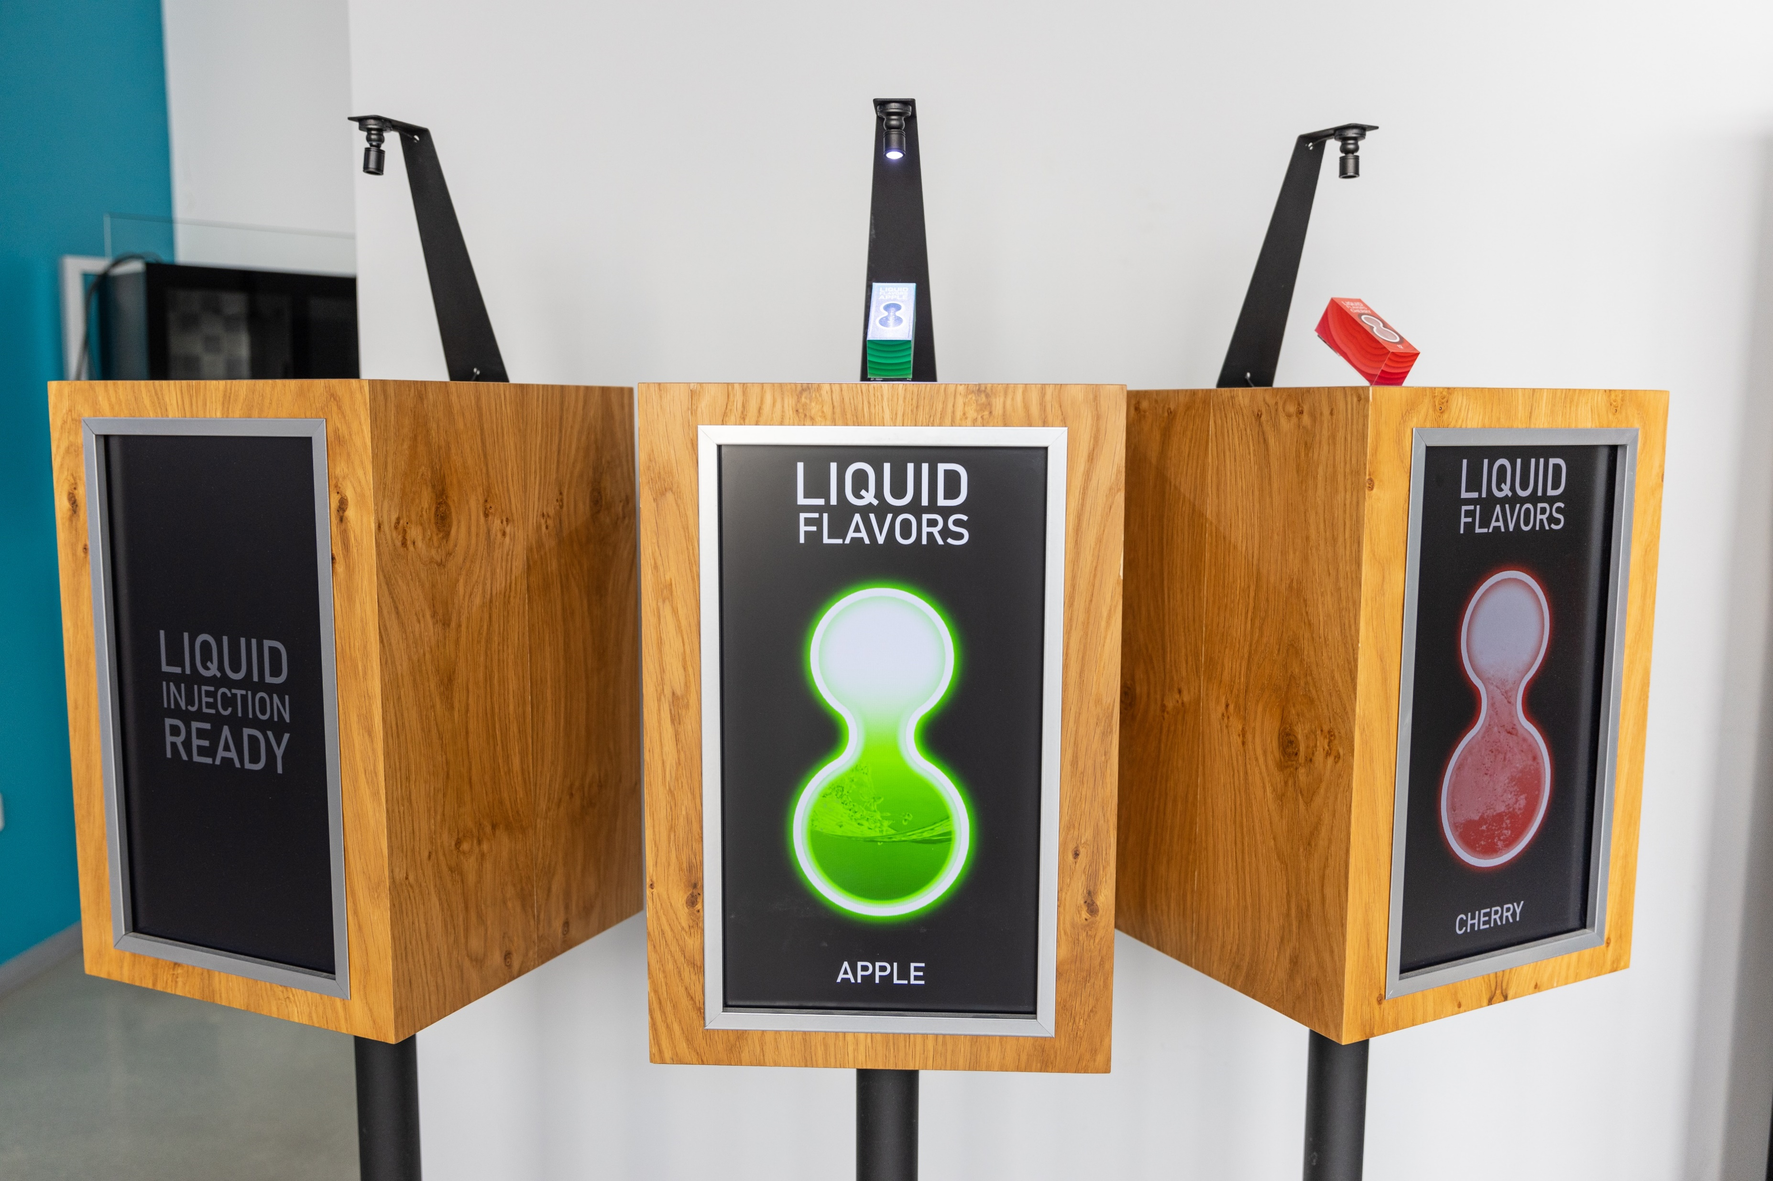
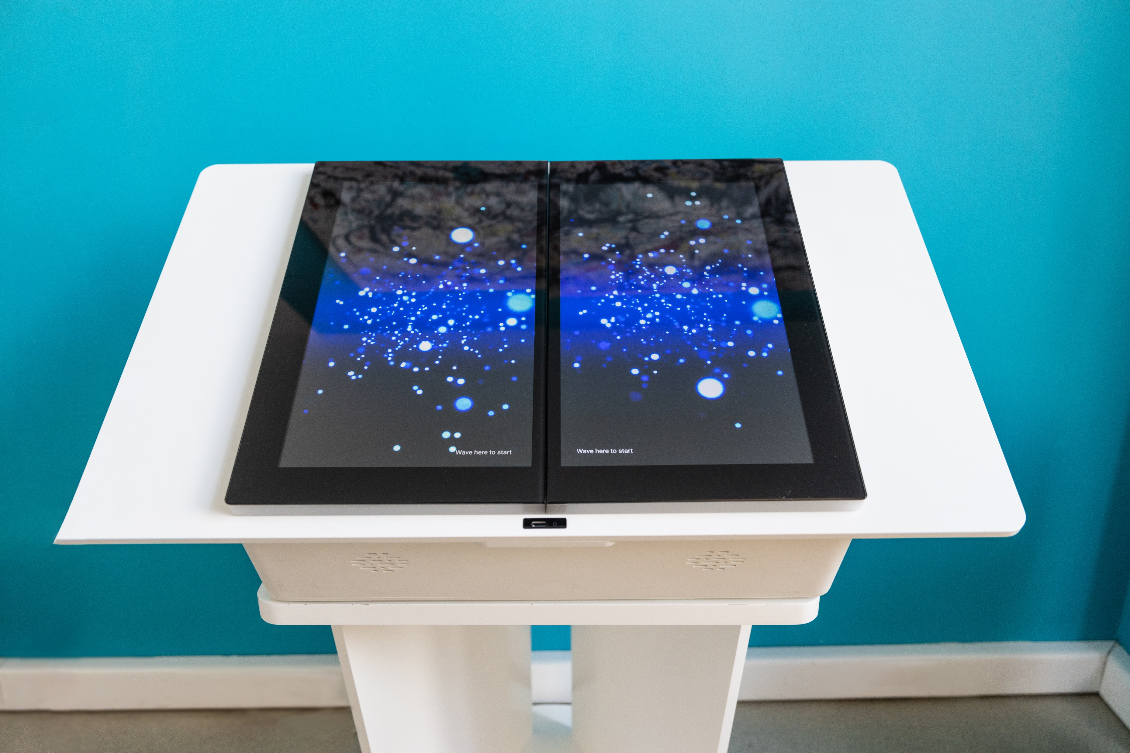

Slide 21
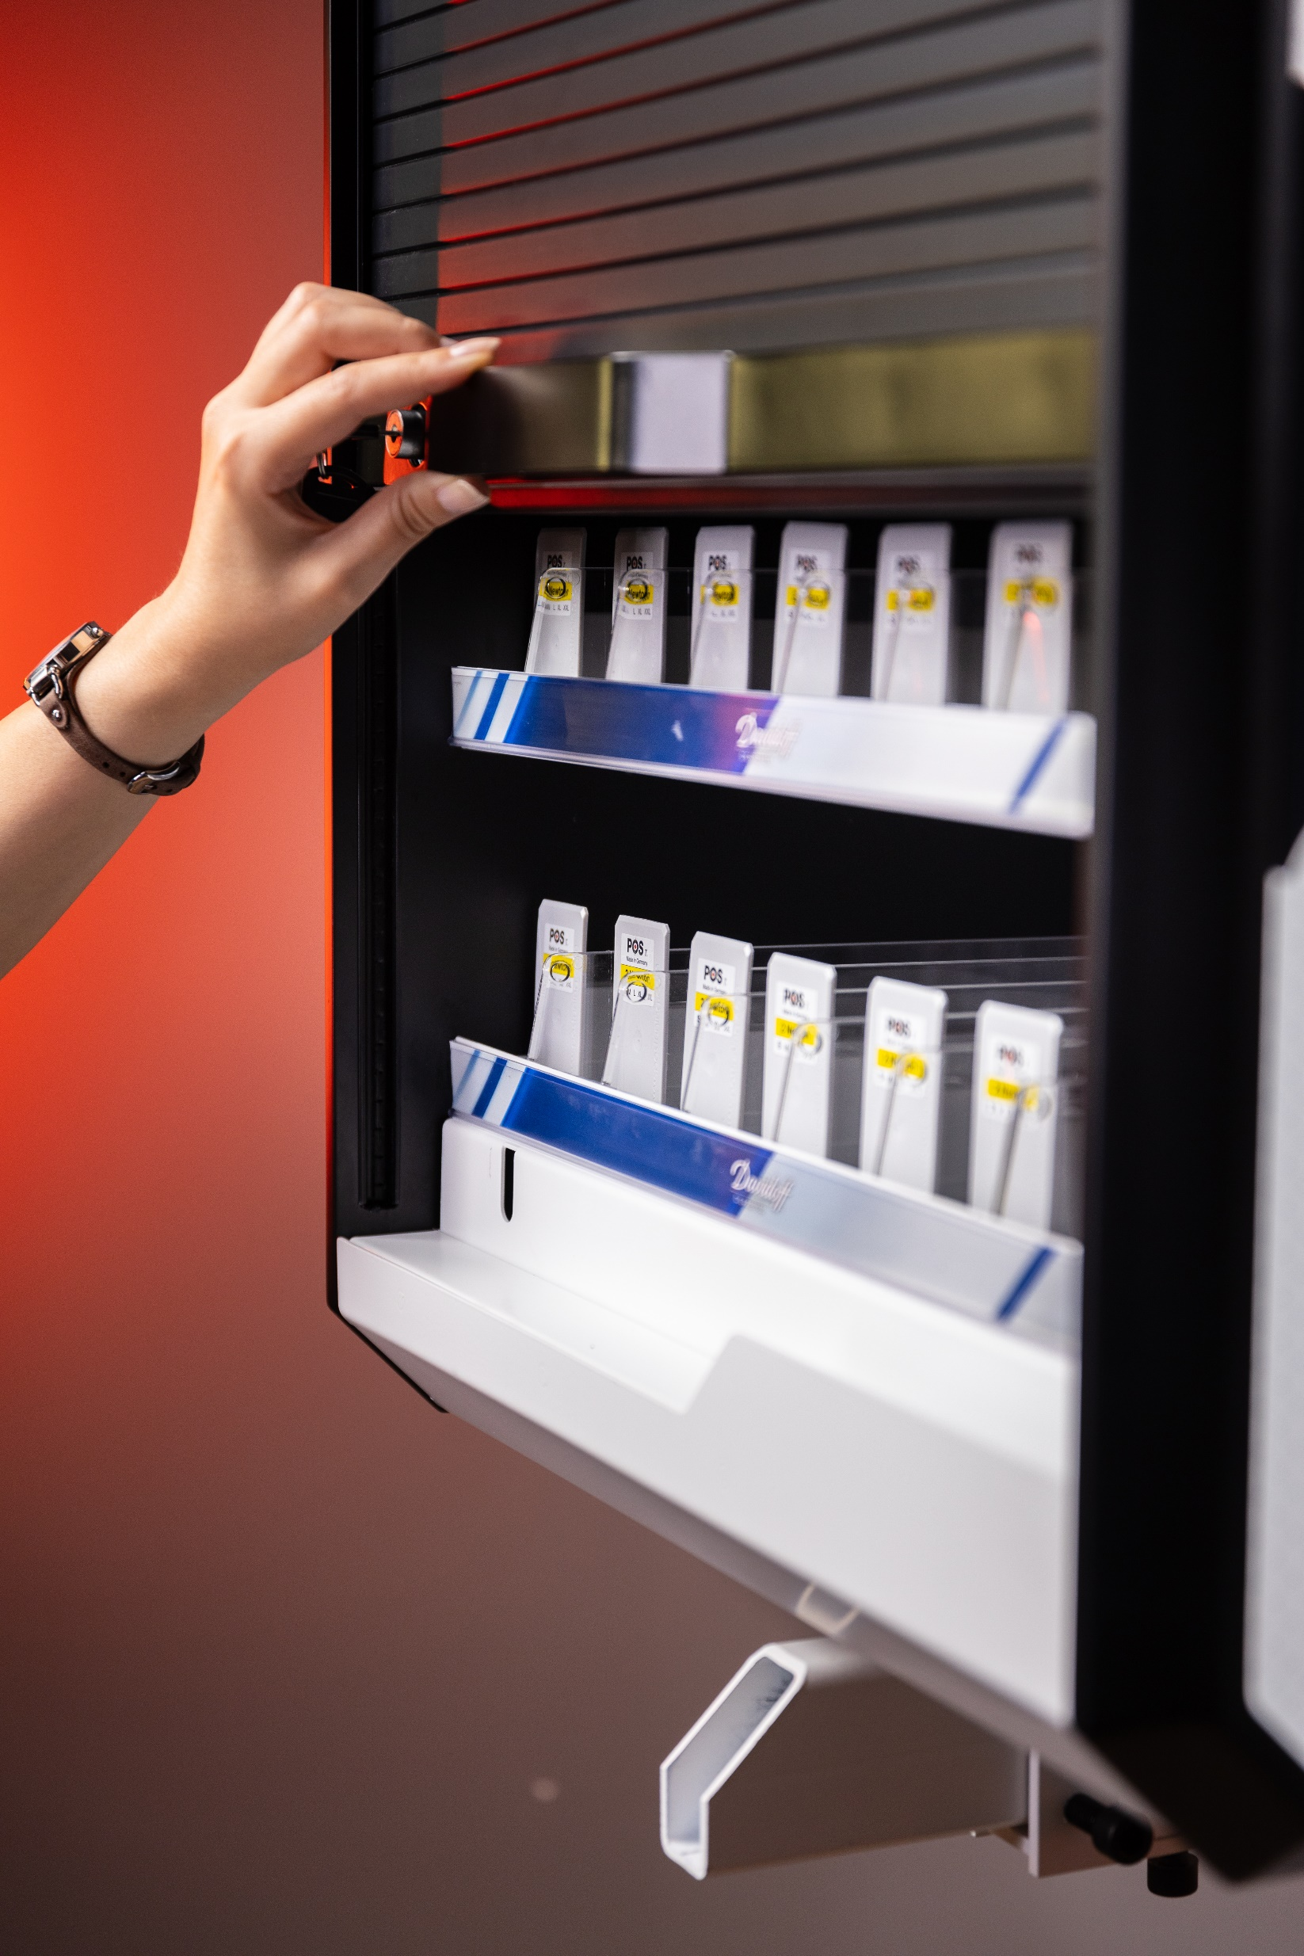
Experience
With
Imperial Tobacco

Slide 22
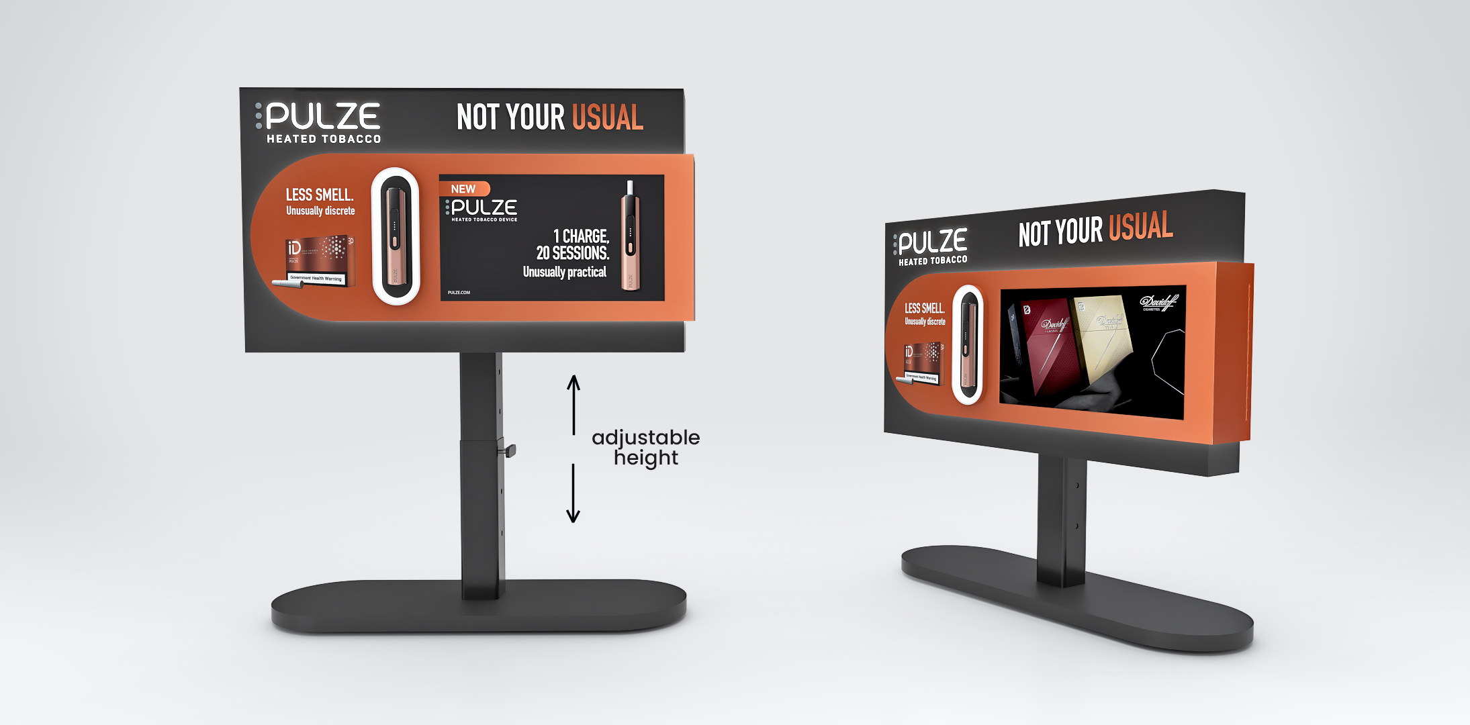

Slide 23
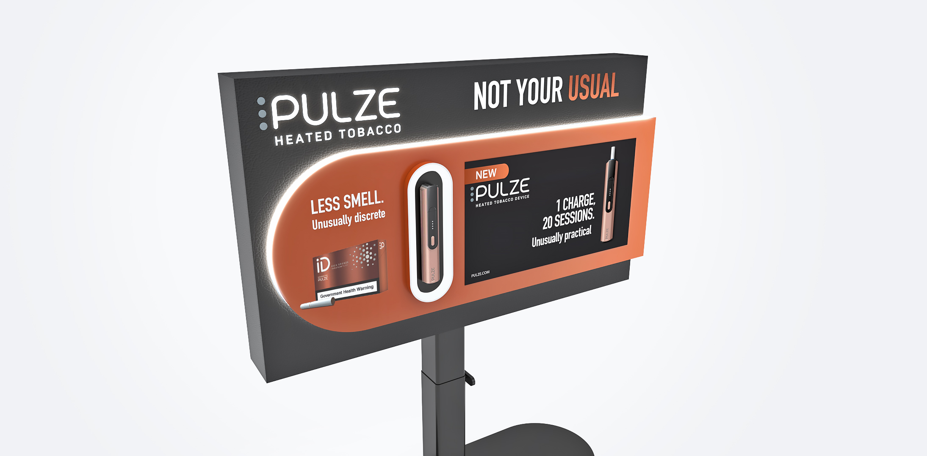

Slide 24
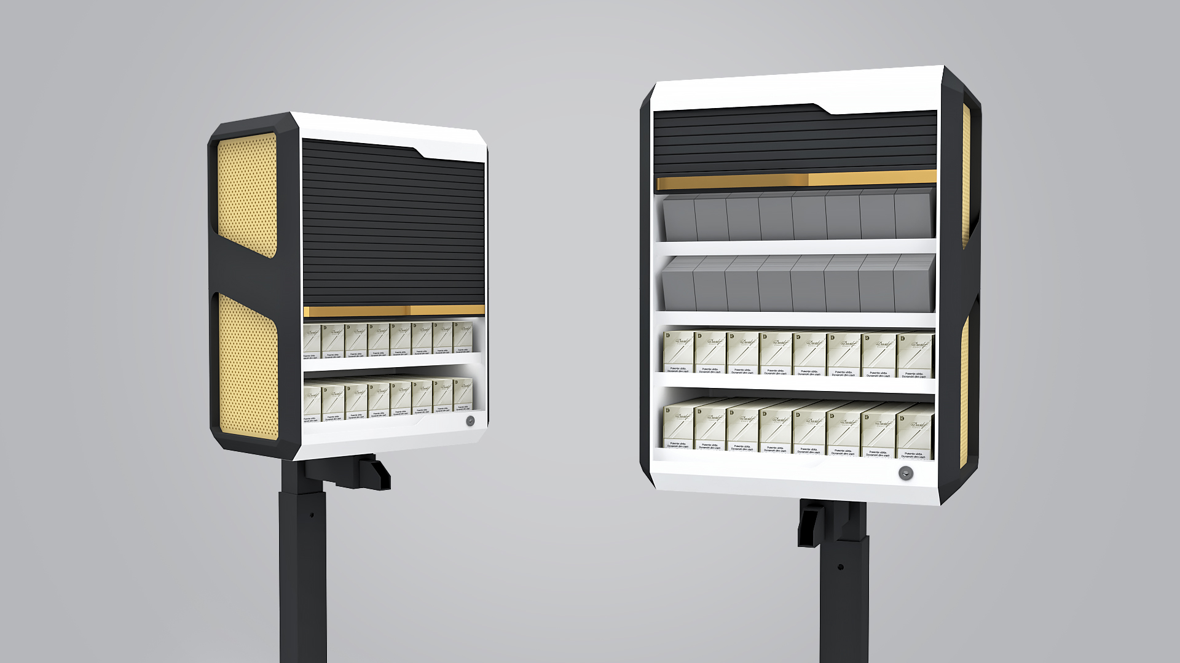

Slide 25
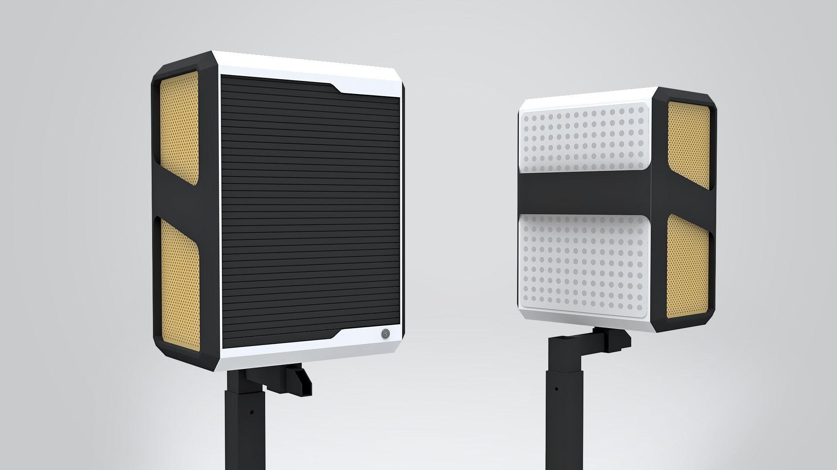

Slide 26
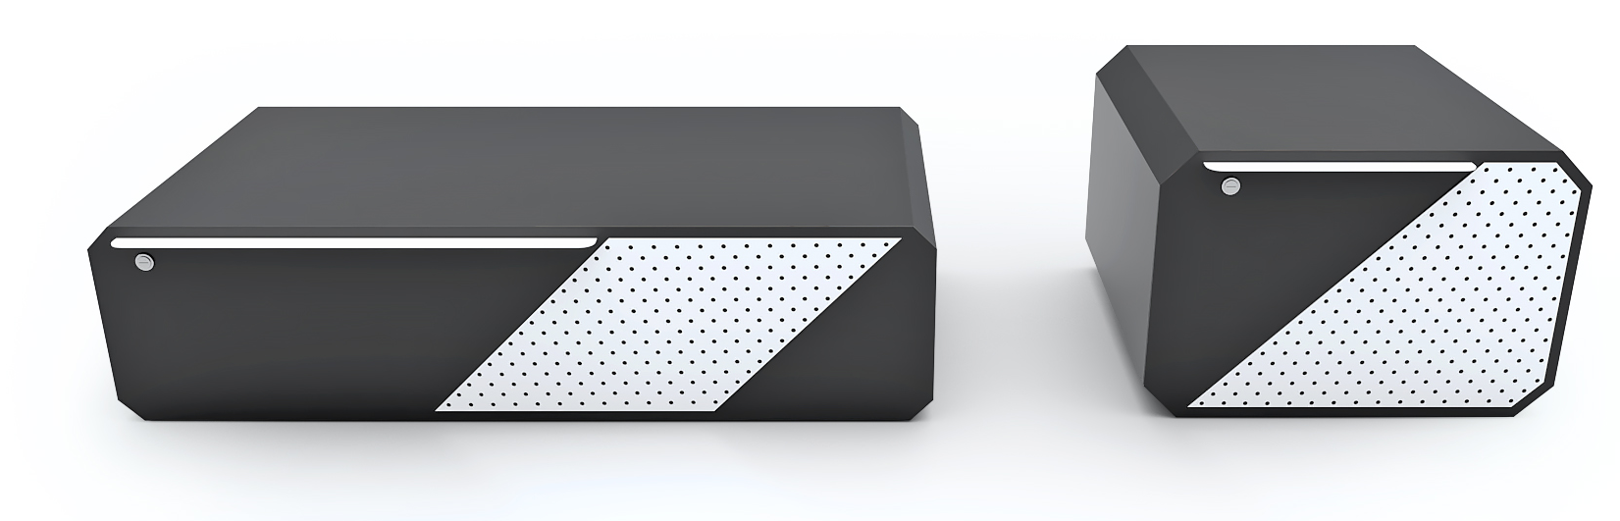
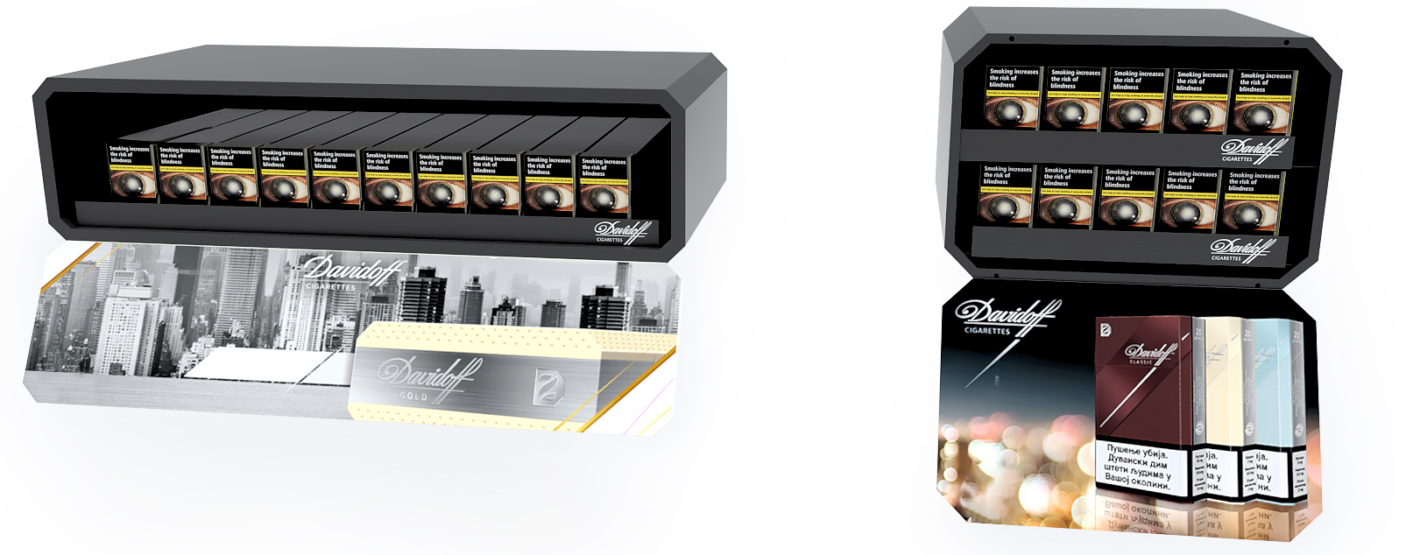

Slide 27
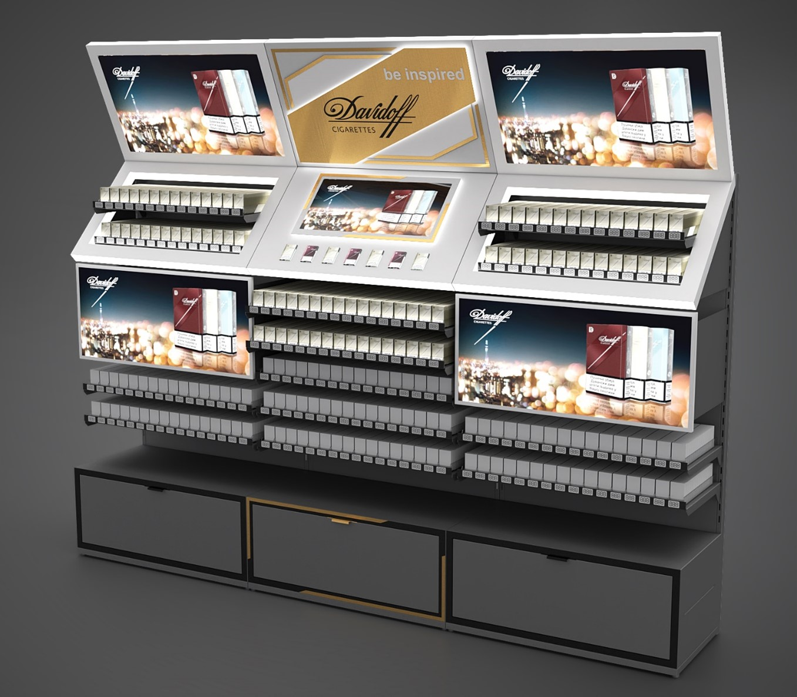

Slide 28
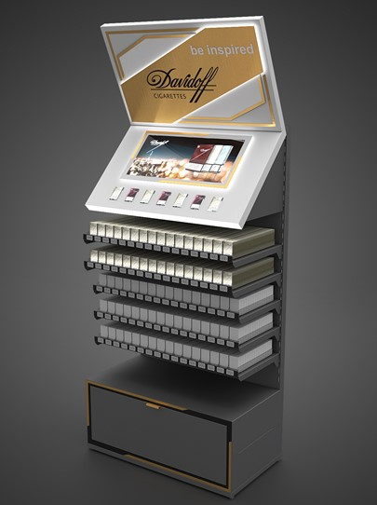
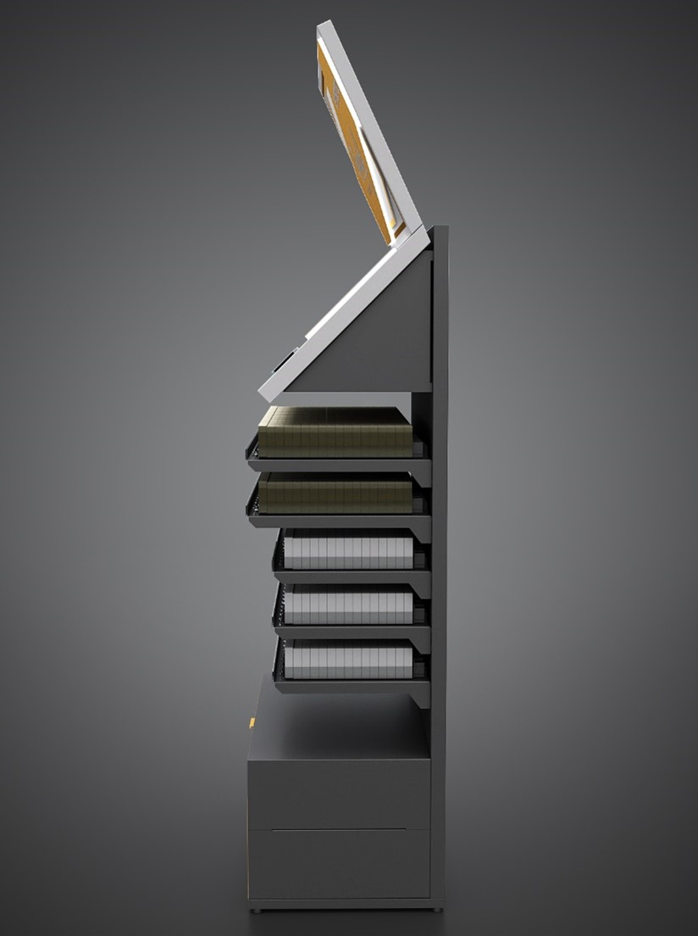

Slide 29
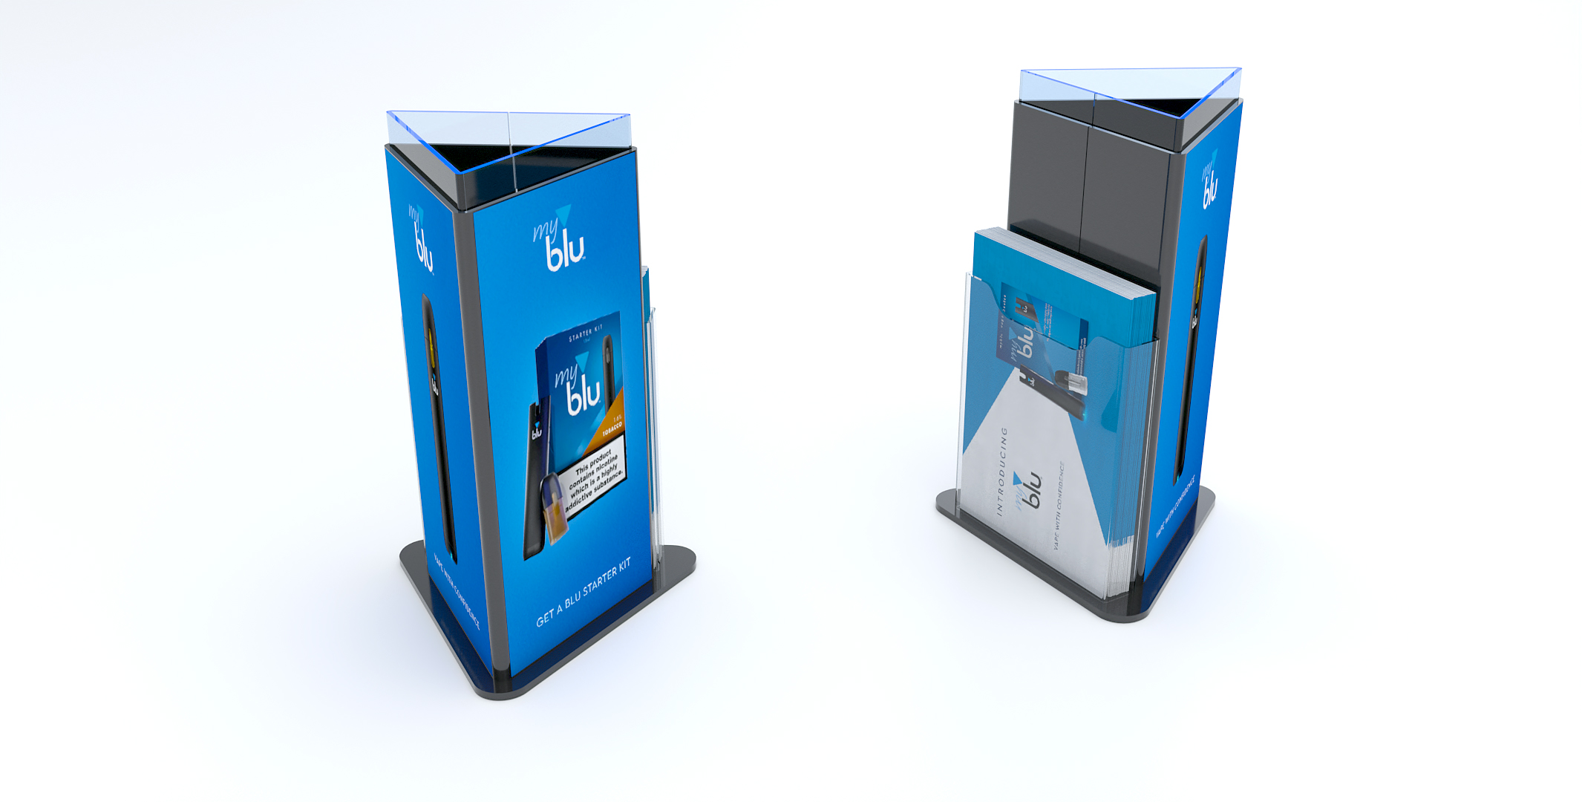

Slide 30
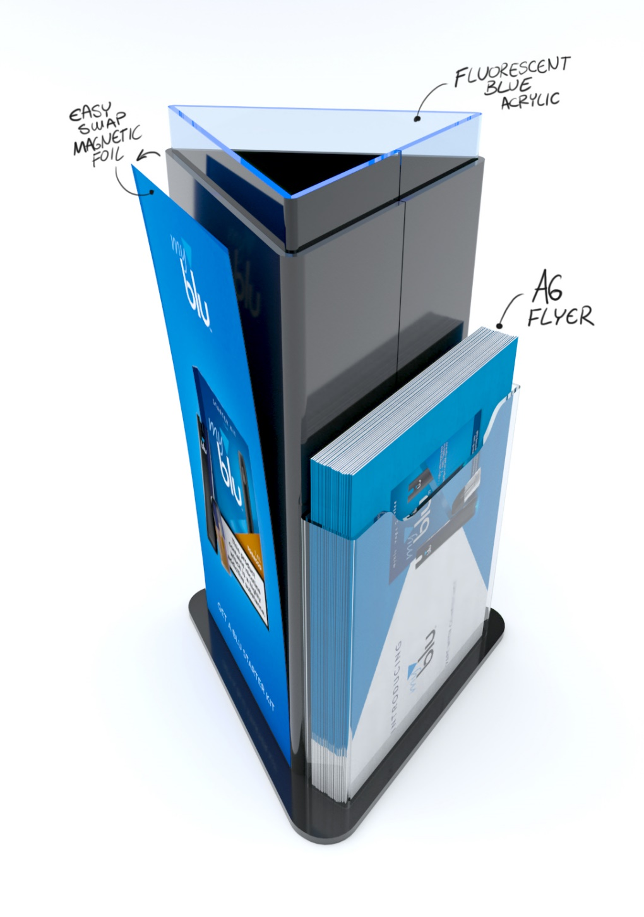

Slide 31
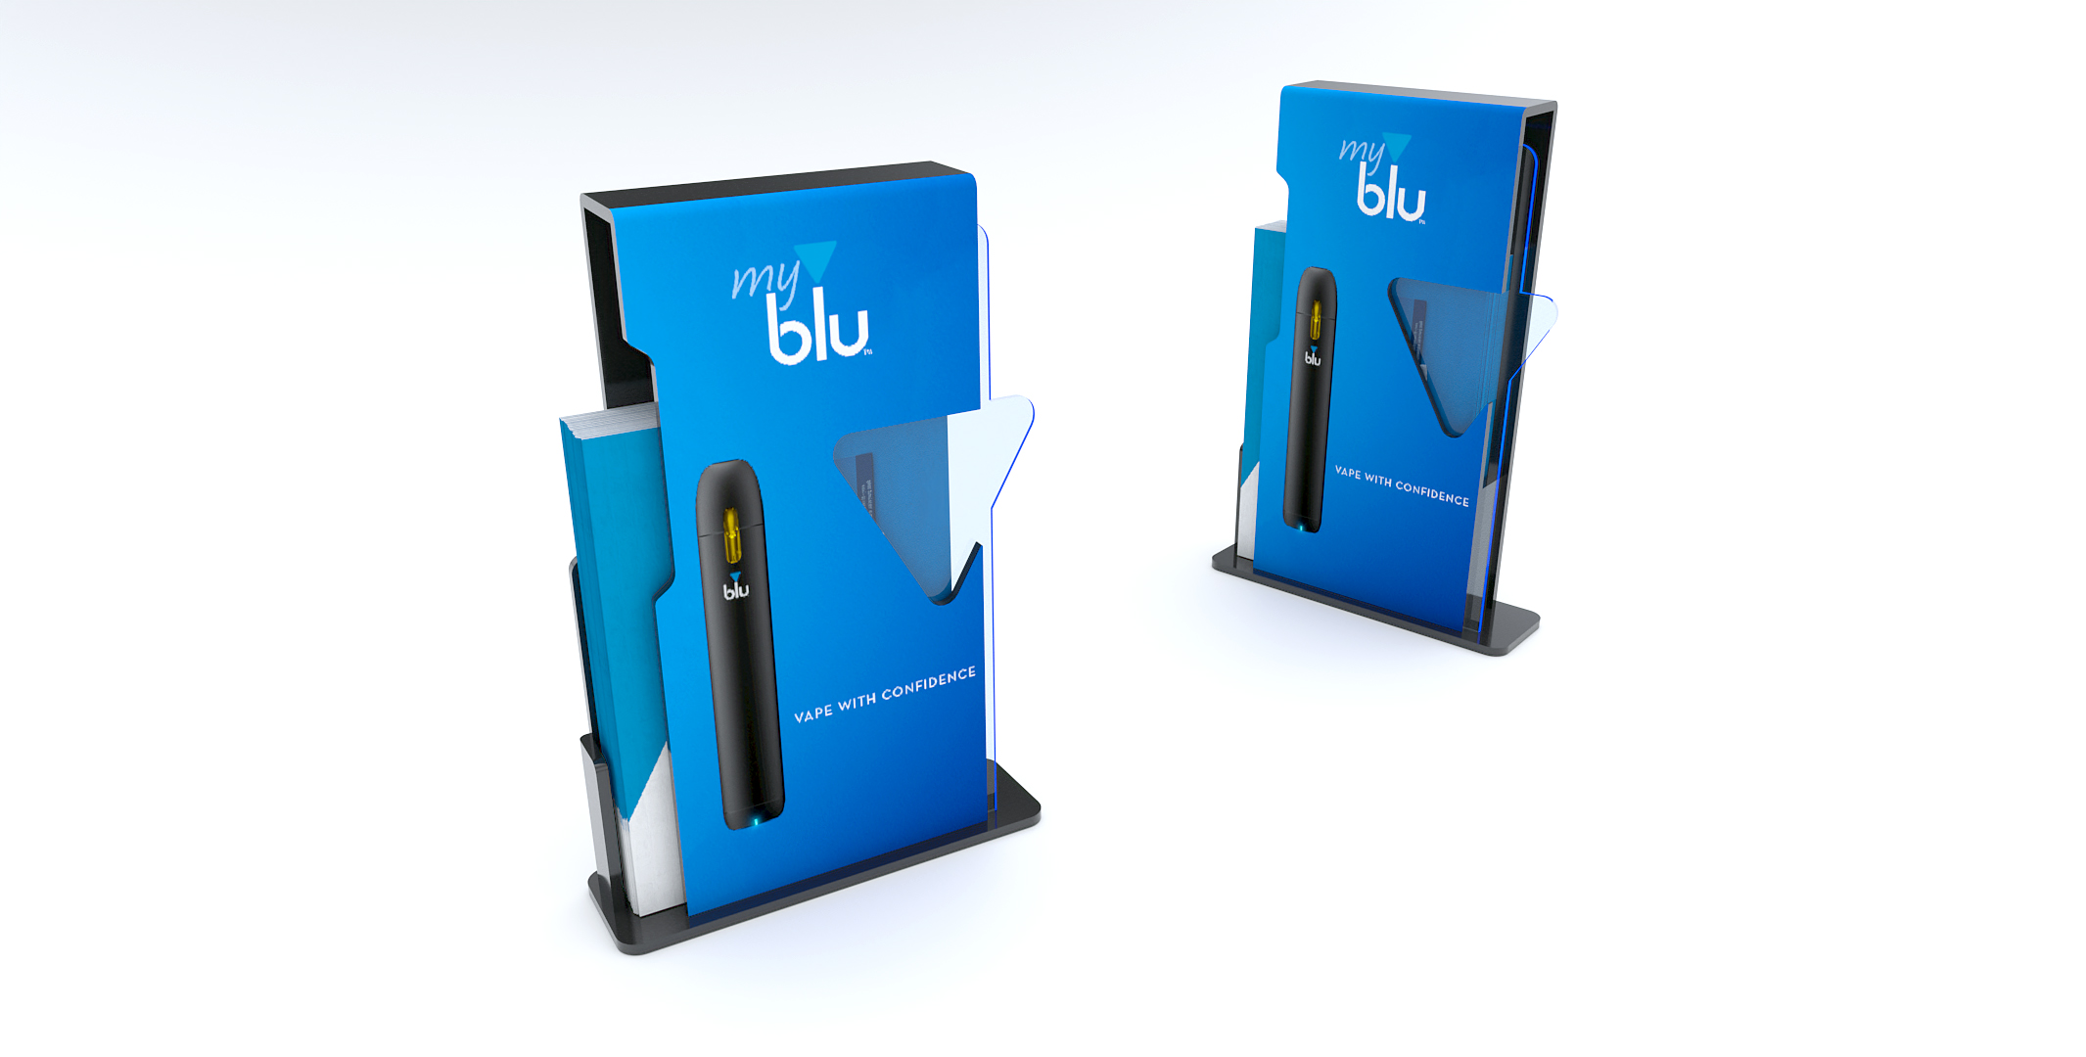

Slide 32
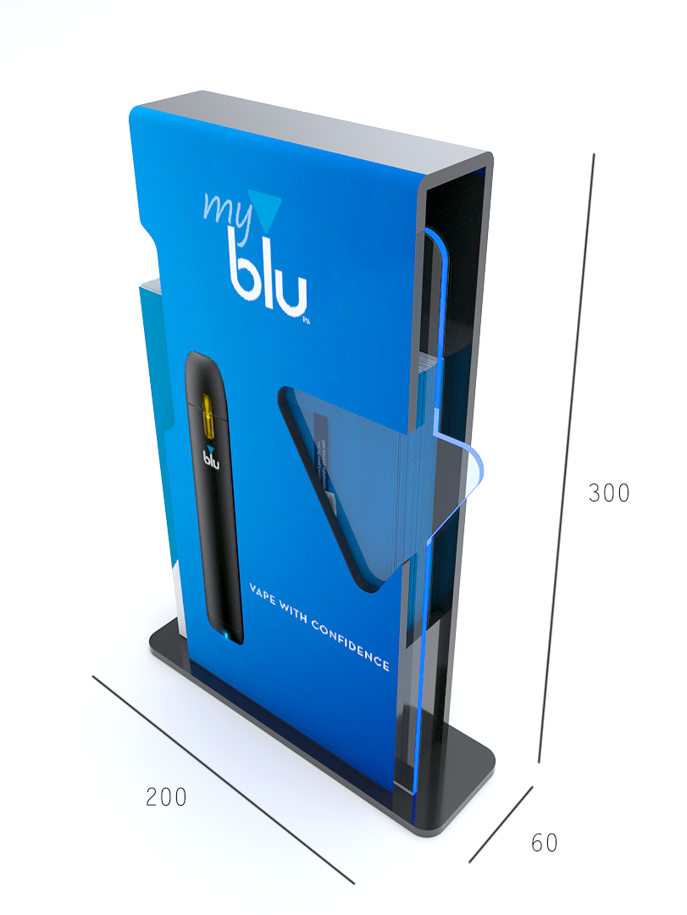

Slide 33
BG REKLAM
HEADQUATERS
29. Novembra 1M
11460 Belgrade, Serbia
info@bgreklam.com
+381 11 785 64 64
+381 60 68 69 110
Thank You.
BG REKLAM GMBH
Leverkusenstraße 3
22761 Hamburg, Deutschland
hamburg@bgreklam.com
+49 40 85413003
www.bgreklam.com
BG REKLAM
UK LTD
2588 Davenport House,
207 Regent St
London, W1B 3HH, UK
+44 75 4288 2312

