Slide 1
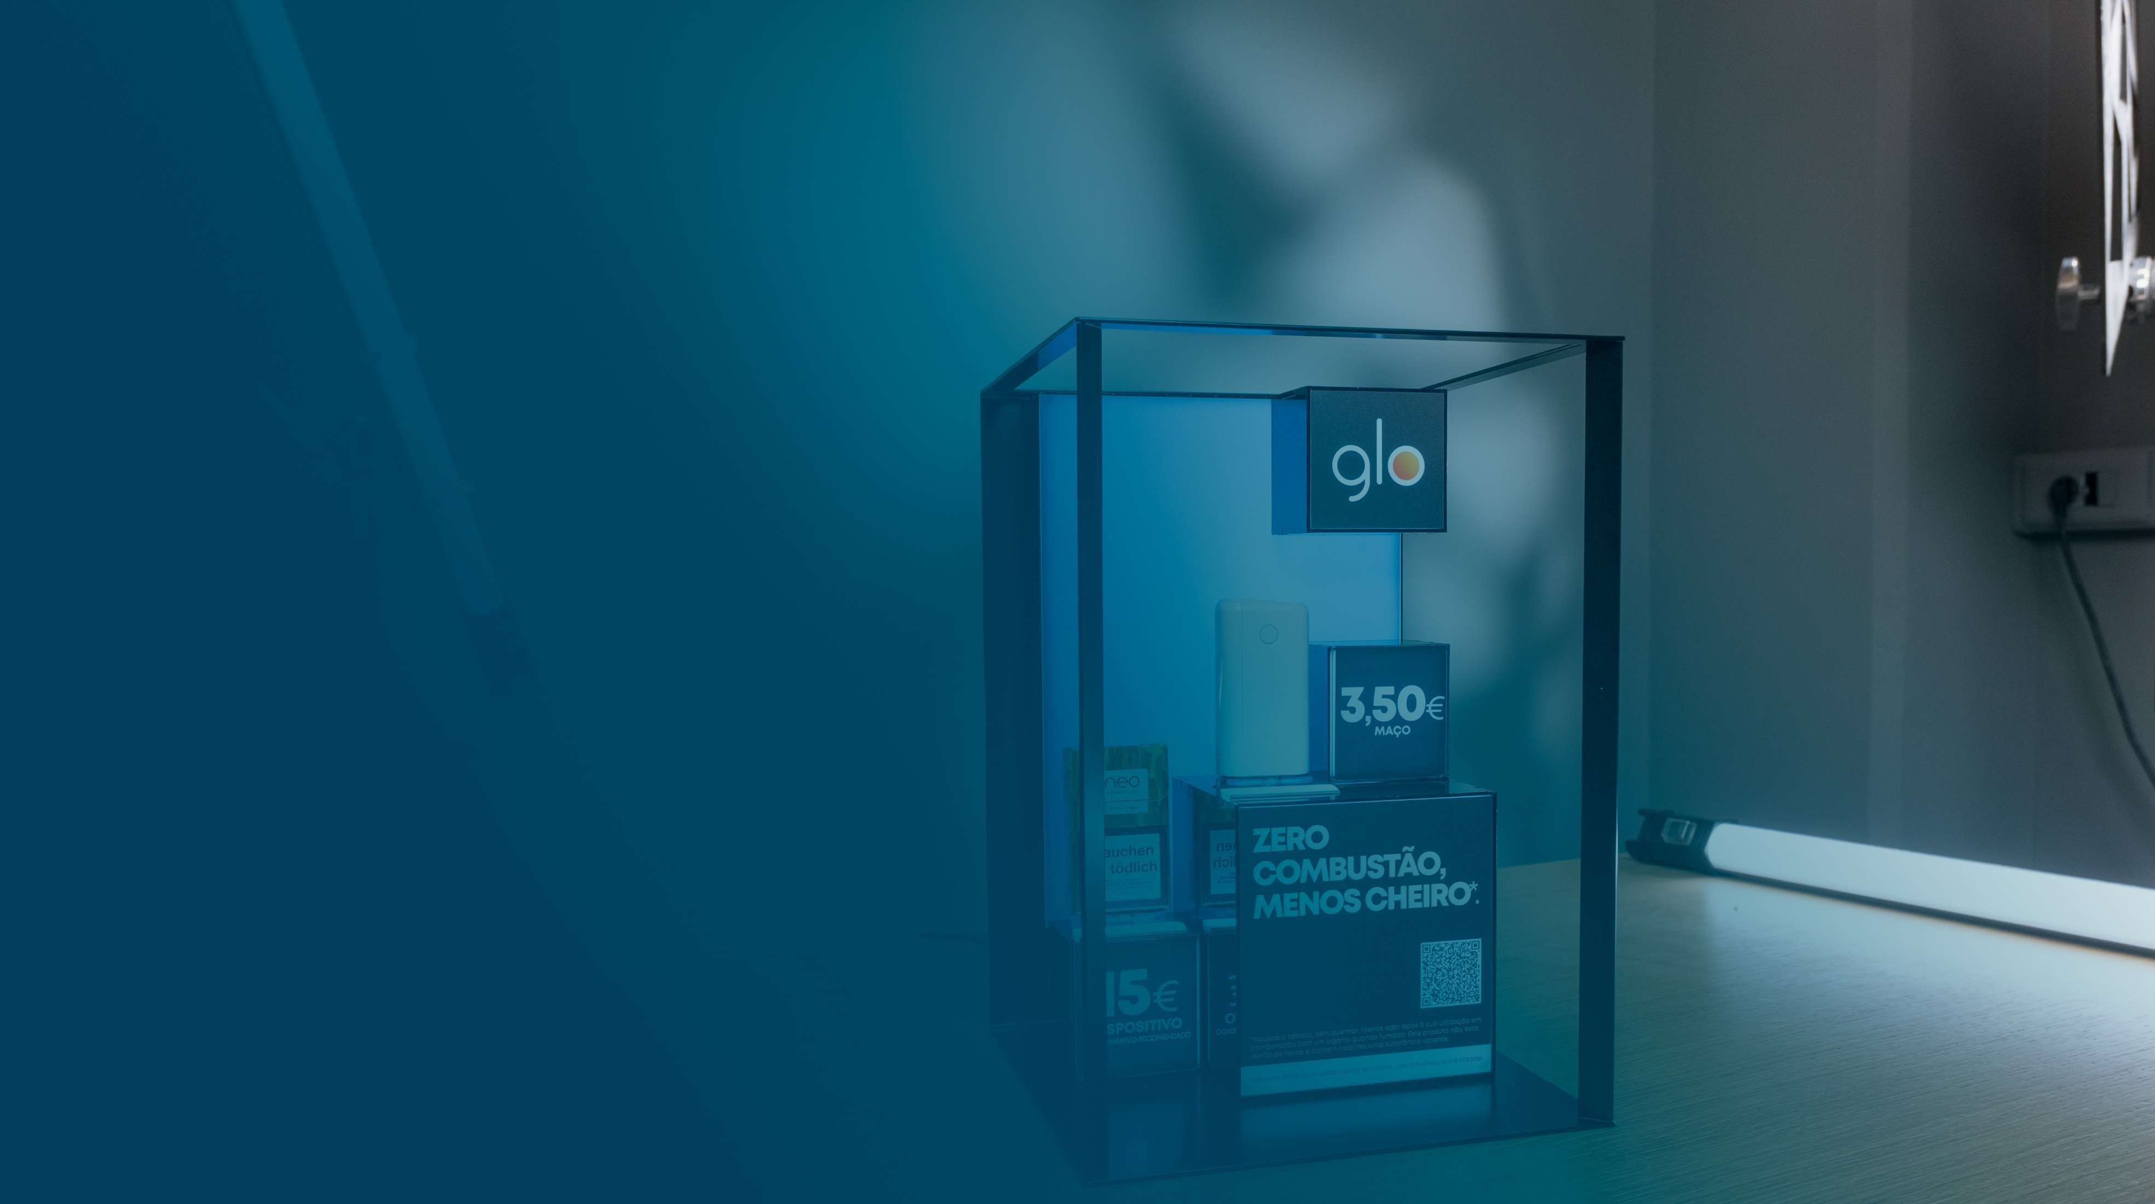

Premium
POS Industry
People are always going to go shopping.
A lot of our effort is just ‘how do we make the retail experience a great one!

Slide 2
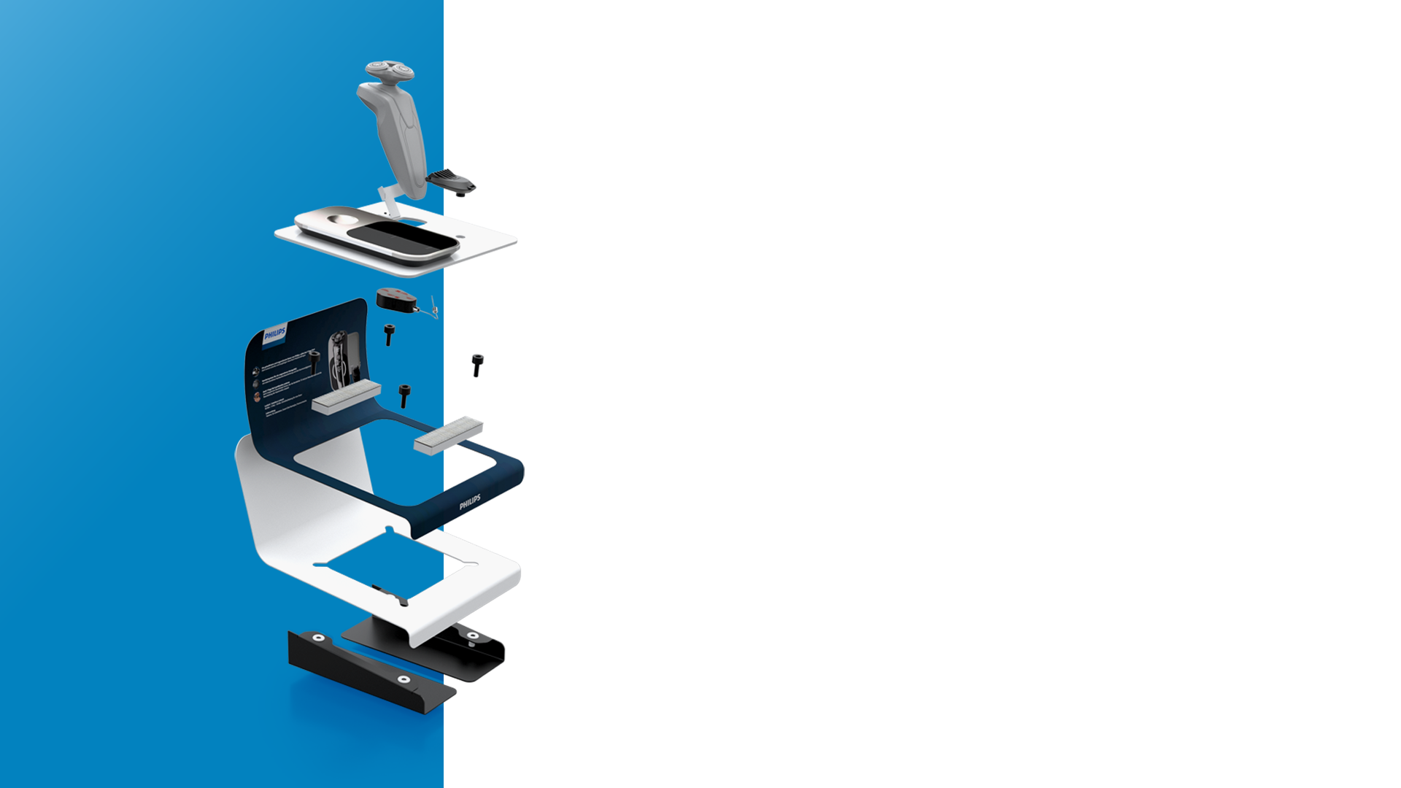
Contents.
Company Profile
Markets
Working with BG Reklam
Partners
More planet less waste
Accreditations
Projects

Slide 3

01.
Company
Profile
Private company, established in 2001, with factory and HQ in Belgrade, Serbia.
Entire value chain from design and production, installation
and maintenance at the point of sale.
Sustainable materials the core of our production process.
200+ skilled employees and 5.000 square meters of office and production space.
20+
Years of experience
and development of
Premium POS solutions.

Slide 4
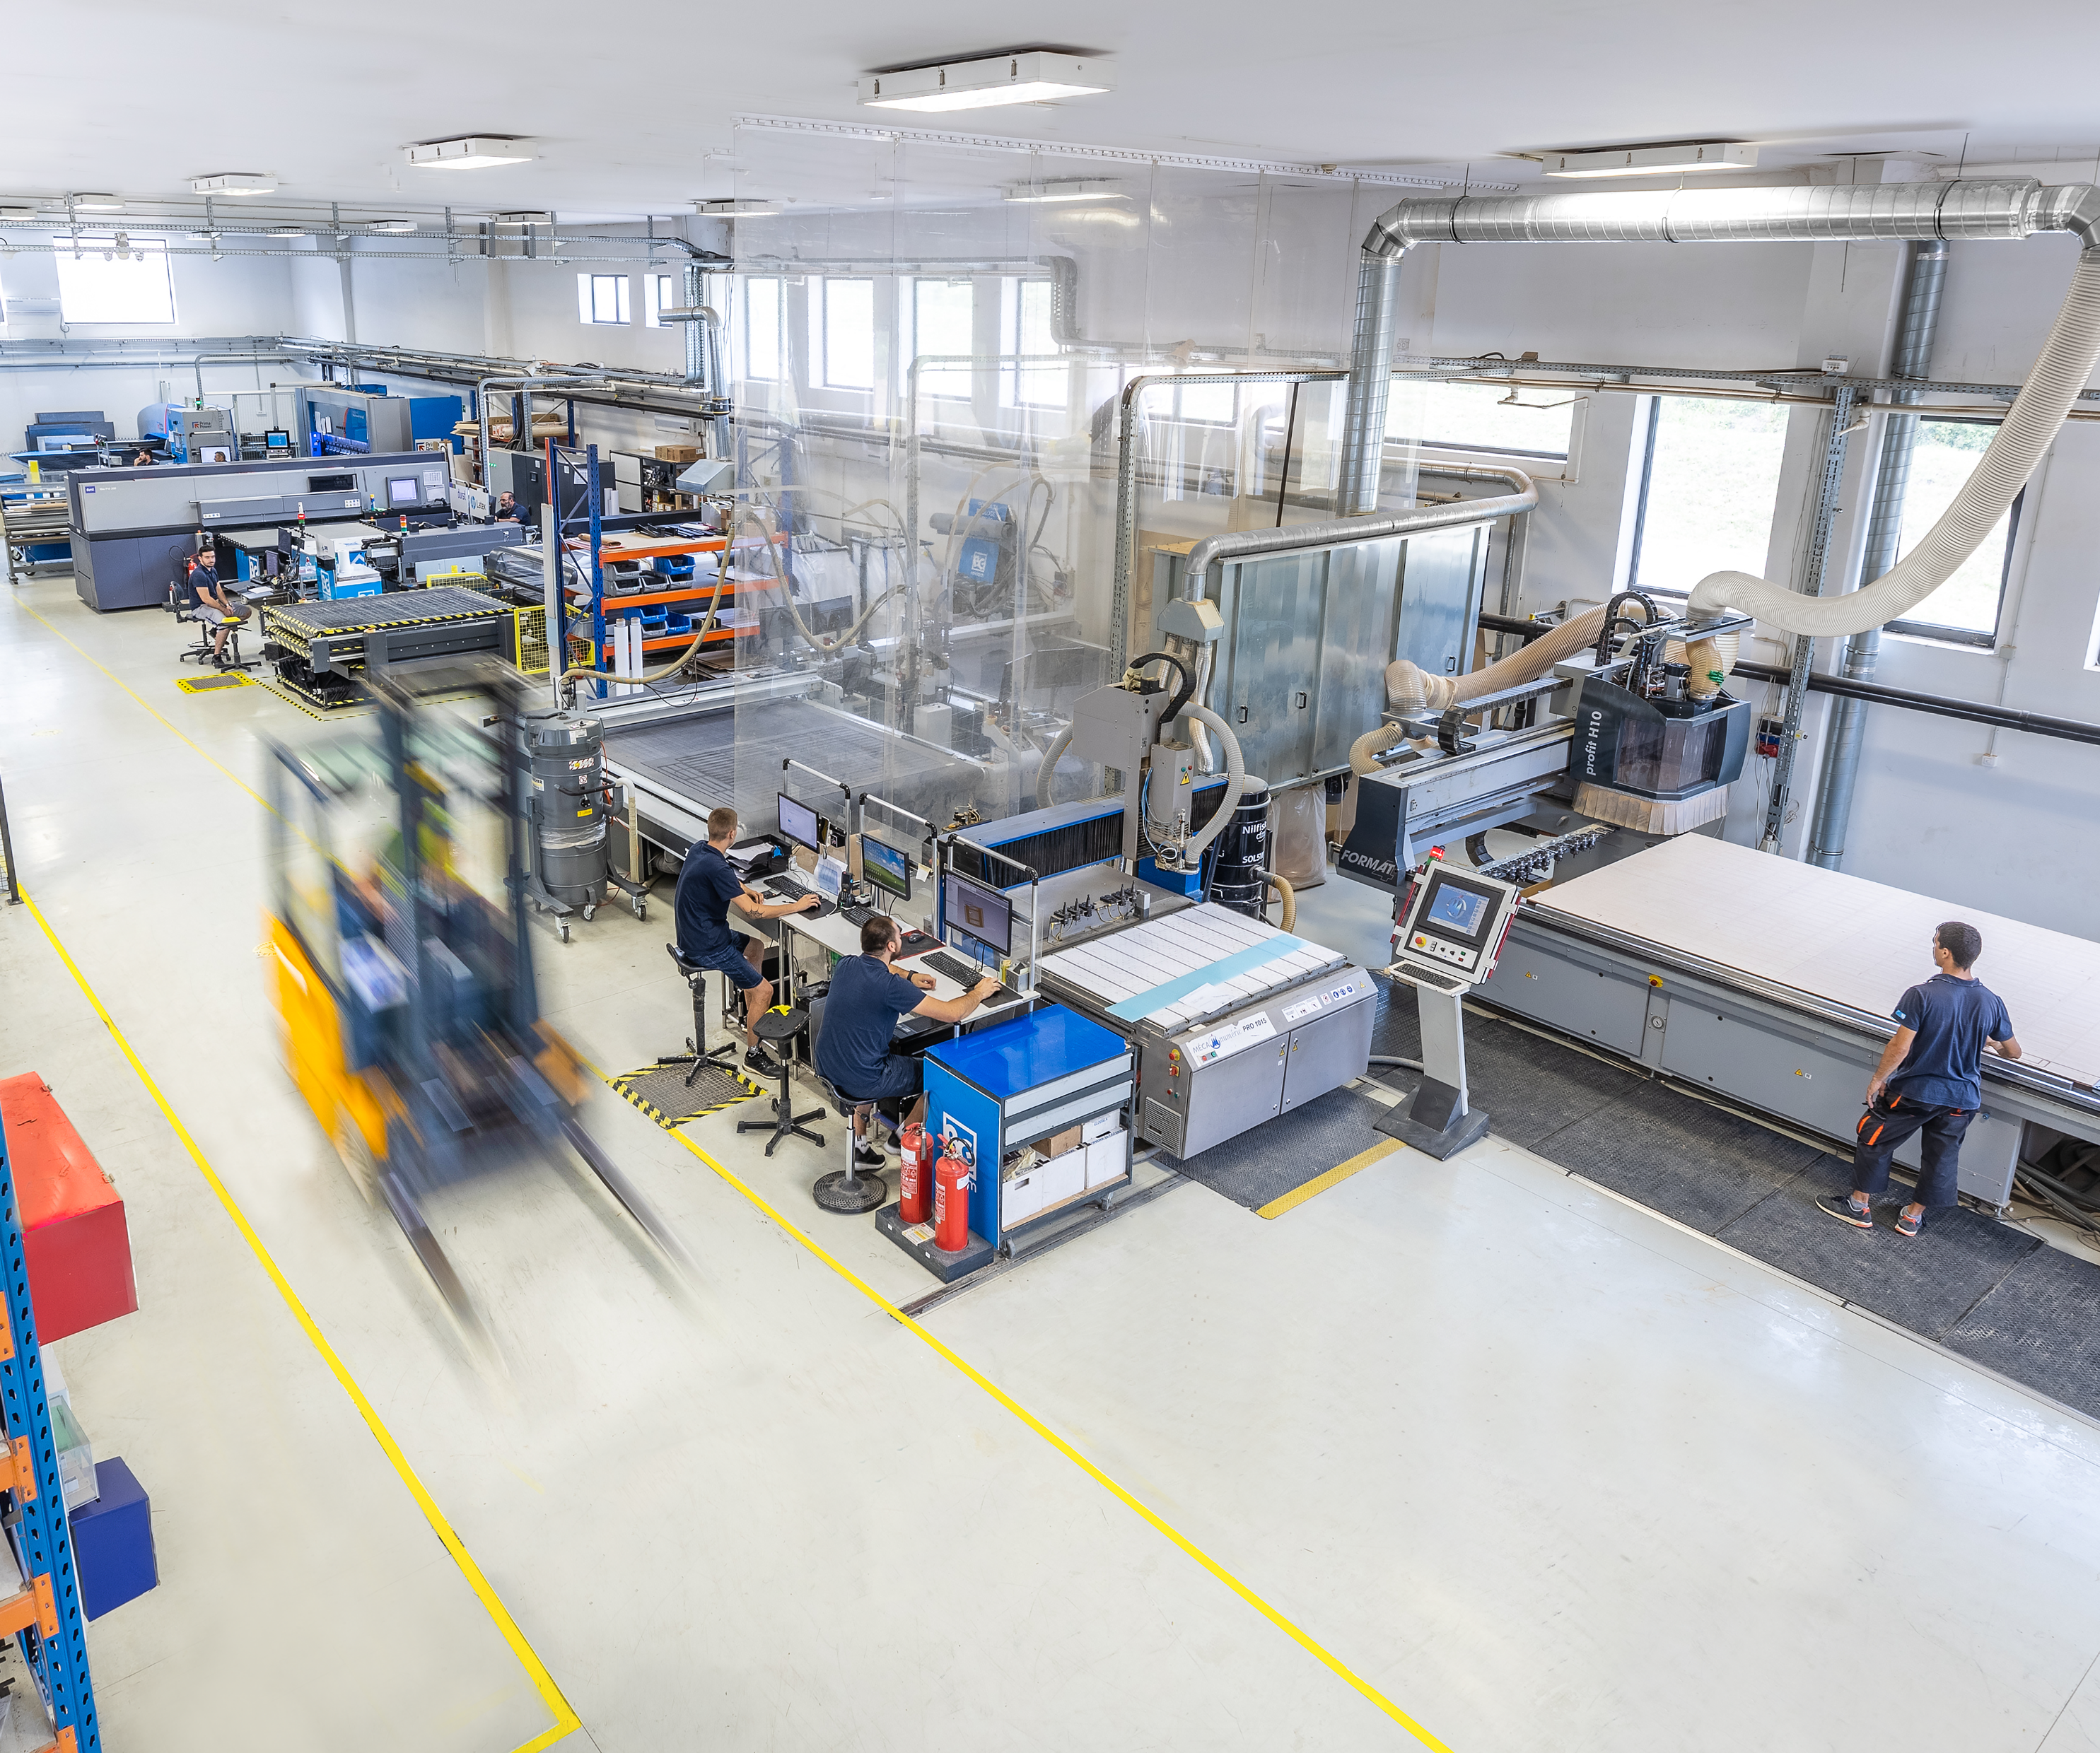
Technology
& Efficiency
Technology is just a way to reach our objectives: to grow, to improve efficiency, and to implement processes, products, and enable our clients to increase profits.
Our objective is to find the most efficient and easiest way to use technology to improve the efficiency, quality, and reduce cost for our clients.

Slide 5


02.
Markets
We cover
Region in focus:
Western and Central Europe
Presence:
25+ Markets across the globe
Offices:
Belgrade Hamburg London
Delivery times:
We deliver our products to any European destination within three working days.

Slide 6
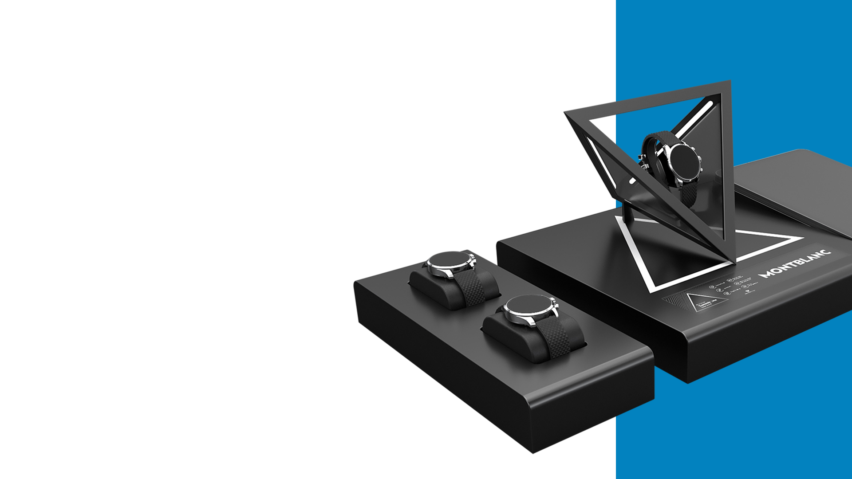
03.
03.
From idea
To stores
At BGReklam everything is designed and produced under one roof.
Giving our design, engineering, production, andsales teams a unique perspective and rare opportunity to be part of the entire production process.

Slide 7
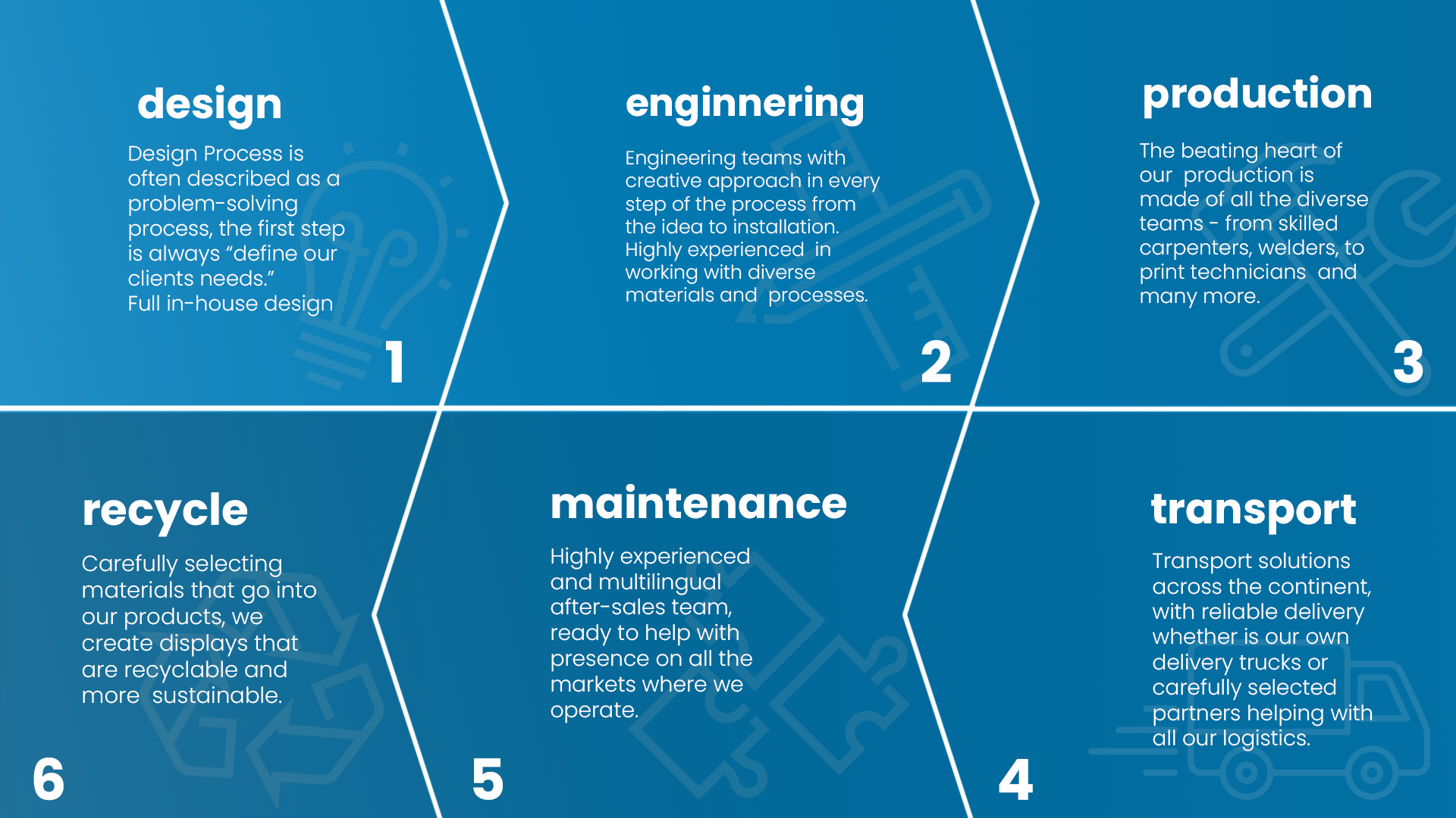
1
2
3
6
5
4

Slide 8
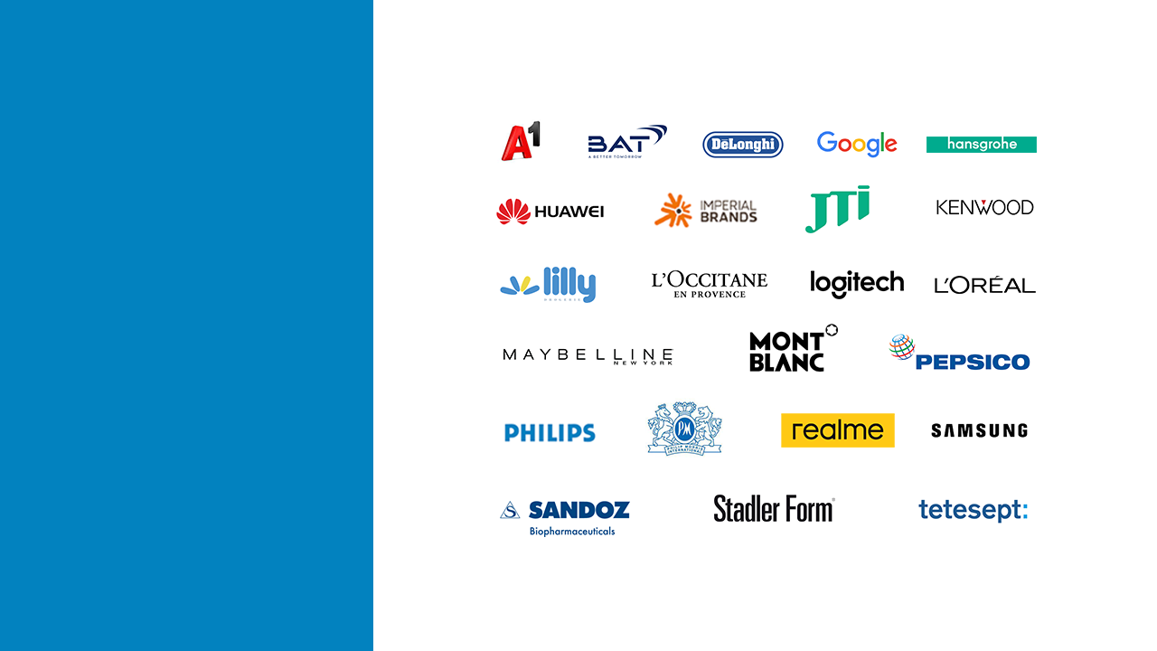
04.
Partners

Slide 9

05.

Slide 10

More planet
Less waste.
Re-Use:
Designing versatile and easily adaptable displays with longer life and use with any future products.
Re-Duce:
By always investing in cutting edge technology, we significantly reduce scrap and improve efficiency.
Re-Cycle:
Engineering displays that can be easily disassembled and recycled. Always ensuring to use sustainable materials.
Re-Peat:
Plant new trees and create eco projects for our community and give back to the environment.

Slide 11

06.
Certifications
ISO the International Organization for Standardization.
ISO 9001 Sets out the criteria for a quality management system
ISO 14001 Sets out the criteria for an environmental management system
ISO 45001:2018 Occupational health and safety (OH&S) management system
ISO 20400 Integrating sustainability within procurement.
ISO 26000 Organization’s commitment to sustainability and its overall performance.

Slide 12
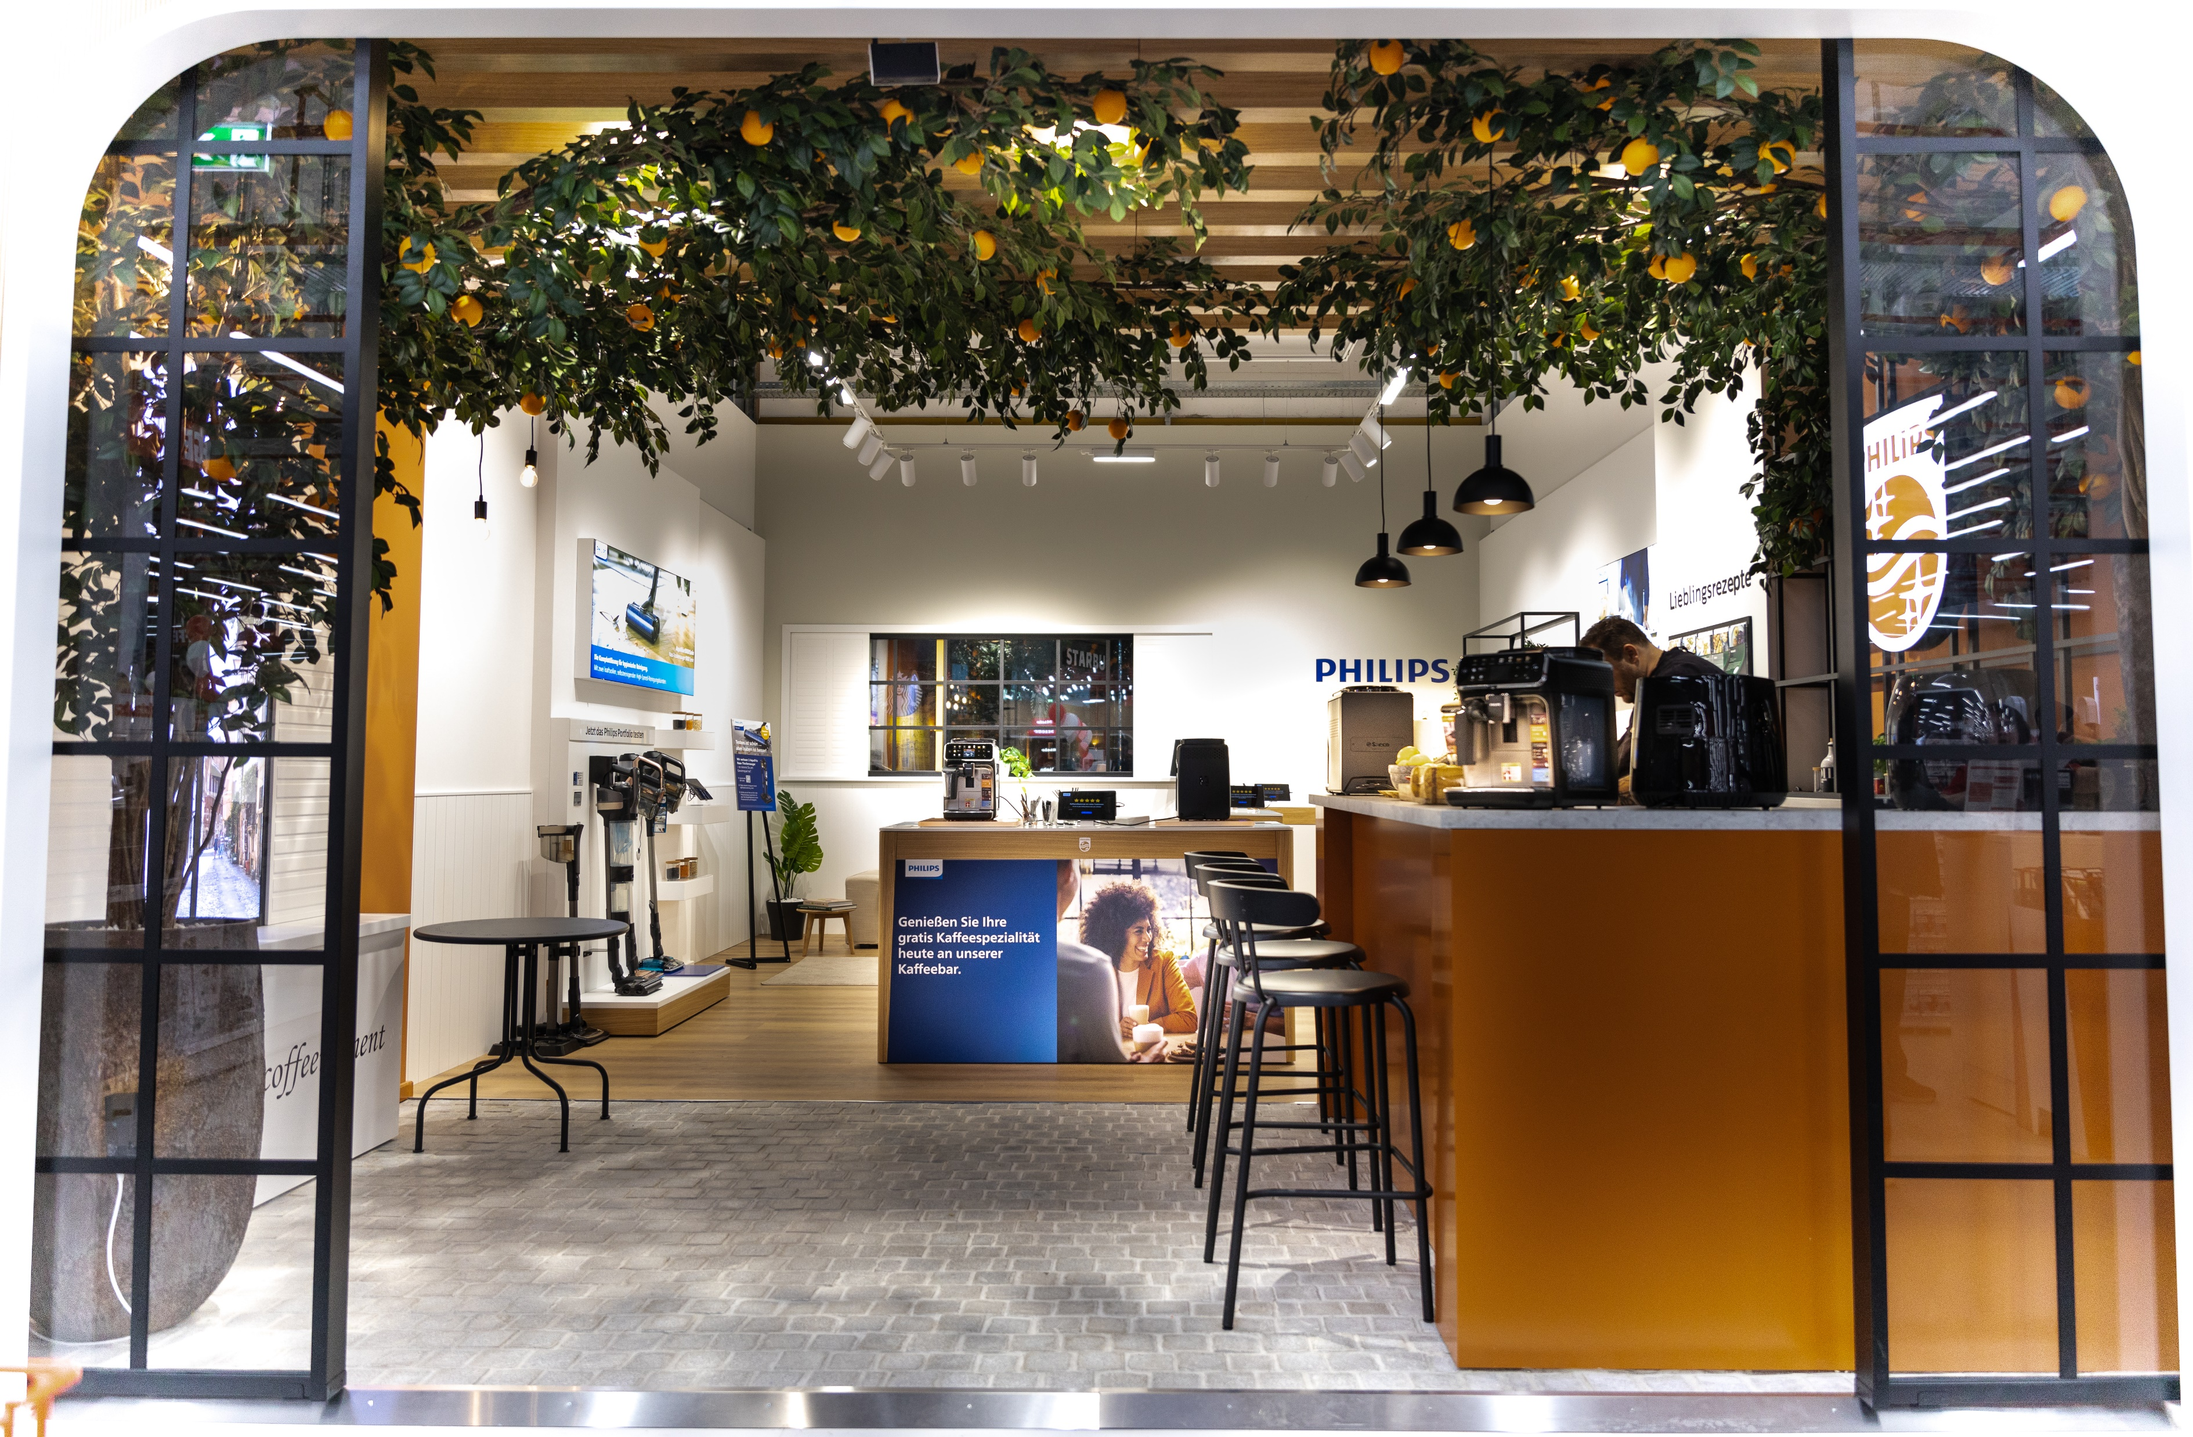
07.
Shop in
Shop
solutions
Description
Premium Shop in Shop concept for Philips domestic apliances. Designed, produced and installed by BGReklam in Berlin Germany.

Slide 13
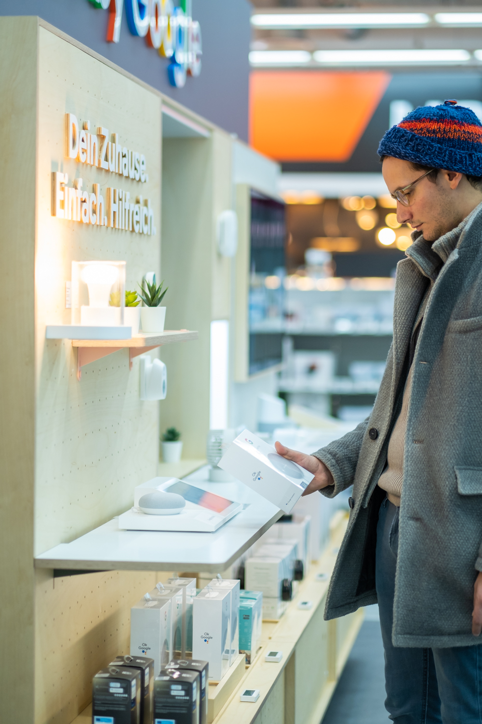
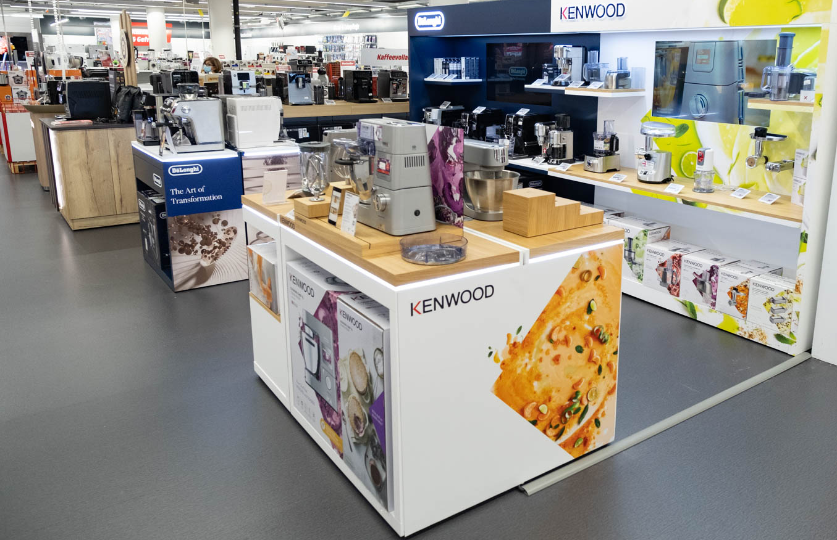
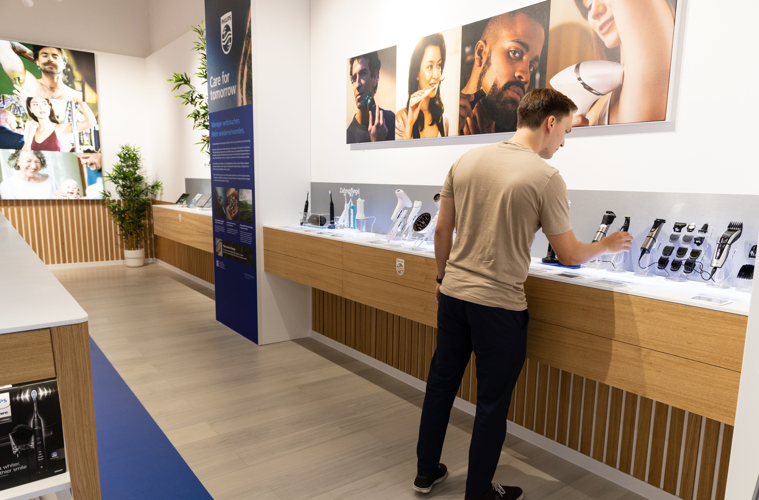
MediaMarkt
Aleksandarplatz, Berlin
Philips Domestic appliances
Philips Personal care

Slide 14
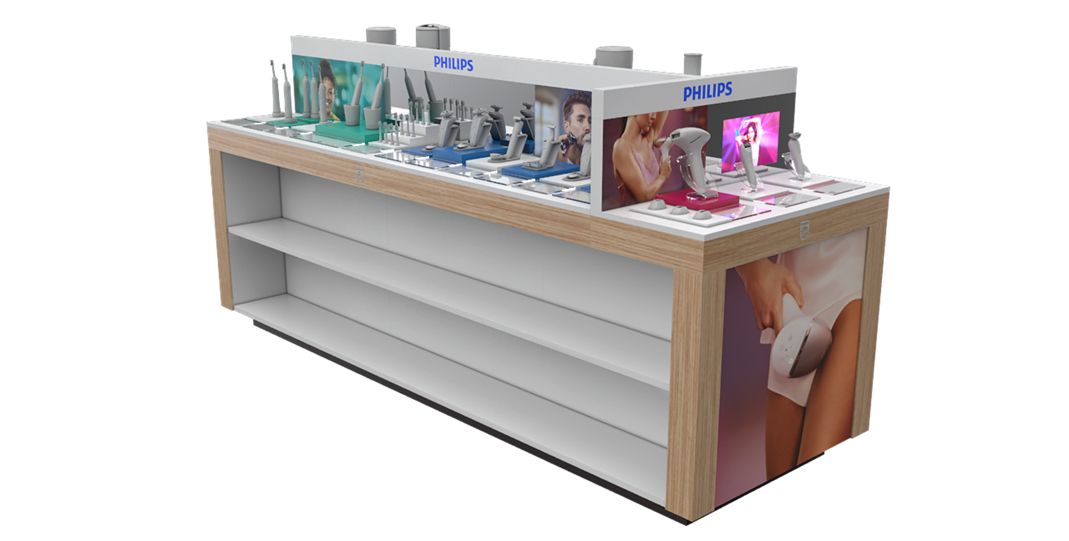
Large
Displays
This is a big one! Displays that lives up to their large name.
Large in size our big displays are usually made from Materials like:
MDF, Acrylic, Metal, Printed PVC stickers, LED lights

Slide 15
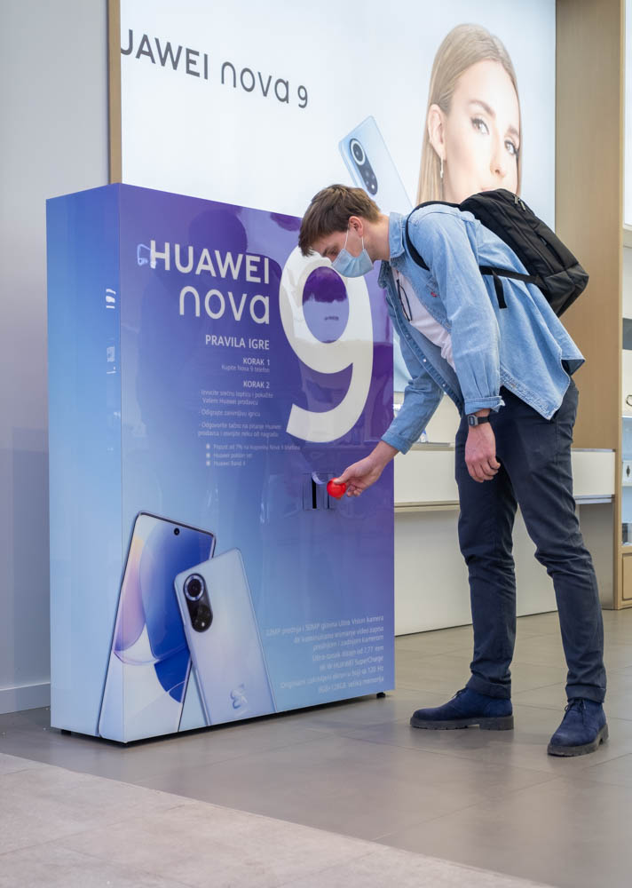
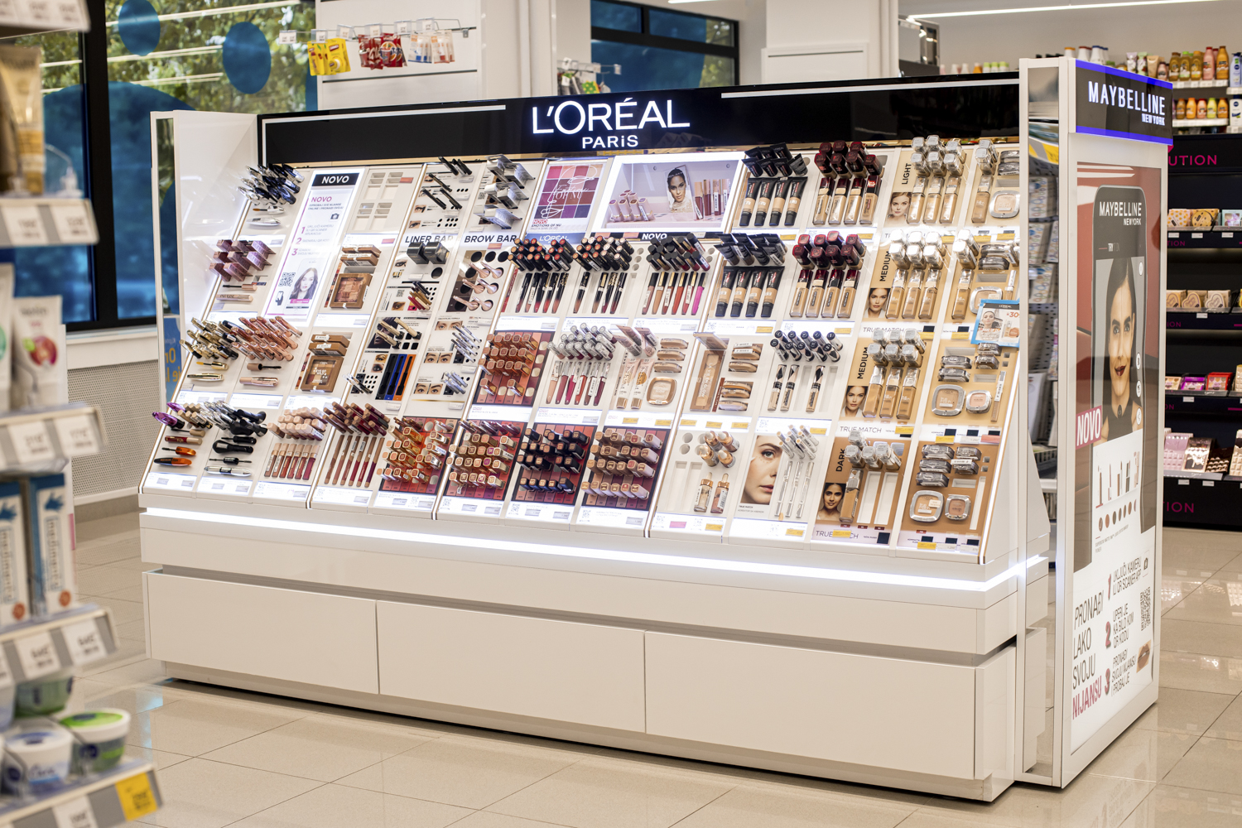
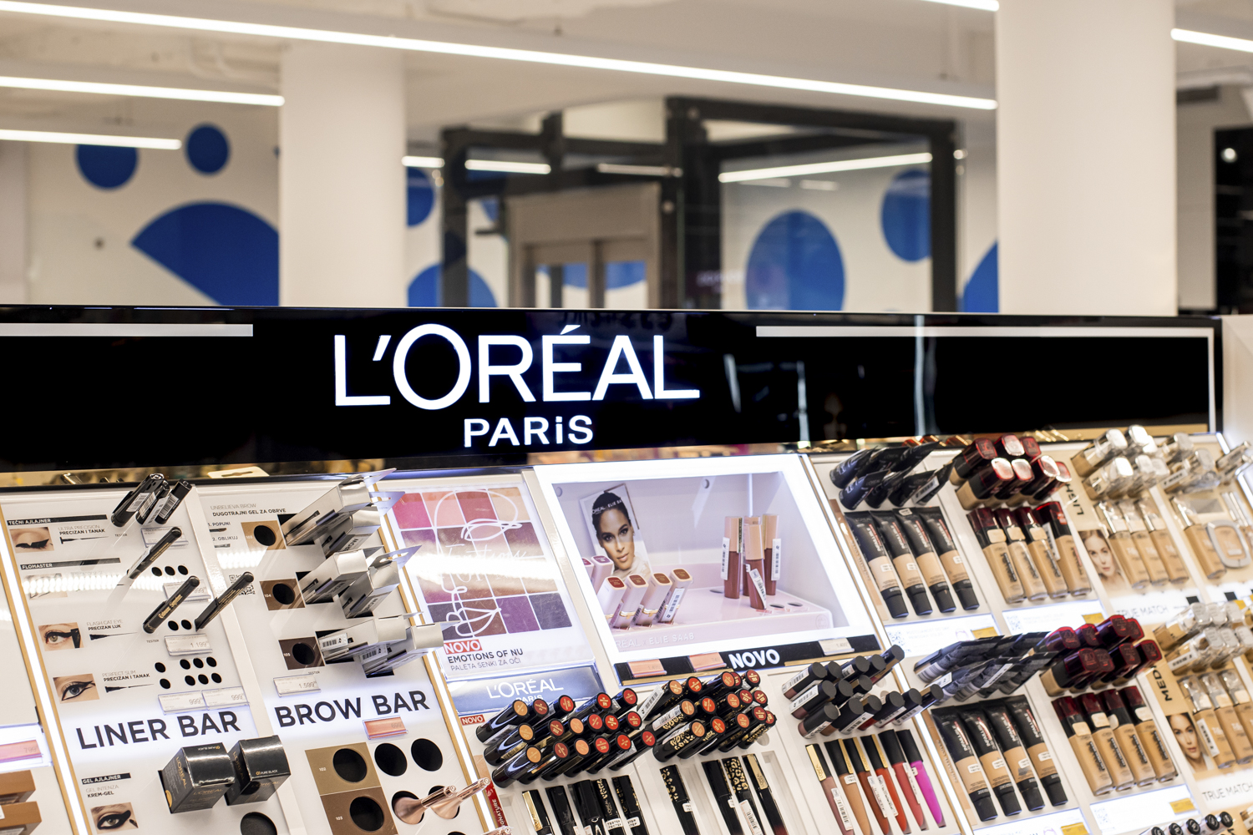
Belgrade Serbia
Clients:
Huawei Adria
L'Oréal Paris Serbia

Slide 16
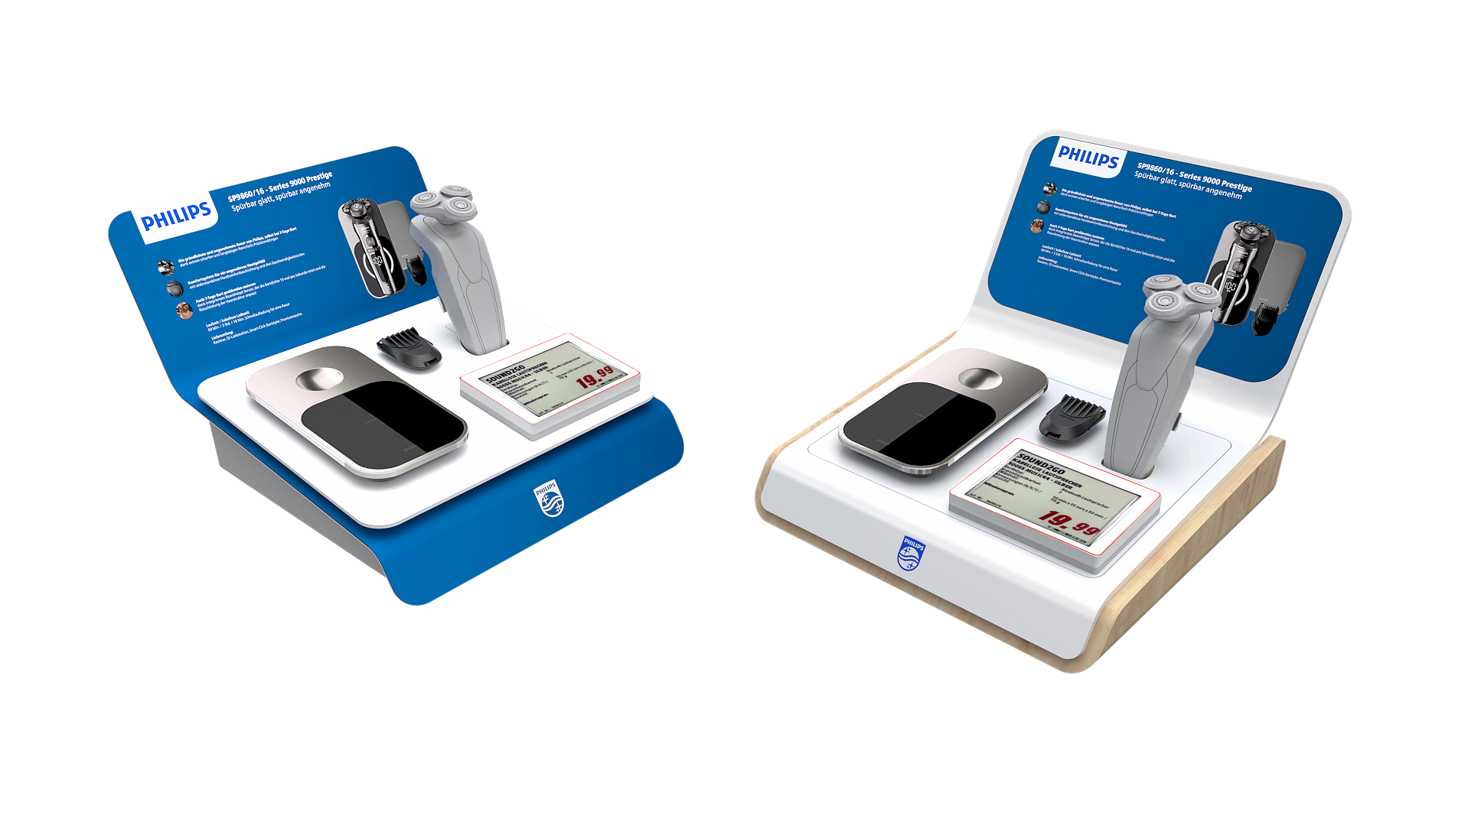
Small
Displays
Striking and premium design meets modularity and future proofing .
These displays must stand out among the see of other similar products and brands.

Slide 17
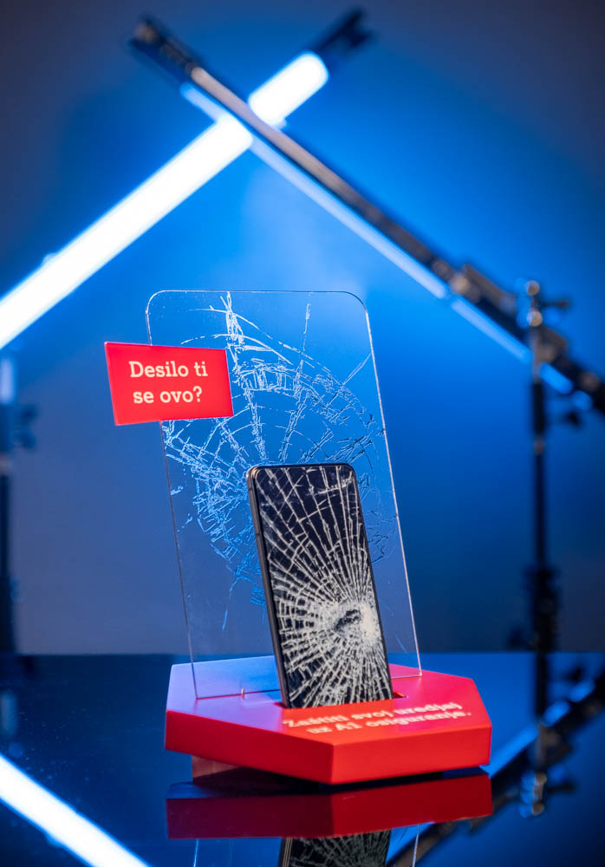
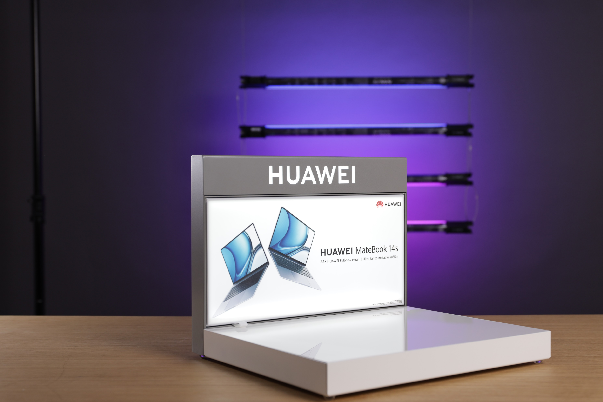
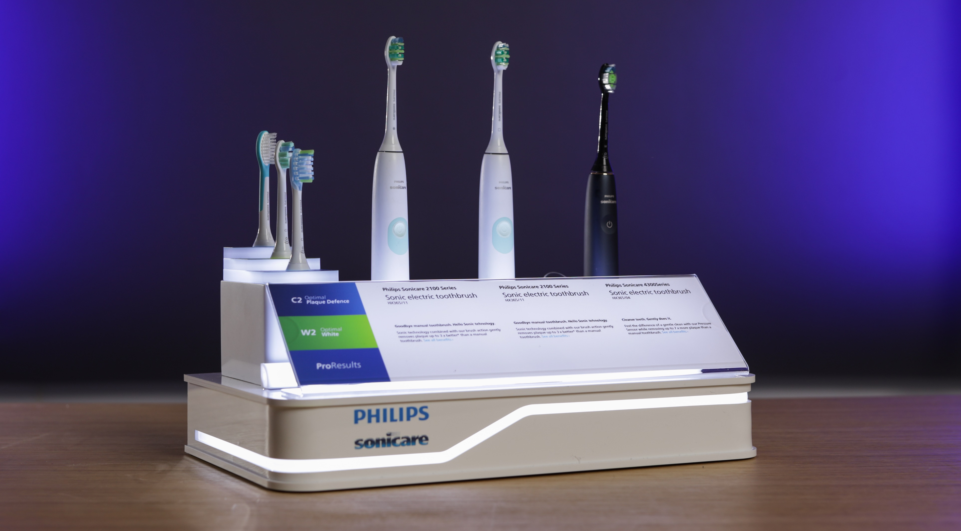
Clients:
A1 Serbia
Philips OHC
Huawei

Slide 18
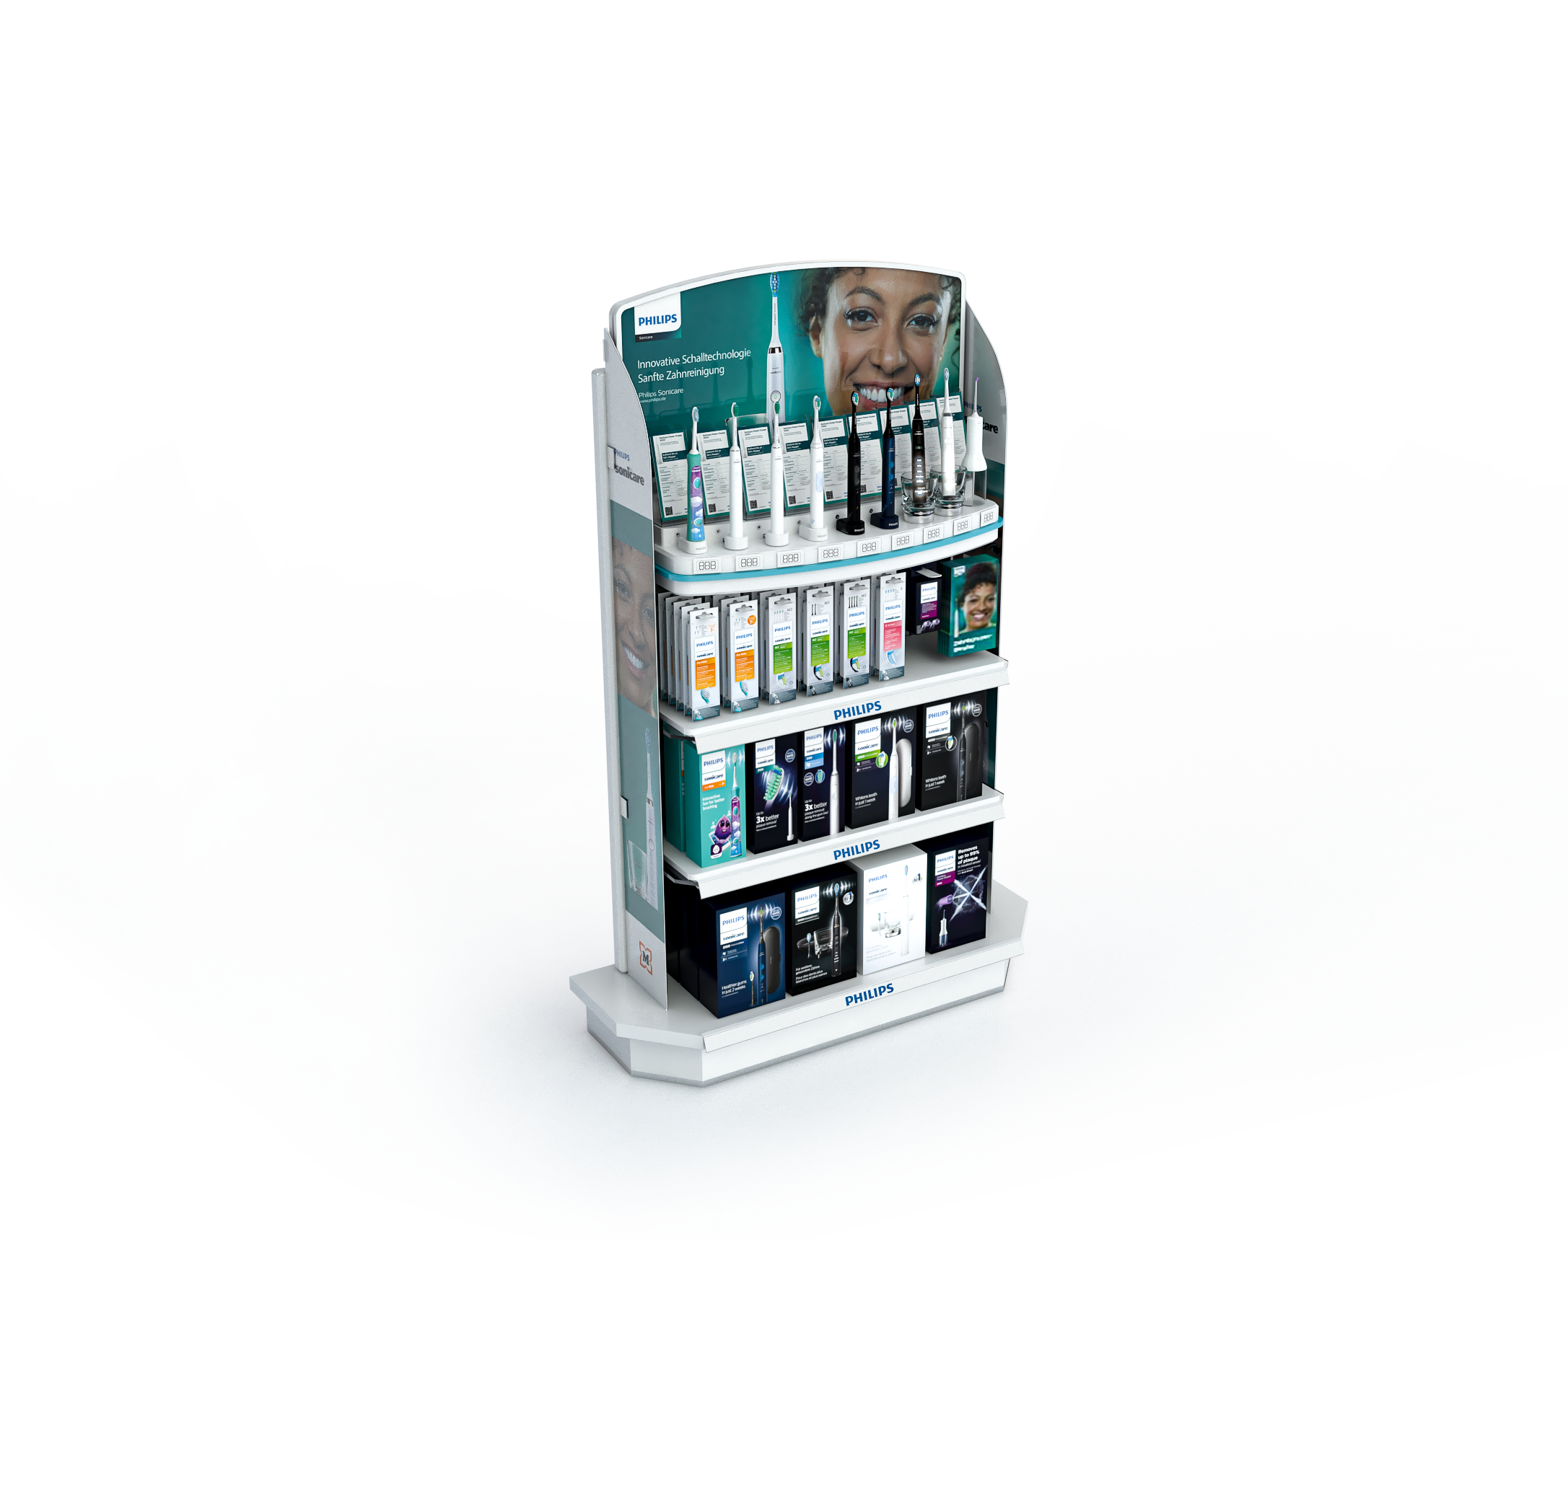
Different
Materials we
Use
The main goal was to create a visually striking display that stands out among crowded stores and is instantly recognizable. The visual impact of the shelf was only half of the design brief as the shelf must be versatile, easily adaptable to future products and visuals.

Slide 19
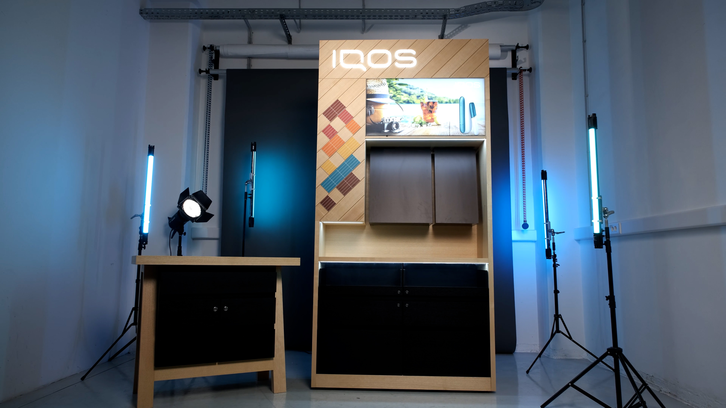
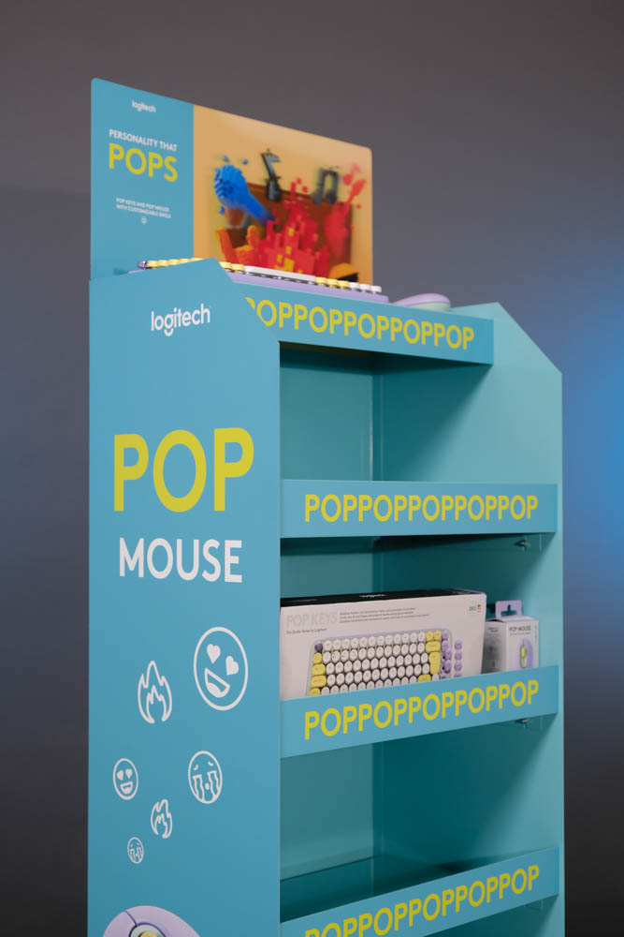
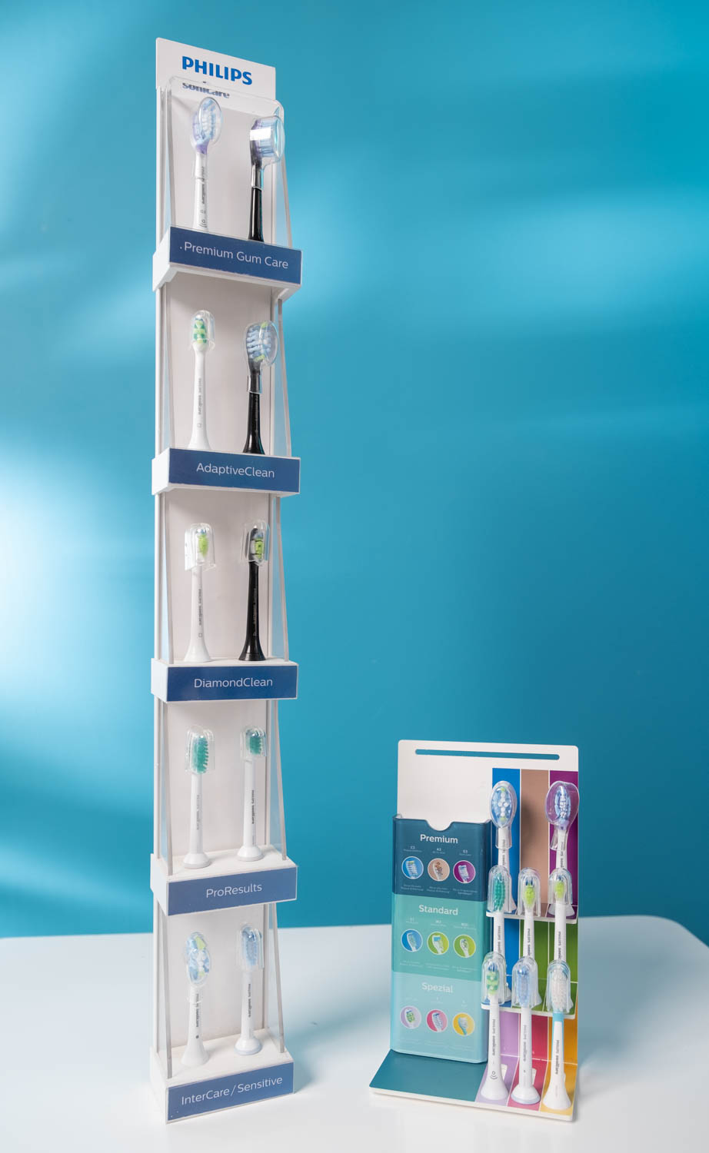
Wood
Acrylic
Metal

Slide 20

Innovating
displays

Slide 21
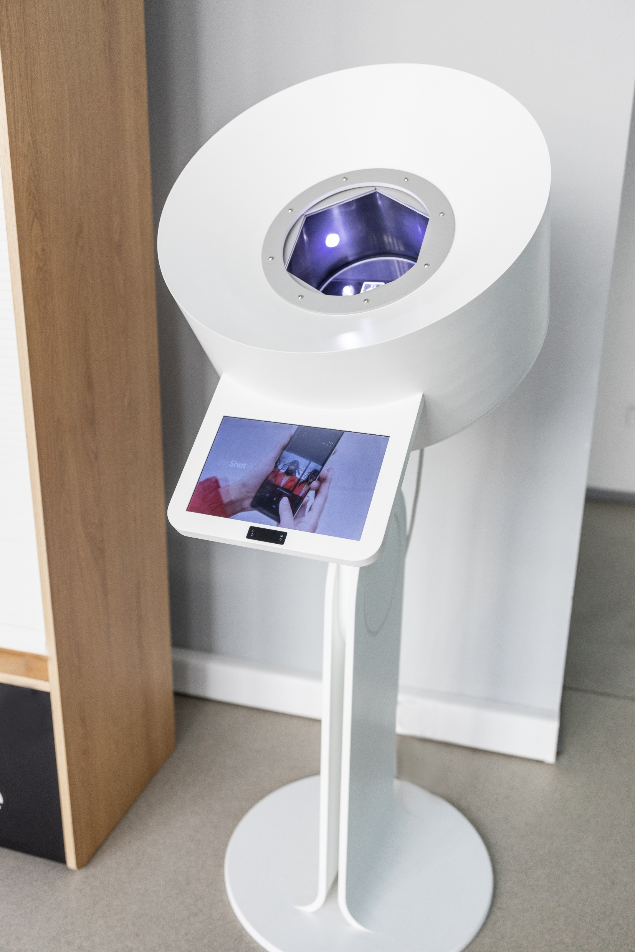
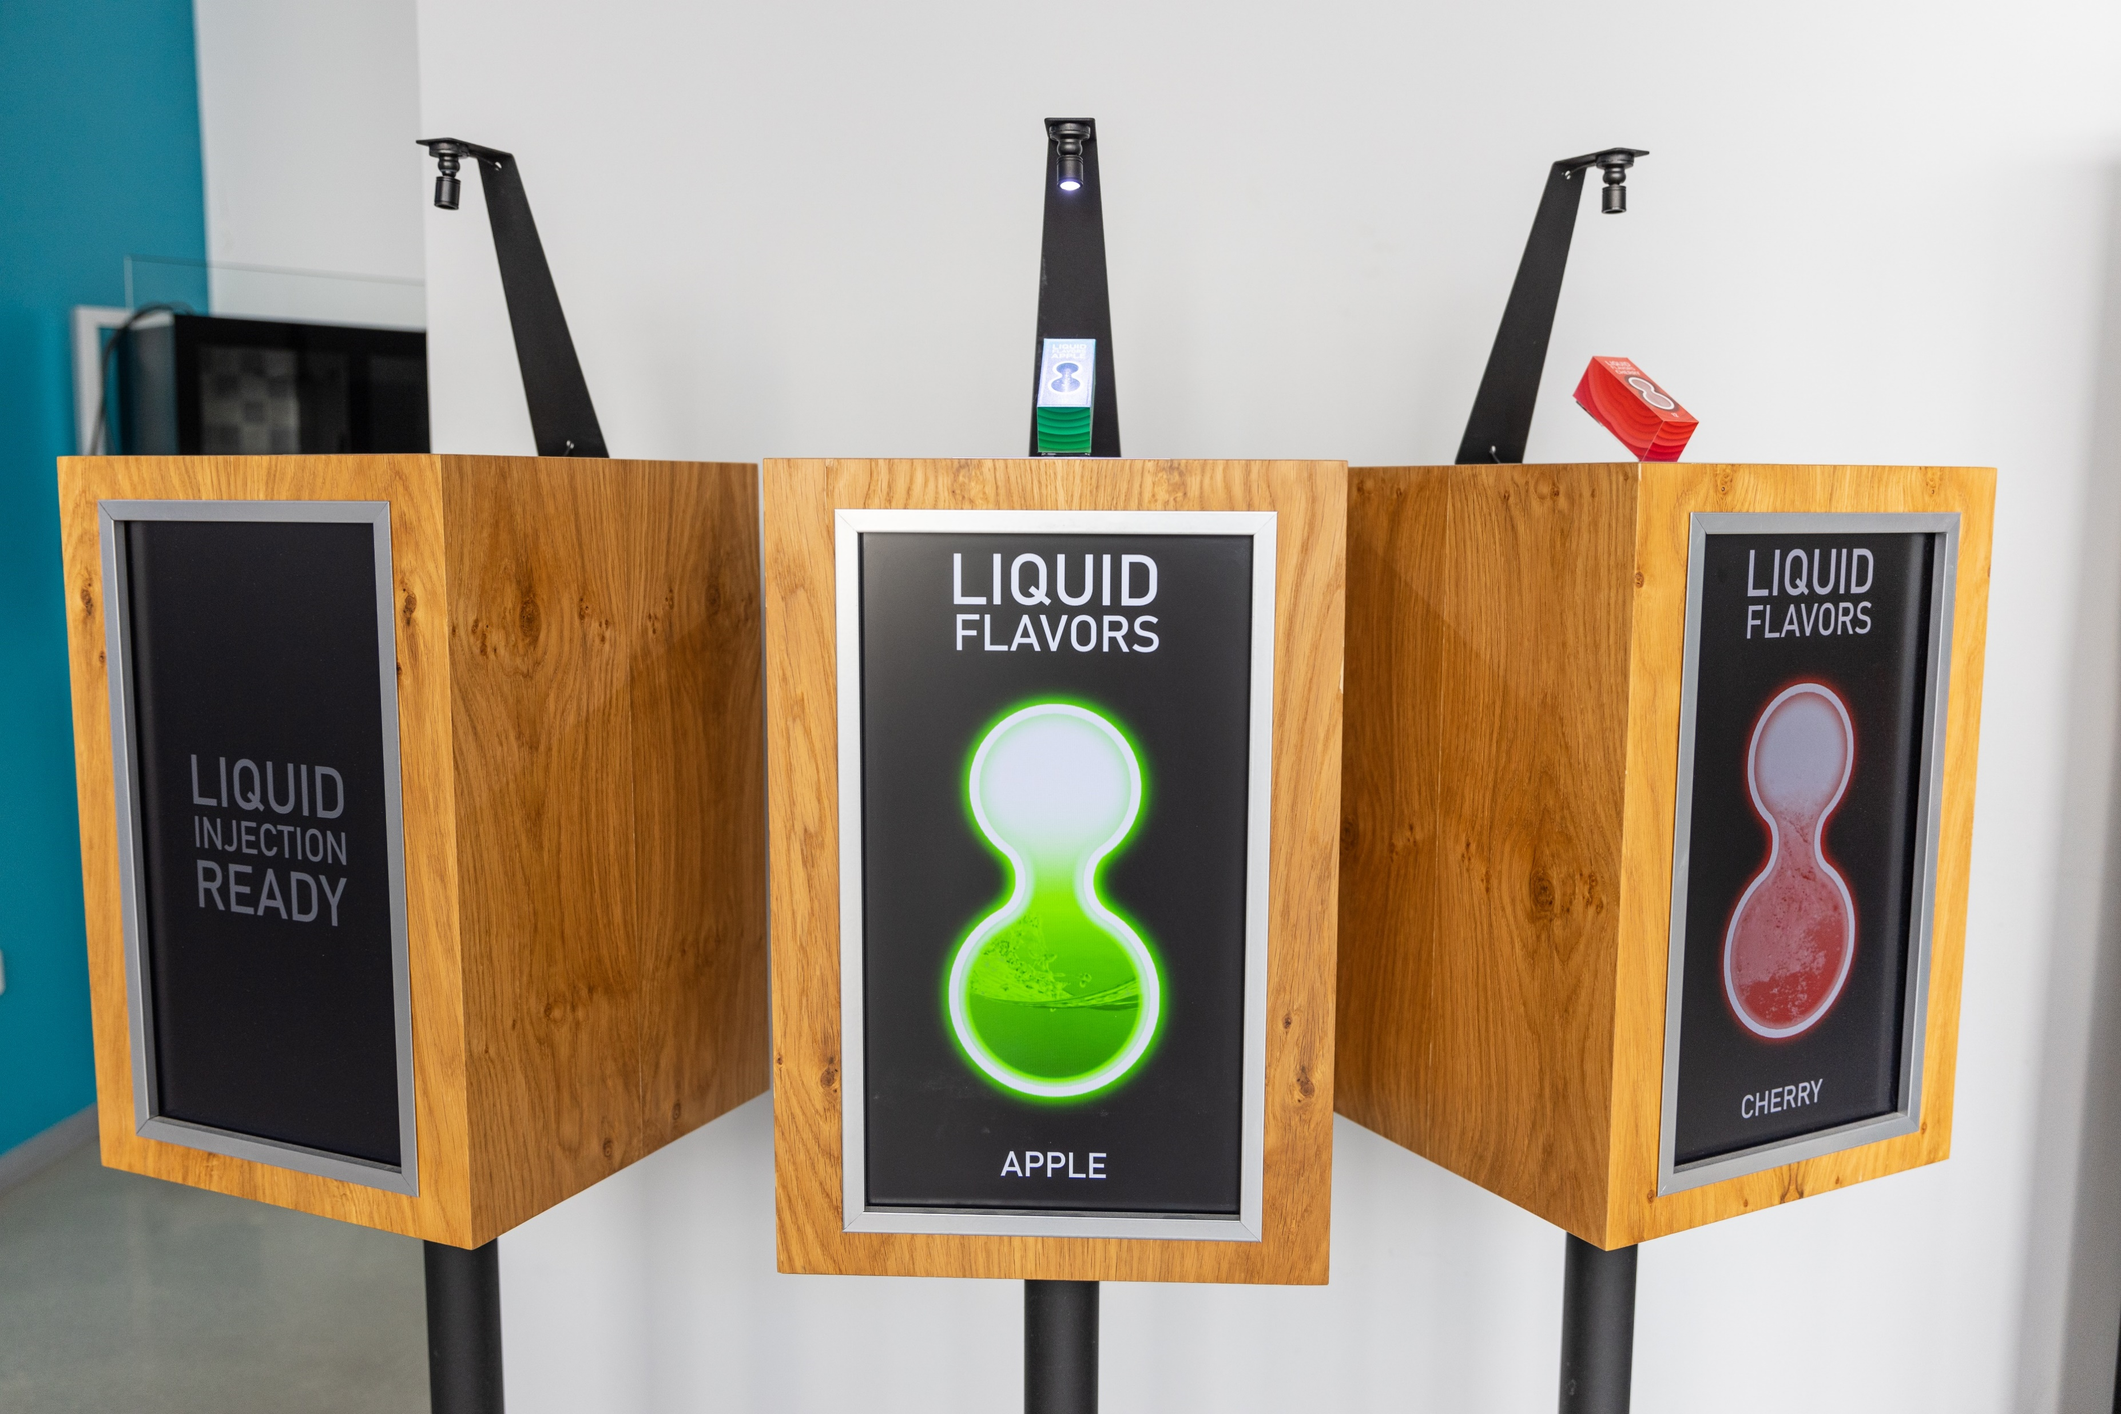
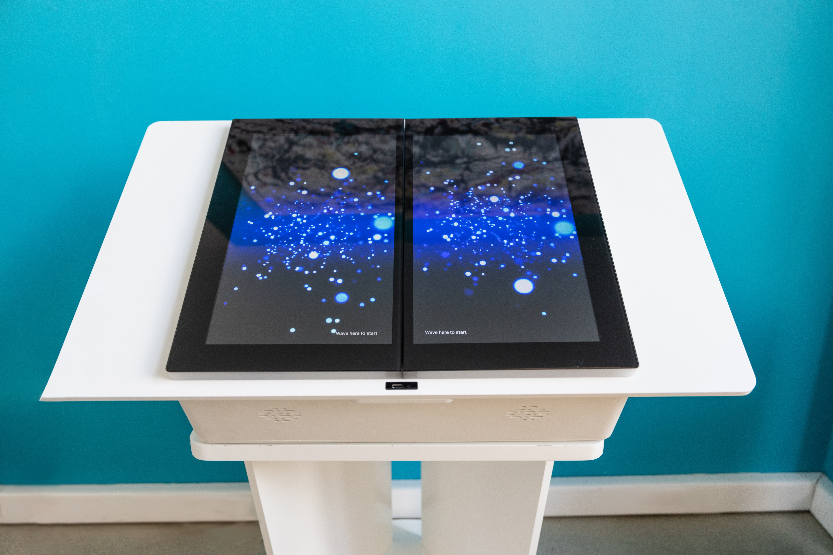
Belgrade Serbia
Clients:
Google
BAT Global

Slide 22
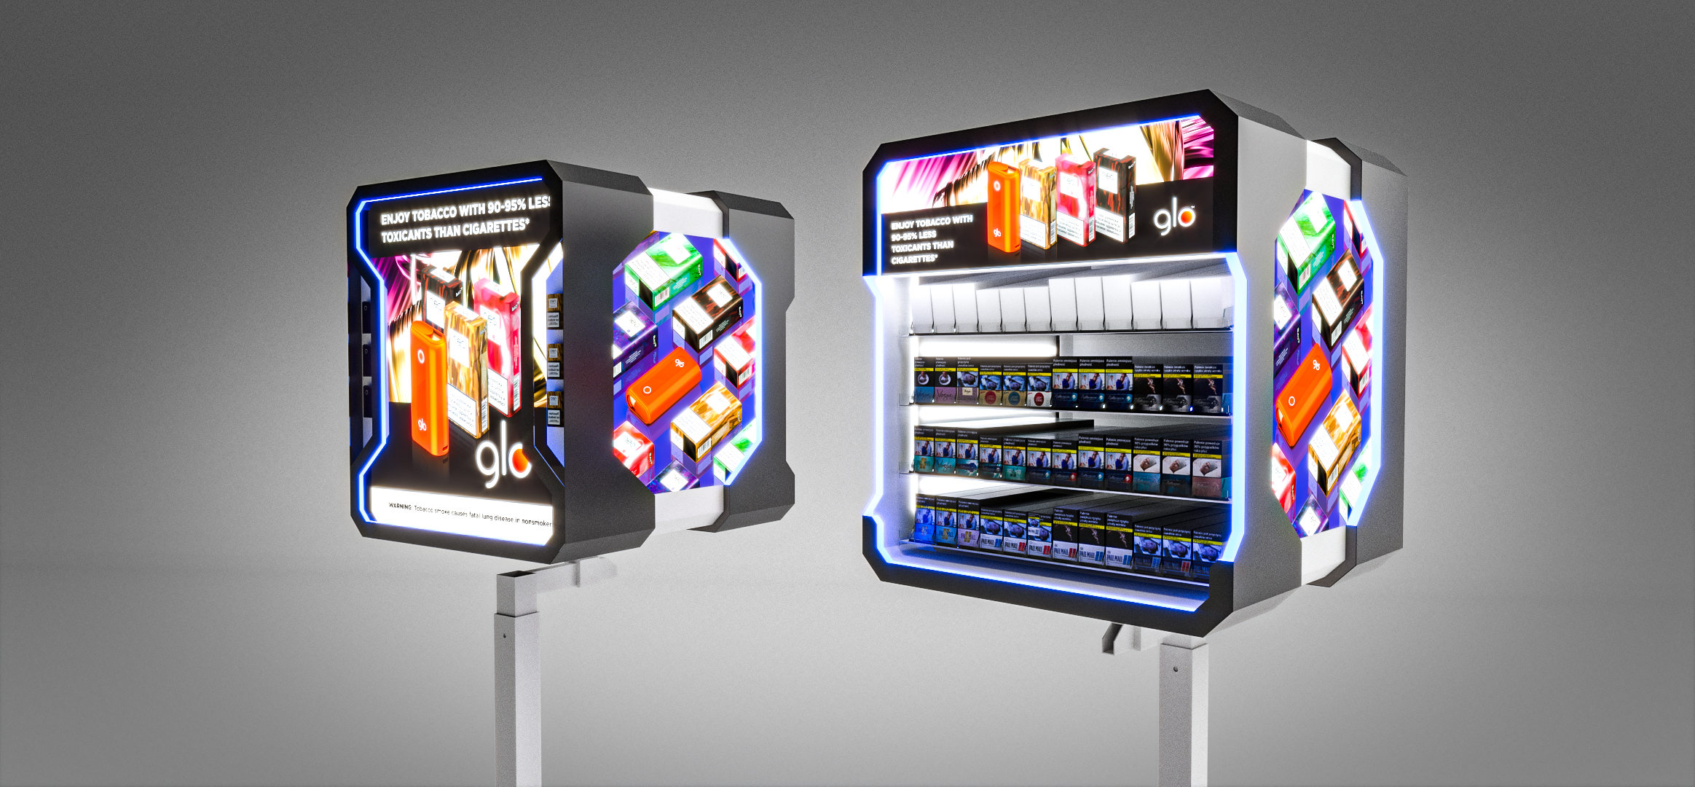
Overhead
Prototypes

Slide 23
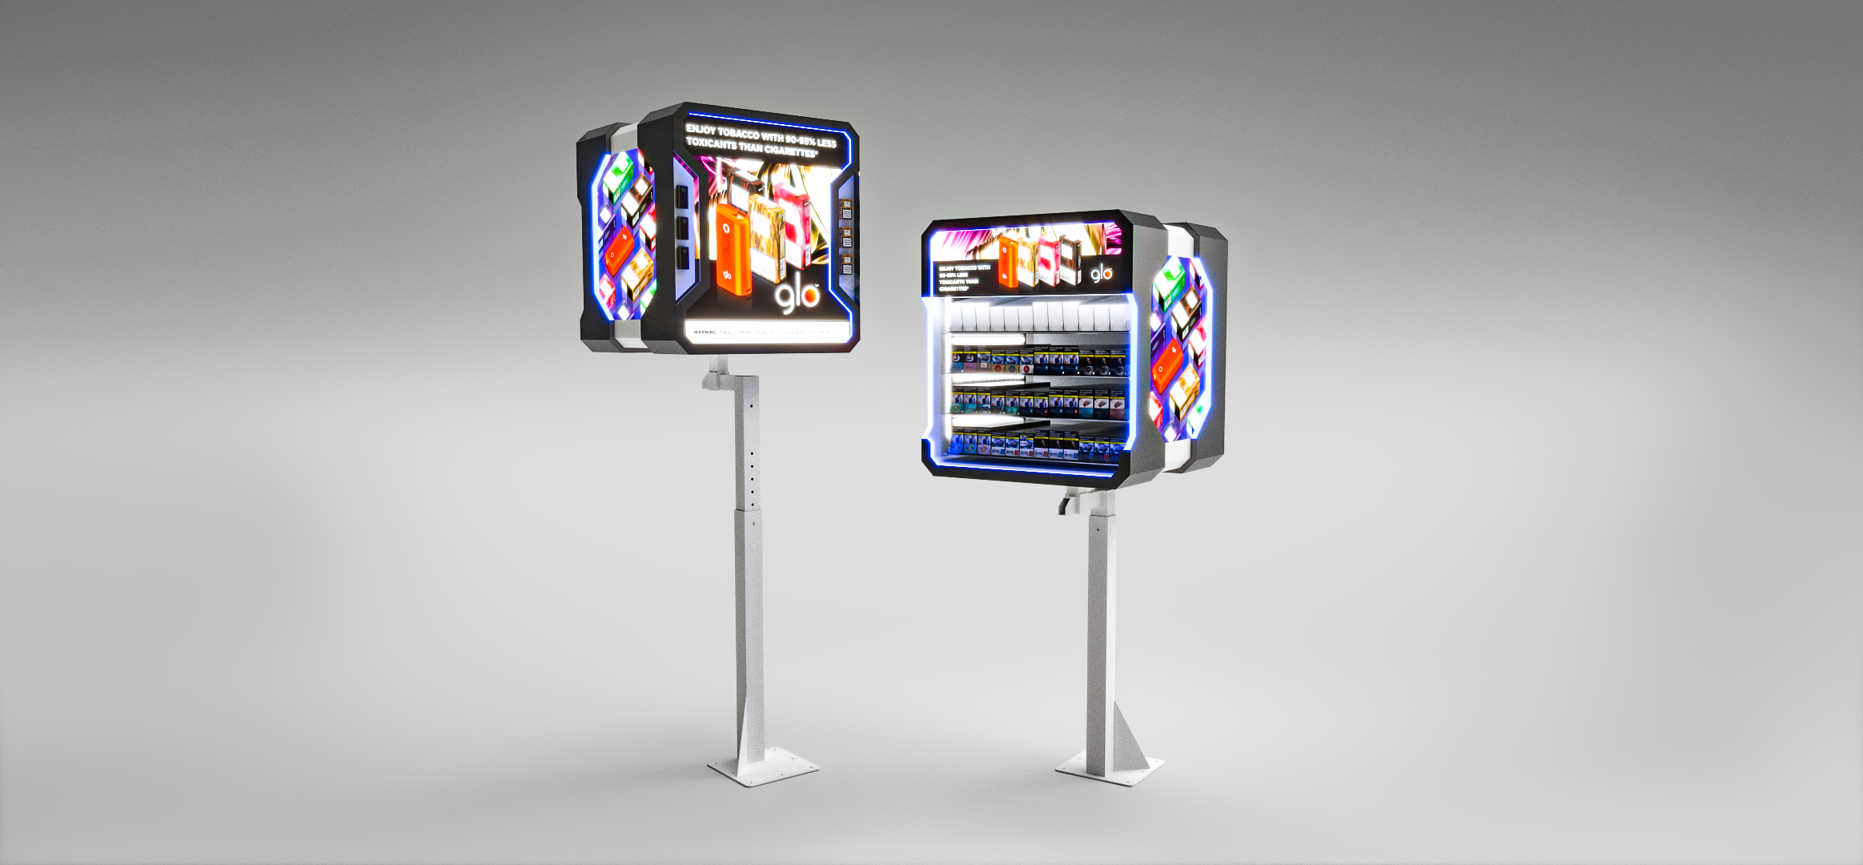

Slide 24
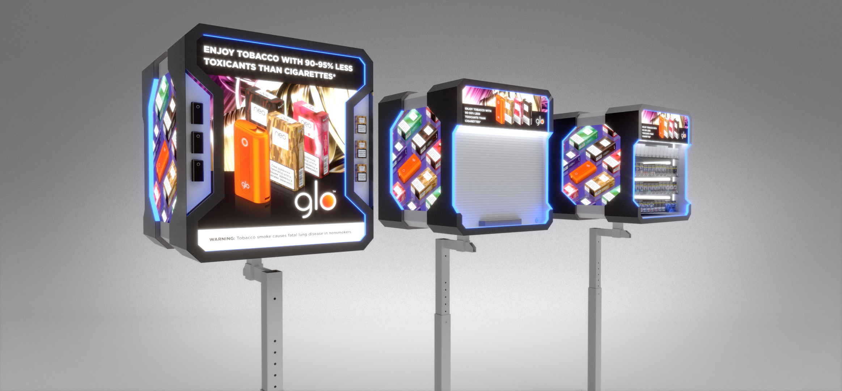

Slide 25
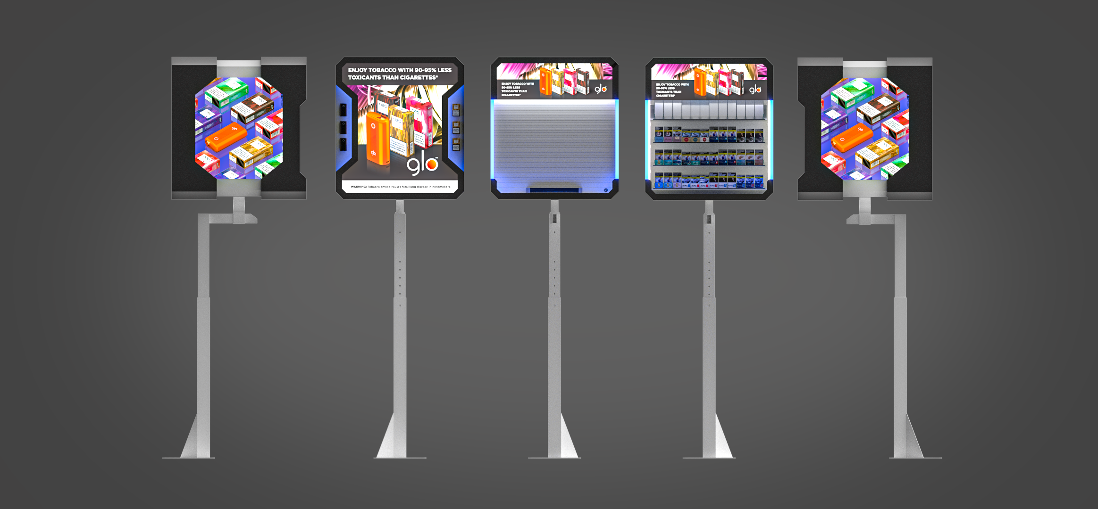

Slide 26
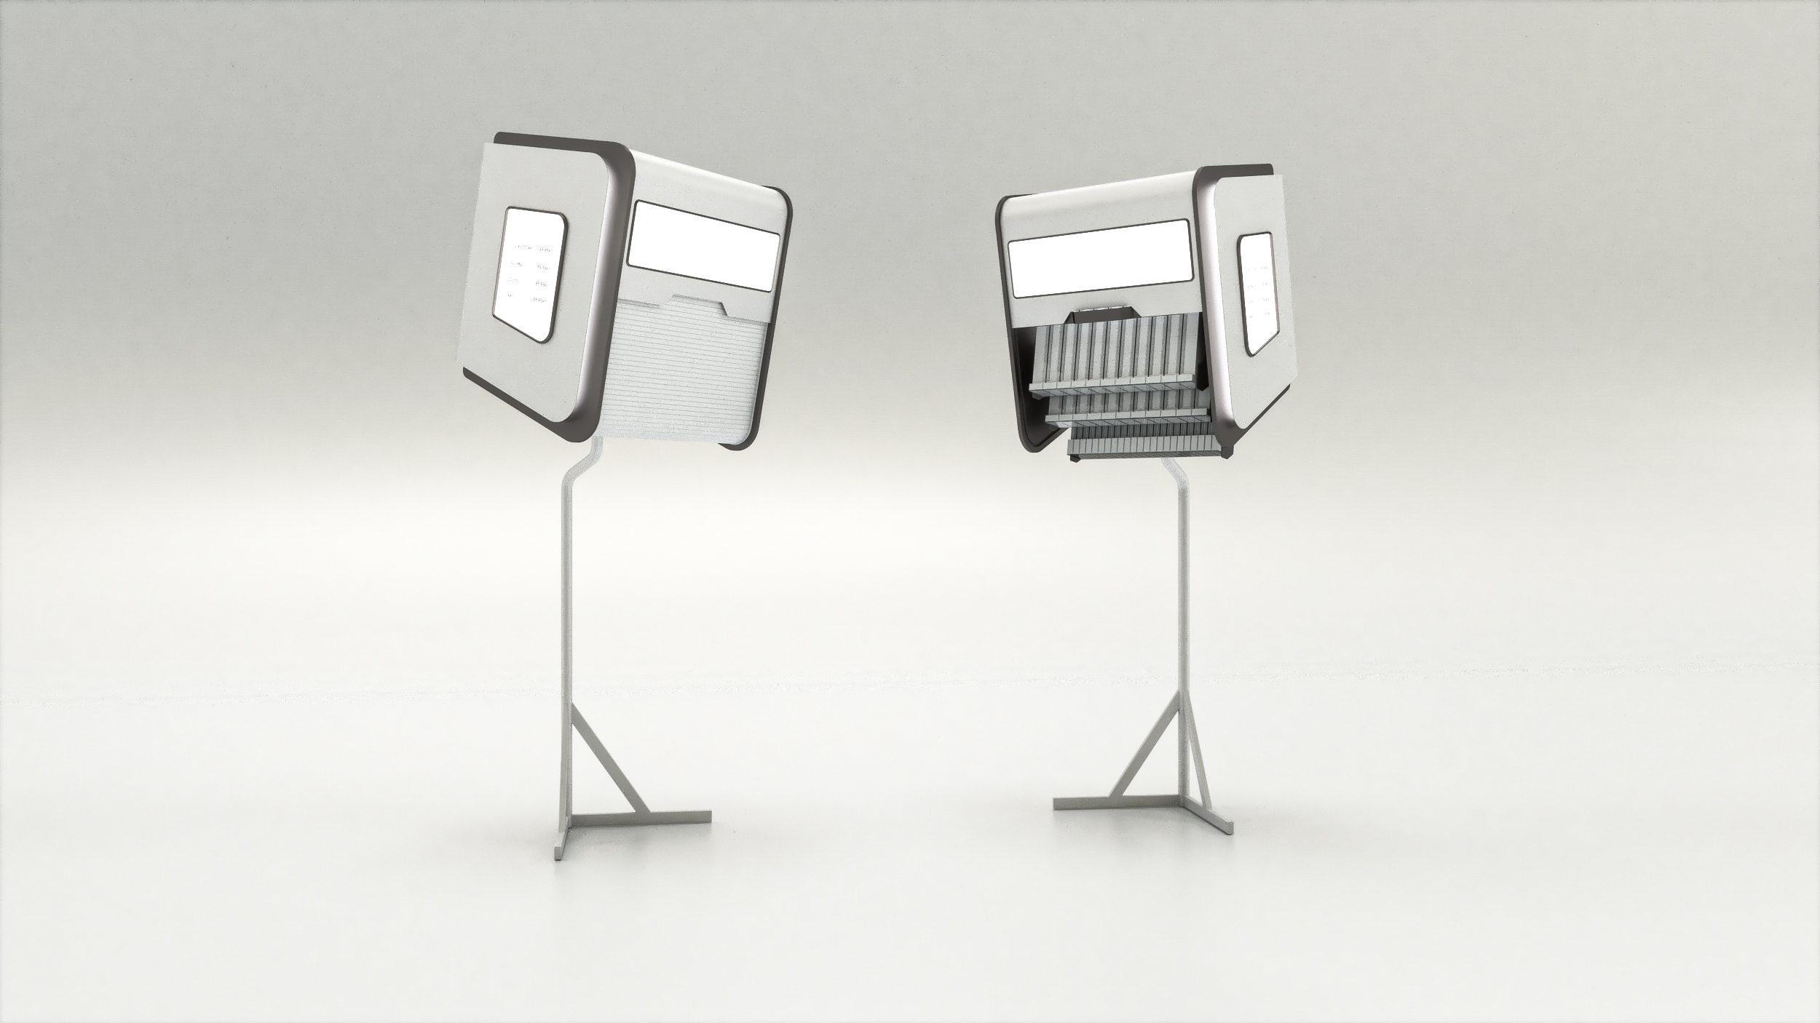
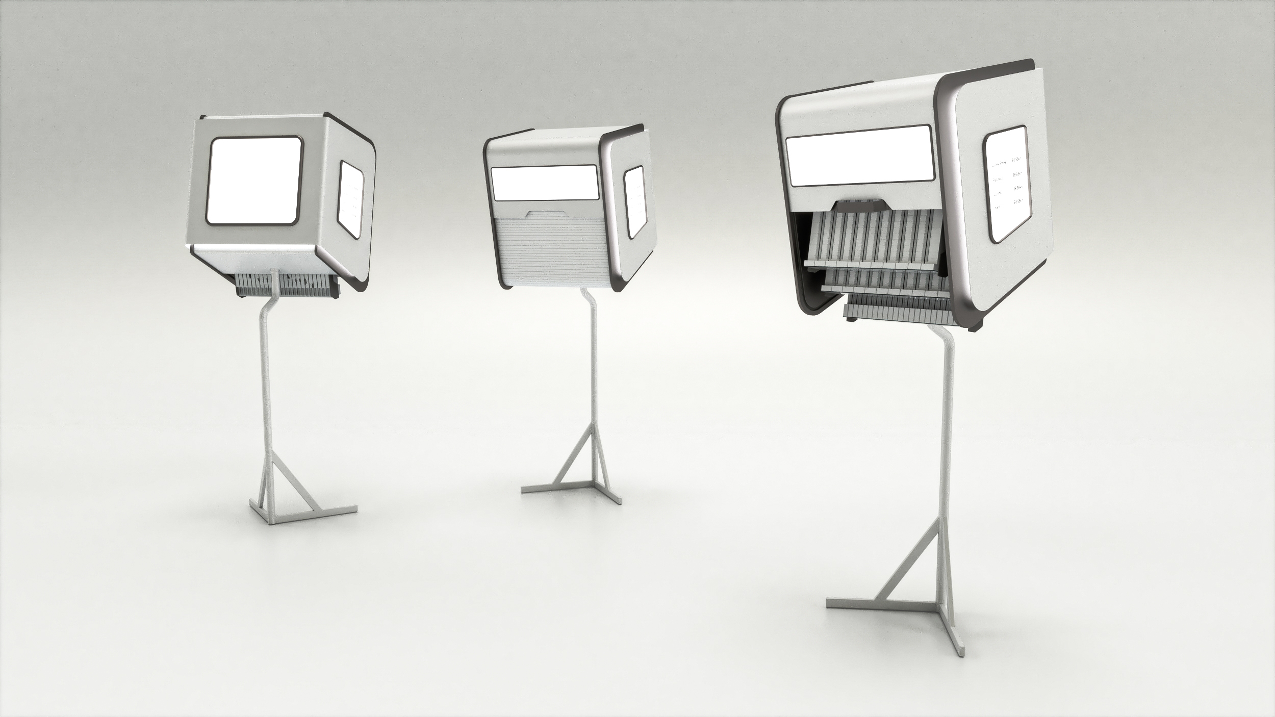

Slide 27
BG REKLAM
HEADQUATERS
29. Novembra 1M
11460 Belgrade, Serbia
info@bgreklam.com
+381 11 785 64 64
+381 60 68 69 110
Thank You.
BG REKLAM GMBH
Leverkusenstraße 3
22761 Hamburg, Deutschland
hamburg@bgreklam.com
+49 40 85413003
www.bgreklam.com
BG REKLAM
UK LTD
2588 Davenport House,
207 Regent St
London, W1B 3HH, UK
+44 75 4288 2312

