Slide 1
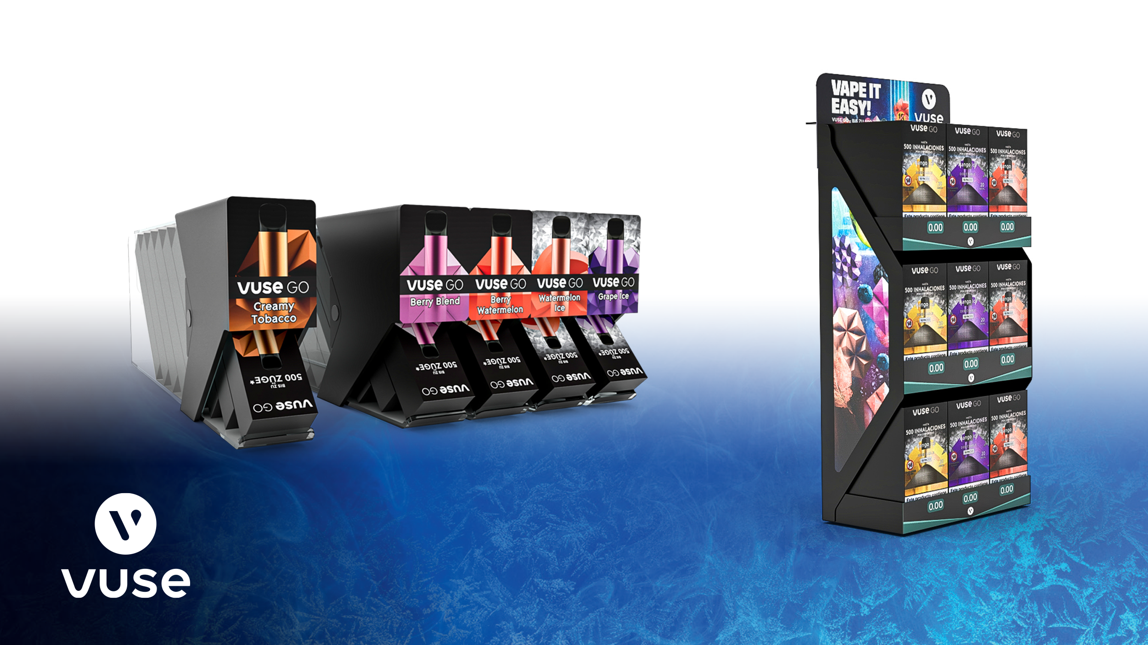


Slide 2
MODI
Solutions

Slide 3

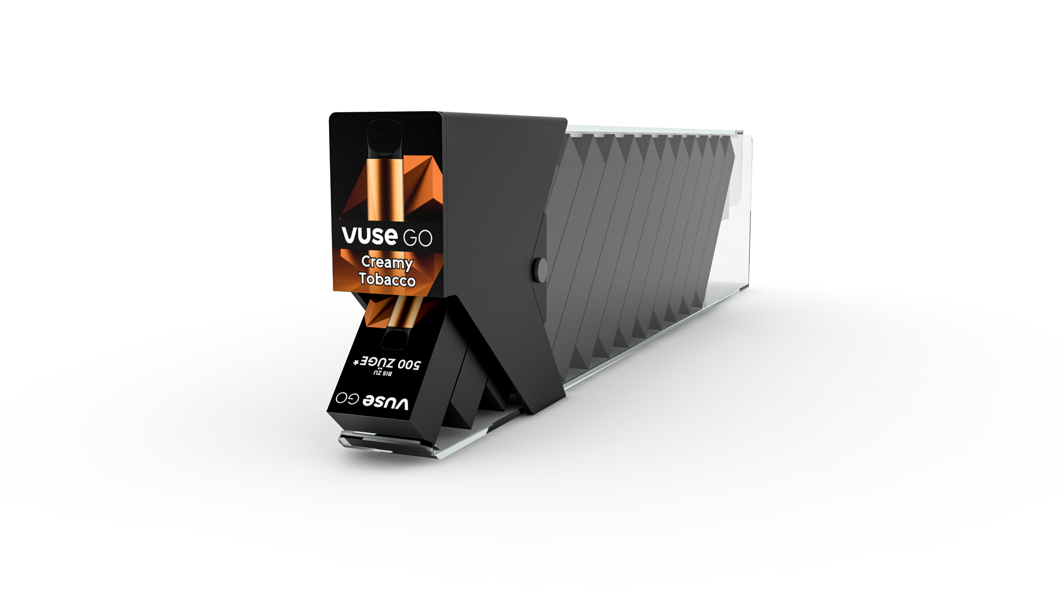
MODI
In-shelf

Slide 4
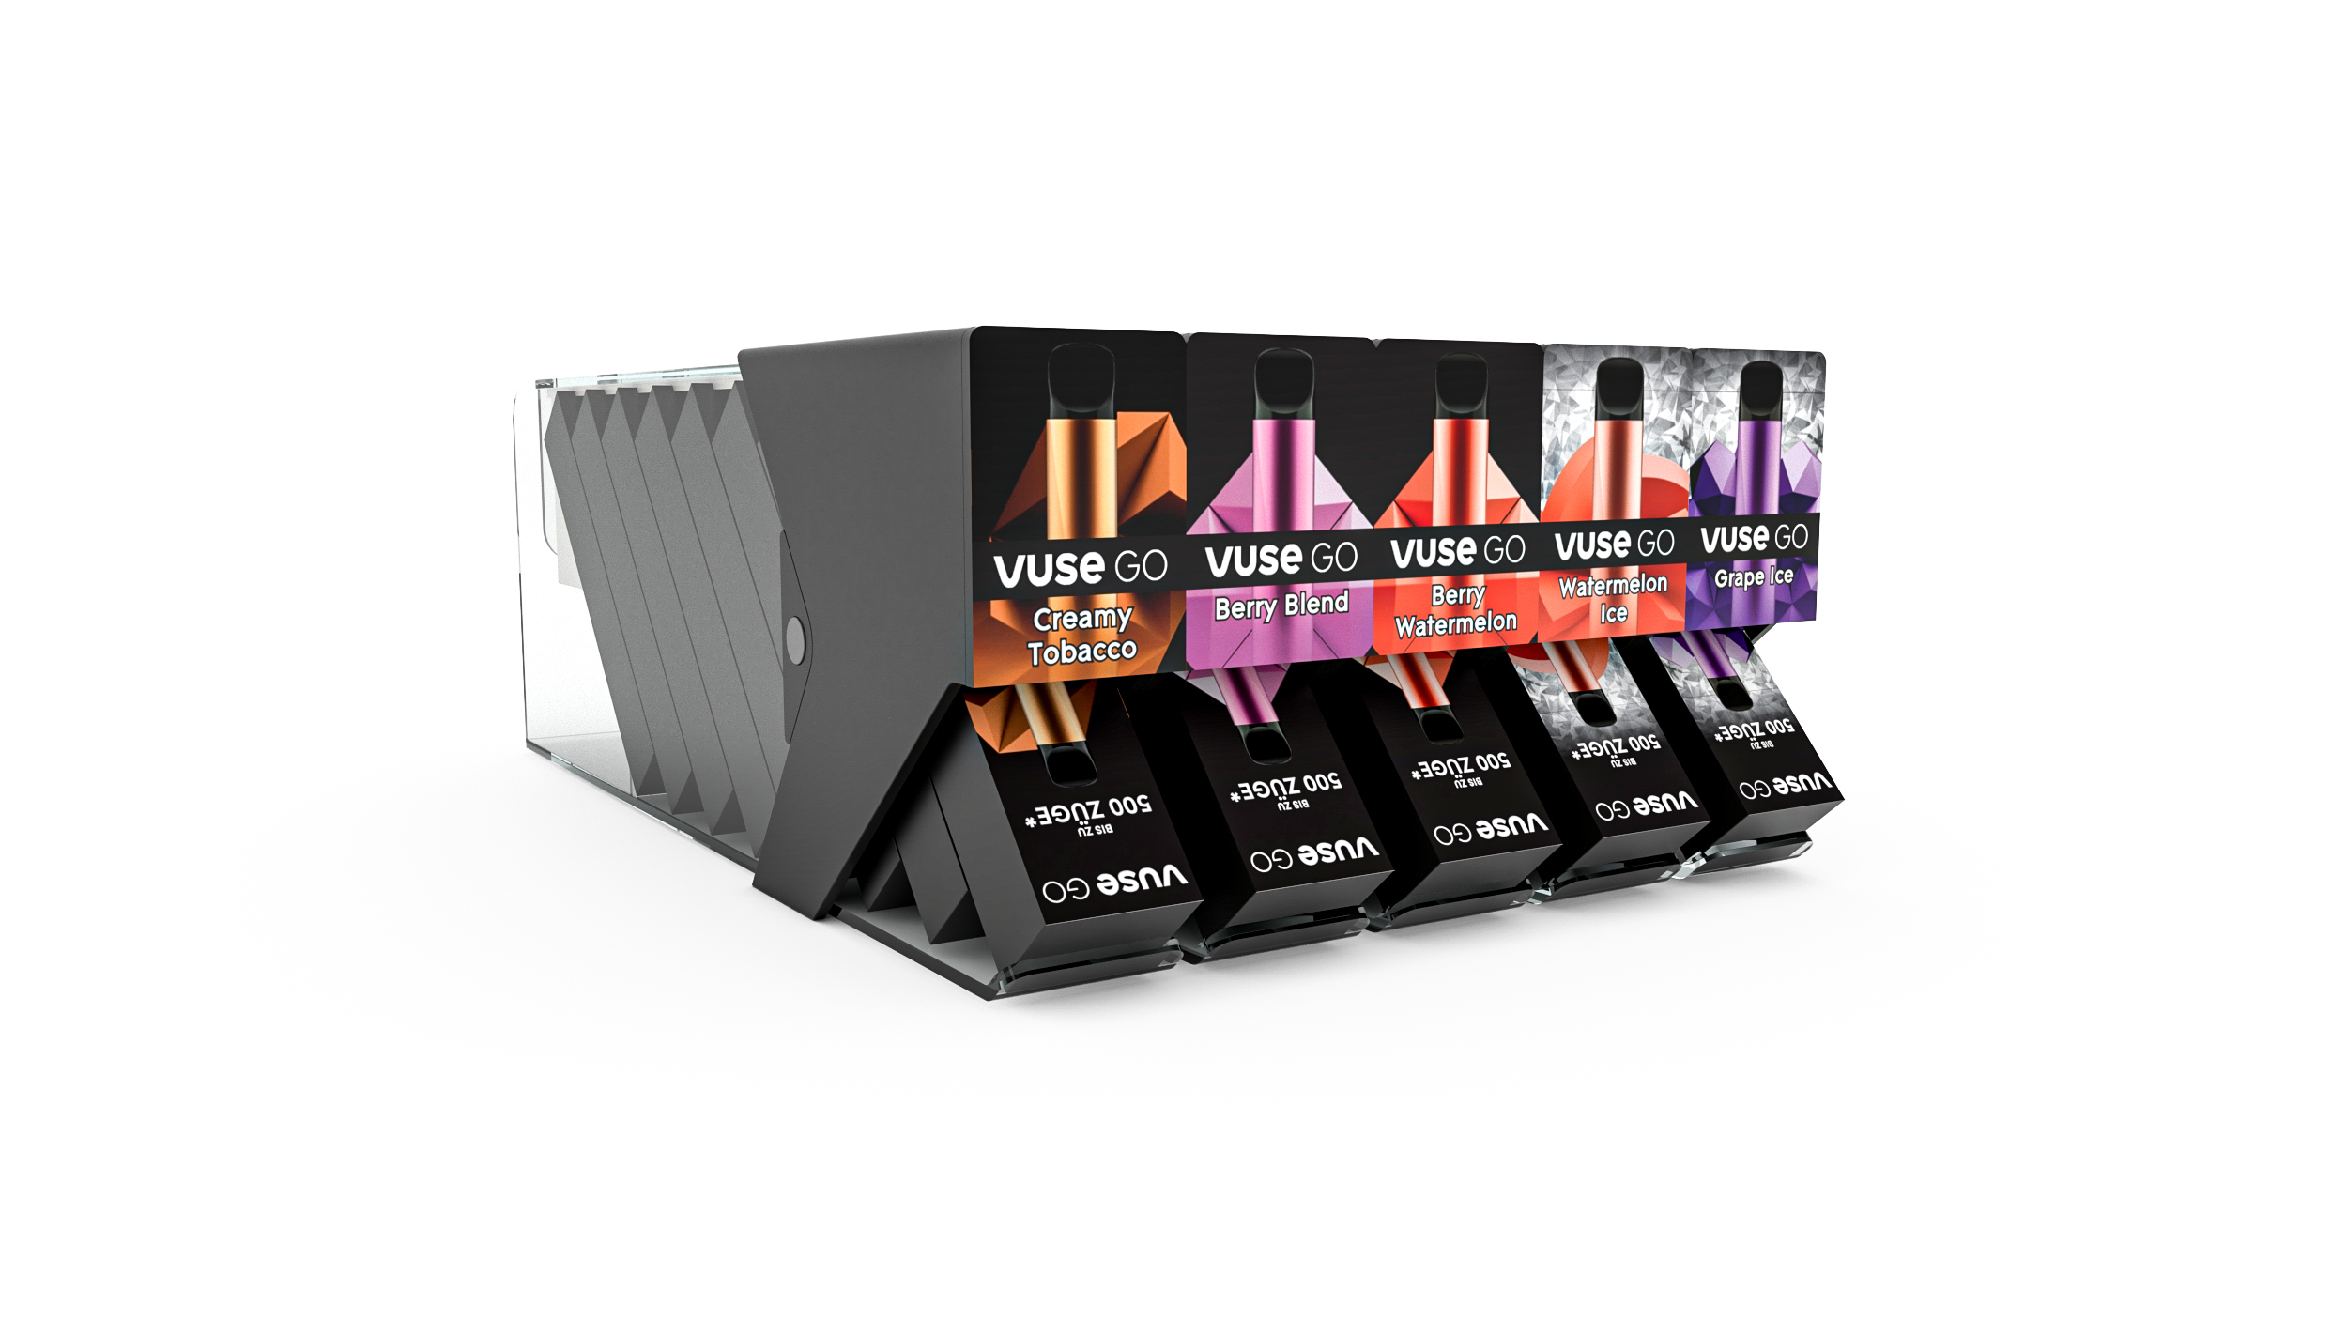
Brief
The brief was to create a unique solution that overcomes unusual dimension of the product that did not fit inside the standard retail shelf dimensions.
By placing all the products at an angled approach, we managed to fit them inside the restrictions of a standard shelf height of 12 cm.
Spring loaded pusher is now rotated and placed above the product and pushing out the next pack as they get depleted.

Slide 5
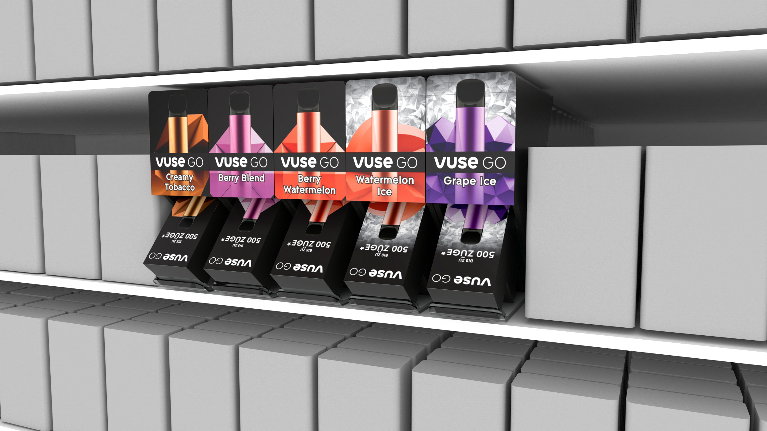

Slide 6
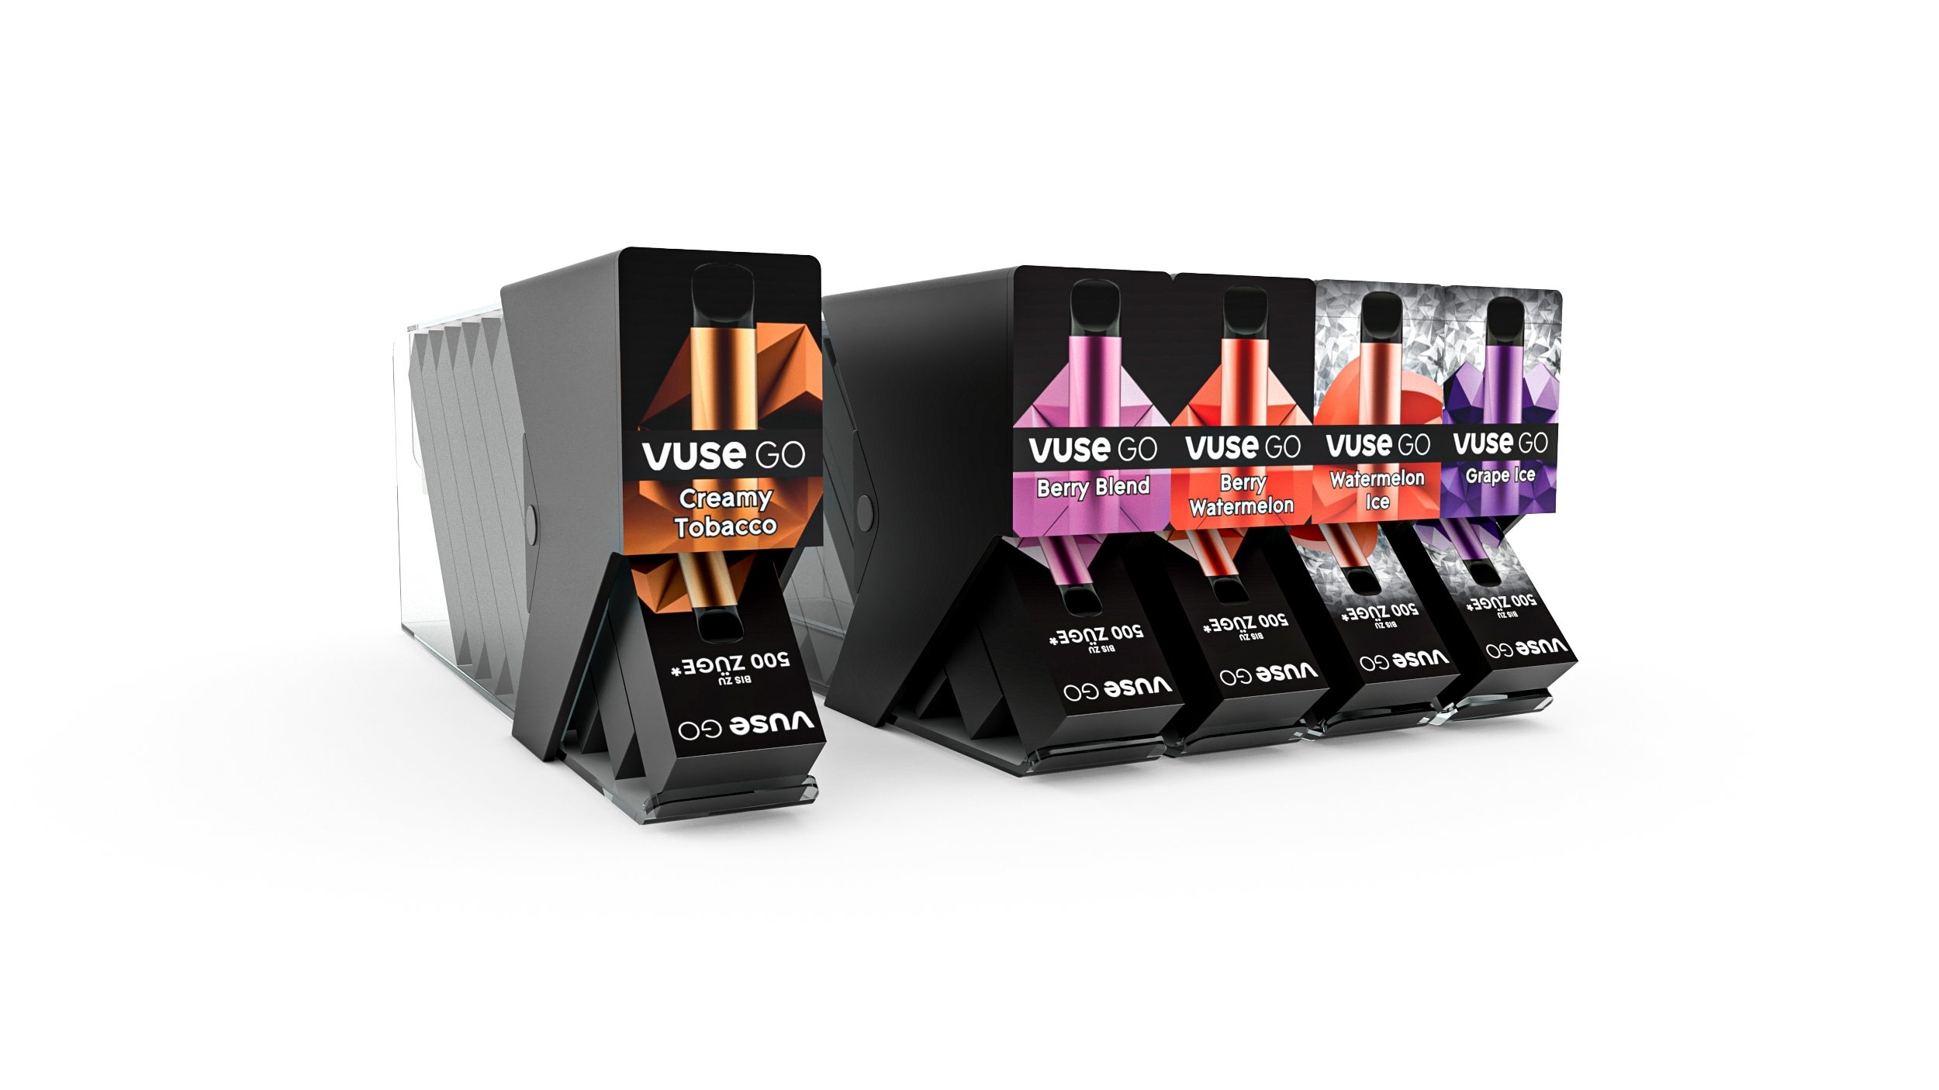
Modularity
In-shelf is fully modular concept and can be used in many different variations, ranging from five in a row or just one standalone unit.
They are smartly designed to be easily configured without the need of any tools or mechanical screws holding them together.
Making them intuitive and adjustable on the spot by merchants.

Slide 7
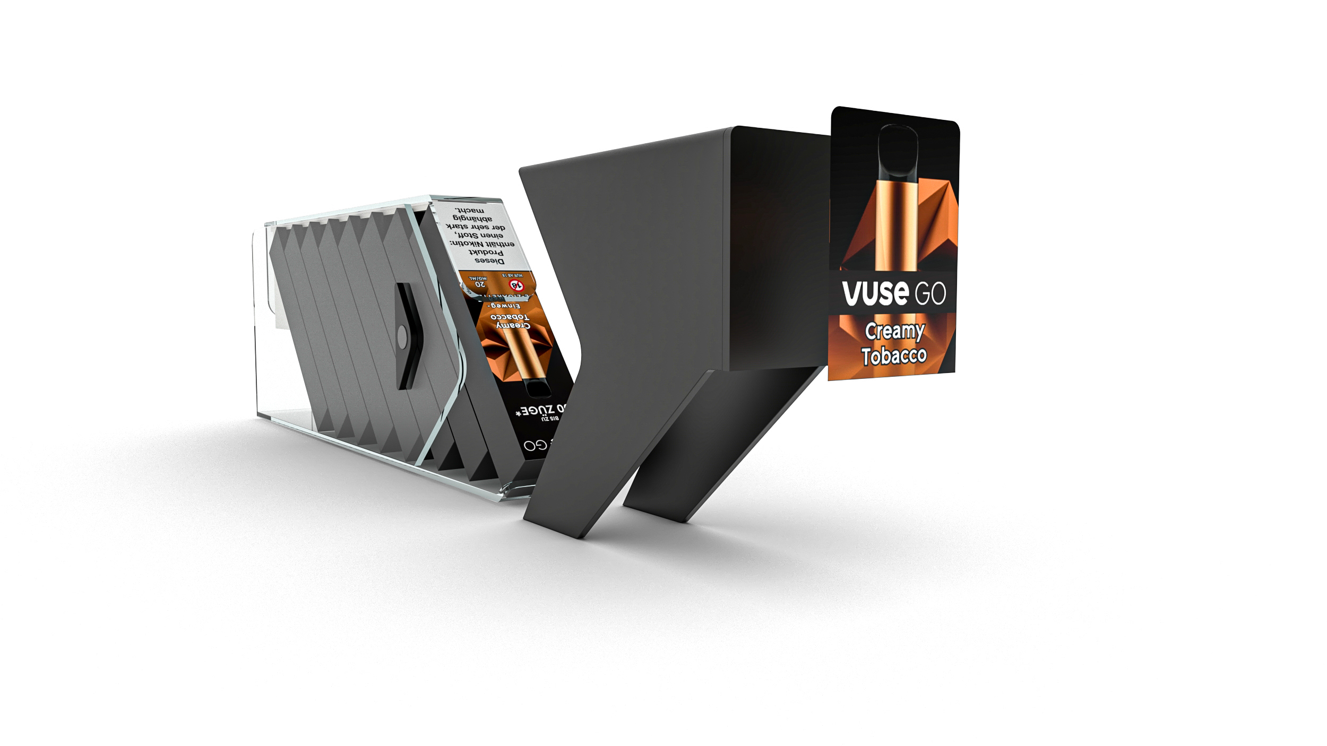
Interchangeable
Visuals
Future proof design allows the in-shelf to be used with any future products with similar dimension or new flavors. This is achieved by simply changing and adapting visuals on the font of the unit.

Slide 8
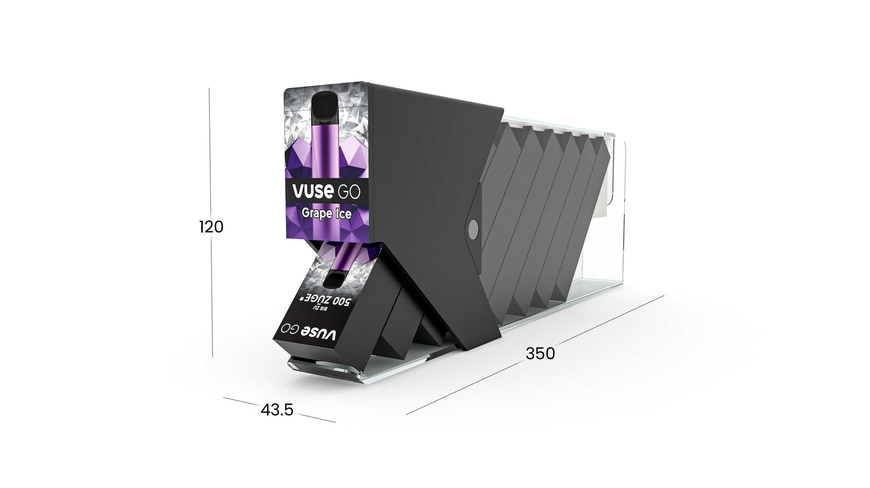
Dimensions

Slide 9
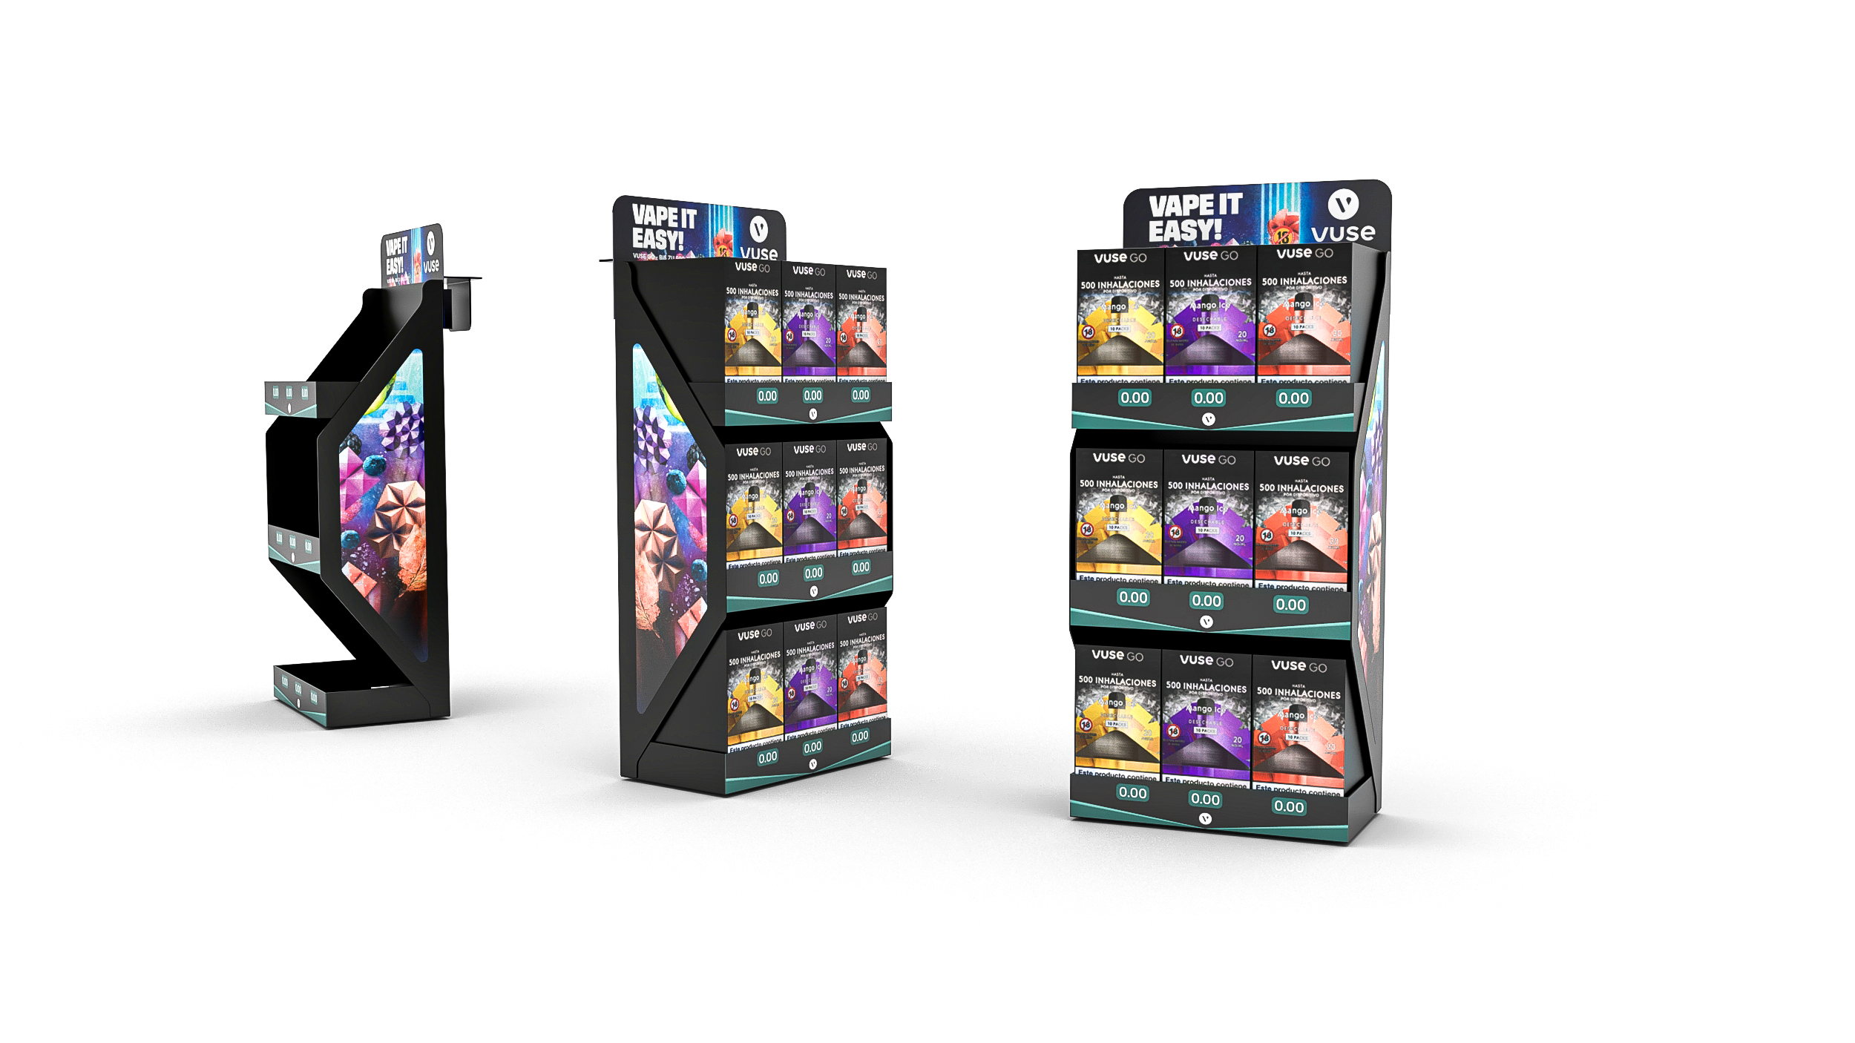
MODI
Counter

Slide 10
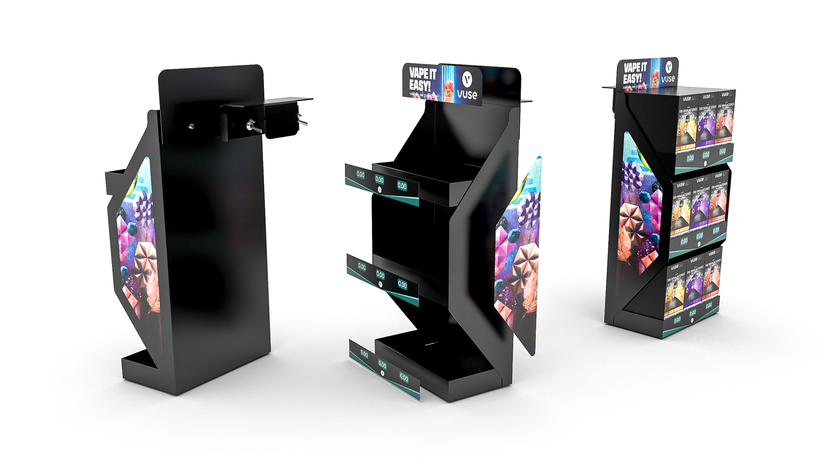
Modularity
Future proof design allows the counter to be used with any future products with similar dimension or new flavors. This is achieved by simply changing and adapting visuals on the font and sides of the display.
New labels/prices can be printed sent out and replaced by merchants in stores without using any tools or chemicals.

Slide 11
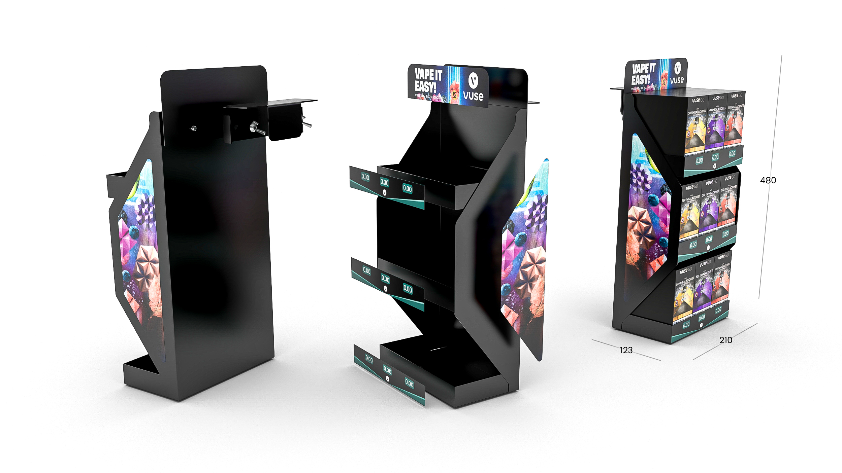
Dimensions

Slide 12
BG REKLAM
HEADQUATERS
29. Novembra 1M
11460 Belgrade, Serbia
info@bgreklam.com
+381 11 785 64 64
+381 60 68 69 110
Thank You.
BG REKLAM GMBH
Leverkusenstraße 3
22761 Hamburg, Deutschland
hamburg@bgreklam.com
+49 40 85413003
www.bgreklam.com
BG REKLAM
UK LTD
2588 Davenport House,
207 Regent St
London, W1B 3HH, UK
+44 75 4288 2312

