Slide 1
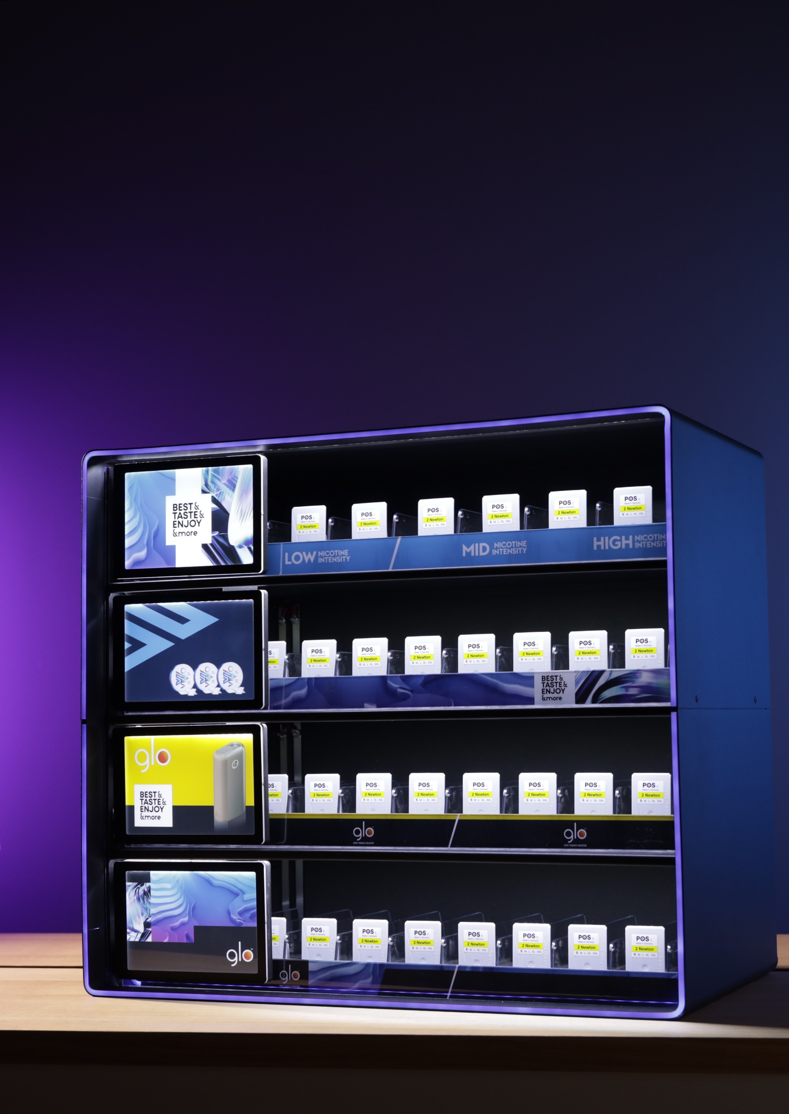

BAT
Multi-box CEN

Slide 2
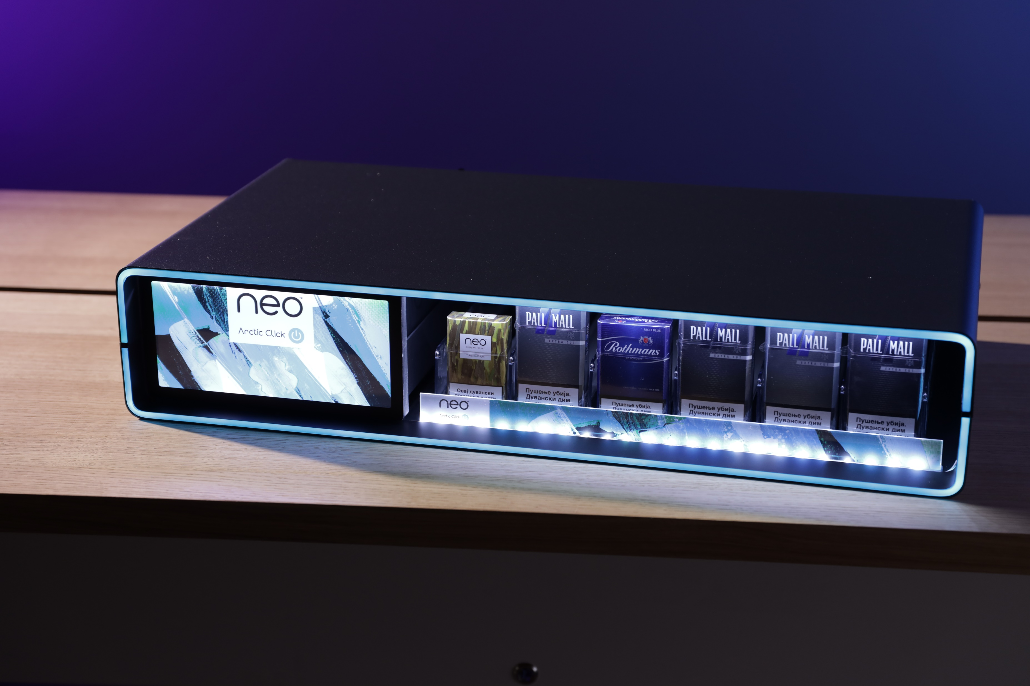

Slide 3
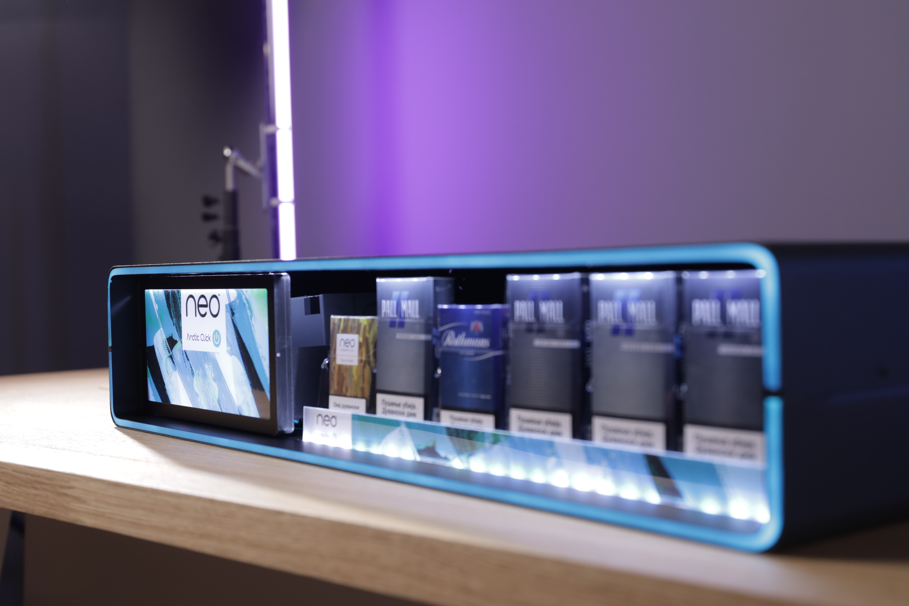
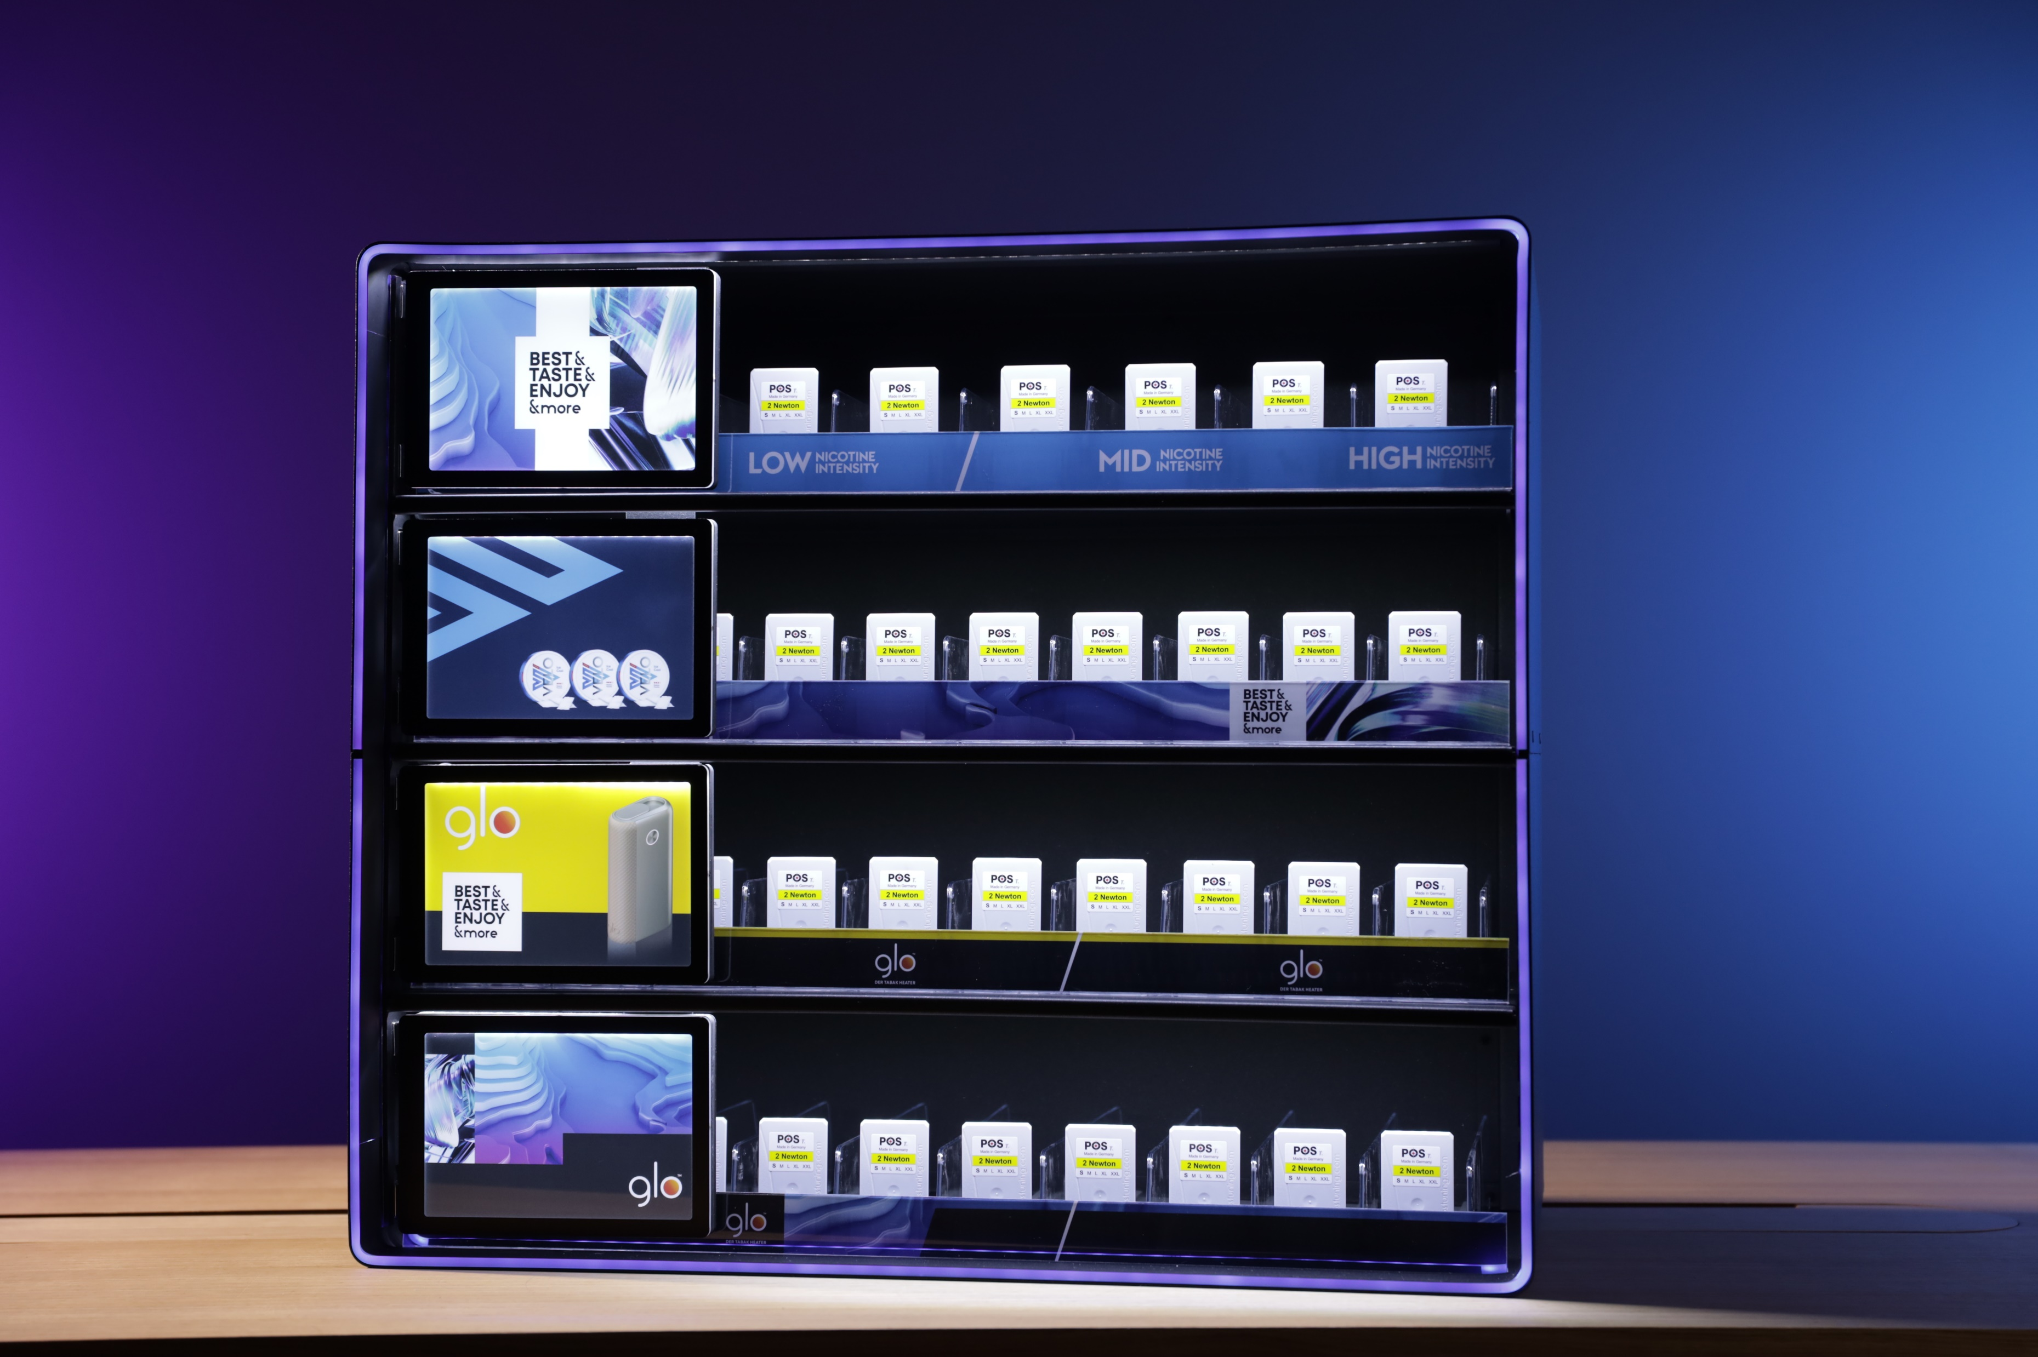

Slide 4
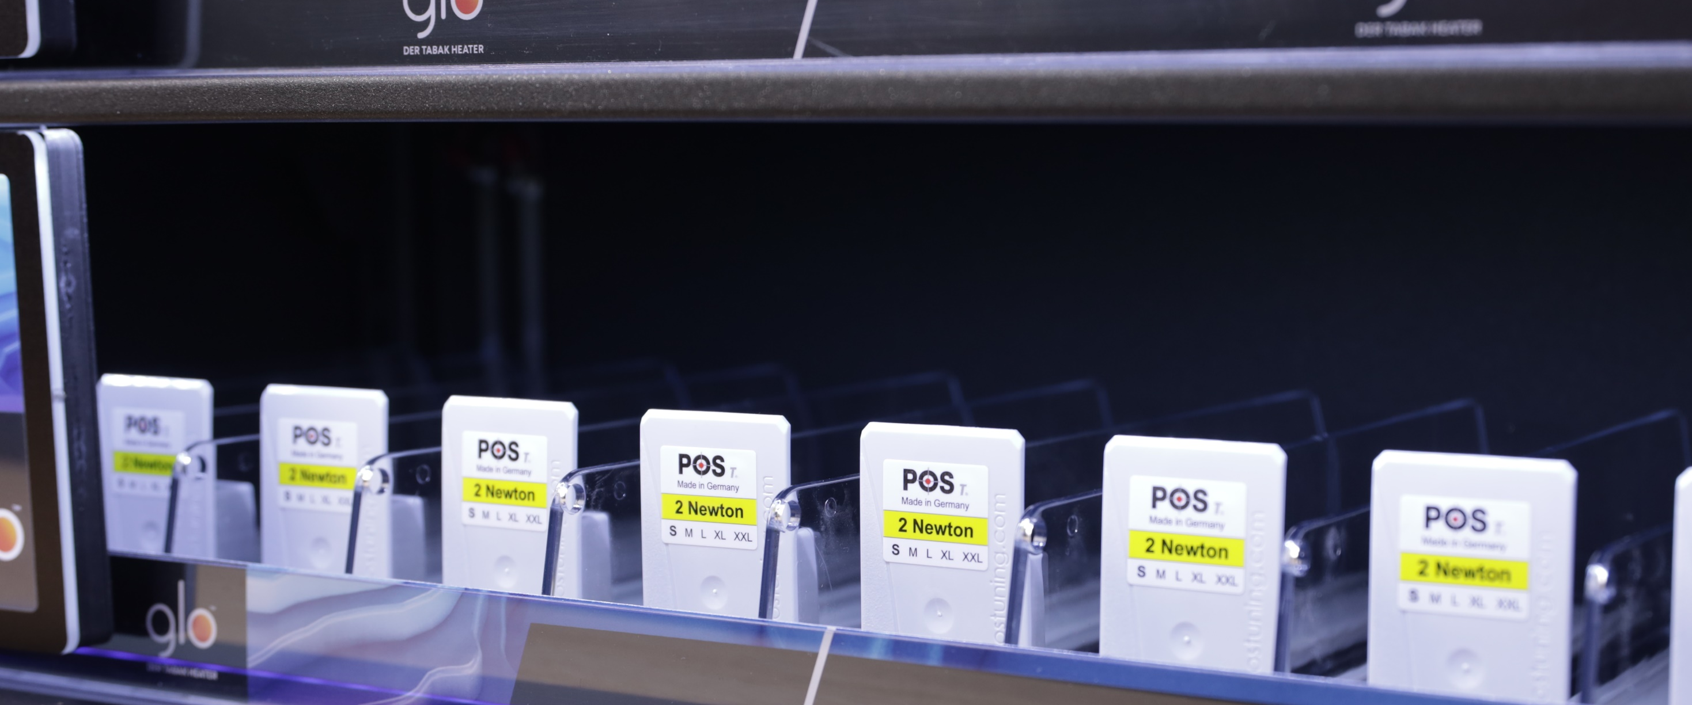
Endless versatility and fully adjustable pushers for different product sizes

Slide 5
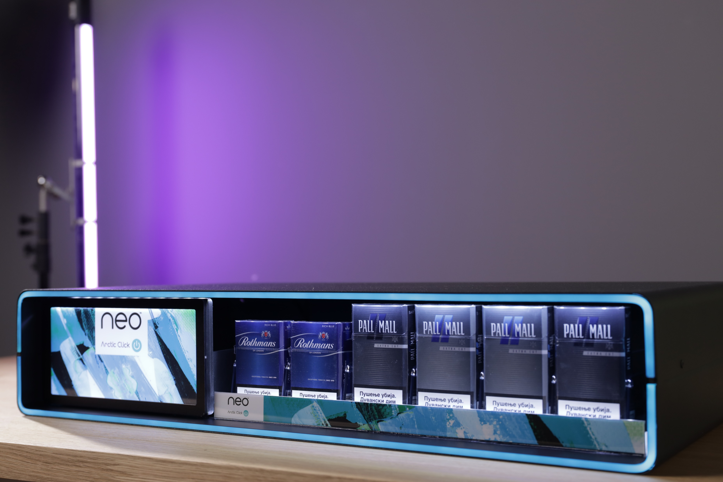
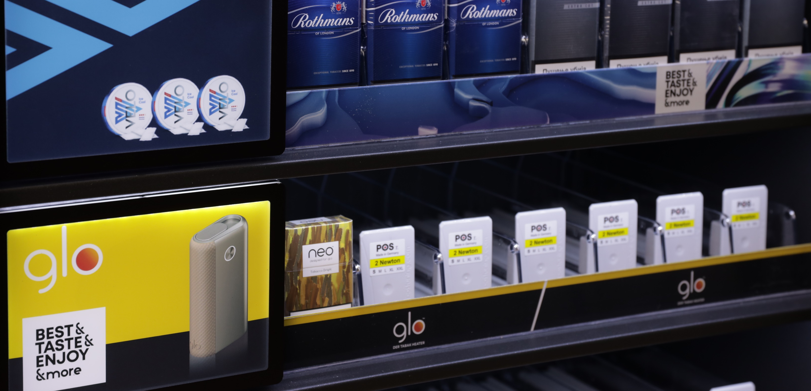
Interchangeable
graphic stripes.

Slide 6
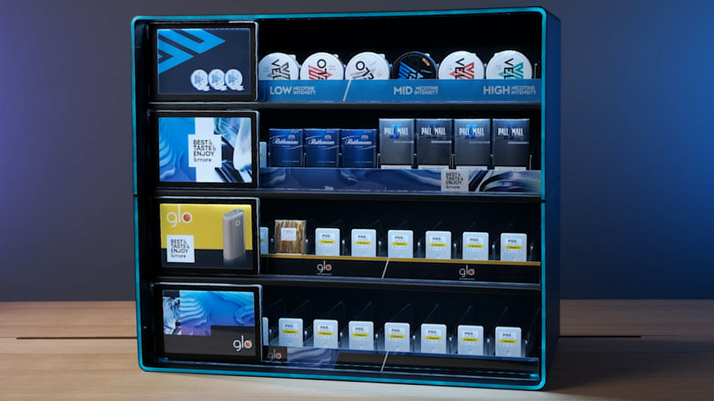

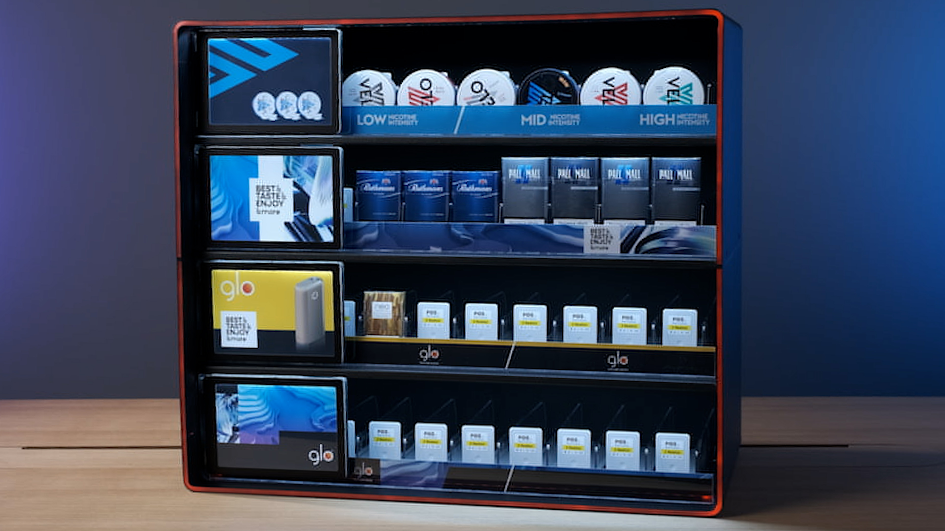

All-round
RGB illuminated
Frame

Slide 7
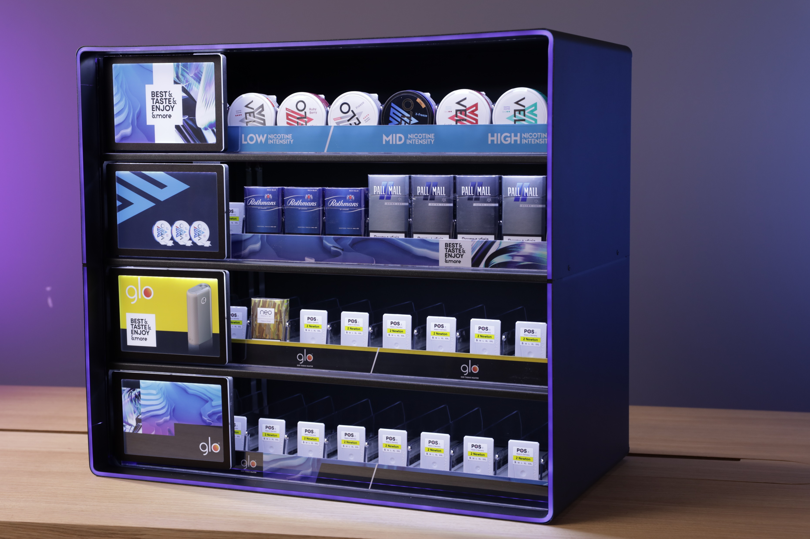
LED lights
That illuminate
Packs from above
and bellow

Slide 8
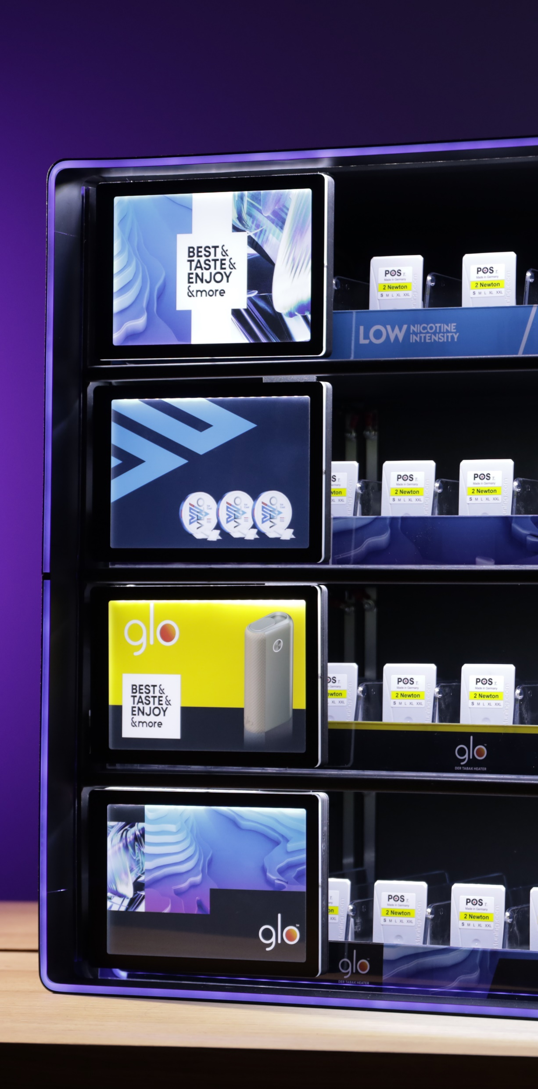
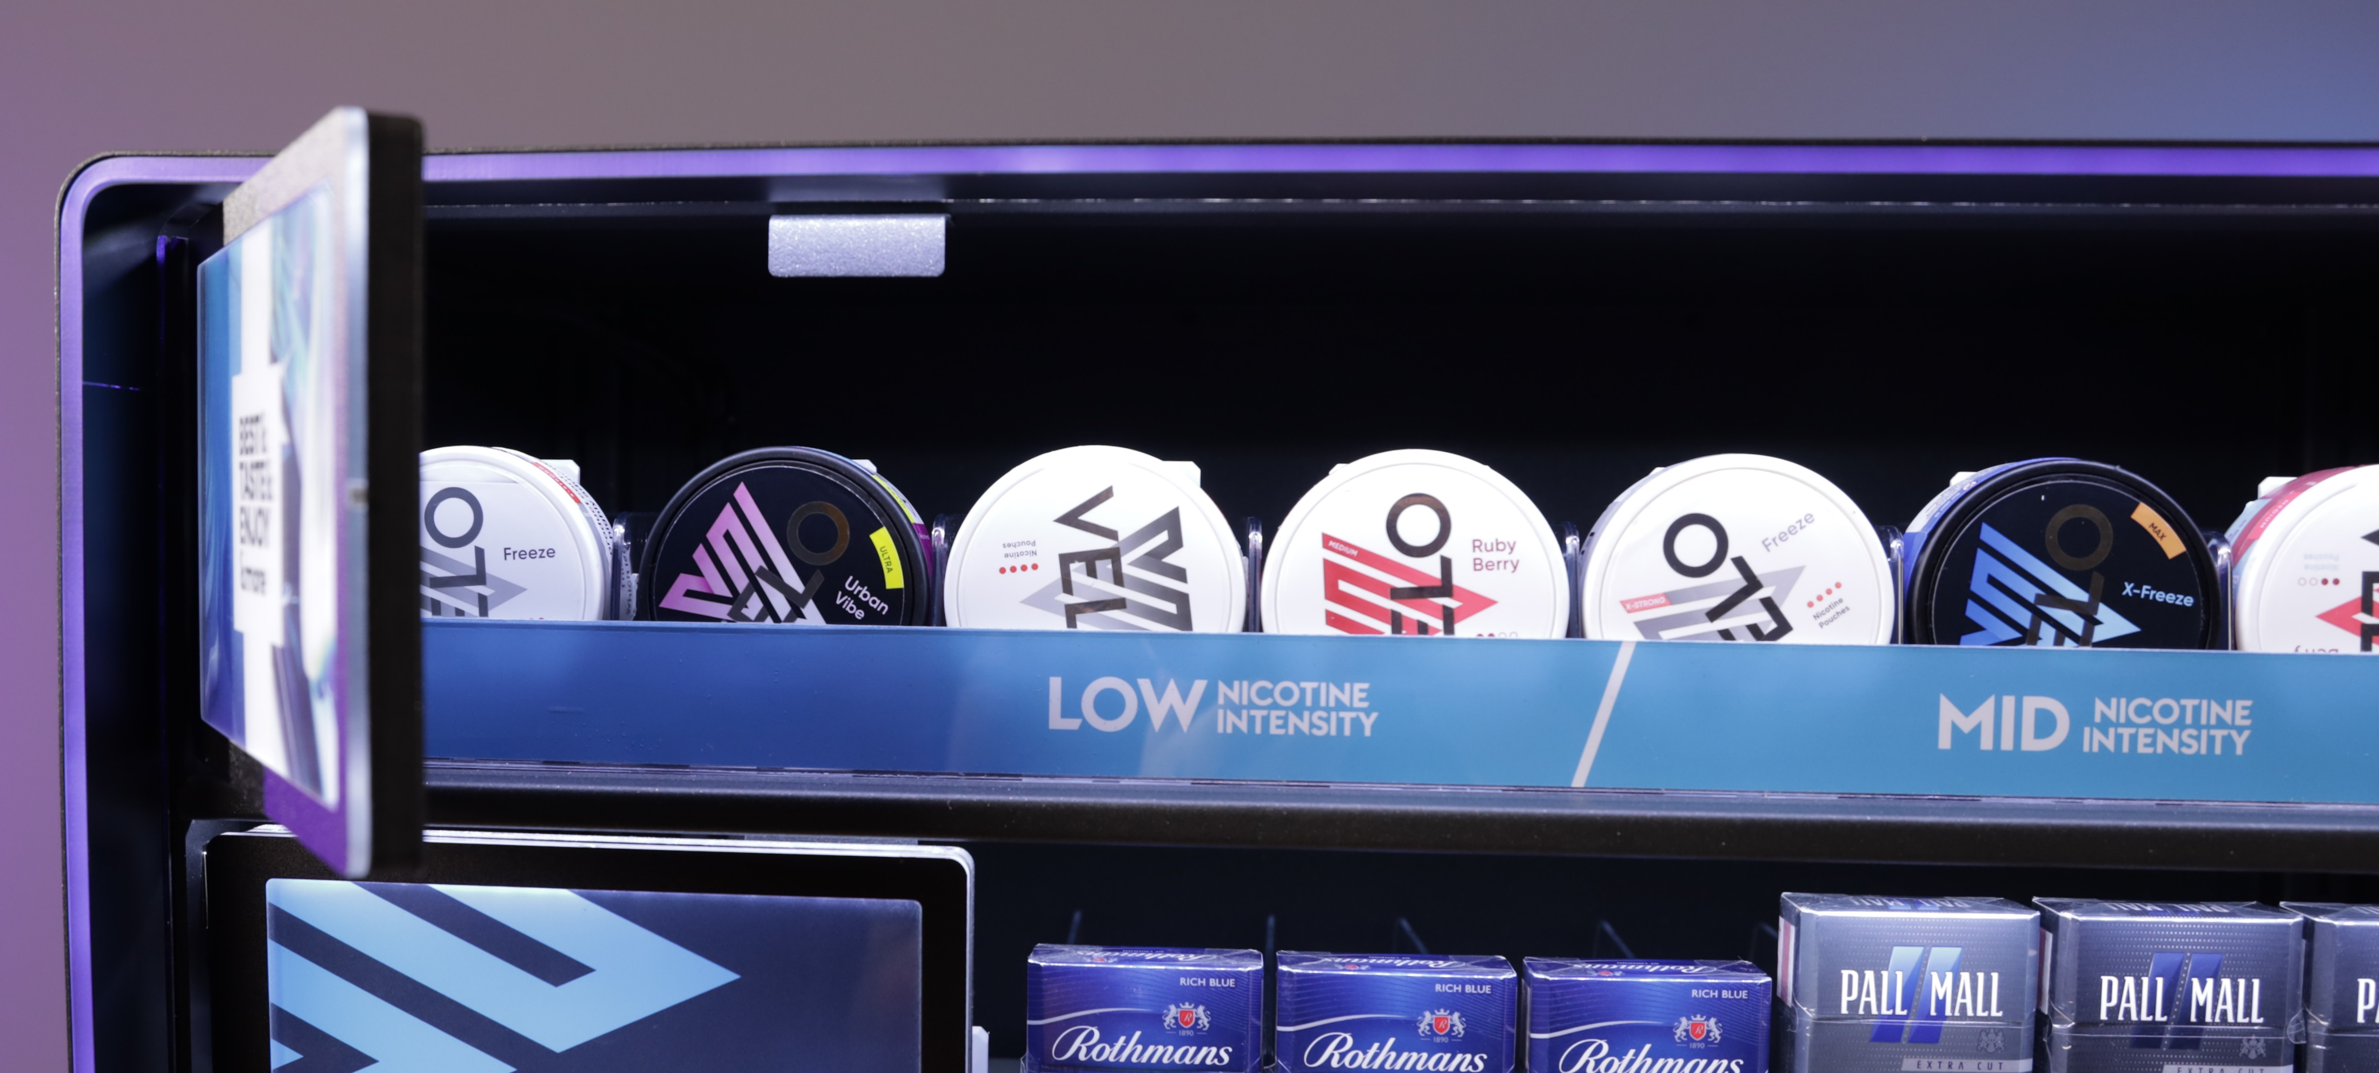
Fully removable magnetic flaps with illuminated visuals.

Slide 9
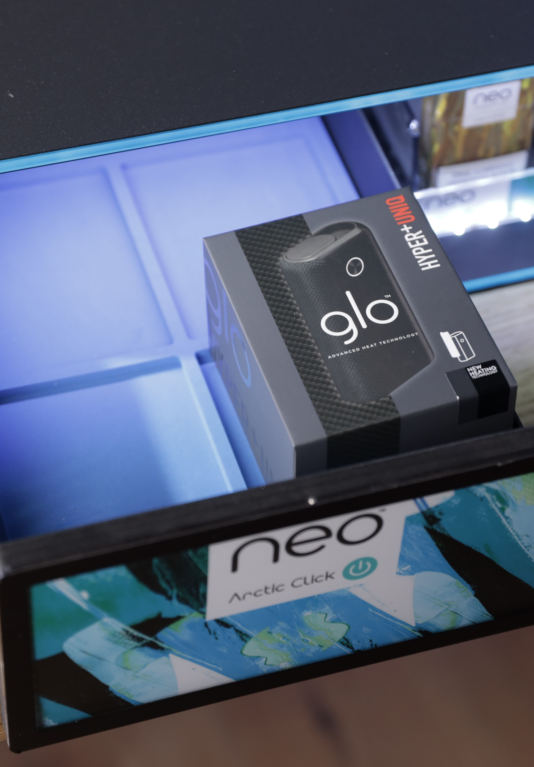
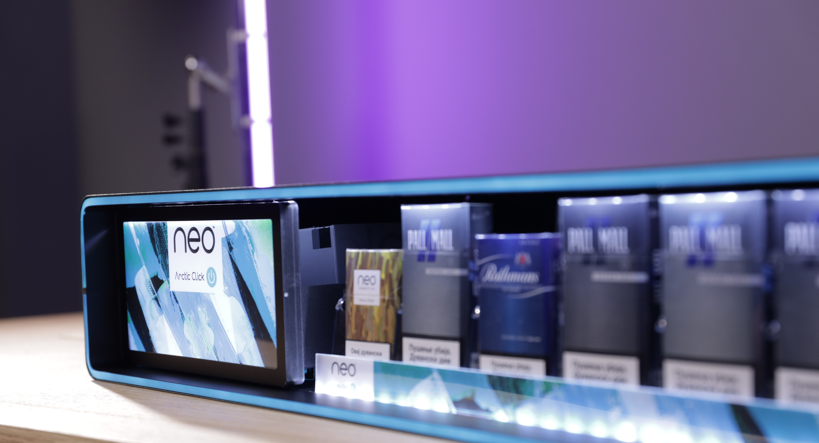
Fully removable magnetic drawer with backlit visuals

Slide 10
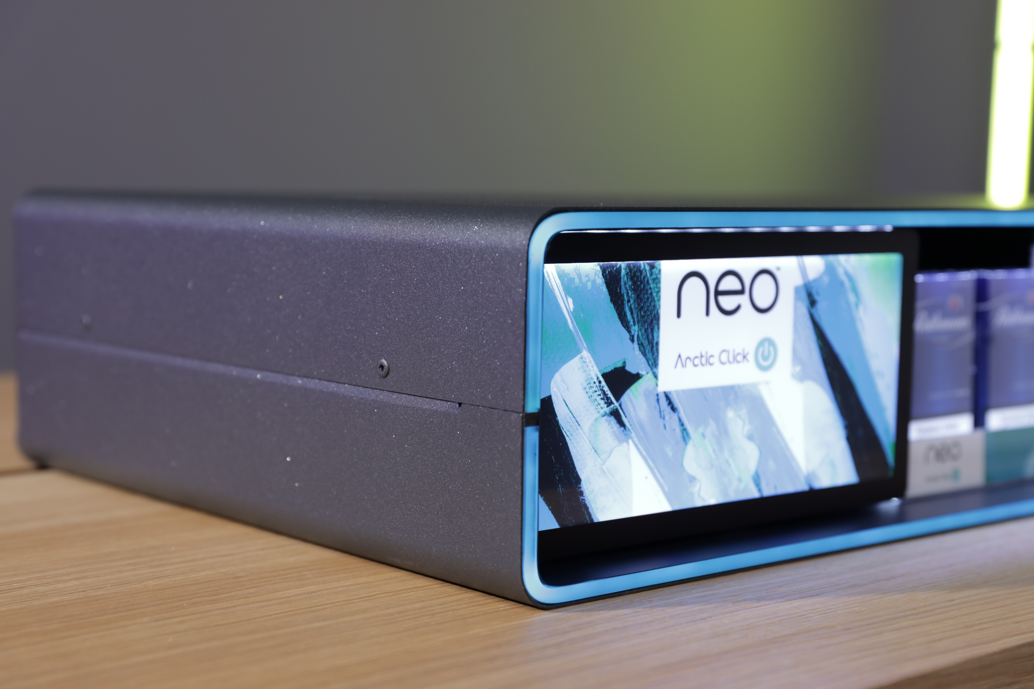
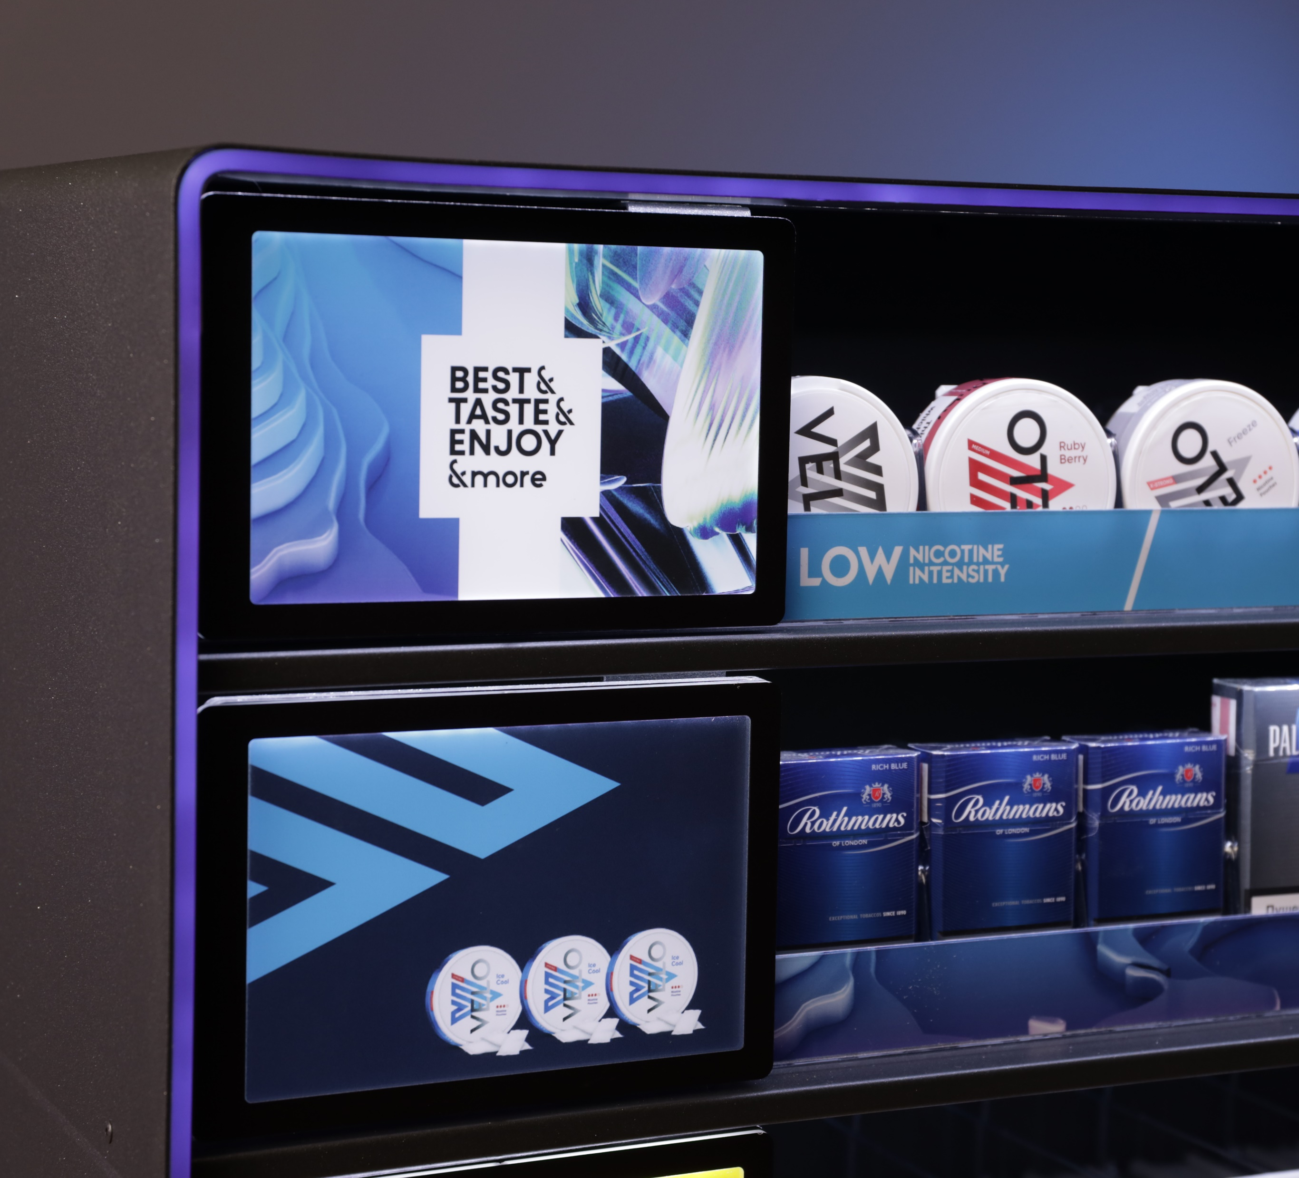

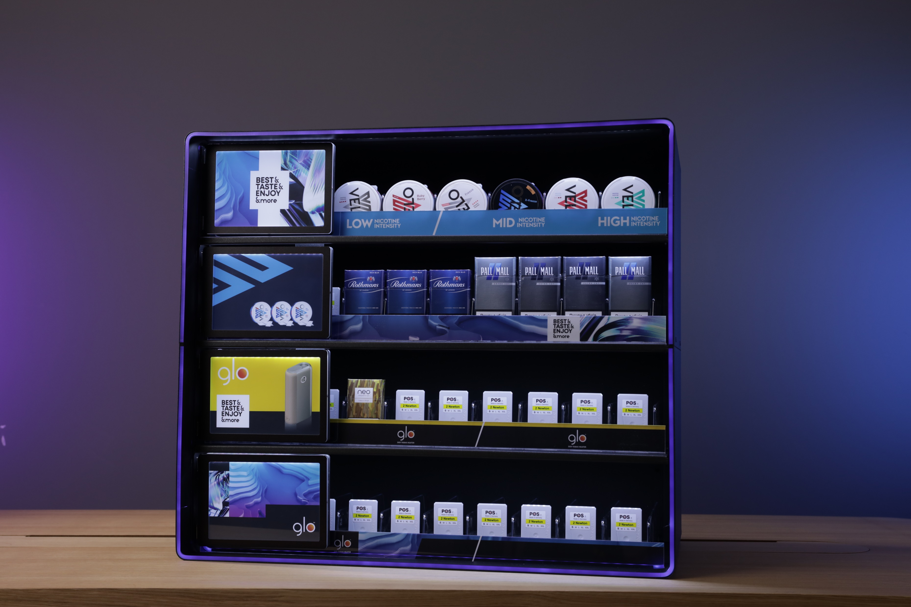

Slide 11
BG REKLAM
HEADQUATERS
29. Novembra 1M
11460 Belgrade, Serbia
info@bgreklam.com
+381 11 785 64 64
+381 60 68 69 110
Thank You.
BG REKLAM GMBH
Leverkusenstraße 3
22761 Hamburg, Deutschland
hamburg@bgreklam.com
+49 40 85413003
www.bgreklam.com
BG REKLAM
UK LTD
2588 Davenport House,
207 Regent St
London, W1B 3HH, UK
+44 75 4288 2312

