Slide 1
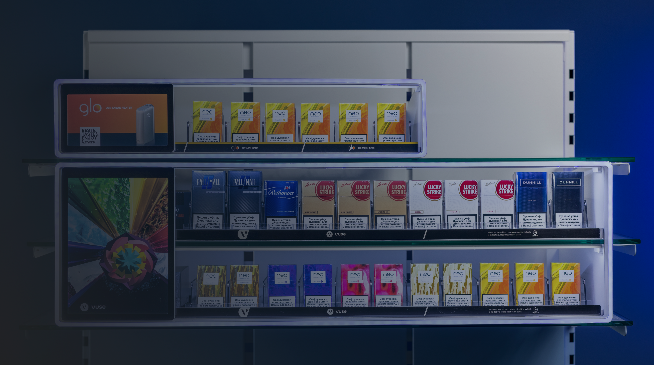

Premium
POS Industry
People are always going to go shopping.
A lot of our effort is just how we make the retail experience a great one!

Slide 2
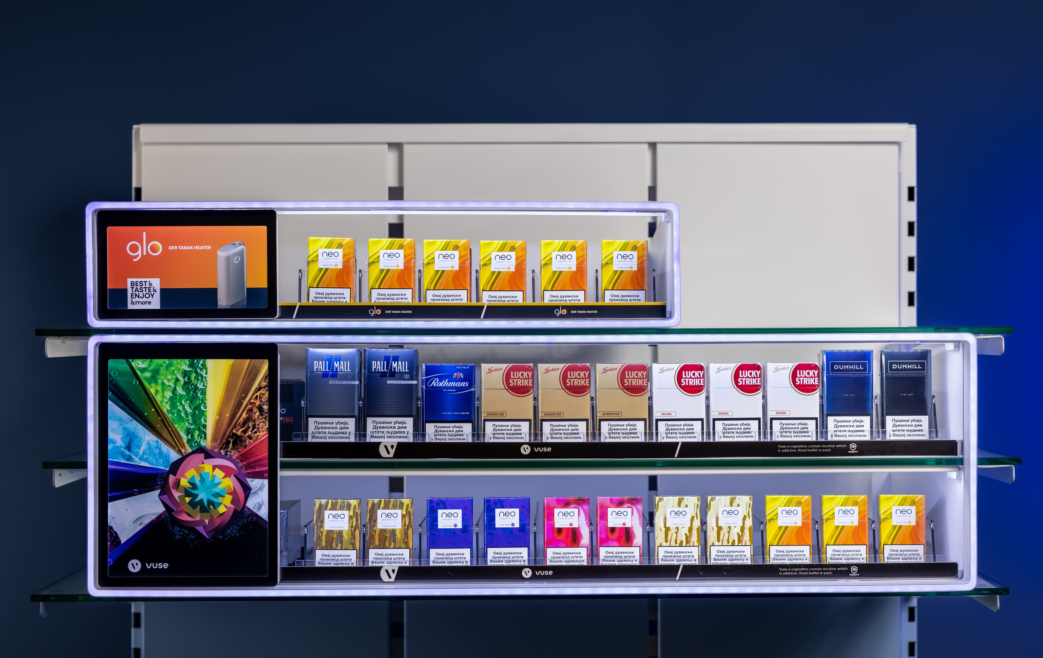

Slide 3
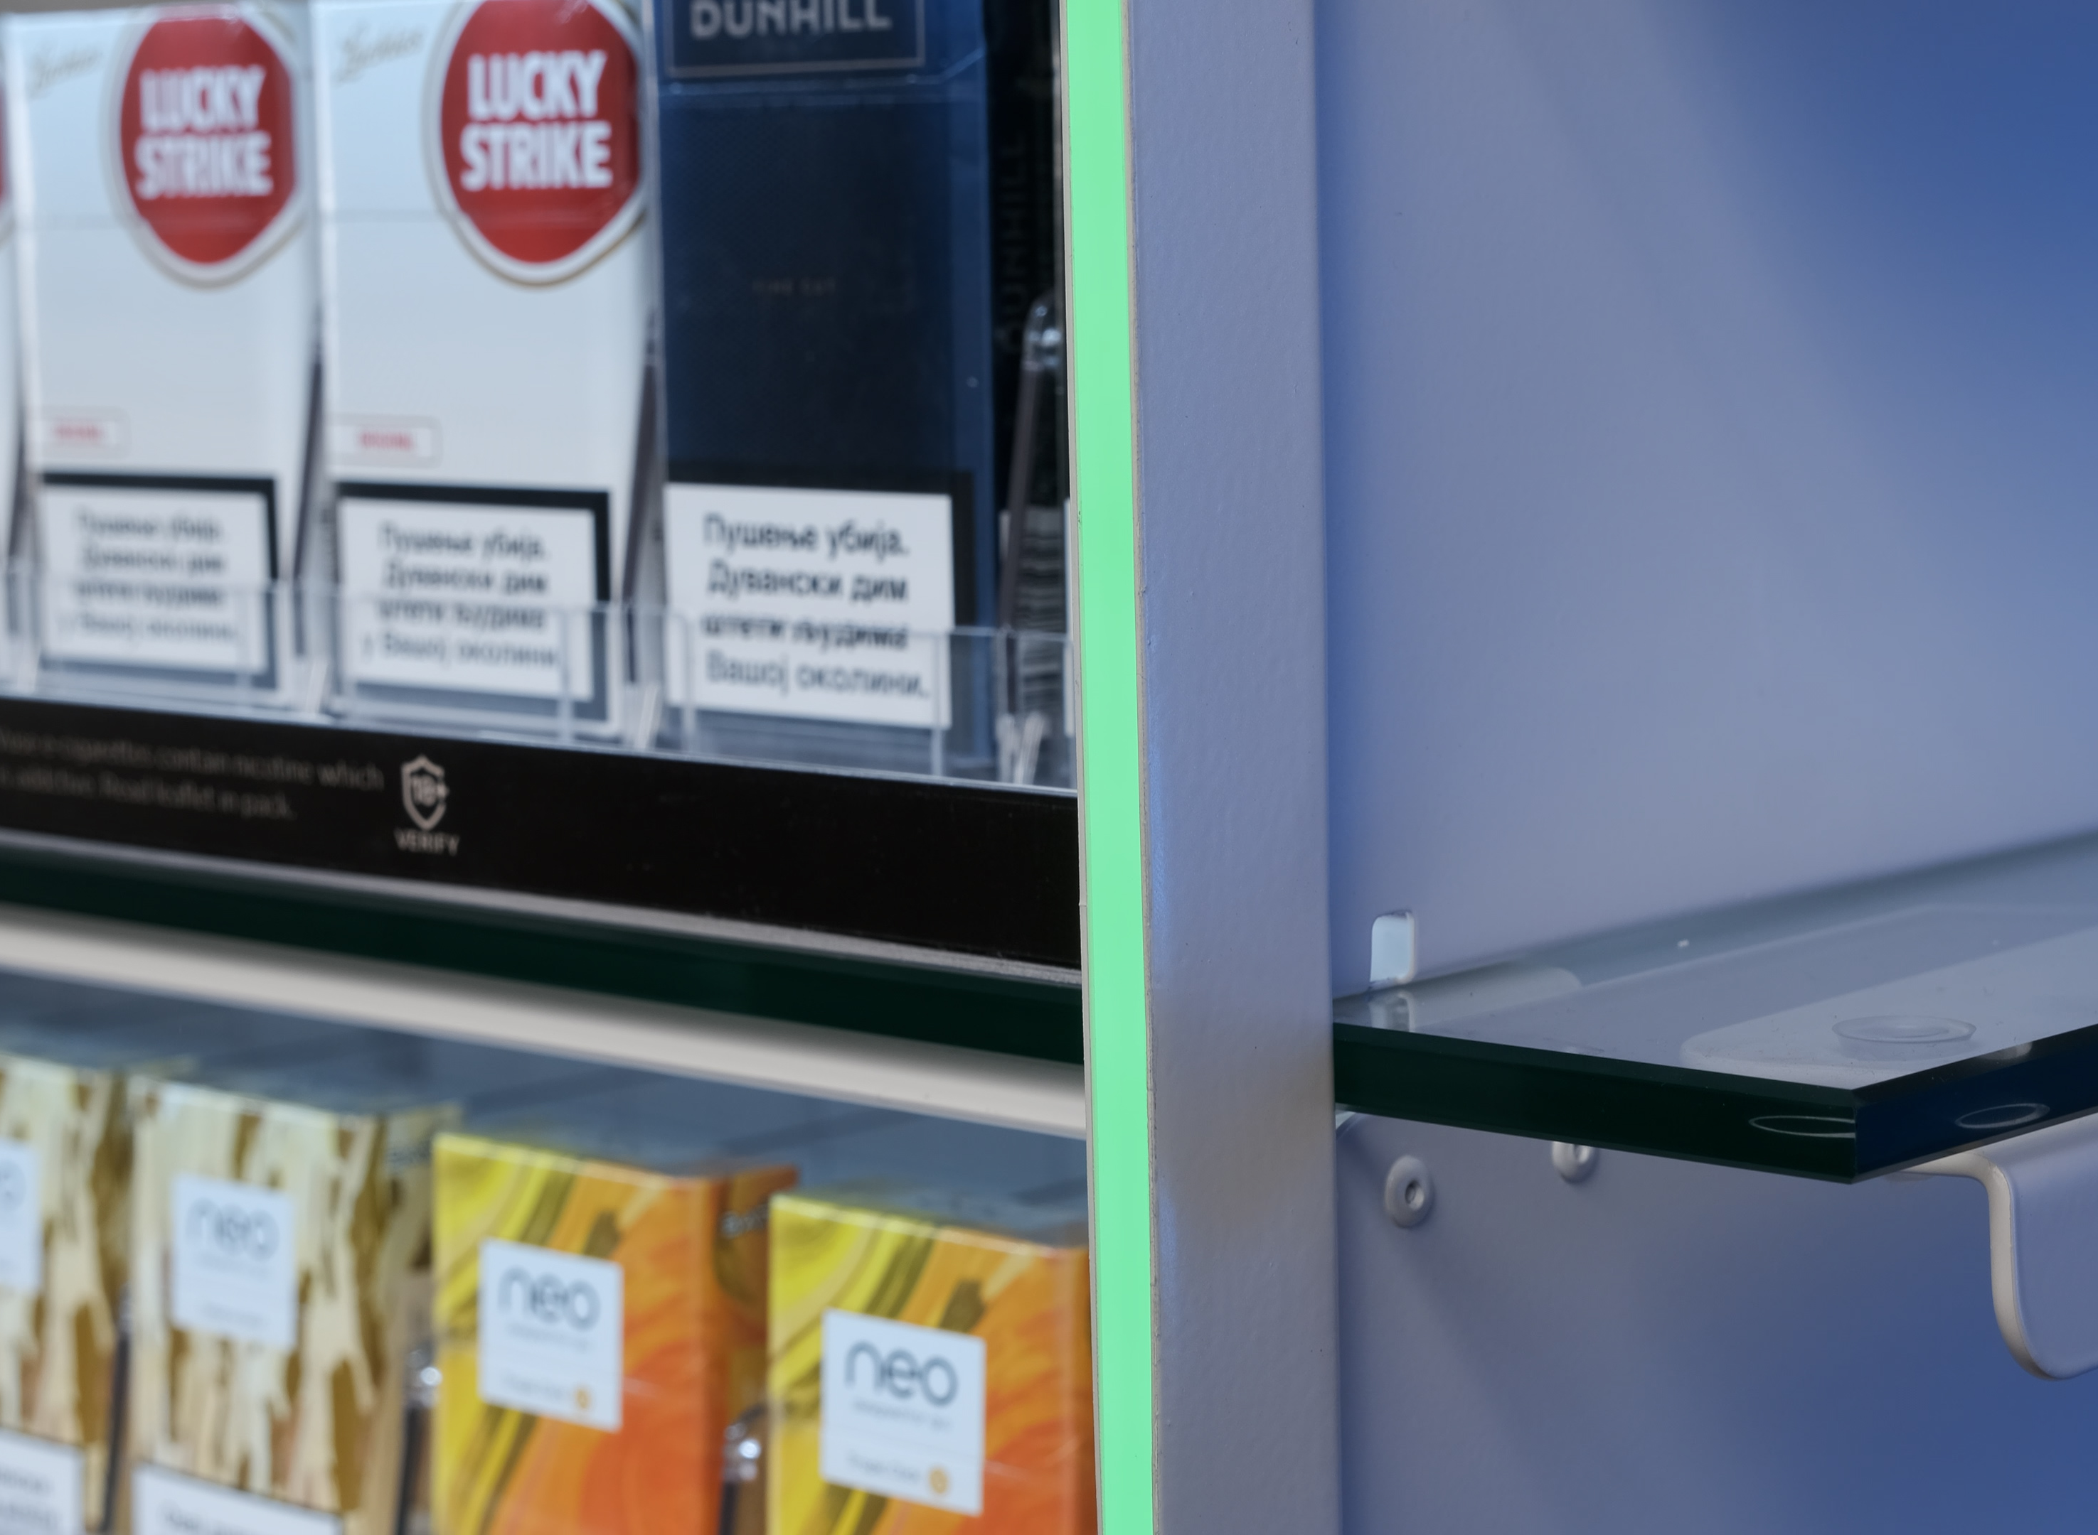
Metal as Primary
Material
-30% Reduction in CO2 compared to using plastic materials.
At only 0.8 mm thick metal overall weight is 10x less vs maximum recommended per square meter. Also, metal is the only material that can provide durability for required minimum of 5+ years.
Metal is also very resistant to any potential heat emission from LED lights and does not change structurally in any way, unlike plastics or similar materials.
Adaptability – higher range of tolerance in height unlike plastic or solid surface.
Multiple options when it comes to colours.
And most importantly best option from sustainability point of view.

Slide 4
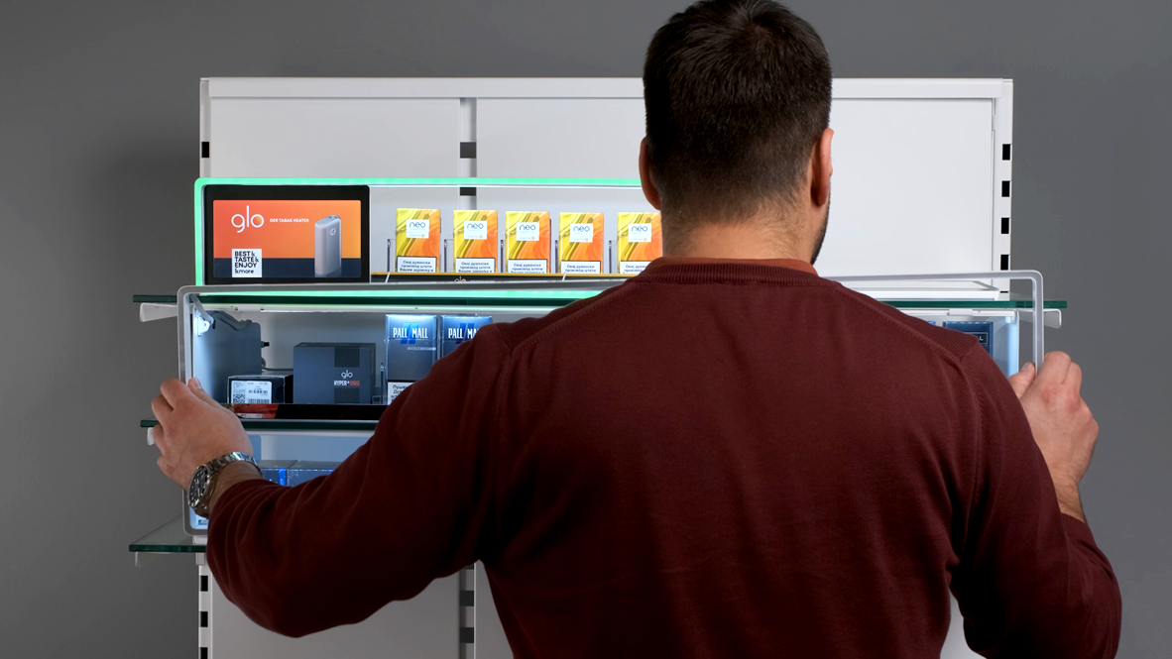
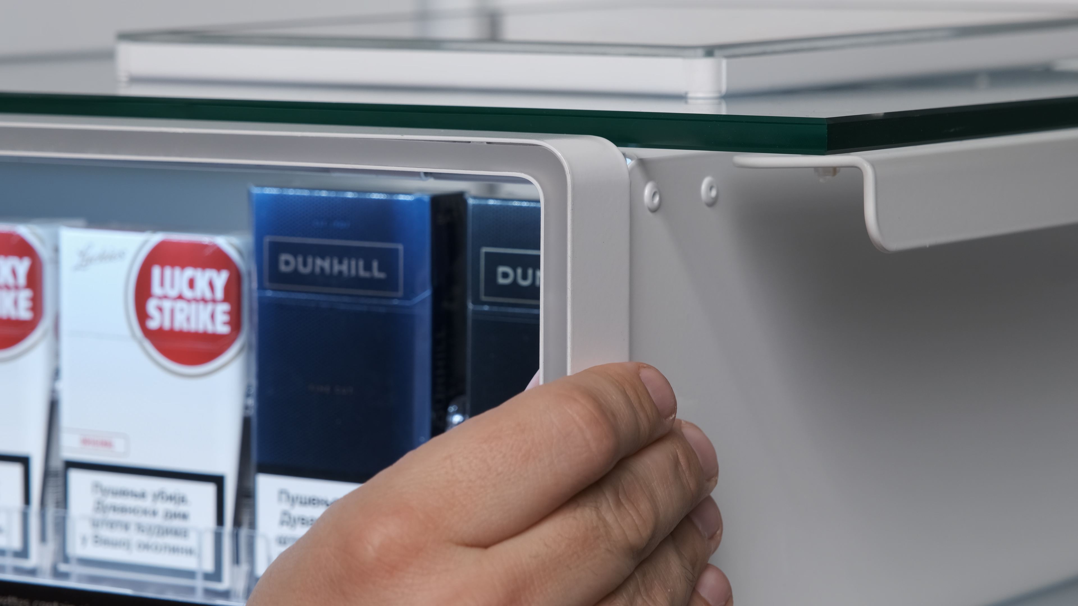
RGB Frame
-Height adjustable.
-Easy to replace as a spare part.
RGB Illuminated frame that can be easily replaced for maintenance. It only takes three screws and less than two minutes to completely remove and install a spare frame.

Slide 5
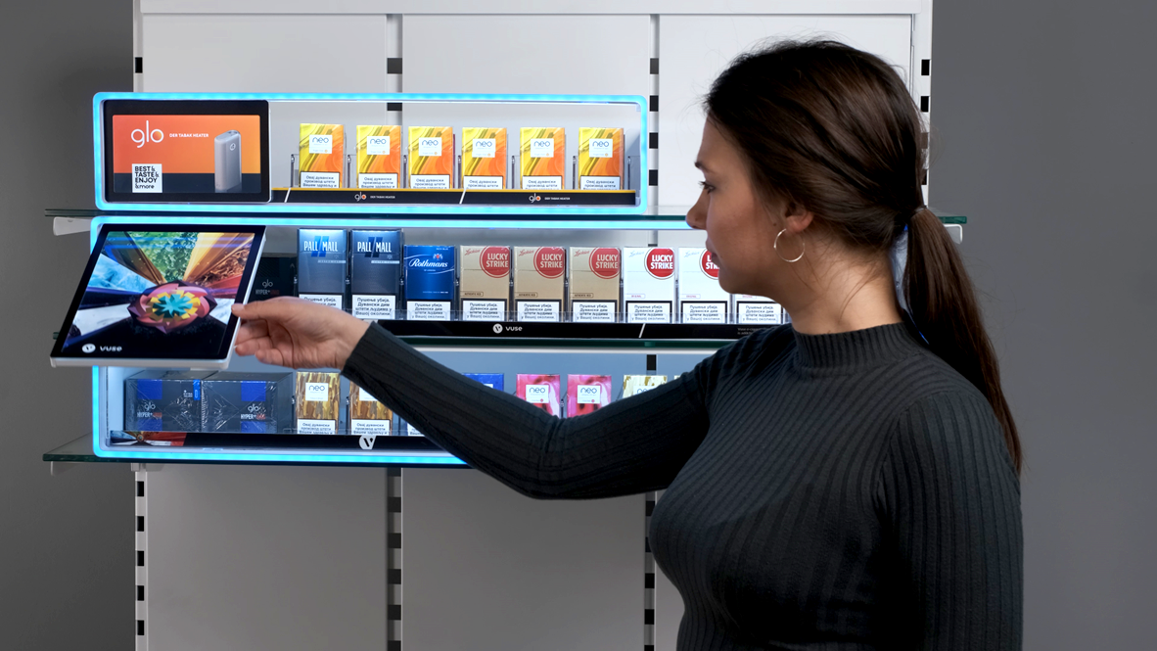
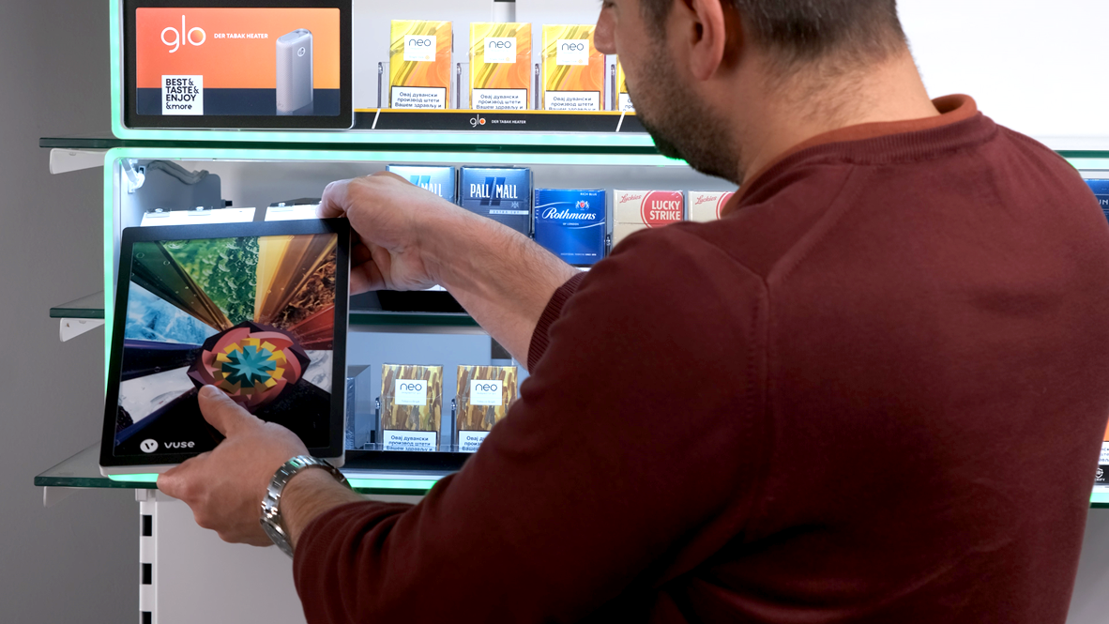
Versatile and
Modular flap
-Easy to remove.
Upper smaller size or bottom big flaps with clever gravity self-closing system. These flaps are back illuminate with printed and easy to swap visuals that stand out.
Both flaps are attached by strong magnets that allow you to transform the display and simply insert more pushers or perform maintenance in seconds.

Slide 6

Illuminated packs
More LEDs densely arranged makes for a better product lightning.

Slide 7
BG REKLAM
HEADQUATERS
29. Novembra 1M
11460 Belgrade, Serbia
info@bgreklam.com
+381 11 785 64 64
+381 60 68 69 110
Thank You.
BG REKLAM GMBH
Leverkusenstraße 3
22761 Hamburg, Deutschland
hamburg@bgreklam.com
+49 40 85413003
www.bgreklam.com
BG REKLAM
UK LTD
2588 Davenport House,
207 Regent St
London, W1B 3HH, UK
+44 75 4288 2312

