Slide 1
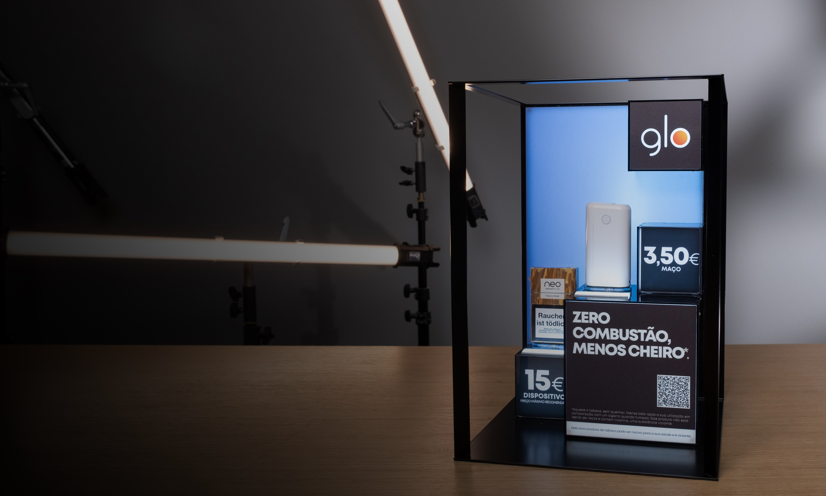

Premium
POS
Industry
People are always going to go shopping.
A lot of our effort is just ‘how do we make the retail experience a great one!

Slide 2
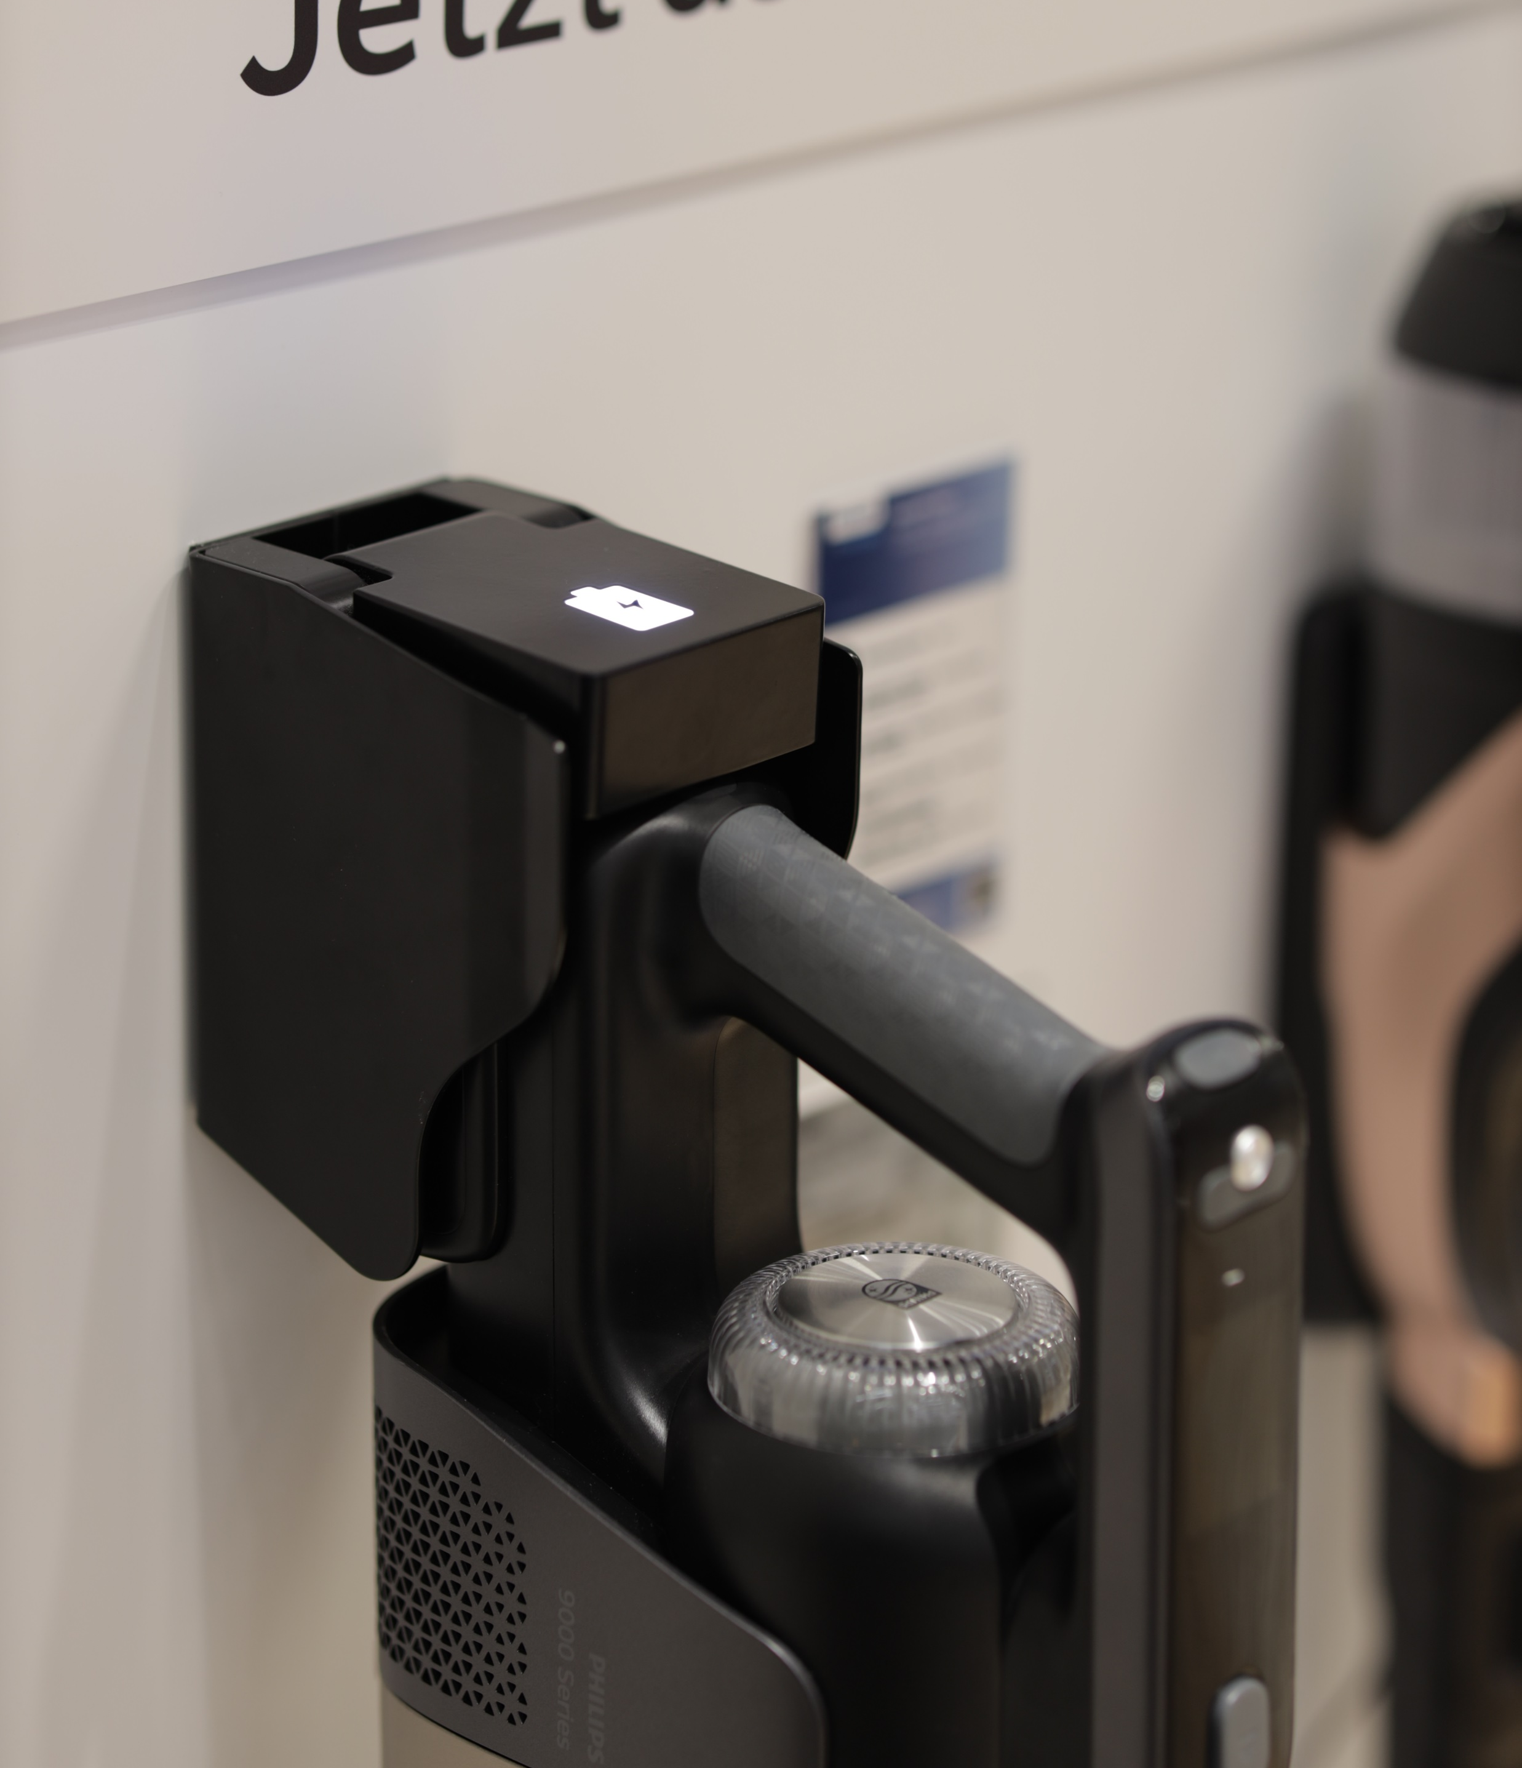
Project Neptune
A great example when it comes to achieving the most efficient process is project Neptune, that we developed last year in partnership with Philips.
We Developed a custom-made hinge/charging system Worked very closely with the client on research and development. Neptune launched in 2021 accost the entire the continent and we since made over 1000 units since launch.
True Innovation.

Slide 3
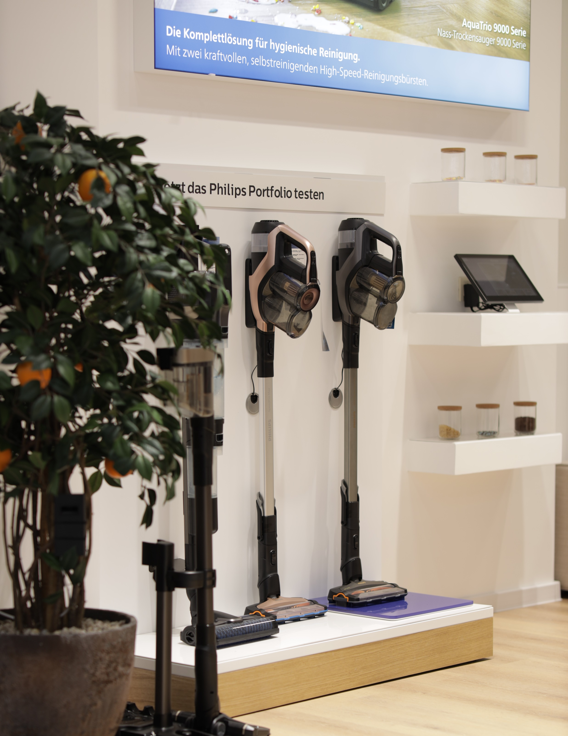
Partnership
tender
Faze one
It all starts with the client defining the project outlining the general requirements and sending the brief to selected 4/5 trusted suppliers.
Vendors and supplier create initial custom-made solutions, ideas and proposals.
Based on the previous experience on similar projects, markets, unique technology requirements, manufacturing capacity or simply material requirements, client selects one supplier for the development.
Simplified Process.

Slide 4
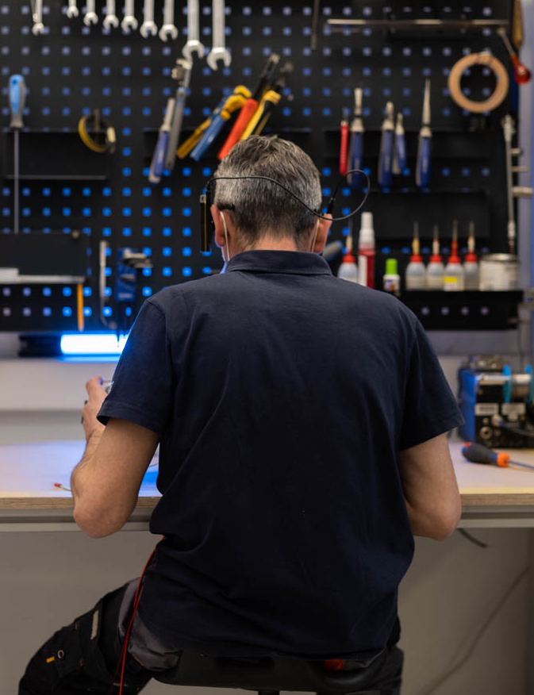
The Development
Faze Two
Faze two is the fun part, here we get to really get to know the project requirements down to the smallest details and occasionally this even includes market research, target audience, product specifics. Working closely with the client on the initial design and exchange several proposed 3D designs. Share best practices, select materials and create prototypes.
Finally at this stage of faze two comes testing and refining the final prototype.
100% Client Focus.

Slide 5
Example
Country | Units | Cost
Germany | 450 | Main/Developed
Benelux | 320
Nordic | 270
France | 400
Austria | 110
Swiss | 70
East. Europe | 120
The Delivery
Faze Three
With the product developed and lunched It is indisputably easier, faster and less expensive to adapt, make minimal changes and launch in different markets globally.
Partnership allows us the opportunity to fix any issues that we might experience at the initial market launch.
This process also lowers the potential for any corruption or malpractice with local suppliers.
Problem Free.
Total Saving | 12%

Slide 6
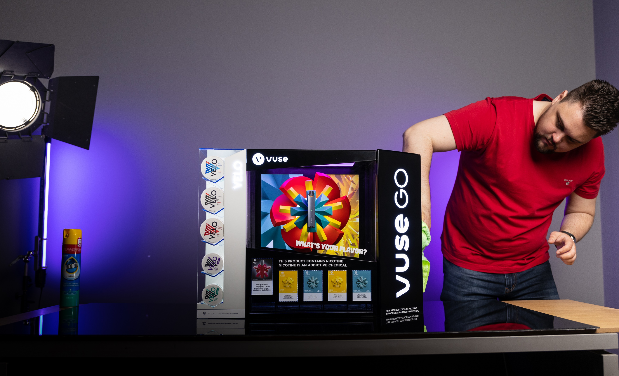
The Benefits
Long Lasting Partnership
True Innovation- Partnership tender gives way to some creative solutions, great designs and inventions .
Simplified Selection Process- Eliminate the tedious, unnecessary and time-consuming tender processes.
100% Client Focus- receive the client focus you expect and forget the typical client/supplier relationships and form a long-lasting partnerships.
Problem Free- Reduce all the emblematic problems and any potential malpractice that come with creating individual tenders and launching individual markets globally.

Slide 7
BG REKLAM
HEADQUATERS
29. Novembra 1M
11460 Belgrade, Serbia
info@bgreklam.com
+381 11 785 64 64
+381 60 68 69 110
Thank You.
BG REKLAM GMBH
Leverkusenstraße 3
22761 Hamburg, Deutschland
hamburg@bgreklam.com
+49 40 85413003
www.bgreklam.com
BG REKLAM
UK LTD
2588 Davenport House,
207 Regent St
London, W1B 3HH, UK
+44 75 4288 2312

