Slide 1
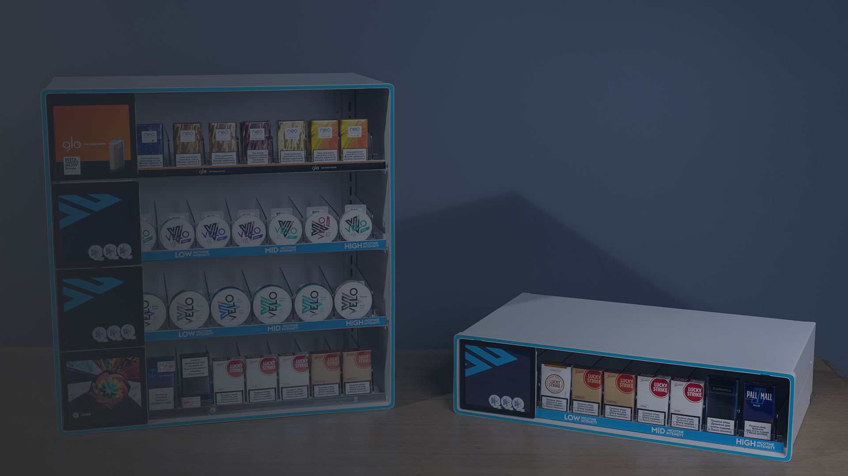

Premium
POS Industry
People are always going to go shopping.
A lot of our effort is just how we make the retail experience a great one!

Slide 2
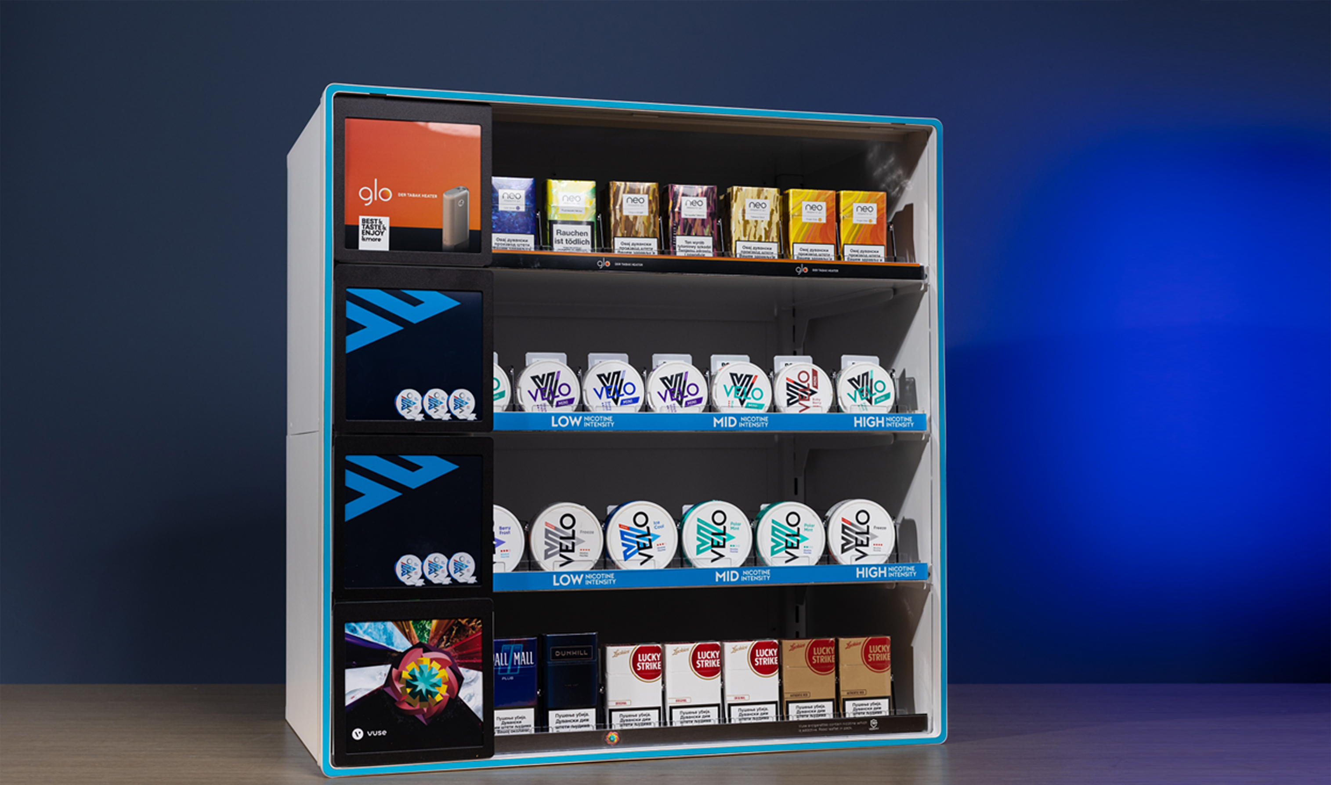

Slide 3
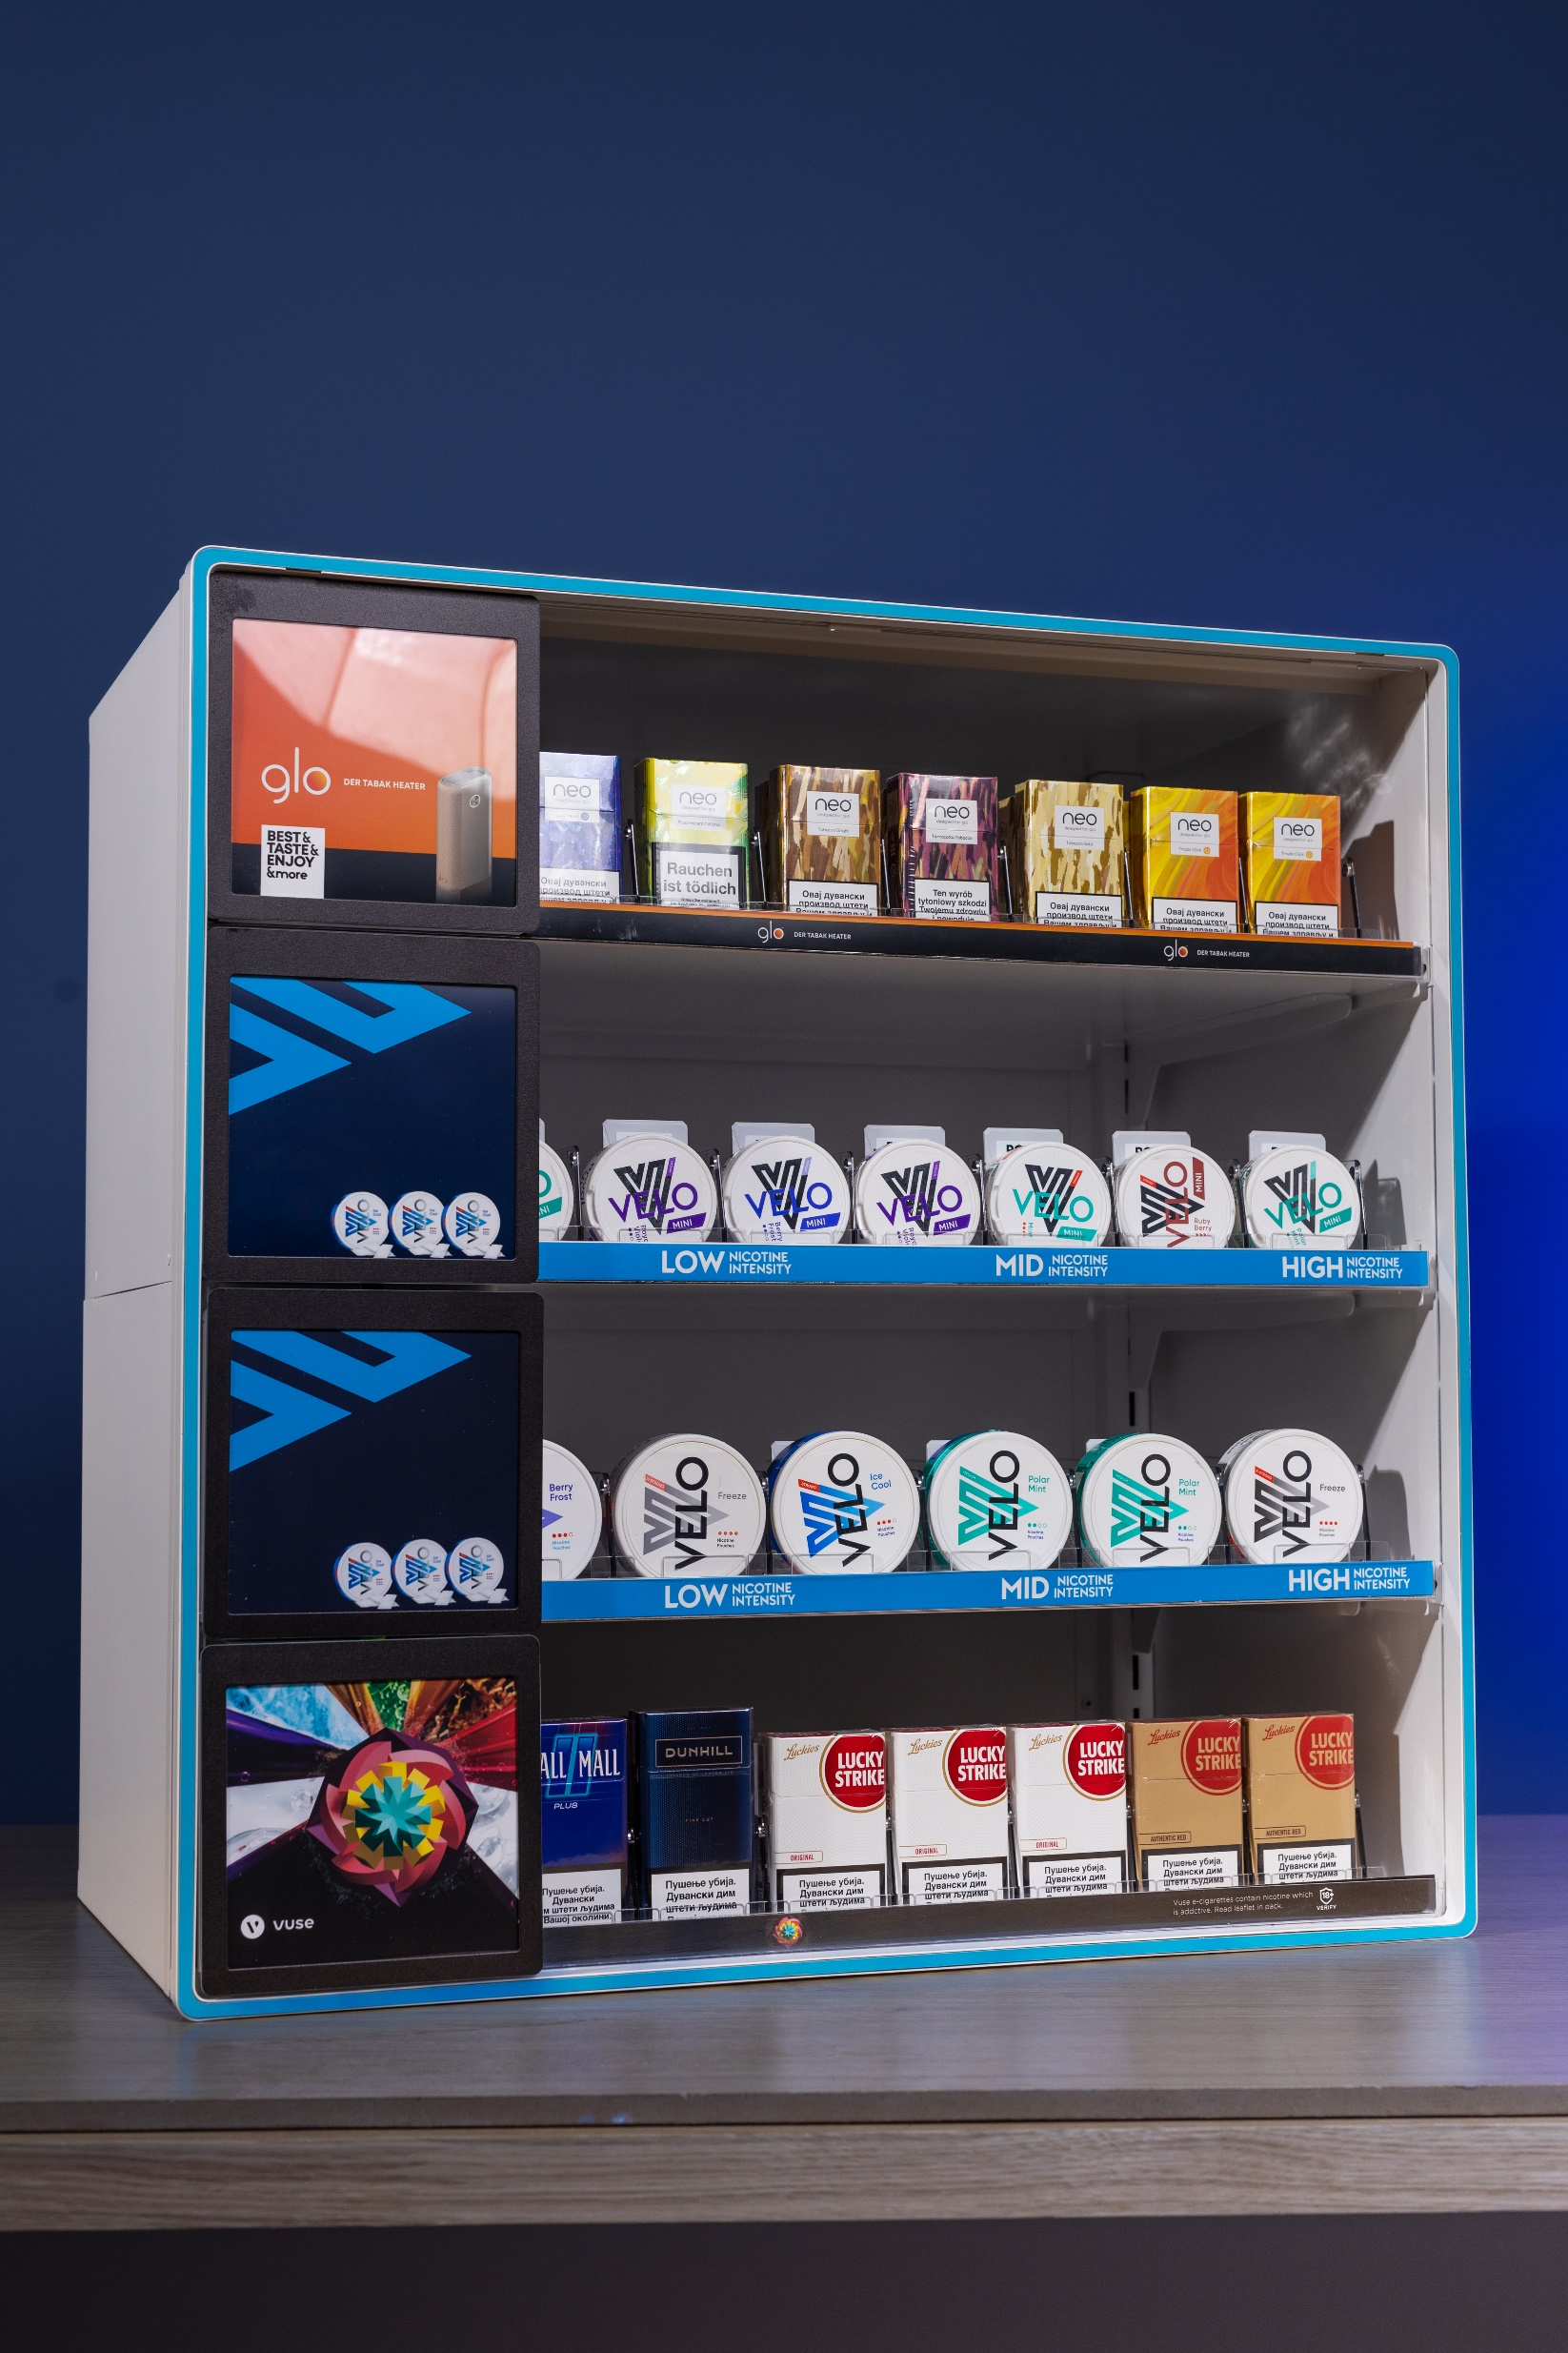
Metal as Primary
Material
-30% Reduction in CO2 compared to using plastic materials.
Metal is the only material that can guarantee premium look and durability for required period of 5+ years.
Metal is also very resistant to any potential heat emission from LED lights and does not change structurally in any way, unlike plastics or similar materials.
Most importantly (as stated above) best option from sustainability point of view.

Slide 4
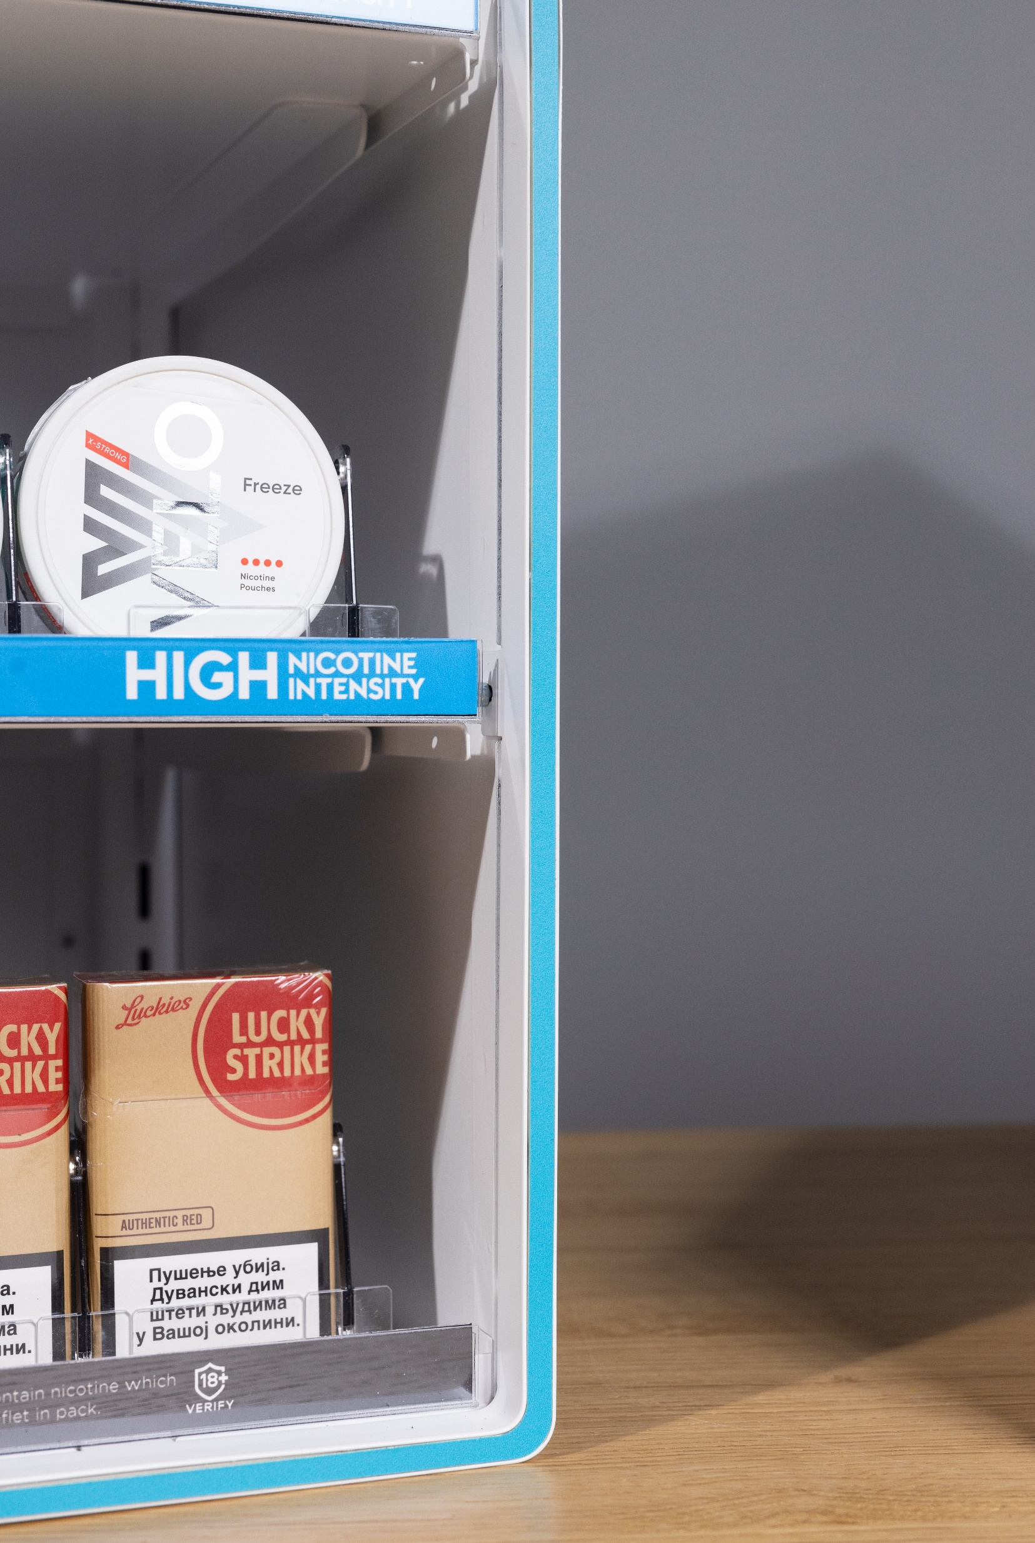
Frame
-Easy to replace as a spare part.
Coloured frame that can be easily replaced. Stock will be available in our warehouse with service lead time 2-3 days.
It only takes three screws and less than two minutes to completely remove and install new frame.

Slide 5
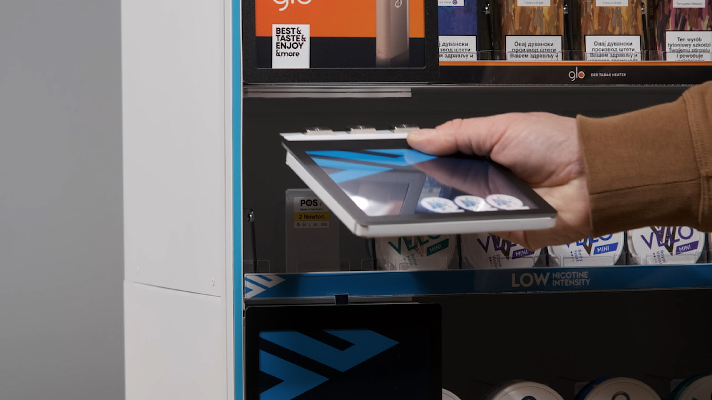
Versatile and
Modular flap
-Easy to remove.
Flaps with clever gravity self-closing system. These flaps come with printed back and easy to swap visuals that stand out.
Flaps are attached by strong magnets that allow you to transform the display and simply insert more pushers or perform maintenance in seconds.

Slide 6
BG REKLAM
HEADQUATERS
29. Novembra 1M
11460 Belgrade, Serbia
info@bgreklam.com
+381 11 785 64 64
+381 60 68 69 110
Thank You.
BG REKLAM GMBH
Leverkusenstraße 3
22761 Hamburg, Deutschland
hamburg@bgreklam.com
+49 40 85413003
www.bgreklam.com
BG REKLAM
UK LTD
2588 Davenport House,
207 Regent St
London, W1B 3HH, UK
+44 75 4288 2312

