Slide 1
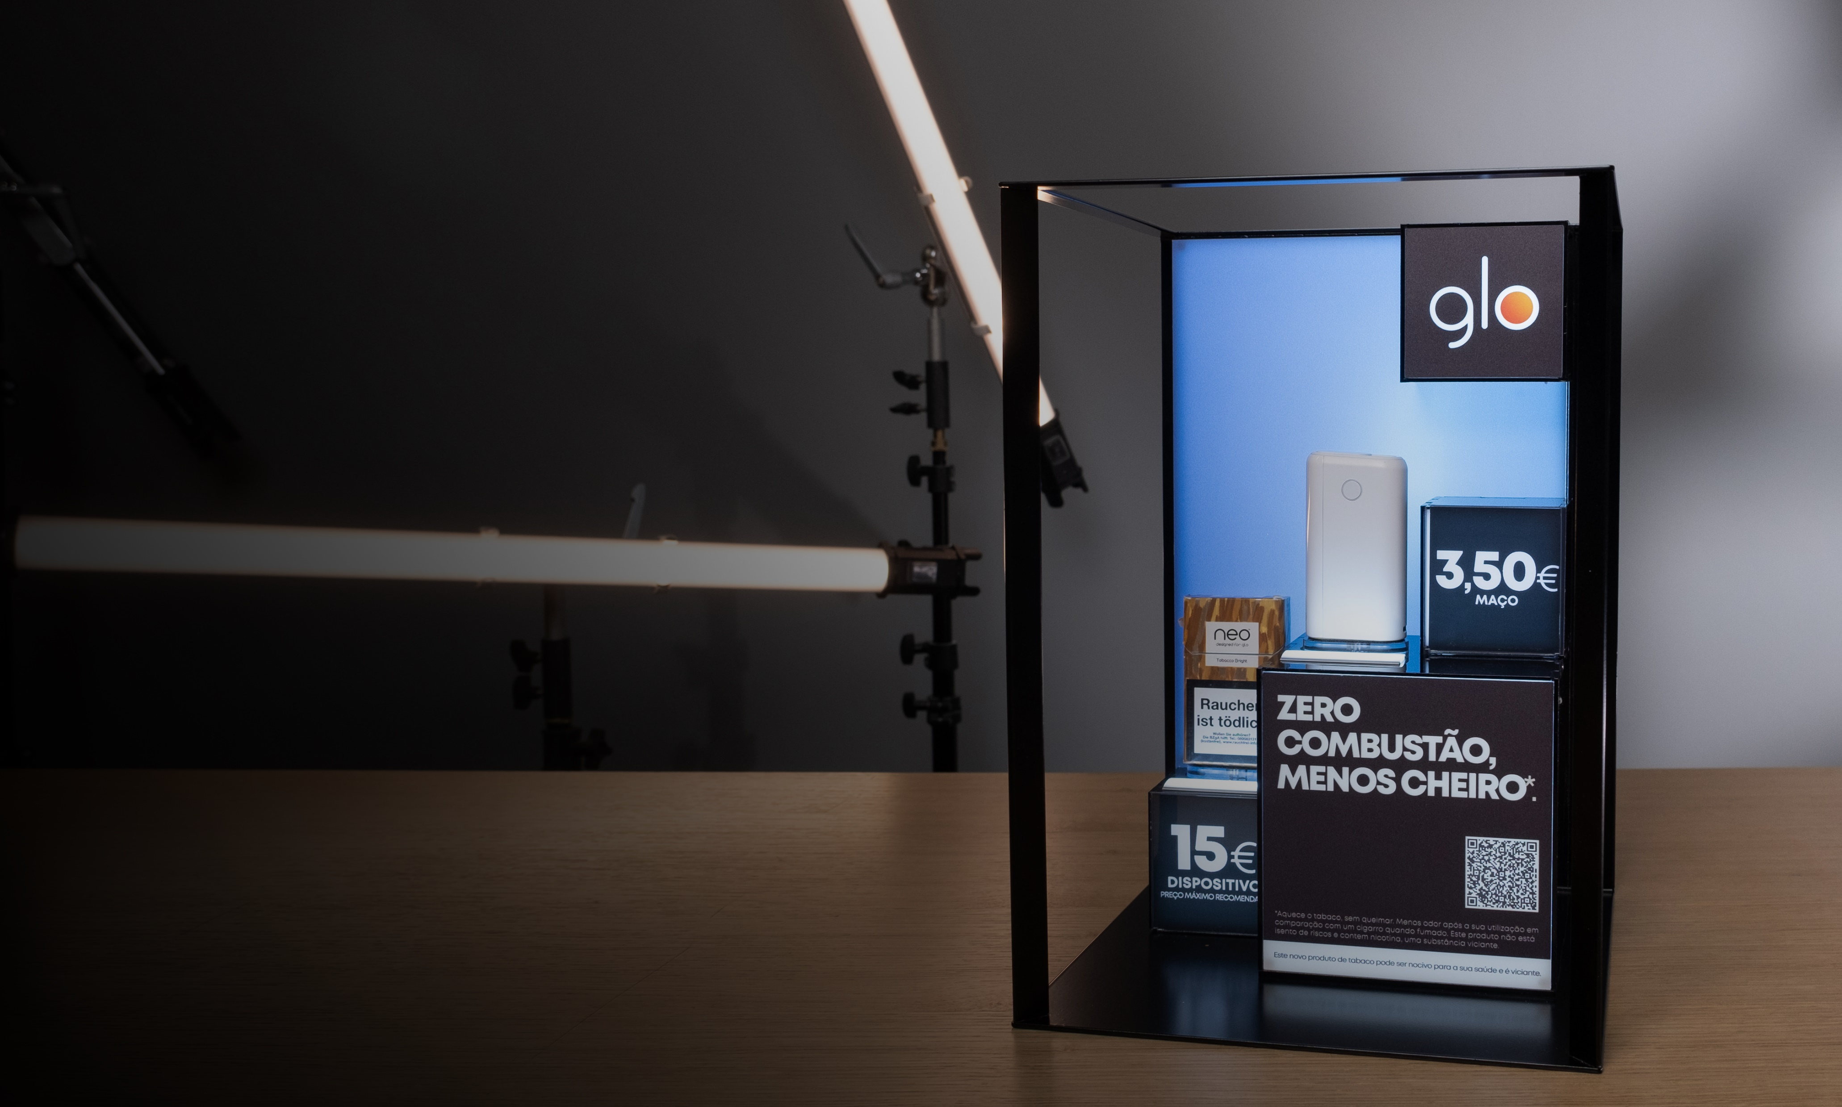

Premium
POS
Industry
People are always going to go shopping.
A lot of our effort is just ‘how do we make the retail experience a great one!

Slide 2
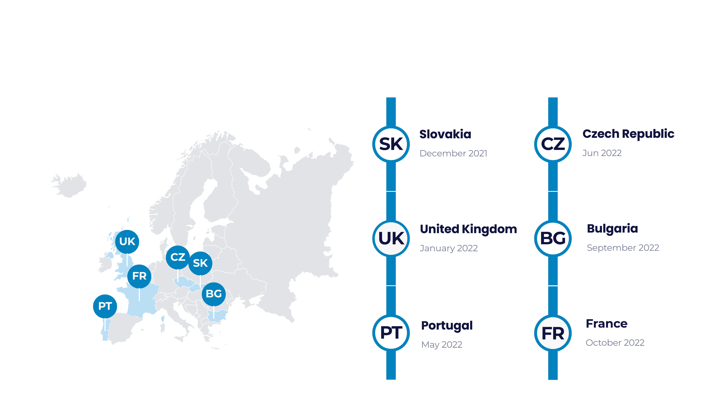
BAT Global
Snapshot of the past twelve months and markets we have opened

Slide 3
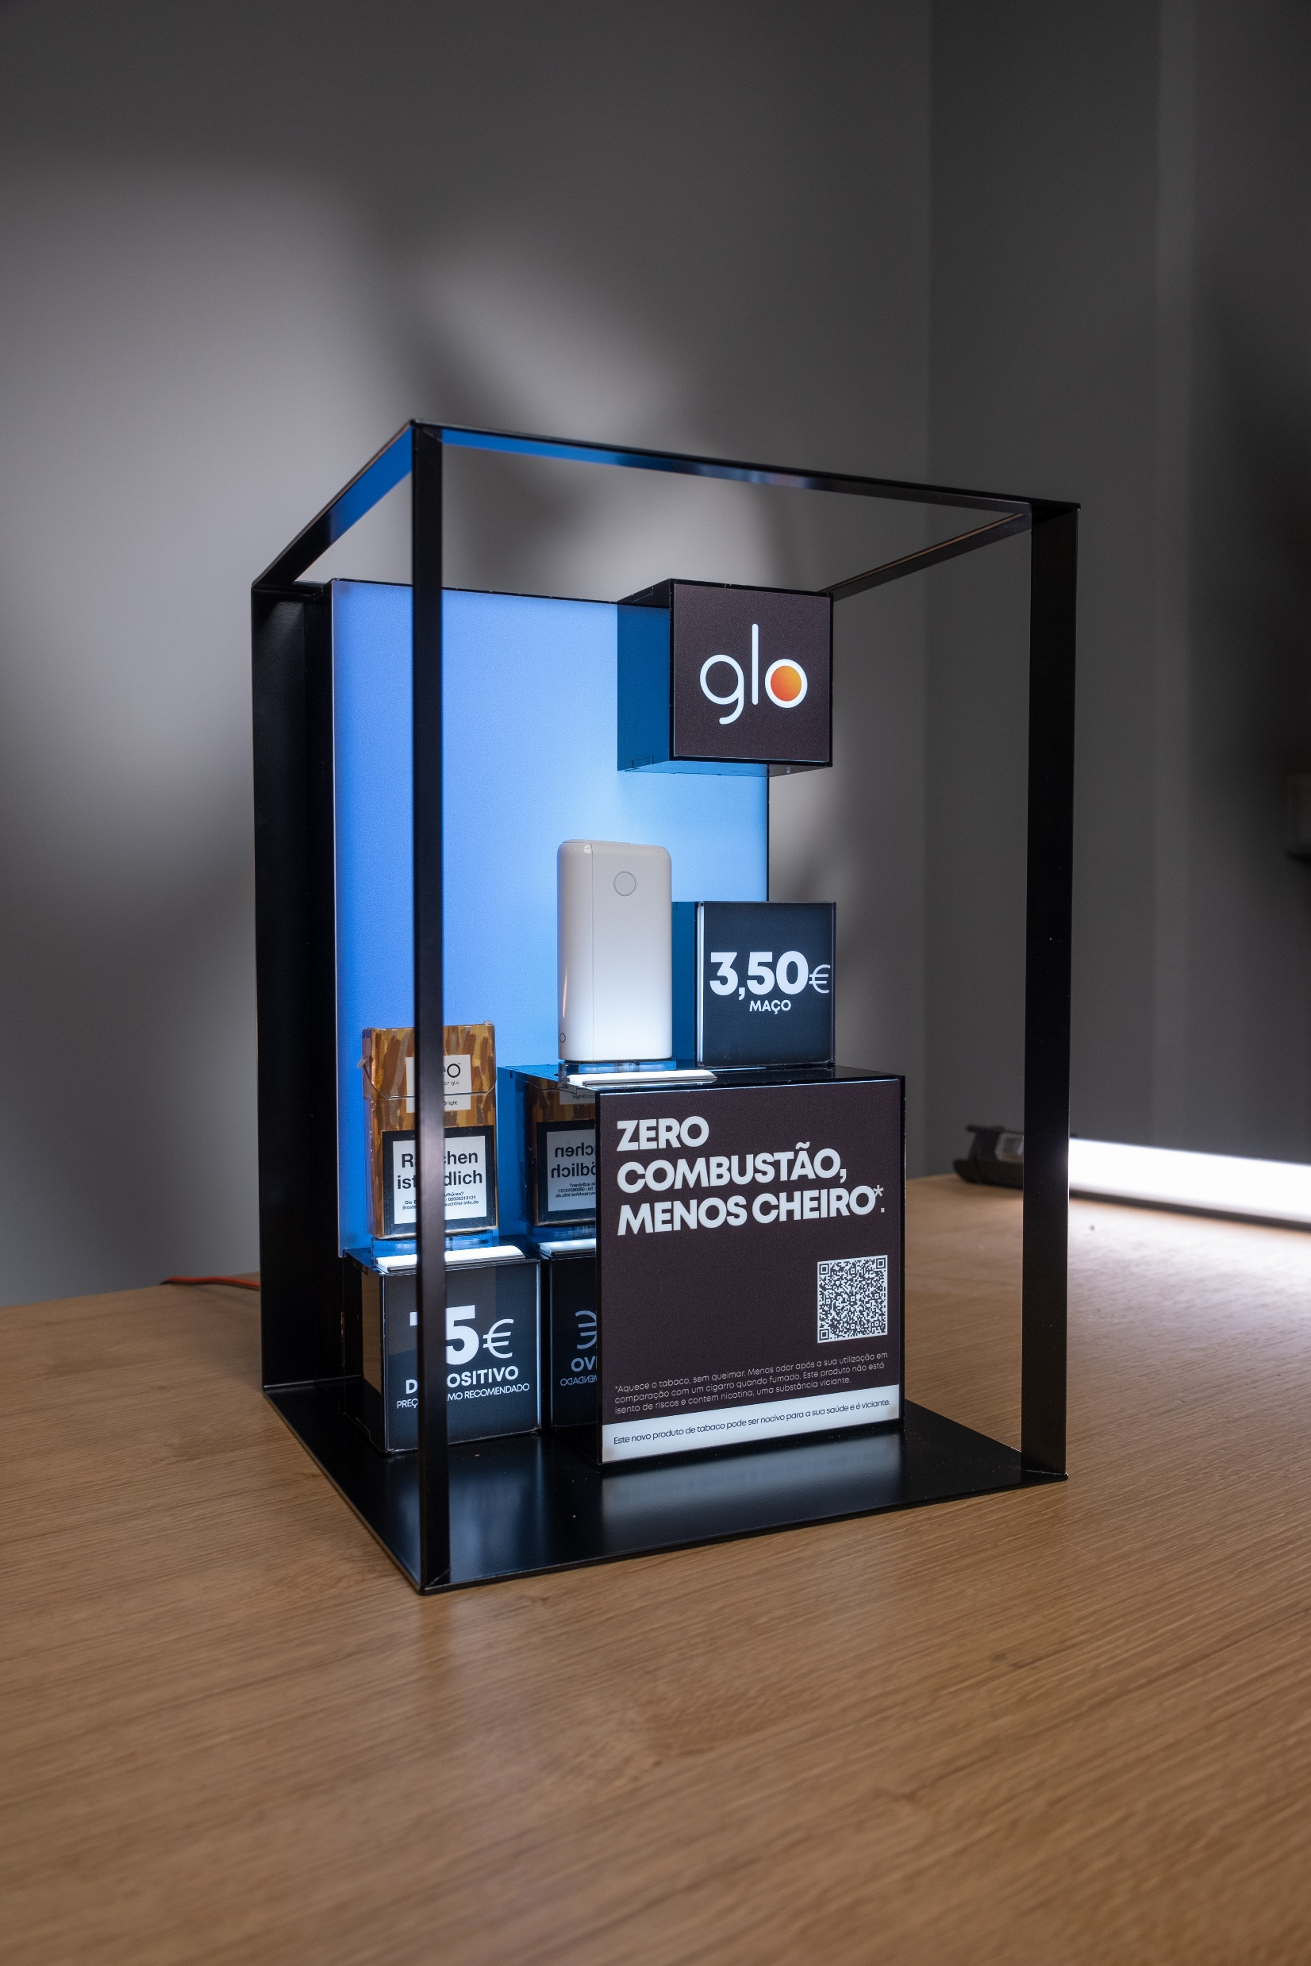
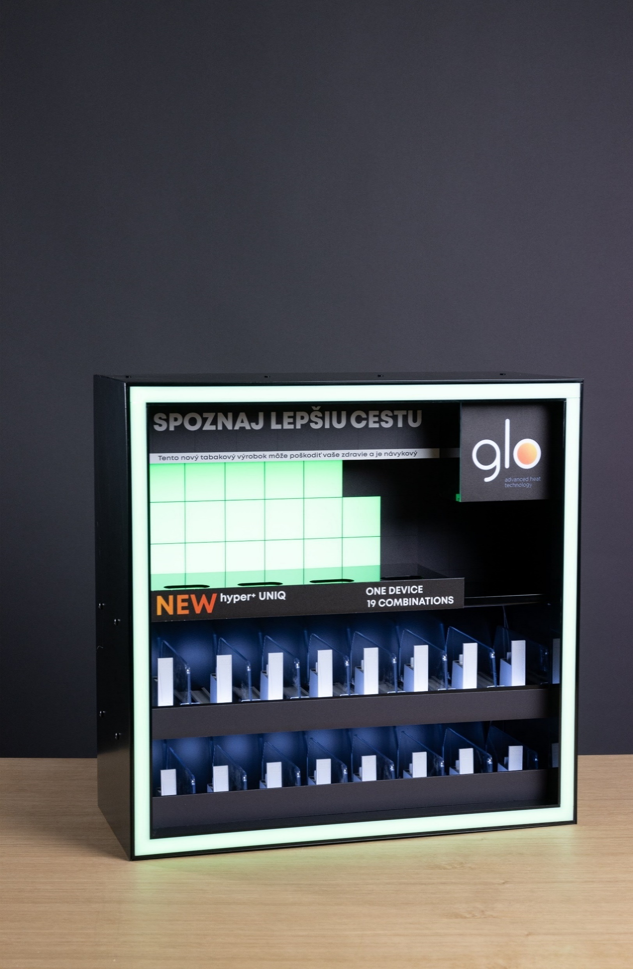
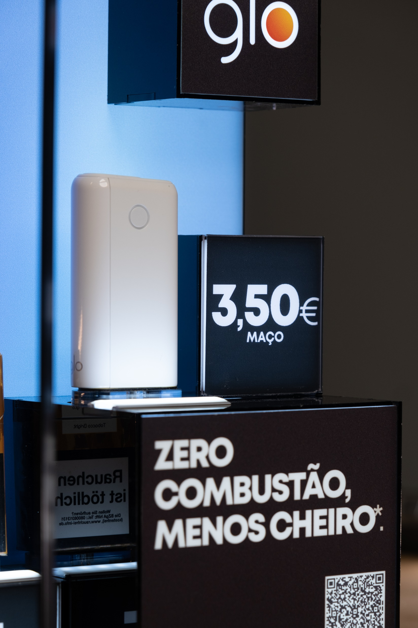
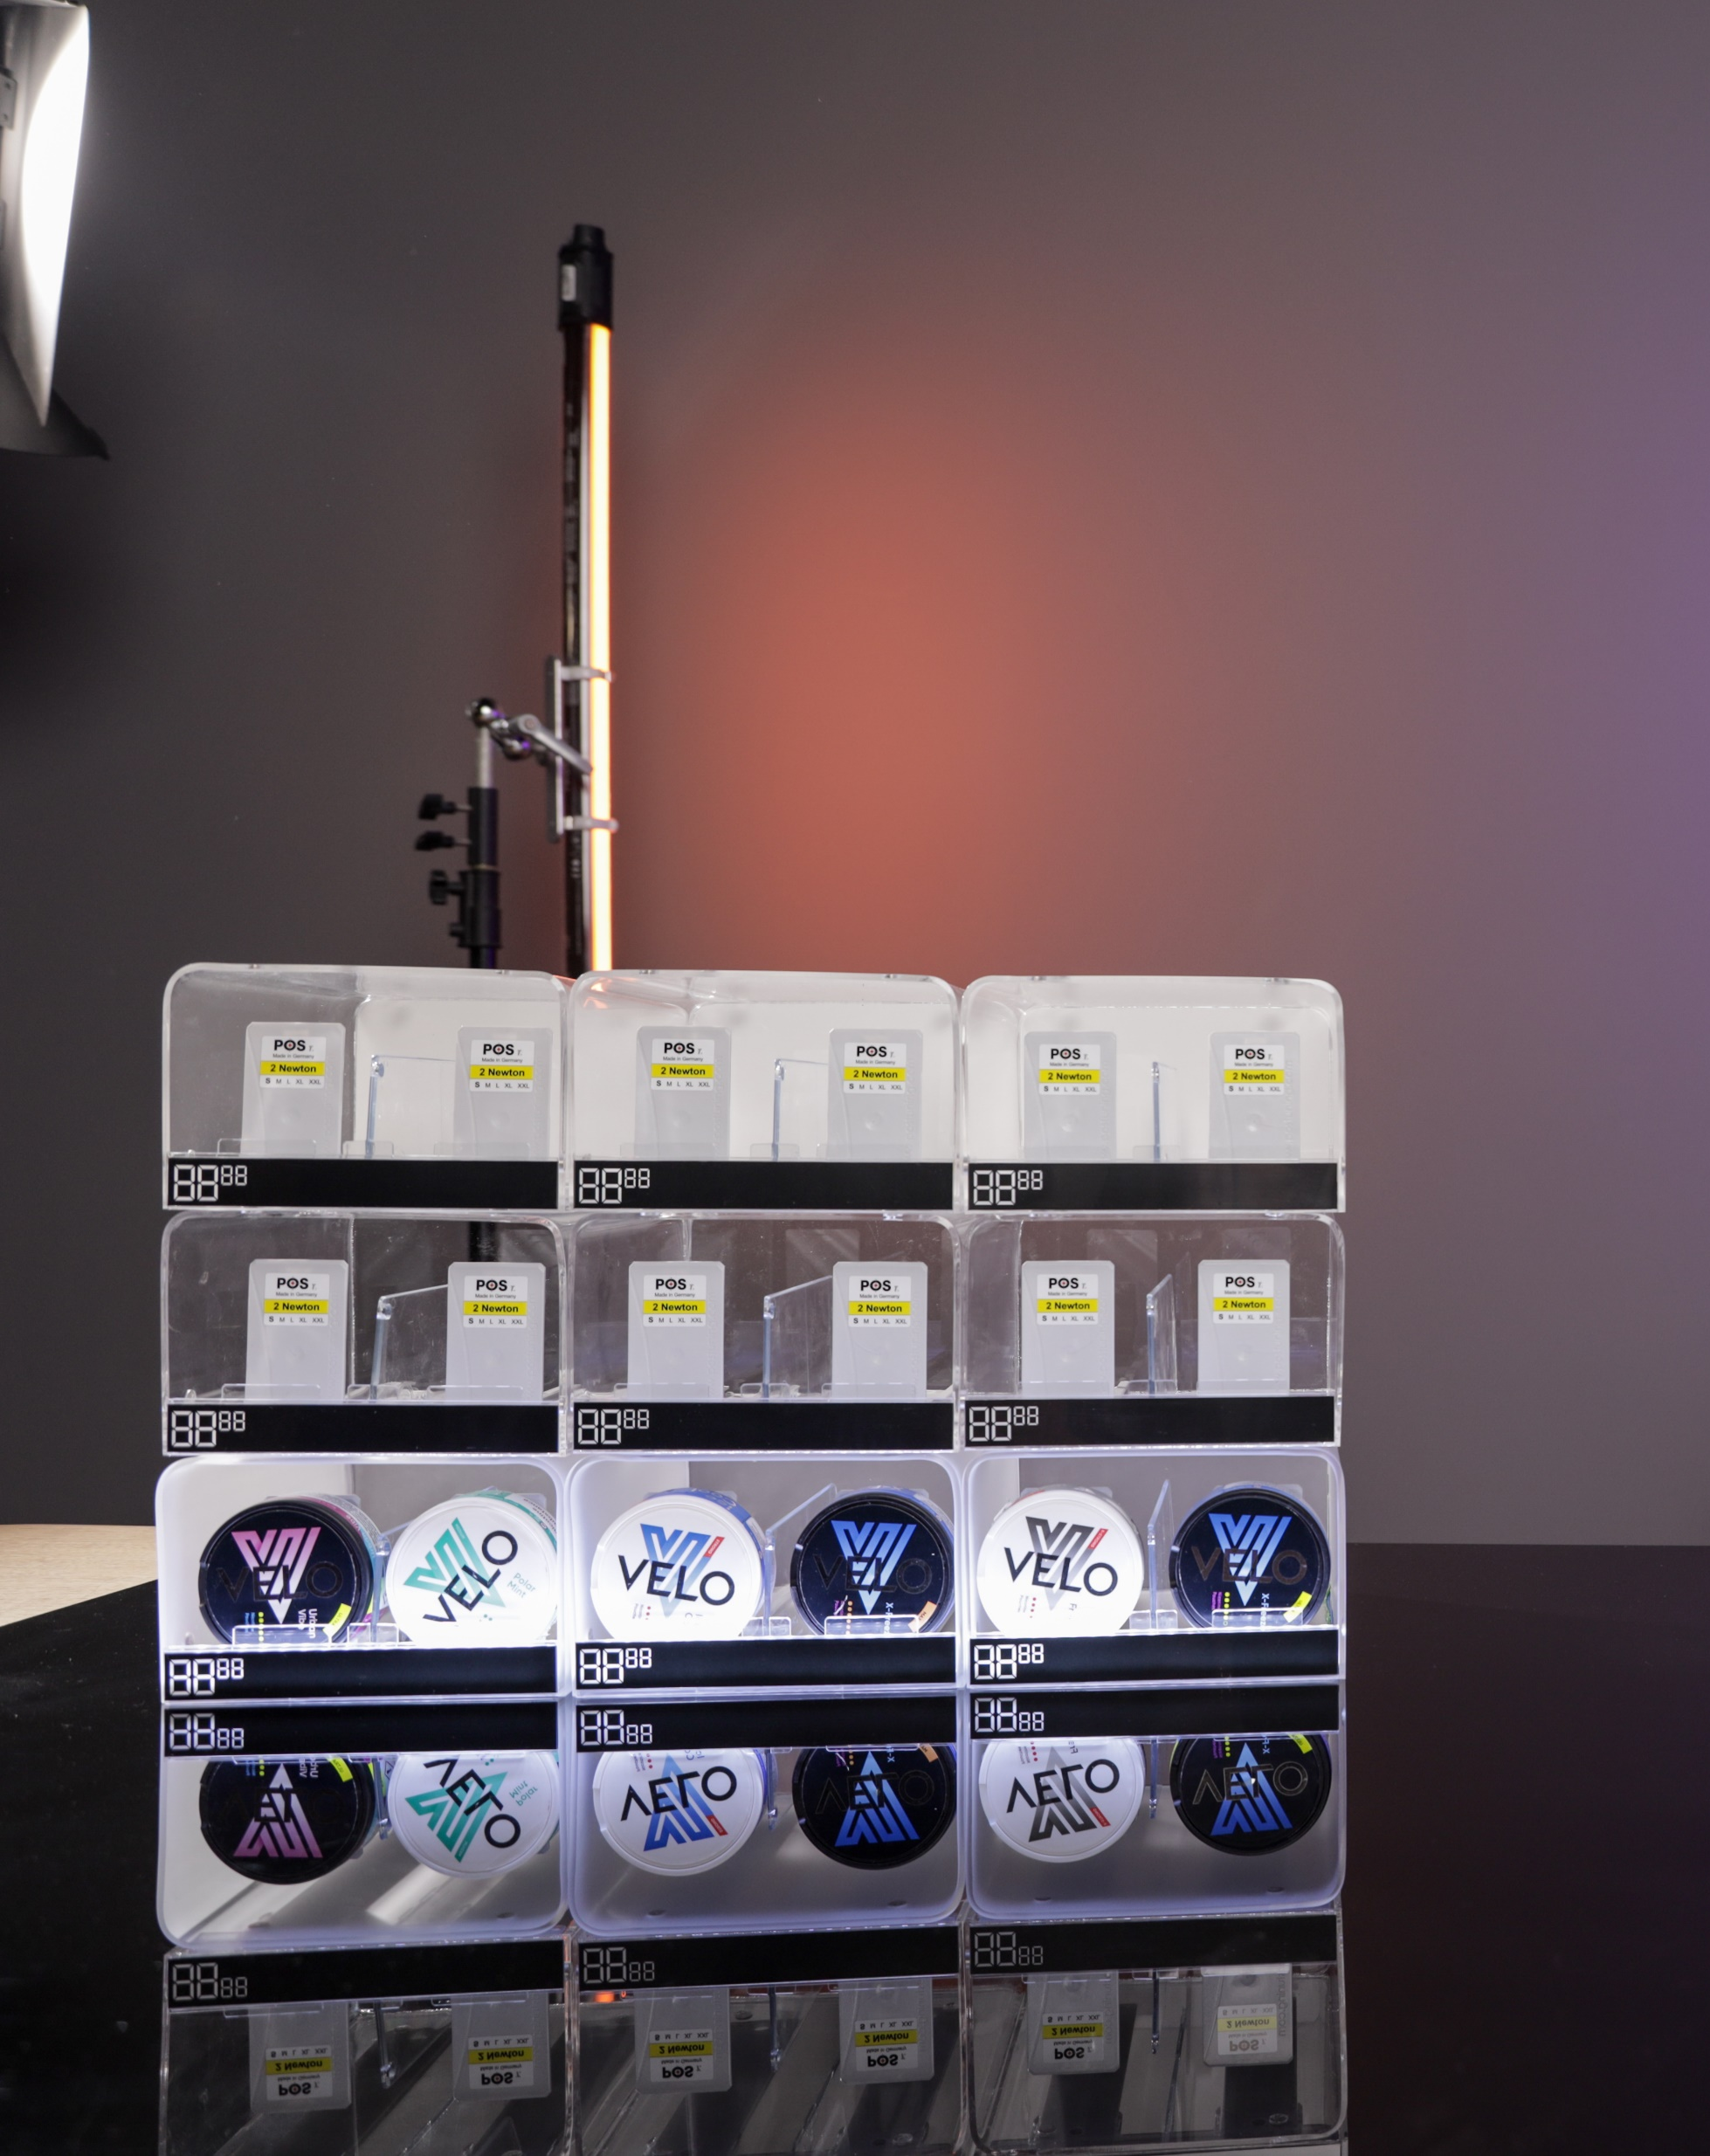
Portfolio

Slide 4


Slide 5

More planet
Less waste.
Re-Use:
Designing versatile and easily adaptable displays with longer life and use with any future products.
Re-Duce:
By always investing in cutting edge technology, we significantly reduce scrap and improve efficiency.
Re-Cycle:
Engineering displays that can be easily disassembled and recycled. Always ensuring to use sustainable materials.
Re-Peat:
Plant new trees and create eco projects for our community and give back to the environment.

Slide 6

Certifications
ISO the International Organization for Standardization.
ISO 9001 Sets out the criteria for a quality management system
ISO 14001 Sets out the criteria for an environmental management system
ISO 45001:2018 Occupational health and safety (OH&S) management system
ISO 20400 Integrating sustainability within procurement.
ISO 26000 Organization’s commitment to sustainability and its overall performance.

Slide 7
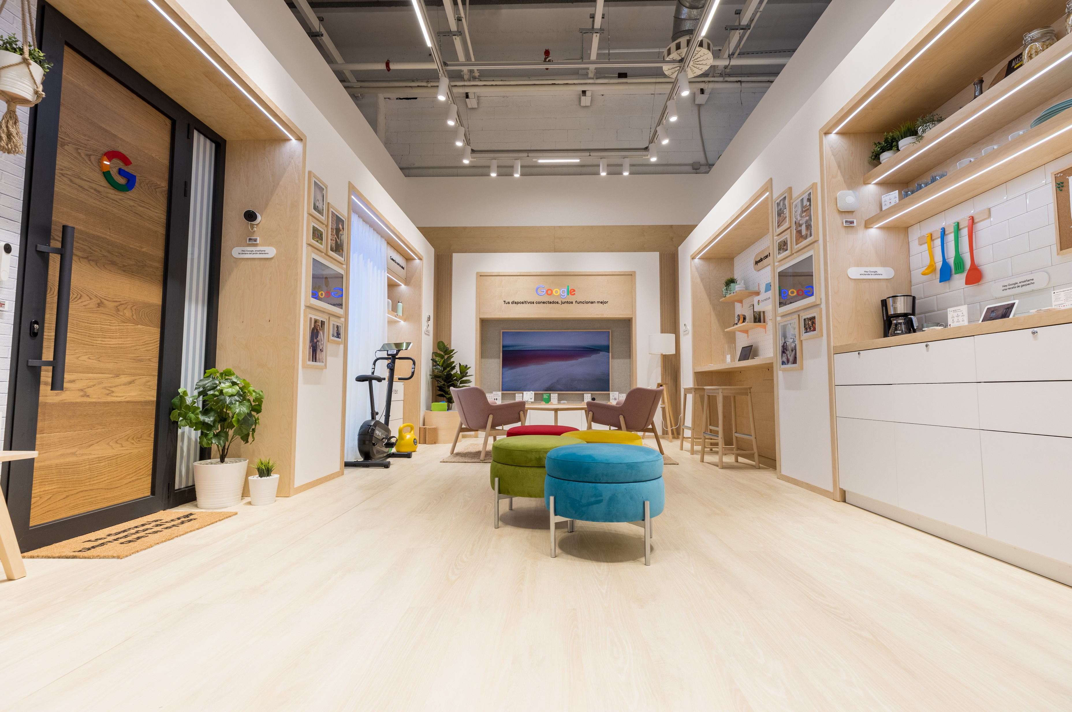

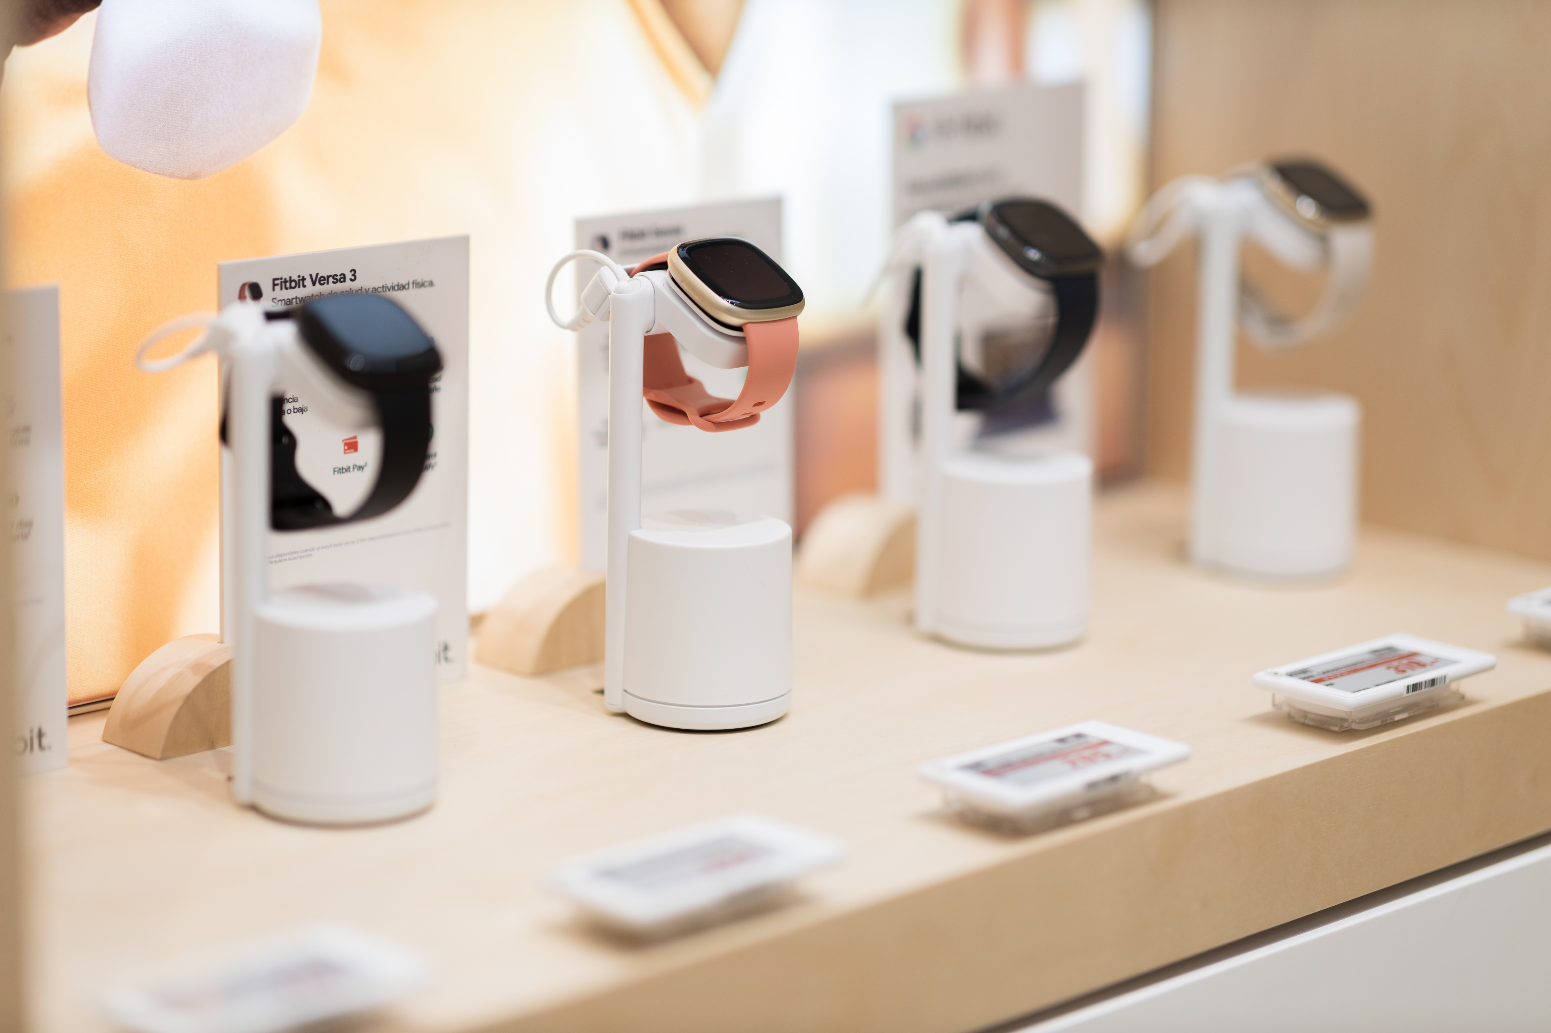
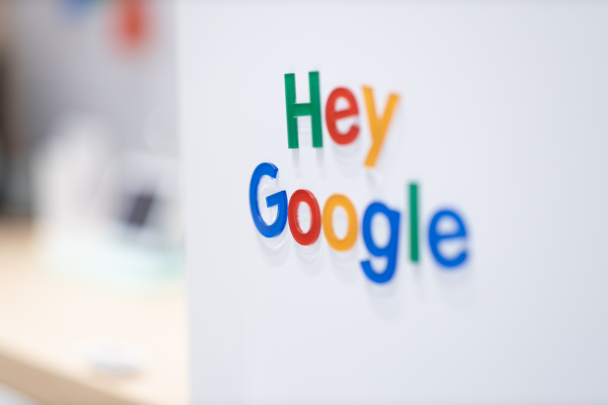

Google as
Benchmark.
Using materials that are more sustainably sourced.
Materials that are lightweight and reduce transport C02 impact.
Sourcing local suppliers and reducing transport.
Clever design and engineering, making displays that are easily dissembled and recycled.
Plywood
Aluminium
Textile

Slide 8
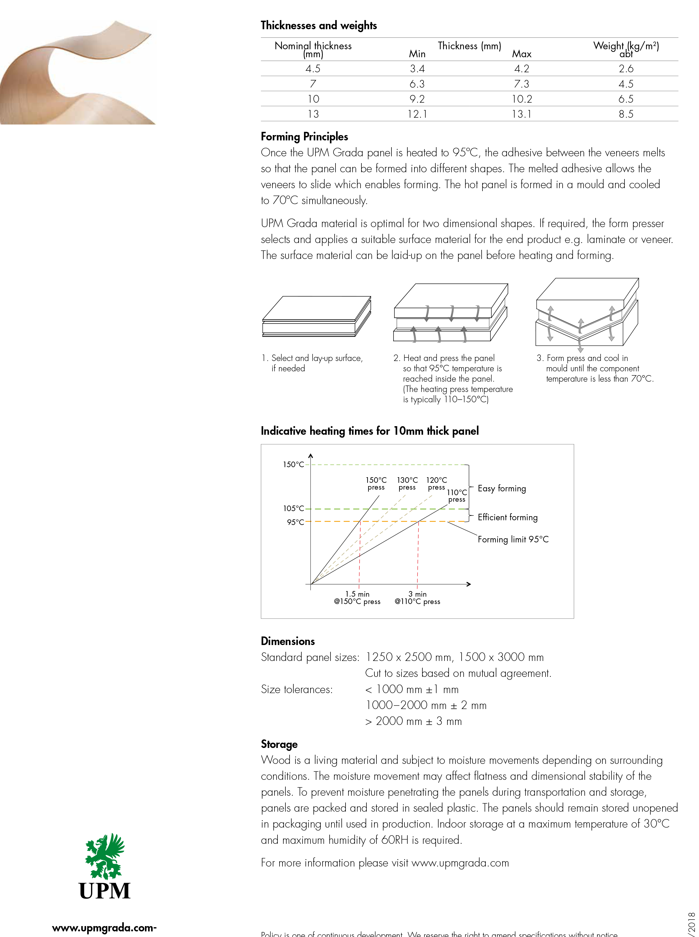
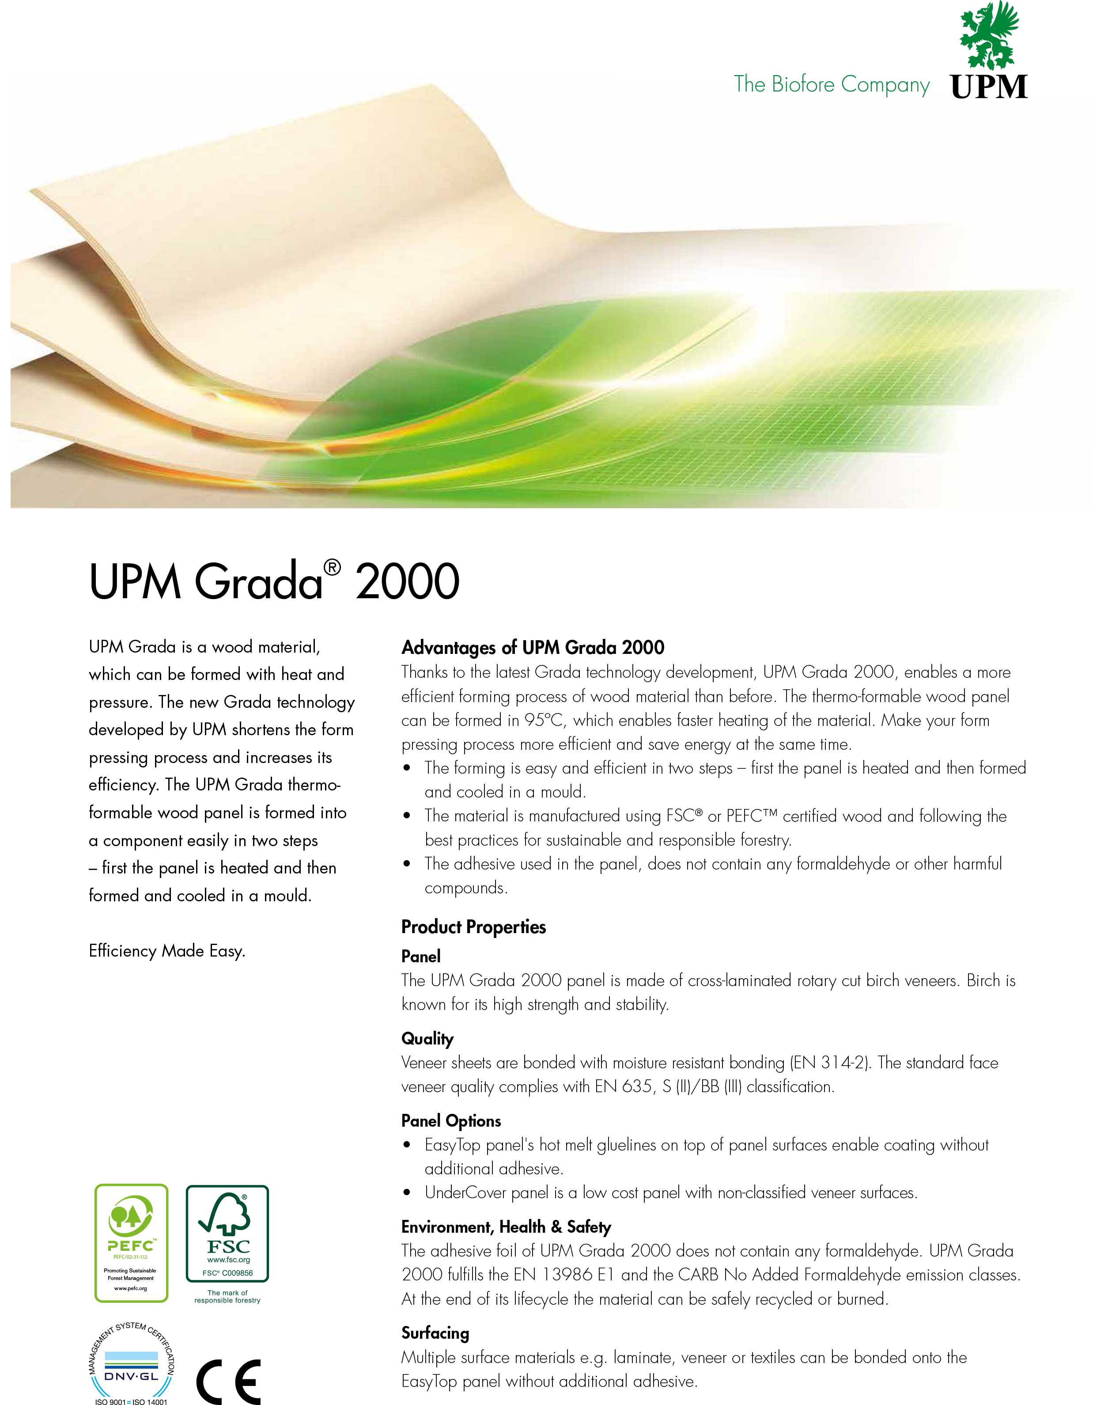

Slide 9
BG REKLAM
HEADQUATERS
29. Novembra 1M
11460 Belgrade, Serbia
info@bgreklam.com
+381 11 785 64 64
+381 60 68 69 110
Thank You.
BG REKLAM GMBH
Leverkusenstraße 3
22761 Hamburg, Deutschland
hamburg@bgreklam.com
+49 40 85413003
www.bgreklam.com
BG REKLAM
UK LTD
2588 Davenport House,
207 Regent St
London, W1B 3HH, UK
+44 75 4288 2312

