Slide 1
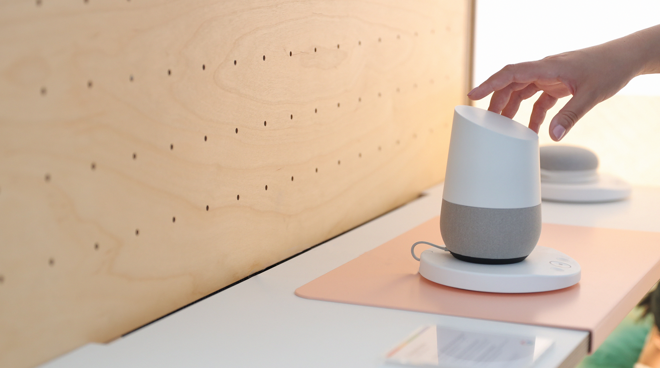



Slide 2


Slide 3


Slide 4

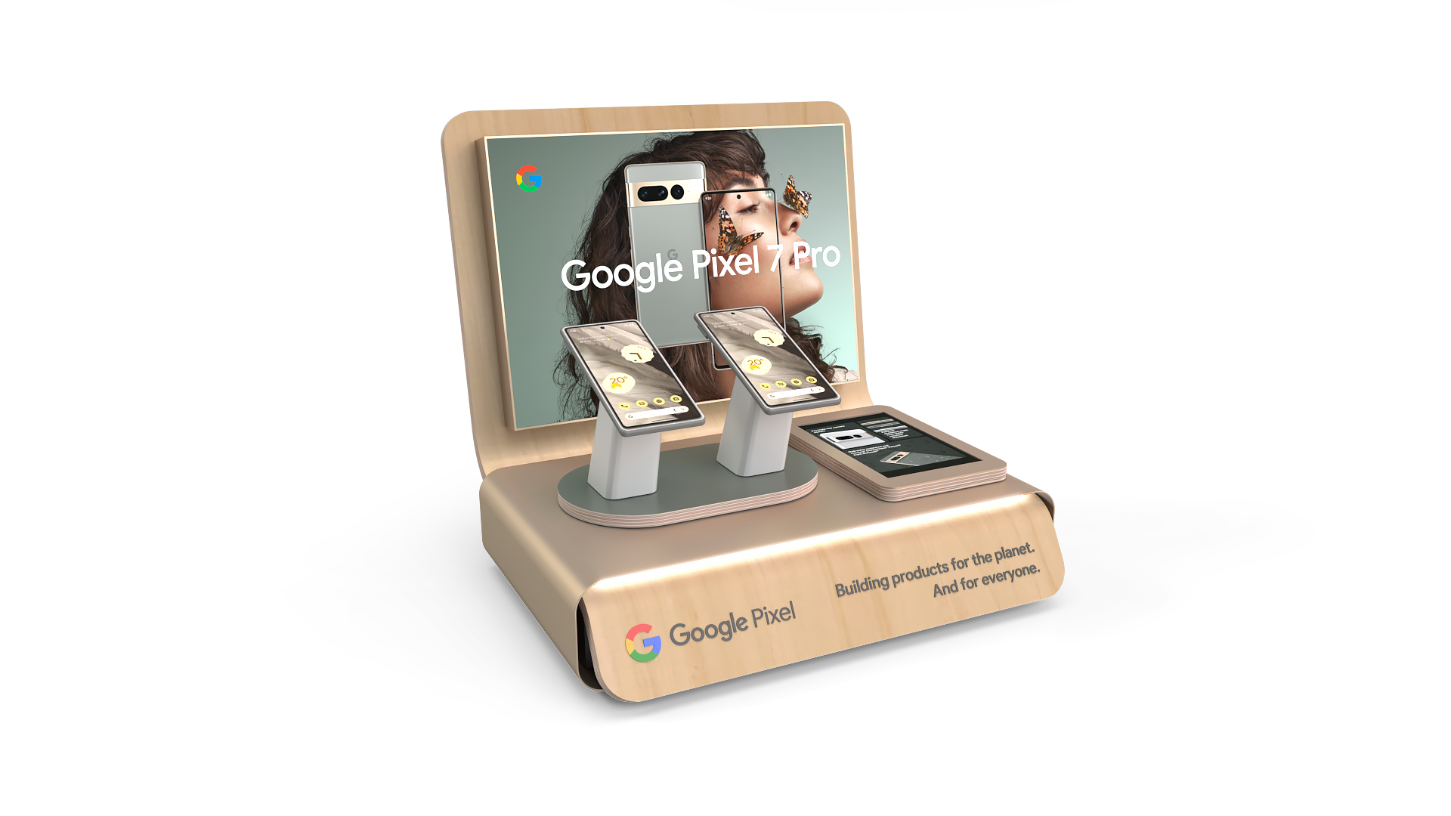

Slide 5
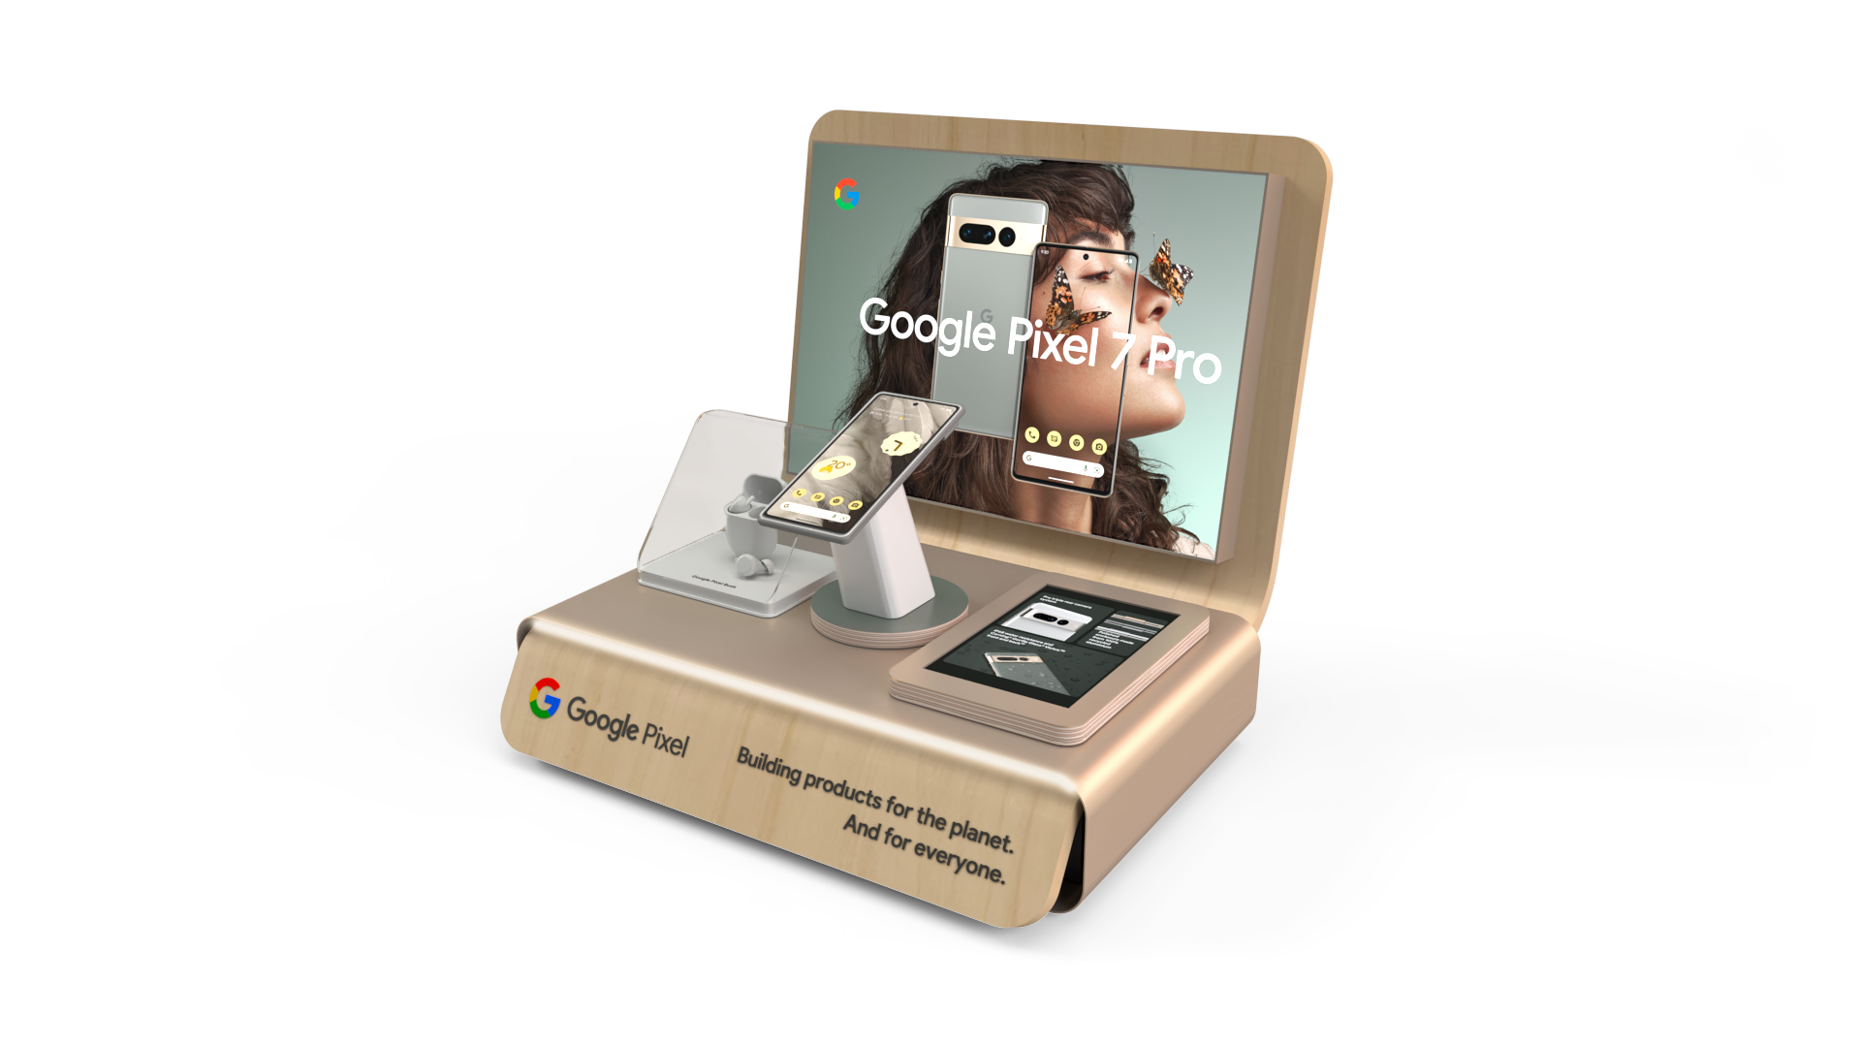

Slide 6
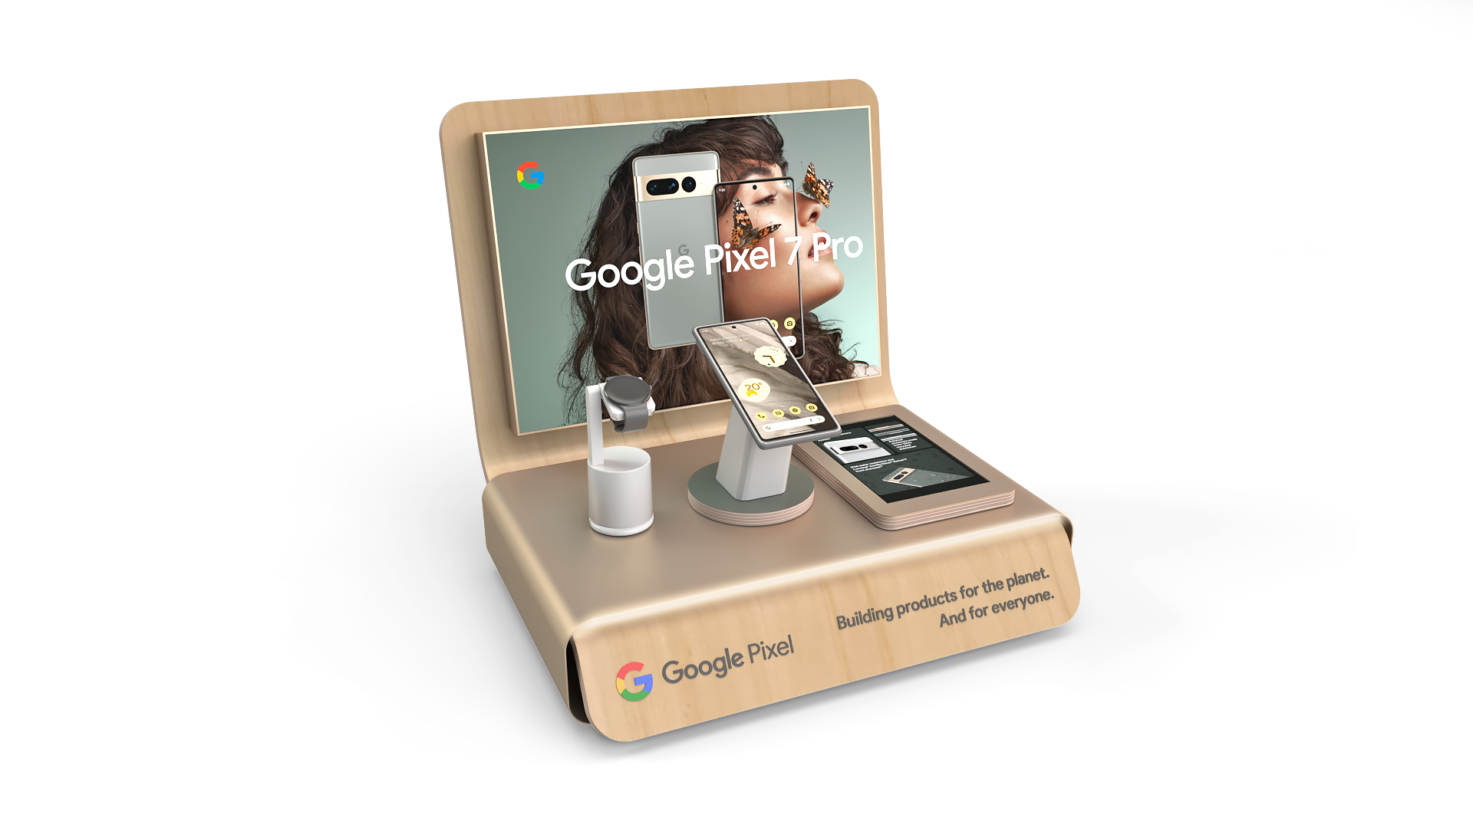

Slide 7
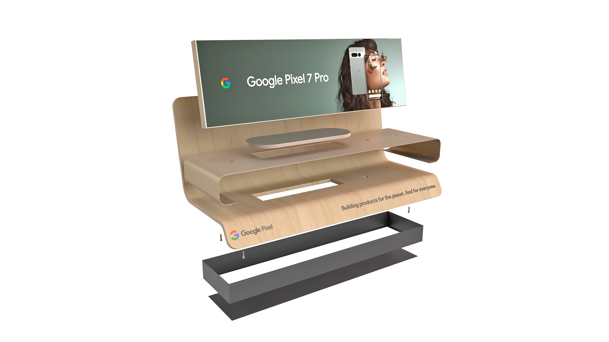


Slide 8
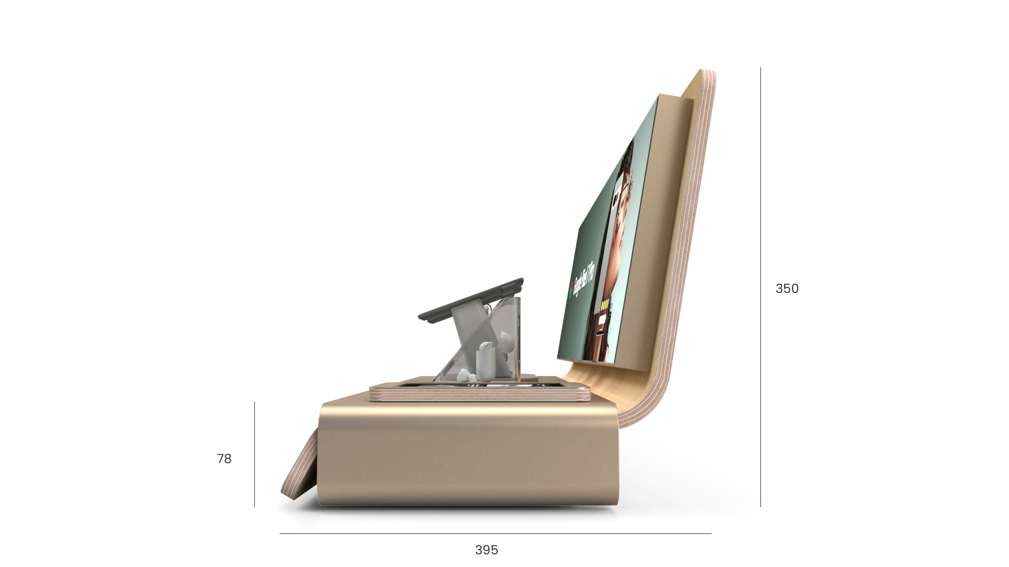


Slide 9
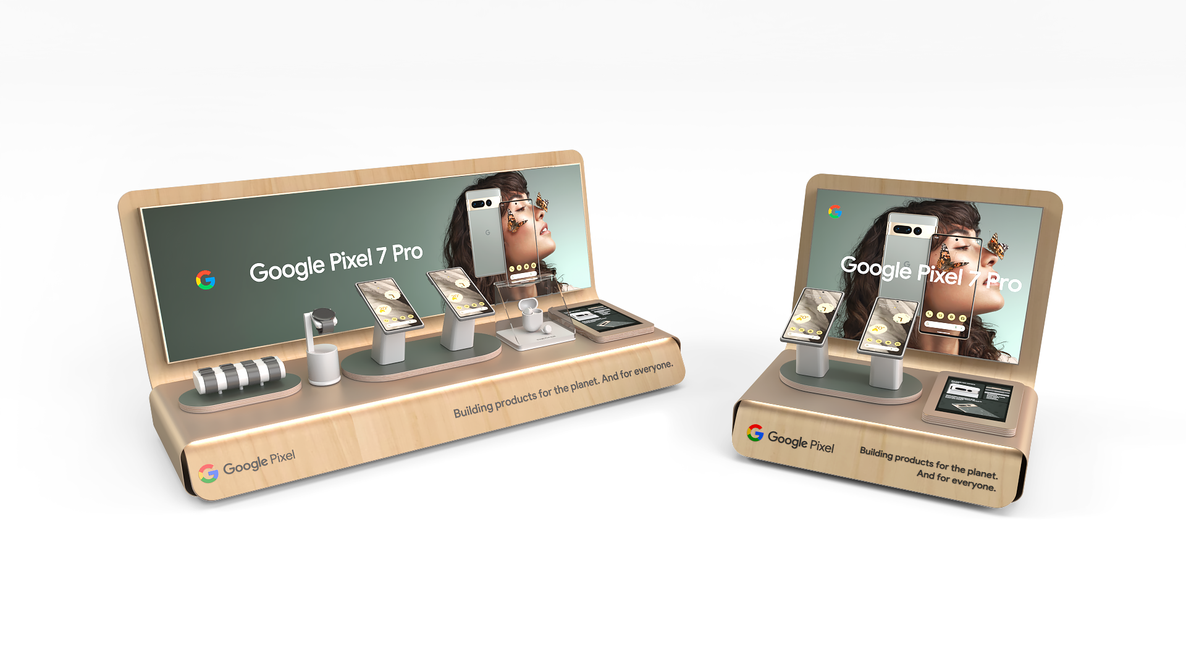


Slide 10
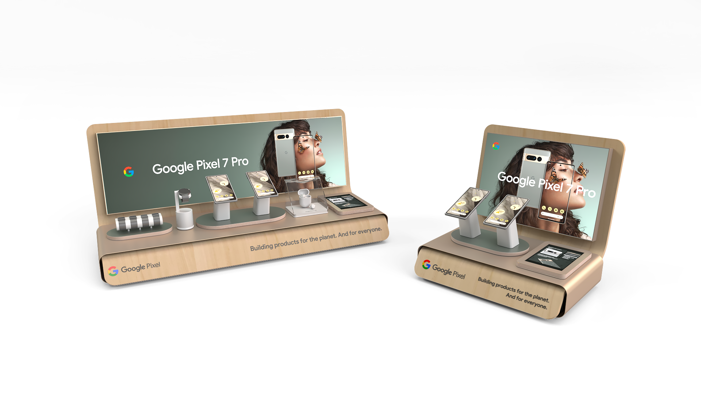


Slide 11
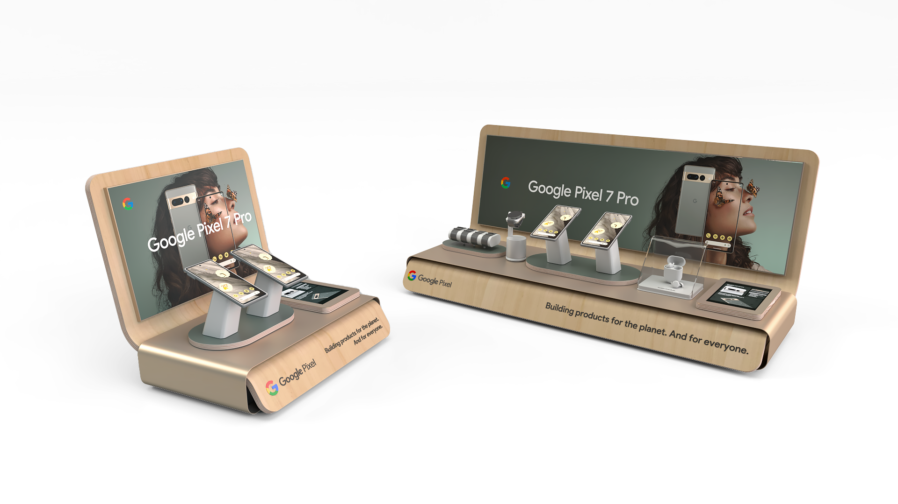


Slide 12
BG REKLAM
HEADQUATERS
29. Novembra 1M
11460 Belgrade, Serbia
info@bgreklam.com
+381 11 785 64 64
+381 60 68 69 110
Thank You.
BG REKLAM GMBH
Leverkusenstraße 3
22761 Hamburg, Deutschland
hamburg@bgreklam.com
+49 40 85413003
www.bgreklam.com
BG REKLAM
UK LTD
2588 Davenport House,
207 Regent St
London, W1B 3HH, UK
+44 75 4288 2312

